Slide 1
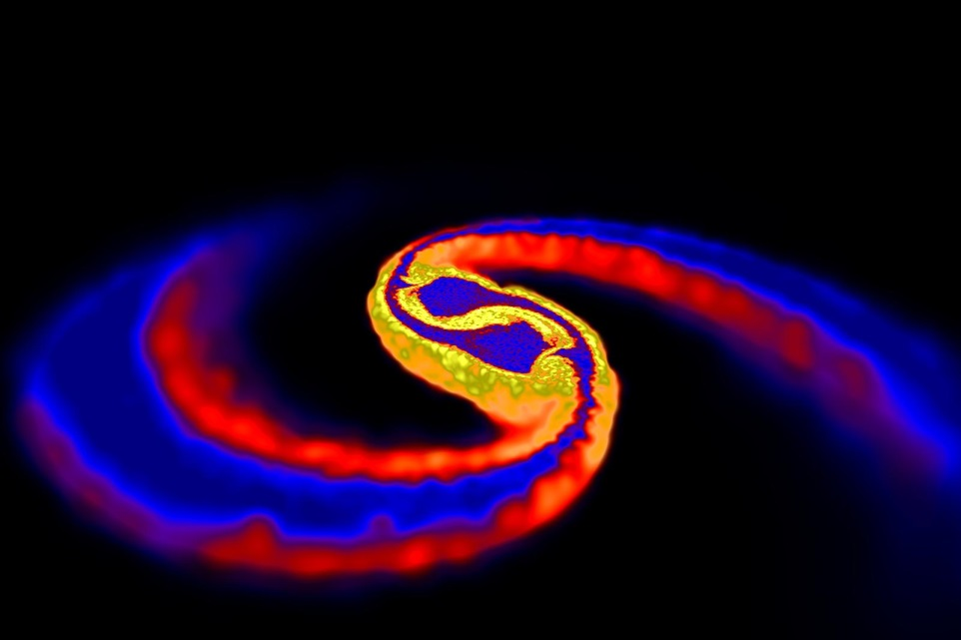
MERGING REVEALS Neutron Star INNARDS
R Turolla
Department of Physics and
Astronomy
University of Padova, Italy
Simulation of two neutron stars merging

Slide 2
Basics
Compact objects, i.e. neutron stars and black holes, are born in the core collapse following a supernova (SN) explosion
Present rate of SN events in the Galaxy: ≈ 0.01/yr (possibly higher in the past)
Galactic population of compact objects: ≈ 10⁸ – 10⁹ (≈ 1% of stars)
Nature of compact remnant depends on progenitor mass

Slide 3
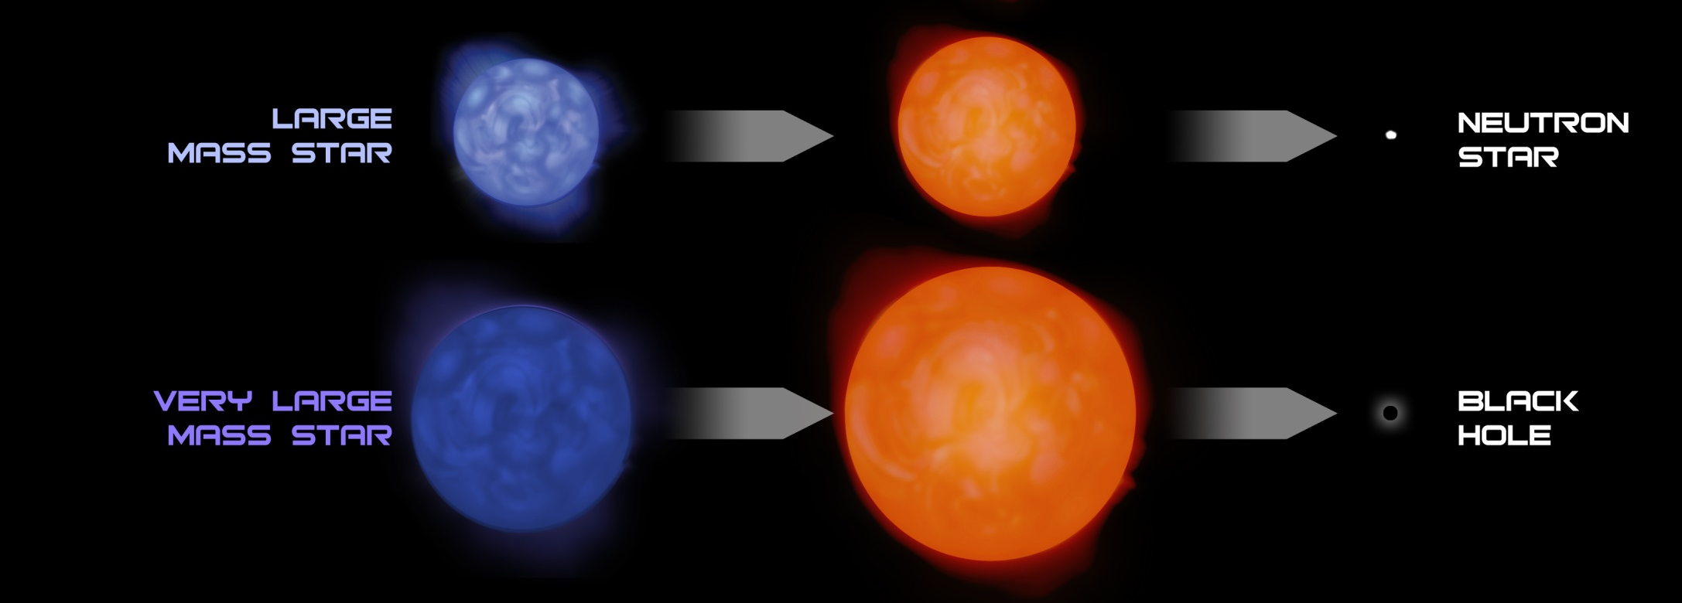
If N(>M) ~ M^{-1.3} only ~ 20% of stars with M > 8 M are more massive than 25 M
Vast majority (~ 80-90%) of Galactic compact objects are compact stars (no horizon)
8 < M/M < 20-25
M/M > 20-25

Slide 4
Neutron Stars in a Nutshell
Why neutrons ?
Because of the huge density electrons are completely degenerate
Their Fermi energy becomes larger than p-n mass difference, Q ~ 1.29 MeV
Electron capture e⁻+p → n+ν is energetically favourable at ρ > 10⁷ g/cm³, or R < 10⁴ km for M ~ 1 M
Typical radius R ≈ 10 km, masses 0.1 < M/M < 3 (theoretical estimates)
Highly relativistic objects
Huge compactness, M/R ~ 0.15 (M/M)(R/10 km)⁻¹
Large specific angular momentum, J/M ~ 0.25 (1 ms/P) (M/M)(R/10 km)²

Slide 5
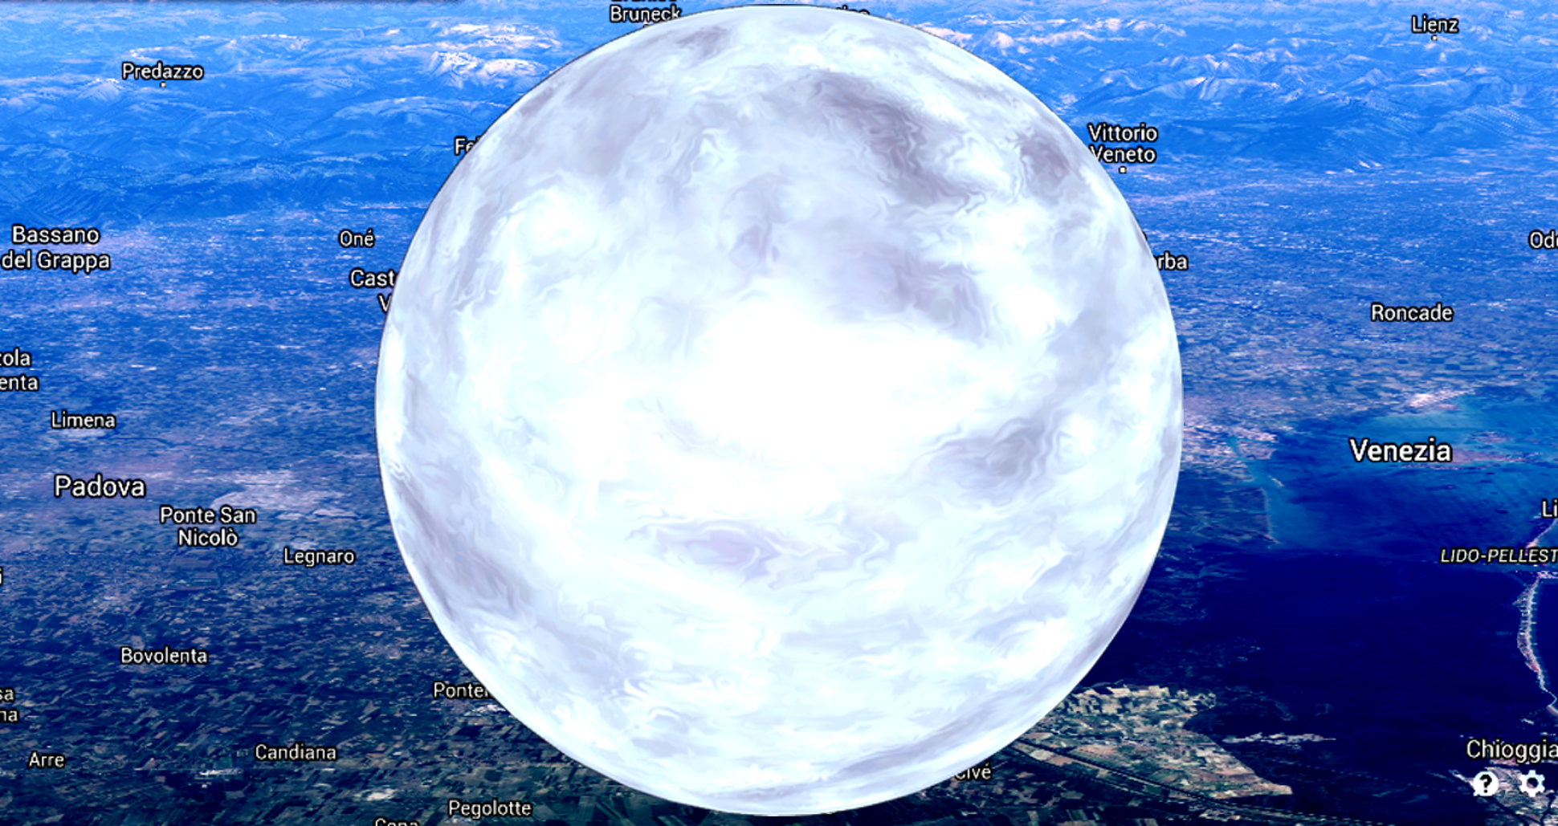
Average density ≈ 4x10¹⁴ g/cm³
One spoonful about a billion tons !

Slide 6
Neutron Star Structure
Spherically symmetric space-time
Hydrostatic
equilibrium
(TOV)
Gravitational mass
Einstein
equation

Slide 7
or
Need an Equation of State
P = P(ρ) ?
Given an EoS, compute sequence of equilibrium models: the
Mass-Radius relation
Maximum NS mass
(TO mass)

Slide 8
NS Matter EoS: The Holy Grail
“Neutron” stars: a misnomer
Inner core may contain
Hyperons (Σ, Ξ, Λ)
Meson (K⁻,π⁻) condensates
Deconfined quarks (u, d, s) – Hybrid Stars
Strange quark stars
Page & Reddy (2006)

Slide 9
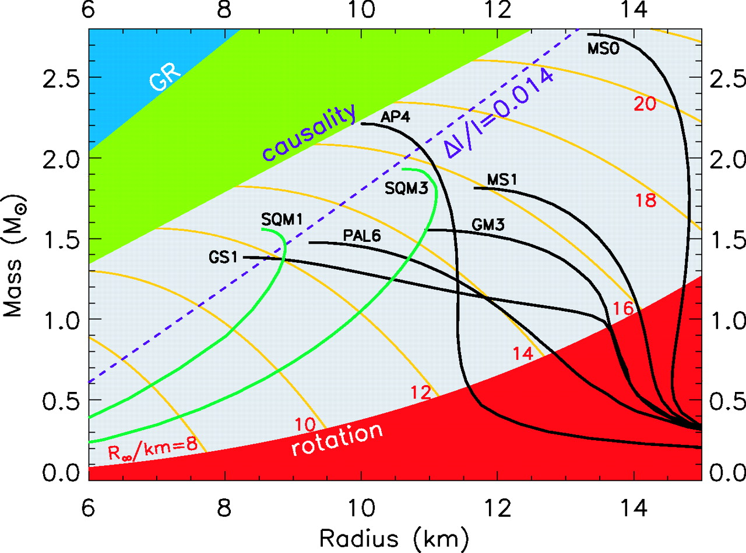
R=2GM/c²
Lattimer & Prakash (2004)
P=ρ
R~3GM/c²
Soft EoSs ruled out
ω=ω_{K}
Maximum measured mass, ~ 2M

Slide 10
NSs in Binaries
Majority of stars are in binary or multiple systems
A binary initially formed by two massive stars may survive the double SN event and form a NS+NS system
Eight presently known in the Galaxy, including the Hulse-Taylor binary (first indirect evidence for GWs) and the double pulsar PSR J0737−3039
Allow a very precise determination of NS masses

Slide 11
Multi-messenger Observations of GW170817 and the NS EoS
GW170817 and the associated kilonova involved the merging of two NSs with a total mass M₁+M₂ = 2.74 M (Ligo-Virgo collaboration 2017; Smartt et al. 2017)
Ejecta mass (“blue”+”red” emission) ≈ 5x10⁻² M
What is left ?
Prompt Collapse
HMNS or Short-lived SMSN
Long-lived SMNS
Ejecta mass much lower than
inferred from KN observations
Spin-down energy from SMNS
not seen
Margalit & Metzger (2017)

Slide 12
Constraints placed by GW and EM signals imply
M_{max} < 2.17M (Margalit & Metzger 2017)

