Slide 1


β-decay, Collectivity and Shell Structure Evolution Around N=50: a Common Physics ?
Andrea Gottardo

Slide 2
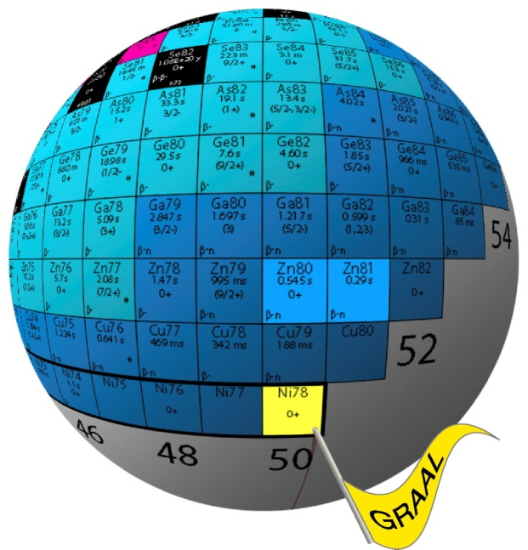

OUTLINE
The N=50 region: a «rich» shell structure
Intruder states: a probe of collectivity-spherical gap interplay
Electron spectroscopy in ⁸⁰Ge
Nuclear structure: from shape
coexistence to β -decay
properties
β decay study of high-energy
gamma emission in ⁸³Ge
Perspectives: a common physics ?
Courtesy of D. Verney

Slide 3
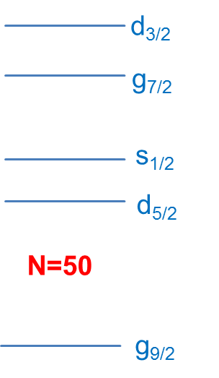
The N=50 Region: a Good Testing Ground
Zr90
Zr91
Zr92
Zr93
Y89
Sr84
Sr86
Sr87
Sr88
Rb85
Rb87
Kr78
Kr80
Kr82
Kr83
Kr84
Kr86
Br79
Br81
Br85
Se76
Se77
Se78
Se80
Se82
Se84
As75
As83
Ge74
Ge76
Ge82
fp proton space
Ga81
Zn80
Cu79
Ni70
Ni71
Ni72
Ni73
Ni74
Ni75
Ni76
Ni77
Ni78
50
Quasi-SU(3) scheme: gds shells, similar case to N=20 with f_{7/2}-p_{3/2}

Slide 4
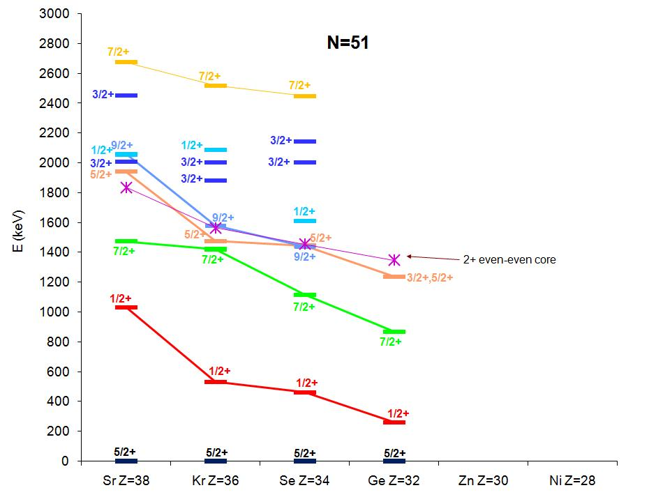
Lowering of the s_{1/2} Sshell
Coupling to continuum: G. Hagen, Phys. Rev. Lett. 117, 172501 (2016)
Courtesy of D. Verney
(1/2+)?
β-decay at Orsay
O. Perru et al. Eur. Phys. J. A 28, 307 (2006)
2⁺ d_{5/2}
from (d,p) Oak Ridge : J. S. Thomas et al. PRC 76, 044302 (2007)
and βn-decay at Orsay : M. Lebois PRC 80, 044308 (2009)
0⁺ s_{1/2}
d_{5/2}

Slide 5
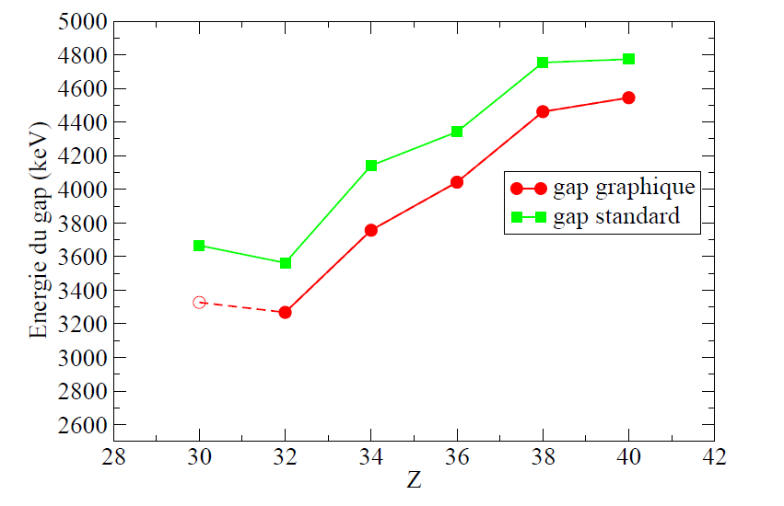
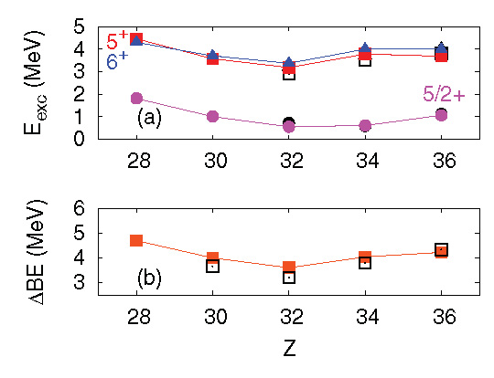
The N=50 EI Shell Closure: which Gap ?
Duflo Zuker gap PRC59 (1999)
⁹⁰Zr =4,7 MeV
Duflo Zuker gap
⁷⁸Ni =5,7 MeV
Origin of shell closures: three-body ?
Unbiding of upper shells ?
J. Bonnard, A.P. Zuker, arXiv:1606.03345 (2016)
local minimum at Z=32
« standard »
Reduction of the N=50 spherical MASS GAP from N=51 isotones mass
εd_{5/2} – εg_{9/2} (MeV)
« graphical »
M.-G. Porquet and O. Sorlin, Phys. Rev. C 85, 014307 (2012)
D. Verney HDR
Ni
Zn
Ge
Se
Kr
Sr
Zr
p-h states across N=50 in N=49 and N=50 isotones: minimum at Z=32
SPECTROSCOPIC GAP
K. Sieja et F. Nowacki, Phys. Rev. C 85, 051301(R) (2012)

Slide 6
2p-2h Intruder States as Probes of Gap
s_{1/2}
2 particle – 2 hole across N=50
d_{5/2}
g_{9/2}
Spherical gap (2p-2h):
energy cost
Correlations by breaking the core:
energy gain
fp
Z=28
N=50
protons
neutrons

Slide 7
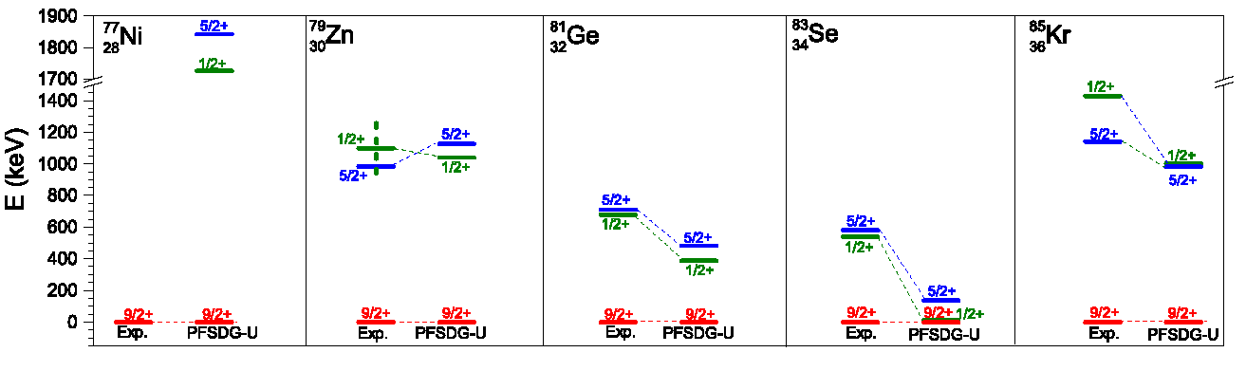
Intruder States in N=49 Isotones
C. Wraith et al., Physics Letters B 771 (2017) 385–391
s_{1/2}
Intruder states (1p-2h) in N=49 states:
Minimum at Z=34
Inversion 1/2⁺ - 5/2⁺
Pure s_{1/2} wave function ? Shape ?
d_{5/2}
N=50
g_{9/2}
X. F. Yang et al. Phys. Rev. Lett. 116, 182502 (2016)
Large isomer shift for the 1/2⁺ state: large radius of the state ?
What is then happening to the even-even nuclei: low-lying 0⁺ states ?

Slide 8
The PARRNE Measurement point @ ALTO
Search for E0 transitions
Ge
collection point
(surface ionized) ⁸⁰Ga beam (10⁴ pps)
tape
counting position
photomultiplier
β-detection
Ge
ε_{β}= 20%
Cryogenic finger
γ-detection
LN2-cooled Si(Li) e⁻ detector
ε_{(1MeV)}= 0.7%
ε_{e-}= 14%
SiLi
Plastic scintillator
Courtesy of D. Verney

Slide 9
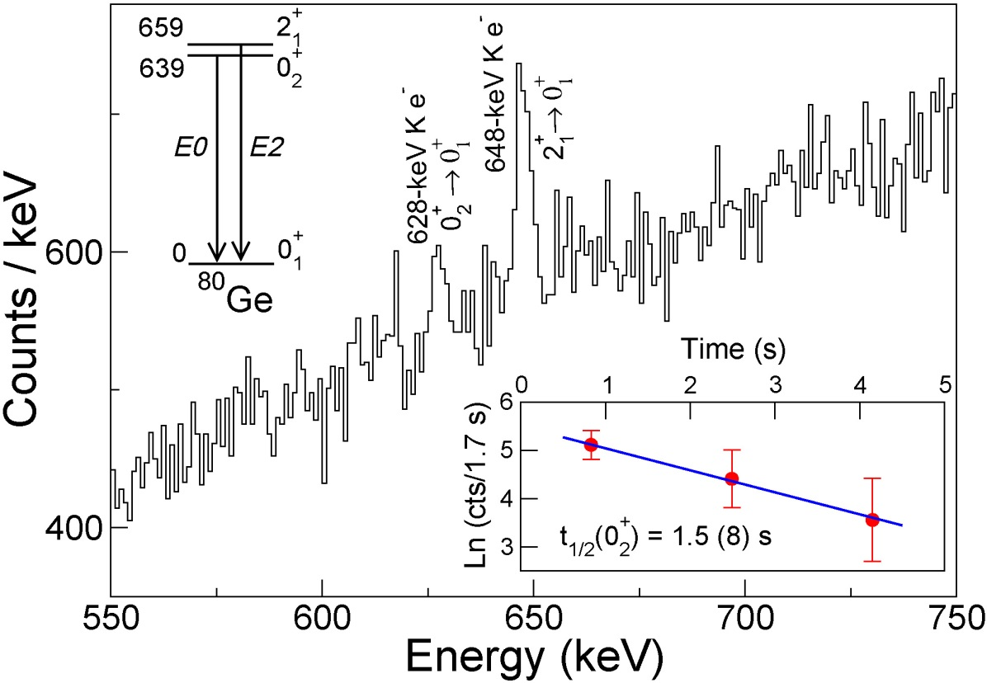
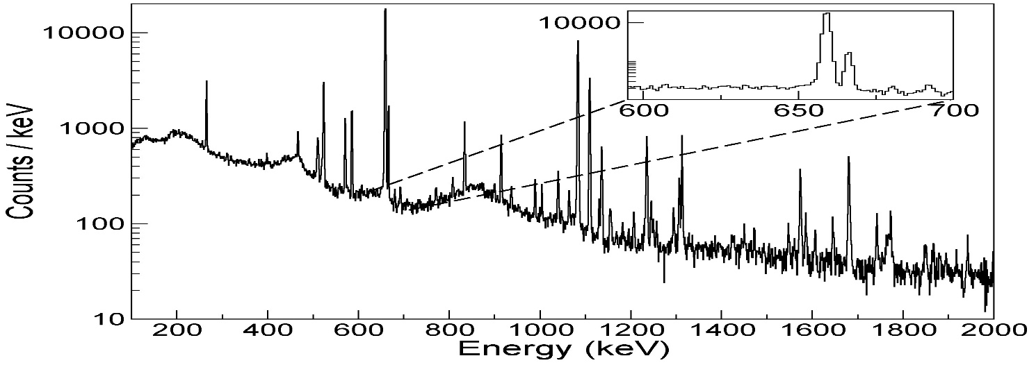
Electron Spectrum
659
2⁺₁
639
0⁺₂
E2
E0
0
0⁺₁
⁸⁰Ge
No transition at 639 keV which could justify electron conversion at 628 keV

Slide 10
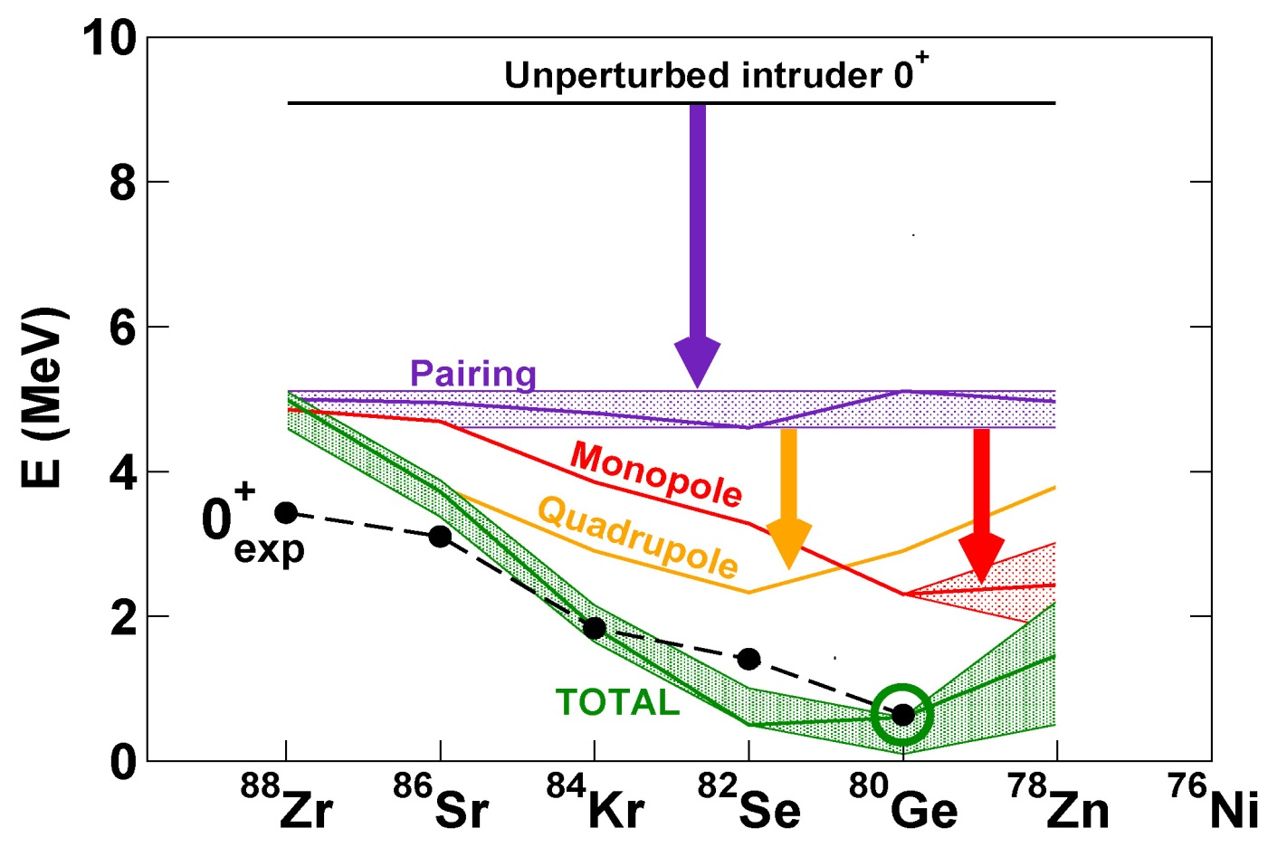
Results and Perspectives
Shape coexistence in ⁷⁸Ni ?
Monopole evolution towards Z=28: mass measurement in ⁸³Zn
Reduction the Z=28 gap (increased quadrupole) ?
Our result
Possibility of finding a
(2p-2h) 0⁺ state in ⁷⁸Ni around 2.5 - 3 MeV
A. Gottardo, D.Verney et al.,
Phys. Rev. Lett. 116, 182501 (2016)

Slide 11
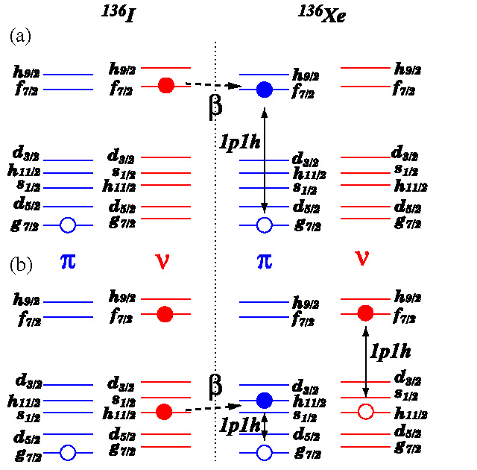
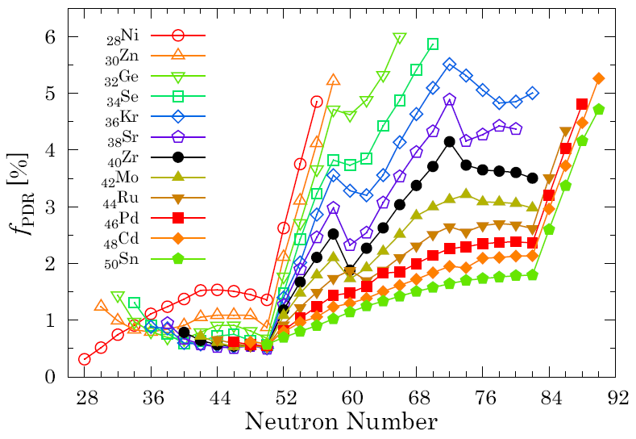
Effects of s_{1/2} Shell Lowering on β Decay ?
β-decay populates part of the pygmy dipole resonance
Strong increase of PDR after N=50 in Ge, Zn, Ni linked to an increased skin thickness
S. Ebata, T. Nakatsukasa, T. Inakura, Phys. Rev. C 90 (2013) 024303.
M. Sheck et al. : PRL 116, 132501 (2016)

Slide 12
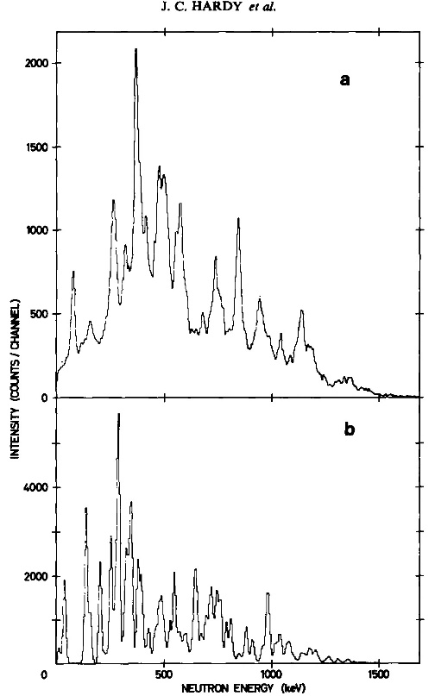
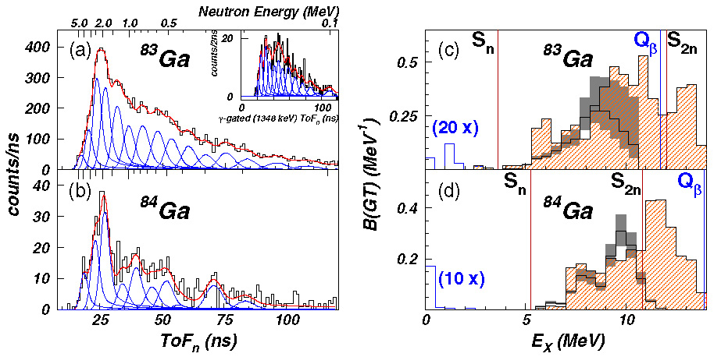
Where is the Gamow-Teller Strength ?
Exp. ¹³⁷I
BUT
Statistical model
J.C. Hardy NPA 305, 15 (1978)
No structure effects in either the β-decay or n emission were required to account for experiment…
R. Grzywacz, M. Madurga et al: PRL 117, 092502 (2016)
Strong shell structure dependence !

Slide 13
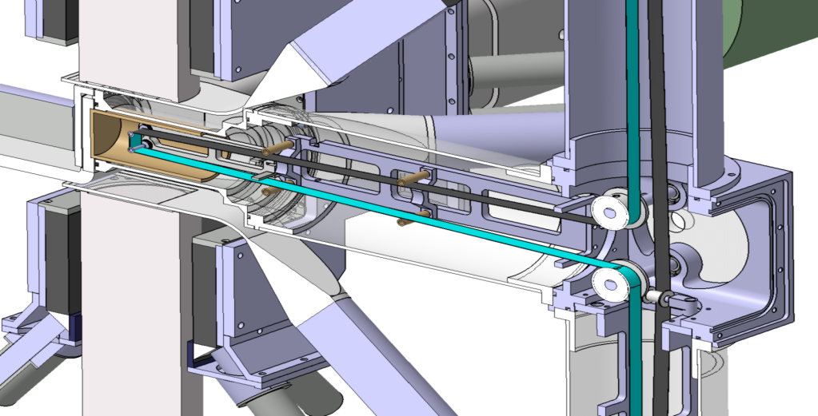
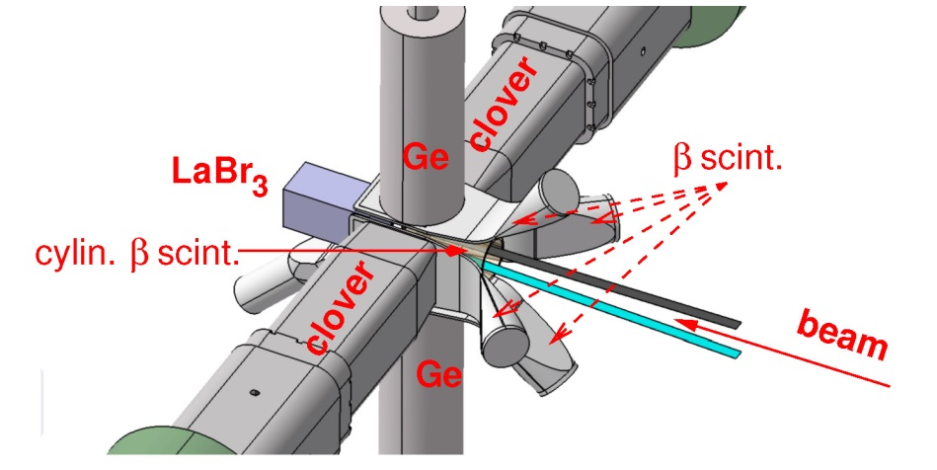
⁸³Ge @ ALTO ISOL FACILITY
BEDO tape station
plastic (β detection)
collection point
Up to 5 Ge detectors
Compton BGO shielding
Plastic veto detector
> 50 % β efficiency
beam axis
BGO anti-Compton shield
plastic (β rejection)
Ge detector
BEDO setup with large LaBr₃
Optimal configurations:
4 clovers (~ 3.5 - 4% eff. @ 1 MeV)
1 planar Ge for X rays
OR
- FAST timing configuration (2 LaBr + 2 Ge)

Slide 14
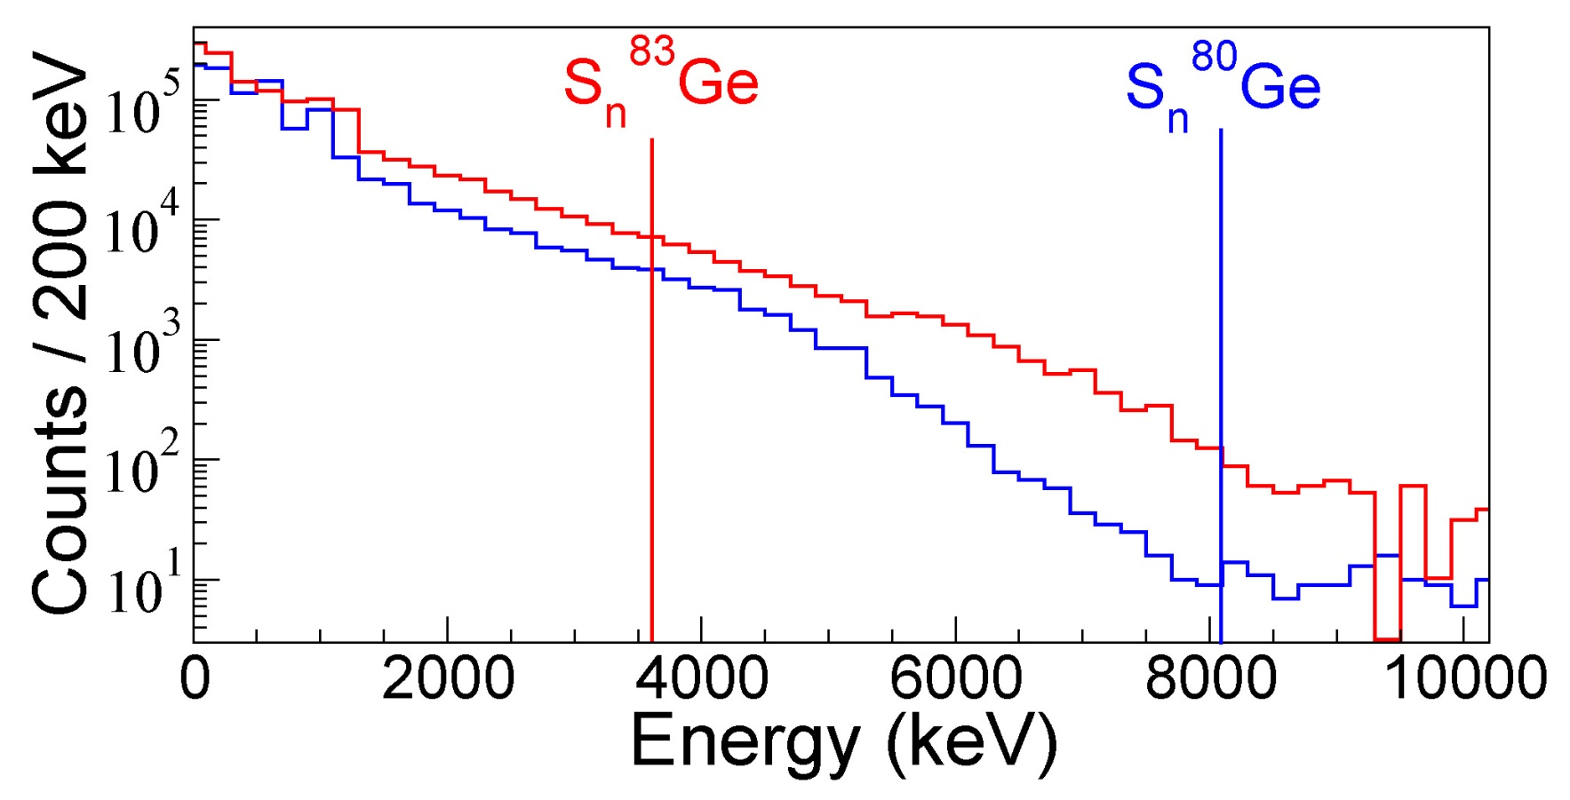
⁸³Ga - ⁸⁰Ga β Decay: High Energy
After N=50
Large γ emission from ⁸³Ge after S_{n} !
⁸³Ga
⁸³Ge (15%),
⁸²Ge (85%)
Before N=50
⁸⁰Ga
⁸⁰Ge (98%),
⁷⁹Ge (2%)
A. Gottardo et al, Phys. Lett. B 772 (2017) 359–362
1- Geant4 SToGs simulated spectra from 100 keV to 10 MeV, verified at ARAMIS CSNSM
2- Unfolding with the Gold algorithm
In total 16(4)% of absolute γ strength beyond S_{n} in ⁸³Ge
3.5% I_{βγ} in J.L. Tain et al. Phys. Rev. Lett., 115, 062502 (2015)

Slide 15
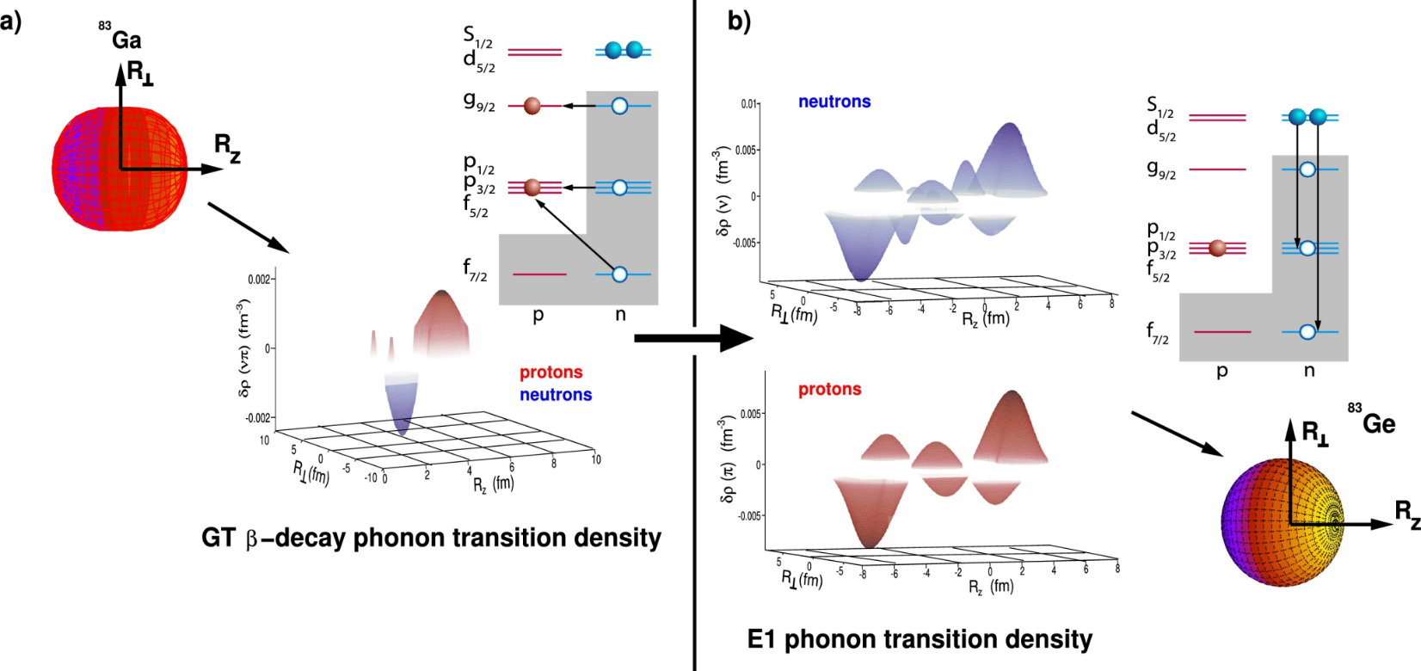
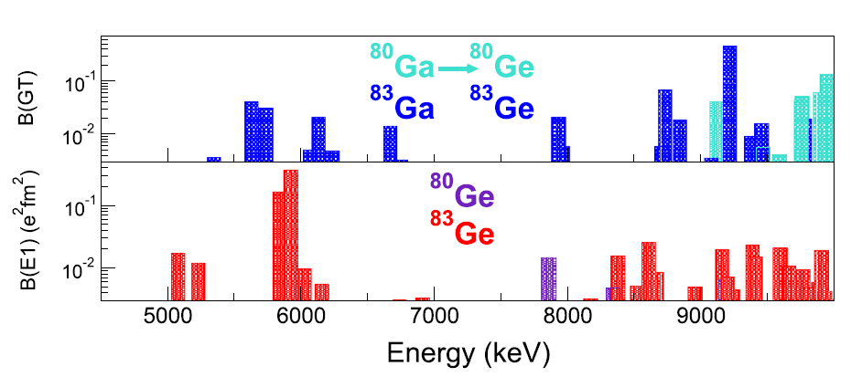
⁸³Ge: Theoretical Calculations of Strengths
⁸³Ga
5/2⁻
β GT
3/2⁻,5/2⁻, 7/2⁻
n
E1
5/2⁺
⁸³Ge
E1 γ strength to compete with neutron emission:
0.01-0.1 W.u.
I. Deloncle, Sophie Peru-Desenfants, Marco Martini DAM -CEA
^{80,83}Ga: PDR and GT from Gogny D1M – QRPA (DAM - CEA)

Slide 16
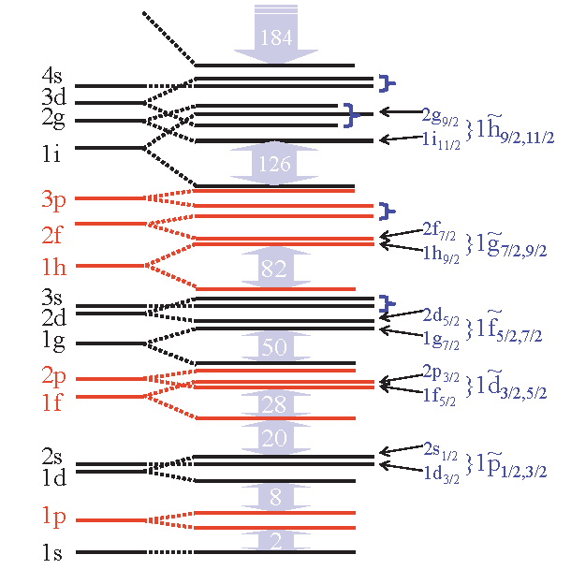
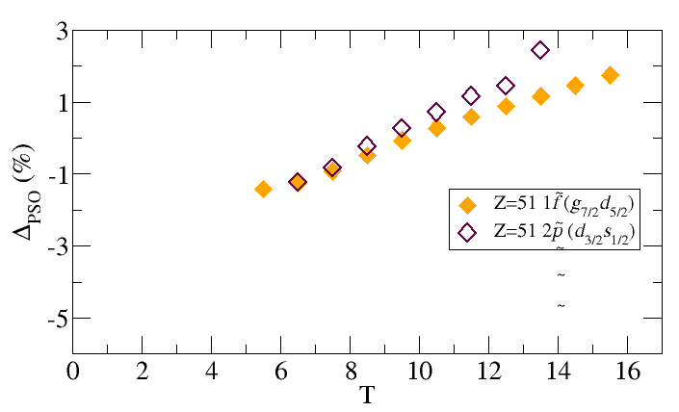
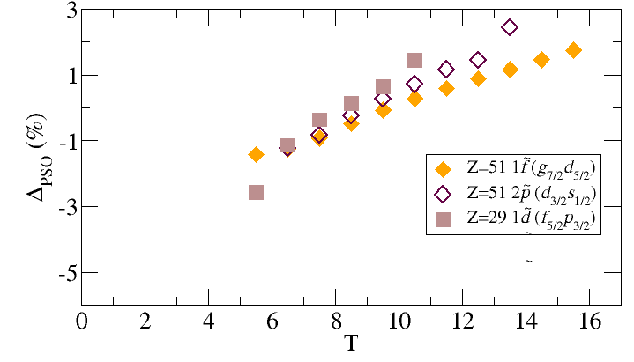
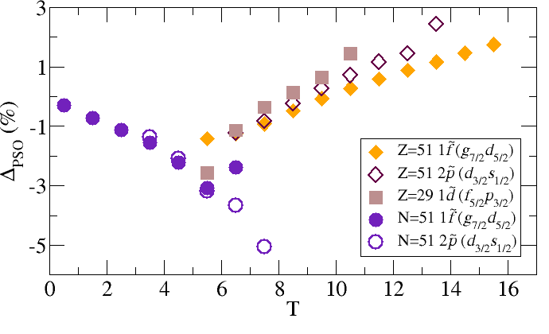










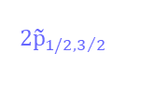

Nuclear PSS and Shell Energies
2d_{3/2}
$$2{\tilde{\text{p}}}_{1/2,3/2}$$
3s_{1/2}
C. Delafosse, D. Verney et al., submitted to PRL
$$Δ_{\text{PSO}}=(ε_{j<}−ε_{j>})/\left[ℏω(2\tilde{l}+1)\right]$$
T=1/2
ρ meson interaction,
in neutron rich nuclei :
• repulsive for the neutrons
• attractive for the protons
Binding Σ_{n}
R
neutron skin formation ?
neutron diffusivity
$$\tilde{ℓ}$$
$${\tilde{ℓ}}_{↑}$$
$${\tilde{ℓ}}_{↑}$$
$$\tilde{ℓ}$$
$${\tilde{ℓ}}_{↑}$$
$${\tilde{ℓ}}_{↓}$$
$$\tilde{ℓ}$$
$${\tilde{ℓ}}_{↓}$$
$${\tilde{ℓ}}_{↑}$$
$${\tilde{ℓ}}_{↓}$$
d_{5/2}
$$\tilde{ℓ}$$
T=23/2
50
$${\tilde{ℓ}}_{↓}$$
g_{9/2}
s_{1/2}
d_{5/2}

Slide 17
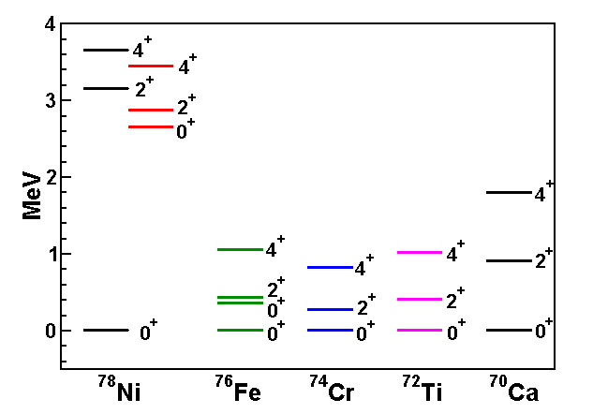
Conclusions and Perspectives
Electron spectroscopy reveals E0 transition in ⁸⁰Ge pointing to a low-lying excited 0⁺ state. The N=50 gap evolution reveals a lowering of the
νd5/2- νs1/2 shells.
Strong γ yield (~15%) from states up to 4 MeV above the neutron separation threshold. GT populates core-excited states which could act as doorway states for β decay
A possible common physics exists, based on RMF calculations showing a change in the pseudo-spin symmetry
F. Nowacki et al., Phys. Rev. Lett. 117, 272501 (2016)
Physics of “2⁺” vs “precision physics”:
EURISOL-DF + FAIR will allow one to explore complementary observables to understand the underlying physics

Slide 18
THIS IS THE END, MY ONLY FRIEND, THE END

Slide 19

⁸³Ga: GT triggers low-lying nuclear dipole oscillations ?
Density variation in 5 MeV PDR
I. Deloncle, Sophie Peru-Desenfants, Marco Martini DAM -CEA
A. Gottardo et al, PLB 772 (2017) 359–362

Slide 20
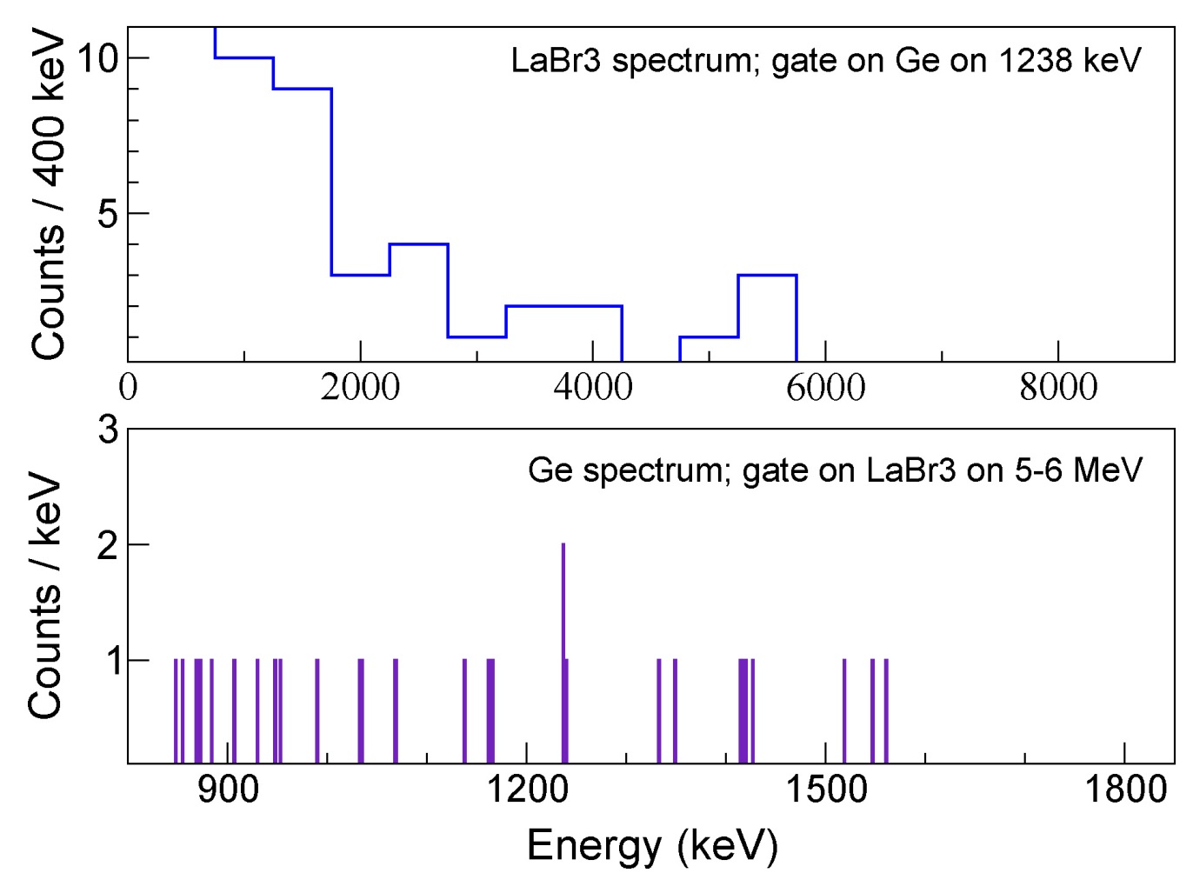
⁸³Ga: mutal high-low energy γ coincedences
γ rays between 4.5 – 6 MeV in coincidence with ⁸³Ge 1238 keV line

Slide 21
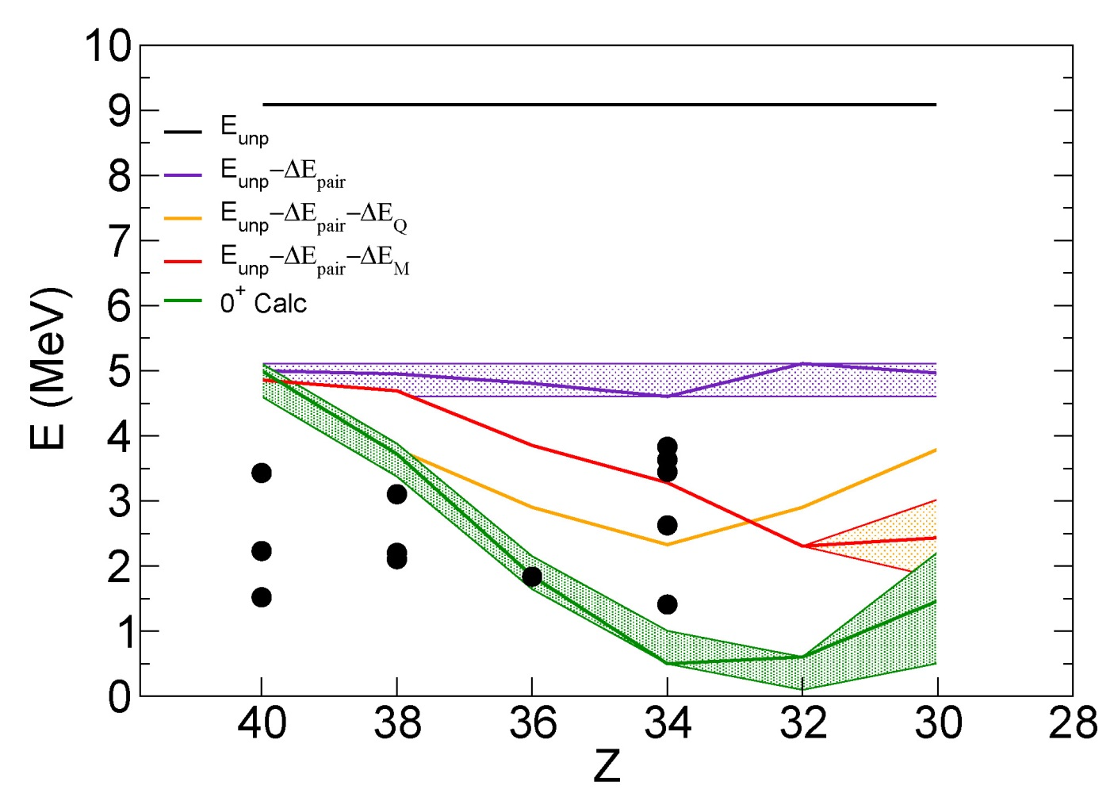



Energy of intruder (2p-2h) 0⁺ states
$$E_{0_{\left(2p−2h\right)}^{+}}=2\left(E_{νd5/2}−E_{νg9/2}\right)+{ΔE}_{Pairing}^{υυ}+{ΔE}_{Quadrupole}^{πυ}+{ΔE}_{Monopole}^{πυ}$$
Where:
${ΔE}_{Pairing}^{υυ}$: from 2n separation energies
${ΔE}_{Quadrupole}^{πυ}$ : IBM-2 approximation
;
${ΔE}_{Monopole}^{πυ}$: graphical method
K. Heyde et al.: PLB176, 189 (1986)
J. L. Wood et al., Phys. Rep. 215, 201 (1992).
s_{1/2}
N=48
d_{5/2}
The (2p-2h) 0⁺ states are going down in energy
0⁺ Exp
N=50 gap
g_{9/2}
The monopole contribution flattens out the midshell Z=34 quadrupole minimum
D. Verney

Slide 22
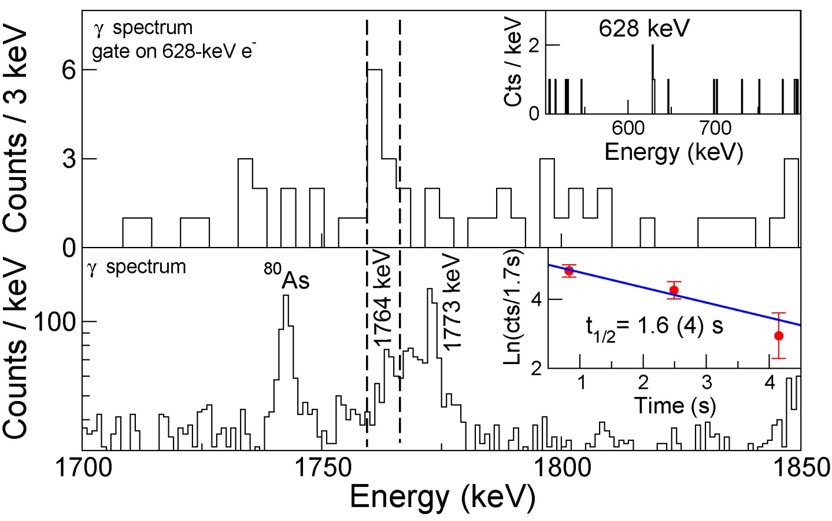

Electron–γ coincidences
(2403)
(2⁺_{x})
$$≈$$
(E2)
659
2⁺₁
639
0⁺₂
E2
E0
Electron-γ coincidences to
Confirm spectroscopy
Future studies of the structure of the second 0⁺
0
0⁺₁
⁸⁰Ge

Slide 23
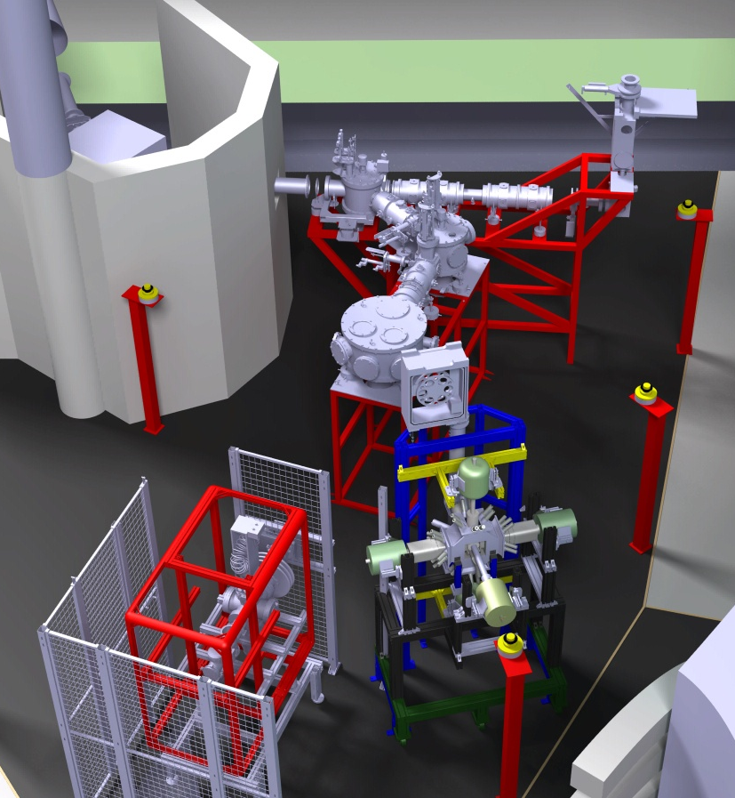
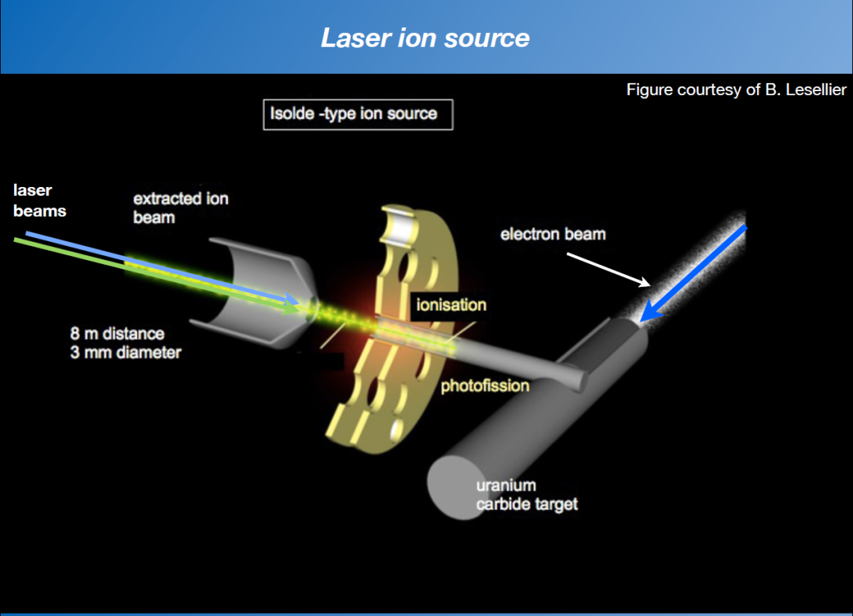
Experimental setup: ALTO @ IPN ORSAY
ISOL facility at Orsay:
50 MeV, 10 μA e⁻ beam, UC_{x} target
10¹¹ fissions/s
Surface and laser ionization
PARRNe on line mass separator
PARRNE β-decay station
BEDO β-decay station

Slide 24
2-state repulsion toy model
Delta interaction (s=0.3)

Slide 25
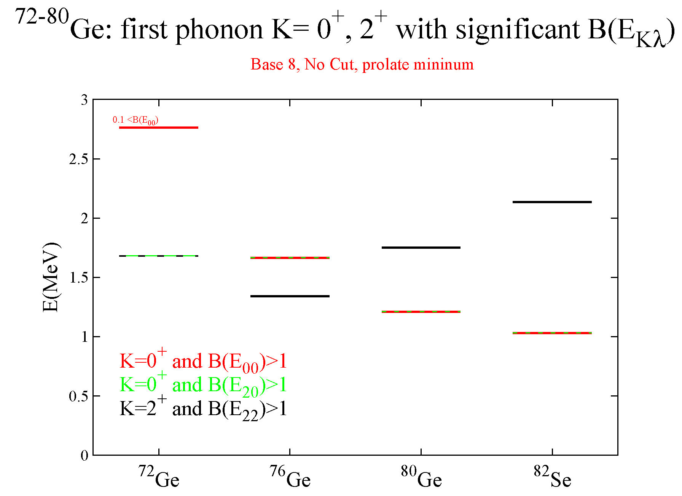
Gogny d1M - QRPA

Slide 26
ρ(E0) and configuration mixing
τ<50 ns : ρ²(E0) >0.1
For comparison :
30Mg: τ(E0) = 400(100) ns : ρ²(E0) = 0.03 (1)

Slide 27
spherical gap from masses: graphical method
Graphical method by K. Heyde et al.: PLB176, 189 (1986)
Shell gap: energy to separate the 51th neutron on ⁸²Ge, NOT ⁸³Ge
S_{n}(N=50) - S_{n}(N _{extr})
S_{n}(N=50)-S_{n}(N=51)
Duflo Zuker gap
⁷⁸Ni =5,7 MeV
Duflo Zuker gap PRC59 (1999)
⁹⁰Zr =4,7 MeV
local minimum at Z=32
« standard »
εd_{5/2} – εg_{9/2} (MeV)
« graphical »
The shell gap N=50 is overestimated (~300 keV) by the S_{n}(N+1)-S_{n}(N) difference
Ni
Zn
Ge
Se
Kr
Sr
Zr

Slide 28
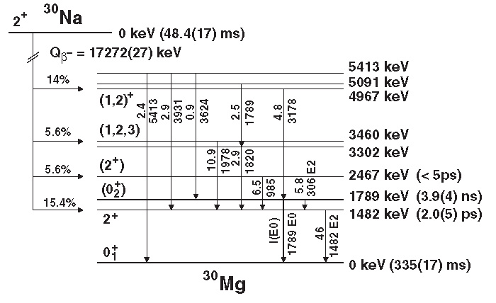
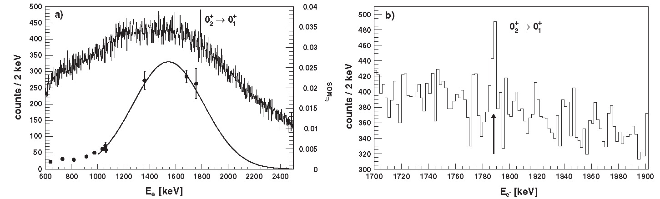
N=26 ³⁰Mg: a similar case
W. Schwerdtfeger et al., PRL 103, 012501 (2009)

Slide 29
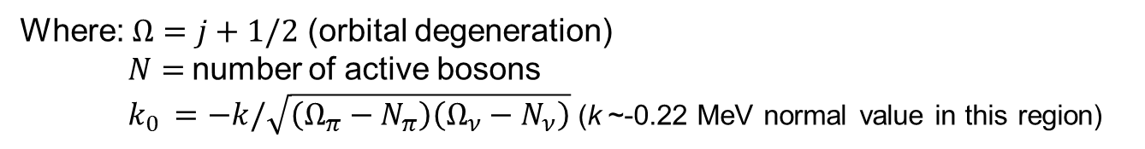
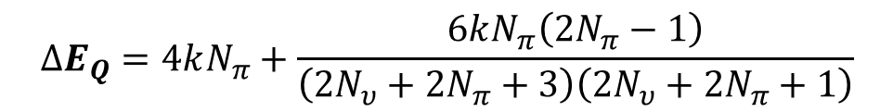
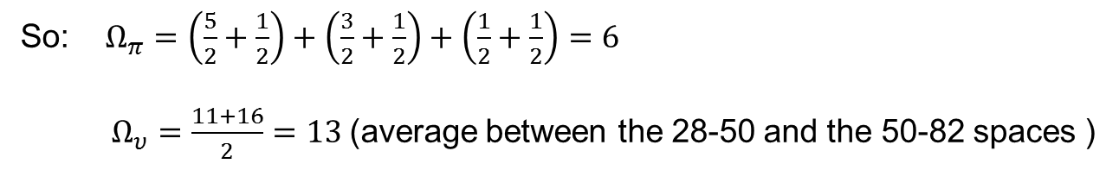
Quadrupole contribution
K. Heyde et al., Nucl. Phys. A466, 189 (1987)
Quadrupole energy in IBM-2: $E_{Q}(N_{υ},N_{π})=2k_{0}{N_{π}N}_{υ}\left\{1+\frac{3}{4\left(N_{π}+N_{υ}\right)−2}\right\}$
Where: $Ω=j+1/2$ (orbital degeneration)
$N=$number of active bosons
$k_{0 }=−k/\sqrt{\left(Ω_{π}−N_{π}\right)\left(Ω_{ν}−N_{ν}\right)}$ (k ~-0.22 MeV normal value in this region)
So: $Ω_{π}=\left(\frac{5}{2}+\frac{1}{2}\right)+\left(\frac{3}{2}+\frac{1}{2}\right)+\left(\frac{1}{2}+\frac{1}{2}\right)=6$
$Ω_{υ}=\frac{11+16}{2}=13$(average between the 28-50 and the 50-82 spaces )
K. Heyde et al., Nucl. Phys. A484, 275 (1988)
$$∆E_{Q}=4kN_{π}+\frac{6kN_{π}\left(2N_{π}−1\right)}{\left(2N_{υ}+2N_{π}+3\right)\left(2N_{υ}+2N_{π}+1\right)}$$
${ΔE}_{}^{υυ}Pairing=\left[2S_{n}\left({}_{}^{90}{Zr}\right)−S_{2n}\left({}_{}^{90}{Zr}\right)\right]+\left[2S_{n}\left({}_{}^{91}{Zr}\right)−S_{2n}\left({}_{}^{92}{Zr}\right)\right]$

Slide 30
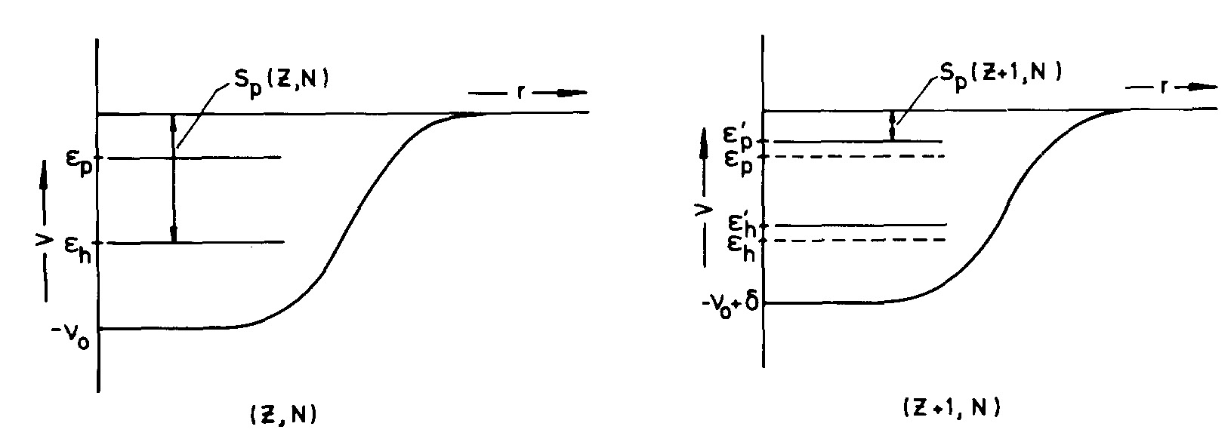
Graphical method
K. Heyde et al., Phys. Lett. B 176, 255 (1986)
[...] this 0⁺ state lies below the first-excited 2⁺ state. Within a deformed mean-field approach this is equivalent to a macroscopic phase change from a spherical to an oblate shape. A.N. Andreyev, Nature 405, 430 (2000)

Slide 31
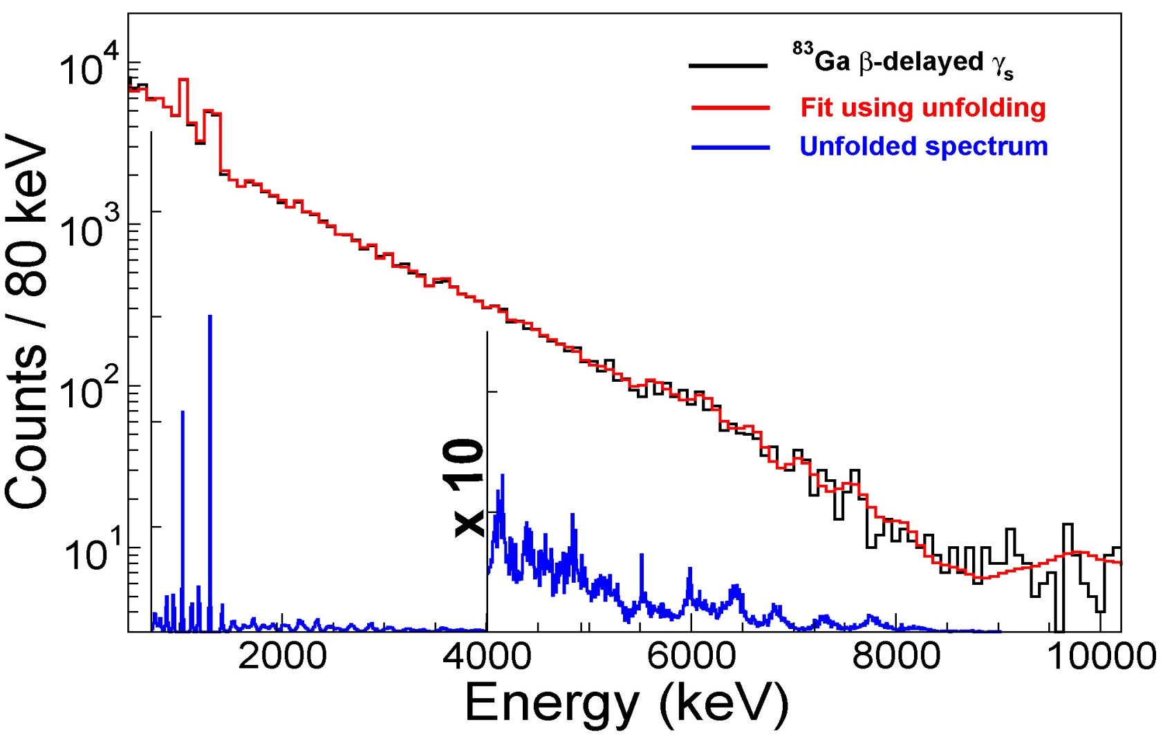
⁸³Ga: unfolding with geant4 simulation
1- 1000 Geant4 simulated spectra from 100 keV to 10 MeV, 10 keV step
2- Unfolding with the Gold algorithm
3- From that total γ yield 3.6 – 9 MeV normalized to 1348-keV line

Slide 32
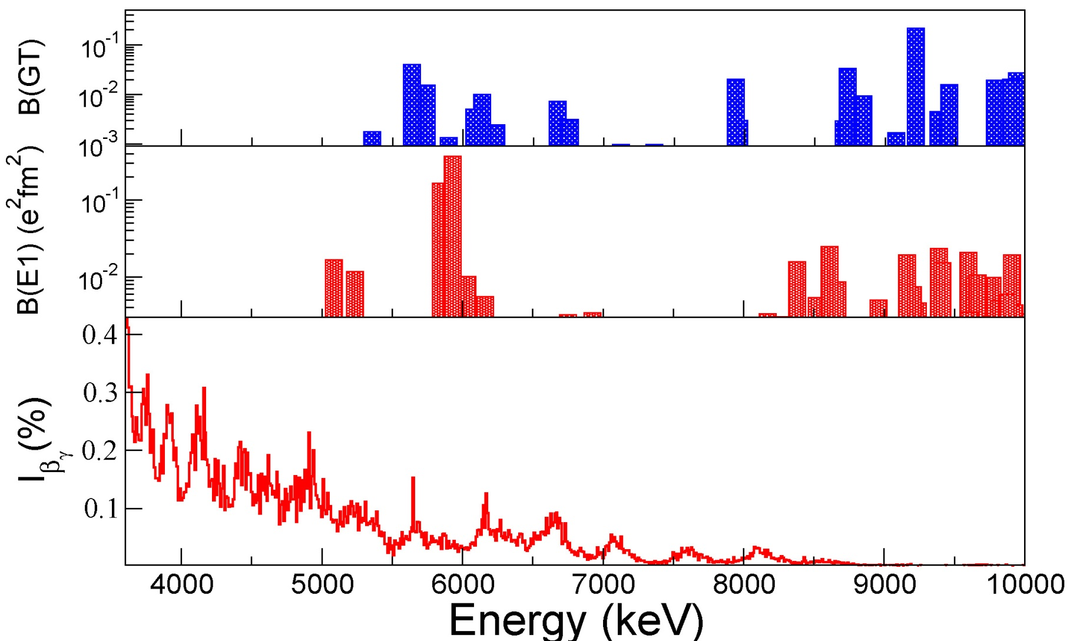
⁸³Ga: PDR and GT from Gogny D1M – QRPA (DAM - CEA)
QRPA
QRPA
β feeding intensity from deconvolution: in total around 15 %
I. Deloncle, Sophie Peru-Desenfants

Slide 33
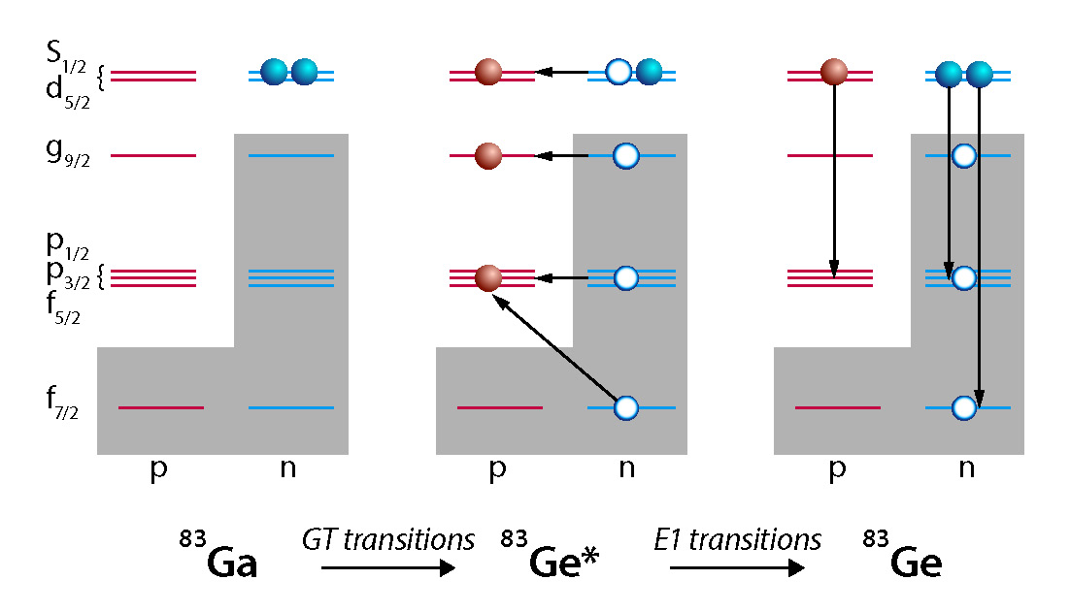
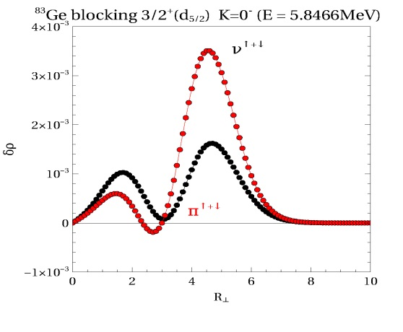
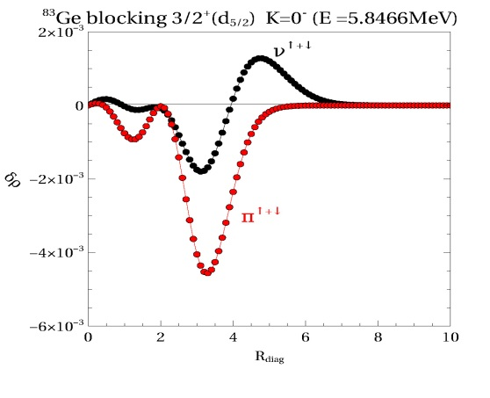
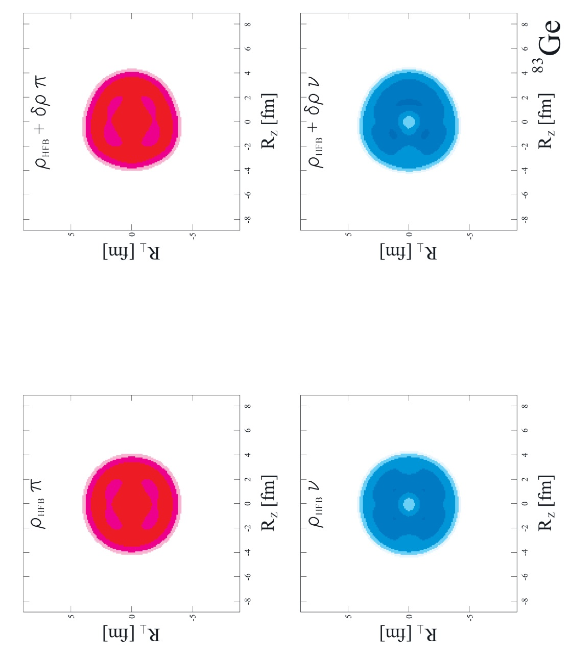
⁸³Ga: GT triggers low-lying nuclear dipole oscillations ?
I. Deloncle, Sophie Peru-Desenfants, DAM -CEA
Neutron density variation in 5 MeV PDR

Slide 34
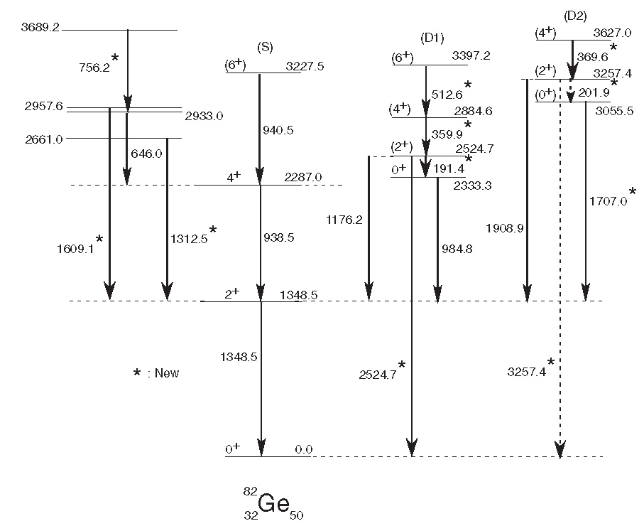
Excited 0⁺ states in ⁸²ge
⁸²Ge in spontaneous fission.
Highly deformed structures observed on the excited 0⁺ states
J. K. Hwang et al. Phys. Rev. C 84, 024305 (2011)

Slide 35
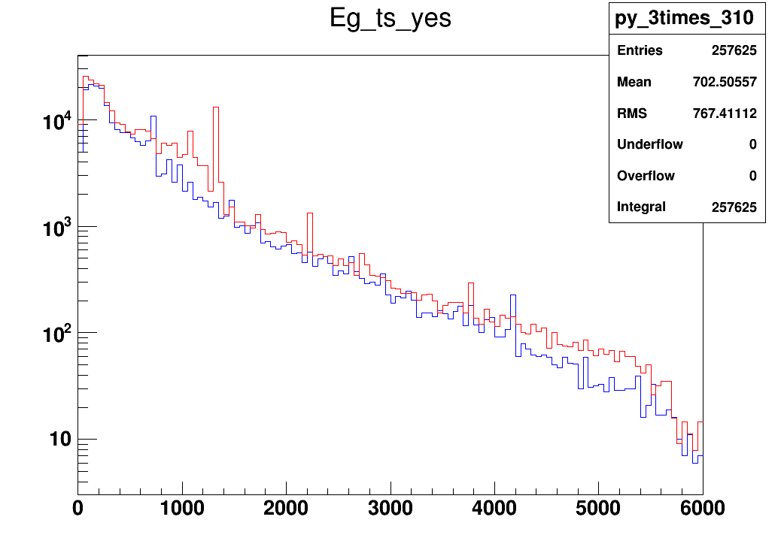
⁸³Ga
⁷⁹Cu
γ rays between 4.5 – 5.5 MeV of ⁸³Ga
1.7 times those if ⁷⁹Cu

Slide 36
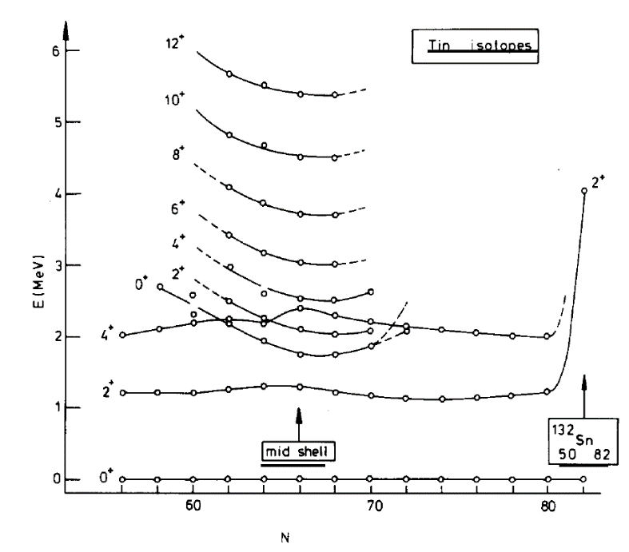
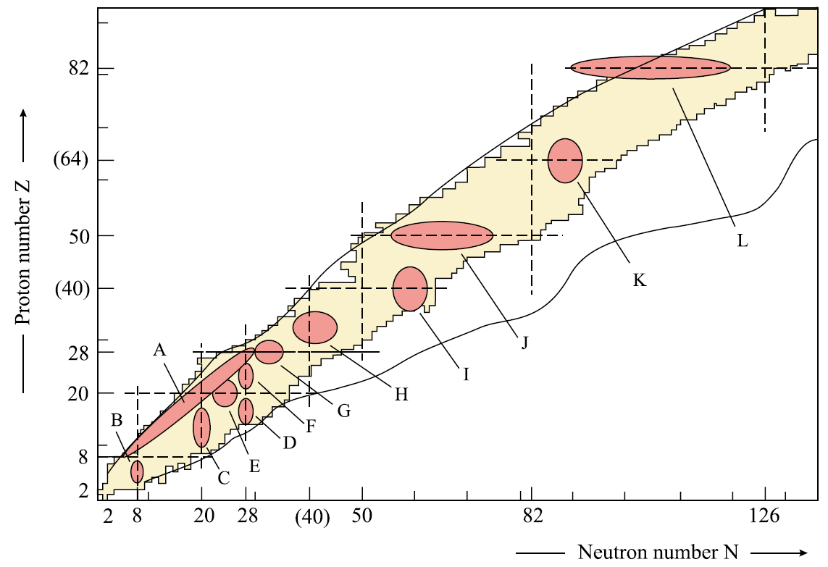
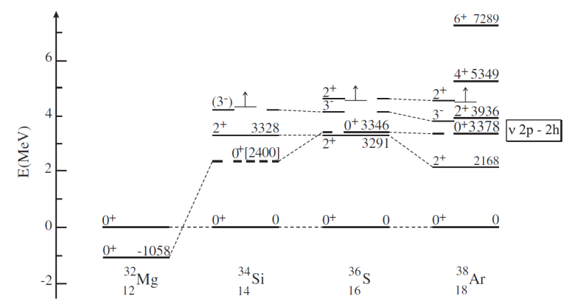
Shape coexistence in the nuclear chart
Z=50
N=20
?
⁷⁸Ni
Modified from Heyde & Wood Rev. Mod. Phys. 83 (2011) 1467

Slide 37
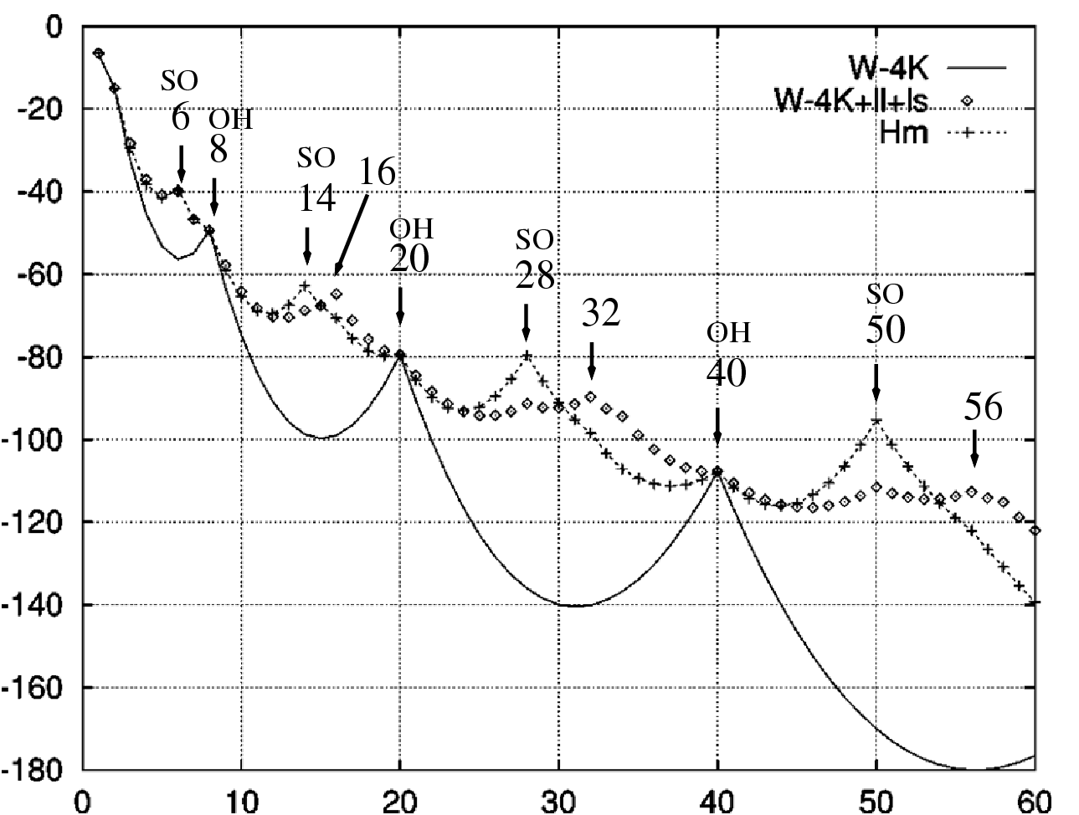
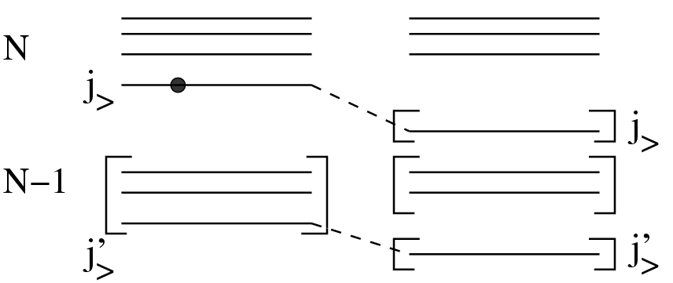
Why are there shell closures ?
J. Duflo et A. P. Zuker, Phys. Rev. C 59, R2347 (1999)
the true origin of spin-orbit shell closures ?
the role of the 3-body forces
Binding energy
Harmonic oscillator
Spin Orbit
Monopole tot
3-body interactions produce “naturally” this mechanism
A. P. Zuker, Phys. Rev. Lett. 90, 042502 (2003)
3-body generating “SO” or EI gaps:
N=14 in oxygen
N=28 in calcium
T. Otsuka et al., Phys. Rev. Lett. 104, 012501 (2010),
J. D. Holt et al. arXiv :1009.5984v3 [nucl-th] (2012)
Or unbinding of shells above the gap ?
, Phys. Rev. Lett. 90, 042502 (2016) and arXiv (2107)

Slide 38
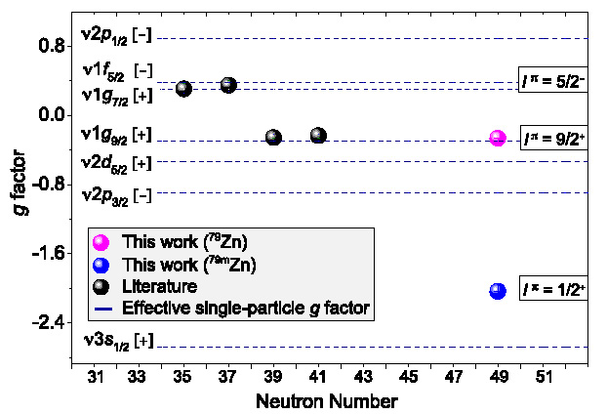

ISOMER SHIFT IN N = 49 isotones
X. F. Yang et al. Phys. Rev. Lett. 116, 182502 (2016)
The 1/2⁺ state in ⁷⁹Zn has a dominant ν(g_{9/2}⁻² s_{1/2}) character
Large isomer shift. Interpreted as large deformation (β ~0.22) of the intruder state
s_{1/2}
N=50
g_{9/2}

Slide 39

Pygmy dipole resonance via beta decay ?
M. Sheck et al. : PRL 116, 132501 (2016)

Slide 40

Systematics of 0⁺ states in Z=32 and N=50
Modified from D. Verney et al. Phys. Rev. C 87, 054307 (2013)
Ge isotopes and N=48 isotones seem to cross around the energy of ~ 600 keV in ⁸⁰Ge
s_{1/2}
d_{5/2}
N=50
g_{9/2}
Coexistence of triaxial shapes in ⁷²Ge:
A.D. Ayangeakaa et al., Phys. Lett. B 754 (2016) 254–259

