Slide 1
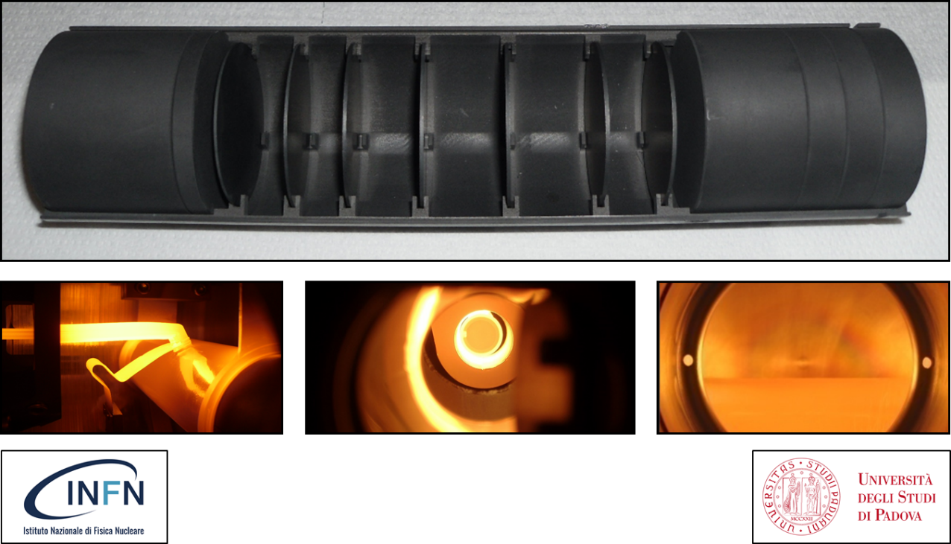
The SPES target, ion sources and beam transport
Mattia Manzolaro
on behalf of the SPES target group
(A. Andrighetto, S. Corradetti, M. Ballan, A. Monetti, G. Meneghetti, D. Scarpa, M. Rossignoli, F. D’Agostini, F. Borgna)
Mattia Manzolaro

Slide 2

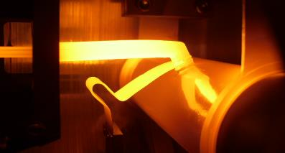
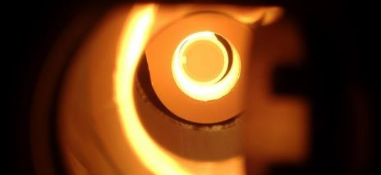
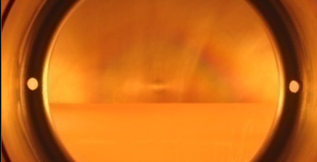
SUMMARY
1- Introduction
2- The SPES target
3- The SPES ion sources
4- The SPES 1+ beam line
5- Conclusions
Mattia Manzolaro slide 2/32

Slide 3
SUMMARY
1- Introduction
2- The SPES target
3- The SPES ion sources
4- The SPES 1+ beam line
5- Conclusions
Mattia Manzolaro slide 3/32

Slide 4
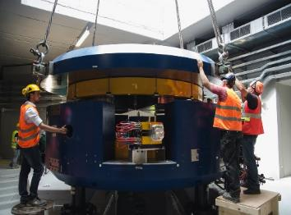
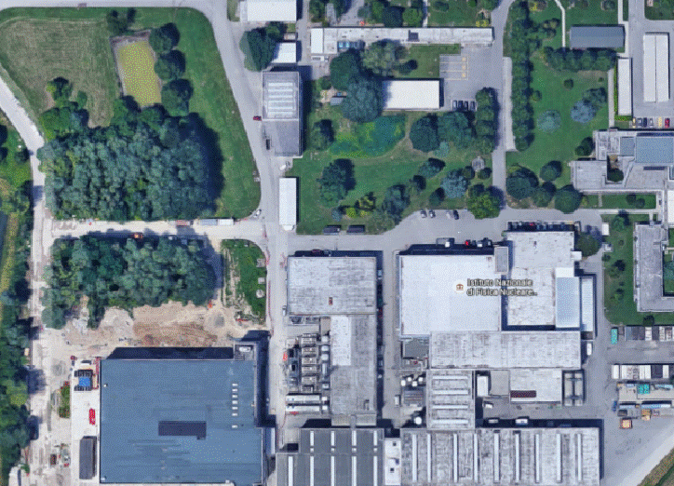
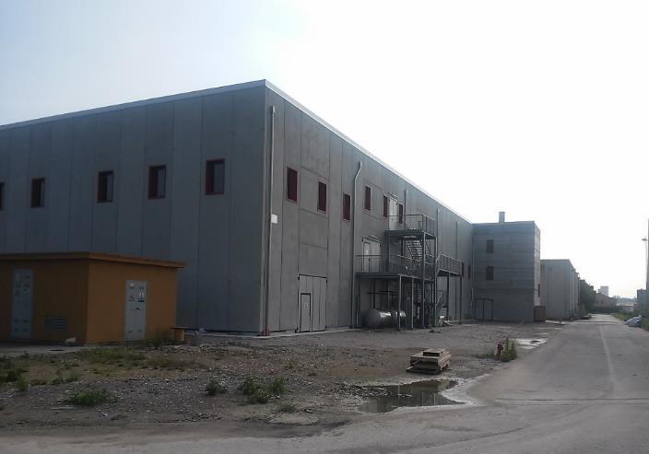
1- Introduction: the SPES facility @ LNL
SPES is: 1) A second generation ISOL RIB Facility (for neutron-rich radioactive ion beams)
2) An interdisciplinary Application Facility (for p,n applications)
New infrastructure for:
Cyclotron
ISOL RIB Facility
Application Facility
Mattia Manzolaro slide 4/32

Slide 5
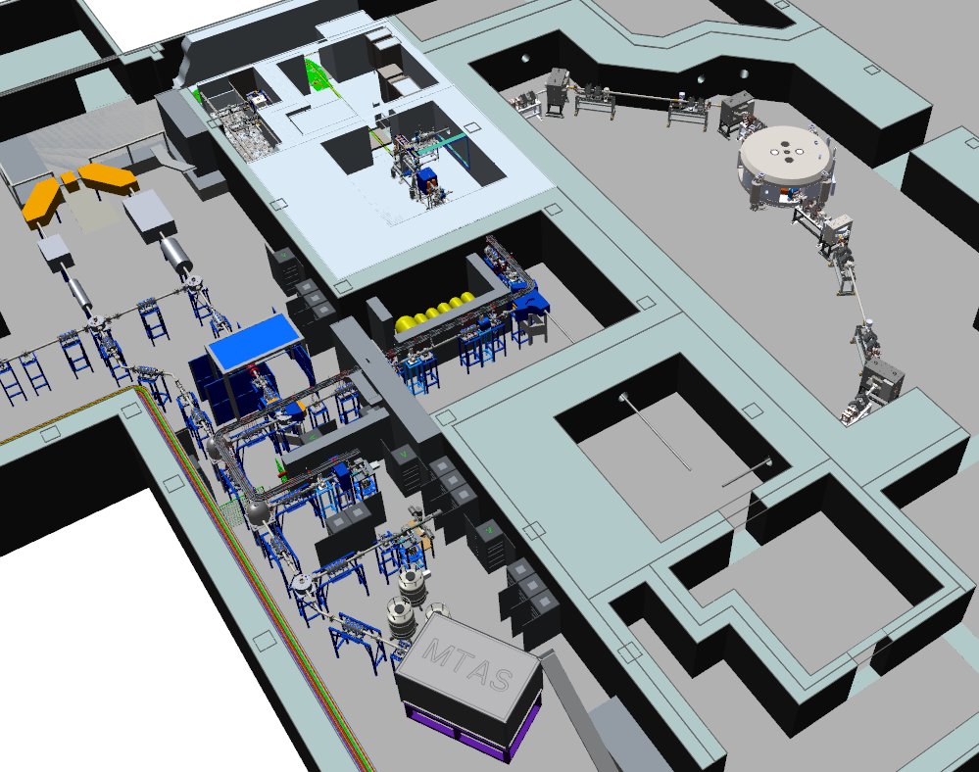
1- Introduction: the ISOL RIB (Radioactive Ion Beam) facility
ISOL hall
40 MeV 200 µA primary proton beam
1⁺ RIB @ LE
to MRMS/HRMS
and n⁺ RIB @ HE
Mattia Manzolaro slide 5/32

Slide 6
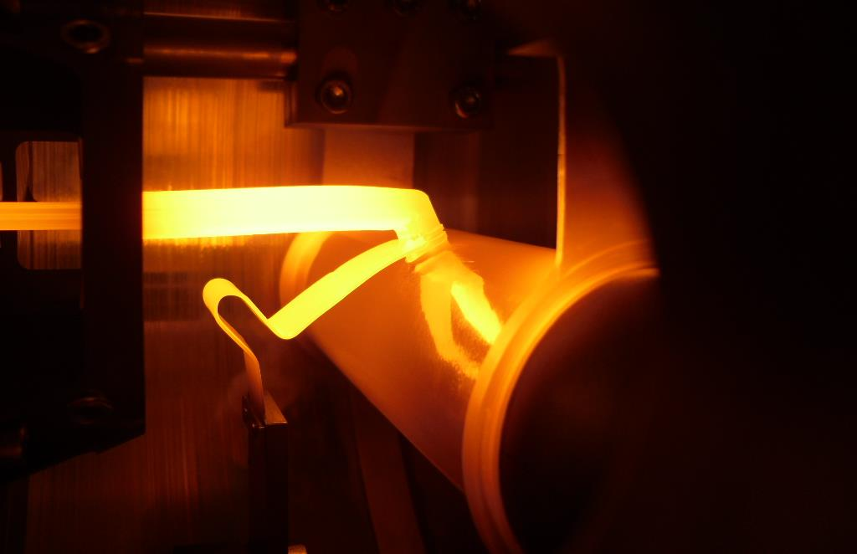
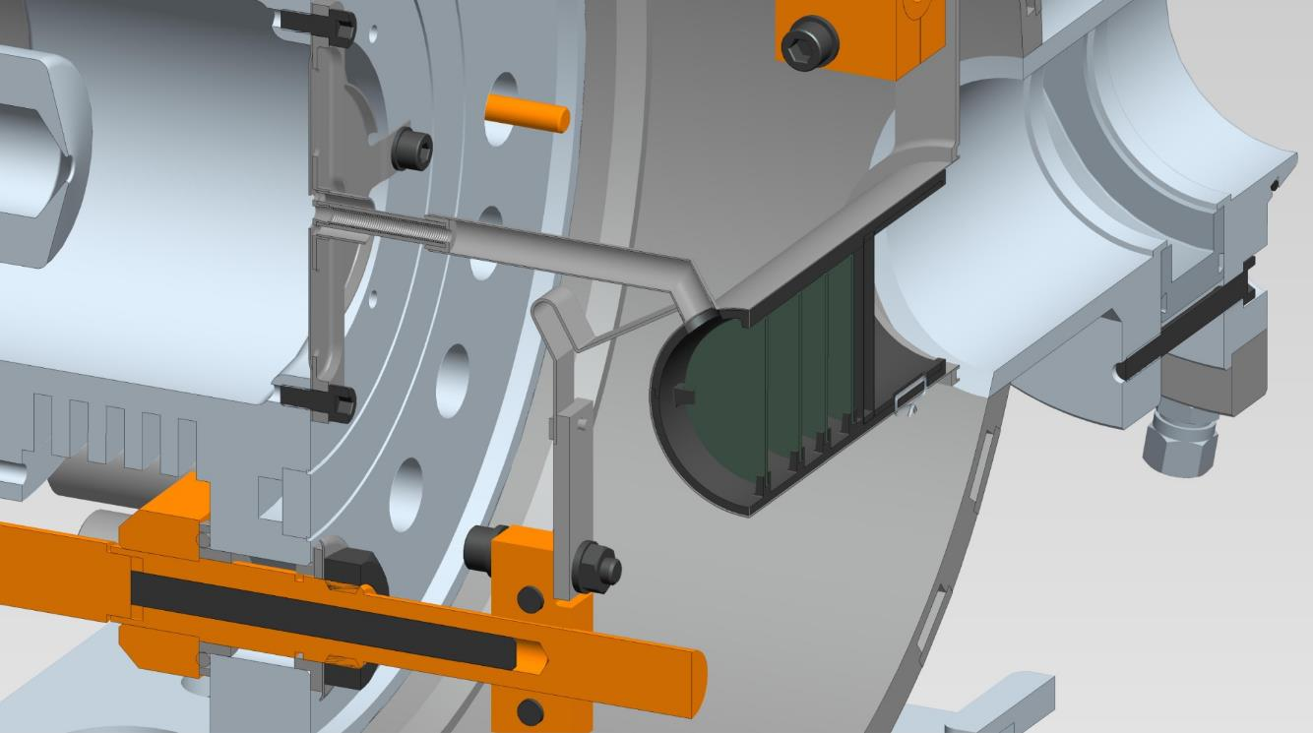
1- Introduction: the RIB bunker and the TIS (Target – Ion Source) system
surface
ion source
proton
beam
transfer line
1+
extraction electrode
SPES
production target
I_{T} = 700 A
I_{IS} = 200 A
Mattia Manzolaro slide 6/32

Slide 7
SUMMARY
1- Introduction
2- The SPES target
3- The SPES ion sources
4- The SPES 1+ beam line
5- Conclusions
Mattia Manzolaro slide 7/32

Slide 8
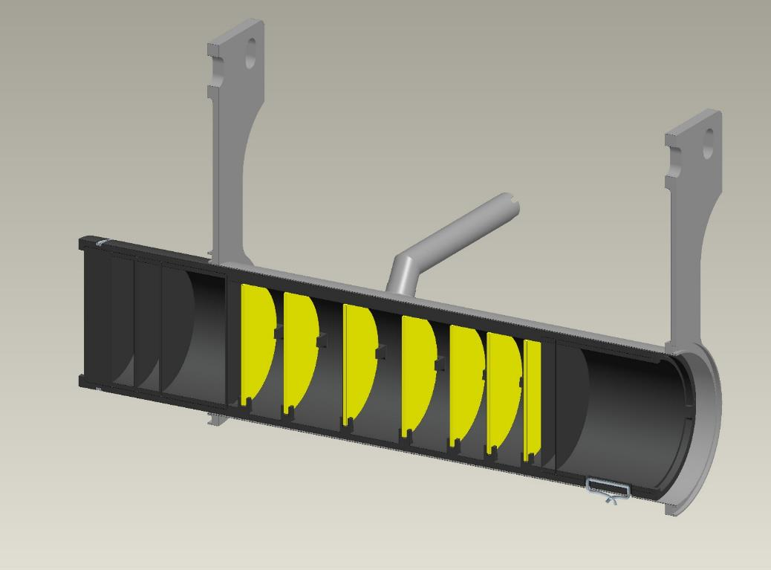
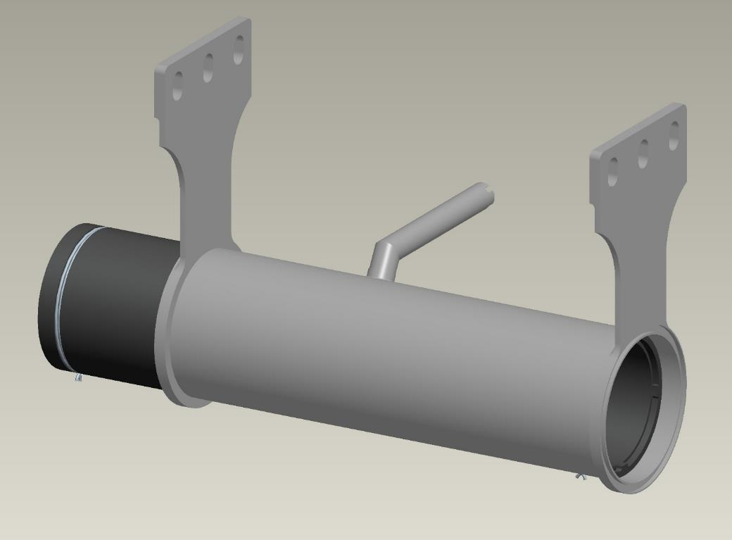
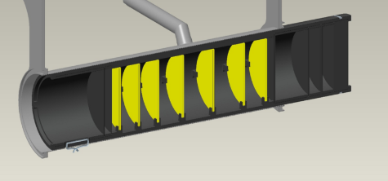
2- The SPES target: general architecture and main characteristics
p energy: 40 MeV
p intensity: 200 µA
40 MeV, 200 µA
proton beam
box (C)
heater (Ta)
window (C)
disc (UCx)
dumper (C)
Mattia Manzolaro slide 8/32

Slide 9
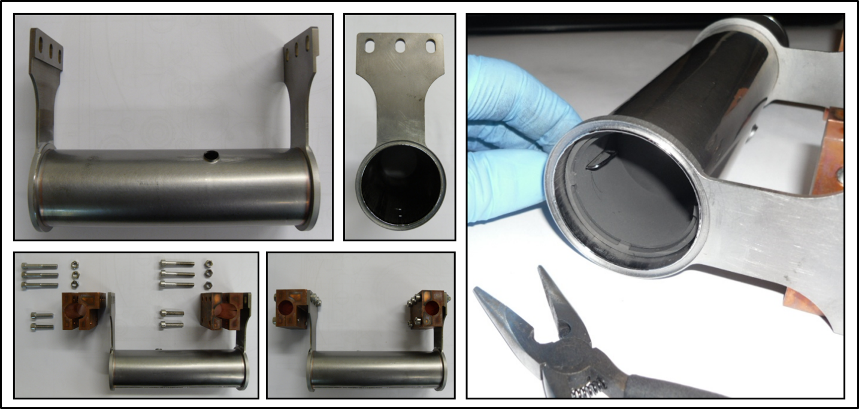
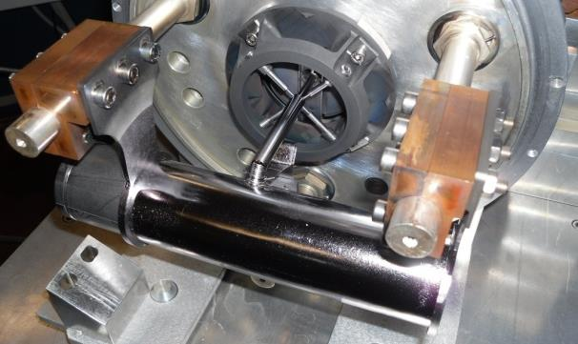
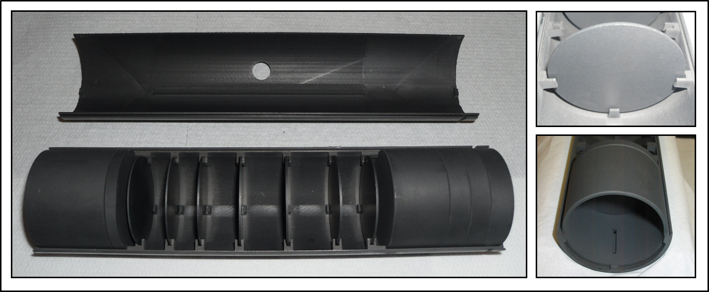
2- The SPES target: general architecture and main characteristics
Mattia Manzolaro slide 9/32

Slide 10
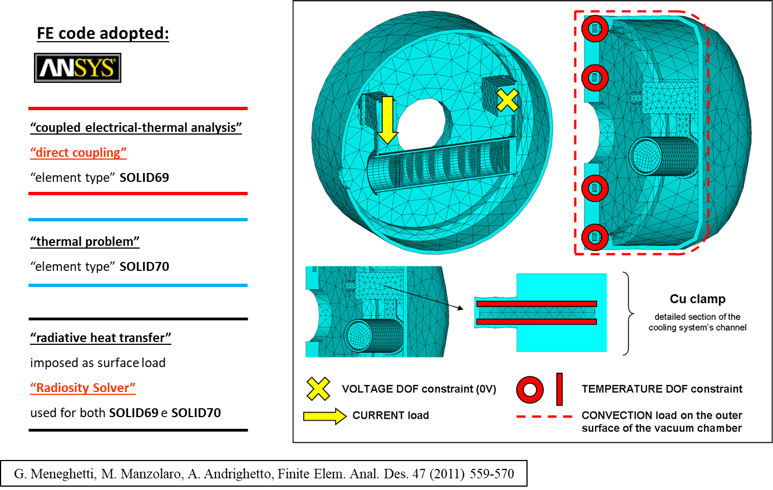
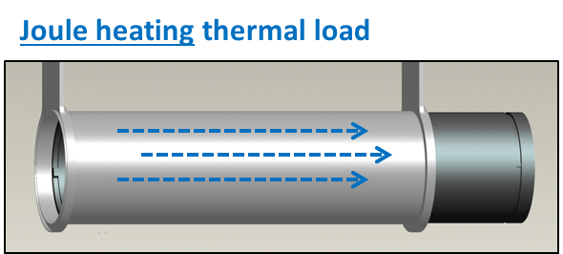
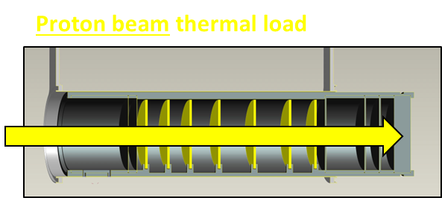
2- The SPES target: the electrical-thermal Finite Element model
directly implemented (electrical-thermal FE model)
power density tables import (from FLUKA model)
Mattia Manzolaro slide 10/32

Slide 11
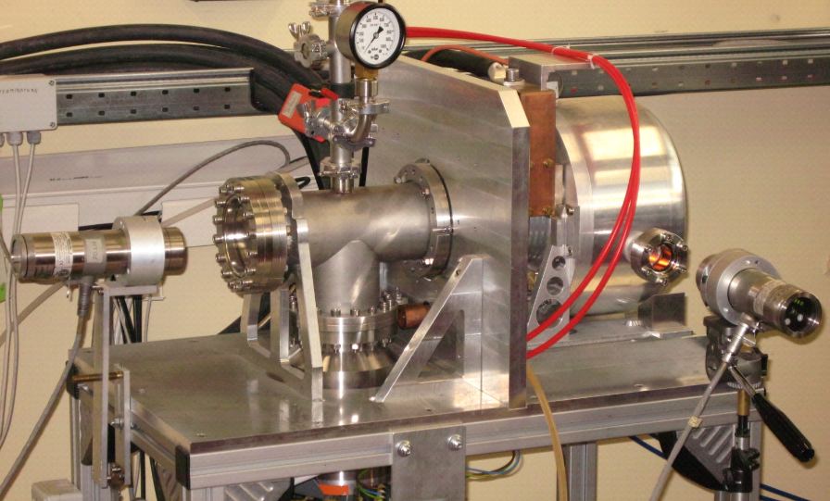
2- The SPES target: the electrical-thermal Finite Element model
Joule heating thermal load (1300 A) to heat the target during the conditioning phase
2
1
7
8
5
6
3
4
1.
Target vacuum chamber
5.
HT pyrometer
2.
Power supply connection
6.
LT pyrometer
3.
Vacuum turbomolecular pump
7.
Kodial viewport (Ta tube)
4.
Cooling water line
8.
Kodial viewport (graphite window)
Mattia Manzolaro slide 11/32

Slide 12
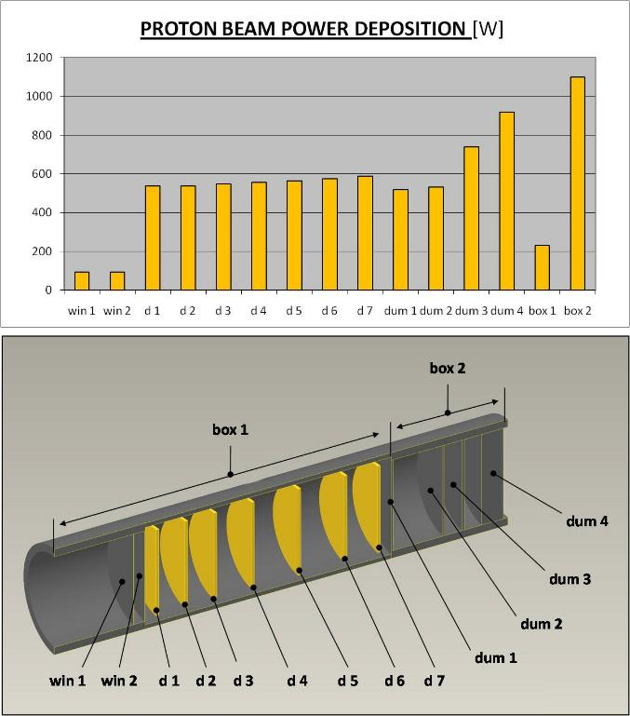
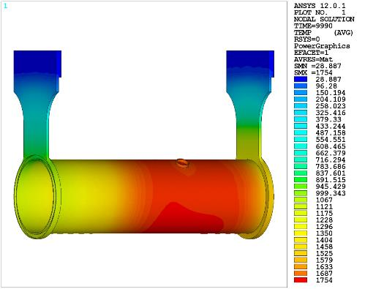
2- The SPES target: the electrical-thermal Finite Element model
Proton beam thermal load: 40 MeV, 0.2 mA (≈ 8 kW) (power density input for the Finite Element model calculated by means of particle physics MonteCarlo codes)
TEMPERATURE DISTRIBUTION [°C]
Mattia Manzolaro slide 12/32

Slide 13
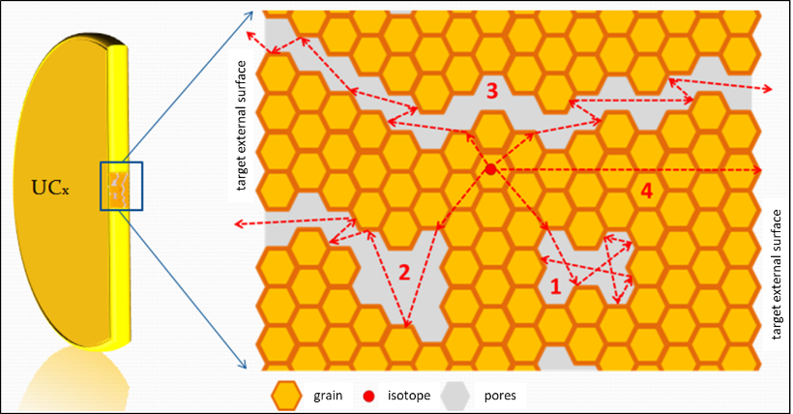
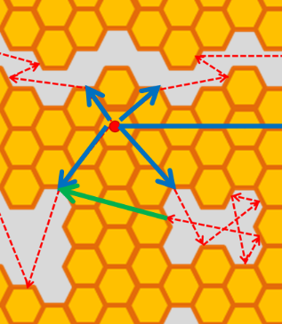
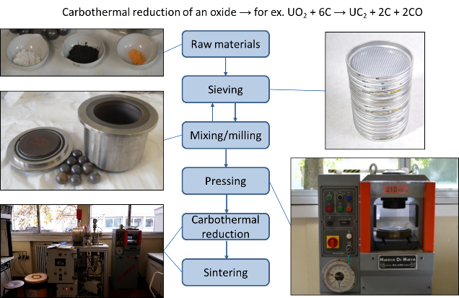
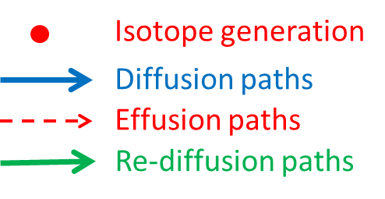
2- The SPES target: material characterization @ HT
homemade materials for the target disks (strong R&D activity required)
main requirements for ISOL target materials @ high temperatures
- open porosity and reduced grain size (diffusion & effusion)
- low vapor pressure (low gas load in the ion source and long term stability at high temperature)
- high emissivity
- high thermal conductivity
- good mechanical properties
total isotope yield deeply affected by open porosity (diffusion/effusion processes)
Courtesy of Stefano Corradetti
Mattia Manzolaro slide 13/32

Slide 14
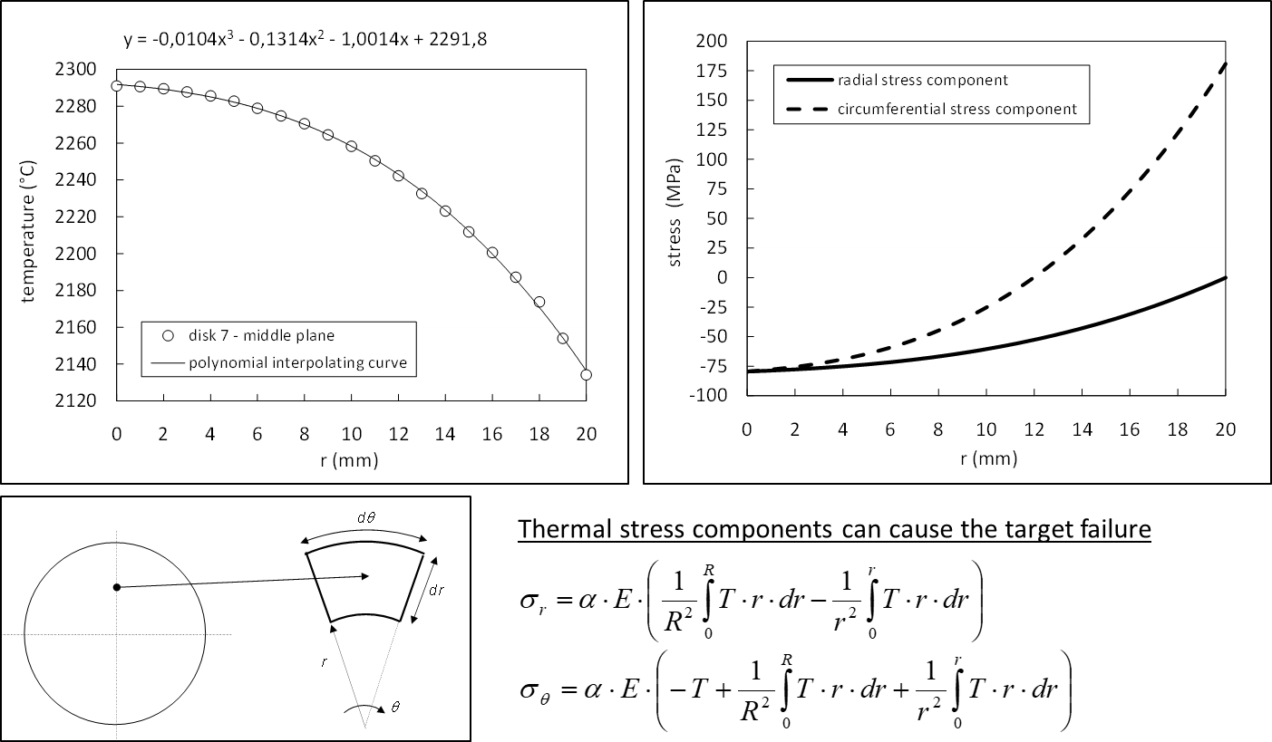
2- The SPES target: material characterization @ HT
Emissivity ε (th. radiation) and thermal conductivity λ (th. conduction) control the target temperature field
Temperature gradients generate stress states and a good tensile/compressive strength σ_{TS} is required
Mattia Manzolaro slide 14/32

Slide 15
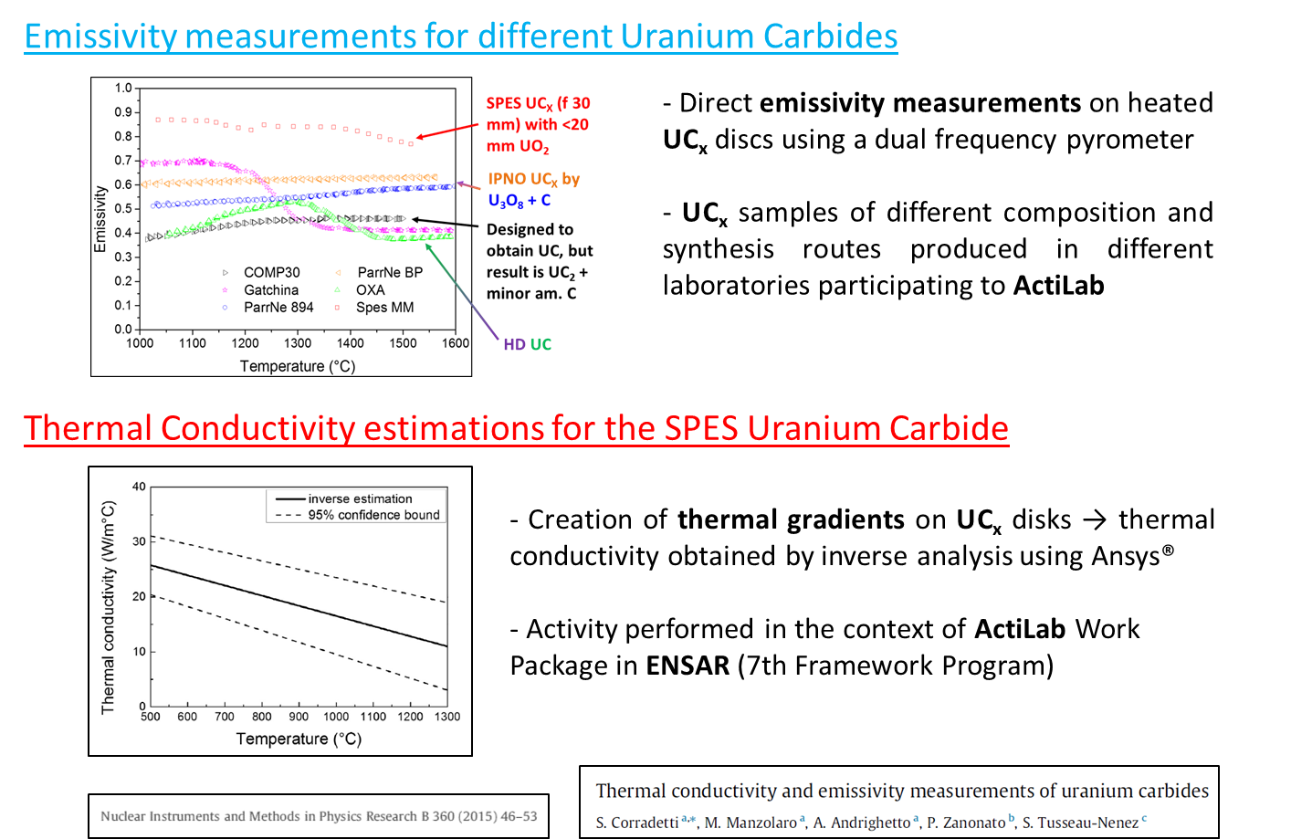
2- The SPES target: material characterization @ HT
Emissivity ε meas. method
L. Biasetto, M. Manzolaro, A. Andrighetto, Eur. Phys. J. A 38 (2008) 167-171
Thermal conductivity λ meas. method
M. Manzolaro, S. Corradetti, A. Andrighetto, L. Ferrari, Rev. Sci. Instrum. 84, (2013) 054902
Mattia Manzolaro slide 15/32

Slide 16
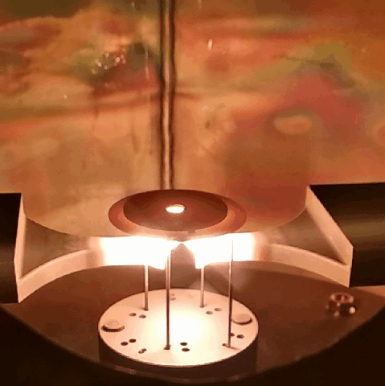
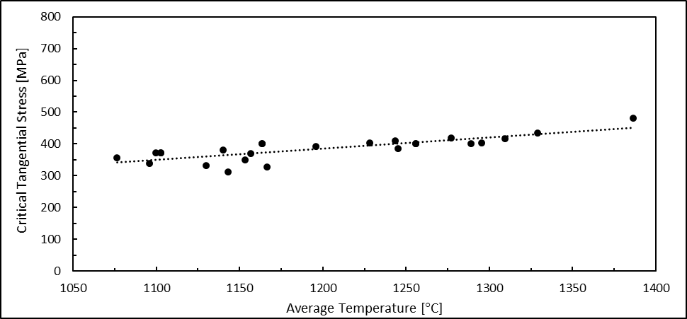
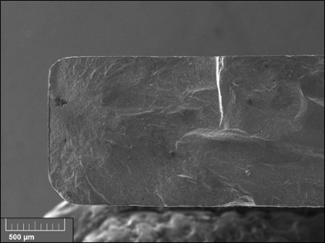
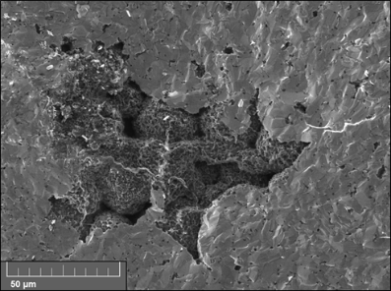
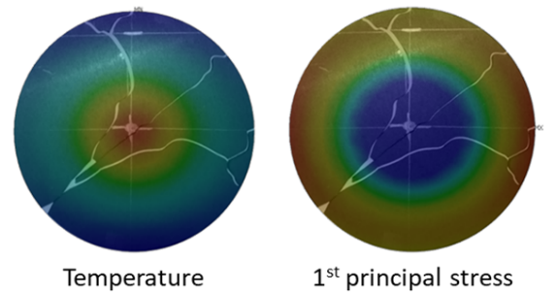
2- The SPES target: material characterization @ HT
A new method to estimate the Tensile Strength @ HT (Silicon Carbide)
SiC disk (Hexoloy SA) – Matteo Sturaro master’s thesis, University of Padova
Supervisors: G. Meneghetti, A. Andrighetto, M. Manzolaro, M. Ballan
average stress level during operation with primary beam
Mattia Manzolaro slide 16/32

Slide 17
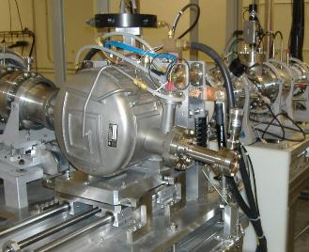
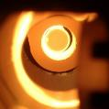
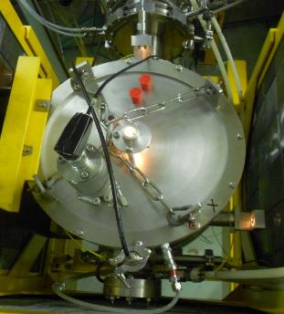
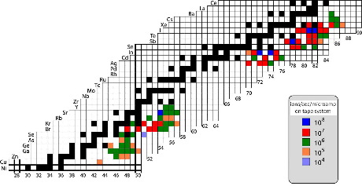
2- The SPES target: on-line tests @ other facilities
Scaled SiC Target Prototype tested @ ORNL
- 40 MeV, 12 µA proton beam (40 MeV, 200 µA @ SPES)
- SiC disks → acceptable activation levels
- 7 disks
Full-scale SiC Target Prototype tested @ iThemba LABS
- 66 MeV, 60 µA proton beam (40 MeV, 200 µA @ SPES)
- SiC disks → acceptable activation levels
- 13 disks
Scaled UC_{x} Target Prototype tested @ ORNL
- 40 MeV, 50 nA (low proton beam intensities for yields measurements)
- UC_{x} disks and low proton beam intensities → acceptable activation levels
- 7 disks
- 2 target prototypes tested at 3 different temperature levels (2000°C, 1800°C and 1600°C)
- more than 80 isotopes (20 elements) collected
Mattia Manzolaro slide 17/32

Slide 18

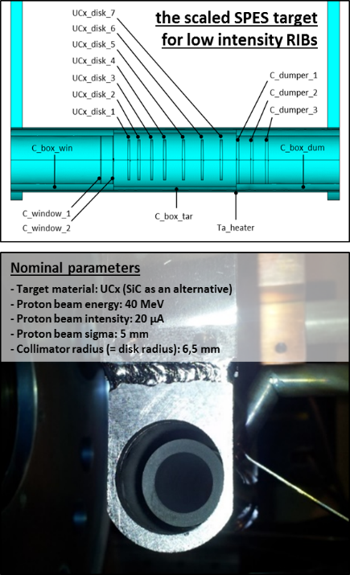
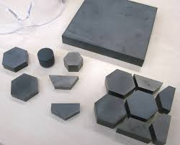
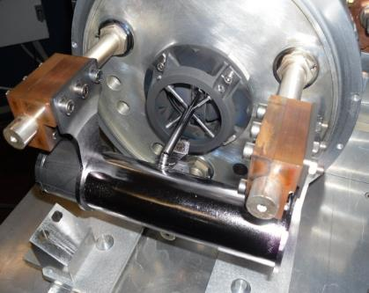
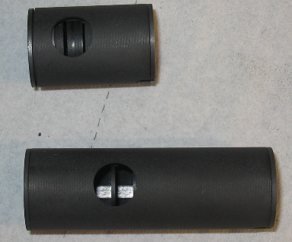
2- The SPES target: commissioning plan @ SPES
the next two steps of the commissioning phase
2020: 40 MeV, 20 µA
40 MeV, 20 µA, 10¹² f/s
40 MeV, 200 µA, 10¹³ f/s
SiC target
UCx target
UCx target
the full-scale SPES target for high intensity RIBs
Nominal parameters
- Target material: UCx (SiC as an alternative)
- Proton beam energy: 40 MeV
- Proton beam intensity: 200 µA
- Proton beam sigma: 7 mm
- Wobbling radius : 11 mm
First SPES RIB (²⁶Al)
to high proton beam intensities
(increase by a factor of 10)
first n-rich fission isotopes
Mattia Manzolaro slide 18/32

Slide 19
SUMMARY
1- Introduction
2- The SPES target
3- The SPES ion sources
4- The SPES 1+ beam line
5- Conclusions
Mattia Manzolaro slide 19/32

Slide 20
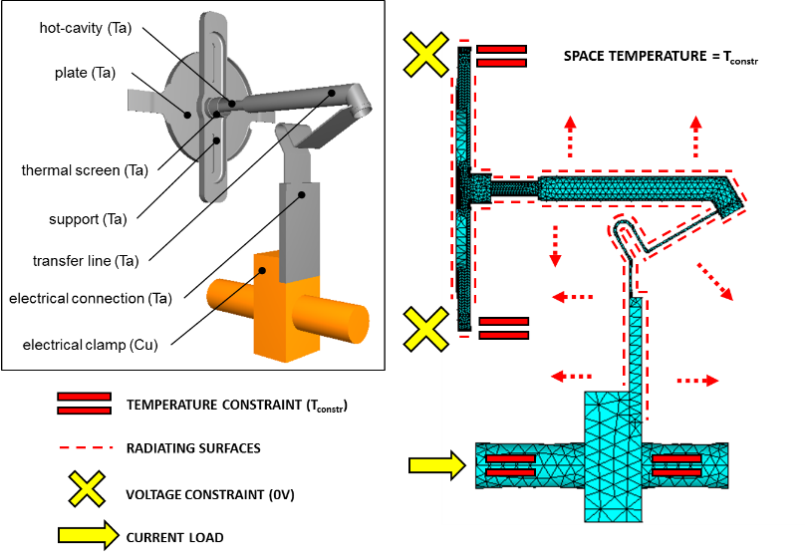
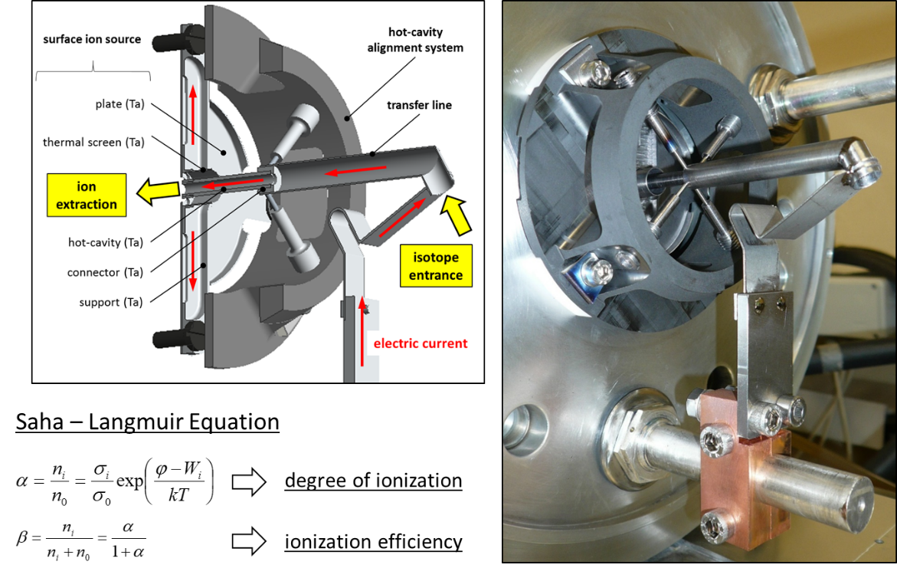
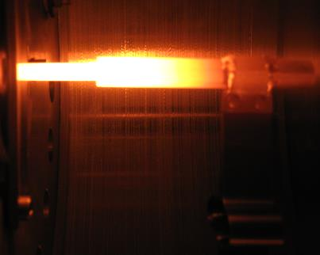
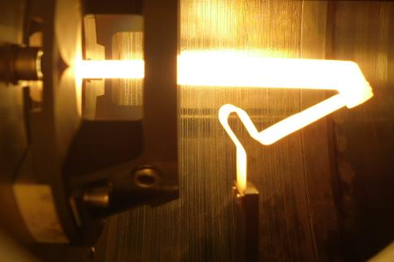
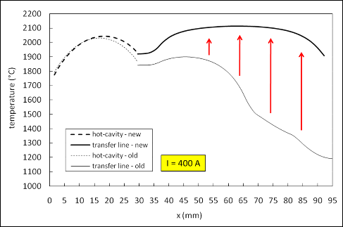
3- The SPES ion sources: surface ionization
starting point: ISOLDE MK1 ion source
Mattia Manzolaro slide 20/32

Slide 21
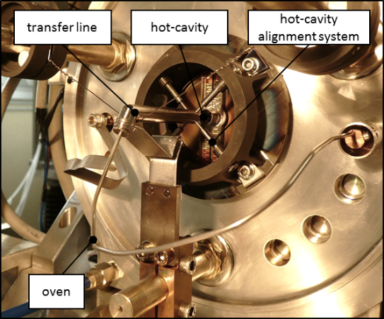
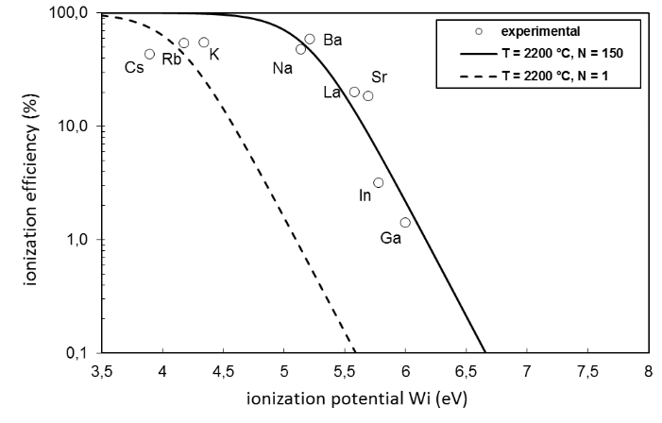
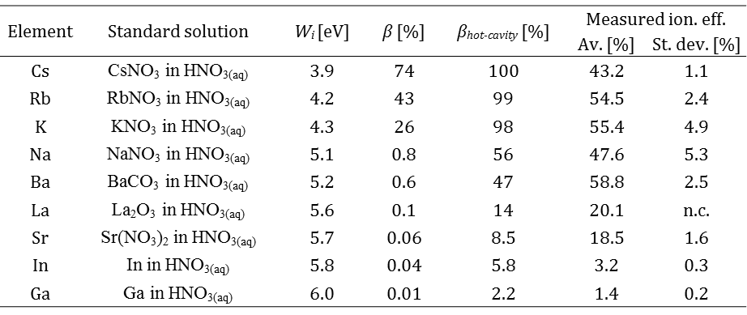
3- The SPES ion sources: surface ionization
R&D activities at the SPES Front-End Laboratory
Ionization Efficiency measurements (M. Manzolaro, F. D’Agostini)
Mattia Manzolaro slide 21/32

Slide 22
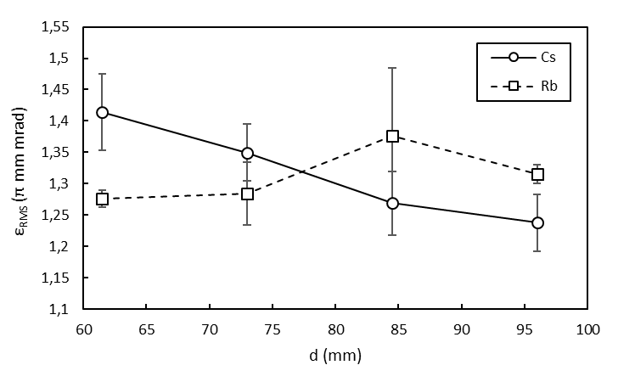




3- The SPES ion sources: surface ionization
R&D activities at the SPES Front-End Laboratory
Emittance (RMS) measurements (A. Monetti, M. Manzolaro)
Emittance vs puller position
Emittance vs beam current
Emittance vs temperature
Endurance tests (M. Manzolaro, F. D’Agostini)
SPES SIS after 17 days of operation @ 2200 °C
SPES SIS after the last test @ 2850 °C (still operative)
Mattia Manzolaro slide 22/32

Slide 23








3- The SPES ion sources: electron impact ionization
General improvement of the SPES Plasma Ion Source design: the optimized cathode and the alignment system
starting point / reference design: ISOLDE MK5
HOT-SPOT
cathode optimized to avoid hot-spots and to maximize the anode current (electron current impinging the anode)
anode currents up to 250 mA (V_{anode} = 150 V)
cathode alignment system reducing the thermal axial deformation of the cathode surface facing the anode
this is a good point to prevent the anode-cathode contact
Endurance testing with the SPES Plasma Ion Source and final visual inspection of the cathode
monitoring over time (heating-cooling cycles) of the anode current (el. current emitted by the cathode)
CATHODE OK!
STILL OPERATIVE!
status of the cathode
after
≈ 40 heating-cooling cycles
and
≈ 300 working hours
@ 2000°C
- cathode heating current = 380 A
- anode voltage = 150 V
- extraction voltage = 25000 V
slight sublimation rate > increasing el. resistance > increasing temperature > increasing thermionic emission
Delivered beams: Ar, Kr, Xe, Y Ongoing ionization efficiency and emittance measurements @ SPES Front End
Mattia Manzolaro slide 23/32

Slide 24







3- The SPES ion sources: electron impact ionization
R&D activities at the SPES Front-End Laboratory
Plasma Ion Source
beam | ion. eff. (%) | injection mode | cathode temp. (°C)
Ar | 6 | gas tube | 2200
Br | 8 | oven | 2200
Kr | 8.5 | gas tube | 2200
Y | very low | oven | 2300
Sn | 10 | oven | 2200
I | 19 | oven | 2200
Xe | 11 | gas tube | 2200
Ar beam
Kr beam
Xe beam
Sn beam
Mattia Manzolaro slide 24/32

Slide 25
SUMMARY
1- Introduction
2- The SPES target
3- The SPES ion sources
4- The SPES 1+ beam line
5- Conclusions
Mattia Manzolaro slide 25/32

Slide 26




4- The SPES 1+ beam line: Low Energy experiments at LNL
ISOL hall
1+ beam line
1+ beam line
Mattia Manzolaro slide 26/32

Slide 27

4- The SPES 1+ beam line: Beam Optics
Beam Optics defined (in collaboration with Tony Mendez)
floor coordinates – GIOS 3rd-order calculation
RIBs from FE
Beam starts at WF exit
slits
−50 mm
+50 mm
EQT
Shield
Wall
Thickness
2.8 m
HRMS
Beamline
Shield
Wall
Thickness
1.0 m
90° Spherical Electrostatic
Dipole (ESD)
EQT
Object
Slits
EQT
EQT
EQT
Mass Separator
Two 45° Mag Dipoles
EQT
Kicker
Slits
Image
Slits
+30 mm
Diagnostic Box
Tape Station
−30 mm
EQT
Mattia Manzolaro slide 27/32

Slide 28

4- The SPES 1+ beam line: Detailed Layout
Detailed Layout defined (in collaboration with Tony Mendez)
Mattia Manzolaro slide 28/32

Slide 29






4- The SPES 1+ beam line: Manufacturing and Assembly
electrostatic triplet of quads
prototype OK
tender ongoing
magnetic dipole
technical docs ready
tender ongoing
electrostatic dipole
prototype OK
under construction
electrostatic steerers
design completed
constructed and tested
diagnostic box
under construction
tape system
vacuum chambers ready
constr. of int. parts @ LNL
Mattia Manzolaro slide 29/32

Slide 30
SUMMARY
1- Introduction
2- The SPES target
3- The SPES ion sources
4- The SPES 1+ beam line
5- Conclusions
Mattia Manzolaro slide 30/32

Slide 31
5- Conclusions
The SPES Targets and Ion Sources are ready for the facility commissioning and for the operation phase
Numerical models and simulation activities are fundamental for the design of High Temperature ISOL Targets and Ion Sources
Validation of numerical models by means of dedicated experimental tests (both off-line and on-line) is extremely important
Numerical models and simulation activities can be extremely useful for Safety and Machine Protection Systems
The SPES 1+ Beam Line for experiments at Low Energy is under construction
The SPES facility commissioning (SiC Target & Plasma Ion Source) is scheduled for 2020
Poster Session: see posters by A. Monetti (The SPES Front-End) &
M. Ballan (Production target concepts for the SPES – ISOLPHARM project)
Mattia Manzolaro slide 31/32

Slide 32

MANY THANKS FOR YOUR ATTENTION!
Acknowlegments: Prof. G. Meneghetti and Prof. P. Colombo (UNIPD-DII), Prof. L. Biasetto (UNIPD-DTG), ISOLDE group (CERN), Dr. D.W. Stracener (ORNL), and all the BEAMLAB collaboration network
Mattia Manzolaro slide 32/32

