Slide 1






Innovative Charge Breeding Techniques (ICBT)
P.Ujić, F.J.C. Wenander, L. Standylo, P. Delahaye, Y. Blumenfeld, J.F. Cam, J. Choinski, B-M. Retailleau, E.Traykov,

Slide 2
Overview
EBIS activities at CERN
HIL ECRIS test stand status (HIL Warsaw)
Performances of the EBIS debuncher (GANIL)

Slide 3

EBIS activities at CERN
F. Wenander for the CERN EBIS team

Slide 4

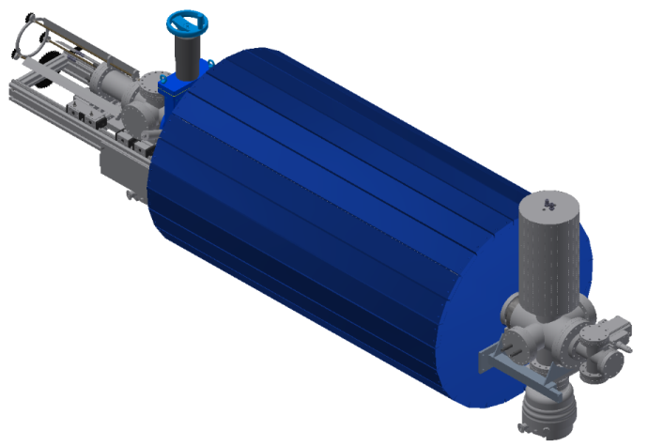
MEDeGUN - Motivation
Electron Beam Ion Source
HF-linac requirements:
300 – 400 Hz
<5 µs pulses
10⁸ C⁶⁺ ions per pulse
Parameter | Design Value
Main magnet | 2 T
Trap length | 0.25 m
Electron current | 1 A
Current density | 1.5 kA/cm² (3.5 kA/cm², 5 T)
Electron energy | 7.5 keV
Capacity C⁶⁺ | 1·10⁹ ions pp
Repetition rate C⁶⁺ | 180 Hz (440 Hz, 5 T)
Courtesy of TERA foundation
Updates on TULIP and CABOTO projects

Slide 5
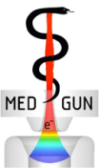
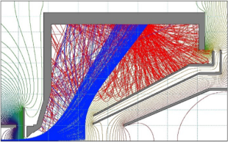
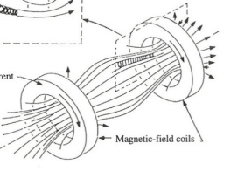
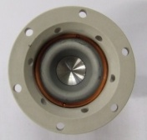
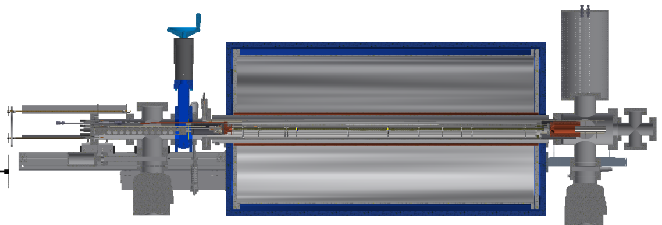
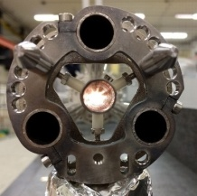
MEDeGUN challenges
Backscattered and secondary electrons
Magnetic mirror effect
High precision machining
Alignment
Minimizing loss currents on all electrodes while transmitting 1 A of electron beam
Notes:
Designed and constructed a high-compression electron gun (MEDeGUN). Aim for a current density of 1.5 kA/cm2 in a 2 T solenoid. If successful, could be implemented at REX-ISOLDE and would then reduce the charge breeding time with a factor 10. Higher charge states could also be reached as the electron beam energy is higher.

Slide 6
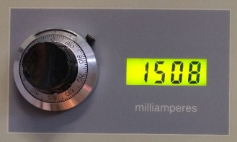
MEDeGUN results
A 1 A beam at 10 keV was transported through the 2 T solenoid with < 1 mA electron beam losses
Record current 1.5 A, although with higher losses
Record current 1.5 A
Transmitted electron beam
1.1 A
Anode
0.55 mA
Last Drift Tube
0.13 mA
Suppressor
0.32 mA
Total losses
1 mA
After optimization, the operation of the gun was reproducible: a few seconds after applying the extraction voltage a stable 1.1 A beam is achieved.
Notes:
First commissioning run late spring 2017. Managed to reach the design values. i. e. very low electron losses for a 1 A at 10 keV. Even a higher electron current could be transmitted through the solenoid, although with higher losses. No possibilities to establish a value for the electron current density in this configuration.

Slide 7
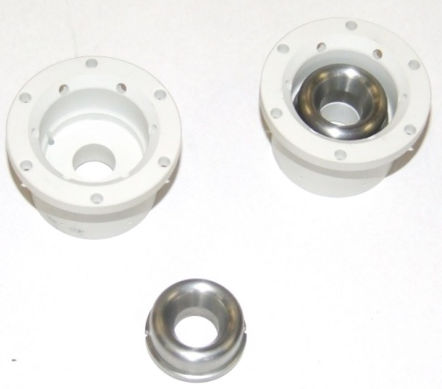
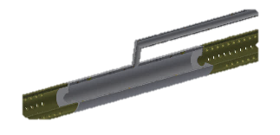
2nd MEDeGUN iteration
Anode in solid Mo brazed to insulator
Cathode surface retracted 50 um
Improved alignment precision of gun cross
Gas injection line installed winter 2018
Voltage isolation of drift tubes increased to 5 kV
Gas inlet tube
(Gas cell)
Regular drift tube
Notes:
First results very promising. Nevertheless, we suspect ripples on the electron beam that would prevent us from using the gun design in a future higher B-field solenoid (5 T). Thus preparing for a second commissioning run with MEDeGUN.

Slide 8
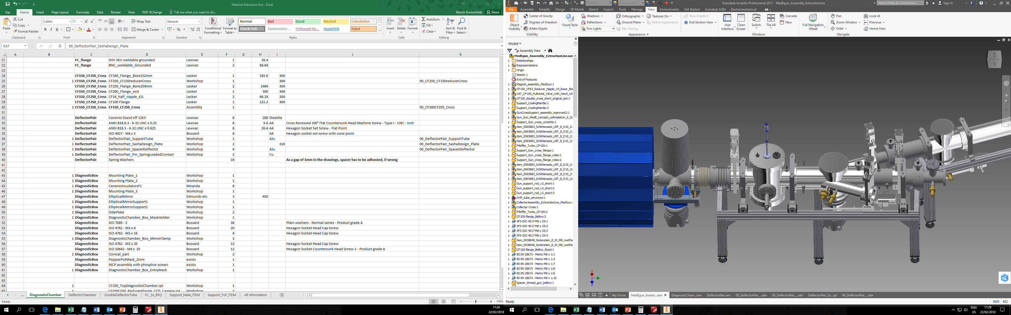
Compact, modular and multipurpose design
Ion extraction line
Beam viewing + pepper-pot emittance meter
TOF branch
750 MHz RFQ branch
EBIS collector cross
Bi-directional FC
Beam injection branch
Notes:
Until now all effort and investigation have focused on the electron beam and not on the ions.
Would like to build up an ion extraction line. Only with that we can characterize the electron beam (and electron current density) correctly.

Slide 9
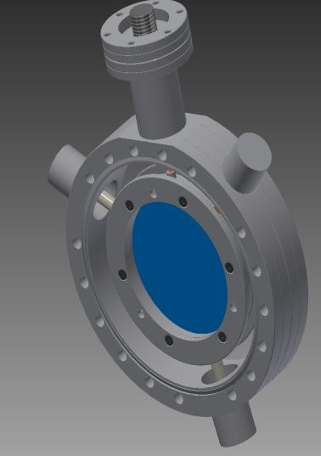
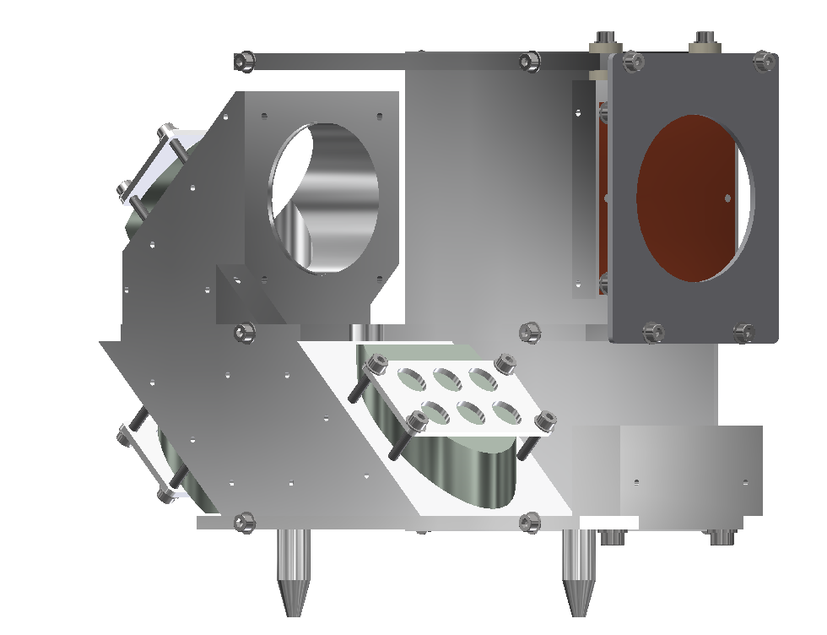

Beam elements
MCP position
Pepper pot grid
40kV feedthrough
“Light guide”
Dome for insulator
Incoming ion beam
Grid (~90% transparency)
Insulator
Grid holder
Gridded lens
Elliptical mirror
Alignment pins
Lens and camera
Production about to be launched
If manpower available installation winter 2019
9
Beam viewing + PPEM device
Notes:
Features large aperture elements to reduce emittance aberrations. Innovative beam diagnostics.
Production of mechanical pieces until end of the year.
* Beam optics verified.
* Mechanical design finished
* Need to manufacture the pieces
* Specify power supplies, beam diagnostics
* Purchase external parts
+ Labview control system upgrade specified (start implementation 1/6-2018)

Slide 10
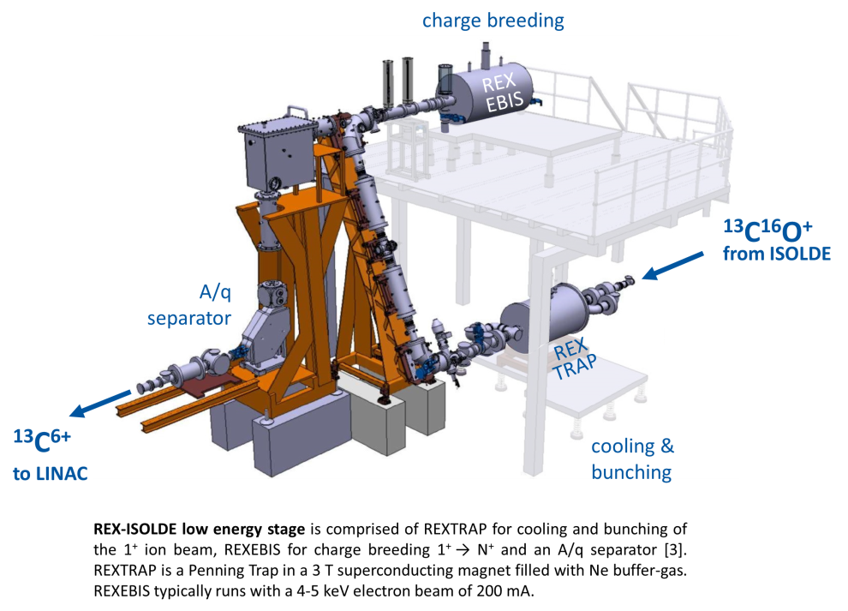
Milestone MS51
Experiments for the optimal breeder configuration
“To be or not to be” of the preparatory Penning trap / RFQ cooler in a charge breeding system
Pre-bunching:
+ increases the efficiency of the charge breeding stage
- Complicated
- Limited capacity (around 1E8 ions/bunch)
? Use direct ion injection from ISOL target-ion source into EBIS
(skip the Penning trap / RFQ cooler?)

Slide 11
Milestone MS51
Results
1. cw efficiency lower than pulsed – already known and explained
2. cw efficiency decrease with higher ion current – new!
  a. injection and trapping conditions (space-charge) changes during injection cycle
  b. increased space-charge compensation -> high energy ions are lost from the trap region
3. cw efficiency decreases with period time
longer accumulation times give rise to higher ion energy caused by electron-ion heating
4. trapping capacity of EBIS one order of magnitude lower than expected
  don’t manage to make full use of the electron beam space charge due to the high energy of the injected ions
Notes:
The decrease in efficiency as function of injected ion current is in part related to changed injection conditions. When the trapping region becomes partially space-charge compensated during the accumulation/breeding period, the voltage difference between the trapping region and the outer barrier changes and therefore also the probability for trapping of ions that are ionized from 1+ to 2+ during the injection round-trip within the trap.
Furthermore, with increased space-charge compensation ions with high energy are lost from the trap. This is particularly pronounced for cw injection as the ion energy is high compared to the lowest voltage barrier, which is the outer barrier in this case. Ideally, the trapping and outer barrier potentials should be varied continuously during the accumulation/breeding cycle in order to optimize the trapping condition, while minimizing the ion boil-off. This functionality is not included in the control system though and could therefore not be tested during the experiment.
When extrapolating the breeding efficiencies to very high injected beam currents, it was found that only a fraction of the electron space-charge is occupied. For gas ionization one expect that a 50% neutralization (k=0.5) is achievable, while in this measurement series the k-value was one order lower. The main difference is the high injection energy (a few 100 eV per charge) of the externally injected ions compared with gas ionization (typically a few 10 eV per charge).

Slide 12
Milestone MS51
Recommendation for a EURISOL facility
A preparatory cooling stage is therefore still recommended, although instead of using a Penning trap, a simpler RFQ cooler-buncher is advised.
To address the increased ion currents expected from EURISOL, where the space-charge limitation in the cooler-buncher will pose problems, the charge breeding repetition rate has to be increased as the number of ions per bunch is inversely proportional to the repetition rate.
Shorter charge breeding times is attained by increasing the electron current density inside the EBIS. The MEDeGUN electron gun design aims to increase the current density by a factor 15, and thereby reduce the charge breeding time with a similar value, compared to the present 100-150 A/cm² at REXEBIS.
Notes:
Recent high ion-current tests at the REX-ISOLDE low-energy stage have shown that the charge breeding efficiency is decreasing with higher beam intensities when cw injection into the EBIS is used. Hence, even though the poor transmission through the Penning trap for high beam currents is circumvented, the overall efficiency does not improve by the use of cw injection into the EBIS

Slide 13
Conclusions and outlook
Results
1. MEDeGUN design current reached.
2. Tests shows that an RFQ cooler or Penning trap is mandatory for an EBIS, even for high-intensity beams.
Outlook
3. Upcoming 2nd commissioning round of MEDeGUN.
4. Ion extraction line under construction

Slide 14

HIL ECRIS test stand status
Notes:
Efficiency improvement of the charge breeder.
14

Slide 15

Introduction
→ 2013: start program for ECR ion sources performance improvement at HIL
→ collaboration with the EMILIE project
Goals:
→ Development of a model for 1+ ion beam introduction into existing ECR source
→ Design of effective system for formation, injection and extraction of 1+ beam
Planned to upgrade and development of ECRIS test bench for charge breeding purposes:
→ Build an ion source for production of 1+ ion beam and combine it with working ECRIS
→ Buil a 1+ ion beam injection system
→ Optimization of CB operation
Notes:
The total efficiency of isotopes production is one of the most important parameters to be improved in modern nuclear physics facilities
- obtain the desired charge state and transport the highly charged ions further
The total efficiency of raising the charge of 1+ radioactive intense beams to highest possible states is one of the crucial parameters to be improved in the ISOL facilities.
Increase charge breeding efficiency and better understanding of this process
Better understanding of 1+ ions capture and ionization processes -> increase charge breeding efficiency
- axial injection → give a small fraction of interaction of 1+ beam with plasma
axial injection → gives a small fraction of interaction of 1+ beam with plasma
Zmienić GOAL na „sprawdzenie wpływu nieaksjalnego wstrzykiwnia na efektywność”
15

Slide 16
Motivations
Depending on the optical characteristics of the 1+ ion beam entrance in the charge breeder, the charge breeding efficiency may be increased significantly.
→ Numerical calculations of 1+ ion beam injection into plasma chamber of the HIL ECR test bench
axial injection → gives a small fraction of interaction of 1+ ion beam with plasma and it is necessary to change series of parameters to optimize charge breeding efficiency
Assumptions:
→ Possibility of controlling the energy of the 1+ ion beam and a residence time in plasma
→ Adjusting two parameters (E, t_{res}) independently could increase efficiency of 1+ ion beam capture
→ 1+ ion beam residence time in plasma is expected to be increase with extended beam
path through plasma chamber
Goal:
Create a model of non-axial 1+ ion beam injection to conventional ECR ion source
and to increase charge breeding efficiency and better understanding of this process
→
Notes:
16

Slide 17

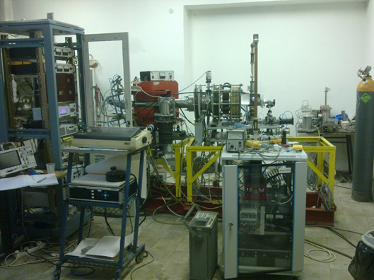
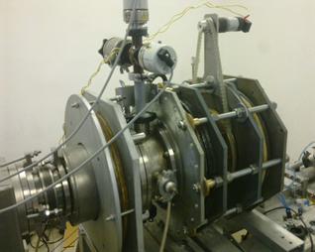
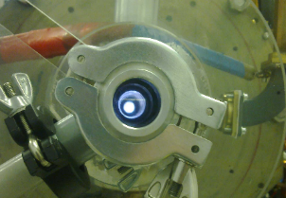
First part ECRIS for HIL CB
Power supply rack
Analysing
magnet
Source
Klystron
Rotating hexapole
Up to the end of year 2015, several primary experiments were carried
out with Al ions sputtered on the different liner materials using Ne, Ar, N and
He as supporting gas.
Neon plasma

Slide 18
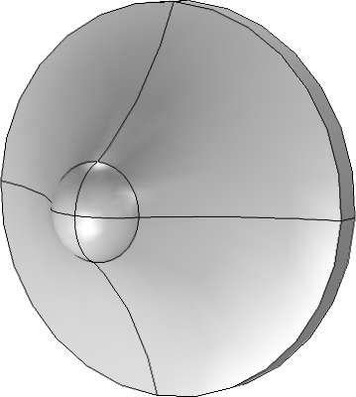
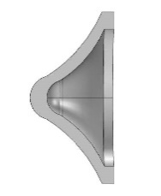
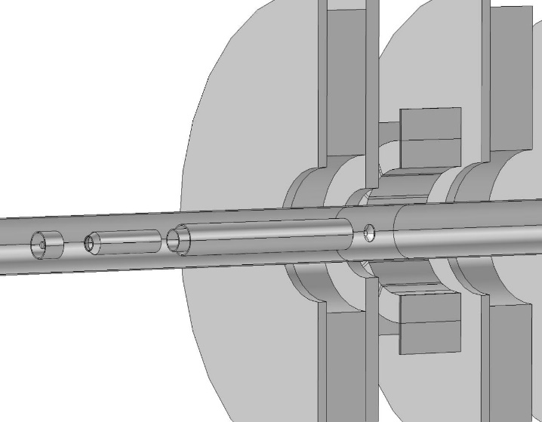
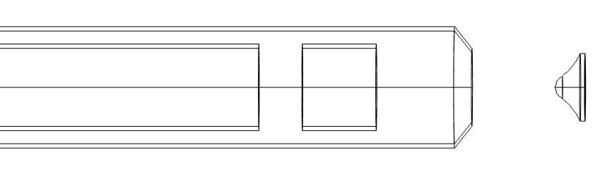
Ion injection setup
1+ puller
RF tube
RF tube: +DV_{infl}
Axial symmetric inflector
Decererated beam
1+ beam
+DV_{infl}
1+ source
- Energy of 1+ ion beam will be controlled by cathode potential
- Magnitude of a beam inflection will be controlled by inflector potential
Deceleration of 1+ ion beam may lead to the optimal velocity for their capture in the plasma

Slide 19
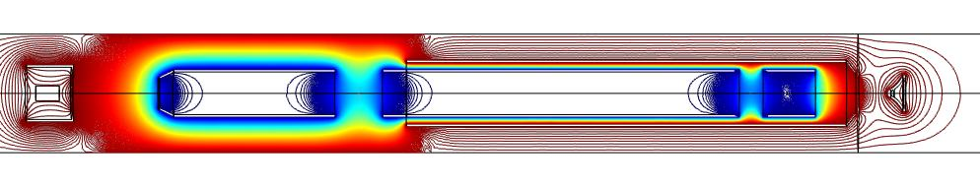
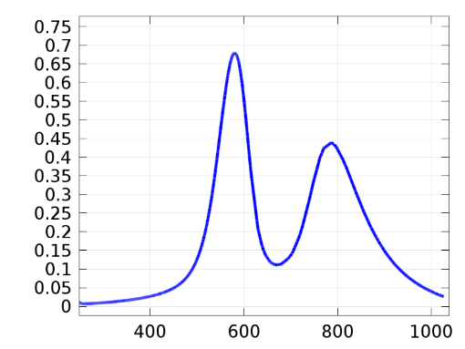
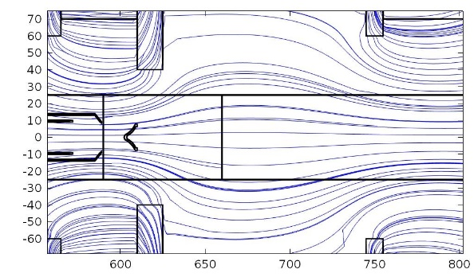
Magnetic and electrostatic field
Two gap deceleration system allows better control of the incoming beam
B[T]
x[mm]
Positions of the deflecting electrode and beam outlet
Magnetic field used in calculations was reconstructed from measured one.

Slide 20
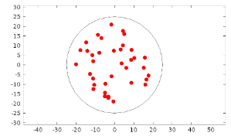
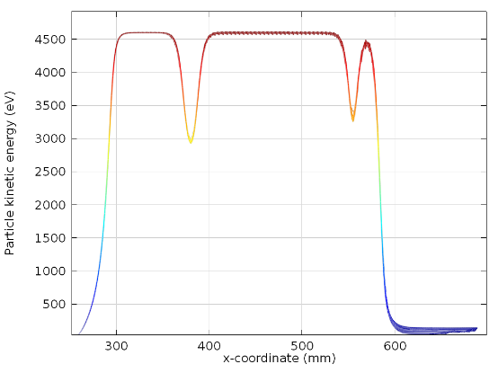
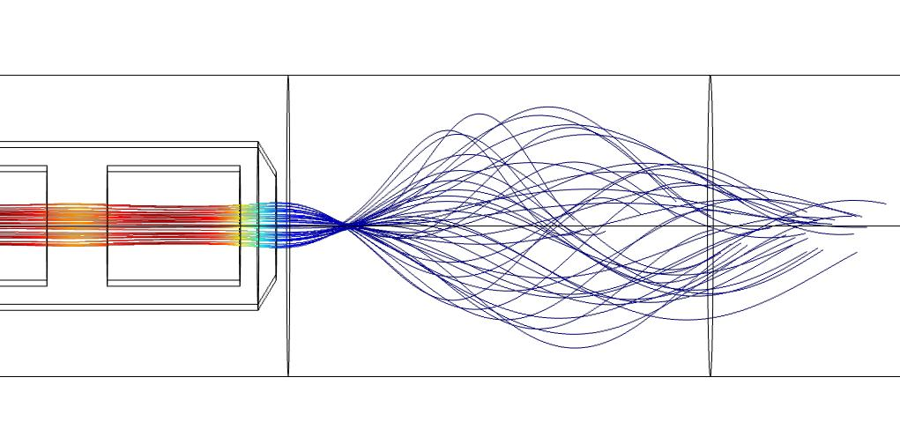
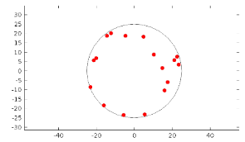
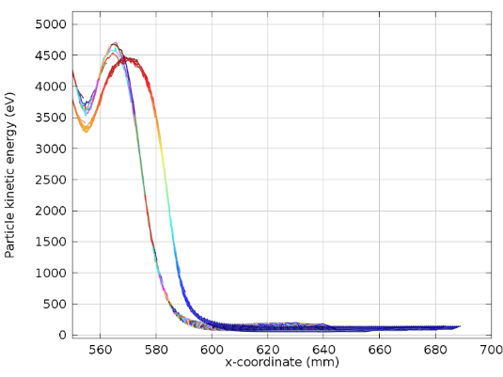
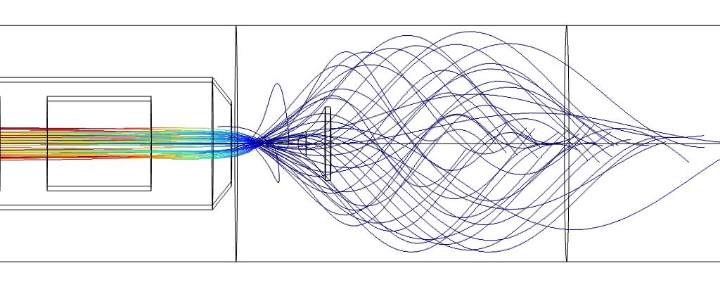
1+ beam trajectories
Ca+1
Puller=5.5kV
Δcathode = +100V
Δwehnelt = +120V
No deflector
Δdefl
Δdeflector = +30V

Slide 21
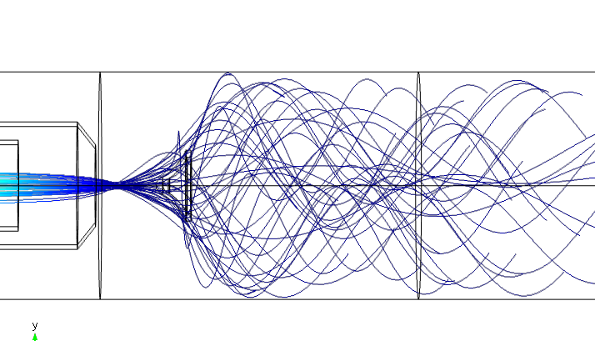
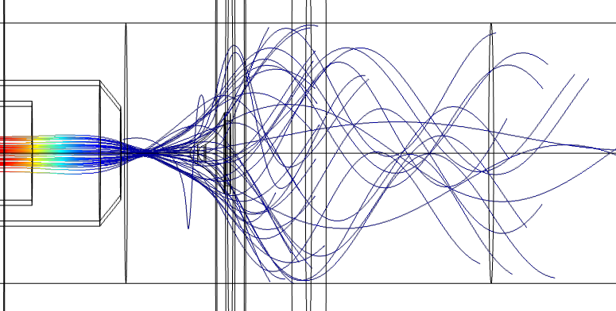
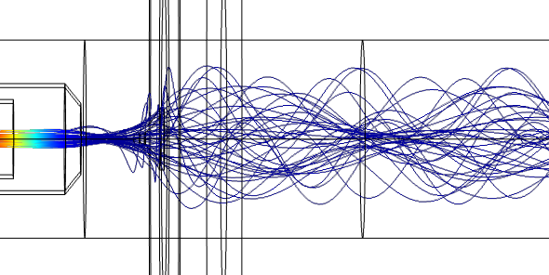
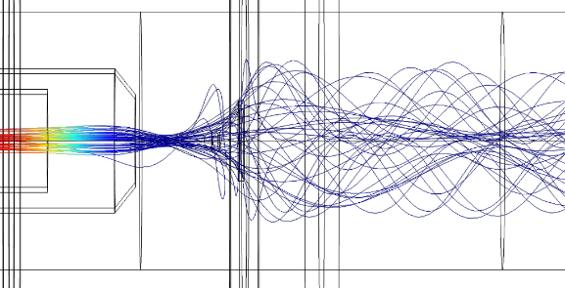
1+ beam trajectories
Puller=5.5kV
Δcathode = +150V
Δwehnelt = +170V
Δdeflector = +80V
Mg⁺¹
Al⁺¹
Na⁺¹
B⁺¹
Simulations of the beam trajectories of B⁺¹, Al⁺¹, Na⁺¹ and Mg⁺¹
(time of residence of ligher ions is shorter)

Slide 22
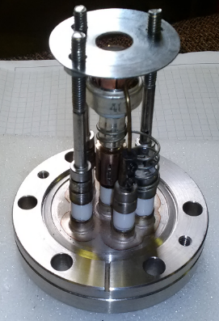
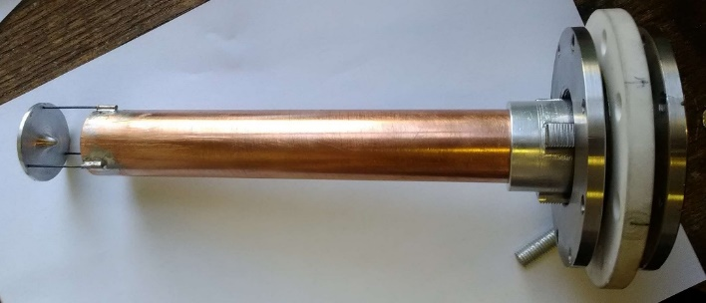
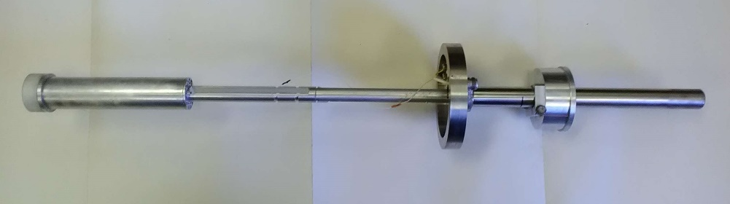
Ion injection setup parts
First tests of the 1+ ion beam transmission trough the ECR magnetic trap with and without magnetic field were conducted.
Injection system will be mounted to RF coupler tube.
Prototype of thermal Li⁺¹ source
(current 0.5-1.5 μA)
Latest measurements aimed to check performance of deflector
Preliminary results were promising

Slide 23

Performances of the EBIS debuncher
Notes:
Find densities and intensities

Slide 24
Electron Beam Ion Source (EBIS)
Charge breeding by electron beam
Radial confining of the ions by the electron beam
Axial confining by the trapping electrodes
Magnetic coils for the electron beam confining
In comparison with ECR ion sources:
Faster breeding time
Higher efficiency
Higher charge states
Pulsed mode more efficient
~ Lower beam intensity
More convenient for radioactive beams
arXiv:1411.2445;CERN-2013-007 G.Zschornacka,b, M.Schmidtb and A.Thornb
Notes:
Find densities and intensities

Slide 25
Continuous Wave (CW) EBIS charge breeder
EBIS
CW injection or bunching in a RF trap
Dead time,
pile-up,
fake coincidences
REX-EBIS and MINIBALL: DAQ problems with intensities as low as
10⁵-10⁶ pps
Slow extraction
CW
RFQ cooler
N+
Buffer trap
1+
Pulsed
(Pseudo) CW
Mass separation
In trap decay
A/q or TOF
separation
Linear RFQ trap
Using the energy spread
CW
Pulsed
Charge breeding
Pulsed
Bunching
Post acceleration

Slide 26
Continuous Wave (CW) EBIS charge breeder
EBIS
CW injection or bunching in a RF trap
Slow extraction
CW
RFQ cooler
N+
Buffer trap
1+
(Pseudo) CW
Mass separation
In trap decay
A/q or TOF
separation
Linear RFQ trap
Using the energy spread
CW
Pulsed
Charge breeding
Pulsed
CW
Post acceleration
Bunching
Debunching

Slide 27

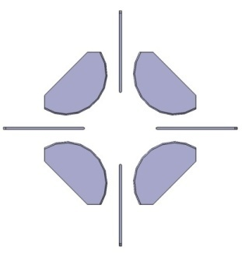
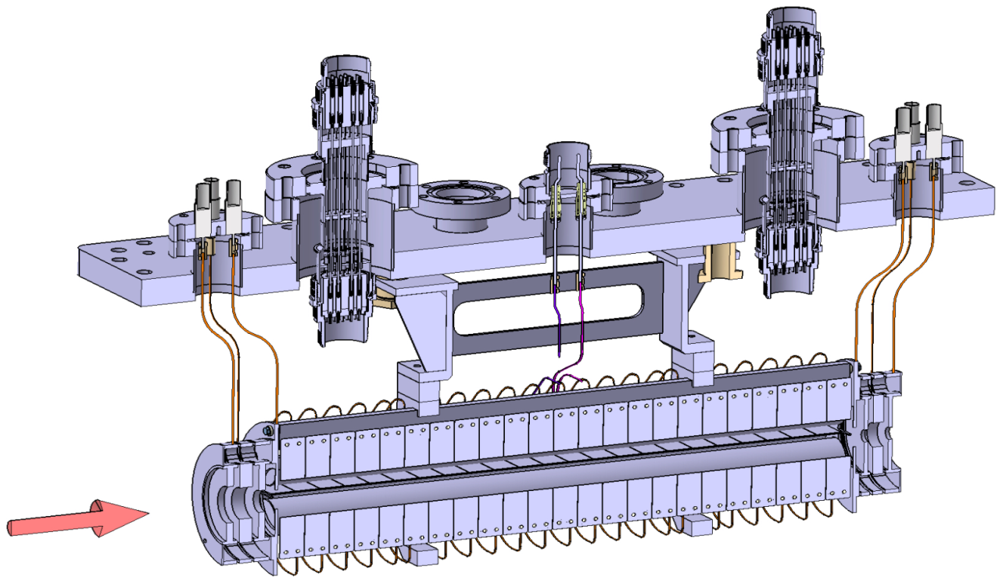
Debuncher prototype design
DC segments
Y. Merrer
P. Desrues
Completed in 2012 at LPC
DC
R₀ = 15 mm
DC
Focusing
electrodes
RF rods Ø34.4 mm
Focusing
electrodes
RF
MCP
Li¹⁺
DC trapping „cross“ electrodes

Slide 28
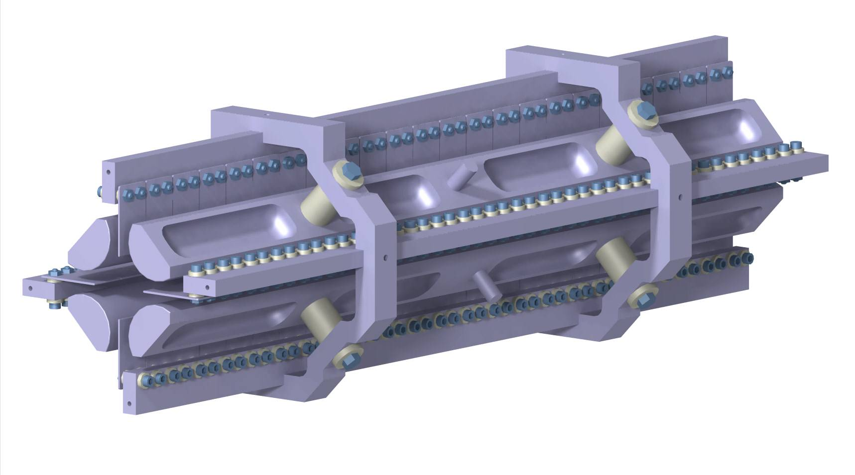
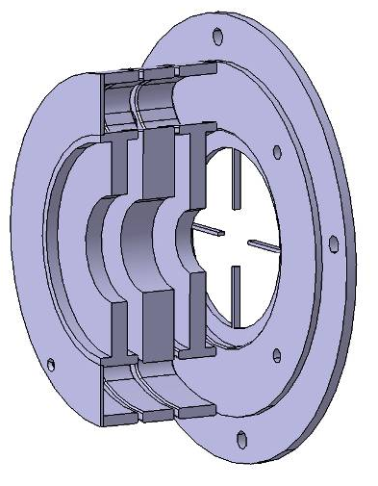
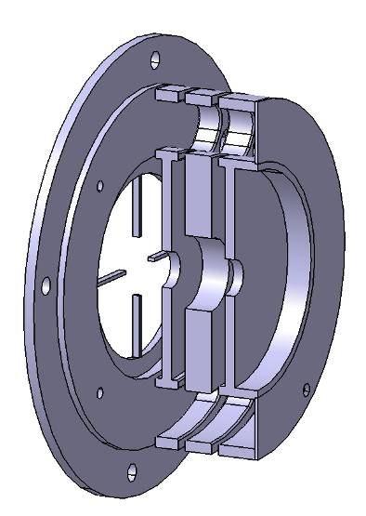
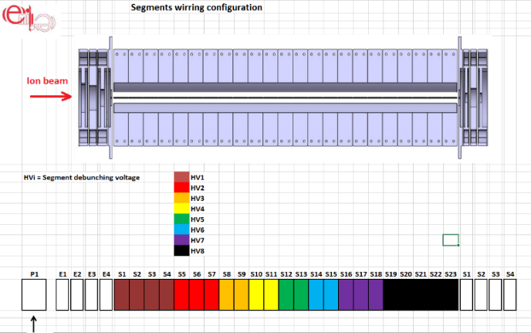
Debuncher prototype design
DC segments
Y. Merrer
P. Desrues
Completed in 2012 at LPC
RF rods
DC
R₀ = 15 mm
DC
Focusing
electrodes
Entrance
electrodes
Exit
electrodes
RF rods Ø34.4 mm
Focusing
electrodes
RF
DC segments
MCP
Li¹⁺
DC trapping „cross“ electrodes

Slide 29
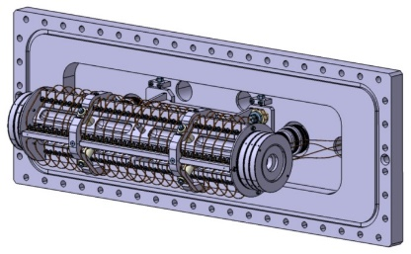
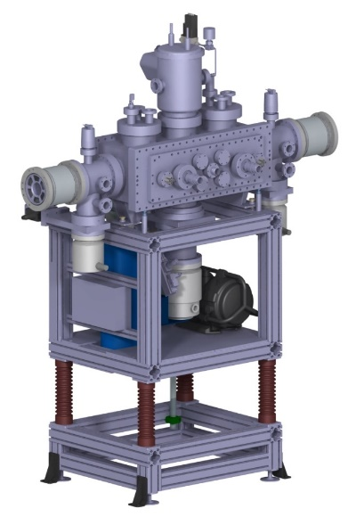
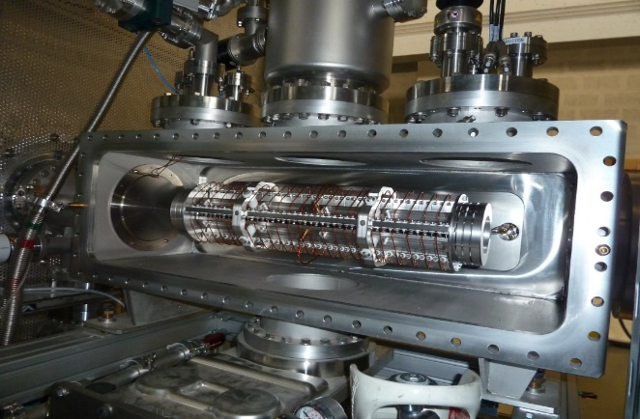
Experimental Setup
Emilie debuncher on the test bench
Emilie debuncher on the adaptation flange

Slide 30
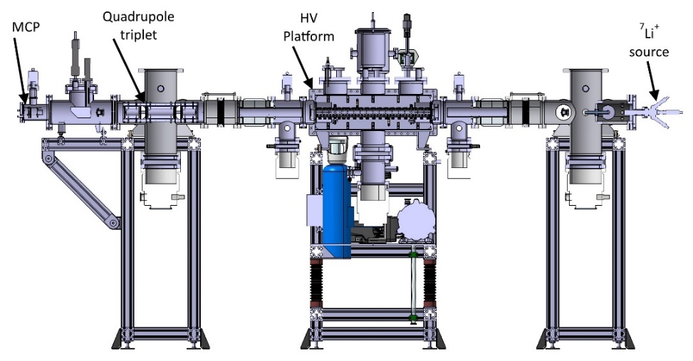
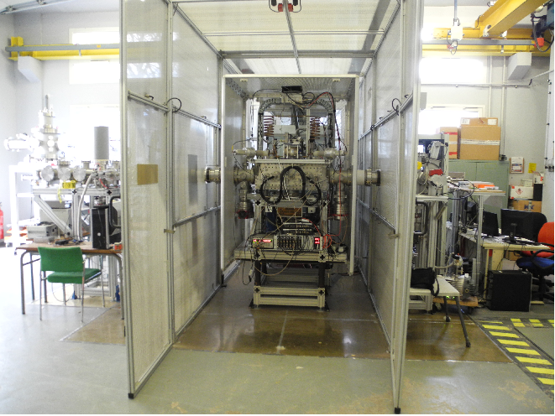
Experimental Setup
Emilie debuncher on the test bench
Emilie debuncher on the adaptation flange
SPIRAL2 high intensity RFQ cooler demonstrator (SHIRaC) at LPC CAEN
MCP
source

Slide 31
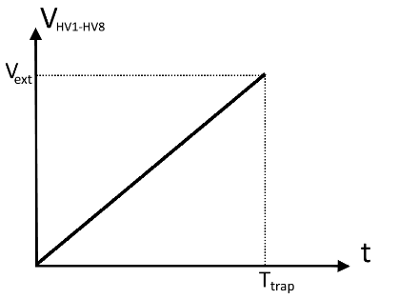
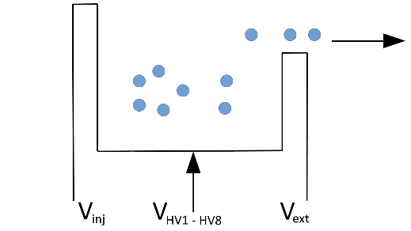

„Inverse function“ method
The idea is to apply a potential function which make uniform extraction of given energy density distribution
STEPS:
1) Find the energy distribution
Ramp potential applied to all segments
Distribution in time (potential) domain

Slide 32


„Inverse function“ method
The idea is to apply a potential function which make uniform extraction of given energy density distribution
STEPS:
1) Find the energy distribution
Ramp potential applied to all segments
Distribution in time (potential) domain
2) Calculate inverse cumulative energy distribution
exchange axes
Cumulative distribution function
Inverse cumulative distribution function
(inversed function)

Slide 33
„Inverse function“ method
The idea is to apply a potential function which make uniform extraction of given energy density distribution
STEPS:
1) Find the energy distribution
Ramp potential applied to all segments
Distribution in time (potential) domain
2) Calculate inverse cumulative energy distribution
exchange axes
Cumulative distribution function
Inverse cumulative distribution function
(inverse function)
3) Apply inverse function instead of the ramp potential
Uniform beam extraction

Slide 34
„Inverse function“ method
Ions extracted by linearly increased voltage on all segments simultaneously
0 – 120 V in this case
10 ms
debunching
Inverse cumulative distribution
Calculation of the inverse cumulative distribution (numerically in this case)
Applying the „inversed function“ instead of the linear ramp to get uniform extraction

Slide 35




Ion extraction 2
100 ms extraction
High noise and a lot of parasitic peaks in the distribution
25 min difference
Instabilities caused poor reproducibility – impossible to remove the peaks

Slide 36


Ion extraction 2
100 ms extraction
800 ms extraction
High noise and a lot of parasitic peaks in the distribution
25 min difference
Flatten distribution due to the cooling effect
→ The vacuum was not sufficient ~10⁻⁷ mbar
Instabilities caused poor reproducibility – impossible to remove the peaks

Slide 37


Efficiencies
„Cooling“ effect
Injection efficiency 20-30 %
No measurable losses up to ~1 s trapping time !

Slide 38



Buffer method
(fully continuous extraction)
Injection in main buffer
Extraction of auxiliary buffer
Extraction of main buffer
Trapping in auxiliary buffer

Slide 39

Buffer method
(fully continuous extraction)
Injection in main buffer
Extraction of auxiliary buffer
Extraction of main buffer
Trapping in auxiliary buffer

Slide 40
Conclusions/results:
Uniform ion extraction for trapping times up to ~1 s​
Ultra-high vacuum level (<10⁻¹¹ mbar) necessary​
An optimized ion optics is needed
Outlook/projection
Test of the space charge effects will be necessary in the next step
Projections for the use of such device with operational or future EBIS devices are encouraging

Slide 41
Thank you for your attention !

