Slide 1





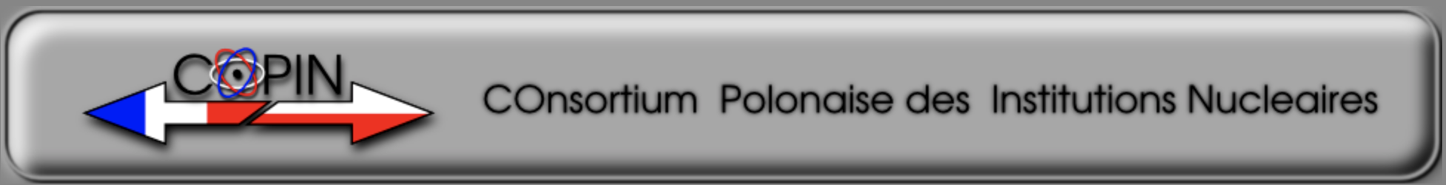
Contributions from the facilities: ISOLDE, GANIL-SP2/ALTO, SPES, MYRRHA, JYFL, COPIN

Slide 2

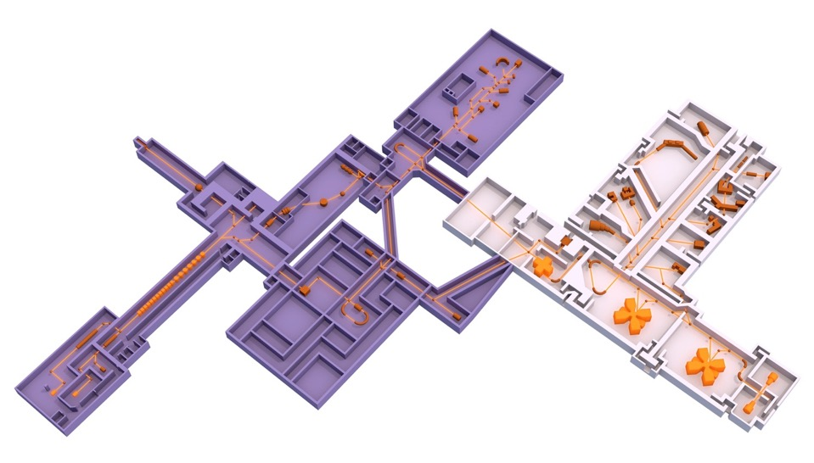
GANIL-SPIRAL2 layout
ESFRI landmark facility
DESIR
(construction phase)
Phase 1
GANIL current facility
NFS
S³
SC Linac
A/Q=7
Production
up to 10¹⁴ FF/s
Phase 2
SPIRAL2 & SPIRAL1 Upgrade
High intensity stable beams
High intensity neutron beams
High intensity RIBs
A/Q= 2 & 3

Slide 3
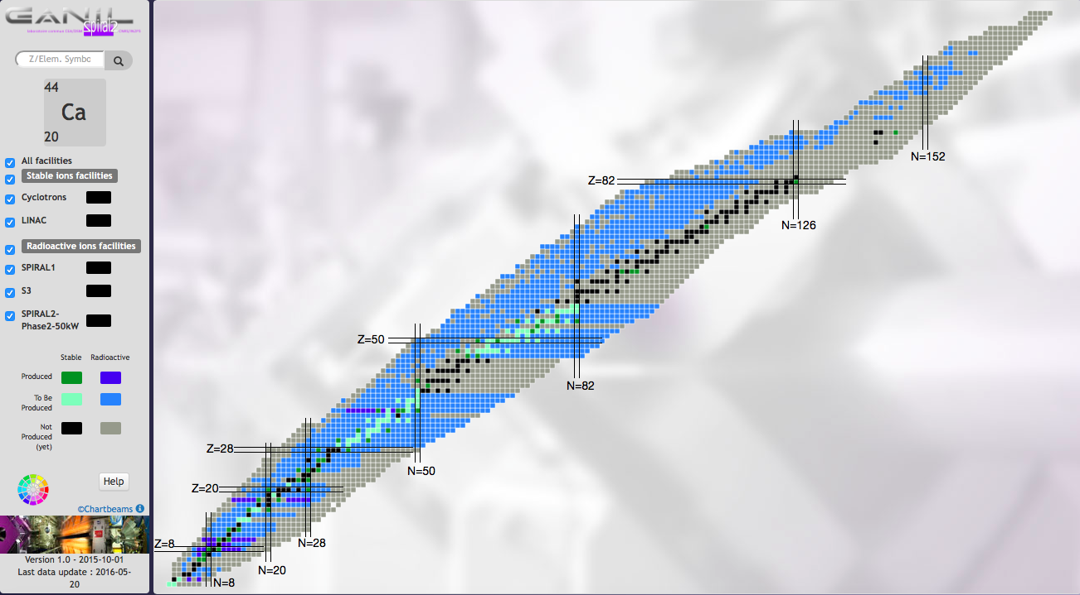
Scientific Strategy GANIL-SPIRAL2
Principal regions of interest
Heavy and SH Nuclei
LISE 3
AGATA-VAMOS-GFS
S3
N=Z nuclei
EXOGAM-n-wall
AGATA-NEDA, S3
Neutron-rich nuclei in
the vicinity of N=126 AGATA-VAMOS
Light nuclei far from stability
& astrophysics
SPIRAL1, LISE
AGATA-VAMOS-MUGAST

Slide 4
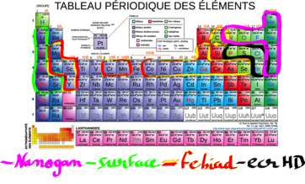
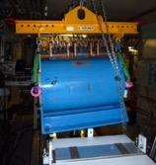

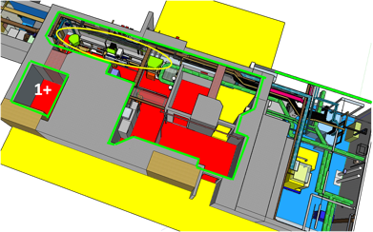
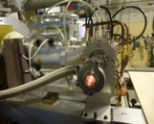
SPIRAL1 UPGRADE
  - Developing a new 1+ ion source : ECS FEBIAD + Graphite Target
  - Install a Charge breeder to transform the 1+ beam into N+ beam
  - Accelerate the N+ beam with CIME Cyclotron
  - Infrastructure Works on the SPIRAL1 Facility (Nuclear Ventilation, …)
  New 1+ radioactive beams
  New accelerated RIB
  Safety improvement (RXS)
Potentially more than 20 new elements
CIME
Charge Breeder
LEBT
N+
Nuclear Ventilation -80Pa
Nuclear ventilation -120Pa
New ECS
Booster services
Fire zone improvement

Slide 5
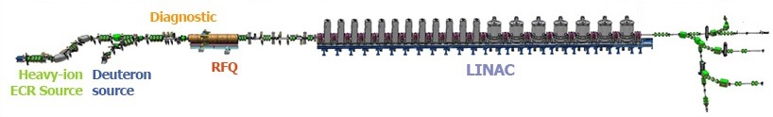
SPIRAL 2 SC LINAC beams
1000 μAp ⁴He²⁺
150 μAp ¹⁸O⁶⁺
3,2 μAp ⁴⁰Ar¹⁴⁺ (60 kV)
5 mA protons (Q/A=1)
500 μAp ⁴He²⁺ (Q/A=1/2)
100 μAp ¹⁸O⁶⁺ (Q/A=1/3)
Ions | Intensity (pµA) [A/Q=3] | High Intensity (pµA) [A/Q=6-7]
¹⁸O | 216 | 375
¹⁹F | 28,6 | 50
³⁶Ar | 17.5 | 40
⁴⁰Ar | 2.9 | 30
³⁶S | 4.6 | 30
⁴⁰Ca | 3 | 20
⁴⁸Ca | 1.25 | 15
⁵⁸Ni | 1.1 | 10
⁸⁴Kr | 0 | 20
¹²⁴Sn | 0 | 10
¹³⁹Xe | 0 | 10
²³⁸U | 0 | 2.5
✕5-10
Average beam current (I A/Q) [μA u]
✕10^{x}
Energy [GeV/n]

Slide 6
GANIL/SPIRAL2 in EURISOL-DF
With existing GANIL-SPIRAL2 facility
  SPIRAL1 RIB (up to 1.5 months/year)
  High intensity accelerator (SPIRAL2 LINAC)
    Operation with very high intensity stable-ion beams
    Accelerator Protection System
    S3 RIB (up to 1.5 months/year)
  Innovative Instrumentation (ACTAR, PARIS, MUGAST, magnetic spectrometers,…)
With future SPIRAL2 Phase 2
  Handling of the high radioactivity and maintenance
  High-power 200kW converter and big volume UCx target
    (SPIRAL2 Phase 2)
    Very high intensity RIB (SPIRAL2 Phase 2)
www.ganil-spiral2.eu

Slide 7
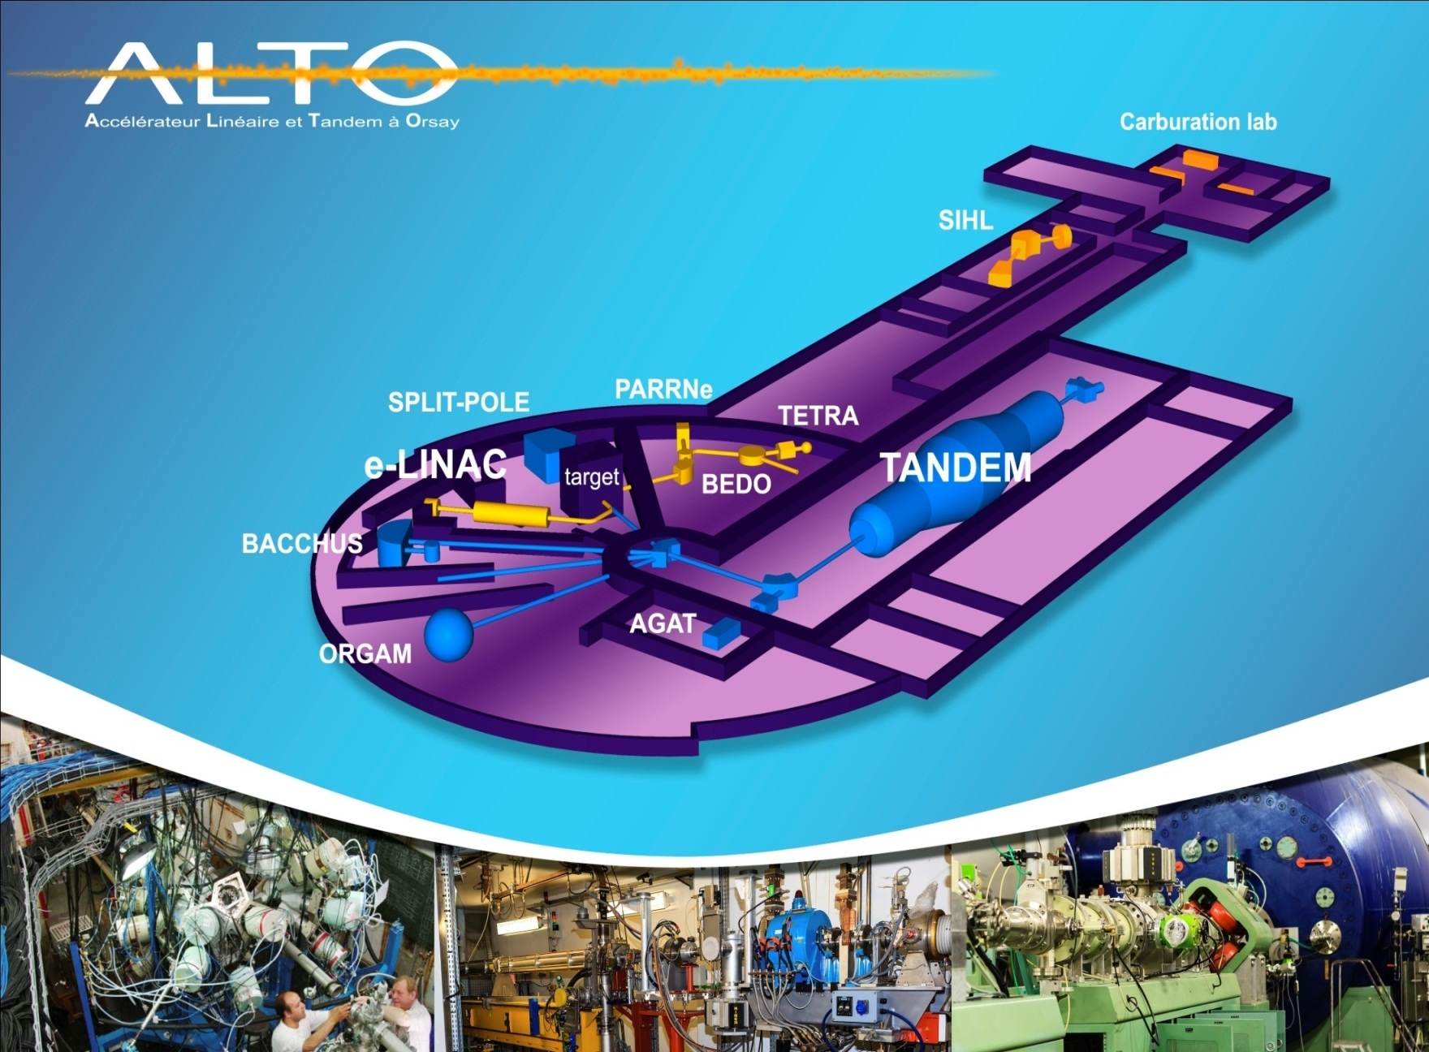
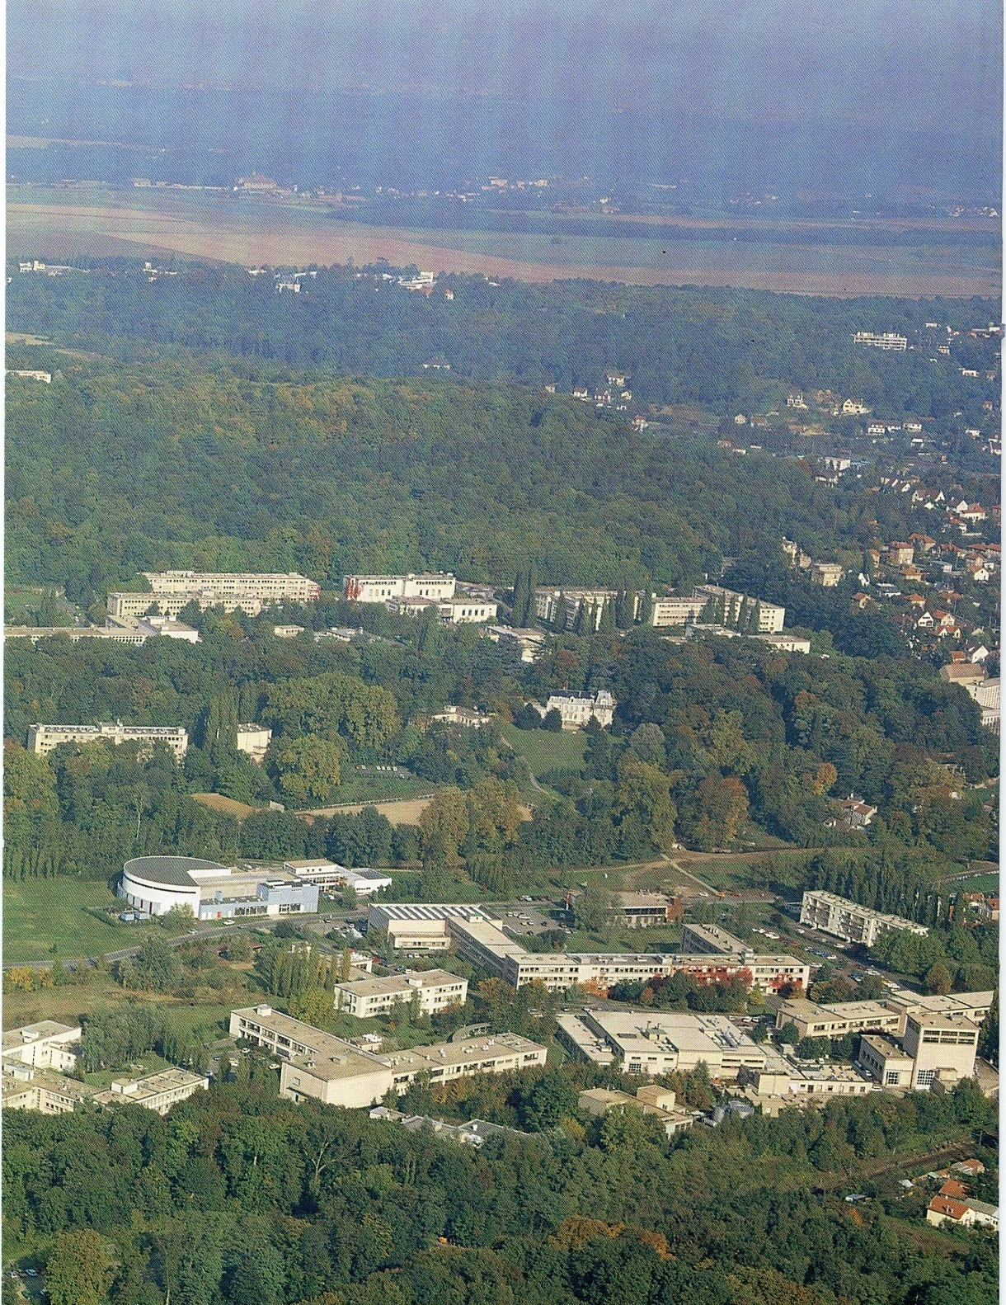
The ALTO facility
Tandem building
Institut de Physique Nucléaire
Campus of the Paris Sud University Orsay (France)

Slide 8
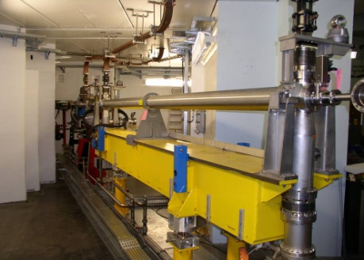
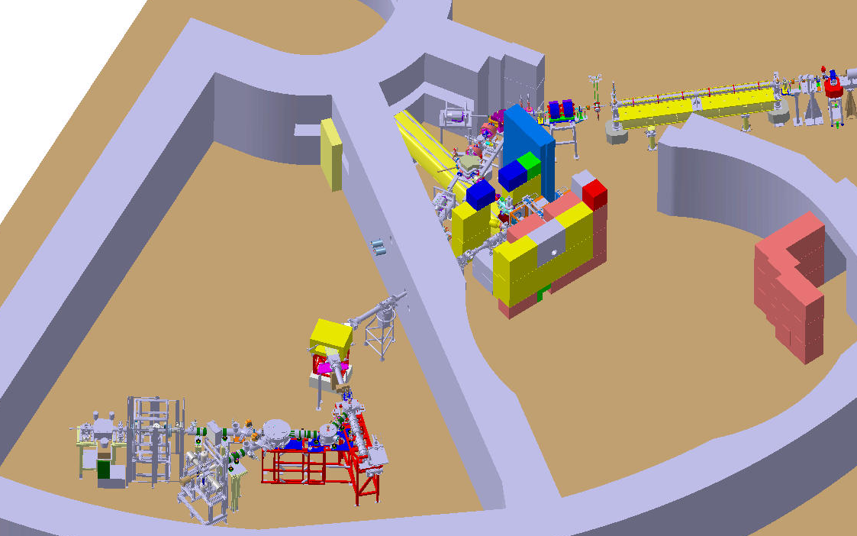
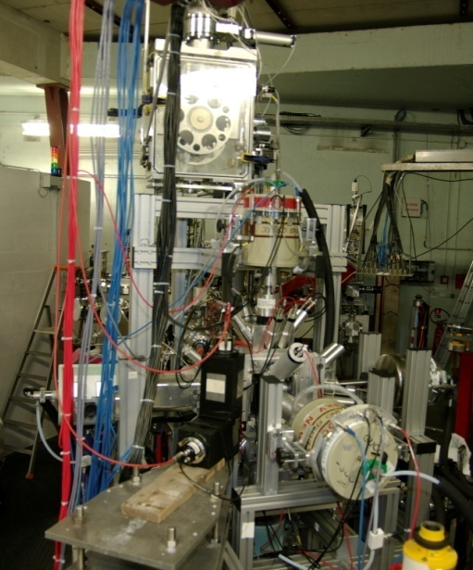
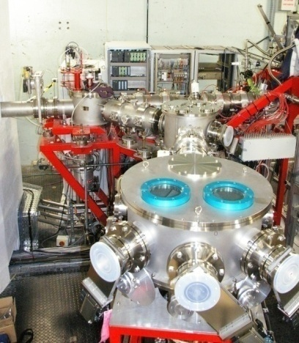
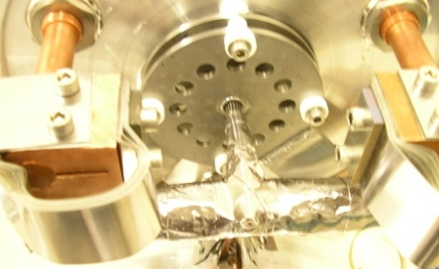
The ISOL installation based on photo-fission: the first of its kind in the world
e-LINAC
10 µA 50MeV
(former 1st section of the LEP injector)
BEDO
beta decay spectroscopy
secondary
beam lines
TIS vault
~5.10^11 fissions/s
POLAREX
nuclear orientation on line
PARRNe
mass separator
Target Ion-source ensemble
kicker - bender
identification station

Slide 9
The RIB hall at ALTO: 6 experimental lines (3 operational and 3 in 2019)

Slide 10
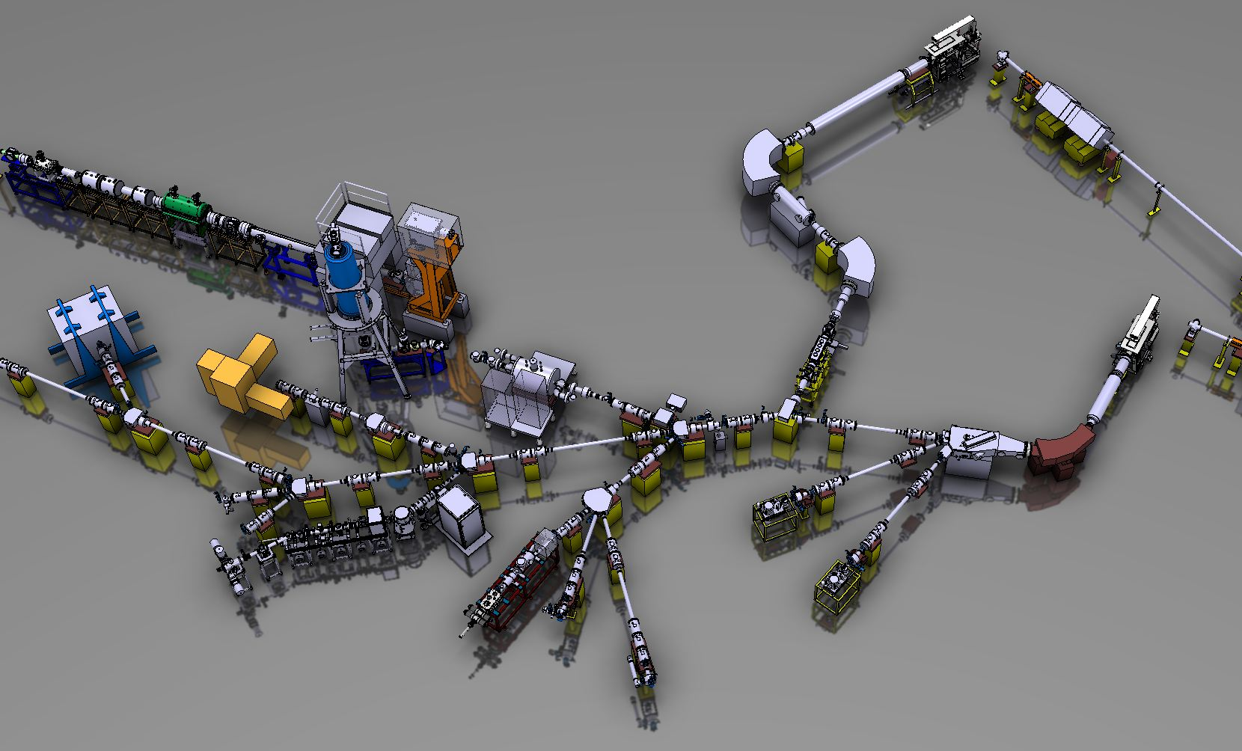


Proton driver: 1.4 GeV, 2 μA (future: 2 GeV / 4 μA)
→ factor of 2 to 10 gain in intensity
Two target stations (partially in parallel)
Ion cooler-buncher (μs bunches, user-defined repetition rate)
Post-accelerated beams ~ 10 MeV/u
HRS
Low-energy beams 40-60 keV

Slide 11
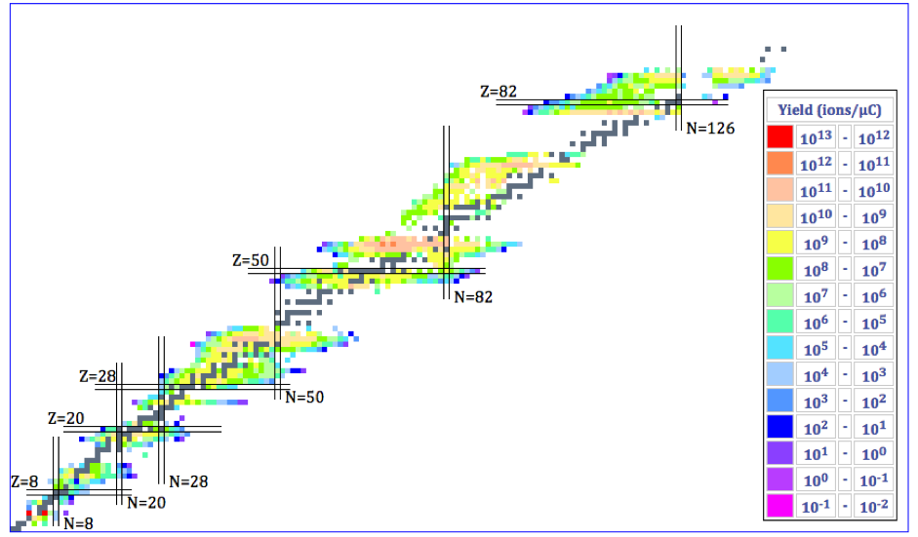
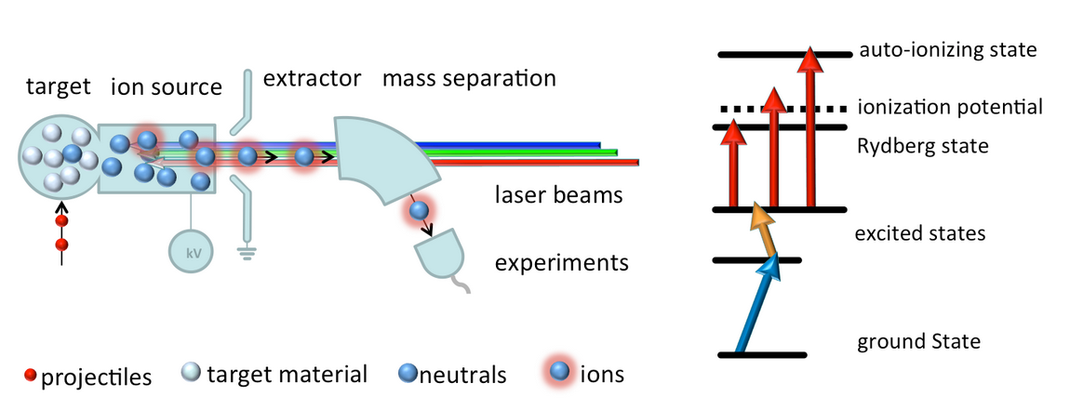
Produced Nuclei: 50 y Experience
Over 20 target materials (carbides, oxides, solid metals, molten metals and molten salts) operated at high temperature
3 types of Ion-sources: Surface, Plasma, laser
> 1300 nuclides of 75 chemical elements produced→ B (BF₂) and Ge (GeS)
p+
p+

Slide 12
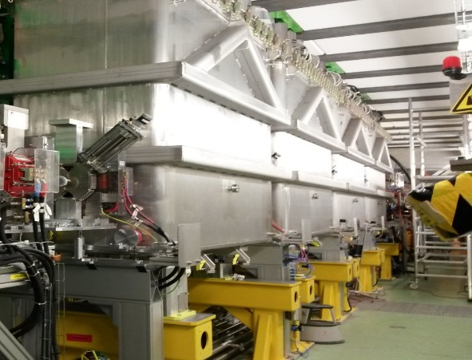
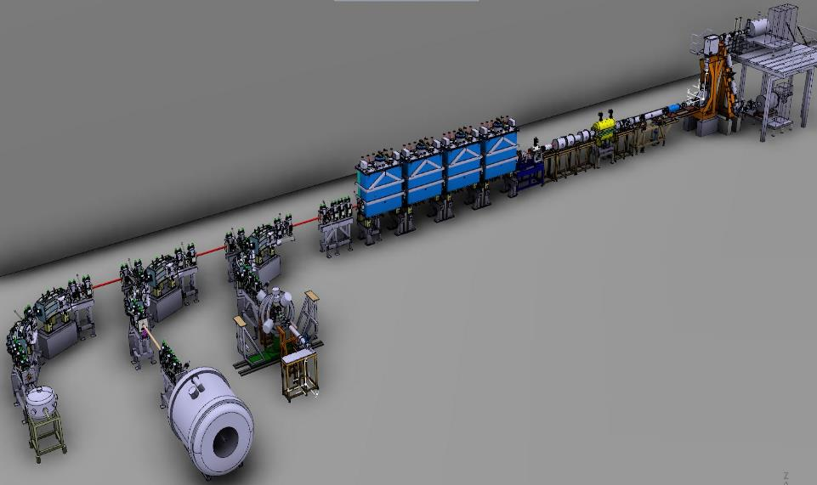
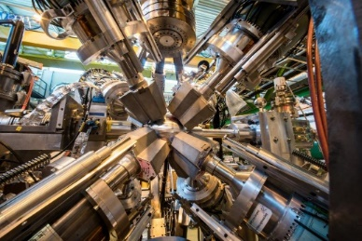
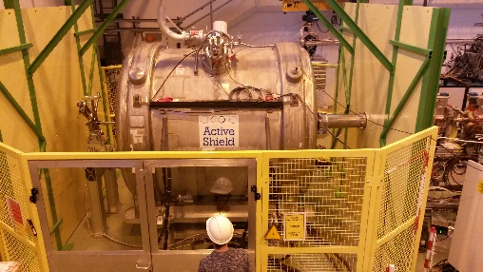
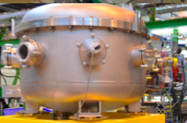

> 15 years of post-accelerated beams reaching 10 MeV/u in 2018 with HIE-ISOLDE
Coulomb excitation, lifetimes (Miniball, plunger)
Transfer reactions (Miniball+Trex, ISS, ..)
Multipurpose scattering chamber
FUTURE (beyond 2023)
Intensity upgrade !
Storage ring ?
HIFI Spectrometer ?
XT01
XT02
Typical beams for this year (start July 8)
XT03
Isotope | Emax MeV/u | Rates [pps] | Rates based on yields, transmissions and efficiencies measured during
²⁸Mg | 9.5 | 3.5E6 | IS628 (Nov. 2017)
²⁰⁶Hg | 7.4 | 2E6 | IS547 - RILIS mode (Nov. 2017)
¹⁰⁶Sn | 7.9 | 6E5 | IS562 (Oct. 2017)
¹³²Sn | 7.7 | 3E6 | IS551 – Molecular ¹³²Sn³⁴S beam (Oct. 2016)
Miniball
Scattering chamber
ISOLDE Solenoid Spectrometer (ISS)

Slide 13
ISOLDE upgrades 2021-2023
Prepare ISOLDE to receive higher proton powers (13 kW instead of 2.8 kW) (part 1 of HIE-ISOLDE phase 3)
  This is based on two CERN accelerator improvements (ready 2020):
- LINAC4 should provide at least 2x higher proton intensities (up to 3x more)
- The booster will be modified to deliver 2 GeV beams (now 1.4 GeV)
MODIFICATIONS NEEDED for ISOLDE to receive these higher-power p-beam:
  new beam dumps to receive up to 13 kW power (currently 2.8 kW)
      Estimated full cost (2015) ~ 3-4 MCHF
  new transfer line to receive 2 GeV proton beams (with option for 1.4 GeV)
      Estimated full cost (2015) ~ 3 MCHF
Upgrade of REX-ISOLDE (part 2 of phase 3): modify to a superconducting low-energy section
  Cost estimation to be done ~ 3-4 MCHF
Upgrades of ISOLDE beam purity and emittance ~1 MCHF
  MR-TOF-MS at 30 keV for beam characterization and optionally purification (1/50.000)
  Upgraded cooler/buncher (performance tests in off-line laboratory)
  A new HRS
HIFI: a fragment identifier behind MINIBALL ~ 500 kCHF – 2 MCHF (new)
Prepare for receiving AGATA ? - installation of a liquid Nitrogen distribution system in the hall

Slide 14
ISOLDE request 2024-2028
Install new beam dumps (during LS3 ?)
Modify the transfer lines from Booster to ISOLDE for 2 GeV beam transport
Upgrade REX-ISOLDE low-energy section (during LS3?)
Storage ring ? 25 MCHF – needs CERN accelerator group support
AGATA ? 600 kCHF hardware + 350 kCHF/year operation
Question: can all of this be combined into an extended ISOLDE hall ?

Slide 15
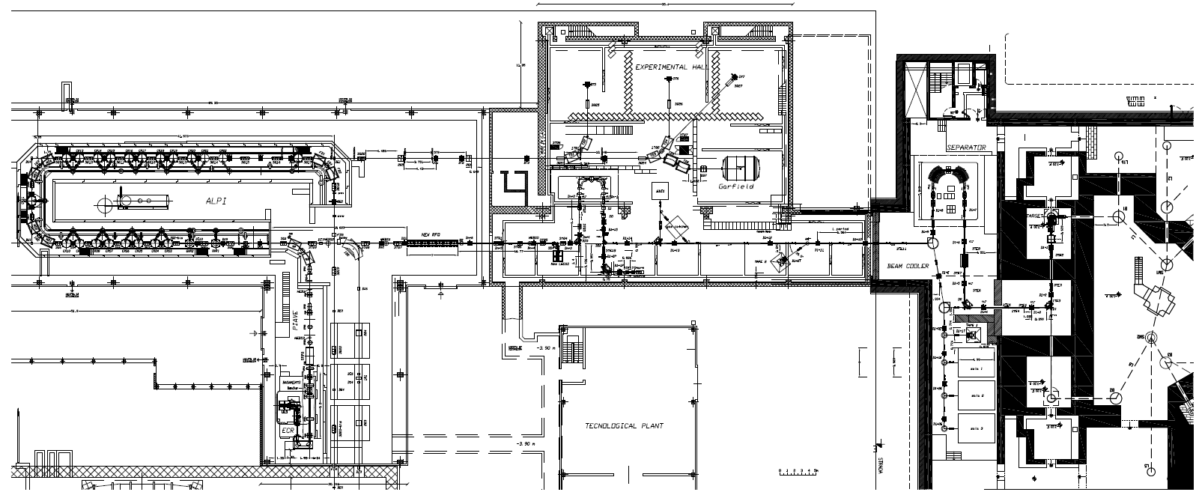
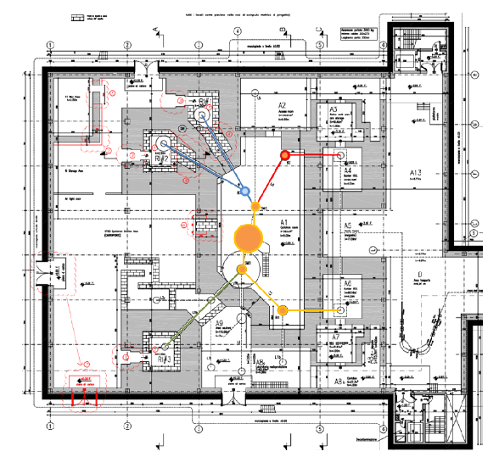


SPES towards EURISOL Distributed Facility
Principal improvements of the SPES facility towards Eurisol – DF:
High Resolution Mass Separation up to 1/20000 – upgrade 2021-2023
Purity Upgrade
Second ISOL bunker and new target – upgrade 2024-2030
Intensity Upgrade
Reaccelerated beam energy - upgrade 2024-2030
(new cavities for ALPI + new EBIS Charge Breeder)
Energy Upgrade
Reacceleration
HRMS
RIB transfer and selection
ISOL1
Low Energy area
CYCLOTRON
ISOL2

Slide 16
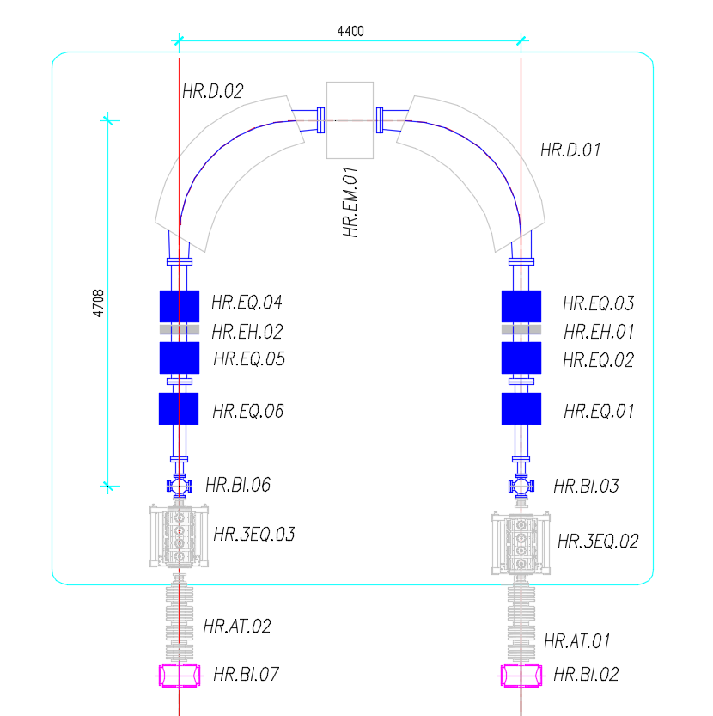
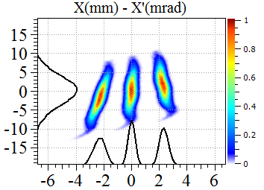
HRMS up to 1/20000 – Purity upgrade 2021-2023
Follow the design of “modern” mass separators as CARIBU_ANL, DESIR_SPIRAL2, ARIEL_TRIUMF
Beam Selectivity with LRMS (1/200)
¹³²Sn
SELECTIVITY %
Beam Selectivity with HRMS (1/20000)
SELECTIVITY %
Selected beam (>90%)

Slide 17
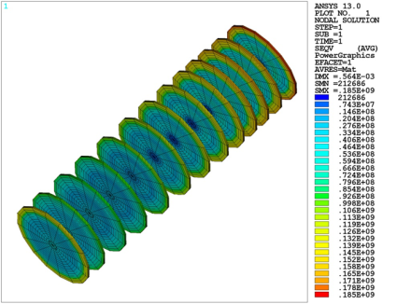
Second ISOL bunker and new target – Intensity upgrade 2024-2030
 | Proton Energy | Proton current | UCx target | Target power | In-target Fission/s
SPES | 40 MeV | 0.2 mA | 30 gr | 8 kW | 10E13 f/s
Up-grade under study | 70 MeV | 0.15 mA | 60 gr | 10 kW | 2x10E13 f/s
Up-grade to be evaluated | 70 MeV | 0.3 mA | 60 gr | 20 kW | 4x10E13 f/s
Preliminary Calculations 13 UCx discs (40 mm. dia):
Disk: 0,9 mm
UCx density: 4,2 g/cm²
dump
target

Slide 18
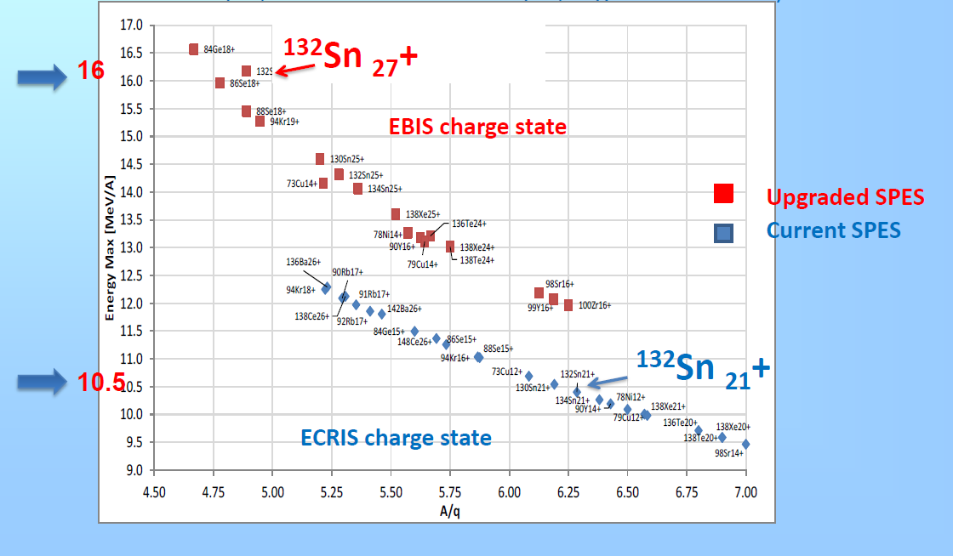
Reaccelerated beam energy - Energy Upgrade 2024-2030
(new cavities for ALPI + new EBIS Charge Breeder)
Preliminary results for ALPI upgraded performances
Low Beta=5 MV/m, Medium Beta=5.5 MV/m, High Beta=5.5 MV/m
Low Beta=5 MV/m, Medium Beta=4.3 MV/m, High Beta=5.5 MV/m

Slide 19



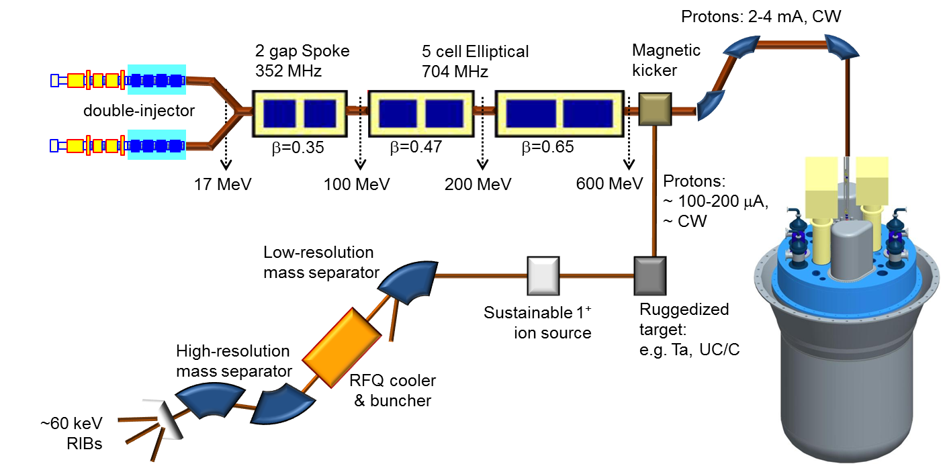













ISOL@MYRRHA
Concept and Scientific Cases developed within BriX:
The Belgian research initiative on eXotic nuclei for atomic, nuclear and astrophysics studies
ISOL@MYRRHA

Slide 20


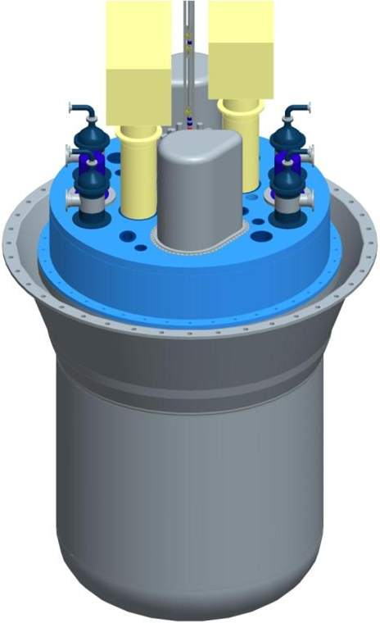
Phased-implementation of MYRRHA
In phase 1 (2016-2024): ISOL Target Station at the 100-MeV accelerator
Protons: 2-4 mA, CW
Magnetic kicker
double-injector
17 MeV
100 MeV
200 MeV
600 MeV
Protons:
~ 100-200 μA, ~ CW
Low-resolution mass separator
Sustainable 1⁺ ion source
Ruggedized
target:
e.g. Ta, UC/C
High-resolution mass separator
Phase 1
RFQ cooler
& buncher
~60 keV
RIBs
Phase 2
Phase 3

Slide 21
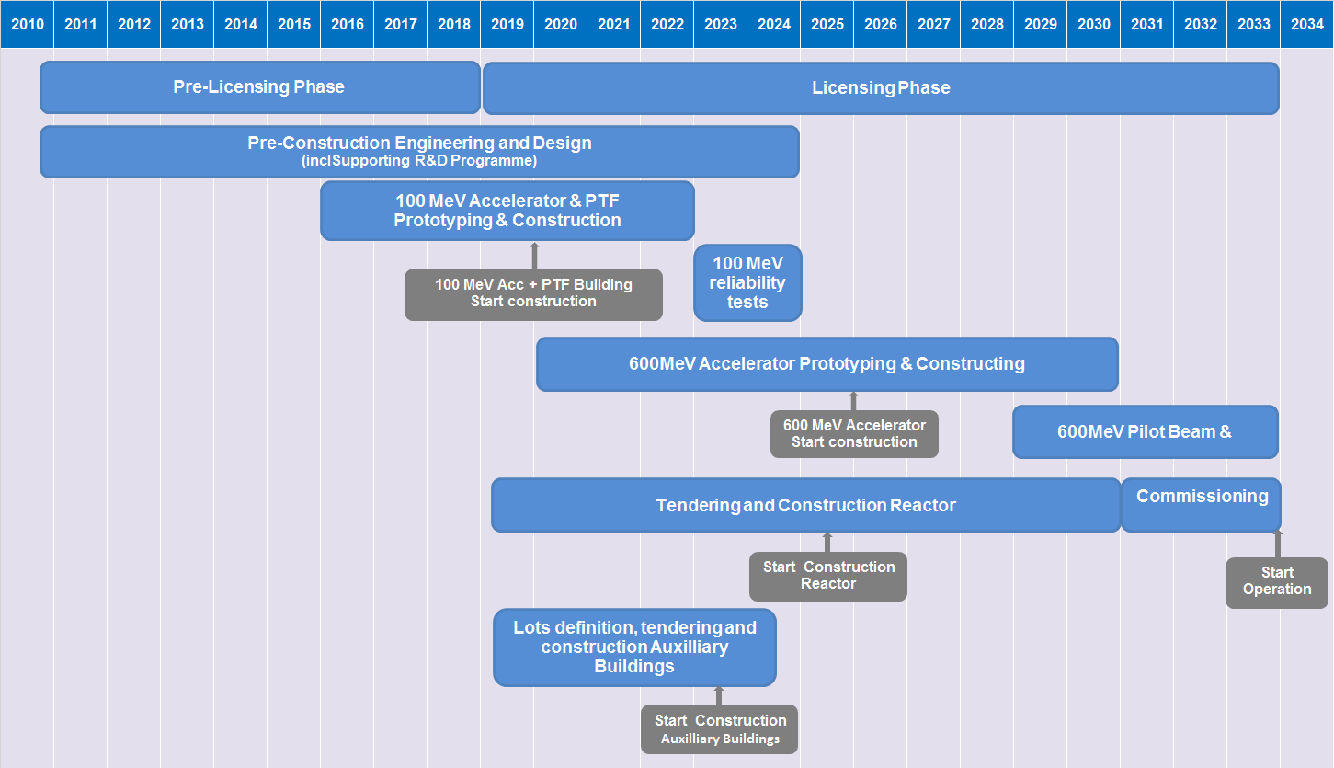
MYRRHA High-level Global Planning (2016-2030)

Slide 22
JYFL Accelerator Laboratory
Pelletron
Commercial applications
Medical
Reactions
ECR
MARA
*RADEF
Space
Microfilters
CLinac
RITU
K=30 MeV
K=130 MeV
IGISOL4
Medical
*RADiation Effects Facility

Slide 23
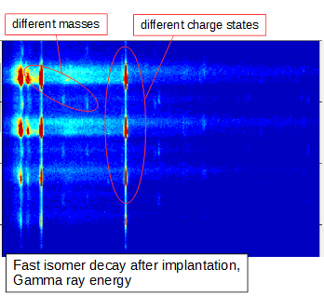
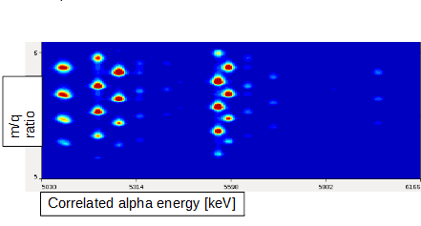
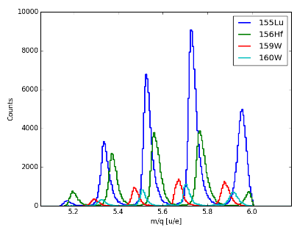
Recent commissioning of MARA
Mass/charge ratio of fusion products
eg. ⁵⁸Ni + ¹⁰⁶Cd → ¹⁶⁴Os
MARA efficiency 50(10)%
Recoil-correlated α-energy spectrum vs. m/q spectrum
Isomeric γ-decay tagging can be enhanced by the mass resolving power
m/q spectra correlated with
different α energies
¹⁶⁹Au – new isotope
¹⁶⁵Ir – gs proton decay seen
¹⁷⁰Hg – new alpha emitter
¹⁶⁵Pt – new alpha emitter
Notes:
if the target thickness is 500 ug/cm2 and we are at the right charge state settings we can say the that efficiency should be around 50(10) % with this symmetry (58Ni+106Cd).
Upper left – different alpha lines correspond to different masses.
Isomeric gamma-ray energies shown in upper right.
Bottom left shows the acceptance of 4 charge states.

Slide 24
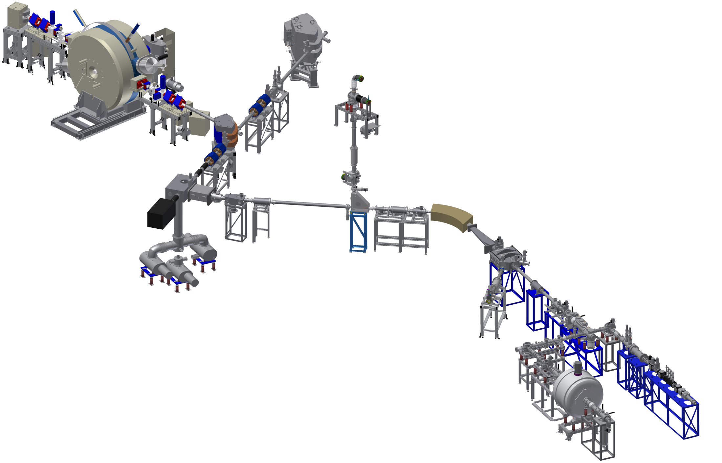
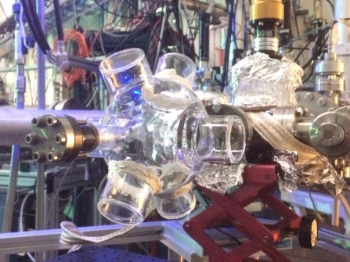
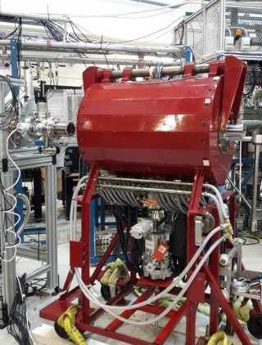
Expertise on ion beam manipulation: The IGISOL-4 facility
Off-line ion sources (surface, gas discharge…)
http://www.jyu.fi/igisol
K=30 MeV
cyclotron
Cs atom trap
Laser ionization
(RIB production,
actinide spec,
rf cavity…)
Decay spectroscopy
Collinear laser
spectroscopy
Ground-state nuclear structure
State-of-the-art ion manipulation
techniques:
- ion trapping
- atom trapping
- optical spectroscopy & lasers
Decay spectroscopy
Mass spectrometry & post-trap spectroscopy
Notes:
Complete redesign of ion guide mounting system Significantly improved optical transport to target chamber. Fully new gas purification and transport system. New electrostatic switchyard. Layout of facility dramatically different. Picture of a magnetic electron transporter.

Slide 25
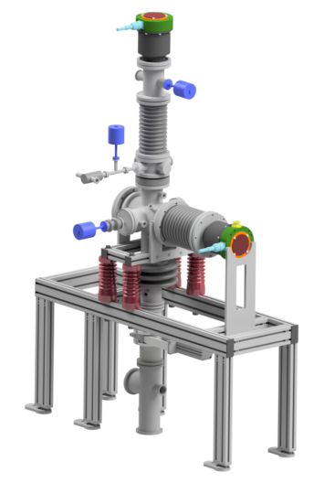


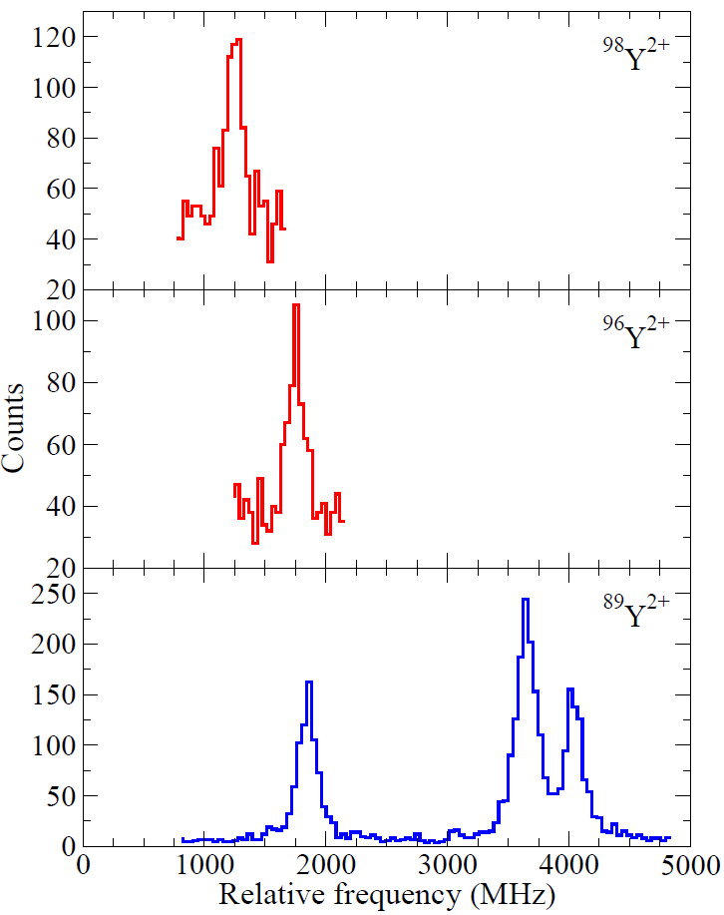
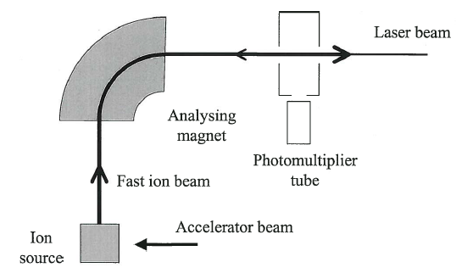
Laser spectroscopy of Y²⁺ fission fragments
Discharge ion source/
alkali surface ion source
Demonstration of simultaneously available ion beams from two sources
fission
fragments
(2⁺)
30-60kV
PMT
reference
(⁸⁹Y²⁺)
30 kV
PMT
L.J. Vormawah, M. Vilen et al., PRA 97 (2018) 042504,
published 16 April 2018
Notes:
Accurate frequency rerference from 89Y
The main issue for reliably determining the mean–square charge radii is that yttrium has only one stable isotope, 89Y. Non-optical data for changes in charge radii along the yttrium chain are not available to serve as a calibration.
Only one stabel isotopes – has to rely on calculations. Doubly charged ioins provides access to easier transition in terms of calcilations
More efficient scheme by using ´2+ ions optically pumped in an ion cooler

Slide 26
Consortium COPIN was created in 2008 to coordinate scientific cooperation of Polish Institutions in nuclear physics and its applications and particle physics with France, mainly with Instytut National de Physique Nucleaire et Physique des Particules (IN2P3), CNRS and CEA. It grouped 9 institutions - 7 university units and 2 scientific institutes. In 2008, by decision of the Consortium Council, the cooperation was enlarged and included ECT* in Trento and INFN Italy.
Coordination: IFJ PAN Krakow
Chair od the Steering Commitee: Adam Maj
The COPIN consortium offers a unique cyclotron facility in Poland operating a double site infrastructure: at the Heavy Ion Laboratory (SLCJ) of the University of Warsaw and at the Cyclotron Centre Bronowice (CCB), the protontherapy and basic research facility of the Institute of Nuclear Physics Polish Academy of Sciences in Kraków.
Both facilities can conduct basic research and applications on 4 cyclotrons: two at SLCJ (the K=160 isochronous heavy-ion cyclotron and the high-intensity proton-deuteron PET K=16.5 cyclotron), and two at CCB (the 60 MeV light-ion cyclotron AIC-144 and the new Proteus-235 proton cyclotron).
The investigations carried out in Warsaw and Kraków are also in many aspects complementary - at CCB high-energy proton beam is available while at SLCJ beams of heavier nuclei from boron to nickel can be accelerated.
COPIN (HIL Warsaw and CCB Krakow) offers in total
200 h/year of beam time for EURISOL DF

Slide 27
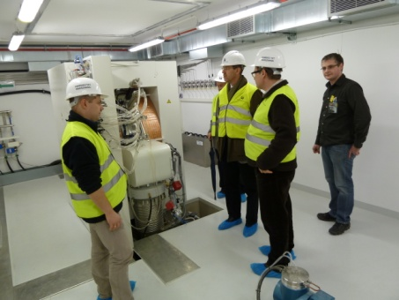
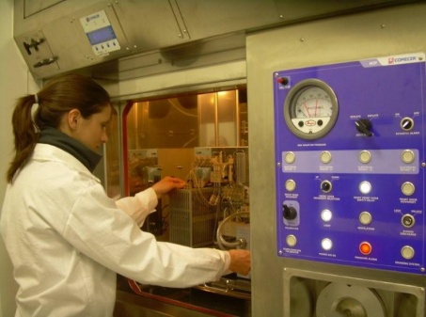
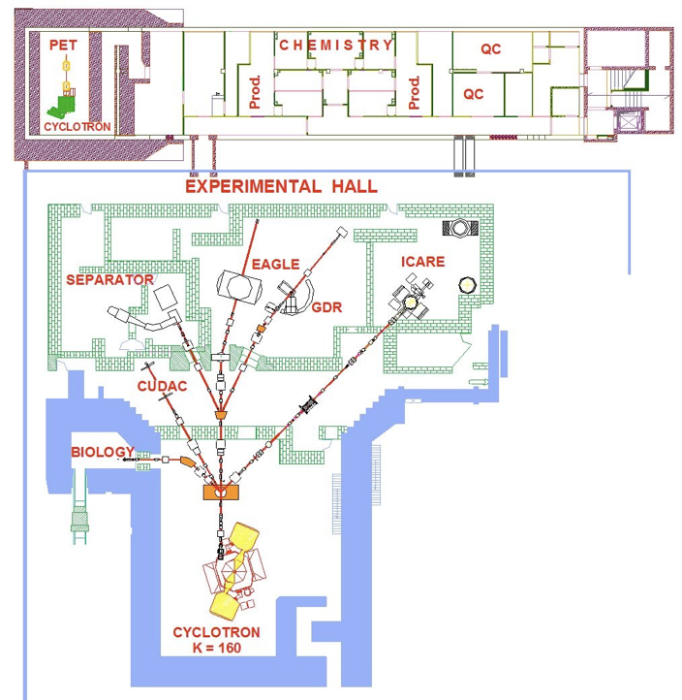
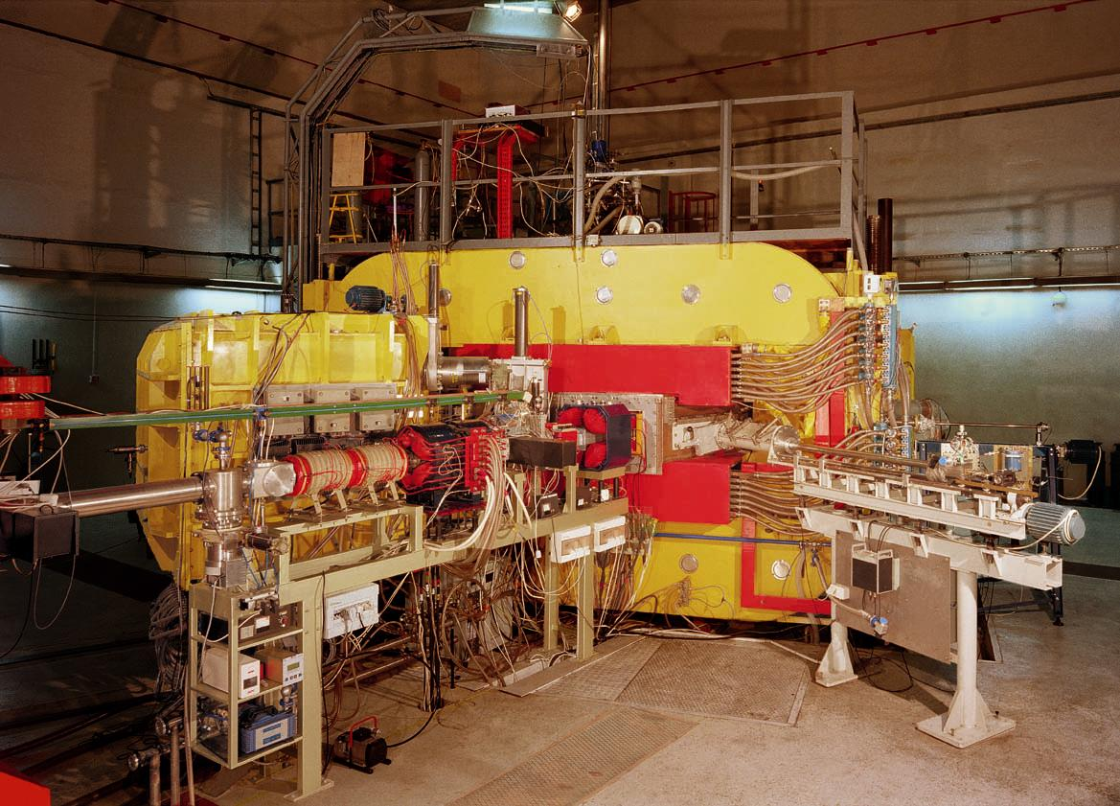
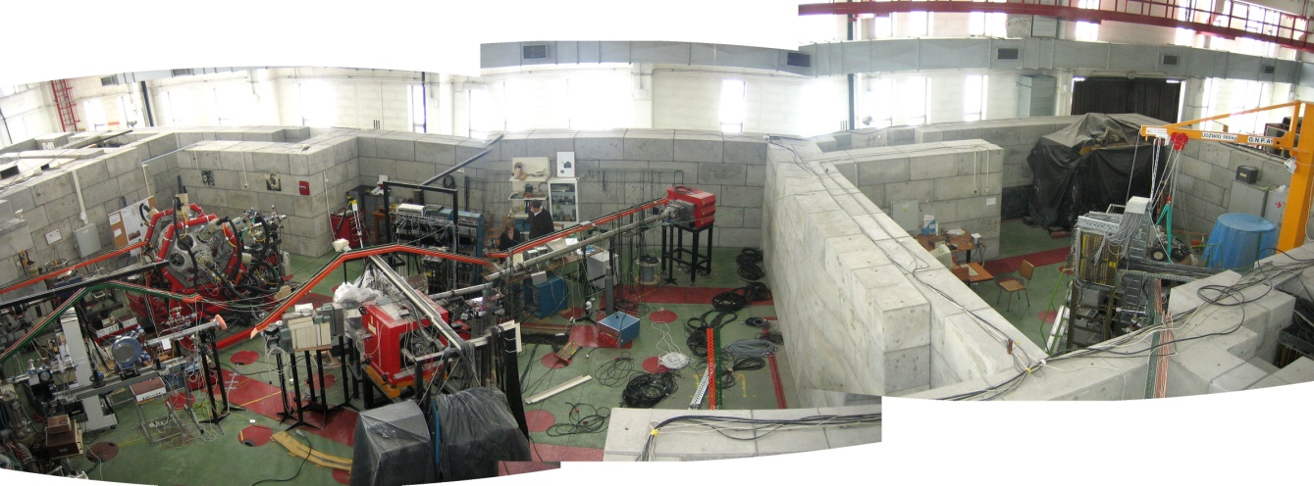
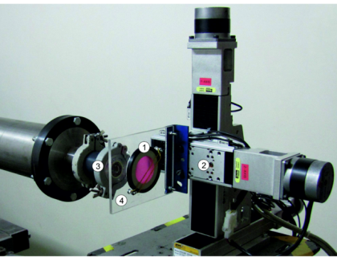
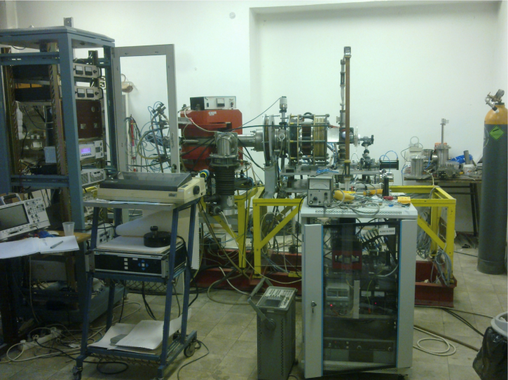
GE PETTrace:
p 16.5MeV
d 8 MeV
Radiofarmaceutcals studies
γ-ray Spectroscopy
Reactions
Detector tests
Beams: He*÷Ar (Ni)
Energies 2 ÷10 MeV*A
*⁾Internal only
ECR test bench
Radiobiology
& Applications
Offer for EURISOL DF:
ECR source development
Detector development (e.g. FAZIA, NEDA) and tests with heavy ion beams

Slide 28

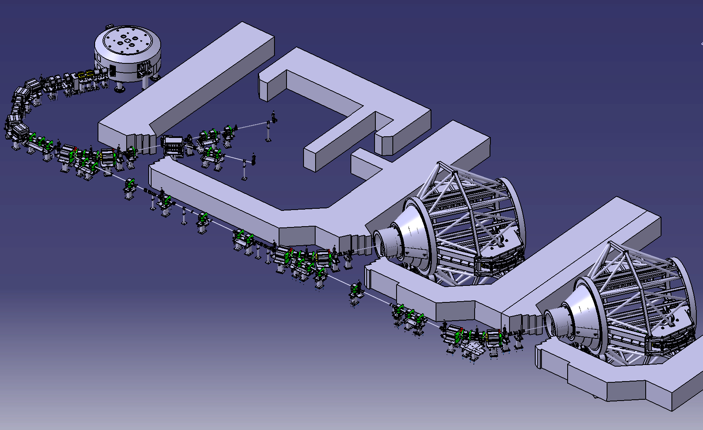
Cyclotron Center Bronowice
Institute of Nuclear Physics Polish Academy of Sciences
Krakow, Poland
230 MeV proton cyclotron (IBA)
Energy selector
(70-230 MeV,Δp/p<0.7%)
Eye-therapy room
2 gantries for whole body theraphy
Experimental hall
Offer for EURISOL DF:
Detector development (e.g. PARIS) and characterization with the high-energy proton beam: CALIFA@NUSTAR, PARIS, FAZIA, ….
Experiments of gamma-decay of giant and pygmy resonances, high-lying states in light nucleu and fission and spallation studies

Slide 29
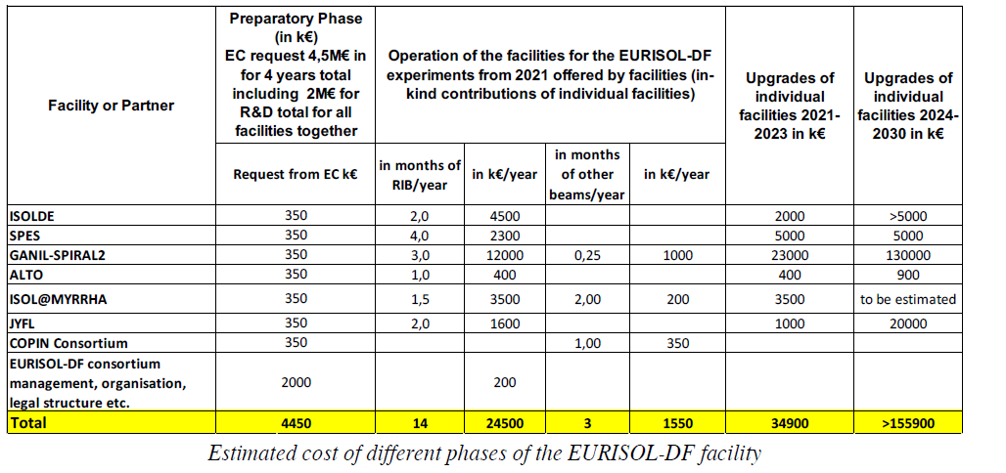
Beam Time and Financial Contribution

Slide 30
Complementarity
BEAMS
  Light Nuclei: GANIL/SPIRAL1; ISOLDE
  Fission Fragments: SPES; ISOLDE; ALTO
  Refractory elements: JYFL; GANIL-S3
  N=Z : GANIL-S3
  Heavy elements; GANIL-S3; JYFL; ISOLDE
SPECTROMETERS
  GANIL-/SPIRAL1: VAMOS
  SPES: PRISMA
  ISOLDE: ISS
  JYFL: MARA; RITU

