Slide 1
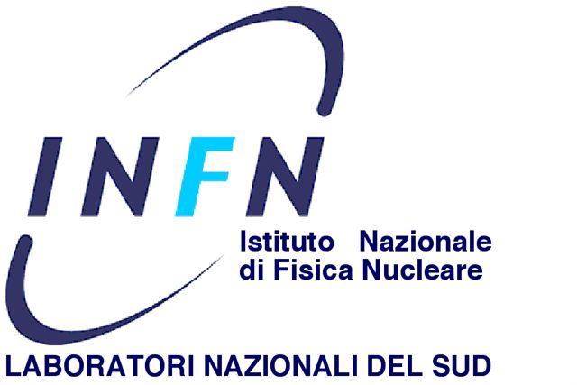
Role of nuclear structure on reaction dynamics
Alessia Di Pietro
INFN-Laboratori Nazionali del Sud

Slide 2
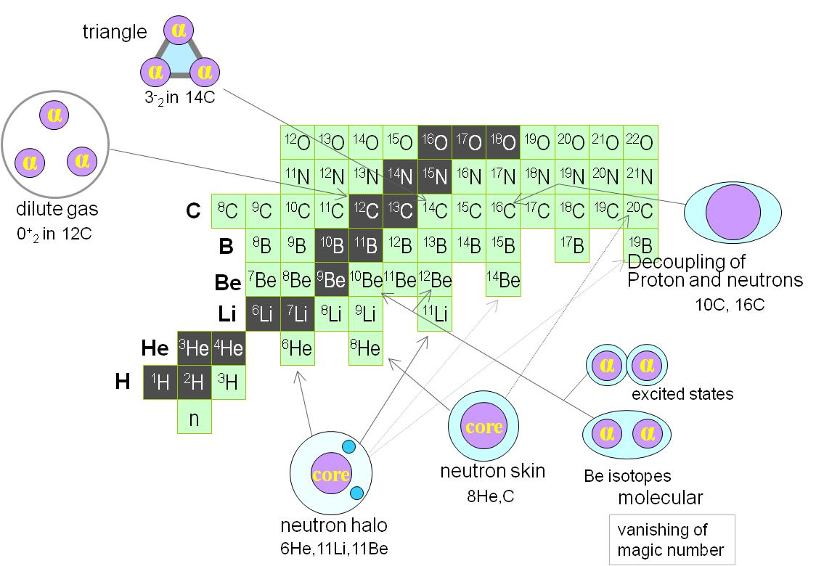
The special case of light Nuclei
From Kanada-En’yo
Light nuclei: a quantum mechanics laboratory
Quantum mechanics plays a role in creating peculiar structures in ground states of light nuclei: nuclear skins and/or nuclear halos, nuclear clusters, nuclear molecules, gas condensate ….
Theoretical understanding structure of light drip-line nuclei challenging → necessary to go beyond mean field approach.
In order to handle new observables and exotic structures extension of theoretical models needs to be made also in the description of reaction dynamics

Slide 3
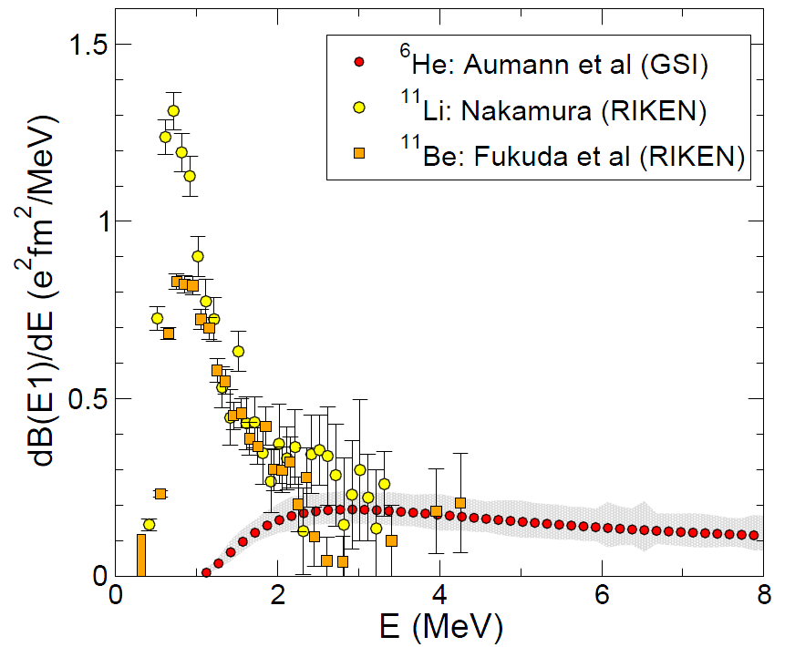
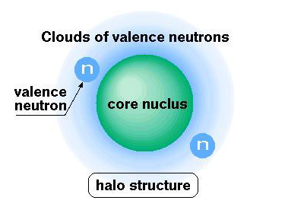
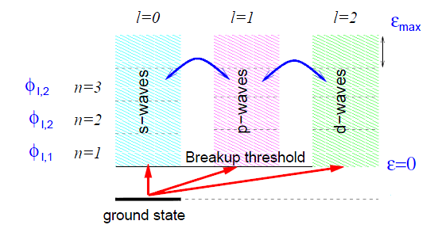
Nuclear Halo
The n-halo case: e.g. ¹¹Li, ¹¹Be, ⁶He
B(E1) distribution
Weakly bound (easy to break-up)
Easy to polarise (large B(E1) low energy strenght)
Suffer lower Coulomb barrier
Higher transfer probability?
T. Nakamura et al., Phys. Rev. Lett. 96, 252502 (2006).
T. Aumann et al., Phys. Rev. C 59, 1252 (1999).
N. Fukuda et al., Phys. Rev. C70, 054606 (2004).
At low bombarding energy, coupling between relative motion and intrinsic excitations important.
Halo nuclei → small binding energy, low break-up thresholds → coupling to break-up states (continuum) important → CDCC.
A. Di Pietro et al. to be published

Slide 4
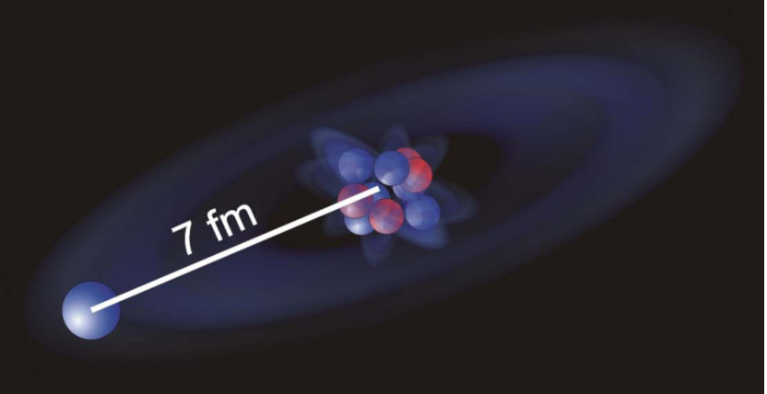
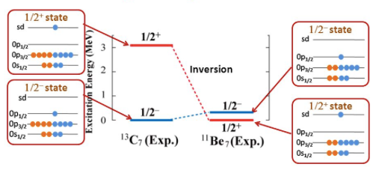
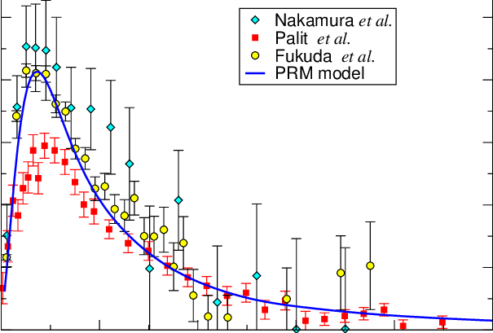
¹¹Be case:
Extremely large radius
W.Nortershäuser et al. PRL 102, 062503 (2009)
Parity inversion of g.s. and 1st excited state
Strongest known electric dipole transition between bound states in nuclei
B(E1)=0.102(2)e²fm²
Large non-resonant dipolar strength above threshold
B(E1) distribution

Slide 5
The importance of core-excitation
¹¹Be+¹⁹⁷Au @ TRIUMF
Elastic scattering
¹¹Be*_{1/2-}+¹⁹⁷Au
V. Pesudo et al. Phys. Rev. Lett. 118, 152502 (2017)
CDCC accounts of halo degrees of freedom. Coupling to continuum effects insufficient to reproduce the experimental data.
XCDCC accounts for both the halo and core degrees of freedom.
The structure model accounts for the appropriate admixture of 0+ and 2+ components in the ¹⁰Be core.
))
h
C
))
Core-excitation effects in 2n-halo nuclei (e.g.¹¹Li) far from being calculable!

Slide 6
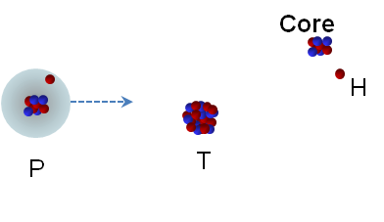
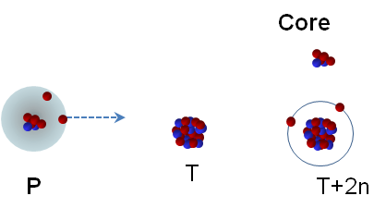
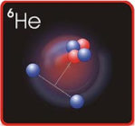
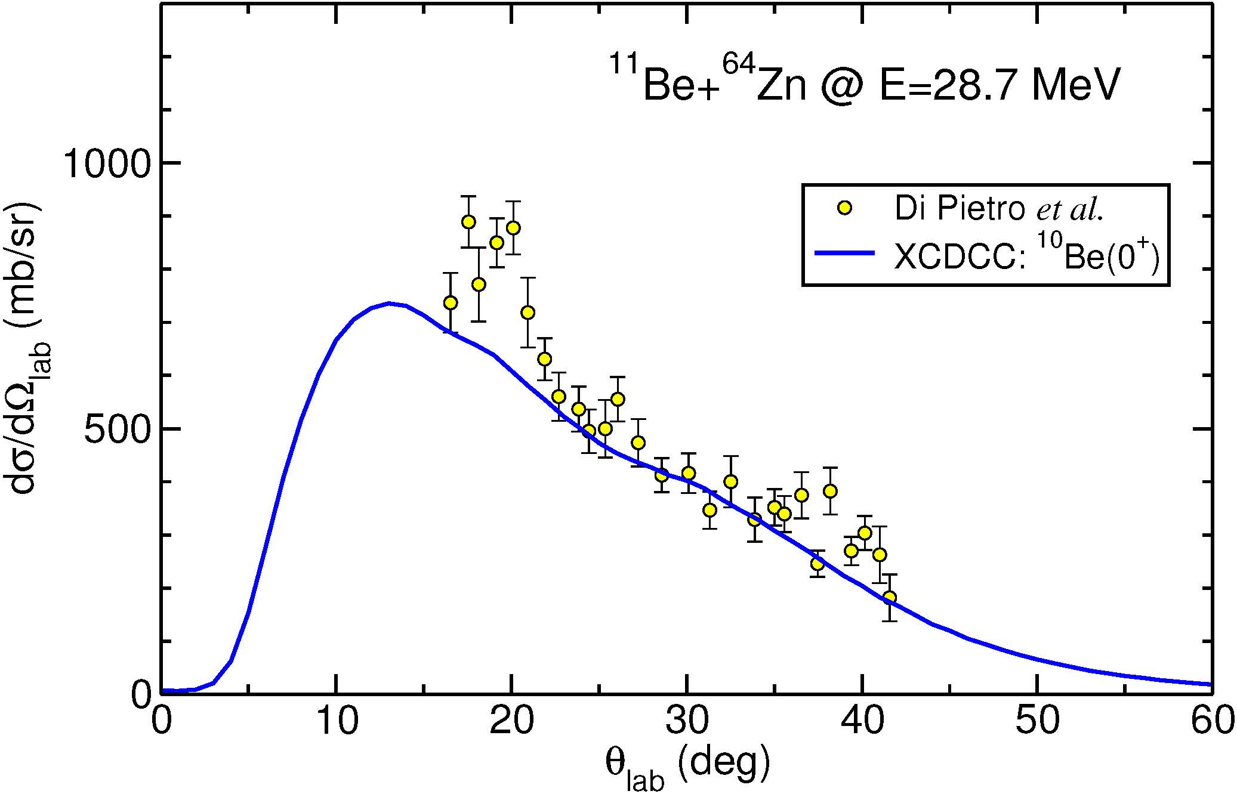
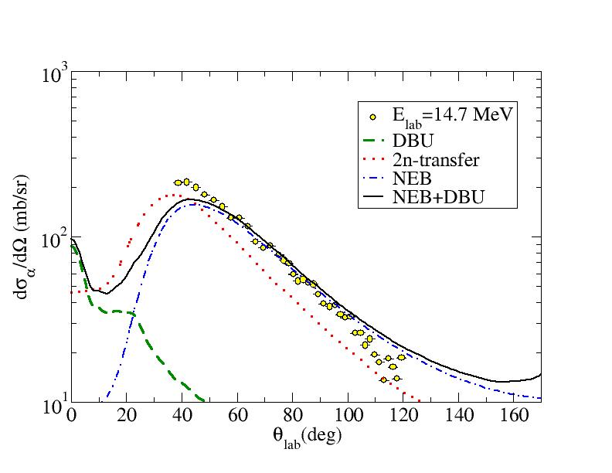
Inclusive breakup
Elastic break-up
Non-elastic break-up e.g.transfer
¹⁰Be angular distribution
⁴He angular distribution
¹¹Be+⁶⁴Zn
⁶He+⁶⁴Zn
A. Di Pietro et al. paper in preparation
A. Di Pietro et al. Phys. Rev. Lett. 105, 022701 (2010)
V. Scuderi et al. Phys. Rev. C 84, 064604 (2011)
Di Pietro et al. paper in preparation
Elastic-break-up is not the only process contributing to the inclusive cross-section producing the core as spectator. Non elastic-break-up contribution can be large, such as in the ⁶He case.

Slide 7
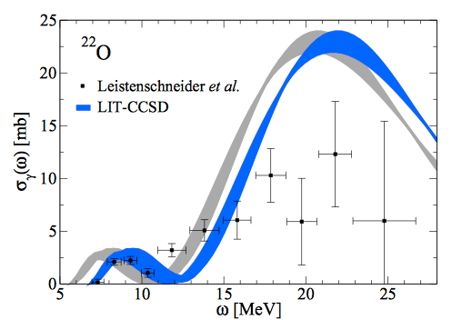
The neutron-skin and the Pygmy Dipole Resonance
PDR
GDR
Oscillation of neutron-skin against the core.
Ab-initio calculation well describe the experimental cross-section.
S. Bacca et al. Phys. Rev. C 90, 064619 (2014)

Slide 8
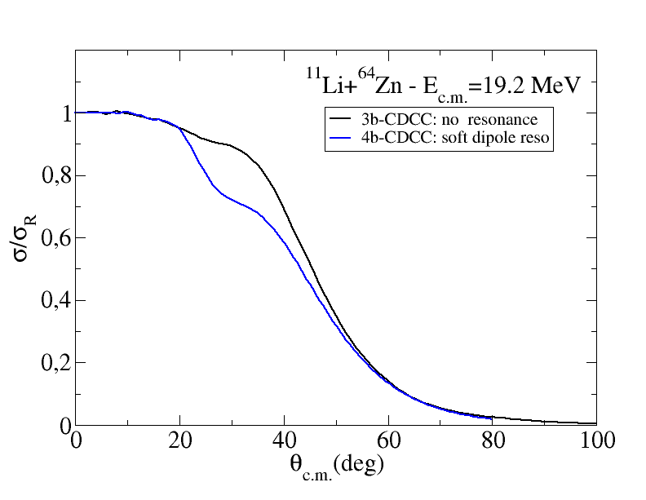
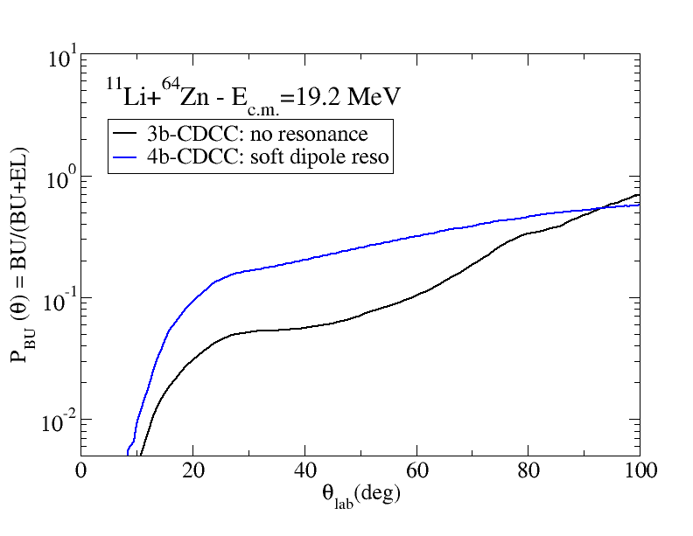
Effects of coupling with the soft dipole resonance in ¹¹Li
Predictions for ¹¹Li+ ⁶⁴Zn
Comparison of 4-body and 3-body CDCC
Elastic scattering
Break-up probability

Slide 9
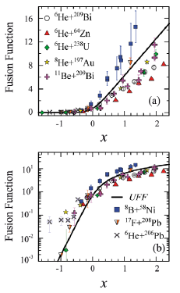
Sub-barrier fusion
L.F. Canto et al.: NPA 821,51, (2009)
Situation unclear below the barrier
Most of data show suppression above the barrier
Besides the interest of investigating sub-barrier fusion of halo nuclei, the sub-barrier fusion dynamics of n-rich nuclei important for nuclear astrophysics studies.
Fusion reactions between n-rich nuclei occur in some explosive scenario (e.g. ²⁴O+²⁴O or ²⁸Ne+²⁸Ne could provide a significant energy source to drive X-ray super-bursts). How important are the dynamic effects (like coupling to transfer channels) on the fusion process?
Clustering effects do enhance sub-barrier fusion? Do these effects explain the unexpectedly high electron screening potentials found? C. Spitaleri et al. Physics Letters B 755 (2016) 275.

Slide 10
Summary
Light exotic nuclei exhibit many peculiar structures and many other very “exotic” structures are predicted to exist.
The investigation of such structures undergoing and future experiments are already planned.
The experimental study of the dynamics of reaction induced by exotic nuclei has shown how it strongly depends on their structure.
Needed more experimental results of high quality to tune the theory (these are still scarce!) along with improvements of beam intensities and of theory.

