Slide 1
The ¹⁴⁰Ce(n,γ)¹⁴¹Ce reaction at n_TOF-EAR1: a litmus test for theoretical stellar models.
(Preliminary) ABSTRACT
Evolutionary stellar models need nuclear input data as much accurate as possible. This holds in particular for nucleosynthesis calculations involving the production of nuclei heavier than iron. The case of ¹⁴⁰Ce (88% of solar cerium) is particularly interesting, because of its intrinsic closed shell nuclear structure. Cerium is mostly synthesized by the slow neutron capture process (the s-process). It has been carefully characterized in laboratory and observed in almost all stellar evolutionary phases. Currently, stellar models and observations of s-process enriched stars belonging to galactic globular clusters well agree for elements belonging to the 2nd s-process peak, apart from cerium. The re-evaluation of its neutron cross section is needed to verify the robustness of theoretical predictions, possibly solving the afore-mentioned discrepancy.

Slide 2
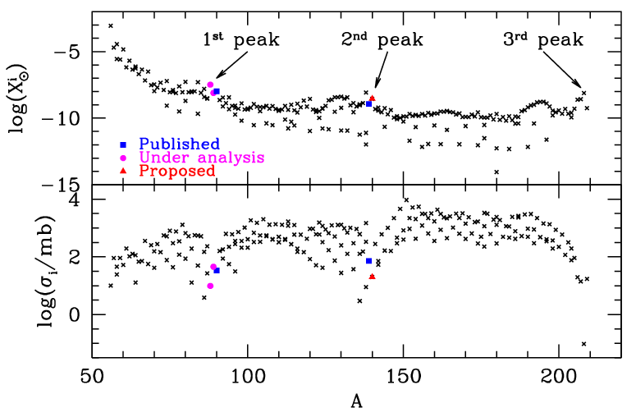
The solar distribution and the s-process peaks
Magic nuclei are bottleneck for the s-process nucleosynthesis

Slide 3
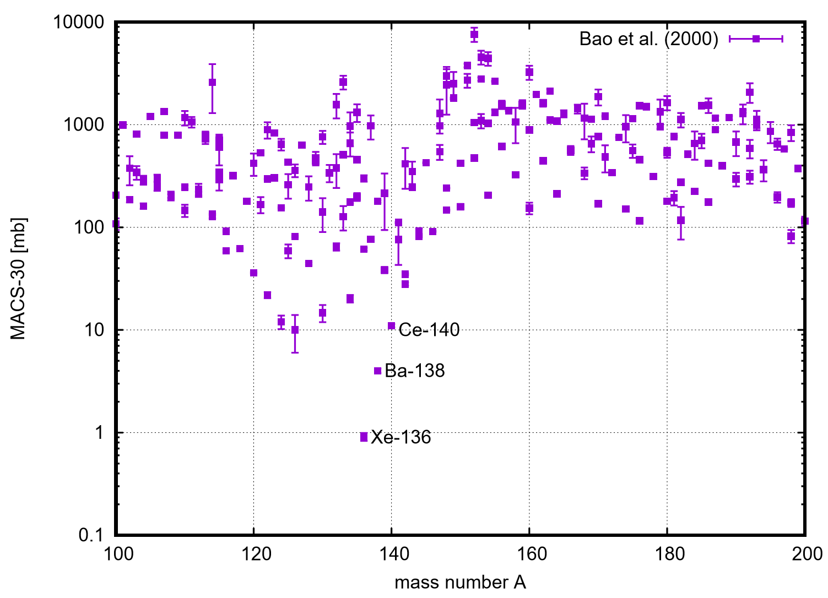
The solar distribution and the s-process peaks
Magic nuclei are bottleneck for the s-process nucleosynthesis

Slide 4
1st s-process peak (N=50)
(⁸⁶Kr – ⁸⁷Rb) ⁸⁸Sr - ⁸⁹Y - ⁹⁰Zr
2nd s-process peak (N=82)
(¹³⁶Xe) ¹³⁸Ba - ¹³⁹La - ¹⁴⁰Ce – ¹⁴¹Pr – ¹⁴²Nd (¹⁴⁴Sm)
3rd s-process peak (N=126)
²⁰⁸Pb – ²⁰⁹Bi
Z=82

Slide 5
The s-process in AGB stars
Busso et al. 1999

Slide 6
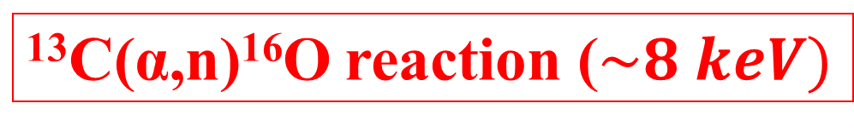

The s-process in AGB stars
²²Ne(α,n)²⁵Mg reaction ($\sim 23 keV)$
¹³C(α,n)¹⁶O reaction ($\sim 8 keV)$
Busso et al. 1999

Slide 7
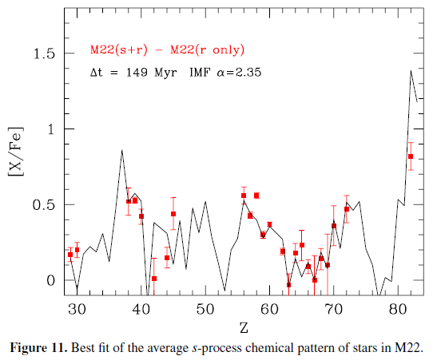
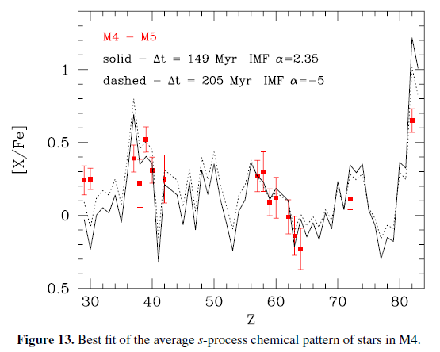
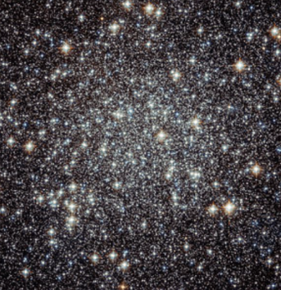
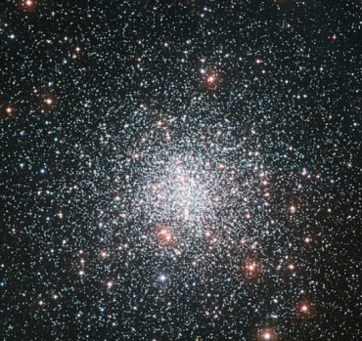
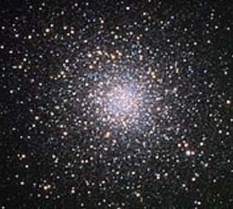
The s-process in Globular Clusters
Roederer+ 2011 (6 stars)
Young+ 2008 (14 stars)
Straniero, Cristallo & Piersanti 2014
Hot low metallicity Main Sequence stars:
reliable observations
The pollution of asymptotic giant branch (AGB) stars with a mass ranging between 3 to 6 M_{SUN} may account for most of the features of the s-process enrichment of M4 and M22.
M22
M4
M5

Slide 8
The s-process in Globular Clusters
Roederer+ 2011 (6 stars)
Young+ 2008 (14 stars)
s-process dominated
Straniero, Cristallo & Piersanti 2014
Hot low metallicity Main Sequence stars:
reliable observations
The pollution of asymptotic giant branch (AGB) stars with a mass ranging between 3 to 6 M_{SUN} may account for most of the features of the s-process enrichment of M4 and M22.
Ba 89%
La 71%
Ce 81%
Pr 52%
Nd 57%
Sr 97%
Y 92%
Zr 96%
s-process contributions:
Pb 87%

Slide 9
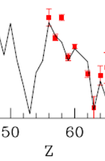
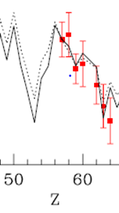
The s-process in Globular Clusters
Roederer+ 2011 (6 stars)
Young+ 2008 (14 stars)
s-process dominated
Straniero, Cristallo & Piersanti 2014
The pollution of asymptotic giant branch (AGB) stars with a mass ranging between 3 to 6 M_{SUN} may account for most of the features of the s-process enrichment of M4 and M22.
Ba 89%
La 71%
Ce 81%
Pr 52%
Nd 57%
Sr 97%
Y 92%
Zr 96%
s-process contributions:
Pb 87%

Slide 10
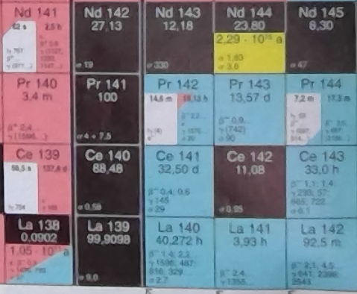
Cerium
¹⁴⁰Ce is the most abundant cerium isotope (88%)
(n,γ)
β⁻ decay

Slide 11
Cerium
¹⁴⁰Ce is the most abundant cerium isotope (88%)
(n,γ)
β⁻ decay
Its production channel has already been explored by the n_TOF collaboration (Terlizzi+ 2007)

Slide 12
Cerium
¹⁴⁰Ce is the most abundant cerium isotope (88%)
(n,γ)
β⁻ decay
Cerium has been observed in all evolutionary phases (MS,RGB, AGB) at various metallicities. Most of its lines, however, are blended (less problematic at low metallicities).
Its oscillator strengths have been determined precisely by Lawler+ 2009 (oscillator strenghts express the probability of absorption or emission of electromagnetic radiation in transitions between energy levels).

Slide 13
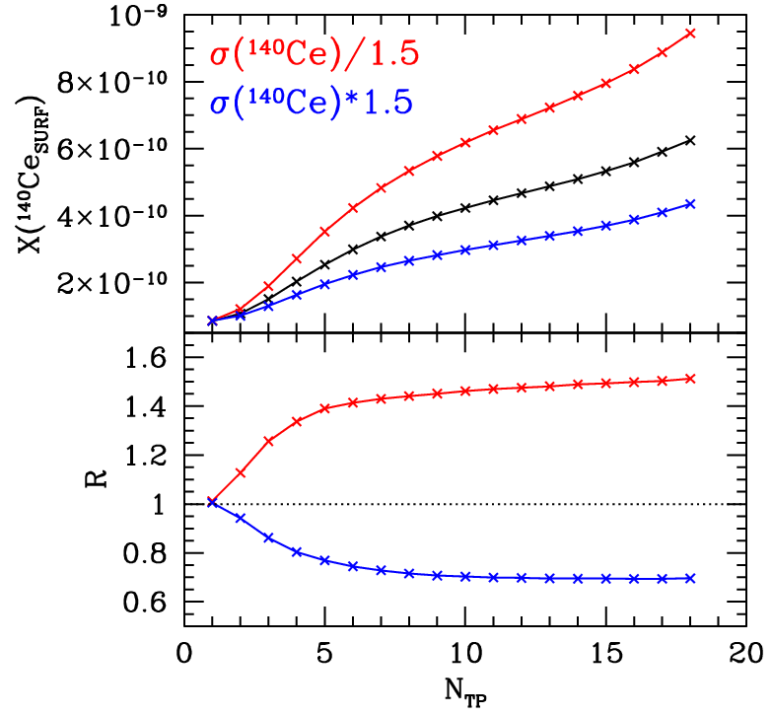
Stellar nucleosynthesis
Stellar surface
abundances
Surface ratio with respect
to standard
(Bao&Kappeler 2000)
FUNS M=4 M_{SUN} [Fe/H]=-1.67

Slide 14
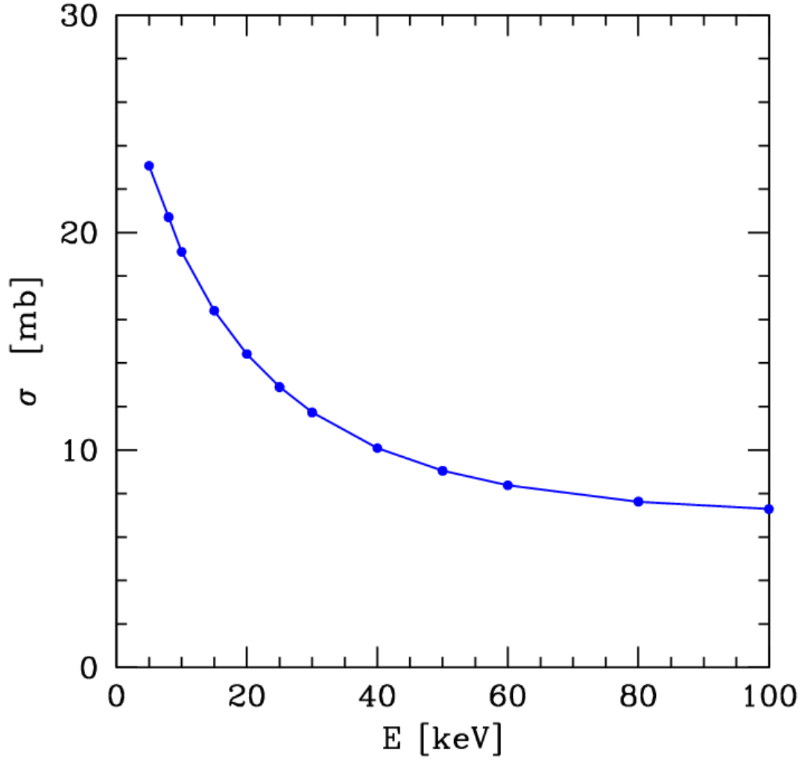
¹⁴⁰Ce neutron capture cross section (I)
MACS
KADONIS 1p0

Slide 15
¹⁴⁰Ce neutron capture cross section (I)
MACS
Stellar cross section [mb]
⁸⁸Sr(n, γ)
²⁰⁶Pb(n, γ)
KADONIS 1p0

Slide 16
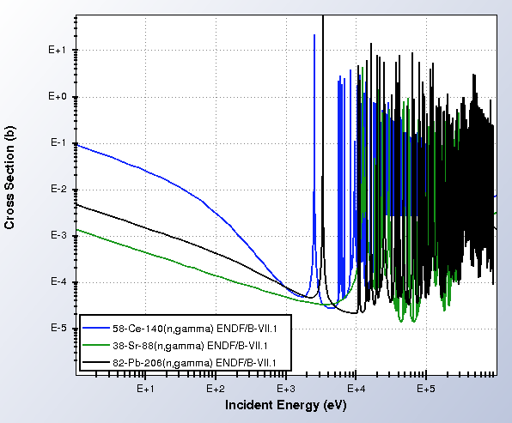
¹⁴⁰Ce neutron capture cross section (I)
MACS
Stellar cross section [mb]
⁸⁸Sr(n, γ)
²⁰⁶Pb(n, γ)
KADONIS 1p0

Slide 17
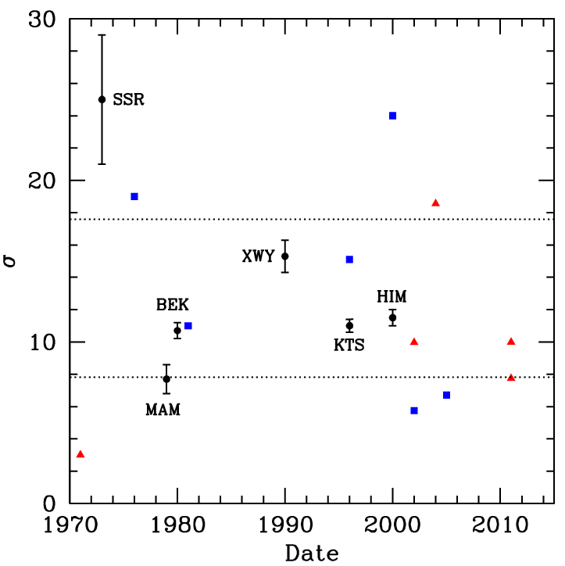
¹⁴⁰Ce neutron capture cross section (II)
SSR (1973)
K. Siddappa+, Nuovo Cim. 18A, 48
MAM (1979)
A.de L. Musgrove+, Aust. J. Phys. 32, 213
XWY (1990)
Y. Xia+, Chin. J. Nucl. Phys. 12, 261
KTS (1996) + BEK (1980)
F. Käppeler+, Phys. Rev. C 53, 1397
H. Beer +, Phys. Rev. C 21, 534
HIM (2000)
S. Harnood+, J. Nucl. Sci. Techn.37 740
Stellar cross section [mb]
Experimental
Library
Theoretical
KADONIS 1p0

Slide 18
¹⁴⁰Ce neutron capture cross section (II)
Activation @24-30 keV
SSR (1973)
K. Siddappa+, Nuovo Cim. 18A, 48
MAM (1979)
A.de L. Musgrove+, Aust. J. Phys. 32, 213
XWY (1990)
Y. Xia+, Chin. J. Nucl. Phys. 12, 261
KTS (1996) + BEK (1980)
F. Käppeler+, Phys. Rev. C 53, 1397
H. Beer +, Phys. Rev. C 21, 534
HIM (2000)
S. Harnood+, J. Nucl. Sci. Techn.37 740
Stellar cross section [mb]
Experimental
Library
Theoretical
KADONIS 1p0

Slide 19
¹⁴⁰Ce neutron capture cross section (II)
SSR (1973)
K. Siddappa+, Nuovo Cim. 18A, 48
MAM (1979)
A.de L. Musgrove+, Aust. J. Phys. 32, 213
XWY (1990)
Y. Xia+, Chin. J. Nucl. Phys. 12, 261
KTS (1996) + BEK (1980)
F. Käppeler+, Phys. Rev. C 53, 1397
H. Beer +, Phys. Rev. C 21, 534
HIM (2000)
S. Harnood+, J. Nucl. Sci. Techn.37 740
Stellar cross section [mb]
TOF
(3-100 keV)
(10-100 keV)
Experimental
Library
Theoretical
KADONIS 1p0

Slide 20
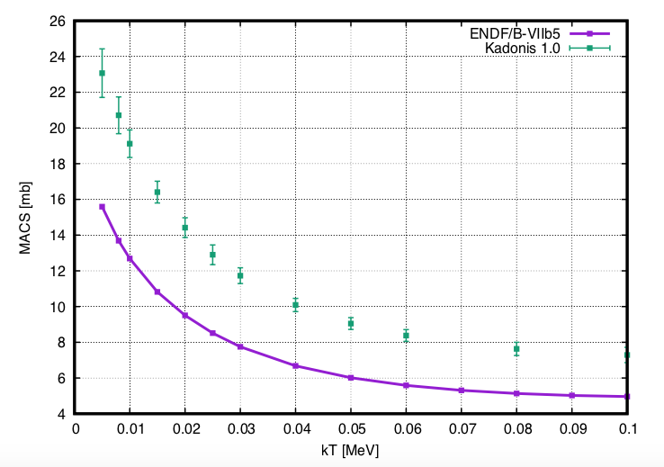
¹⁴⁰Ce neutron capture cross section (III)
EVALUATIONS:
Capture ORELA 40 m, C₆F₆
5 < E_{n} < 100 keV
A.de L. Musgrove+, Aust. J. Phys. 32, 213
Transmission RPI 250 m
20 < E_{n} < 60 keV
H. S. Camarda. PRC 18, 1254
Transmission JAERI ^{nat}Ce
E_{n} < 60 keV
Ohkubo, jaeri report 1993
Capture (preliminary) 1974
En<65 keV
by Hacken (Columbia)
not
published

Slide 21
¹⁴⁰Ce neutron capture cross section (III)
40% discrepancy
at kT=8 keV
EVALUATIONS:
Capture ORELA 40 m, C₆F₆
5 < E_{n} < 100 keV
A.de L. Musgrove+, Aust. J. Phys. 32, 213
Transmission RPI 250 m
20 < E_{n} < 60 keV
H. S. Camarda. PRC 18, 1254
Transmission JAERI ^{nat}Ce
E_{n} < 60 keV
Ohkubo, jaeri report 1993
Capture (preliminary) 1974
En<65 keV
by Hacken (Columbia)
Evaluation | MACS @ 8 keV
ENDF/B-VIII.b (ENDF/B-VI) | 13.8 mb (40.3 mb)
JEFF-3.1 | 16.7 mb
JENDL-4.0 | 17.3 mb
not
published

Slide 22
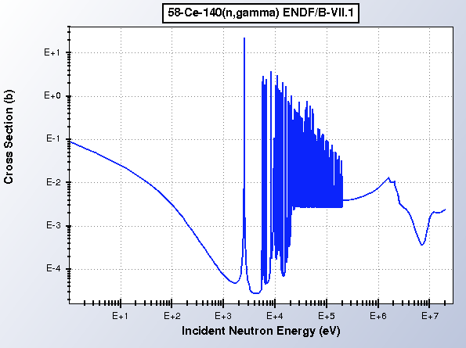
¹⁴⁰Ce neutron capture cross section (III)
EVALUATIONS:
Capture ORELA 40 m, C₆F₆
3 < E_{n} < 100 keV
A.de L. Musgrove+, Aust. J. Phys. 32, 213
Transmission RPI 250 m
20 < E_{n} < 60 keV
H. S. Camarda. PRC 18, 1254
Transmission JAERI ^{nat}Ce
E_{n} < 60 keV
Ohkubo, jaeri report 1993
Capture (preliminary) 1974
En<65 keV
by Hacken (Columbia)
Musgrove
Camarda
Hacken
Ohkubo
not
published

Slide 23
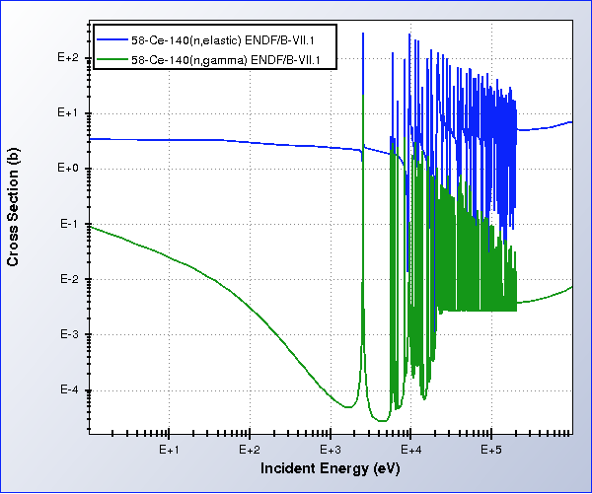

Slide 24
Room for improvement with C₆D₆

Slide 25
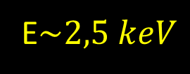
¹⁴⁰Ce neutron capture cross section (III)
EVALUATIONS:
Capture ORELA 40 m, C₆F₆
3 < E_{n} < 100 keV
A.de L. Musgrove+, Aust. J. Phys. 32, 213
Transmission RPI 250 m
20 < E_{n} < 60 keV
H. S. Camarda. PRC 18, 1254
Transmission JAERI ^{nat}Ce
E_{n} < 60 keV
Ohkubo, jaeri report 1993
Capture (preliminary) 1974
En<65 keV
by Hacken (Columbia)
Musgrove
Camarda
Hacken
Ohkubo
not
published
E$\sim 2,5 keV$

Slide 26
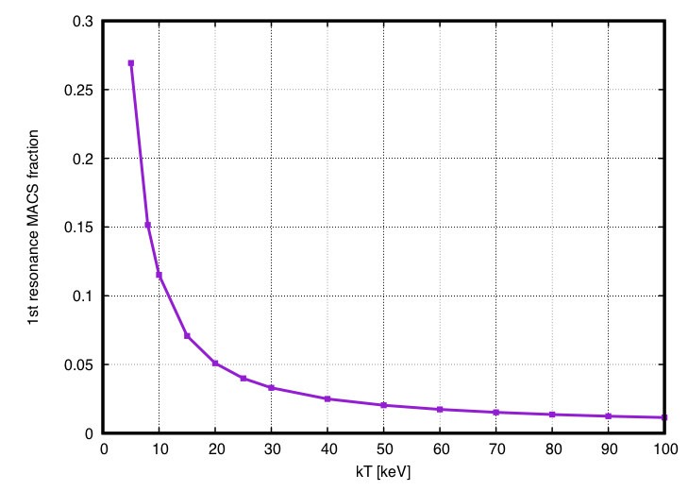
¹⁴⁰Ce neutron capture cross section (III)

Slide 27
¹⁴⁰Ce neutron capture cross section (III)
1st resonance ~ 15% of MACS @ kT=8 keV

Slide 28
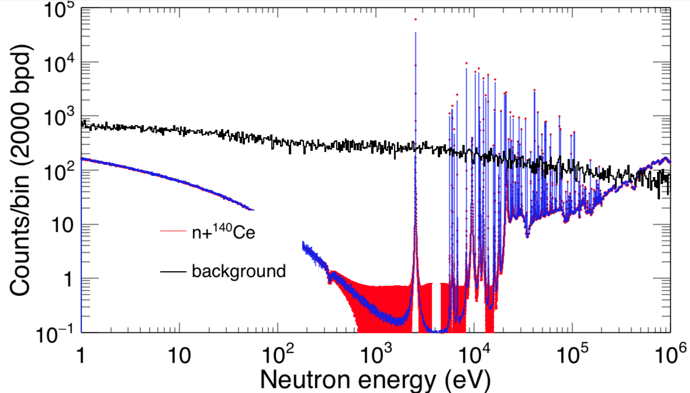
Count rate @ EAR1 – 4 g ¹⁴⁰Ce

Slide 29
Count rate @ EAR1 – 4 g ¹⁴⁰Ce
Oak Ridge Natioanl Laboratory: 4gr → 26040 ε
Approved by III commission INFN (2018 budget): 5000 ε
BUT…

Slide 30



Slide 31
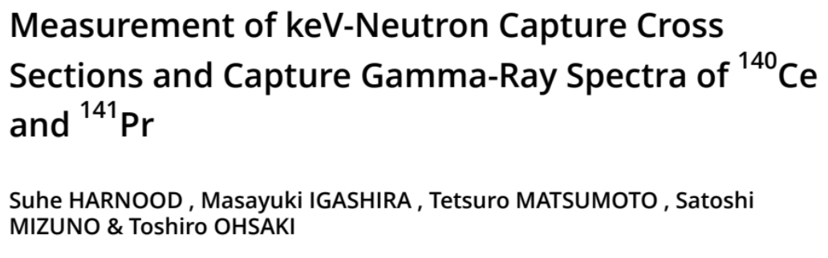
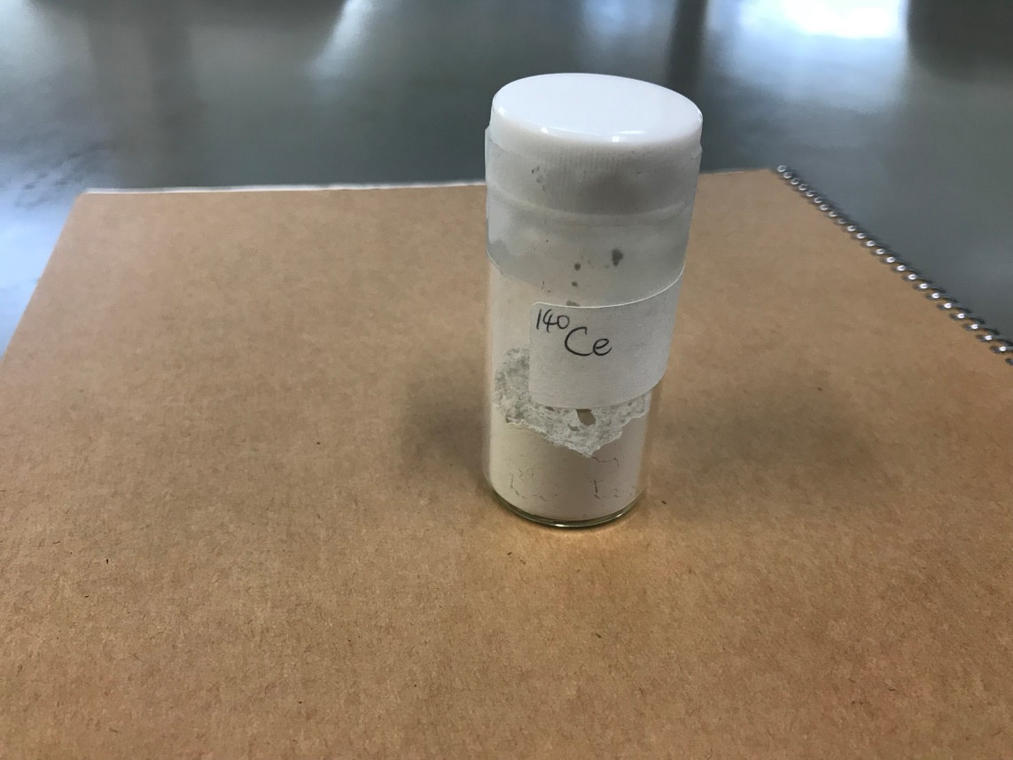
10 gr of CeO₂

Slide 32
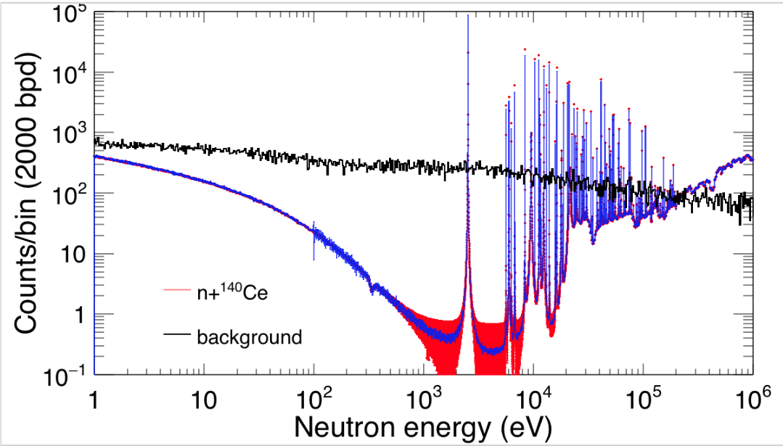
Count rate @ EAR1 – 10 g ¹⁴⁰Ce

Slide 33
Conclusions
¹⁴⁰Ce is a magic nucleus (88% os solar cerium), mostly synthesized by the s-process (81% of Galactic cerium). It has been observed in all evolutionary phases and metallicities.
Heavy-element abundances in s-rich galactic Globular Clusters show good agreement with theoretical AGB models for elements belonging to the 2nd s-process peak…apart from cerium!
MACS at AGB energies are higly uncertain due to lack of experimental data:
  2 transmission experiments in literature (^{nat}Ce was used, energy region does not cover the whole region of interest, En>20 keV)
  1 capture experiment in literature (C₆F₆ as capture detector, not well suited for this measurement: Γ_{n} >> Γ_{γ})
  No capture data below 5 keV reported in literature (just one unpublished report)!
Clear need of accurate capture data on ¹⁴⁰Ce
n_TOF can provide capture data in the energy region of interest:
  Low cross section → 3x10¹⁸ protons
  Resonances in the keV region → EAR1
  Γ_{n} >> Γ_{γ}→ C₆D₆

Slide 34
Conclusions
¹⁴⁰Ce is a magic nucleus (88% os solar cerium), mostly synthesized by the s-process (81% of Galactic cerium). It has been observed in all evolutionary phases and metallicities.
Heavy-element abundances in s-rich galactic Globular Clusters show good agreement with theoretical AGB models for elements belonging to the 2nd s-process peak…apart from cerium!
MACS at AGB energies are higly uncertain due to lack of experimental data:
  2 transmission experiments in literature (^{nat}Ce was used, energy region does not cover the whole region of interest, En>20 keV)
  1 capture experiment in literature (C₆F₆ as capture detector, not well suited for this measurement: Γ_{n} >> Γ_{γ})
  No capture data below 5 keV reported in literature (just one unpublished report)!
Clear need of accurate capture data on ¹⁴⁰Ce
n_TOF can provide capture data in the energy region of interest:
  Low cross section → 3x10¹⁸ protons
  Resonances in the keV region → EAR1
  Γ_{n} >> Γ_{γ}→ C₆D₆
Why this measurement:
New cross section → new stellar evaluations
Confirmed cross section → blending problem in stellar spectra

Slide 35
