Slide 1
Neutron capture cross section of ⁸⁸Sr(n,γ), ⁸⁹Y(n,γ) @EAR1
Lucia Anna Damone, G. Tagliente, N. Colonna, M. Mastromarco, A. Mazzone, M. Barbagallo, S. Cristallo, A.C. Larsen, M. Lugaro, C. Massimi, P.M. Milazzo, F. Mingrone , and the n_TOF collaboration.
e-mail: lucia.damone@ba.infn.it
Meeting n_TOF Italia, Bari 28-29 November

Slide 2
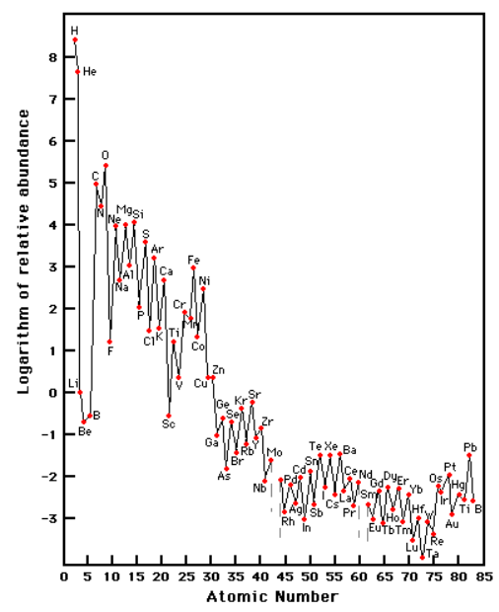
${}_{}^{89}Y$and ${}_{}^{88}{Sr}$ neutron capture measurement
nuclear fusion
neutron capture processes
slow neutron capture process (s-process)
${τ }_{n}>$ ${τ }_{β}$ and ${\text{n} }_{n}\sim {10}^{8}{cm}^{−3}$
rapid neutron capture process (r-process)
${τ }_{n}<$ ${τ }_{β}$ and ${\text{n} }_{n}\sim {10}^{22}{cm}^{−3}$
their neutron-capture cross sections are lower
than those of neighboring nuclei. As a result, they act as bottlenecks on the neutron-capture path.
neutron capture
s-process bottlenecks
N=50 ls
N=82 hs
Meeting n_TOF Italia, Bari 28-29 November

Slide 3
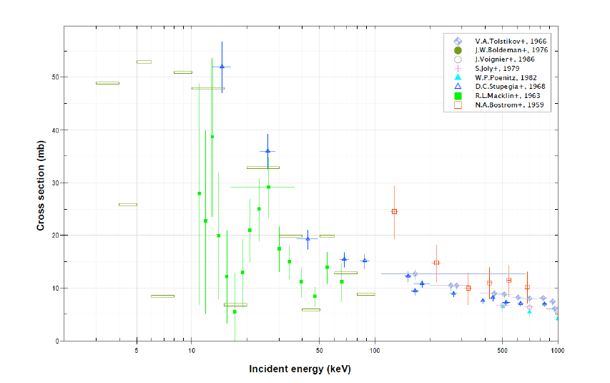
${}_{}^{89}Y$and ${}_{}^{88}{Sr}$ neutron capture measurement
The${}_{}^{88}{Sr}$ and ${}_{}^{89}Y$ abundances in stars easy to derive thanks to a large number of strong lines in spectra.
constrain stellar models and astrophysical scenarios.
${}_{}^{89}Y$ hydride offers advantages as a moderator for high temperature thermal nuclear reactors.
It retains its relatively high content of hydrogen at very high temperatures, between 850 °C to 1150 °C.
Meeting n_TOF Italia, Bari 28-29 November

Slide 4
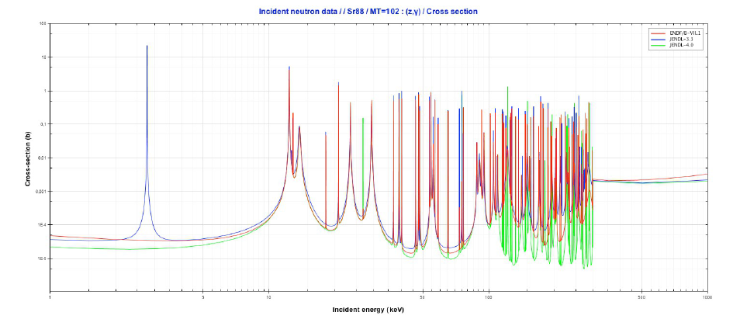
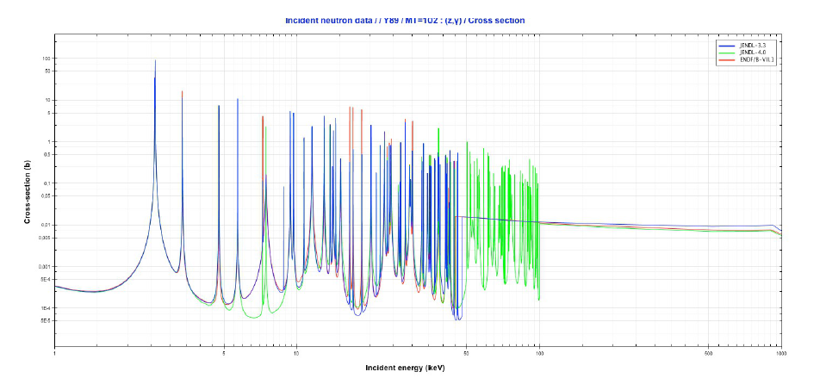
${}_{}^{89}Y$and ${}_{}^{88}{Sr}$ neutron capture measurement
The status of the experimental data is also reflected in the quality of the cross sections in the evaluated data libraries.
${}_{}^{88}{Sr}$(n,γ)
${}_{}^{89}Y$(n,γ)
Meeting n_TOF Italia, Bari 28-29 November

Slide 5
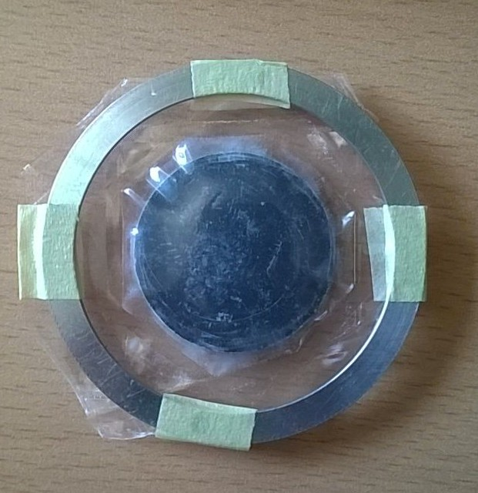
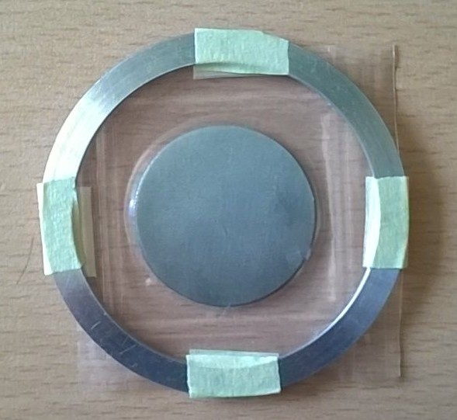
${}_{}^{89}Y$and ${}_{}^{88}{Sr}$ samples
${}_{}^{88}{Sr} is$the most abundant Sr isotope
(82% in the Sun)
${}_{}^{89}Y$ is the only stable isotope of Y
3 cm
3 cm
ISOFLEX
carbonate powder with
an enrichment > 99.9%
Goodfellow
metal disk with a purity of 99,9%
Meeting n_TOF Italia, Bari 28-29 November

Slide 6
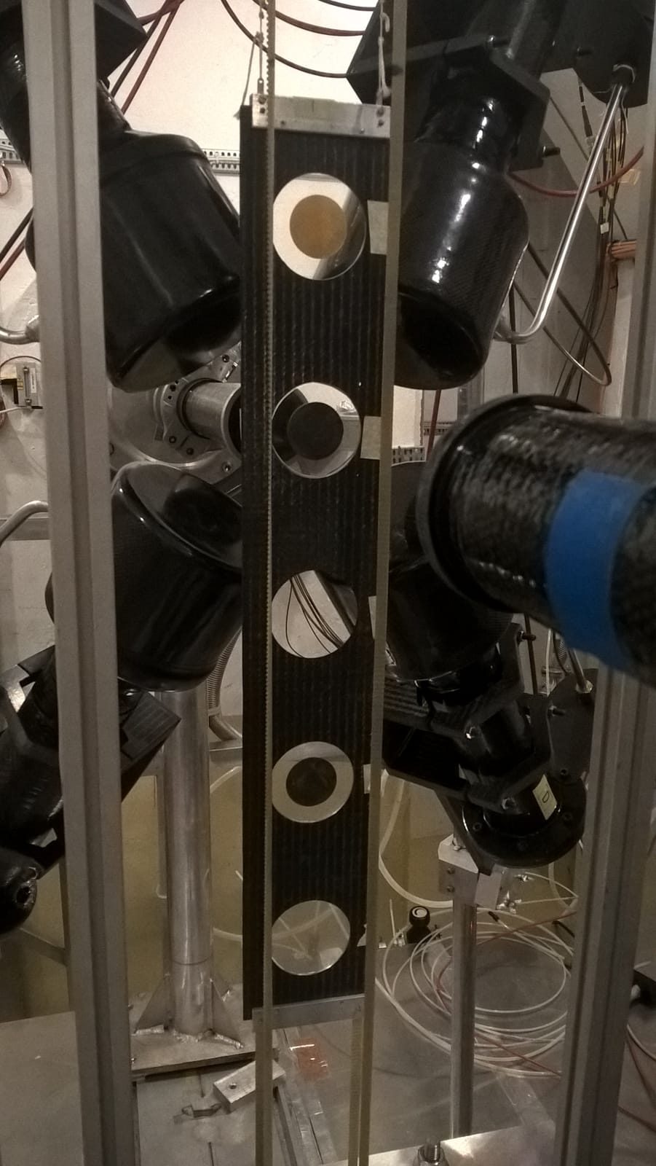
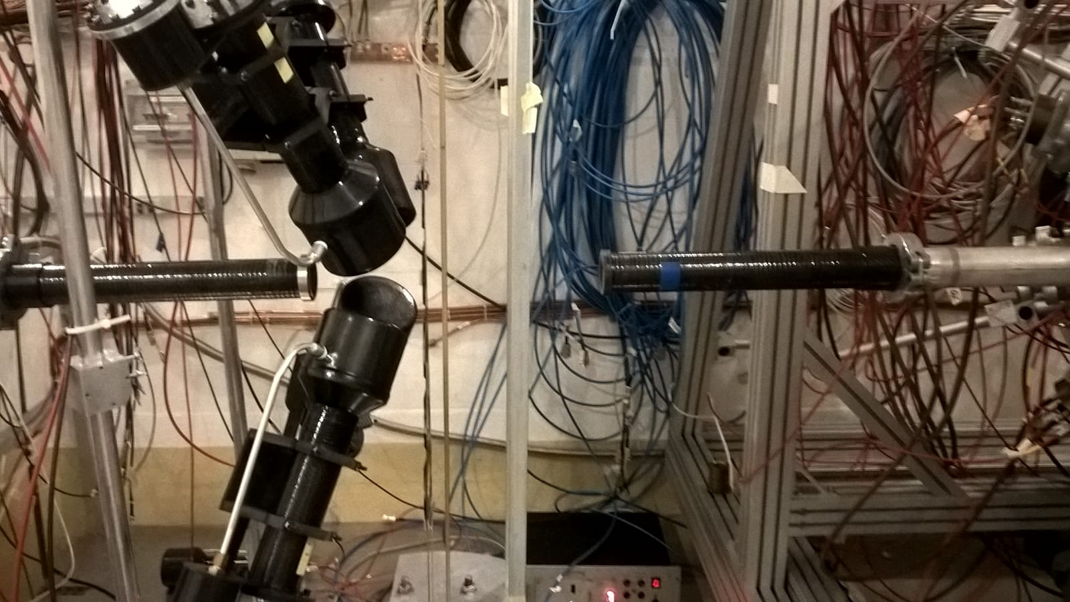
$$Experimental set−up$$
neutrons
SiMon a silicon based neutron beam monitor based on the${}_{}^{6}{Li}$(n,t)α reaction
4 C6D6 Liquid scintillators
Sample Exchanger
Meeting n_TOF Italia, Bari 28-29 November

Slide 7
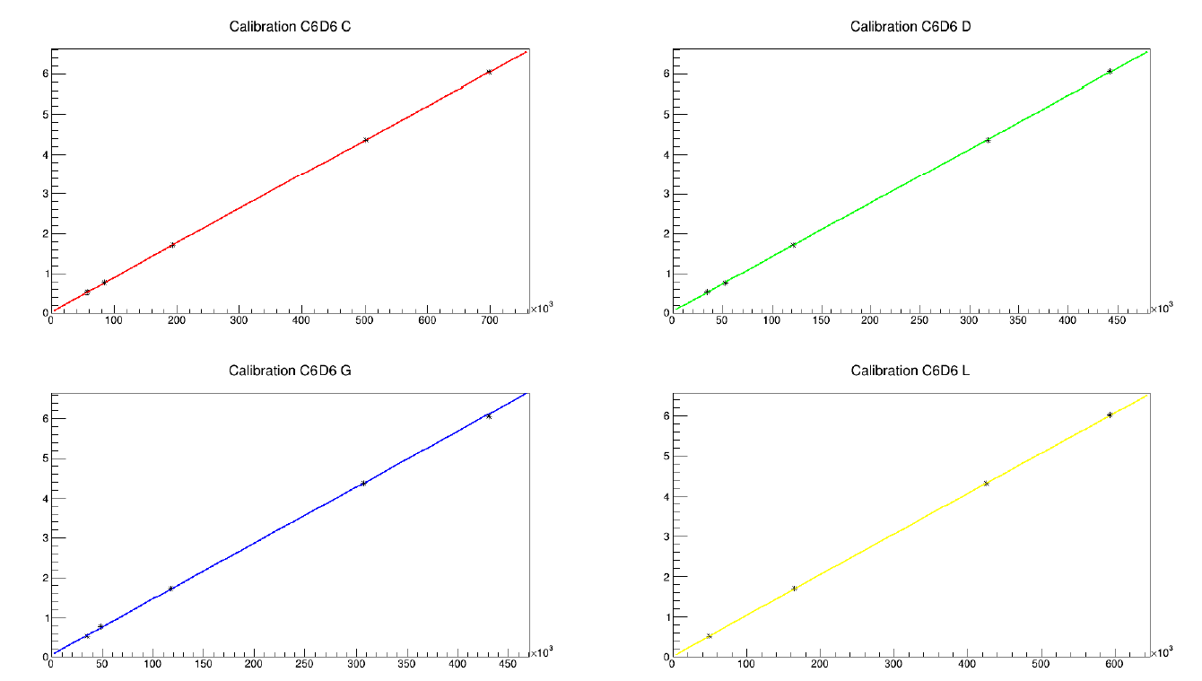
$$\text{E}\text{nergy} \text{calibration} \text{of} \text{the} \text{C}\text{6}\text{D}\text{6 }\text{detectors}$$
Calibration γ-ray sources:${}_{}^{ 137}{Cs},{}_{}^{ 88}Y, AmBe, CmC$
Meeting n_TOF Italia, Bari 28-29 November

Slide 8
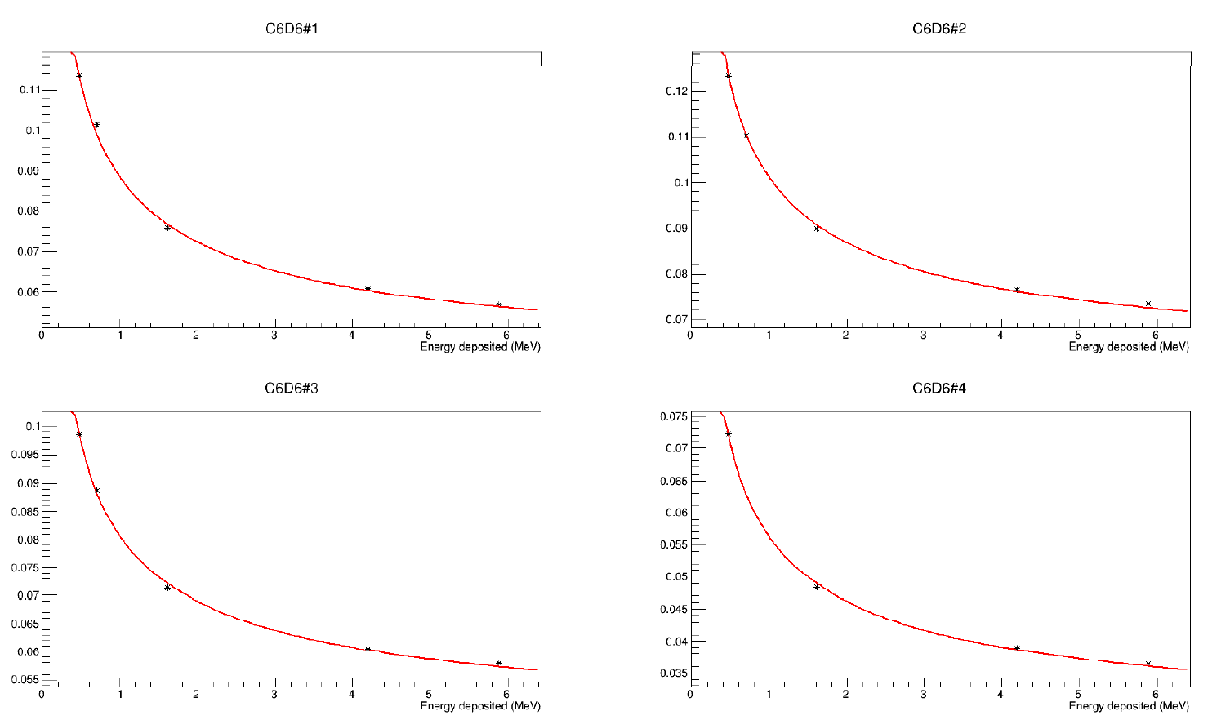
$$\text{P}\text{ulse} \text{height} \text{weighting} \text{technique}$$
The weighting functions ensure that the efficiency εγ of a detector is linear with the Eγ
The weighting function W(E) is determined by minimizing the expression:
R(j;E) is the simulated detector response to a γ ray of energy Eγ convoluted with the Experimental Resolution Functions
Meeting n_TOF Italia, Bari 28-29 November

Slide 9
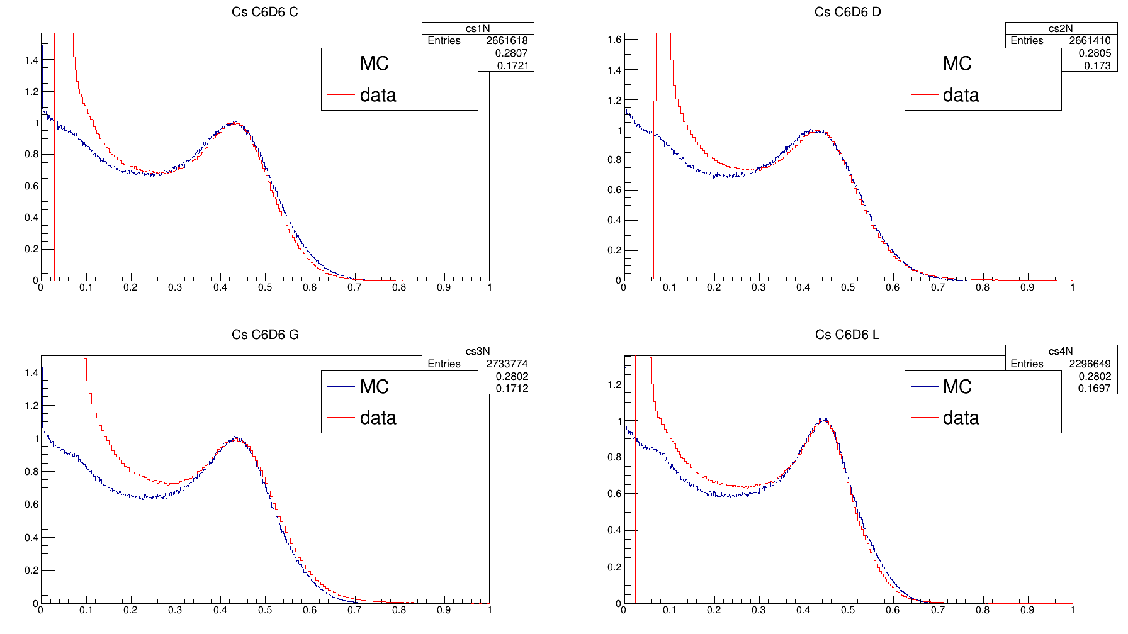
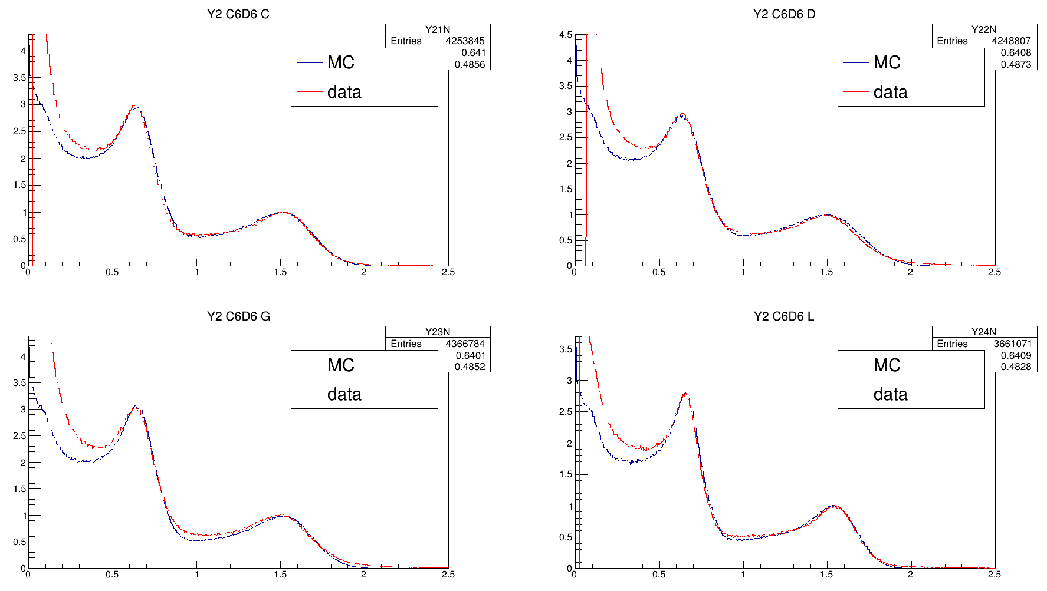
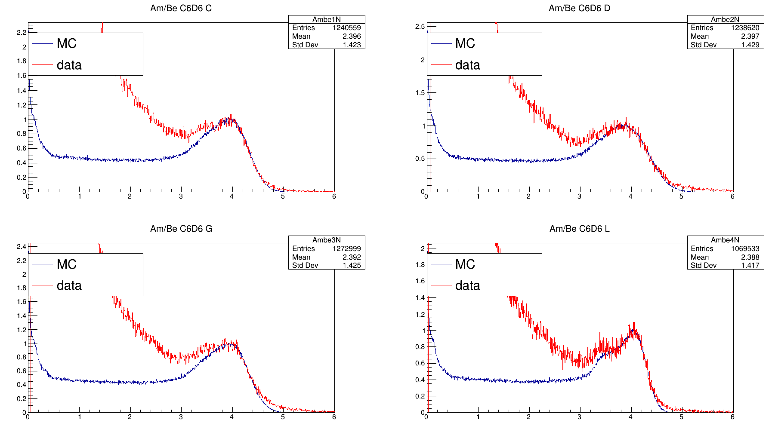
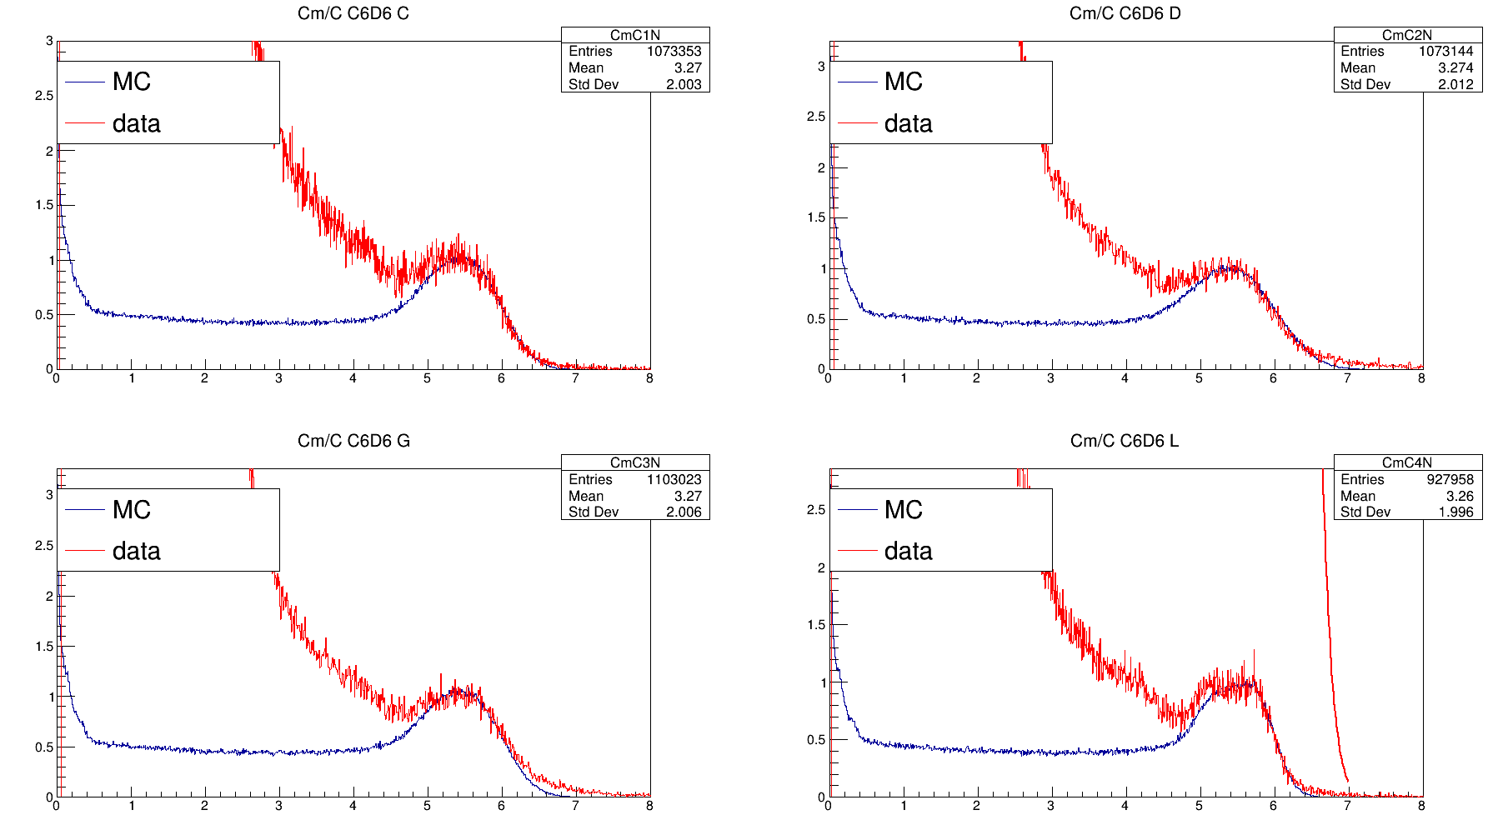
$$\text{P}\text{ulse} \text{height} \text{weighting} \text{technique}$$
Comparison between R(j;E) and the Experimental Detector Response
Meeting n_TOF Italia, Bari 28-29 November

Slide 10
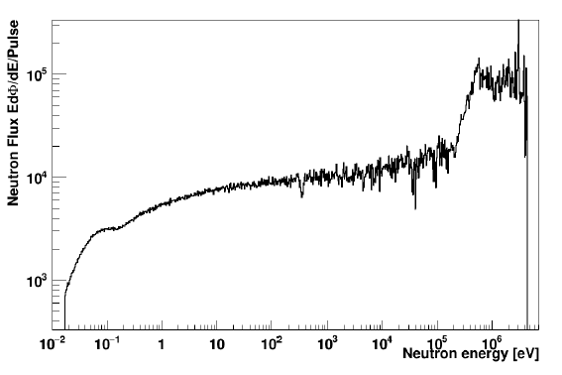
$$Extracted Flux in EAR1$$
Extracted flux that will be used for the determination of the capture yield
Meeting n_TOF Italia, Bari 28-29 November

Slide 11
$$Background$$
Gold
Used for the Yield normalization
Lead
Component, caused by scattered in-beam γ rays
Empty
Background related to the neutron beam
Carbon
Neutron background
Meeting n_TOF Italia, Bari 28-29 November

Slide 12
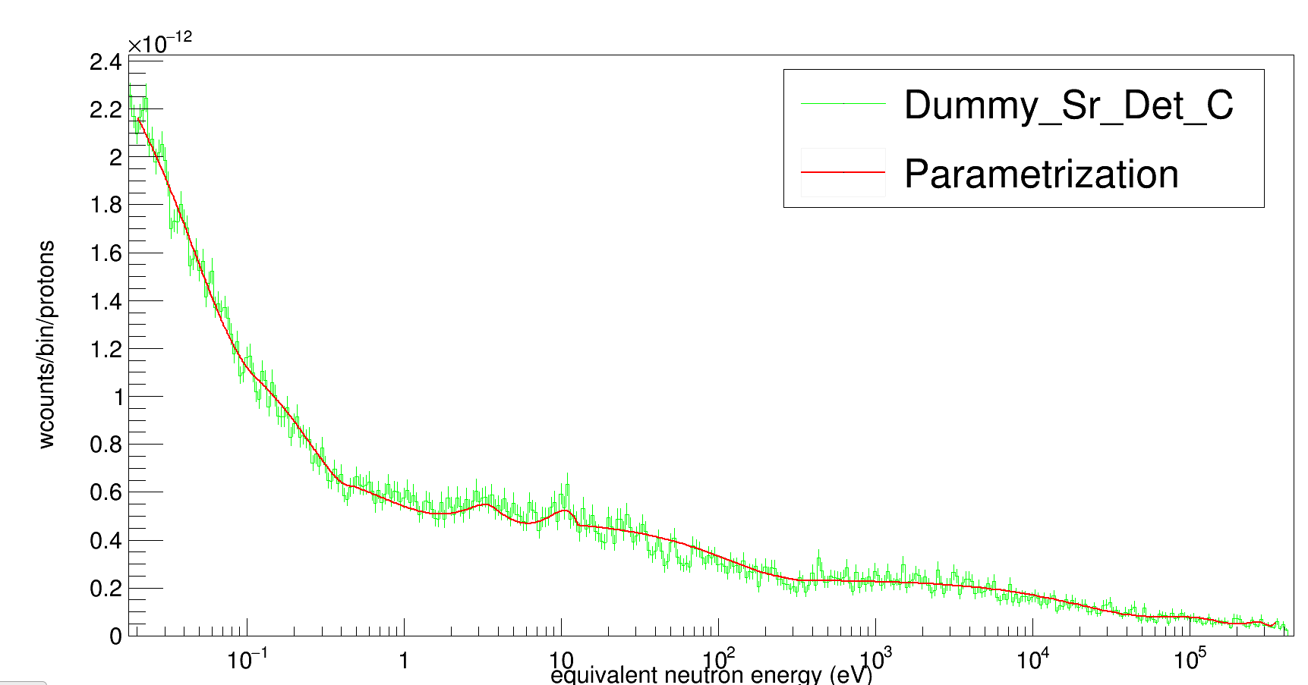
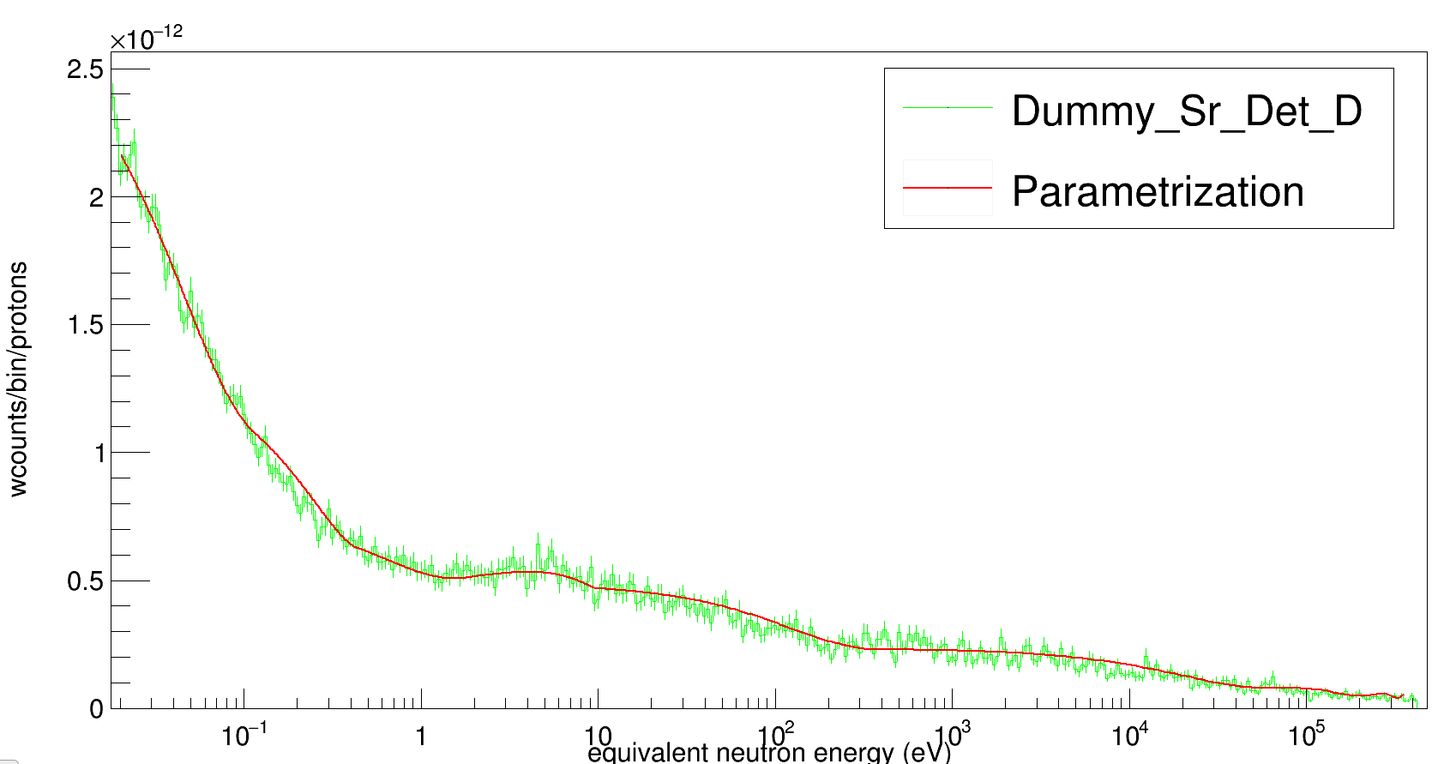
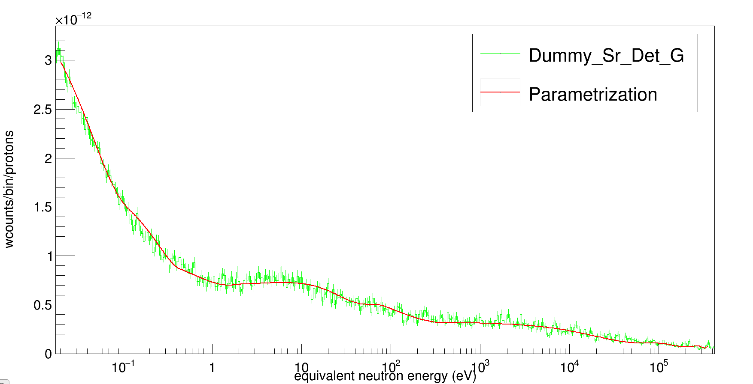
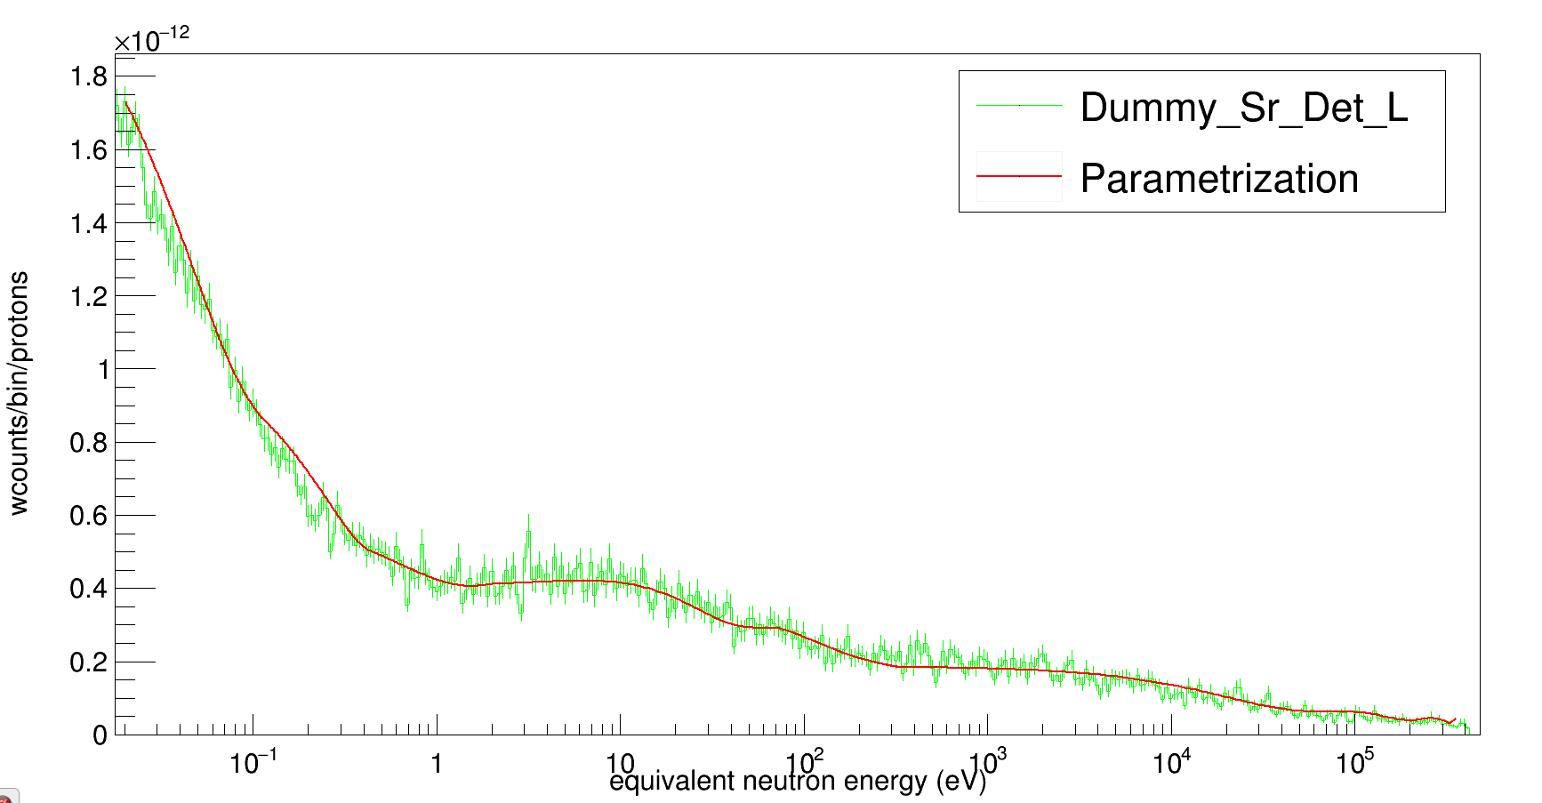
N$eutron Beam Background$ Parametrization
Meeting n_TOF Italia, Bari 28-29 November

Slide 13
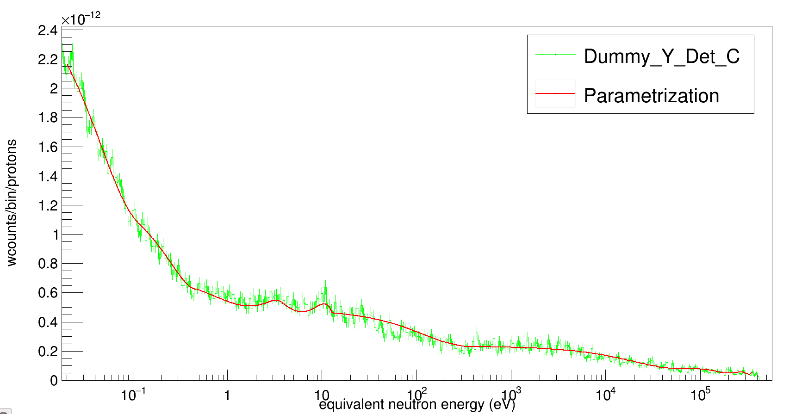
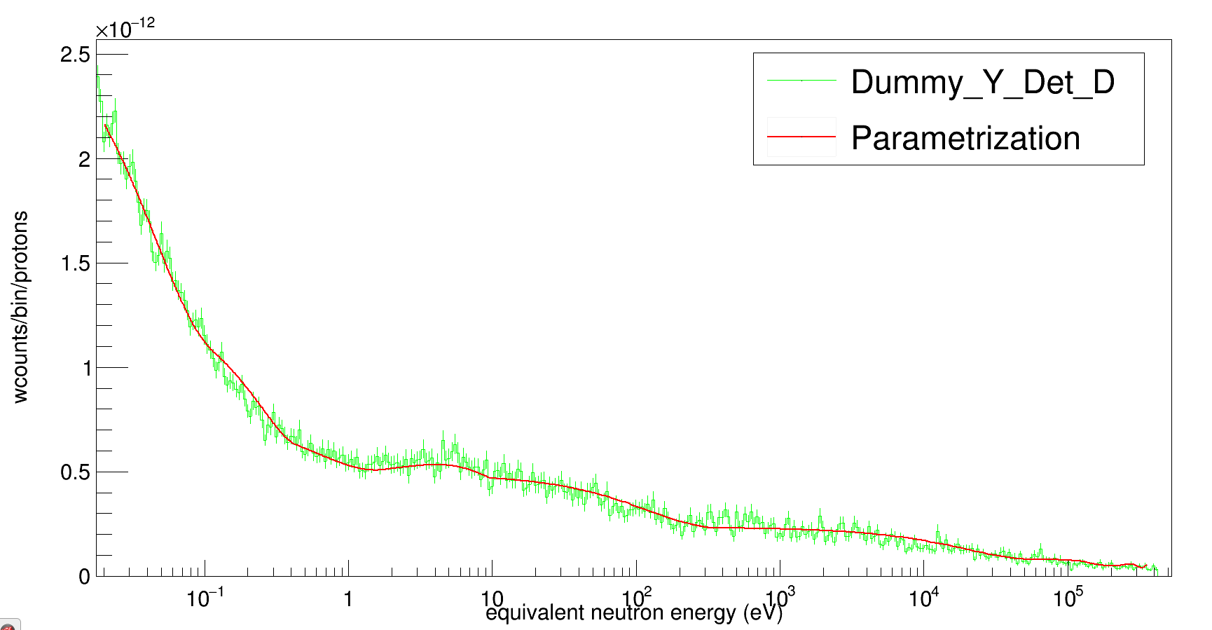
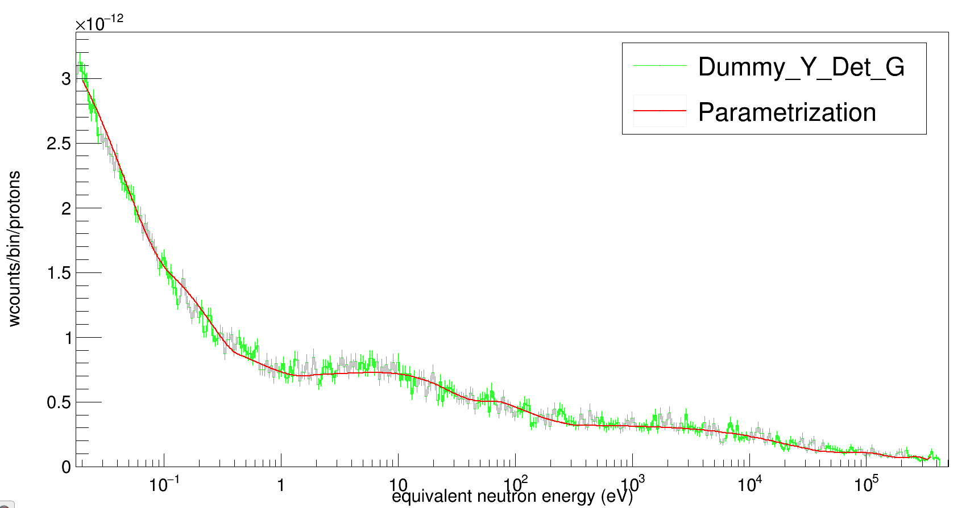
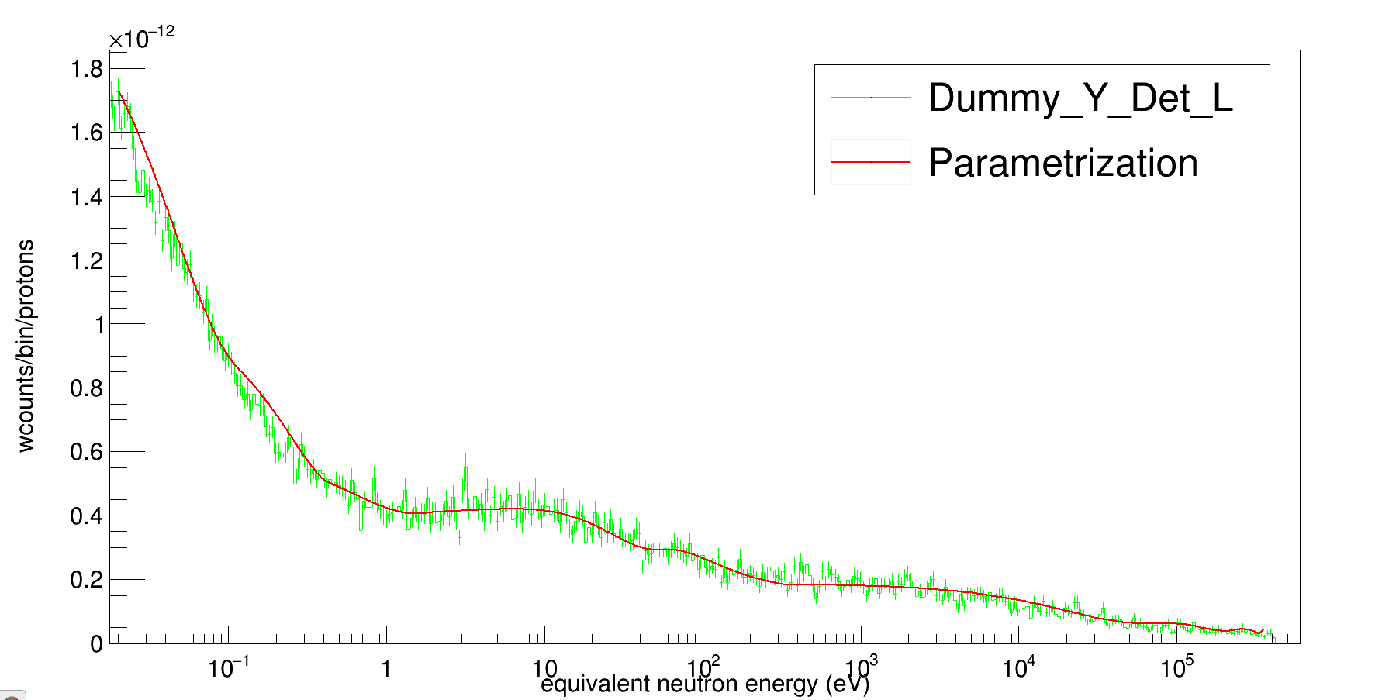
N$eutron Beam Background$ Parametrization
Meeting n_TOF Italia, Bari 28-29 November

Slide 14
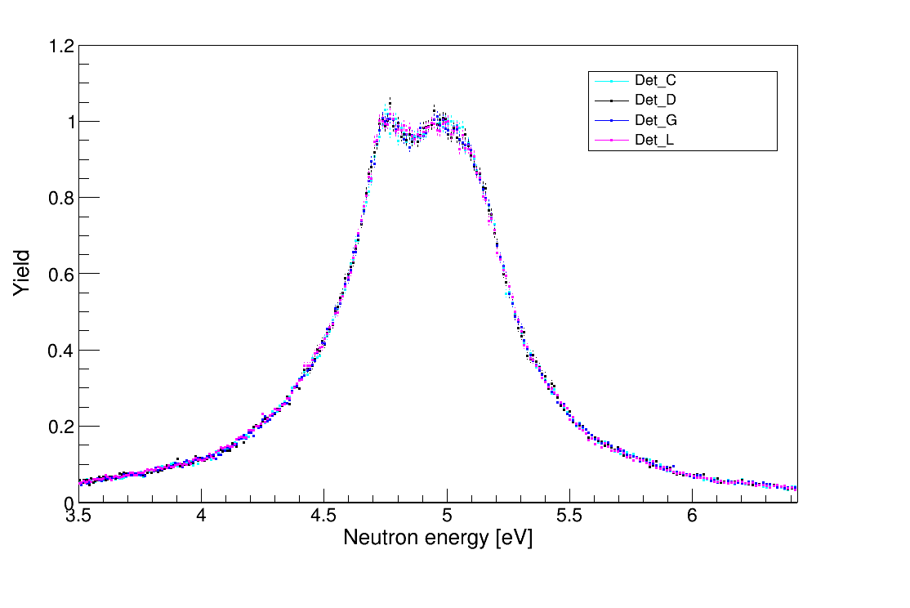
$$Gold peak normalization$$
SAMMY
Meeting n_TOF Italia, Bari 28-29 November

Slide 15
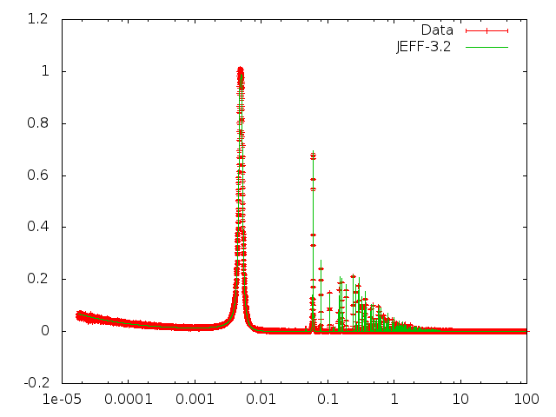
$$Gold Cross Section$$
SAMMY
Meeting n_TOF Italia, Bari 28-29 November

Slide 16
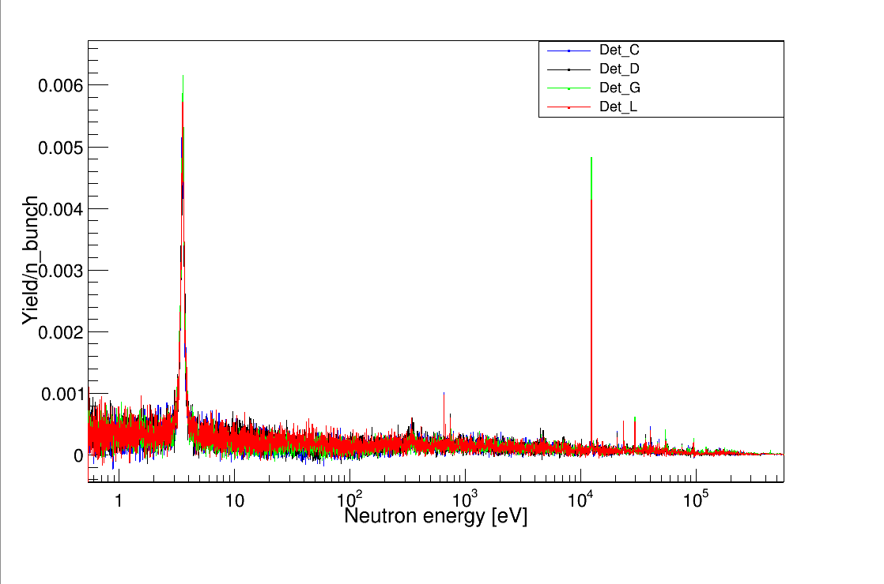
$$Preliminary results for{}_{}^{88}{Sr}$$
Meeting n_TOF Italia, Bari 28-29 November

Slide 17
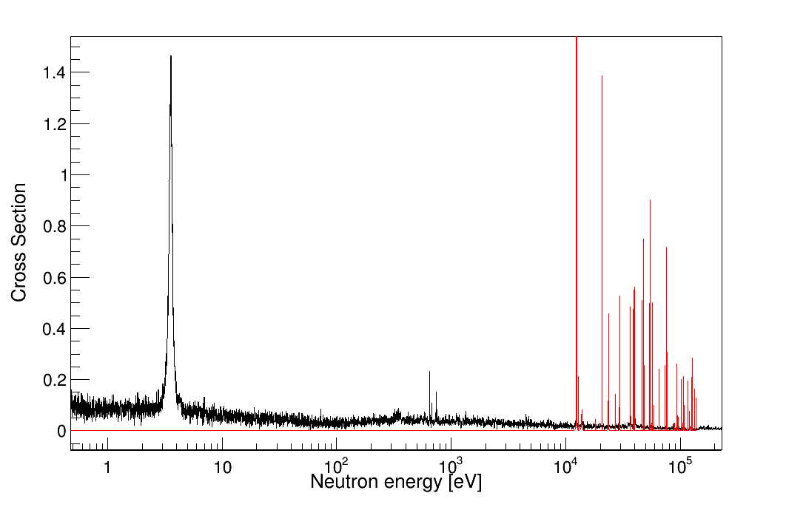
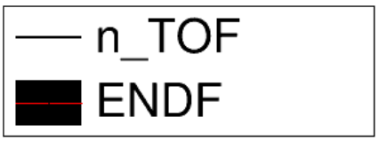
$$Preliminary results for{}_{}^{88}{Sr}$$
Meeting n_TOF Italia, Bari 28-29 November

Slide 18
$$Preliminary results for{}_{}^{88}{Sr}$$
$${}_{}^{87}{Sr}$$
??
Meeting n_TOF Italia, Bari 28-29 November

Slide 19
$$Preliminary results for{}_{}^{88}{Sr}$$
Meeting n_TOF Italia, Bari 28-29 November

Slide 20
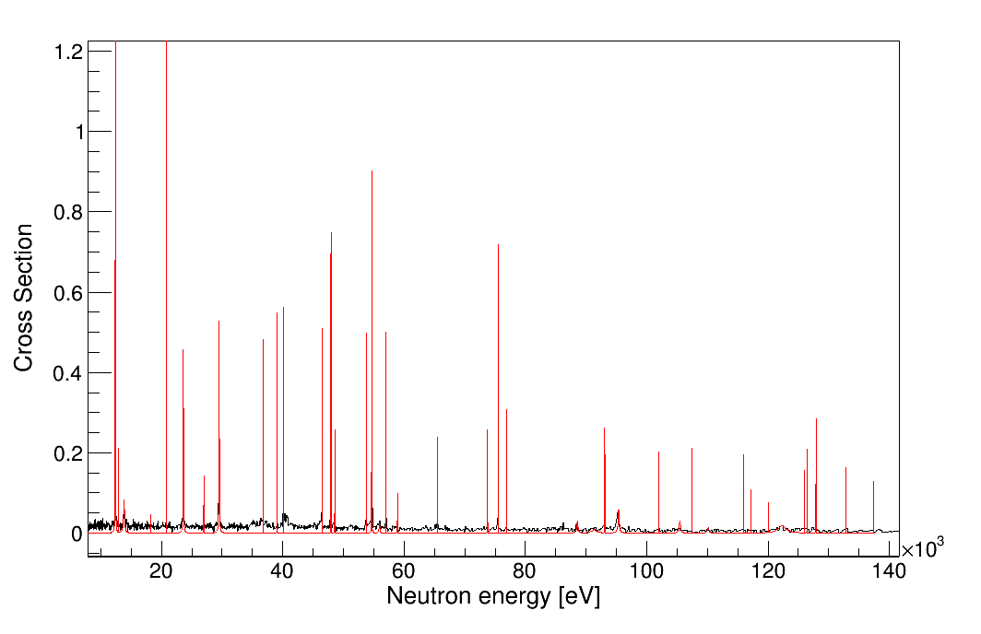
$$Preliminary results for{}_{}^{88}{Sr}$$
Meeting n_TOF Italia, Bari 28-29 November

Slide 21
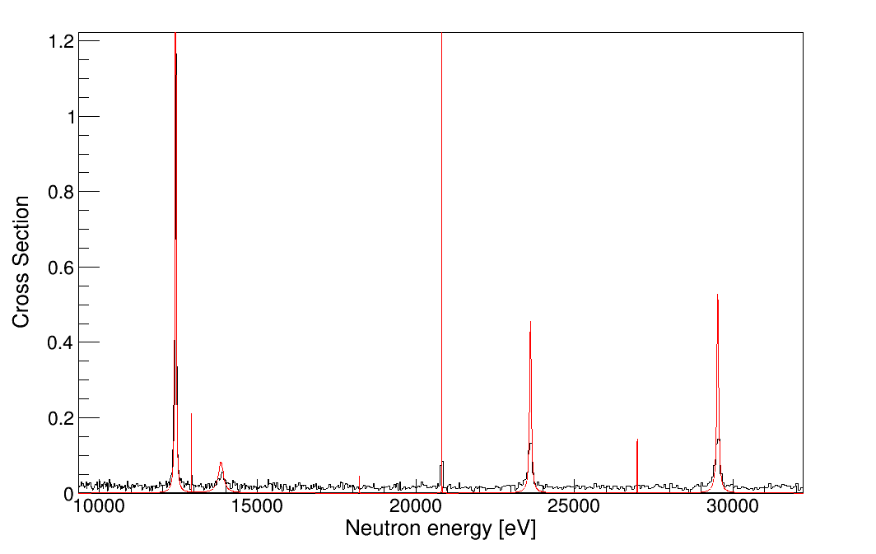
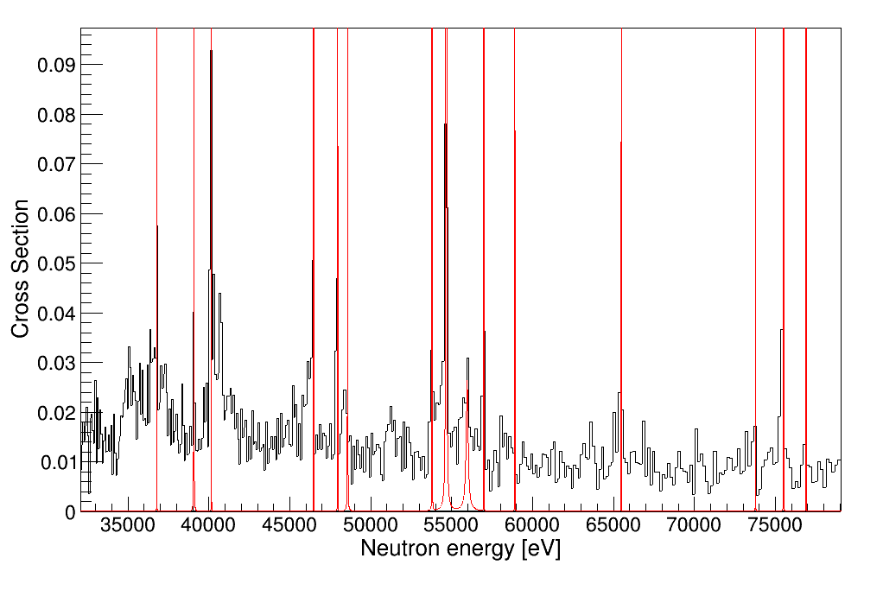
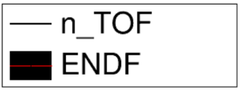
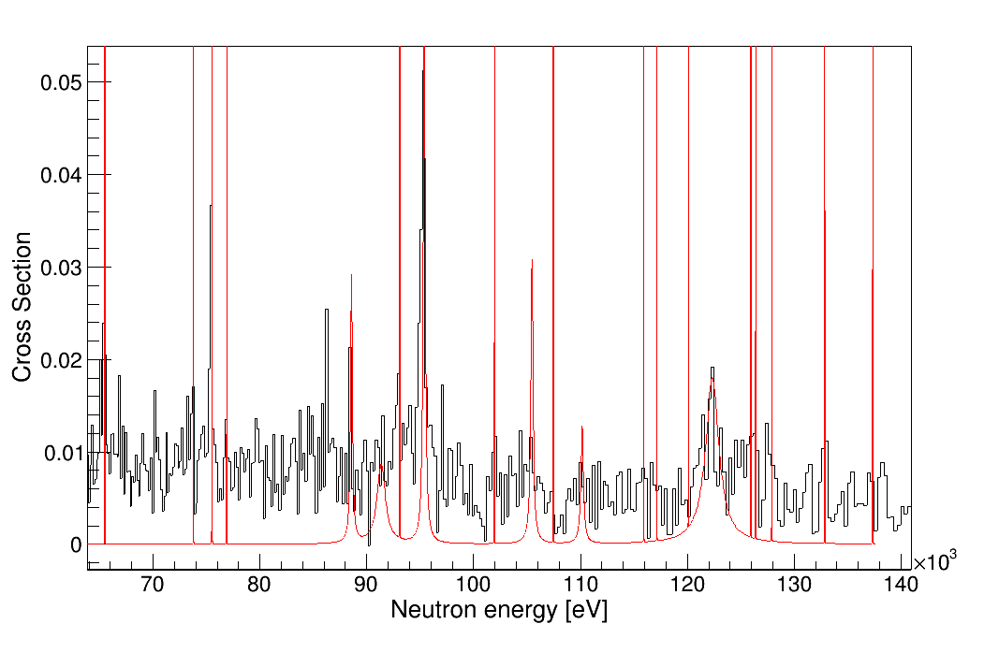
$$Preliminary results for{}_{}^{88}{Sr}$$
Meeting n_TOF Italia, Bari 28-29 November

Slide 22
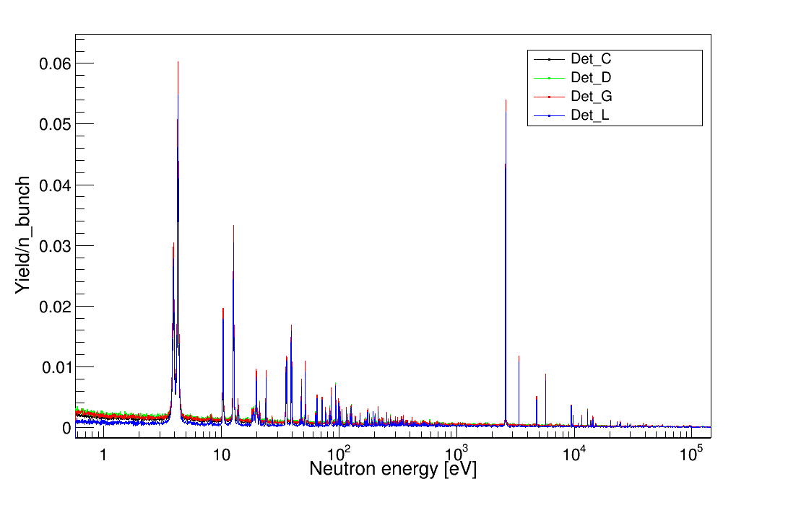
$$Preliminary results for{}_{}^{89}Y$$
Meeting n_TOF Italia, Bari 28-29 November

Slide 23
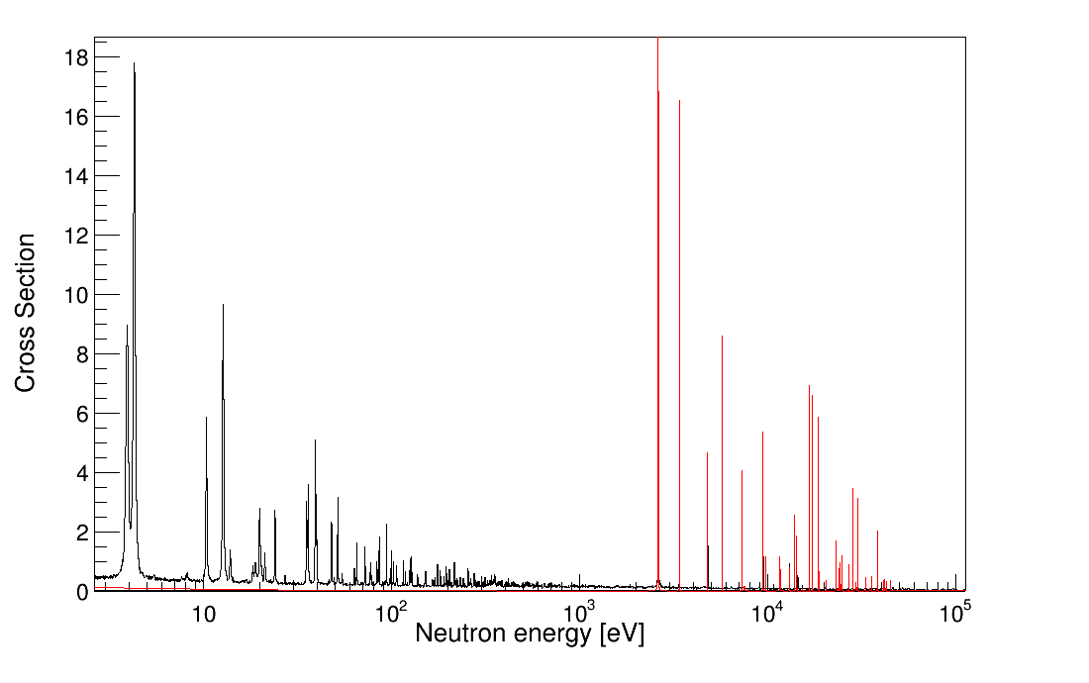
$$Preliminary results for{}_{}^{89}Y$$
Meeting n_TOF Italia, Bari 28-29 November

Slide 24
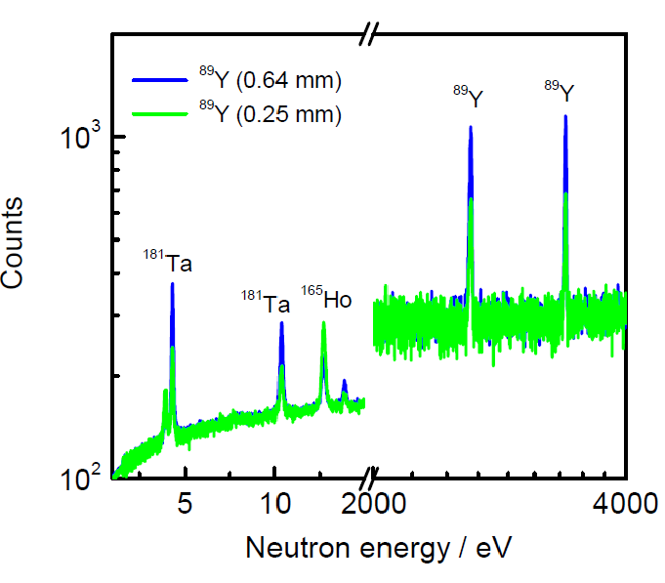
$$Preliminary results for{}_{}^{89}Y$$
Peter Schille beeckx
JRC Geel, SN3S
Meeting n_TOF Italia, Bari 28-29 November

Slide 25
$$Preliminary results for{}_{}^{89}Y$$
Meeting n_TOF Italia, Bari 28-29 November

Slide 26
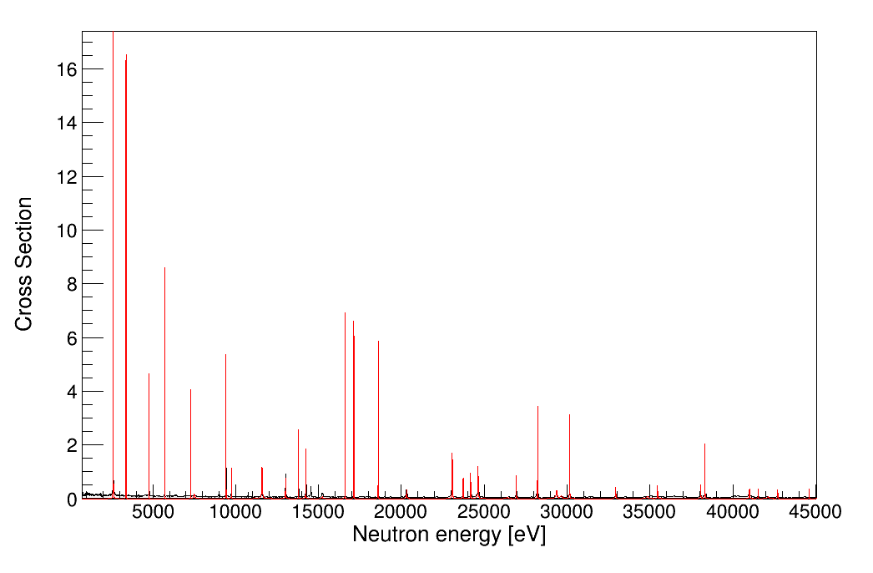
$$Preliminary results for{}_{}^{89}Y$$
Meeting n_TOF Italia, Bari 28-29 November

Slide 27
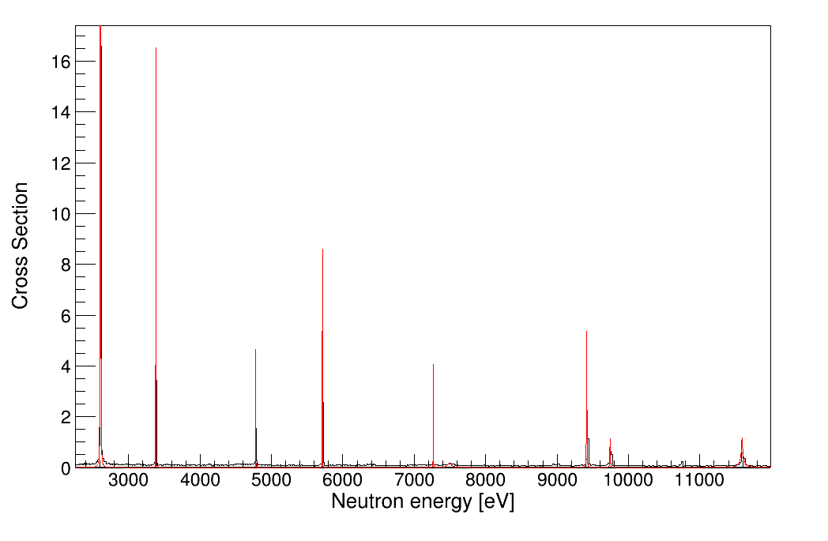
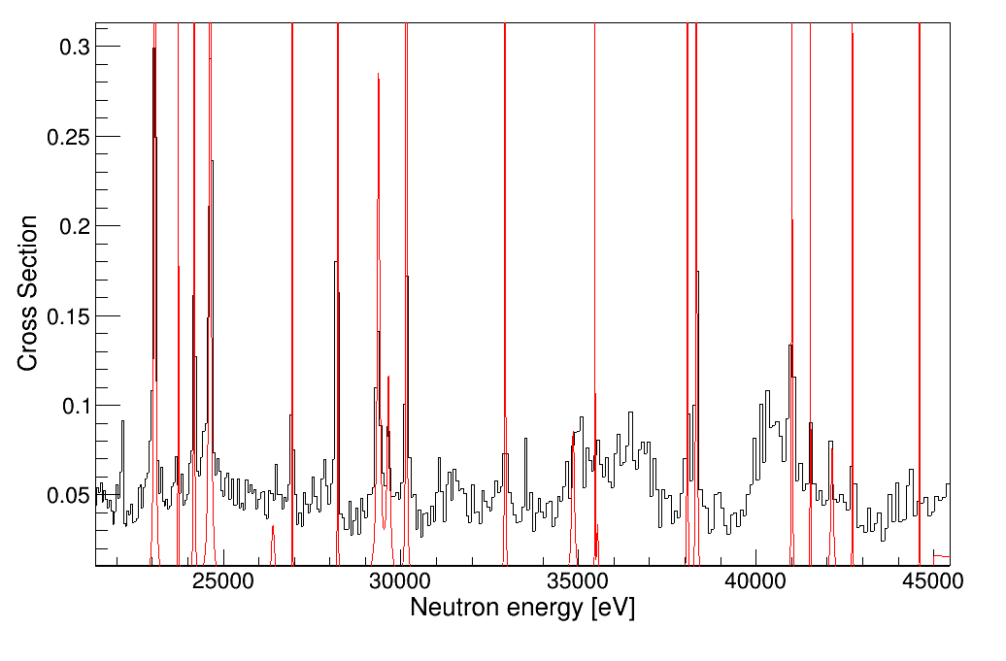
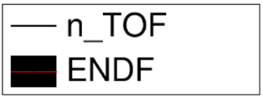
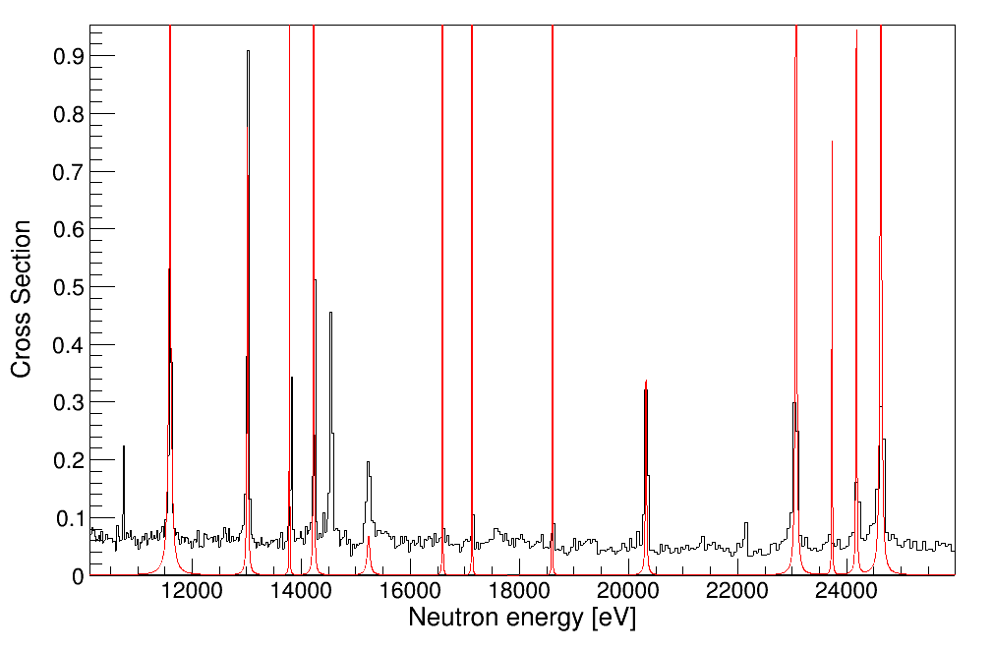
$$Preliminary results for{}_{}^{89}Y$$
Meeting n_TOF Italia, Bari 28-29 November

Slide 28
$$Conclusion$$
The measure has been successfully completed: the C6D6 worked, and even if we had some problems with Sr oxidation, we managed to collect the full statistic expected.
The analysis is well on the way, the yields are practically ready, and show differences from what was expected by the libraries
Next step, resonance analysis with SAMMY
We plan to complete the analysis in mid 2018
Meeting n_TOF Italia, Bari 28-29 November

Slide 29
THANK YOU FOR YOUR KIND ATTENTION!
Meeting n_TOF Italia, Bari 28-29 November

