Slide 1
Beam-off and in beam L6D6 gain shift
M. Mastromarco, P. Mastinu, P. Milazzo, F. Mingrone, L. Tassan-Got

Slide 2
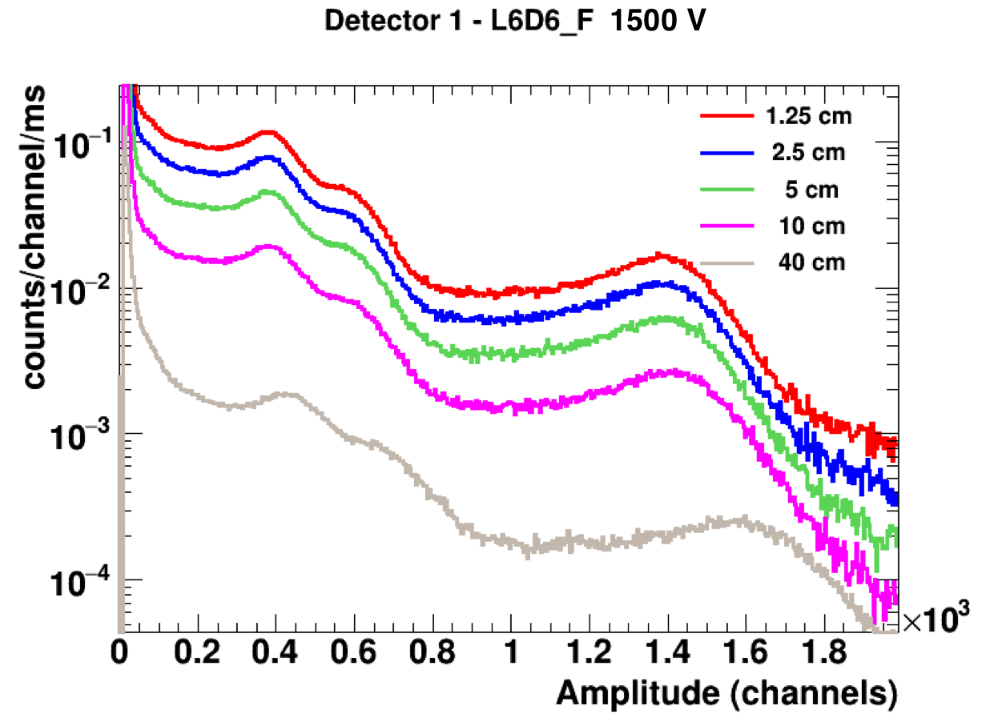
First hint of a gain shift
L6D6_F @ 1300 V, ⁸⁸Y + ¹³⁷Cs
L6D6_F @ 1500 V, ⁸⁸Y + ¹³⁷Cs
From closer at 1.25 cm (≈ 20 kHz) to farther at 70 cm (≈ 200 Hz): Δg ≈ 12 %
Notes:
Following a preliminary tests for the Cm measurement done at the end of January 2017 in EAR2, an anomalous behaviour was observed in the L6D6 detectors. A gain shift is present when the count rate changes as shown here. This change in the gain is also present at higher high voltage .

Slide 3
Testing the old L6D6s
Apart the L6D6_L the old detectors do not present any significant shift in the gain.
Notes:
For this reason, a campaign of measurement has been launched to investigate the problem. As a first check, we made the same type of measurements with detectors A, B, D and L, the ones used in EAR1 for the 2016 capture campaigns. As can be seen the gain of the A, B and D detectors appears to either not or slightly suffer from the rate effect. The gain of detector L, on the contrary, is affected by the increasing of the counting rate.

Slide 4
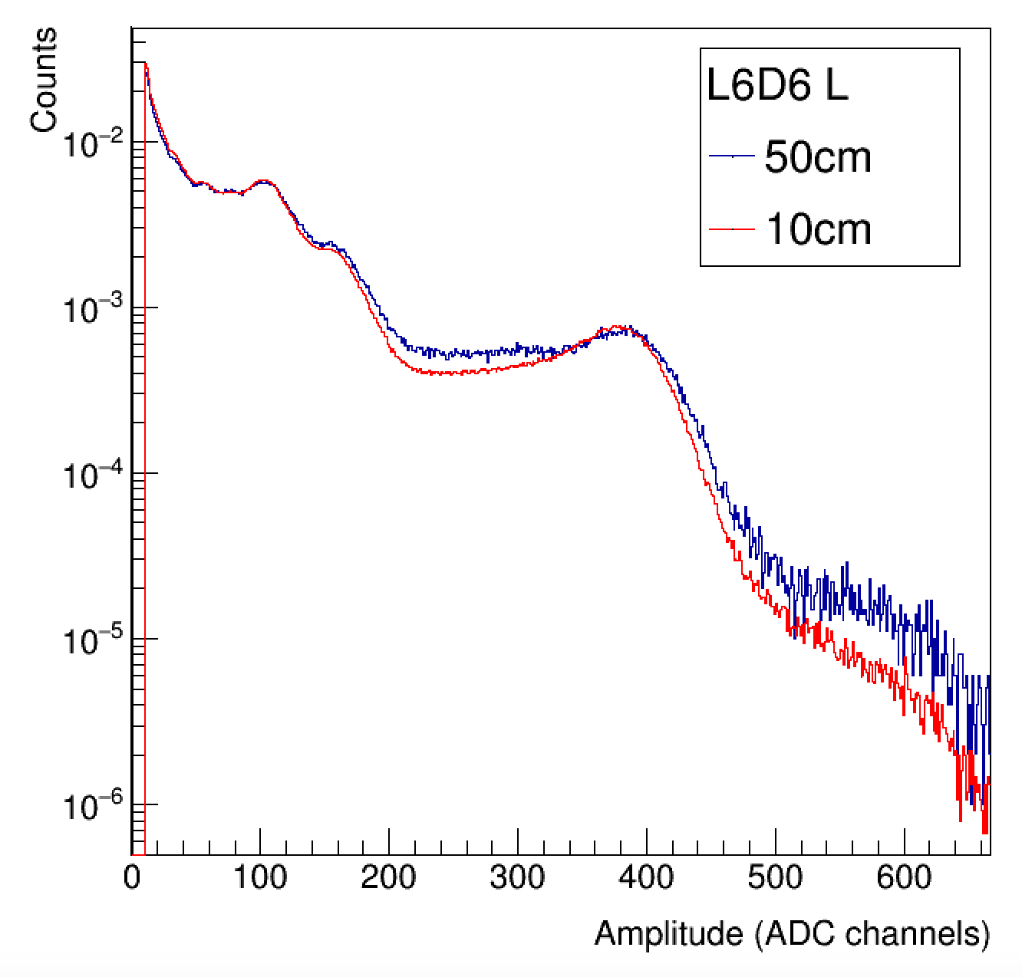
Swapping PMT+V.D. of A and L

Slide 5
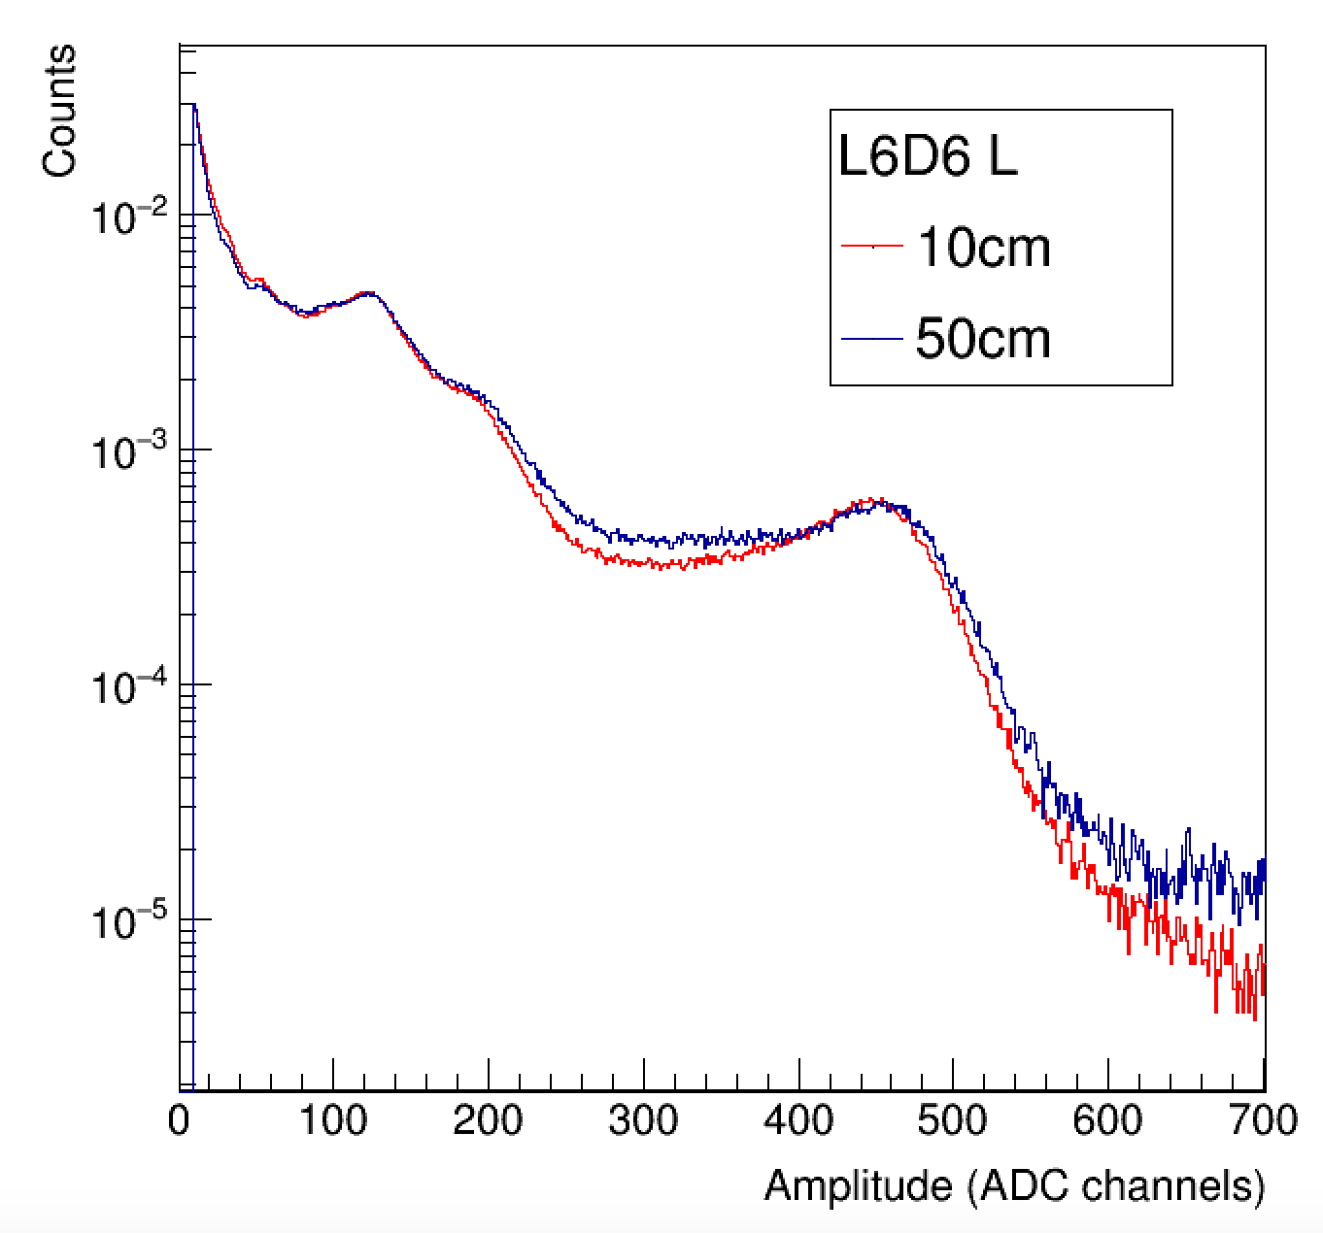
Swapping back the V.D. of A and L
Notes:
Also swapping again the V.D. between the two detectors the problem is still present in L6D6_A. You can conclude that the main responsible of this effect is the PMT.

Slide 6
Rate Effect
Il problema visto con la sorgente potrebbe essere dovuto alla resistività del catodo e quindi alla sua costante di tempo di ricarica. Questo lo dovremmo ridurre con il catodo a SbCs
In pulsed applications there is a hysteresis effect in the PMT which produces a change in the pulse height with the count rate;
It is not directly related to the count rate;
It depends on the mean anodic current which in turn itself a function of the count rate [1].
[1] https://my.et-enterprises.com/pdf/Understanding%20Pmts.pdf

Slide 7
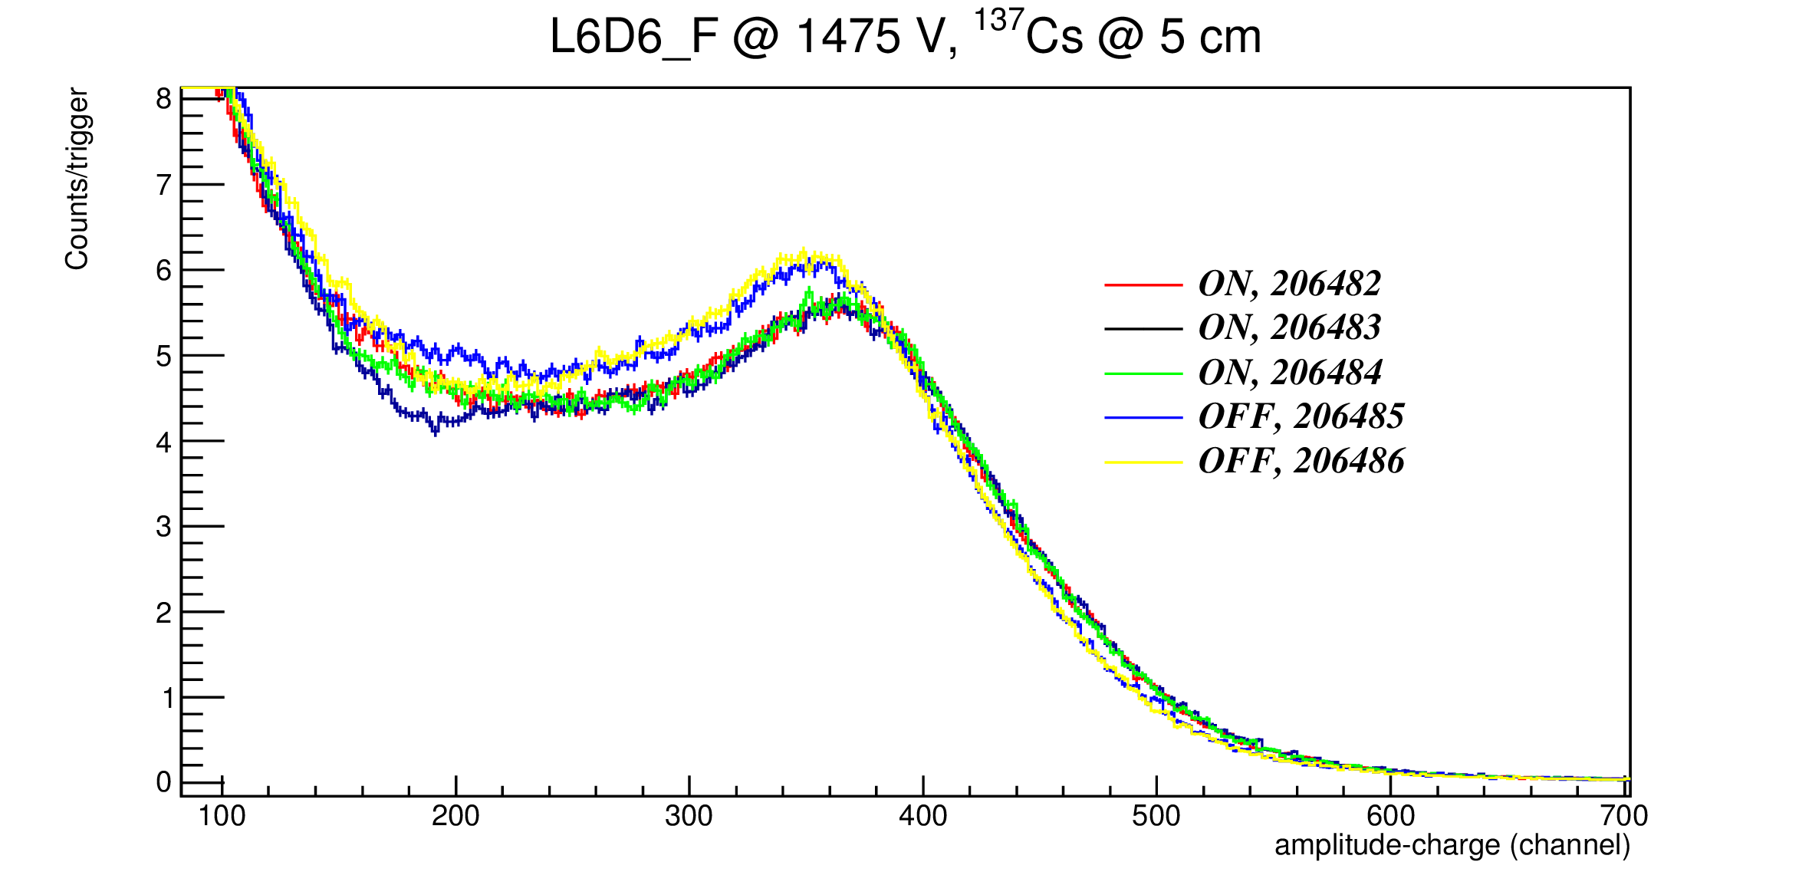
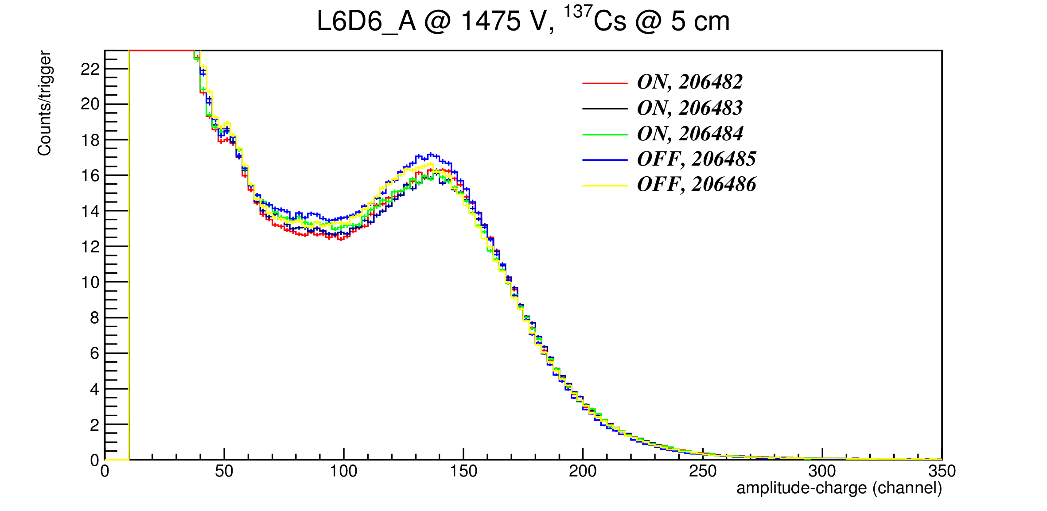
Test: LIGHT switched ON/OFF
Δg ~ 1 %
Δg ~ 8 %
Notes:
In order to verify this, several test have been performed by switching ON and OFF the light in the experimental area 2. The result are here shown. There is a systematic effect when light is ON…. From now on all the test and measurements have been performed with light switched OFF.

Slide 8
Once upon a time…
Late January: test for the Cm-measurement experimental setup -> first indication of a gain shift;
February and March: investigation on the cause of the shift and all possible influences;
Several test have been performed to find the cause of this shift; among the main candidate: the light shielding and the rate effect;
Try to find a possible solution to the rate effect: “ageing”.

Slide 9
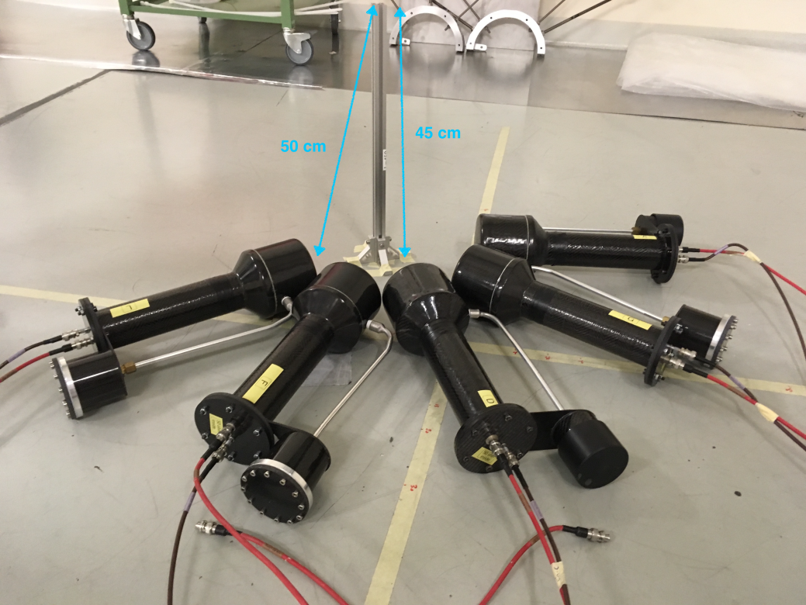
Experimental setup

Slide 10
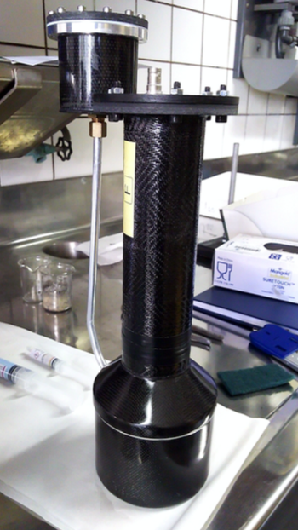

Slide 11
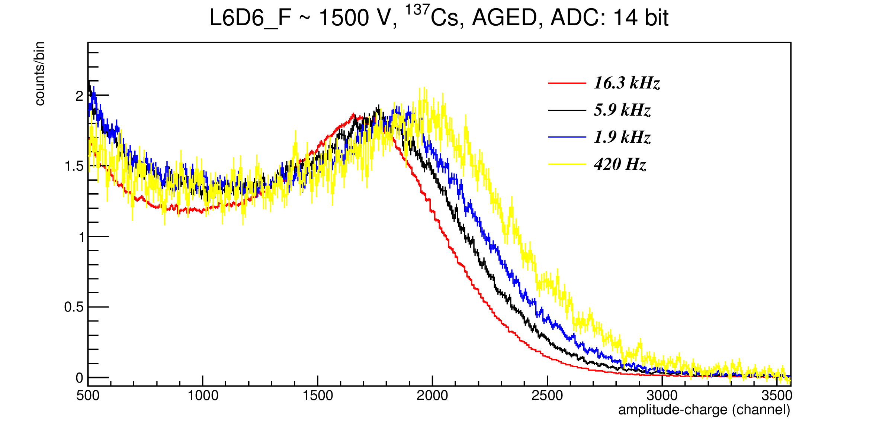
Ampl. spectra: before/after ageing

Slide 12
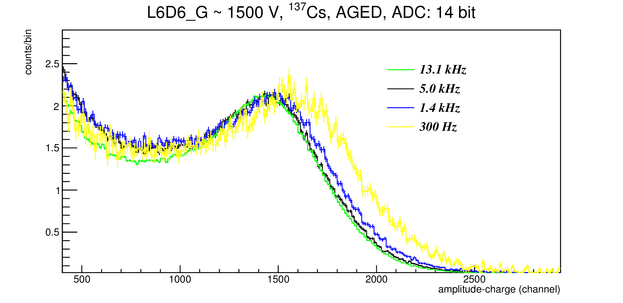
Ampl. spectra: before/after ageing

Slide 13
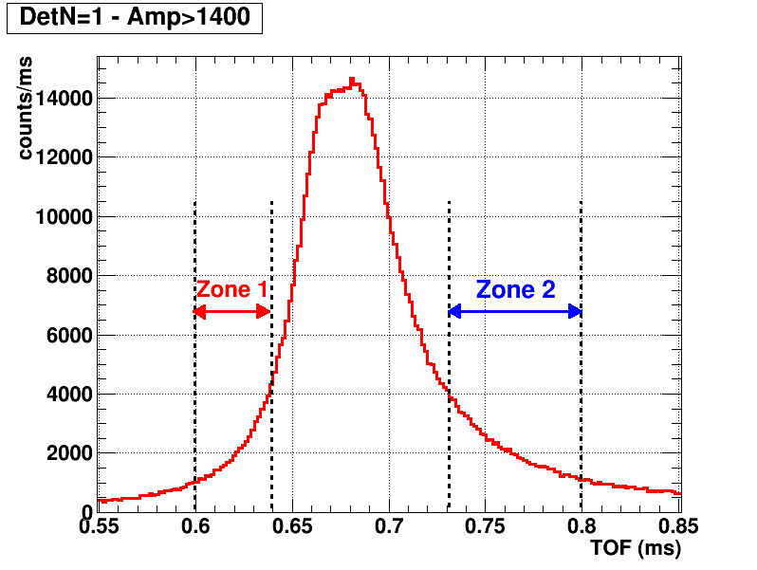
Area 2, in beam test: Second week of May measurements
In the measurements performed in May we placed three LNL detectors (A, G and L) and the four BICRON detectors closer and farther from a gold sample in order to obtain different counting rates. Then, we looked to the amplitude spectra at both sides of the saturated resonance (the time-of-flight intervals were chosen to have similar counting rates) and at the thermal region.
Notes:
Termico 4 -8 ms
Cascadas mismas resoncia
Mismo rango de cuentas no deberia d haber pile up y si lo hay lo hay en los dos
En el termico las tasas son 10 veces menores

Slide 14
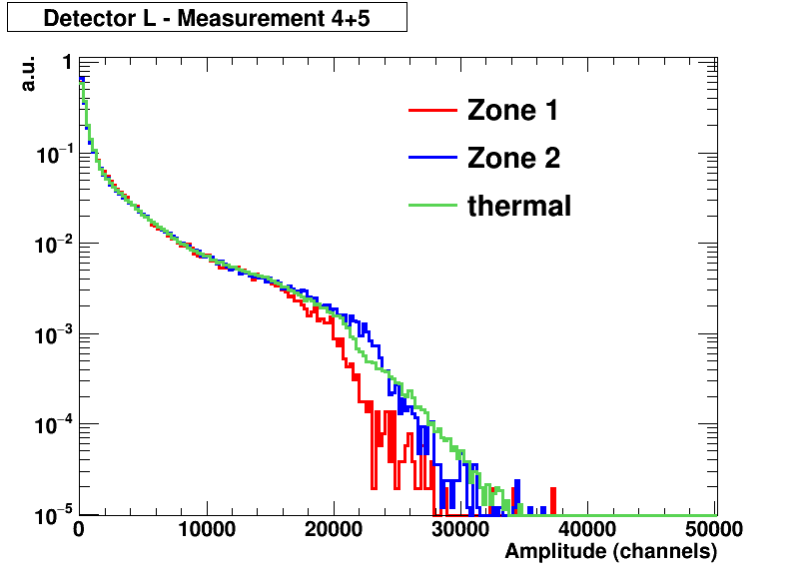
6- Second week of May measurements
3100 counts/ms in the plateau of the saturated resonance
background
Amplitude spectra normalized to the same area

Slide 15
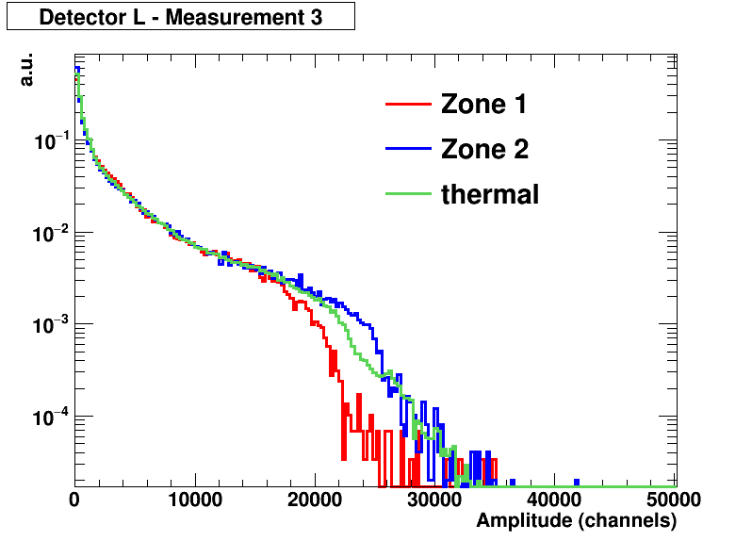
6- Second week of May measurements
5000 counts/ms in the plateau of the saturated resonance
background
Amplitude spectra normalized to the same area
Notes:
Falta valore sShift pero imagino que sera un un 10%

Slide 16
Gain shift in beam
Problema: l’aumento di guadagno sotto fascio può essere spiegato con la caduta sul partitore e potrebbe essere risolto con il partitore attivo

Slide 17
Bump signal
Light collection or impedance adaptation ??

Slide 18
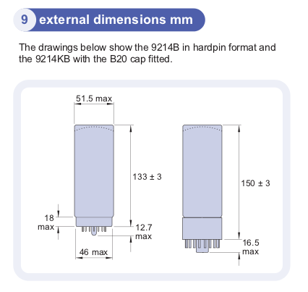
New PMT and Voltage divider by ET
PMT: 9214 QSB with SbCs dynodes to minimise rate effect;
VD: E238 ASN2 active voltage divider

Slide 19
Test
Black box for the beam-off tests with a laser source
Test con sorgente
At the 10 m beam line at GEEL ? (necessario per tests sotto fascio. Linea a 10 m ?)

