Slide 1
Capture cross-section of ^{92,93}Zr

Slide 2
Scientific Motivations
Tecnologie Nucleari
Astrofisica Nucleare

Slide 3
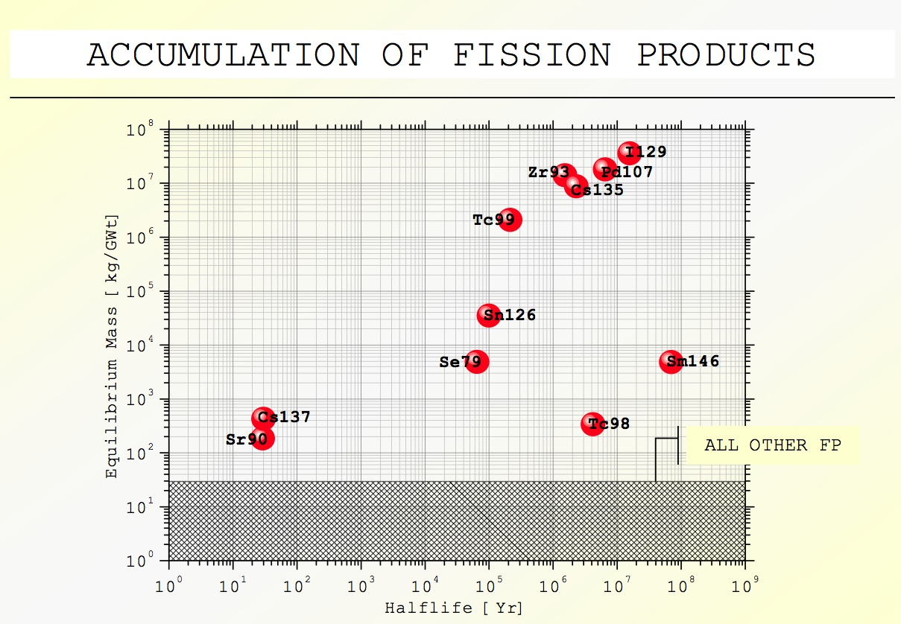
Nuclear Technology
PWR 33GWtd THM⁻¹ burnup
3 yr cooling spent fuel

Slide 4
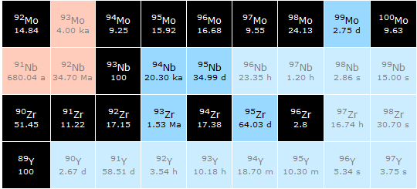

Slide 5
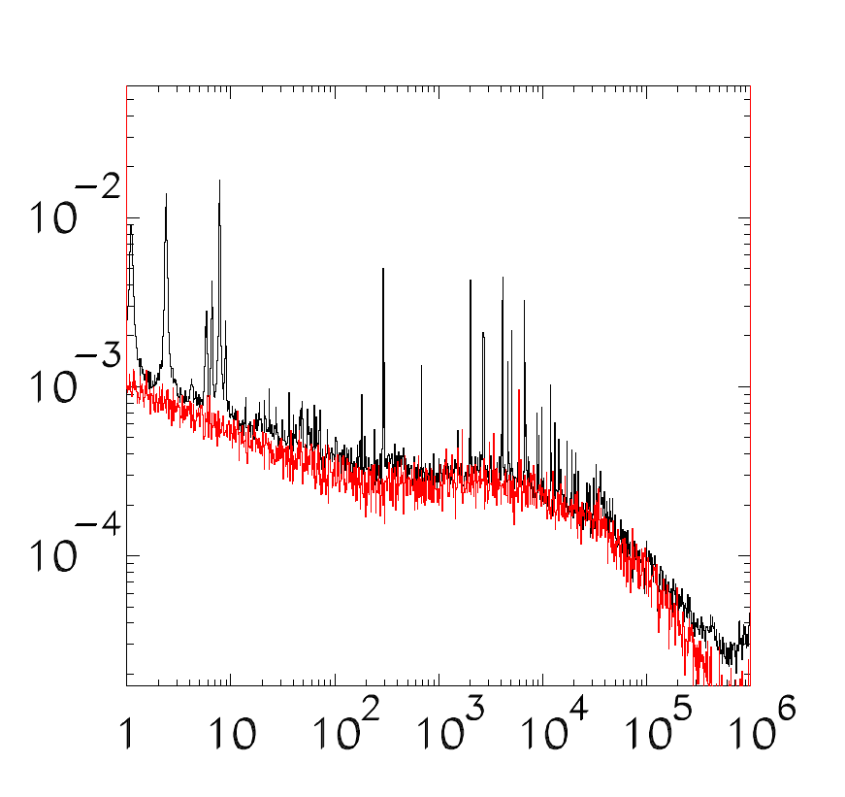
MACS: Experimental energy ranges
MaxwellianAveraged Cross Sections(MACS)
⁹²Zr
 | Energy range (keV) n_TOF
⁹⁰Zr | 0.01 - 66
⁹¹Zr | 0.01 - 26
⁹²Zr | 0.01 – 40
⁹³Zr | 0.01 – 7
⁹⁴Zr | 0.01 – 74
⁹⁶Zr | 0.01 – 42
Yield
E_{n}(eV)
⁹³Zr
The n_TOF data have to be
complemented with a data library
Jendl 3.3 and ENDF IV
Yield
E_{n}(eV)

Slide 6
Implicazioni Astrofisiche
Nucleus | N_{ʘ} Normalized to N(Si)=10⁶ atoms | N_{s}/ N_{ʘ} % Old MACS | N_{s}/ N_{ʘ} % n_TOF MACS
⁹⁰Zr | 5.546 | 0.789 | 0.844
⁹¹Zr | 1.21 | 1.066 | 1.024
⁹²Zr | 1.848 | 1.052 | 0.981
⁹⁴Zr | 1.873 | 1.217 | 1.152
⁹⁶Zr | 0.302 | 0.842 | 0.321
Abbondanze solari, N, Lodders 2009, accuracy 10%
Le abbondanze-s, N_{s}, sono calcolate usando un modello TP per stelle AGB di masse fra 1.5 e 3 M, accuratezza 8%.
Le vecchie MACS sono prese dalle libreria KADoNiS.

Slide 7
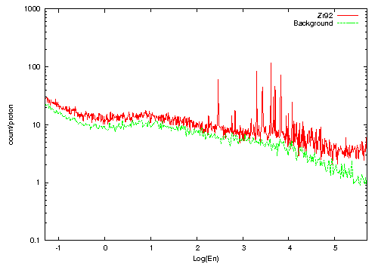
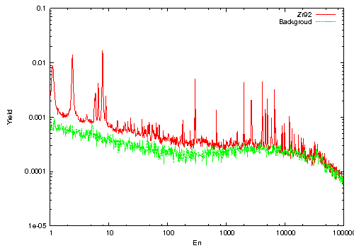
⁹²Zr n_TOF
n_TOF phase II (2012)
n_TOF phase I (2002)

Slide 8
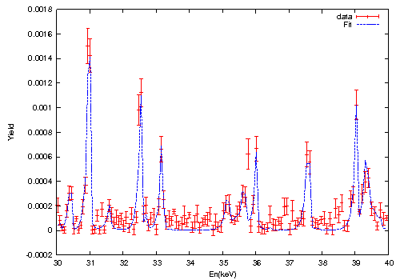
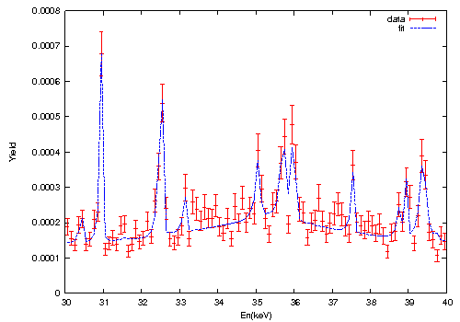
Preliminary data ⁹²Zr
n_TOF phase II (2012)
n_TOF phase I (2002)

Slide 9
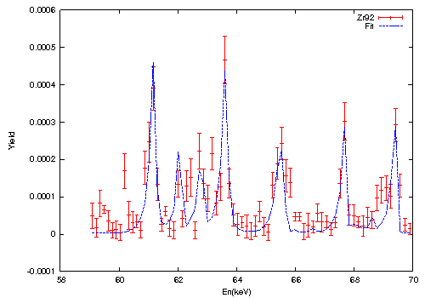
Preliminary data ⁹²Zr
n_TOF phase II (2012)

Slide 10
⁹²Zr @ GELINA
Measured 2013
Capture: 2 (same used at n_TOF), 5, 10g
Transmission: 2, 10, 17 g

Slide 11
⁹²Zr GELINA Transmission

Slide 12
⁹²Zr GELINA Transmission
Transmission

Slide 13
⁹²Zr Transmission

Slide 14
⁹²Zr Transmission

Slide 15
Capture: GELINA vs n_TOF

Slide 16
Capture: GELINA vs n_TOF

Slide 17
Capture: GELINA vs n_TOF

Slide 18
Capture: GELINA vs n_TOF

Slide 19
⁹³Zr Capture
⁹³Zr phase I
⁹³Zr phase II

Slide 20
⁹³Zr Capture

