Slide 1
Gigi Cosentino
Proton Recoil Telescope ver. 2017

Slide 2
The role of the ²³⁵U(n,f) reaction
Neutron Cross Section Standards are essential for measurements and evaluations of other neutron cross sections
The ²³⁵U(n,f) cross section is one of the most important standard for neutron fluence measurements and for several applications, such as accelerator-driven nuclear systems, biological effectiveness of high-energy neutrons, etc..
²³⁵U(n,f) is a standard reaction at
Thermal energy: 0.025 eV
Energy range: 0.15MeV ÷ 200MeV.

Slide 3
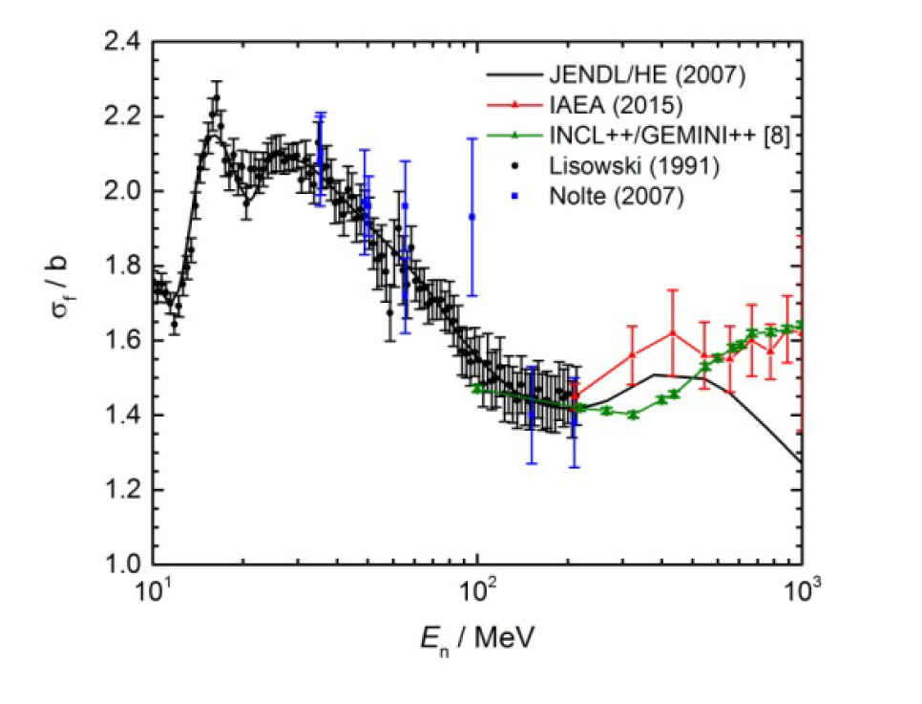
Status of the ²³⁵U(n,f) cross section
No experimental data above 200MeV. Only theoretical models
Two sets of experimental data in the range 20 MeV – 200 MeV

Slide 4
Status of the ²³⁵U(n,f) cross section
No experimental data above 200MeV. Only theoretical models
Two sets of experimental data in the range 20 MeV – 200 MeV

Slide 5
Status of the ²³⁵U(n,f) cross section
The theoretical cross section above 200MeV may be substantially different, depending on the model used for the calculations.
No experimental data above 200MeV. Only theoretical models
Two sets of experimental data in the range 20 MeV – 200 MeV
The International Atomic Energy Agency (IAEA) strongly requests new data for the ²³⁵U(n,f) cross section up to 1GeV, in order to improve the uncertainty within 5%.
New measurements above 20 MeV are needed!

Slide 6
The experimental approach to measure the ²³⁵U(n,f) cross section
The Technique:
Two measurements to be made simultaneously with a suitable neutrons beam.
²³⁵U(n,f) reaction vs neutron energy
H(n,n)H reaction vs neutron energy

Slide 7
The experimental approach to measure the ²³⁵U(n,f) cross section
The Technique:
Two measurements at the same time with a neutron beam.
²³⁵U(n,f) reaction vs neutron energy
H(n,n)H reaction vs neutron energy
Proton Recoil Telescope
Fission fragments detectors (PPFC & PPAC)
(In total n.15 of ²³⁵U targets)
(n,p) scattering
protons
$E_{n}$< 1GeV
²³⁵U
$$θ$$
$$E_{p}=E_{n}∙\cos^{2}θ$$
Neutrons beam
Neutrons beam
CH₂ target
₍polyethylene₎

Slide 8
The experimental approach to measure the ²³⁵U(n,f) cross section
The Technique:
Two measurements at the same time with a neutron beam.
²³⁵U(n,f) reaction vs neutron energy
H(n,n)H reaction vs neutron energy
Proton Recoil Telescope
Fission fragments detectors (PPFC & PPAC)
(In total n.15 of ²³⁵U targets)
(n,p) scattering
protons
$E_{n}$< 1GeV
²³⁵U
$$θ$$
$$E_{p}=E_{n}∙\cos^{2}θ$$
Neutrons beam
Neutrons beam
CH₂ target
₍polyethylene₎
The (n,p) scattering is used as a reference reaction for the ²³⁵U(n,f) cross section
The Proton Recoil Telescope (PRT) detects the recoil protons emitted by the target, to measure the neutron flux vs. neutron energy

Slide 9
The experimental approach to measure the ²³⁵U(n,f) cross section
The Technique:
Two measurements at the same time with a neutron beam.
²³⁵U(n,f) reaction vs neutron energy
H(n,n)H reaction vs neutron energy
Proton Recoil Telescope
Fission fragments detectors (PPFC & PPAC)
(In total n.15 of ²³⁵U targets)
(n,p) scattering
protons
$E_{n}$< 1GeV
²³⁵U
$$θ$$
$$E_{p}=E_{n}∙\cos^{2}θ$$
Neutrons beam
Neutrons beam
CH₂ target
₍polyethylene₎
The (n,p) scattering is used as a reference reaction for the ²³⁵U(n,f) cross section
The Proton Recoil Telescope (PRT) detects the recoil protons emitted by the target, to measure the neutron flux vs. neutron energy
N: detected events
n: sample areal density
Ω: PRT solid angle
ε: efficiency
$σ$: cross section

Slide 10
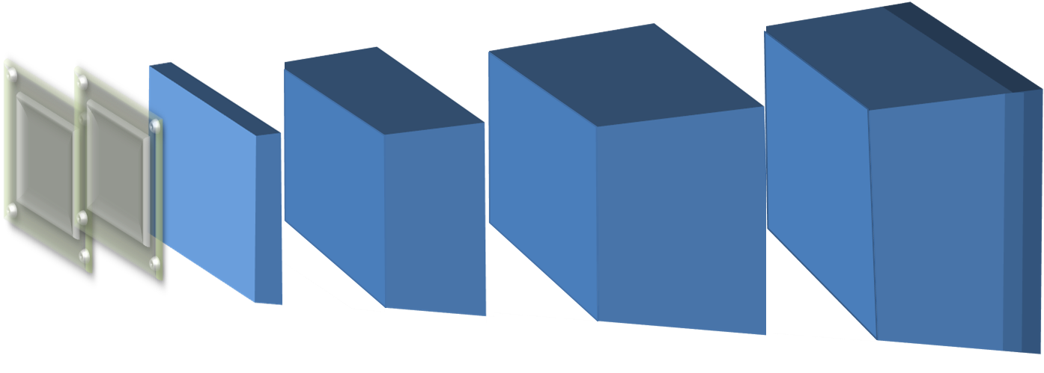
The multilayer Proton Recoil Telescope
Scint. 4
Six detector layers to cover the full energy range
Scint. 3
Scint. 2
Scint. 1
Si
Si
CH₂target
Neutrons beam
Recoil protons
2 Silicon detectors 300 um thick
4 plastic scintillators BC408 (τ = 2.1 ns) 0.5cm, 3cm, 6cm, 6cm
Fast PMT (Hamamatsu R1924A)
CH₂ target (polyethylene): 2mm – 10mm

Slide 11
The multilayer Proton Recoil Telescope
Scint. 4
PMT
Six detector layers to cover the full energy range
Scint. 3
PMT
Scint. 2
PMT
Scint. 1
Si
Si
CH₂target
Recoil protons
Thin scintillator. Double ended reading to reduce the dependence from the position of the protons on the scintillator surface.
Neutrons beam
2 Silicon detectors 300 um thick
4 plastic scintillators BC408 (τ = 2.1 ns) 0.5cm, 3cm, 6cm, 6cm
Fast PMT (Hamamatsu R1924A)
CH₂ target (polyethylene): 2mm – 10mm

Slide 12
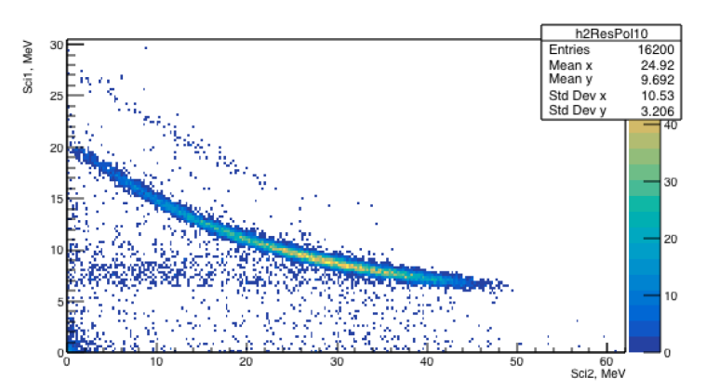
Monte Carlo simulations
Scint. 4
Monte Carlo simulations have allowed to study the response of the PRT
Scint. 3
Scint. 2
Scint. 1
Si
Si
CH₂target (10mm)
Neutrons beam
̴ 60 MeV
Resolution is sufficient to separate protons from deuterons
d
p

Slide 13
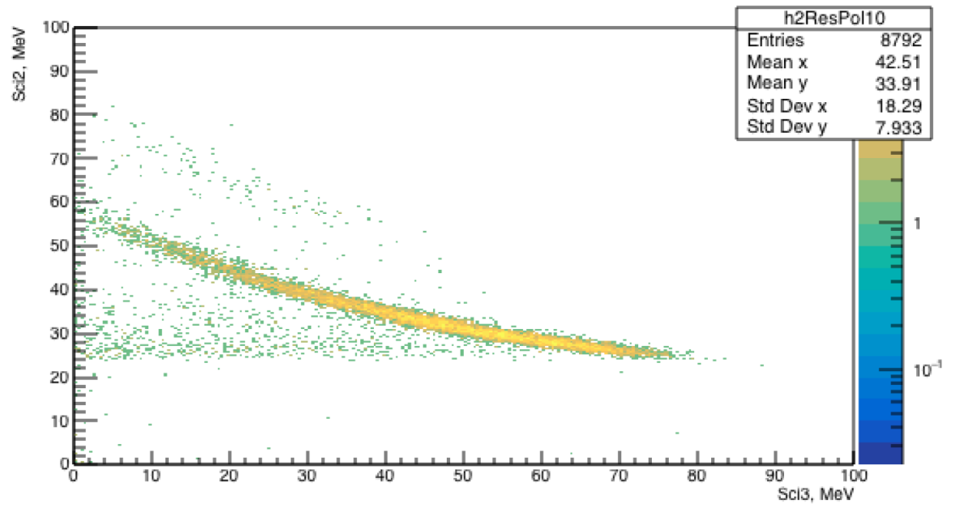
Monte Carlo simulations
Scint. 4
Monte Carlo simulations have allowed to study the response of the PRT
Scint. 3
Scint. 2
Scint. 1
Si
Si
CH₂target (10mm)
Neutrons beam
̴ 120 MeV
d
p

Slide 14
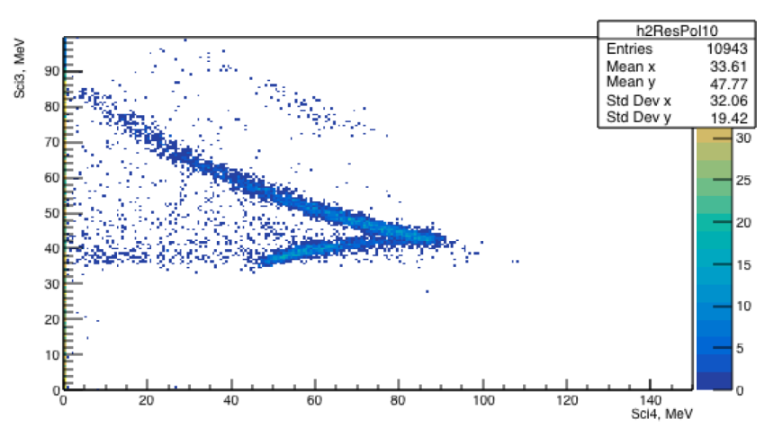
Monte Carlo simulations
Recoil protons > 150MeV
Scint. 4
Monte Carlo simulations have allowed to study the response of the PRT
Scint. 3
Scint. 2
Scint. 1
Si
Si
CH₂target (10mm)
Neutrons beam
̴200 MeV
d
p

Slide 15
How to place the PRT
In the experimental set-up the scintillators are compacted between them
15.5cm
3cm
̴15cm
Ω_{PRT} = 62msr
θ
Neutrons beam
θ= 25 deg
The aim is to reach a statistical uncertainty around 2% within neutron energy regions of 5% relative width.

Slide 16
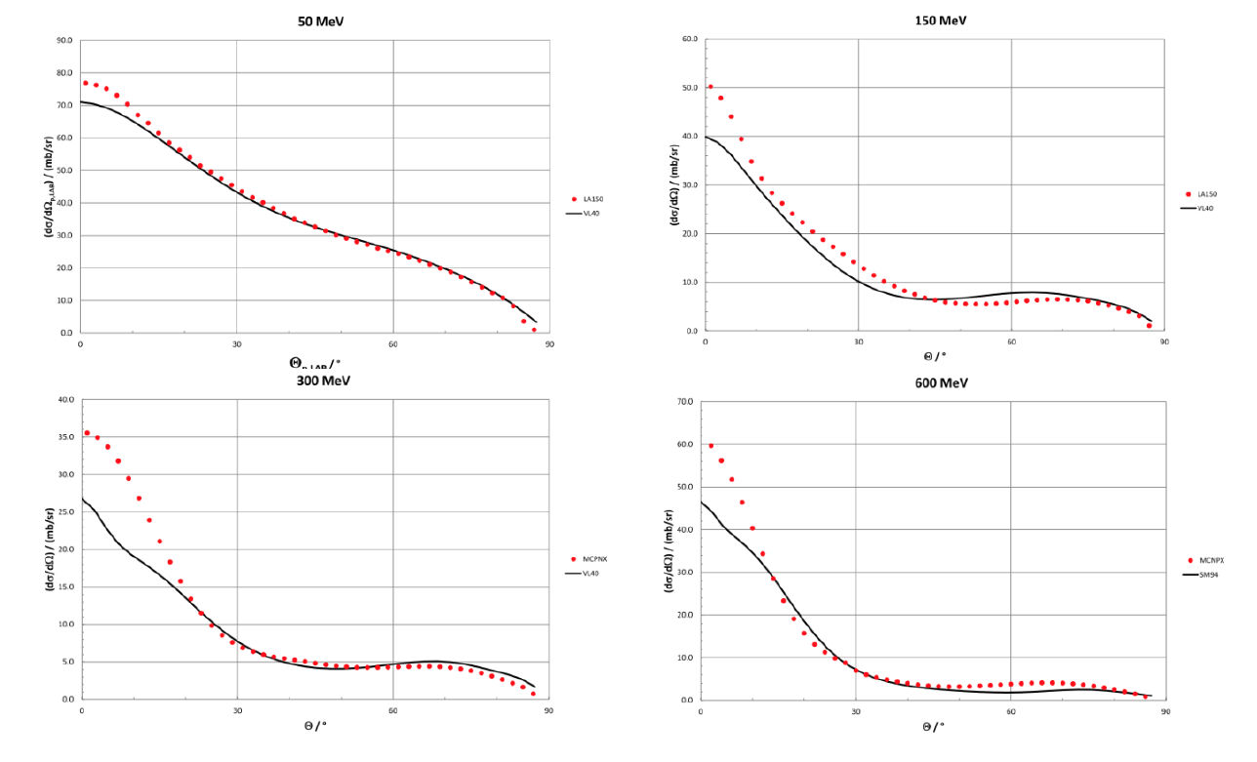
(n,p) cross section vs. angle of recoil protons
0
30
60
90
0
30
60
90
0
30
60
90
0
30
60
90
20 – 30 deg

Slide 17
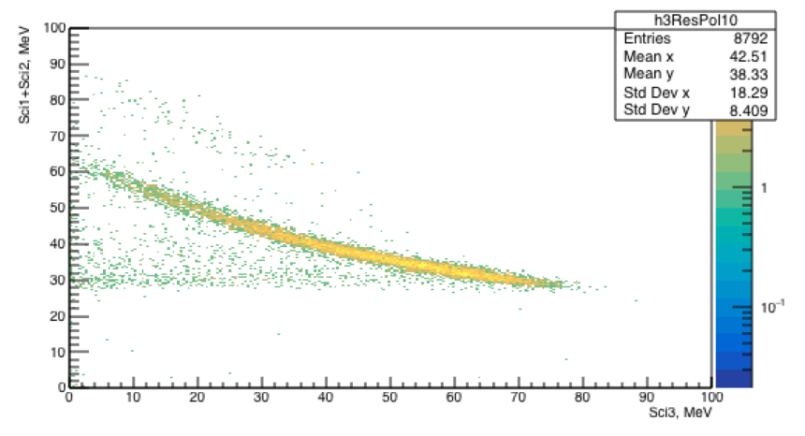
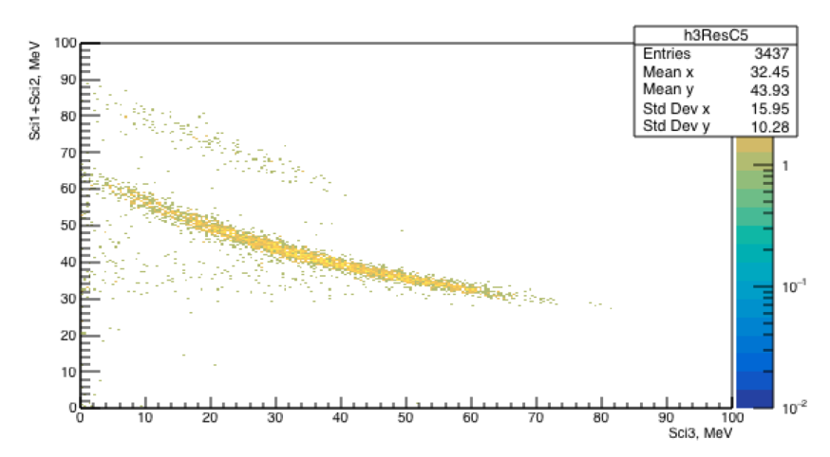
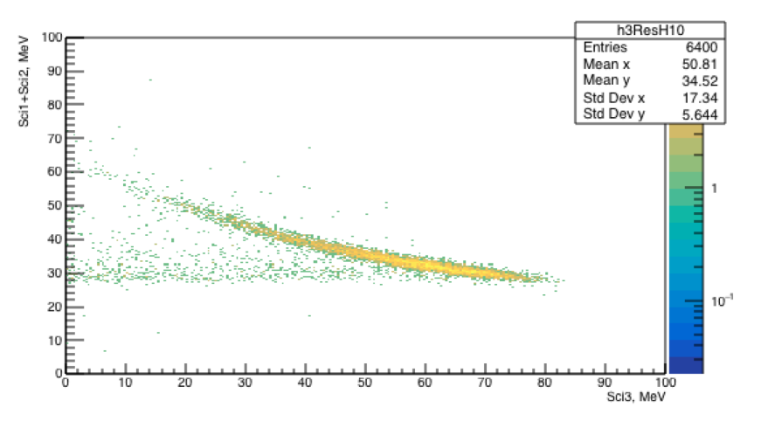
Select only the events due to hydrogen atoms in the CH₂ target
CH₂
target
C
target
‘H₂’
target
-
=
Measurements with graphite targets to subtract the contribution of the Carbon in the CH₂ (polyethylene) target
Monte Carlo
Monte Carlo
CH₂ target
-
C target
d
d
p
p
Monte Carlo
‘H₂’ target
p

Slide 18
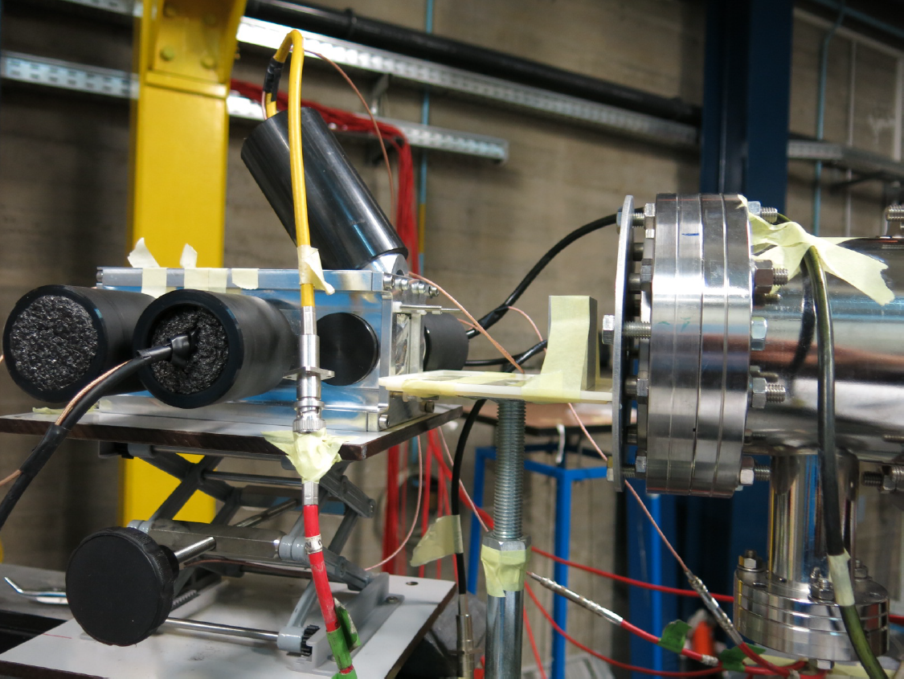
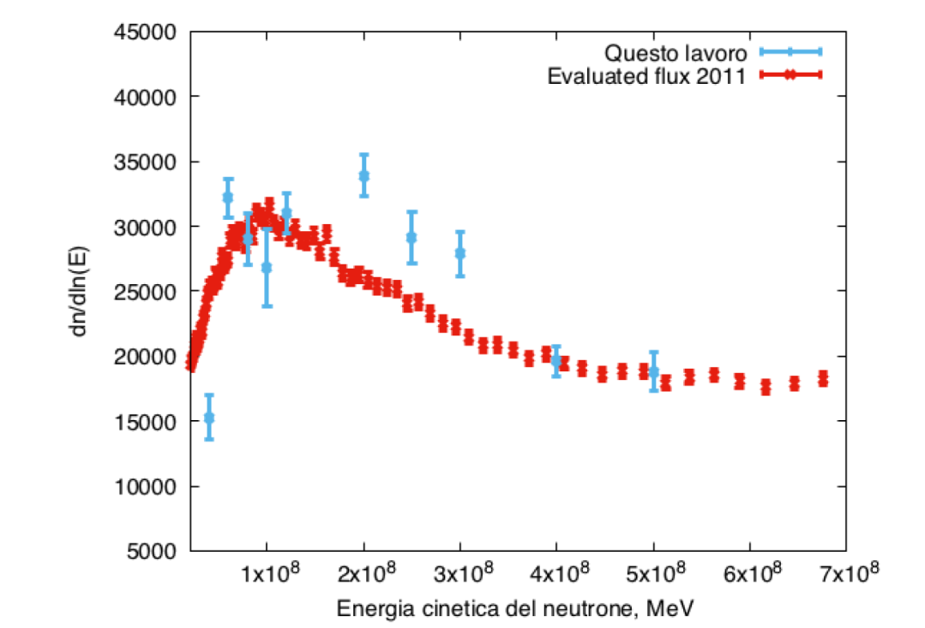
Neutron Flux in EAR1.
A first attempt of reconstruction with the first PRT prototype (2016)
PRT
Evaluated flux 2011
Very preliminary attempt
Neutron Energy (MeV)
Alignment of the PRT to the neutron beam was not perfect
The amount of material in the PRT mechanics must be reduced, in order to cut down the background events
$$φ_{n}=\frac{C}{nΩεσ}$$
C: counts
n: sample areal density
Ω: solid angle
ε: efficiency
$σ$: (n,p) cross section

Slide 19
Configurazione proposta per il 2017
Ultima slide meeting Perugia
Adeguati sostegni permetteranno di ancorare i cavi per evitare effetti sull’accoppiamento ottico (con colla ottica).
Box silici
L’oscuramento sarà ulteriormente garantito da un telo nero.
Assemblare i silici un una box elettricamente schermata (alluminio e mylar alluminizzato nelle finestre).
Il preamplificatore ‘Bassini’ garantisce una risposta in tempo adeguata, meno di 2usec dal g-flash.
Calibrazione preliminare ai LNS (se possibile..)?

Slide 20
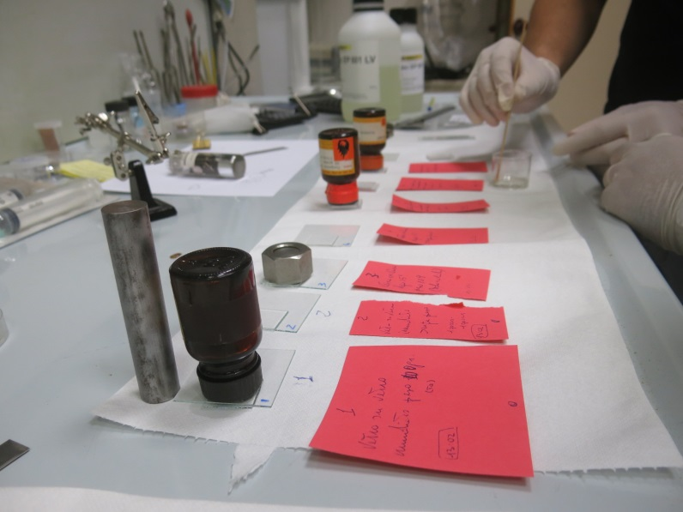
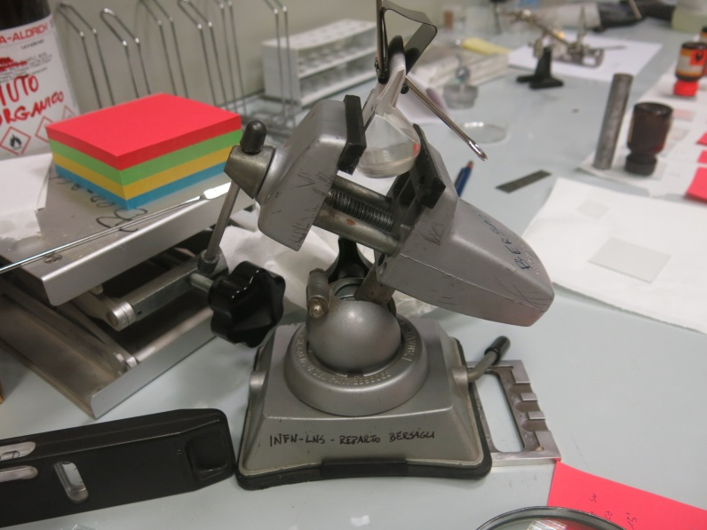
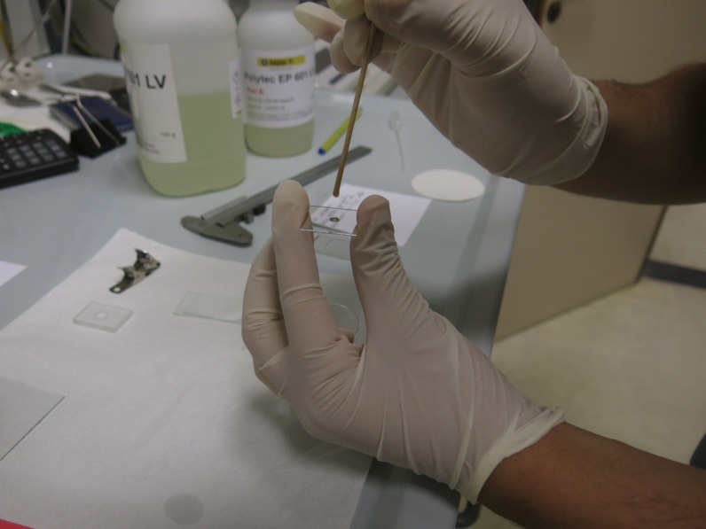
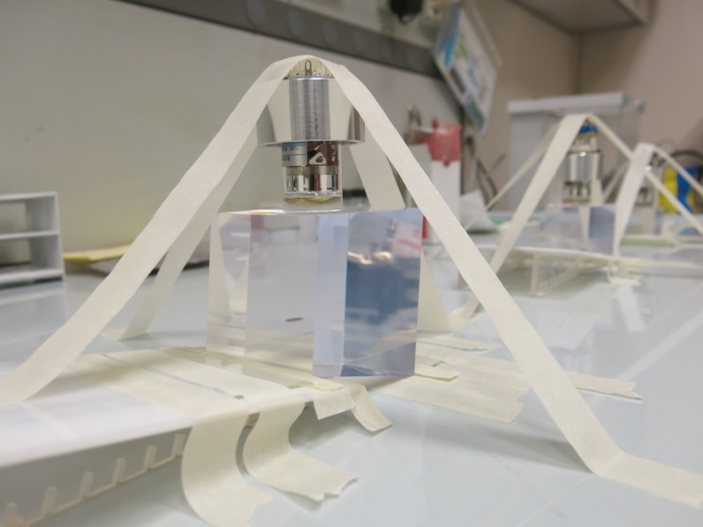
Assemblaggio PRT_2017

Slide 21
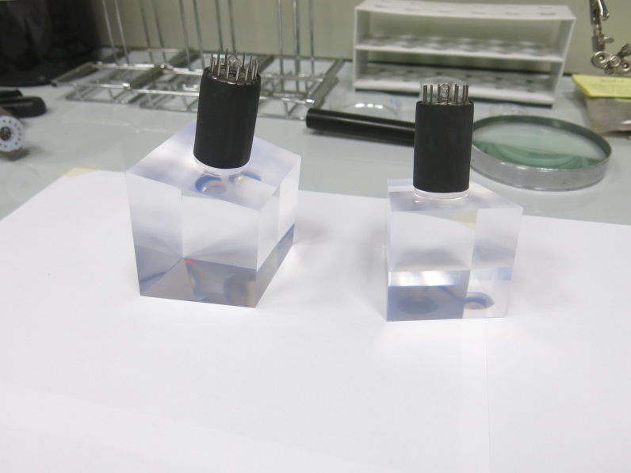
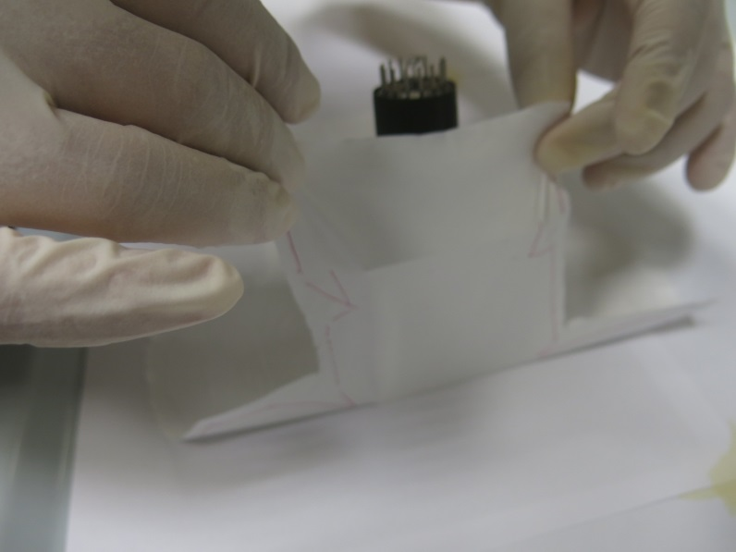
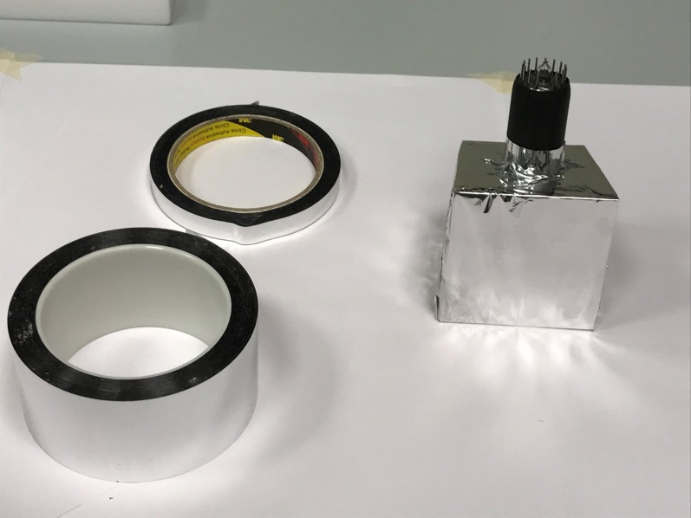
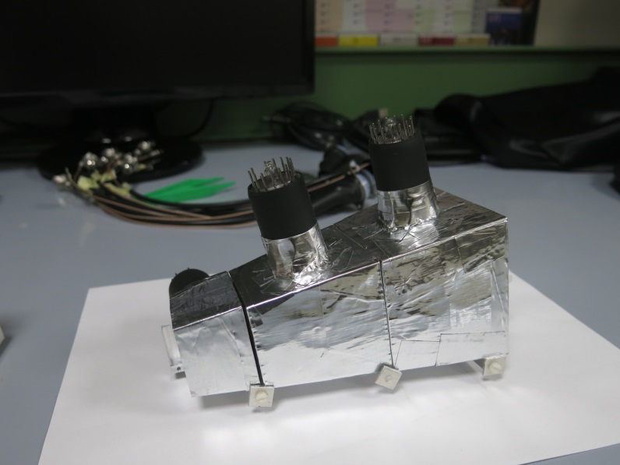
Assemblaggio PRT_2017

Slide 22
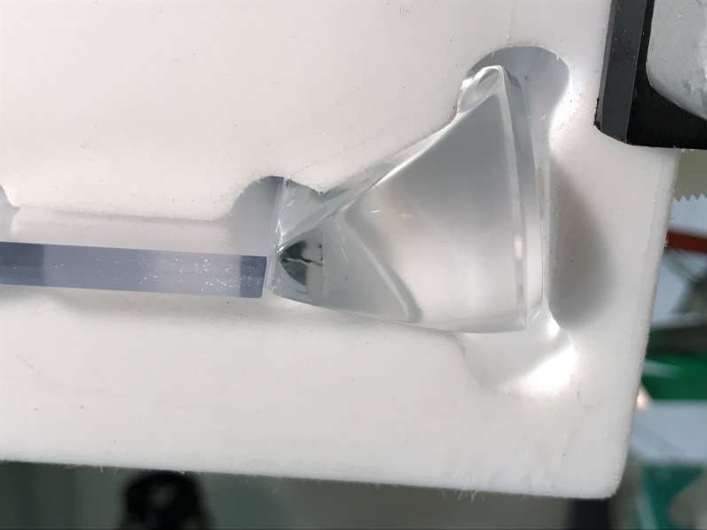
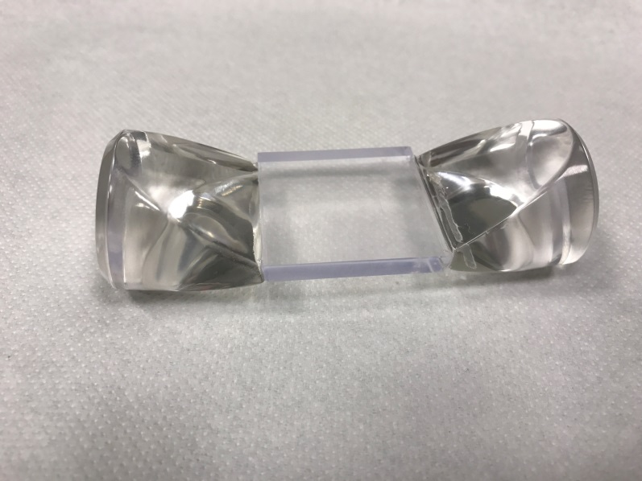
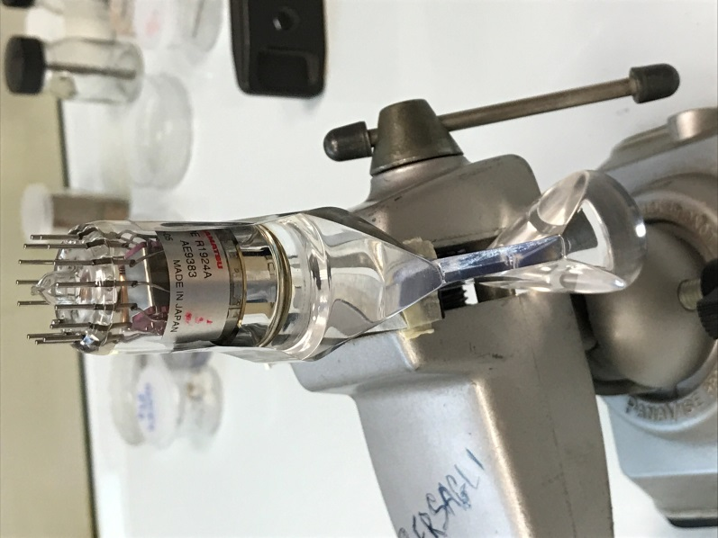
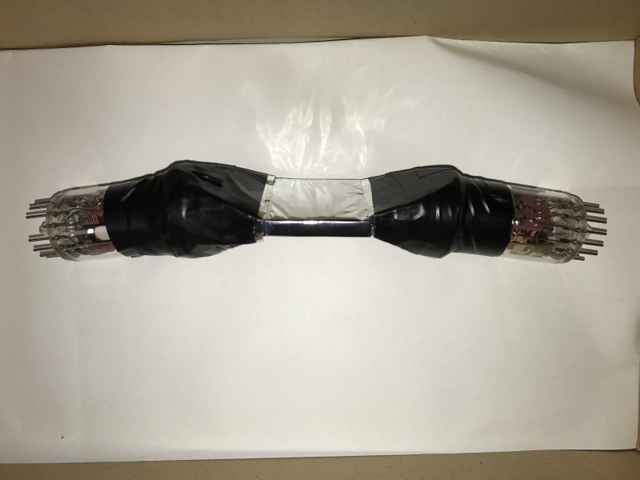
Assemblaggio PRT_2017

Slide 23
Assemblaggio PRT_2017
Test su banco per valutare la dipendenza dalla posizione con lo scintillatore sottile
2 PMT con guide di luce. Plastico 5 mm
Sorgente collimata di ¹³⁷Cs
Collimatore piombo
(Φ=1mm)
centro
3 posizioni con step da 1cm
sx
dx
u.a.
Differenza segnali PMT normalizzata alla radice del prodotto (i.e. energia rilasciata), per le 3 posizioni.
Spettri radice del prodotto per le 3 posizioni.
Nel plot grande gli stessi sovrapposti.

Slide 24
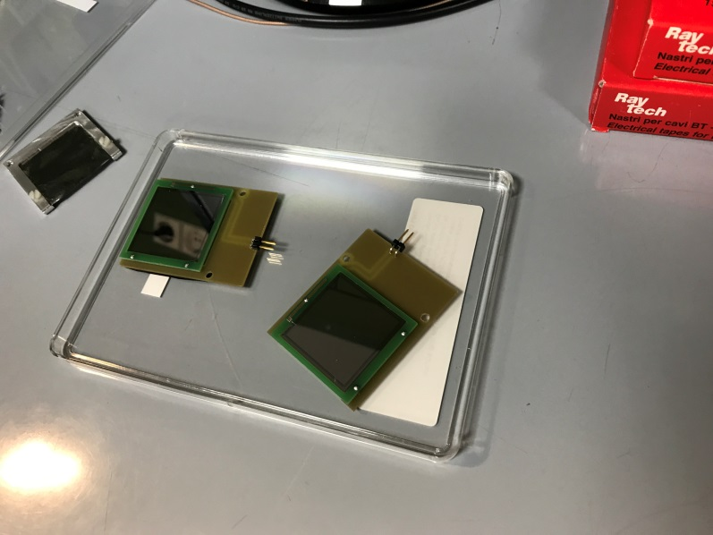
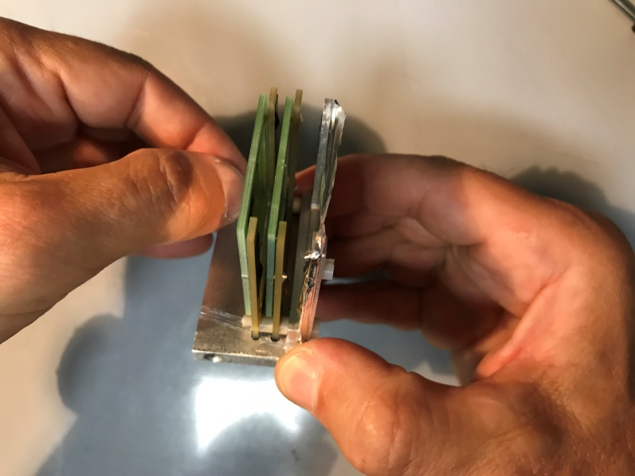
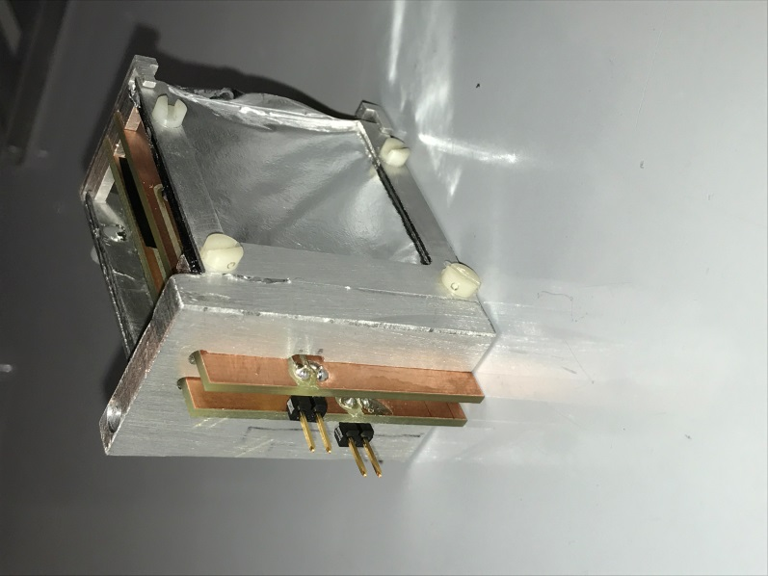
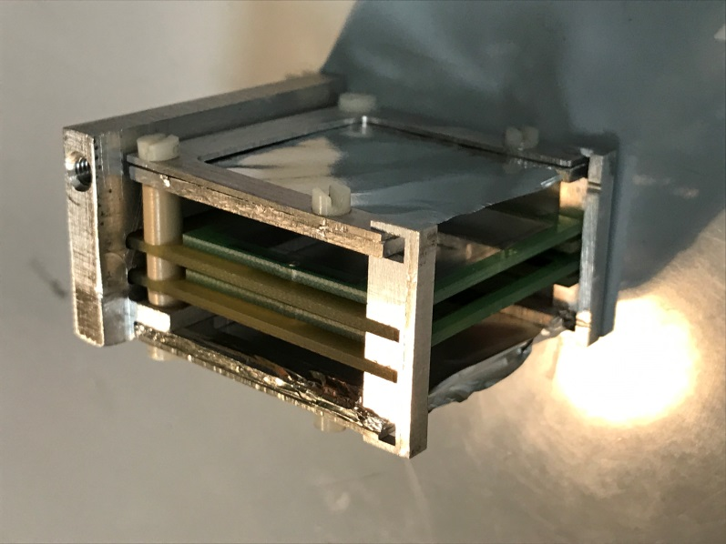
Assemblaggio PRT_2017

Slide 25
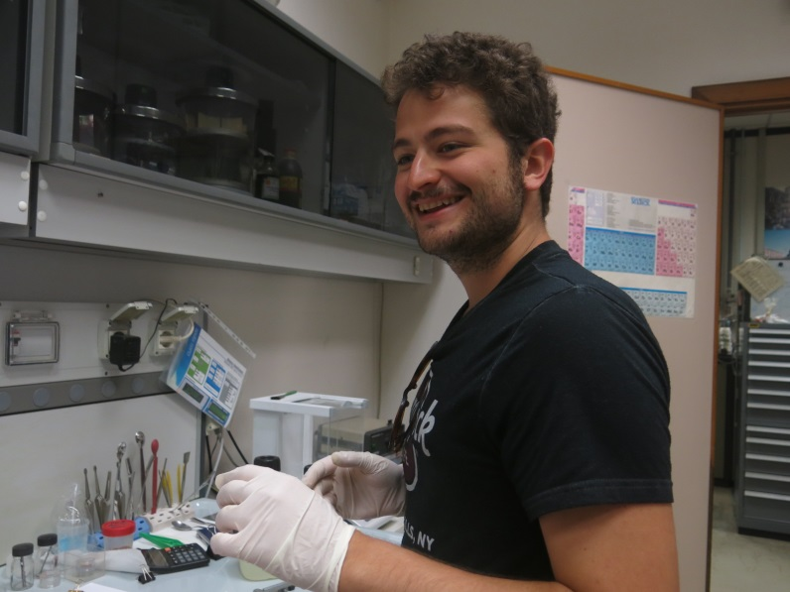
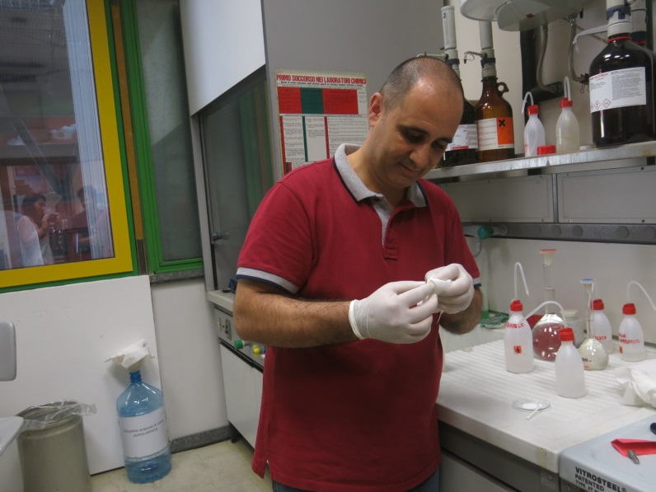
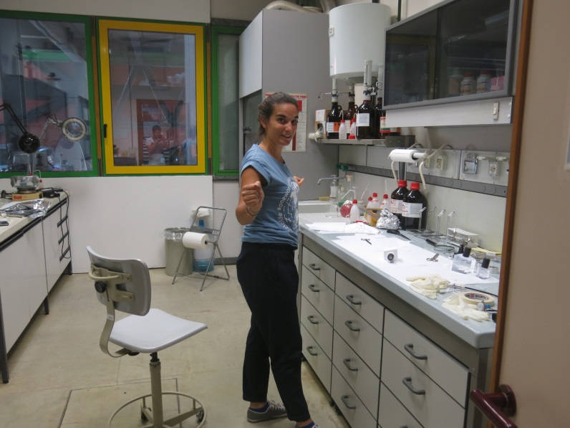
Assemblaggio PRT_2017
Il dream team ai LNS

Slide 26
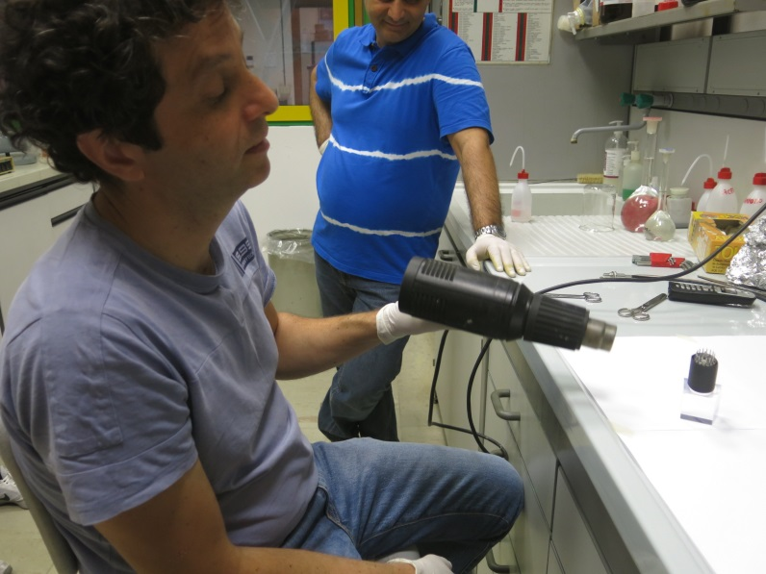
Assemblaggio PRT_2017
Il dream team ai LNS
Come al solito, gli altri fanno le cose importanti e a me tocca fare lo shampista…

Slide 27
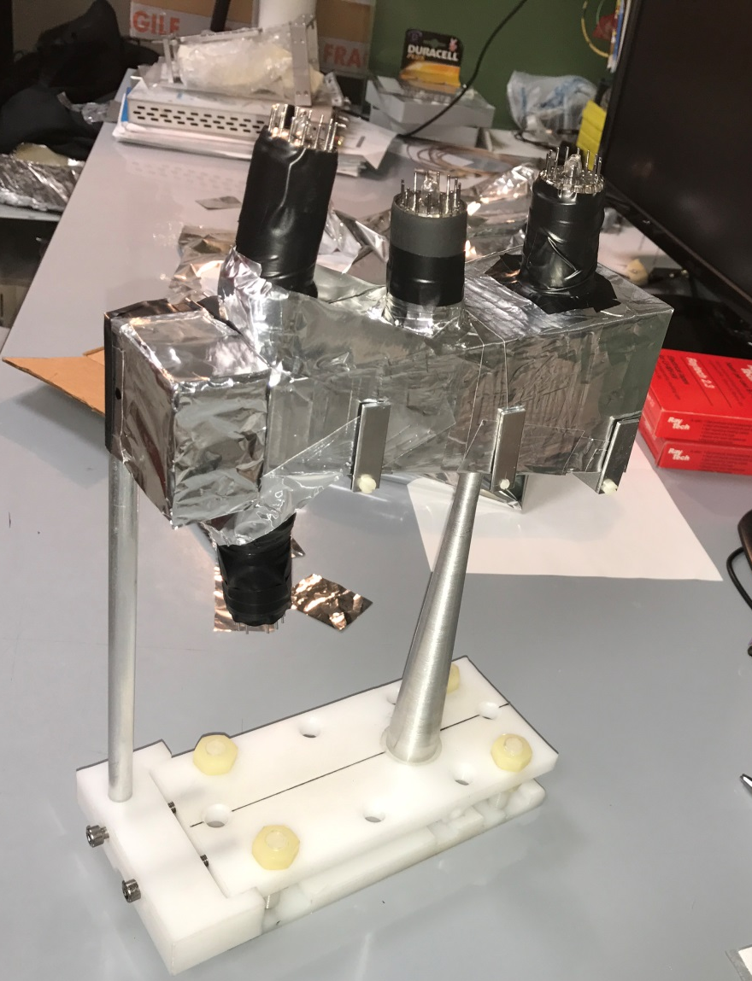
Pronto per il CERN (sett. 2017)
Pronto per rivelare protoni di rinculo, coprendo un range di energia (dei neutroni) da qualche MeV a 1 GeV

Slide 28
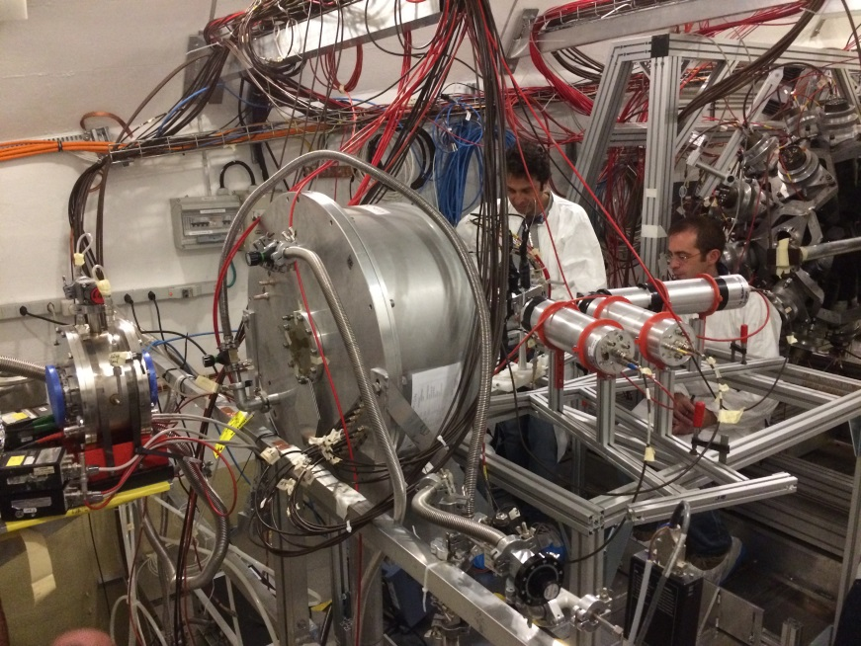
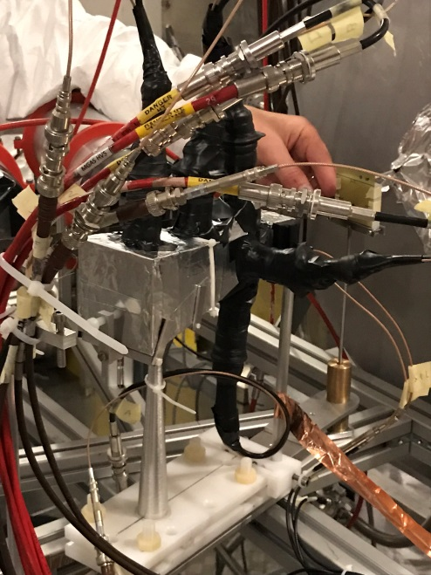
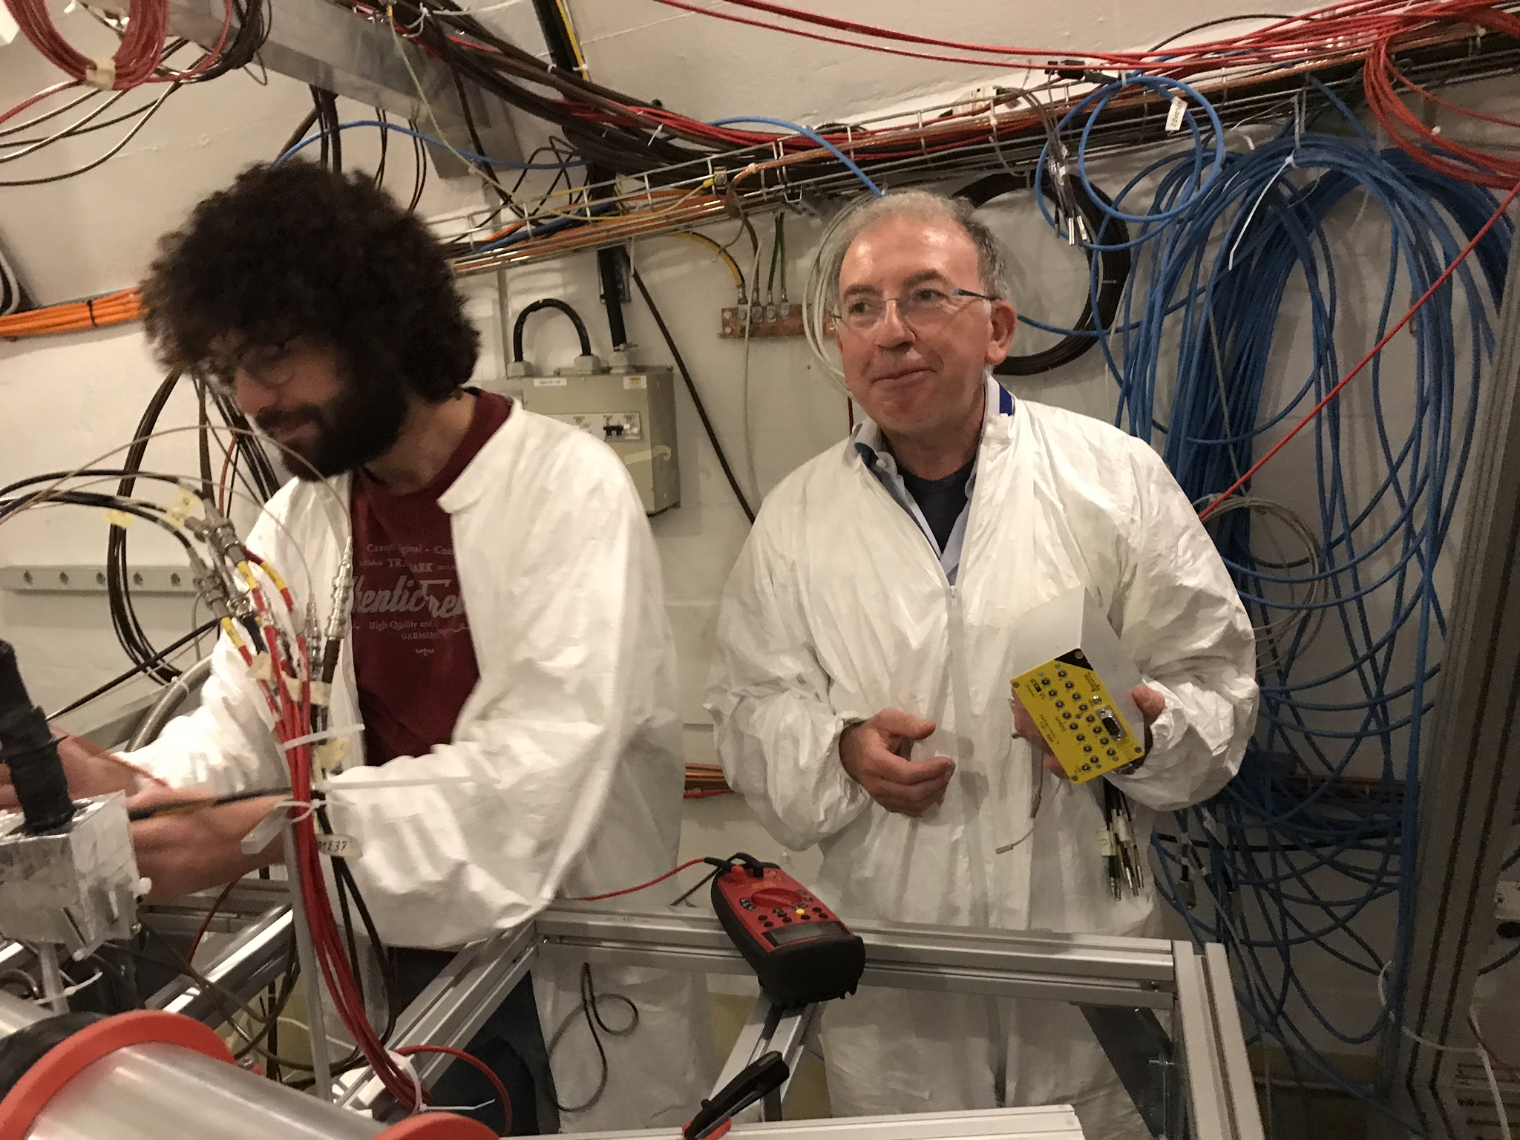
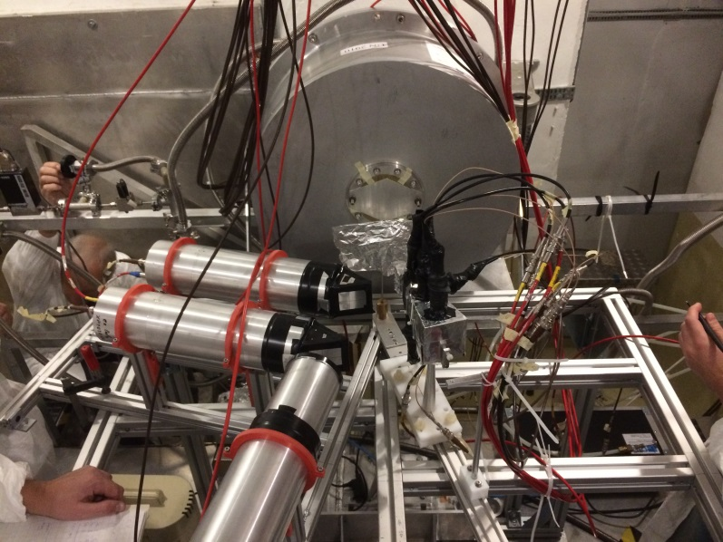
Installazione e avvio test (ott. 2017)

Slide 29
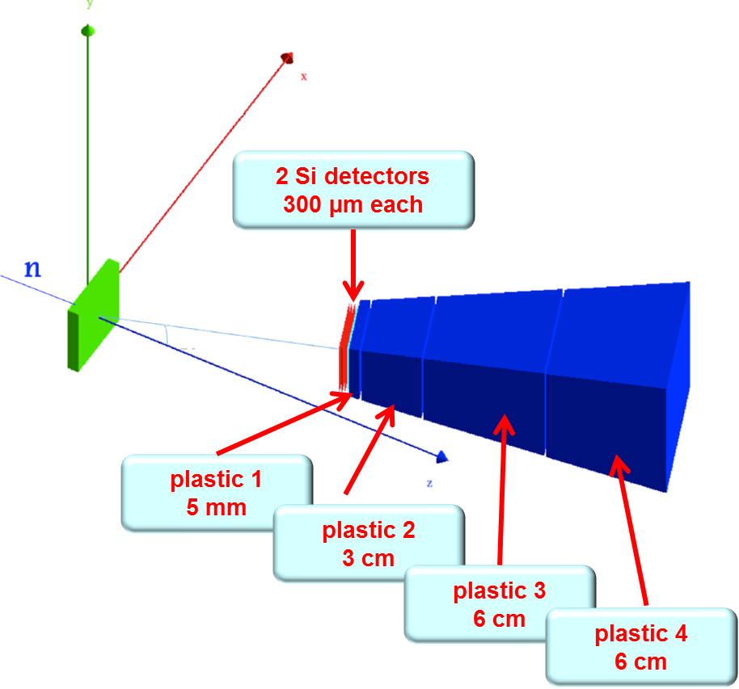
Installazione e avvio test (ott. 2017)
ϑ = 25°
d = 14.8 cm

Slide 30
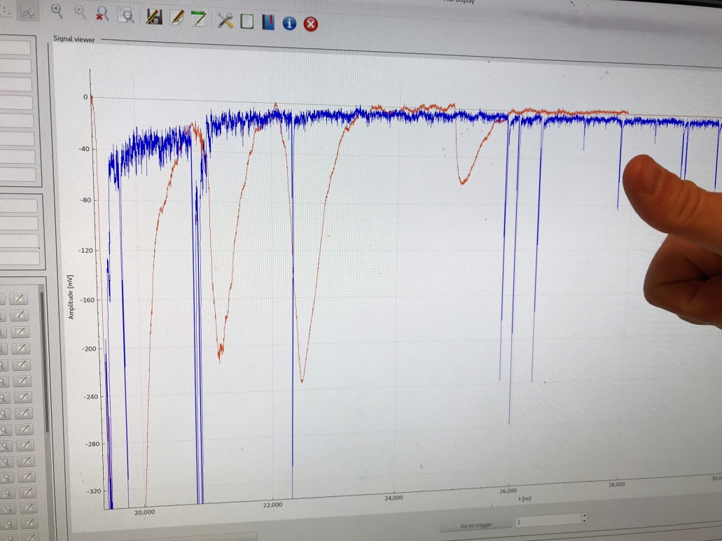
I primi segnali

Slide 31
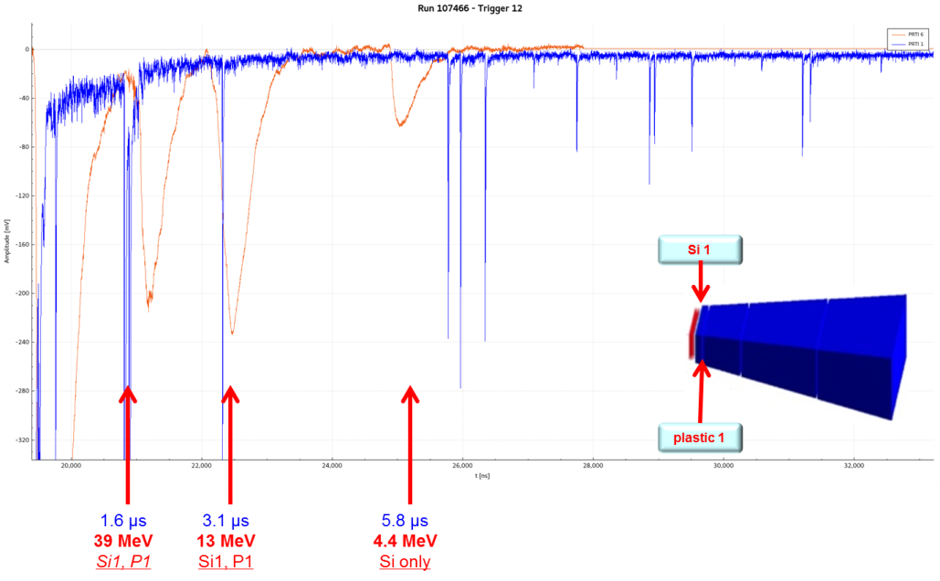
INFN Proton Recoil Telescope

Slide 32
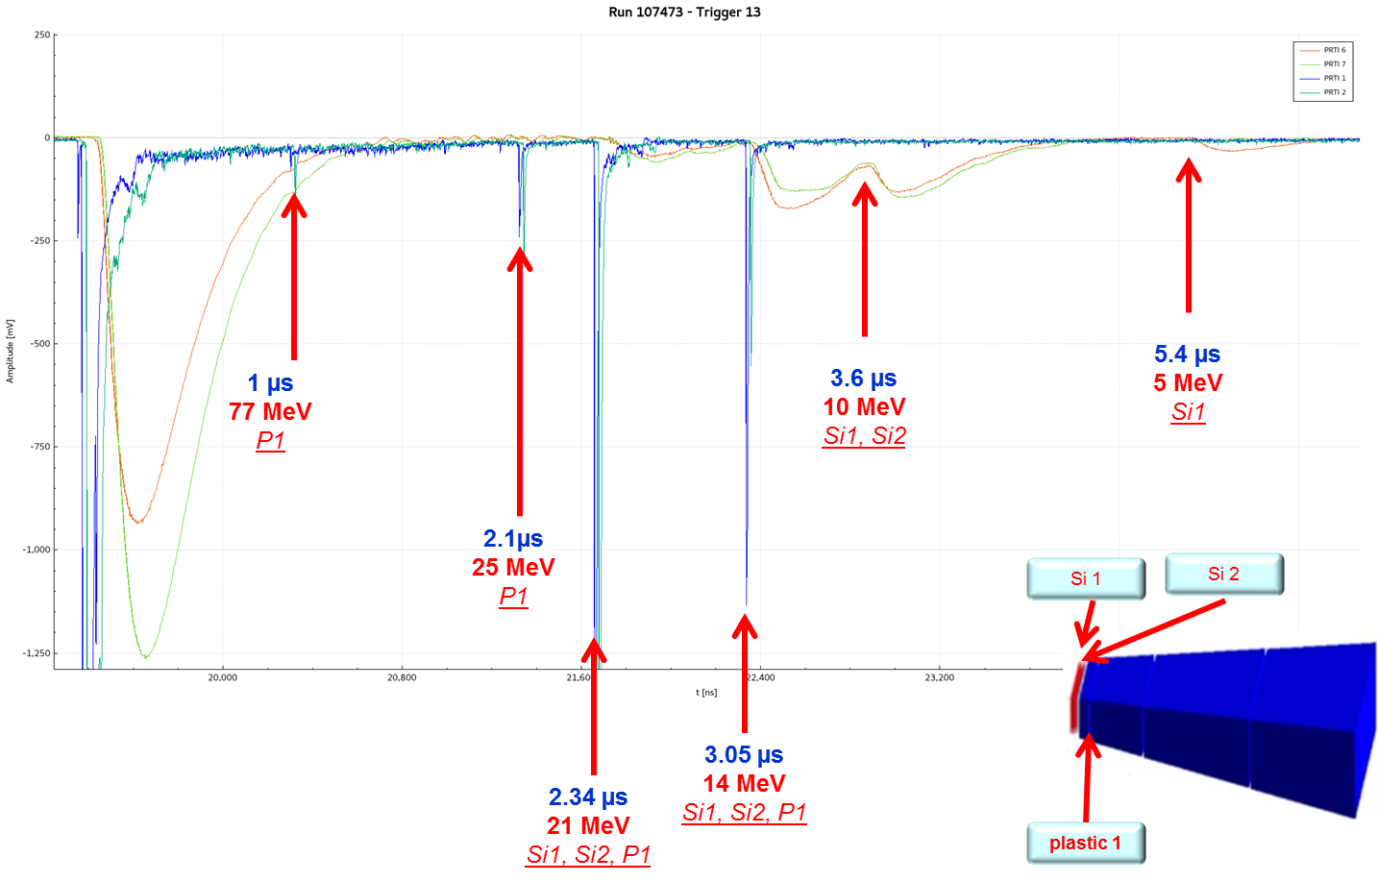
I primi segnali

Slide 33
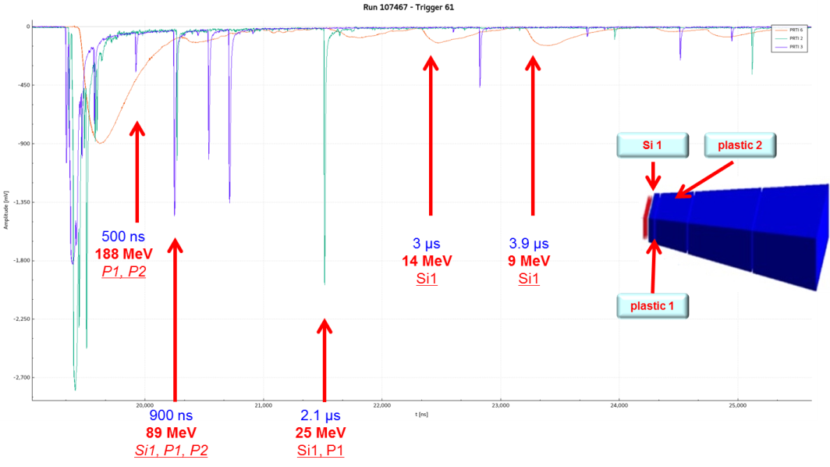
I primi segnali

Slide 34
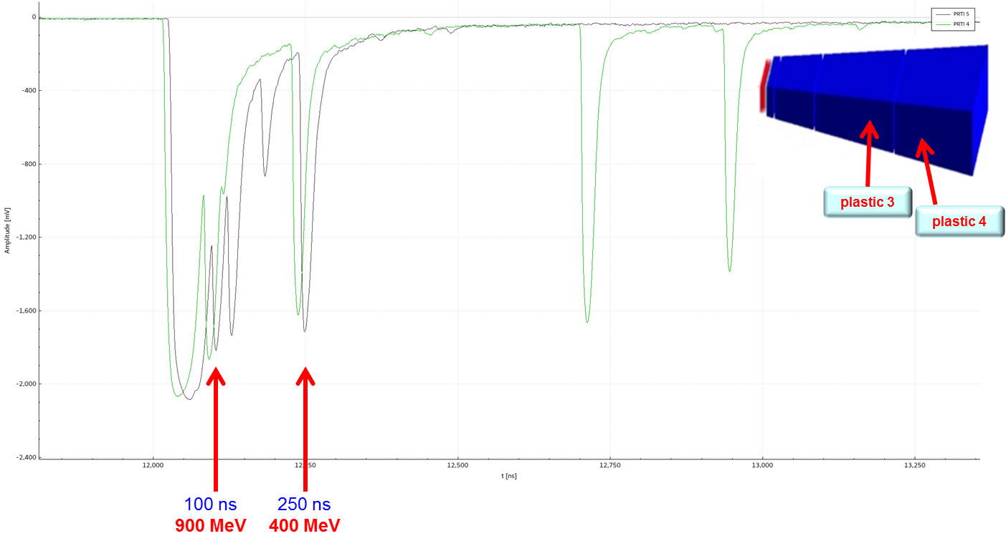
I primi segnali

Slide 35
Very preliminary data
plastic 3
plastic 4

Slide 36
Il PRT pare abbia funzionato molto bene, riuscendo a rivelare segnali in un ampio range di energia dei neutroni, i.e da qualche MeV sino a circa 1GeV
Gli scintillatori sembrano soffrire di una certa non linearità, dovuta a quenching degli scintillatori o ad abbassamento del guadagno nei PMT
Attendiamo l’analisi dei dati acquisiti per stabilirne prestazioni, limiti e possibili margini di miglioramento

