Slide 1



Advanced Virgo results and the dawn of GW multimessenger astronomy
Fabio Garufi – Univ. Di Napoli Federico II and INFN Napoli
On behalf of the VIRGO Collaboration

Slide 2
Outline
Introduction to GW
The Advanced Virgo Detector
Upgrades from Virgo/Virgo+
Main troubles during installation
A network of GW interferometers
Detector sensitivity and behaviour progresses
The observing run O2
Observations
The birth of multi-messenger Gravitational Waves astronomy

Slide 3
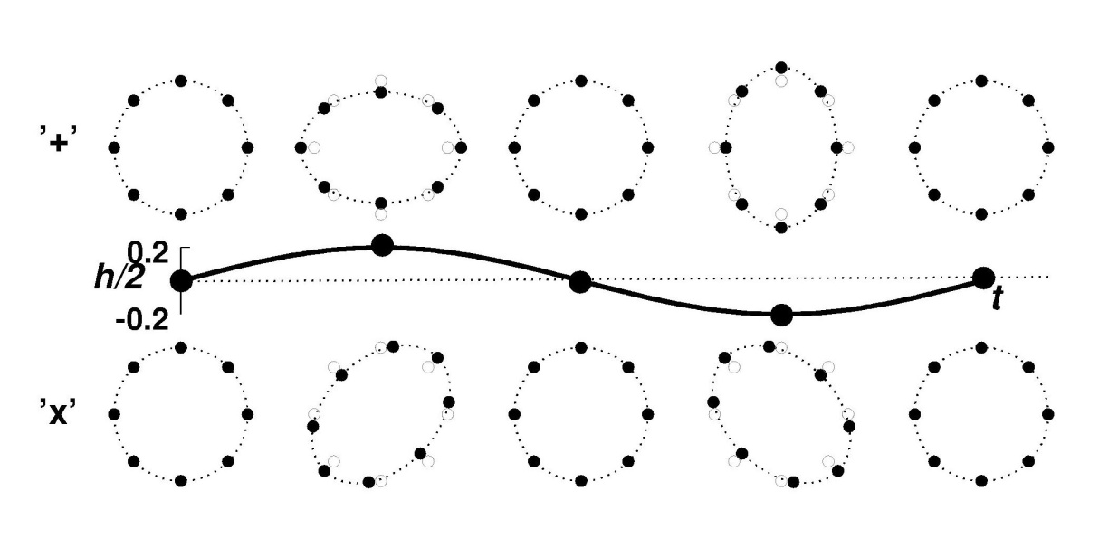
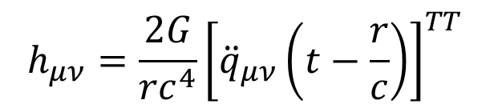
Intro to gravitational waves
GW are small perturbations of space-time curvature, propagating at the speed of light (i.e. linearized solutions of Einstein equations)
They are created by mass distributions changing in a non spherically symmetric way (i.e. with a quadrupole moment)
Their effect is to change lengths orthogonal to their propagation direction in a quadrupolar way, while preserving areas.
$$h_{μν}=\frac{2G}{rc^{4}}{\left[{\ddot{q}}_{μν}\left(t−\frac{r}{c}\right)\right]}^{TT}$$

Slide 4
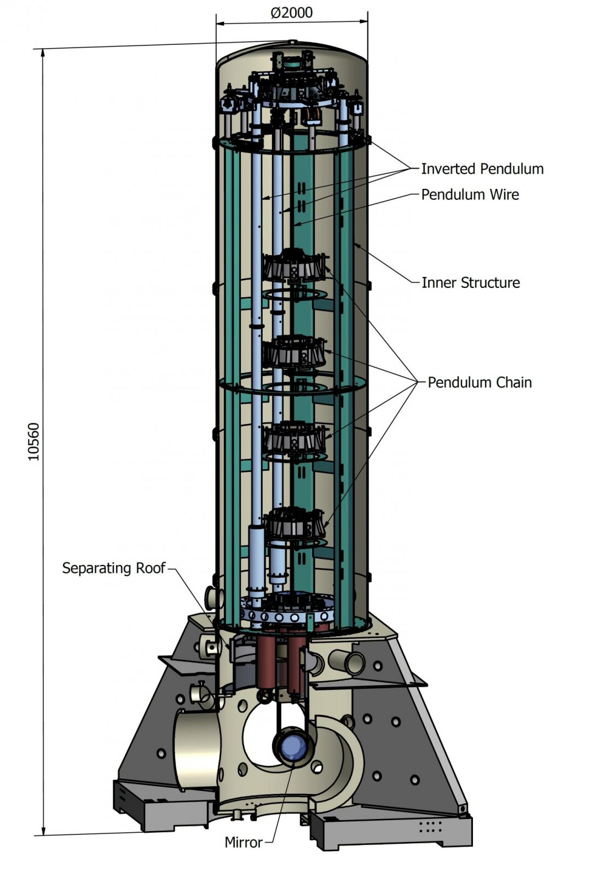
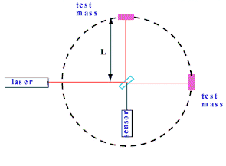
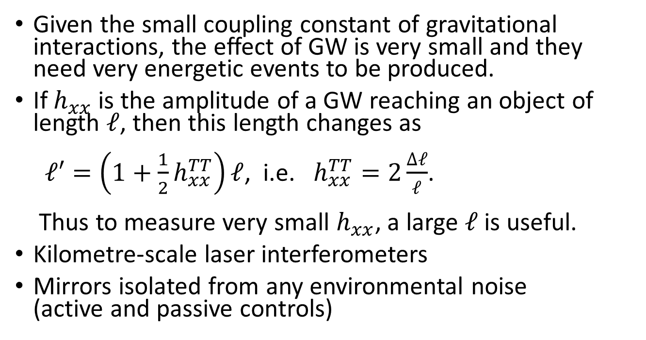
Intro to gravitational waves
Strong | e.m. | weak | gravity
0.1 | 1/137 | 10⁻⁵ | 10⁻³⁹
Given the small coupling constant of gravitational interactions, the effect of GW is very small and they need very energetic events to be produced.
If $h_{xx}$ is the amplitude of a GW reaching an object of length $ℓ$, then this length changes as
$ℓ′=\left(1+\frac{1}{2}h_{xx}^{TT}\right)ℓ$, i.e. $h_{xx}^{TT}=2\frac{∆ℓ}{ℓ}$.
Thus to measure very small $h_{xx}$, a large $ℓ$ is useful.
Kilometre-scale laser interferometers
Mirrors isolated from any environmental noise
(active and passive controls)

Slide 5
Initial interferometric detectors

Slide 6

Initial Virgo evolution

Slide 7

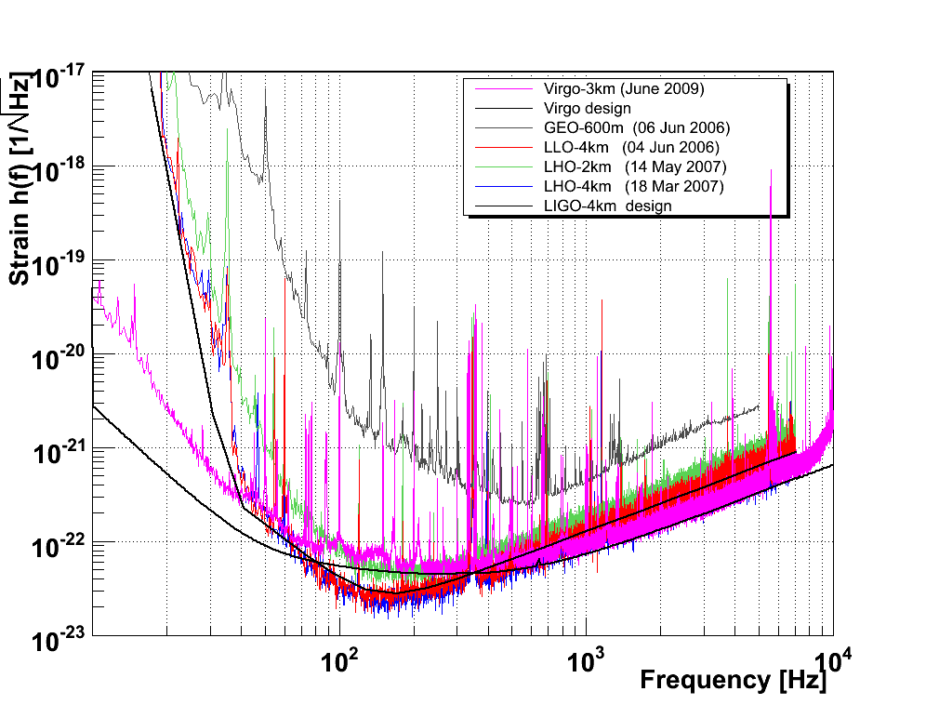
Initial interferometric detectors

Slide 8
Initial to advanced detectors
AdvVirgo
aLIGO

Slide 9







The Advanced Virgo detector
In late 2011 the larger GW detectors, LIGO, VIRGO and GEO finished their scientific runs and started their upgrades to improve their sensitivity by factor 10 in the detection band
The Advanced Virgo Collaboration:
  Scientists from France, Italy (former Virgo founders), the Netherlands, Poland, Hungary, Spain and, recently, Germany;
  7 countries, 21 labs involved, about 280 members
      APC Paris
      ARTEMIS Nice
      EGO Cascina
      INFN Firenze-Urbino
      INFN Genova
      INFN Napoli
      INFN Perugia
      INFN Pisa
      INFN Roma La Sapienza
      INFN Roma Tor Vergata
      INFN Trento-Padova
      LAL Orsay – ESPCI Paris
      LAPP Annecy
      LKB Paris
      LMA Lyon
      Nikhef Amsterdam
      POLGRAW(Poland)
      RADBOUD Uni. Nijmegen
      RMKI Budapest
      Univ. of Valencia
      University of Jena

Slide 10
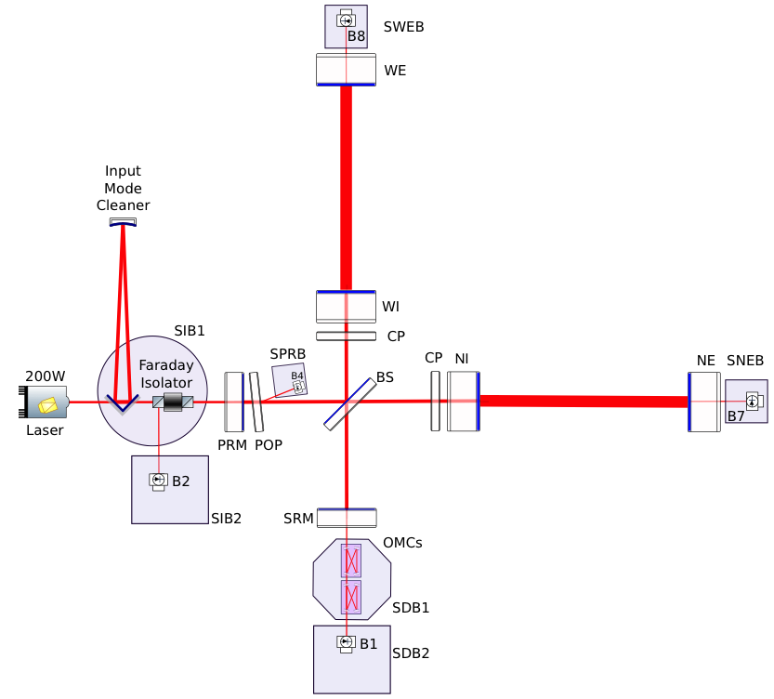
Advanced Virgo
Advanced Virgo started operation on August 1, 2017. It features many improvements with respect to Virgo and Virgo+
  For 2017 and 2018
  Larger beam: 2.5x larger at ITMs
  Heavier mirrors: 2x heavier
  Higher quality optics: residual roughness < 0.5 nm
  Improved coatings for lower losses: absorption < 0.5 ppm, scattering < 10 ppm
  Reducing shot noise: arm finesse of cavities are 3 x larger than in Virgo+
  Thermal control of aberrations: compensate for cold and hot defects on the core optics:
  ring heaters
  double axicon CO2 actuators
  CO2 central heating
  diagnostics: Hartmann sensors & phase cameras
  Stray light control: suspended optical benches in vacuum, and new set of baffles and diaphragms to catch diffuse light
  Improved vacuum: 10⁻⁹ mbar instead of 10⁻⁷ mbar

Slide 11
AdvVirgo – main issues encountered
Detector integration troubled by repeated breakage of fused silica fibres when test masses suspended in vacuum
Lead to decision of suspending them with steel wires in order not to stop commissioning progress
Extensive/intense research in parallel to understand the cause
Eventually culprit found: dust particle generated by scroll pumps and blown towards the fibres during a venting of the vacuum chamber
Risk mitigation action plan ready, implemented after O2
  upgrade of the vacuum system: scroll pumps replacement, modifications of the venting piping
  installation of “fibre guards”
Test masses suspended again with fused silica fibres after O2

Slide 12
Sensitivity with steel wires

Slide 13
Advances in sensitivity
BNS range: the distance at which the signal from a 1.4+1.4 solar masses binary merger has a SNR of 8.
Steel wires best sensitivity 28 Mpc
Steel wires design sensitivity: 45 Mpc

Slide 14
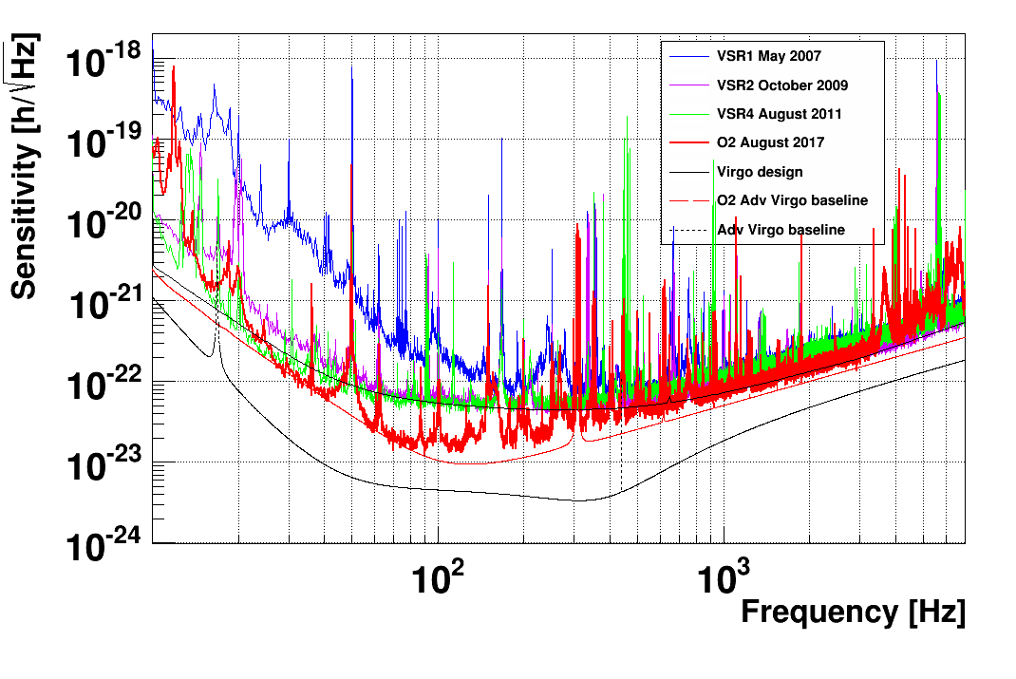

Slide 15
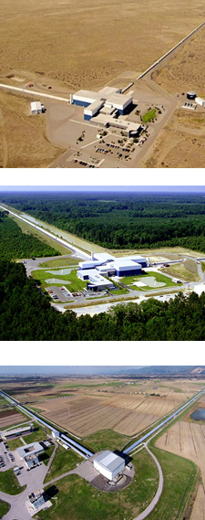
Scientific run O2 – a network of GW detectors
After the first observing run O1, the Advanced LIGO interferometers in Handford (H1) and Livingston (L1) started a second observing run O2 on November 30 2016.
Virgo interferometer joined the run on August 1.
O2 ended on August 25.

Slide 16
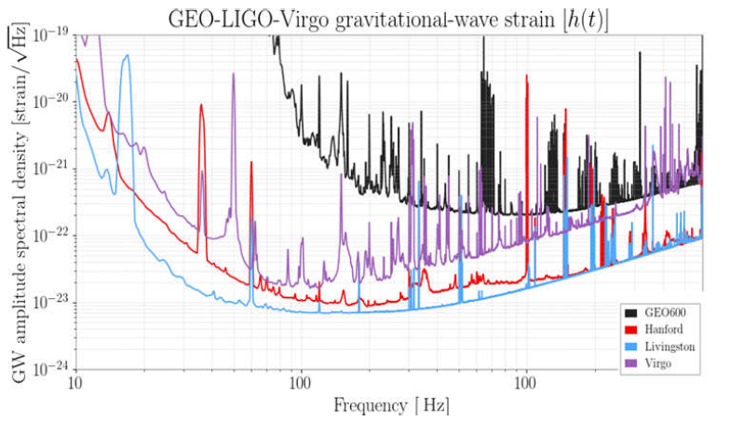
Detectors sensitivities during O2

Slide 17

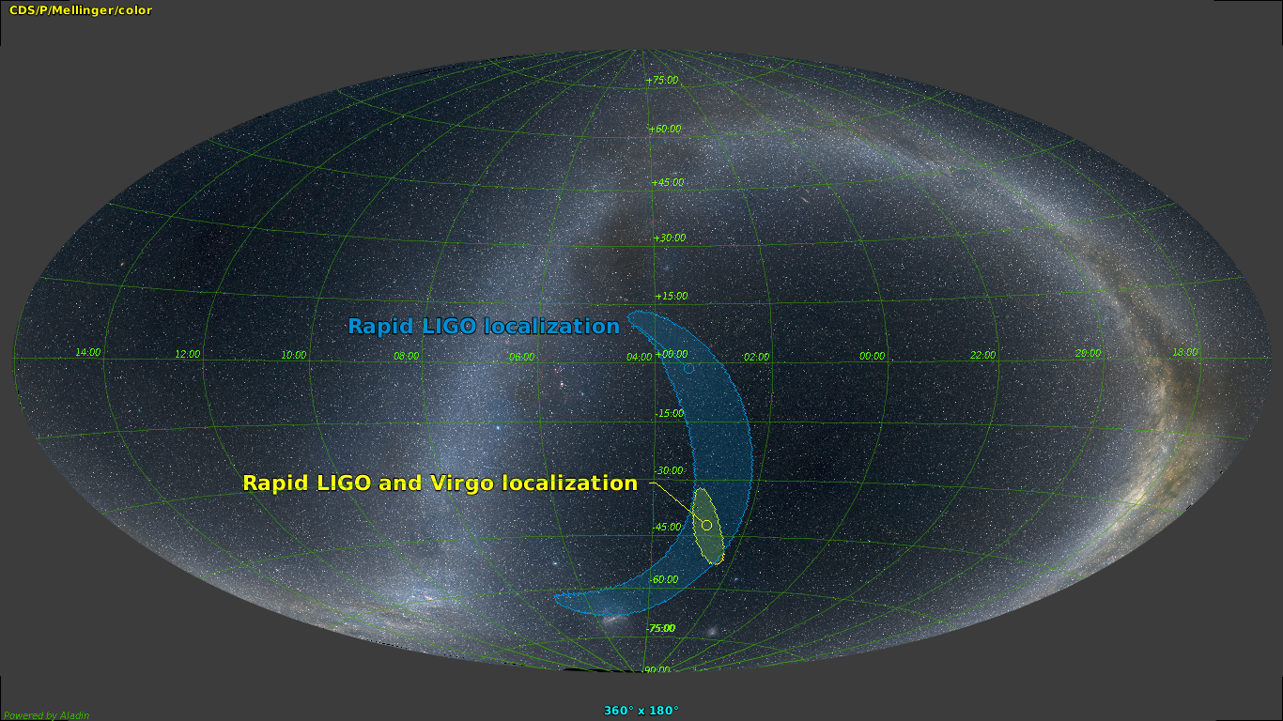
GW170814 The first BH-BH network observation
Physical Review Letters 119(14),141101
SNR=7.3
SNR=13.7
SNR=4.4
The sky region for GW170814 has a size of only 60 square degrees, more than 10 times better than for the two LIGO interferometers alone
Polarization
Virgo doesn’t respond in the exactly same way to passing gravitational waves as the LIGO detectors because of its orientation on Earth, meaning that one can test polarizations of gravitational waves.
The analysis of the data shows that Einstein’s prediction is strongly favored

Slide 18
GW170814 factsheet
signal-to-noise ratio: 18
false alarm rate: < 1/27,000 years
probability of noise producing V1 SNR peak: 0.3%
Redshift: 0.07 to 0.14
primary BH mass: 28-36 (31 median) SM
secondary BH mass: 21-29 (25) SM
Remnant BH mass: 51-56 (53) SM
Remnant BH spin: 0.65 – 0.77

Slide 19
GW170817 – NS-NS coalescence
Physical Review Letters 119(16),161101
The signal is clearly visible in the time-frequency plane for the three detectors with different SNR:
  H1: 18.8;
  L1: 26.4;
  V1: 2.0;
Combined SNR: 32.4
  It is the strongest signal detected so far:
    GW150914: 24;
    GW161226: 13;
    GW170114: 13;
    GW170814: 18;
  It is also the longest
    About 100 s vs 0.2 – 1 s;

Slide 20
GW170817 – the role of VIRGO
The signal is scarcely visible in Virgo data;
Nonetheless, Virgo horizon, at the event date was about 58 Mpc (L1: 218 Mpc and H1: 107 Mpc);
From waveform analysis, the source distance can be estimated to be around 40 Mpc
This contradiction can be explained with the source position with respect to the interferometer antenna pattern
As it is well known, interferometers are not isotropically sensitive

Slide 21
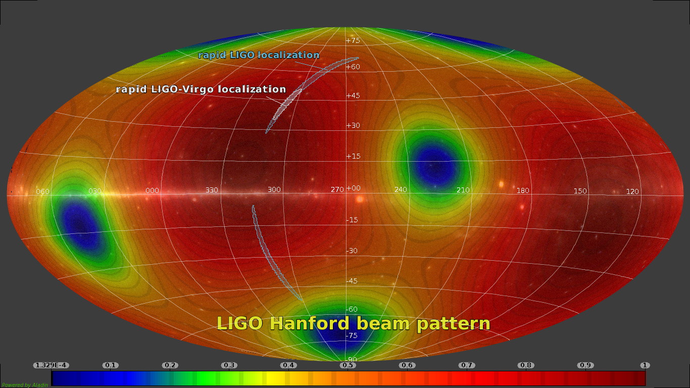

Slide 22
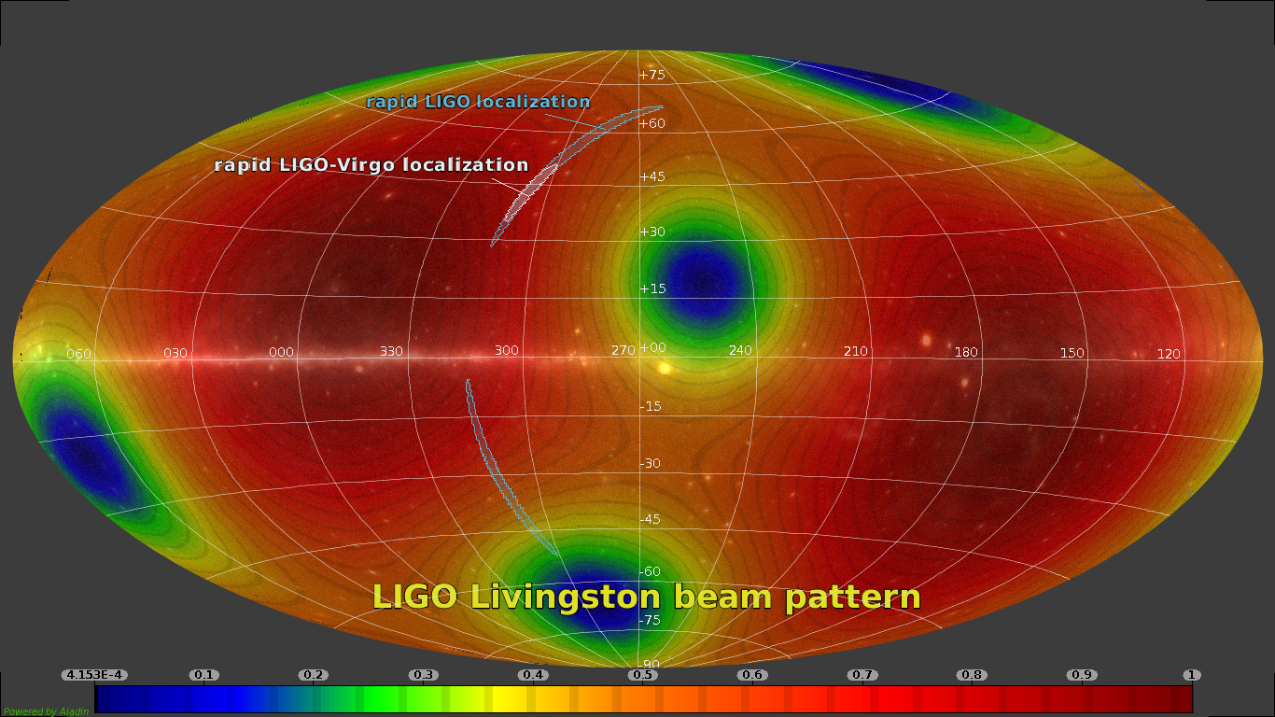

Slide 23
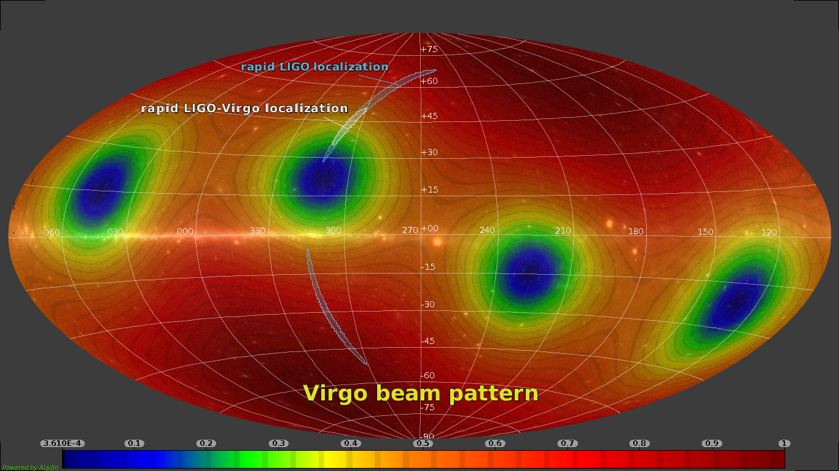

Slide 24
GW170817 – the role of Virgo: source localization
Although Virgo data have not been used to estimate the source physical parameters, its role has been fundamental in the source localization.
The localization with LIGO data only, determines an area of 190 deg²;
With the inclusion of Virgo information, this area is reduced to 28 deg²;
The distance to source is 40 Mpc (130 millions of light years);
We will se later how the distance can be found by GW data only

Slide 25
GW170817 – Source characteristics
Source characteristics have been extracted using different pipelines, based on the matched filtering technique, with a template bench with a combined mass ranging from 2 to 100 solar masses;
The total mass of the system is between 2.73 and 3.29 M_{S};
Each component mass is between 0.86 and 2.26 M_{S};
A strong correlation between mass ratio and the spin of the components does not allow to identify the individual components masses

Slide 26
Coincidences with other observatories
21516 LIGO/Virgo G298048: Potential host galaxies from the GLADE catalog
21515 LIGO/Virgo G298048: IPN triangulation of Fermi/GBM trigger 524666471/170817529
21514 LIGO/Virgo G298048: Astrosat CZTI upper limits
21513 LIGO/Virgo G298048: Further analysis of a binary neutron star candidate with updated sky localization
21512 LIGO/Virgo G297595: Liverpool Telescope observations of MASTER transients
21511 LIGO/Virgo G298048: COINCIDENT IceCube neutrino candidate with Fermi GBM trigger 524666471/170817529
21510 LIGO/Virgo G298048: correction to the luminosity distance reported in GCN 21509
21509 LIGO/Virgo G298048: Identification of a binary neutron star candidate coincident with Fermi GBM trigger 524666471/170817529
21508 LIGO/Virgo G298048: FOUND COINCIDENT IceCube neutrino observation
21507 LIGO/Virgo G298048: INTEGRAL detection of a prompt gamma-ray counterpart
21506 LIGO/Virgo G298048: Fermi GBM trigger 170817.529 and LIGO single IFO trigger
21505 LIGO/Virgo G298048: Fermi GBM trigger 524666471/170817529: LIGO/Virgo Identification of a possible gravitational-wave counterpart

Slide 27
Astrophysical Journal Letters 848(2),L13

Slide 28
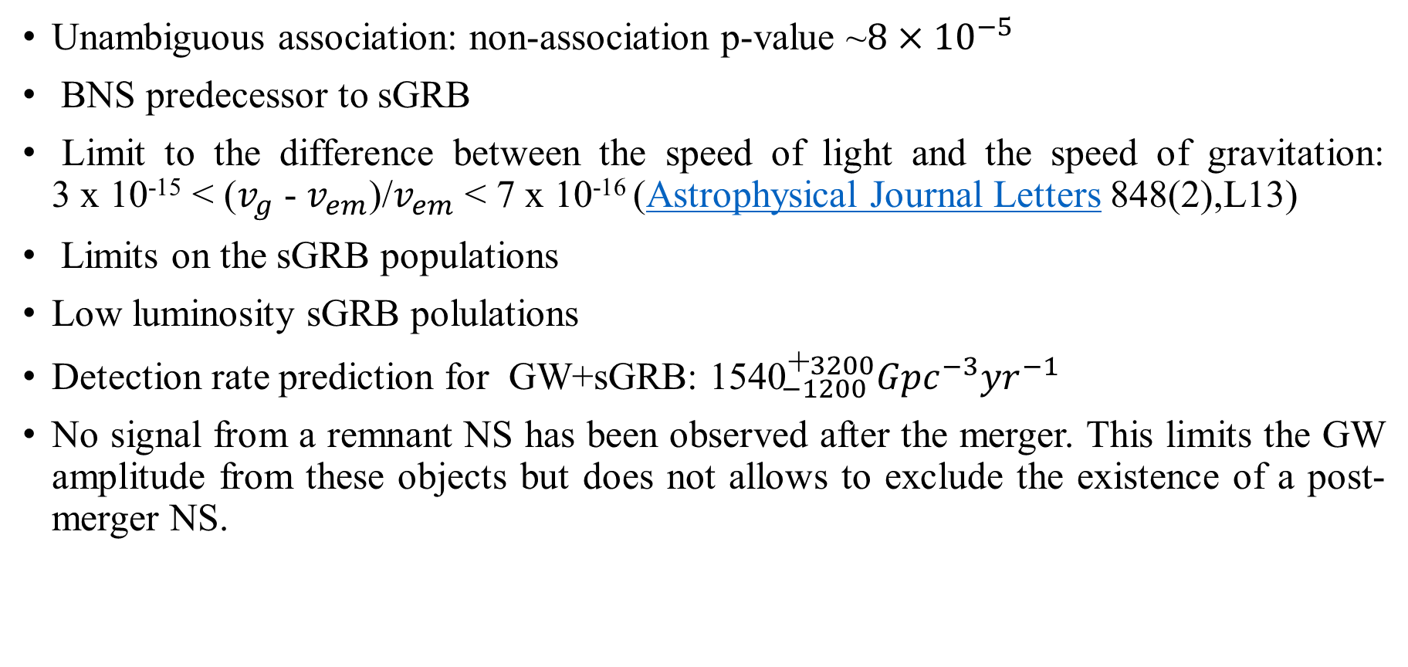
Implications of a coincident observation with GRB
Unambiguous association: non-association p-value ~$8×{10}^{−5}$
BNS predecessor to sGRB
Limit to the difference between the speed of light and the speed of gravitation:
3 x 10⁻¹⁵ < ($v_{g}$ - $v_{em}$)/$v_{em}$ < 7 x 10⁻¹⁶ (Astrophysical Journal Letters 848(2),L13)
Limits on the sGRB populations
Low luminosity sGRB polulations
Detection rate prediction for GW+sGRB: ${\text{1540}}_{−1200}^{\text{+}3200}{Gpc}^{−3}{yr}^{−1}$
No signal from a remnant NS has been observed after the merger. This limits the GW amplitude from these objects but does not allows to exclude the existence of a post-merger NS.

Slide 29
Electromagnetic counterparts
Optical
An optical counterpart has been observed by Swope and DECam in the NGC4993 galaxy in the Hydra (Science, 358 (6370), and Astrophysical Journal Letters 851(1),L16)
An image of the same galaxy taken 20 days before clearly shows that this object was not present.

Slide 31
Electromagnetic counterparts
Optical, UV, IR, Radio, X
Several other observatories followed the source evolution for many days. Apparently it is a kilonova.
It is the first time an astronomical object is studied with so many information from different messengers
The multi-messenger GW astronomy has born.

Slide 32
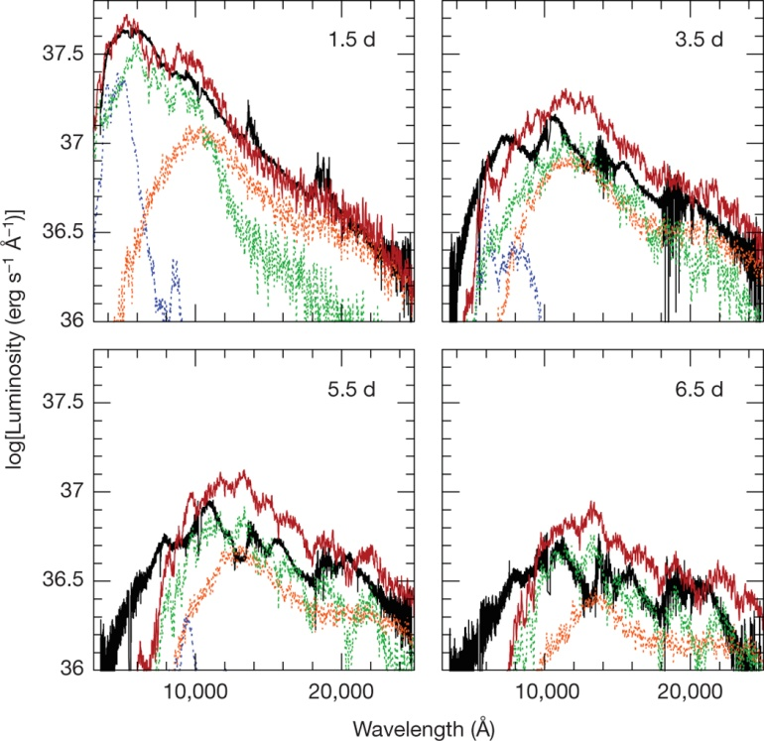
Kilonova models compared with the AT 2017gfo spectra
Electromagnetic counterparts
Optical
observational data
lanthanide-rich dynamical ejecta region
wind region with mixed (lanthanide-free and lanthanide-rich) composition
wind region with lanthanide-free composition
sum of the three model components
E Pian et al. Nature 551, 67–70 (2017) doi:10.1038/nature24298

Slide 34
Electromagnetic counterparts
X-Ray
9 days after the GW trigger, an X-ray counterpart has been discovered with Chandra
The x-ray light curve is consistent with
the afterglow of a GRB viewed off-axis
Troja et al., Nature (2017)

Slide 35
Electromagnetic counterparts
Radio
A radio counterpart detection consistent with the HST position of SSS17a/AT 2017gfo was observed 16 days after GW170817
Astrophysical Journal Letters 848(2),L21
Light curve is consistent with:
emission from an ultra relativistic jet viewed off-axis;
emission from a “cocoon" of mildly relativistic ejecta

Slide 36
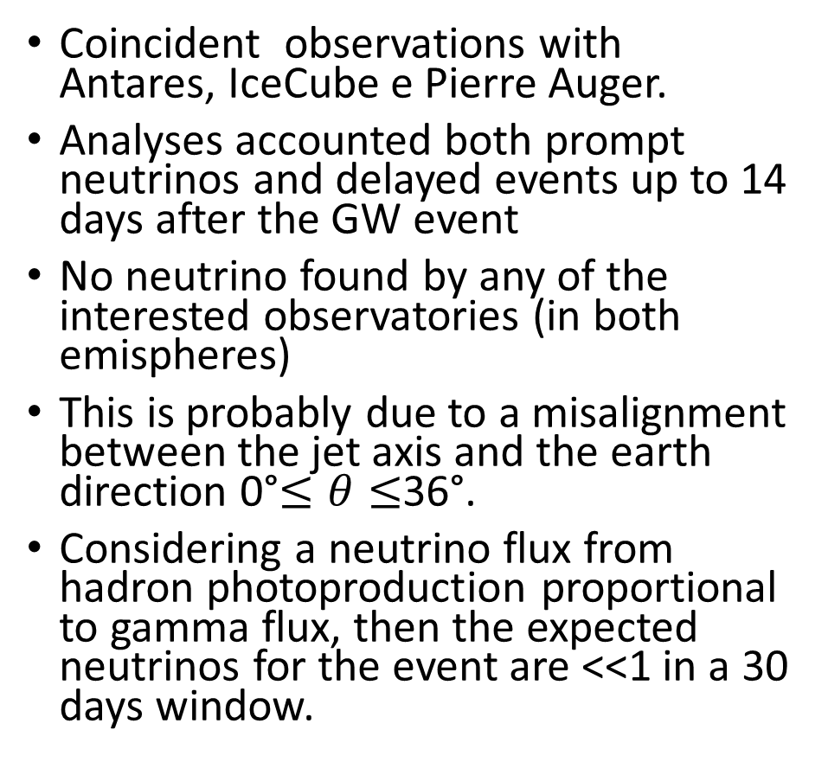
No Neutrino
Astrophysical Journal Letters 850(2),L35
Coincident observations with Antares, IceCube e Pierre Auger.
Analyses accounted both prompt neutrinos and delayed events up to 14 days after the GW event
No neutrino found by any of the interested observatories (in both emispheres)
This is probably due to a misalignment between the jet axis and the earth direction 0°$≤θ≤$36°.
Considering a neutrino flux from hadron photoproduction proportional to gamma flux, then the expected neutrinos for the event are <<1 in a 30 days window.

Slide 37
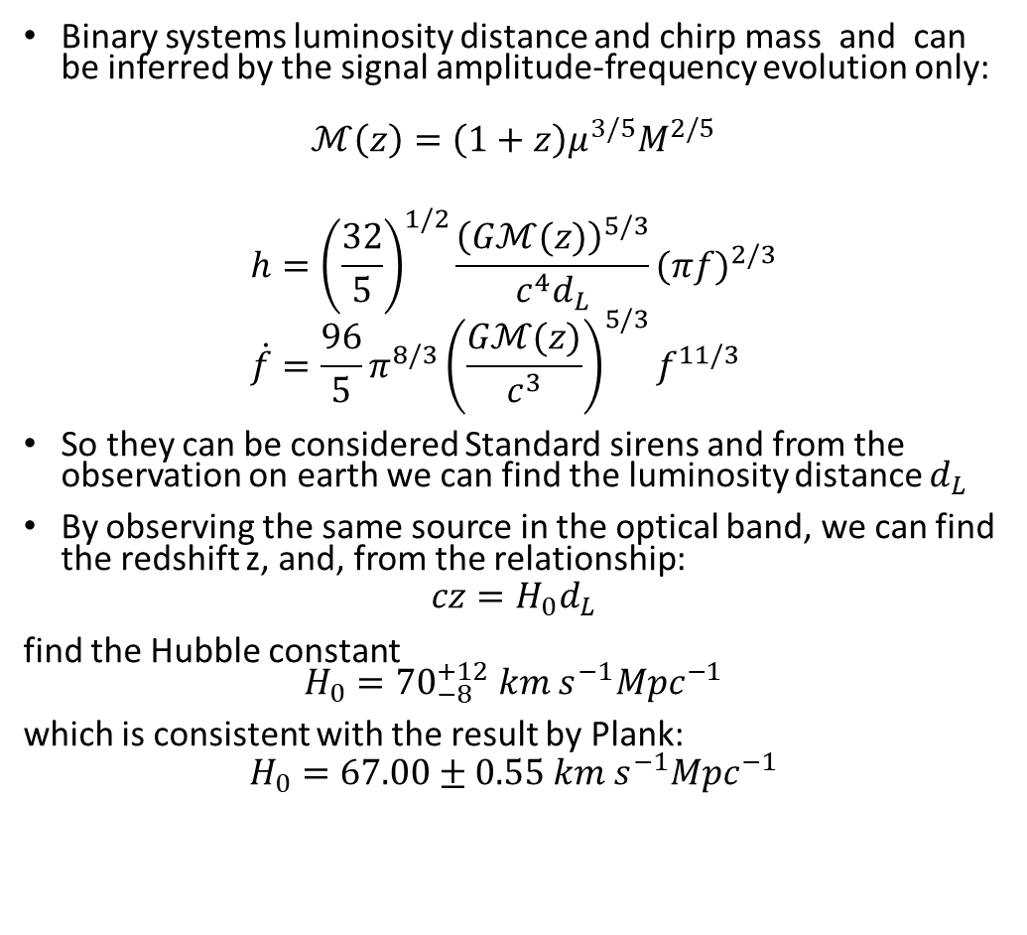
Hubble constant measurement
Binary systems luminosity distance and chirp mass and can be inferred by the signal amplitude-frequency evolution only:
$$ℳ\left(z\right)=\left(1+z\right)μ^{3/5}M^{2/5}$$
$$h={\left(\frac{32}{5}\right)}^{1/2}\frac{{\left(Gℳ(z)\right)}^{5/3}}{c^{4}d_{L}}{(πf)}^{2/3} \\ \dot{f}=\frac{96}{5}π^{8/3}{\left(\frac{Gℳ(z)}{c^{3}}\right)}^{5/3}f^{11/3}$$
So they can be considered Standard sirens and from the observation on earth we can find the luminosity distance $d_{L}$
By observing the same source in the optical band, we can find the redshift z, and, from the relationship:
$$cz=H_{0}d_{L}$$
find the Hubble constant
$$H_{0}={70}_{−8}^{+12} km{ s}^{−1}{Mpc}^{−1}$$
which is consistent with the result by Plank:
$$H_{0}=67.00±0.55 km{ s}^{−1}{Mpc}^{−1}$$
Astrophysical Journal Letters 848(2),L13

Slide 38
After 02 observing run
After the end of the O2 run in August 2017, the next common observation run O3 is foreseen to start early 2019. The period between the runs is used for upgrading the detectors and improving the sensitivities.
Reserve commissioning time
Limit the number of upgrades
Minimum target sensitivity for O3: 60 Mpc
Main benefit should come from putting back the monolithic suspension
  Removing the steel wire thermal noise from noise budget should give a 20 Mpc range increase
Theoretical limits: 100 Mpc @13W, no squeezing

Slide 39
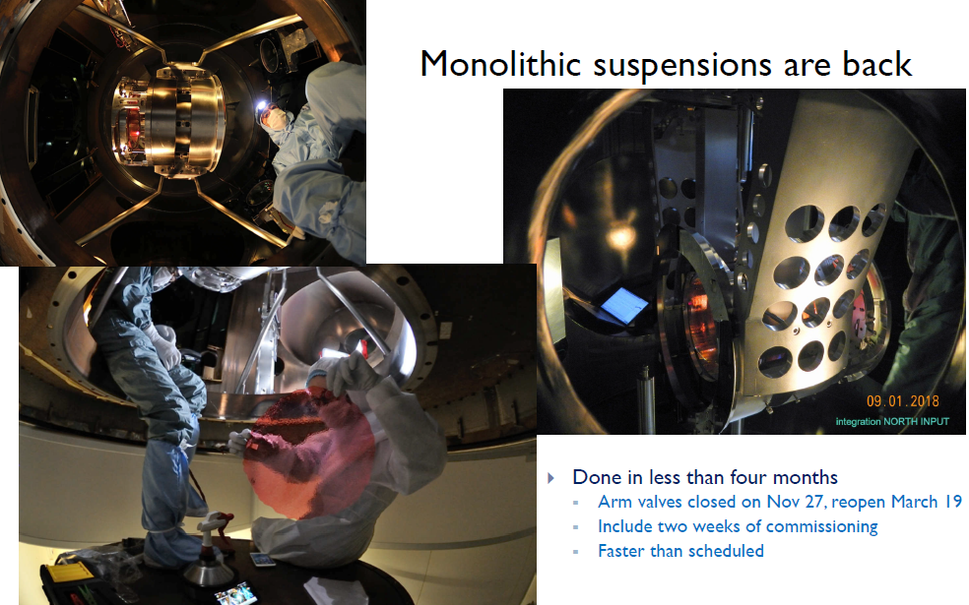

Slide 40
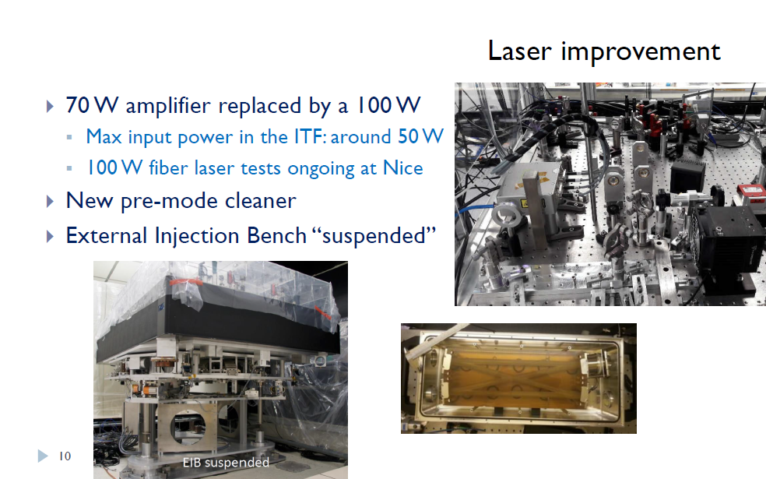

Slide 41
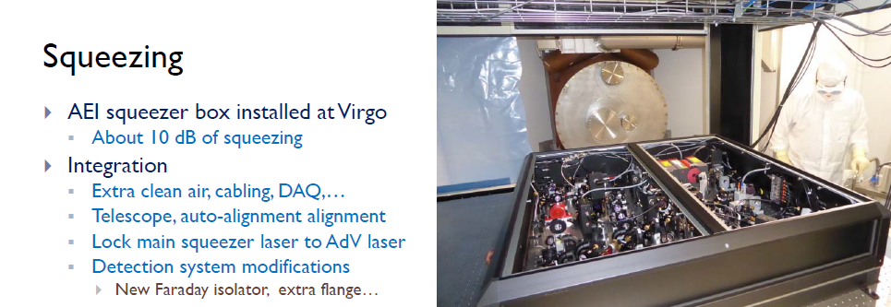
Squeezed light
Increasing the laser power for further reducing shot noise is difficult while maintaining the required high beam quality and low noise.
Thermal Effects,
Pressure noise
Parametric instabilities i.e. excitations of mirrors’ internal vibrations interacting with high-order resonance modes of the arm cavities
Can be reduced by injecting squeezed vacuum states in the detection system

Slide 42
Newtonian noise monitoring and cancellation
Masses moving near the suspended mirrors, e.g. due to seismic vibrations, exert a varying force on the mirrors and can thus create a noise.
An array of seismometers was installed in one of the end buildings for characterizing the seismic excitation field and developing models in view of a future subtraction of this noise from the GW signal.
After completing the installation of these upgrades, Virgo is presently in commissioning mode for achieving the projected sensitivity for the O3 run.

Slide 43
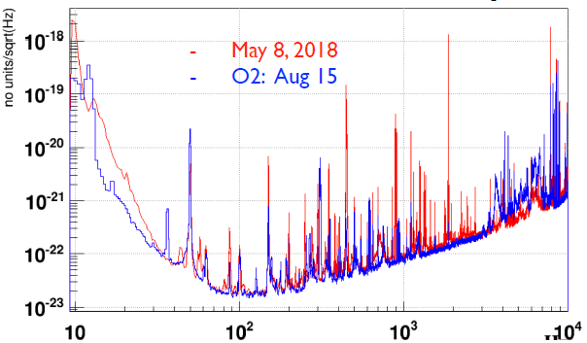
First recoveries after upgrades
Commissioning
Usual noises/glitches reduction
Robustness
Commissioning of the squeezer
Power increase
  Max power for O3: 50W
‥◻ Not critical for the BNS range…
Engineering Runs
Once per month over a weekend
Long ER priori O3
O3 start early 2019; aligned with LIGO

Slide 44
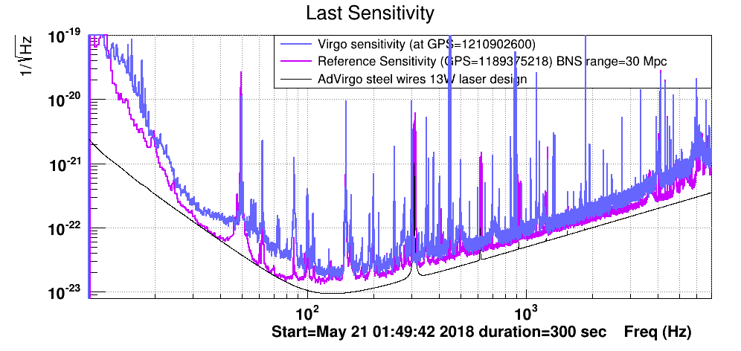
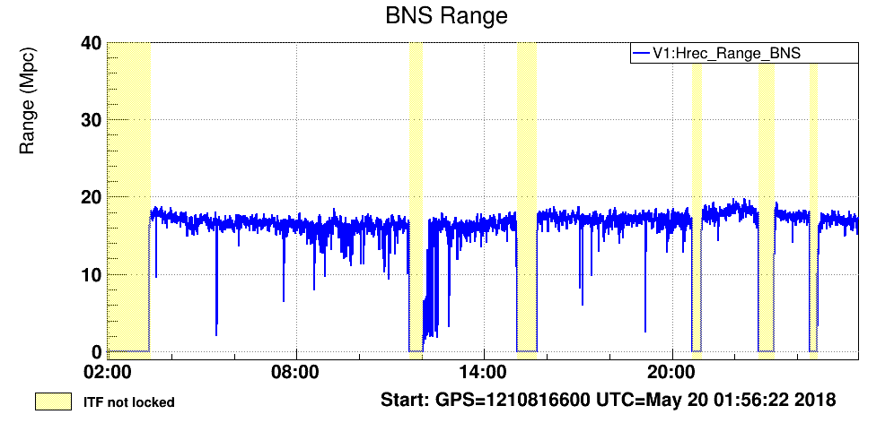
First Engineering run May 18-21

Slide 45
What next?

Slide 46
Conclusions
Advanced Virgo joined the second scientific run, despite the problems encountered.
It has been fundamental in the localisation of the sources observed during the joint run.
A network of GW detectors is ready to observe and proved to be capable to accurately locate sources in the space.
A new chapter in the multimessenger astronomy has started and a lot of physics can be done.
Now we are upgrading the detector to make a new joint observing run from next year.

