Slide 1
Prospettive di applicazioni industriali sulla Tomografia Muonica
Contributo del gruppo di Fisica Fondamentale Nucleare e Applicata
Dipartimento di Ingegneria Meccanica e Industriale
Università di Brescia e INFN Pavia
Aldo Zenoni, Germano Bonomi, Antonietta Donzella, Davide Pagano, Matteo Ferrari
... we started to investigate the possibility to use
the cosmic ray muons to monitor the alignment of physical part of a vertical structure (tower, pillar, mechanical press, etc., etc.) ...

Slide 2
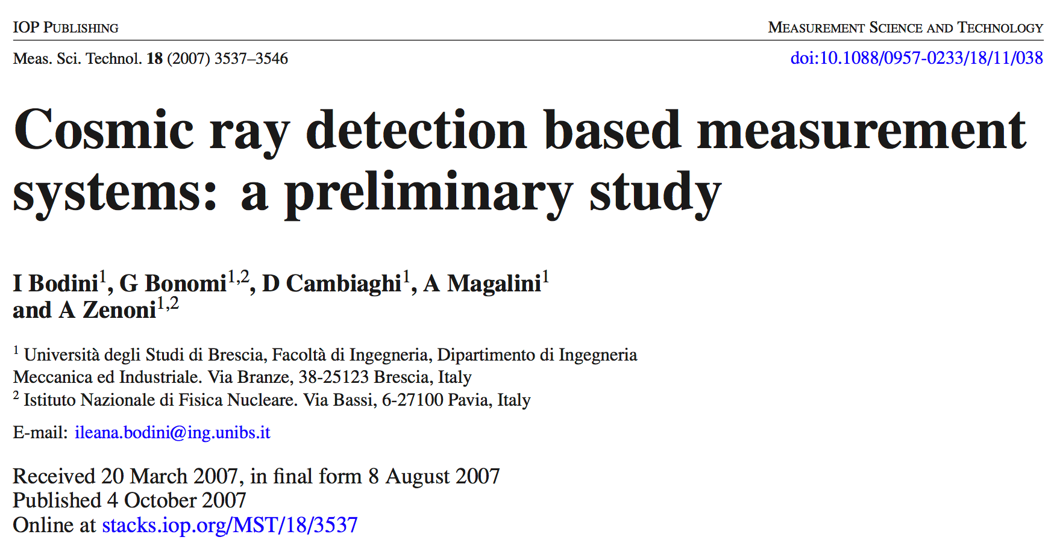
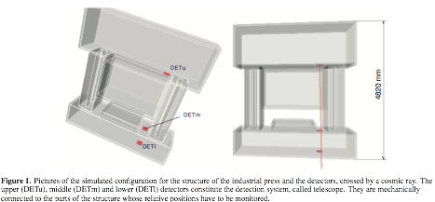
…
This paper is aimed at assessing potentialities and limits of muon detection techniques, when applied outside the field of Particle and Nuclear Physics, with particular reference to the engineering applications, such as alignment and positioning measurements and monitoring on large mechanical
and civil structures.
...

Slide 3
after the “mechanical press” study, we investigated the possibility of using cosmic muons for the stability monitoring of historical building

Slide 4
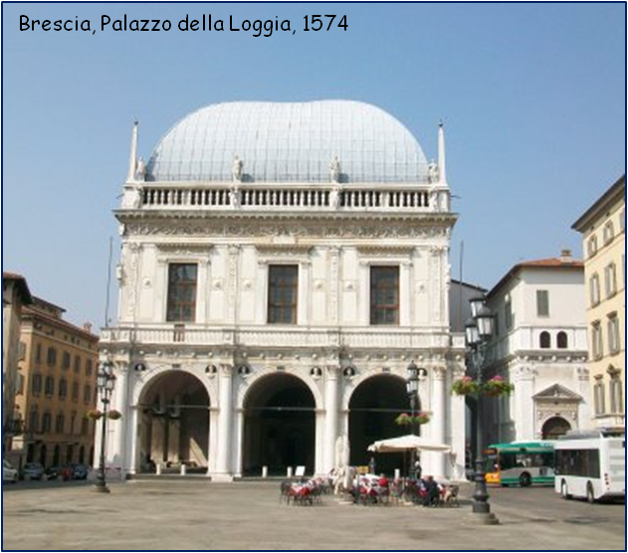
Historical building stability monitoring with cosmic ray muons
MONSTER&CO project (2013-14)
MONitoraggio di STrutture Edili mediante Raggi Cosmici
Project of Dipartimento di Ingegneria Meccanica
e Industriale, Università di Brescia
A.ZENONI, G. BONOMI,
A.DONZELLA, D. PAGANO,
G.BARONIO, I. BODINI
Department of Mechanical and Industrial Engineering, University of Brescia, Italy
O. BARNABA’, F. FALLAVOLLITA,
R. NARDO’, M. ROSSELLA, P. VITULO
Department of Physics,
University of Pavia , Italy
G. ZUMERLE
Department of Physics,
University of Padova , Italy

Slide 5
The case study: the “Palazzo della Loggia”, Brescia - Italy
The roof was reconstructed in 1914 with shape and construction technique as the original one destroyed in 1575 by a fire
Constructon of the actual roof, 1914
25 x 50 m²
16 m height
Wooden vaulted roof, reconstructed in 1914
Immediately after reconstruction, the roof exhibited a progressive deformation of the top beam and key points of the arches
Top beam deflections
19.0 cm in 1923
52.0 cm in 1945
80.0 cm in 1980
Brescia, Palazzo della Loggia, 1574
Studies reported here have been performed by the
“Centro di studio e ricerca per la conservazione ed il recupero dei
beni architettonici ed ambientali”
Dipartimento di Ingegneria Civile, University of Brescia
Detail of a joint

Slide 6
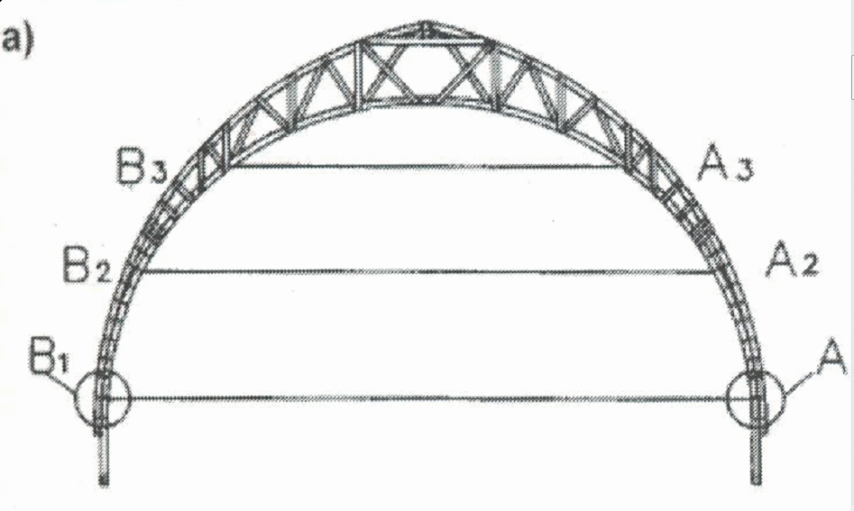
The stability monitoring of the roof
of the “Palazzo della Loggia”
11 years
A1 – B1
25 m
displacement (mm)
time (days)
Pairs of steel and invar wires compensation of thermal deformations
A2 – B2
Progressive deformation : 1 mm/yr
Elongation of the wires monitored mechanically (vernier); sensitivity 0.1 mm
displacement (mm)
time (days)

Slide 7
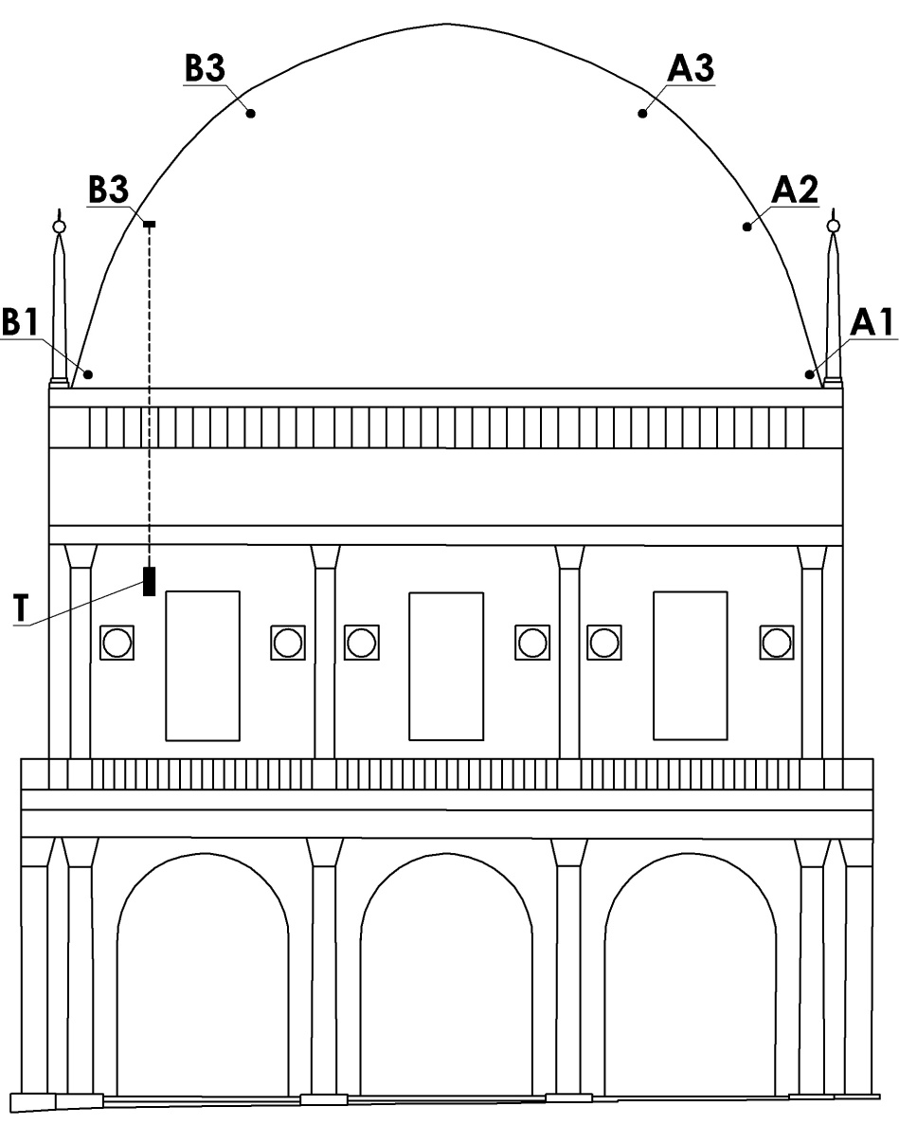
A basic idea: a simple cosmic ray tracking system
tracked μ
Why evaluating cosmic rays
Continuous rain of 210 000 μ/s
P_{rec}
PROS
natural radiation, continuous
no artificial source, no radiological risks
muos are highly penetrating; walls and floors are easily traversed
no need of visibility or empty spaces
limited invasiveness and flexibility
possibility to design a global monitoring system (one telescope, more targets)
easy measurements with “standard” techniques in physics
y
x
B2
target in the point to be monitored
muon telescope
CONS
stochastic nature of muon deviations in crossing matter
need to cumulate statistical distributions for application of statistical inference
fixed rate of cosmic ray radiation which implies “long” data takings
unfit when a prompt response is needed
telescope fixed to the building structure
100 cm
40 cm
40 cm

Slide 8
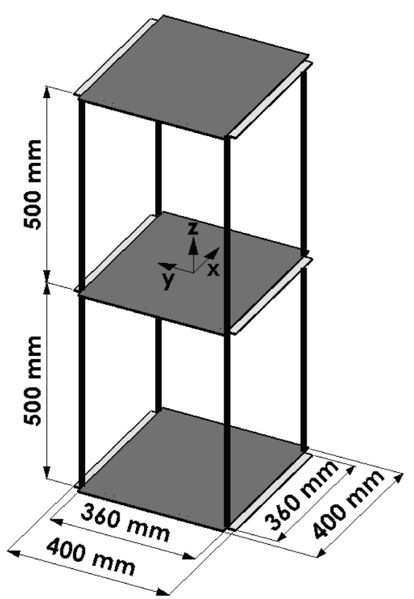
A (possible) cosmic ray muon detector
Detector features required for the application
double layers of scintillating (3 x 3) mm² fibers
fibers coupled to SiPMs
low voltage operation
good spatial and time resolution
necessary to correlate reconstructed events
in the two independent telescopes
Muon telescope
400 mm
400 mm
read by SiPM 3 x 3 mm²

Slide 9
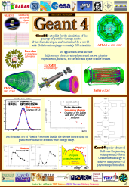
Simulation of the “Palazzo della Loggia”
Antonietta Donzella
GEANT4 VMC simulation of the displacement resolution as a function of time
15 cm of wood
GEANT4 Simulation:
realistic muon generator¹
geometry and the materials of the detectors
relevant structure of the building
(such as the 15 cm wood roof)
¹ from “L. Bonechi et al., in Proc. 29th Int. Cosmic Ray Conference, (Pune, 9 2005) p. 283”

Slide 10
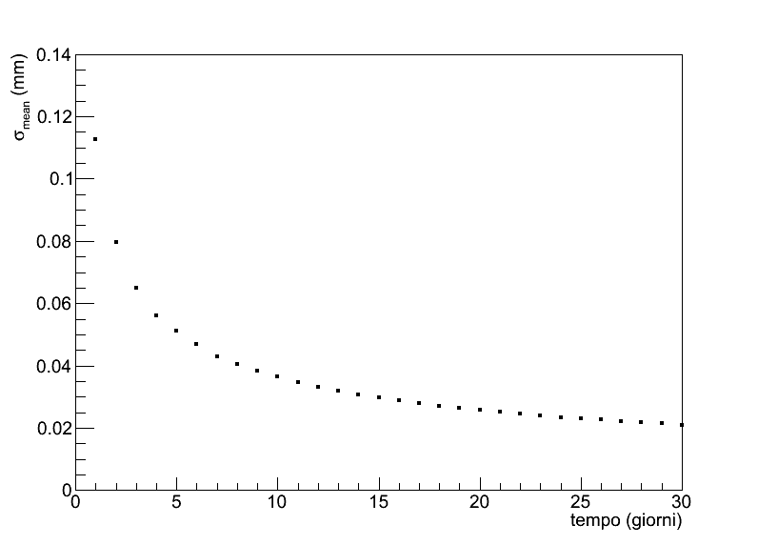
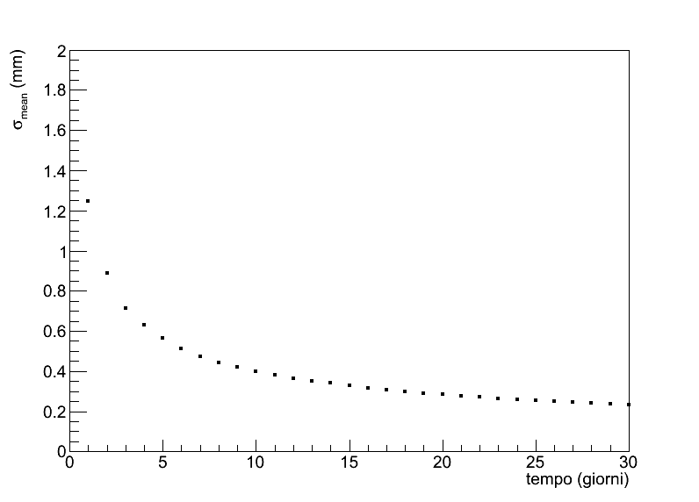
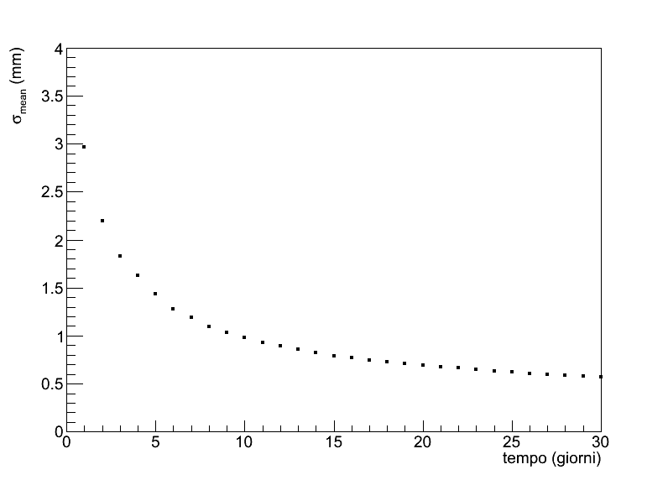
Simulation of the displacement resolution
15 days
Difference between the coordinate
measured in the target detector and that obtained with the extrapolation based on the detector telescope measurement
precision curve B1
N (eventi)
0.03 mm
15 gg
N (eventi)
Δy (cm)
precision curve B2
15 gg
B3
0.33 mm
Δy (cm)
N (eventi)
B2
precision curve B3
15 gg
13.00 m
0.79 mm
Δy (cm)
8.80 m
15 cm of wood
B1
3.50 m
3.00 m
1.00 m
σ_{mean} = σ_{distr}/√N

Slide 11
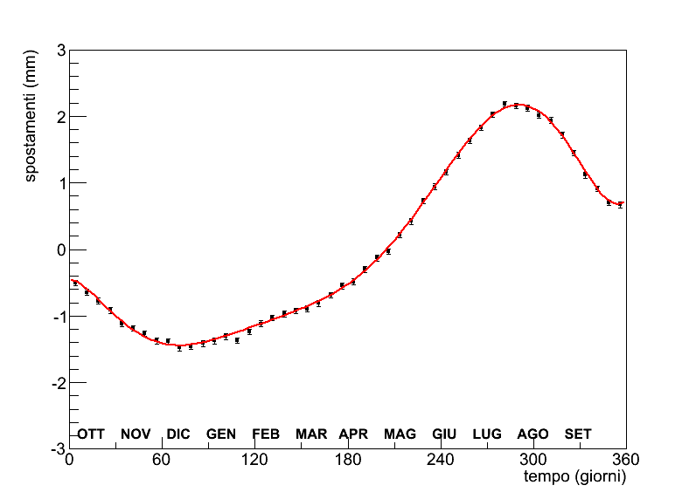
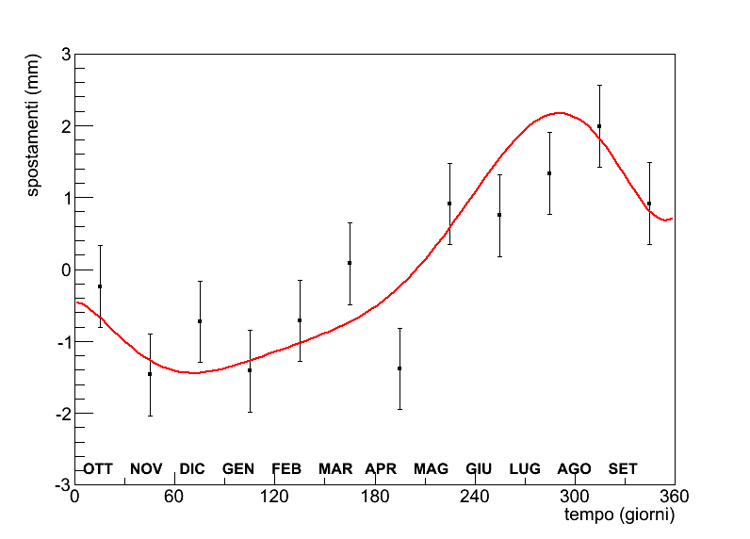
Simulation of the seasonal displacement
Details in “A. Donzella, Il nuovo cimento, Vol. 37 C (2014) 223"
displacement in B1
7 days sampling
displacement (mm)
MC
DATA
·
15 cm of wood
time (days)
displacement in B2
15 days sampling
displacement (mm)
MC
DATA
·
Real data
plate B2
time (days)
displacement in B3
30 days sampling
displacement (mm)
MC
DATA
displacement (mm)
·
1 year
time (days)
A more refined statistical analysis can improve the resolution
time (days)

Slide 12
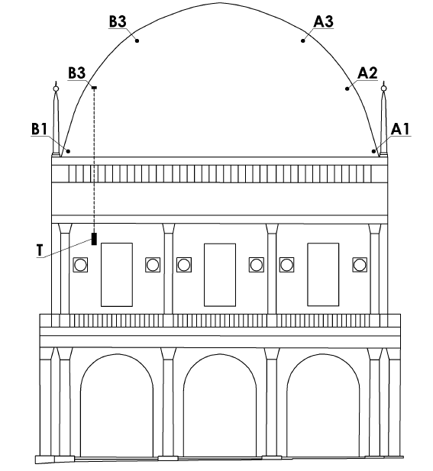
Possible improvements of the performance of the monitoring system
Improve the design of the measurement system
Increasing the module dimensions
Filtering low momentum muons with absorbers and coincidence techniques
Using two indipendent telescopes to measure the muon direction at the “muon target” too
indipendent telescopes

Slide 13
Possible improvements of the performance of the monitoring system
Improve the reconstruction alghorithms
Use a more efficient estimator of the “muon target” position: a parameter of the Δy parent population shape (measured or calculated by Monte Carlo)
If muon direction is measured too at “muon target” a more realistic model for the muon trajectory extrapolation (broken line) can be adopted
muon target
straight line model extrapolation
broken line model extrapolation
measurement of position and direction
geometrical information
concrete ceiling
concentrated scattering
muon telescope

Slide 14
Design and development of a small-scale prototype

Slide 15
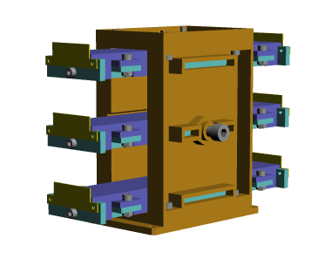
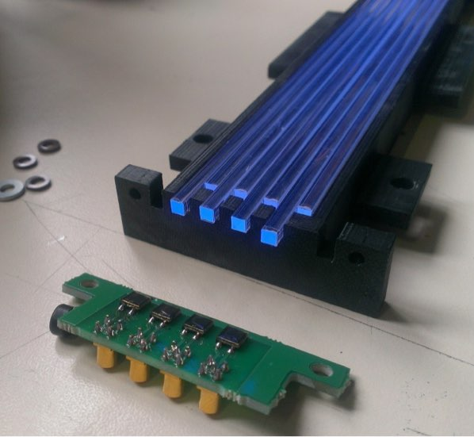
A small-scale detector prototype
Two hodoscopes (“telescopes”in the following) composed by three detecting layers
All the mechanical supports (ABS) created with a 3D printer
Each layers composed by 8 scintillating fibers (from Saint-Gobain)
Each fiber coupled to a SiPM (SiPM3S-P from AdvanSiD)
(3 x 3 x 200) mm³

Slide 16
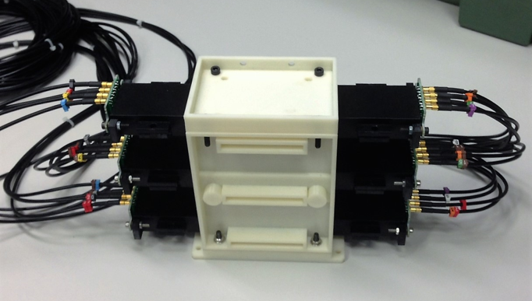
The final telescope

Slide 17
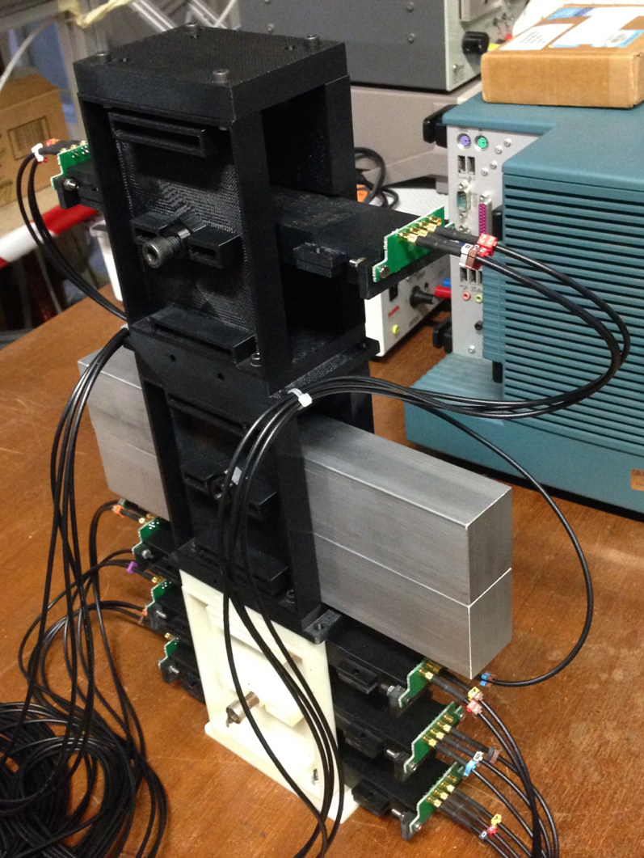
Experimental setup
~10 cm of Al

Slide 18
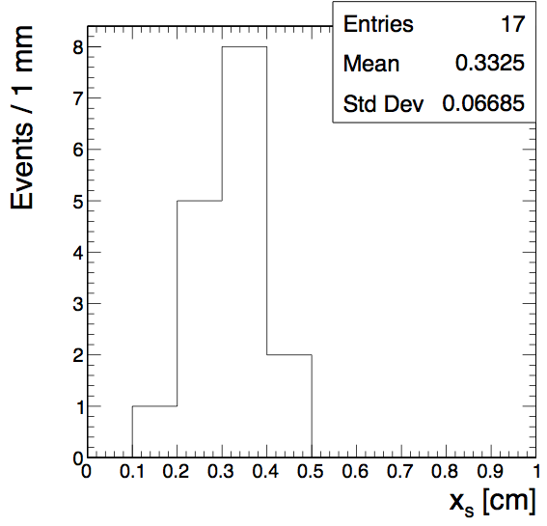
Data and MC comparison for the small-scale prototype
y
xs
xs set to 3.76 mm
DATA
x
17 samples of 100 events each (~2 days)
18

Slide 19
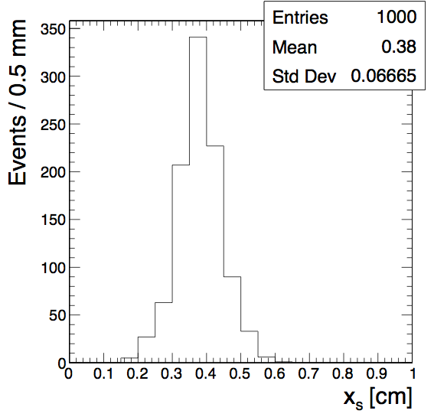
Data and MC comparison for the small-scale prototype
y
xs
xs set to 3.76 mm
MC
x
1000 samples of 100 events each (~2 days)
With systematic uncertainties

Slide 20
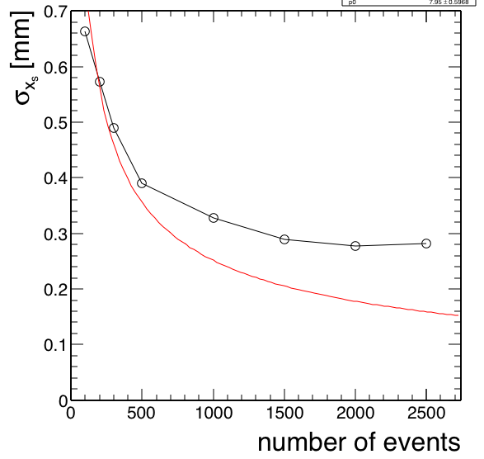
Data and MC comparison for the small-scale prototype
MC
~30 days
Resolution computed with 500 samples
With systematic uncertainties
20

Slide 21
Conclusions
Despite the fixed rate of cosmic ray muons, the possibility of using
muons for the stability monitoring of historical building was
investigated
The technique was applied to a realistic scenario, using the “Palazzo
della Loggia” in Brescia as case study
MC results showed that resolutions smaller than 1 mm could be
achieved with one week of data taking
As a proof of principle, we also developed a small-scale detector
prototype based on the same technology of the proposed detector
We are now designing a specific SiPM readout board and we would
like to build an easy-to-use detector for cosmic ray muons applications

Slide 22
Backup slides

Slide 23
Broken line reconstruction alghorithms
y
θu
xu
xs
x^{ʹ}u
independent of the event
Δx
Given , event :
Δθ
determined by
x^{ʹ}d
Estimate from minimization:
not in scale
θd
xd
x

Slide 24
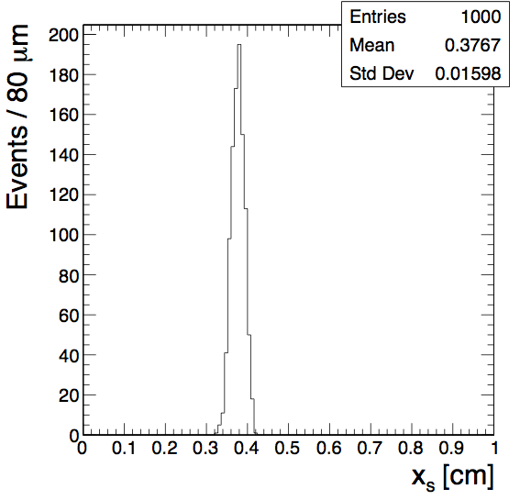
Data and MC comparison for the small-scale prototype
y
xs
xs set to 3.76 mm
MC
x
1000 samples of 1k events each (~3 weeks)
NO systematic uncertainties

Slide 25
Data and MC comparison for the small-scale prototype
MC
detector misalignment
detector noise
detector cross-talk
1000 samples of 100 events each (~2 days)
With systematic uncertainties
25

