Slide 1


PhD thesis on collaborative studies between:
- INFN / Rm1 and CERN
- INFN / Rm1 and ELI
- INFN / Rm1 and SBAI
INFN / Rm1 and Uni Napoli
R. Cimino – LNF-INFN

Slide 2
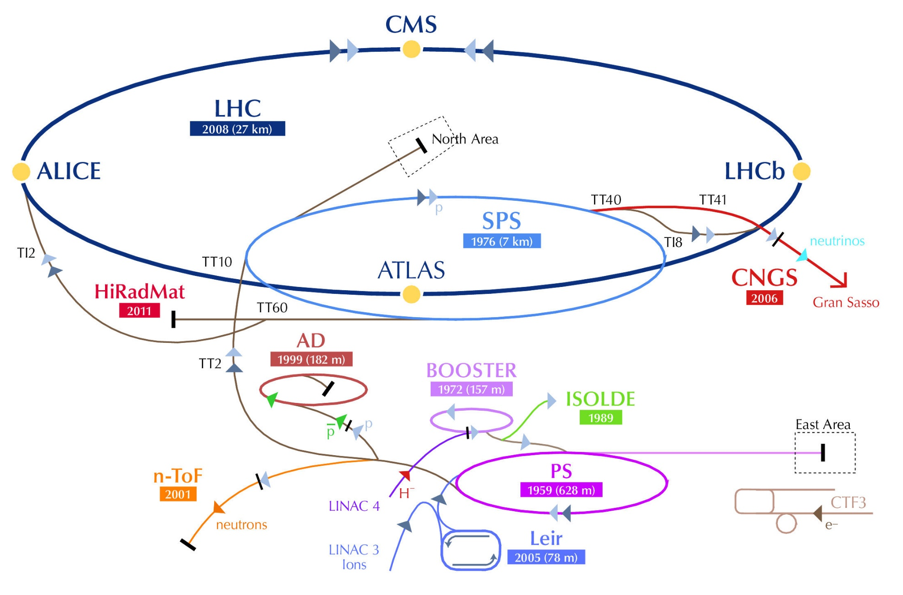
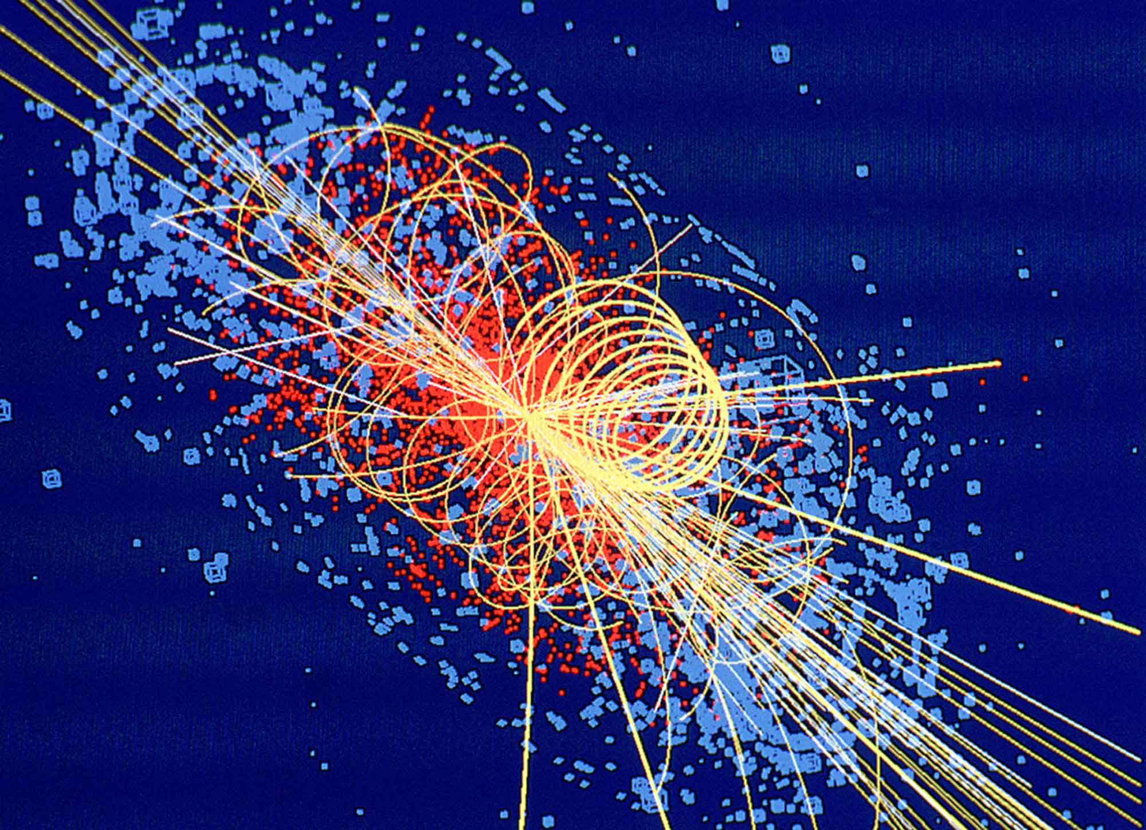
CERN Accelerators Complex
LINAC 2
P

Slide 3
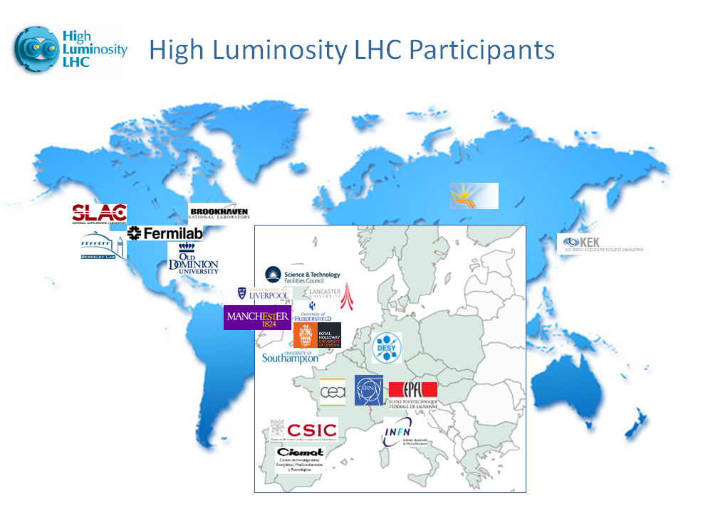
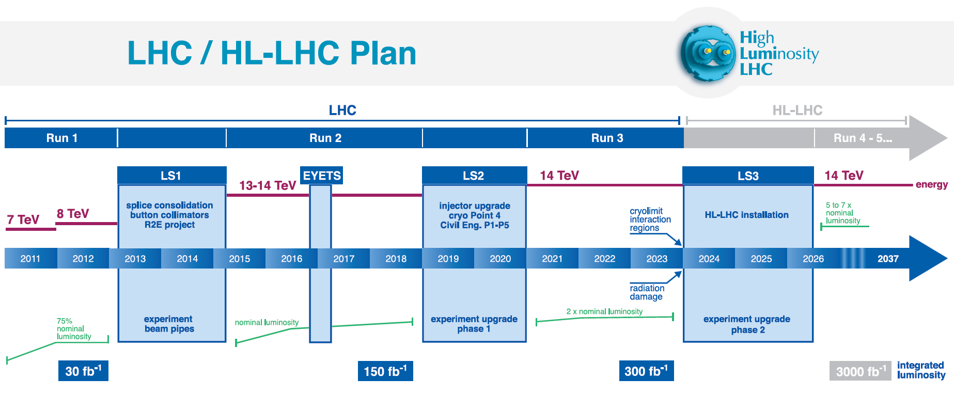
Upgrade of LHC (HL-LHC)
Notes:
EYETS: Extended Year End Technical Stop

Slide 4
The Future Circular Collider project (FCC)
1980
1985
1990
1995
2000
2005
2010
2015
2020
2025
2030
2035
20 years
Constr.
Physics
LEP
Design
Proto
Construction
Physics
LHC
Design
Construction
Physics
HL-LHC
FCC
Design
Proto
Construction
Physics

Slide 5
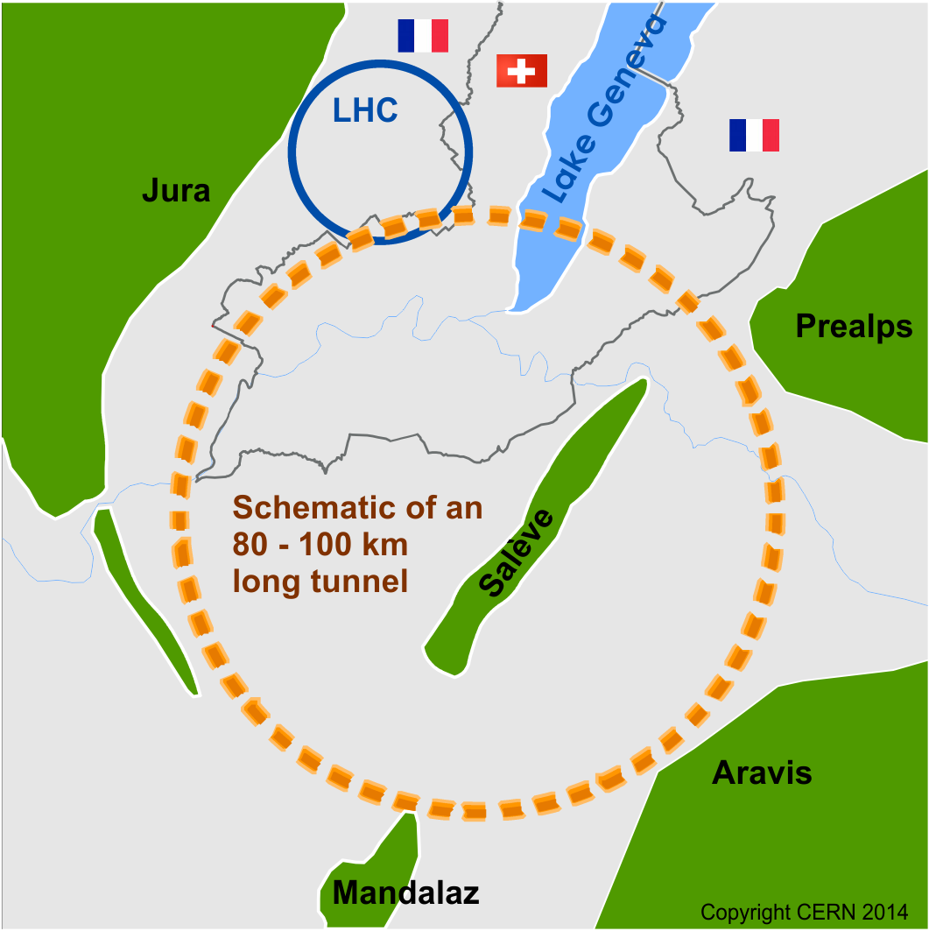
The Future Circular Collider project (FCC)
international FCC collaboration to study:
pp-collider (FCC-hh) → main emphasis, defining infrastructure requirements
80-100 km infrastructure in Geneva area
e⁺e⁻ collider (FCC-ee) as potential intermediate step
p-e (FCC-he) option
~16 T ⇒ 100 TeV pp in 100 km

Slide 6
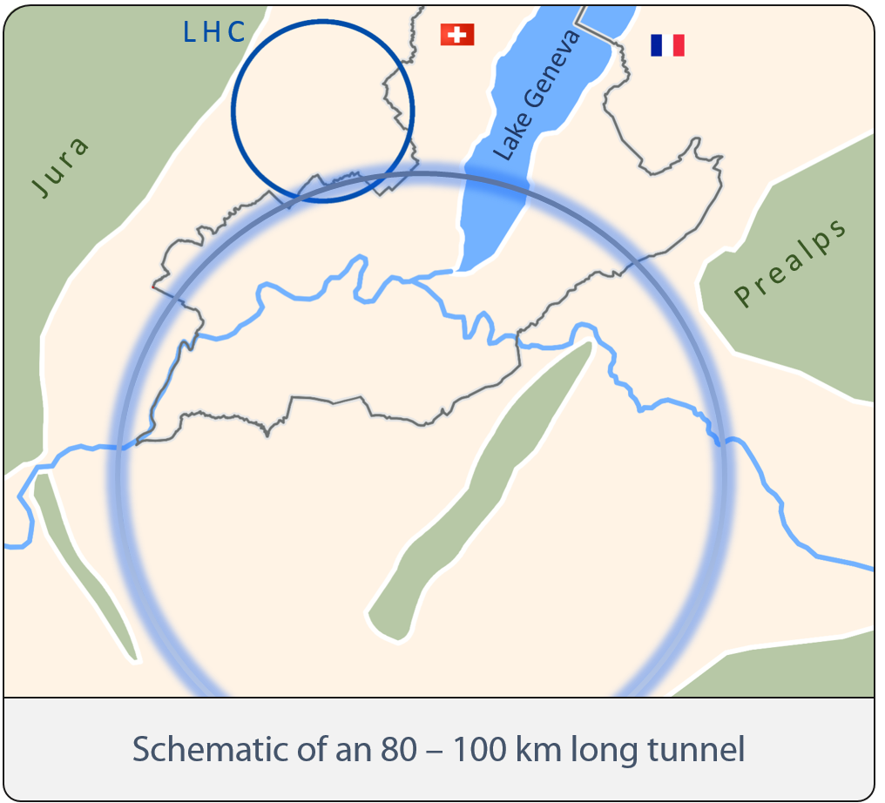
FCC-ee
Key Parameters
Parameter | FCC-ee |  |  | LEP2
Energy/beam [GeV] | 45 | 120 | 175 | 105
Bunches/beam | 16700 | 1360 | 98 | 4
Beam current [mA] | 1450 | 30 | 6.6 | 3
Luminosity/IP x 10³⁴ cm⁻²s⁻¹ | 28 | 6 | 1.8 | 0.0012
Energy loss/turn [GeV] | 0.03 | 1.67 | 7.55 | 3.34
Synchr. Power [MW] | 100 |  |  | 22
RF Voltage [GV] | 2.5 | 5.5 | 11 | 3.5

Slide 7
FCC-hh
Key Parameters
Parameter | FCC-hh | LHC
Energy [TeV] | 100 c.m. | 14 c.m.
Dipole field [T] | 16 | 8.33
# IP | 2 main, +2 | 4
Luminosity/IP_{main} [cm⁻²s⁻¹] | 5-10 x 10³⁴ | 1 x 10³⁴
Energy/beam [GJ] | 8.4 | 0.39
Synchr. rad. [W/m/apert.] | 28.4 | 0.17
Bunch spacing [ns] | 25 (5) | 25

Slide 8
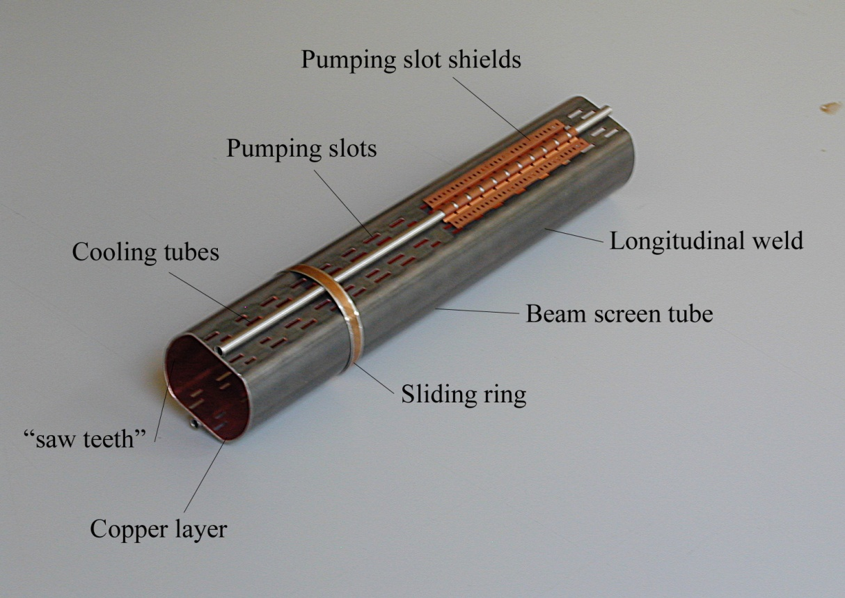
LHC Beam Screens Functionalities
Intercept the heat load induced by the circulating beam (impedance, synchrotron radiation, electron cloud)
Operate between 5 and 20 K
Non-magnetic stainless steel substrate to withstand quench forces (few tons) and to ensure a good field quality
Copper colamination onto non-magnetic stainless steel to reduce impedance
Courtesy N. Kos CERN AT/VAC
Pumping holes to control the gas density
Rounded pumping slots to reduce electromagnetic leakage towards the cold bore held at 1.9 K or 4.5 K
Electron shield to protect the cold bore from the heat loads induced by the electron cloud
Saw teeth to reduce photoelectron yield and forward reflectivity of photons to decrease the seed of electrons

Slide 9
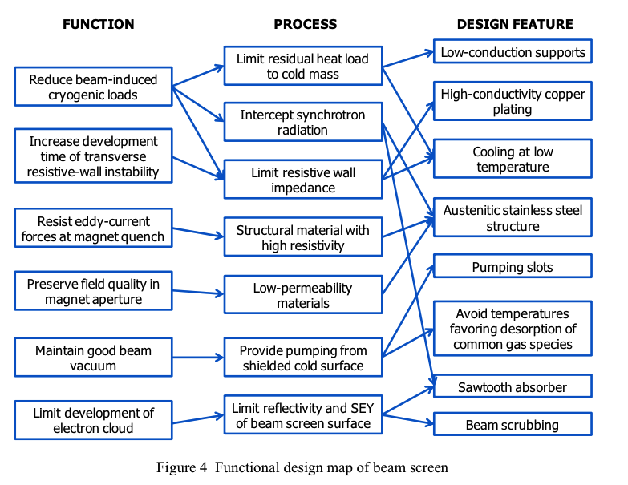
Any adopted solution for the Beam screen has to compel with many other requirements and boundary conditions.
V. Baglin et al CERN-ATS-2013-006

Slide 10
IMPEDANCE
Change in
geometry or electrical conductivity
Wake field = Electromagnetic field generated by the beam interacting with its surroundings (vacuum pipe, etc.)
  Power loss
  Beam instabilities
Impedance = Fourier transform of the wake field (wake function)

Slide 11
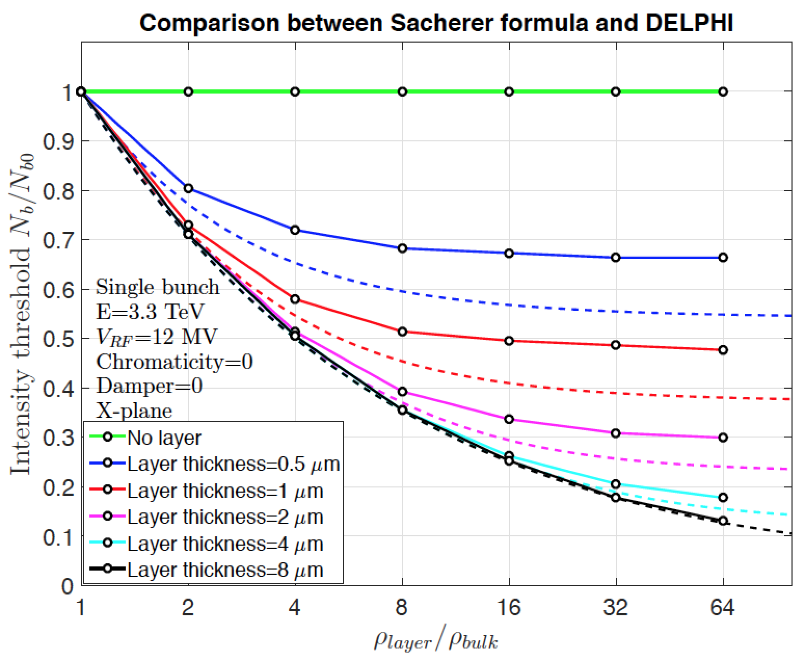
THE IMPEDANCE
  The impedance is a complex function of frequency and at least 5 contributions are needed to correctly characterized an equipment
    Longitudinal impedance
    Horizontal dipolar/driving impedance
    Vertical dipolar/driving impedance
    Horizontal quadrupolar/detuning impedance
    Vertical quadrupolar/detuning impedance
An example:
COATING (e.g. a-C) OR SURFACE TREATMENT (e.g. LESS)
TO FIGHT AGAINST E-CLOUD
    Increase of imaginary part of transverse impedance at high frequency
    Example case of FCC-hh, where laser treatment was proposed as baseline for SEY reduction
Dotted line

Slide 12
An accelerator Vacuum pipe contains low energy electrons that can induce Electron cloud effects
Electron cloud formation in a vacuum pipe
Generation of electrons inside the vacuum chamber
(primary, or seed, electrons)
Desorption from the losses on the wall
Residual gas ionization
Photoelectrons from synchrotron radiation
Thanks to G. Rumolo: workshop "Beam Dynamics meets Vacuum, Collimations, and Surfaces” 8-10 March 2017 Karlsruhe.

Slide 13
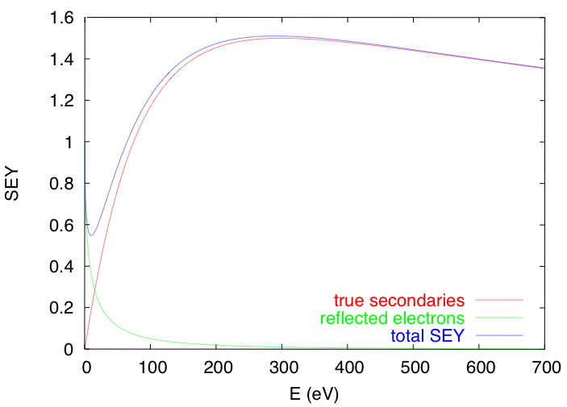
Electron cloud formation in a vacuum pipe
Generation of electrons inside the vacuum chamber
(primary, or seed, electrons)
Acceleration of primary electrons in the beam field
Secondary electron production when hitting the wall
θ
E
secondaries
elastically reflected

Slide 14
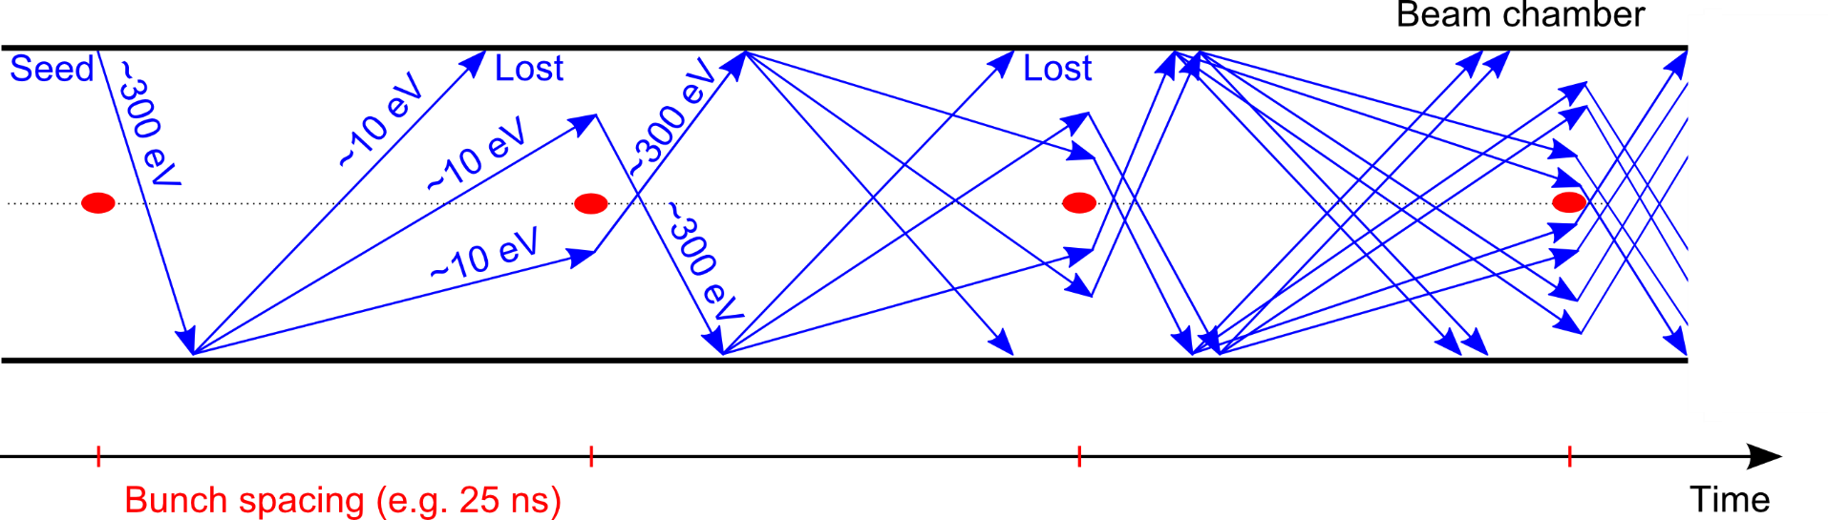
Electron cloud formation in a vacuum pipe
Generation of electrons inside the vacuum chamber
(primary, or seed, electrons)
Acceleration of primary electrons in the beam field
Secondary electron production when hitting the wall
Avalanche electron multiplication

Slide 15
Electron cloud formation in a vacuum pipe
Generation of electrons inside the vacuum chamber
(primary, or seed, electrons)
Acceleration of primary electrons in the beam field
Secondary electron production when hitting the wall
Avalanche electron multiplication
After the passage of several bunches, the electron distribution inside the chamber reaches a stationary state (electron cloud)

Slide 16
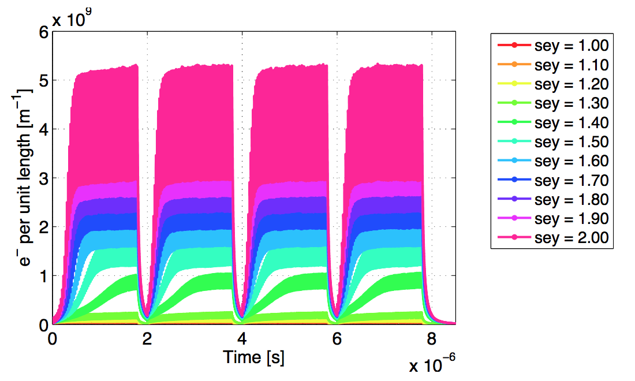
Electron cloud formation in a vacuum pipe
Could be simulated with SEY curve (and δ_{max}) as input parameter
Generation of electrons inside the vacuum chamber
(primary, or seed, electrons)
Acceleration of primary electrons in the beam field
Secondary electron production when hitting the wall
Avalanche electron multiplication
After the passage of several bunches, the electron distribution inside the chamber reaches a stationary state (electron cloud)
→ Several effects associated

Slide 17
Effects of the electron cloud
The presence of an e-cloud inside an accelerator ring is revealed by several typical signatures
Fast pressure rise, outgassing
Additional heat load (LHC has cold Dipoles)
Baseline shift of the pick-up electrode signal
Tune shift along the bunch train
Coherent instability
  Single bunch effect affecting the last bunches of a train
  Coupled bunch effect
Beam size blow-up and emittance growth
Luminosity loss in colliders
Energy loss measured through the synchronous phase shift
Active monitoring: signal on dedicated electron detectors (e.g. strip monitors) and retarding field analysers
Machine observables
Beam observables

Slide 18
PhD thesis in collaboration with CERN :

Slide 19
Beam dynamics and collective effects for the upgrade program of LHC and FCCee
(contact: mauro.migliorati@uniroma1.it)
HiLumi LHC, is the major funded upgrade to increase LHC luminosity by a factor of 10 beyond its design value. The project is co-funded by the EU and implies significant upgrades not only for LHC but for all the machines in the injection chain (LIU project).
FCC (Future Circular Collider): is a global effort (lead by CERN) to study a post-LHC particle accelerator in a worldwide context. The project is co-funded by the EU and it is exploring the potential of hadron and lepton circular colliders, considering the technology R&D programs that would be required to build them.
The goal of the PhD work is to predict the behaviour of these future accelerators in terms of beam stability due to the increase of beam intensity that could lead to undesirable collective effects, triggered by self-induced em fields, which may play an important role in the machine performance.
The thesis activity is based at the Department of Basic and Applied Science for Engineering of La Sapienza, but some periods at CERN for beam based measurements during some Machine Development sessions and for discussions are foreseen.

Slide 20
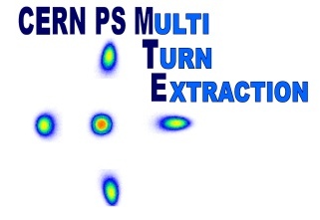
Use of non-linear beam dynamics
for beam extraction at CERN PS
Why non-linear dynamics should be useful?
  Richer dynamical behaviour, e.g., existence of stable islands (see later).
  The non-linear motion introduces a dependence of the particle frequency in phase space on amplitude. The frequency spread cures collective instabilities (Landau damping).
  A non-linear system might be more
  robust than a linear one (stable
  under perturbation).
Integrability of the motion is an
added value as it ensures stable
motion
Typical non-linear motion with regular and chaotic orbits.

Slide 21
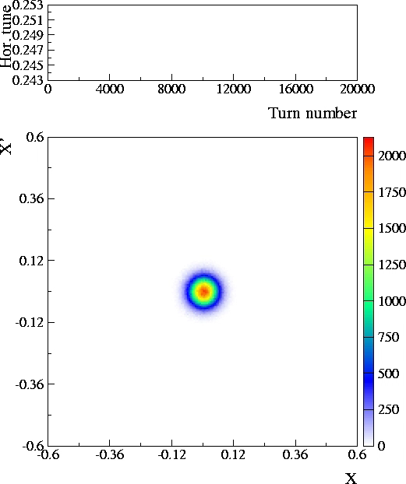
Novel multi-turn extraction with fourth-order resonance
Standard approach: nonlinear elements represented as a single kick at the same location in the ring (Hénon-like polynomial maps).
Vertical motion neglected.
Normalised (adimensional co-ordinates).
The linear tune is time-dependent
Quadrupoles
Sextupole
Octupole

Slide 22
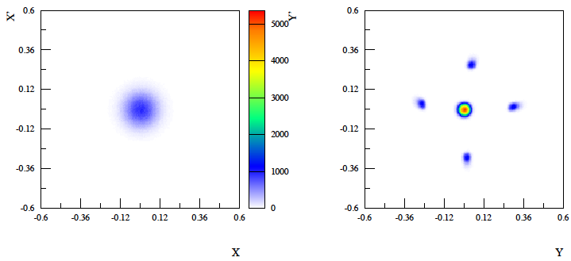
Novel applications (for this project)
(contact: mauro.migliorati@uniroma1.it)
By using skew sextupoles and normal octupoles it is possible to split the beam in the vertical phase space by crossing a vertical resonance.
Pursue the study of beam splitting in the vertical plane
Study the possibility of optimising the slow extraction using stable islands (essential for high-intensity beams)
Possibly study stable islands for lepton rings
This PhD activity is based at CERN

Slide 23
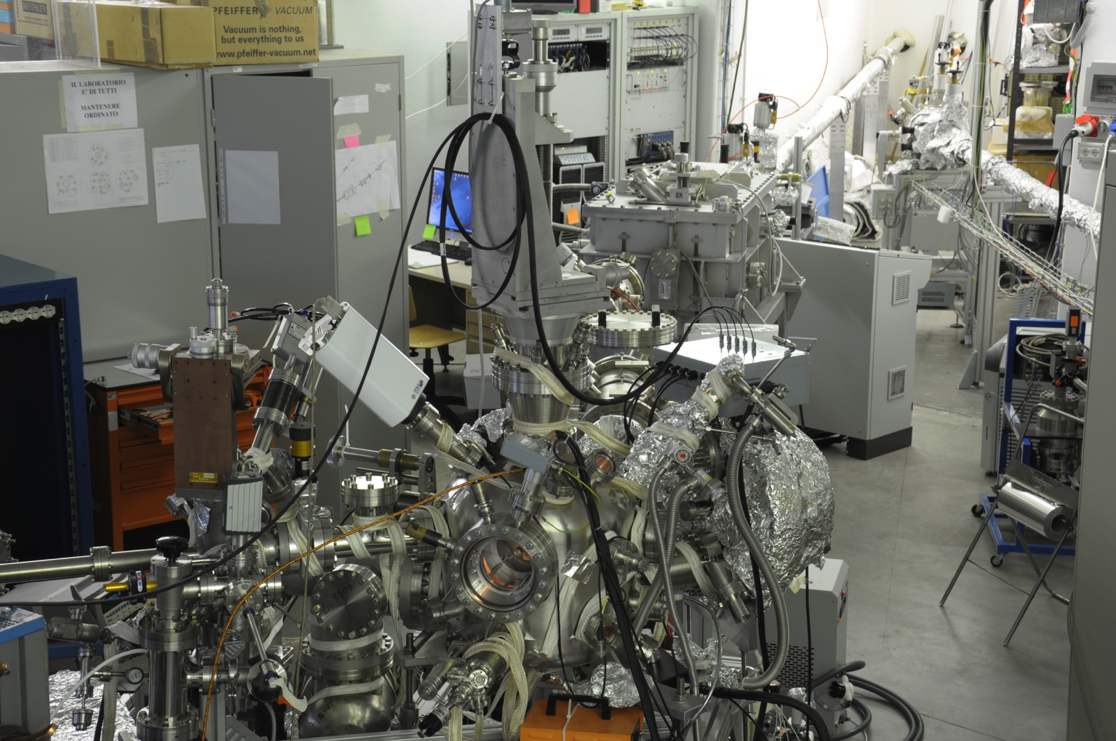
Experimental investigation on relevant material properties for FCC & Hi Lumi LHC
- Surface properties of Carbon and Cu Surfaces for HL-LHC (INFN project)
- Vacuum stability at FCC-hh (EU / INFN Project)
- Synchrotron radiation material studies (MoU with CERN/ INFN)
“State of the art” Surface Science
These PhD thesis foreseen experimental studies (with SR and Surface Science techniques) on material properties of interest to the accelerator community.
The interested candidate will work in an international contest, within various international collaborations and will be mainly performing experiments in Frascati National Lab but also in various Facilities around Europe.
Manipulator
Syncrotron Radiation
Farady Cup
Electron Analyser
Sample Prep.
Chamber for
reactions
LEED + e⁻ gun
e⁻ gun
X-ray Lamp
Tesi da svolgere presso il Laboratori Nazionali di Frascati dell’INFN
Contact person: R. Cimino (roberto.cimino@lnf.infn.it)

Slide 24
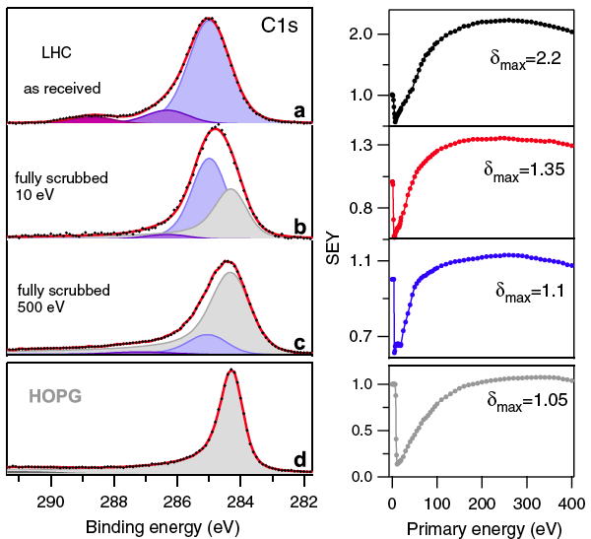
Experimental investigation on relevant material properties for FCC & Hi Lumi LHC
The Surface Science properties of relevance:
Chemical structure;
Secondary Electron Yield;
Photon Reflectivity;
Photoelectric Yield;
Photo/ electron stimulated Desorption;
Low temperature studies
XPS
SEY
R
PY
R. Cimino and T. Demma “Electron cloud in Accelerators” Int. J. Mod. Phys. A 29 (2014) 1430023 (pag. 65).
Tesi da svolgere presso il Laboratori Nazionali di Frascati dell’INFN
Contact person: R. Cimino (roberto.cimino@lnf.infn.it)

Slide 25
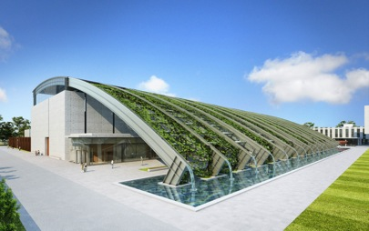
Thesis in collaboration with:
ELI Nuclear Physics (Romania)
Laser-Induced Photonuclear Physics
nuclear physics methods to study laser-target interactions, new nuclear spectroscopy, new photonuclear physics

Slide 26
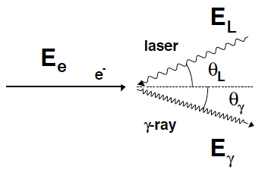
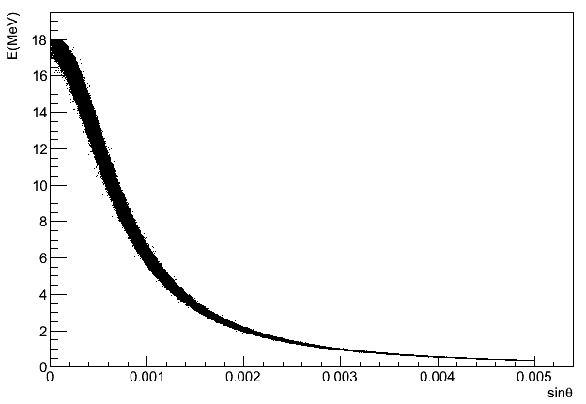
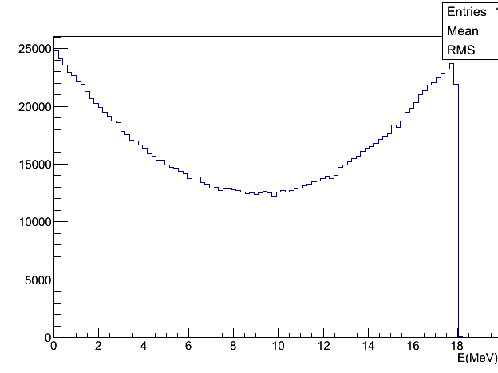
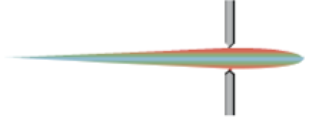
Compton effect: the best energy booster
Photon electron collision (γ ≫ 1)
2 boosts, the most efficient energy amplifier
Relativistic antenna effect, forward boost
dN/dE
Compton
edge
γ = 10³ → Δθ ~ 1 mrad
It is a kinematical effect: angle – energy correlation, bw and tunability (polarization)
… but cross section ~ 10^{–25} cm² -> small for a light source

Slide 27
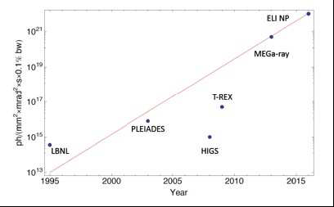
ELI-NP γ beam: the quest for higher flux and narrow bandwidths
2 order of magnitude in flux and 2 in bandwidth !!!!!!!!

Slide 28
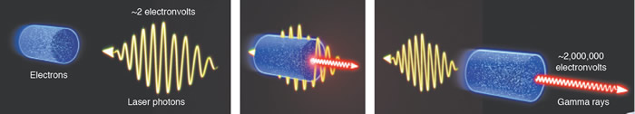
CHALLENGES !!!!
Outstanding electron beam @ 720 MeV with high phase space density (all values are projected, not slice!)
Scattering off a high quality J-class psec laser pulse

Slide 29
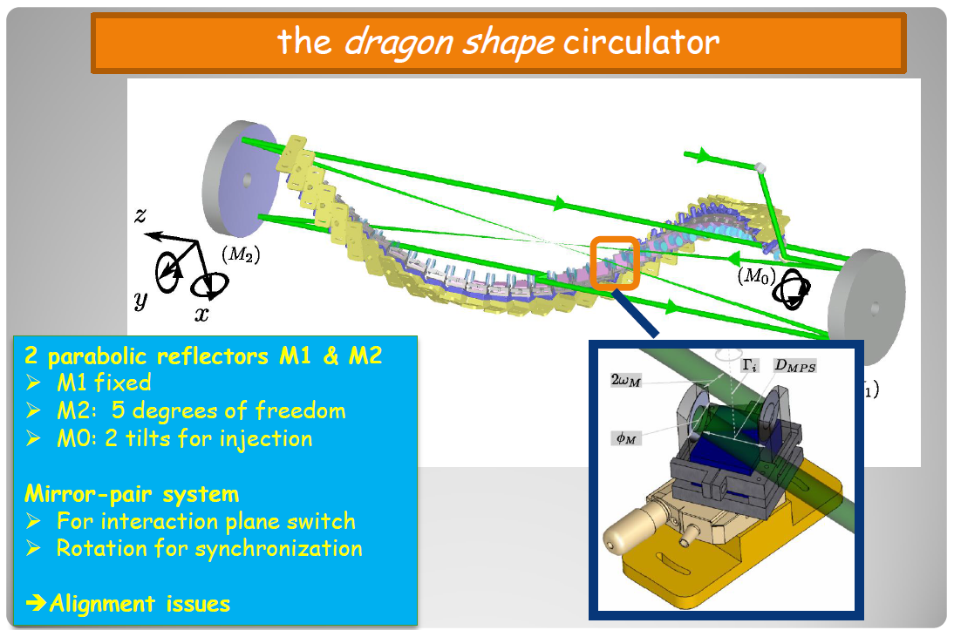
Advance technology: the dragon shape circulator

Slide 30
Proposed thesis within the activity @ ELI NP

Slide 31
Experimental activity at ELI-NP GBS gamma source for the commissioning/optimization of the high brightness photo-injector and RF linac towards the tuning of the Compton Interaction for the Gamma source
The Eurogammas international collaboration is meant to produce a gamma source, based on the Compton back-scattering of high quality electron beams and high-power laser pulses, with unprecedented quality in terms of small bandwidth (0.5 %), very high spectral density (> 10⁴ photons/sec/eV) in the wide energy range 0.2 - 19.5 MeV.
Here the scientific advanced potentials will be explored of a high intensity laser system (up to 10²⁴ W/cm²) joined with a high brilliance Gamma ray Beam System, in the field of Nuclear Physics and Nuclear Photonics for users, not yet addressable nowadays.
The gamma source represents a step forward in the available technologies in comparison to the present state of the art, with an expected step-up of the various beam performances by at least two orders of magnitude.
Beside the ultra-high quality of the electron beams, the upgrade comes from the operation at 100 Hz repetition rate for the RF in the multi-bunch configuration and the circulation of the laser pulse as many times as possible at the IP that allow to increase the number of collision per second, and so the gamma flux.
The PhD thesis will focus on the experimental activity translating, also thanks to the development of novel and advanced high-level applications, electron beam dynamics studies produced so far, into commissioning strategies for the high-brightness photo-injector, high-current high-gradient C-band lilac, transfer lines and Compton interaction region.
Supervisors:A. Variola, C. Vaccarezza
Take part in commissioning an innovative machine!

Slide 32
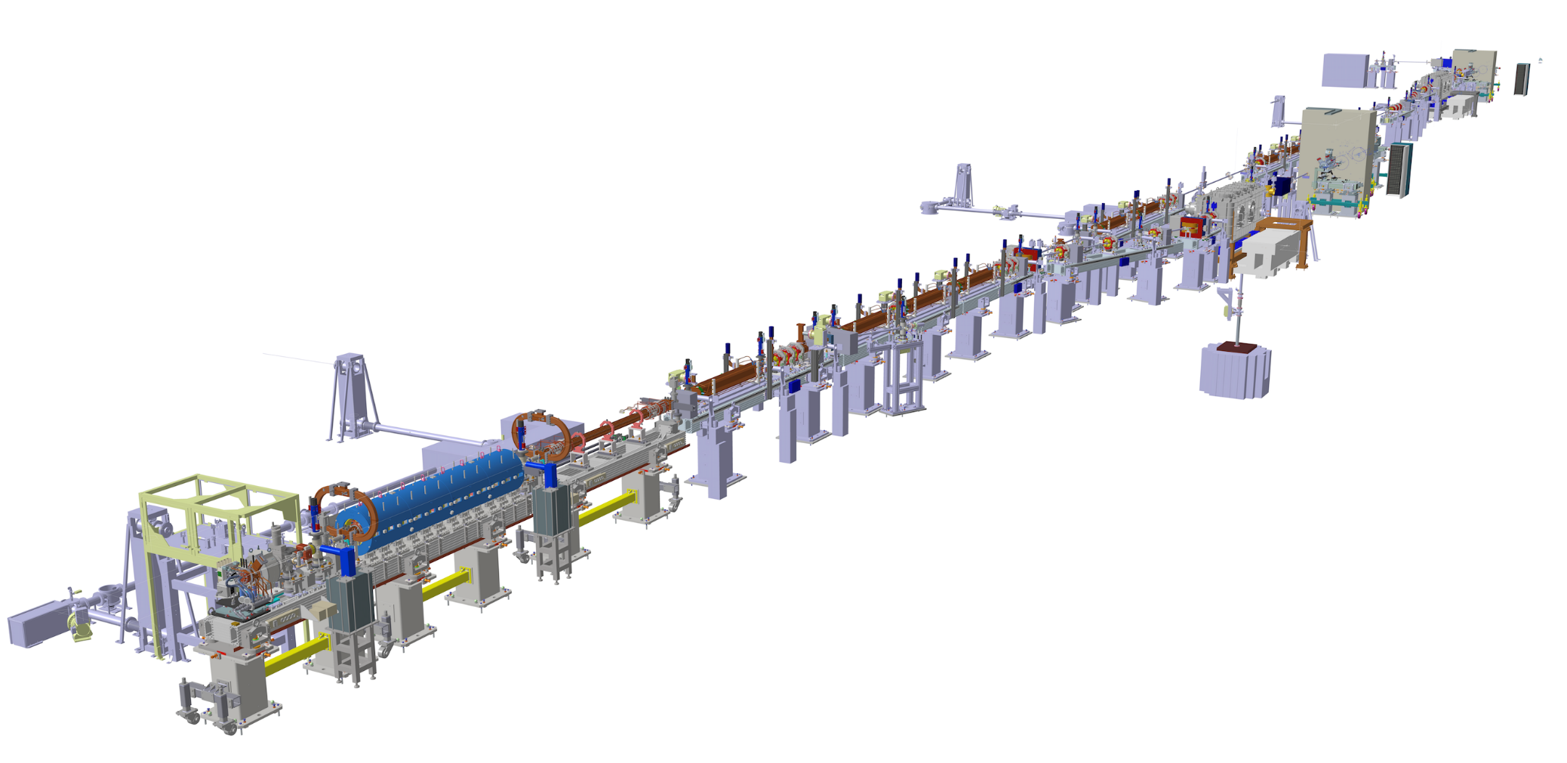
Advanced Diagnostics for bunch by bunch measurements in ELI-NP GBS
Electron LINAC
Interaction Point
Electrons (up to 720 MeV)
C-Band structures (5.712GHz)
S-Band structures (2.856GHz)
Studies on advanced beam diagnostic techniques and devices are required in order to perform bunch by bunch and single-shot measurements on the electron beam with challenging requirements.
The main focus will be to perform studies on bunch by bunch beam imaging diagnostic systems.
Studying and development activities will be held at INFN-LNF.
There will be the possibility to join the developer team during the LINAC commissioning and to test the diagnostic techniques by first hand.
Slide 32

Slide 33
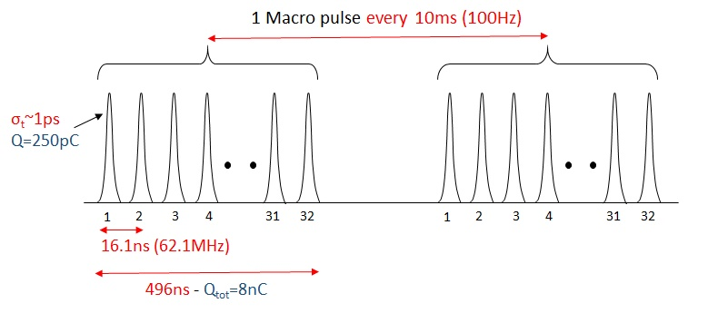
Advanced Diagnostics for bunch by bunch measurements in ELI-NP GBS
Electron Beam
Imaging diagnostics will be based on Optical T Transition Radiation (OTR) beam screens and fast digital camera, coupled with gated image intensifier.
Bunch by bunch imaging diagnostics is required to measure:
  position and size
  energy and energy spread
  emittance and Twiss parameters
  bunch length
  …for every bunch within the beam pulse.
Electron Beam Specifications
Parameter | Value
Max. Energy at IP [MeV] | 280 – 720
Macro Pulse rep. Rate [Hz] | 100
Number of bunches | up to 32
Bunch spacing [ns] | 16.1
Bunch length [ps] | 0.91
Bunch charge [pC] | 25-250
Bunch Energy Spread | < 0.1%
Slide 33

Slide 34
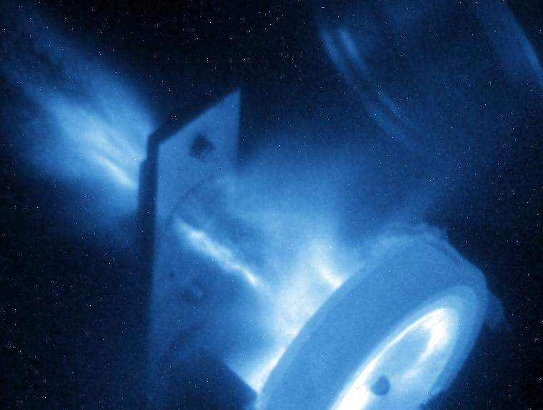
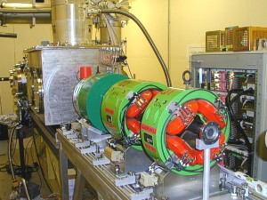
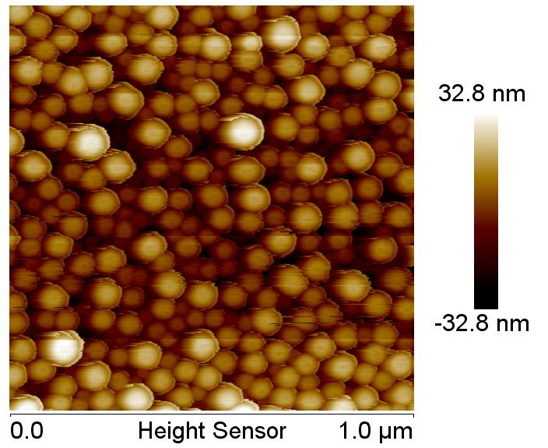
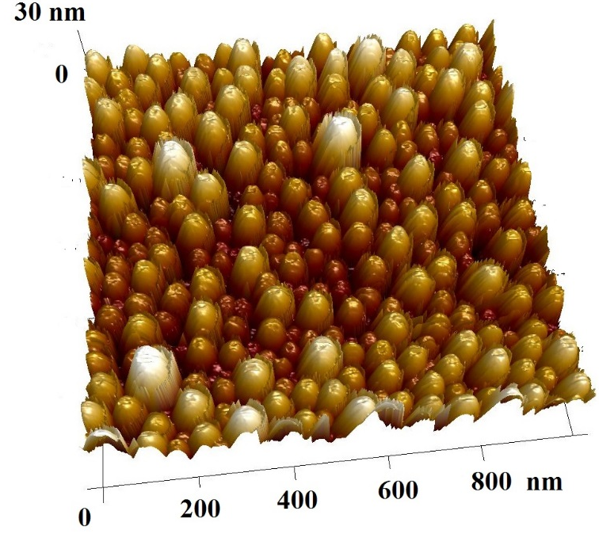
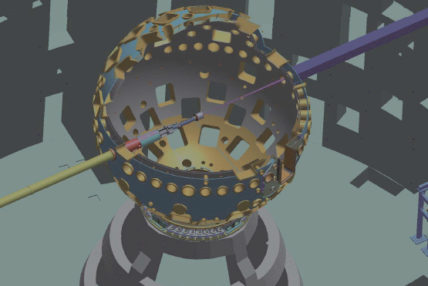
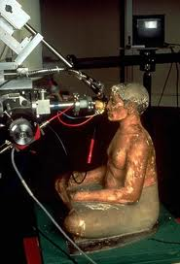
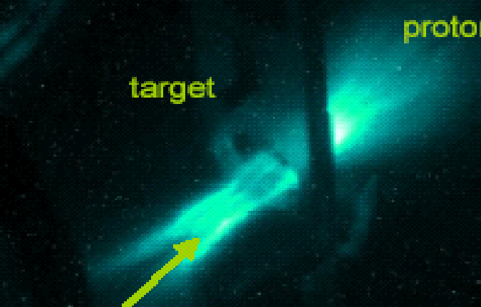
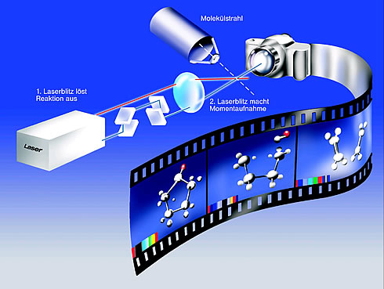

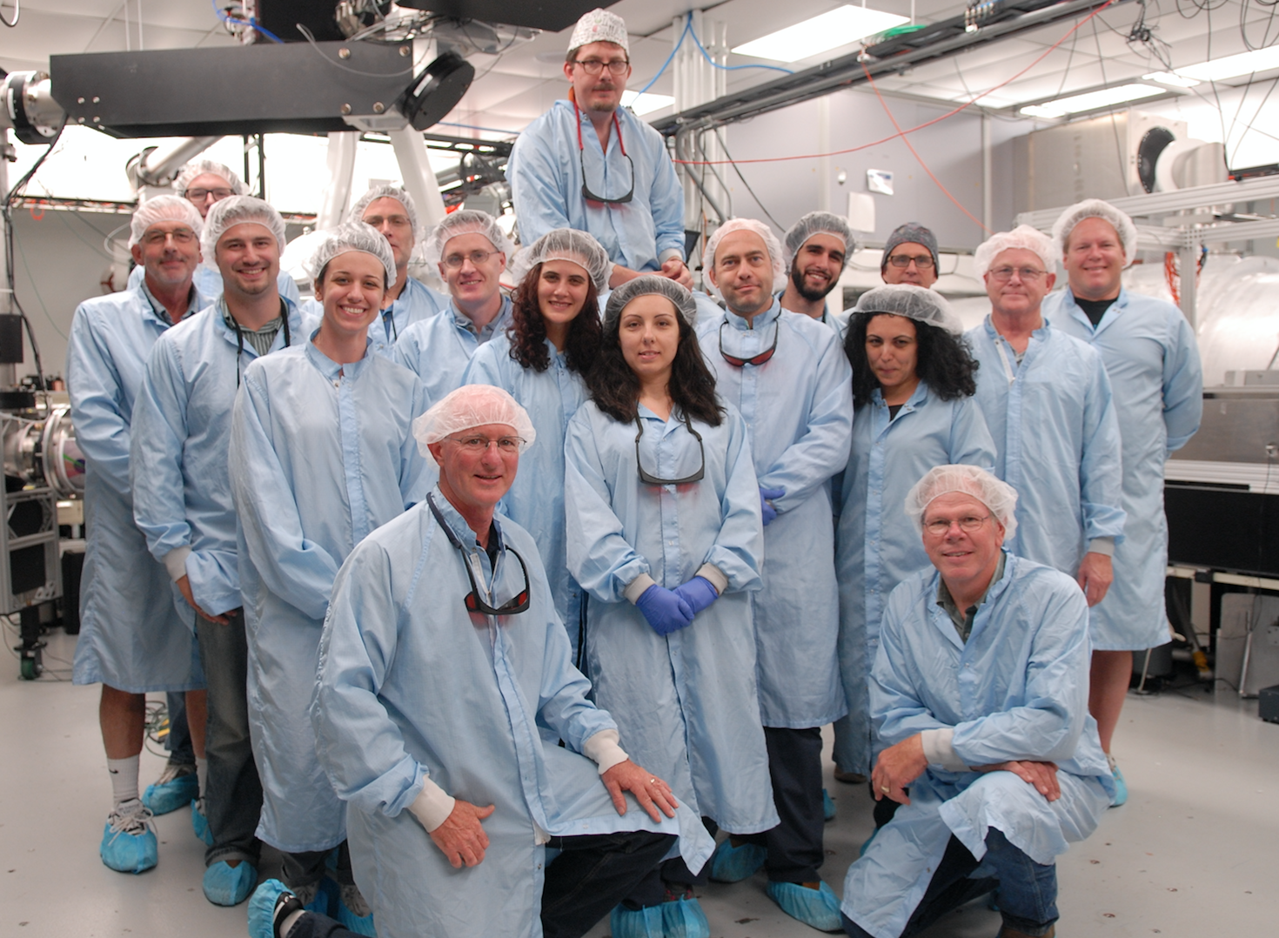

Proposed Ph.D. Thesis (P. Antici, INFN-RM1)
Laser-driven proton (LDP) acceleration and applications PhD. Topics:
  Development and characterization of a laser-driven proton beamline (collaboration with INRS (Canada) and ELI-ALPS (Hungary)
  Generation of nanoparticles obtained by laser-driven proton acceleration for early cancer detection (collaboration with SLOAN Kettering Memorial Cancer Center, New York, INRS Canada)
  Development of a material stress testing platform using laser-accelerated protons (collaboration with INRS Canada, LLNL USA and UniCal Calabria)
  Development of a novel diagnostics for Cultural Heritage based on laser-accelerated protons (coll. With Ministero Beni Culturali, INRS Canada)
  Improved laser-driven proton acceleration using nanostructured targets (collaboration with INRS (Canada) and ELI-ALPS (Hungary)
  Characterization of ElectroMagnetic Pollution produced in high-power laser-matter interaction experiments (coll. ELI-ALPS)
Laser-driven electron (LDE) acceleration and applications
  Beamhanding of low-energy LDE for electron diffraction applications (coll INRS Canada and FORTH Crete)
Activities also in the context of
www.ipat-lab.net patrizio.antici@uniroma1.it

Slide 35
Proposed thesis within SBAI

Slide 36
X band mode launcher
(contact: bruno.spataro@lnf.infn.it)
Recent studies of RF breakdown in cryogenic copper structure have shown a strong increase in the operating gradient and the surface electric field that can be attained.
The RF photoinjector of future generation will use this increase in surface electric field to create an ultra-high brightness cryogenic normal conducting photo-injector. The brightness is expected to increase by over one order of magnitude.
This RF photoinjector is fed by a dedicated mode launcher with no multipolar components in order to avoid an undesirable emittance growth in the electron beam launched from the RF photoinjector.
The goal of this work, is to design and fabricate a compact X band mode launcher in order to remove the multipolar RF components.
The thesis activity is based at the Department of Basic and Applied Science for Engineering of La Sapienza.

Slide 37
Open Split Structure
(contact: bruno.spataro@lnf.infn.it)
Accelerating structures are usually manufactured by precision turning of individual cells, and combined with precision milling for complex parts such as RF power couplers.
These multiple parts are brazed into a complete structure. An alternative approach is the use of precision milling to cut cells into metal blocks that comprise either halves or quarters of the complete structure.
One of the main motivations for this work is to study the high gradient performance of accelerating structures made with novel manufacturing methods (or milled out of two halves and brazed together) in order to reduce the fabrication cost.
The thesis activity is based at the Department of Basic and Applied Science for Engineering of La Sapienza.

Slide 38
TW Accelerating Structures with RF power flow outside of accelerating cavities
(contact: bruno.spataro@lnf.infn.it)
An accelerating structure is a critical component of particle accelerators for medical, security, industrial and scientific applications. Standing-wave side-coupled accelerating structures are used when available rf power is available and average current and average power lost in the structure are large.
These structures are expensive to manufacture and typically require a circulator; a device that diverts reflected power away from rf source, klystron or magnetron. Physics and technology of rf accelerating structures is a mature field with variety of existing geometries and methods.
The goal of the this activity is to design a new type of traveling wave accelerating structure, which combines the high shunt impedance of the side-coupled standing wave structures with the advantages of traveling wave structures, such as simpler tuning and manufacturing. In addition, the traveling wave structure is matched to the rf source so no circulator is needed.
The thesis activity is based at the Department of Basic and Applied Science for Engineering of La Sapienza.

Slide 39
Study high gradient accelerating structures in X and W band
(contact: bruno.spataro@lnf.infn.it)
Building more compact accelerators to deliver high brightness electron beams for the generation of high flux, highly coherent radiation is a priority for the photon science community. A relatively straightforward reduction in footprint can be achieved by using high-gradient accelerating structures. RF breakdown is one of the major factors limiting the operating accelerating gradient in rf particle accelerators.
The breakdown rate could be linked to the movements of crystal defects induced by periodic mechanical stress. Pulsed surface heating possibly creates a major part of this stress.
The goal of the this activity is to study some material properties in order to design high-gradient accelerating structures in X and W band.
The thesis activity is based at the Department of Basic and Applied Science for Engineering of La Sapienza in collaboration with INFN-LNF.

Slide 40

Doctoral thesis at INFN Naples site and Federico II University of Napoli in collaboration with CERN
USE OF METAMATERIALS
FOR THE REDUCTION OF LHC collimator
coupling impedance: study, simulations and measurements
Reference people : Maria Rosaria Masullo –masullo@na.infn.it
Antonello Andreone –andreone@unina.it

Slide 41
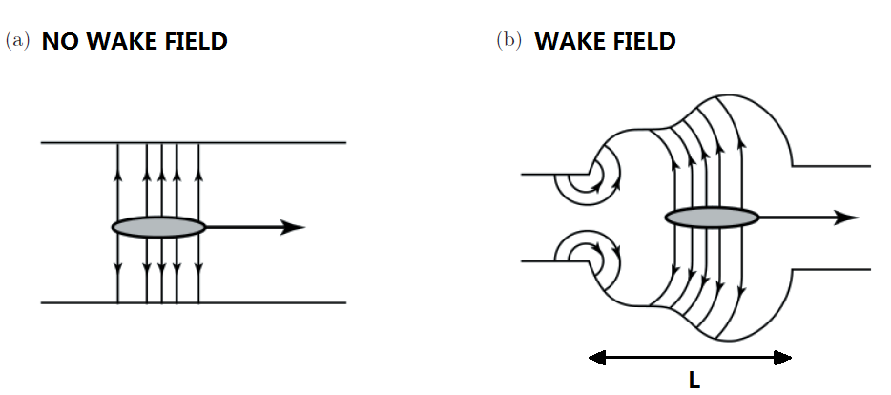
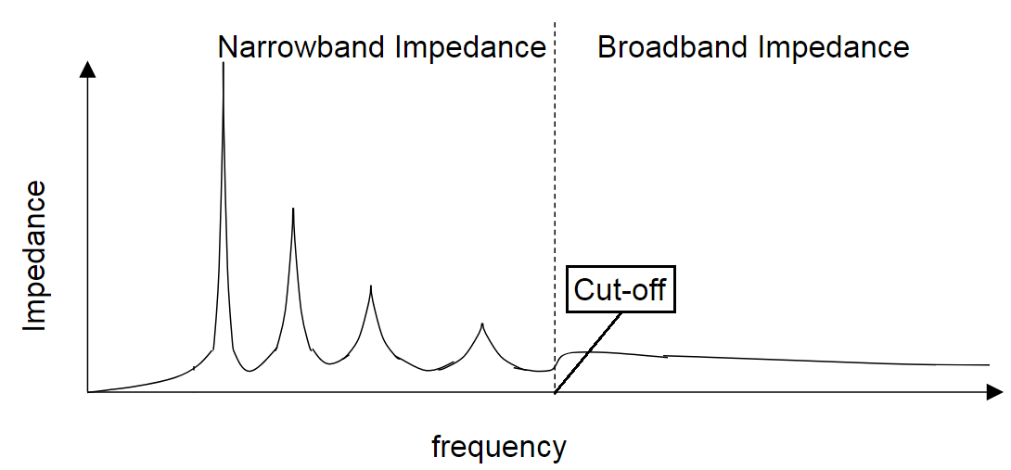
In an accelerator the electromagnetic interaction between the beam and the surrounding equipment can be the source of instability problems. In order to study and characterize the interaction process it is possible to use two different parameters:
Wakefield in the time domain
Coupling impedance in the frequency domain
Due to this interaction, EM fields are produced. Under some conditions, they can remain in the vacuum chamber perturbing the original field distribution which has to guide the beam.
The coupling impedance function connects the new fields to the perturbed charge and current densities.
This function has to be kept under a well defined threshold in order to reduce the perturbation and instability phenomena. This point is crucial if we want to improve the beam intensity.
A typical behaviour of the impedance in two frequency regions. The resonances must be “reduced” lowering their quality coefficient, Q.
A.W. Chao. “Physics of Collective Beam Instabilities in High Energy Accelerators”, Wiley (1993)

Slide 42
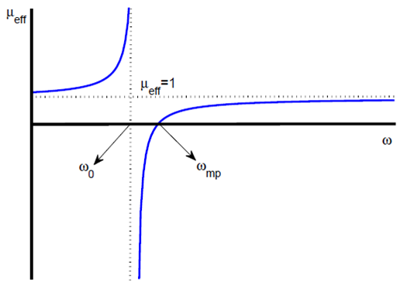
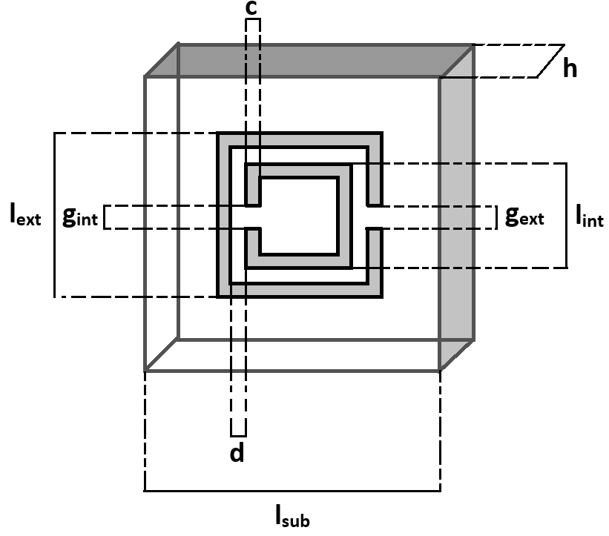
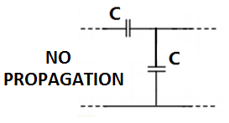
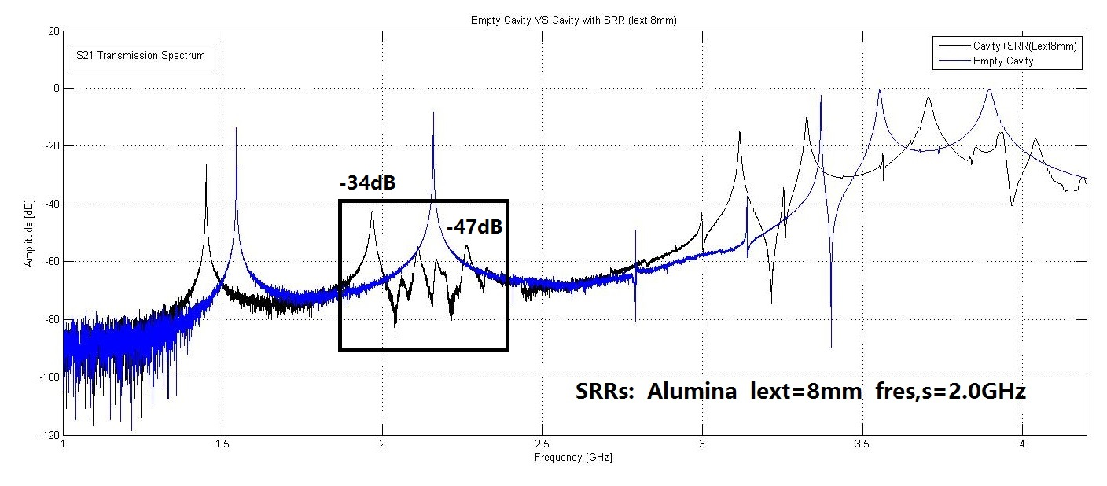
Metamaterials are structures and composite materials that either mimic known material responses or qualitatively have new, physically realizable response functions that do not occur or may not be readily available in nature, as negative μ and ε
MNG Material(µ<0)
Engheta & Richard W. Ziolkowsk “Metamaterials: Physics, Engineering and Explorations” IEEE & Wiley Interscience Press
MNG Material(µ<0)
Suitably dimensioned and excited they can be used as absorbers and/or modify the EM response of the region in which they are allocated
c)

Slide 43
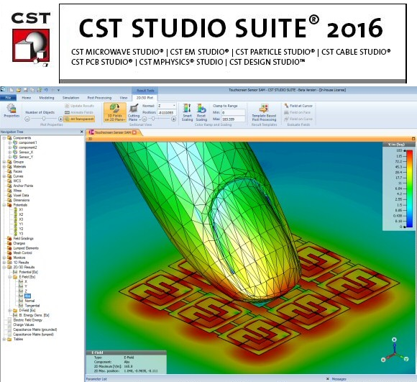

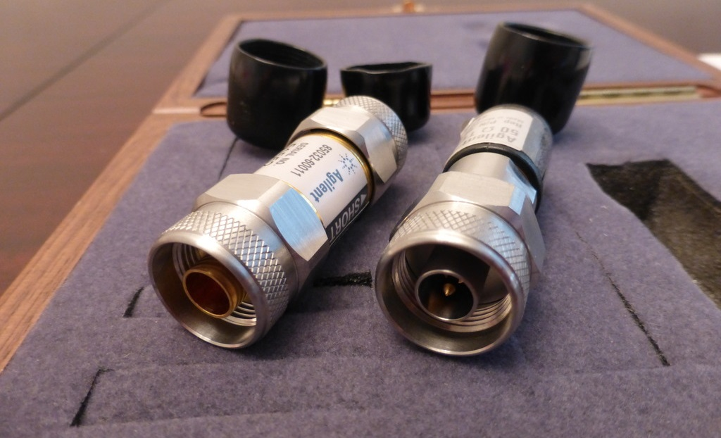
What can you learn
Issues related to the coupling mechanism between beam and accelerator
Metamaterial application
How to use simulation EM code (CST)
EM characterization measurements with network analyzer
Expertise in the field of radiofrequency
Which knowledge is required
Electromagnetism
A previous knowledge of any em simulation code would be helpful.

Slide 44
Conclusion
Phd Thesis is a very important transition from students to researchers
One of the important skills you are supposed to have and develop is: choosing on what and with whom you want to work!
So: read carefully, study, look on google scholar publication lists, check for grants available and capabilities of thesis proposers, talk to people, visit labs ... (Supervisors, ex-students, etc.)
You need to choose where and with whom to spend your next 3 years.
Take your time!

