Slide 1
The FOOT Pixel tracker status
Hardware of the Vertex
Status at G&A Engineering
PlumeM28 assembly procedure
The Committee III submitted schedule
The TIIMM proposal
Conclusion

Slide 2
FOOT overall detector schematic picture
FOOT Pixel tracker

Slide 3
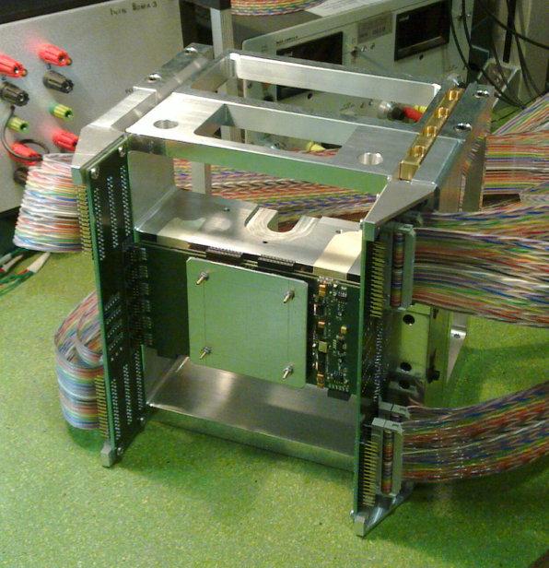
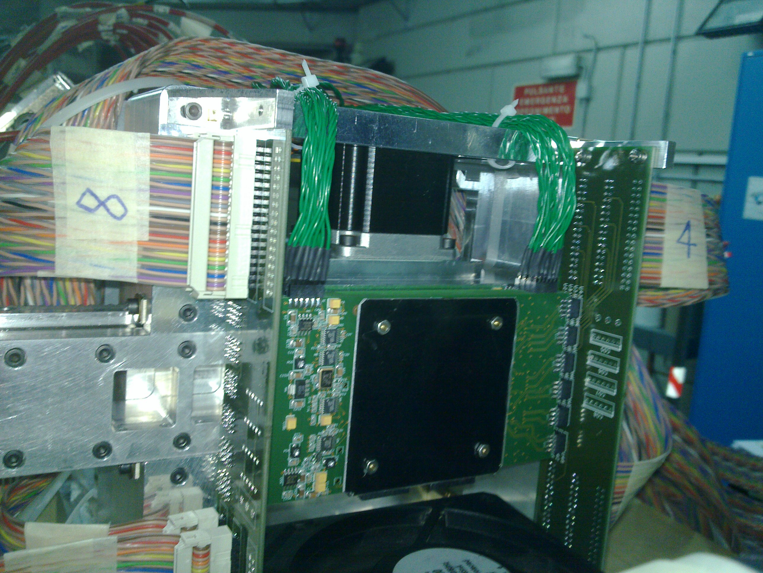
The FIRST target and Vertex setup

Slide 4
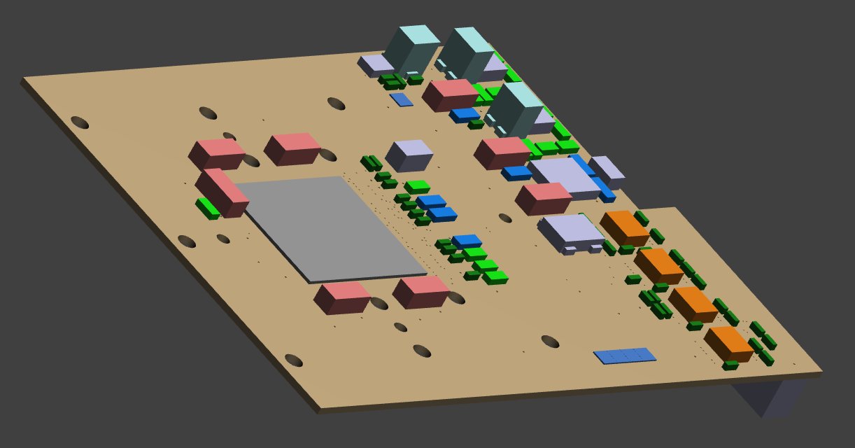
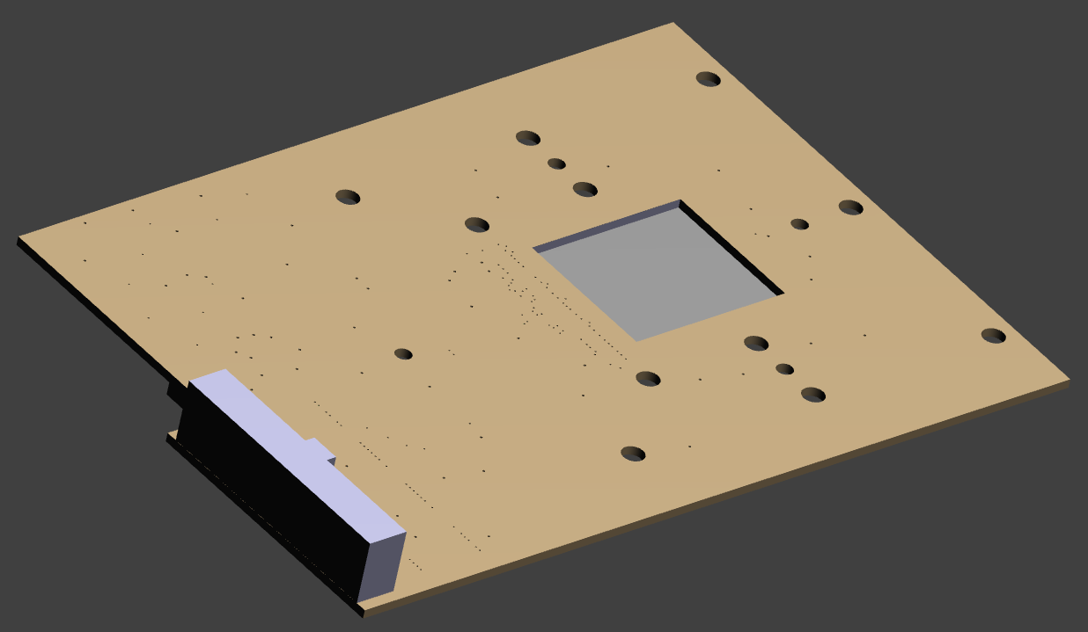
New M28 sensor holding PCB designed for PADME/FOOT
M28 sensor ( 50 μm thick )
PCB hole below the M28 sensor
PCB hole below
the M28 sensor

Slide 5
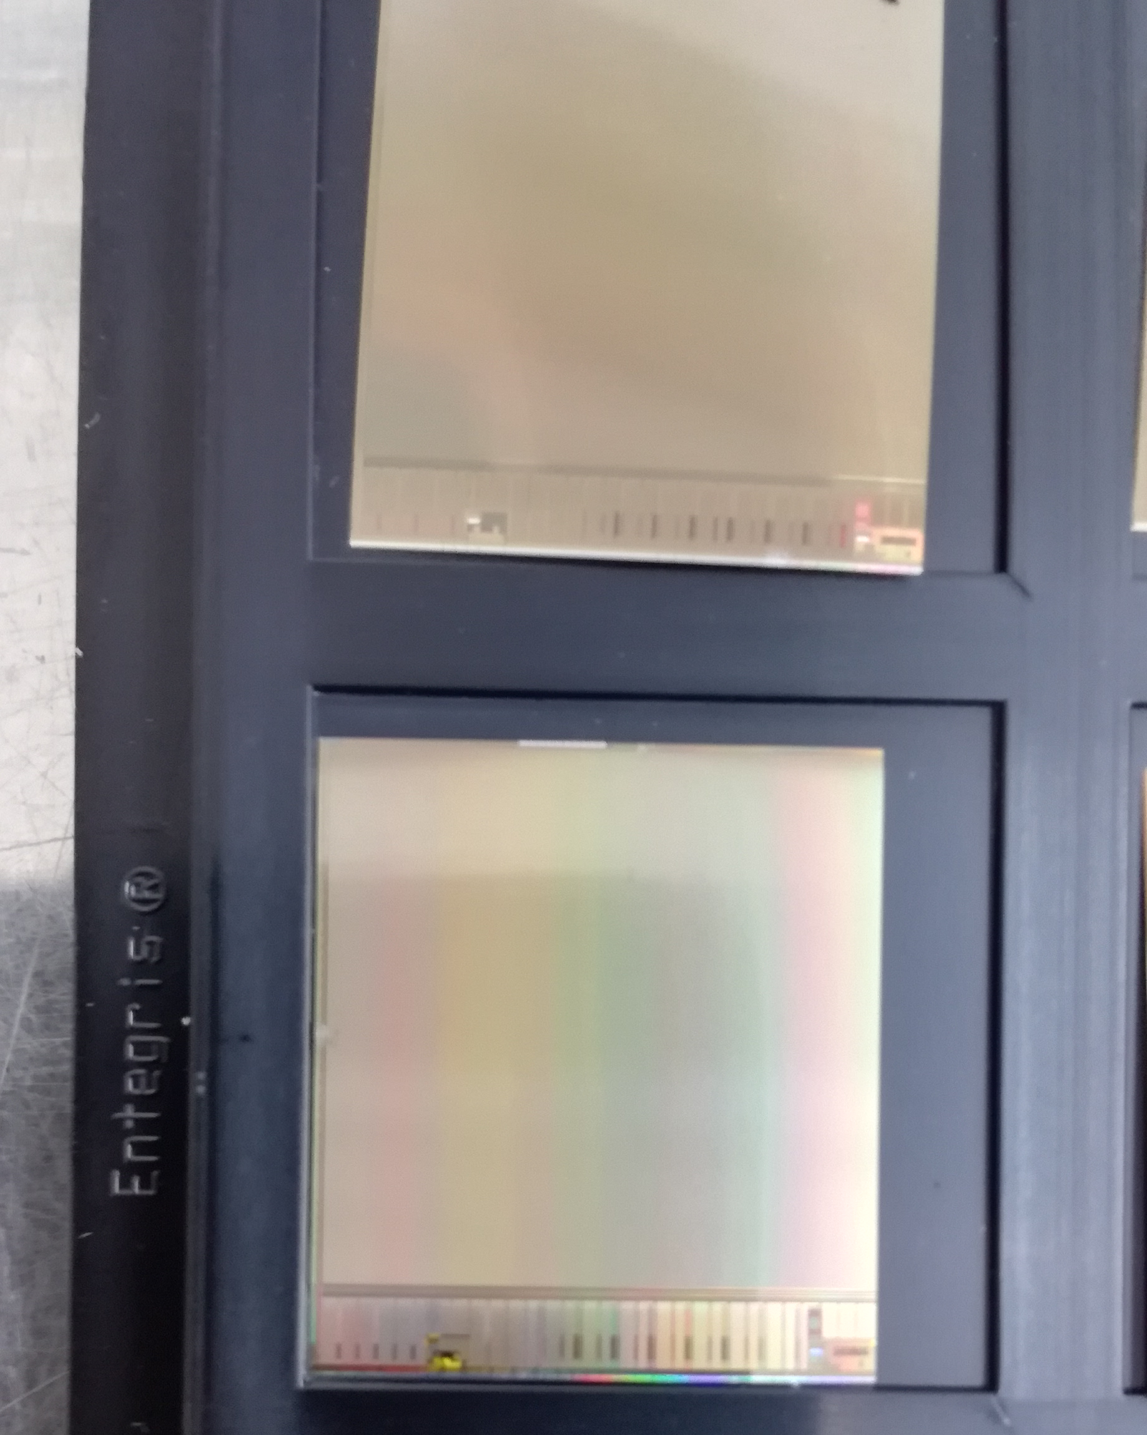
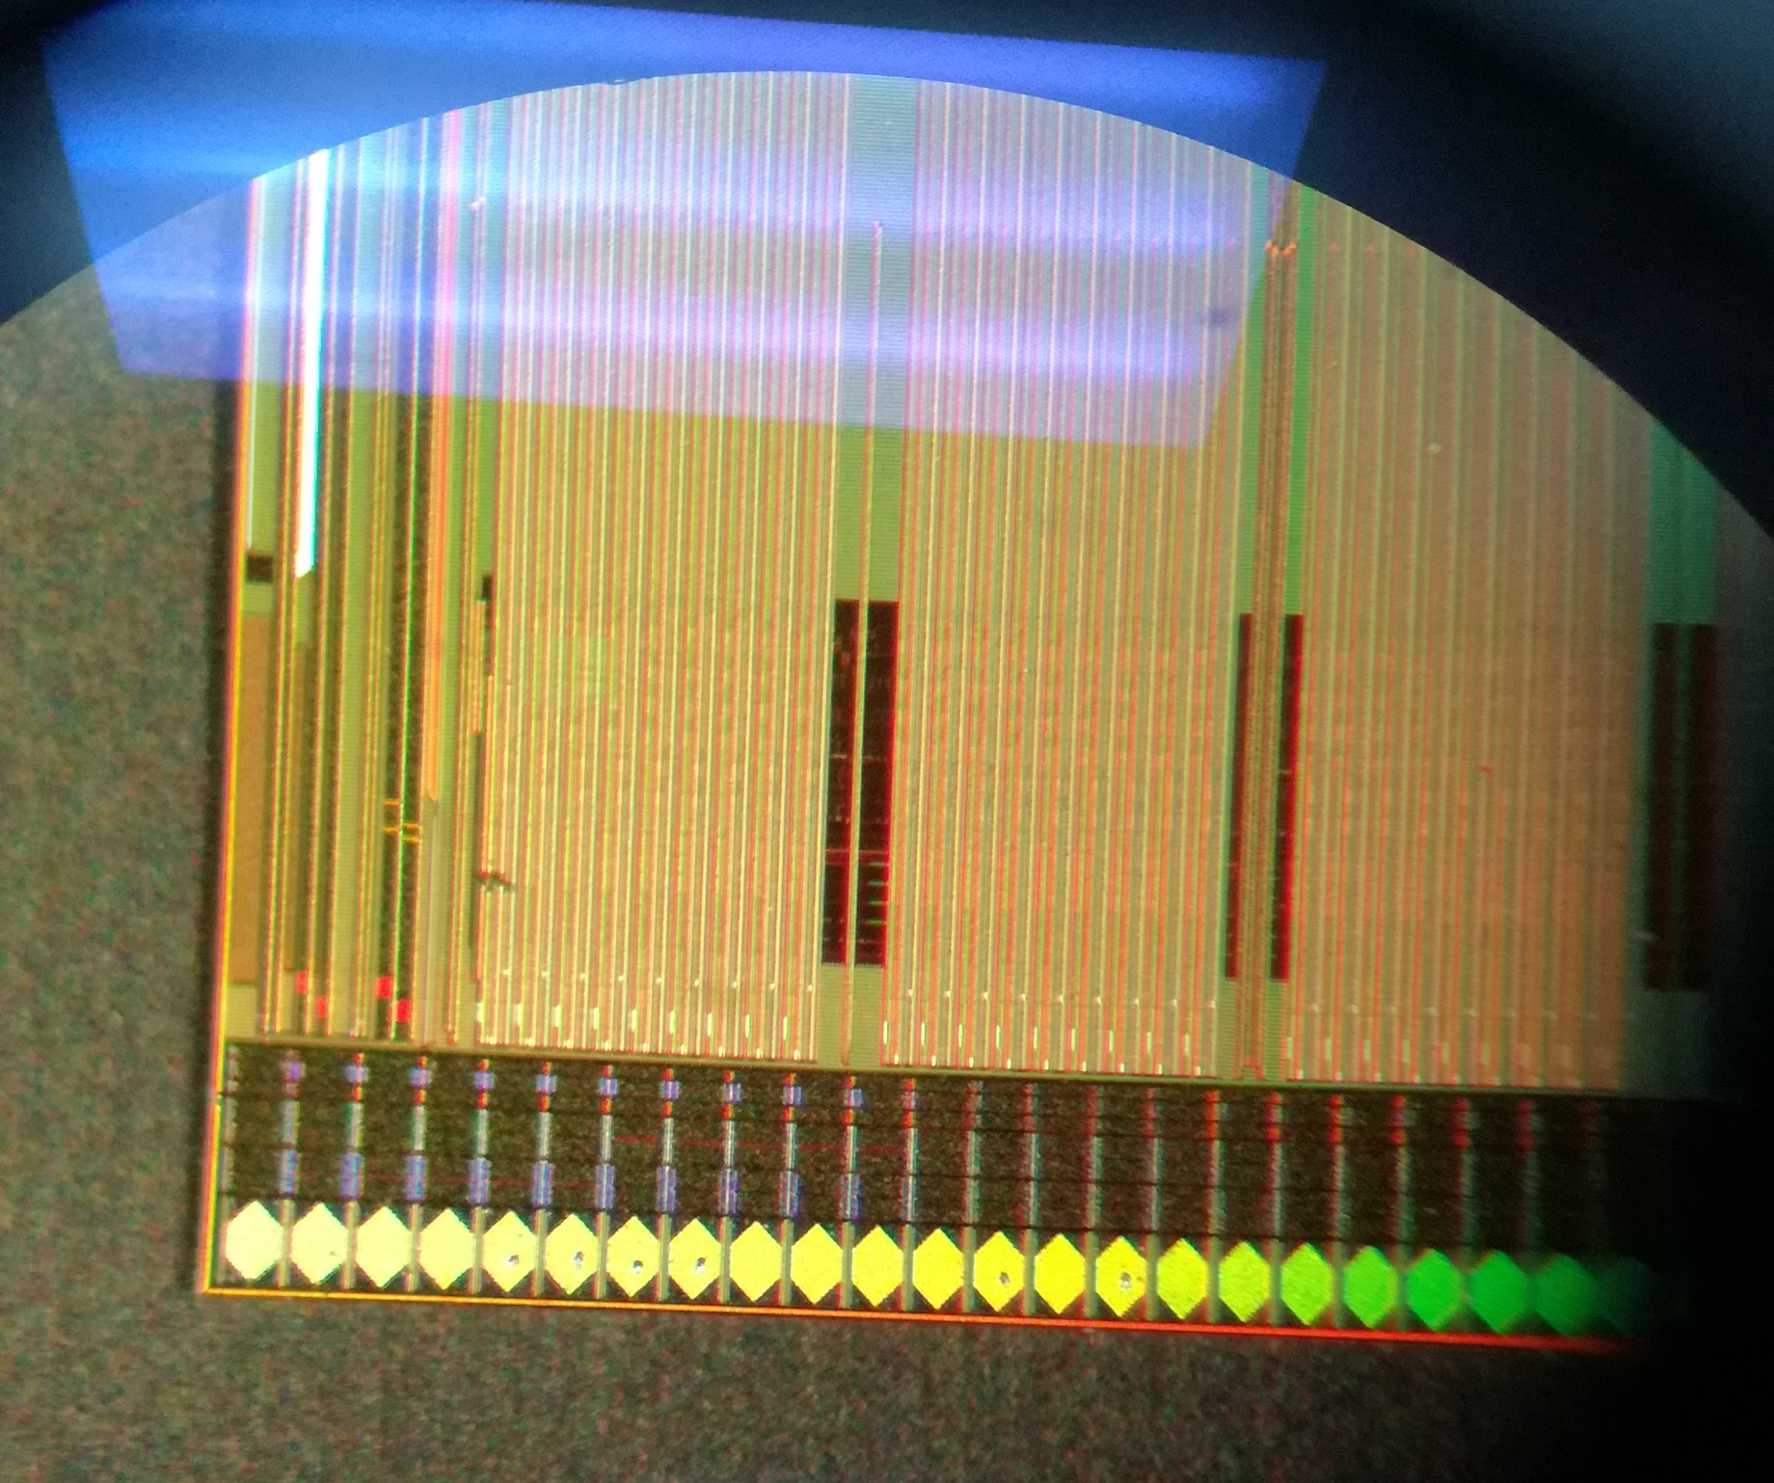
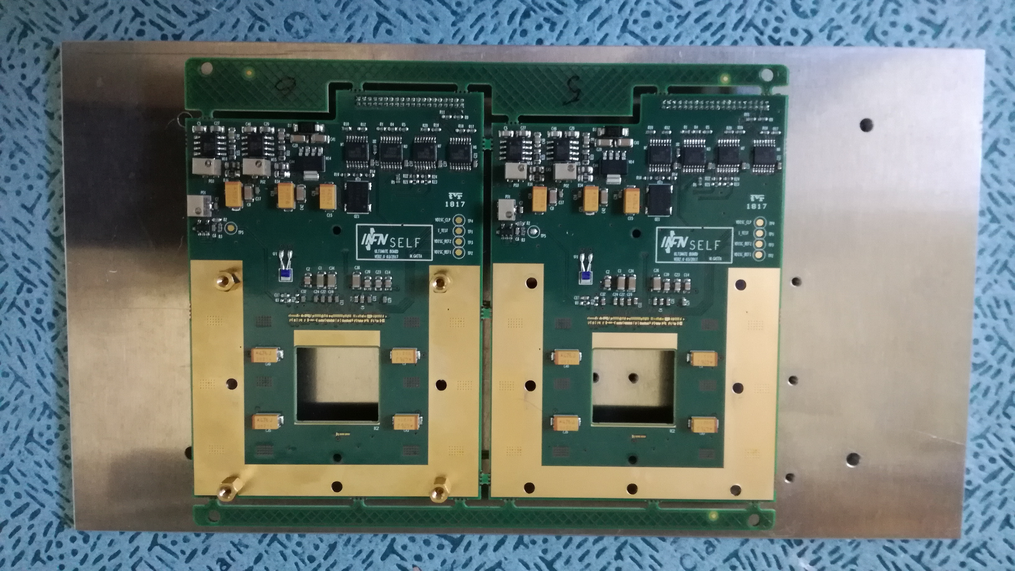
PADME pixel beam monitor status: MIMOSAs
Sensors at G&A Engineering
First assembled board to be tested ready in about one week
Boards to be assembled at G&A Engineering

Slide 6
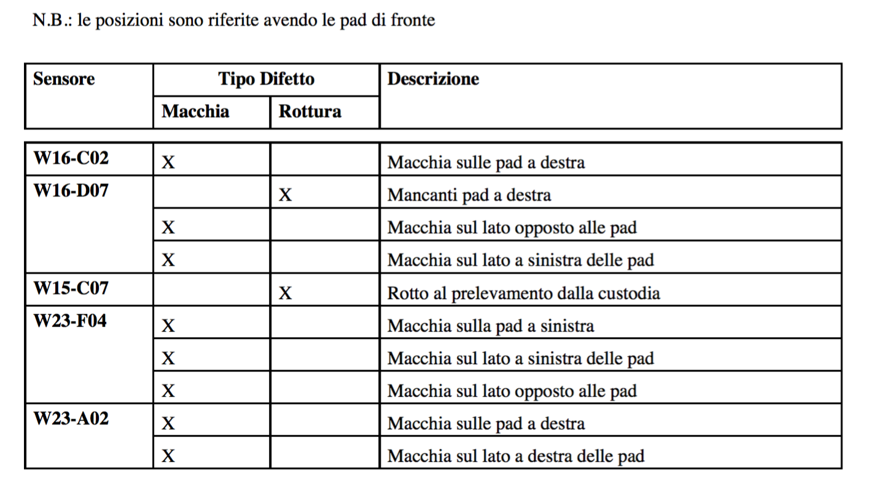
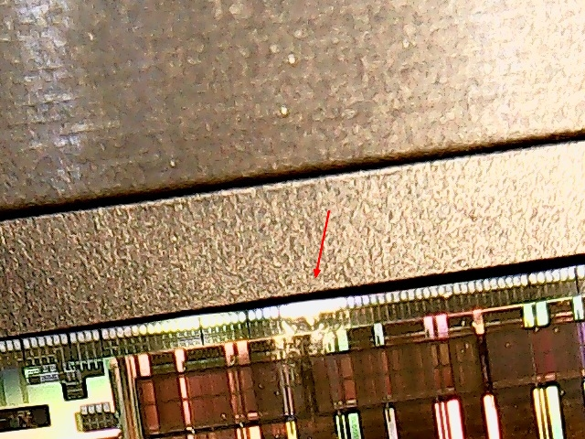
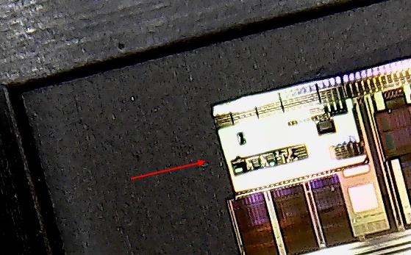
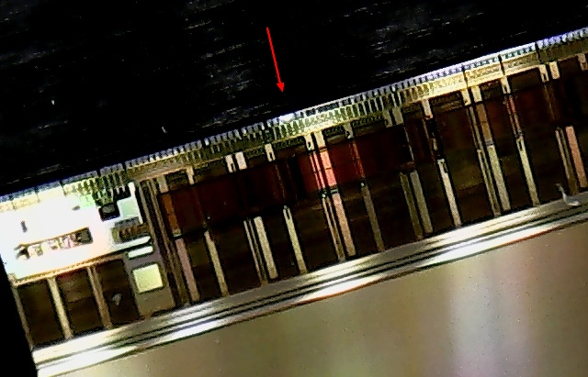
G&A engineering report on sensor to be assembled

Slide 7
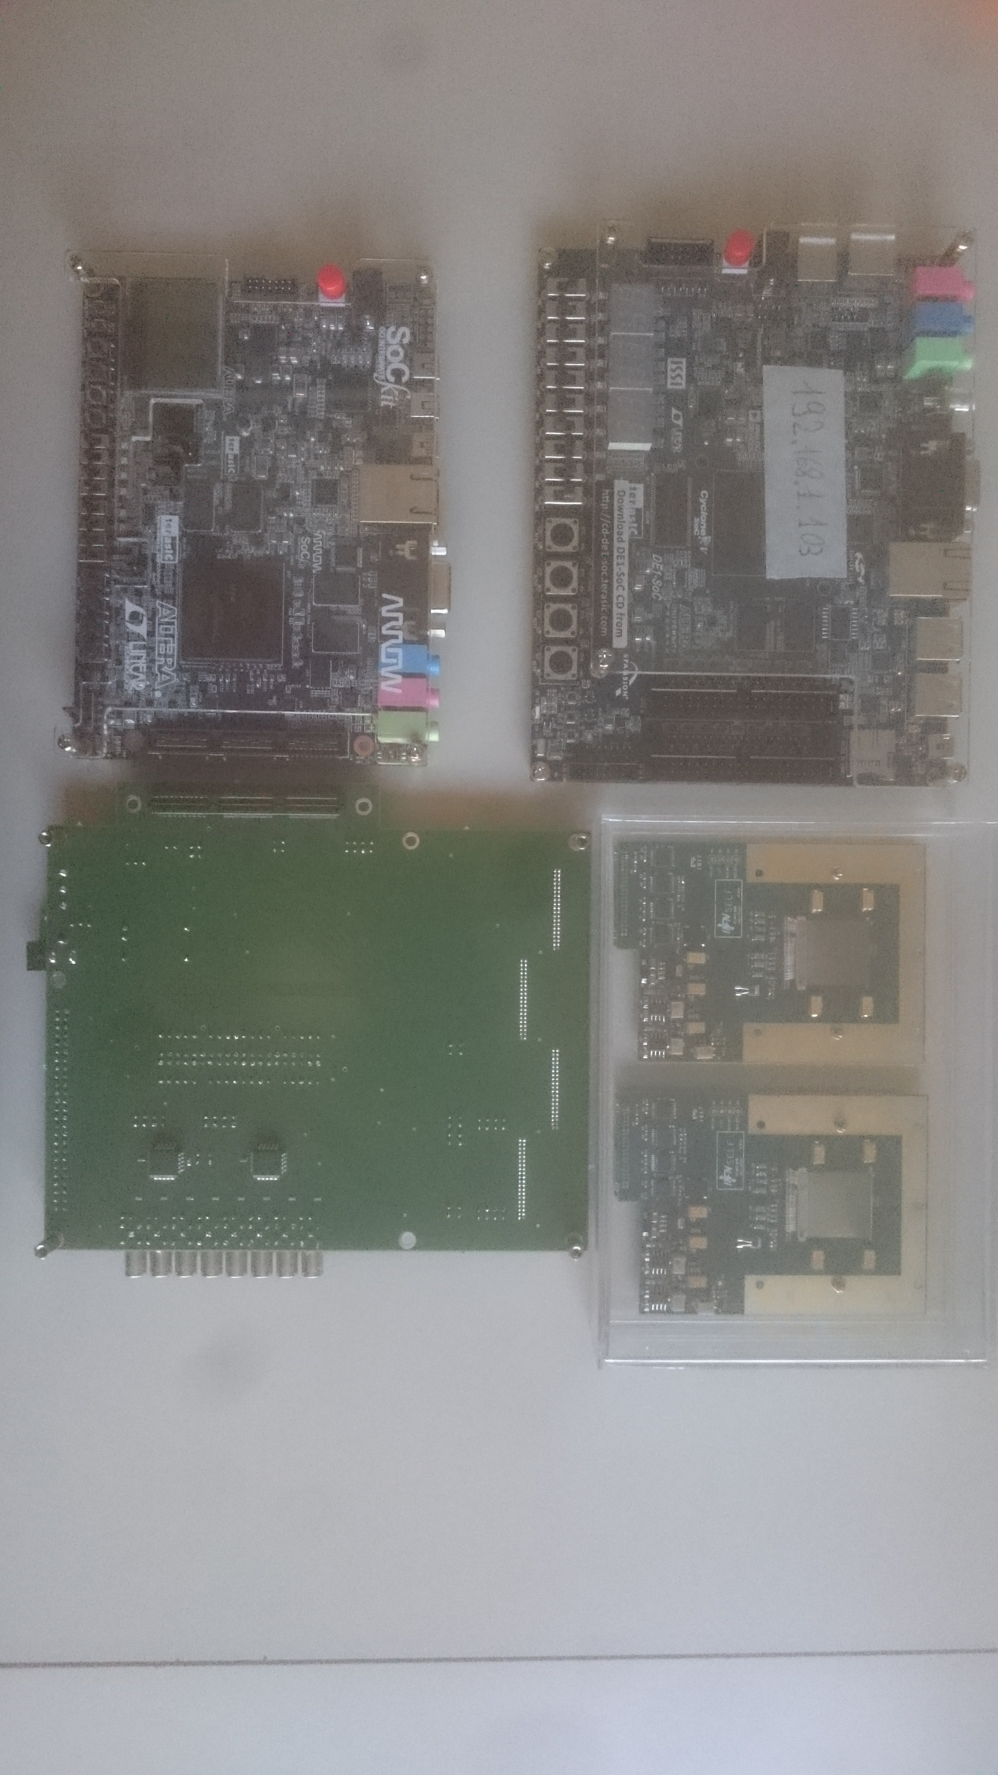
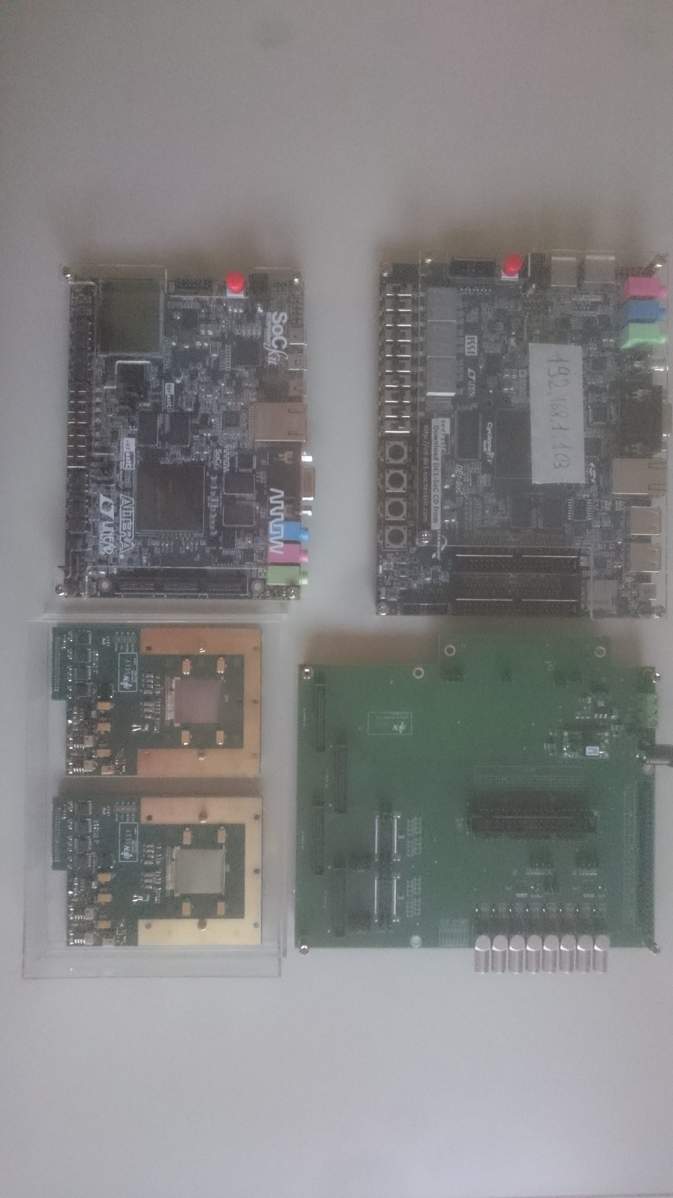
PADME pixel beam monitor status: MIMOSAs
Ultimate boards
Adapter board (Flat cable and HSMC connector)
DAQ boards (FPGA, Linux, Ethernet output)

Slide 8
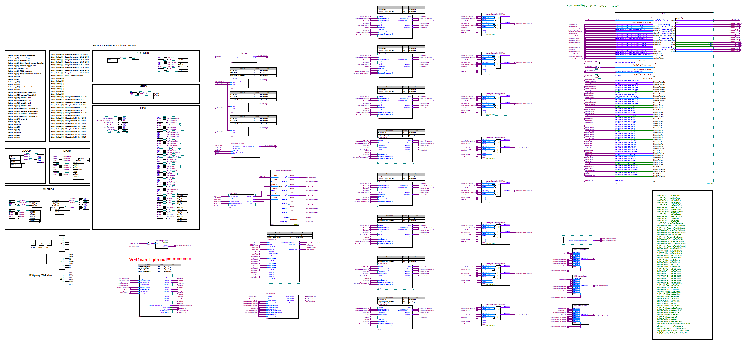
Terasic DE01 board (Cyclone V Altera FPGA) M28 FPGA new firmware
New DAQ version with single serial input line (from M28) authonomous synchronization logic.
( for cable delay differecies compensation )

Slide 9
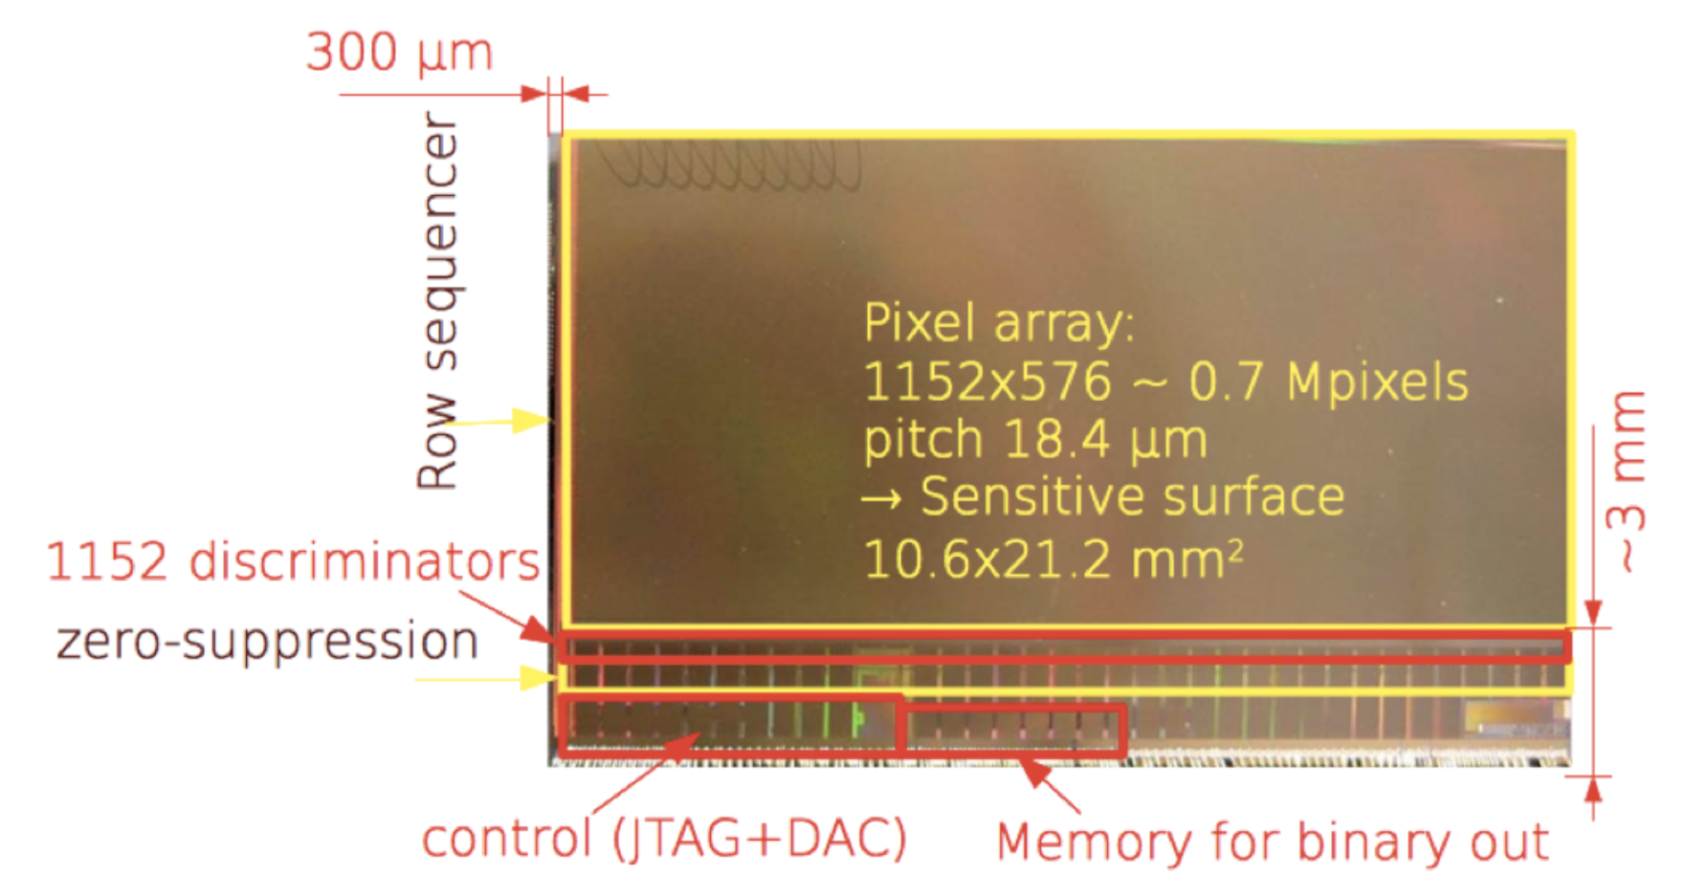
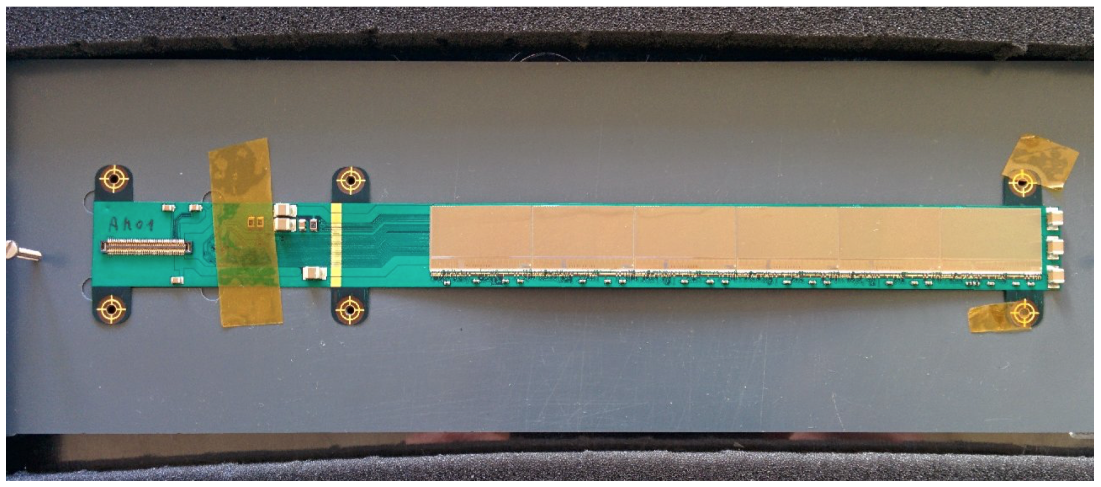
FOOT Inner tracker
The basic building block idea: the PLUME module

Slide 10
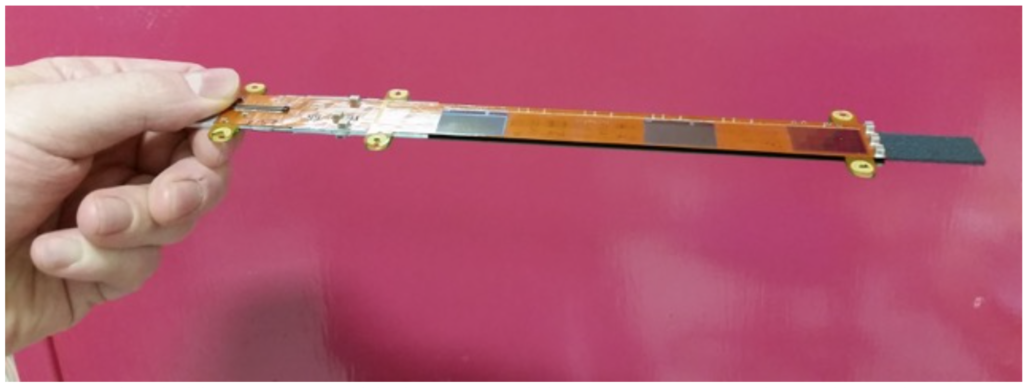
FOOT Inner tracker
Plume 2011 with 0.35% X₀
Epoxy glue
(few µm)
SMD
Mi26 sensor (50µm)
Top Cover Layer (25µm)
Top Metal Al (10µm)
Subtrat Kapton (50µm) 120µm
Bottom Metal Al (10µm)
Bottom Cover Layer (25µm)
Picture of PLUME ladder equipped with M26 sensors
SiC Foam 4 %
2 mm
SiC foam can be 2 % of normal SiC density
Should we investigate carbon fibers?
Should we evaluate Al instead of Cu?
Do we stick to this structure in the simulation?
18 mm

Slide 11
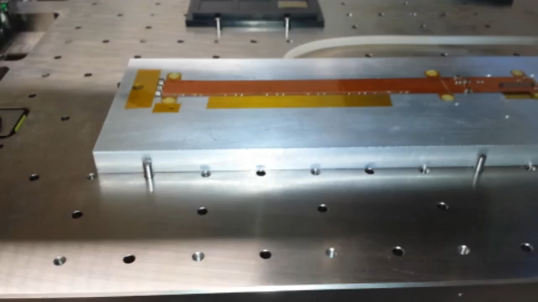
FOOT Inner tracker: module assembly procedure

Slide 12
FOOT LNF 2018 financial request
Schema temporale attività nel triennio 2018-2020
( I-S = Primo semestre , II-S = Secondo semestre )
Gara magneti tracciatore | I-S 2018
Costruzione magneti tracciatore | II-S 2018
Costruzione Vertice | I-S 2018
Test su fascio Vertice (BTF, LNS) | II-S 2018
Acquisto secondo wafer M28 | I-S 2018
Disegno e realizzazione prototipi dei moduli/ladders Inner Tracker | I-S 2018
Disegno e realizzazione scheda interfaccia FPC-SOM (Inner Tracker) | I-S 2018
Disegno/realizzazione frame meccanico Inner Tracker | I-S 2018
Disegno meccanica supporto tracciatore | II-S 2018
Test su fascio ladder Inner Tracker (BTF,LNS) | I-S 2019
Costruzione ladders finali Inner Tracker | II-S 2018, I-S 2019
Realizzazione meccanica supporto tracciatore | I-S 2019
Mappa campo magneti tracciatore | I-S 2019
Assemblaggio meccanico tracciatore | II-S 2019
Prima presa dati con tracciatore al GSI | II-S 2019, I-S 2020

Slide 13

Conclusions at the committe III last september
A lot of work in front of us!
2017 main activities
Test of the new M28 sensor board ( test @ BTF and, if possible @ LNS )
Improvement of the new SoC DAQ ( in vacuum for PADME )
Study of a possible mechanical solution of the Inner Tracker
Tentative design of the new kapton FPC ( Flexible Printed Cable ) for the
FOOR version of the PLUME ladder
Interaction with G&A Engineering for a preliminary cost estimation
2018 main activities
Assembly of the new M28 ladder prototype
Definition and building of the new DAQ for the Inner Tracker
Study of the solution of the entire Tracker mechanics
Bid for the two magnets and mapping
Building of the final Inner Tracker
Test of the different components

Slide 14
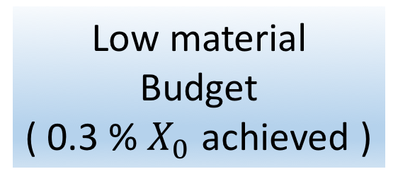
The TIIMM proposal: main goal
What can we do ( and would like ) with MAPS today?
Precision
Tracking
( few μm obtained)
Low material
Budget
( 0.3 % $X_{0}$ achieved )
Energy loss
measurement
( still missing on large area )

Slide 15
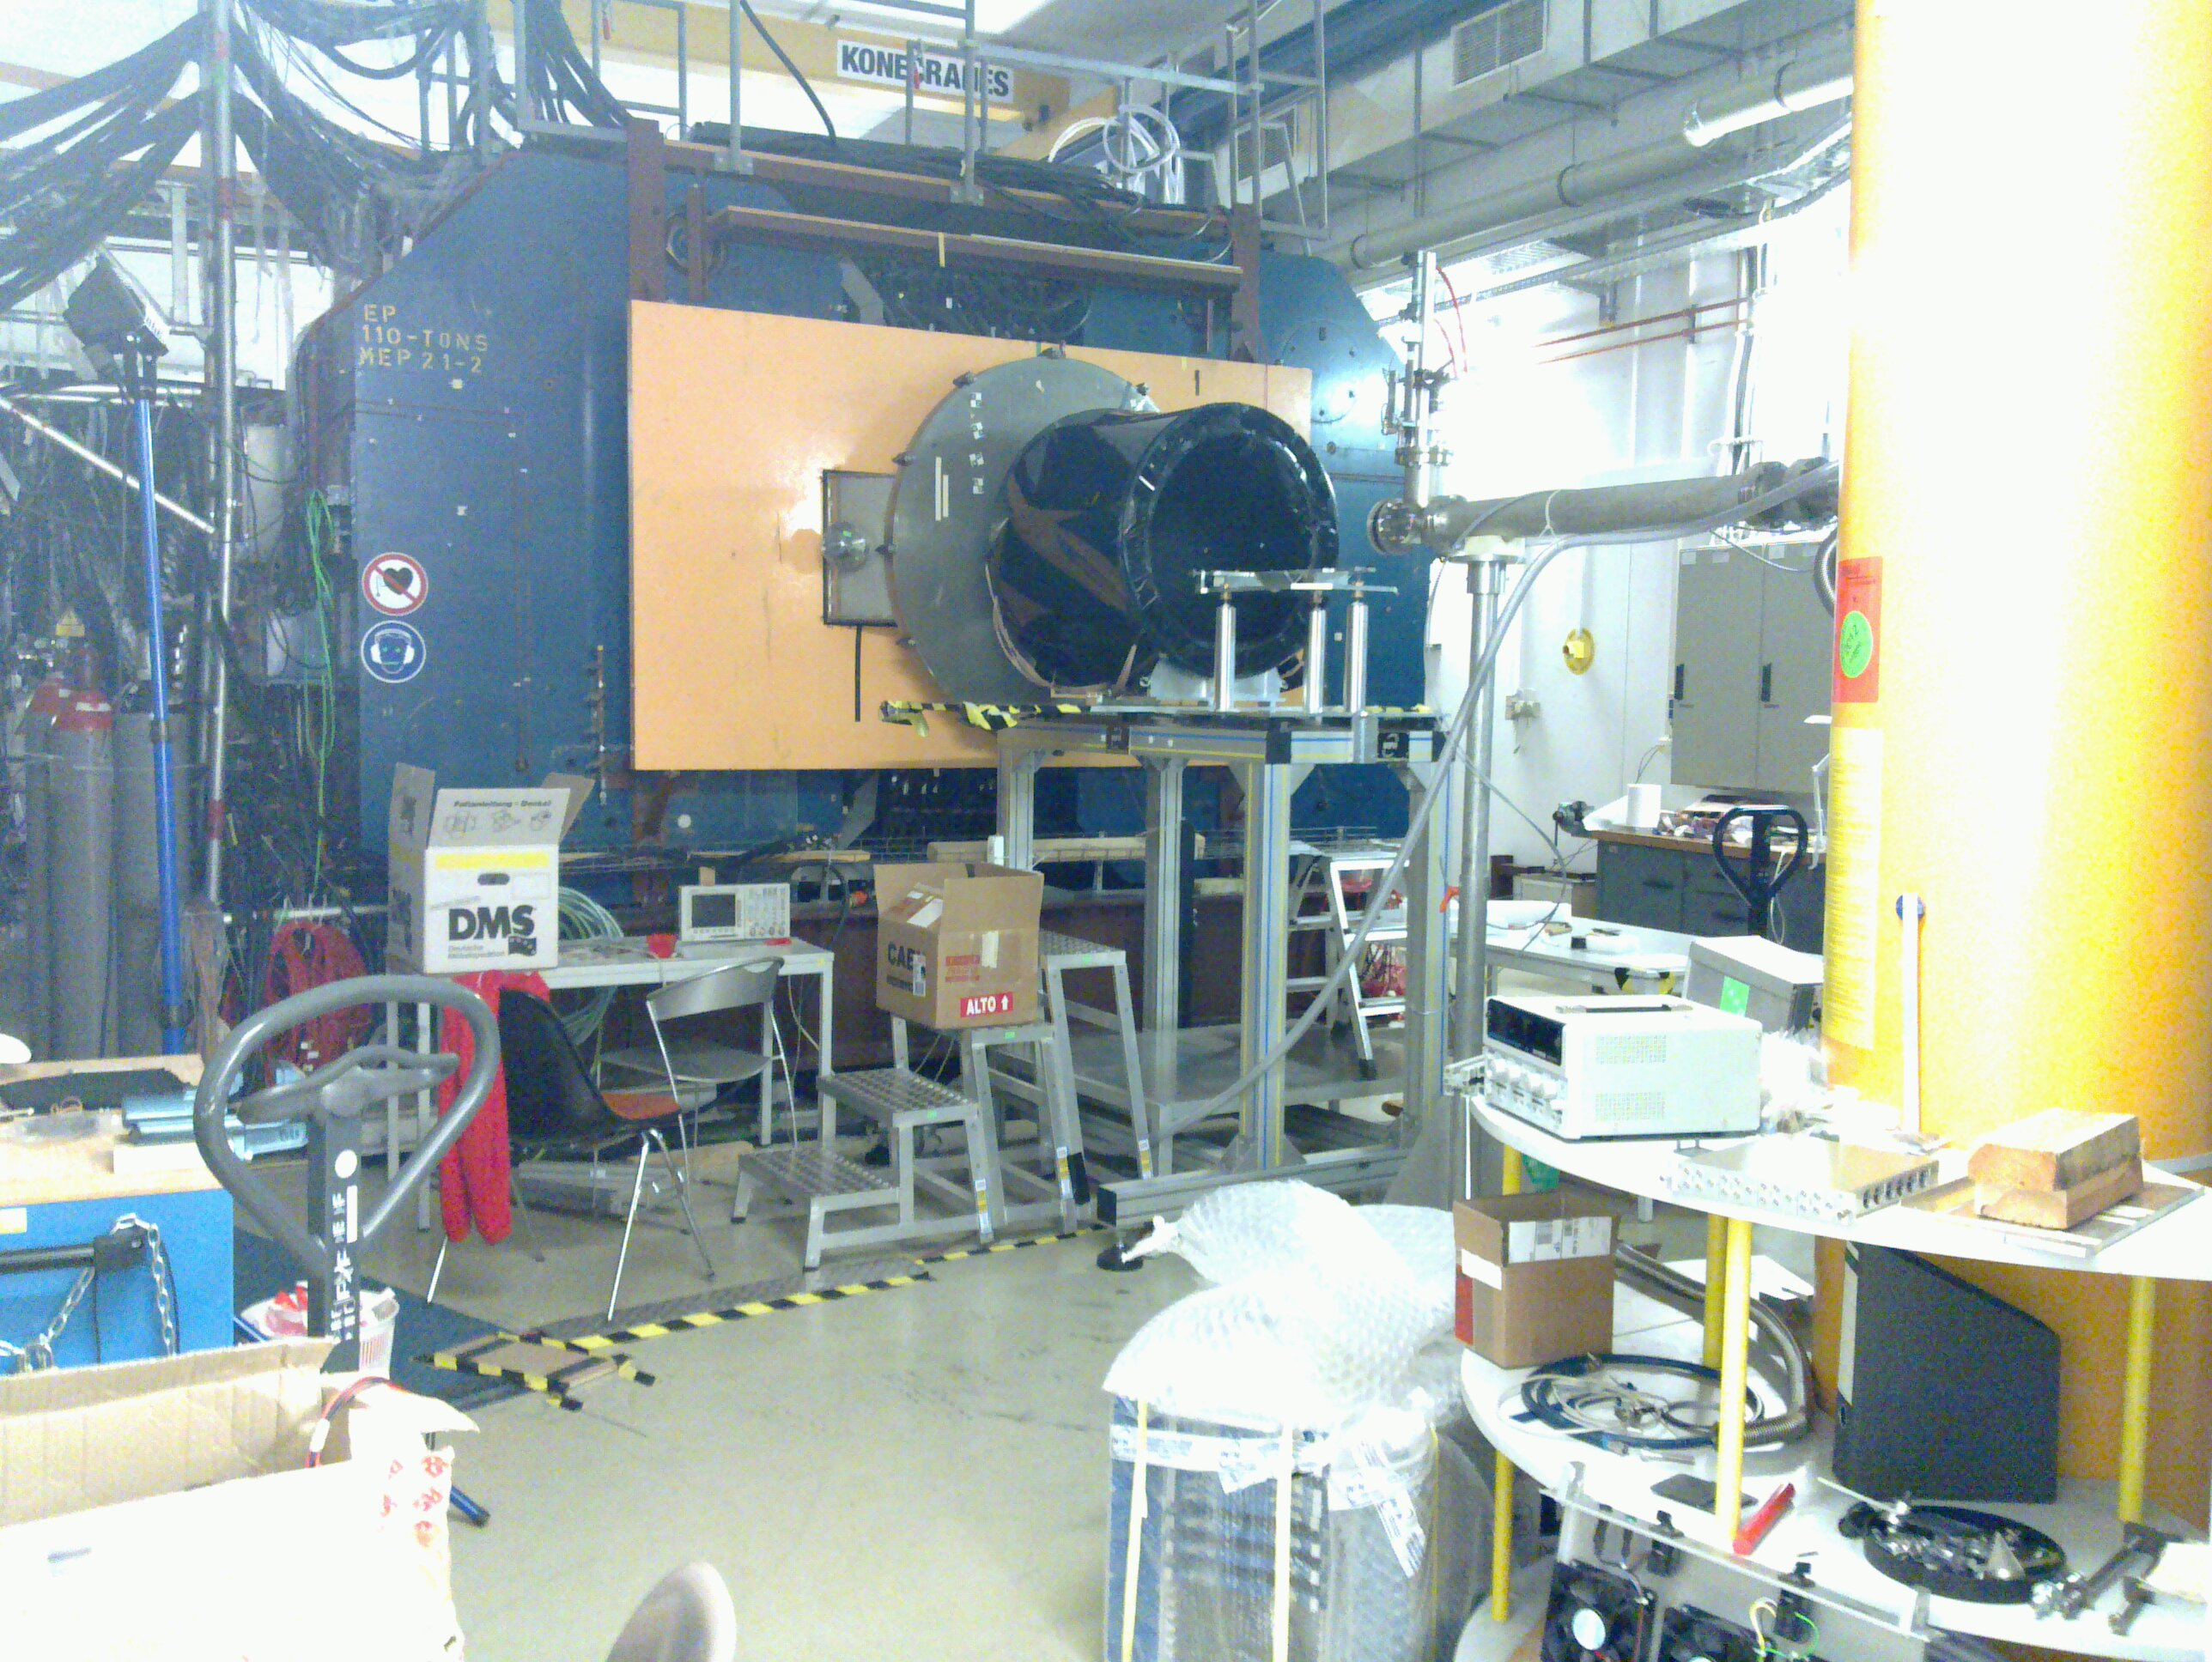
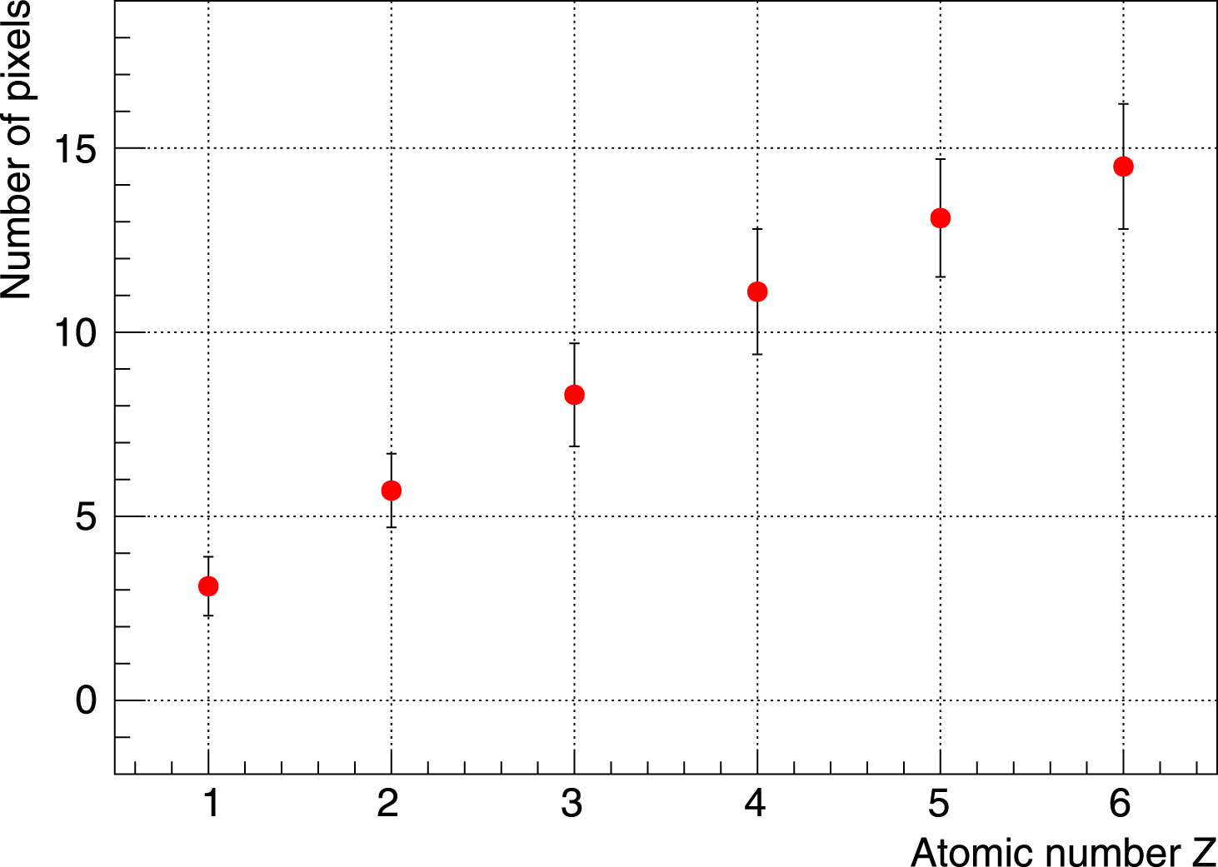
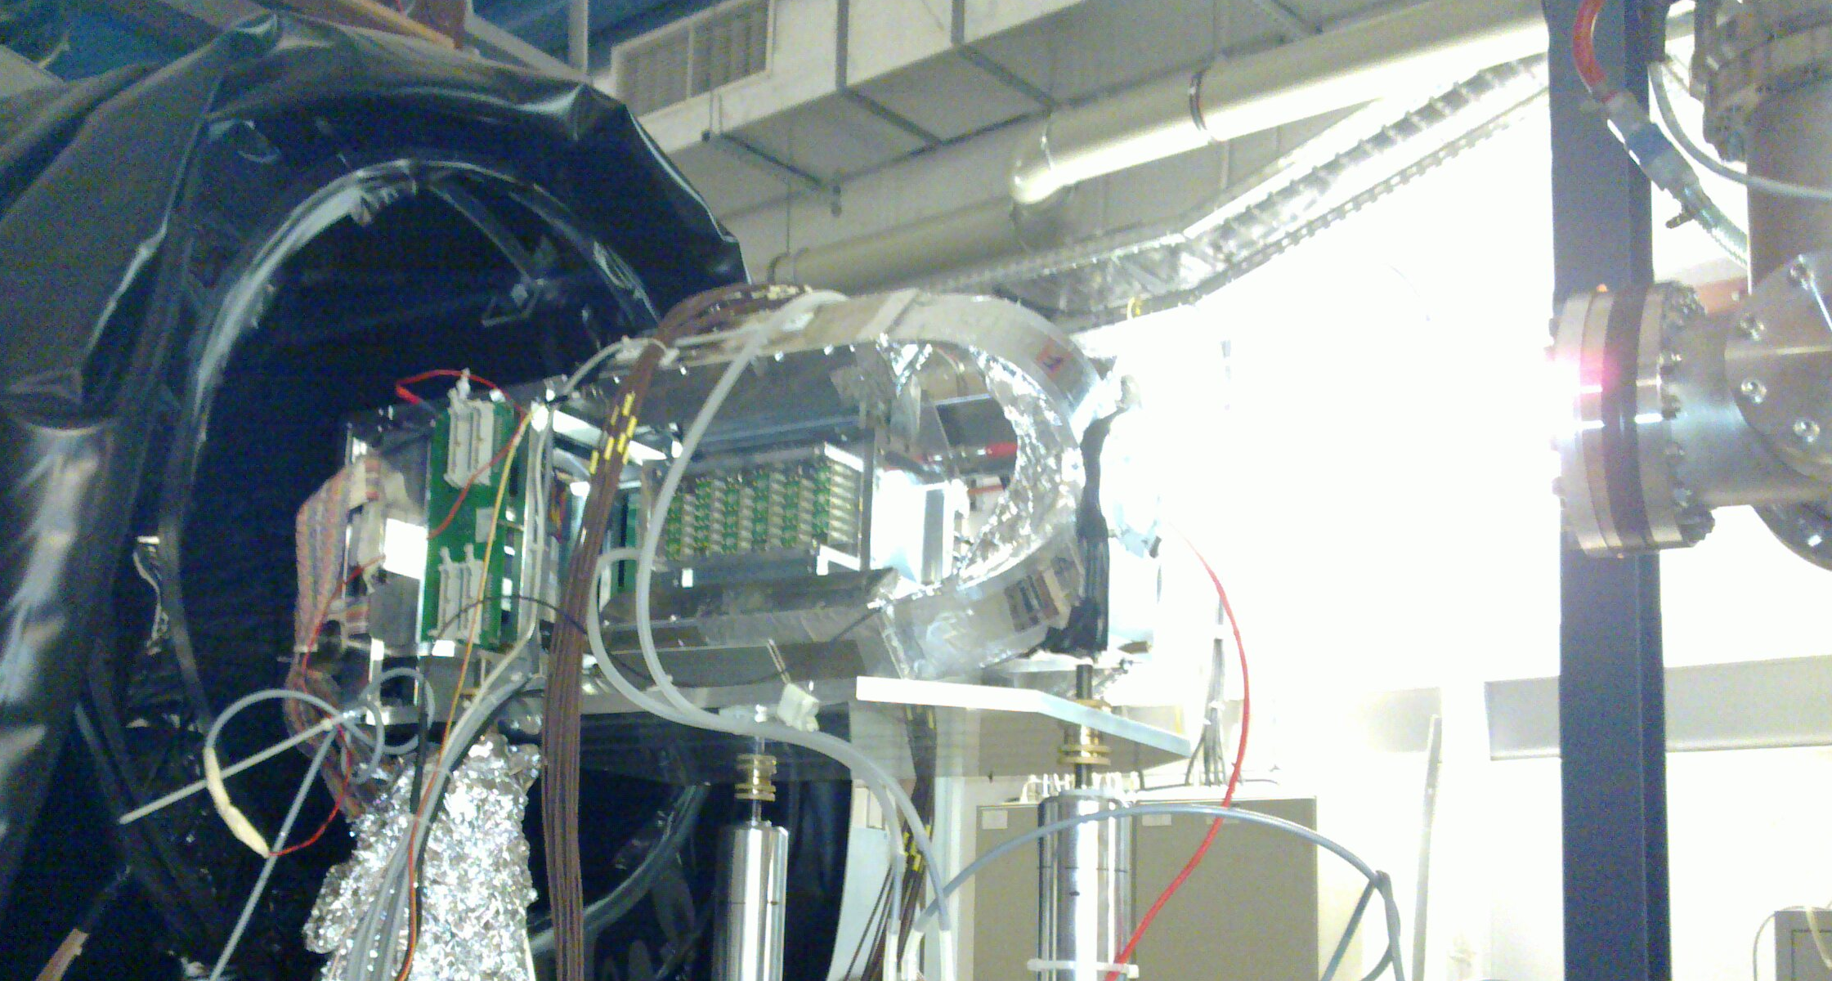
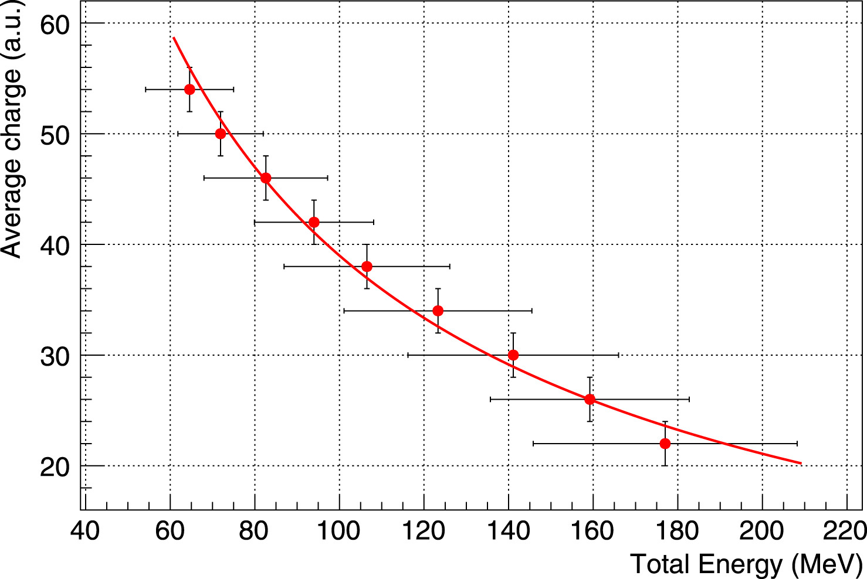
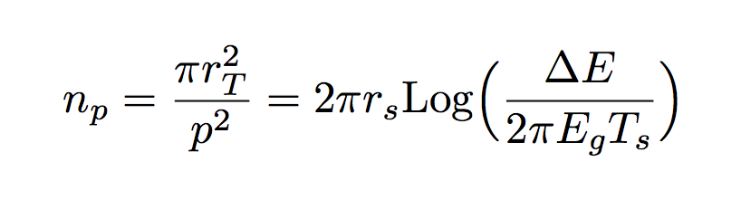
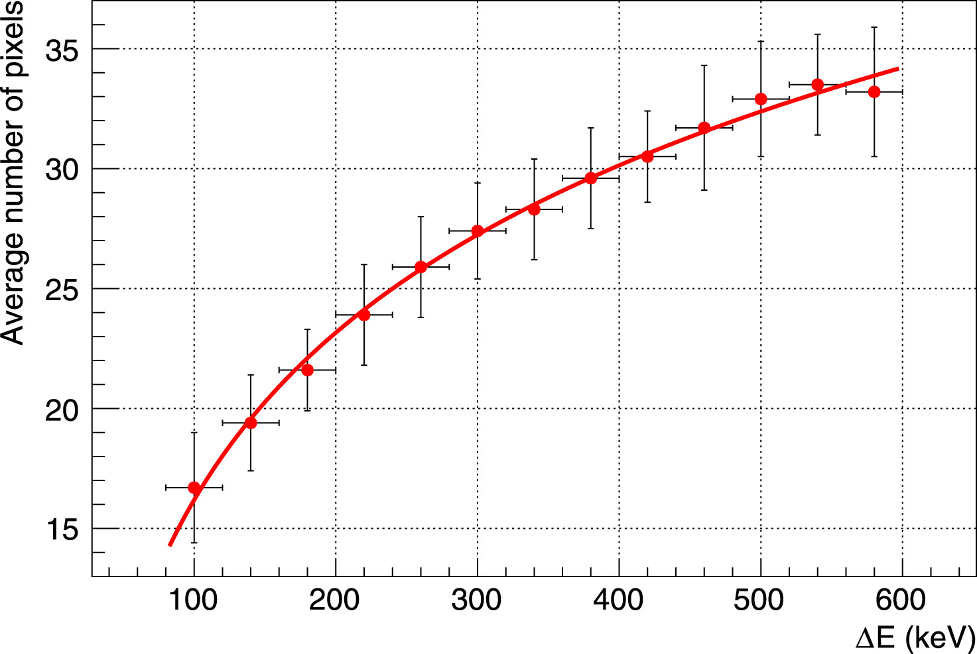

The TIIMM proposal
  dE∕dx in existing MAPS: where do we stand.
FIRST (Fragmentation of Ions foR Space and Therapy)
M. Toppi et al., “Measurement of fragmentation cross sections of C ions on a thin gold target with the FIRST apparatus,” Phys. Rev. C, vol. 93, no. 6, p. 064601, 2016.
Number of pixel per cluster vs ion atomic number in FIRST data taking at GSI.
Measured in the MAPS (M26) vertex detector .
E. Spiriti et al.,“CMOS active pixel sensors response to low energy light ions”; Nuclear Inst. and Methods in Physics Research, A 875C (2017) pp. 35-40
Empirical model
$r_{s}=σ^{2}{/p}^{2}$ and $T_{s}=Tσ^{2}$ ( only two parameters )
$σ$ = spread of Gaussian charge diffusion, T = single pixel charge threshold
Measured (M18 sensor) released charge in 14 𝜇m thick silicon epitaxial layer vs total ion (Z=2) energy (measured in CsI telescope).

Slide 16
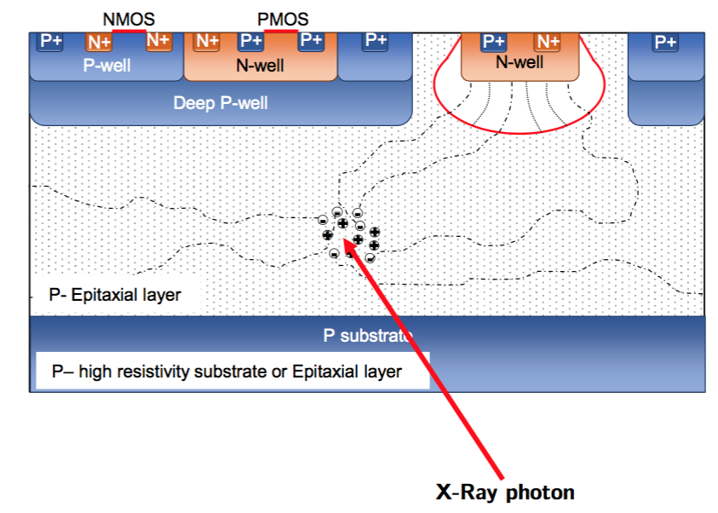
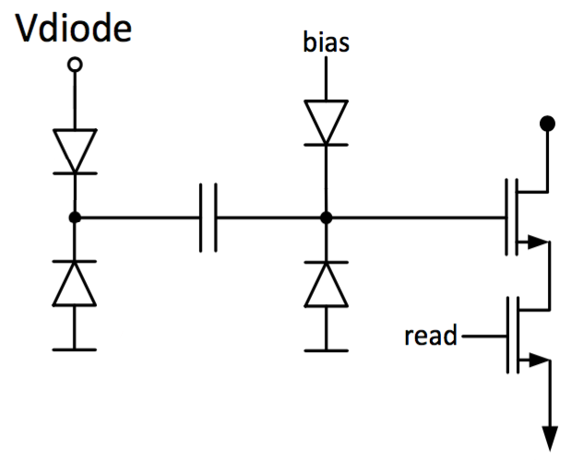
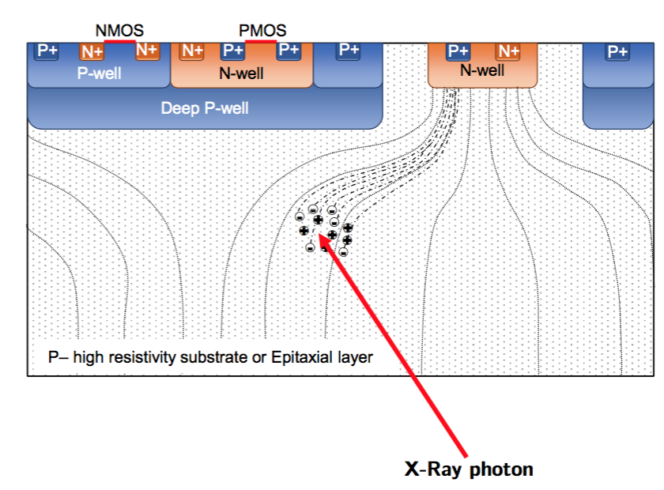
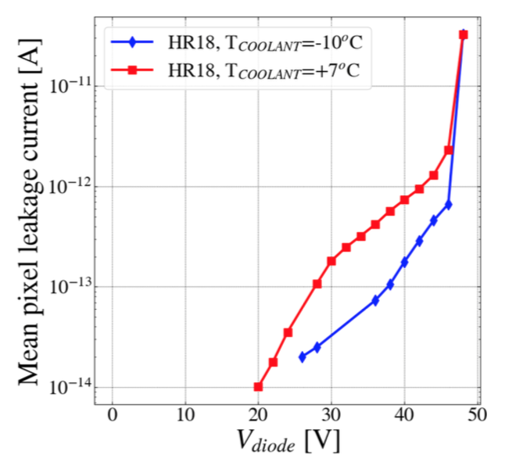
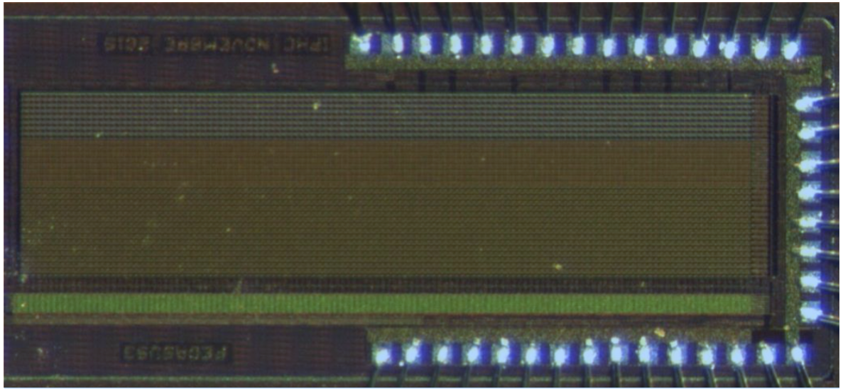
The TIIMM proposal: fully depleted MAPS
J. Heymes ; “Performances of depleted Monolithic Active Pixel Sensor in a high-resistivity CMOS process for X-ray detection”, slide, 11th International Conference on Position Sensitive Detectors PSD2017, Milton Keynes, the UK, 3-8 September 2017
Evolution of standard self-biased 3T solution
Charge produced by the photon conversion is collected by diffusion
Leakage current in sensing diode
Charge produced by the photon conversion is collected by drift
21 fF fringe coupling capacitor
In both options we maintain
MAPS solution advantages:
low material budget
low noise
small pitch
standard CMOS technology
5.57 mm
1.40 mm
PIPPER-2 sensor
Prototype picture

Slide 17
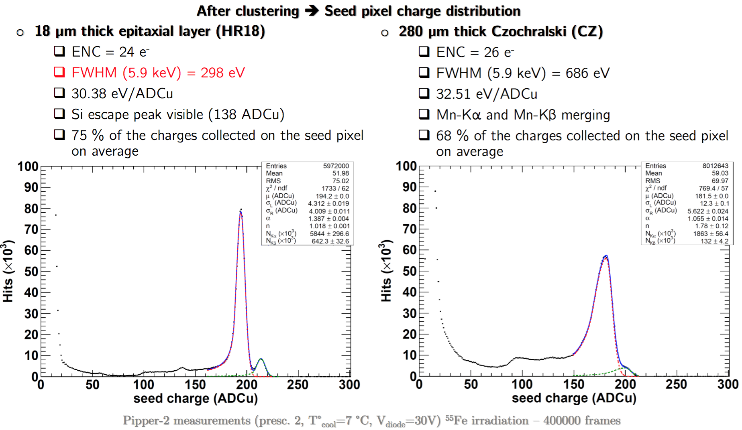
The TIIMM proposal: fully depletion results
J. Heymes ; “Performances of depleted Monolithic Active Pixel Sensor in a high-resistivity CMOS process for X-ray detection”, slide, 11th International Conference on Position Sensitive Detectors PSD2017, Milton Keynes, the UK, 3-8 September 2017
Very last news (preliminar)!
( 50 𝜇m thick, CZ silicon, backside processed, 30V bias )
ENC unchanged
FWHM = = 350 eV
31.1 eV/ADCu
72 % of charge on seed pixel

Slide 18
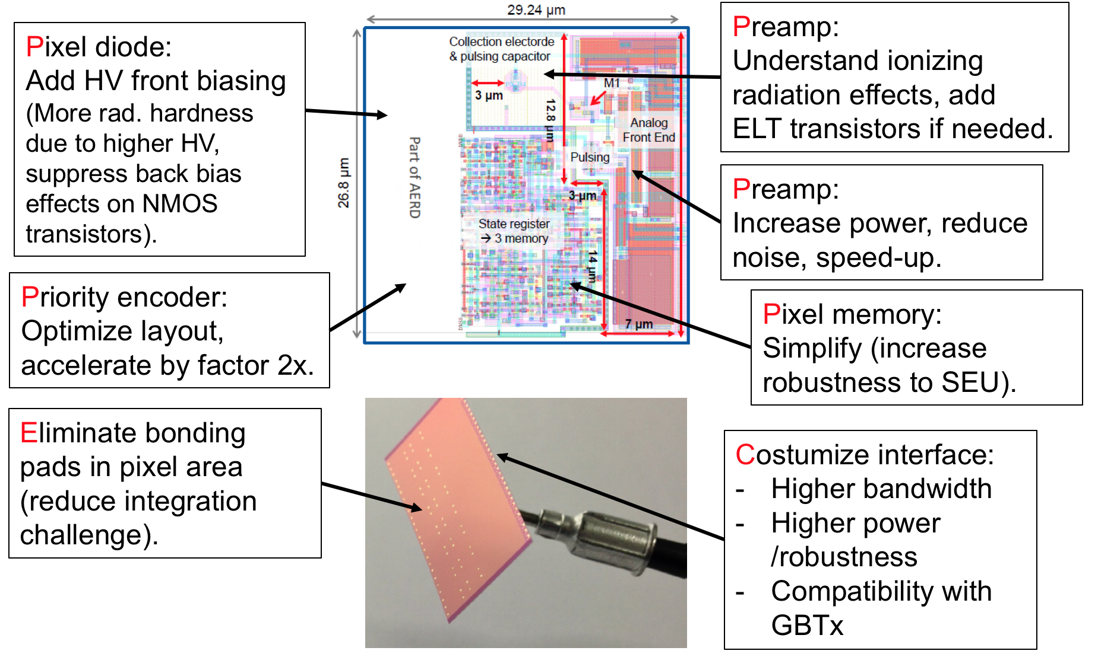
The TIIMM proposal
Which relevant innovations we target in the TIIMM project?
A proof of principle device integrating the MAPS good tracking performancies with the dE/dx measurements capabilities on large area sensors.
  Still a lot of open questions:
Analog or digital output?
Power consumption?
Pixel pitch (single point resolution)?
In pixel discriminator?
In pixel Analog to Digital Conversion (pipeline ADC)?
Integration time?
Sparse or full frame readout? (application dependent)
….................................
Common goal with TIIMM
Example of similar questions in the MIMOSIS project for CBM
Which characteristics for the final instrument TIIMM is aimimg?
Incorporate as much as possible the functionalities existing in the hybrid sensors ( Timepix3 ?!?!?!?! ).
Most of the trade off choices are strongly dependent on the final application.
TIIMM goal zero: deliver a prototype to establish the feasibility at a large sensor scale size.

Slide 19
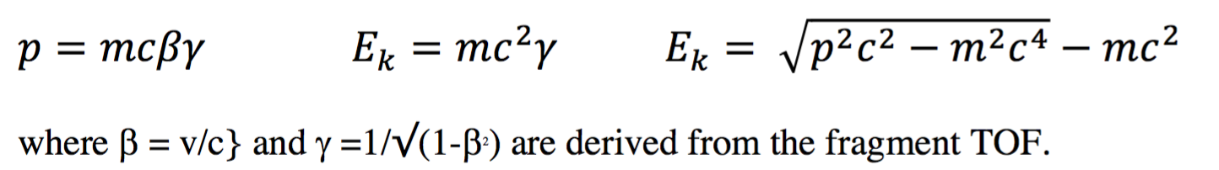
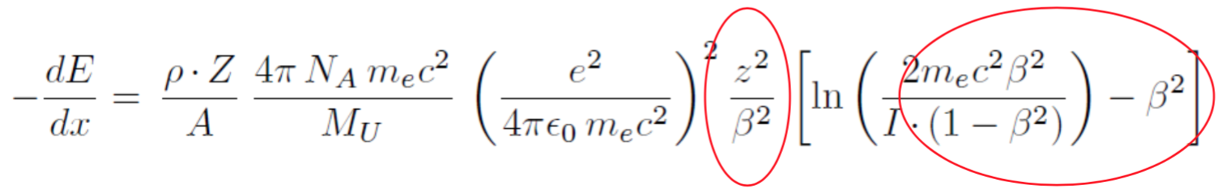
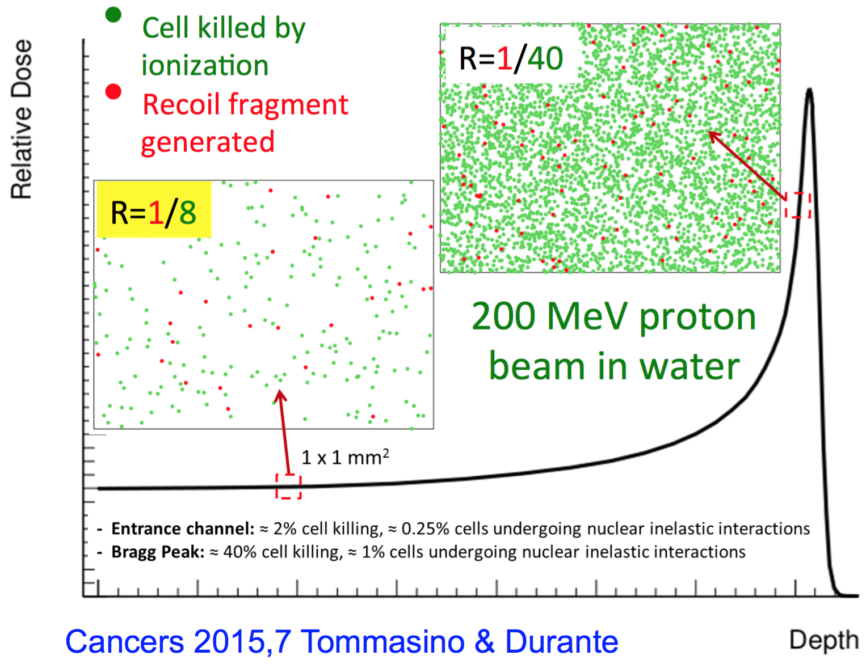
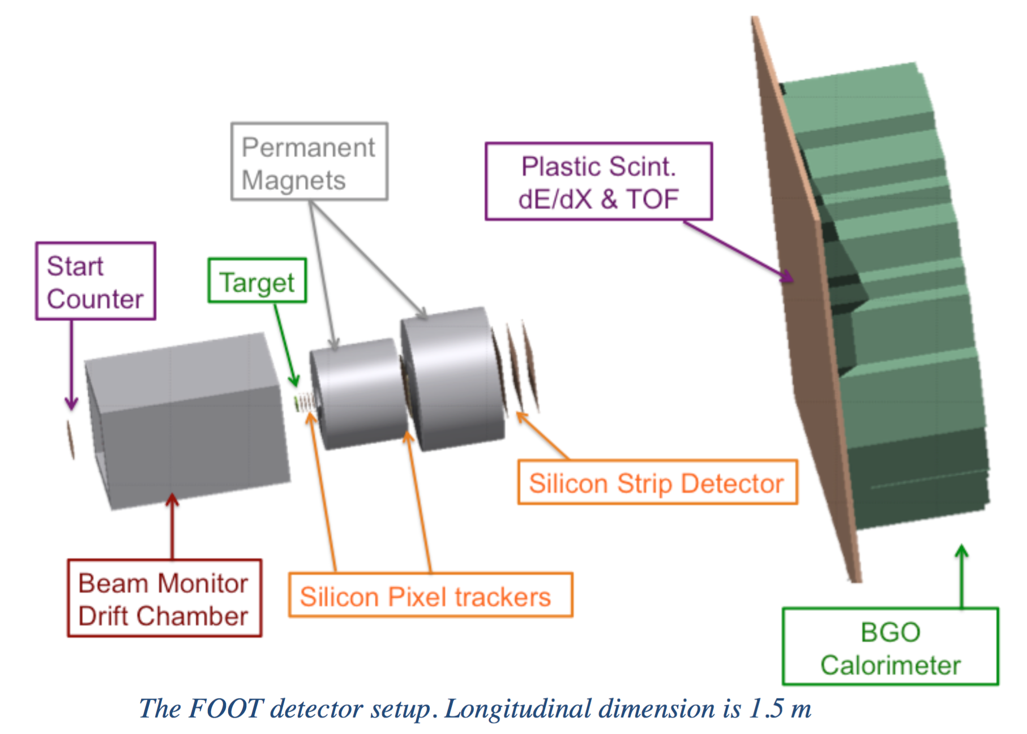
The TIIMM proposal: a possible practical application example
FOOT ( FragmentatiOn Of Target )
Dose released in proton entrance channel
Dose released after the Bragg peak
Radioprotection in space
momentum resolution 5 %;
TOF resolution 100 ps;
energy resolution 2 %;
resolution deltaE 2-6 %;
Silicon pixel tracker
MAPS ( Mimosa28)
Can MAPS play a role here?
About 10% of biological effect in the entrance channel due to secondary fragments (Grun 2013)

Slide 20


Conclusions
Let’s check at the La Biodola shore where we will stand???

