Slide 1
Beam-Test Facility status
54th LNF Scientific Committee
The BTF staff and upgrade team
Paolo Valente – Roma
Bruno Buonomo, Claudio Di Giulio, Luca Foggetta, David Alesini,
Maurizio Belli, Simone Bini, Bruno Bolli, Sergio Cantarella, Riccardo Ceccareli, Alberto Cecchinelli, Oreste Cerafogli, Renato Clementi, Enrico Di Pasquale, Alessandro Drago, Adolfo Esposito, Oscar Frasciello, Andrea Ghigo, Simona Incremona, Franco Iungo, Stefano Lauciani, Valerio Lollo, Roberto Mascio, Stefano Martelli, Luigi Pellegrino, Graziano Piermarini, Luis Antonio Rossi, Lucia Sabbatini, Claudio Sanelli, Franco Sardone, Giancarlo Sensolini, Serena Strabioli, Ruggero Ricci, Ugo Rotundo, Alessandro Stecchi, Angelo Stella, Raffaele Zarlenga – LNF

Slide 2
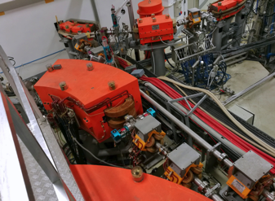
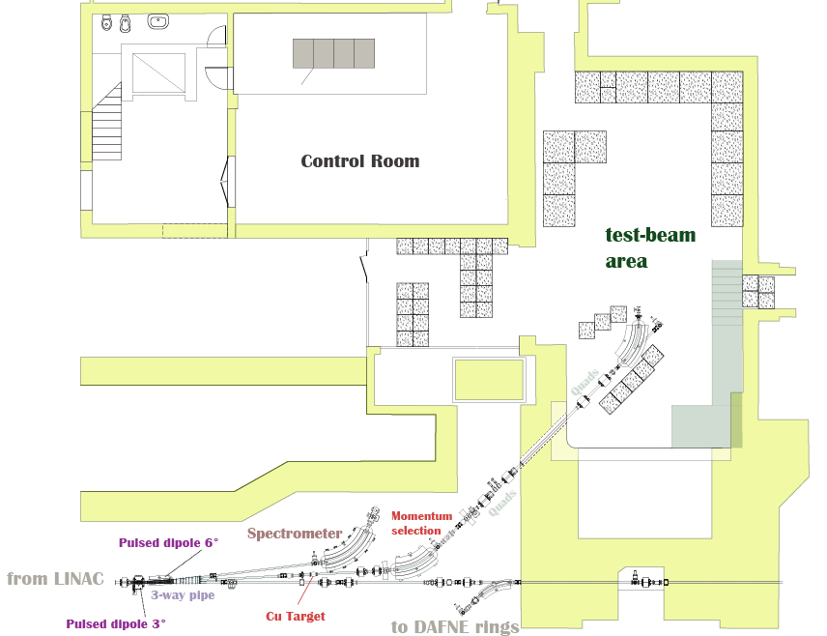
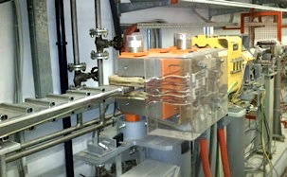
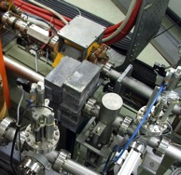
BTF in 2 slides (1)
Part of the DAΦNE accelerator complex
Composed by:
A pulsed 3° dipole, selecting individual LINAC pulses (not used for the collider rings)
A beam-attenuating and energy-spreading target (2 x₀, Cu) + collection system (2 quads)
A magnetic energy-selection and intensity tuning system (42° DC dipole + collimators)
A transfer line (2 quad doublets + 45° DC dipole) for beam manipulation
A dedicated experimental area, diagnostics, acquisition, network, vacuum, gas, cryogenics services (and more)
A control room

Slide 3
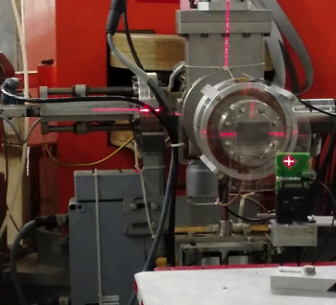
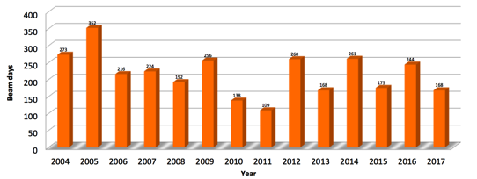
BTF in 2 slides (2)
Pulsed electron and positron beams (up to 49 pulses/second)
Different ranges of parameters in the two running modes:
Dedicated (no collider operation, exclusive LINAC users)
“Opportunistic”
Two possibilities: with and without attenuating target
Maximum energy fixed by LINAC (750 MeV in dedicated)
Minimum energy dictated by:
Beam extracted in air through 0.5 mm Be exit window
Low currents in all magnetic line
Energy vs. angle distribution out of target gives strong dependence of intensity on selected energy
Beam spot minimum size and divergence dominated by multiple scattering on exit window (σ=350 μm at 450 MeV)
0.5 mm Be
Silicon pixel
MIMOSA monolithic pixel
σ ≈ 6 μm
Poisson distribution
@100 MeV
Average of 200 beam days/year, 25-30 experimental groups, 150-200 users
Undergoing a major upgrade in 2018:
Split beam-line for serving two experimental areas
Shielding of second hall
LINAC consolidation
New control room
PADME searching for dark forces: ≈6 months in 2018

Slide 4
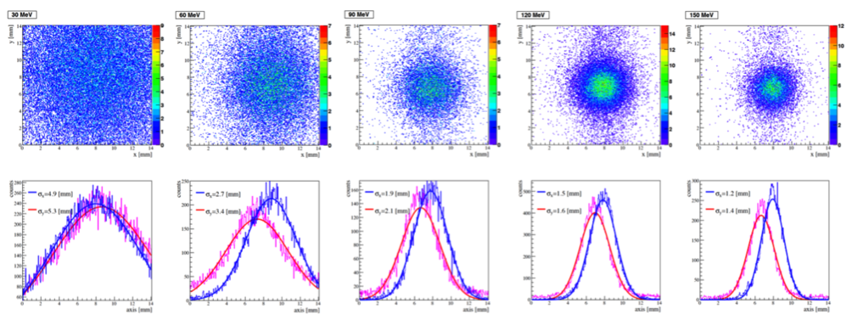
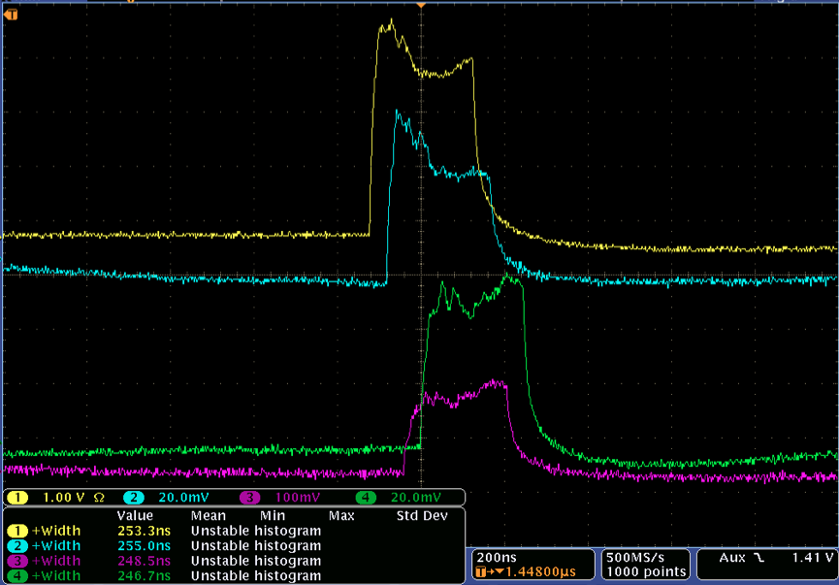
BTF staff (2016-2017)
1. The Frascati LINAC beam facility performance and upgrades
BTF upgrade team (Paolo Valente (INFN, Rome) for the collaboration)
2016 - 6 pages
PoS ICHEP2016 (2016) 937
SISSA (2016-11-14)
2. DAΦNE BTF Improvements of the Transverse Beam Diagnostics
Paolo Valente (INFN, Rome), Bruno Buonomo, Claudio Di Giulio, Luca Gennaro Foggetta (Frascati). 2017. 3 pp.
DOI: 10.18429/JACoW-IPAC2017-MOPAB061
3. Long beam pulses with SLED compression in DAΦNE LINAC
Paolo Valente (INFN, Rome) et al.. 2017. 3 pp.
Published in J.Phys.Conf.Ser. 874 (2017) no.1, 012017
DOI: 10.1088/1742-6596/874/1/012017, 10.18429/JACoW-IPAC2017-TUPAB048
Conference: C17-05-14 Proceedings
4. The Frascati LINAC beam test facility performances and upgrades
B. Buonomo (Frascati), Claudio Di Giulio (INFN, Rome), L. Foggetta (Frascati), P. Valente (INFN, Rome). 2017. 5 pp.
Published in Nuovo Cim. C40 (2017) no.1, 69
DOI: 10.1393/ncc/i2017-17069-6
5. Status of positron beams for dark photons experiments
Paolo Valente (INFN, Rome). 2017. 8 pp.
Published in EPJ Web Conf. 142 (2017) 01028
DOI: 10.1051/epjconf/201714201028
6. Linear Accelerator Test Facility at LNF : Conceptual Design Report
Paolo Valente (INFN, Rome) et al.. Mar 17, 2016. 71 pp.
INFN-16-04-LNF
e-Print: arXiv:1603.05651 [physics.acc-ph] | PDF
7. Frascati Beam Test Facility (BTF) High Resolution Beam Spot Diagnostics
B. Buonomo (Frascati), Claudio Di Giulio (INFN, Rome), L. Foggetta (Frascati), P. Valente (INFN, Rome). 2017. 4 pp.
DOI: 10.18489/JACoW-IBIC2016-MOPG65
8. The Frascati Beam Test Facility (BTF) Performance and Upgrades
B. Buonomo (Frascati), Claudio Di Giulio (INFN, Rome), L. Foggetta (Frascati), P. Valente (INFN, Rome). 2017. 4 pp.
DOI: 10.18489/JACoW-IBIC2016-TUPG29
9. A hardware and Software Overview on the New BTF Transverse Monitor
B. Buonomo (Frascati), Claudio Di Giulio (INFN, Rome), L. Foggetta (Frascati), , P. Valente (INFN, Rome). 2017. 4 pp.
DOI: 10.18489/JACoW-IBIC2016-WEPG73
Beam spot vs. energy
Long beam pulses

Slide 5
Citations (2016)
1. Energy and time resolution of a LYSO matrix prototype for the Mu2e experiment
N. Atanov (Dubna, JINR) et al.. May 30, 2016. 2 pp.
Published in Nucl.Instrum.Meth. A824 (2016) 684-685
FERMILAB-CONF-16-325-PPD
DOI: 10.1016/j.nima.2015.09.051
e-Print: arXiv:1605.09419 [physics.ins-det] | PDF
2. Performance of the PADME Calorimeter prototype at the DAΦNE BTF
M. Raggi (Rome U. & INFN, Rome) et al.. Nov 17, 2016. 5 pp.
Published in Nucl.Instrum.Meth. A862 (2017) 31-35
DOI: 10.1016/j.nima.2017.05.007
e-Print: arXiv:1611.05649 [physics.ins-det] | PDF
3. Study of the performance of the NA62 Small-Angle Calorimeter at the DAΦΦNE Linac
A. Antonelli, F. Gonnella, V. Kozhuharov, M. Moulson, M. Raggi, T. Spadaro. Oct 12, 2016. 5 pp.
Published in Nucl.Instrum.Meth. A877 (2018) 178-182
DOI: 10.1016/j.nima.2017.09.065
e-Print: arXiv:1610.03827 [physics.ins-det] | PDF
4. Electron Beam Test of Key Elements of the Laser-Based Calibration System for the Muon g− 2 Experiment
A. Anastasi (Frascati & Messina U.) et al.. Oct 11, 2016. 6 pp.
Published in Nucl.Instrum.Meth. A842 (2017) 86-91
FERMILAB-PUB-16-441-E-PPD
DOI: 10.1016/j.nima.2016.10.047
e-Print: arXiv:1610.03210 [physics.ins-det] | PDF
5. Characterization of a 5 × 5 LYSO Matrix Calorimeter Prototype
N. Atanov (Dubna, JINR) et al.. 2016. 9 pp.
Published in IEEE Trans.Nucl.Sci. 63 (2016) no.2, 596-604
DOI: 10.1109/TNS.2016.2522818
6. The PADME experiment at Laboratori Nazionali di Frascati
PADME Collaboration (Gabriele Piperno (Frascati) for the collaboration). Jul 29, 2016. 6 pp.
Conference: C16-05-09.3 Proceedings
e-Print: arXiv:1608.00036 [physics.ins-det] | PDF
7. Test beam results with a sampling calorimeter of cerium fluoride scintillating crystals and tungsten absorber plates for calorimetry at the HL-LHC
R. Becker (Zurich, ETH) et al.. 2016. 3 pp.
Published in Nucl.Instrum.Meth. A824 (2016) 681-683
DOI: 10.1016/j.nima.2015.09.052
8. The AMY experiment: Microwave emission from air shower plasmas
J. Alvarez-Muñiz (Santiago de Compostela U., IGFAE) et al.. 2016. 6 pp.
Published in EPJ Web Conf. 121 (2016) 03010
DOI: 10.1051/epjconf/201612103010
9. SLRI Beam Test Facility Development Project
Kritsada Kittimanapun, Narong Chanlek, Sampart Cheedket, Nawin Juntong, Prapong Klysubun, Siriwan Krainara, Kreukrit Sittisard, Somphong Supajeerapan. 2016. 3 pp.
DOI: 10.18429/JACoW-IPAC2016-WEPMY002
10. Diamond Sensor Resolution in Simultaneous Detection of 1,2,3 Electrons at the PHIL Photoinjector Facility at LAL
Viacheslav Kubytskyi, Philip Bambade, Sergey Barsuk, Oleg Bezshyyko, Vlad Krylov, Volodymyr Rodin. 2016. 4 pp.
DOI: 10.18429/JACoW-IPAC2016-MOPMB007
11. A pure CsI calorimeter for the Belle II experiment at SuperKEKB
A. Aloisio (Naples U. & INFN, Naples) et al.. 2016. 6 pp.
Published in Nucl.Instrum.Meth. A824 (2016) 704-709
DOI: 10.1016/j.nima.2015.11.045
12. The Mu2e crystal calorimeter and improvements in the μ−N→e−N search sensitivity
Gianantonio Pezzullo (Pisa U.). 2016. 139 pp.
FERMILAB-THESIS-2016-02
13. The PADME experiment at INFN LNF
PADME Collaboration (Salvatore Fiore (ENEA, Frascati & INFN, Rome) for the collaboration). 2016. 6 pp.
Published in J.Phys.Conf.Ser. 770 (2016) no.1, 012039
DOI: 10.1088/1742-6596/770/1/012039

Slide 6
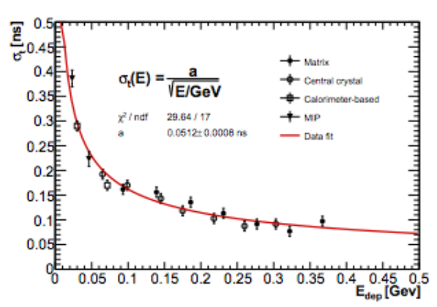
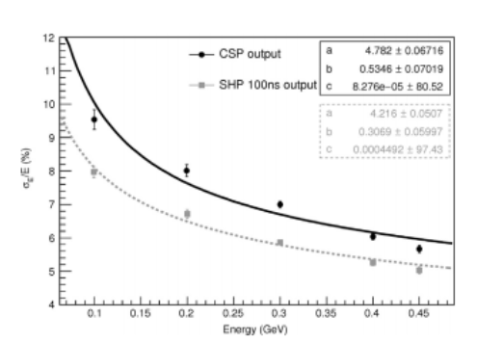
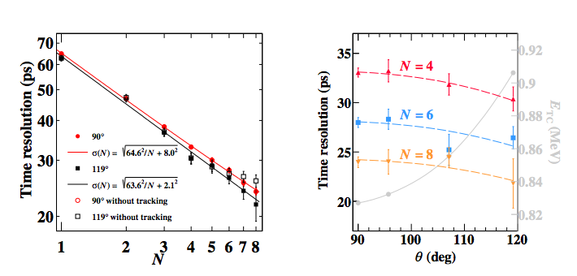
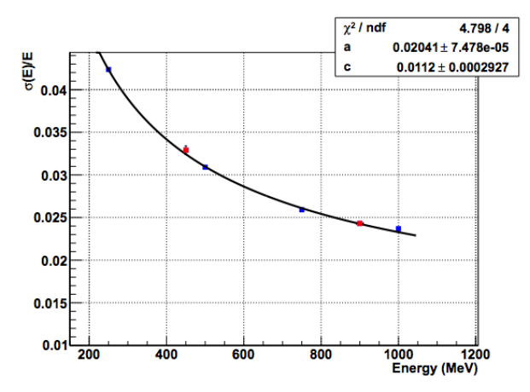
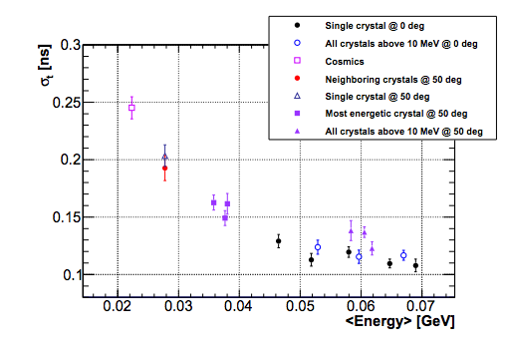
Citations (2016)
LYSO Mu2e
15. !CHAOS: A cloud of controls
S. Angius et al.. 2016.
Published in Nuovo Cim. C39 (2016) no.1, 268
DOI: 10.1393/ncc/i2016-16268-y
16. Characterization of a prototype for the electromagnetic calorimeter of the Mu2e experiment
N. Atanov (Dubna, JINR) et al.. 2016.
Published in Nuovo Cim. C39 (2016) no.1, 267
DOI: 10.1393/ncc/i2016-16267-0
17. Pixelated Positron Timing Counter with SiPM-readout Scintillator for MEG II experiment
Miki Nishimura (Tokyo U.) et al.. 2016.
Published in PoS PhotoDet2015 (2016) 011
18. Time resolution of time-of-flight detector based on multiple scintillation counters readout by SiPMs
P.W. Cattaneo (INFN, Pavia), M. De Gerone (INFN, Genoa), F. Gatti (Genoa U. & INFN, Genoa), M. Nishimura (Tokyo U.), W. Ootani (Tokyo U., ICEPP), M. Rossella (INFN, Pavia), S. Shirabe (Kyushu U., Fukuoka (main)), Y. Uchiyama (Tokyo U., ICEPP). Nov 12, 2015. 10 pp.
Published in Nucl.Instrum.Meth. A828 (2016) 191
DOI: 10.1016/j.nima.2016.05.038
e-Print: arXiv:1511.03891 [physics.ins-det] | PDF
CsI Belle-II
MEG-II timing counters
BGO PADME
CsI G-2

Slide 7
Citations (2017)
1. ORANGE: A high sensitivity particle tracker based on optically read out GEM
M. Marafini, V. Patera, D. Pinci, A. Sarti, A. Sciubba, E. Spiriti. 2017. 4 pp.
Published in Nucl.Instrum.Meth. A845 (2017) 285-288
DOI: 10.1016/j.nima.2016.04.014
2. Micro-channel plates in ionization mode as a fast timing device for future hadron colliders
A.Yu. Barnyakov (Novosibirsk, IYF & Novosibirsk State U. & Novosibirsk State Tech. U.) et al.. 2017.
Published in JINST 12 (2017) no.08, C08014
DOI: 10.1088/1748-0221/12/08/C08014
3. Response of microchannel plates in ionization mode to single particles and electromagnetic showers
A. Yu Barnyakov (Novosibirsk, IYF & Novosibirsk State U. & Novosibirsk State Tech. U.) et al.. Jul 26, 2017. 7 pp.
Published in Nucl.Instrum.Meth. A879 (2018) 6-12
DOI: 10.1016/j.nima.2017.10.002
e-Print: arXiv:1707.08503 [physics.ins-det] | PDF
4. Carbon nanotubes as target for directional detection of light WIMP
V.C. Antochi (Rome U. & INFN, Rome), E. Baracchini (Frascati), G. Cavoto (Rome U. & INFN, Rome), E. Di Marco (INFN, Rome), G. Mazzitelli (Frascati), D. Pinci (INFN, Rome), A.D. Polosa (Rome U. & INFN, Rome), F. Renga (INFN, Rome & Rome U.), C. Voena (INFN, Rome). Jul 9, 2017. 4 pp.
e-Print: arXiv:1707.02549 [physics.ins-det] | PDF
5. Experimental result on the propagation of Coulomb fields
R. de Sangro, G. Finocchiaro, P. Patteri, M. Piccolo, G. Pizzella (Frascati). 2017. 14 pp.
Published in J.Phys.Conf.Ser. 845 (2017) no.1, 012015
DOI: 10.1088/1742-6596/845/1/012015
6. From vertex detectors to inner trackers with CMOS pixel sensors
A. Besson (U. Strasbourg), A. Pérez Pérez (Strasbourg, IPHC), E. Spiriti (Frascati), J. Baudot (U. Strasbourg), G. Claus, M. Goffe, M. Winter (Strasbourg, IPHC). Apr 11, 2016. 5 pp.
Published in Nucl.Instrum.Meth. A845 (2017) 33-37
DOI: 10.1016/j.nima.2016.04.081
7. Performance of the diamond active target prototype for the PADME experiment at the DAΦNE BTF
R. Assiro (INFN, Lecce) et al.. Sep 20, 2017. 7 pp.
e-Print: arXiv:1709.07081 [physics.ins-det] | PDF
8. First Optics Design and Beam Performance Simulation of PRAE: Platform for Research and Applications With Electrons at Orsay
Angeles Faus-Golfe (Orsay, LAL) et al.. 2017. 4 pp.
DOI: 10.18429/JACoW-IPAC2017-THPVA079
9. Carbon nanotubes as target for directional detection of light WIMP
V. C. Antochi, et al.. Jul. 2017. 4pp.
e-Print: arXiv:1707.02549 [physics.ins-det] | PDF
10. The construction of the Fiber-SiPM beam monitor system of the R484 and R582 experiments at the RIKEN-RAL muon facility
M. Bonesini (INFN, Milan Bicocca & Milan Bicocca U.) et al.. Mar 4, 2017. 11 pp.
Published in JINST 12 (2017) C03035
DOI: 10.1088/1748-0221/12/03/C03035
e-Print: arXiv:1703.01447 [physics.ins-det] | PDF
11. Study of low multiplicity electron source LEETECH with diamond detector
V. Kubytskyi (Orsay, LAL) et al.. 2017. 16 pp.
Published in JINST 12 (2017) no.02, P02011
DOI: 10.1088/1748-0221/12/02/P02011
12. Measurement of the energy and time resolution of a undoped CsI + MPPC array for the Mu2e experiment
O. Atanova (Dubna, JINR) et al.. Feb 13, 2017. 10 pp.
Published in JINST 12 (2017) no.05, P05007
FERMILAB-TM-2648-E
DOI: 10.1088/1748-0221/12/05/P05007
e-Print: arXiv:1702.03720 [physics.ins-det] | PDF
13. Negative ion Time Projection Chamber operation with SF66 at nearly atmospheric pressure
E. Baracchini (Frascati & INFN, Rome & Rome U.), G. Cavoto (INFN, Rome & Rome U.), G. Mazzitelli, F. Murtas (Frascati), F. Renga (INFN, Rome & Rome U.), S. Tomassini (Frascati). Oct 5, 2017. 14 pp.
e-Print: arXiv:1710.01994 [physics.ins-det] | PDF
14. The Calibration System of the E989 Experiment at Fermilab
Antonio Anastasi (Messina U.). 2017. 113 pp.
FERMILAB-THESIS-2017-07

Slide 8
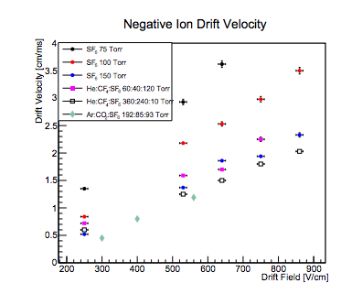
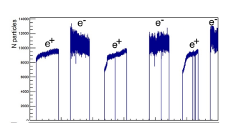
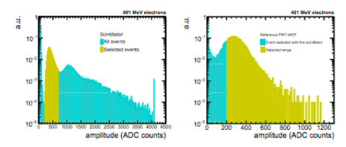
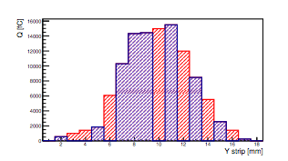
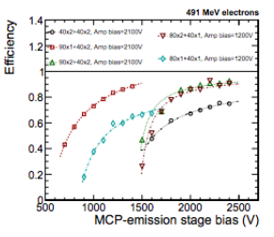
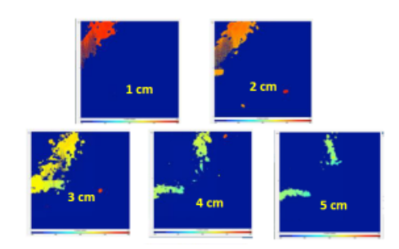
Citations (2017)
Negative ion drift chamber
PADME diamond target
Micro-channel Plates
Carbon nanotubes +GEM TPC

Slide 9
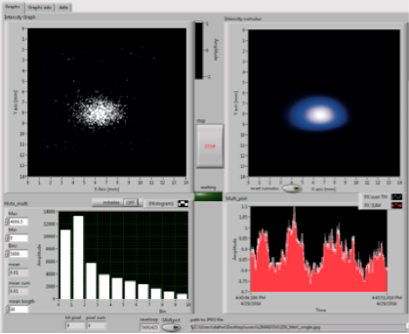
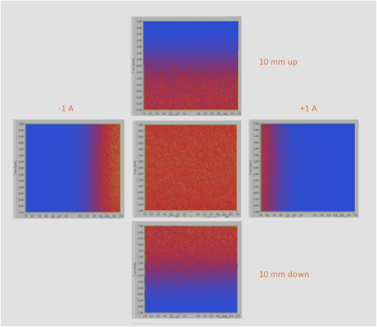
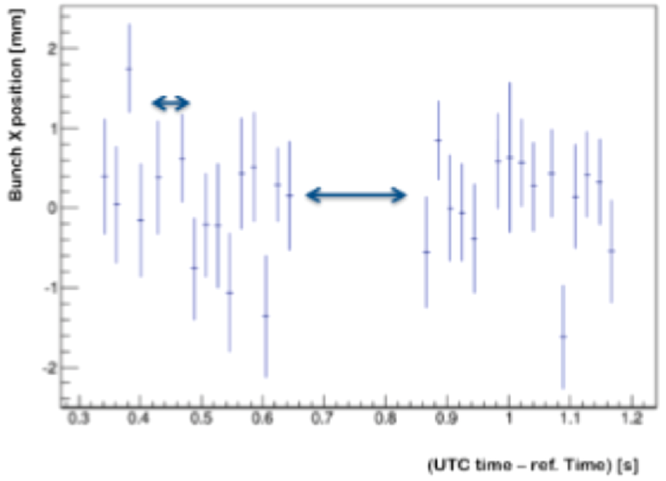
ASI supported irradiation facility (ASIF)
BTF almost unique for electron irradiation of devices for Jupiter missions
FitPIX detectors used as real-time flux monitors, allow to have a good (<10%) dose measurement
Requirements are to have a uniform (<10%) beam, over a wide area (several cm²), at relatively low energy (tens to 200 MeV), and integrate 10¹²-10¹⁵ electrons
20 ms
Empty bunches
100 MeV
1 year project for assessing the feasibility
1 preliminary test done with ESA/CERN/TRAD

Slide 10
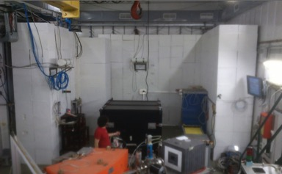
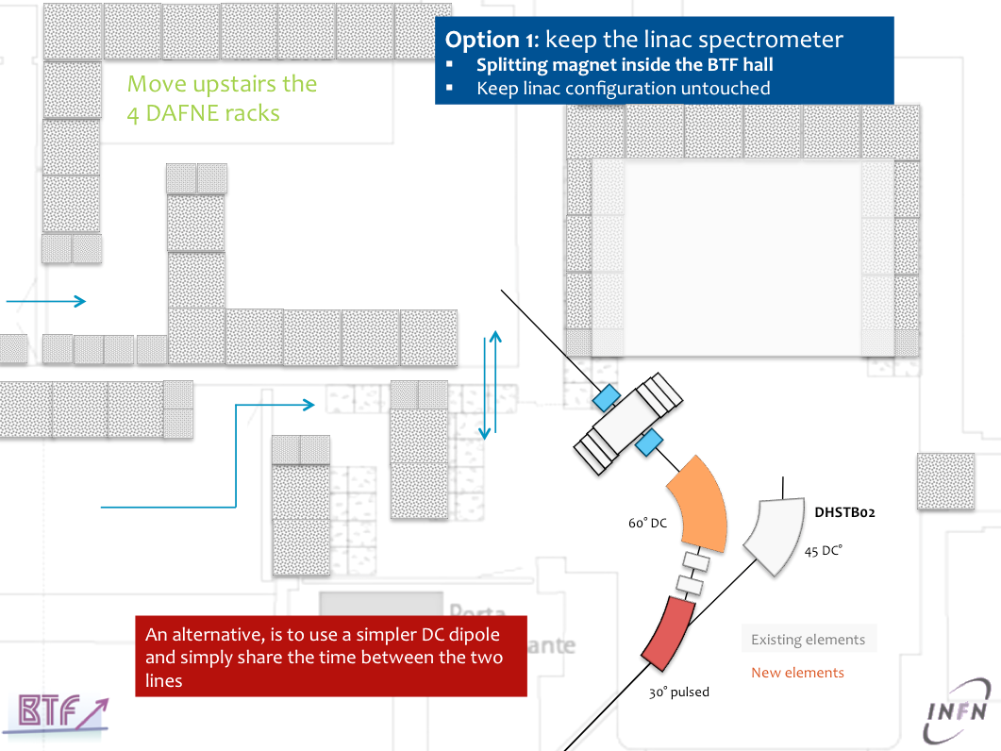
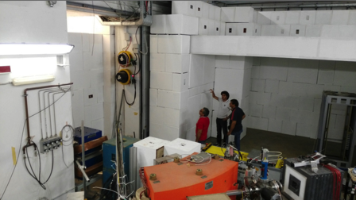
BTF upgrade history (1/3)
BTF Users Workshop, 6-7 May 2014
What Next LNF, 10-11 November 2014
Add top shielding to BTF main hall for high intensity and irradiations
Split the BTF line and use the control room as second experimental area

Slide 11
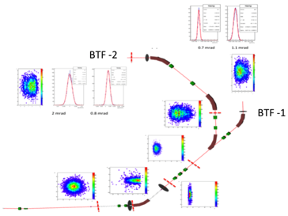
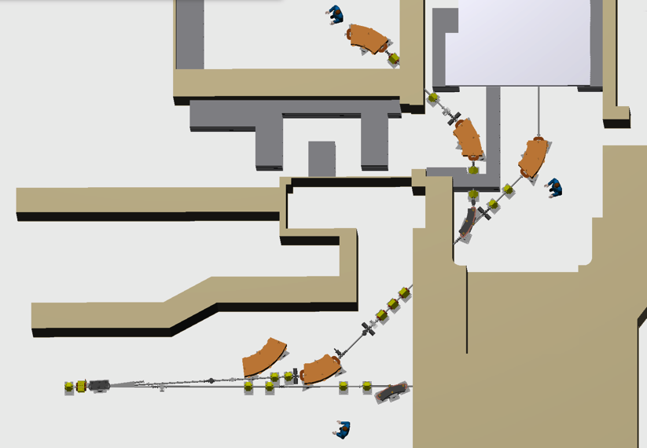
BTF upgrade history (2/3)
Detailed project, presented to INFN Machine Advisory Committee
… asking for comprehensive CDR
INFN-MAC
12 November 2015

Slide 12
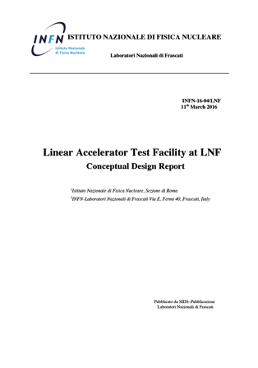
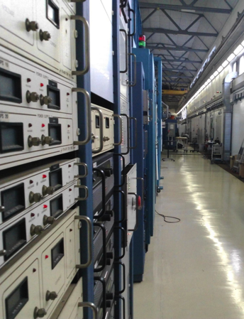
BTF upgrade history (3/3)
2nd INFN-MAC review, March 2016
WP1: LINAC modulators consolidation
WP2: LINAC energy upgrade
Not funded
Request to SLAC of several components of dismantled LINAC
WP3: BTF beam-line doubling
1600 k€ in 2017 (+350 k€)
1000 k€ in 2018
3nd INFN-MAC review, June 2017

Slide 13
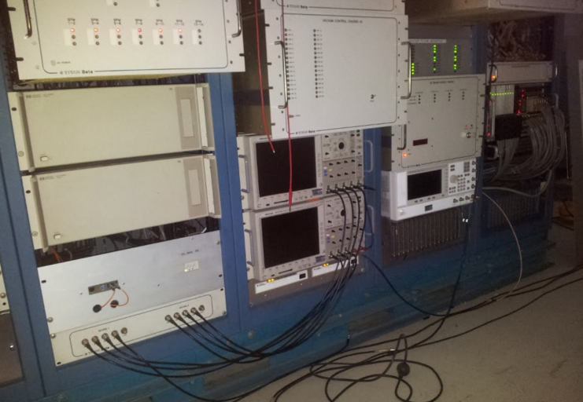
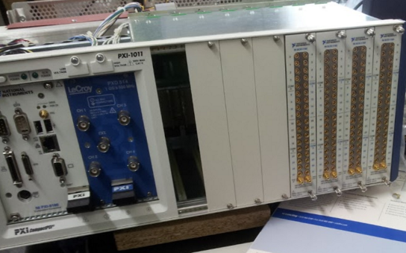
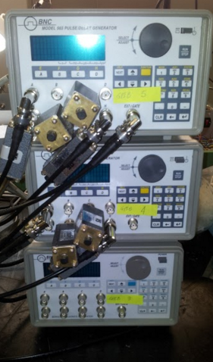
LINAC consolidation: past 4 years
Helmoltzs coils power supply
Vacuum System upgrade
Modulators timing system
RF fast syncro timing system
Gun deck and opto-coupling devices
Gun Low voltage power supply
Gun pulser
Cathode and pyrometer
Nd:Ce flags system
Termination loads
Improved multiplexed BPM diagnostics hardware and software
BCM/ICT detectors
Cooling system (primary, secondary and services)
Cooling feedbacks and Supervisor software
LINAC slow control software
LINAC subsystem ETH, WIFI network
LINAC peripherals bus system
LL RF and low power amplifiers
RF measurement system
PFN, Klystron and Transformer upgrade
HVPS and thyratron circuit upgrade
Full hodoscope replacement
…

Slide 14
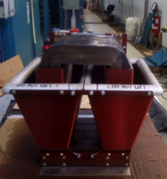
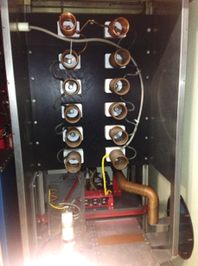
LINAC consolidation (1/4)
Task: replace PFN charging circuit in all four modulators
New step-up pulse transformer, 15× replacing the original 12×, installed in modulator D, in order to supply a lower voltage to the transformer primary
This allows using on-the-shelf high voltage PS
PFN impedance has to be matched to the klystron load
New inductors for re-matching Z_{PFN} installed
Z_{PFN}
Z_{PFN}=R_{L}
Z_{PFN}<R_{L}
Z_{PFN}>R_{L}
V
R_{L}
V_{R}
_{L}
Z_{PFN}≈[L_{PFN}/C_{PFN}]^{1/2}
New configuration operational since January 2017, without issues

Slide 15
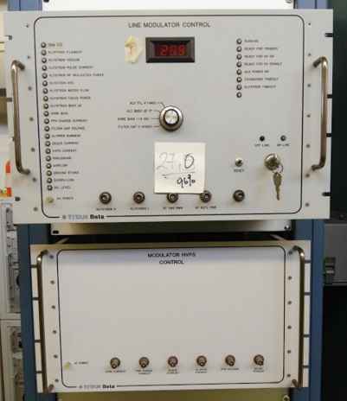
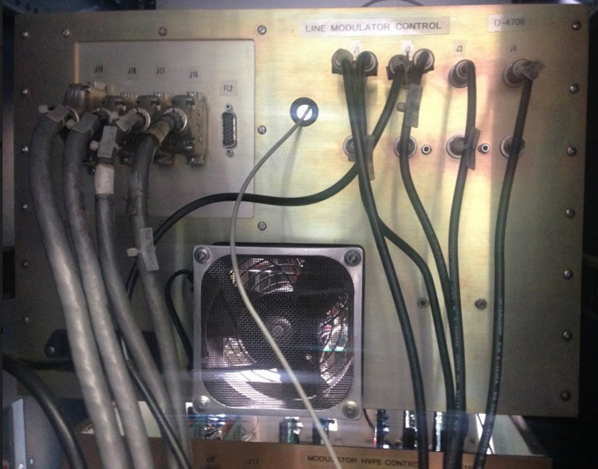
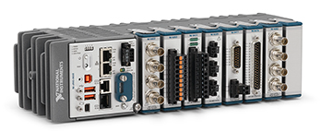
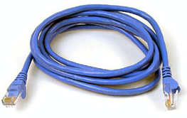
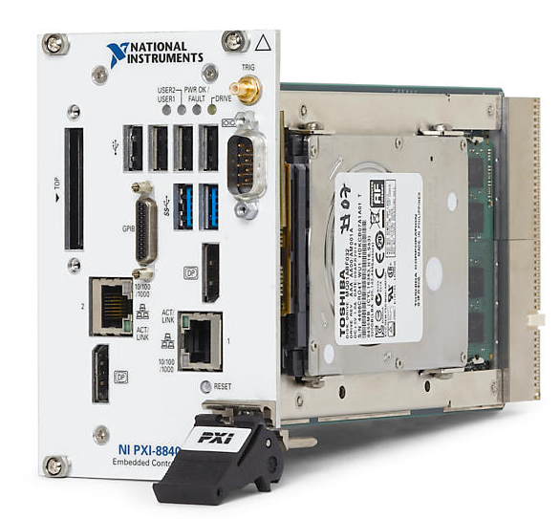
LINAC consolidation (2/4)
Task: 5th modulator for commissioning of new components
New control and interlock system
Profit of new HV power supplies
Increase reliability and performance
Design done, using modern modular electronics
First unit purchased, currently under test
Software development also started
New high voltage switch under study: new thyratron (ordered) vs. solid state
After validation, all new solutions will be propagated to the working 4 RF stations, then, it will be possible to install new high-power HV capacitors, pulse transformers, power supplies, etc.
Replace with
Compact-RIO + PXI

Slide 16
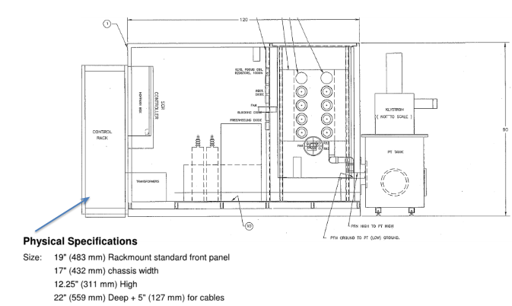
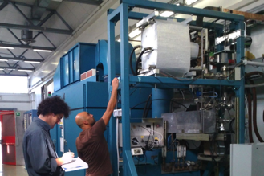
LINAC consolidation (3/4)
Re-design of modulator rack for fitting new components
New tank designed and ordered

Slide 17
LINAC consolidation (4/4)
Schedule:
New components available not before Spring 2018: all tenders started (but with slightly different timing, complexity and delivery time)
End of 2017 shutdown devoted to ordinary maintenance
Many activities can be done without stopping the LINAC operations, but some stops will be needed for:
Installing the first new units of PFN charging supplies (on modulator “D”)
Approximately 1 week
Installing and testing the new modulator in the service gallery
Approximately 2 weeks
Commissioning of the new control system
Install all new pulse transformers and power supplies and new control system in modulators “A”, “B” and “C”
Approximately 1 month

Slide 18
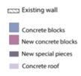
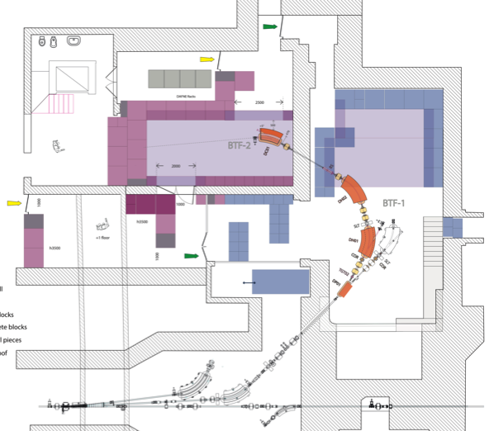
BTF-2 final layout
Modified (and removable) staircase to get larger access space from the front of new hall
Preserve DAΦNE racks in order to have no interference with SIDDHARTA-2 run
Enlarged (top) side access for better use of the area and at the same time improve protection of racks area
Additional labyrinth in place of sliding shielded door on the (bottom) side of new hall for simpler and faster civil engineering
Correctors added for better beam control
Secondary vacuum for new BTF lines, separated from LINAC primary vacuum for safer operation: added pump, modify interlock.

Slide 19
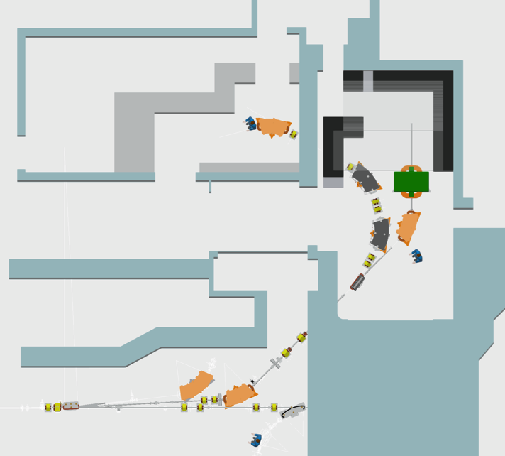
Final layout: 3D

Slide 20
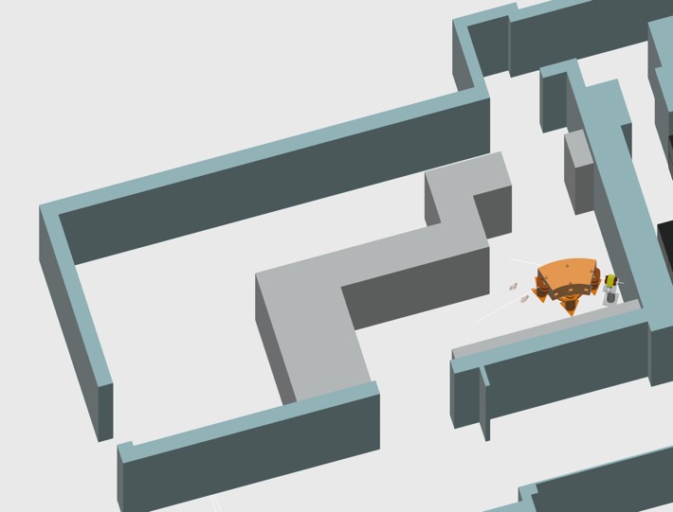
New area
DAΦNE
racks

Slide 21
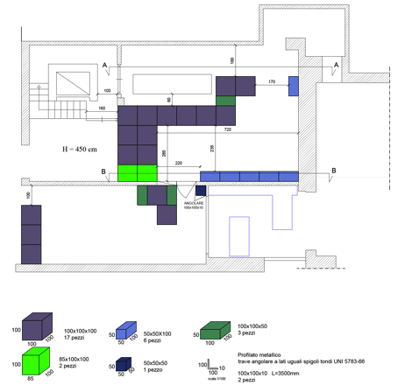
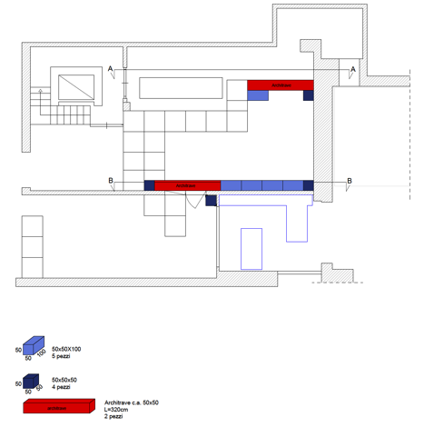
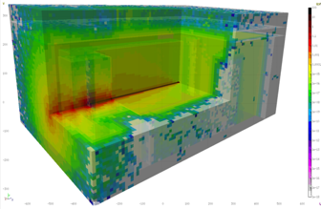
Civil engineering and shieldings (1/4)
Radio-protection paper-work on-going

Slide 22
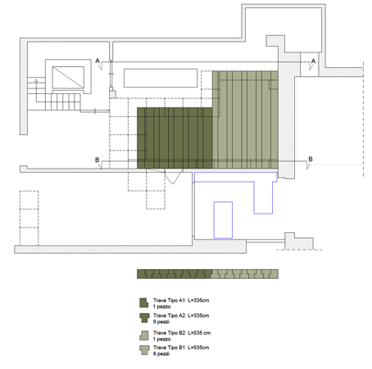
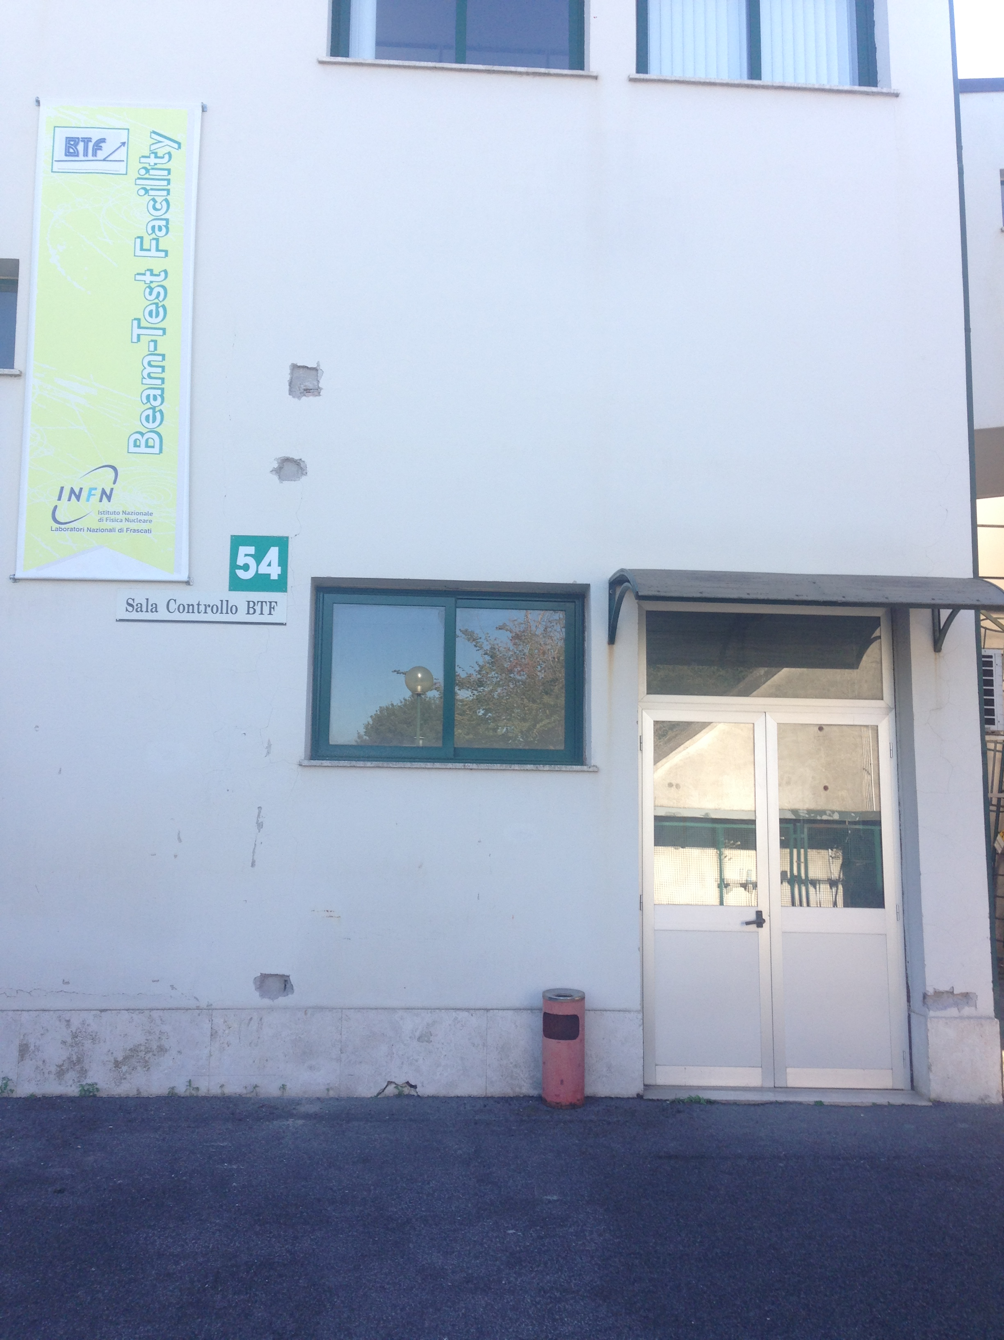
Civil engineering and shieldings (2/4)
New magnet power supplies: three racks in room upstairs of the (old) control room, path for cables identified without major intervention
Path for additional cooling piping and power cables in preparation
Cooling and power plants modifications in preparation
Final project done, tender assigned
Road consolidation & first demolitions starting in Dec. 2017
Sampling

Slide 23
Civil engineering and shieldings (3/4)
Present situation
New layout
2nd floor
Bridge
1nd floor
Shielding blocks
New door
New chicane

Slide 24
Civil engineering and shieldings (4/4)
Power supplies
Bridge
2nd floor
1st floor

Slide 25
New magnets
PADME dipole
13 new magnets:
Dipoles
Quadrupoles
Correctors
DHSTB02
New line
Fast dipole
DP-01
DH-02
DH-01

Slide 26
Magnetic design
Main constraints
Fit inside the existing BTF hall for turning by 135° and thus use the former control room as second experimental area
Split the bending into three dipoles in order to control the dispersion
Take into account a possible energy upgrade of the LINAC up to 1 GeV: at least 920 MeV secondary beams
As a consequence, iron core dipoles working close to saturation
Full iron, compact quadrupoles
Allow the use the parallel of the two lines as much as possible:
Be compatible with present DAΦNE operation without linking too much to it
Pulsed dipole for splitting sequence of LINAC pulses
Iron lamination dipole, making a relatively small angle (15°)
As compact as possible

Slide 27
Pulsed dipole
GENERAL DATA
Beam energy (MeV) | 1000
Curvature radius (m) | 3
Gap (mm) | 25
Pole width (mm) | 110
Nominal flux density (T) | 1,11
Bending angle (deg) | 15
N per pole (turns) | 36
Ampere-turns/pole | 11052
Yoke Width (mm) | 277
Yoke Height (mm) | 359
Yoke Length (mm) | 760
Overall Length (mm) | 329
Overall Height (mm) | 359
Overall Length (mm) | 913
Good Field Region (mm) | ±25
Field quality (ΔB/B) | 6,4E-03
Integrated Field quality (ΔIB/IB) | 2,3E-03
Total weight (kg) | 516
ELECTRICAL INTERFACE
Conductor dimension | 7x7 Φ4
Nominal Current (A) | 316
Nominal Resistive Voltage (V) | 113
Rtot (Ω) | 0,078
Nominal inductance (H) | 0,029
Nominal Power (kVA) | 35
Maximum Line Cable lenght (m) | 20
Proposed cable cross section ( mm²) | 95
Proposed Output PS Current (A) | 330
Proposed Output PS Voltage (V) | 130
Proposed Output PS Power (kVA) | 42,9
WATER COOLING
Number of pancakes per pole | 3
Number of pancake circuits | 6
Number of series circuits | 2
ΔT water (°C) | 15
Maximum Water flow (m³/s) | 0.117
Maximum Water velocity (m/s) | 1,55
Maximum ΔP (bar) | 2,94
IRON
V (mm3) | PACK FAC | d (kg/dm3) | Weight (kg)
6,75E+07 | 0,96 | 7,85 | 509
COILS
V (mm3) | FILL FAC | d (kg/dm3) | Weight (kg)
9.46E+06 | 0,59 | 8,9 | 50
Iron lamination dipole
Magnetic and electro-thermical design, mechanical drawings completed
Construction started
Power supply specifications and tender completed; ramping+stabilization within ≈100 ms

Slide 28
Pulsed dipole detailed drawings

Slide 29
Pulsed dipole construction
Laser cut
Electron Discharge Machining
CMM shape measurement
First coil

Slide 30
New DC dipoles
GENERAL DATA
Beam energy (MeV) | 921
Curvature radius (m) | 1,8
Gap (mm) | 35
Pole width at the gap (mm) | 190
Pole width at the yoke (mm) | 220
Nominal flux density (T) | 1,7056
Bending angle (deg) | 45,00
N per pole (turns) | 120
Iron Width (mm) | 735
Overall Width | 780
Overall Height (mm) | 503
Overall Lenght (mm) | 1672
Good Field Region (mm) | ±15
Field quality (ΔB/B) | 4,29E-04
Integrated Field quality (ΔIB/IB) | 3,78E-04
Total weight (kg) | 4006
ELECTRICAL INTERFACE
Conductor dimension | 9.5x9.5 Φ5.5
Nominal Current (A) | 262
Nominal Resistive Voltage (V) | 72
Rtot (Ω) | 0,276
Nominal inductance (H) | 0,423
Nominal Voltage on magnet (V) with a 10 s raising time (V) | 83
Nominal Power (kVA) | 22
Maximum Line Cable lenght (m) | 20
Proposed cable cross section ( mm²) | 95
Proposed Output PS Current (A) | 280
Proposed Output PS Voltage (V) | 95
Proposed Output PS Power (kVA) | 26,6
WATER COOLING
Number of pancake per pole | 6
Number of Turn per pancake | (10 H 2 V)
ΔT water (°C) | 15
Maximum Water flow (m³/s) | 3,44E-04
Maximum Water velocity (m/s) | 1,21
Maximum ΔP (bar) | 3,82
IRON
V (mm3) | PACK FAC | d (kg/dm3) | Weight (kg)
3,99E+08 | 1 | 7,86 | 3140
COILS
V (mm3) | FILL FAC | d (kg/dm3) | Weight (kg)
9,5E+07 | 0,599 | 8,9 | 506
Iron core dipoles
Magnetic and electro-thermical design, mechanical drawings completed
Power supplies specifications and tender completed

Slide 31
DC dipole detailed drawings

Slide 32
New quadrupoles
Iron core quadrupoles
Magnetic, electro-thermical, design completed
Detailed mechanical drawings almost completed
Power supplies specifications and tender completed

Slide 33
Power, cooling & services
Detailed estimate of additional electrical and thermal power
Technical solutions both for cooling and power identified
New pumping and secondary circuit distribution for the BTF area
Revision and upgrade of power distribution for the area
Detailed projects started

Slide 34
PADME
PADME setup design starts where the BTF-1 line ends
Assume re-using exactly the present vacuum pipe inside DHSTB02, pre-vacuum port, flange, etc.
DHSTB02

Slide 35
Beam region and vacuum chamber
Diamond target
MIMOSA M28
beam tracker
Almost ready both for vacuum chamber and target region (see M. Raggi report on PADME)

Slide 36
MIMOSA MAPS tracking
Based on MIMOSA M28 (monolithic active pixel sensor, 0.35 μm technology), by IPHC Strasbourg, but in vacuum, never implemented, so far
20.8 μm pitch, 20.2×22.7 mm² area
50 μm thickness
Mechanics and cooling
Vacuum linear stage mirrored from diamond side: purchased
Support and cooling structure details designed
New board and cooling support under test
Sensors: OK
DAQ, software
In advanced development: April 2017 test-beam successful
Plane 2
Plane 1
Track angle (mrad)

Slide 37
Beam, vacuum & target region
Aim at having the target region (main vacuum cross and diamond) connected to a BTF secondary vacuum by the PADME test beam of July 2017 January 2018
At the same time integrate in the new vacuum configuration (separate LINAC primary vacuum from new BTF & PADME secondary vacuum) by October 2017
Install MIMOSA system & testing
Commissioning with beam as soon as available
Main vacuum vessel coming with the PADME magnet, tender started

Slide 38
Summary (1/2)
New components for LINAC consolidation and BTF-2 available starting from the last months of 2017 first months of 2018 (bids started or starting in the next weeks all tenders practically assigned)
LINAC consolidation
Ordinary maintenance during end of 2017 DAΦNE shutdown
First part of new components installation pushed at the end of the KLOE-2 run
Trade-off between reliability of LINAC during PADME run and time subtracted to physics
Installation of new BTF line
Civil engineering should come first
Emptying the present control room
Re-routing cabling and preparation for new line installation
Modifications to the building
New shieldings installation
Modifications to cooling plant
Some intervention on the plants, services and inside the LINAC tunnel must be done during the DAΦNE shutdown, but a large part of the work can be prepared without stopping operations
Separation of BTF vacuum from LINAC one will allow performing further activities independently (e.g. new pipes installation, PADME vessel connection, etc.)

Slide 39
Summary (2/2)
Installation of PADME
PADME dipole should enter the BTF hall before the installation of the BTF new lines
Operation of PADME dipole requires power cables and cooling pipes
Existing cables and pipes probably OK per the PADME magnet but not enough also for the new BTF magnets
Most of the operations for PADME installation can be performed independently from the BTF new lines installation
Interference
Commissioning of the new BTF lines will require closing the experimental areas, thus stopping all PADME installation activities (a few days also needed for installation of shielding blocks in the access area)
In principle installation of PADME and components of new lines are compatible, apart from obvious incompatibilities: usage of crane, access to PADME area with large components after second line installation, etc.

Slide 42
Tenders

