Slide 1
Neutron induced reaction cross section measurements for primordial and stellar nucleosynthesis at CERN n_TOF
Alberto Mengoni
ENEA/INFN, Bologna
on behalf of the n_TOF Collaboration
Generalities
Example of experimental activity at CERN n_TOF:
  (n,a) and (n,p) on ⁷Be for the BBN
  Re/Os clock
  Neutron sources for the s-process
IX European Summer School on Experimental Nuclear Astrophysics
Santa Tecla (Catania), 17-24 September 2017
alberto.mengoni@enea.it

Slide 2
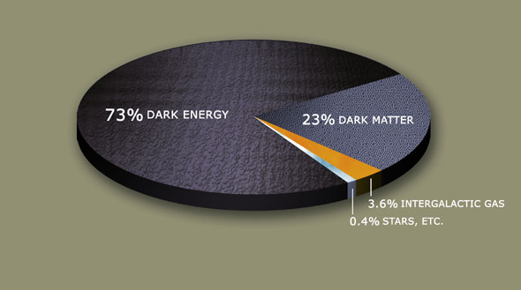

Introducing the Universe
Our universe is formed of matter and radiation
Both of them come in quantized forms (particles and photons)
We live (now) in a universe of matter
$ρ$(E_{mvis}) >> $ρ$(E_{rad})
Source: for example C.E. Rolfs and W.S. Rodney, "Cauldrons in the Cosmos”
The University of Chicago Press (1988)
alberto.mengoni@cern.ch

Slide 3
Introducing the Universe
Our universe is formed of matter and radiation
Both of them come in quantized forms (particles and photons)
We live (now) in a 𝚲 dominated universe
Atomic nuclei exist in the universe
Radioactivity and nuclear reactions show that nuclei are NOT immutable
objects but that they have been formed somewhere, sometime
(nuclear archeology)
The matter in the universe is essentially in the form of Hydrogen and Helium
with a tiny addition of “metals”
The distribution of the abundance of the elements show common patterns
for the stars of our galaxy (the local distribution on the Earth surface is NOT a
typical distribution. For example: there is very little Hydrogen)
Source: for example C.E. Rolfs and W.S. Rodney, "Cauldrons in the Cosmos”
The University of Chicago Press (1988)
alberto.mengoni@cern.ch

Slide 4
A brief history of the Universe
BANG!
nucleosynthesis
4.6 Ga
Now
(& here)
Galaxy & star
formation
Solar-system formation

Slide 5
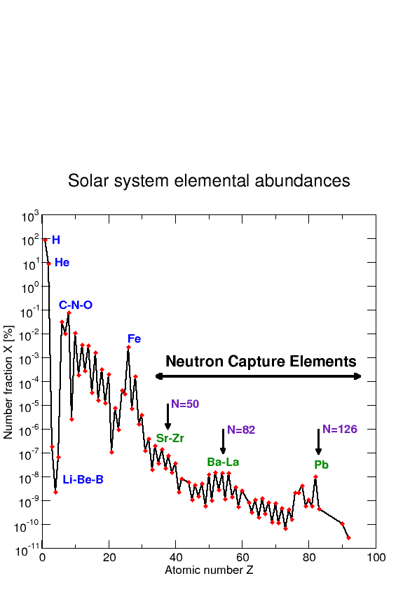
Nucleosynthesis
The distribution of the abundance of the elements show common patterns for the stars of our galaxy
Reaction rates for charged particle reactions are very slow for high-Z elements at low-Temperatures (T ≈ T₈)
At much higher T, there would be the onset of NSE and nuclei in the Iron-peak would be favored
Neutrons are produced during stellar evolution
Heavy nuclei have large σ(n,γ), some correlated with abundances
Double peaks can only be explained by neutron capture processes
There is enough seed material
www.cern.ch/n_TOF
alberto.mengoni@cern.ch

Slide 6
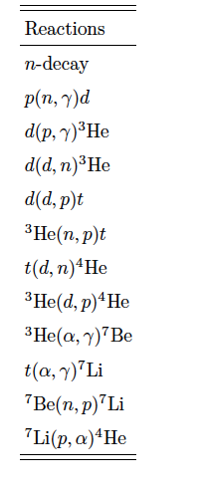
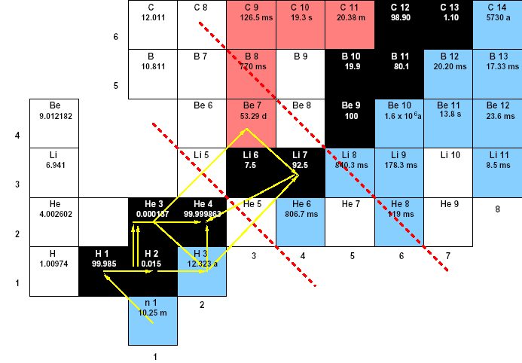
Big bang nucleosynthesis

Slide 7
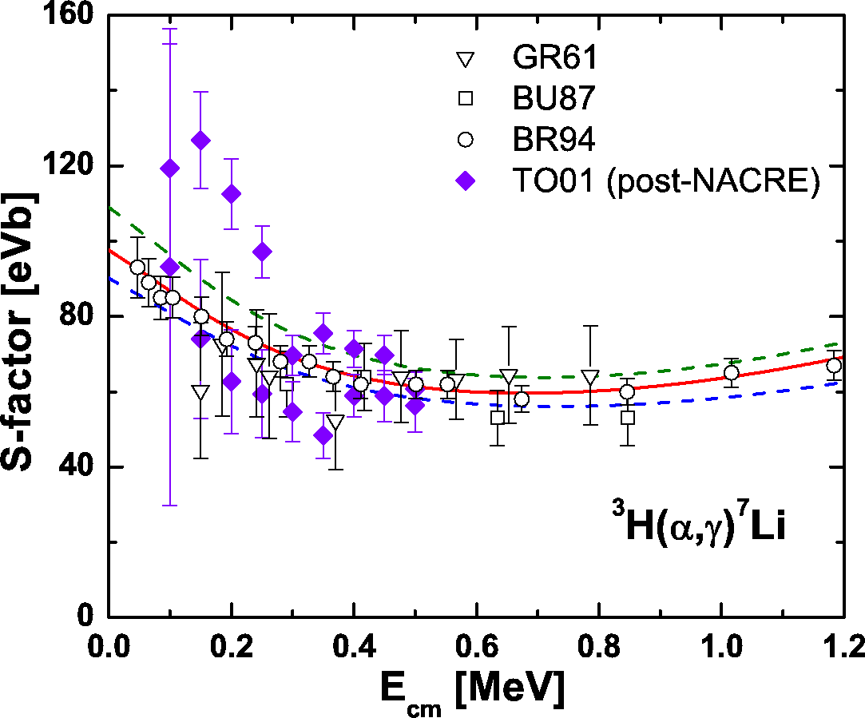
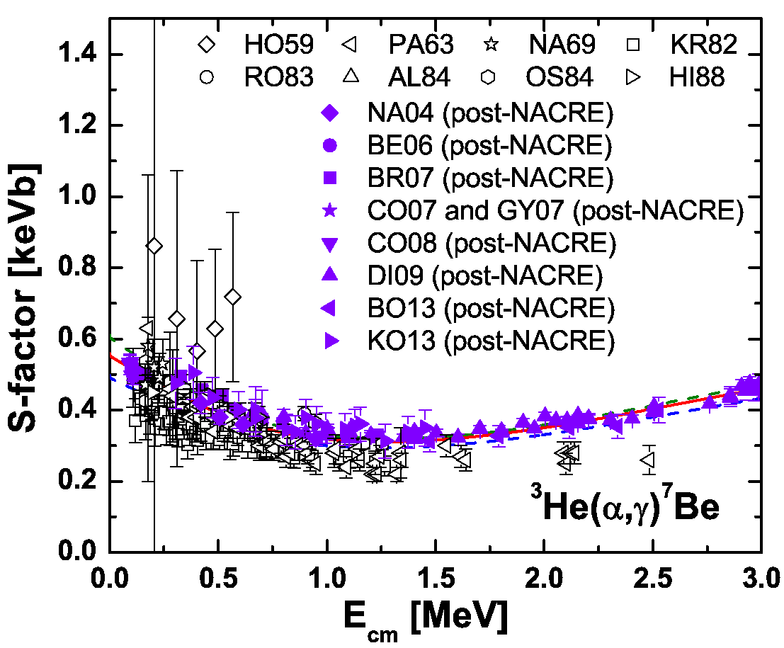
Big bang nucleosynthesis: Lithium

Slide 8
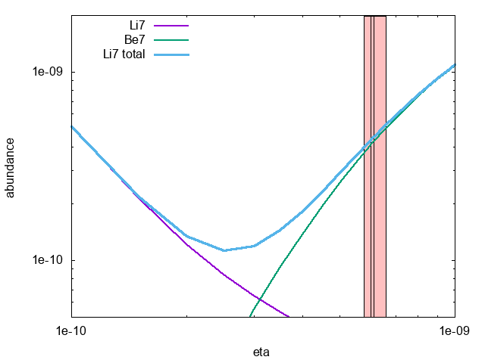
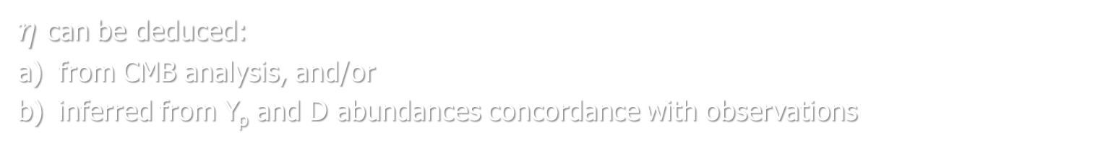


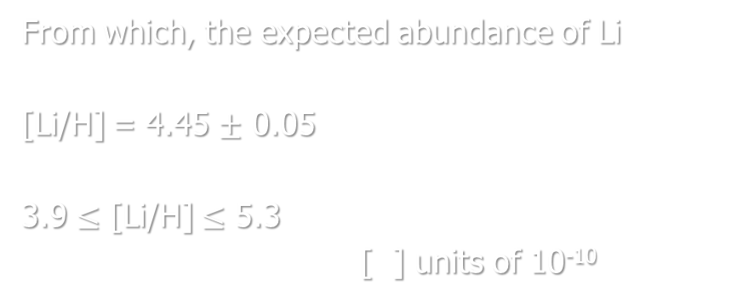
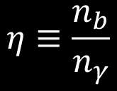
Big bang nucleosynthesis: Lithium
Light-element formation depends critically
on the baryons/photons ratio:
$$η≡\frac{n_{b}}{n_{γ}}$$
$η$ can be deduced:
from CMB analysis, and/or
inferred from Y_{p} and D abundances concordance with observations
[$η$] $=$ 6.09 $±$ 0.06
5.8 $≤\text{[}η\text{]}≤$ 6.6 (95% CL)
From which, the expected abundance of Li
[Li/H] = 4.45 $±$ 0.05
3.9 $≤$ [Li/H] $≤$ 5.3
[ ] units of 10⁻¹⁰
BD Fields et al., PDG Review (2016)

Slide 9
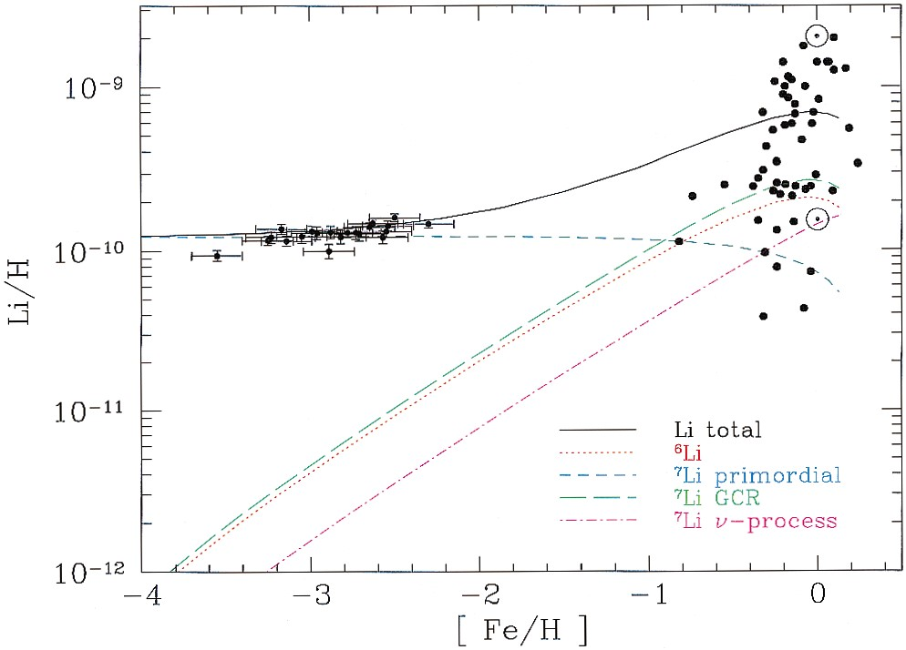



Lithium: observation
Best value from observations:
[Li/H] = 1.6 $±$ 0.3
Expected from CMB analysis
and standard BBN
[Li/H] = 4.45 $±$ 0.05
Expected from standard BBN
Y_{p} and D
abundance concordance
3.9 $≤$ [Li/H] $≤$ 5.3
Contributions to the total predicted lithium abundance from the adopted GCE model of Fields & Olive (1999a, 1999b), compared with low metallicity stars (RNB) and high-metallicity stars (Lambert, Heath, & Edvardsson 1991). The solid curve is the sum of all components.
S G Ryan et al. ApJ 530 (2000) L57
BD Fields et al., PDG Review (2016)

Slide 10
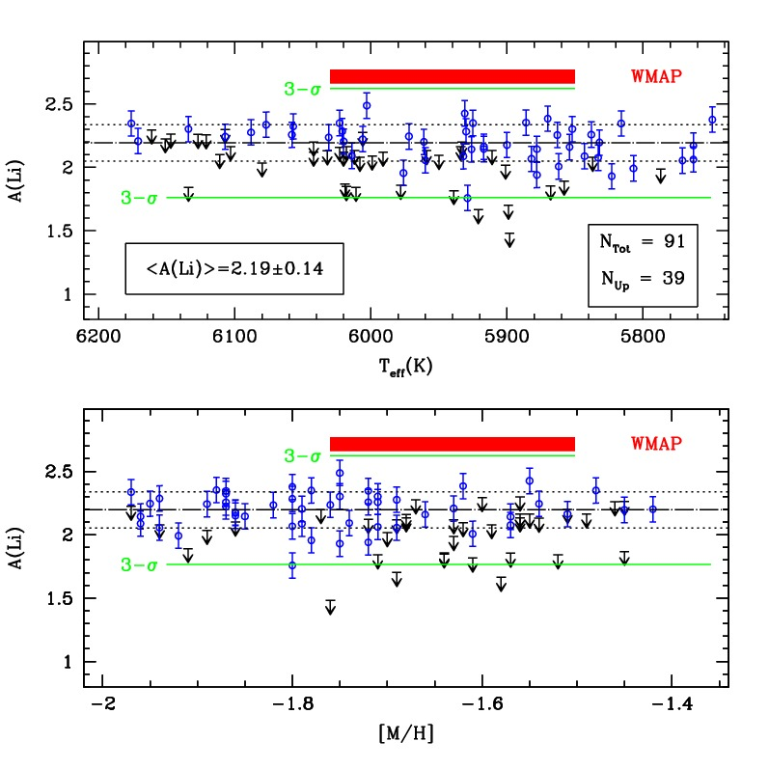
The Spite plateau is cosmic
Figure 3
Le plateau des Spite dans ω Centauri,
tel qu’il est révélé par les observations Flames/Giraffe.
Toutes les étoiles observées ont la même abondance de lithium, quelle
quesoit leur métallicité ou température.
L Monaco et al. A&A 519 (2010) L3

Slide 11
⁷Be destruction by neutrons
⁷Be(n,α)⁴He

Slide 12
Neutron Induced Reaction Experiments
γ-ray detector
particle detector
beam
sample
beam monitor

Slide 13
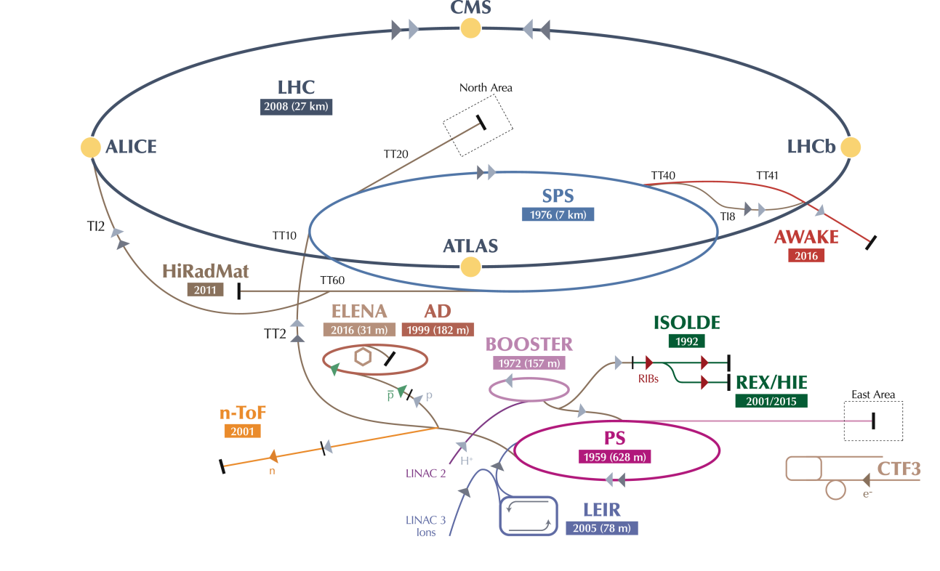
n_TOF @ CERN

Slide 14
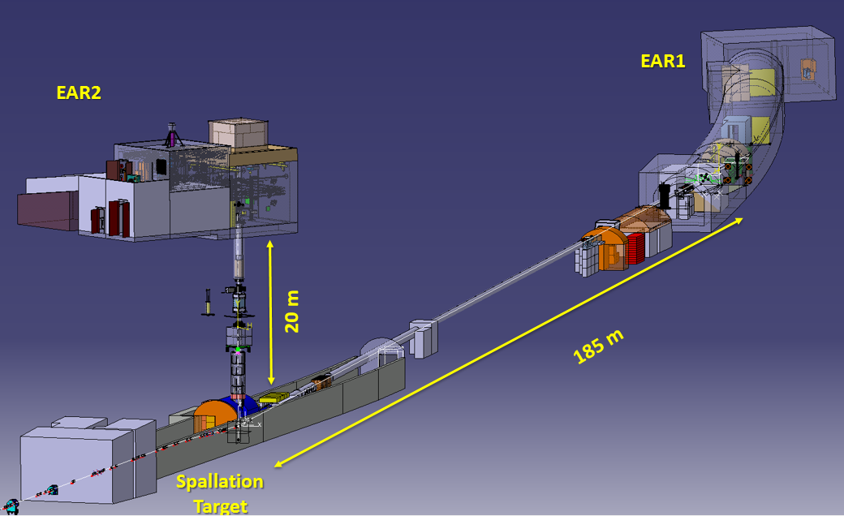
The n_TOF facility
EAR-1
EAR-2
20 m
185 m
spallation target
proton beam line
Notes:
With greater accuracy

Slide 15
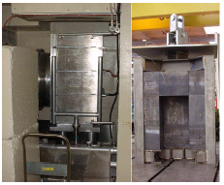
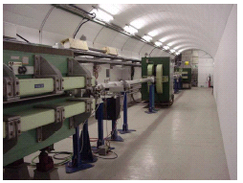
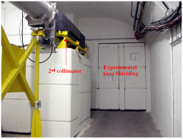
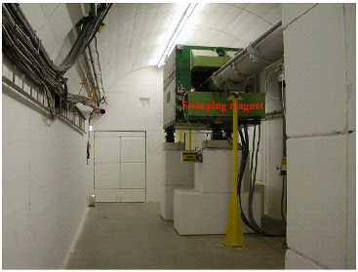
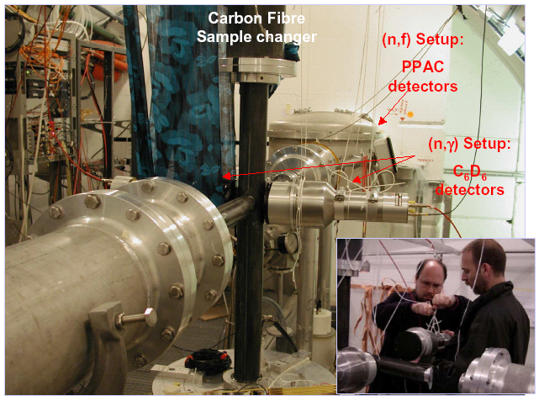
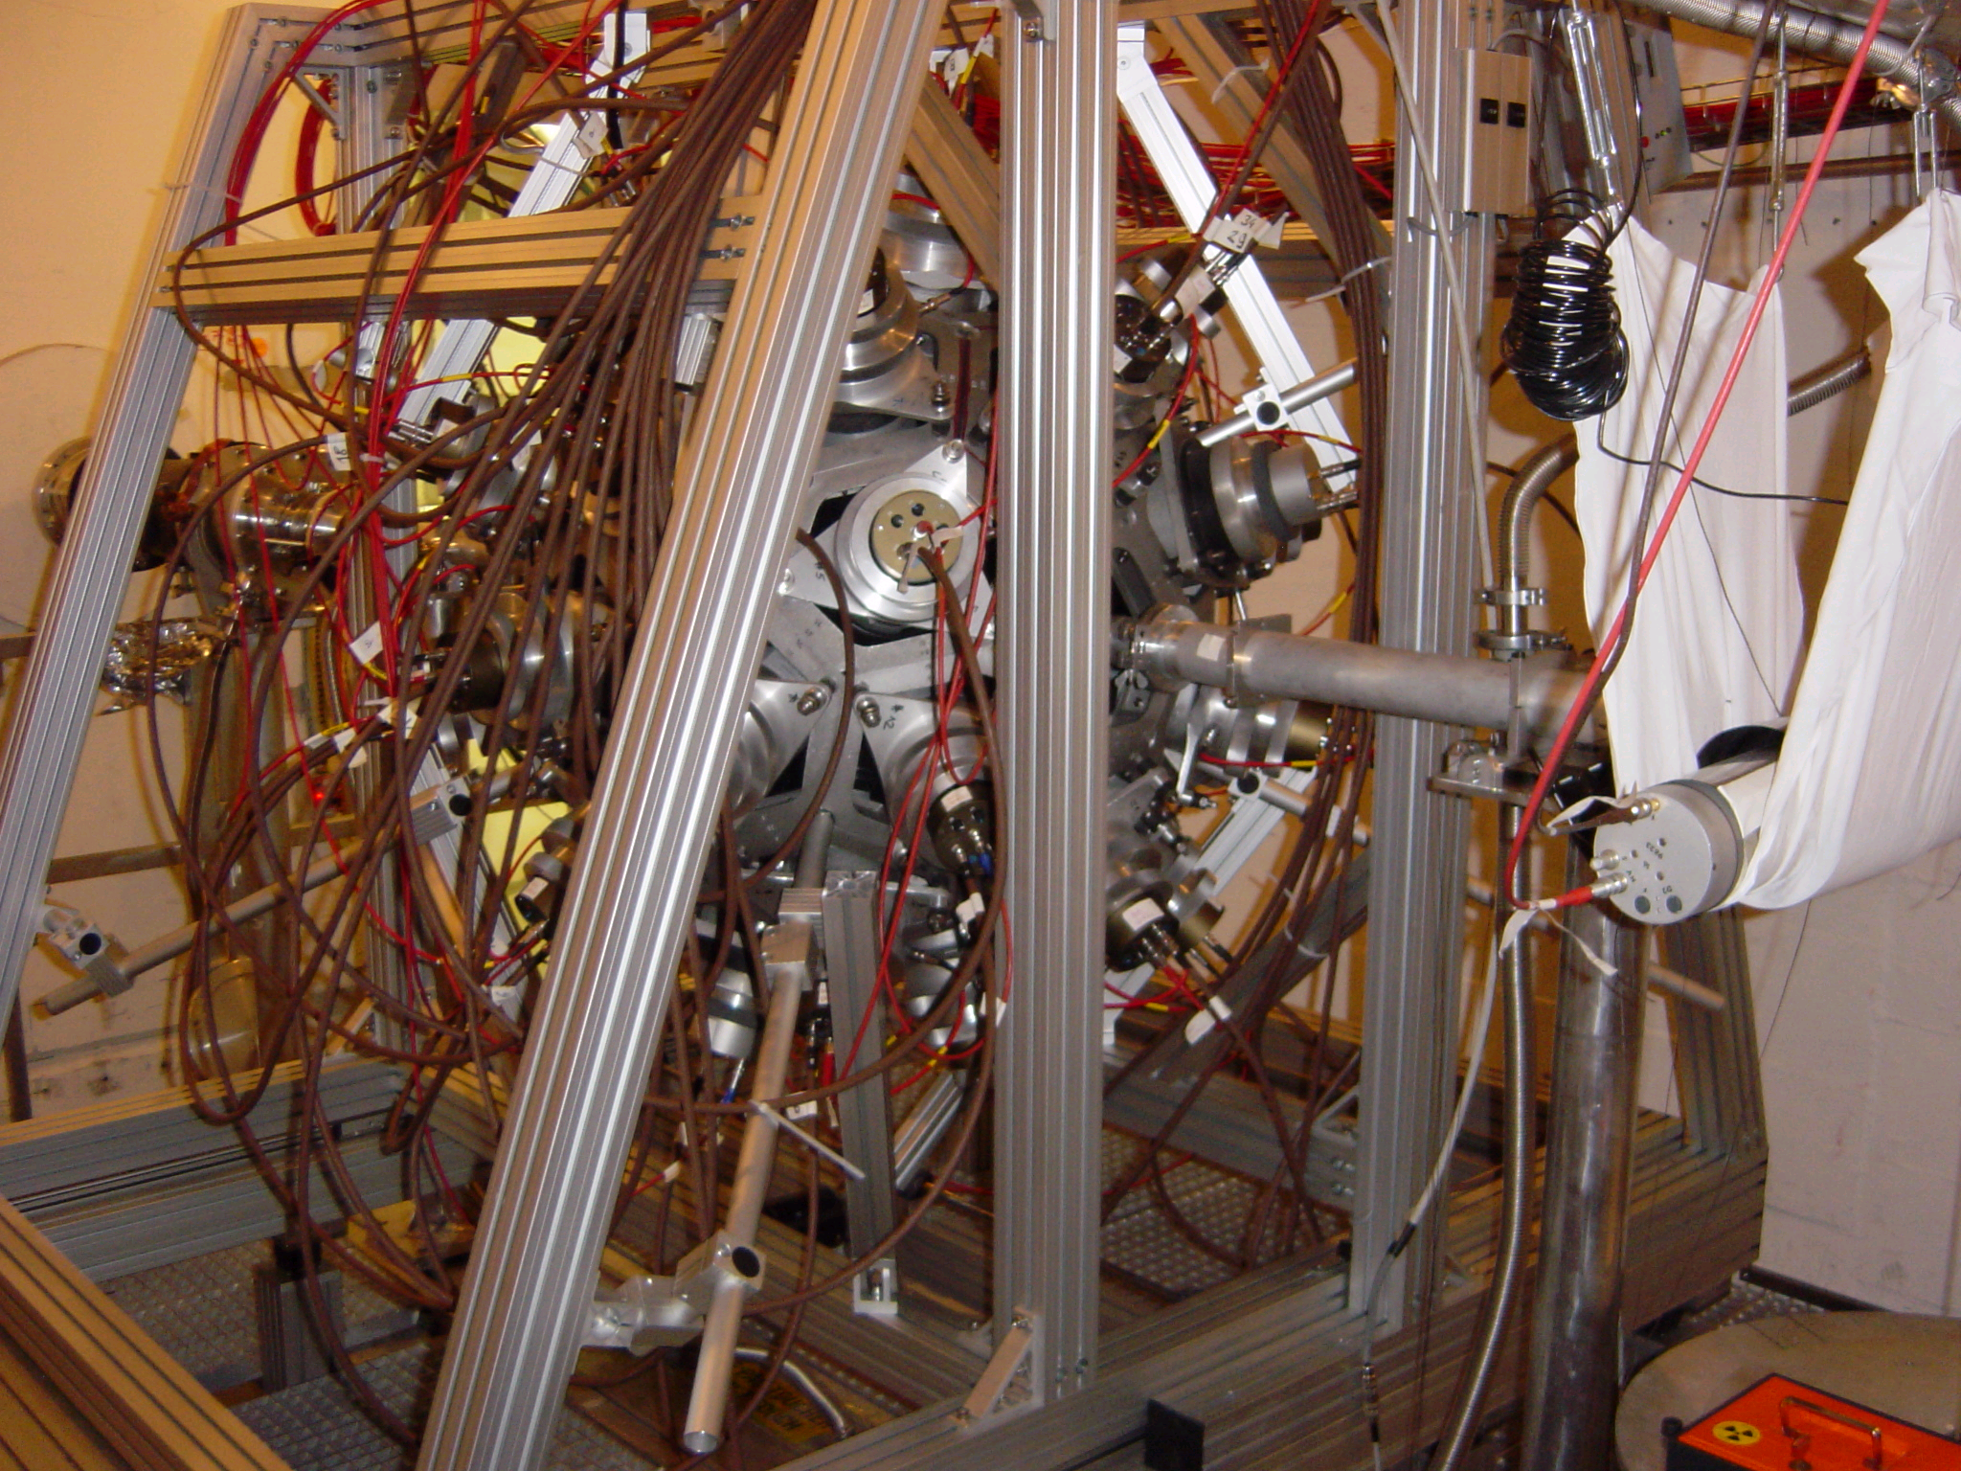
The real world
n_TOF commissioned
in 2001-2002
www.cern.ch/n_TOF

Slide 16
n_TOF basic parameters
proton beam momentum | 20 GeV/c
intensity (dedicated mode) | 7 x 10¹² protons/pulse
repetition frequency | 1 pulse/1.2s
pulse width | 6 ns (rms)
n/p | 300
lead target dimensions | 80x80x60 cm³
cooling & moderation material | H₂O (borated)
moderator thickness in the exit face | 5 cm
neutron beam dimension in EAR-1 (capture mode) | 2 cm (FWHM)
www.cern.ch/n_TOF
The n_TOF Collaboration

Slide 17

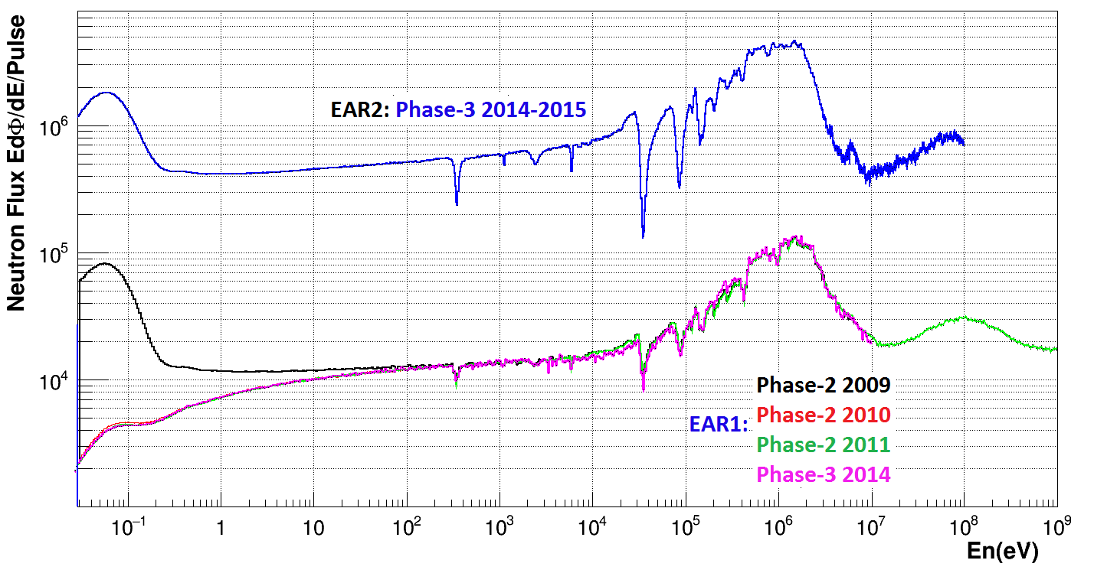
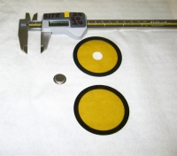
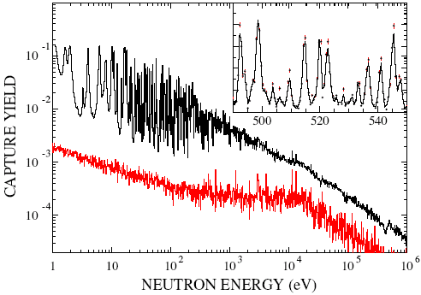
n_TOF basic characteristics
small samples
wide energy range
high neutron flux &
high energy resolution
low repetition rate
of the proton driver
low background conditions
EAR-2
U Abbondanno et al. (The n_TOF Collaboration)
Phys. Rev. Lett. 93 (2004), 161103
&
S Marrone et al. (The n_TOF Collaboration)
Phys. Rev. C 73 03604 (2006)
¹⁵¹Sm(n,γ)
EAR-1
EAR-1 (185 m)
In operation since 2001
Measure radionuclides with half-life down to a few hundred years
High resolution in energy allows to study resolved resonances up to several keV
EAR-2 (19 m)
In operation since 2014
Neutron intensity increased by a factor 40, relative to EAR1
Possible to measure sub-mg samples, and radionuclides with half-life of a few years

Slide 18
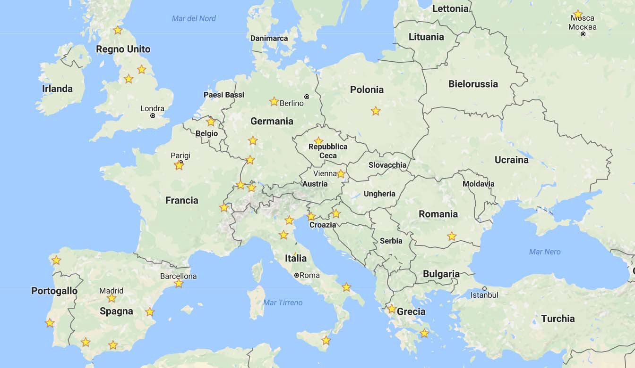



The n_TOF Collaboration
38 Participating Institutes: EU (34), Japan (2), India (1), Australia (1)
120 Participating researchers

Slide 19
FIC0
²³⁴U
²³⁶U
²³²Th
²³⁷Np
FIC0
²³⁶U
■ Capture reactions (56)
EAR2
■ Fission reactions (33)
STEFF
²³⁵U
FIC1
²⁴⁵Cm
²³³U
²⁴¹Am
²⁴³Am
EAR2
FIC1
²⁴⁵Cm
²³³U
²⁴¹Am
²⁴³Am
■ (n,cp) reactions (8)
STEFF
²³⁵U
MGAS
²³⁷Np
MGAS
³³S
C6D6
²⁴⁴Cm
²⁴⁶Cm
FIC2
²³⁵U
²³⁸U
MGAS
³³S
C6D6
¹⁸⁶Os
¹⁸⁷Os
¹⁸⁸Os
⁹⁰Zr
⁹¹ Zr
⁹²Zr
⁹⁴Zr
⁹⁶Zr
²⁴Mg
²⁶Mg
²⁰⁸Pb
¹³⁹La
Si
⁷Be
Si
⁷Be
²⁶Al
FIC0
²³⁴U
PPAC
²³⁷Np
²³³U
²³⁴U
²⁰⁹Bi
^{nat}Pb
²³²Th
CVD
⁵⁹Ni
C6D6
¹⁴⁷Pm
¹⁷¹Tm
MGAS
²⁴⁰Pu
²⁴²Pu
EAR1
FIC-G
¹⁶O
PPAC
²³²Th
²³⁴U
TAC
²³⁸U
⁸⁷Sr
EAR1
PPAC
²³⁷Np
Si
²³⁵U
TAC
²³⁸U
EAR2
C6D6
¹⁵¹Sm
²⁰⁴Pb
²⁰⁶Pb
²⁰⁷Pb
²⁰⁹Bi
²³²Th
MGAS
²⁴⁰Pu
PPAC
²³⁷Np
C6D6
²³⁸U
²³⁶U
⁶³Ni
⁶²Ni
⁵⁸Ni
⁵⁷Fe
¹²C
C6D6
¹⁴⁷Pm
²⁴²Pu
²⁰⁴Tl
⁷⁶Ge
⁷⁴Ge
⁷⁰Ge
C6D6
TAC
²⁴⁰Pu
²³⁷Np
²⁴³Am
²³³U
TAC
²³⁵U
TAC
²³³U
²³⁸U
²⁵Mg
⁹²Zr
⁹³Zr
EAR1
C6D6
¹⁵⁵Gd
¹⁵⁷Gd
⁷²Ge
C6D6
⁵⁶Fe
⁶²Ni
C6D6
⁵⁴Fe
²⁴¹Am
C6D6
¹⁷¹Tm
⁷³Ge
2002
2003
2004
2009
2010
2011
2012
2014
2015
2016
Phase - I
Phase - II
Phase - III

Slide 20
⁷Be(n,α)⁴He measurement
Silicon detectors insterted directly into the neutron beam
3x3 cm² active area, 140 μm thickness
Two samples with ∼18 GBq activity each (∼1.4 μg of ⁷Be)
Strong rejection of BG events due to tof,
low duty-cycle, coincidence signals for:
det 4
α
protons from the (n,p) channel
γ from ⁷Be activity
n+⁷Li → ⁸Li (β⁻) 840 ms → ⁸Be* → αα
sample 2
α
det 3
det 2
α
sample 1
α
det 1
neutrons

Slide 21
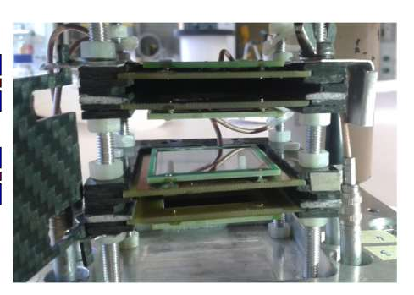
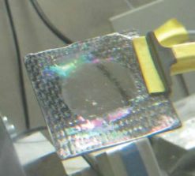
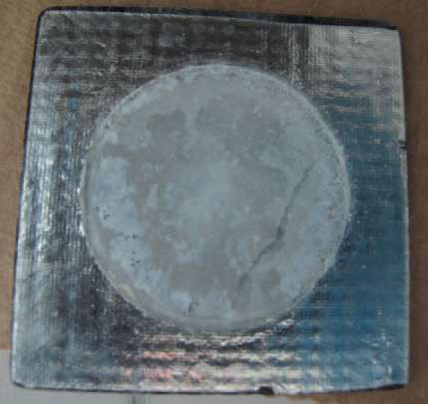
⁷Be(n,α)⁴He measurement
Two samples with ∼18 GBq activity each (∼1.4 μg of ⁷Be)
electrodeposition on a 5-μm-thick Al foil
droplet deposition on a 0.6-μm-thick low-density polyethylene foil
Both ⁷Be samples were prepared at PSI, starting from a 200 GBq solution extracted from the spallation target of the SINQ source, as Be(NO₃)₂ solution
E Maugeri et al. (n_TOF Collaboration), Journ. of Instr., 12, P02016, (2017)

Slide 22
⁷Be(n,α)⁴He measurement
M Barbagallo et al. (The n_TOF Collaboration)
Phys. Rev. Lett. 117 (2016) 152701

Slide 23
⁷Be(n,α)⁴He & ⁷Be(n,γα)⁴He
n + ⁷Be → α + α (+γ)
Q-value: 19 MeV, no threshold
s-wave neutrons can form
J^{π}=1⁻ or 2⁻ states
J^{π}=0⁺, 2⁺ states can be
populated by γ-ray emissions
only J^{π}=0⁺, 2⁺, 4⁺ , …
can decay into 2α channel

Slide 24
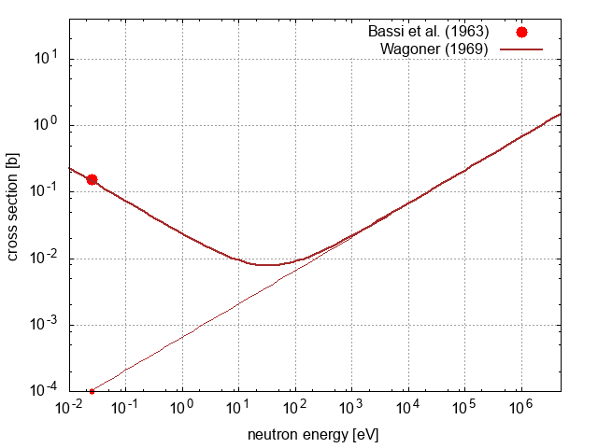
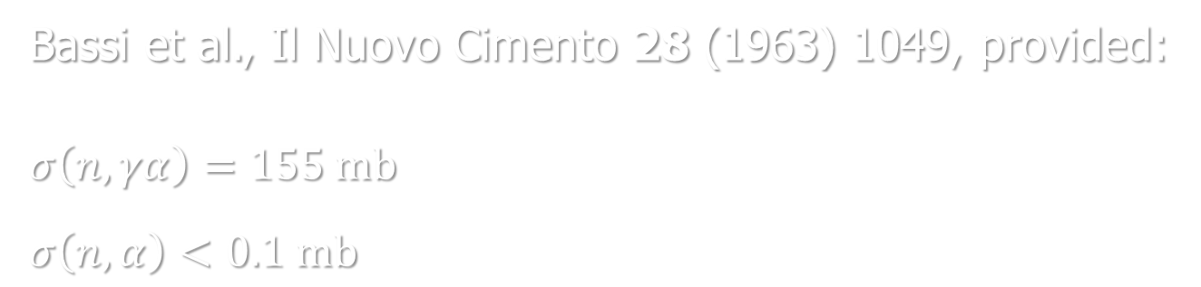
⁷Be(n,α)⁴He & ⁷Be(n,γα)⁴He
Bassi et al., Il Nuovo Cimento 28 (1963) 1049, provided:
$$σ\left(n,γα\right)=155 mb$$
$$σ\left(n,α\right)<0.1 mb$$
reaction rate by RV Wagoner (1969):
s-wave component:
1/v normalized at thermal
p-wave component:
~ E^{1/2}

Slide 25
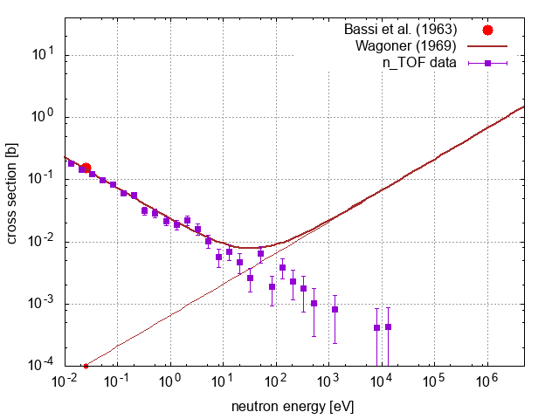
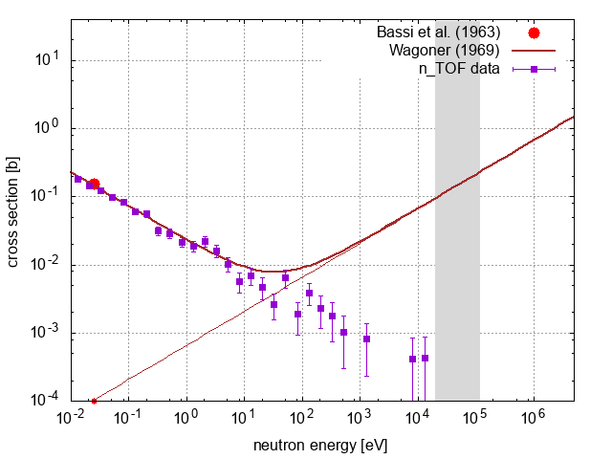
⁷Be(n,α)⁴He @ n_TOF (2016)
The n_TOF measurement confirmed:
the 1/v behavior of the (n,γα) cross section
no onset of the p-wave component up to E_{n} ~ 10 keV
M Barbagallo et al. (The n_TOF Collaboration)
Phys. Rev. Lett. 117 (2016) 152701

Slide 26
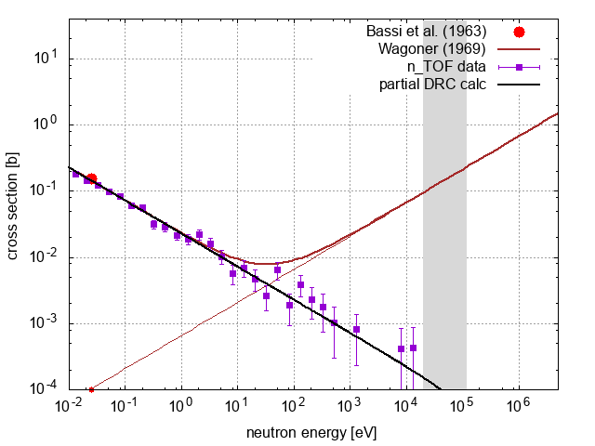
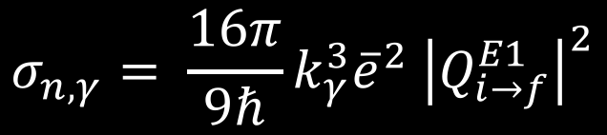

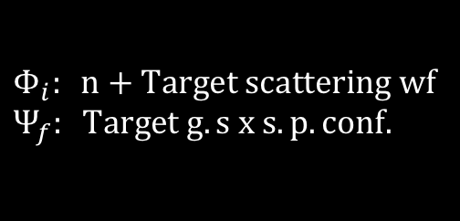
⁷Be(n,α)⁴He modeling
$$σ_{n,γ}= \frac{16π}{9ℏ}k_{γ}^{3}{\overline{e}}^{2} {\left|Q_{i→f}^{E1}\right|}^{2}$$
Direct Radiative Capture
$$Q_{i→f}^{E1}= \left\langle Ψ_{f} | {\hat{T}}^{E1} | Φ_{i}\right\rangle$$
s-wave dominated
(1/v behavior at low energy)
single-particle configuration of the final state
prediction of branching ratios
$$Φ_{i}: n+Target scattering wf$$
$$Ψ_{f}: Target g.s x s.p. conf.$$
M Barbagallo et al. (The n_TOF Collaboration)
Phys. Rev. Lett. 117 (2016) 152701

Slide 27
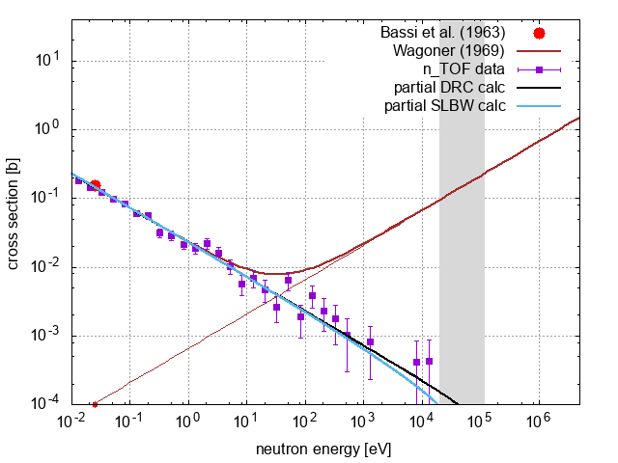
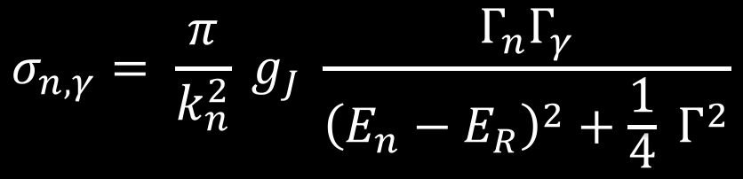
⁷Be(n,α)⁴He modeling
$$σ_{n,γ}= \frac{π}{k_{n}^{2}} g_{J} \frac{{Γ_{n}Γ}_{γ}}{{\left(E_{n}−E_{R}\right)}^{2}+\frac{1}{4} Γ^{2}}$$
Resonance mechanism
Resonance energies & widths
from nuclear structure data
1/v low energy behavior
for s-waves
no prediction for unmeasured transitions
M Barbagallo et al. (The n_TOF Collaboration)
Phys. Rev. Lett. 117 (2016) 152701

Slide 28
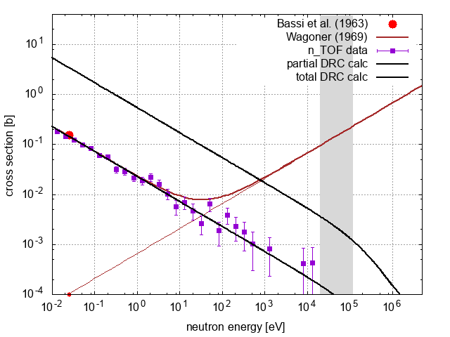
⁷Be(n,α)⁴He
A factor of 25 larger (n,a) cross section
at thermal energy!
M Barbagallo et al. (The n_TOF Collaboration)
Phys. Rev. Lett. 117 (2016) 152701

Slide 29
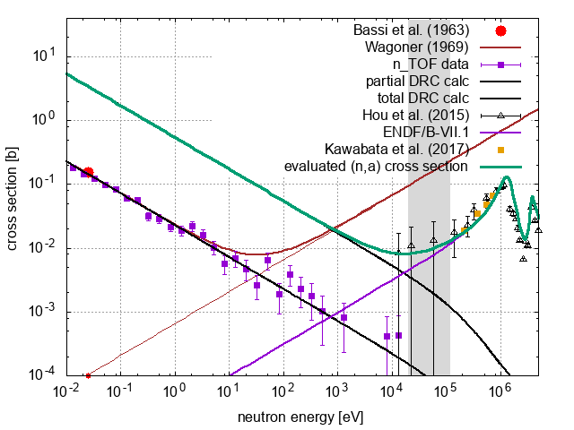
⁷Be(n,α)⁴He: new cross section
(n,α) data combined with measurements of time-reversal and/or indirect reactions, e.g. α(⁴He,n)⁷Be
M Barbagallo et al. (The n_TOF Collaboration)
Phys. Rev. Lett. 117 (2016) 152701

Slide 30
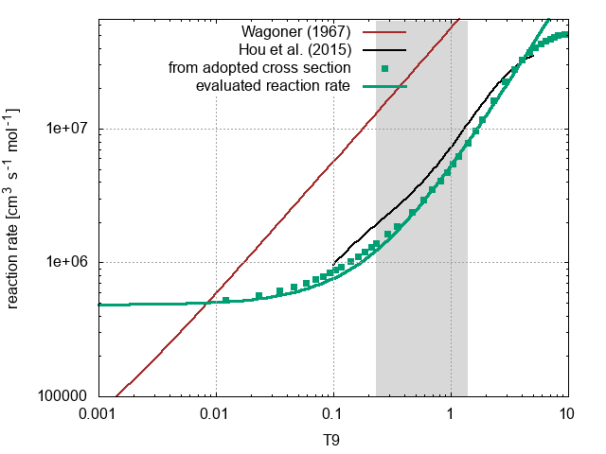


⁷Be(n,α)⁴He: new reaction rate
$$MACS≡\frac{\left\langle σv\right\rangle }{v_{T}}=\frac{2}{\sqrt{π}}\frac{1}{{\left(kT\right)}^{2}}\int_{0}^{∞}{E σ(E)}e^{−E/kT}dE$$
$$r=N_{A}{\left\langle σv\right\rangle }_{kT}$$
M Barbagallo et al. (The n_TOF Collaboration)
Phys. Rev. Lett. 117 (2016) 152701

Slide 31
⁷Be(n,α)⁴He: implications on CLiP
⁷Li production in standard BBN calculations
remains essentially unchanged
[Li/H] = 4.5
to be compared with
[Li/H] = 4.4
obtained with the ”standard”
reaction rate from Wagoner
[ ] = units of 10⁻¹⁰
M Barbagallo et al. (The n_TOF Collaboration)
Phys. Rev. Lett. 117 (2016) 152701

Slide 32
⁷Be(n,p)⁷Li

Slide 33
⁷Be(n,p)⁷Li

Slide 34
⁷Be(n,p)⁷Li
Silicon telescope from Lodz Uni.
Detection and identification of protons of 1 and 1.4 MeV
see the presentation by
Lucianna Damone
high purity sample, 1 GBq
produced @ ISOLDE
p
E
ΔE
neutrons

Slide 35
⁷Be(n,p)⁷Li

Slide 36
Measurements of (n,γ) cross sections of s-process branching points nuclei

Slide 37
FIC0
²³⁴U
²³⁶U
²³²Th
²³⁷Np
FIC0
²³⁶U
■ Capture reactions (56)
EAR2
■ Fission reactions (33)
STEFF
²³⁵U
FIC1
²⁴⁵Cm
²³³U
²⁴¹Am
²⁴³Am
EAR2
FIC1
²⁴⁵Cm
²³³U
²⁴¹Am
²⁴³Am
■ (n,cp) reactions (8)
STEFF
²³⁵U
MGAS
²³⁷Np
MGAS
³³S
C6D6
²⁴⁴Cm
²⁴⁶Cm
FIC2
²³⁵U
²³⁸U
MGAS
³³S
C6D6
¹⁸⁶Os
¹⁸⁷Os
¹⁸⁸Os
⁹⁰Zr
⁹¹ Zr
⁹²Zr
⁹⁴Zr
⁹⁶Zr
²⁴Mg
²⁶Mg
²⁰⁸Pb
¹³⁹La
Si
⁷Be
Si
⁷Be
²⁶Al
FIC0
²³⁴U
PPAC
²³⁷Np
²³³U
²³⁴U
²⁰⁹Bi
^{nat}Pb
²³²Th
CVD
⁵⁹Ni
C6D6
¹⁴⁷Pm
¹⁷¹Tm
MGAS
²⁴⁰Pu
²⁴²Pu
EAR1
FIC-G
¹⁶O
PPAC
²³²Th
²³⁴U
TAC
²³⁸U
⁸⁷Sr
EAR1
PPAC
²³⁷Np
Si
²³⁵U
TAC
²³⁸U
EAR2
C6D6
¹⁵¹Sm
²⁰⁴Pb
²⁰⁶Pb
²⁰⁷Pb
²⁰⁹Bi
²³²Th
MGAS
²⁴⁰Pu
PPAC
²³⁷Np
C6D6
²³⁸U
²³⁶U
⁶³Ni
⁶²Ni
⁵⁸Ni
⁵⁷Fe
¹²C
C6D6
¹⁴⁷Pm
²⁴²Pu
²⁰⁴Tl
⁷⁶Ge
⁷⁴Ge
⁷⁰Ge
C6D6
TAC
²⁴⁰Pu
²³⁷Np
²⁴³Am
²³³U
TAC
²³⁵U
TAC
²³³U
²³⁸U
²⁵Mg
⁹²Zr
⁹³Zr
EAR1
C6D6
¹⁵⁵Gd
¹⁵⁷Gd
⁷²Ge
C6D6
⁵⁶Fe
⁶²Ni
C6D6
⁵⁴Fe
²⁴¹Am
C6D6
¹⁷¹Tm
⁷³Ge
2002
2003
2004
2009
2010
2011
2012
2014
2015
2016
Phase - I
Phase - II
Phase - III

Slide 38
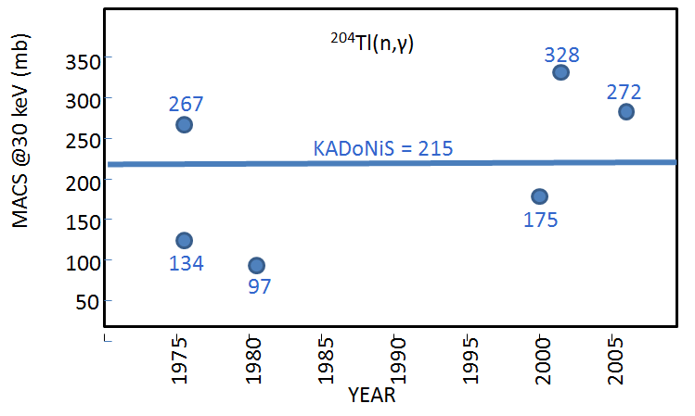
Branching points: ¹⁴⁷Pm, ¹⁷¹Tm, ²⁰⁴Tl
²⁰⁴Tl(n,γ)
¹⁷¹Tm(n,γ)
Short-lived branching isotopes (a few years) have either never been measured before or have been measured only by activation (a few tens of ng) at a fixed temperature.
¹⁴⁷Pm(n,γ)
as provided by N Colonna

Slide 39
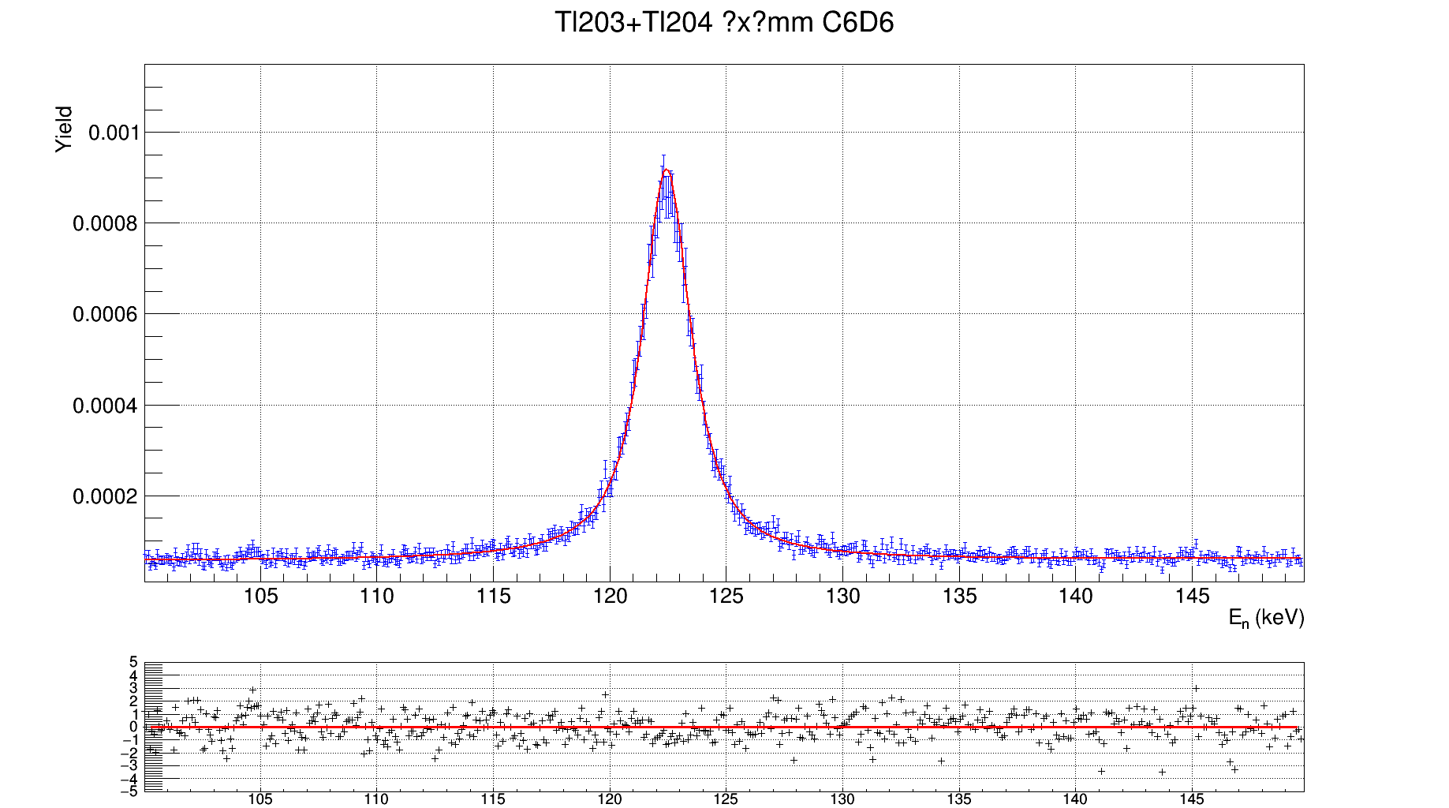
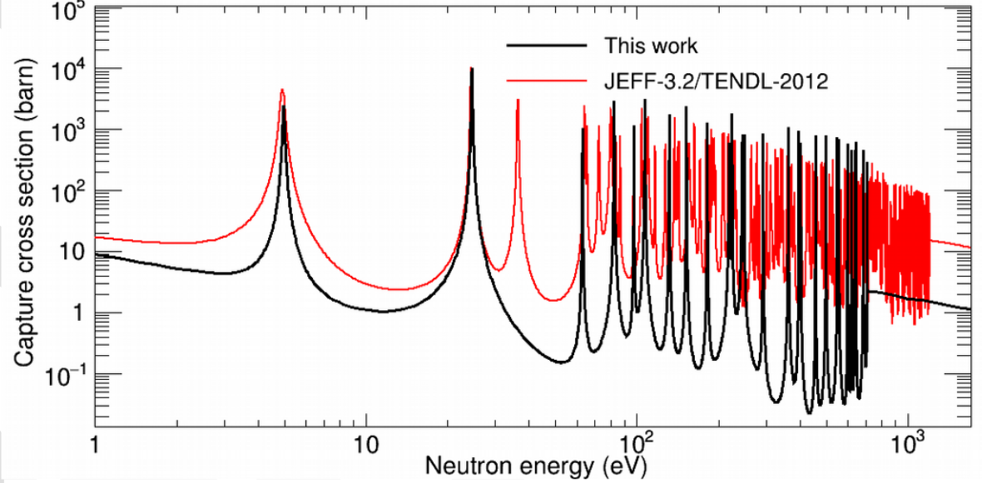
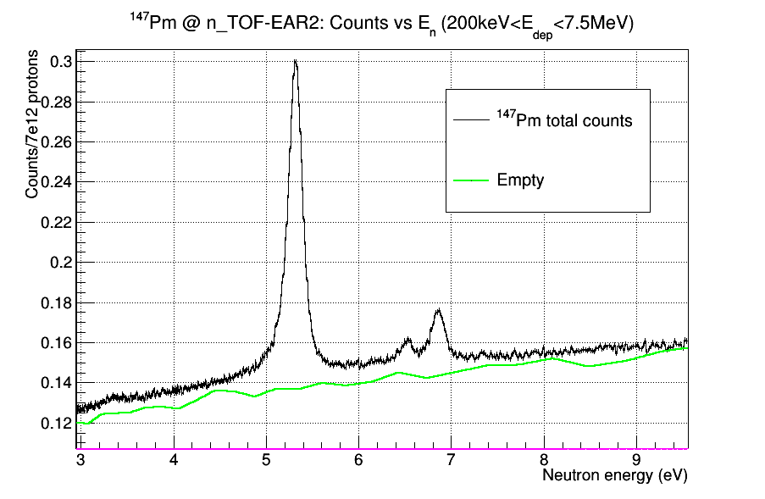
Branching points
Isotope production by neutron irradiation at @ ILL (Grenoble)
Chemical separation and sample preparation by AC group @ PSI
²⁰⁴Tl (3.8 y) – 11 mg sample
¹⁷¹Tm (1.9 y) - 3.6 mg sample
Preliminary
A. Casanovas et al., in preparation
C. Guerrero et al., in preparation
¹⁴⁷Pm (2.6 y) - 80 μg sample
Preliminary results indicate important differences in the MACS relative to calculations and (very few) previous integral measurements (confirmed by complementary measurements at SARAF).
as provided by N Colonna
J. Lerendegui et al., in preparation

Slide 41
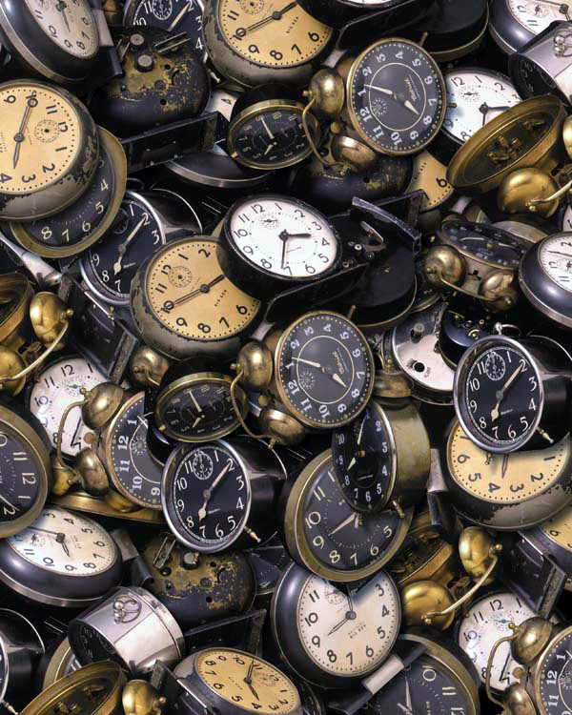
Tuning the Re/Os clock: neutron cross sections
Re/Os
Measurements at CERN n_TOF
Stellar rates
Uncertainties
alberto.mengoni@cern.ch

Slide 42
A brief history of the Universe
BANG!
nucleosynthesis
4.6 Ga
Now
(& here)
Galaxy formation
Solar-system formation
Age: (1) cosmological, (2) astronomical, (3) nuclear

Slide 43
Age from CMB observations
The detailed structure of the cosmic microwave background fluctuations will depend on the current density of the universe, the composition of the universe and its expansion rate. WMAP has been able to determine these parameters with an accuracy of better than 5%. Combining the various CMB observation the age of the universe has been determined with an accuracy < 0.2%
13.799 ± 0.021 Ga
Source: The Planck Collaboration, A&A, June 2016

Slide 44
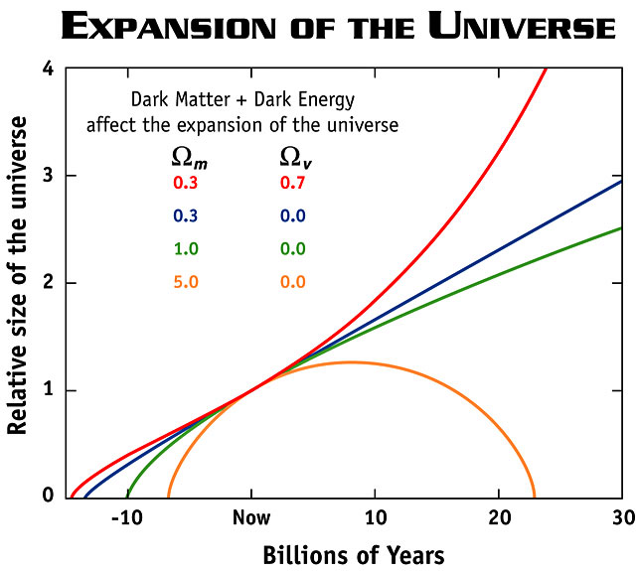
Cosmological “problems” with age
http://map.gsfc.nasa.gov/

Slide 45
Age from globular clusters
The age derived from observation
of the luminosity-color relation of stars in globular clusters
from > 11.2 Ga (*)
to 14 ± 2.0 Ga
(*) LM Krauss and B Chaboyer, Science 299 (2003) 65
Source: DN Spergel et al.
Proc. Natl. Acad. Sci. USA 94 (1997) 6579
alberto.mengoni@cern.ch

Slide 46
The nuclear way
Traditional nuclear clocks are those based on:
²³⁵U/²³⁸U
²³²Th/²³⁸U
¹⁸⁷Os/¹⁸⁷Re
Th/Eu, Th/X or U/Th abundances in low-Z stars

Slide 47
s-process nucleosynthesis
BANG!
?
4.6 Ga
Now
s-only
Os
Os 184
0.02
Os 185
94 d
Os 186
1.58
Os 187
1.6
Os 188
13.3
Os 189
16.1
Os 190
26.4
Os 191
15.4 d
Os 192
41.0
Re
Re 183
71 d
Re 184
38 d
Re 185
37.4
Re 186
90.64 h
Re 187
62.6
Re 188
16.98 h
Re 189
24.3 h
Re 190
3.1 m
42.3x10⁹ a
W
W 182
26.3
W 183
14.3
W 184
30.67
W 185
75.1 d
W 186
28.6
W 187
23.8 h
W 188
69 d
s-process
r-only
r-process
(*) DD Clayton, ApJ 139 (1964) 637

Slide 48
key quantities: neutron cross sections
BANG!
?
4.6 Ga
Now
s-process condition: < σ > × N ≈ const.
i.e. for the Re/Os clock:
σ(186) × N(186) ≈ σ(187) × N(187)

Slide 49
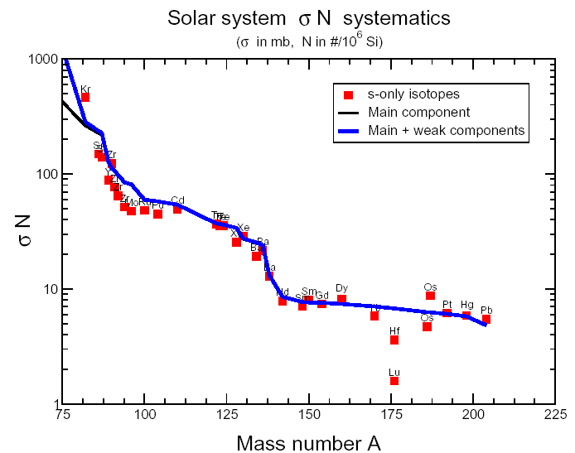
Enhanchement of [¹⁸⁷Os] by ¹⁸⁷Re(β⁻)
The s-process condition σ_{A}N_{A} = const. implies that:
σ₁₈₆ N(186) = σ₁₈₇ N(187)
From (n,γ) measurements:
σ₁₈₆ / σ₁₈₇ = 0.48
On the other hand, from solar-system abundances:
N[¹⁸⁷Os] / N[¹⁸⁶Os] = 0.79
alberto.mengoni@cern.ch

Slide 50
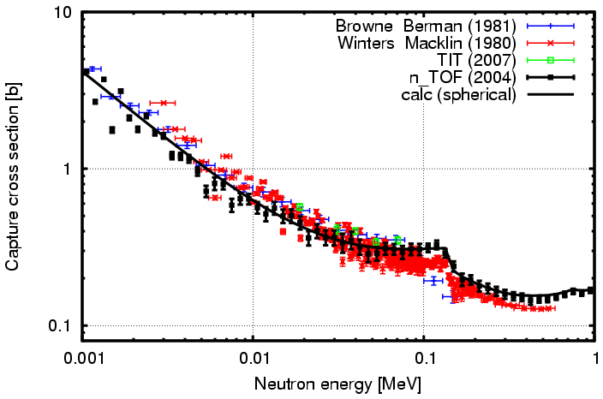
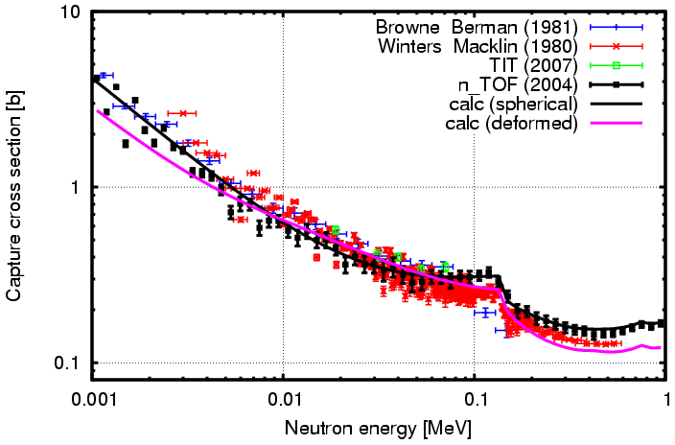
n_TOF-04: ¹⁸⁶Os capture x-section
MACS-30
BrB81 | 438 ± 30 mb
WiM82 | 418 ± 16 mb
n_TOF | 414 ± 17 mb
CC calculations including
ground-state collective band
in a deformed OMP
www.cern.ch/n_TOF
alberto.mengoni@cern.ch

Slide 51
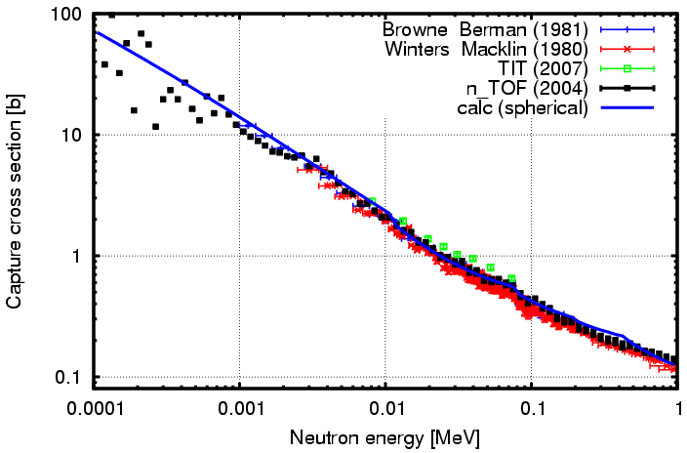
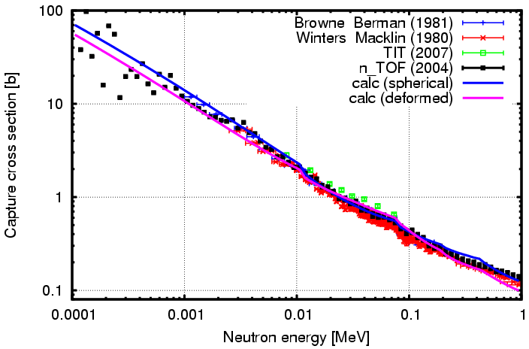

n_TOF-04: ¹⁸⁷Os capture x-section
MACS-30
BrB81 | 919 ± 43 mb
WiM82 | 874 ± 28 mb
n_TOF | 969 ± 32 mb
CC calculations including
ground-state collective band
in a deformed OMP
www.cern.ch/n_TOF
alberto.mengoni@cern.ch

Slide 52

Lab cross sections & the clock
BANG!
t₀
4.6 Ga
Now
R_{σ} = 0.43 ± 0.02
t₀ = 8.7 ± 0.4 Ga
age:
8.7 + 4.6 = 13.3 Ga

Slide 53

Stellar ¹⁸⁷Os(n,γ) rate
¹⁸⁷Os at kT = 30 keV:
P(gs) = 33%
P(1st) = 47%
P(all others) = 20%
Include thermal population
Include super-elastic scattering channels
Nuclear structure effects (deformation)
<σ_{n,γ}>* = SEF ∙ <σ_{n,γ}>
SE Woosley and WA Fowler, ApJ 233 (1979) 411
alberto.mengoni@cern.ch

Slide 54

¹⁸⁷Re(β⁻) decay
The β-decay half-life of ¹⁸⁷Re is t_{b} = 43.2 ± 1.3 Gyr.
Under stellar conditions, the ¹⁸⁷Os and ¹⁸⁷Re atoms can be partly or fully ionized.
The β-decay rate can then proceed through a transition to bound-electronic states in ¹⁸⁷Os.
The rate for this process can be orders of magnitude faster than the neutral-atom decay.
The bound-state b-decay half-life of fully-ionized ¹⁸⁷Re has been measured @ GSI.
The half-life of fully-ionized ¹⁸⁷Re turns out to be: t_{b} = 32.9 ± 2.0 yr.
(F. Bosch, et al., PRL 77 (1996) 5190)
Impact on the age: up to 1 Gyr
alberto.mengoni@cern.ch

Slide 55
Lab cross sections & the clock
BANG!
t₀
4.6 Ga
Now
R_{σ} = 0.43 ± 0.02
t₀ = 8.7 ± 0.4 Ga
age:
8.7 + 4.6 = 13.3 Ga

Slide 56

Stellar cross sections & the clock
BANG!
t₀
4.6 Ga
Now
R*_{σ} = 0.34 ± 0.02
t₀ = 10.7 ± 0.5 Ga
age:
10.7 + 4.6 = 15.3 Ga
SEF(30 keV):
1.28 ± 0.04

Slide 57



Results and uncertainties
Abundances : 0.49 Ga
x-section ratio* : 0.47 Ga
Re-187 b-decay half-life : 0.29 Ga
Total uncertainty : < 1 Ga

Slide 58
Summary
Cosmological way (CMB observation)
Astronomical way (globular clusters)
Nuclear way: Re/Os clock U/Th clock
13.799 ± 0.021 Ga
The Planck Collaboration, A&A, June 2016
14 ± 1 Ga
G Imbriani et al., A&A 420 (2004) 625
15.3 ± 0.8 ± 2 Ga(*)
>13.4 ± 0.9 ± 2.2 Ga
A Frebel et al. ApJ 660 (2007) L117
(*) 2 Ga uncertainty assigned to GCE modeling + astration(?)

Slide 59


U/Th and Re/Os clocks: complementary
BANG!
4.6 Ga
Now
GCE : independent
Primordial yields : model-dependent
GCE : dependent
Yields : well determined

Slide 61
The End

