Slide 1

Neutron production and monitoring at the new LUNA-MV facility
Paolo Prati
INFN & University of Genoa
prati@ge.infn.it
LNGS, Oct. 2nd 2017

Slide 2

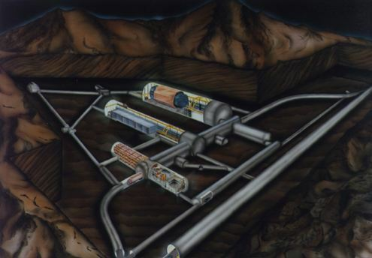
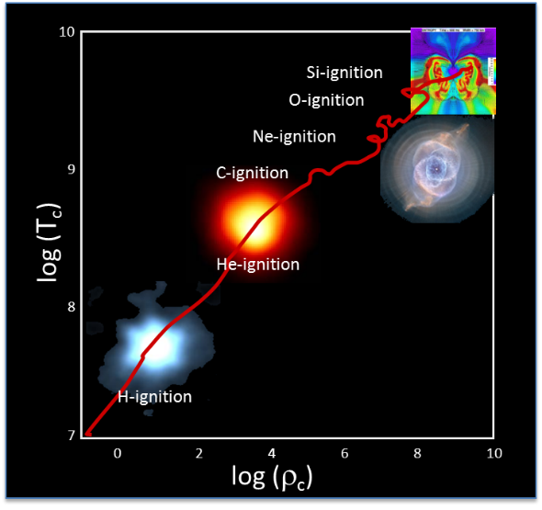
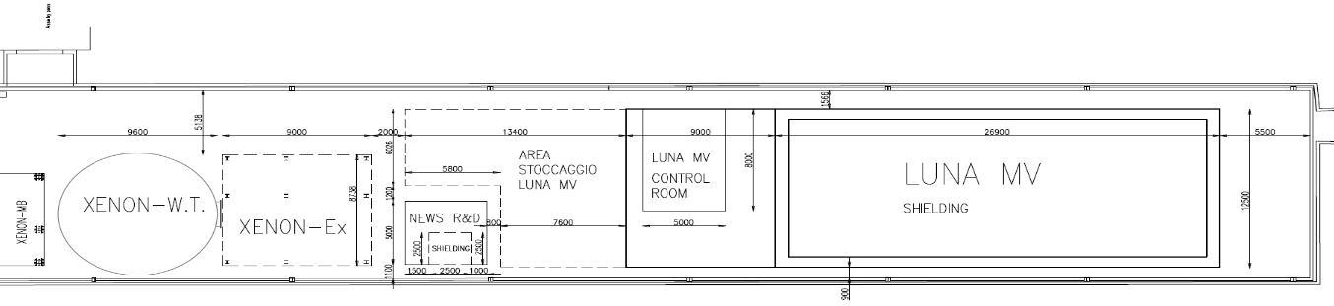
LUNA-MV
LUNA MV will be installed in the North part of Hall B of LNGS
See LUNA-MV proposal
≈ 30 m
α and C induced reactions

Slide 3
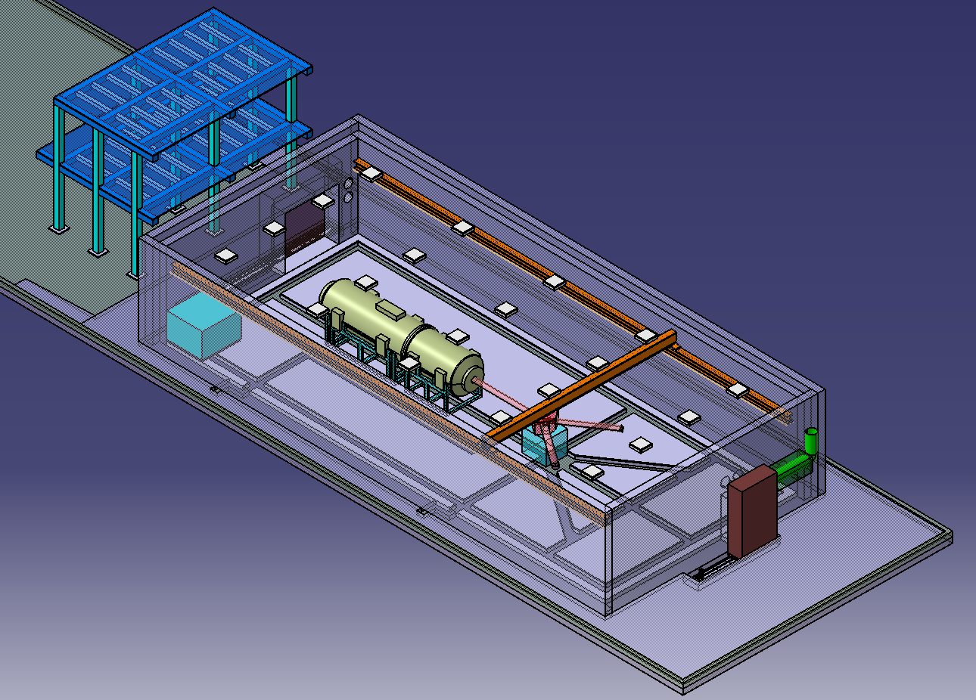
Layout of the new LUNA-MV facility
5.5 m
27 m
12.5 m

Slide 4

The accelerator and the neutron shielding
H
¹H⁺ (TV: 0.3 – 0.5 MV): 500 μA
inline Cockcroft Walton accelerator
TERMINAL VOLTAGE: 0.2 – 3.5 MV
Precision of terminal voltage reading: 350 V
Beam energy reproducibility: 0.01% TV
Beam energy stability: 0.001% TV / h
Beam current stability: < 5% / h
¹H⁺ (TV: 0.5 – 3.5 MV): 1000 μA
He
⁴He⁺ (TV: 0.3 – 0.5 MV): 300 μA
⁴He⁺ (TV: 0.5 – 3.5 MV): 500 μA
C
¹²C⁺ (TV: 0.3 – 0.5 MV): 100 μA
¹²C⁺ (TV: 0.5 – 3.5 MV): 150 μA
¹²C⁺⁺ (TV: 0.5 – 3.5 MV): 100 μA
A key-point: at low energy LUNA-MV must deliver very intense beams to make the nuclear cross sections measurable…however in the highest part of the energy range, in particular with proton beam, experiments can be performed by beam of much, much lower intensity !
Nevertheless we are committed to guarantee the full operation beyond the peculiar NA needs.

Slide 5

The “history” of neutron simulation for LUNA-MV
Maximum neutron production calculated in 2014 on the basis of the long-term scientific program:
¹³C(α,n)¹⁶O; Q=2.216 MeV, E_{n} ~ 3 MeV @ E_{α} = 1 MeV
²²Ne(α,n)²⁵Mg, Q= - 0.478 MeV, E_{n} ~ 0.368 MeV @ E_{α} = 1 MeV
¹³C(α,n)¹⁶O as 10⁻⁵ contaminant of ¹²C(α,γ)¹⁶O
E_{n}^{cm} ~ 4.89 MeV @ E_{α} = 3.5 MeV; production rate: 2 10³ n/s @ I_{α} = 200 μA
Simulation input/Design benchmark
Point-like n-source, 2 10³ n/s , E_{n}^{lab} = 5.6 MeV

Slide 6
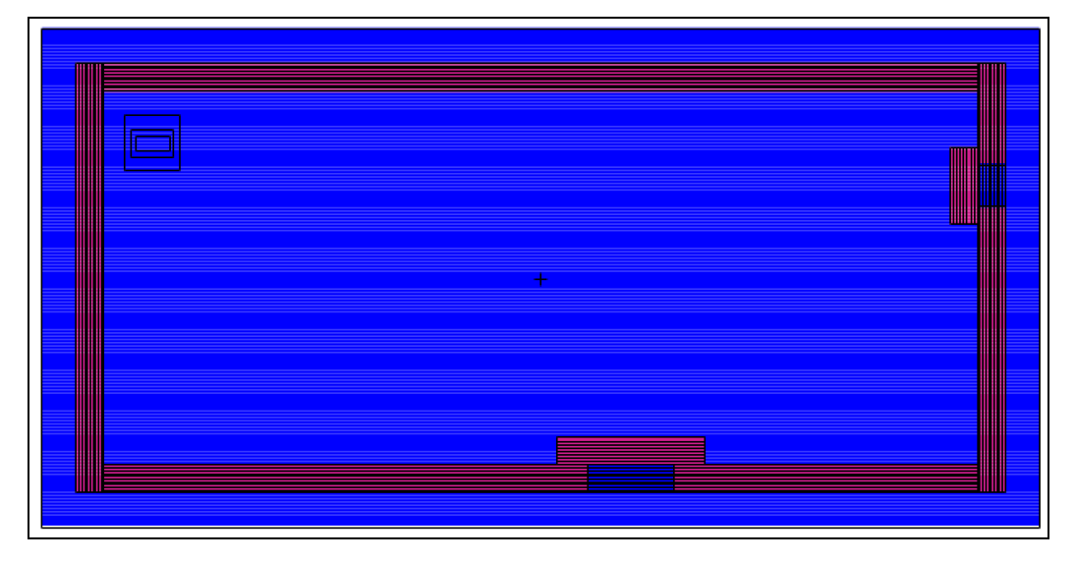
INFN-FISMEL: MCNP independent simulations (2015-16)
Run with the «source» in the realistic position,
80 cm thick concrete shieding in each direction
U
Xenon (~10 m)
R
(in Hall B)
LUNA
Surface | MCNP (10⁻⁷ n/cm² s) | GEANT4 (10⁻⁷ n/cm² s)
Left | 5.69888 ± 0.00007 | 12.3 ± 0.1
Upper | 2.58450 ± 0.00003 | 5.71 ± 0.05
Lower | 0.67484 ± 0.00002 | 1.53 ± 0.03
Right | 0.29462 ± 0.00002 | 0.64 ± 0.02
Roof | 0.68379 ± 0.00001 | 1.96 ± 0.02
Total (weighted mean) | 1.38535 ± 0.00001 | 3.40 ± 0.02

Slide 7
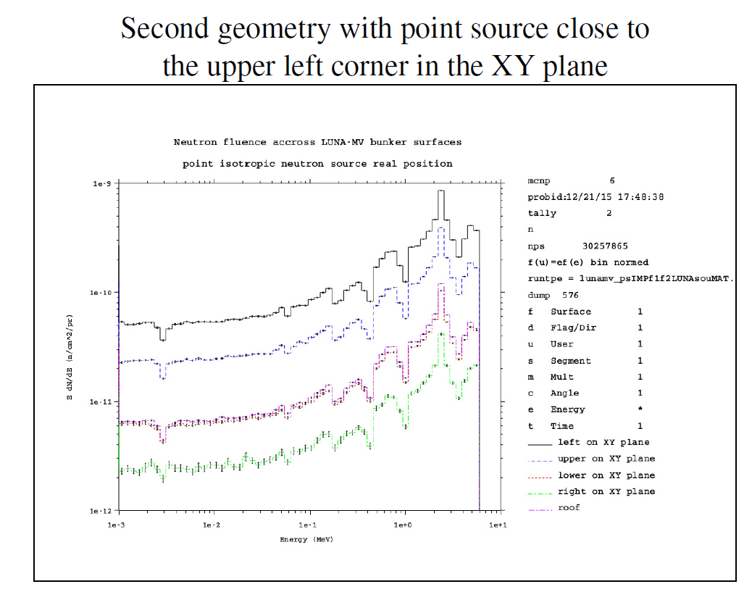
INFN-FISMEL: MCNP independent simulations
Fraction of fast neutrons
( E_{n} > 1 MeV)
< 1%
E* dN/dE
E (MeV)

Slide 8
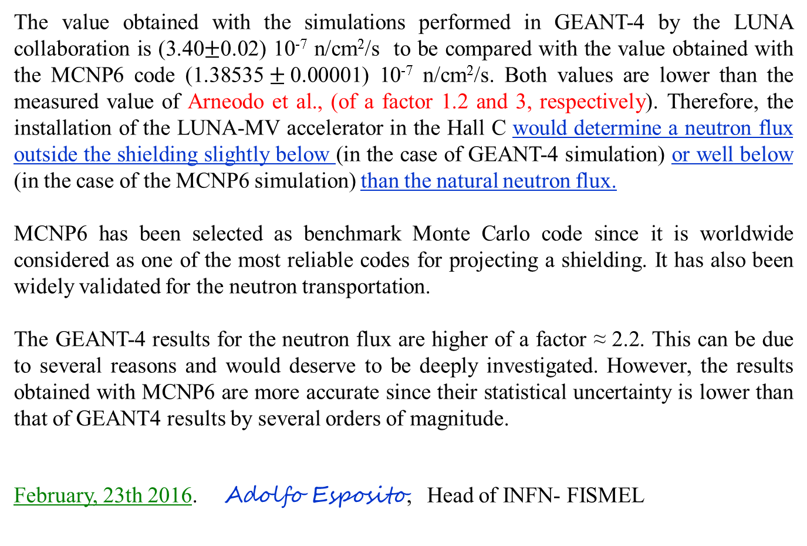
INFN-FISMEL: conclusions
The value obtained with the simulations performed in GEANT-4 by the LUNA collaboration is (3.40$±$0.02) 10⁻⁷ n/cm²/s to be compared with the value obtained with the MCNP6 code (1.38535$±$0.00001) 10⁻⁷ n/cm²/s. Both values are lower than the measured value of Arneodo et al., (of a factor 1.2 and 3, respectively). Therefore, the installation of the LUNA-MV accelerator in the Hall C would determine a neutron flux outside the shielding slightly below (in the case of GEANT-4 simulation) or well below (in the case of the MCNP6 simulation) than the natural neutron flux.
MCNP6 has been selected as benchmark Monte Carlo code since it is worldwide considered as one of the most reliable codes for projecting a shielding. It has also been widely validated for the neutron transportation.
The GEANT-4 results for the neutron flux are higher of a factor ≈ 2.2. This can be due to several reasons and would deserve to be deeply investigated. However, the results obtained with MCNP6 are more accurate since their statistical uncertainty is lower than that of GEANT4 results by several orders of magnitude.
February, 23th 2016. Adolfo Esposito, Head of INFN- FISMEL

Slide 9
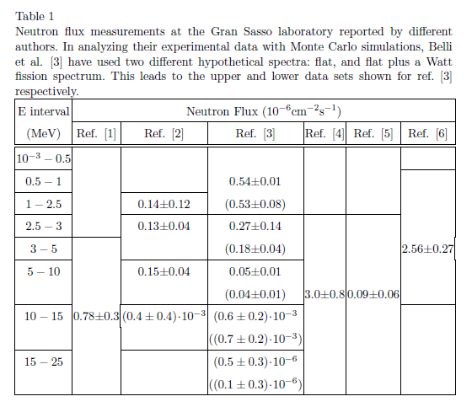
Final remarks
Belli
1989
Arneodo
1999
Wulandari et al., 2004
Aleksan 1989
Bellotti 1985
Rindi
1988
Cribier 1995
≈ 3
E_{n} < 1 keV
≈ 0.4
1 <E_{n}< 10 MeV
10⁻⁶ cm⁻² s⁻¹

Slide 10
Other possible sources for neutron emission
Besides those emitted from the target, LUNA-MV could produce neutrons as result of the interaction of the beam with the components of the accelerator and/or of the vacuum line. This could happen in particular with the proton beam at E_{beam} > ~1.5 MeV (not negligible at E_{beam} > ~2 MeV).
Possible Scenarios
Event | Cause | Frequency | Safeguards to keep R_{n} < 2 10³ s⁻¹
Beam on Faraday cup (beam stopper) | Routine operation | daily | Tantalum coating (passive) Automatic shutdown triggered by the neutron monitors (active)
Beam on slits, collimators, walls | Beam tuning, components failure, operator mistake | daily | Beam Wizard (active) Tantalum coating (passive) Automatic shutdown triggered by the neutron monitors (active)
Vacuum loss | Pumps failure, leaks, breaks | Rare ( y⁻¹) | Automatic shutdown triggered by the accelerator diagnostic (active)

Slide 11
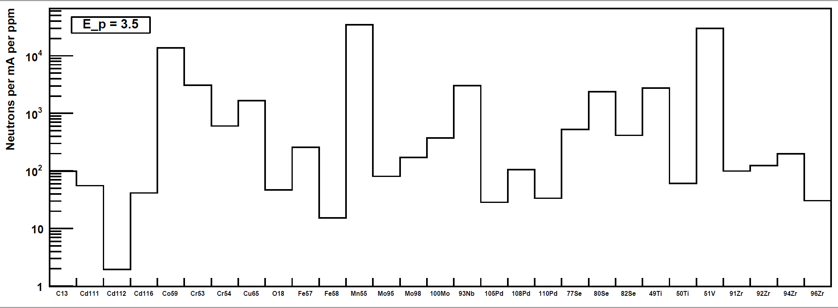
Passive safeguards: Ta (or Au) coating
At E_{p} = 3.5 MeV: range of proton in metals ranges form 50 to 100 μm.
The contract between INFN and HVEE foresees the coating by Ta of any part of the accelerator and transport line which could be hit by the beam. Tantalum (or Au…alternative solution for parts of the set-up designed directly by LUNA) is an inert material, however internal contaminants must be controlled.
⁵⁹Co
⁵⁵Mn
⁵¹V
⁹³Nb
E_{p} =3.5 MeV, I_{p} = 1 mA, 1 ppm impurity in Ta

Slide 12
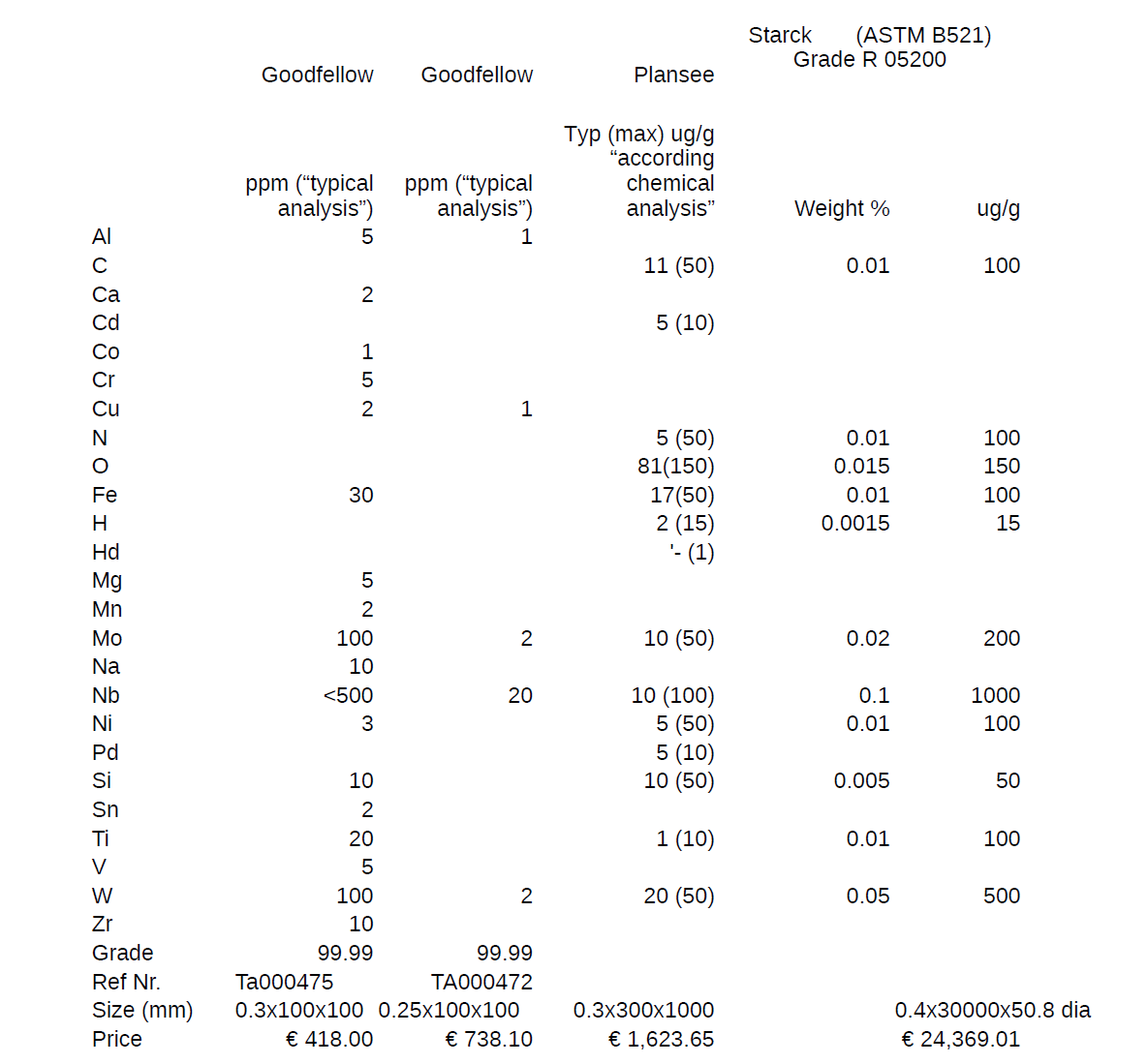
Passive safeguards
Clean Ta foils are available in the market
LUNA/HVEE R&D work… in progress
First check: in-house acceptance tests. Spring 2018

Slide 13

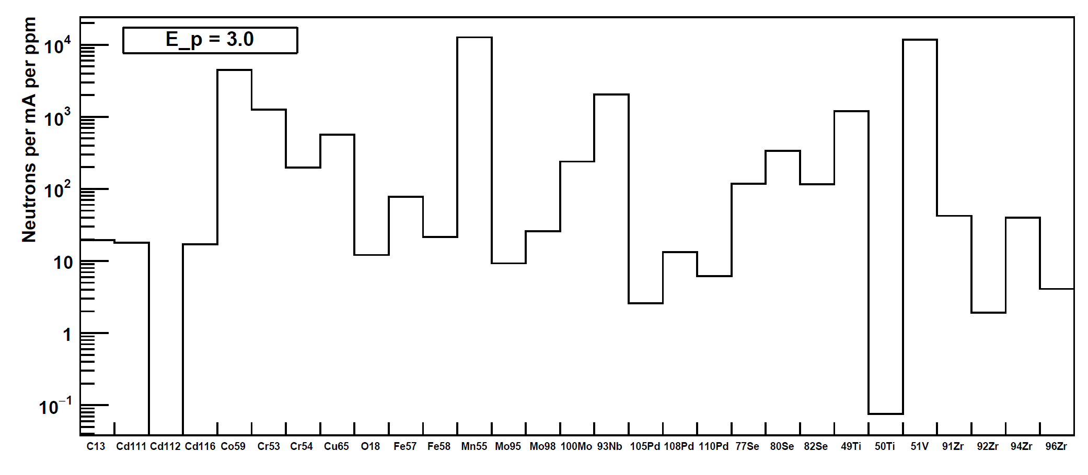
Neutron rate due to Ta contaminants: 3.5 vs. 3 MeV (E_{p})

Slide 14
Active safeguards: neutron monitors
Commercial neutron (and X/γ) monitors will be installed inside the accelerator room and directly connected/controlled to/by the LNGS safety system. (ref. Authorization procedure)

Slide 15
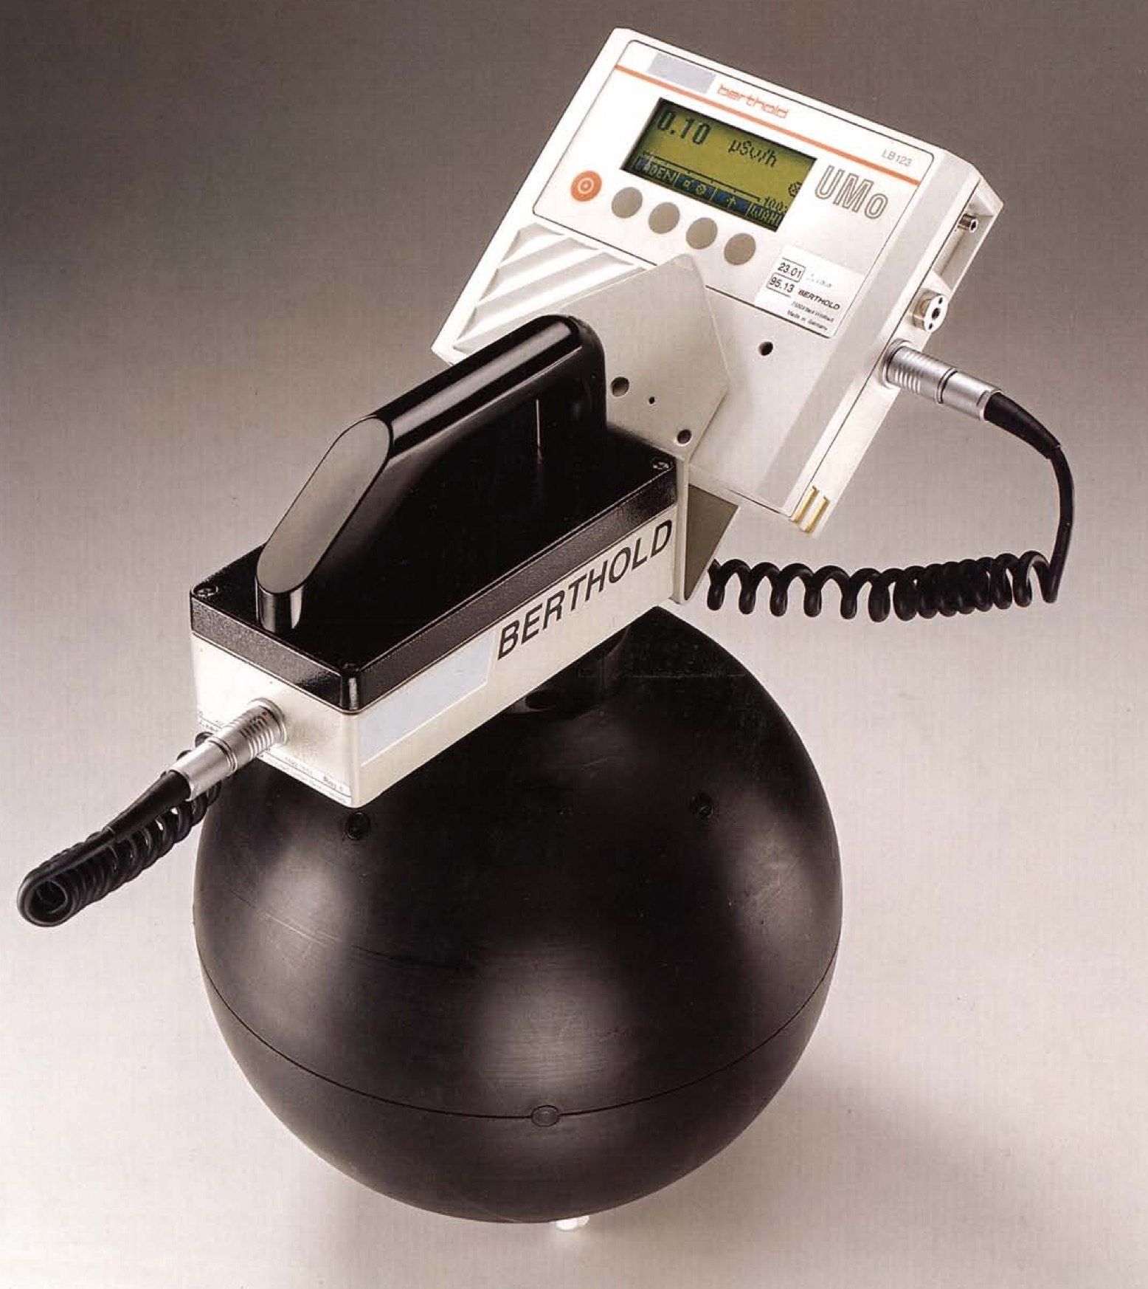
Active safeguards: neutron monitors
Berthold LB6411
Ambient Dose Equivalent ICRP60
Berthold LB6414
Neutron Survey Meter
ELSE Lupin 5401 He3-NP
REM Counter

Slide 16
Active safeguards: neutron monitors
Model | Berthold LB6411 Ambient Dose ICRP60 | Berthold LB 6414 Survey Meter | ELSE LUPIN 5401 HE3-NP REM Counter
External diameter [mm] | 250 | 310x180x130 | 250
Counter | ³He@2 atm cylindrical | ³He@2 atm cylindrical | ³He@2 (4, 6 e 8) atm spherical
Range [nSv/h] | > 30 |  | > 10
Fluence response [cm²] | 1.09 | 10.7 Am-Be 26.4 fission
H*(10) response [counts/nSv] | 2.83 | 68, 27 Am-Be | 4 @2 atm; 6.4 @ 4 atm 8.8 @ 8 atm
Gamma sensitivity [µSv/h] | < 40 @ 10 mSv/h, 662 keV |  | < 0.5 @ 50 mSv/h, 662 keV
η ( 3 < En < 6 MeV) | 3.47 * 10⁻⁵ |  | 0.54 ÷ 1.20 * 10⁻⁴
Berthold LB6411 and ELSE 5401 has been/will be tested underground: background meas./expect. < 1 c.p.m.

Slide 17
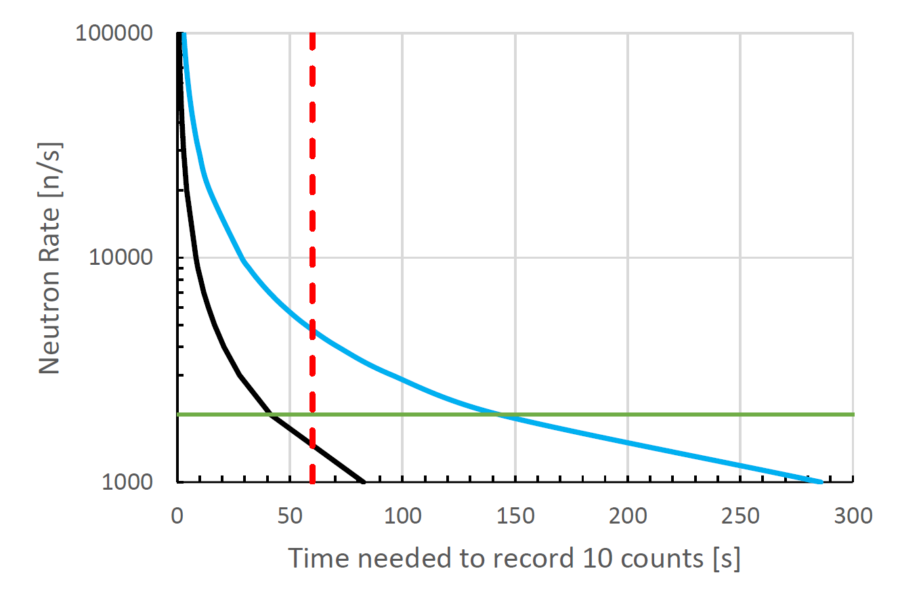
Active safeguards: reacting time→ shutdown
BERTHOLD
ELSE
@ 2000 n/s → 40 s (ELSE, 8 atm)
Safety thres. of 7 counts in ≈ 30 s

Slide 18
Conclusions and next steps
The LUNA-MV shielding has been designed (and validated) assuming a max. neutron emission of 2 10⁻³ s⁻¹ , E_{n} = 5.6 MeV
Proper coating of the beam line components that will/could be hit by the beam (in particular: Faraday cups and beam stoppers) will prevent uncontrolled n emissions. Work is in progress to select the cleanest coating materials.
Neutron monitors will be placed near (≈ 50 cm) the “hot spots” to guarantee the accelerator shutdown in less than 40 s in case the emission limit is overcome
As final measure, limitations to the maximum beam current and energy (in particular for protons) could be implemented
LUNA suggests to install a LNGS-controlled, long-term, neutron monitor in Hall B, in the area between LUNA-MV and Xenon

Slide 19

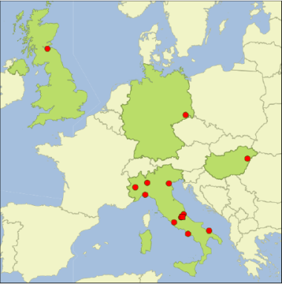
The LUNA collaboration
G.F. Ciani*, L. Di Paolo, A. Formicola, I. Kochanek, M. Junker | INFN LNGS /*GSSI, Italy
D. Bemmerer, M. Takacs, T. Szucs | HZDR Dresden, Germany
C. Broggini, A. Caciolli, R. Depalo, P. Marigo, R. Menegazzo, D. Piatti | Università di Padova and INFN Padova, Italy
C. Gustavino | INFN Roma1, Italy
Z. Elekes, Zs. Fülöp, Gy. Gyurky| MTA-ATOMKI Debrecen, Hungary
M. Lugaro | Monarch University Budapest, Hungary
O. Straniero | INAF Osservatorio Astronomico di Collurania, Teramo, Italy
F. Cavanna, P. Corvisiero, F. Ferraro, P. Prati, S. Zavatarelli | Università di Genova and INFN Genova, Italy
A. Guglielmetti| Università di Milano and INFN Milano, Italy
A. Best, A. Di Leva, G. Imbriani, | Università di Napoli and INFN Napoli, Italy
G. Gervino | Università di Torino and INFN Torino, Italy
M. Aliotta, C. Bruno, T. Chillery, T. Davinson | University of Edinburgh, United Kingdom
G. D’Erasmo, E.M. Fiore, V. Mossa, F. Pantaleo, V. Paticchio, R. Perrino, L. Schiavulli, A. Valentini| Università di Bari and INFN Bari, Italy
.

Slide 20

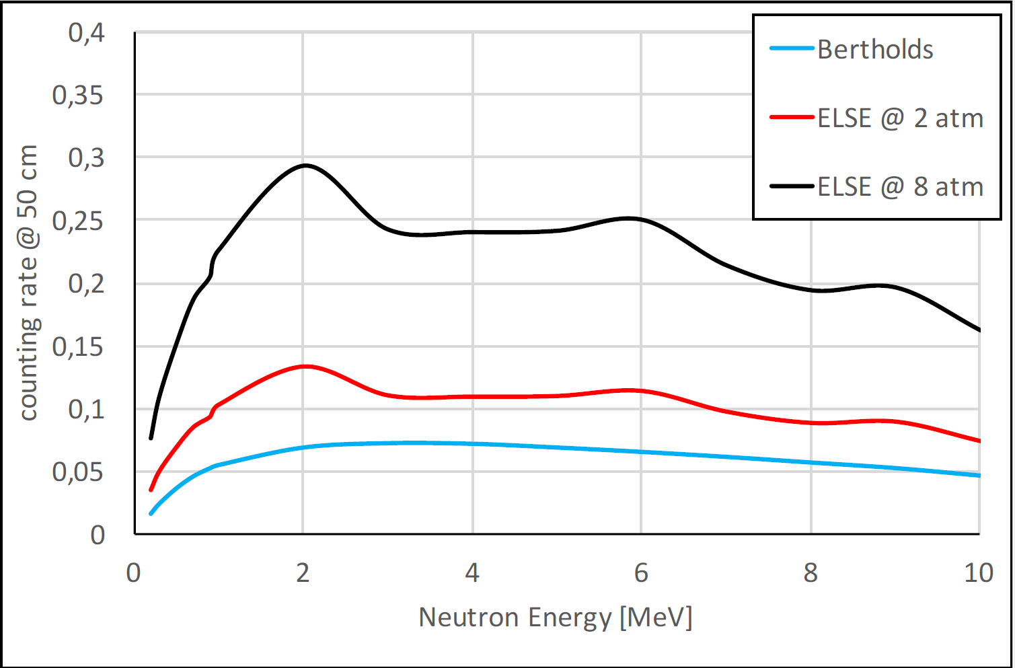
Counting rate vs. E_{n}

Slide 21
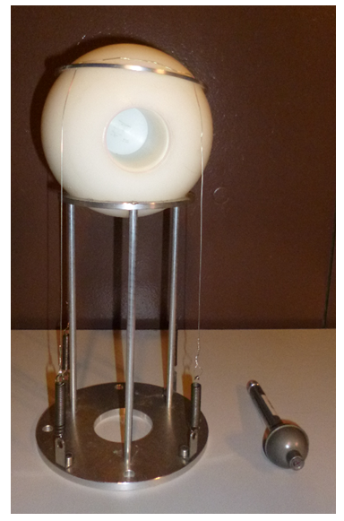
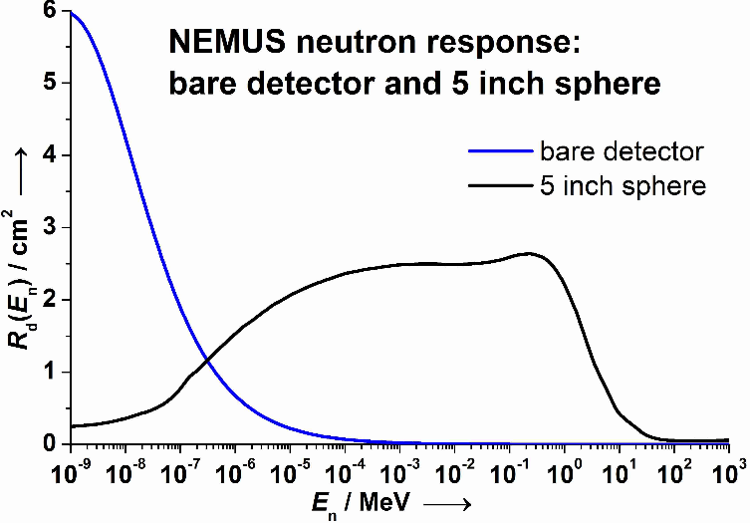
Neutron flux monitoring in Hall B
(slide shown at the last SC meeting)
Bonner Sphere spectrometer
PTB (Physikalisch-Technische Bundesanstalt) property and certification
³He detector for thermal neutrons
A bck. run is going to start today
Data taking actually started Oct 20th 2016…still ongoing !

Slide 22
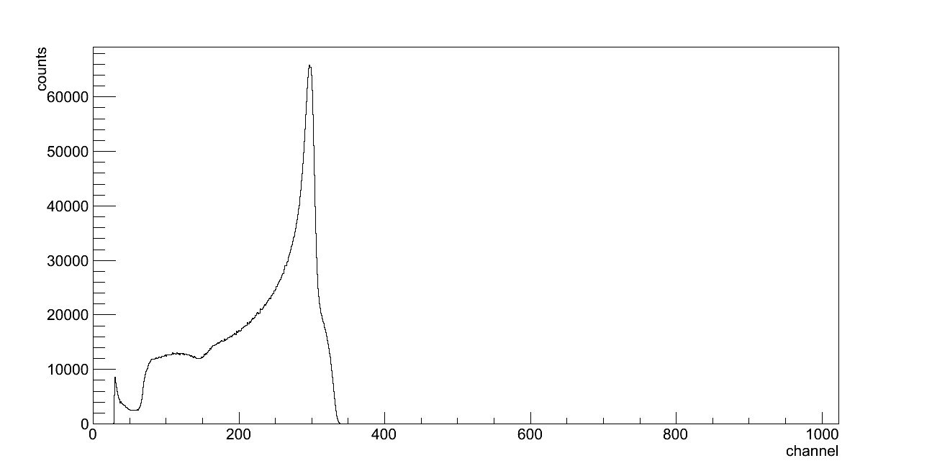
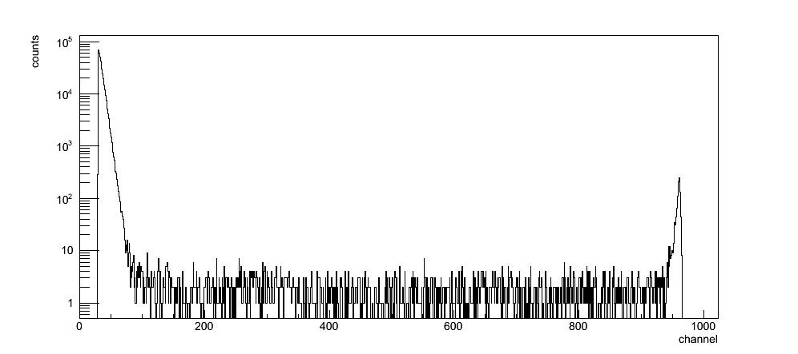
Neutron flux monitoring in Hall B
(first 142 days)
Net counts in RoI = 157 ± 26
Mean neutron flux = (6.4 ± 2.5) 10⁻⁶ n/(cm² s)
?
Am-Be ref. spectrum
integrated neutron flux = (6.4 ± 1.0) 10⁻⁶ n/(cm² s)

Slide 23

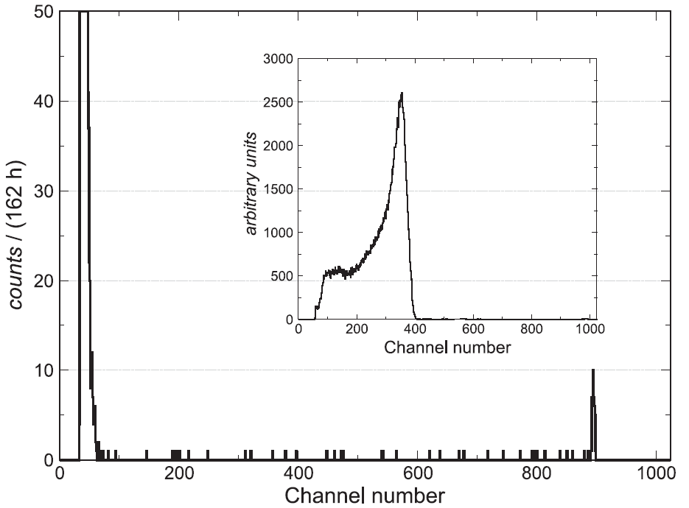
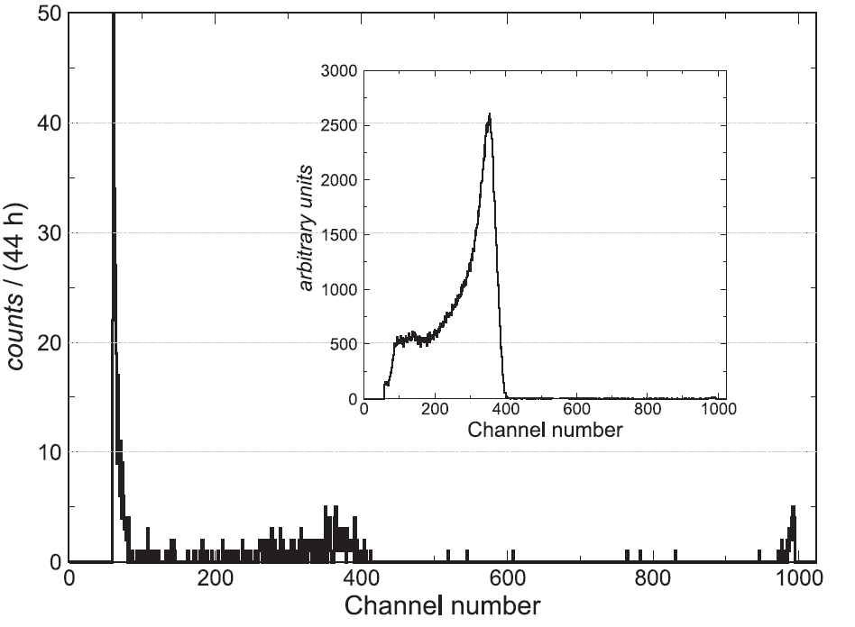
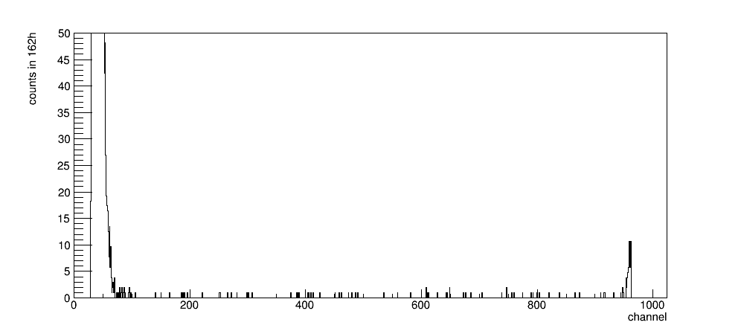
Hall B vs. Reginatto et al., AIP proc. 1553, 77 (2013)
UDO salt mine (490 m depth)
Felsenkeller (50 m depth)
LNGS – Hall B
(preliminary)

Slide 24
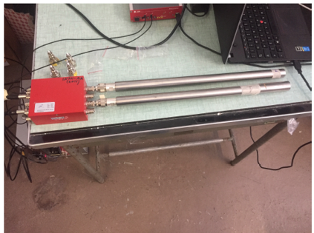
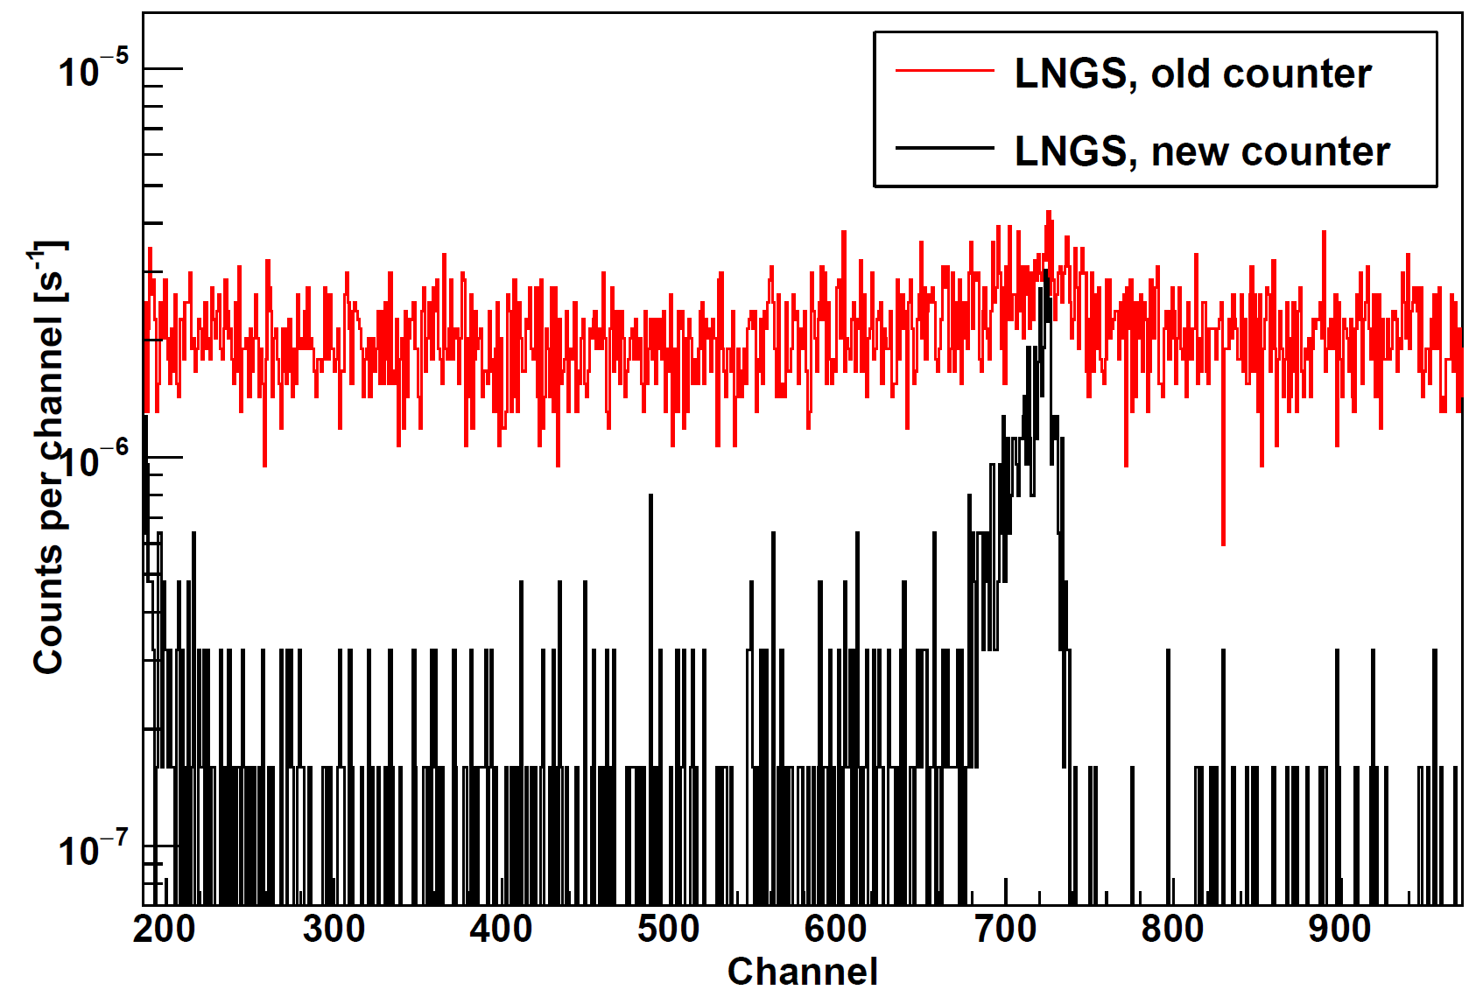
Recent achievements in the neutron bck. Monitoring: the new «LUNA» ³He tubes
Φ_{n}(therm)≈ 5 10⁻⁷ cm⁻² s⁻¹ (LUNA400 site)

Slide 25
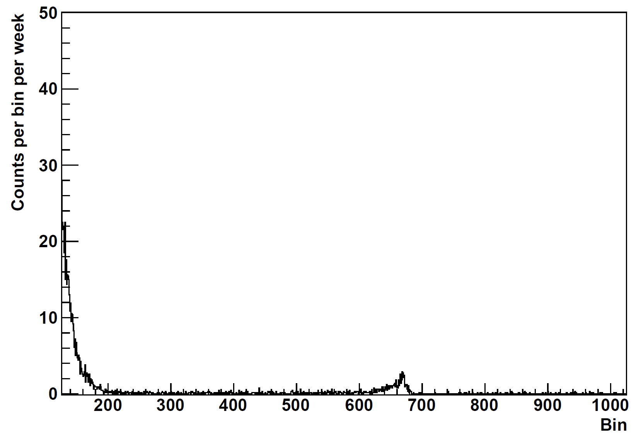
Hall B vs. Reginatto et al., AIP proc. 1553, 77 (2013)
UDO salt mine (490 m depth)
Felsenkeller (50 m depth)
New LUNA ³He tubes
Thermal n. only !
LNGS – Hall B
(preliminary)

Slide 26
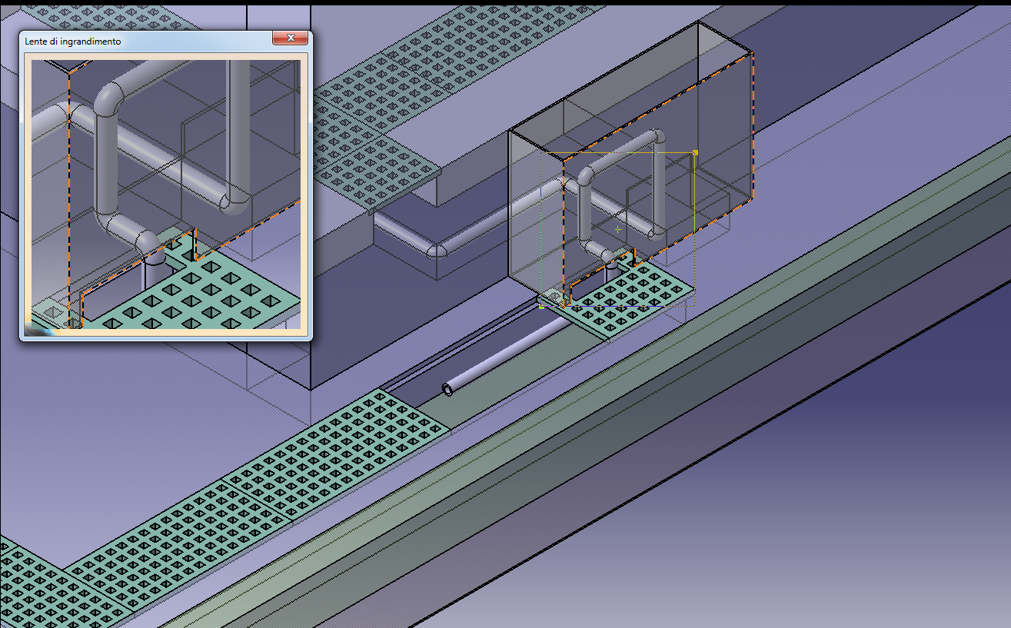
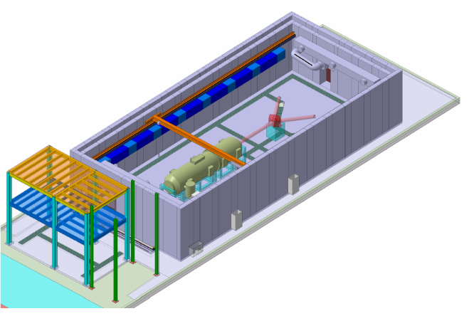
LUNA MV: detail of the shielding pass through
Filled by polyethylene μspheres
Pass through dimension:
H = 20 cm, W = 40 cm
En ~ MeV
Trasm.~ 1/10 each turn
Solid angle fraction at the nearest pass through ≈ 4 10⁻⁴
With 4 turns → ≈ 10⁻⁷ n/cm² s through the «critical» pass-through

Slide 27

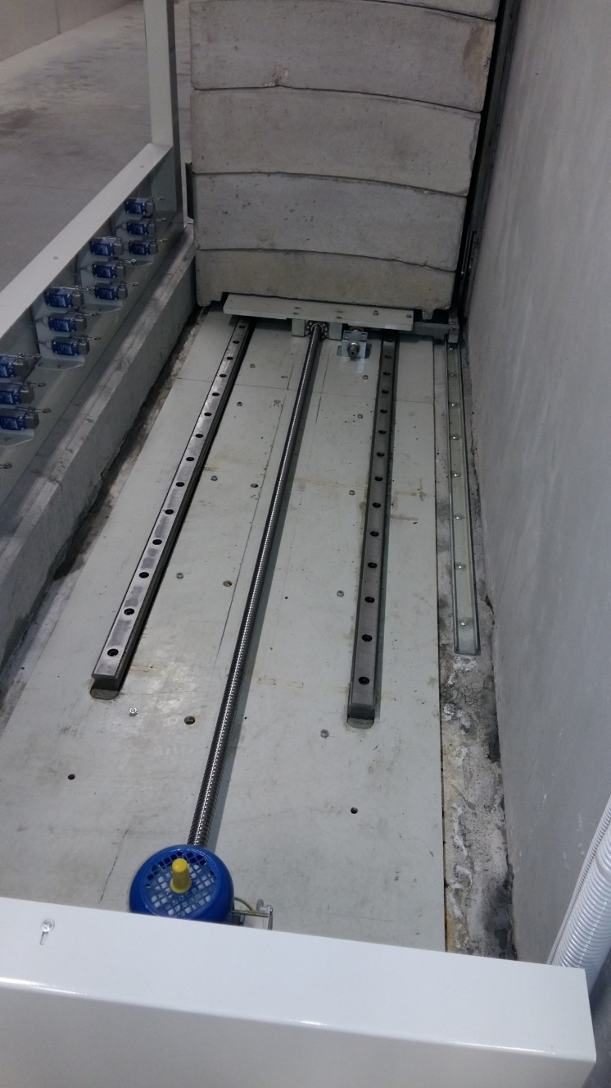
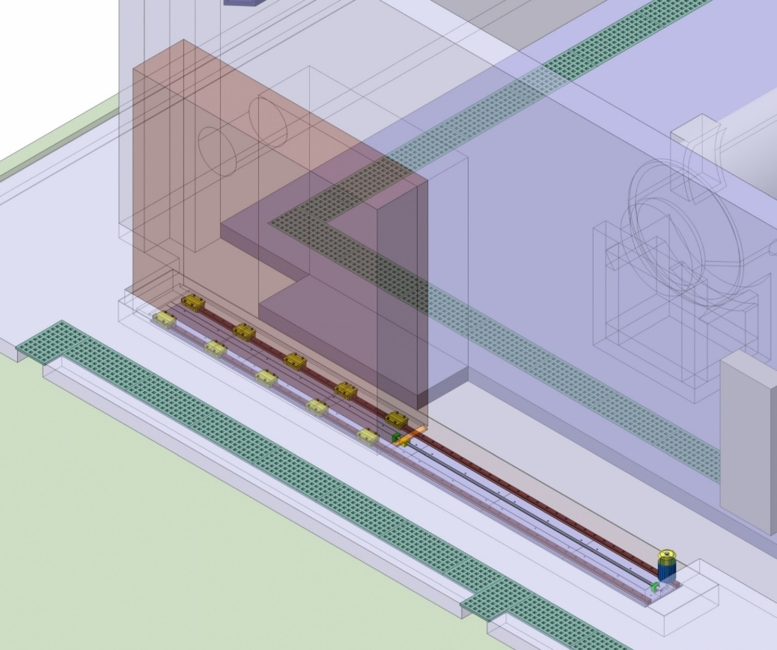
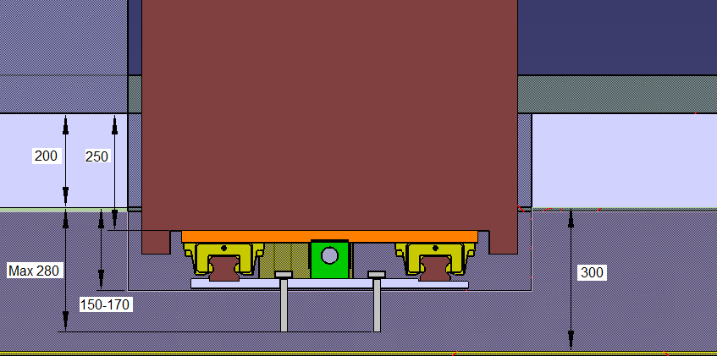
LUNA-MV: details of the two sliding doors (SPES-like)

