Slide 1
Muon colliders

Slide 2
Outline
Muons case
Muon accelerators challenges:
  muon production
  emittance reduction via cooling
  high-gradient acceleration
Conclusions
Ancora in fase di R&D o idee, ancora molto lontani rispetto al Linear Collider o Circular collider

Slide 3
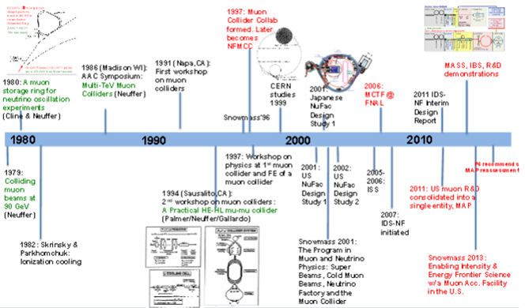

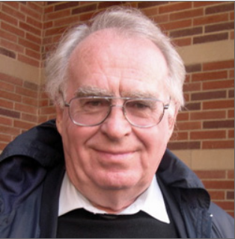
Muons: a long history of development
Rob
Ryne
C.Rubbia
proposal
2015

Slide 4
Muon based colliders great potential
  IF THE MUON BEAM NOVEL TECHNOLOGY
  CAN BE DEMONSTRATED TO BE FEASIBLE
As with an e⁺e⁻ collider, a μ⁺μ⁻ collider offers a precision probe of fundamental interactions without energy limitations
By synchrotron radiation (limit of e⁺e⁻ circular colliders)
By beam-strahlung (limit of e⁺e⁻ linear colliders)
Muon Collider is the ideal technology
to extend lepton high energy frontier in the multi-TeV range
with reasonable dimension, cost and power consumption
Muon based Higgs factory takes advantage of
a strong coupling to Higgs mechanism by s resonance

Slide 5
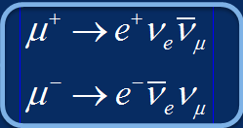
Muons: Issues & Challenges
Limited lifetime: 2.2 μs (at rest)
    Race against death: generation, acceleration & collision before decay
    Muons decay in accelerator and detector
      Shielding of detector and facility irradiation
      Collider and Physics feasibility with large background environment?
        Not by beamshtrahlung as with e+/e- but by muon decay (e, ν)
        Reduced background at high energy due to increased muon lifetime
    Decays in neutrinos:
      Ideal source of well defined electron & muon neutrinos in equal quantities whereas Superbeams by pion decay only provide muon ν:
      The neutrino factory
      concept
Generated as tertiary particles in large emittances
    powerful MW(s) proton driver and pion decay
    novel (fast) cooling and acceleration methods
  Development of novel technologies
  with key accelerator and detector challenges
☹
☺
☹
π ⁺ → μ ⁺ + ν_{μ}
π ⁻ → μ ⁻ + ν_{μ}

Slide 6

Muon beams specific properties
Muons are leptons like electrons & positrons
but with a mass (105.7 MeV/c²) 207 times larger
Negligible synchrotron radiation emission (α m⁻²)
  Multi-pass collisions (1000 turns) in collider ring
    High luminosity with reasonable beam power and wall plug power consumption
      relaxed beam emittances & sizes, alignment & stability
    Multi-detectors supporting broad physics communities
    Large time (15 μs) between bunch crossings
  No beam-strahlung at collision:
    narrow luminosity spectrum
  Multi-pass acceleration in rings or RLA:
    Compact acceleration system and collider
    Cost effective construction & operation
  No cooling by synchrotron radiation in
  standard damping rings
    Requires development of novel cooling method
☺
☺
3 TeV
☺
☹

Slide 7
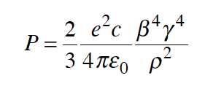

Synchrotron radiation
Uo = 5.5 x 10⁻¹⁸ γ⁴/ρ
electrons Uo (GeV) = 9 10⁻⁵ E⁴(GeV)/ρ(m)
muons Uo (GeV) = 5 10⁻¹⁴ E⁴(GeV)/ρ(m)
protons Uo (GeV) = 7 10⁻¹⁸ E⁴(GeV)/ρ(m)
r =3000 m (LEP/LHC tunnel)
@ Uo/Eb ~ 10% electrons are limited to ~ 150 GeV (Uo = 15 GeV)
@ Uo/Eb ~ 10% muons can go up 200 TeV (Uo = 20 TeV)

Slide 8
Multipass
E ≈ P(GeV) = 0.3 B(T) ρ (m)
Lacc = 2π ρ 3/2(dipole filling factor)
Lacc (m) = 3 π E/[0.3 B(T)] ≈ 30/B(T)
decay length = γβc τ_{μ} = 6000 E
τ_{μ} = 2.2 μs
Lifetime (machine turns) = decay length / Lacc = 200 B(T)
B= 16 T
3000 turns
Luminosity and RF acceleration can benefit of this factor !

Slide 9
Luminosity
N(e⁺) number of e⁺
ρ(e⁻) target electron density
L target length
N(p)= σ(p) N(e⁺) ρ(e⁻) L
N(e⁺) number of e⁺
N(e⁻) number of e-
A area of intersection
N(p)= σ(p) N(e⁺)N(e⁻)/A
dN(p)/dt= σ(p) N(e⁺) N(e⁻) /A f
L=N(e⁺) N(e⁻) /A f
f intersection frequency
Notes:
efficienza massima che si puo’ avere: processo che domina e’ il radiative Bhabha (e+ su e-, senza nuclei)
sigma*L*rho
radiative Coulomb scattering (brems) e’ sui nuclei
mettendoli insime il processo va come 10^-25 cm-2 *Z^2

Slide 10
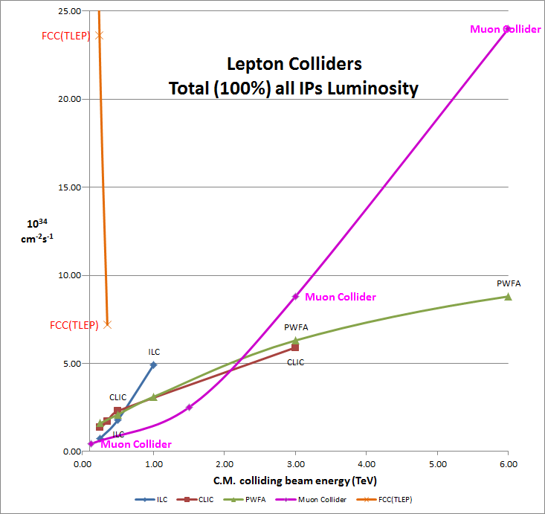
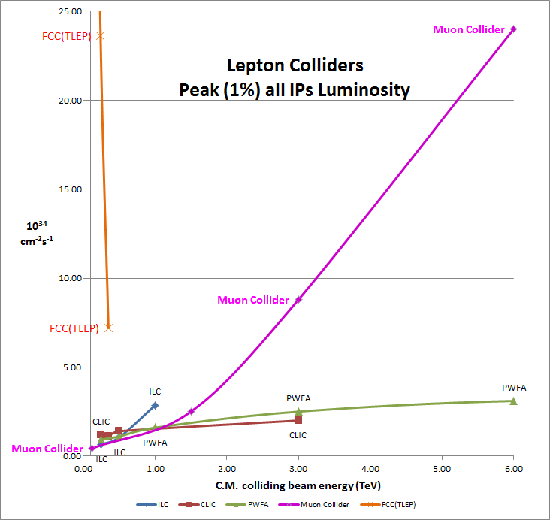
Muon Colliders potential of extending leptons high energy frontier with high performance
Muons
Muons
Circular
Circular
Linear
Linear
C.Rubbia
C.Rubbia

Slide 11
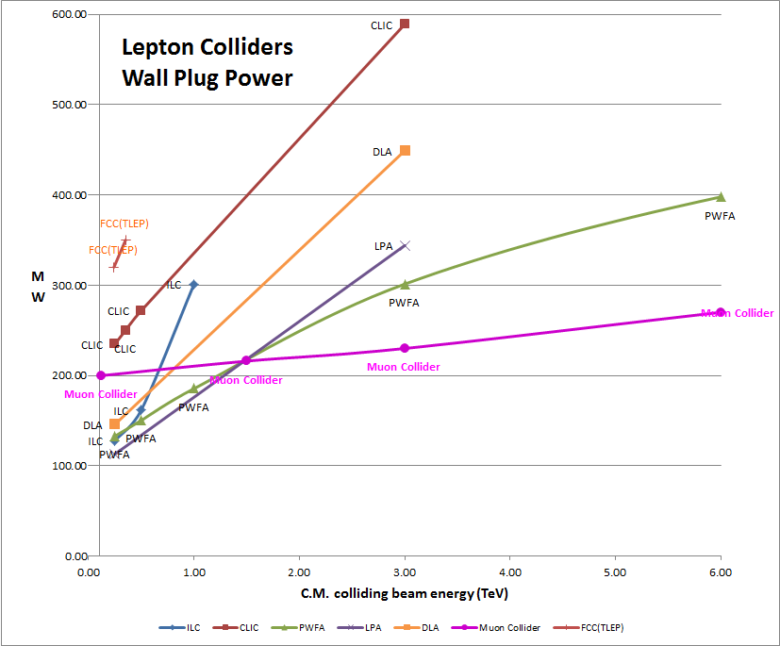
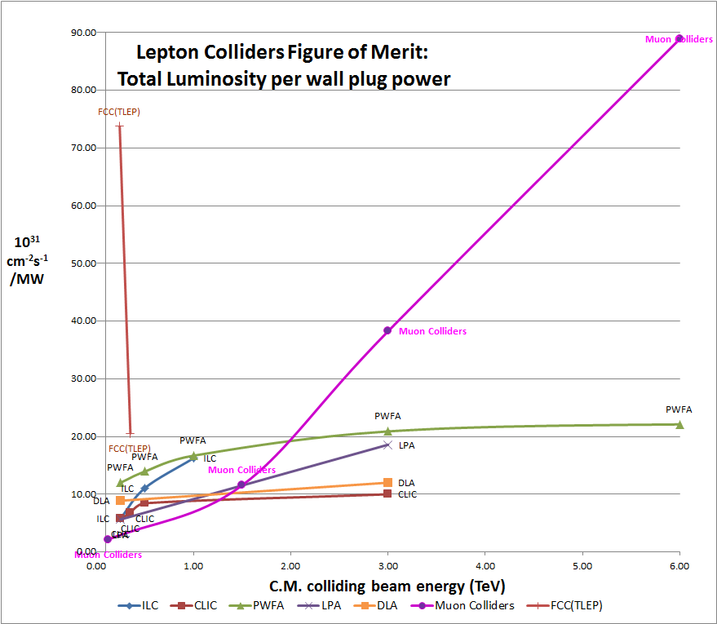
Muon Colliders extending leptons high energy frontier with potential of considerable power savings
Muons
Circular
Linear
Muons

Slide 12
Muon Source
Goals
Neutrino Factories: O(10²¹) μ/yr within the acceptance of a μ ring
Muon Collider: luminosities >10³⁴/cm⁻²s⁻¹ at TeV-scale (~N_{μ}²)
Options
  Conventional: Tertiary production through proton on target (and then cool), baseline for Fermilab design study
    Rate > 10¹³μ/sec N_{μ} = 2×10¹² /bunch
  e⁺e⁻ annihilation: positron beam on target (very low emittance and no cooling needed), baseline for our proposal here Rate ~ 10¹¹ μ/sec N_{μ}~ 5x10⁷ /bunch
  by Gammas: GeV-scale Compton γs
  Rate ~ 5×10¹⁰ μ/sec N_{μ} ~ 10⁶ (Pulsed Linac )
  Rate > 10¹³ μ/sec N_{μ} ~ few×10⁴ (High Current ERL)
  Unconventional:
not discussed here
[V. Yakimenko (SLAC)]
see also: W. Barletta and A. M. Sessler NIM A 350 (1994) 36-44

Slide 13
Proton-Based Source

Slide 14
Muon Accelerator Program (MAP)
Muon based facilities and synergies
Mark
Palmer
~10¹³-10¹⁴ μ / se
Tertiary prby MW p+
od.: pgπgFast μ: cosund
(1kHz0
Key Challenges
~10¹³-10¹⁴ μ / sec
Tertiary particle pgπgμ:
Fast cooling
(τ=2μs)
by 10⁶ (6D)
Fast acceleration
mitigating μ decay
Background
by μ decay
MW proton driver
MW class target
NCRF in magnetic field
Ionization cooling
High field solenoids (30T)
High Temp Superconductor
Cost eff. low RF SC Fast pulsed magnet
(1kHz)
Detector/machine
interface
Key R&D

Slide 15
Key Feasibility Issues
M. Palmer
Proton Driver
Target
Front End
Cooling
Acceleration
Collider Ring
Collider MDI
Collider Detector
High Power Target Station
Capture Solenoid
Energy Deposition
RF in Magnetic Fields
Magnet Needs (Nb₃Sn vs HTS)
Performance
Acceptance (NF)
>400 Hz AC Magnets (MC)
IR Magnet Strengths/Apertures
SC Magnet Heat Loads (μ decay)
Backgrounds (μ decay)

Slide 16
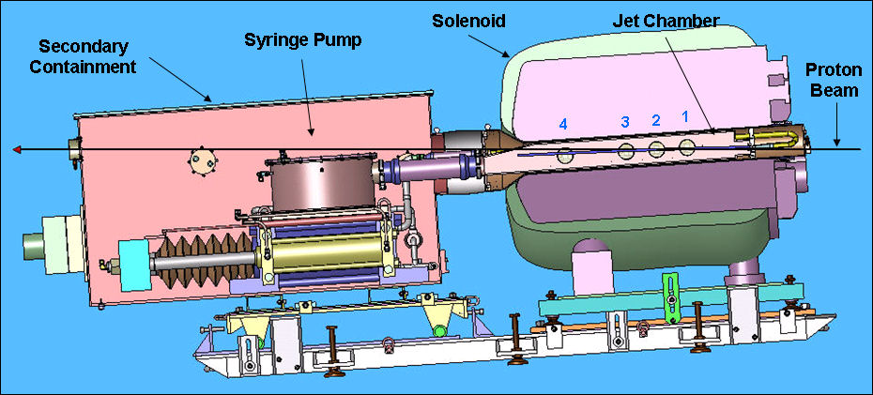

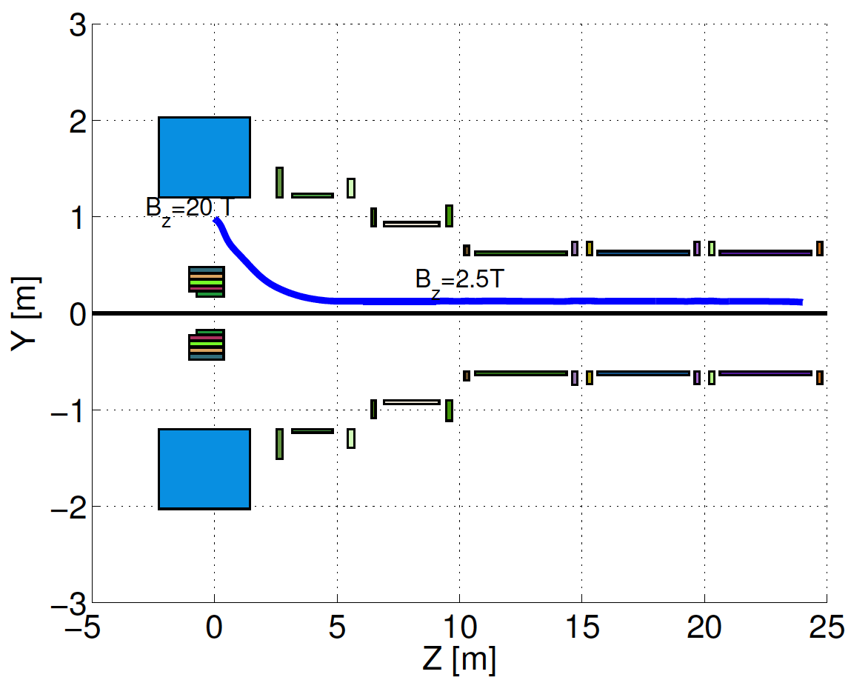
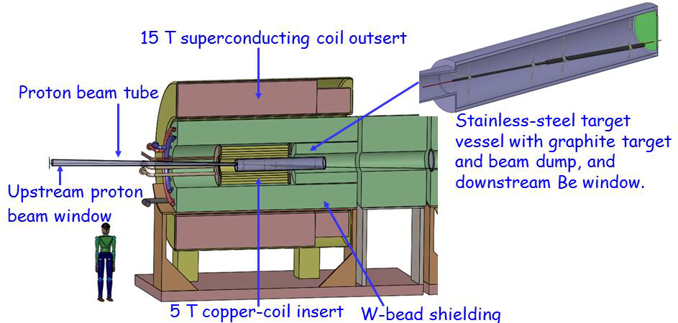
High Power Target
MERIT Expt:
  LHg Jet in 15T
  Capability: 8MW @70Hz
MAP Staging aims at 1-2 MW a C Target
Improved Compact Taper Design
  Performance & Cost
MERIT
@CERN
1 cm
Compact
Taper Design
C Target
Option

Slide 17
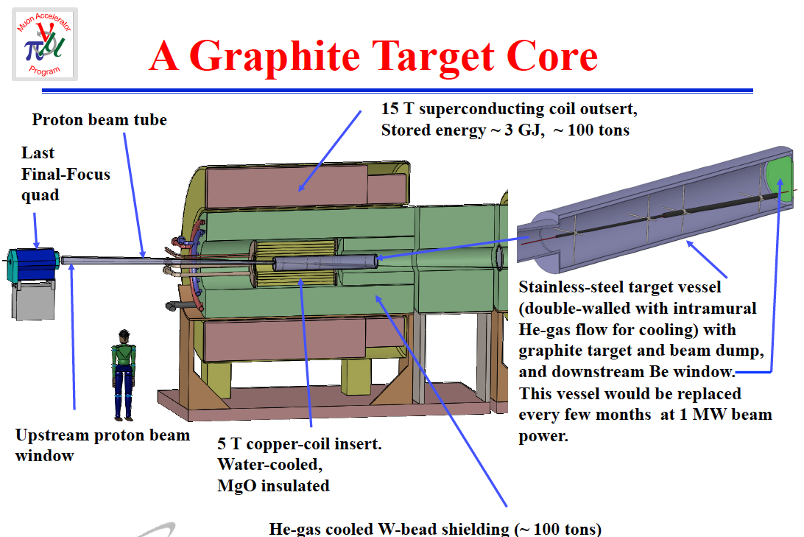
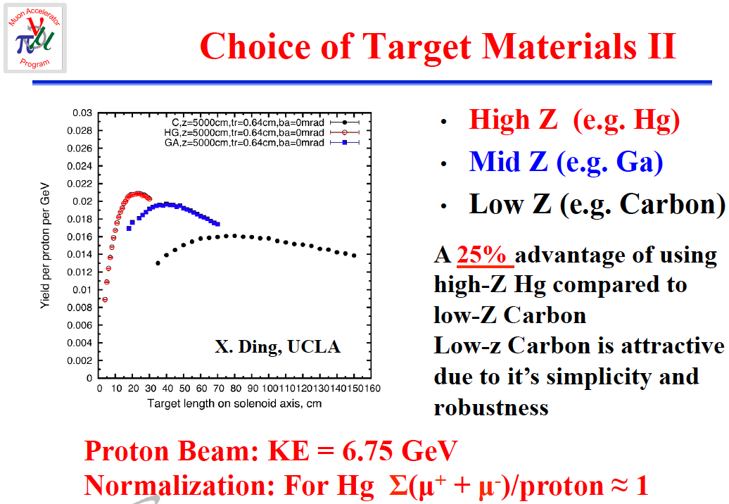
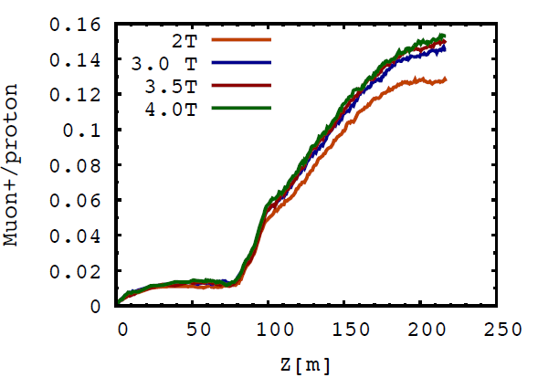
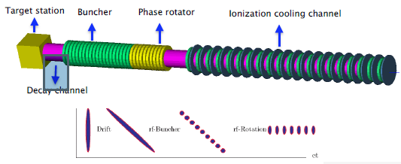
MAP muon generation by Proton driver
H.Kirk
(BNL)
MW-Class proton driver at ~5-10 GeV
Capture solenoid system (μ⁺ & μ⁻)
  15 T outsert, 5 T insert
  ~3GJ stored energy
Initial operation with 1MW carbon target
Upgrade to multi-MW with Liquid Metal Jet Technology (demonstrated in MERIT Experim.)
H.K.Sayed
(BNL)
Muon per proton production at Front End exit

Slide 18
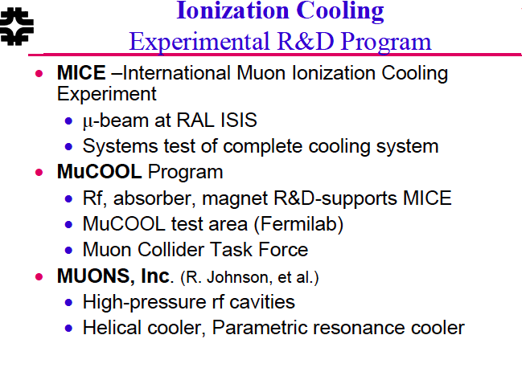
Ionization Cooling
No damping from SR ->Ionization ‘dE/dx’ cooling:
  Helical 6D Cooling
  PIC
  …
D. Neuffer

Slide 19
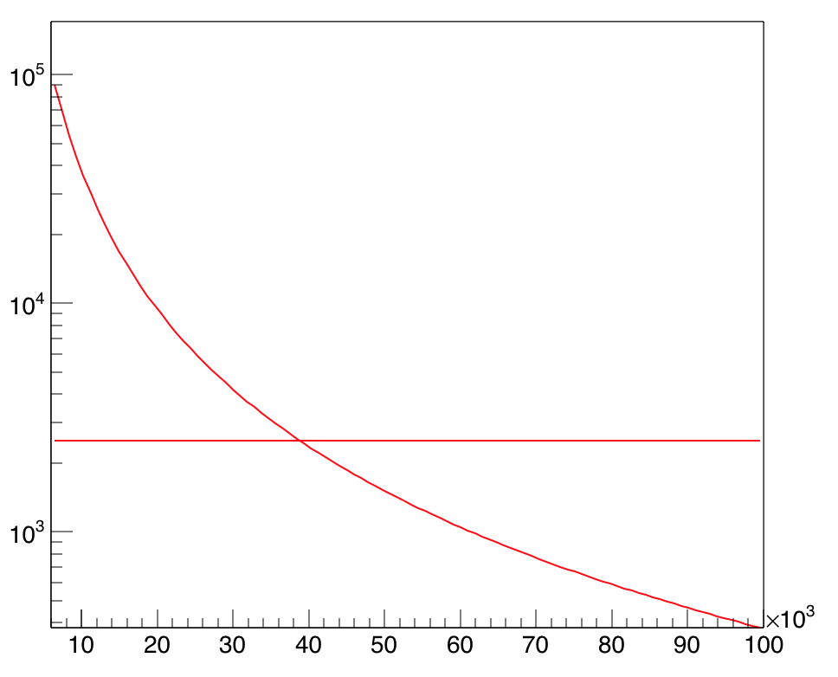
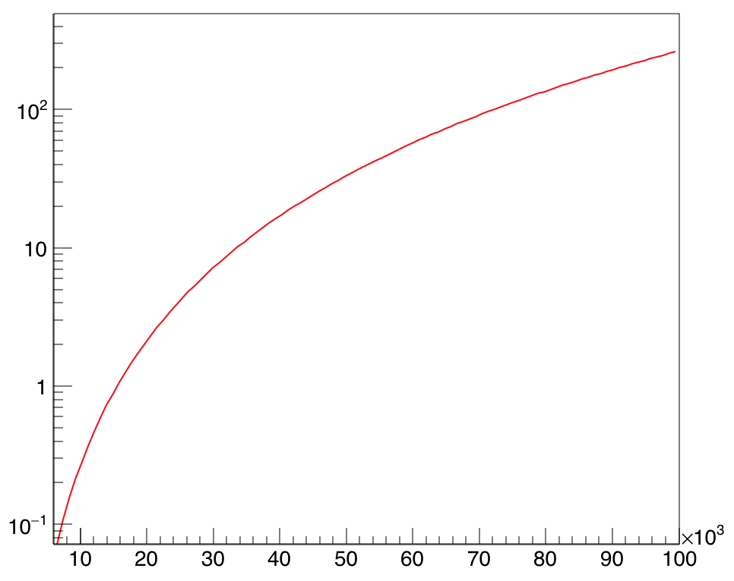
SR and damping in μ collider
Damping time (turns)
U0 (GeV)
B=16 T
B=16 T
Muon lifetime (turns)
Beam energy(TeV)
Beam energy(TeV)

Slide 20
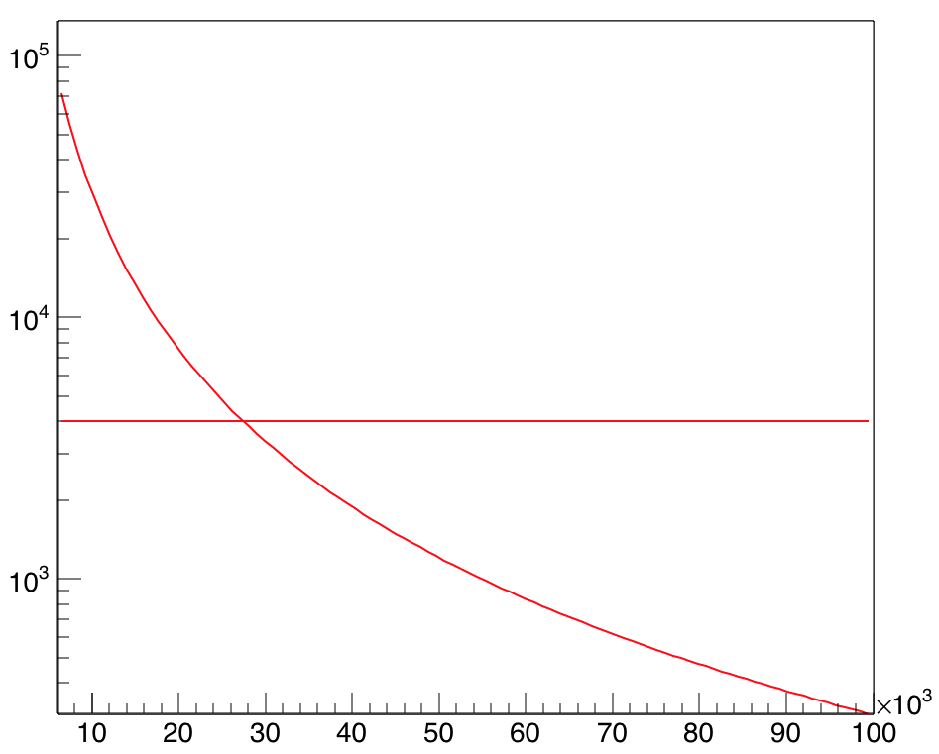
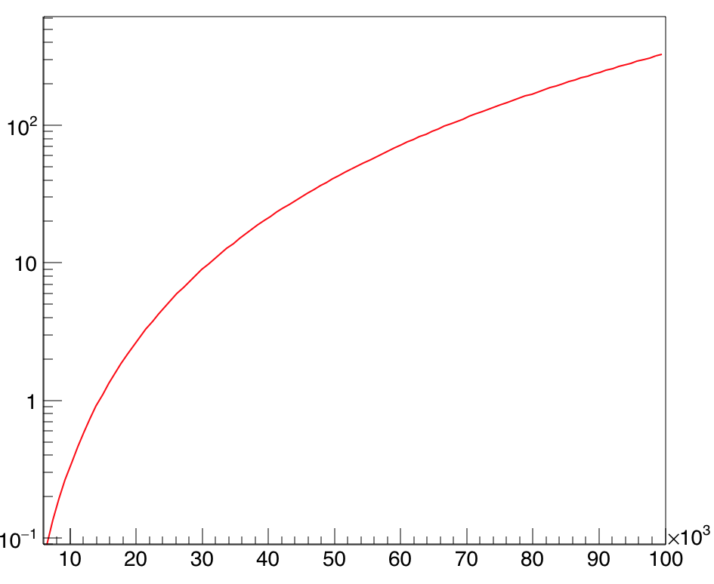
SR and damping in μ collider
Damping time (turns)
U0 (GeV)
B=20 T
B=20 T
Muon lifetime (turns)
Beam energy(GeV)
Beam energy(GeV)

Slide 21
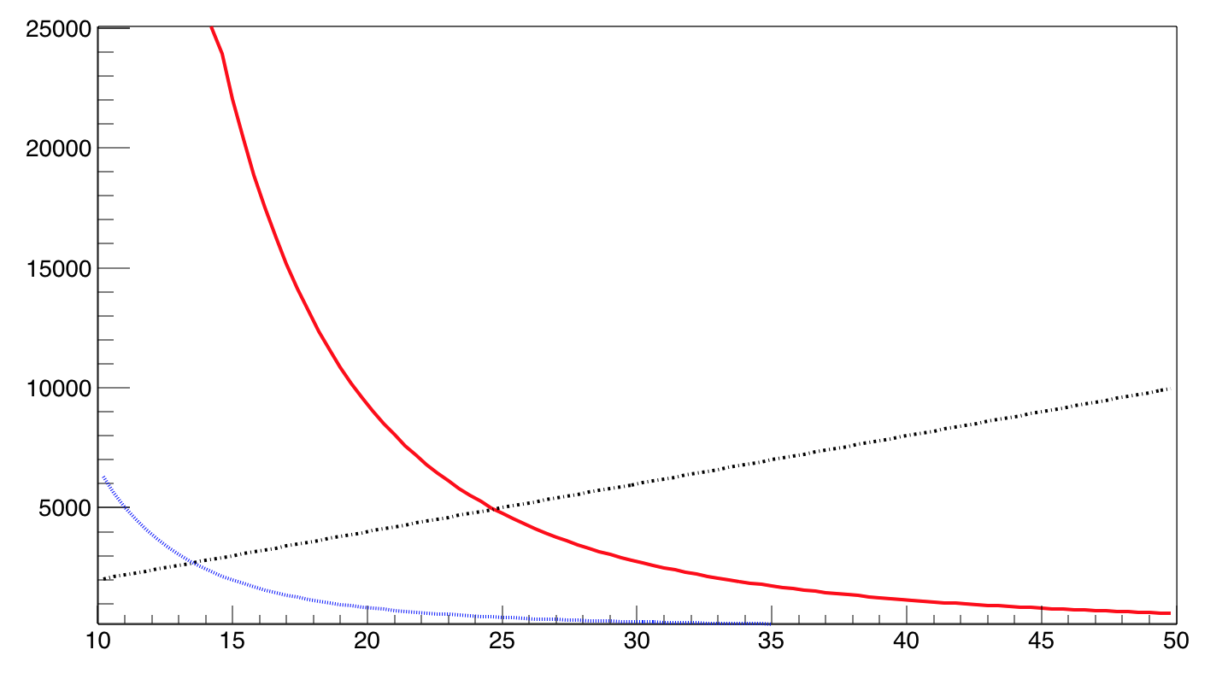
Damping time & muon lifetime
Uo = 5.5 x 10⁻¹⁸ γ⁴/ρ
turns
Damping time in LHC tunnel
Muon lifetime
Damping time in FCC tunnel
Dipole field (Tesla)

Slide 22
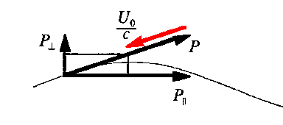
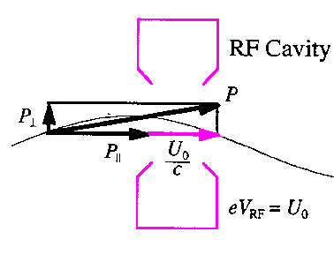
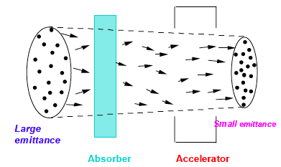
Ionization Cooling-general principle
This method, called “dE/dx cooling" closely resembles to the synchrotron compression of relativistic electrons - with the multiple energy losses in a thin, low Z absorber substituting the synchrotron radiated light.
Transverse Cooling:
Particle loses momentum in material
Particle gains only p|| in RF
On the other hand,
Multiple scattering in material increases rms emittance

Slide 23
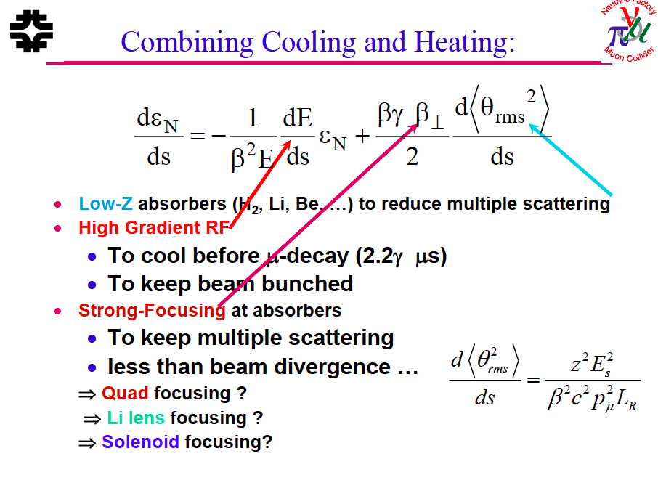
small beam size and large divergence
then damped by absorber + RF
D. Neuffer

Slide 24
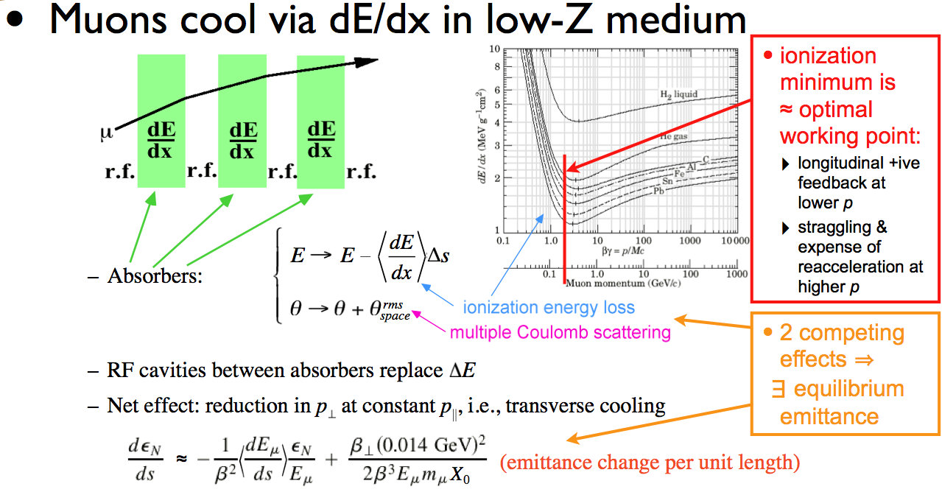
Cooling Methods
M. Palmer
The particular challenge of muon cooling is its short lifetime
  Cooling must take place very quickly
  More quickly than any of the cooling methods presently in use
  a Utilize energy loss in materials with RF re-acceleration
Muon Ionization Cooling
Kaplan

Slide 25
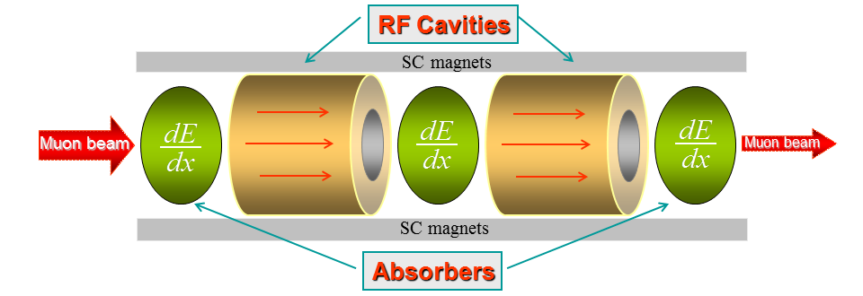
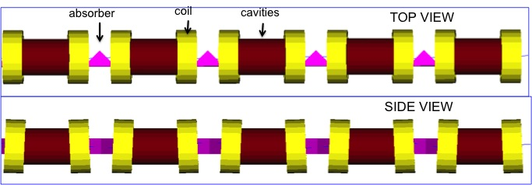
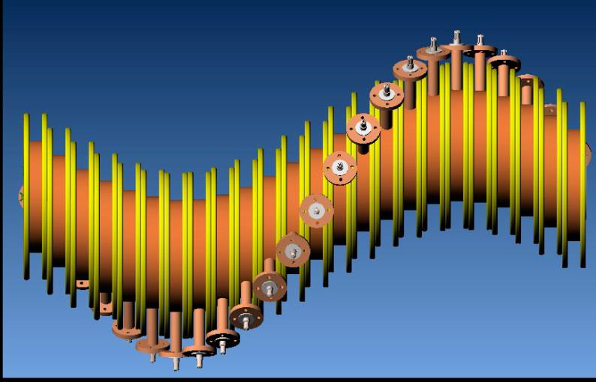
MAP Cooling scheme overview
P.Snopok
(IIT)
Ionization cooling
Vacuum Cooling Channel (VCC)
Helical Cooling Channel (HCC)
Two
methods
Major
challenges
Accelerating field limitation
by magnetic field (10 T)
High pressure (160atm)
Gas (GH2) filled RF cavities

Slide 26
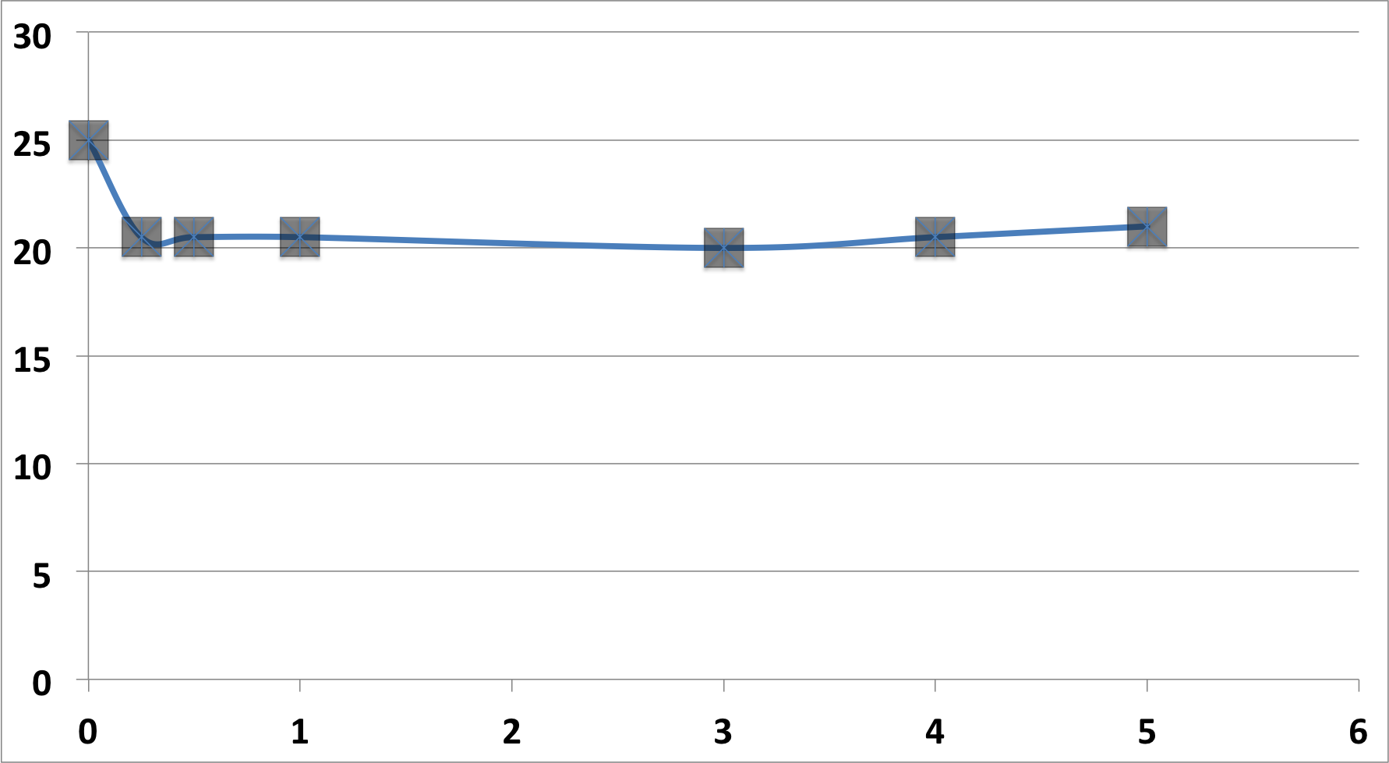
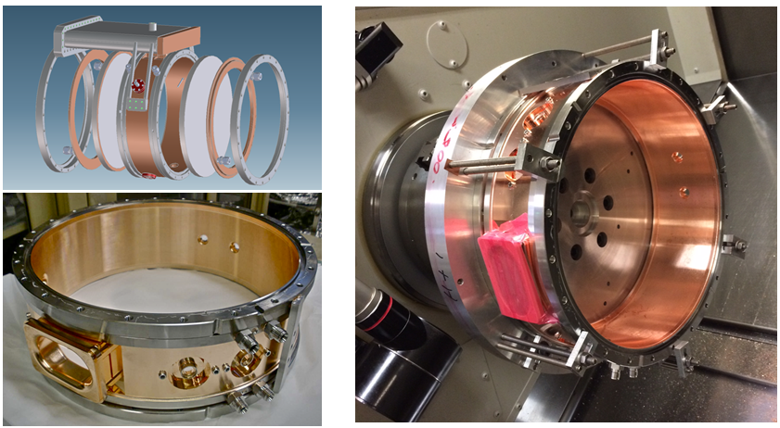
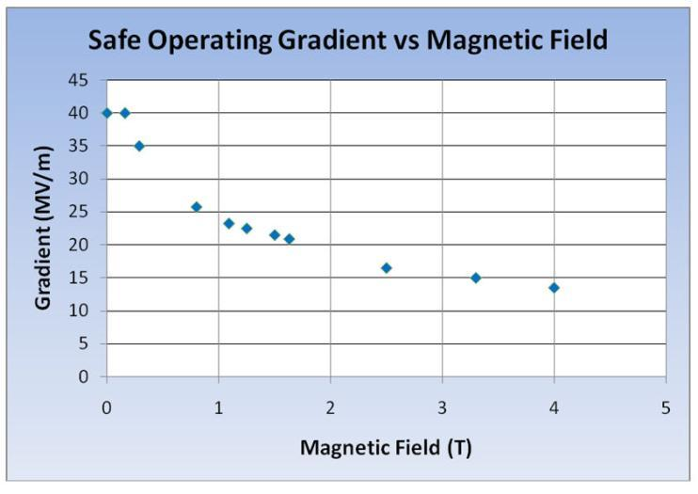
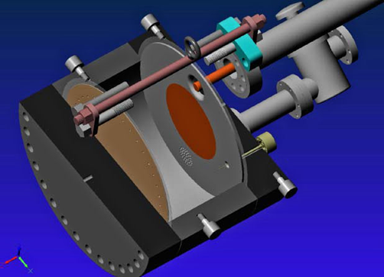
RF cavities in strong magnetic field
D.Li
(LBNL)
RF cavity in vacuum:
RF cavity filled with gas
Accelerating field (MV/m)
25 MV/m at 3 T
Magnetic field (T)
New cavity design
very encouraging !
New cavity by LBNL/SLAC
for tests in FNAL/MTA
Breakdown by field emission
1% Dry Air (0.2% O2) in GH₂
Pure GH₂
1% Dry Air
(0.2 % O2)
in GH₂ at
B = 3T
No accelerating field degradation up to 3 T
Operation with beam under heavy beam loading
~50X reduction in
RF power dissipation
E₀ = 25 MV/m

Slide 27
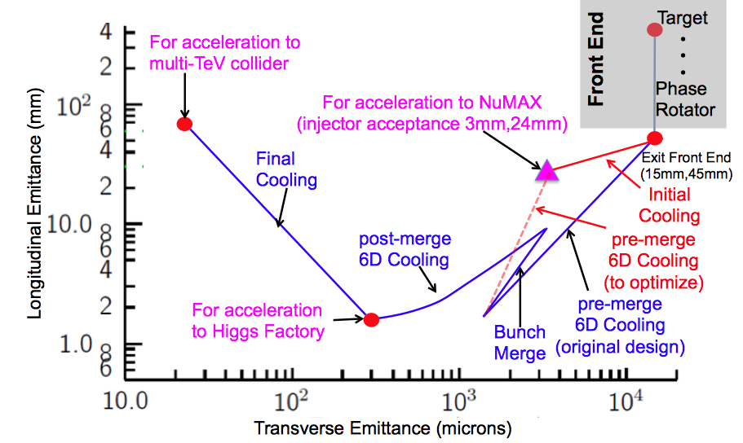
Muon Ionization Cooling
M. Palmer
Advanced techniques a
Improved HF Luminosity
Simplified Final Cooling requirements
MAP Higgs
Factory Target
PIC assumed in Carlo
Rubbia’s Proposal

Slide 28
3.-PIC, the Parametric Resonance Cooling of muons
C. Rubbia
Combining ionization cooling with parametric resonances is expected to lead to muon with much smaller transv. sizes.
A linear magnetic transport channel has been designed by Ya.S. Derbenev et al where a half integer resonance is induced such that the normal elliptical motion of particles in x-x' phase space becomes hyperbolic, with particles moving to smaller x and larger x' at the channel focal points.
Thin absorbers placed at the focal points of the channel then cool the angular divergence by the usual ionization cooling.
LEFT ordinary oscillations
RIGHT hyperbolic motion
induced by perturbations near an (one half integer) resonance of the betatron frequency.
x x’ = const
V. S. Morozov et al, AIP 1507, 843 (2012);

Slide 29
Details of PIC
C. Rubbia
Without damping, the beam dynamics is not stable because the beam envelope grows with every period. Energy absorbers at the focal points stabilizes the beam through the ionization cooling.
The longitudinal emittance is maintained constant tapering the absorbers and placing them at points of appropriate dispersion, vertical β and two horizontal β.
. Comparison of cooling factors (ratio of initial to final 6D emittance) with and without the PIC condition vs number of cells: more than 10x gain

Slide 30
Parametric Resonance Cooling
The first muon cooling ring should present no unexpected behaviour and good agreement between calculations and experiment is expected both transversely and longitudinally
The novel Parametric Resonance Cooling (PIC) involves instead the balance between a strong resonance growth and ionization cooling and it may involve significant and unexpected conditions which are hard to predict.
Therefore the experimental demonstration of the cooling must be concentrated on such a resonant behaviour.
On the other hand the success of the novel Parametric Resonance Cooling is a necessary premise for a viable luminosity of the initial proton parameters of the future CERN accelerators since the expected Higgs luminosity is proportional to the inverse of the transverse emittance, hence about one order of magnitude of increment is expected from PIC.
Carlo Rubbia – FNAL May 2015

Slide 31
Acceleration Requirements
M. Palmer
Key Issues:
  Muon lifetime a ultrafast acceleration chain
  NF with modest cooling a accelerator acceptance
  Total charge a cavity beam-loading (stored energy)
  TeV-scale acceleration focuses on hybrid Rapid Cycling Synchrotron a requires rapid cycling magnets
  B_{peak} ~ 2T f > 400Hz

Slide 32
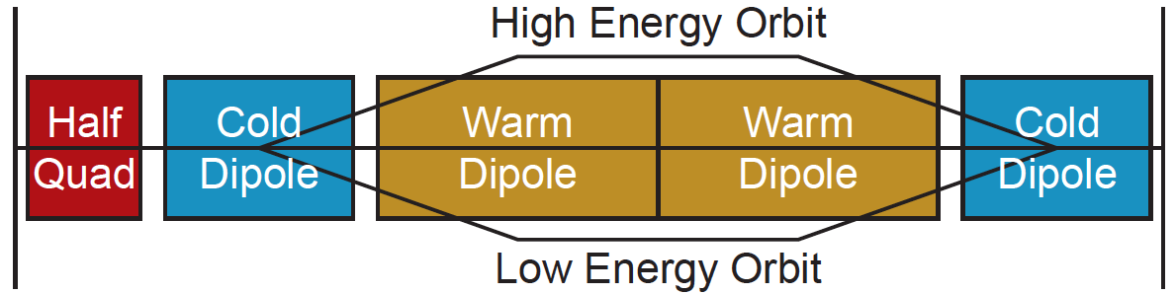
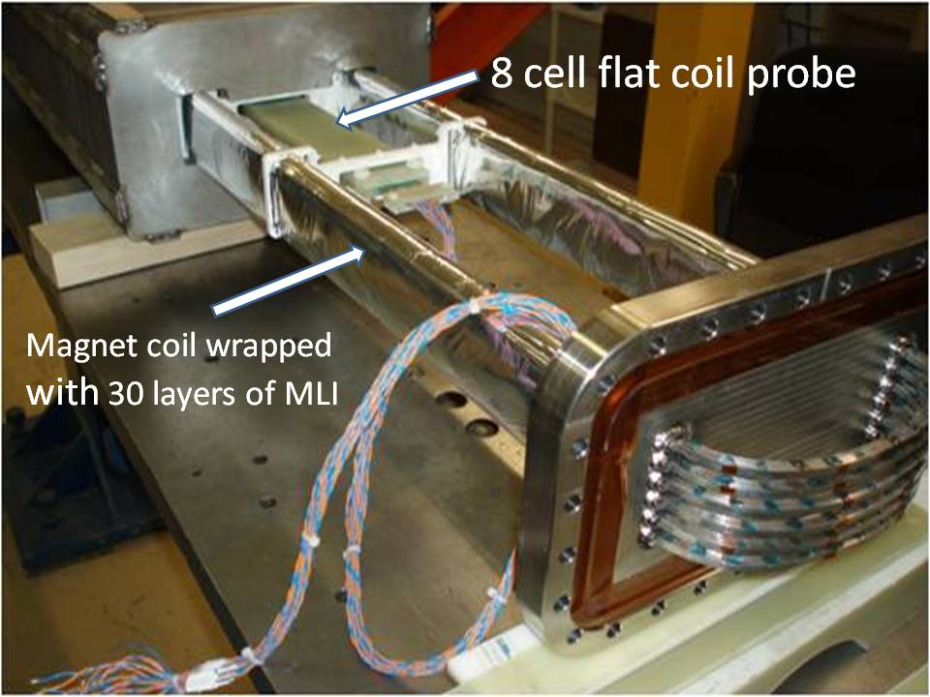
Acceleration
M. Palmer
Technologies include:
  Superconducting Linacs (NuMAX choice)
  Recirculating Linear Accelerators (RLAs)
  Fixed-Field Alternating-Gradient (FFAG) Rings
  (Hybrid) Rapid Cycling Synchrotrons (RCS) for TeV energies
Hybrid RCS
  RCS requires
  2 T p-p magnets
  at f > 400 Hz
  (U Miss & FNAL)
EMMA – FFAG
Design concepts in hand
Magnet R&D indicates parameters achievable

Slide 33
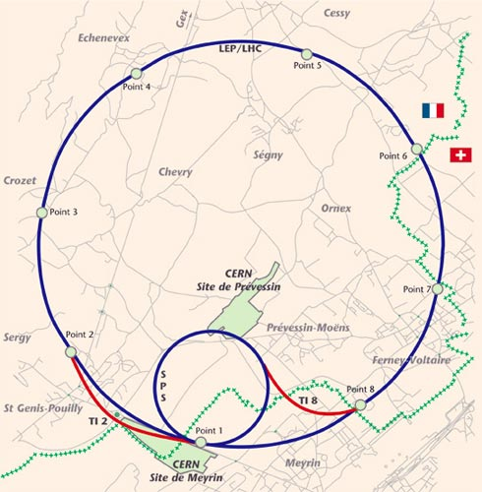
CMC
CERN
Muon
Collider
SRF
SRF
14 TeV cme
LHC tunnel
SPS tunnel and mb PS
~7GeV SRF
Cost ~LHC
SRF
SRF

Slide 34
Assume RCS Acceleration
B_{max} : DC
B_{min} : pulsed from –B_{min} to + B_{min}
Packing factor П<1
B
<B>C= 2π E_{beam} /0.3, e.g. 146 Tkm
for 7 TeV and 26.7 km

Slide 35
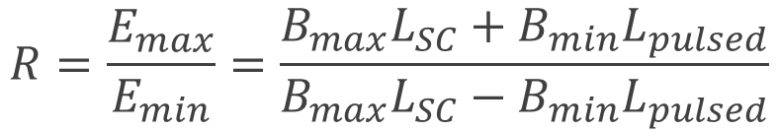
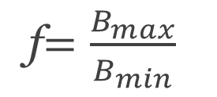
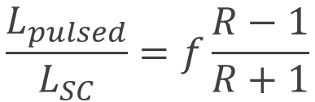
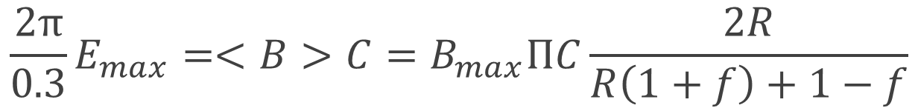
(Simple math)
Acceleration range:
$$R=\frac{E_{max}}{E_{min}}=\frac{B_{max}L_{SC}+B_{min}L_{pulsed}}{B_{max}L_{SC}−B_{min}L_{pulsed}}$$
f$=\frac{B_{max}}{B_{min}}$
$$\frac{L_{pulsed}}{L_{SC}}=f\frac{R−1}{R+1}$$
If the ratio of fields :
then :
and equation for the required fields reads :
$$\frac{2π}{0.3}E_{max}=<B>C=B_{max}ПC\frac{2R}{R\left(1+f\right)+1−f}$$

Slide 36
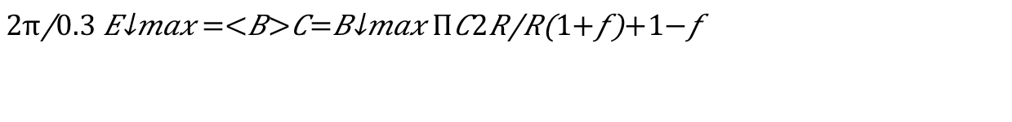




Example: 7 TeV, 26.7 km tunnel, 16T max
$$\frac{2π}{0.3}E_{max}=<B>C=B_{max}ПC\frac{2R}{R\left(1+f\right)+1−f}$$
146 T×km 26.7km 16T 0.85 0.4=1/2.5
4.2 | 16 | 3.8T | 0.45TeV
4.5 | 7 | 3.5T | 1TeV
5 | 4 | 3.2T | 4TeV
8 | 1.75 | 2.0T | 9.1TeV
then :
$$R=\frac{f−1}{f−4}$$
f$=\frac{B_{max}}{B_{min}}$
$$B_{min}$$
$$E_{inj}$$

Slide 37
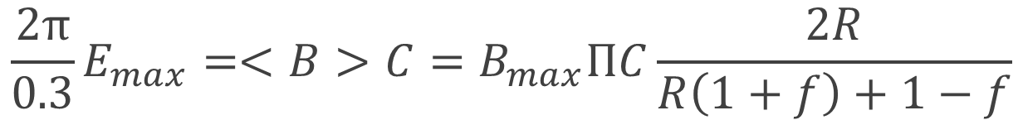




Example 2: 1 TeV, 6.9km tunnel, 16T max
$$\frac{2π}{0.3}E_{max}=<B>C=B_{max}ПC\frac{2R}{R\left(1+f\right)+1−f}$$
20.9 T×km 6.9km 16T 0.9 0.21=1/5
10 | 9 | 1.6T | 110 GeV
9.5 | 17 | 1.7T | 60 GeV
then :
$$R=\frac{f−1}{f−9}$$
f$=\frac{B_{max}}{B_{min}}$
$$B_{min}$$
$$E_{inj}$$

Slide 38
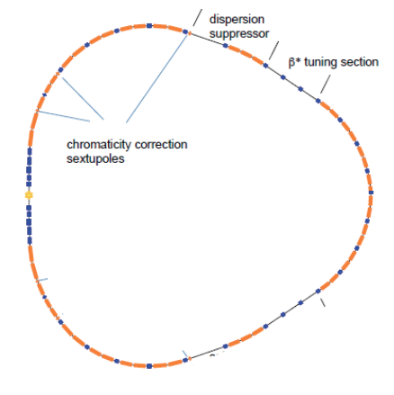
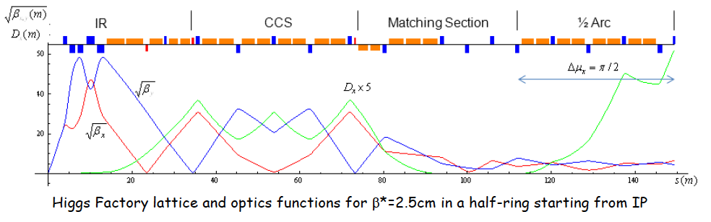
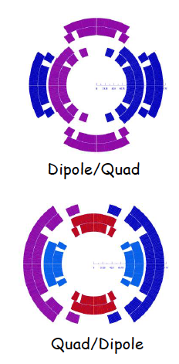


Collider Rings
Detailed optics studies for Higgs,
1.5 TeV, 3 TeV and now 6 TeV CoM
  With supporting magnet designs
  and background studies
Higgs Ring (single IR)
Higgs, 1.5 TeV CoM and 3 TeV CoM Designs
  With magnet concepts
  Achieve target parameters
Preliminary 6 TeV CoM design
  Key issue is IR design and impact on luminosity
  Utilizes lower power on target
Higgs
1.5 TeV
3 TeV
M. Palmer

Slide 39

M. Palmer
Muon Collider Parameters
Exquisite Energy Resolution
Allows Direct Measurement
of Higgs Width
Success of advanced cooling concepts
a several × 10³² [Rubbia proposal: 5×10³²]

Slide 40


Annual dose
Straight section
arc
muon rate: p on target option 3 10¹³ μ/s

Slide 41
Backup Slides

Slide 42
M. Palmer
Conclusion
NF a precision ν microscopes
Multi-TeV MC a potentially
only cost-effective route to
lepton collider capabilities with
E_{CM} > 5 TeV
Key technical hurdles have
been addressed:
  High power target demo (MERIT)
  Realizable cooling channel designs with acceptable performance
  Breakthroughs in cooling channel technology
  Significant progress in collider & detector design concepts
Muon accelerator capabilities offer unique potential for the future of high energy physics research

Slide 43
Future accelerators programs at CERN
C. Rubbia
A new LHC injector complex to increase the collider luminosity 10x with the High Luminosity LHC (HL-LHC)).
Two accelerators (the LP-SPL and a new 50 GeV synchrotron, PS2) would replace the three existing ones (Linac2, the PSB, and the PS), with the injection of the SPS at 50 GeV,

Slide 44
CERN-SPL parameters
C. Rubbia
Layout of superconducting SPL with intermediate extractions.
SPL design is very flexible and it can be adapted to the needs of many high-power proton beam applications.
50 Hz
4 MWatt
CERN 14-07
Venice,March.2015

Slide 45
A muon based Higgs factory at CERN
C. Rubbia
A muon cooled Higgs factory can be easily housed within CERN
The new 5 GeV Linac will provide at 50 c/s a multi MWatt H- beam with enough pions/muons to supply the muon factory.
The basic additional accelerator structure will be the following:
  Two additional small storage rings with R ≈ 50 m will strip H- to a tight p bunch and compress the LP-SPL beam to a few ns.
  Muons of both signs are focused in a axially symmetric B = 20 T field, reducing progressively pt with a horn and B = 2 T
  A buncher and a rotator compresses muons to ≈ 250 MeV/c
  Muon Cooling in 3D compresses emittances by a factor 106.
  Bunches of about 2x1012 m± are accelerated to 62.5 GeV
  Muons are colliding in a SC storage ring of R ≈ 60 m (about one half of the CERN-PS ,1/100 of LHC) where about 104 Higgs events/y are recorded for each of the experiments.
Venice,March.2015

Slide 46


Staged Neutrino Factory and Muon Colliders
main parameters
Neutrino Factory at intensity frontier
Muon Collider at the energy frontier
Cooling 6D no final Full 6D

Slide 47


Muon generation by
GeV-scale Compton γs
V.Yakimenko
(SLAC)
Brightness 10³ larger than with proton driver
10³ too low with pulsed linac
10² flux increase with high current ERL
Approaching intensities desired for NF (but train structure not favorable for collider luminosity,
N² issue)

