Slide 1
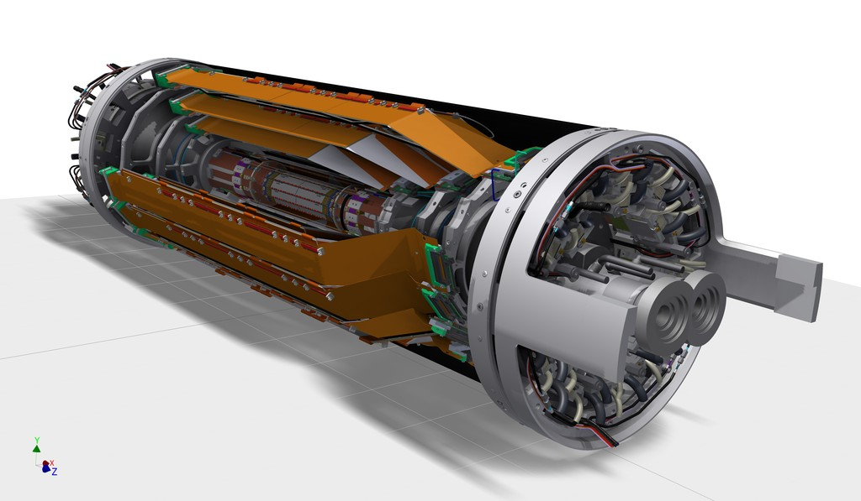
SVD Introduction & Ladder mount status
Carbon fiber (CF) cone
Outer CF shell
End flange
End rings
S. Bettarini
on behalf of the
Italian-SVD-Group
Ladders
Beam pipe
PXD (independent sub-detector inside SVD)
SVD session:
Belle II Italy Meeting – Nov. 21st Pisa

Slide 2
On Nov. 18th the phase-2 VXD/BEAST detector installed into Belle II

Slide 3
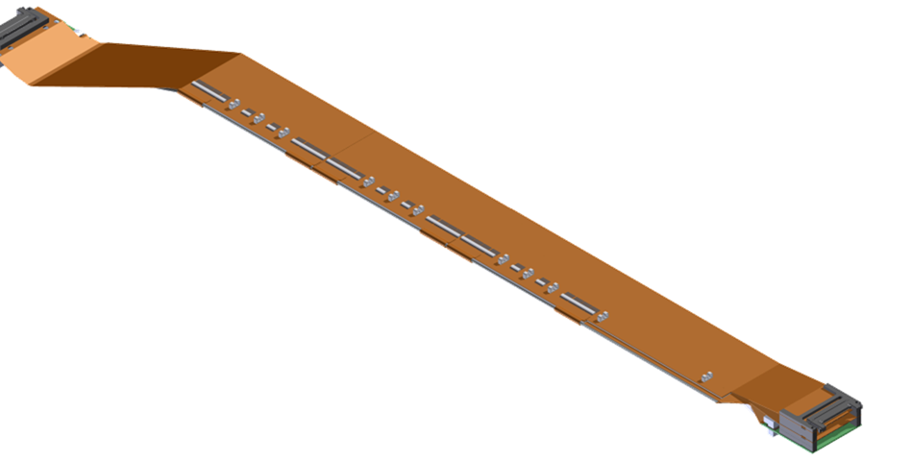
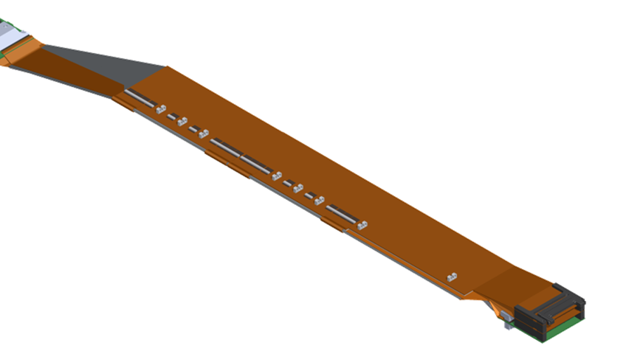
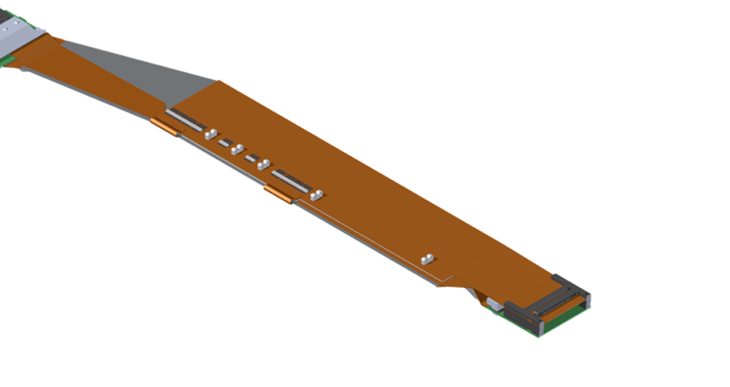
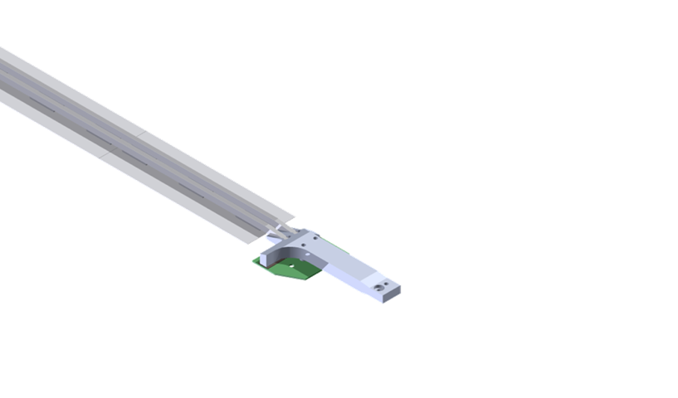
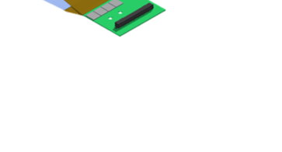
Ladder assembly
Layer | Ladders (spares) | DSSDs / ladder
6 | 16 (4) | 5
5 | 12 (3) | 4
4 | 10 (2) | 3
3 | 7 (2) | 2
L6 Ladder (Kavli IPMU)
FWD module
FWD
Origami +z
47 FW + 47 BW
L5 Ladder
(HEPHY)
Origami ce
BWD
Origami -z
L4 Ladder (TIFR)
BWD module
L3 Ladder (Melbourne)
Cooling pipe
FWD module
(Pisa)
Cooling pipe
BWD module (Pisa)
Cooling pipe

Slide 4
SVD ladder production status
Ladder assembly is in its final phase: 3 out of 5 sites have completed their production:
Pisa (FW/BW) Production completed – in total 60 class A FW and 55 BW subassemblies built
Melbourne ( L3 ) Production completed – 11 good ladders available out of 7+2 ladders needed
TIFR ( L4 ) 9 good ladders in hand, 3 more to build (expect to finish in Jan 2018)
HEPHY ( L5 ) Production completed – 15 good ladders in hand
Kavli-IPMU ( L6 ) 15 good ladders available, 5 more to go. Precisely on June 2017 B2GM schedule (end of production: second half of Feb 2018, consistent with the ladder mount schedule)
PF1 peel off problems have been addressed by “type 3” reinforcement and have not reappeared

Slide 5
Threefold PF1 peel off mitigation strategy implemented by L4/L6 in June 2017
Staged assembly: FW sensor is glued first, assembly continues after 1 week wait (to minimize loss of sensors if peel-off happens)
Glue brace reinforcement: to secure the weakest corner (sacrificing one alignment mark)
Mylar strip with flaps (type 3): to mechanically push PF1/PF2 onto the sensor

Slide 6
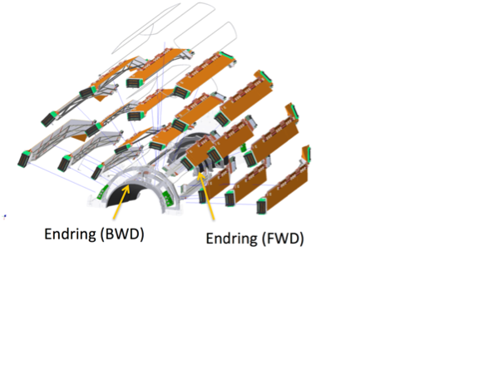
Ladder mount
Tools and procedures have undergone a series of technical reviews and were finally approved on Sep 5, 2017
LM has started; progress is behind the original schedule due to a number of issues on the L3
ladders; no issues are seen in the LM tools/procedures itself
+X (-X) half-shell is expected to be mounted by Jan (Apr) 2018

Slide 7
Ladder mount tools
Mount tool
Protection cover and 3D measurement system
Cooling pipe attachment tool
Dry volume and CO2 system

Slide 8
Ladder mount procedures
Helper/watcher
https://confluence.desy.de/display/BI/Process+Flow

Slide 9
End of October: L4 completed!

Slide 10
Brazing Issue

Slide 11
Outcome of today 8 am SVD meeting…
SEM Investigation On brazing samples @UNIPI

Slide 12
Readout electronics
FADC v4 has been produced and evaluated in the real Belle II environment at KEK; significant improvement in the noise performance is observed
Mass production has been started: half of the FADC system will be at KEK by end of Feb 2018; full system will arrive by mid Mar 2018
SVD Software
Online software is well on track for phase 2
Offline software is undergoing a refactoring to include important new features such as hit time determination; major effort is required to make it ready for phase 2

