Slide 1
Tracking with Multiple Mass Hypotheses
Stefano Spataro
ISTITUTO NAZIONALE
DI FISICA NUCLEARE
Sezione di Torino
Monday, 20th November 2017

Slide 2
Track Fitting?
The Kalman Filter:
extrapolation, filtering
and smoothing
X_{i+1}
K_{i+1}
Kalman filter
e_{i+1}
smoothing
e_{i}
track
follower
k_{i}
f_{i}
track
follower
Kalman filter
X_{i}
k_{i-1}
backtracking
prefit
Final result
Detector plane
vertex
(from A. Rotondi)
x
Measured point

Slide 3
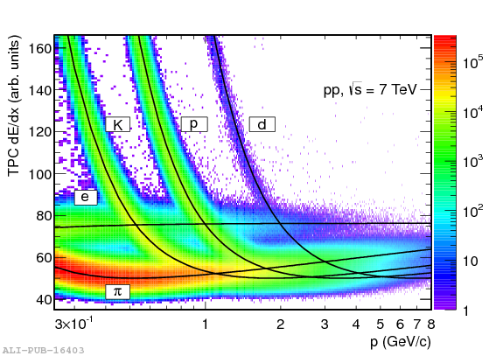
Energy Loss Importance
Different particles, different energy loss
At high momentum not large differences
At low momentum, wrong mass hypothesis can lead to wrong results

Slide 4
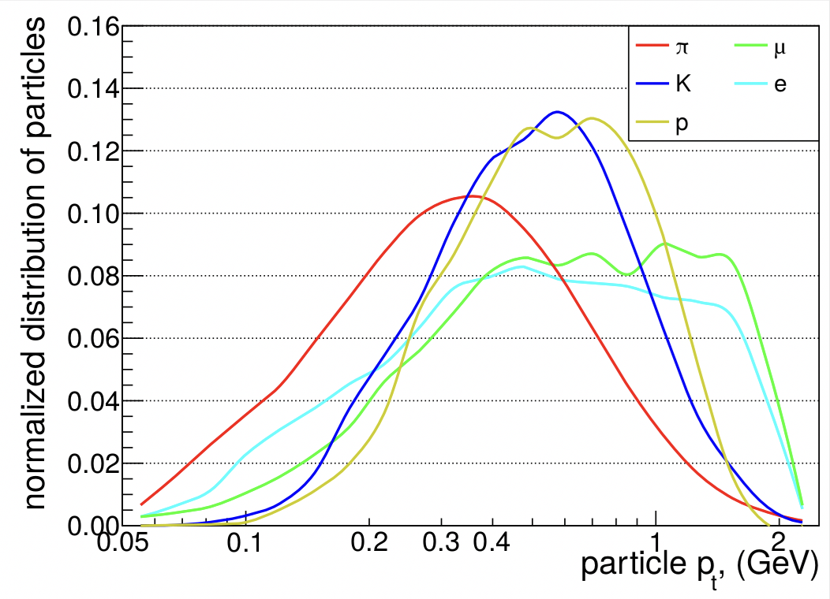
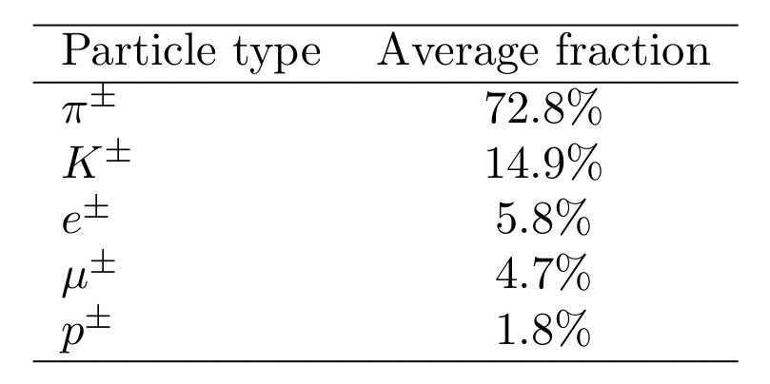
Our Momentum Range of Interest
Y(4S) bbbar generic sample
Large fraction of pions
Particles below 1 GeV/c (mostly)
from T. Hauth
WARNINGS
Low multiplicity samples reach larger momentum values
Energy loss depends on total momentum (and not on p_{t})

Slide 5
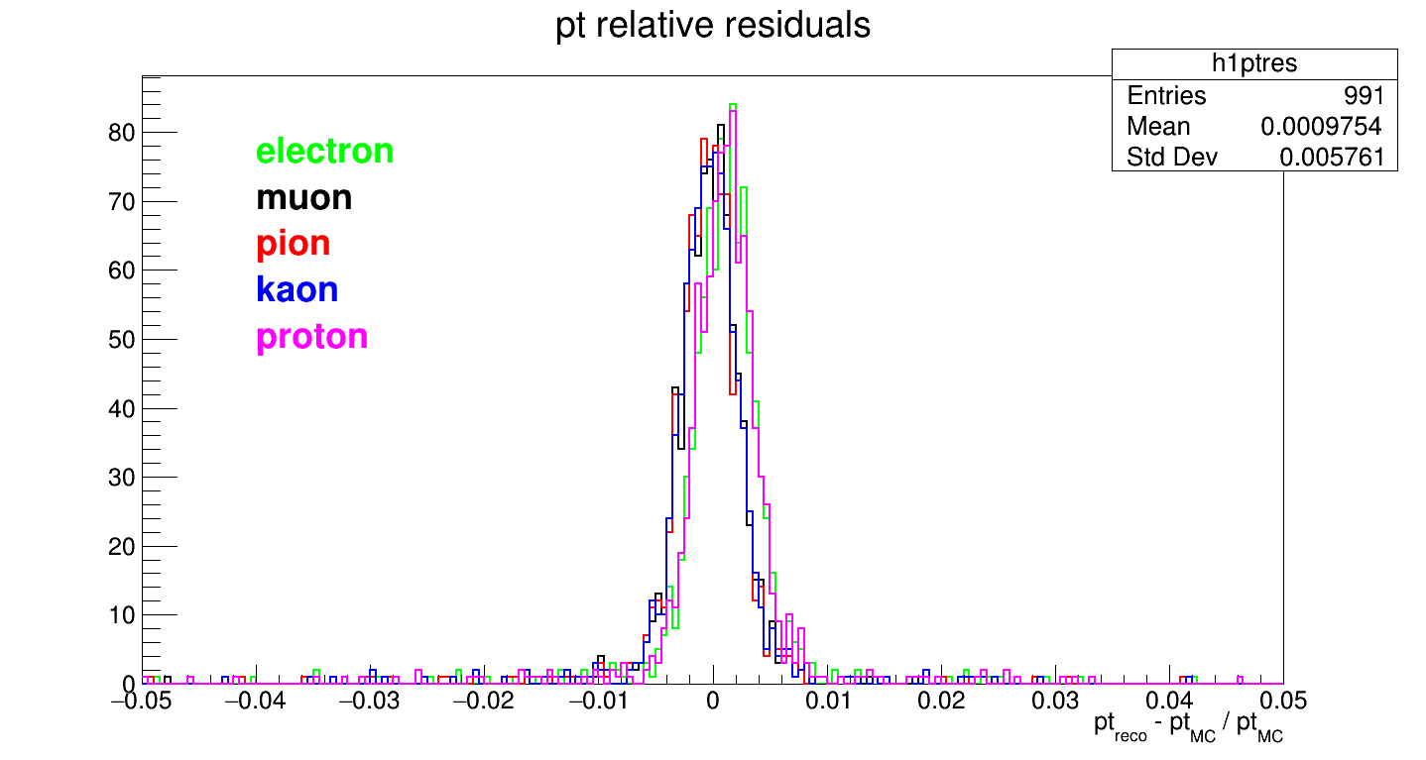
Kaons at p_{t} 1 GeV/c, 60°
Let’s fit the kaon tracks with different particle hypotheses
Everything more or less consistent, protons at bit higher momentum

Slide 6
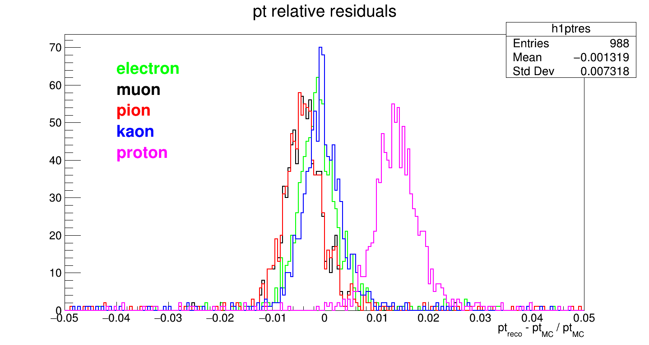
Kaons at p_{t} 0.5 GeV/c, 60°
Correct hypothesis good, pions at low momentum, protons at higher momentum

Slide 7
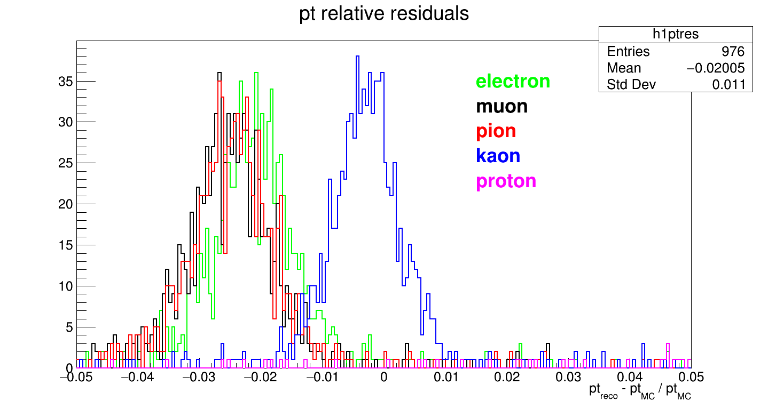
Kaons at p_{t} 0.3 GeV/c, 60°
The lower the momentum, the larger the discrepancy
when wrong particle is assumed in the fit

Slide 8
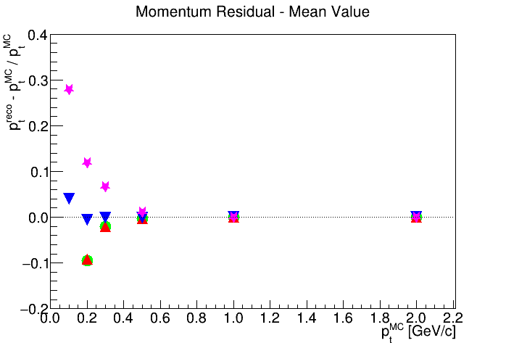
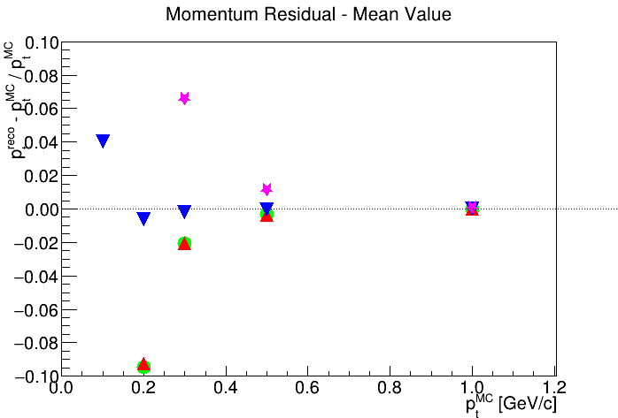
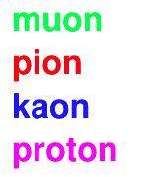
Mean Peak Position for kaon tracks
ZOOM

Slide 9
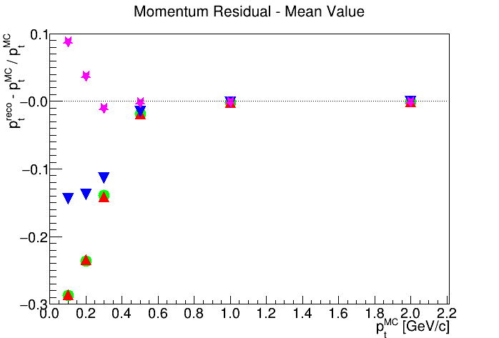
Mean Peak Position for proton tracks

Slide 10
Current Software Status
Before (pre)release-01-00-00(a)
In the releases: single particle hypothesis (𝜋)
In the head: 4 particle hypotheses (𝜇 𝜋 K p)
Starting from (pre)release-01-00-00(a)
In both release and head: 3 particle hypotheses (𝜋 K p)
Muon hypothesis?
Equivalent to pion, not needed
Electron hypothesis?
No good treatment for bremsstrahlung so far, better to use pion hypothesis
A possible cure: find the ECL bremsstrahlung cluster and merge the energy

Slide 11
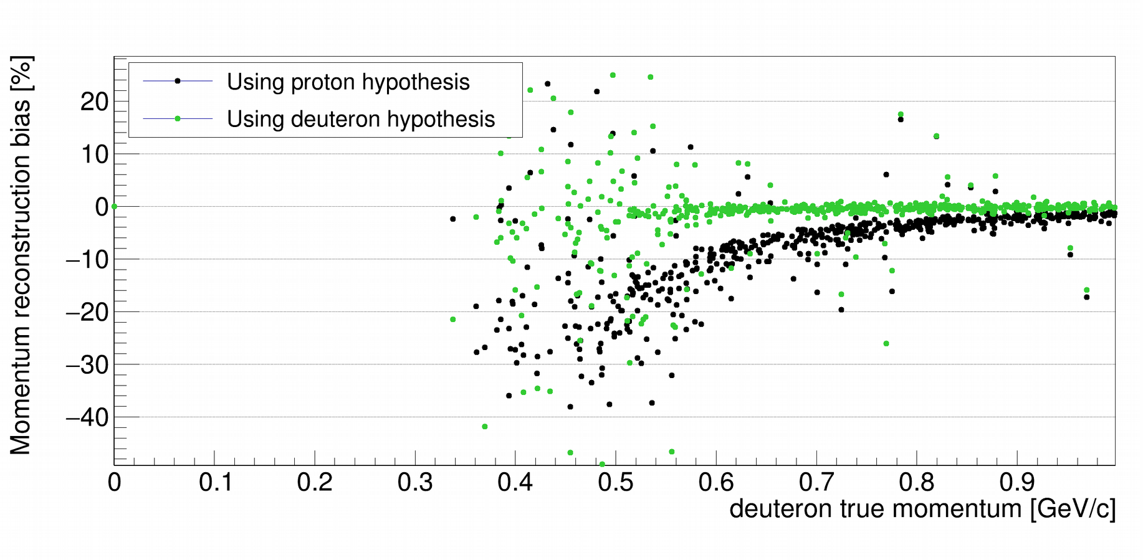
Deuterons?
Some analyses will need deuteron reconstruction
An additional particle hypothesis costs disk space and CPU time
At some time we will need also this hypothesis for dedicated studies
from U. Tamponi

Slide 12
Resource Estimation: Disk Space
 | Total branch size kB/evt |  |  | Size difference kB/evt |  | Ratio with 1 hyp
 | 1 hyp | 3 hyp | 4 hyp | 3-1 hyp | 4-3 hyp | 3/1 hyp | 4/1 hyp
mDST | 13.54 | 15.83 | 16.59 | 2.29 | 0.76 | 1.17 | 1.22
Track | 0.02 | 0.03 | 0.03 | 0.01 | 0.01 | 1.76 | 2.22
TrackFitResults | 1.42 | 3.69 | 4.44 | 2.27 | 0.75 | 2.59 | 3.12
MCParticles | 3.31 | 3.31 | 3.31 | 0.00 | 0.00 | 1.00 | 1.00
mDST increases of 17% with 3 fit hypotheses, up to 22% with 4 hypotheses
TrackFitResults increase does not scale exactly with number of fit hypothesis:
3 hypotheses -> size x 2.59
4 hypotheses -> size x 3.12

Slide 13
Resource Estimation: Computing Time
 | Total computing time s/evt |  |  | Time difference s/evt |  | Ratio with 1 hyp
 | 1 hyp | 3 hyp | 4 hyp | 3-1 hyp | 4-3 hyp | 3/1 hyp | 4/1 hyp
All | 6.40 | 6.83 | 7.00 | 0.43 | 0.17 | 1.07 | 1.09
SumSimulation | 4.61 | 4.61 | 4.61 | 0.00 | 0.00 | 1.00 | 1.00
SumTracking | 1.19 | 1.61 | 1.78 | 0.42 | 0.17 | 1.35 | 1.49
Track Fitting | 0.15 | 0.45 | 0.58 | 0.29 | 0.13 | 2.89 | 3.75
SumTracking - Track Fitting | 1.04 | 1.17 | 1.20 | 0.13 | 0.03 | 1.12 | 1.16
The global time time increases of 7% with 3 fit hypotheses,
up to 9% with 4 hypotheses

Slide 14
Open Issues

Slide 15
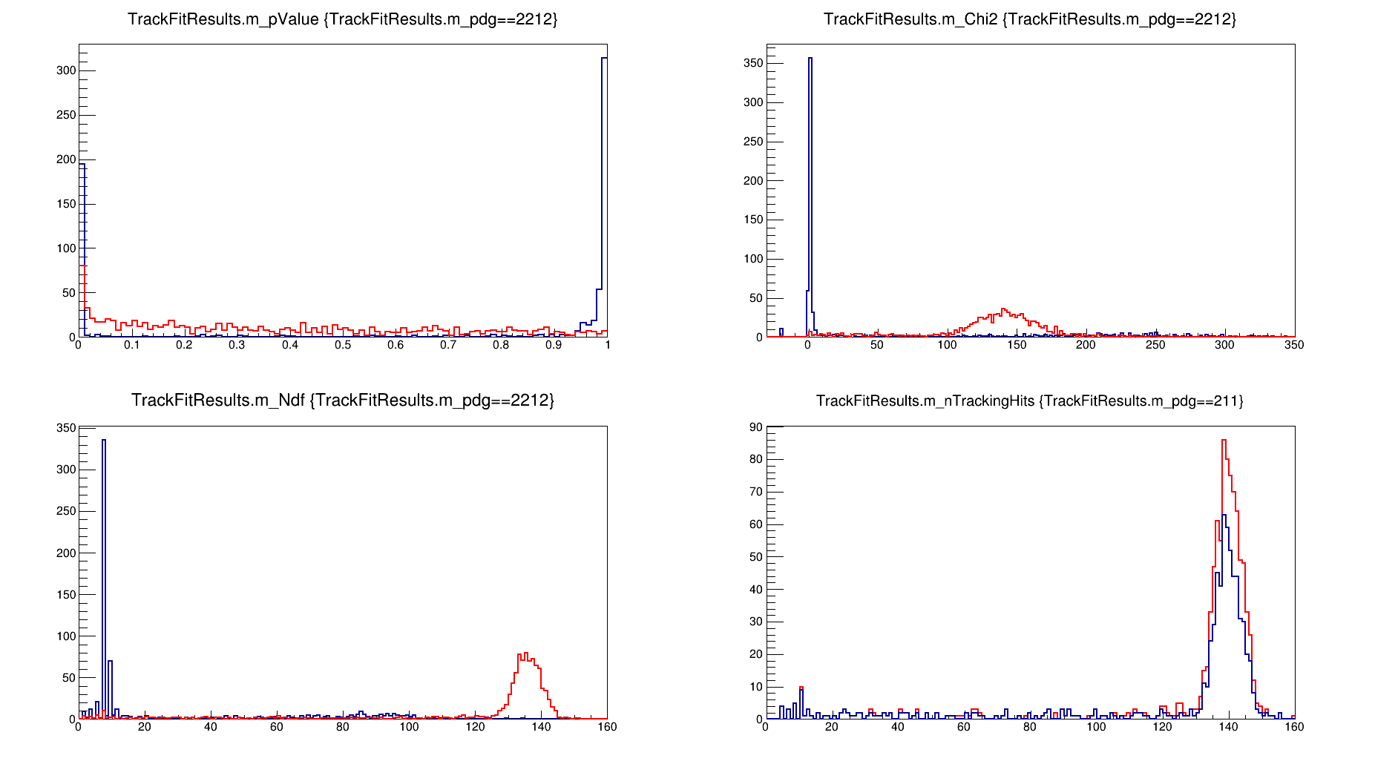
Wrong hypothesis fit
Pions at p_{t} 0.2 GeV/c, 60°- MC Track Finding
?
pValue
?
Chi2
Pion hypothesis
Proton hypothesis
Pion hypothesis
Proton hypothesis
Pion hypothesis
Proton hypothesis
nTrackingHits
NDF
?
Pion hypothesis
Proton hypothesis
protons are less since fit can fail

Slide 16
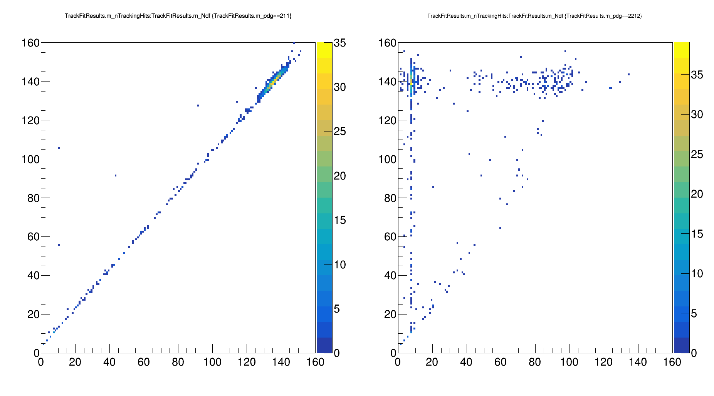
Wrong hypothesis fit
Pions at p_{t} 0.2 GeV/c, 60°- MC Track Finding
?
Pion hypothesis
nTrackingHits
nTrackingHits
Proton hypothesis
NDF
NDF
If the hypothesis “very wrong”, DAF removes almost all the hits
Efforts needed to remove bad fitted tracks

Slide 17
Trying to summarize
From (pre)release-01-00-00 three mass hypotheses for the track fitting.
This solves systematic deviations in the reconstructed momentum.
The increase in disk space and in computing time is inside the budget, still room to add additional particle hypotheses
Very bad fits (i.e. low pt with wrong particle hypothesis) sometimes return a very low number of degrees-of-freedom, due to DAF outlier removal. Possibility to check nTrackingHits/NDF to remove badly fitted tracks?
In the long term: tracking fit quality could provide additional help in particle identification, but first we need to understand better what is doing the fitter.

Slide 18
Spares

Slide 19
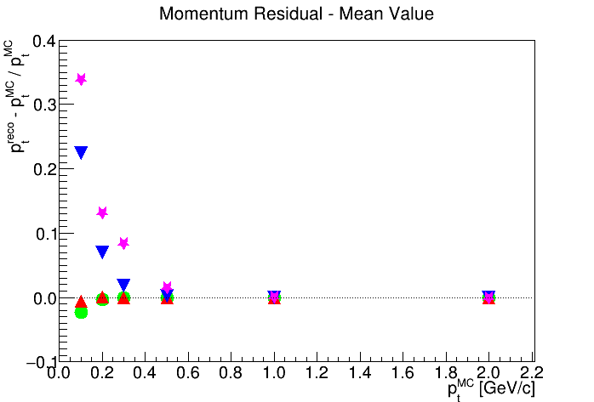
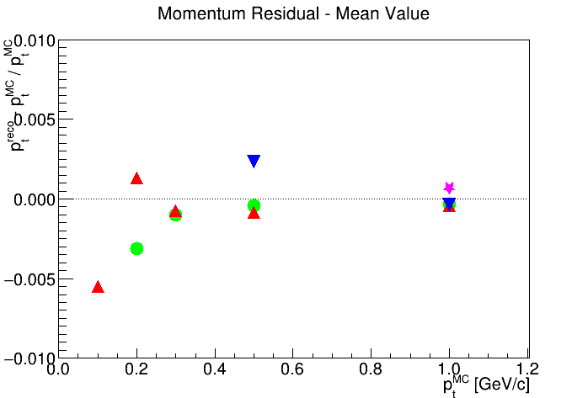
Pions: Mean Peak Position
ZOOM

Slide 20
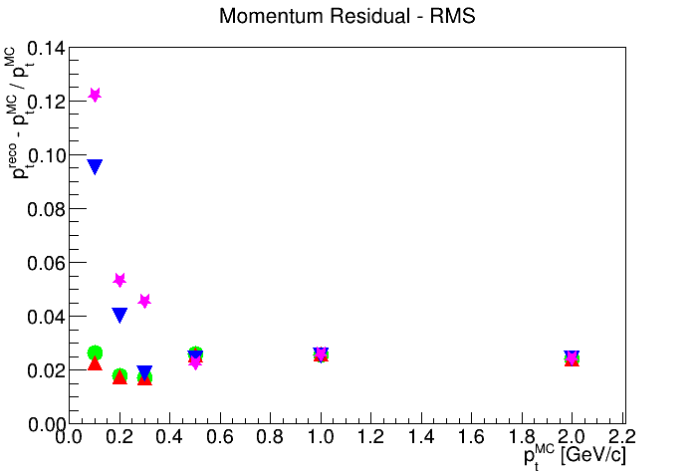
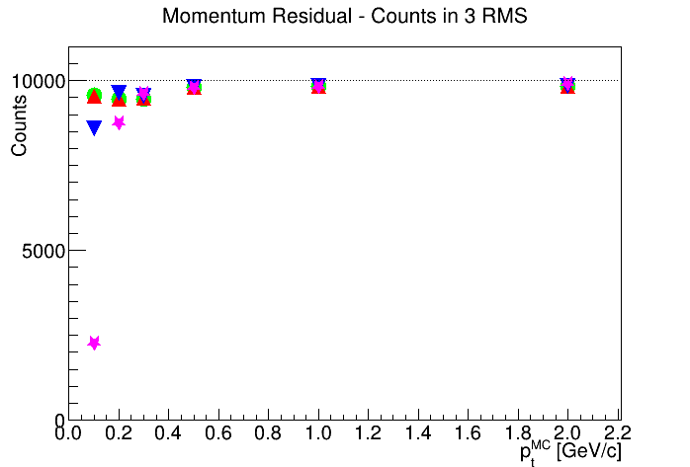
Pions RMS and counts inside 3 RMS
Since wrong-particle hypotheses have no Gaussian shape, no sigma of fit but RMS of residual histograms between -0.8 and 0.8.
This RMS depends on histogram edges. It is NOT the momentum resolution, but just a term of comparison.

Slide 21
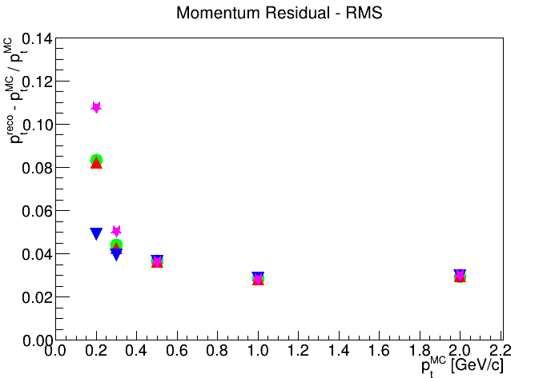
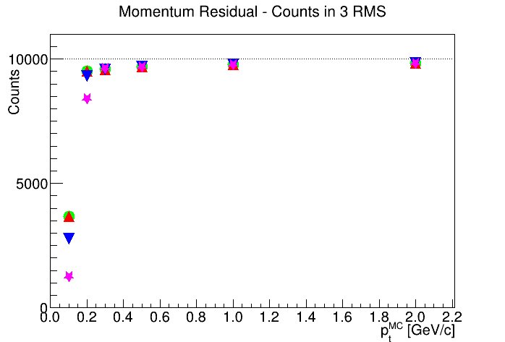
Kaons: RMS and counts inside 3 RMS
Kaon reconstruction with kaon hypothesis always the better
At 100 MeV/c... Goodbye kaons!

Slide 22
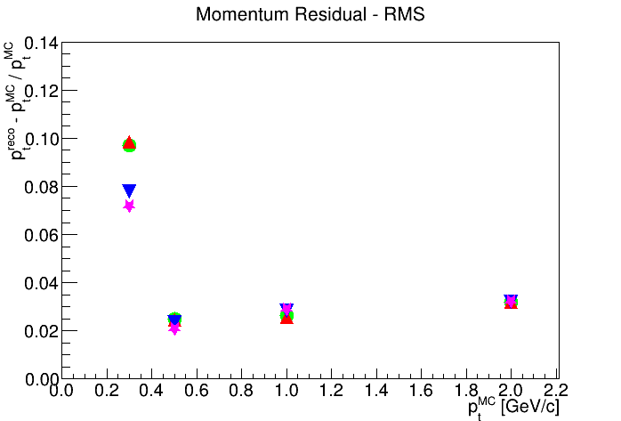
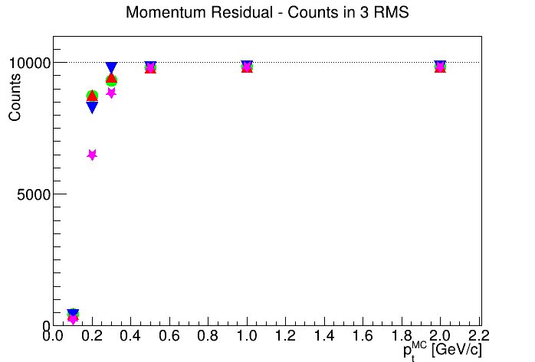
Protons: Mean, RMS, counts in 3 RMS

