Slide 1
The SABRE Crystals
Frank Calaprice

Slide 2
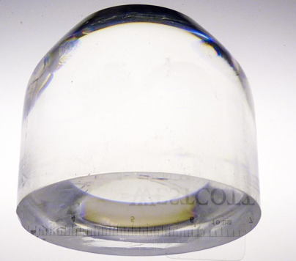
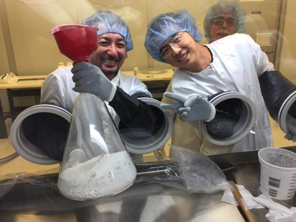
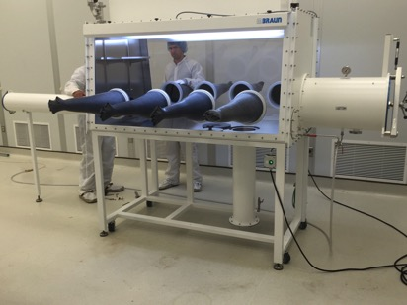
SABRE PoP NaI(Tl) Crystal
Producer: Princeton University & RMD Company (Boston)
Starting point: Astrograde powder by Sigma Aldrich with 9 ppb ^{nat}K.
In fall 2015 RMD grew a 2-kg crystal (3.5” diameter) with:
9 ppb ^{nat}K (same as starting powder)
< 0.1 ppb ⁸⁷Rb
Measured by ICP-MS: First crystal below DAMA ([K]~13 ppb, [Rb]<0.35 ppb)
Research since then focused on:
Growing full-scale 5-kg crystal (≈ 4” diameter)
improving procedures for crystal growing to reduce background
Powder drying, crucible purity, etc.
Refined procedure for crystal handling (polishing, crystal mounting and handling inside the enclosure in glove box)
Facilities at PU: new glove box installed inside Rn-free clean room
Growth setbacks: Impurities in crystal-grade powder- now understood (?)
RMD funded by DoE (1 M$) -> extra 50 kg of Astrograde powder 3 ppb in K
Test growth of full-scale crystal with Astrograde Powder (AP) August 2017
1st crystal with RMD AP and crucible: Oct 3 2017 (still cooling…)
2nd crystal with PU AP and crucible: Nov. 2017 (starting soon)
2kg test crystal
Glove box @ PU
Notes:
LY SABRE 14 pe/keV
LY DAMA 5.5-7.5 pe/keV

Slide 3
Princeton SABRE Crystal Group -July 2017

Slide 4
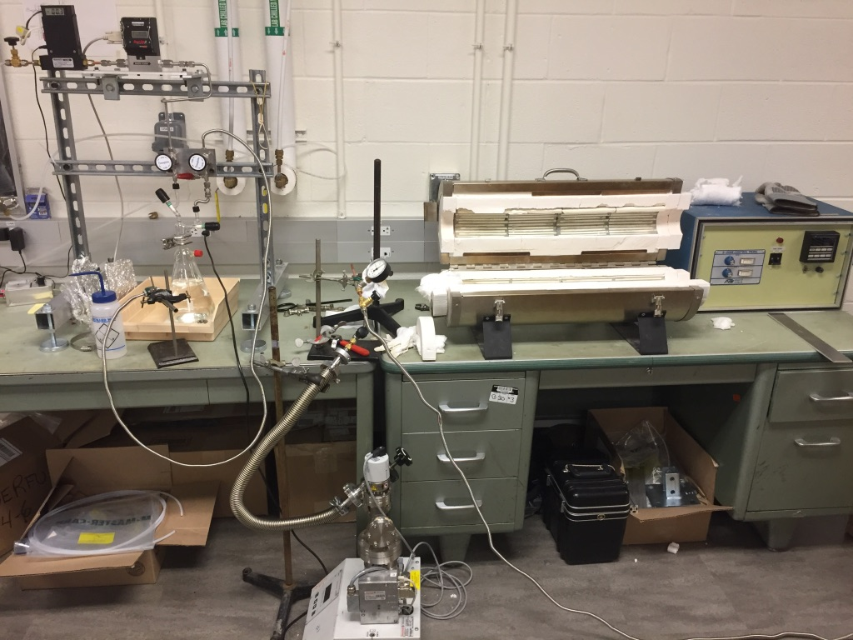
Small Oven System for Crystal Growing Tests.

Slide 5
Small 2-inch Crystal grown in Princeton

Slide 6
SABRE PoP Summary
Setbacks in crystal growth, delay of site preparation, and delay in purchase orders, all introduced several months of delay. We passed these problems and expect to good progress now.
Growth of 1st 5-kg crystal is expected to finish in early October. A second will come in November.
Fluid operations, blocked by laboratory management, can start under new agreement with Regional Authorities. With completed Safety Review, cleaning with fluids and scintillator operations should start soon.
Most of the major components are either in LNGS, or ordered for delivery in October or November. The orders include the external shielding, the crystal insertion system, and the crystal enclosure.
Provided there are no further delays, we expect to assemble the detector and begin commissioning by the end of 2017.

Slide 7
PoP Milestones Schedule
Milestones completion Date
Veto vessel dry commissioning (Hall B) July 31st, 2017
Hall C Site available (5 months after Hall C vacated) May 12th
Lower Lead shielding July 3rd
PRA approval by LNGS Sep 14th
CIS delivery to LNGS Sep 20th
Crystal enclosure delivery to LNGS Oct 15th
PE + SS +catch basin+ water tanks shielding delivery to LNGS Oct 15th
PE shielding installation in Hall C Oct 31th
Veto vessel cleaning + Lumirror + PMTs installation in Hall C Oct 31th
Electronics + DAQ installation in Hall C Oct 31th
Crystal insertion system installation inside the veto vessel Nov 10th
Fluid handling installation in Hall C Nov 30th
5 kg crystal growth @ RMD Oct 3nd
Crystal enclosure delivery to PU Oct 31th
Crystal-PMT installation in enclosure in glove box @ PU Nov 15th
Crystal shipment to LNGS Nov 30th
Crystal installation in the vessel Dec 10th
LS preparation (to be done in advance, BX activity) ???
Veto commissioning End 2017
PoP run 2018

