Slide 1
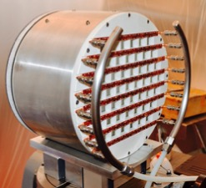
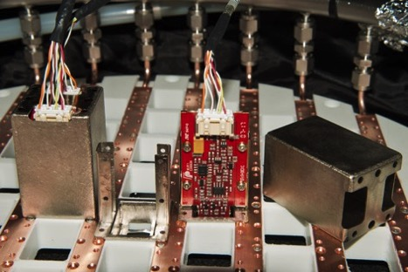

Mu2e status for CSN1 referees
S.Miscetti , LNF/INFN
For the Mu2e INFN group
Meeting with CSN1 referees
Sept 6th 2017, Rome

Slide 2
Agenda
Part-1
Today we will make an update of what already discussed in June.
So you will see few presentations on:
Status of the magnetic system
CRR of Crystals and SiPMs, EMC plans and status of BIDs (this talk)
Status of trigger simulation (S. DiFalco)
Status of mechanics (F.Happacher)
Status of cooling (F.Raffaelli)
Status of FEE (S.Miscetti)
Status of WD (F.Spinella)
Part-2
- We will go through the financial requests
- Discussion

Slide 3
Where are we as an experiment ?
In March meeting @ CSN1 (June referees’ meeting), we have reported that:
Superconducting cables have been procured
Civil construction is done, TS/DS/PS constructions started.
Accelerator is progressing well.
Pasquale will describe the status of TS production.
Difficulties in winding PS conductor has delayed the schedule for the PS and DS by 2 months.
This delays the Project by about 2 months.
  Have succeeded in winding PS conductor after modifications to the winding machine, but it requires a kluge that will not work for production. PS production requires further modifications.
This has been reported to the DOE review
In July 2017 IPR-2017

Slide 4
CD-3 Mu2e Schedule
Critical Path
CD-2/3b
CD-3c
CD-4
Fabricate and QA Superconductor
Project Complete
PS/DS Final Design
PS Fabrication and QA
PS Installation
PO issued for TS Module Fabrication
DS Fabrication and QA
DS Installation
22 months of float
Fabricate and QA TS Modules, Assemble TS
TS Installation
Detector Hall Construction
Solenoid Infrastructure
Cryo and Power hookup
Solenoid Commissioning
KPPs Satisfied
Detector Construction
Cosmic Ray System Test
Accelerator and Beamline Construction
Q3 | Q4 | Q1 | Q2 | Q3 | Q4 | Q1 | Q2 | Q3 | Q4 | Q1 | Q2 | Q3 | Q4 | Q1 | Q2 | Q3 | Q4 | Q1 | Q2 | Q3 | Q4 | Q1 | Q2 | Q3 | Q4 | Q1 | Q2 | Q3 | Q4 | Q1 | Q2 | Q3 | Q4
FY15 FY16 FY17 FY18 FY19 FY20 FY21 FY22

Slide 5
IPR-2017 MU2e Schedule
Critical and near critical path Gantt charts in docdb 11471
CD-4
CD-4 Milestone
PS Fabrication and QA
PS Installation
Fabricate and QA TS Modules, Assemble TS
TS Installation
DS Fabrication and QA
DS Installation
Solenoid Checkout and Commissioning
Accelerator and Beamline Construction
19 months of float
Tracker Construction and Installation
Calorimeter Construction and Installation
Cosmic Ray Veto Construction
May 2021
TDAQ
Cosmic Ray System Test
KPPs Satisfied
FY17 FY18 FY19 FY20 FY21 FY22

Slide 6
IPR-2017 recommendation for solenoids
1) Ensure that the GA schedule, delivery sequence, and testing methodologies for PS and DS are formalized and reflect a clear documented agreement between the parties. This agreement should be completed by the end of calendar year 2017.
2) Closely monitor cryo-system availability at General Atomics’ Poway, CA facility and ensure forecasted interference with U.S. ITER testing activities is factored into the Mu2e testing schedule. Associated risks should be captured in the risk registry.
Report status at the next OPA review.

Slide 7
Where are we in the calorimeter saga?
  CD3-c done (July 2016) + SOW prepared and signed (Oct 2016)
  1st TOC meeting done (Nov 2016)
  BID pre-production SiPMs and Crystals done (Aug 2016)
  QA completed (Feb 2017)
  Module-0 assembly done → TB May 17 (Done)
  MDR (Mechanical Design Review) .. March 2017
  CRR (Construction Readiness Review SiPMs,Crys) → June 19
  IPR-2017 (DOE review) → end of July
  Status of the Large BIDs (CsI+SiPMs)
  Mockup largest pieces done → still in progress
  CRR ALL → Feb-March 2018.

Slide 8
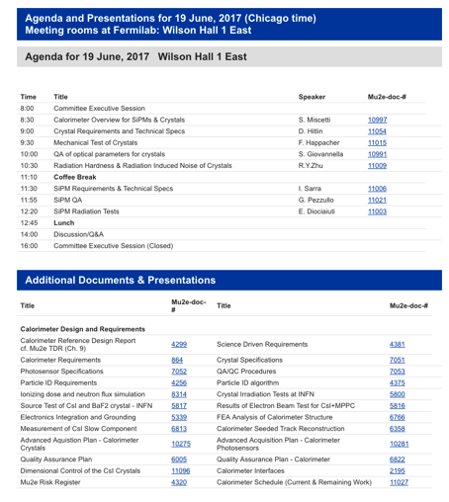
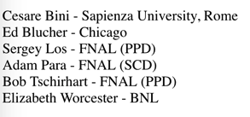
CRR of Calorimeter Crystals and sensors
Procurement of 1450 CsI
+ 3500 Mu2e SiPMs
AAP ready
Tender for CsI @ FNAL
Tender for SiPM @ INFN
It was ½ day review + few hours
discussion.
Charges: many yes, some not yet.
We have received 3 recommendations that must
be closed before procurements can proceed.

Slide 9
CRR of Calorimeter Crystals and sensors (1)

Slide 10
CRR of Calorimeter Crystals and sensors (2)

Slide 11
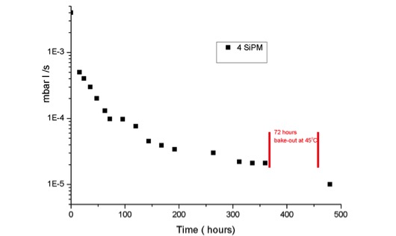
SiPM/FEE +Holder outgassing measurement (1)
4 SiPM holders tested (2 HPK SiPMs, 2 FEE chips, Faraday cages/holders)
Thermic glue used to join SIPMs to holders.
Measurement were taken for almost 3 week → Heating for 72 hours at 45 °C.
After 480 hours (20 days)
We have reached:
1 x 10⁻⁵ mbar x liters/sec
The final calorimeter system has about 1400 full-holders.
Total contribution SiPM/FEE contribution for outgassing is obtained as:
Qtot1 = 1 x 10⁻⁵ mbar x liters/s x 1/4 (4 full-holders) x 1400 = 3,5 x 10⁻³ mbar x liters/sec
Qtot = Qtot1 x 0.75 (Torr/mbar) = 2,6 x 10⁻³ Torr x liters/sec

Slide 12
SiPM/FEE +Holder outgassing measurement (2)
Component | Q (Torr*liters/sec)
Crystal-Tyvek | 2,4 x 10⁻³
Cables | 1,9 x 10⁻³
Diffusive Spheres | 1,2 x 10⁻⁴
Full Holder | 2,6 x 10⁻³
Total | 7 x 10⁻³
Requirement:
Q < 8x10⁻³ Torr*liters/sec
These preliminary measurements show that we are still satisfying the experimental requirements with a factor of 10 safety w.r.t tracker.
Some components have still to be tested (fibers, boards, ..) but some minimization can be still carried out
→ G10 and Laser fibers are next in line for measurement

Slide 13
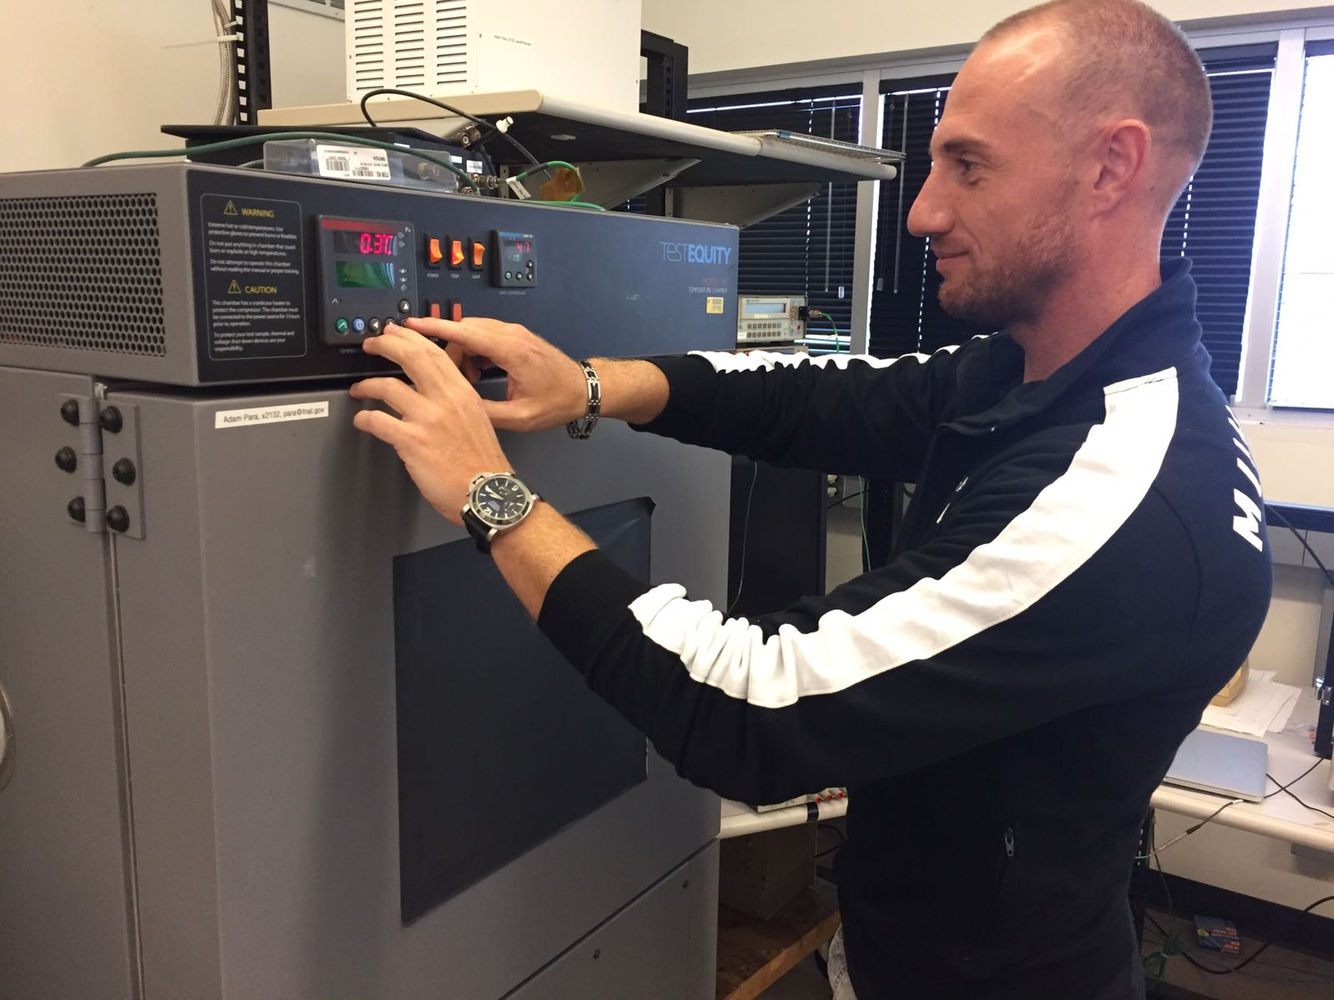
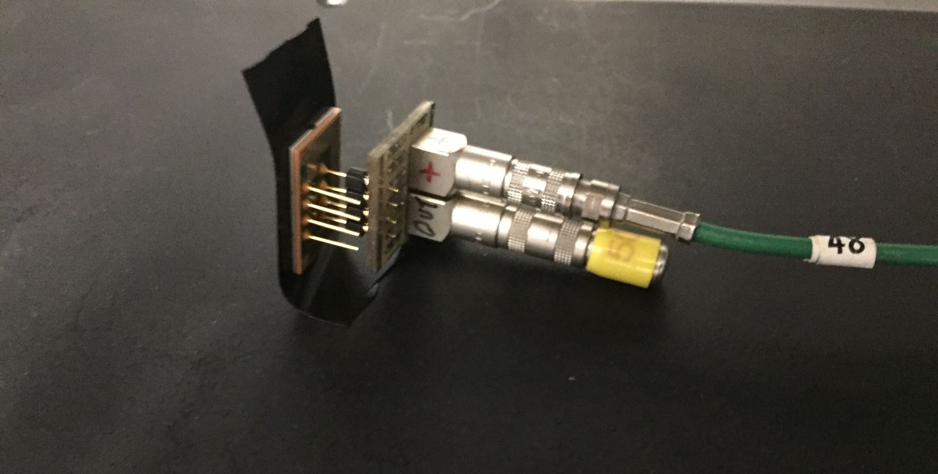
SiPM Thermal Test
We have stressed the MPPC with thermal cycles between 20 and -10 ○C
We used a Temperature Chamber in SiDet LabB borrowed for 1 week.
30 min per Thermal Cycle;
Not relevant variation observed
in the leakage current after 15 cycles.
It will be part of our QA

Slide 14
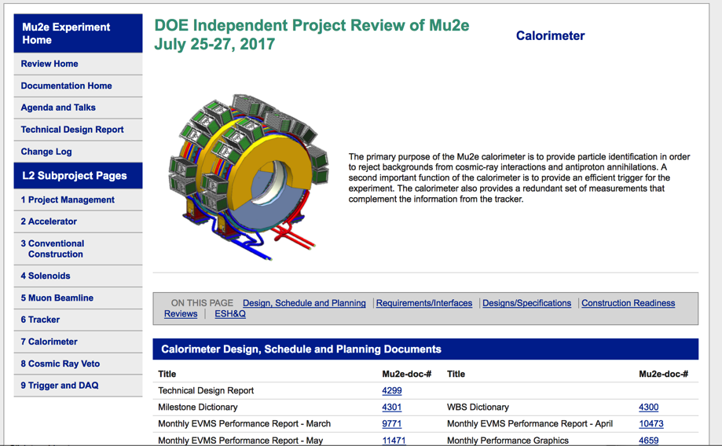
IPR-2017

Slide 15
IPR-2017 recommendations for detectors
1) Update the tracker construction, assembly, and installation schedule with information for steps and procedures already developed, and also with new information. Add additional milestones. Complete the schedule updates comfortably prior to the tracker assemblies Construction Readiness Review (CRR), currently planned for December 2017.
2) Add the risk for CsI delivery delay to the Risk registry, at the next Risk Management Board Meeting. There is a prior history of delays in large crystal procurements. The Committee noted that there are already some mitigations in place, with two CsI vendors.
3) Associate the risk of higher than estimated muon/neutron/gamma backgrounds with the CRV at the next Risk Management Board Meeting. There is a significant risk for substantially increased CRV-induced deadtime, among other impacts, if these estimates are even modestly higher than currently estimated.

Slide 16
Status of Large Bids:
On June I reported Critical items (1) : delays on BIDs → FIXED
(1) Bid for crystals @ FNAL → Choice done in August
2 best vendors selected to minimize schedule risks
725 crystals from St.Gobain + 725 crystals from SICCAS
INFN contribution is of 150 crystals (222 kEuro)
Cost consistent with 1250 $/each + overhead and ex.rate 1.09
(2) Bid for sensors at INFN. INFN contribution 100% . Bid Max 950 kEuro
Opening of proposals done end of June (after CRR)
Bureaucracy completed and send to INFN GE on July.
Last week, I received the letter from GE that order is ready to go.
→ 3350 pieces at 509 kEuro
→ additional 650 pieces for +100 kEuro in the next months.
We got assigned in 2017, 650 kEuro for this bid.
Good news: no further requests for 2018 ( > 300 kEuro savings)
Residual 2017, 40 kEuro.

Slide 17
Sketched Calorimeter Schedule (Set-2016)
MDR
CRR CsI+SiPM
CRR All
Succeeded to complete MDR and CRR1 (IPR) reviews and started large production bids ..
Expect to receive first pieces end of the year → ORGANIZING QA-LAB @ FNAL
Aiming to complete slice test before end of the year.
Aiming to complete engineering/integration for beginning 2018 and CRR_ALL for spring 2018.
→ Few months shift recovered in the long range schedule

Slide 18
Where are we … in the Mu2e Calorimeter saga
June critical items (2):
Irradiation and Doses. Much larger than tested due to large safety factors → Effects of DOSE mainly on WD, FEE
→ Effects of neutrons mainly on SiPMs
Our job:
(1) more realistic calorimeter simulation, better estimates
(2) work on local shielding
(3) prepare tests with DOSE, neutrons
→ SiPMs/crystals tested at Dresden with neutrons at EPOS
→ WD, FEE and SiPM will be tested with Dose at gElbe, HZDR
(request of beam done) and at Calliope (request in progress).
(4) try to reduce DOSE ab-initio (this is joined work for all detectors)
Neutrons difficult to be reduced since they come from muon capture on Al target.

Slide 19
Dose reduction by simulation
Maximum dose in WD/MB,
Assuming tracker shielding:
200 rad x60 = 12 krad (w shield).
A lot of improvement!
Comments from IPR-2017 suggest to proceed with local W/Cu shields
and with selection of a more radhard/Trk-Calo common FPGA → See Spinella

Slide 20
Plans and status of Vertical slice in steps
Step-0a (Dec 2016)
1 Mu2e SiPM + FEE + cable FEE-MD + MD NIM
Step-0b (Jan 2017)
1 CsI Crystal + FEE + cable FEE-MD + MD NIM
Step-1a (March 2017) , CR data taking
Module-0 + cable FEE-MDnim+ MD-NIM
Step-1b (May 2017) , e- test beam at 100 MeV
Module-0 + cable FEE-MDnim + MD-NIM →MB-fake →WD
Step-1c (Summer 2017) → Fall 2017
Module-0 +cable FEE-MD + MD + WD + TDAQ
Step 2 ( Fall 2017) → Winter 2017
High rate tests, Vacuum Cooling, Irradiation Test
CRR 1:
Crys+SiPM
CRR2: All
Calorimeter
System

Slide 21
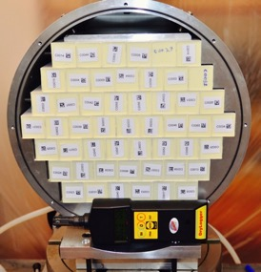
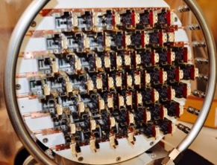
The Module-0 : from CAD to reality
A large size prototype of
the disk with final components.
51 crystals, 102 sensors,
102 FEE chips, cooling
lines and readout.
Completed end of April 2017
A great achievement!

Slide 22
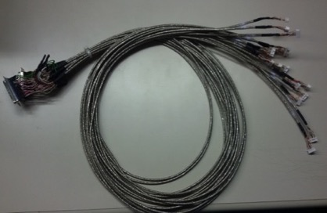
Readout of module-0 for step-1→ step 2
5 16-channel cables of 1.5 m prepared
→ Connectors on FEE side as in final design
→ Connectors to NIM MB board with DB36
Standalone 64 channels DAQ by PADME group (LNF) with coaxial cables for step-1a
Test beam carried out 8-15 May
LNF
Step-2 preparation
PISA
Design of MB final board DONE
Cables reorganization with better connectors from FEE to WD
2-5 WD to match the MB final boards
Readout with TDAQ

Slide 23
Production and testing scheme: Crystals (V0)
Vendor1
Vendor2
Shippings from 2 vendors, 120 crystals/month
Caltech Station
FNAL: Receiving
+ visual inspection
1/2+ random
sample for
radiation
hardness test
Optical parameters,
+RIN (1 hour/crystal)
+
Irradiation test on random sample
@ FNAL
CR test + vacuum- sealed storage
FNAL: Dimension
measurements
10 min/crystal
INFN Station @ FNAL
Optical parameters,
+RIN (1 hour/crystal)
½ of production
Ready to
install
Out of spec
Return to vendor
Out of spec
Return to vendor

Slide 24
QA assembly area at FNAL (1)

Slide 25
QA assembly area at FNAL (2)

Slide 26
MILESTONES 2017
Descrizione | Data proposta
Completamento misure cavi superconduttori | 02-11-2017 | 100%
Completamento test modulo 0 | 02-10-2017 | 80%
Versione finale FEE chips | 30-11-2017 | 80%
Versione finale digitizer | 30-11-2017 | 50%
Completamento test sotto vuoto | 01-09-2017 | 50%
Completamento test irraggiamento | 01-09-2017 | 50%

Slide 27
MILESTONES 2018
Descrizione | Data proposta
QA completato su 500 cristalli finali | 08-09-2018
QA completato su 1000 SiPMs finali | 08-09-2018
Versione finale della board mezzanina | 01-10-2018
Versione finale digitizer con Polarfire | 01-10-2018
Costruzione componenti meccanici per Primo disco: Supporto, CF e Back Plate | 01-12-2018

Slide 28
FTE 2017
Sezione | NUM | FTE | FTE/NUM
Genova | 4 | 1,6 | 0,55
Frascati | 12 (13) | 9,6 (10,1) | 0.80 (0,78)
Lecce | 2 | 0,4 | 0.20
Pisa | 13 | 8,2 | 0,63
TOTALE | 31 (32) | 19,8 (20,3) | 0,64 (0,63)
It does not account for 1 FTE of technical support @ LNF that are of very high quality: A.Saputi is an engineer with a Tech. position. G.Corradi is the FEE designer.
We have again not succeeded to associate 0.5 FTE from ENEA -:(
We have additional 2 FTE of technicians at LNF that do not count
Pisa increase related to the joining of a strong group of neutron experts from
U. of Pisa (see Spinella)
Effective FTE increase (+21%) of MU2E group.
Effective increase of 15% of FTE/Person
→ Stable situation for start of construction

Slide 29
Talks 2017
General talk on MU2E
→ Talk at La Thuille (Young Forum) (Feb 2017), (Donghia)
→ Poster at IFAE-2017 (Mar 2017) (Diociaiuti)
→ Talk at EPS-2017 (Jun 2017) (Miscetti)
→ Invited Talk at SIF-2017 (Set 2017) (Di Falco)
→ Invited Talk at FCCP-2017 (Set 2017) (Giovannella)
Talk on calorimeter system
→ Poster at INSTR 2017 (Happacher)
→ SiPM Poster at NDP-2017 (June 2017) (Morescalchi)
→ Calorimeter Talk at TIPP-2017 (May 2017) (Pezzullo)
→ Talk on SiPMs at TIPP-2017 (May 2017) ( Sarra)
→ Talk on Calo & Tracker (EPS-2017) (July 2017) (Giovannella)
→ Talk on Calorimeter (APS-2017) (Aug 2017) (Donghia)
→ SiPM Poster (APS-2017) (Aug 2017) (Donghia)
→ Poster + talk at SCINT-2017 *Set 2017)
→ Poster + talk at IEEE-2017 (Oct 2017)
Total on 2017 … 9 talks + 7 posters

Slide 30

Status of European network MUSE (1)
MUSE started as planned on 1/1/2016
WEB site fully implemented and Network activities very active
First general meeting held in PISA in Set 2016.
2nd general meeting and Mid-Term review done at LNF in May 2017.
→ great appreciation from EU officers/reviewers
Institution | Scheduled in GA (Jan 2016⎯Aug 2017) | Started | Fraction
ADVANSID | 1 | 0 | 0%
CAEN | 2 | 2 | 100%
HZDR | 12 | 4 | 33%
INFN | 122 | 99 | 81%
LIVERPOOL | 41 | > 30 | > 73%
PRISMA | 8 | 6 | 75%
UCL | 29 | 15 | 52%
In total > 73 % of the secondments already started

Slide 31
Status of European network MUSE (2)
Breakdown for Mu2e component inside Muse
Group | Scheduled | Started+planned | Fraction
LNF | 31 | 30 | 97%
PISA | 28 | 19 | 68%
LECCE | 9 | 4 | 44%
TOTAL | 68 | 53 | 78 %
MU2E group is proceeding fairly well with planned secondments
Proceeding smoothly and steadily on our plan
Milestones (3/3) and Deliverables (9/10) in good status

Slide 32
Conclusions
Civil construction, Super Conducting Cables, Accelerators OK
Magnetic system construction started
→ DELAY OF 3 MONTHS in the overall schedule
Calorimeter is progressing toward construction:
→ Simulation has improved → See trigger next talk
→ Pre-production/QA-test for crystals and SiPMs completed.
→ FEE pre-production completed. First WD produced → see next talks
→ Mechanical review (CRR for CsI and SiPMs) done in March (June) 2017.
→ Module 0 assembled, test beam @ BTF done in May 2017
→ Production of SiPMs and Crystals will start before the end of the year.
→ Preparation of QA facility at FNAL started.
→ Completion of Mockup with integration details in progress → fake crystals,
back disk and cabling ..
NEXT STEPS:
Slice test with full digitizer and TDAQ chain under planning
CRR review for whole calorimeter after Slice test → Feb/March 2018

Slide 33
Part-2

Slide 34
Survey/summary of CA spending in 2016

Slide 35
Survey/summary of CA spending in 2017

Slide 36
What we did ask for July meeting
The release of 10 kEuro (Sj) for MB pre-production (FEE) at LNF
We did not ask to release the WD (Sj) in Pisa but ask to move this
request to 2018 waiting for test of six prototypes and Dose study
The release of “other services” and travelling funds (Sj) for irradiation
at Calliope/FNG and @ HZDR
FEE related
Mechanics related
Do not release 32 kEuro (Sj) for FEE disk production @ Pisa →
this is to allow us to make a tender in September → This is moved to 2018
The release of 34 kEuro (Sj) for CF stuff a Lecce → bid in september, in progress
Cost of WD Crates will be better evaluated for preventivi-2018. They will go
in production @ beginning 2018
Other requests for installation and tooling will go to preventivi-2018.
Also the breakdown of cost for the Cooling station and the request will go to preventivi-2018.

Slide 37
Situation of Cost Estimate – Sep 2017

