Slide 1
Search for the Cosmic Neutrino Background and Novel Directional Detection Methods for MeV Dark Matter
Princeton Tritium Observatory for Light, Early-Universe, Massive-Neutrino Yield (PTOLEMY)
Chris Tully
Princeton
INFN-Roma, Department of Physics, La Sapienza
11 October 2017

Slide 2
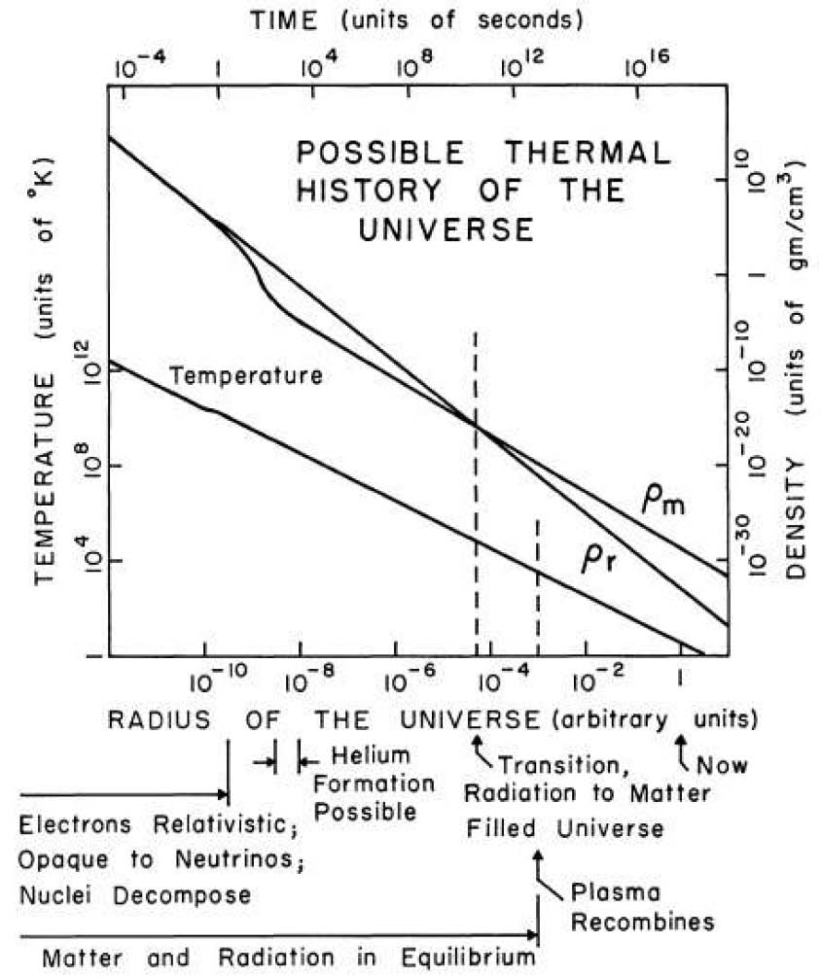
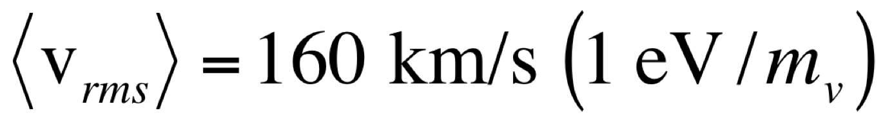
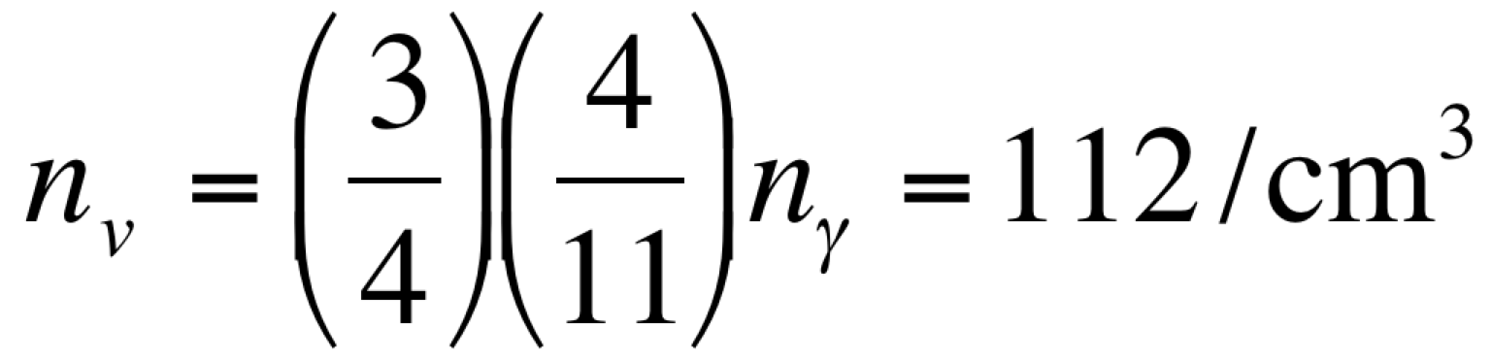
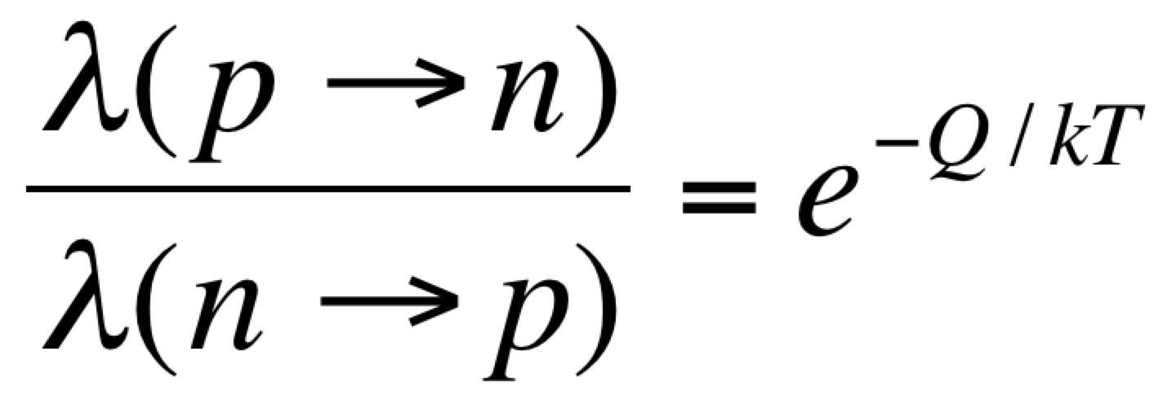
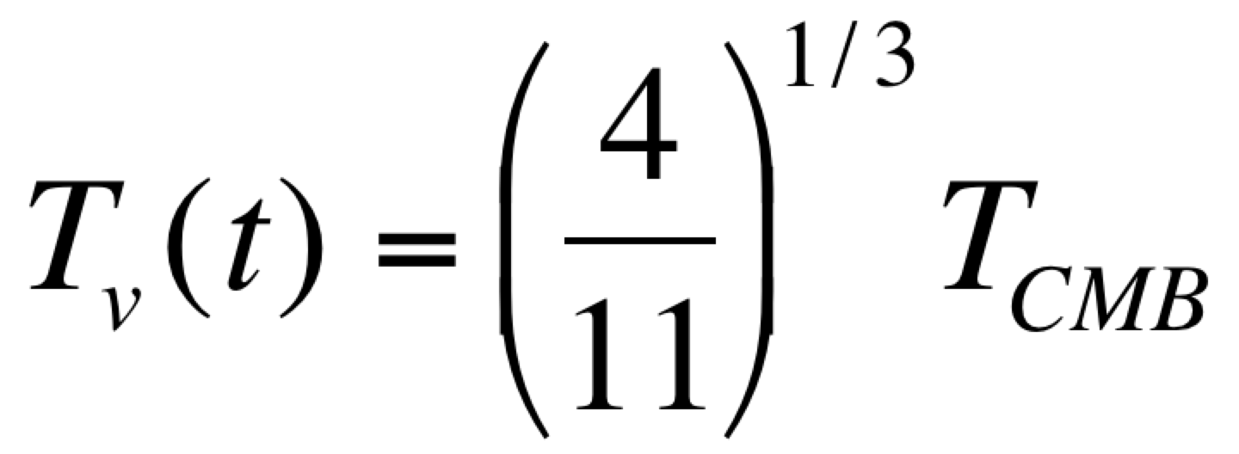
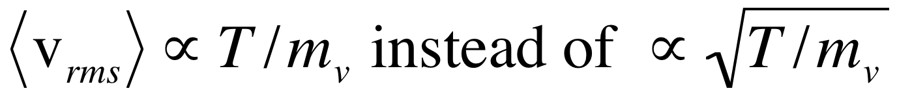
Cosmic Neutrino Background
1 sec
per neutrino species
(neutrino+antineutrino)
T_{ν}~1.95K
    start of nucleosynthesis
    n/p~0.15*0.74~0.11
Relic velocity depends on mass
Dicke, Peebles, Roll, Wilkinson (1965)
IAS Sabbatical (2010)
Non-linear distortions Villaescusa-Navarro et al (2013)

Slide 3
Neutrino Masses from Oscillations
An incredible phenomenon appeared when neutrinos were measured from different sources: solar, atmospheric, reactor, accelerator.
A neutrino created with a definite lepton flavor (in this case, electron or muon) would arrive with a lower probability to be detected with the same flavor and a non-zero probability to have mixed into another flavor.
≈(0.05eV)²
??
0
N_{ν} = 2.984 ± 0.008

Slide 4
Cosmic Coincidence
J. Lesgourgues
Individual neutrino contributions assuming Normal Hierarchy and m₃ = 0.05 eV,
m₂ = 0.009 eV,
m₁ = 0
Neutrinos decouple
Photons
decouple
Coincidence?
Rise of Λ as fraction of Ω occurs roughly at the onset of non-relativistic era of relic neutrinos

Slide 5
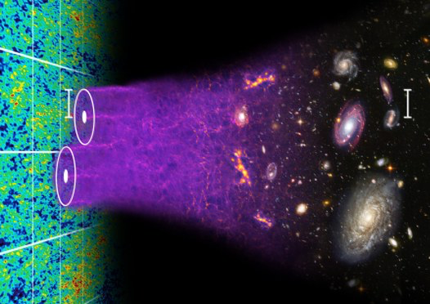
Precision Cosmology Projections
J. Lesgourgues
Dark Energy Spectroscopic Instrument (DESI)
Baryon Acoustic Oscillations

Slide 6
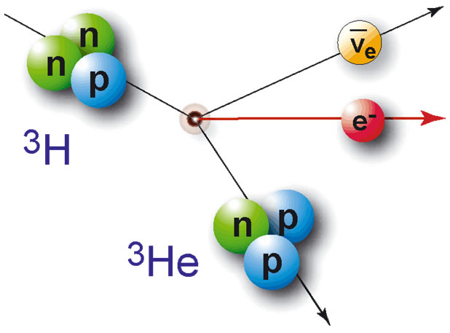
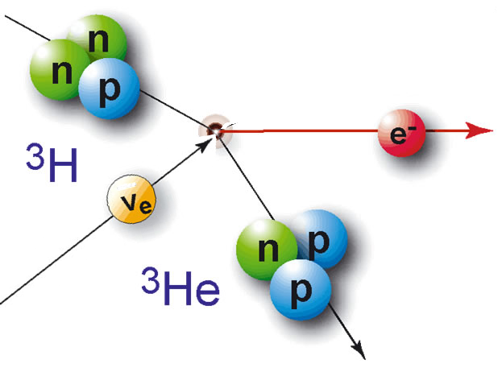
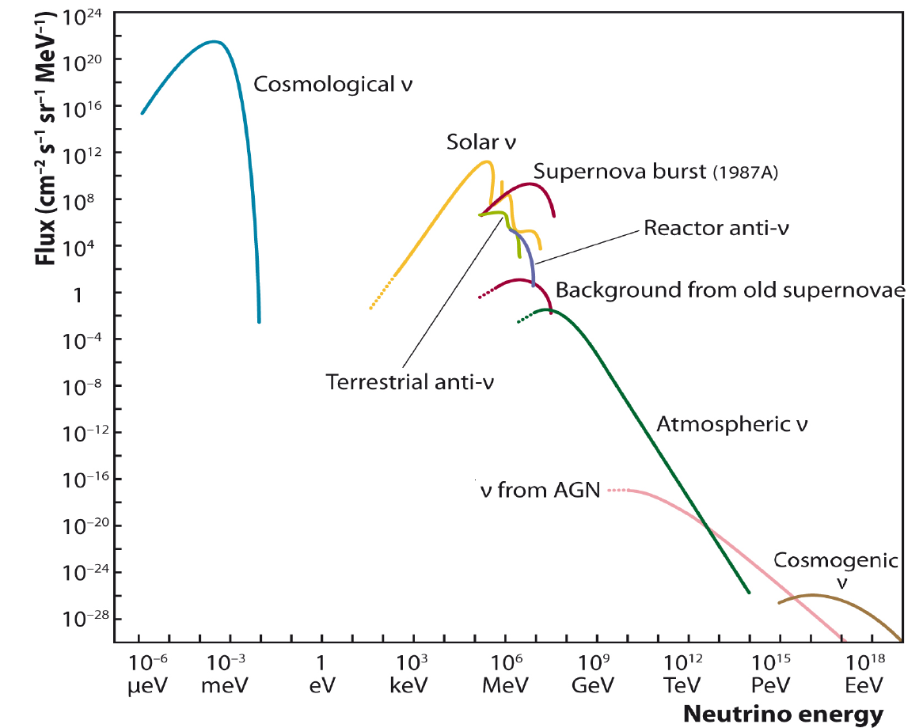
Neutrino capture on Tritium
Tritium β-decay
(12.3 yr half-life)

Slide 7
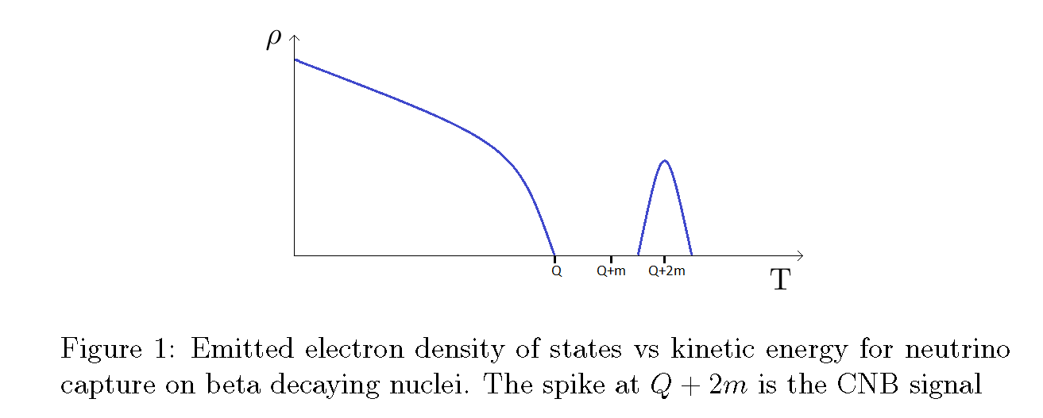


Relic Neutrino Detection
Basic concepts for relic neutrino detection were laid out in a paper by Steven Weinberg in 1962 [Phys. Rev. 128:3, 1457]
  Look for relic neutrino capture on tritium by measuring electrons at or above the endpoint spectrum of tritium beta-decay
Tritium β-decay
Endpoint
Neutrino Capture
What do we know?
Gap (2m) constrained to < ~0.6eV
from Cosmology
How many?
(Signal shape and location predicted from mass measurement)
(some electron flavor expected with 2m>0.1eV
from neutrino oscillations)
Electron energy
Tritium and other isotopes studied for relic neutrino capture in this paper:
JCAP 0706 (2007)015, hep-ph/0703075 by Cocco, Mangano, Messina

Slide 8
Experimental Perspective
Too much rate
(need to filter)
Need very high energy resolution (σ ∼ m_{ν})
Small fraction
(triggering)
Electron energy

Slide 9
Relic Neutrino Capture Rates
Target mass: 100 grams of tritium (2 x 10²⁵ nuclei)
Capture cross section * (v/c) ~ 10⁻⁴⁴ cm² (flat up to 10 keV)
(Very Rough) Estimate of Relic Neutrino Capture Rate:
(56 ν_{e}/cm³) (2 x 10²⁵ nuclei) (10⁻⁴⁴ cm²) (3 x 10¹⁰ cm/s) (3 x10⁷s)
~ 10 events/yr
Lazauskas, Vogel, Volpe: J.Phys.G G35 (2008) 025001.
Cocco, Mangano, Messina: JCAP 0706 (2007) 015
5(10) events/yr for Dirac(Majorana) ν’s
σ(v/c)=(7.84±0.03)x10⁻⁴⁵cm²
Known to better than 0.5%
Gravitational clumping could potentially increase the local number of relic neutrinos.
For low masses ~0.15eV, the local enhancement is ~<10%
m_{ν} =
m_{ν} =
Ringwald and Wong (2004)
Villaescusa-Navarro et al (2011)

Slide 10
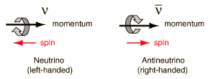
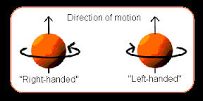
Dirac versus Majorana Neutrinos
Relic neutrinos are uniquely the largest source of non-relativistic neutrinos
Long, Lunardini, Sabancilar: arXiv:1405.7654
Neutrinos decouple at relativistic energies
- Helicity (not chirality) is conserved as the universe expands and the relic neutrinos become non-relativistic
Dirac: after expansion, only ~half of left-handed helical Dirac neutrinos are left-handed chiral (active)
→ antineutrinos are not captured
Majorana: ~half of left-handed helical neutrinos are chiral left-handed and half of right-handed helical neutrinos are chiral left-handed (active)
Factor of 2 difference in capture rate

Slide 11
PTOLEMY Experimental Layout
Princeton Tritium Observatory for Light, Early-universe, Massive-neutrino Yield
Low Field
Region
Cryogenic
Calorimeter
(σ~0.15eV)
Tritium Storage Cell
(Surface Deposition)
Long High Uniformity
Solenoid (~2T)
High Field Solenoid
~50-150eV
below
Endpoint
E₀+30kV
0-1keV
(~150eV)
E₀-18.4keV
Filter removes most low energy e⁻
E₀
RF Tracking
(38-46 GHz)
Calorimeter measures e⁻
e⁻
e⁻ from Tritium start here
Tracker identifies e⁻
MAC-E filter
(De-accelerating
Potential)
Time-of-Flight
(De-accelerating
Potential)
Accelerating
Potential
Accelerating
Potential

Slide 12
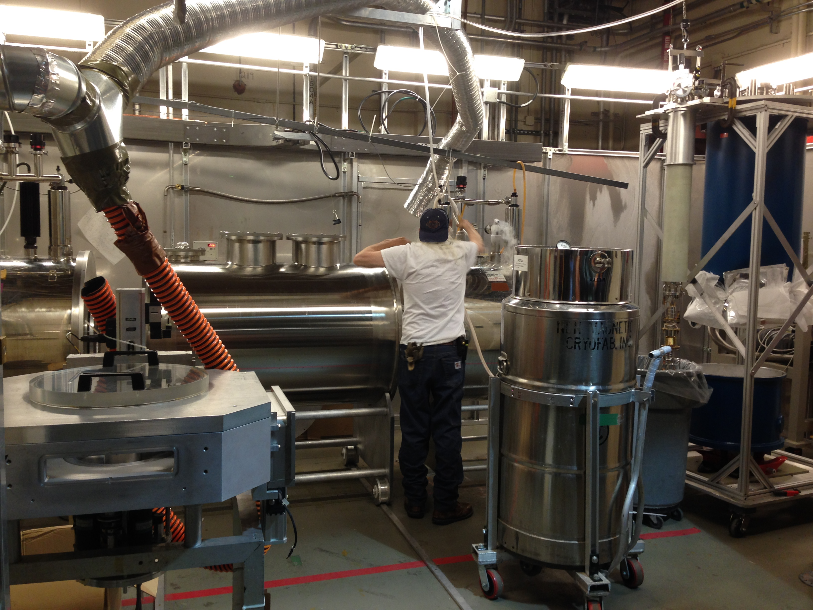
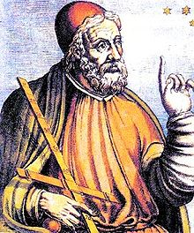
PTOLEMY
R&D Prototype @ PPPL
(August 2, 2016)
Supported by:
The Simons Foundation
The John Templeton Foundation

Slide 13
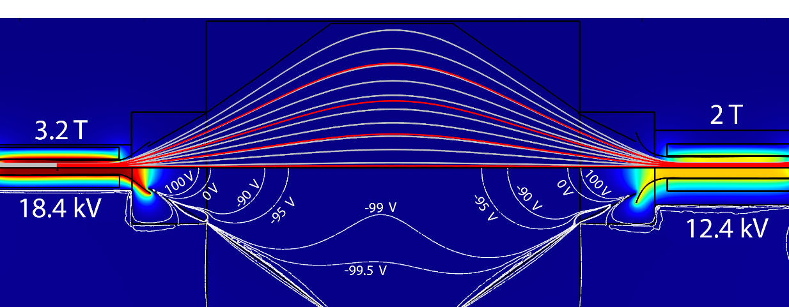
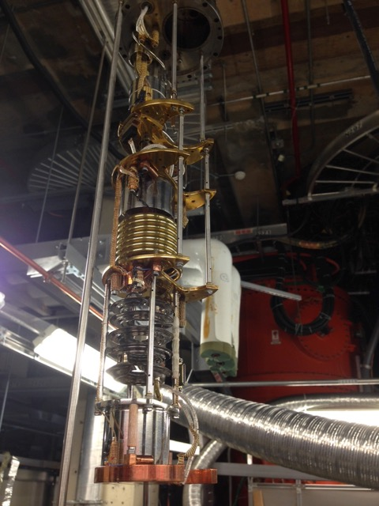
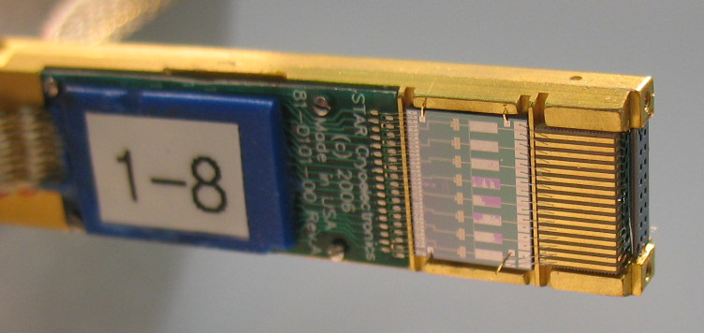
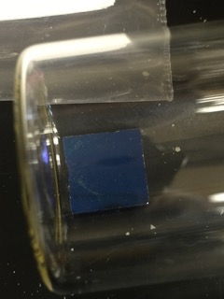
PTOLEMY
Dilution Refrigerator
Kelvinox MX400
10⁻² - 10⁻³
MAC-E Filter
Robot Arm
for Tritiated-Graphene Samples
R&D Prototype @ PPPL
(August 2, 2016)
Supported by:
The Simons Foundation
The John Templeton Foundation
StarCryo Microcalorimeter

Slide 14
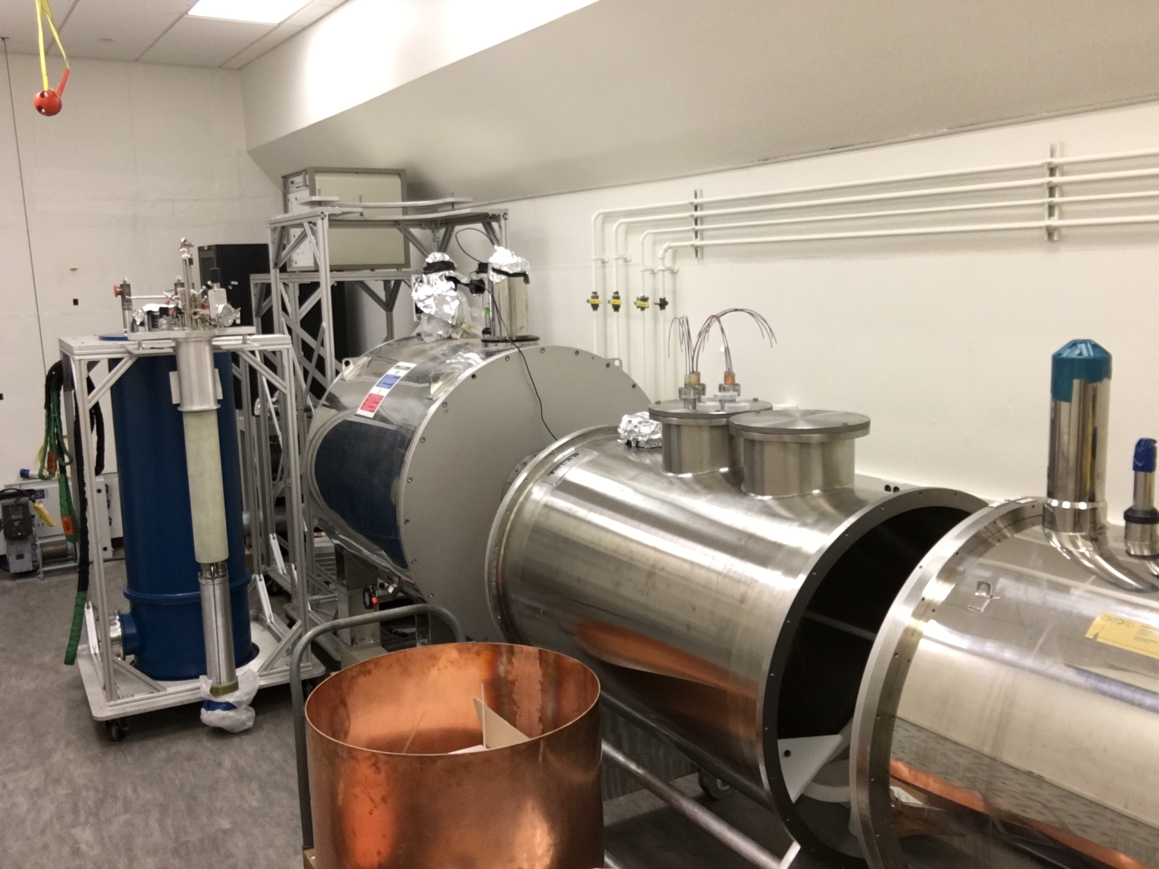
PTOLEMY Prototype
R&D Prototype @ PU
(June 7, 2017)
Supported by:
The Simons Foundation
The John Templeton Foundation

Slide 15
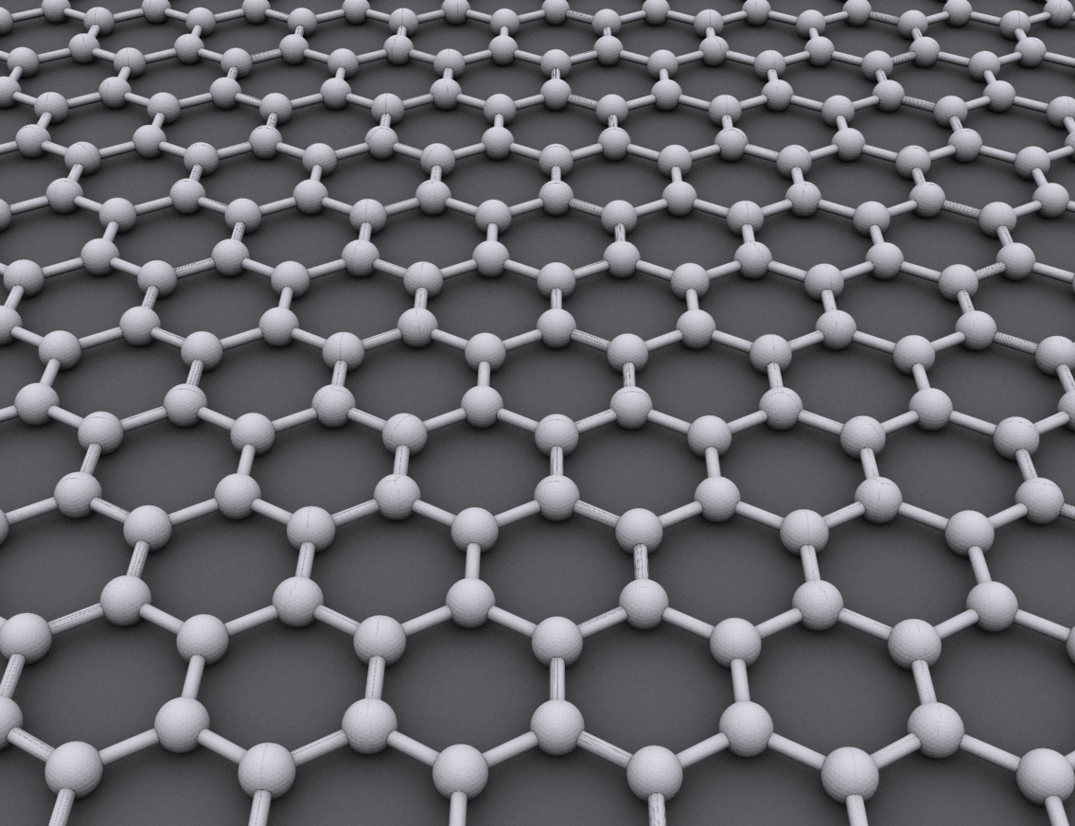
Molecular Broadening
T-T → (T-He³)*
~3eV He³ recoil at endpoint
4.7eV
<3eV binding energy
Graphene

Slide 16
Molecular Broadening
T-T → (T-He³)*
GrapheneBinding Energy
T² Binding Energy
~3eV He³ recoil at endpoint
4.7eV
<3eV binding energy
Graphene
PTOLEMY
First Samples Produced by SRNL
Cryogenic Au(111) also under investigation
with Free Radical or Cold Plasma Loading
SRNL

Slide 17
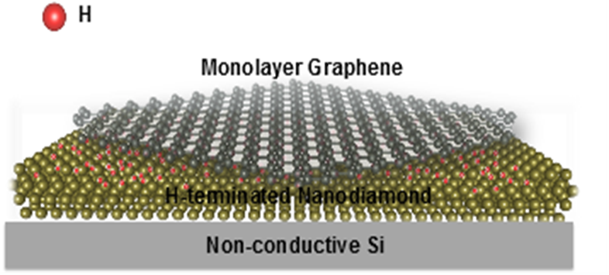
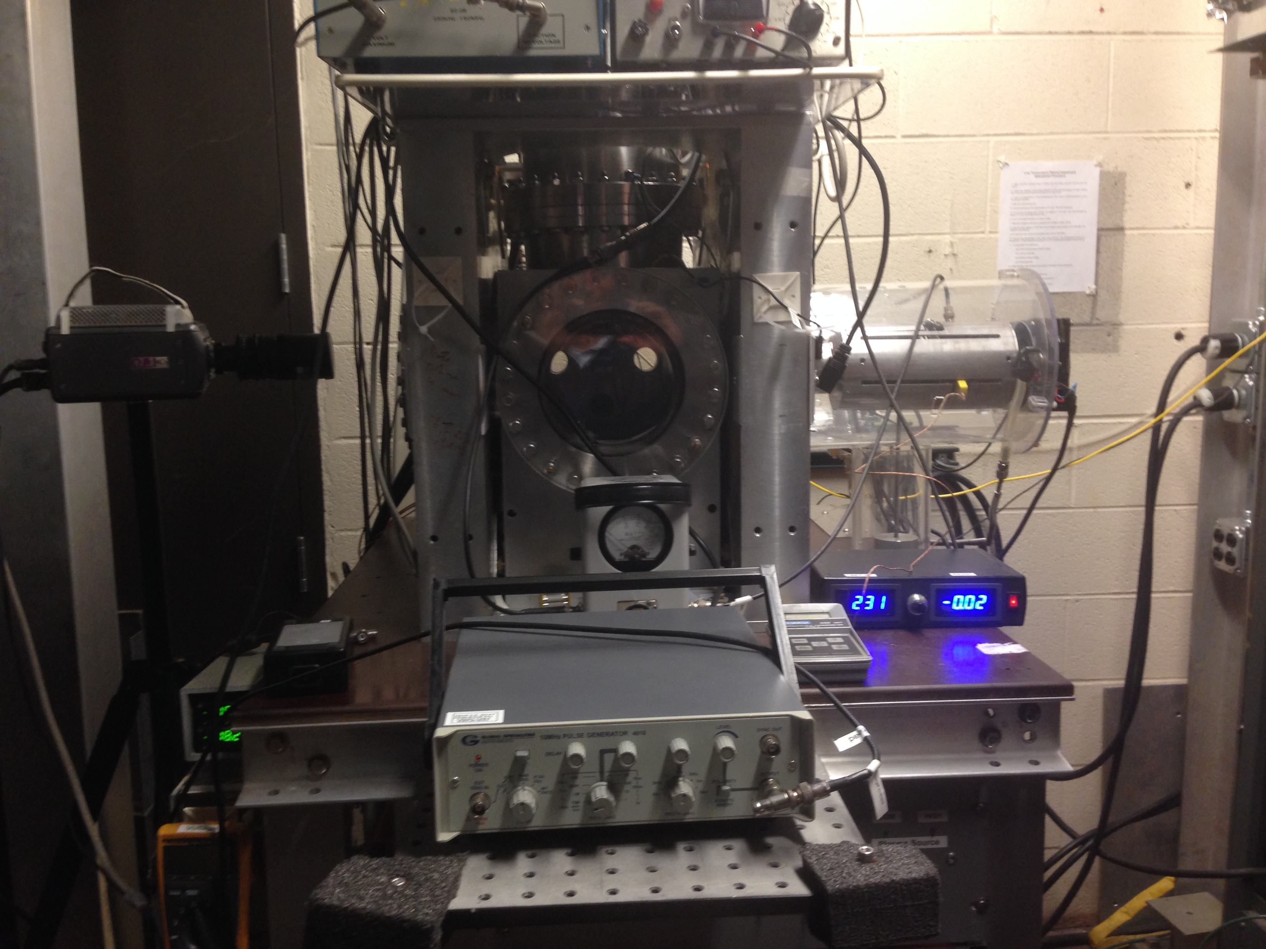

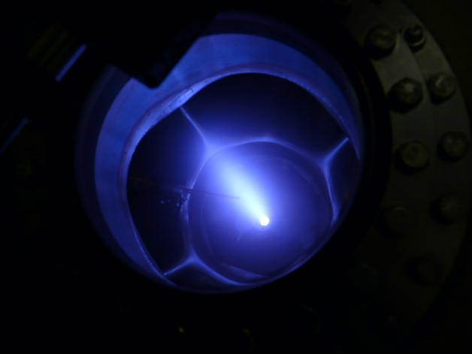
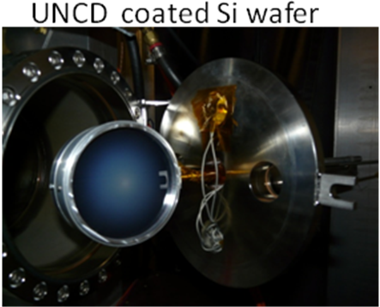
Cold Plasma Loading
H Plasma
Y. Raitses et al.
Below 1eV
Ehemann et al. Nanoscale Research Letters 2012, 7:198

Slide 18
Cold Plasma Loading at PPPL
XPS (X-Ray Photoelectron Spectroscopy) Analysis: sp² is from unhydrogenated C atoms. sp³ is hydrogenated C atoms. The area ratio of sp² and sp³ is used to calculate H coverage.
H coverage summary from the literature
2009 Science | DC plasma. H coverage 10%
2009 ACS Nano | Capacitive coupled RF plasma. H coverage 17%
2010 APL | RF hydrogen plasma. H coverage 9%
2011, Carbon | Oxford Plasmalab 1000. H coverage less than 10%
2011 Advance Material. | STM hydrogen dose, Hydrogen coverage max 25.6%
2014, Applied materials &interfaces | RIE system. H coverage 33%
2015, ACS nano | HPHT. H coverage 10%
40% H Coverage
Best results – aim to achieve saturation at 100% while preserving quality of Graphene
New Results! → BNL Center for Functional Nanomaterials
→ Cryogenic Hydrogen loading and STM Analysis

Slide 19
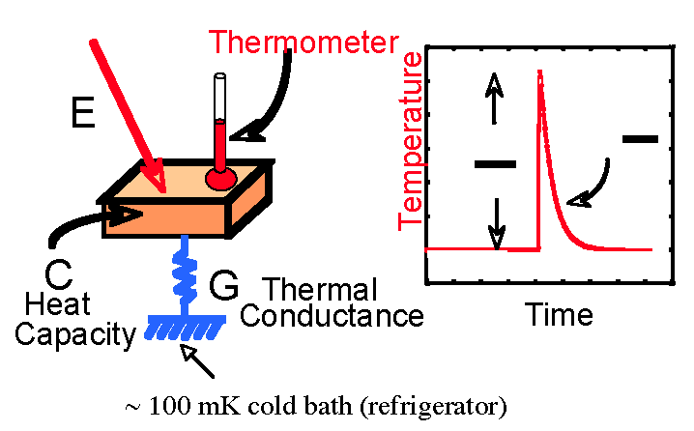
Microcalorimetry
Electron calorimetry with an energy resolution sufficient to resolve the neutrino mass
e⁻
10eV electron can be stopped with very small C
τ =
C
E
G
C
Time response (τ) also small (<μsec)

Slide 20
TES Single Photon IR Detectors
Results from INRIM (Torino) - Istituto Nazionale di Ricerca Metrologica
https://agenda.infn.it/getFile.py/access?contribId=12&sessionId=3&resId=0&materialId=slides&confId=1299
2

Slide 21
Microcal for IR Photons
IR TES achieve 0.12 eV resolution at 0.8 eV for single IR photons
Results from INRIM (Torino) - Istituto Nazionale di Ricerca Metrologica
σ_{E} = 0.05eV

Slide 22
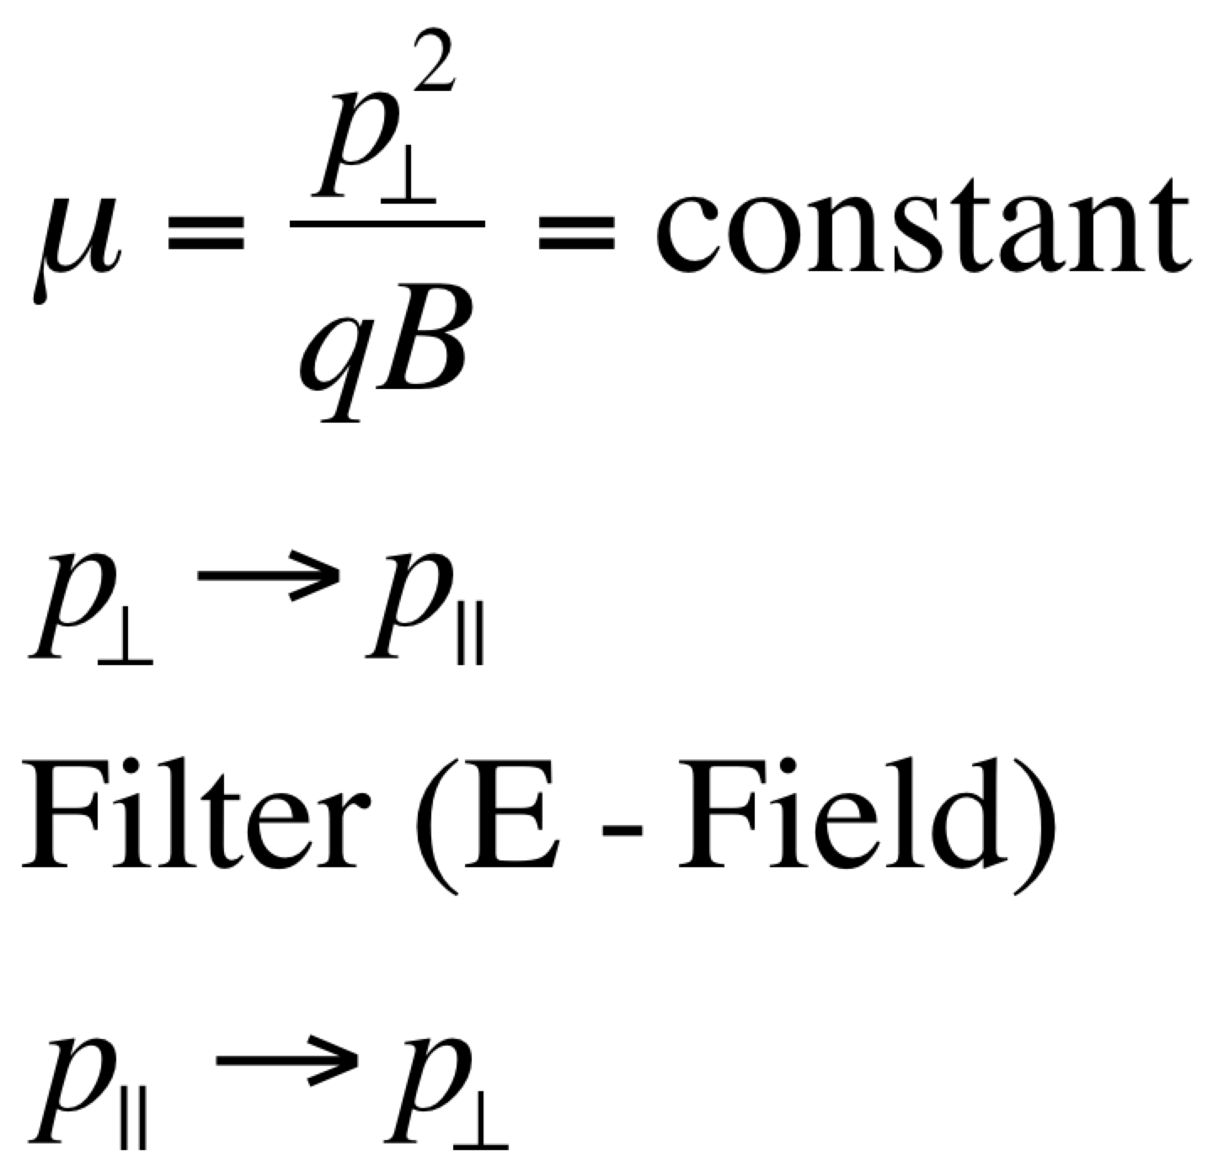
KArlsruhe TRItium Neutrino (KATRIN)
10¹⁰ e⁻/s
10¹⁰ e⁻/s
10³ e⁻/s
10⁰ e⁻/s
Adiabatic Invariance
~70 m
10m
Filter energy resolution (MAC-E)
~0.93 eV

Slide 23
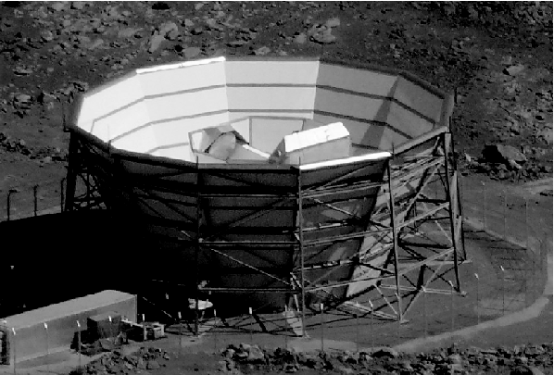
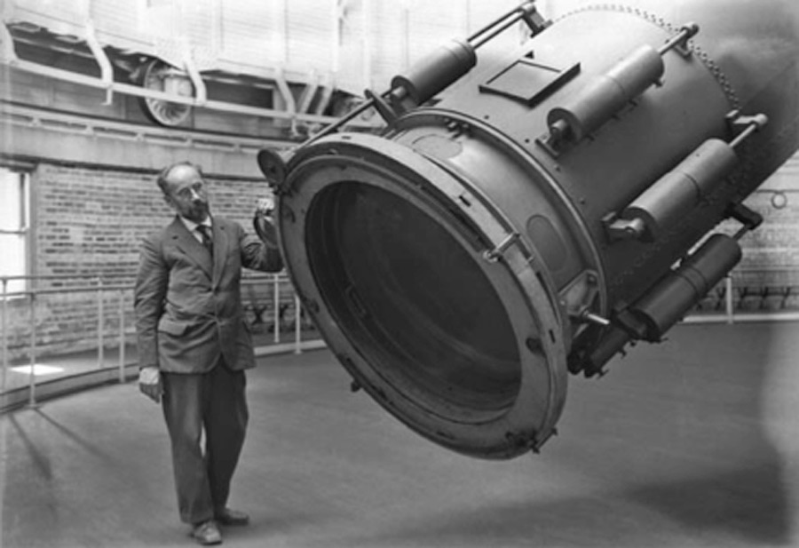
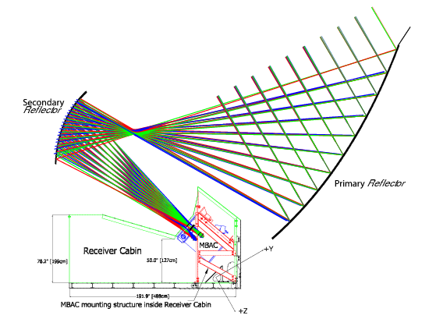
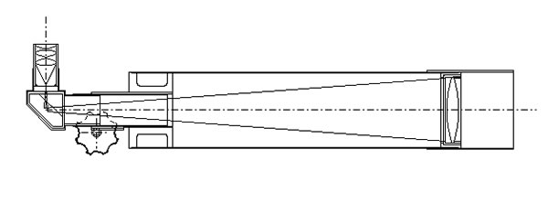
Refractor → Reflector Telescopes
Galilean → Newtonian
Yerkes (1895)
Atacoma (2010)

Slide 24
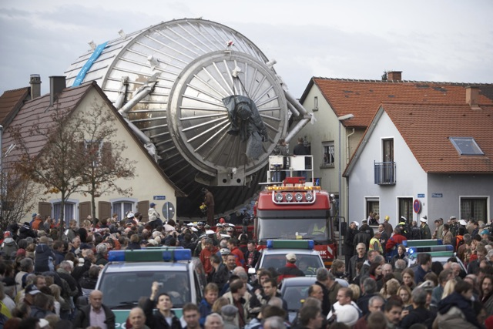
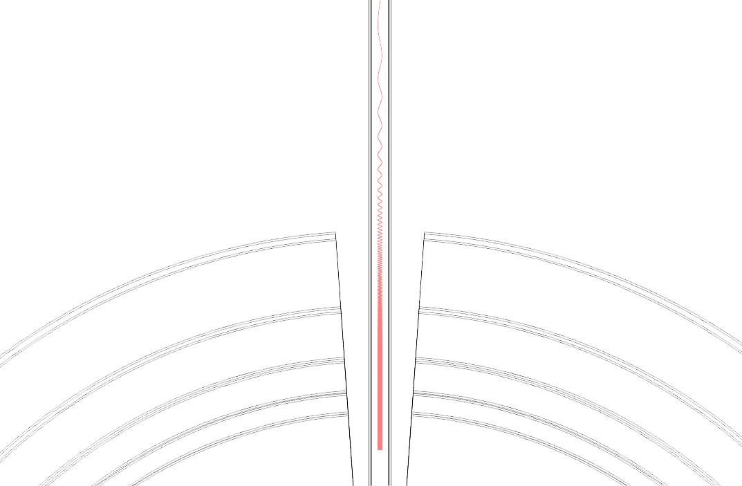
MAC-E “Telescope”
PTOLEMY implements a “reflector” method that is four orders of magnitude more compact along the direction of the B field
E*B ~1cm
ExB Drift
~1m
E*B ~10m
Filtering of the energy is in the vertical direction

Slide 25
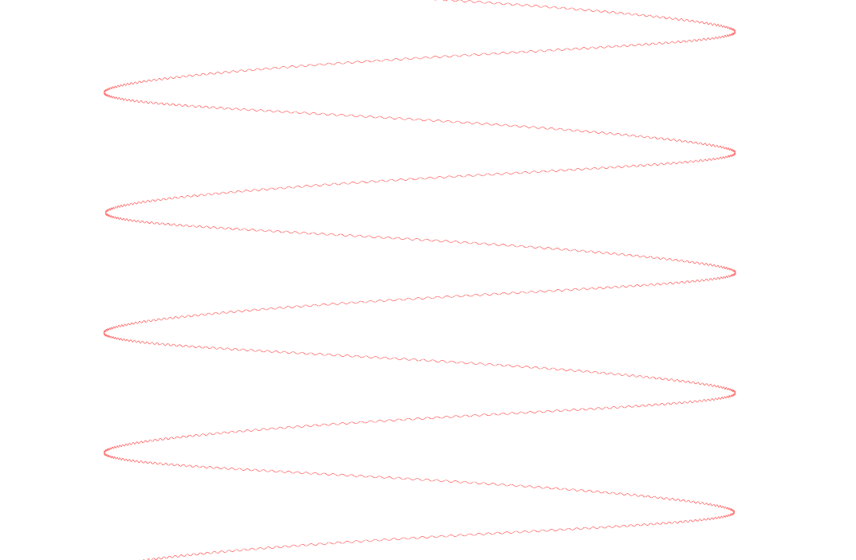
PTOLEMY
x3
Cyclotron Motion
E
ExB
E
B
B
E*B and B Bottle
x10
ExB Drift
Image Stretched

Slide 26
Cyclotron Radiation Emission Spectroscopy (Project 8) → RF Trigger
PTOLEMY ExB Filter is a natural harmonic trap
B field is dropping adiabatically as the electrons drift radially
Drift velocity has to be adjusted so that number of bounces is roughly ~20,000 per FFT/Trigger decision

Slide 27
Relativistic Correction to Cyclotron Frequency
Project 8

Slide 28
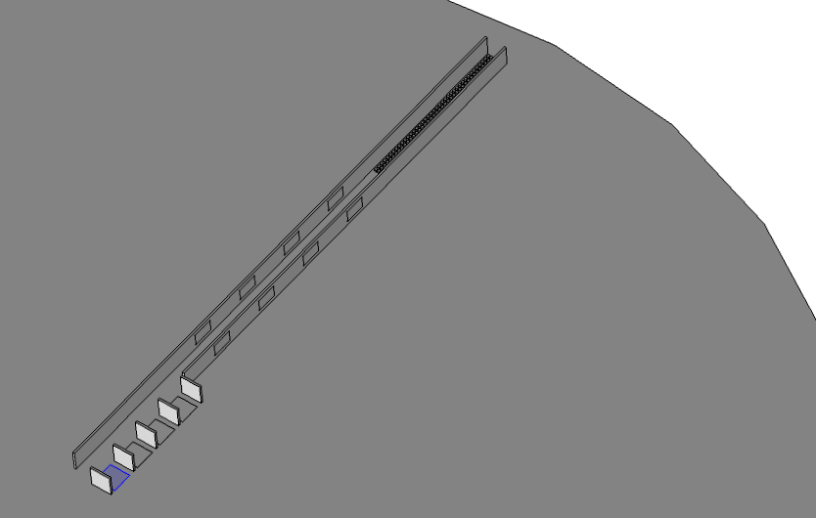
Scalable Underground Design
B Field Normal to Plate
Low B Field
Calorimeter
ExB Radial Drift
RF Trigger
High B Field
Tritiated-Graphene
Voltage Multiplexing (Extraction ExB)

Slide 29
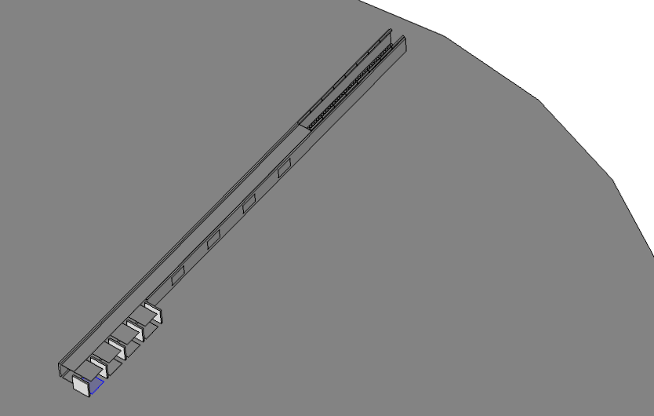
E*B Reflector and Trigger Gate to Calorimeter
E*B Gates (Triggered on RF)
Trigger Gate
Calorimeter on base plate serves multiple target layers
Barrier between layers selectively dropped (akin to a CCD-like readout)
E*B Reflector (Top and Bottom)

Slide 30
Underground Environment
Advantages of Design:
Tritium molecularly bound to Graphene wafers installed in disks (1 microgram per 100 cm² wafer)
Disks are individually vacuum-sealed above ground
Each disk transports ~20 micrograms of tritium target
3m diameter disks can be transported underground with an approved transport container
Disks are interleaved with external coils and installed within a cryostat that serves N~100 disks
Cryostats situated one after the other in strings/loops
System scales with number of cryostats (50 → 1g in ~70m)

Slide 31
Graphene FET Structures

Slide 32
Graphene Nanoribbons (GNR)
Plane
Ribbon
Bi-layer
Biased
Bi-layer

Slide 33
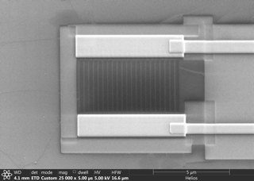
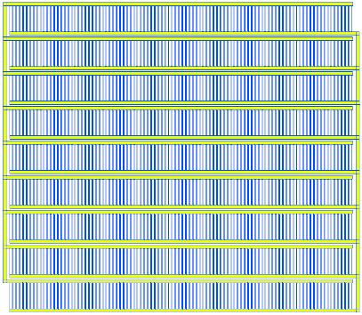
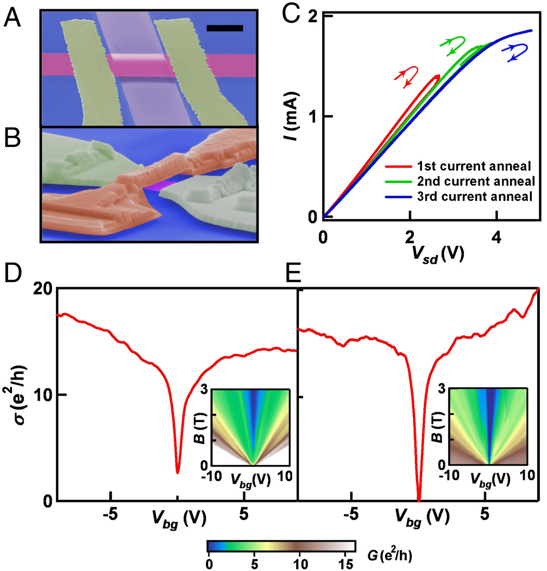
G-FET
  PTOLEMY-G³ Hochberg, et. al, 2016.
  “Directional Detection of Dark Matter with 2D Targets", http://doi.org/10.1016/j.physletb.2017.06.051
Principles of Operation:
Tunable meV band gap set by nanoribbon width (E_{gap} ~ 0.8eV/width[nm])
Large jump in conductivity (~10¹⁰ charge carriers) relative to charge neutrality point under the field-effect from a single electron scatter
Scalability to Interdigitated Capacitor
CNP
Source
Drain
ΔV~e/C
(example behavior: curve rescaled)
(meV)
Back-gated

Slide 34
Photocathode-type e⁻ Emission

Slide 35
Forward-Backward Asymmetry
  G.Cavoto, F.Luchetta, A.D.Polosa, 2017.
  “Sub-GeV Dark Matter Detection with Electron Recoils in Carbon Nanotubes” http://arxiv.org/abs/1706.02487

Slide 36
Anisotropies in the Cosmic Microwave Background
Adiabatic Density Anisotropies δ~10⁻⁵ at z~1100
Where we think there is an initial τ_{i}=0 Big Bang Singularity is believed to be the “end” of an inflation period that slowly pulled out (>60 e-folds a(τ)∼e^{Hτ} ) of a “deSitter”-like spacetime

Slide 37
Origin of Large Scale Structure
Baumann
(TASI 2012)

Slide 38
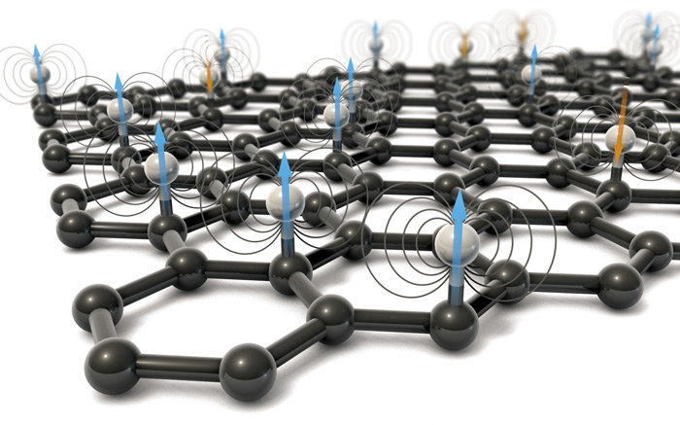
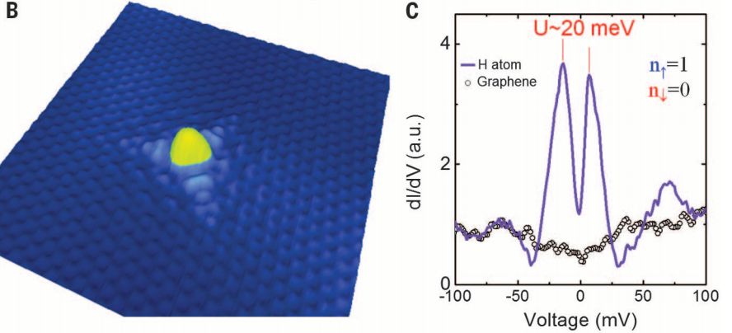
Polarized Tritium Target
  Lisanti, Safdi, CGT, 2014.
  “Measuring Anisotropies in the Cosmic Neutrino Background”
  http://doi.org/ 10.1103/PhysRevD.90.073006
ν_{L}
L.E. Marcucci et al., Phys.Rev.Lett. 108 (2012) 052502
Γ~100%(v*s)
(for relativistic neutrinos)
Tritium Nuclear Spin
Hydrogen doping on graphene reveals magnetism
STM topography of a single H atom chemisorbed on neutral graphene. dI/dV spectrum measured on the H atom, showing a fully polarized peak at E_{F} , and measured on bare graphene far from the H atom.
Gonzalez-Herrero, H. et al. Atomic-scale control of graphene magnetism by using hydrogen atoms. Science (80). 352, 437–441 (2016).

Slide 39
Anisotropies in the CNB
m_{ν} ~10⁻⁵ eV
(Requires: σ ~10⁻³ eV)
m_{ν} ~10⁻³ eV
Hannestad, Brandbyge (2009)
m_{ν} ~10⁻² eV
m_{ν} ~10⁻¹ eV
Simultaneously Probe Linear Perturbations from Inflation and Different Scales of Non-Linear Growth

Slide 40
Backup

Slide 41
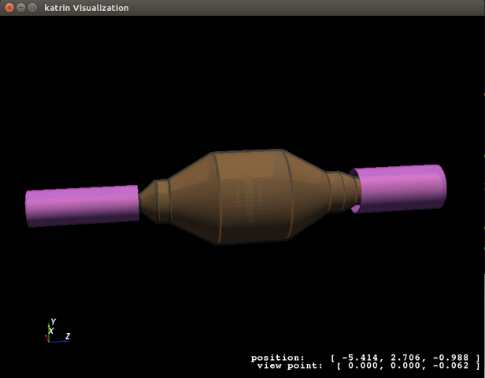
Kassiopeia
A. Cocco

Slide 42
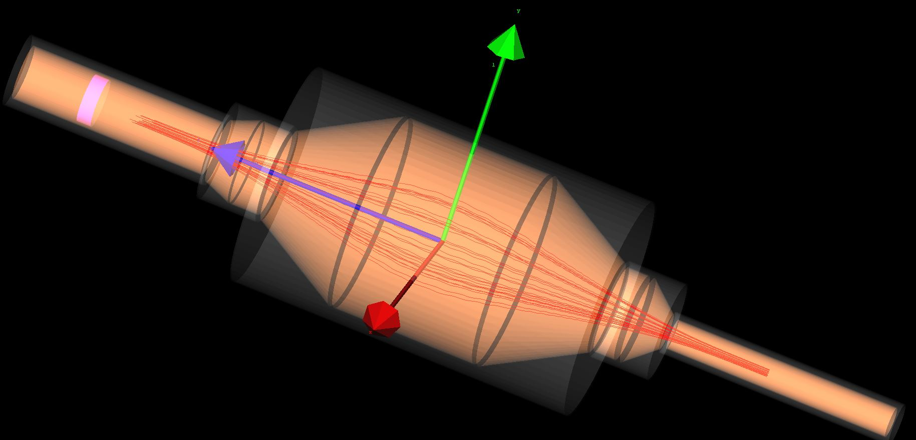
GEANT4

Slide 43
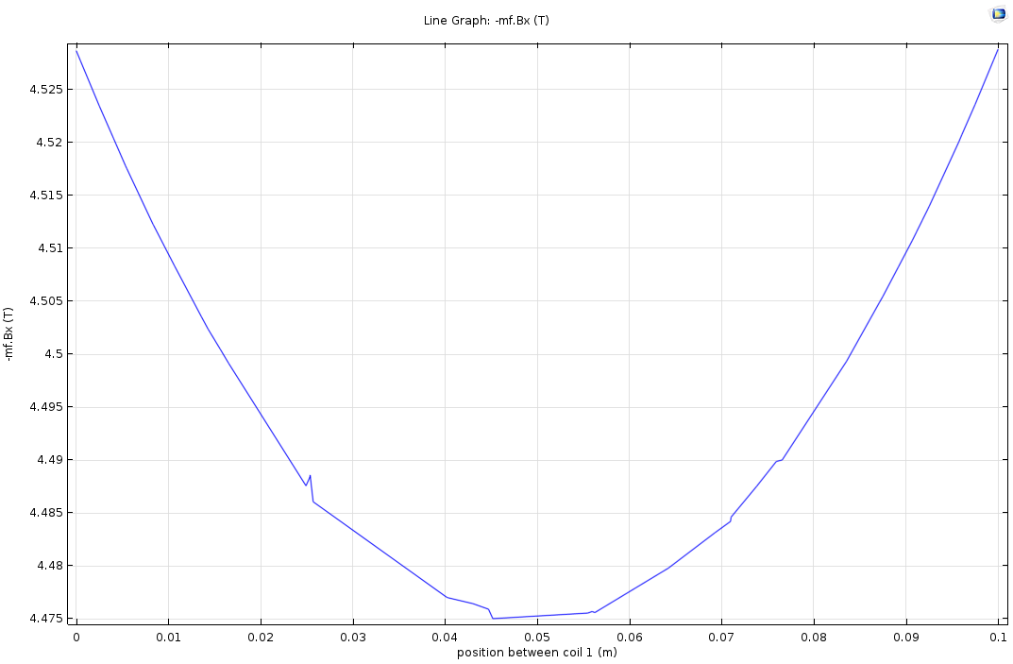
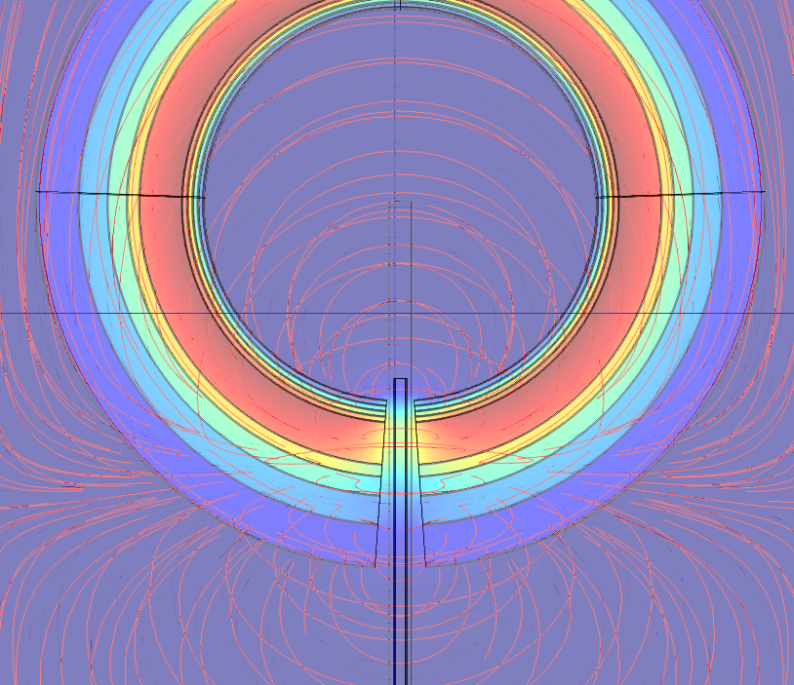
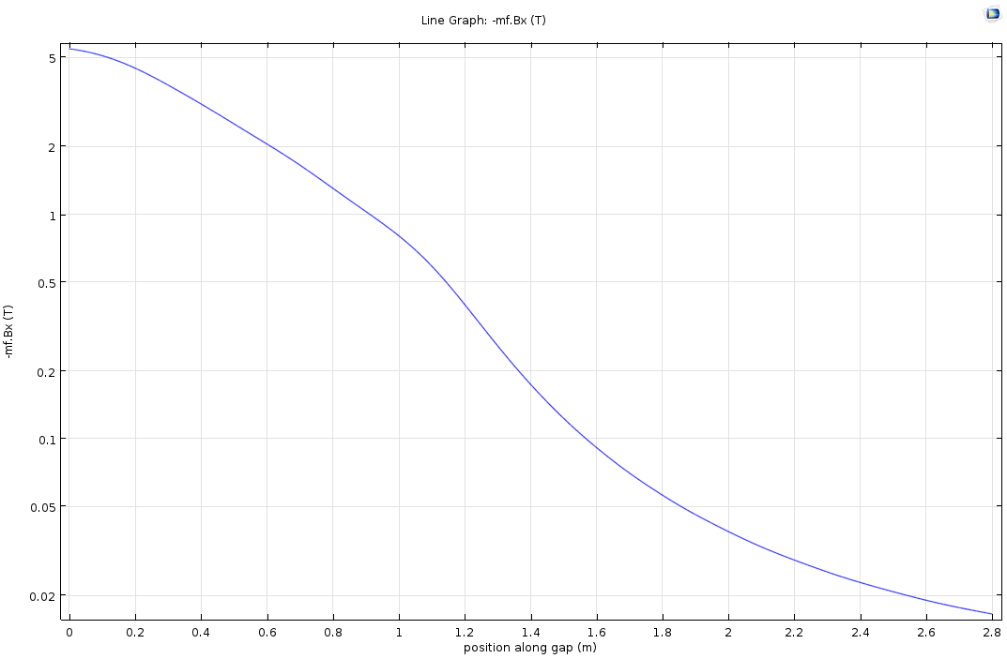
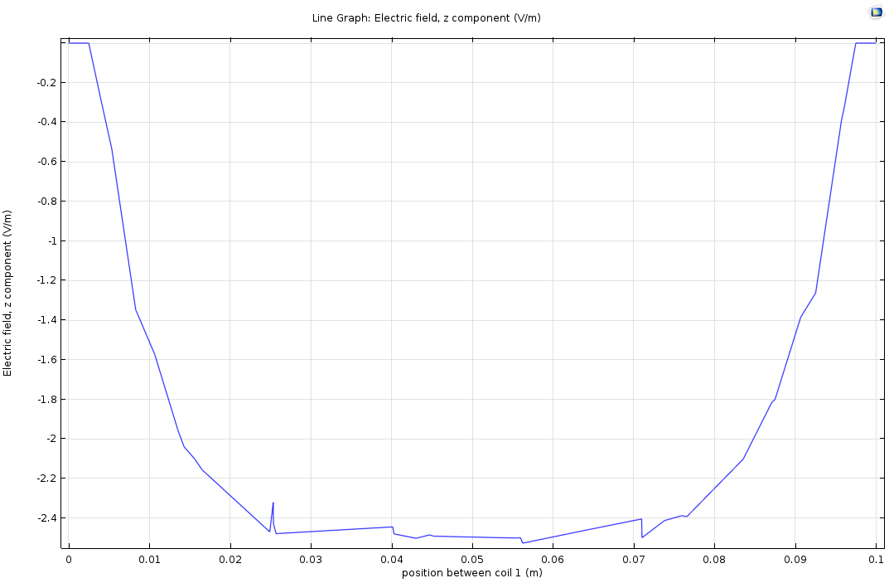
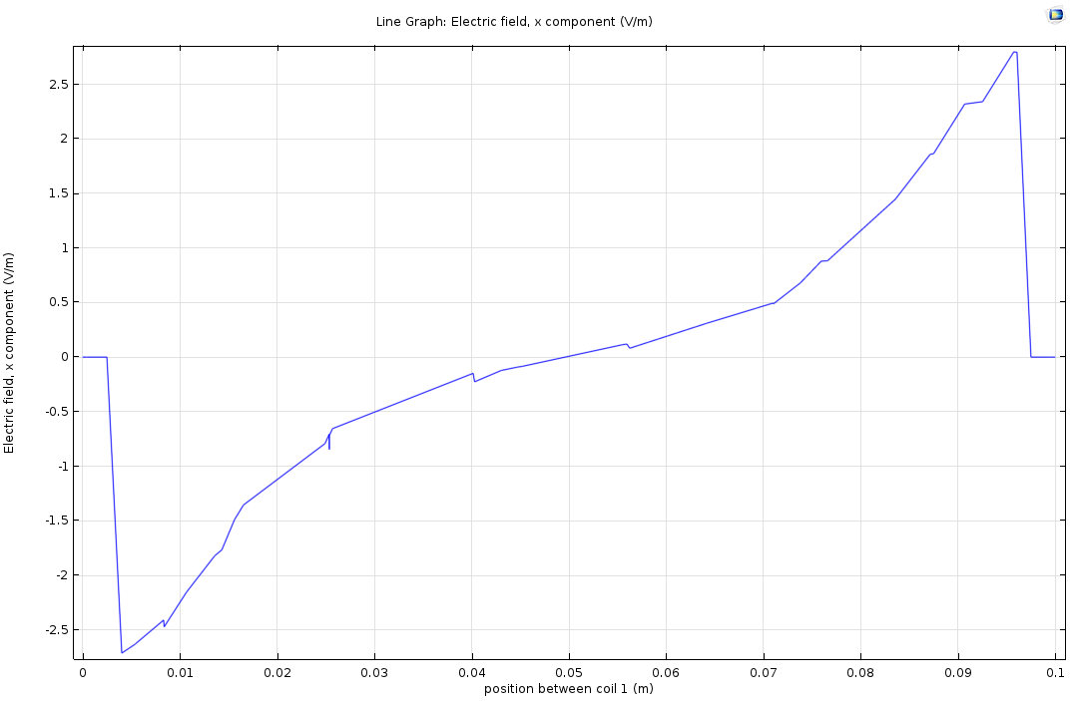
Simulations
PTOLEMY
B Bottle
5T
0.05T
ExB Drift
E*B Bottle

Slide 44
Experimental Challenges
Energy Resolution:
  Molecular tritium source that exhibits minimal energy smearing on the outgoing electron
  Measurement techniques that achieve ~0.05eV energy resolution at the tritium endpoint
Low Background, High Radio-Purity Target
Scalable Kinematic Energy Filtering with Triggering on endpoint electrons:
  Remove the bulk of the β-decay electrons while preserving high acceptance for electrons from neutrino capture

Slide 45
Overcoming T² Molecular Broadening
Tritiated-Graphene
<3eV Binding Energy
Single-sided (loaded on substrate)
Planar (uniform bond length)
Semiconductor (Voltage Reference)
- Polarized tritium(directionality?)
T² Binding Energy
~3x10¹³ T/mm² (~80kHz of decays/mm²)
PTOLEMY
First Samples Produced by SRNL
Cryogenic Au(111) also under investigation
with Free Radical or Cold Plasma Loading
SRNL

Slide 46
Synergy with ECHo and CMB-S4
Common Need for Microwave Multiplexing
Microcalorimeter development work for PTOLEMY builds off of S4 TES designs from Clarence Chang (ANL)
Microwave multiplexing developments for CMB-S4 are directly relevant for PTOLEMY
~100 MHz Lumped Element Resonators → ~1 GHz
Integrated onto wafer (compact, eliminates wire bonding)

Slide 47
Neutrinoless Universe
But isn’t the neutrino is stable because it’s the lowest mass state with spin-1/2 angular momentum?
Bahcall, Cabibbo, Yahil, 1972
Gravitino spin-3/2
Self-annihilation to scalar field?
Beacom, et. al,
10.1103/PhysRevLett.93.121302
http://arxiv.org/abs/astro-ph/0404585
(Possible variant? Super-Higgs)
R-Parity violating decay into GR

Slide 48
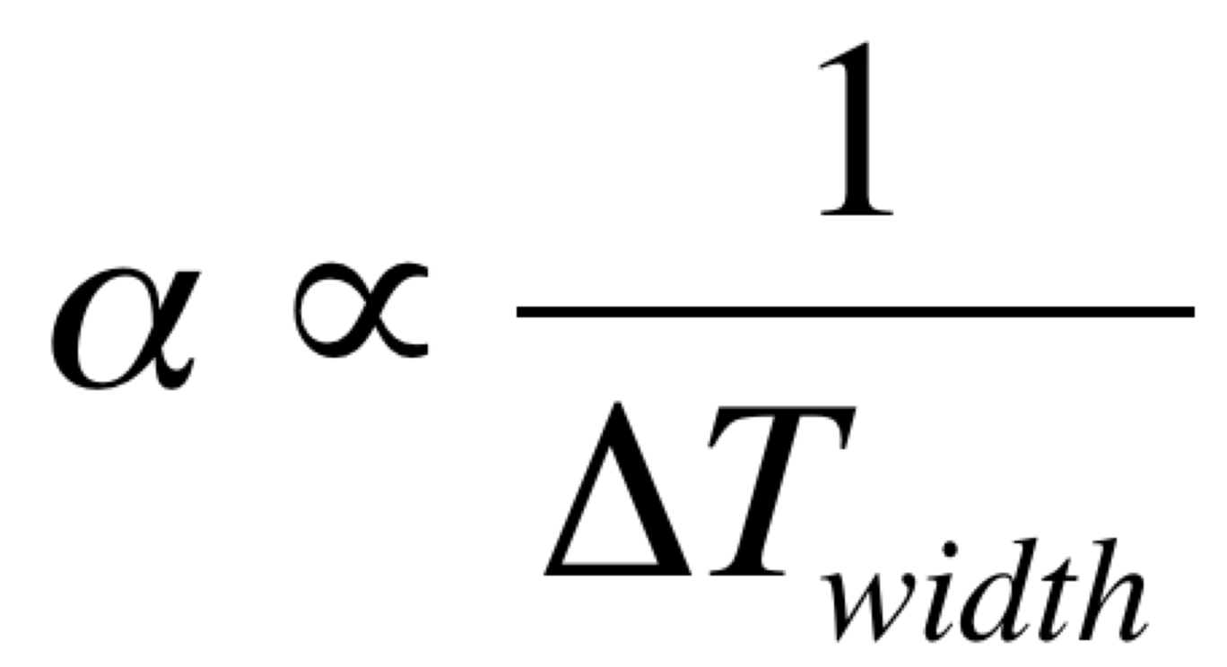
Microcal Energy Resolution
Pushing down microcal resolution
  Most TES work is headed toward optical with extremely low heat capacitance
  0.05eV@10eV (and further linear improvements from pushing down to 50mK)
(C/α) scaled down by a factor of ~1000
Keep α large, keep M small
Applied Physics Letters 87, 194103 (2005); doi: 10.1063/1.2061865
Clarence Chang
Electron energy Thickness of Gold
at calorimeter: Absorber:
100 eV 2.39 nm
10 eV 0.68 nm
Also:
X-Ray microcals are typically 15 μm

Slide 49
TES: IR Photon Counting

Slide 50
Daily Modulation

Slide 51
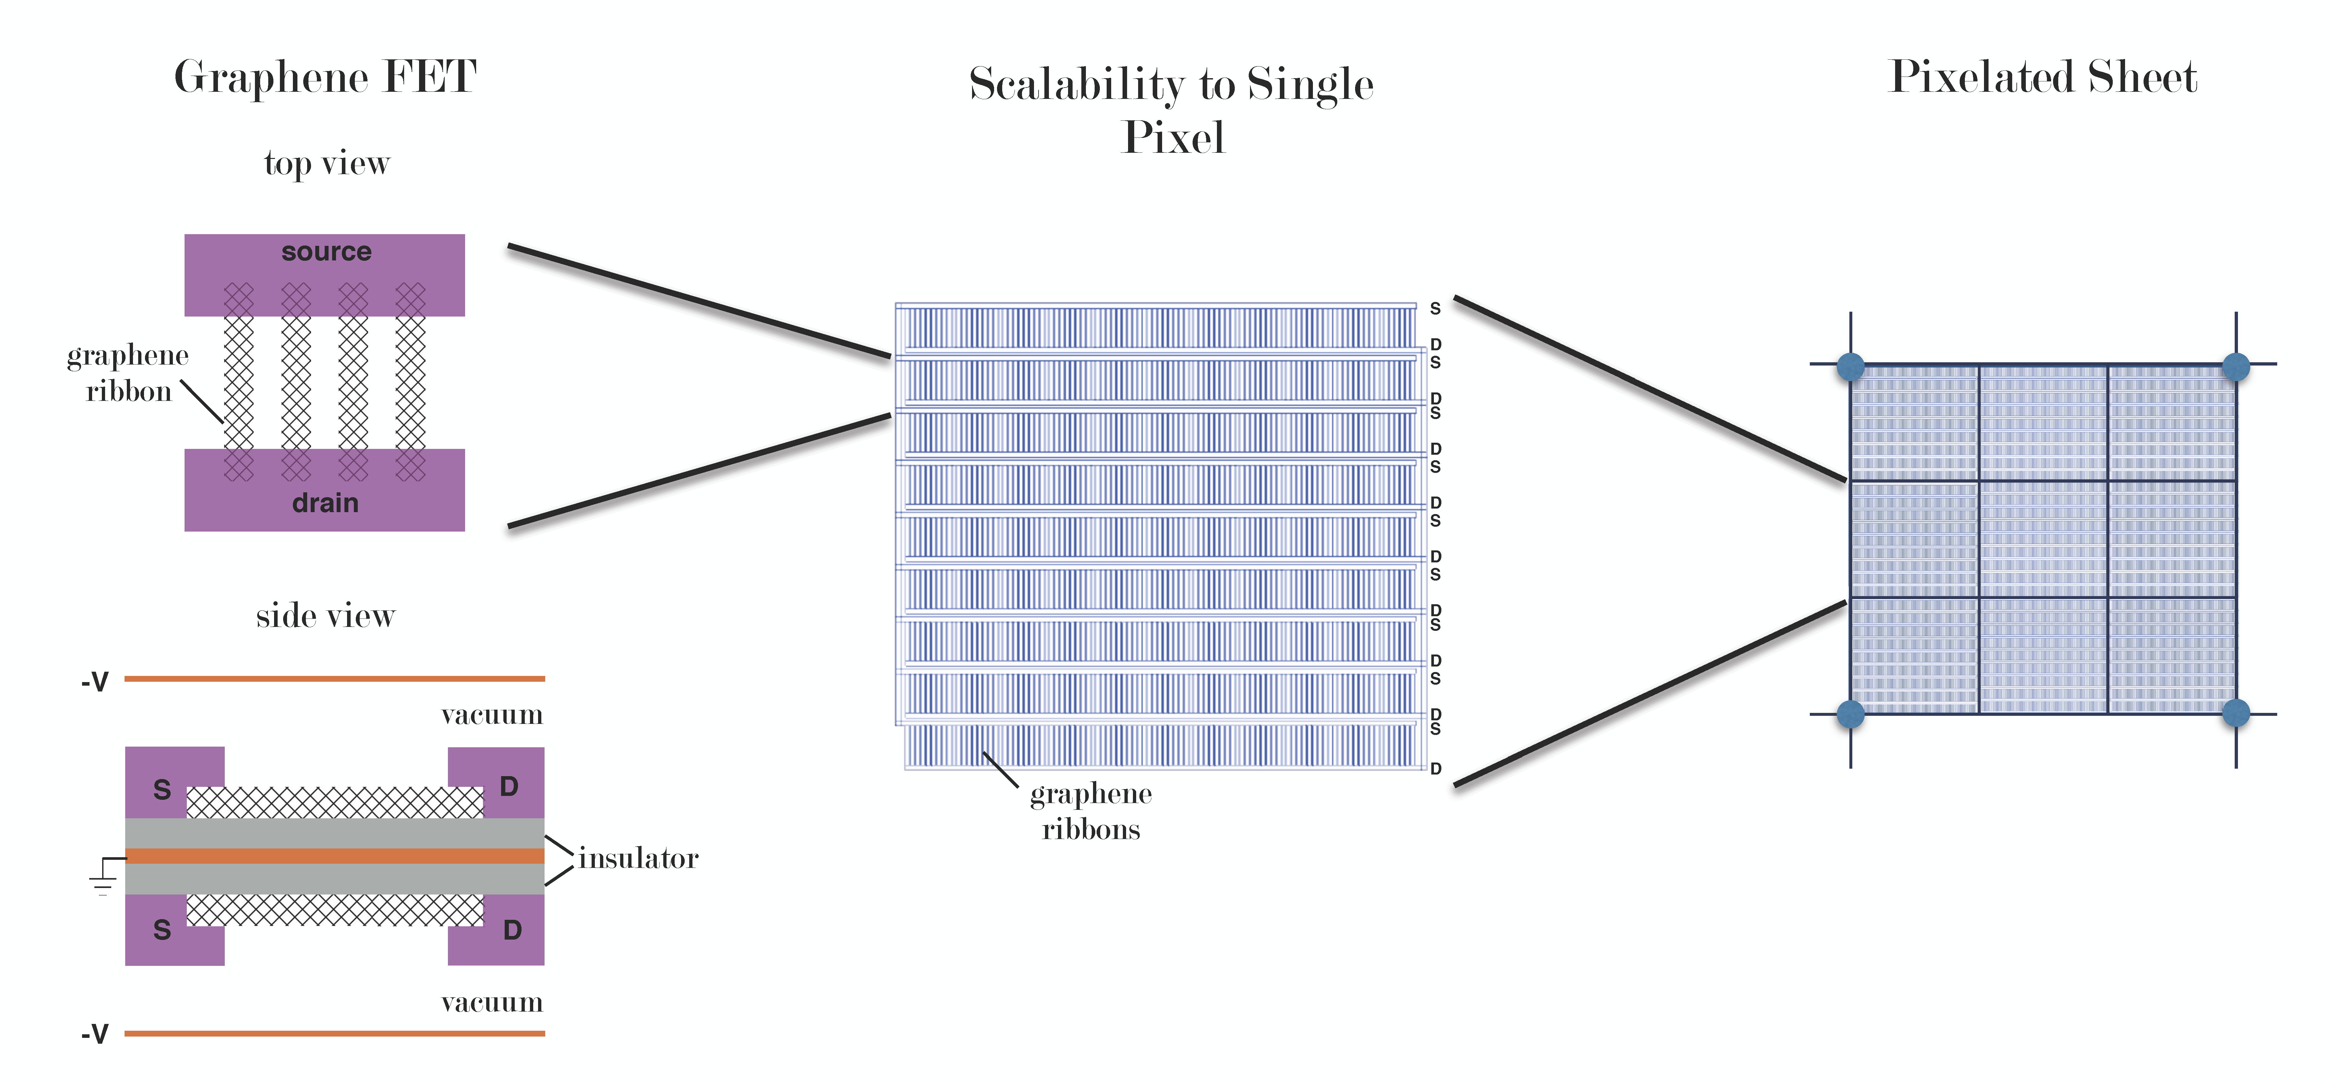
Scaling up ~μm to ~cm

Slide 52
PTOLEMY-G³
2D Targets for Direct Directional Detection of MeV Dark Matter
  Hochberg, et. al, 2016. “Directional Detection of Dark Matter with 2D Targets", http://doi.org/10.1016/j.physletb.2017.06.051
  Graphene field-effect transistors (G-FETs) arranged into a fiducialized volume of stacked planar arrays – Graphene cube (G³)
  Unprecedented sensitivity to electron recoil, at the level of single charge detection
G-FETs provide tunable meV band gaps and provide high-granularity particle tracking when configured into arrays
  A narrow, vacuum-separated front-gate of the G-FET imposes a kinematic discrimination on the maximum electron recoil energy, and the FET-to-FET hopping trajectory of an ejected electron indicates the scattering direction, shown to be correlated to the dark matter wind
Importance for Relic Neutrinos:
Provides an opportunity to “null” experiment with a large “bare” Graphene target (no tritium) to qualify the radiopurity and backgrounds are at the level for relic neutrino detection.

Slide 53
Fiducialized Volume (G³)
G-FET sensor element
FET-to-FET hopping trajectory
Stacked planar arrays of G-FETs
1kg ~ 10¹⁰cm² ~ 10⁹cm³
Individually vacuum-sealed wafers
Cryogenically cooled (4.2K)
Cryopumping of gas contaminants on G³ surface - no line-of-sight trajectories
Low mass substrates with ALD dielectric
20 Graphene Nanoribbon Array (produced at Princeton University)
Resistance-Temperature (RT) and Current-Voltage (IV) curves in progress
Scalability to interdigitated capacitor with pixel areas of 1mm² or larger
Graphene Target: Important Step for PTOLEMY

Slide 54
Projected Low Backgrounds
High radio-purity wafer-level fabrication
  Low background contamination lithography has been demonstrated, see for example ``Cryogenic Dark Matter Search detector fabrication process and recent improvements" by Jastram et. al, 2015. NIM A: 772:14-25.
Ultra-low ratio ¹⁴C/C graphene growth → Push forward on the landmark work done for Borexino (source identified)
  Litherland et. al, 2005. ``Low-level 14C measurements and Accelerator Mass Spectrometry" in AIP Conference Proceedings, vol. 785, p. 48. http://dx.doi.org/10.1063/1.2060452
  A. E. Lalonde AMS Laboratory in Ottawa interested in restarting program to measure ¹⁴C/C at level of 10⁻²¹
Cosmic Ray Overburden
  Pursing possibility of relocating PTOLEMY prototype in an underground laboratory
  An overburden of 3km w.e. would reduce dead-time from self-veto to a reasonable level (estimated to be sub-percent)

Slide 55
Comparing MeV Direct Detection
  New Proposal: PTOLEMY-G³ Hochberg, et. al, 2016. “Directional Detection of Dark Matter with 2D Targets", http://doi.org/10.1016/j.physletb.2017.06.051
Near-term results for MeV Dark Matter expected with 2e⎼ thresholds in Si (DAMIC/SENSEI/SuperCDMS)
Significant overlap in sensitivity to follow up with Directional Detection
(PTOLEMY-G³)
U.S. Cosmic Vision
New Ideas in Dark Matter
http://arxiv.org/abs/1707.04591

Slide 56



Neutrino Capture σ*β
Tritium compares well with Gallium and Chlorine (and has no threshold)
Tritium
σ(10⁻⁴⁶ cm²)*β
Gallium
Chlorine
Cosmological ν
σ(10⁻⁴⁶ cm²)*β
2x10⁻⁴eV
Flattens out at low energy:
σ*β=(7.84±0.03)x10⁻⁴⁵cm²

Slide 57


Neutrino Love Affair
Neutrino Portal
  Mirror Universe → Restore exact L-R symmetry under Mirror Parity by introducing a Dark Sector mirror copy of the visible sector Gauge Group with SU(5)^{VS} x SU(5)^{DS}
Neutrino mass terms (half dark?)
  LH ν coupled to any SM singlet and scalar vev – why not a Mirror RH ν charged under a Dark R and coupled with a Higgs bi-doublet with vev?
  Weinberg 5th Operator
Small mass from Seesaw mechanism (heavy Majorana neutrino or slow roll scalar potential?)
$$ℒ\sim yΦ_{GUT}LR$$
$$ℒ\sim Λ^{−1}(Φ_{VS}L)(Φ_{DS}R)$$
Notes:
Dimopoulos-Wilczek (DW) mechanism for generating a vev that provides the double-triplet splitting. SUSY GxG integrate into string theory. SO(10)xSU(5) also possible.

Slide 58
Mirror thermal relics
1 sec
Visible
Relativistic v’s through recombination
Mirror
Non-relativistic v’s at the point of (visible) recombination?
Would a weak (scalar L-R) interaction between relic v’s and mirror relic v’s alter the local number density of CNB?
Similar Ideas:
(Solar) “Dark MSW” https://arxiv.org/abs/1702.08464
(Cosmic Rays) “High-Energy DM Neutrino” https://arxiv.org/abs/1612.08472
(DM Direct Detection) “Exotic Neutrino Interactions” https://arxiv.org/abs/1701.07443
(CMB and LSS) ”Constraining DM-Neutrino Interactions” https://arxiv.org/abs/1401.7597
→ Limit σ_{DM-v} < 10⁻³³ (m_{DM}/GeV) cm² (for constant cross section, Early Universe MSW)
IAS Sabbatical (2010)

Slide 59
ΛCDM Fits for Σ and Δ
Carlos Peña Garay
Jimenez, Peña Garay & Verde, 2010, 2016

Slide 60

Projected Sensitivity
  Projected detection sensitivity exceeds an equivalent mass target of low noise (5 e- threshold) germanium cryogenic detectors
  With a modest, small-scale deployment of PTOLEMY-G³, a fiducialized volume of 10³ cm³ will search down to σ~10⁻³³ cm² at 4 MeV in one year, uncovering a diffcult blind spot inaccessible to current experiments
Xenon10

Slide 61
Directional Detection Sensitivity
  The new approach of 2D targets opens up for the first time direct directional detection of MeV dark matter

Slide 62
Annual Modulation of Cosmic Relic Neutrinos
B. Safdi, M. Lisanti, et al.
http://arxiv.org/pdf/1404.0680.pdf
Sensitivity to relic neutrino
velocity and direction through
annual modulation amplitude (0.1-1%) and phase
-- Not anytime soon
Possible Sensitivity Enhancement:
Polarized Tritium Nucleus
http://arxiv.org/abs/1407.0393
Safdi, Lisanti, CGT
CMB rest frame = Relic Neutrino Rest Frame?
Velocity sensitivity provides possibility to measure:
Relic Neutrino Rest Frame, and potentially,
Relic Neutrino Temperature (from velocity and mass)
m_{ν} (lightest) = 0? contribution to Unbound fraction?

Slide 63

HV biasing and monitoring system of the PTOLEMY detector electrodes
Voltage provided on a locking capacitor
→ not a resistive divider
Field Mill voltage monitoring
→ On path to supersede all precision voltage systems
LNGS (recent photo)
INFN
Cocco, Messina

Slide 64


Locking capacitor 200 nF
Connection to the Field Mill
Detector/electrode side. The
HV connection is still missing.
Dry N pipe.
In future also
SF6 to prevent
discharge in air.
The plexi-box
is also important
for safety.
Side view of the Field Mill
Connection
to DC power
supply
HV switch to charge up the
capacitor (top position), to
discharge (bottom). Normal position (middle)
while measuring.

Slide 65
n-channel MOSFET
Operates in “enhancement” mode
when conduction opens up in channel region for V_{GS}>V_{Th}
6T-SRAM
SEU from neutron interactions in the depletion region – also contribute charge carriers → basis for SRAM neutron detectors

Slide 66
Graphene FET
One of the most interesting properties of Graphene (noted by Geim et al.) is the sensitivity to a single electric charge (added or removed) in a Field-Effect Transistor configuration – shown here at room temperature
What are the limitations to this
sensitivity and will it create new
opportunities for light DM exps?

Slide 67


Commercial Monolayer Graphene
High quality 1 cm² samples readily available (free samples)
  Common substrates for transport: Copper, Si/SiO₂
Single crystals are less common (discussed later)

Slide 68
Graphene Nanoribbon Array FET via FIB
GNs array: 20 GNs with 40nm width on SiO₂/Si substrate
Bottom gate FET: Pt contacts and channels are deposited with 100nm thick by FIB direct deposition
Before metal deposition, mill the graphene around GNS and on the area for contacts and channels
Raman results for GNs: only G and 2D peaks for pristine graphene. D and D’ peaks appear on GNs

Slide 69

Graphene nanoribbon growth on SiC (in process)
GNs are grown from lithographically patterned trenches in SiC.
When a trench in SiC is oriented perpendicular to the ⟨1̅100⟩ direction, the graphene that grows has its AC edge parallel with the step edge [Figure1 c,e].
When a SiC trench is oriented parallel to the ⟨11̅00⟩ direction, the graphene that grows has its ZZ edge parallel with the step edge(Figure1 d,f)
We use two type of SiC: semi-insulating and n-type semiconducting.
Figure 1. Orientation of the SiC trenches relative to the graphene. (a) The graphene lattice relative to the Brillouin zone in (b). (c,d) Schematic of a pregraphene growth trenches with (c) AC and (d) ZZ sidewalls. AFM images of graphitized SiC trenches with (e) AC edge graphene and (f) ZZ edge graphene. Dark areas are the trench bottoms. ¹
1. Conrad, E. H. The Bottom-up Growth of Edge Specific Graphene Nanoribbons. Nano lett.(2014).

Slide 70

Semimetals
Properties of semimetals:
  Dirac point provides a resistivity spike at a single gate voltage and the height is set by the inverse of the mobility
  Mobility increases by an order of magnitude at cryogenic temperatures
  Small band gap (~meV) induced in Graphene could provide clean on/off transitions

Slide 71
Graphene UHV Vacuum Window
Free-standing Graphene covalently bonded to Si (Si etched away)
~ few thousand layers (for optical opacity)

Slide 72

Project 8 Prototype (Harmonic Trap)

