Slide 1

Photosensors studies
(for HK and IWCD)
Vincenzo Berardi
INFN - Bari
Jennifer Consortium General Meeting – 06 October 2017 KEK, Tsukuba

Slide 2
Current efforts, progress, plans
(even outside Jennifer)
mPMT R&D in Italy (and Canada)
Acrylic R&D in Italy
Test of New 3 inch PMTs
mPMT electronics in Italy and Poland
Simulation (OD), reconstruction and PMT testing in UK
Initial design based on Super-K Outer-detector:
  ~ 6700 20 cms (8”) PMTs facing outward
  1% coverage
  OD Water thickness : 1m barrel / 2m top and bottom
  Basic geometry and digitization implemented.
Remarkable progress in understanding the mPMT concept and in advancing potential designs!

Slide 3
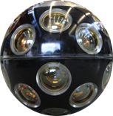
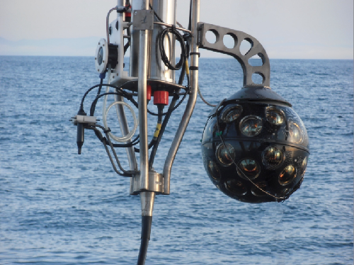
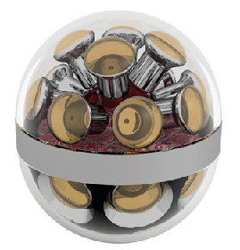
The mPMT concept
A new design for optical sensors developed by the Km3NeT collaboration
KM3NeT experience
Lower price
Several manifacturer of small PMTs
Smaller transit time spread
Negligible effects due to magnetic fields
Almost uniform coverage
Photon counting
High granularity for background rejection
Directional sensitivity
Local time coincidences between PMTs inside the same mPMT
Reconstruction capability improved by exploiting directionality of photodetectors
IceCube mDOM mDOM prototype to be tested in PINGU
Possible application of mPMT in Hyper-K and E61

Slide 4
mPMT in Hyper-K and E61
Potentiality for physics:
Increased granularity enhanced event reconstruction → multi-ring events
Different PMTs orientations → directional information → reduced effective dark hit rate
Improved signal-to-noise separation for low energy events such as solar/supernova neutrinos and the neutron tagging
Technical benefits:
Pressure resistent vessel
Waterproofing vessel → protective for photosensors, readout electronics, monitoring, calibration devices
Compact system → simplified sharing of integration, testing, delivering, installation. Important advantage for mass production and installation, as in our case.

Slide 5
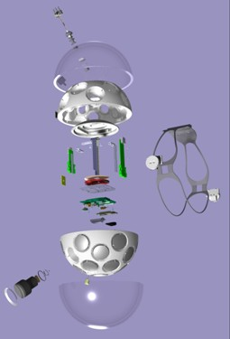
mPMT components
Complex structure
Acrylic vessel
Cooling system
Penetrator
PMTs
PMT bases
Optical-gel
pressure gauge
PMT reflector rings
PMT support structure
PMT Read-out
Main Logic Board
Calibration system
Temperature/Humidity sensors
Great opportunity for international contributions:
in R&D activities
in construction/assembling/testing
as is successfully done for the KM3NeT and IceCube

Slide 6
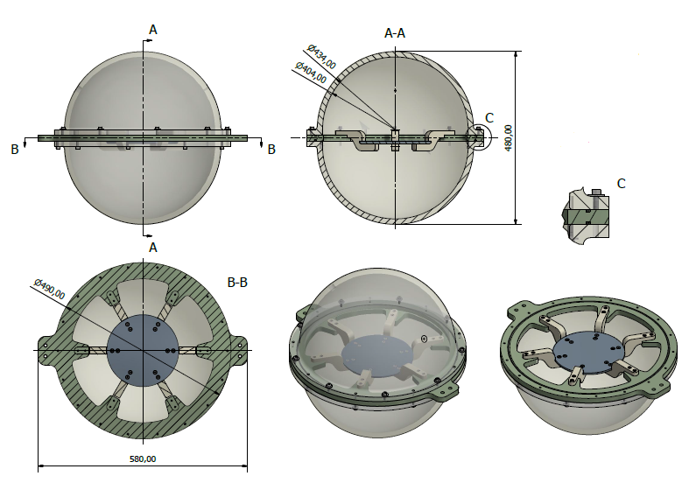
mPMT Prototype
- 17’’ diameter of the vessel (the same as in Km3Net)
- 2 hemisphere:
- ID hemisphere: 19 PMTs
- OD hemisphere: 4/7 PMTs
Acrylic: EVONIK UV transmitting PLEXIGLAS® GS
3’’ PMTs:
Hamamatsu R12199-02 (as in Km3Net)
(for the moment)
Cooling system: design studied at INFN Bari
PMT Read-out:
Sample&Hold+ADC

Slide 7
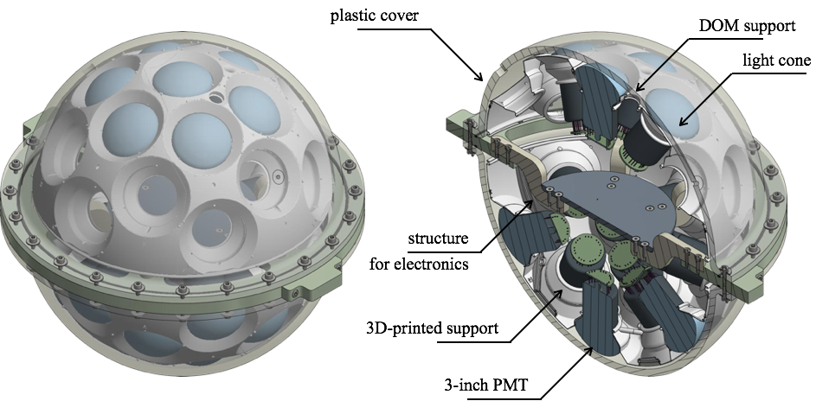
mPMT design

Slide 8
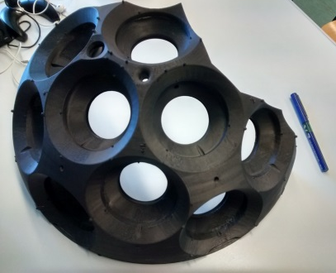
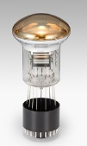
PressureVessel
The acrylic vessel of the first prototype will be a sphere with a diameter of about 17’’ (432 mm, like in Km3NeT) and a thickness to define after last numerical simulations.
A preliminary sketch for acrylic spherical vessel + cooling (seal) system
A seal will be used between the acrylic hemispheres and metal support.
Inside:
Read-out system
PMT support
3’’ PMTs
Timeline:
1 week for the production of the hemispheres, since the design established
1-2 weeks for the cooling system, since the design established
∼3 days for 1/4 of spherical support
x4 = 1 sphere

Slide 9
PressureVessel activity
Test schedule:
Optical test @ completed
Mechanical test @ completed (processing);
Absorption test @ delayed (ongoing);
Radioactivity measurements: planned after PMT tests
Pressure test: @ Navy labs (scheduled in october)

Slide 10
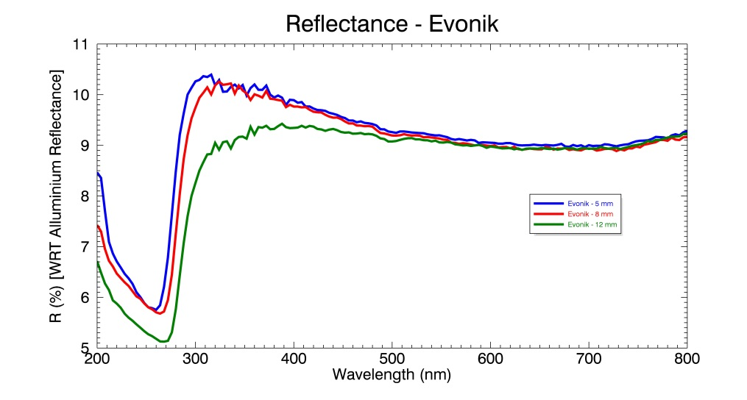
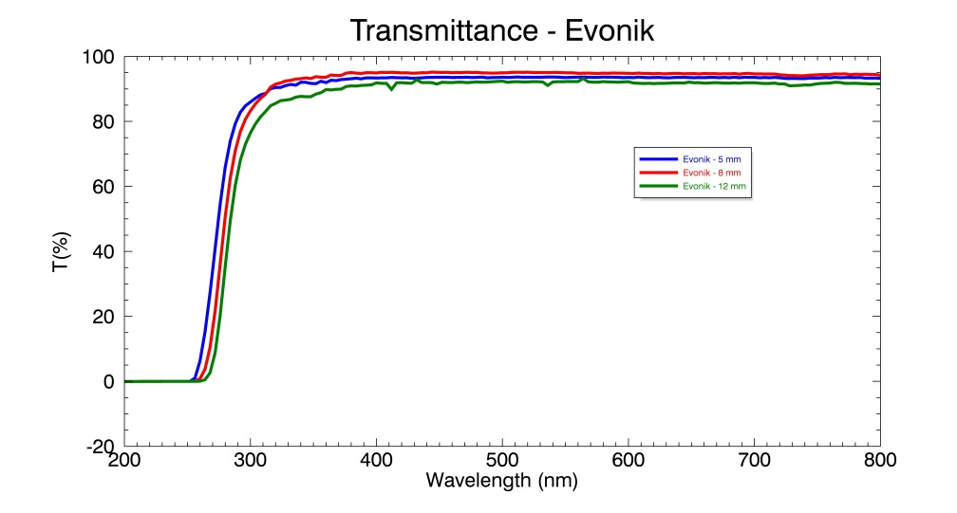
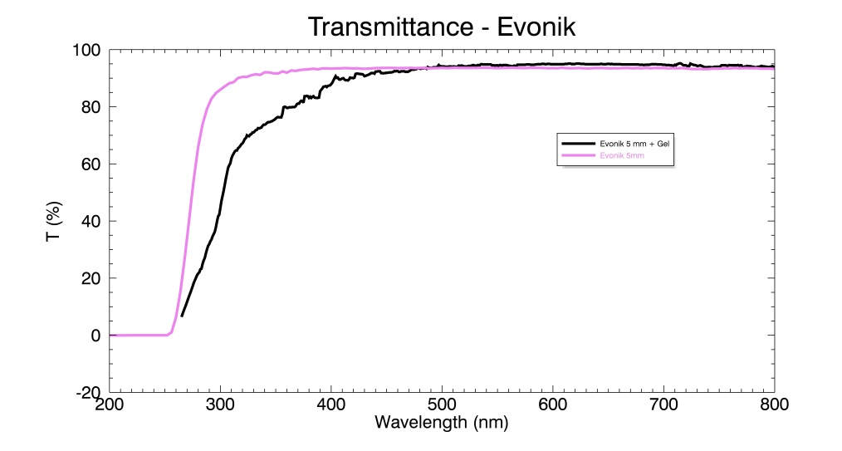
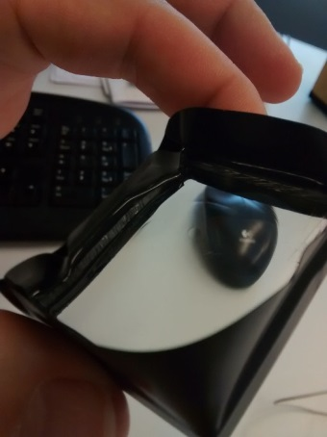
Optics tests
EVONIK UV transmitting PLEXIGLAS® GS choosen for the construction of the prototype.
Checked compatibility between optical gel and acrylic and measuread the transparency of acrylic+optical gel:
In Canada and in Japan, other optical gel options under study
Notes:
Sostituire grafici con quelli generali

Slide 11
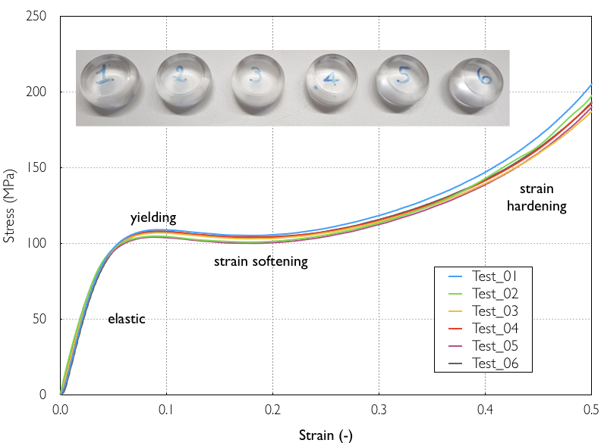
Layers have found a new equilibrium and the compression is now superlinear till breakdown
horizontal landslide of the different layers of materials
Elastic compression, roughly linear (Hooke’s Law)

Slide 12
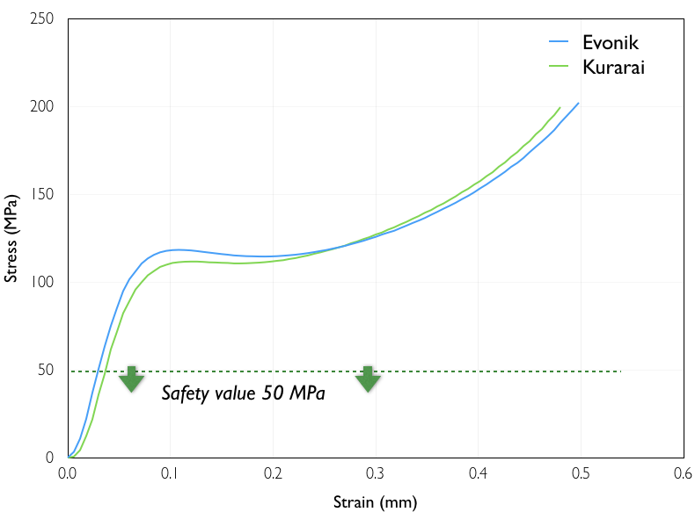

Slide 13
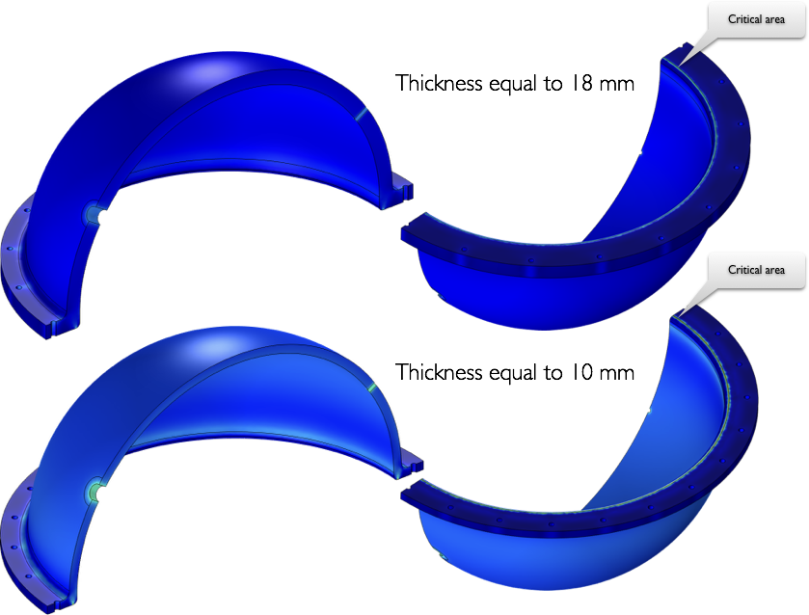
Mechanical tests: simulation (stress)

Slide 14
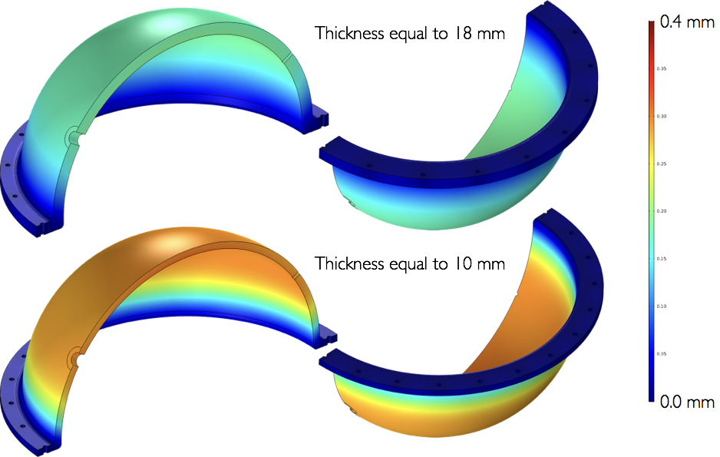
Mechanical tests: simulation (displ.)

Slide 15
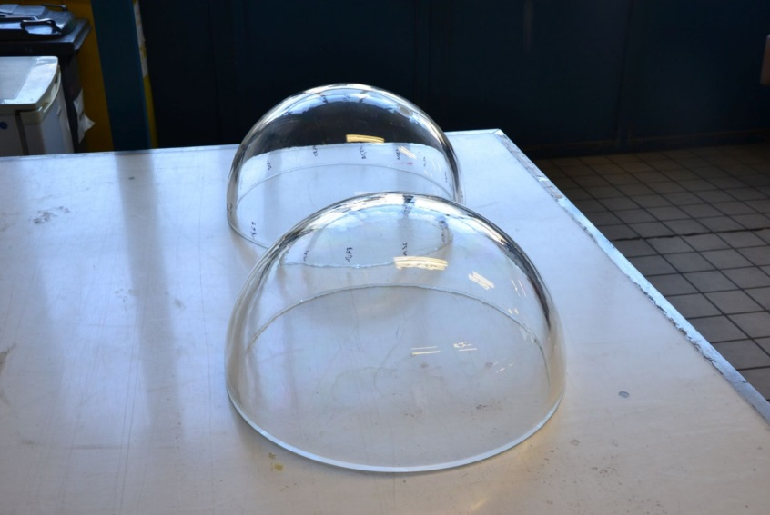
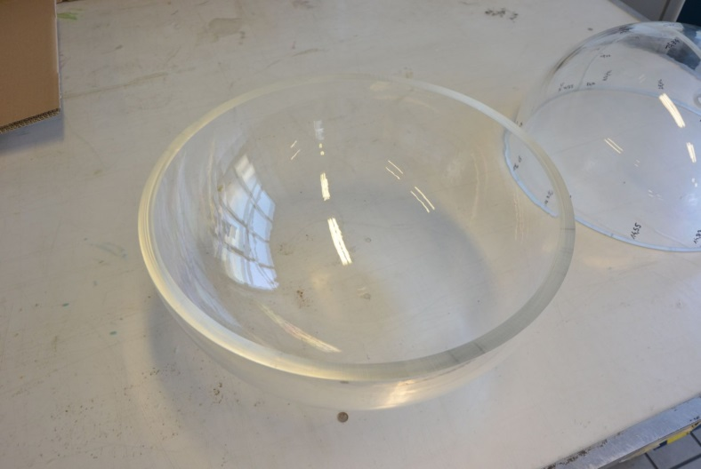
PressureVessel Prototipes
The acrylic vessel prototypes have been produced in 3 different thickness, starting from 15, 18 and 20 mm.
Vessel Production:
Pre-production test is passed.
Our three vessels in production phase.
These vessel will undergo to pressure test (at Italian Navy, in La Spezia or at INFN-LNS pressure test facility)

Slide 16
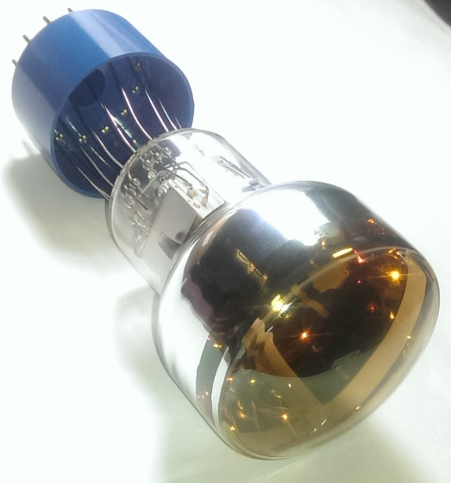
Setup at QM
PMT testing
Testing 3’’, 5’’, 8’’ PMTs. Useful for both IWCD and HK.
New type 3’’ arrived (D793KFL) with much improved 1 PE TTS σ(1.6ns)
Black box with automated control on the LED position w.r.t the photocathode
Optical fibre
D783KFL
Test prototype
Possible tests:
Linearity
Rise time/fall time/Timing resolution
Response time / jitter
Dark rate vs gain
Single PE performance
Surface uniformity (time/charge)
Expanding to:
Long term stability / ageing
QE Frequency response
Effect of magnetic fields
Mechanical, coupling with water
9302B flat
9354KB
XY stage

Slide 17
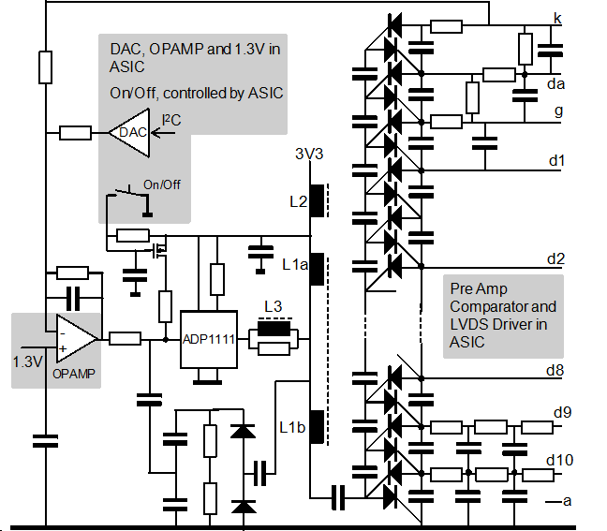
Voltage Multiplier Circuit
A basic Cockcroft-Walton (CW) voltage multiplier circuit design developed by Km3Net Collaboration (See P. Timmer, E. Heine, H. Peek, JINST 5 (2010) C12049) used to generate multiple voltages to drive the dynodes of the photomultiplier tube.
10 different voltages from 5 volt supply
Similar HV circuit developed at INFN-Na
Notes:
The circuit realized to provide the high voltage to the PMTs is based Cockcroft-Walton voltage multiplier, it’s similar to the circuit developed from the km3net collaboration.
This circuit make possible to distribute the 10 different voltages required by cathode and dynodes of the PMTs starting from a 5 volt supply with a very low power consumption.

Slide 18
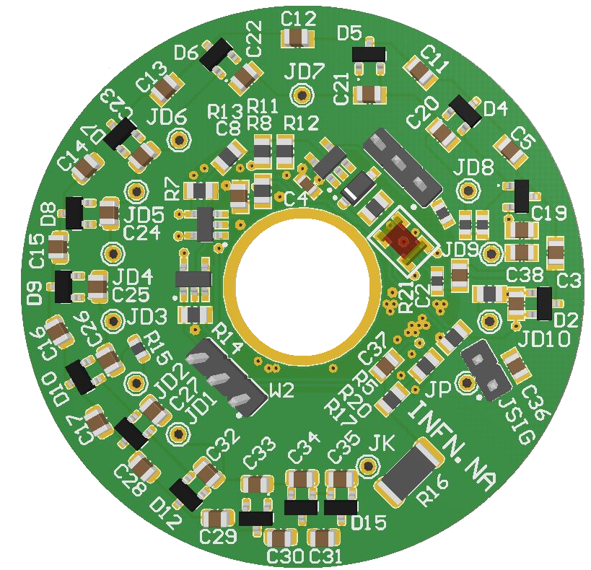
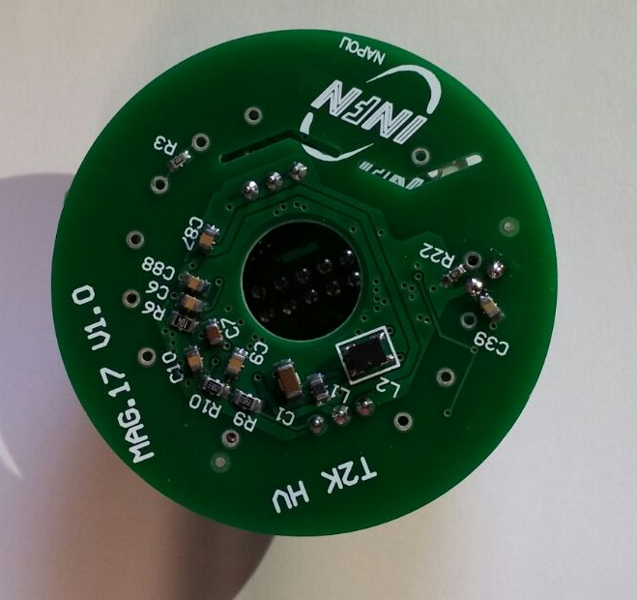
Voltage Multiplier Circuit
HV circuit ready and preliminarly tested
Preliminary result:
Cockcroft-Walton (CW) voltage multiplier CW power consuption: 2-3 mW
Global power consumption ∼13.5 mW
Hole to reduce mounting space
betwen electronic to PMT
Total power dissipated for HV generation in an mPMT module is about 26 × 13.5 mW = 350 mW
Notes:
From the tests done on the circuit we observed a power consumption of about 13.5 mw.
So we can say that the total power consumption, from high voltage distribution, in a multi PMT module with 26 PMTs is at about 350 mW.
This value can be optimized but match with the request.
The hole in the middle of the board let us to put the electronic circuit very close to the PMT saving space.

Slide 19
PMT Read-Out
Requirements:
Low consumption: < 4W
Proposed solution:
Sample&Hold+ADC
    Integrated Read Out Chip: 32-channel fully-analogue front end ASIC dedicated to the gain trimming and read-out of SiPM detectors;
    Sample&Hold+ADC based on discrete components
Notes:
About the redout of the PMT we have the requirement of a total power consumption of 4 W.
We are evaluating two different way.
The first based on ASIC and the second based on Sample&Hold,ADC and TDC.
Both have to satisfy the request of low power consumption, at least 10 bit of energy dynamic range and 300-500 ps of time resolution.

Slide 20
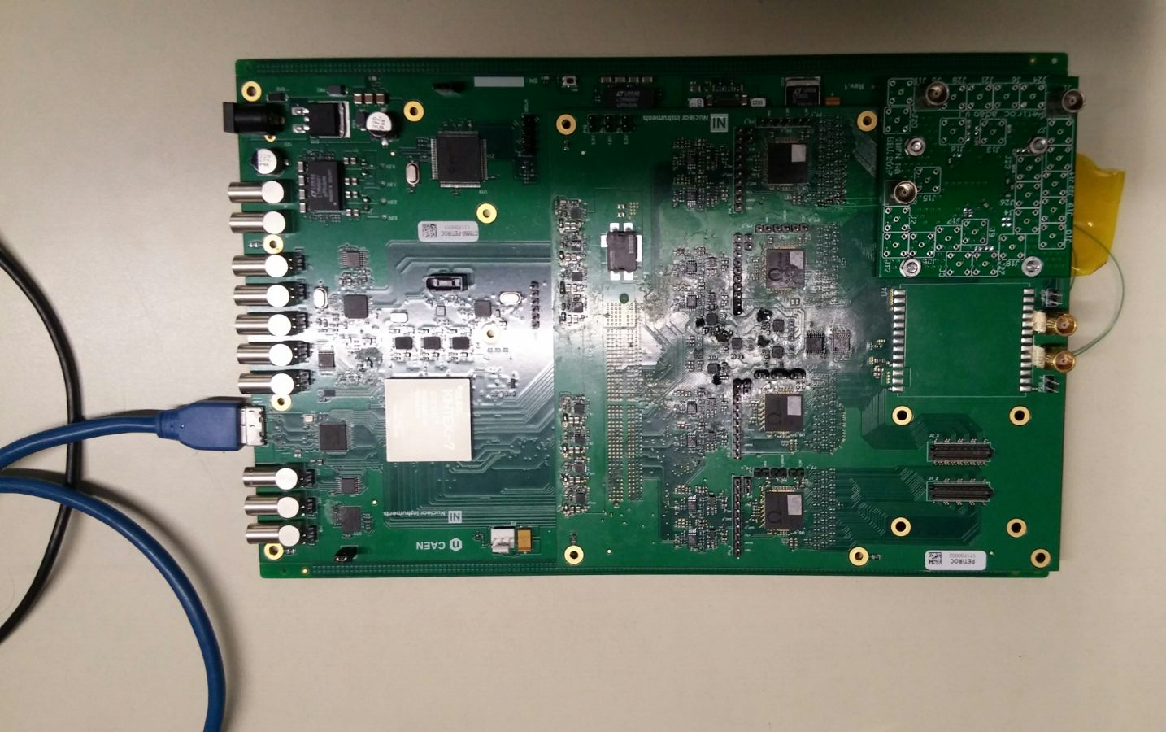
PETIROC
PETIROC Integrated Read Out Chip by OMEGA in collaboration with CAEN
A first version of the PETIROC evaluation board has been realized by CAEN
The board has been testd at INFN-Napoli last week by our group and CAEN technicians
Improvements of the PETIROC chip required.
Optimization and test ongoing now at CAEN
CAEN products: DT5550W and A1PETIROC
Notes:
The second solution examinated was the ASIC PETIROC in collaboration with CAEN.
The first great advantage in this case is that che ASIC accept negative signal but it’s stil request an attenuation.
The development and the test on this board are going on at CAEN.

Slide 21
Conclusion 1/2
mPMT Prototype:
3’’ PMT tubes under test (Italy and UK);
Read-out electronics: undergoing test (Italy and forthcoming in Poland);
Acrylic Vessel:
  Mechanical and optical tests OK
  Vessel design and simulation: ongoing
  Acrylic samples pre-production: OK
  Acrylic samples production for pressure tests: ongoing

Slide 22
Conclusion 2/2
A first prototype for Voltage Multiplier Circuit developed and tested
Optimization studies ongoing
Under study 2 possible solution for PMT Read-Out based on Sample&Hold+ADC:
  PETIROC Integrated Read Out Chip by OMEGA in collaboration with CAEN
  Dedicated board based on discrete components developed at INFN (collaboration with Poland)
Notes:
In conclusion we have a board to provide the high voltage distribution that satisfy the low power request

Slide 23
backup

Slide 24
Mechanical tests: simulation
Wall Thickness.The wall is assumed to be very thin compared to the other dimensions of the vessel. As a result, we may assume that stresses are uniform across the wall.
Symmetries. In spherical vessels, the geometry and the loading are spherically symmetric. Therefore the stresses may be assumed to be independent from the two angular coordinates of the spherical coordinate system.
Uniform Internal Pressure.
Ignoring End Effects. This includes supports and cylinder end caps. The assumption is that disturbances of the basic stress state are confined to local regions and may be ignored.

Slide 25
Mechanical tests: simulation
All shear stresses are zero τ_{r𝜙} = τ_{𝜙r} = 0 and τ_{θ𝜙} = τ_{𝜙θ} = 0
The normal stress σ_{rr} varies from zero on the inner free surface to the the pressure p.
The normal stresses σ_{θθ} and σ_{𝜙𝜙} are equal and constant over the entire vessel, equal to σ.

Slide 26
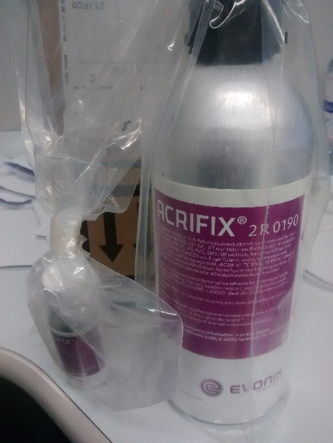
PressureVessel closure system
In the multiPMT option, the two acrylic hemispheres can be glued by using a specific glue for acrylics
EVONIK proposed the glue Acryfix (shipping just got):
- ACRIFIX® CA 0120 + ACRIFIX® 2R 0190
Note that none of Evonik glues are UV transparent
Optical fluorescence tests have been planned on the glue
Based on our simulation a mechanical sealing is to be preferred (under study)

Slide 27
PressureVessel fabrication system
In principle there are two ways of making a spherical object and a combination of them.
Both processes need the sheet to be heated either by recirculating air or infrared heating before processing.
1) a mold made from a positive and negative part. Material of the mold depends on the necessary optical quality and the number of items made. Mostly its either Medium-Density Fibreboard (MDF) with a very smooth surface or Aluminum. The good quality of the mold is the best tool to have a final product close to zero defects.
2) Blowing the flat sheet is another method mainly used for dome light manufacturing (big quantities, less stable process)
3) combination of these two methods by blowing into a positive mold.
The last method has been suggested by Evonik. That way the outside contour is controlled and tolerance for fitting the two hemispheres is minimized.

Slide 28
Open issues
This detector will allow us to profit from increased granularity in imaging Cherenkov rings, better timing resolution, directional information
BUT, physics requirement for mPMT need to be clarified
It is still to be demonstrated
mPMT advantageous relative to 20” PMTs
complementary capabilities/features
Physics studies are a must
vertex resolution for low E?
solar, relic neutrino
p→K+ν?
applications where darknoise, etc. are critical, e.g. n-tagging
…….

Slide 29
Open issues
What’s the best design for our projects?
what’s the best granularity? (3” is okay? or can we use larger PMTs?)
what timing resolution is needed? (PMTs and electronics requirements)
how much directional information is needed (light collector, PMT direction)
what about calibration devices?
what level of Rn containment is? needs testing/measurements!
How PMTs and mPMTs coexist in the same detector?
Can we consider a “universal” interface for mPMT and PMT?
How to manage the mPMT assemblig, QA, testing…..?
Mass production is more challenging due to complex assembly works
sourcing/testing of components
“global” participation in the production needed
can we manage this in a reasonable time and with high reliability?
Can we share informations and experiences and profit as much as possible from E61 and Hyper-K studies?

Slide 30
Setup at QM
Photosensors
Testing 3’’, 5’’ (just ordered), 8’’ PMTs. Useful for both IWCD and HK.
New type 3’’ arrived (D793KFL) with much improved 1 PE TTS σ(1.6ns)
Black box with automated control on the LED position w.r.t the photocathode
Optical fibre
D783KFL
Test prototype
Possible tests:
Linearity
Rise time/fall time/Timing resolution
Response time / jitter
Dark rate vs gain
Single PE performance
Surface uniformity (time/charge)
Expanding to:
Long term stability / ageing
QE Frequency response
Effect of magnetic fields
Mechanical, coupling with water
9302B flat
9354KB
XY stage

Slide 31
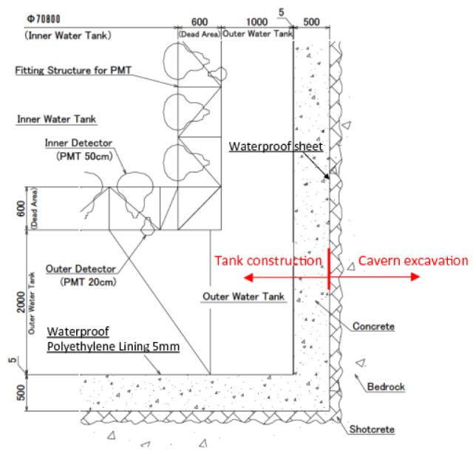
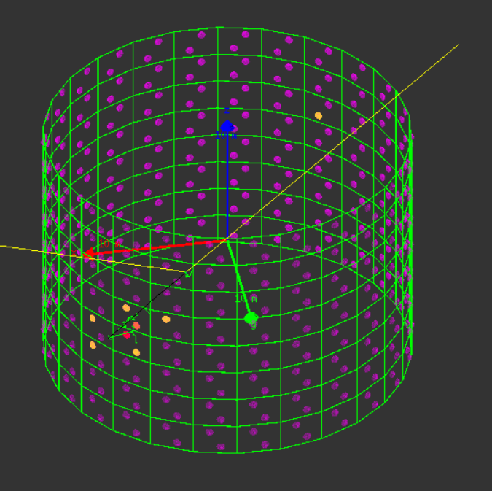
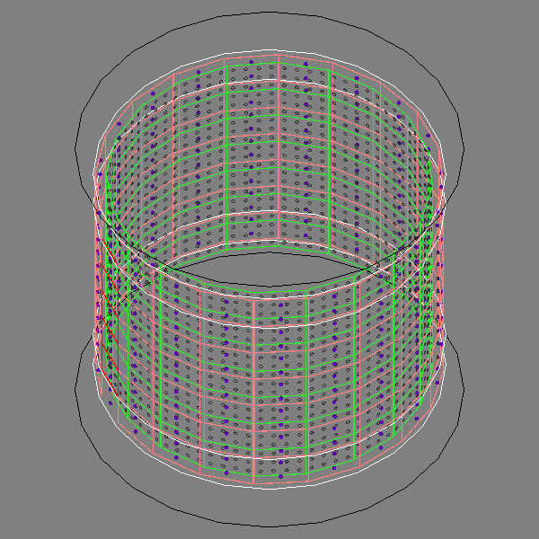
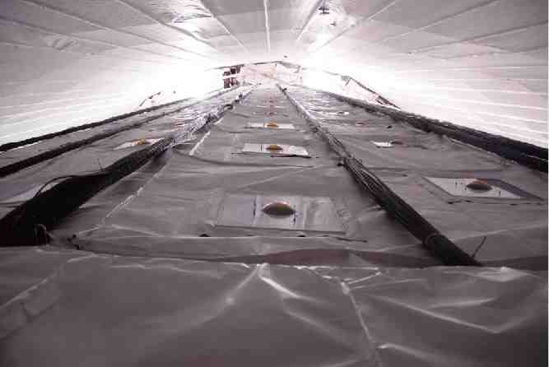
Outer Detector Simulation
Initial design based on Super-K Outer-detector:
  ~ 6700 20 cms (8”) PMTs facing outward
  1% coverage
  OD Water thickness : 1m barrel / 2m top and bottom
  Basic geometry and digitization implemented.
ID + OD
Orange : Tyvek
Purple : OD PMTs
Notes:
31

