Slide 1

Task 2.4 Status of Luminosity Monitor
Philip Bambade
LAL-Orsay
LAL group:
Cécile Rimbault, Didier Jehanno (elec. engineer), Yann Peinaud (mech. engineer)
Dima El Khechen (PhD student → CERN/FCC-ee), Pang Chengguo (PhD student)
Viacheslav Kubytskyi (postdoc), Salvatore di Carlo (postdoc), P. B.
KEK group:
Sadaharu Uehara (Belle II, ZDLM), Yoshihiro Funakoshi, Takashi Kawamoto, Mika Masuzawa, Toshiyuki Oki + several other experts from SuperKEKB
JENNIFER general meeting KEK 6 October 2017

Slide 2
Task 2.4 Deliverables
Release optimized sensor configuration and readout for accelerator feedback (month 36)
➔ Due in March 2018 (during Phase 2 Commissioning)
Two intermediate steps:
Deploy first diamond sensor prototype for synchronization test during 2015 single beam commissioning with nuclear bremsstrahlung background (month 6)
Deploy full set of diamond sensors for luminosity measurements during first commissioning and tuning of colliding beams in 2016 (month 18)
➔ Both done during Phase 1 commissioning in 2016
Task 2.4 Secondments
15 person-months ➔ already used 92.2%
➔ Remaining 7.8% (16 + 19 days) will be used in 2018

Slide 3
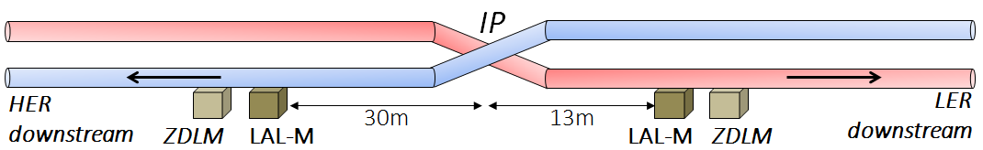
Main goals of luminosity monitor
Input to horizontal IP orbit feedback ➔ Train Integrated Luminosity (TIL)
Integrated bunch-by-bunch luminosities ➔ Bunch Integrated Luminosity (BIL)
Comparison with absolute Belle II luminosity to probe QED screening effects in radiative Bhabha process at vanishing angle (from the nm level vertical beam size)
Specifications
TIL ➔ 10⁻³ → 10⁻² @ 1 kHz 2500 × BIL ➔ 10⁻² @ few Hz
Method
- ∼ 0.2 barn cross section of radiative Bhabha process at vanishing scattering angle
- e⁺ detection ∼ 10 meters after IP in LER
- γ detection ∼ 30 meters after IP in HER
- 140 μm and 500 μm sCVD diamonds with fast charge and current amplifiers
- ZDLM (based on Cherenkov + scintillator)
- 1 GHz ADC + FPGA readout to compute TIL and 2500 × BIL on-line
- DAC to output TIL to SuperKEKB lock-in amplifier for feedback control (initially…)
- EPICS and GUI for convenient TIL and 2500 × BIL transfer, display and “on-line” analysis
- Data storage and archiving for off-line analyses

Slide 4
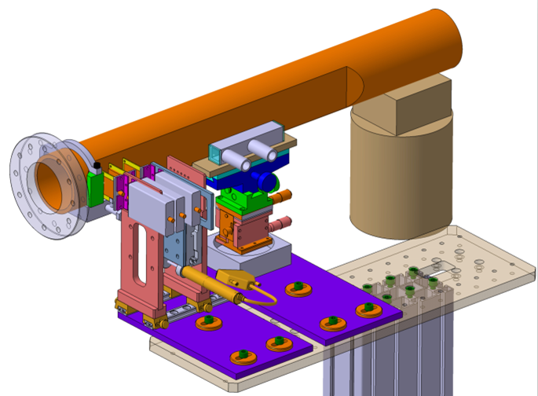
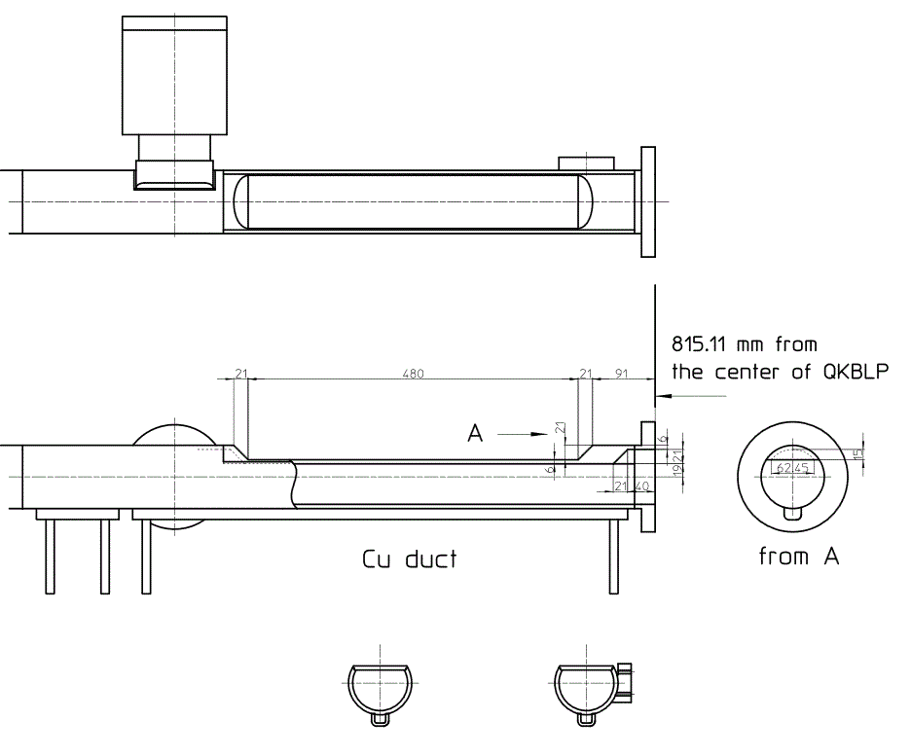
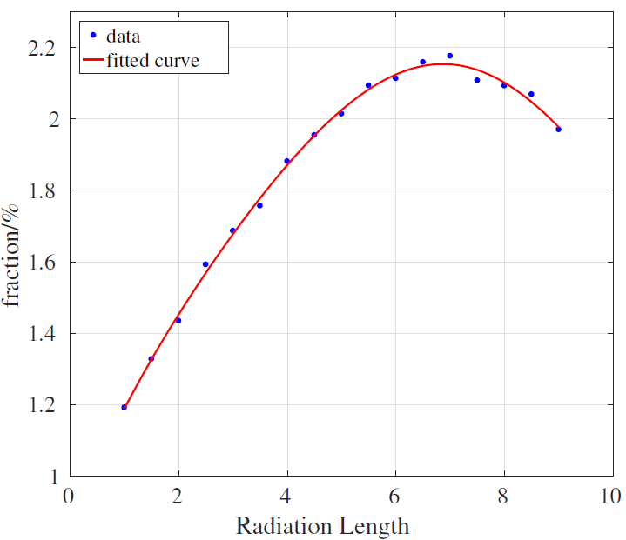
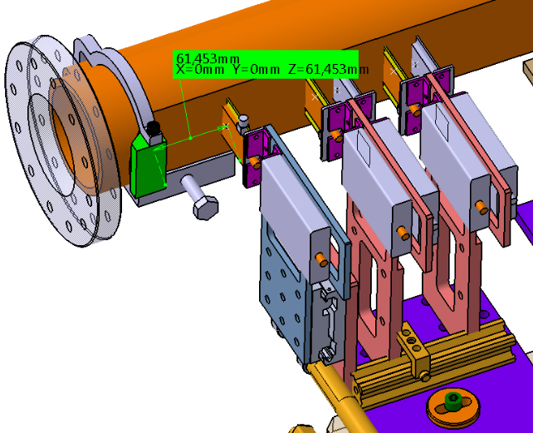
New specially built 45° “window shape” beam pipe to be installed in LER in January 2018 (Kanazawa-san, SuperKEKB)
Window + tungsten radiator boosts detected Bhabha e⁺ fraction up to 2%
➔ 100 × rate with normal beam pipe
Optimization with GEANT4
Yann Peinaud
Chengguo Pang

Slide 5
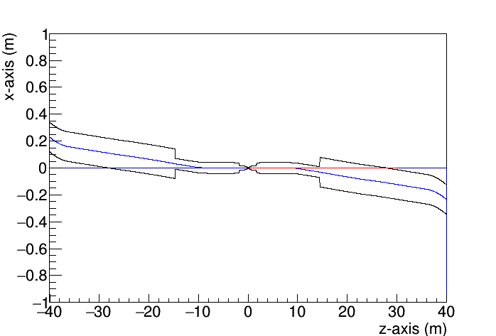
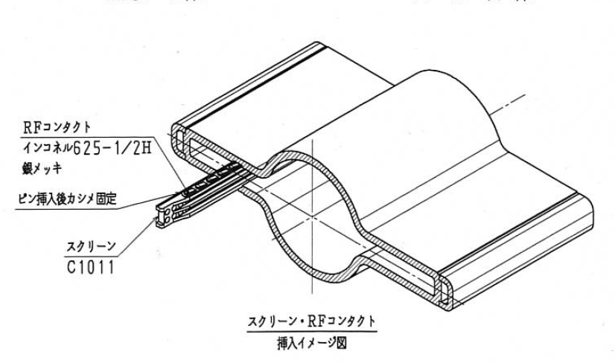

Photon tracking in HER
Exit point
Original library developed for photons tracking
A photon coming out with zero angle from the IP hits the beam-pipe at s=28.01 m
The majority of the photons hit the antechamber
$$γ$$
Salvatore di Carlo

Slide 6
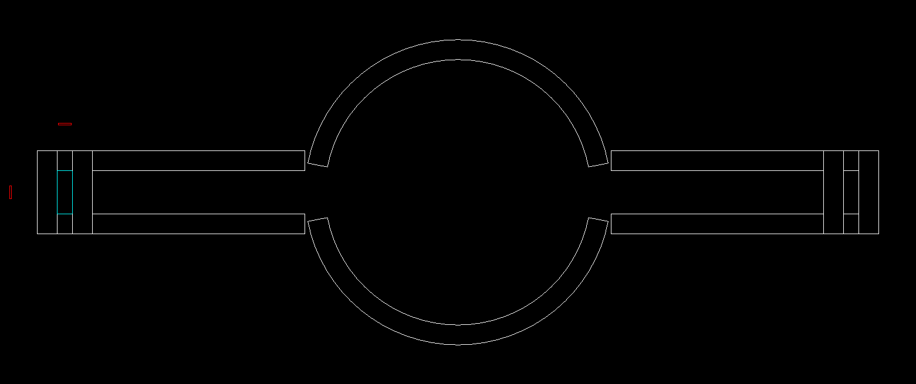
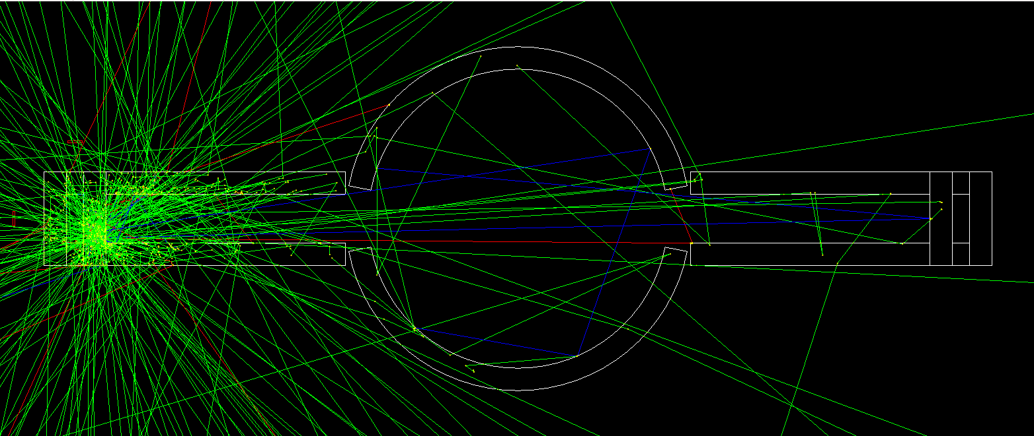
GEANT4 description of HER antechamber
The geometry of the beam-pipe has been reconstructed in GEANT4.
The sensors are located on the side and on the top and bottom of the antechamber
The number of photons tracked in this simulation is 500,000
y
TOP
SIDE
BOTTOM
x
Salvatore di Carlo
Notes:
Sigma1=sigma2 e dare la definizione di probability distribution
𝑓=250 𝑀ℎ𝑧 collision frequency
𝑇=1/𝑓=4𝑛𝑠 interval between to bunches

Slide 7
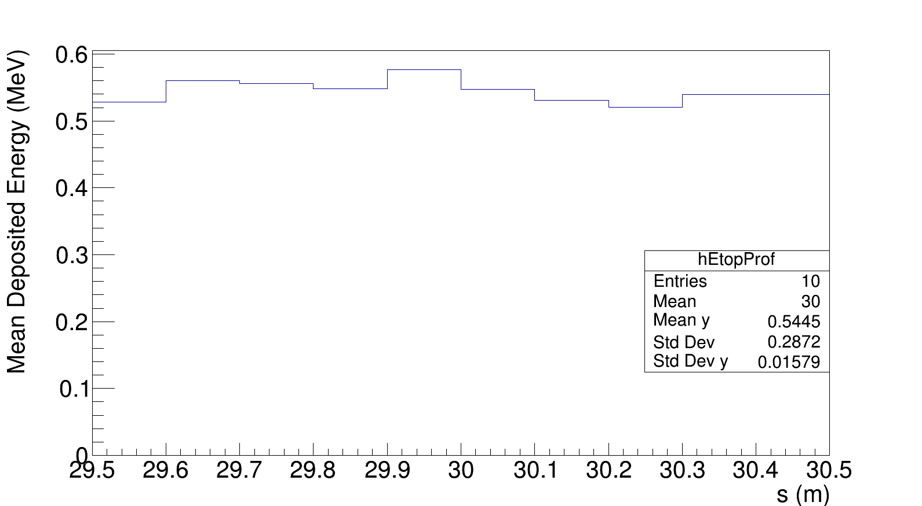
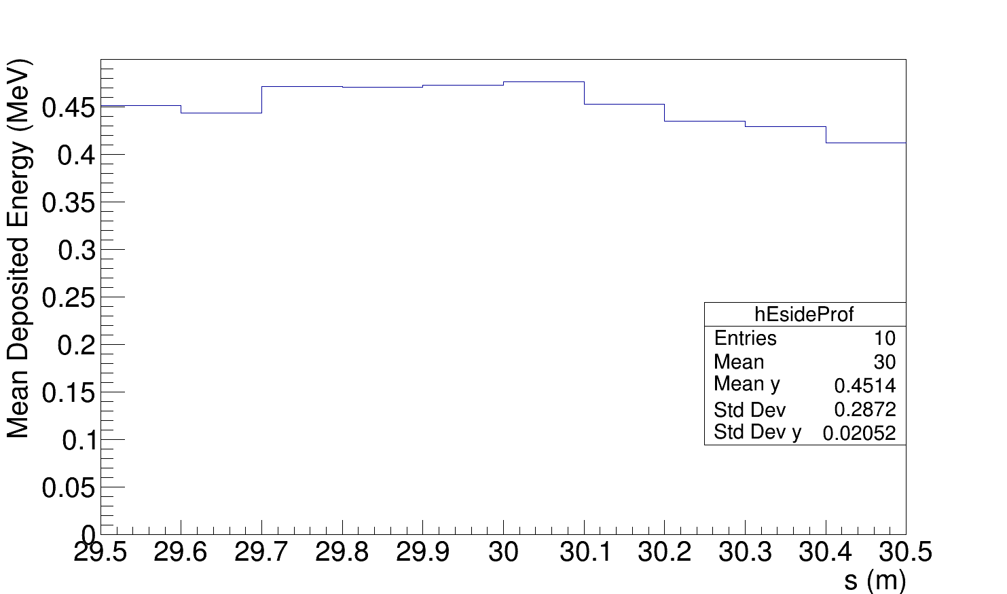
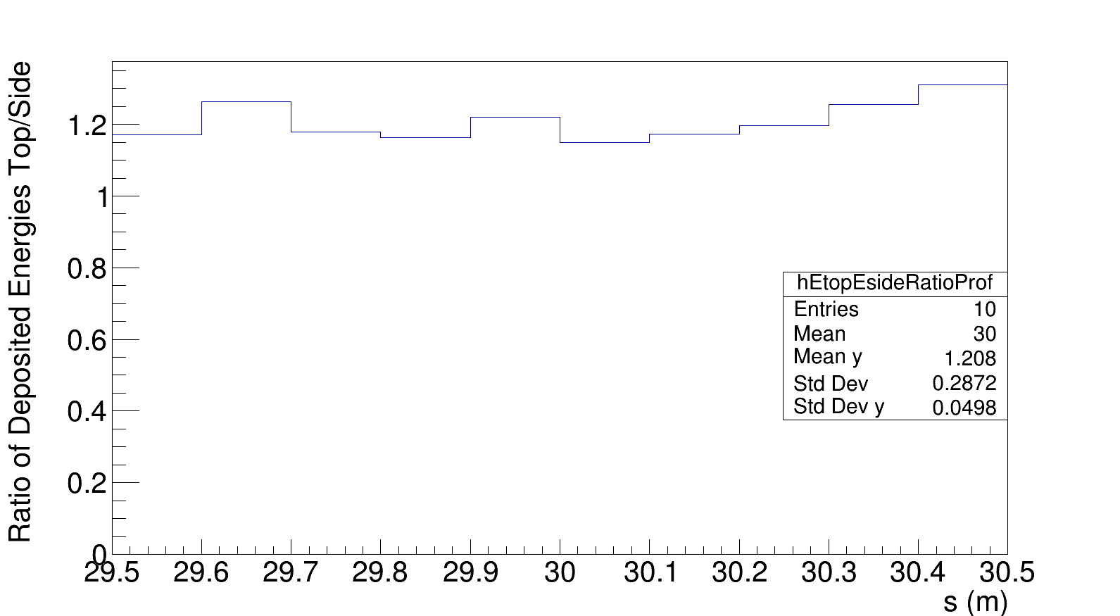
Preliminary results for phase 2.2
About 1% of the photons are detected with cut at 0.1 MeV
The mean deposited energy per detected photon is about 0.4-0.5 MeV on the top-side sensors
The photons deposit more energy on the top sensor by a factor 1.2
Expected precision for phase 2.2 is 5% in 10 ms
Expected precisions for phases 2.3-2.4 and 3 being computed → should be much better due to larger beam angular divergence at the IP
TOP
SIDE
RATIO
Salvatore di Carlo
Notes:
Sigma1=sigma2 e dare la definizione di probability distribution
𝑓=250 𝑀ℎ𝑧 collision frequency
𝑇=1/𝑓=4𝑛𝑠 interval between to bunches

Slide 8



LAL Monitor digital DAQ for Phase 2/3
2017.06.16
DAQ STATUS & PROGRESS
DAQ
EPICS Client
Template GUI for EPICS Client with
to be developped
detectors
FPGA
LER+HER
cables
ADC
firmware
DAC
analog
Roll-In position
TIL
Since 04/11
x4
BIL
x8
(example next slide)
CVD 140µm : OK
b2epics
Amplifier : OK
SERVER (Linux)
network
bdaq
Remote Control : OK
Mechanics : in progress
Network is used to :
SEND Luminosity EPICS PVs (TIL, BIL,…)
RECEIVE SuperKEKB/BELLE2 PV (Current,
Pressure, Fill Pattern, …)
DAQ rack: in progress
Estimated Time of Development : end of 2017/11
ADC 1GSPS : OK
FPGA : firmware OK, tested 50%
DAC : 8-channels (preliminary)
Server : in progress
EPICS : OK in LAL domain
● Deliver Train and Bunch Integrated Luminosities : TILx2 (LER, HER), BILx5120x2 (LER, HER)
LER (1) and HER (1)
LER (1) and HER (1)
TIL
Resolution : 1 train, 10µs
BIL
Resolution : bucket (2ns)
Integration period : 1ms-3600s
Integration period : 1ms-3600s
ZDLM-like counting included
5120 values : 5000 bunches (max) + 120 (Space Charge Reset)
● TIL and BIL are derived from CVD signal AMPLITUDE acquisition at BUCKET (2ns) resolution
● The DAQ is configured by the SERVER (Linux) which includes the protocol
● Provide EPICS GUI for KEK Clients : TIL, BIL configuration + data Display/Archive
● Provide 8x Analog Outputs for : debug, feedback use, …
Didier Jehanno

Slide 9
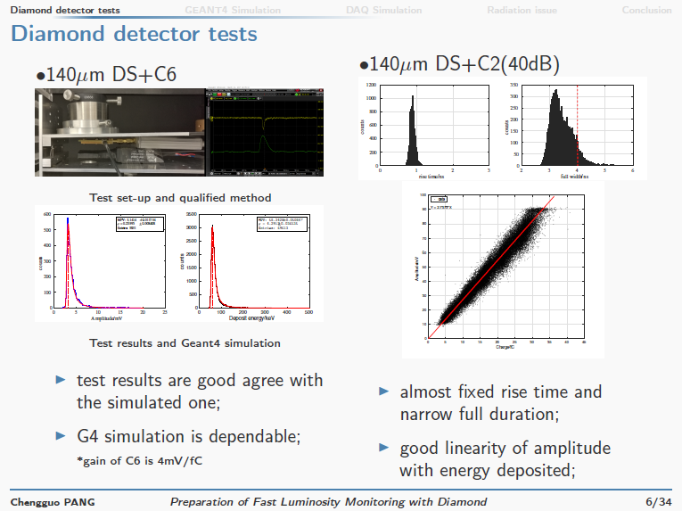

Slide 10
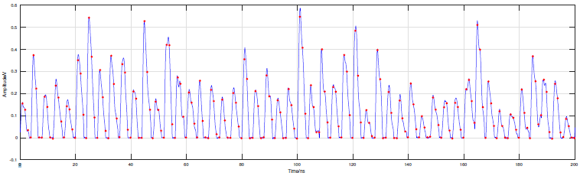
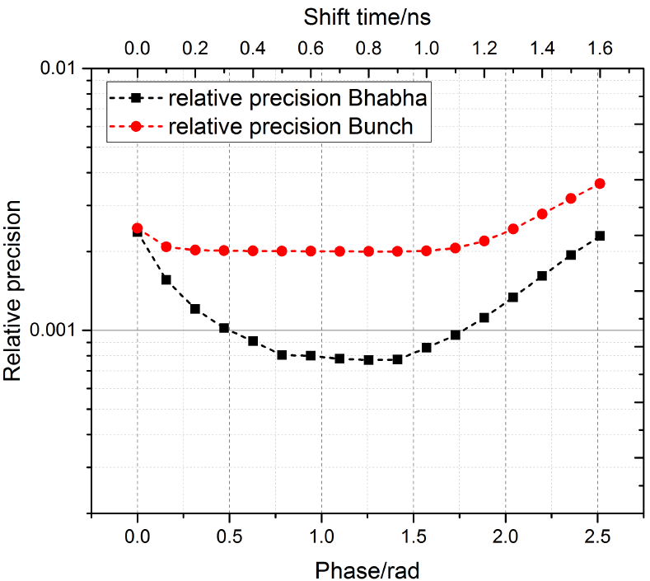
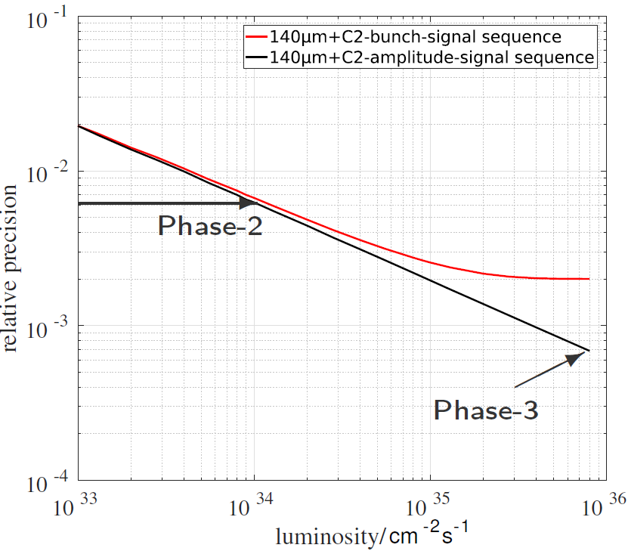



Relative precision can be achieved in LER
“Realistic” Monte Carlo Signal sequence and DAQ sampling
When integrating in every 1ms
6.2$×{10}^{−3}$
not so sensitive to phase
7$×{10}^{−4}$
$$ℒ_{reconstructed}=0.8275×ℒ_{assumed}$$
Chengguo Pang

Slide 11
Summary status and further prospects
ZDLM and LAL luminosity monitors will be ready to measure first luminosities (integrated and bunch-by-bunch) during Phase 2
Horizontal feedback is only expected to be needed during Phase 3
Precision sufficient (∼ 1-2% @ 1kHz) from LER to stabilize the horizontal orbit at the IP from initial to ultimate luminosities
Initial specs of 0.1% @ 1 kHz will cause radiation damage on sCVD diamond sensors in the current design with a fully digital DAQ
HER Bhabha signal efficiency estimate now in good progress
Simulation of feedback controller to re-evaluate specs under way
LER and HER Phase 2/3 single backgrounds investigated in detail → coupling with BEAST effort, also in longer term ?
Simulation of ZDLM ?
Discuss IP ground motion monitoring in operation with SuperKEKB
Upgrade to fully digital dithering feedback (→ LAL FPGA) ?
LAL (4+ people) will support Phase-2 commissioning at KEK

Slide 12
Further topics

Slide 13
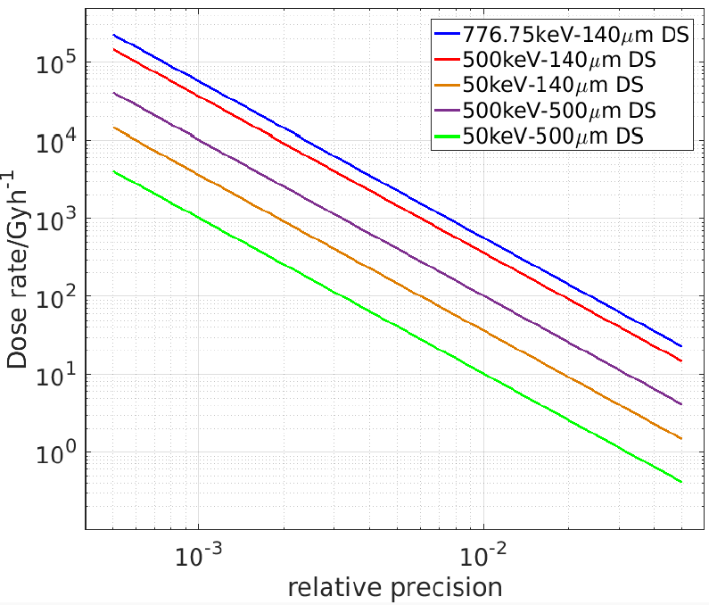
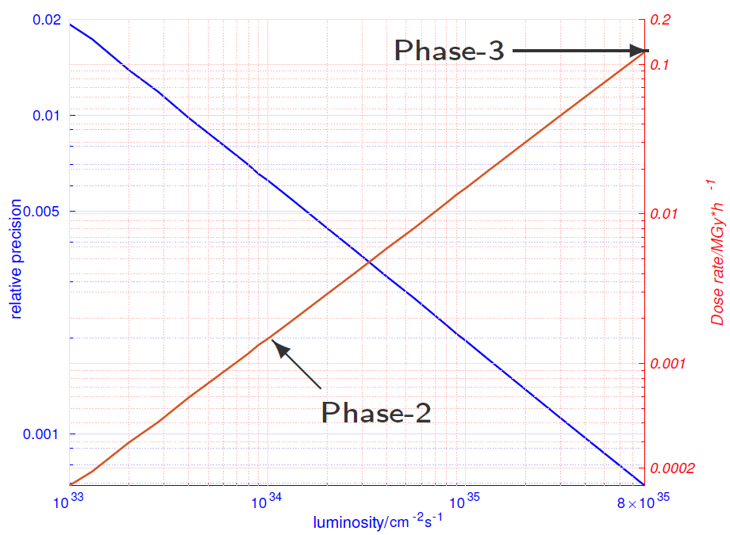


Potential radiation damage
Phase-3
$$7×{10}^{−4}, 0.12MGy/h$$
Phase-2
To reduce the dose rate:
Reduce relative precision
Use thicker diamond DS
Use charge amplifier with lower noise
$$6×{10}^{−3}, 1500Gy/h$$
Chengguo Pang

Slide 14
Analysis of relative luminosity precision needed for dithering based orbit feedback
Luminosity loss
Dithering frequency: 77Hz
Goal of lock-in amplifier :
Minimize Fourier component in luminosity at dithering frequency
Maximize it at twice the dithering frequency

Slide 15
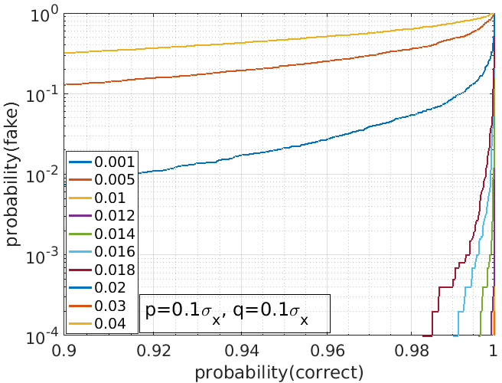
Use toy Monte Carlo to compute probabilities of fake orbit offset detection as function of correct detection (from statistical errors)
2% relative luminosity measurement @ 1 kHz
➔ 1 % confusion probability for > 90% efficient detection
Chengguo Pang

Slide 16
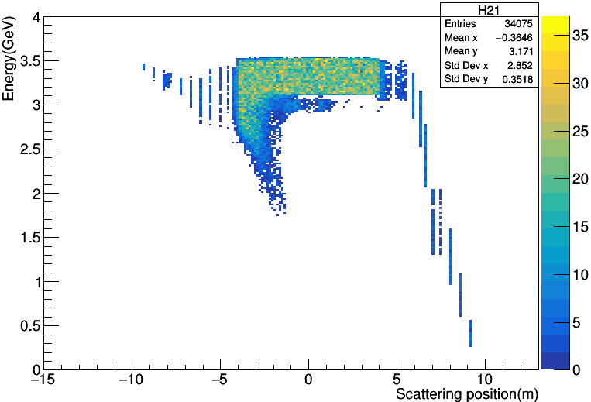
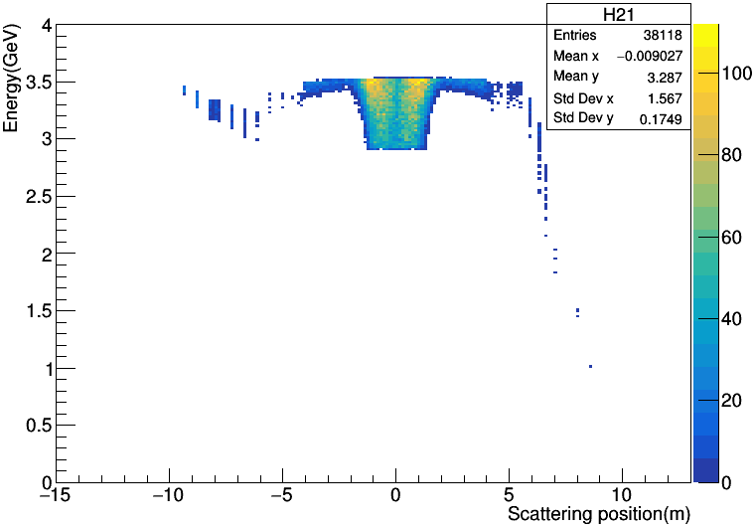
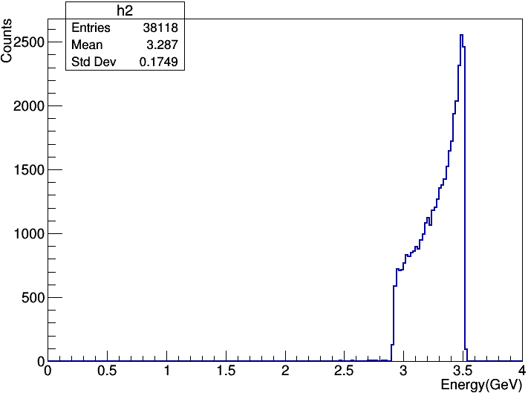
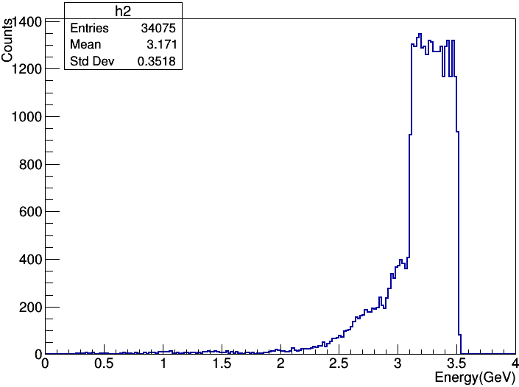
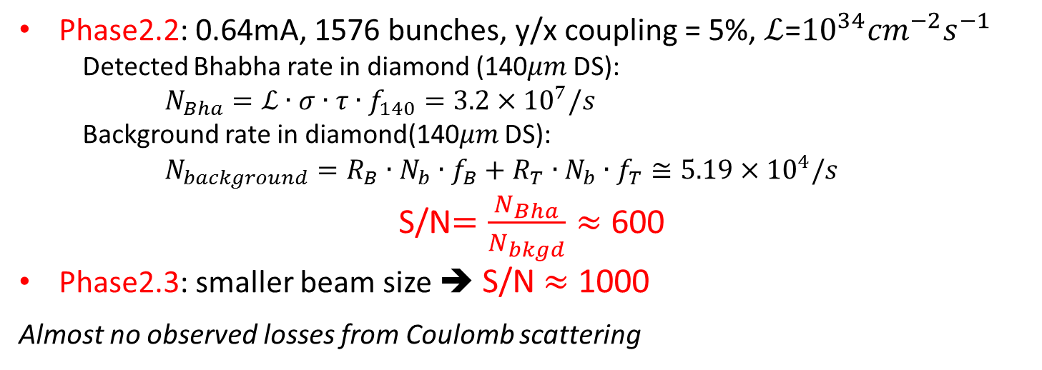
Single beam backgrounds during Phase2 (preliminary)
Bremsstrahlung
Touschek
Phase2.2: 0.64mA, 1576 bunches, y/x coupling = 5%, $ℒ$=${10}^{34}{cm}^{−2}s^{−1}$
Detected Bhabha rate in diamond (140$μm$ DS):
$N_{Bha}=ℒ∙σ∙τ∙f_{140}=3.2×{10}^{7}/s$
Background rate in diamond(140$μm$ DS):
$N_{background}=R_{B}∙N_{b}∙f_{B}+R_{T}∙N_{b}∙f_{T}≅5.19×{10}^{4}/s$
S/N$=\frac{N_{Bha}}{N_{bkgd}}≈$ 600
Phase2.3: smaller beam size ➔ S/N $≈$ 1000
Almost no observed losses from Coulomb scattering
Chengguo Pang

Slide 17
Backup slides

Slide 18
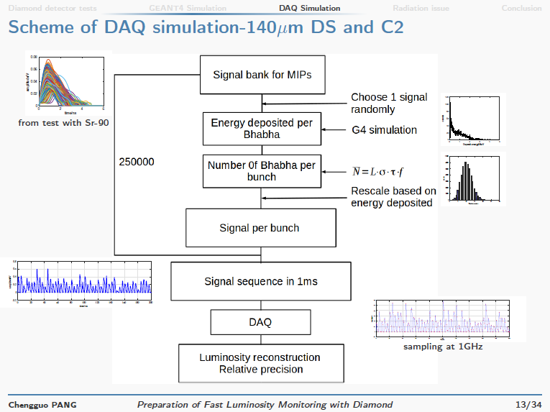

Slide 19
ZDLM / LAL Monitors
▪ Same Location in LER and HER, downstream (after IP)
Sharing same mechanical pillars
Distance from IP : LER / 13 m HER / 30 m
▪ Same positionning along beam pipe, H plan, few mm away
ZDLM
Čerenkov, Scintillator
▪ Different detector types
LAL-M
Diamond sCVD

Slide 20
LAL Monitor digital DAQ
1.965 ns
BUCKET
RF
t
508.887 MHz
THRESHOLD
x2
DIAMOND
signal
t
SAMPLING
1017.774 MHz
t
peak
baseline
▪ For all couples Sample (peak) and Sample (baseline) :
Calculate the DIFFERENCE = Amplitude of the pulse
Make AMPLITUDE = 0 if < THRESHOLD (typ. 10mV)
COUNT +1 if AMPLITUDE > THRESHOLD
▪ For ONE train (round-trip 10.06 µs), we obtain
5120 AMPLITUDES
5120 COUNTS
Didier Jehanno

Slide 21
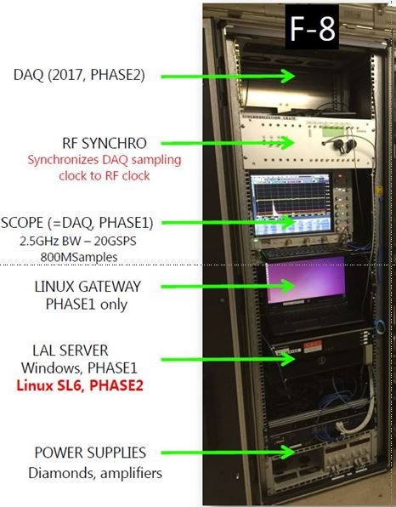
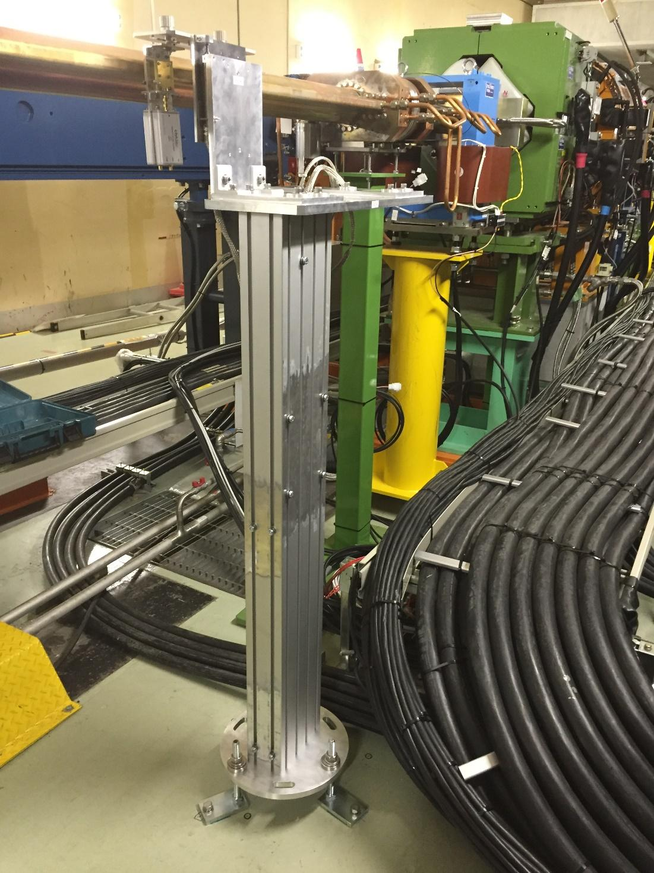
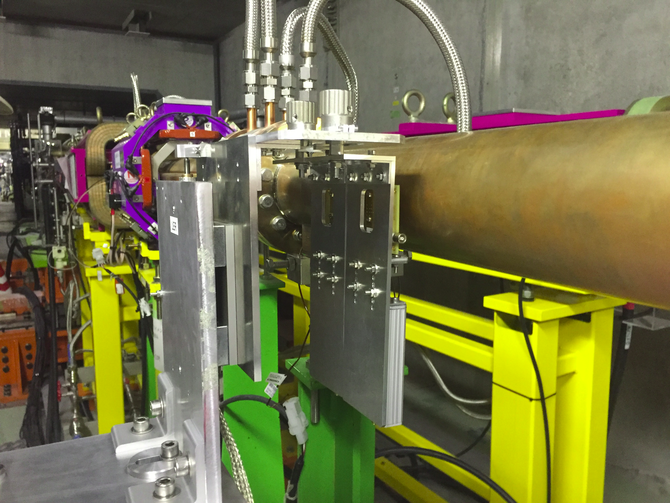
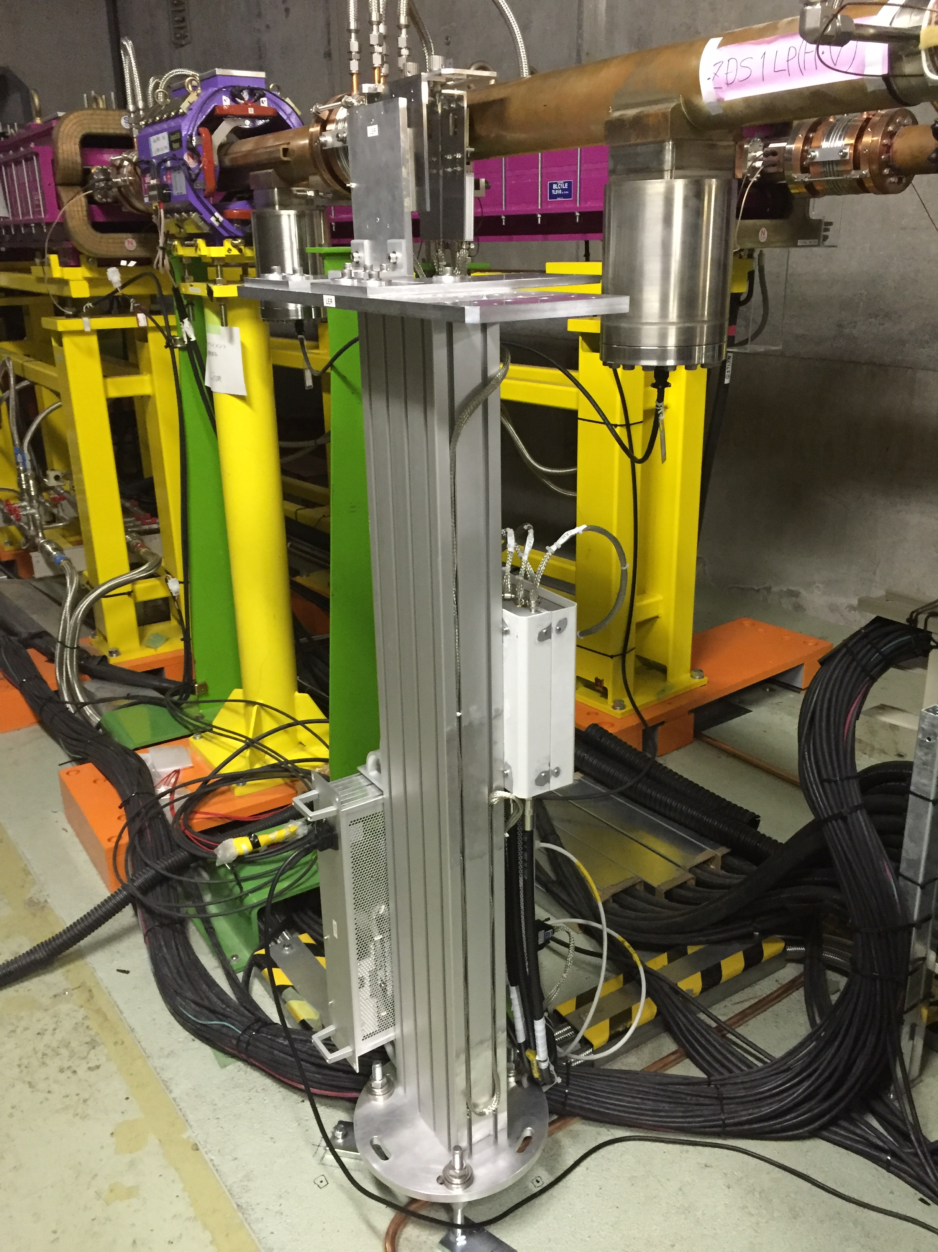
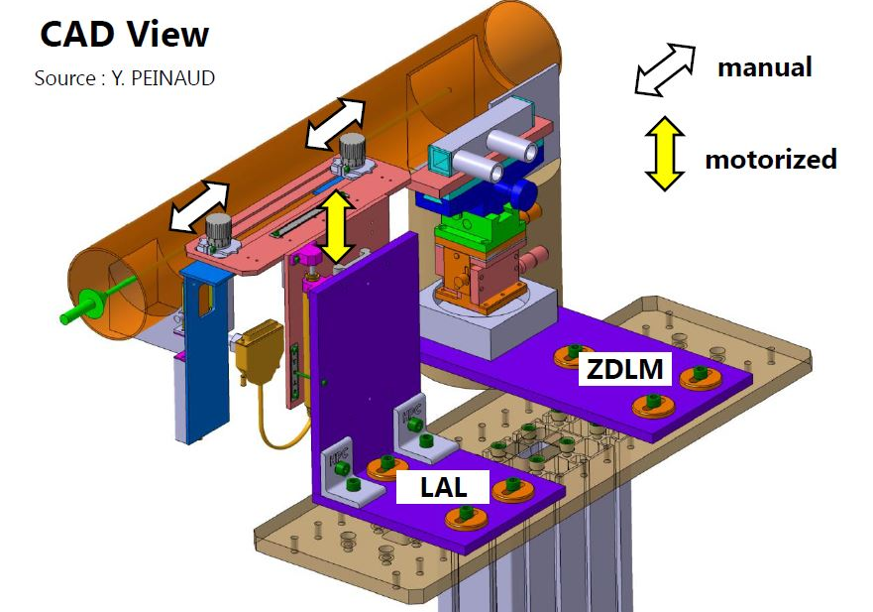
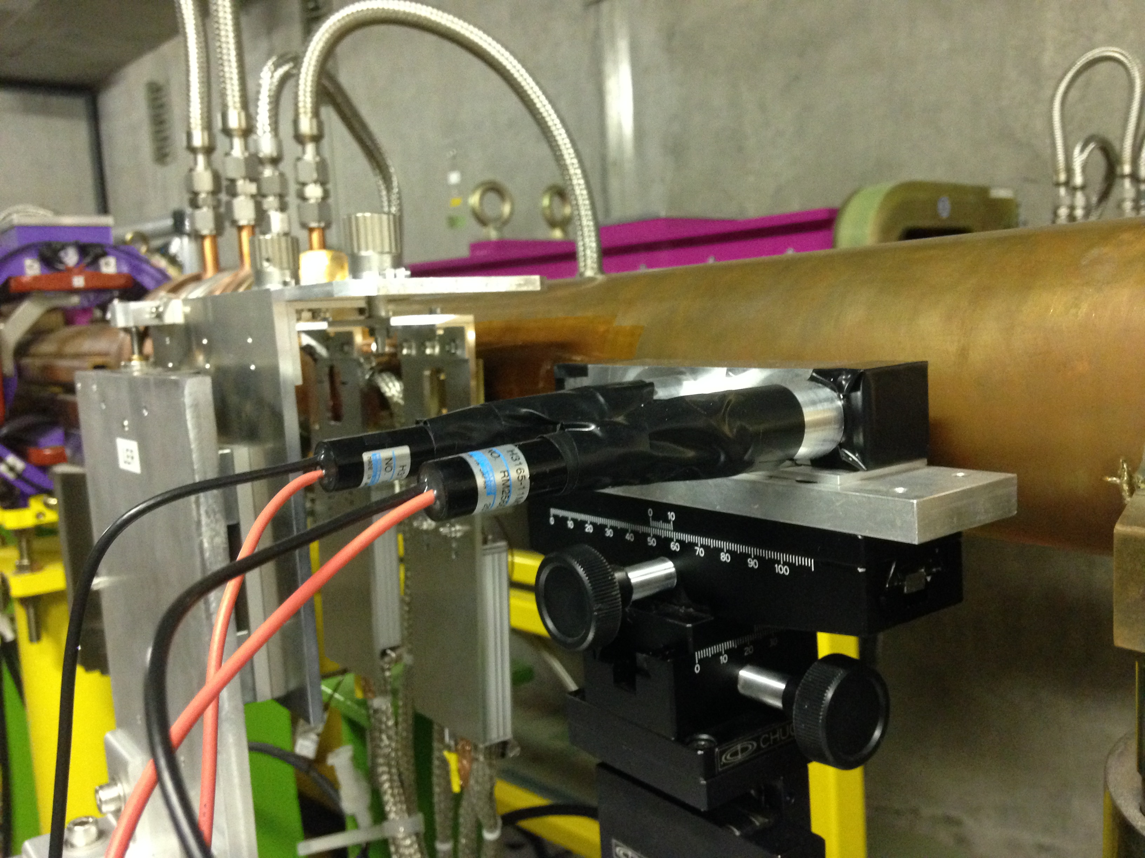
LAL Luminosity monitor : test setup for Phase 1 commissioning
HER ~ 30 m → photon
500 μm diamond sensors
LER ~ 11.9 m → positron

Slide 22
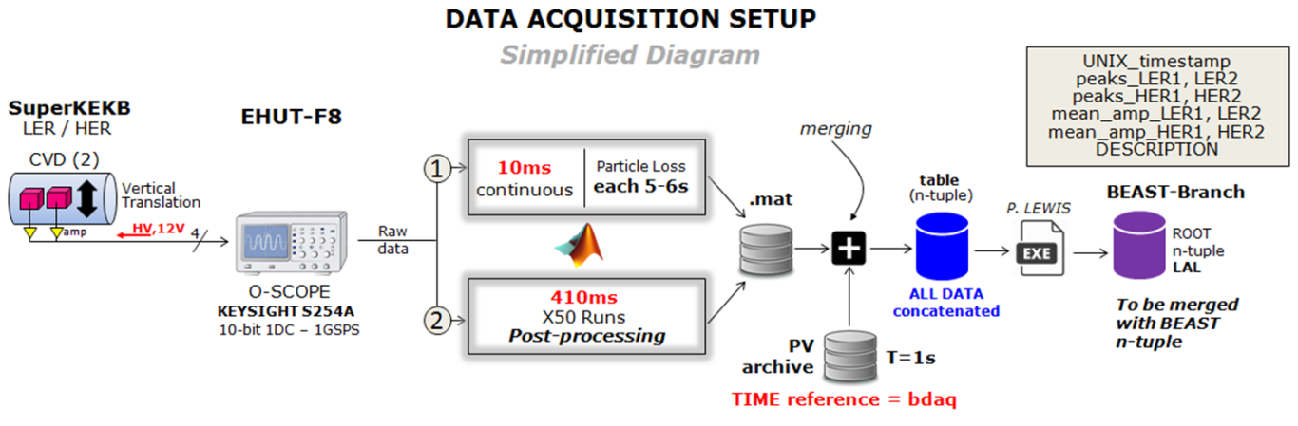
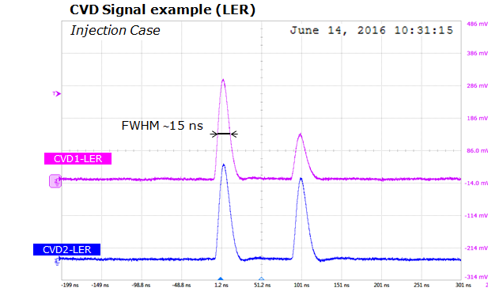
Data acquisition for Phase 1 commissioning
beam background measurement → validation
Data processing
→ Define waveforms and save them
→ Extract maximum of signal (total
integrated charge)
→ Position in time
→ FWHM
→ Save in .mat files
→ Merge them to EPICS

Slide 23
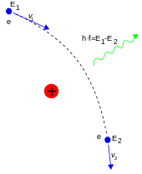
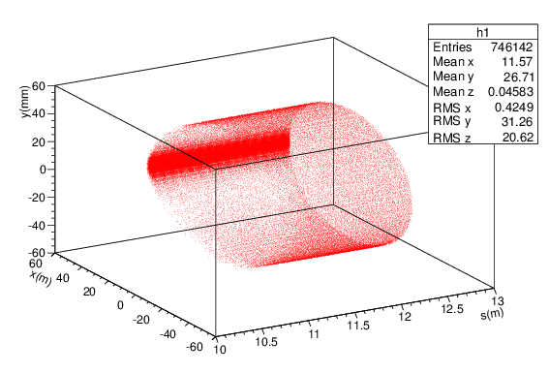
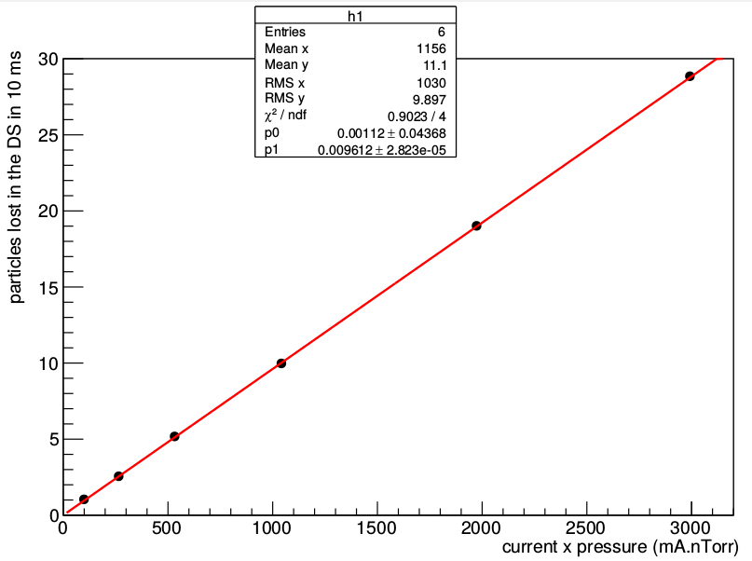
Beam gas Bremsstrahlung
→ Inelastic Coulomb scattering
→ Beam particles pass by EM of nucleus of molecules of residual gas
→ Emission of photon → particle loses energy
→ Particle is lost downstream of emission point
Loss vs (current x pressure)
→ Scattering and loss rates are proportional to beam current and vacuum pressure

Slide 24
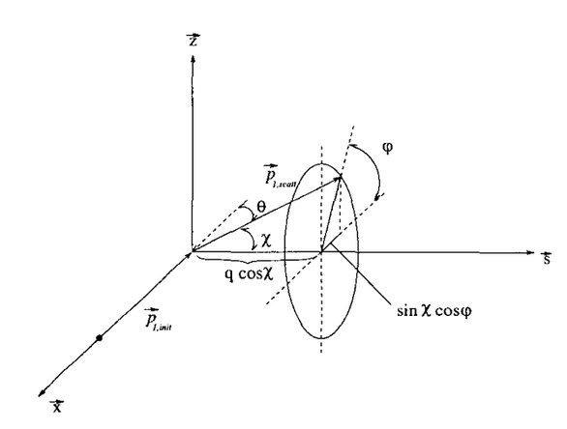
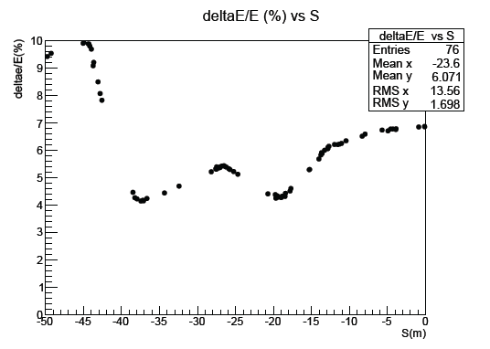
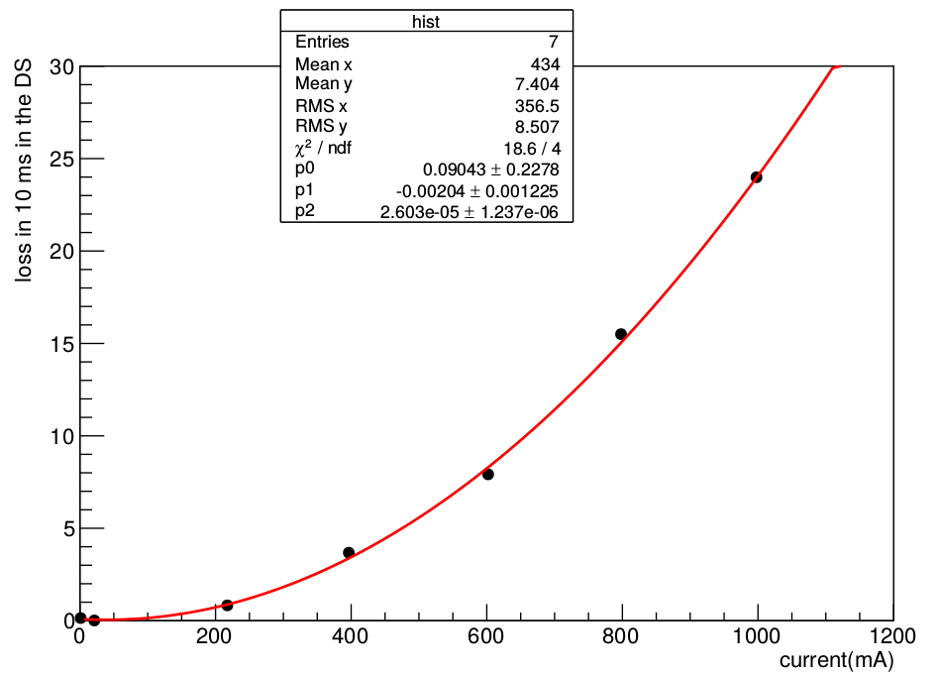
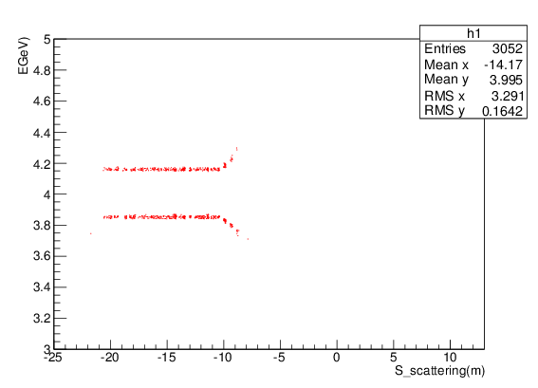

Touschek scattering
→ Scattering of beam particles upon each other
→In CM; p_{init1, 2} = (±p_{x},0,0)
p_{scat1, 2} = (±p_{x} sinχ cosφ, ±p_{x}cosχ, ±p_{x} sinχ sinφ)
→ In Lab frame: maximum momentum transfer : ΔE= γ x p_{x}
→ One particle loses energy and the other gain energy
→ Scattering and loss rates are proportional to I² and inversely proportional to the beam size
$$\frac{p_{x}}{p}=\sqrt{\frac{ϵ_{x}}{β_{x}}}$$
Energy vs emission position
3.7%
analytic calculation

Slide 25
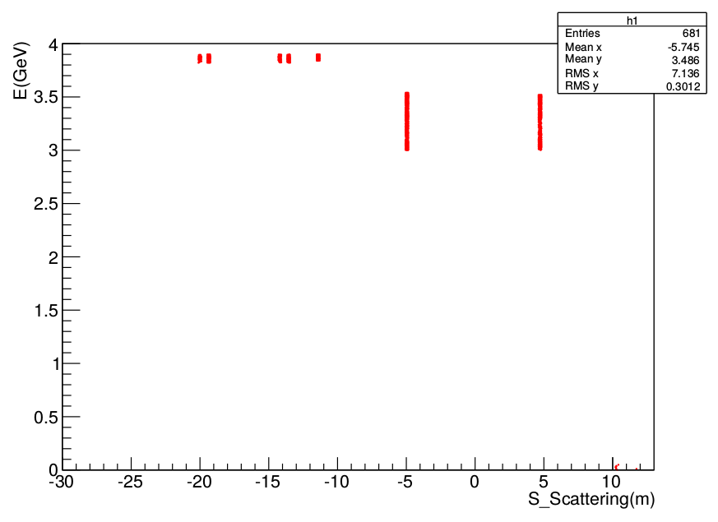
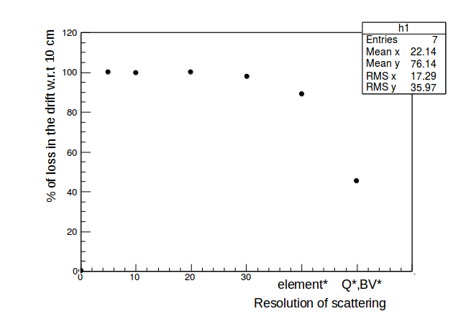
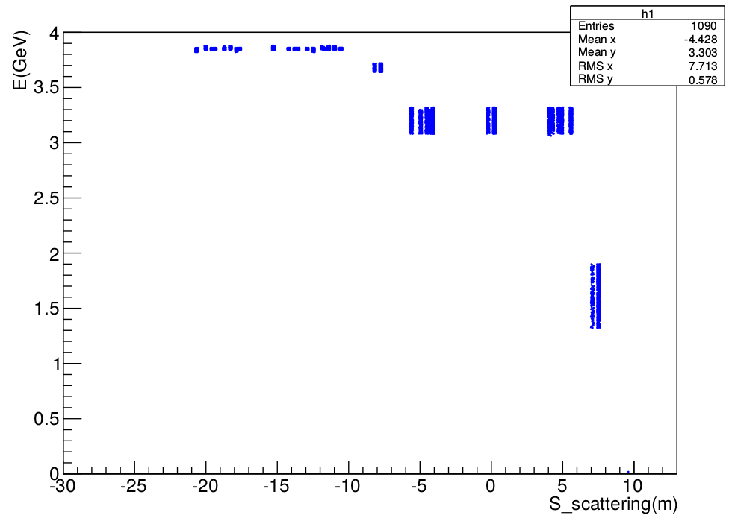
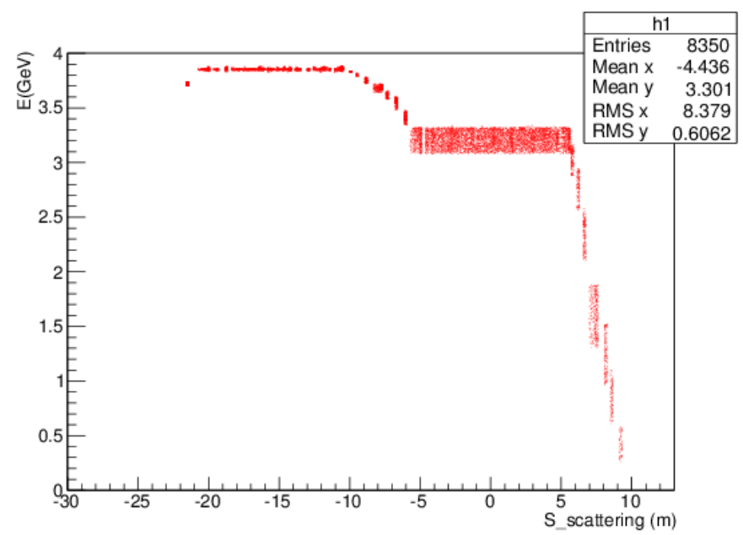
Simulation improvement: scattering resolution
Physical processes interfaced in SAD tracking code by Y. Ohnishi to simulate overall beam loss in SuperKEKB rings
Default code
Scattering @ quad
Energy
vs emission point
Scattering @ all elements
Slicing drifts (10 cm) and bends (15 cm)

Slide 26

Vacuum bumps in LER
→ Vacuum bumps were performed upstream of the IP
→ Fraction of losses in the sCVD from scattering regions were calculated and compared to data
→
is the loss in the sCVD at the maximum of the bump
$$f=\frac{{loss}_{bump}}{{loss}_{all−sections}}$$
total loss simulated in the sCVD, when pressure everywhere in the
ring is equal to that of the maximum of the bump at the given section
Pressure profile
Loss profile
17~35 m
4~12 m
17-35 m
4-12 m
4-12 m
17-35 m

Slide 27
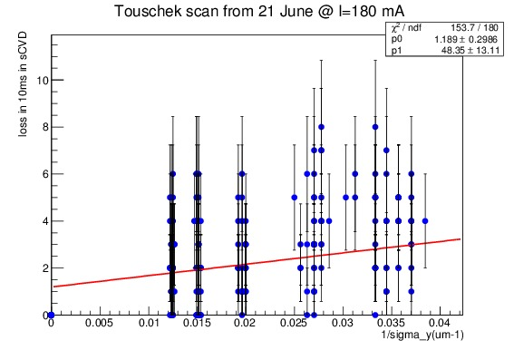
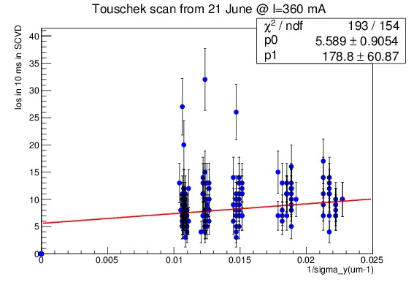
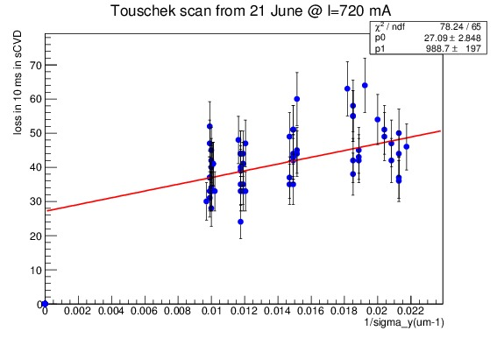
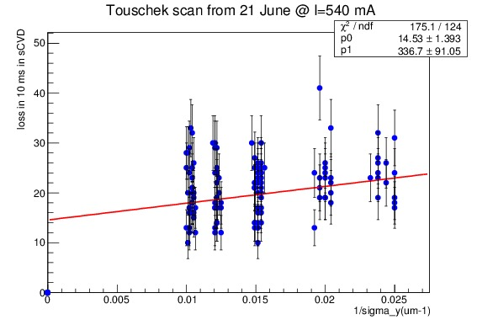
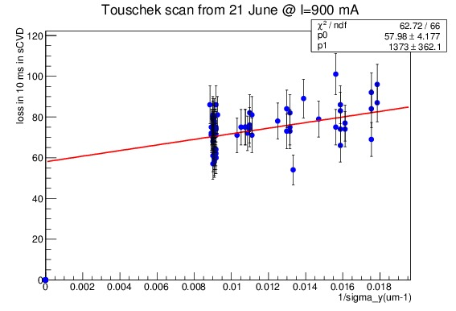
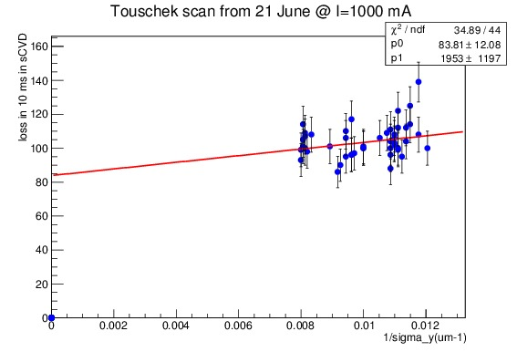
Vertical beam size scans
→ The vertical beam size σ_{y} was varied adjusting
the x-y coupling (“Emittance Control Knob”)
→ Losses in the sCVD were fitted as a function of
the inverse vertical beam size (σ_{y}⁻¹)
→ Loss = Bremsstrahlung + Touschek × σ⁻¹_{y}
180 mA
360 mA
(constant term) (slope)
720 mA
540 mA
900 mA
1000 mA

Slide 28




Bremsstrahlung losses (from constant terms of vertical beam size scans)
→ Data is larger than simulation by factor about 3
data
simulation
→ Factor 3 ± 1.5 was estimated by simulation for KEKB
by vacuum group
→ The pressure measured at Gauges should be multiplied
by ∼ 3 to represent the pressure at center of beam pipes

Slide 29

Touschek losses (from slopes of vertical beam size scans)
Measured slopes combined after quadratic extrapolation to I = 1 A to compare with simulation
→ simulation / data = 1.7 ± 0.74
(preliminary)
Uncertainties
(for future improved comparison)
Statistics (both data and simulation)
Beam size measurement considered reliable in vertical but not in horizontal
Emittance growth with beam current due to intra-beam scattering was neglected

Slide 30
Conclusions from Phase 1
Successful real-scale test of LAL and KEK fast luminosity monitor hardware during 2016 single beam commissioning
Measured single beam backgrounds at LER luminosity monitor location; validated simulation to extrapolate to Phase 2 & 3 :
- LER Bremstrahlung rates consistent with modeling after taking
into account a factor x 3 for the pressure (based on KEKB…)
- LER Bremstrahlung >> LER Touschek
- LER Touschek rates have 1.7 +/- 0.7 discrepancy with modeling
Single beam background rates in HER (Bhabha photons) << in LER (Bhabha positrons), due to absence of final focus to create sizeable divergence
Detailed understanding of data/simulation comparison requires careful handling of SAD-interface to track scattered particles (photons → geometry, apertures ; positrons → optical transport) and constant communication with machine group

Slide 31










140$μm$ diamond test for Phase 2/3
G4 simulation: 58.2KeV
$\frac{58.2×{10}^{3}eV}{13eV}×(1.6×{10}^{−4}fC)×4mV/fC=2.87mV$
Experiment: 3.35mV
G4 simulation
Test with Sr-90
scintillator
diamond
Landau distribution of energy deposited and signal amplitude- 140$μm$ DS
May lead to pile up

Slide 32



Coulomb scattering
→ Elastic scattering of particle beams on the nucleus of residual gas molecules
→ Particle receives a transverse kick and is lost downstream the emission point
→ Transverse offset of particle lost at position B and emitted at A depends on
$$\sqrt{β_{A}×β_{B}}$$

Slide 33
Calibration
→ Maximum of signal of Data were fit by “Landau”
→ A cut at 6 mV separates signal from noise
→ In simulation: minimum of 50 KeV ( > 3σ of noise )
→ MPV= 11.6 mV in data
→ MPV= 9.2 mV in simulations
→ 11.6/9.2 = 1.3 ➔ threshold is at ~ 4.7 mV for simulations
11.6 mV
9.2 mV
data
simulation

Slide 34


Slide 35


Slide 36


Slide 37

Luminosity monitoring with nano-beam concept
Fast & slow variations at IP require feedback corrections
Beam-beam deflection (SLC, KEKB,…) for fast vertical motion
Luminosity feedback by “dithering” (PEP-II) for slower horiz. correction
Luminosity tuning with optical knobs (SLC, FFTB, ATF2) to maintain small spot sizes ( time scales of ∼ hours ? )
Δy at IP=
∼ 5nm ∼ 1/10σ_{y}*
BPM
Δy at BPM= ∼ 1.3μm
Vertical vibration ∼ 25-100 Hz
Sampling (BPMs) ∼ 32 kHz
IP
BPM
↔
2×f₀
Horizontal motion ∼ 1 Hz
Modulation freq. f₀ ∼ 77 Hz
Sampling (lumi. meas.) ∼ 1 kHz
→ minimize f₀ output component
Luminosity
↔
f₀
x

Slide 38

Radiative Bhabha at vanishing scattering angle
σ ∼ 250 mbarn (E_{γ} > 1% E_{beam} )
major background source from induced particle losses after IP
luminosity monitoring
Positron
energy
LAL & KEK
Luminosity monitoring specs
Relative measurements
10⁻³ in 1 ms over all bunches (“dithering”)
10⁻³ in ∼ 1 s for each 2500 bunch → 4ns
(for nominal luminosity)
Non luminosity scaling contamination < 1% (e.g. beam gas bremstrahlung and Touschek losses)
Should also work for low initial luminosity
re-evaluate

Slide 39



ZDLM / LAL Monitors
PHASE-1
2015.12.20
Diamond
Beam pipe
LER
ZDLM
LAL Monitor
Amp.
Det.
PMT

Slide 40
ZDLM / LAL Monitors in Phase 2
Beam pipe
LAL Monitor
LER
ZDLM
IP
H-scan
Window design : KANAZAWA-san
45°
few mm
HV
±x00V
Čerenkov
C
S
Scint.
radiator
passive
LV
12V
PMT
HV
-xkV
CH 1
CH 2
CH3
ČERENKOV
SCINTILLATOR
to E-HUT
to E-HUT
F-8
F-9
54.2 cm

Slide 41
ZDLM / LAL Monitors in Phase 2
Beam pipe
IP
HER
ZDLM
LAL Monitor
few mm
H-scan
Scint.
S
C
Čerenkov
Diamond
HV
±x00V
passive
140-500µm
PMT
HV
-xkV
Amplifier
LV
12V
Charge or Current
SCINTILLATOR
ČERENKOV
CH 1
CH 2
CH3
to E-HUT
to E-HUT
F-9
F-8

Slide 42

LAL Monitor digital DAQ
1.965 ns
BUCKET
RF
t
508.887 MHz
THRESHOLD
x2
DIAMOND
signal
t
SAMPLING
1017.774 MHz
t
peak
baseline
RF ruler
REFERENCE
RF (bucket) ruler
SAMPLING ruler
Must adjust the SAMPLING ruler to the EVENT=RF ruler

Slide 43


Slide 44


Slide 45


Slide 46


Tolerance to Δx depends on crossing angle and β_{y} (IP), not on σ_{x}
K. Ohmi : “nano-beam scheme”
L = 1 x 10³⁴ cm⁻² s⁻¹
L = 1 x 10³⁵ cm⁻² s⁻¹
L = 8 x 10³⁵ cm⁻² s⁻¹
for Δx ∼ 10 μm
tolerance for L_{nominal}
frequency ∼ 0.1Hz
→ 10 x slower dithering specs
For Δx ∼ 100 μm tolerance for L_{Phase 2} frequency << 0.1Hz
→ even looser dithering specs
preliminary
M. Masuzawa :
recent vibration measurements

Slide 47







Relative precision needed
Luminosity loss
Well collimated
For base frequency case:
when ratio is larger than 1, which means we can observe the amplitude change due to offset.
Dithering amplitude/$σ_{x}$
With a small offset
In this case, a relative precision better than 1.3% in 1ms is sufficient for luminosity monitoring.
0.4% luminosity lost !
Dithering frequency: 77Hz
R|x=0.1$σ_{x}$, p=0.1$σ_{x}$
After the lock-in amplifier, we want to :
Minimize the amplitude of base frequency
Maximize the amplitude of double frequency
$$R=\frac{u_{x}−3∗σ_{x}}{u_{0}+3∗σ_{0}}$$

Slide 48







Back-up
$$ν_{p}={10}^{−3}$$
$$ν_{p}={10}^{−2}$$
$$ν_{p}={5×10}^{−3}$$

