Slide 1
Computing strategies for HL-LHC and beyond
Tommaso Boccali
INFN Pisa / CERN
I2FEST - Torino, Feb 18th 2019

Slide 2
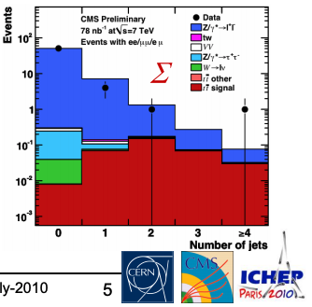
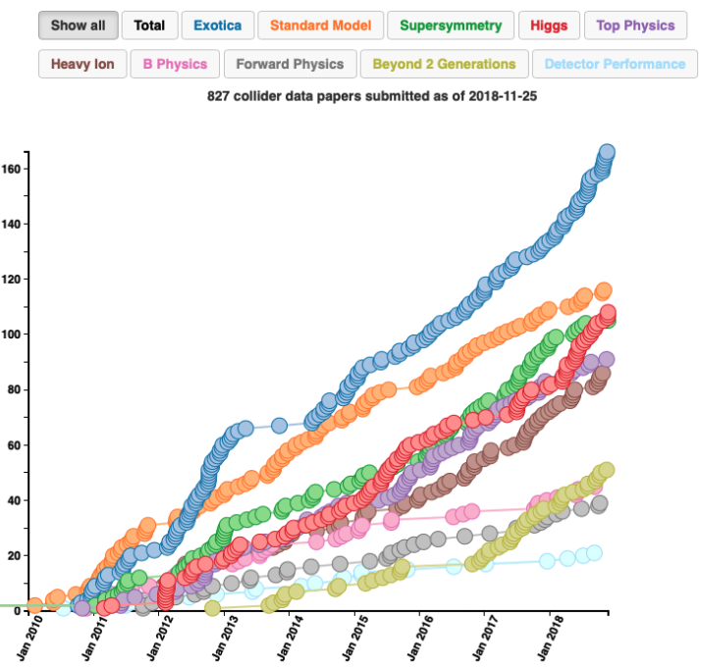
(Computing @) LHC today: it works!
It might seem a trivial statement, but it works well:
When needed (not very often!) turnaround of data-taking to presentation < 1 week
Flexibility to allow for fast reprocessings on a daily basis
2011-2012 Higgs discovery phase
Capability to steer all the resources instantaneously to a high priority analysis / production
Sustains the production of 1 paper/day
Papers/y (4 collaborations):
2016: 302
2017: 328
2018: 326
CMS papers
ttbar “rediscovery” @ ICHEP2010: data taken the week before in a sudden LHC improvement

Slide 3
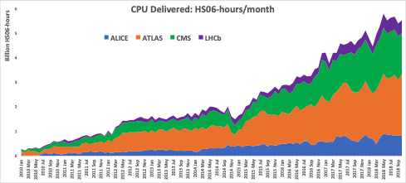
Current WLCG resource utilization & cost estimate
From 2019 pledges :
~700.000 Computing cores (~70 MEur?)
~520 PB disk (~75 MEur?)
~800 PB tape (~ 30 MEur?)
Plus :
Electricity
Personnel
Infrastructure
…
Resource utilization patterns from the start of LHC (~2010) are increasing year by year ~ exponentially
Comparing 2019/2010:
CPU 6x
Disk 5x
Tape 10x
Source: WLCG monitoring

Slide 4
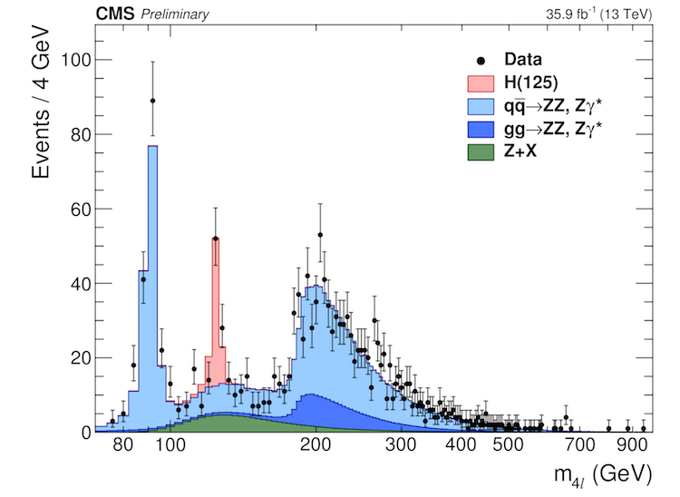
Where are we using Computing resources?
Trigger level (not included in the previous estimates)
Prompt Data Reconstruction
MC Simulation
Re-processings
Analysis
100 GB/s
100 kHz event rate
10-20 B events /y
Trigger Farm
Analysis
Reconstruction (Prompt / reprocessing)
1-2 GB/s
10B events /y
Many times a year
A couple times a year

Slide 5
How are computing resources linked to machine / experiments parameters?
# events collected = Experiment live time * Experiment rate to offline
LHC RunII: 7Msec * 1000 Hz = ~ 10 B events
Bandwidth, total storage = # events collected * (1+ f_{MC}) * F_{STORAGE}(<PU>)
F_{STORAGE}(<PU>) ~ linear in <PU>
Computing power = # events collected * (1 + f_{MC}) * F_{CPU}(<PU>)
F_{CPU}(<PU>) superlinear in <PU>
Storage is also ~ integral with time
Storage_{YearN+1} = Storage_{YearN} + Delta_{NEW EVENTS}
In the end, main parameters are
Trigger rate
Live time of the Accelerator
<PU>
f_{MC} (MC production needs)
PU: the # of pp interactions per single bunch cossing

Slide 6
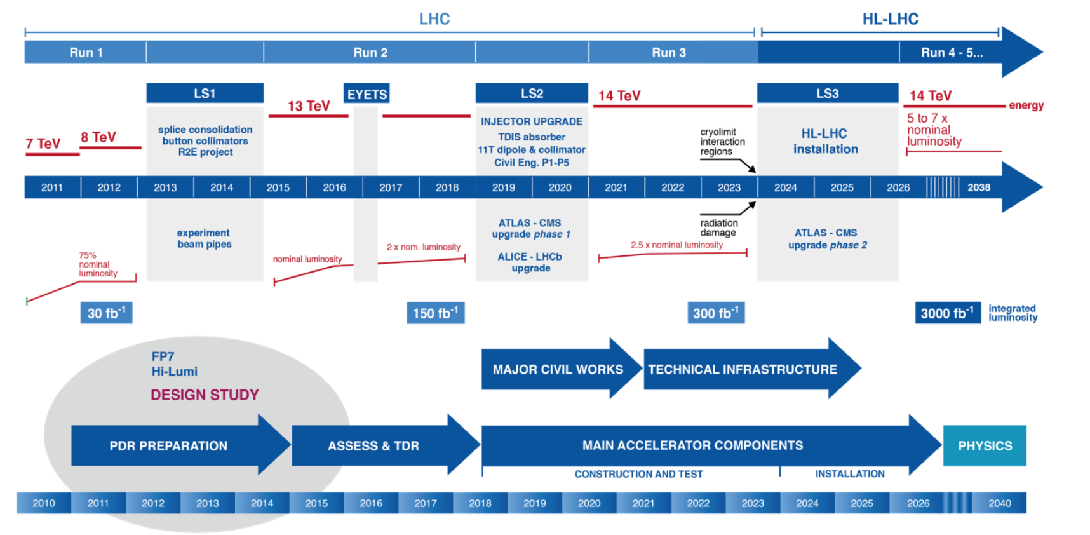
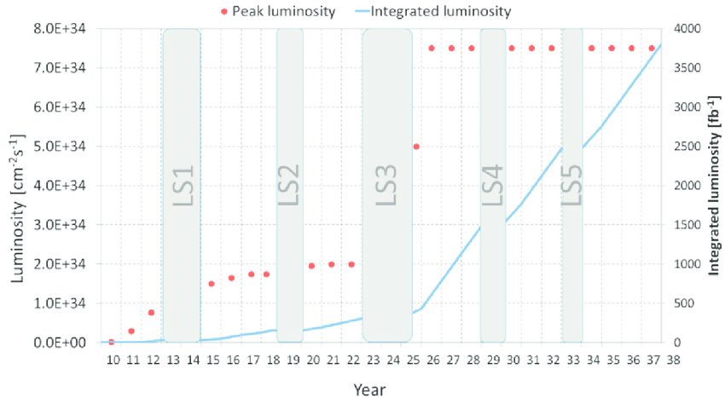
RunIV & V...
RunI
RunIII
RunII
Some true but amazing statements:
“We collected 5% of LHC foreseen integrated luminosity”
“We are at 1/5th of the LHC machine capabilities”
(to be clear: I am not even considering RunIII, it is just a “simple” extension of RunII for ATLAS and CMS - no tension)
RunI
RunII
RunIII
RunIV
RunV
RunVI

Slide 7
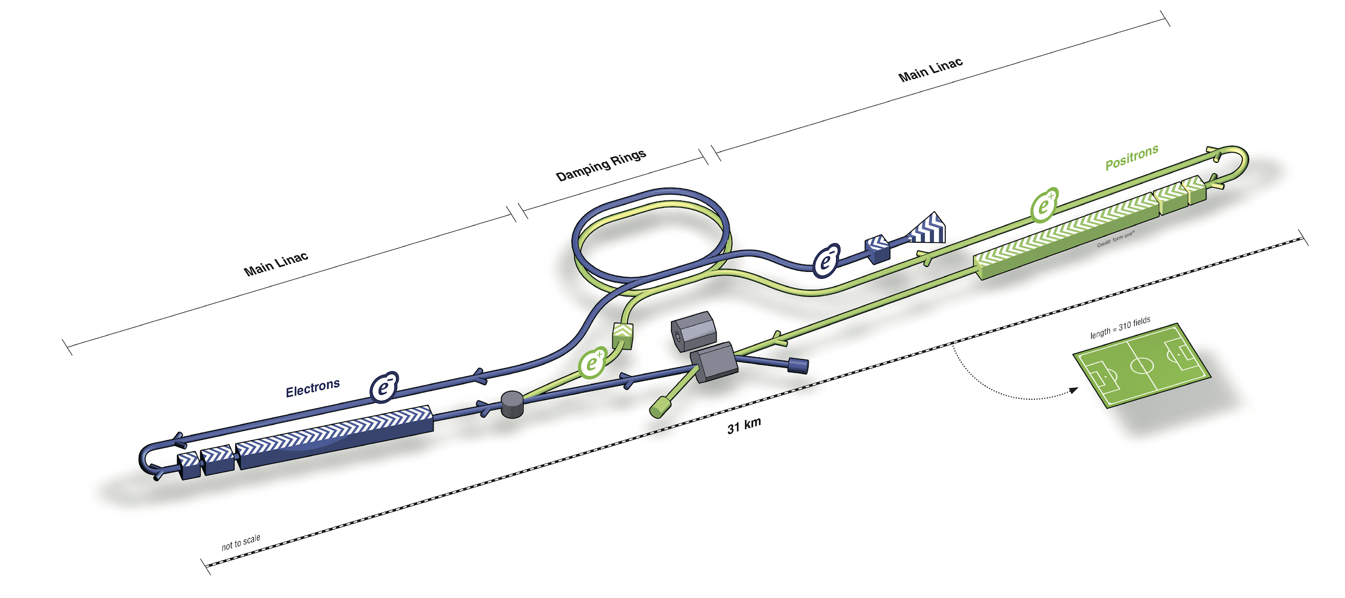
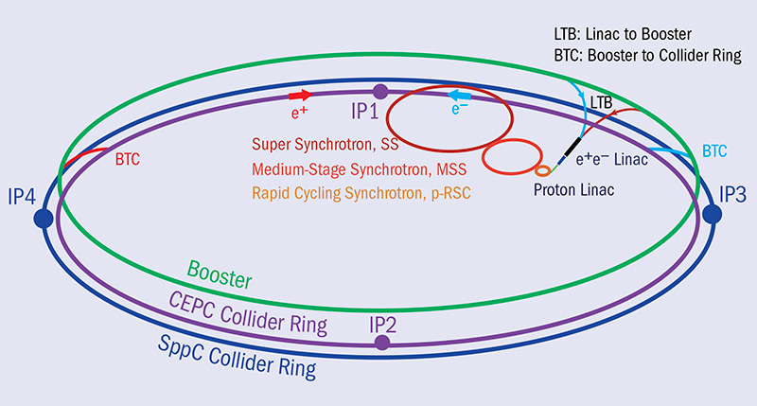
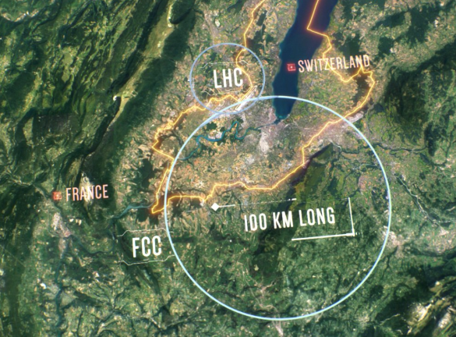
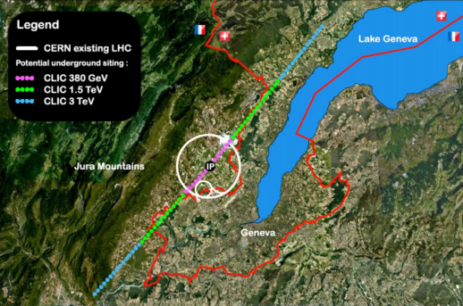
Beyond #1?
ee machines (CLIC, ILC, FCC-ee,CepC ….)
No major computing problem expected
FCC-ee initial event size estimates are 0.01 - 0.1 the current LHC-pp, and 20 years later
Even a huge increase in DAQ channels / interaction rate can hardly be a problem

Slide 8
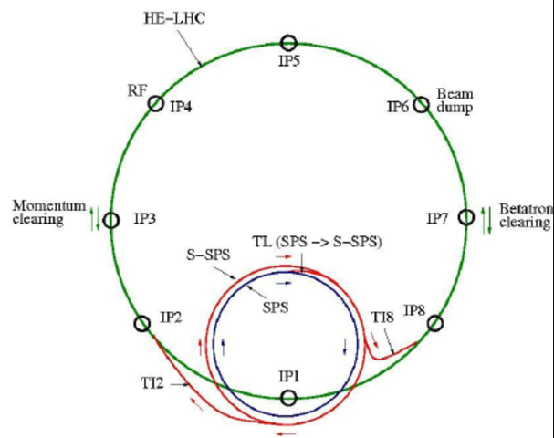
Beyond #2?
hh machines (FCC-hh, HE-LHC, …)
...go as high as you want: FCC-hh has (wrt to current LHC)
<PU> ~30x (and 5x HL-LHC)
Similar collision rate
Event sizes not yet known atm
But: there is at least a +20y between them, which reduces the problem
HE-LHC parameters are intermediate between HL-LHC and FCC-hh, but time scale is still at least 2035
My thoughts: the step LHC→ HL-LHC in 2026 is the biggest; if we can make HL-LHC computing work, we have a clear path

Slide 9
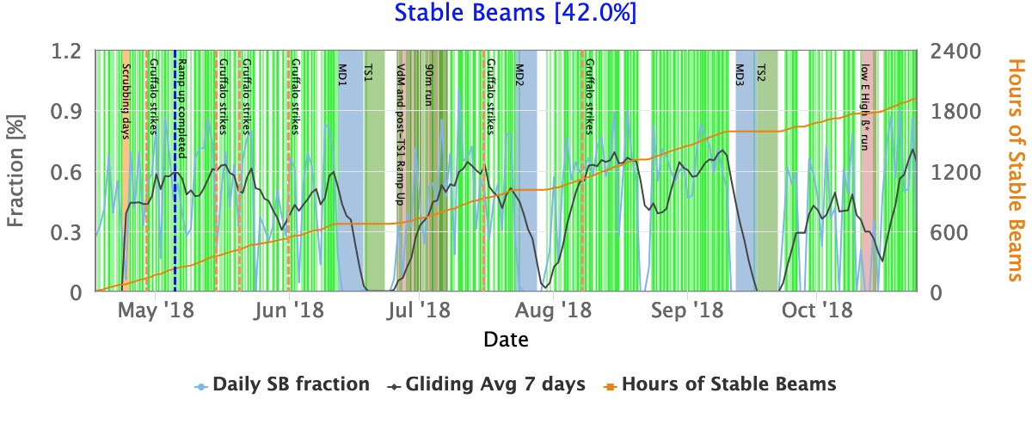
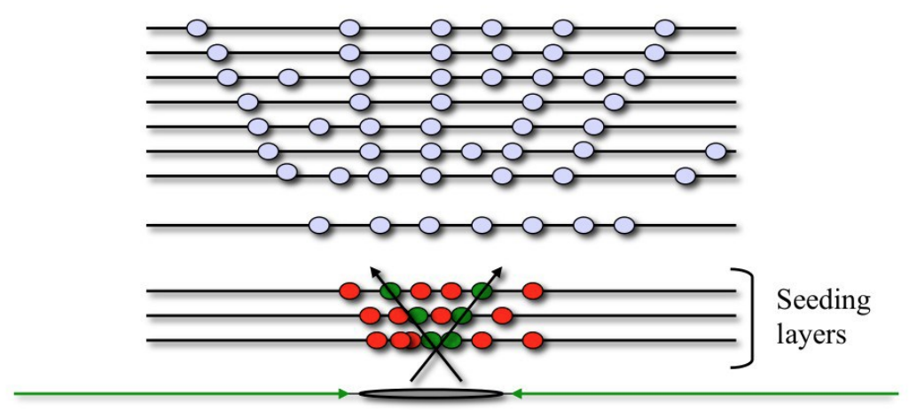
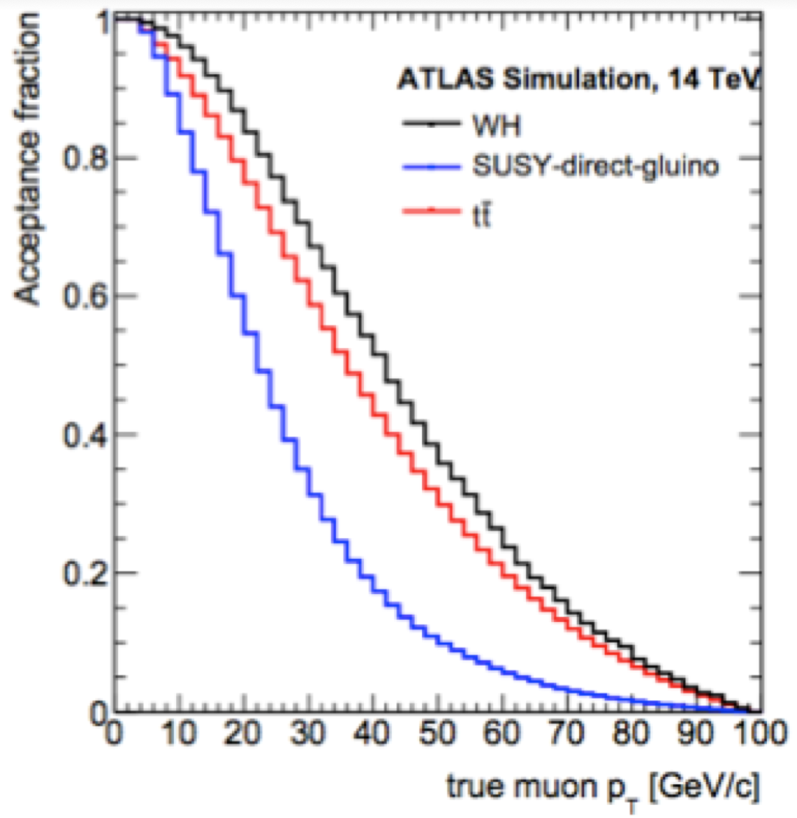
Scaling LHC → HL-LHC
This scaling is the most studied, “thanks” for the continuous push from review committees, worried by the evident increase
Main Evolution of important computing parameters
Live time cannot change much; if anything can go much below
<PU> goes from 35 to 200
Trigger rate 1 kHz → 7.5 kHz
HL-LHC / LHC = (7.5/1) * (200/35) = 42
This is optimistic!
Triggers have to remain clean
Assumes all is linear with <PU>, while reconstruction has at least a superlinear component
Upgraded detectors, more DAQ channels
A more realistic educated guess is 50-100x
Trigger rate scales at best with ℒ for
Same physics
Clean triggers
Difficult to do better than this

Slide 10
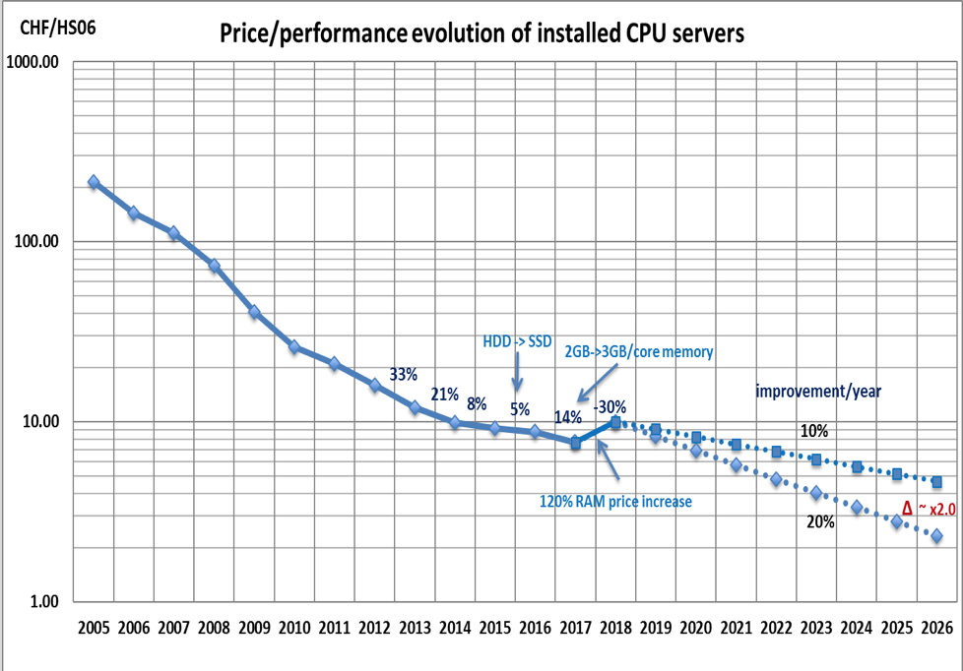
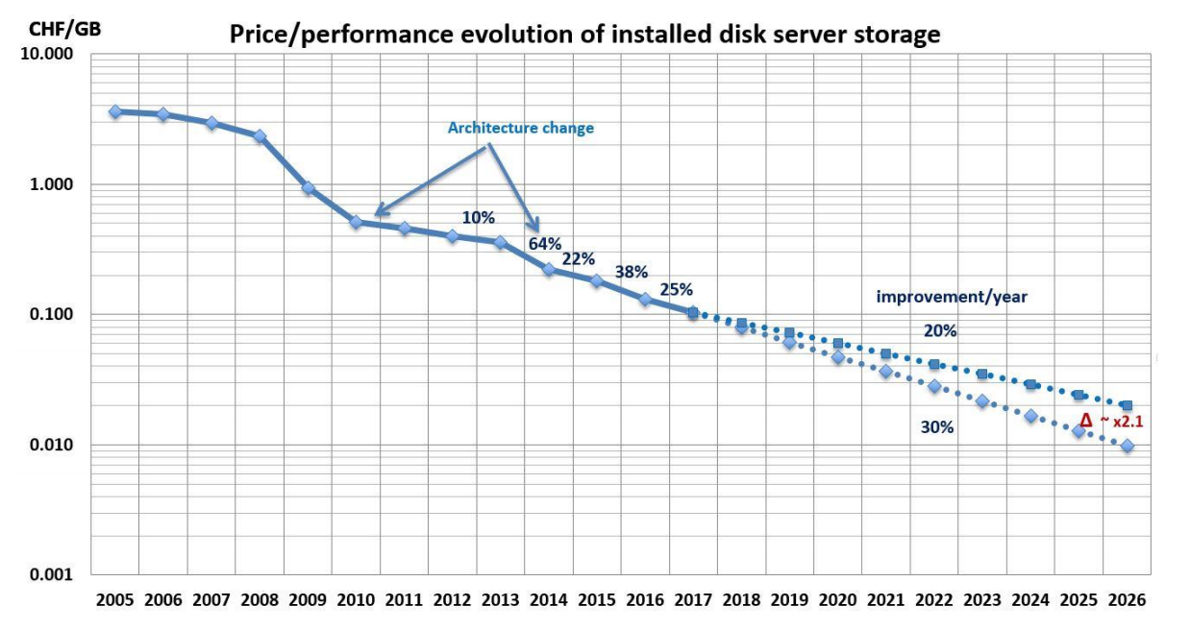
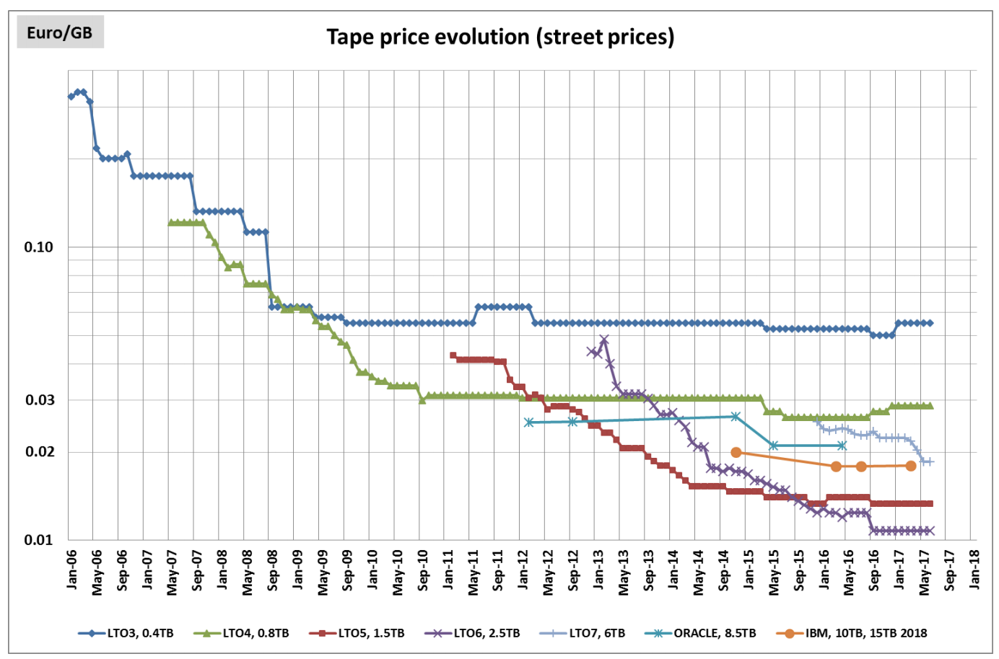
And in the meantime ….
CPU
The days of a +50% value per year from Moore’s (Kryder’s, Butter’s, Nielsen’s, …) law are gone
A +20%/y seems already optimistic, and there is even some indication of inversion of trend
Even if we stick to +20%/y, 1.2^7 = 3.6:
→ natural technology evolution (also known as the “sit-and-wait” approach) is not going to help us.
50-100x → 14-30x taking into account technology
We need real and furious R&D
7 years are not that much!
Disk
Tape
The once trusted “sit-and-wait” approach: do nothing, Intel will solve your problems
Source: B.Panzer/CERN

Slide 11
Which are the possible directions for a viable HEP Computing?
Infrastructure changes
Technological changes
Physics #1: change analysis model
Physics #2: reduce the physics reach (for example increasing trigger thresholds)
Not even considered here … it is the “desperation move” if we fail with everything else
Something unexpected...

Slide 12
Infrastructure changes
Today’s HEP computing
Owned centers, long lifetime (10+ y)
Well balanced in storage vs CPU
FAs pay for resources + infrastructure + personnel
Is it the most economic computing you can buy today?
YES, if you care about your data safety (and your capability to access it)
NO, if you can use stateless resources
They come and go fast
You can hire them (from a commercial provider, ...)
You can use “someone else” resources

Slide 13
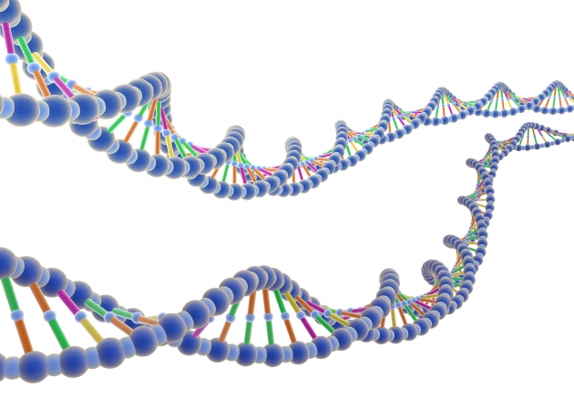
The data lake model
HPC center
Keep the real value from the experiments safe
(RAW) data and a solid baseline of CPU in owned and stable sites
Allow for multiple CPU resources to join, even temporarily
Eventually choosing the cheapest at any moment
Solid networking: use caches / streaming to access data
Reduce requirements for Computing resources
Commercial Clouds
Other sciences’ resources
SKA, CTA, Dune, Genomics, ...
HPC systems
CPU center
Lake Node 1
Lake Node 3
CPU center
> 1 Tb/s
Lake Node 2
Lake Node 4
CPU center
CPU center
HPC center
ProtoDune 2-3 GB/s (like CMS); Real Dune 80x
SKA up to 2 PB/day
A single genome ~ 100 GB. a 1M survey = 100 PB
CTA projects to 10 PB/y

Slide 14
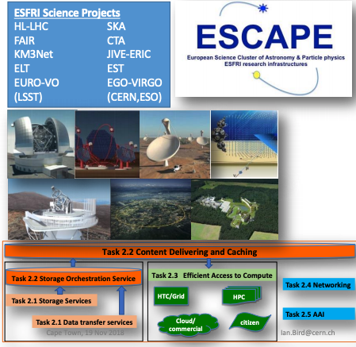
EU INFRAEOSC CALL
15MEur funded
(INFN 885kEur, PI-INFN tb)

Slide 15
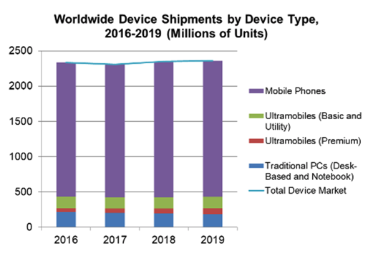
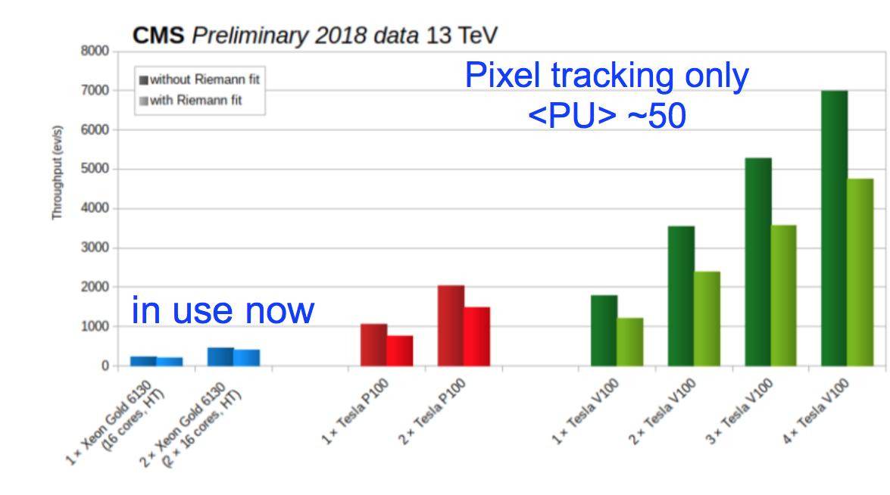
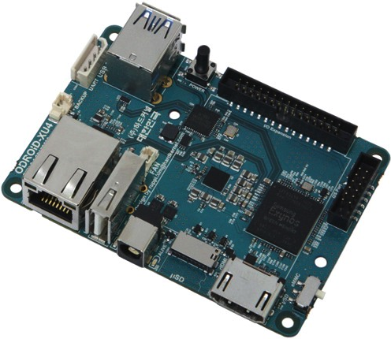
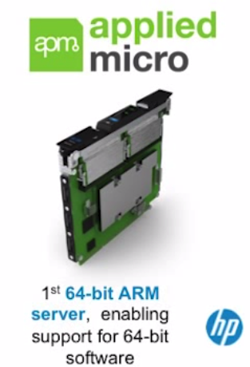
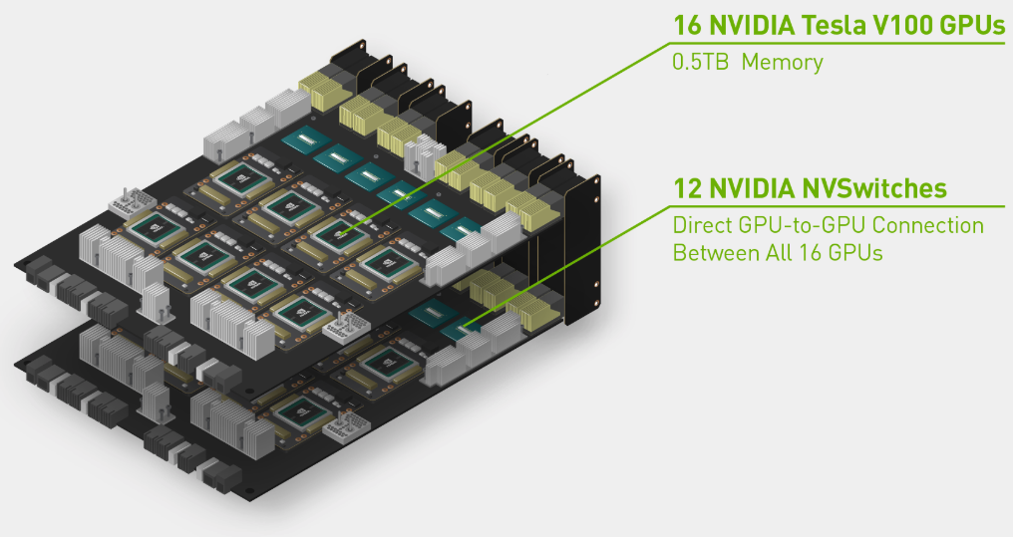
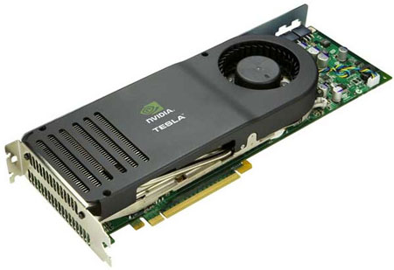
Technology changes
Use the cheapest technology per $. It used to be Linux PCs, now it is
Mobile (low power) processors
Vector processors (“GPGPUs”)
Code-in-hardware (“FPGA”, “ASIC”, …)
Can we use them?
Not easily - limited to mission critical algorithms
We need a way not to write the code once per platform
We need frameworks to embrace Heterogeneous Computing
Common effort needed in exps -- see later
“Newish” GPU
CPU
“Oldish” GPU
High performance
Low power (running cost /4)

Slide 16
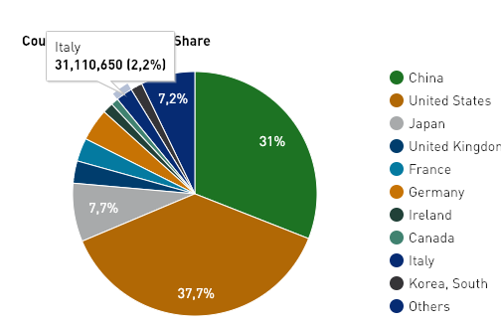
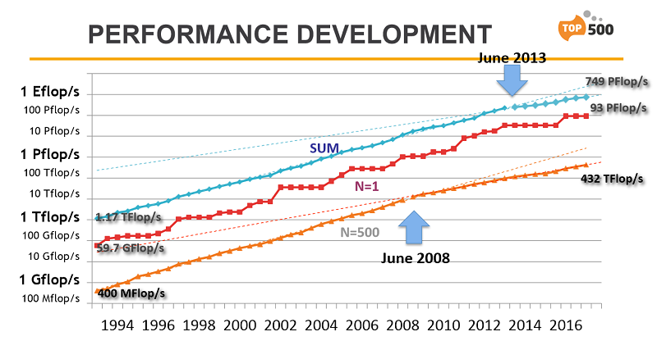
Supercomputing (HPC)
Source: top500 list
The world is literally full of Supercomputers. Why ?
Real scientific use cases
Lattice QCD, Meteo, ...
Industrial showcase
And hence not 100% utilized, opportunities for smart users. Can we be one of them?
Many not trivial problems to solve:
Data access (access, bandwidth, ...)
Accelerator Technology (KNL, GPU, FPGA, TPU, ???, …)
Submission of tasks (MPI vs Batch systems vs proprietary systems)
Node configuration (low RAM/Disk, …)
Not-too-open environment (OS, …)
Some hint of global slowing down, but not for top systems where the “war” is on
ITALY/LHC has applied for a large grant on PRACE/CINECA. Expect positive outcome within days

Slide 17
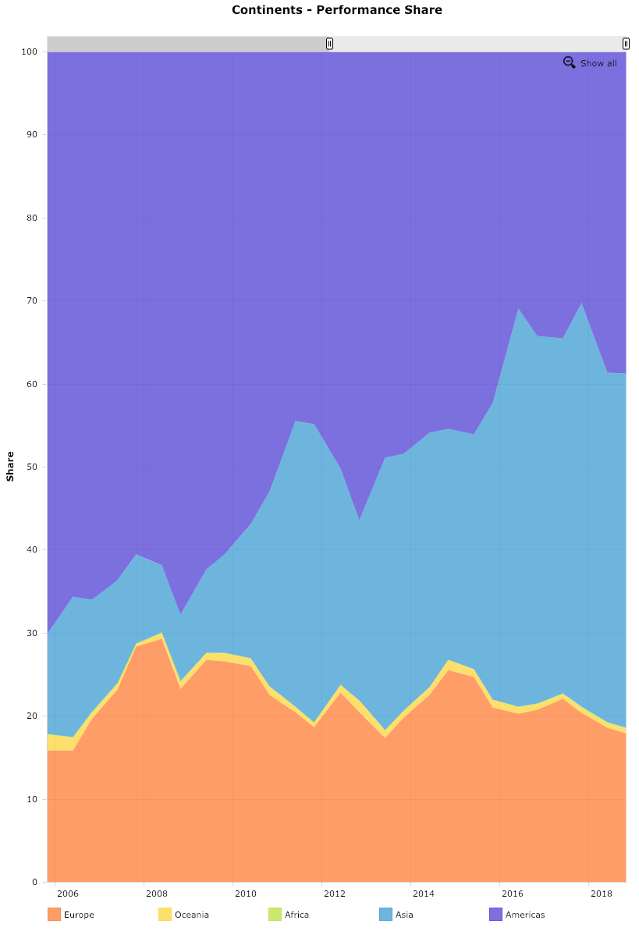
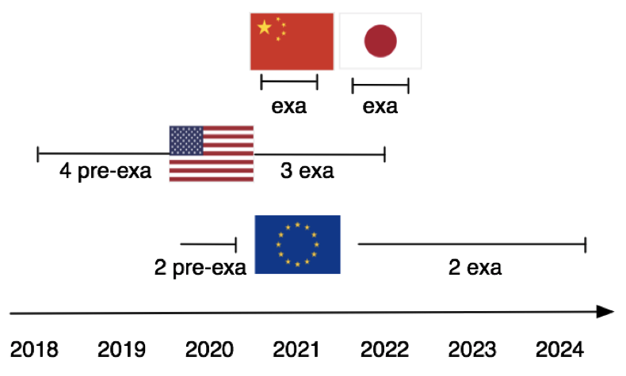
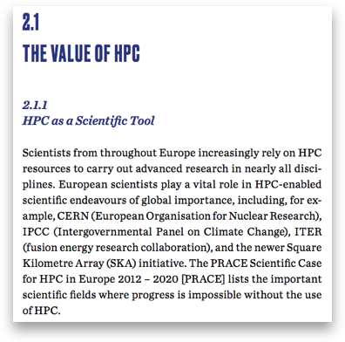
Supercomputing - the expected future
The race will go on, at least between major players
EU wants to enter the game - never a the top in the last 25y
Next big thing is ExaScale (10¹⁸ Flops - operations per second)
Should be well available by HL-LHC
Somehow difficult to compare, technologies / benchmarks, but
LHC needs today the equivalent of ~30 PFlops
A single Exascale system is ok to process 30 “today” LHC
Scaling: a single Exascale system could process the whole HL-LHC with no R&D or model change
Some FAs/countries are explicitly requesting HEP to use the HPC infrastructure as ~ only funding; it is generally ok IF we are allowed to be part in the planning (to make sure they are usable for us)
AMERICAs
ASIA
EU
US: apparently no way to have a say
EU: ETP4HPC has at least “asked for HEP position”
China: ???

Slide 18
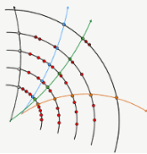
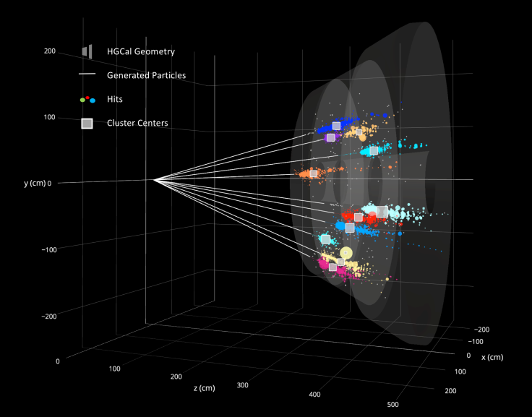
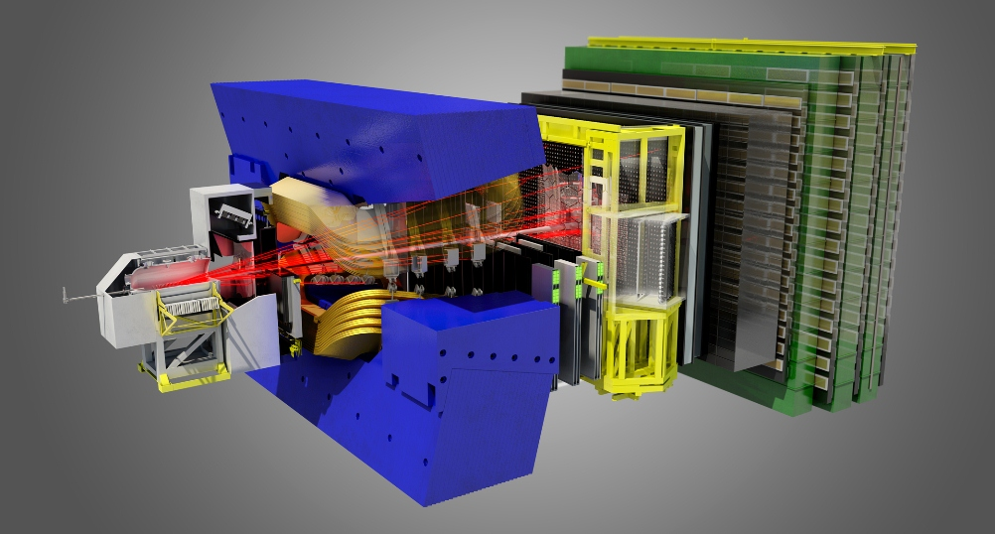
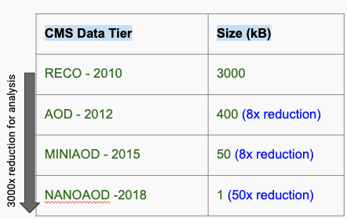
Physics challenges
Can’t we think of new (less resource hungry) ways of processing data? Ideas on the table:
Moving from standard algorithms to Machine Learning/Deep Learning
(seems reasonable, but gain in resources mostly unproven by now) - ALL exps
Merge Trigger and Offline - eventually w/o even saving the raw data - ALICE and LHCb
Standardize (down) to common event formats - CMS Mini/Nano AOD

Slide 19
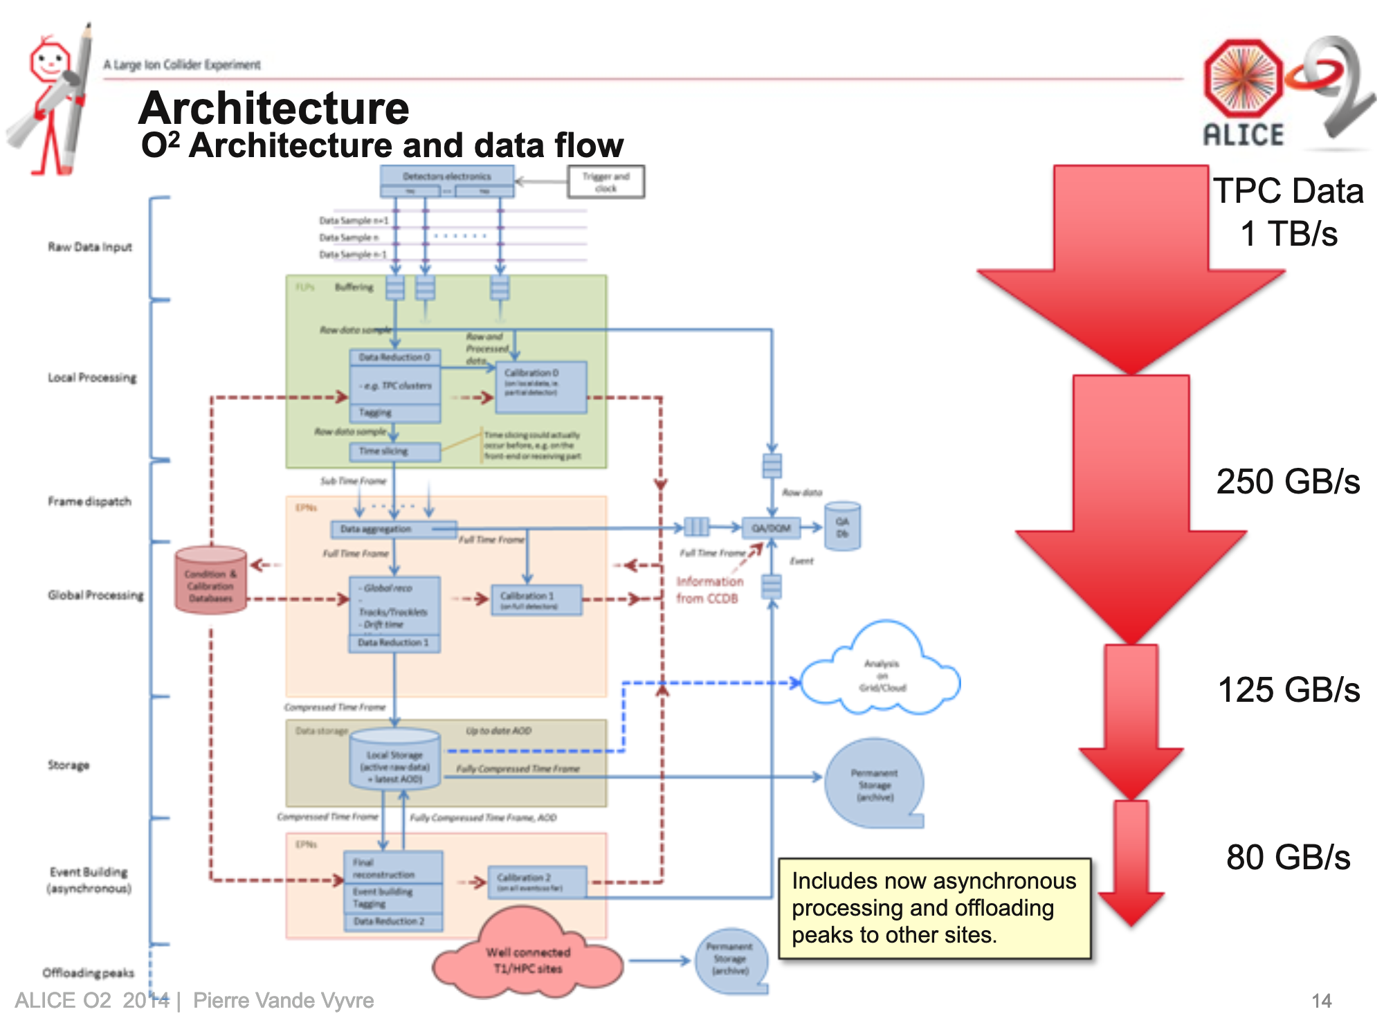
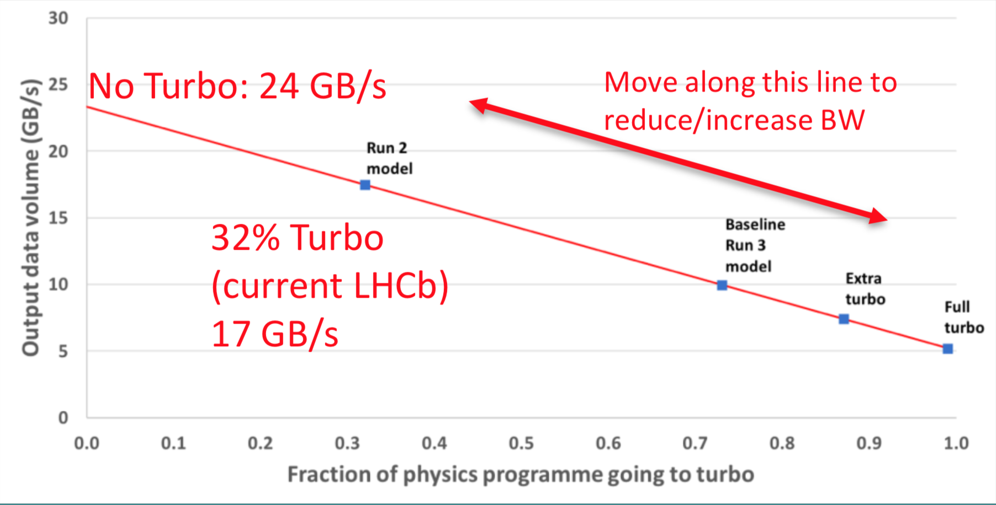
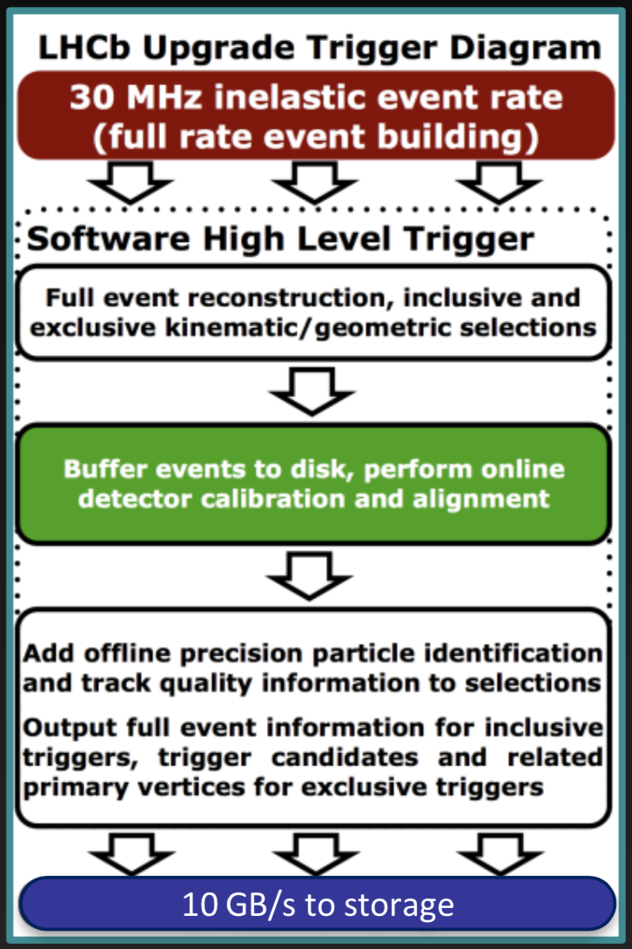
A little more on triggering vs offline
LHCb: already proven that an “online reconstruction” can be good enough for physics → Turbo Stream!
Perform reconstruction “online” (with delay dictated by the disk buffer size)
Never reprocess → why save RAW data at all?
Operate @ 30 MHz (interaction rate); 5 GB/s to offline in case of full turbo
ALICE O2: full merge of offline and online
Continuous readout at the PbPb interaction rate (~50 kHz) - 1 TB/s from the detector
CPU+ GPU driven reconstruction
Still, 80 GB/s to offline!

Slide 20
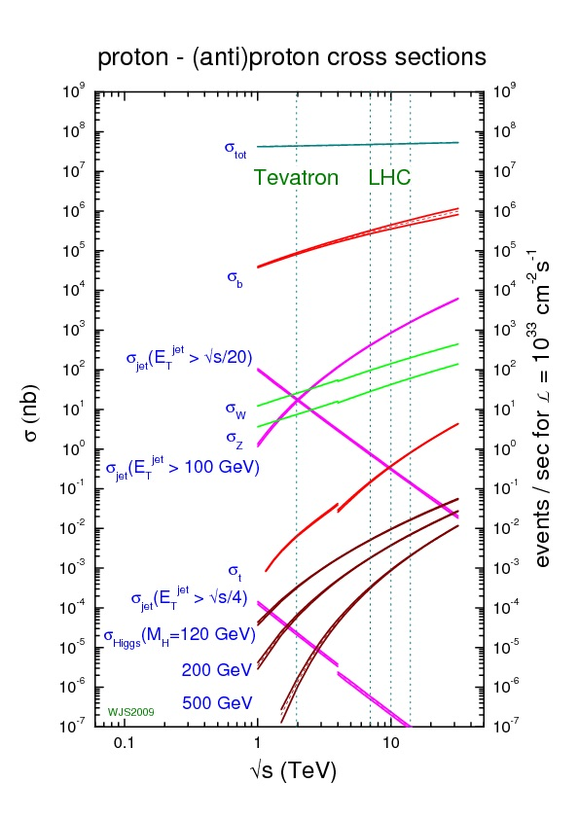
Triggering … what is different?
General Purpose Detectors (ATLAS, CMS) @ HL-LHC:
focus on Higgs, σ ~ 50 pb (at 7.5e34 means ½ Hz)
Even W and Z ~ O(10 kHz); tt ~ O(1kHz)
No need to readout / analyze @ 40 MHz !
LHCb @ LHC:
σ_{bb ~} ~ 100 μb, which is 10⁵ bb per second
Most of the collisions are signal; any standard trigger is cutting into the physics reach
As LHCb loves to say, from “Find a needle in a haystack” to “study needles in a needle stack”

Slide 21
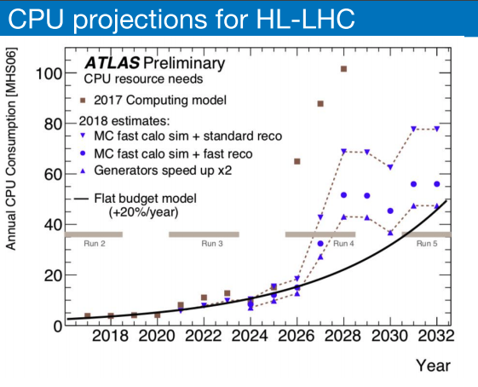
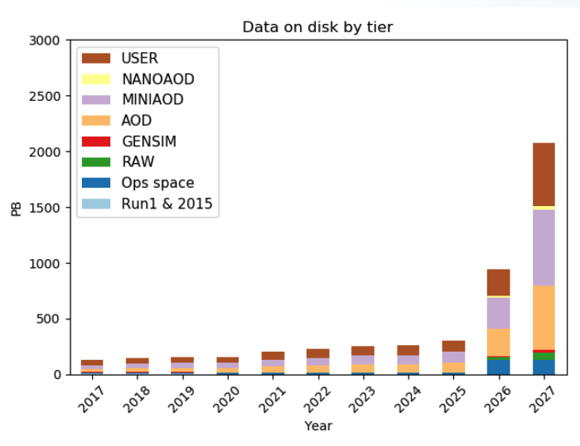
Where are we?
The factor 50-100x being the starting point, the exps have started long ago an intensive program to cover at least the areas discussed up to now
Latest estimates (2018) are largely better. When taking into account a reasonable +20%/y from scaling laws:
CMS - 2018
2018 projections to 2027: a factor 2-4x still missing wrt to +20%/y

Slide 22
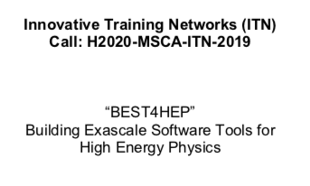
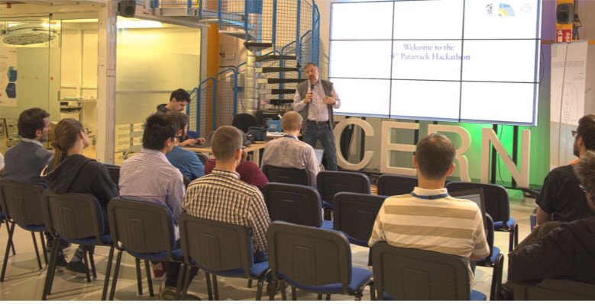
Roads ahead
Support more SW R&D
Careers, positions, infrastructure
Link institutes, share training and effort
US funded (25M$)
EU response (Pending grant)
R&D inside the experiments
CMS hackatons
FA organized schools

Slide 23
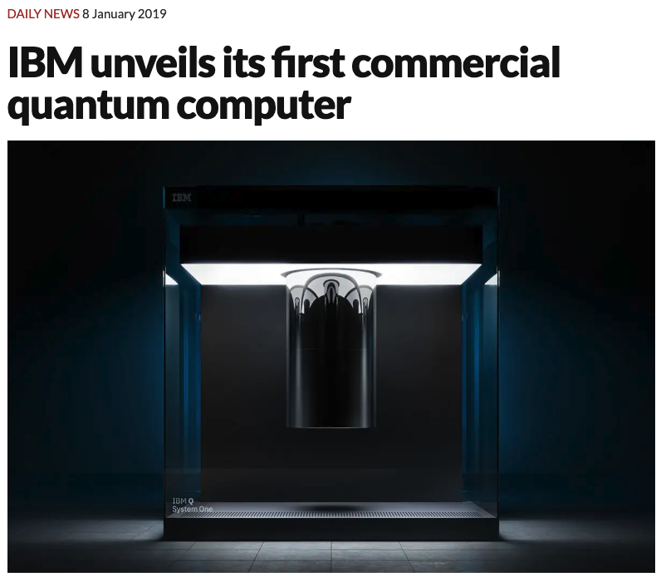
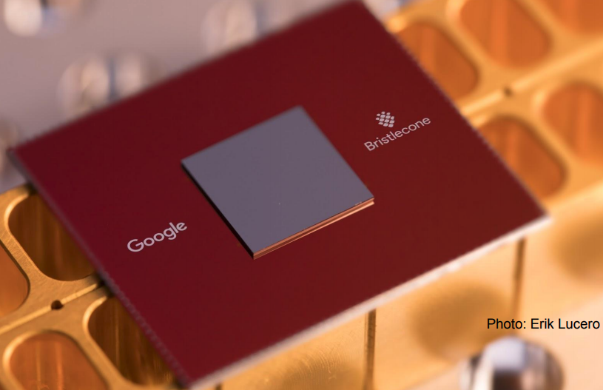
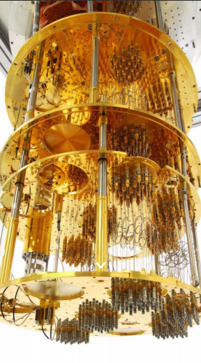
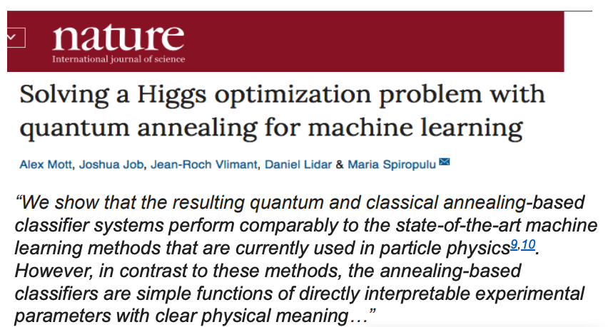
The unexpected ...
We cannot count on a complete change of computing paradigm to solve our problems…. But we can keep our eyes open for opportunities!
Quantum Computing could become relevant for the next experiment after HL-LHC; we are the perfect users (we have a use case not easily solvable with standard means)

Slide 24
Conclusions
Future (hh) experiments computing and analysis model still an unsolved problem
With a naive estimate, computing could even cost more than the experiments!
But: we have directions of work, ideas, plans. Still not there, but getting closer
We will need to change many concepts:
Triggering vs offline
Various computing architectures at the same time
Non-static resources; centers joining and leaving
We need to form researchers with new computing skill, which can be as extreme as the need for learning (back) quantum mechanics

Slide 25
Thanks for your attention!

