Slide 1

pp accelerator challenges and new technologies (magnets et al.)
Lucio Rossi
High Luminosity LHC Project Leader
I2FEST2019 - INFN&IHEP@Torino18Feb2019 - Cavallerizza Reale

Slide 2
Content
FCC nominal parameter for hadrons
Critical Technologies (other than Magnets)
  Vacuum & Synchrotron radiation handling
  Cryogenics
  Beam handling (absorber, dump)
Magnets
  LHC and HL-LHC
  Roadmap for higher field in Europe: Nb₃Sn
  HTS?

Slide 3


FCC-pp collider parameters
parameter | FCC-hh |  |  | HE-LHC | HL-LHC | LHC
collision energy cms [TeV] | 100 |  |  | 27 | 14 | 14
dipole field [T] | 16 |  |  | 16 | 8.33 | 8.33
circumference [km] | 97.75 |  |  | 26.7 | 26.7 | 26.7
beam current [A] | 0.5 |  |  | 1.1 | 1.1 | 0.58
bunch intensity [10¹¹] | 1 |  | 1 | 2.2 | 2.2 | 1.15
bunch spacing [ns] | 25 |  | 25 | 25 | 25 | 25
synchr. rad. power / ring [kW] | 2400 |  |  | 101 | 7.3 | 3.6
SR power / length [W/m/ap.] | 28.4 |  |  | 4.6 | 0.33 | 0.17
long. emit. damping time [h] | 0.54 |  |  | 1.8 | 12.9 | 12.9
beta* [m] | 1.1 | 0.3 |  | 0.25 | 0.15 (min.) | 0.55
normalized emittance [μm] | 2.2 |  |  | 2.5 | 2.5 | 3.75
peak luminosity [10³⁴ cm⁻²s⁻¹] | 5 |  | 30 | 28 | 5 (lev.) | 1
events/bunch crossing | 170 |  | 1000 | 800 | 132 | 27
stored energy/beam [GJ] | 8.4 |  |  | 1.3 | 0.7 | 0.36

Slide 4
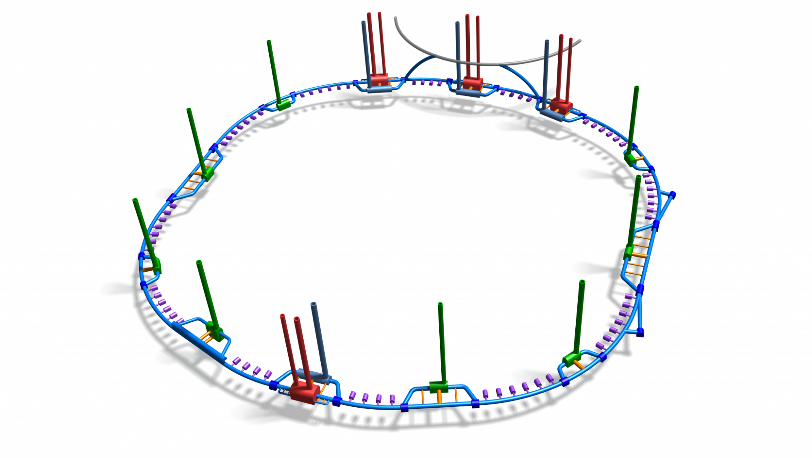
FCC Special Technologies
JM Jimenez – FCC Amsterdam
Beam transfer
devices
[WP3]
Beam vacuum
Magnet Cold Bore
(Eurocircol WP4)
[WP1]
Manufacturing
technologies
[WP4]
Transverse
feedback
[WP6]
Normal
conducting
magnets
[WP5]
Beam vacuum
induced dynamic effects
[WP9]
CryoPlants
efficiency
[WP2]
Radiation Hardness
Assurance
[WP11]
Architecture for magnets
& machine protection
[WP12]
Surface-Vacuum
parameters
for beam-induced
effects
[WP13]
Beam dumps
[WP7]
Cryomagnet
insulation
vacuum
[WP10]
Robotics
[WP14]
Beam
instrumentation
[WP8]

Slide 5
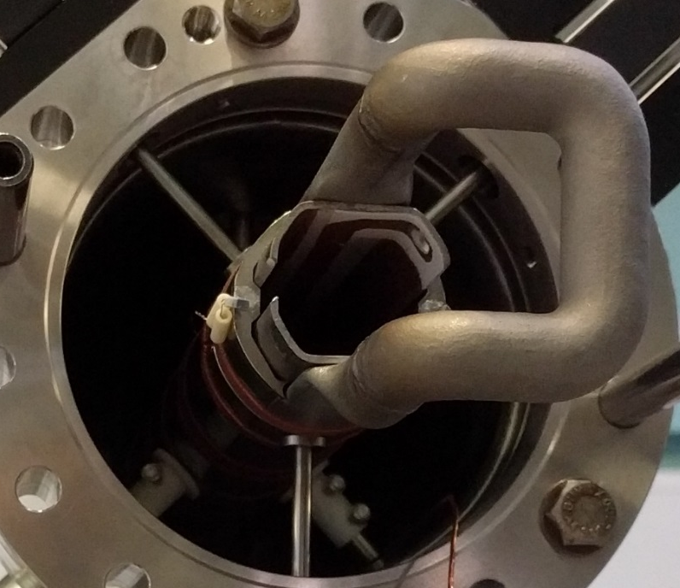
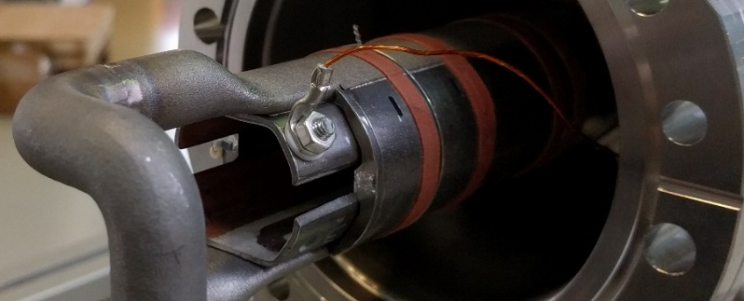
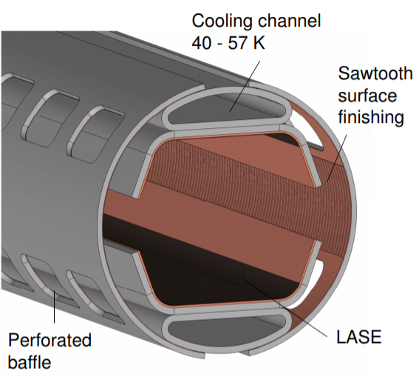
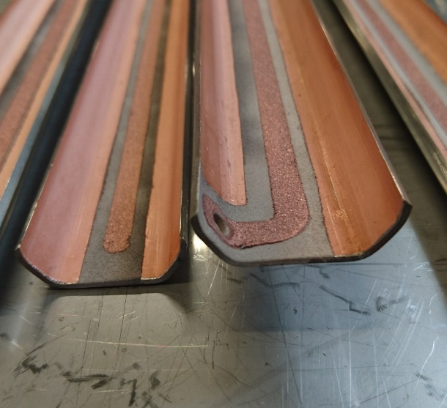
FCC-hh: beam screen evolution & tests
Simplified BS design in view of:
Mass production
Impedance optimization
e- cloud mitigation
latest version to be tested summer ‘18
Cold Sprayed Isolated Electrode
(e-cloud mitigation option)
M. Benedikt –
FCC Amsterdam
Measurements at KARA/KIT (pressure evolution) confirm MC vacuum simulations
Confident to use simulations for all vacuum design
Design optimisation:
Ribs removed; Optimization of thickness of copper and steel
Connection absorber/cooling tube, and welding positions

Slide 6

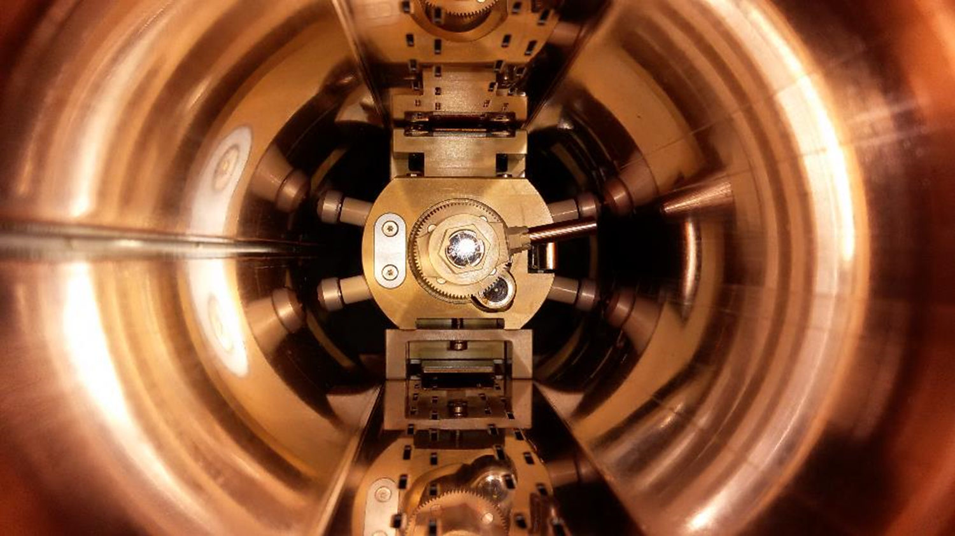

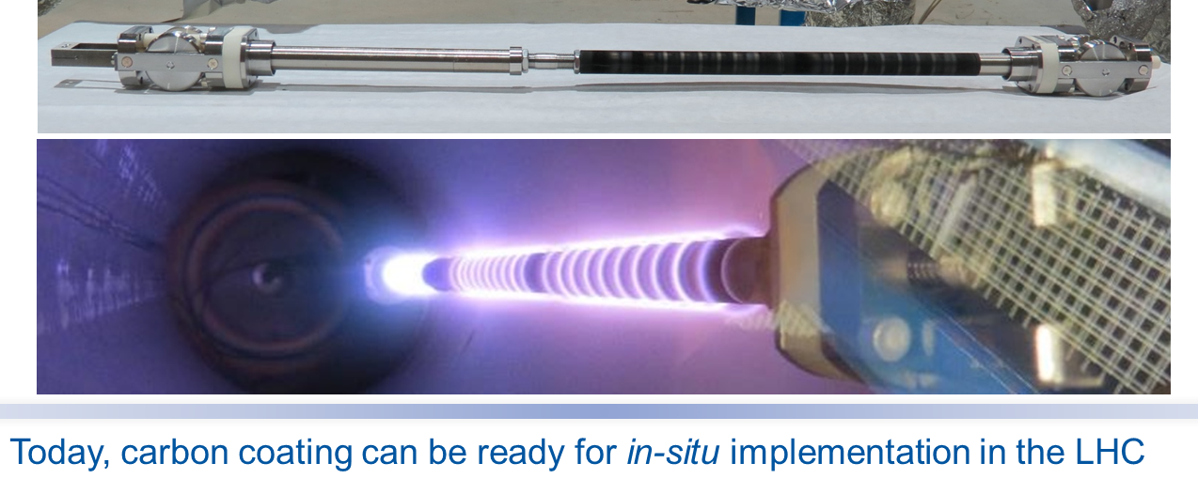
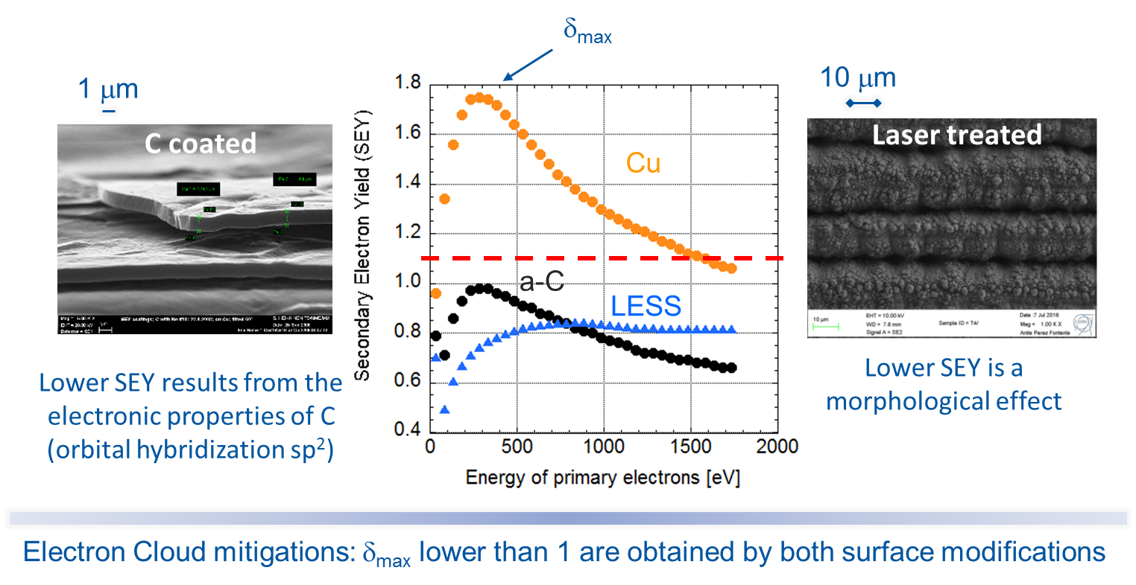

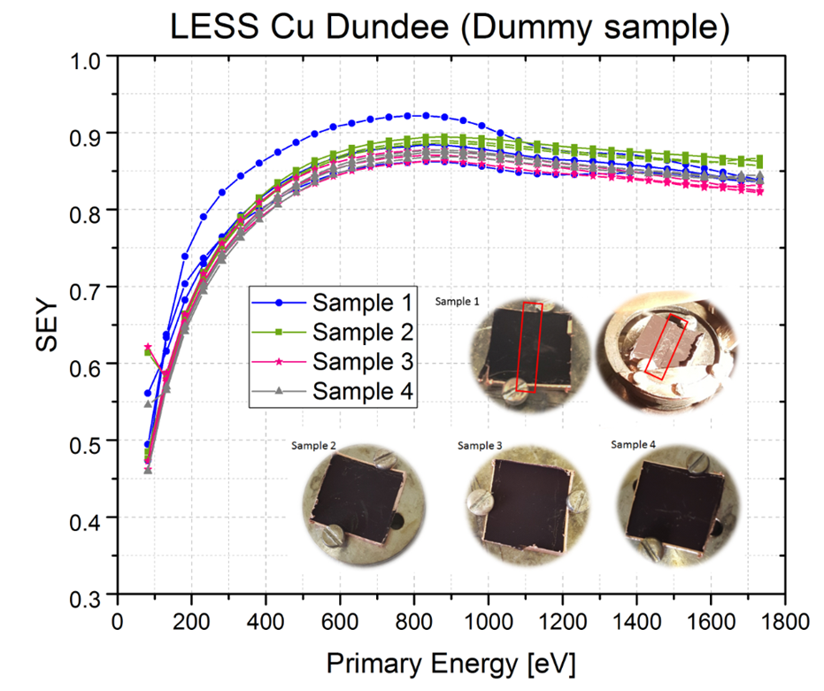
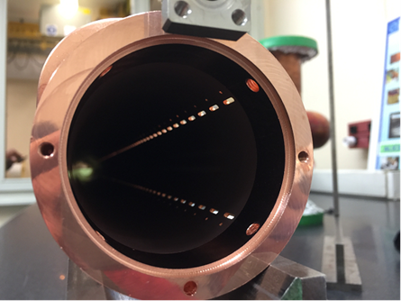
Surface-Vacuum parameters for beam-induced effects
R&D for HL-LHC first, and further development for FCC-hh

Slide 7





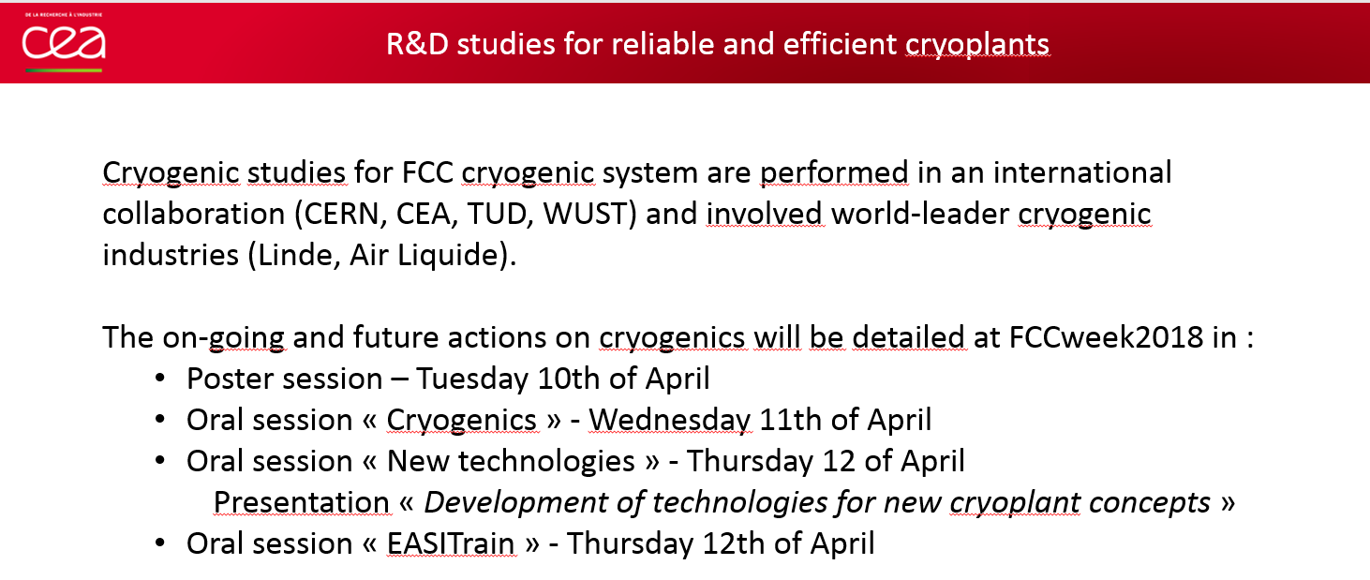
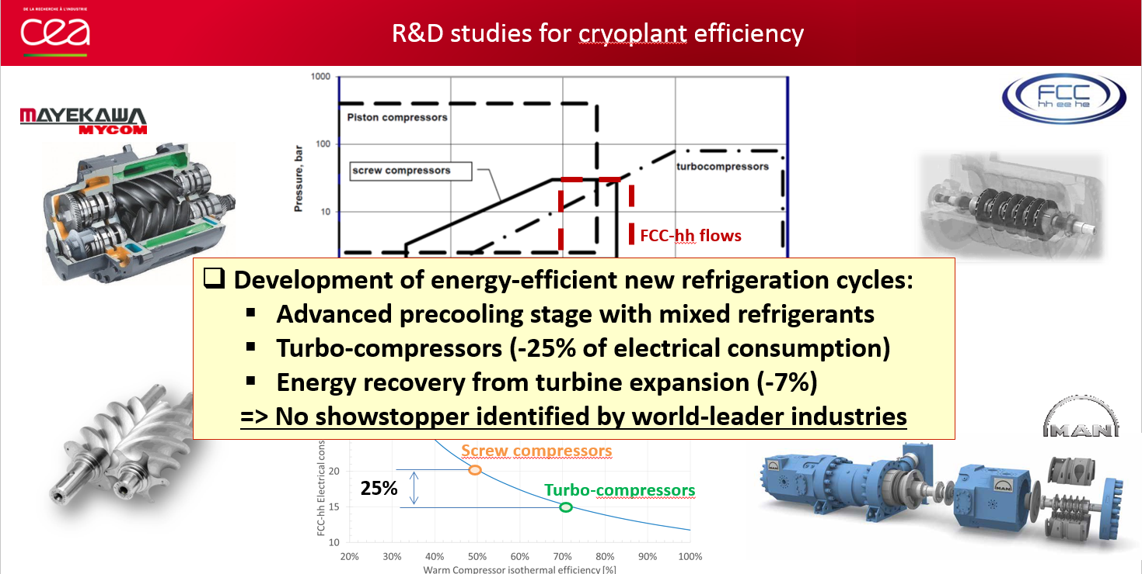
CryoPlants efficiency
JM Jimenez – FCC Amsterdam
CryoPlant efficiency is certainly a must: 30% possible gain

Slide 8
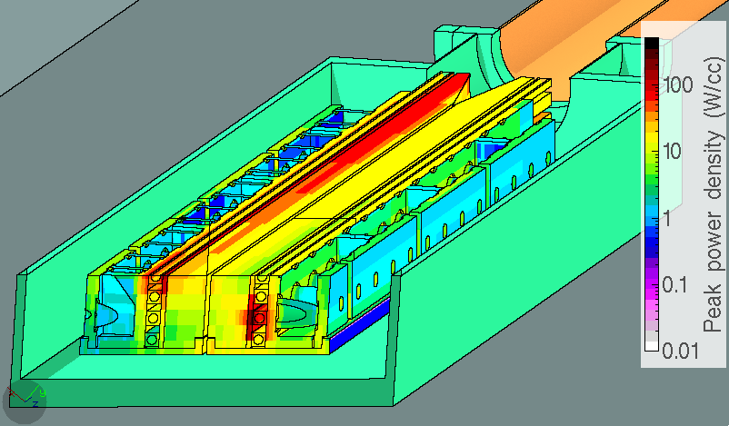
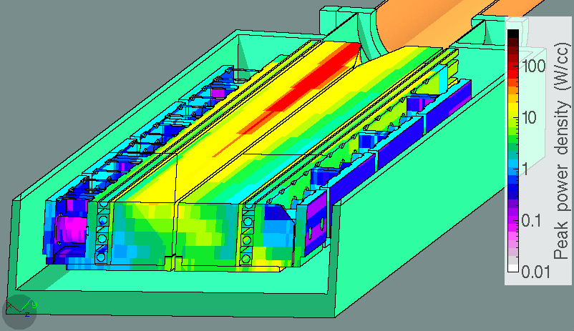
Beam power handling: robust low-loss collimation
Complete designs of collimation insertions, main issue: sustain beam lifetime of 12 mins (12 MW loss)
1 MW
50 kW/m
FLUKA simulations highlighted four critical points
1st Secondary Collimator
Old design
<5 kW
max power density
800 Wcm⁻³
total power
225 kW
260 kW
225 kW
New design
Primary Collimators
Active length halved
Max. power reduced from 260 kW to 80 kW
50 to 100 kW considered OK
max power density
115 Wcm⁻³
total power
92 kW
Arc protection Protection design offers sufficient margin
M. Benedikt –
FCC Amsterdam

Slide 9
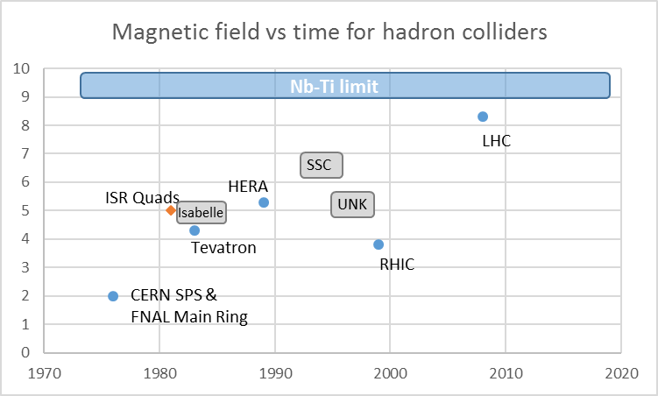
Hadron Colliders are ruled by:
E_{beam} = 0.3 R * B (TeV; km; T)
< 10 y to double field: 2 T MR→ 4 T Tevatron
> 20 y to double again in SC: → 8 T of LHC
Consideration on LHC
Designed for 8.33 T (14 TeV c.o.m.) with margin to go to 9 T (15 TeV c.o.m)
Today operating at 7.75 T (13 TeV)
8.33 T in 2021 possibly
9 T may be in 2026/2030 with HiLumi but very difficult (trade off with loss of lumi)

Slide 10
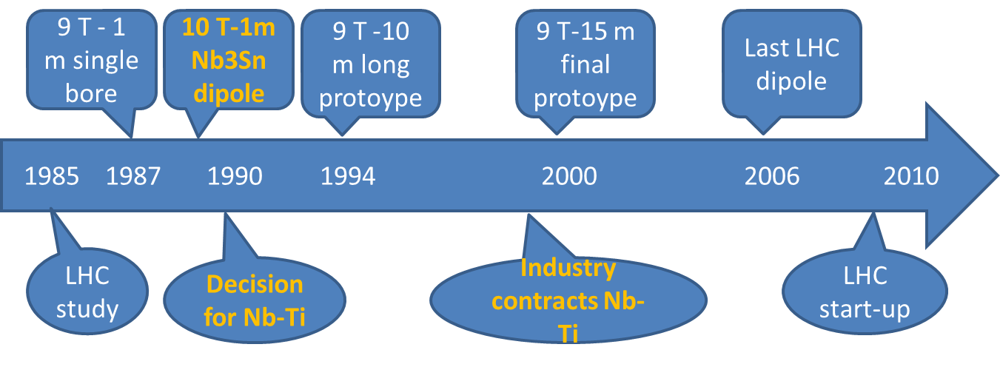
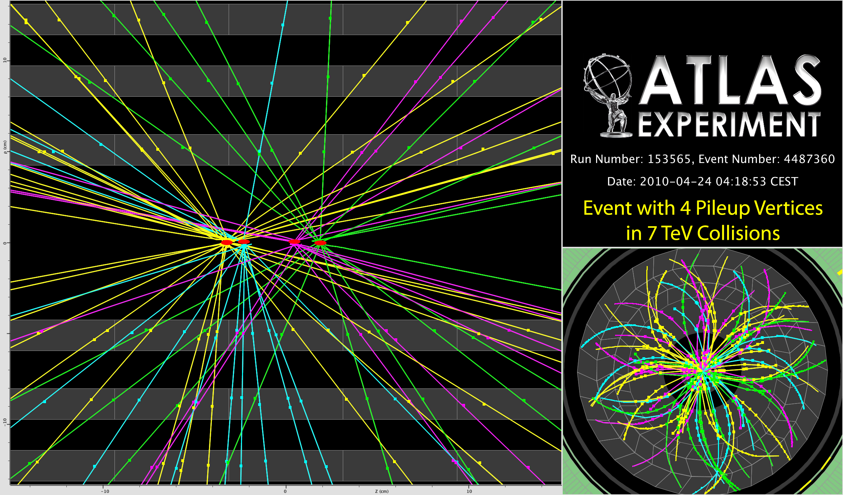
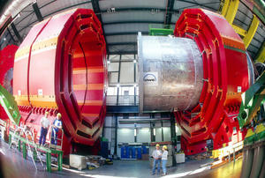
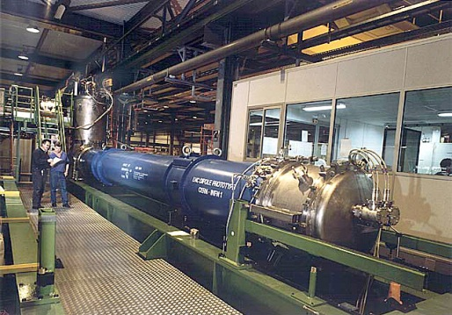
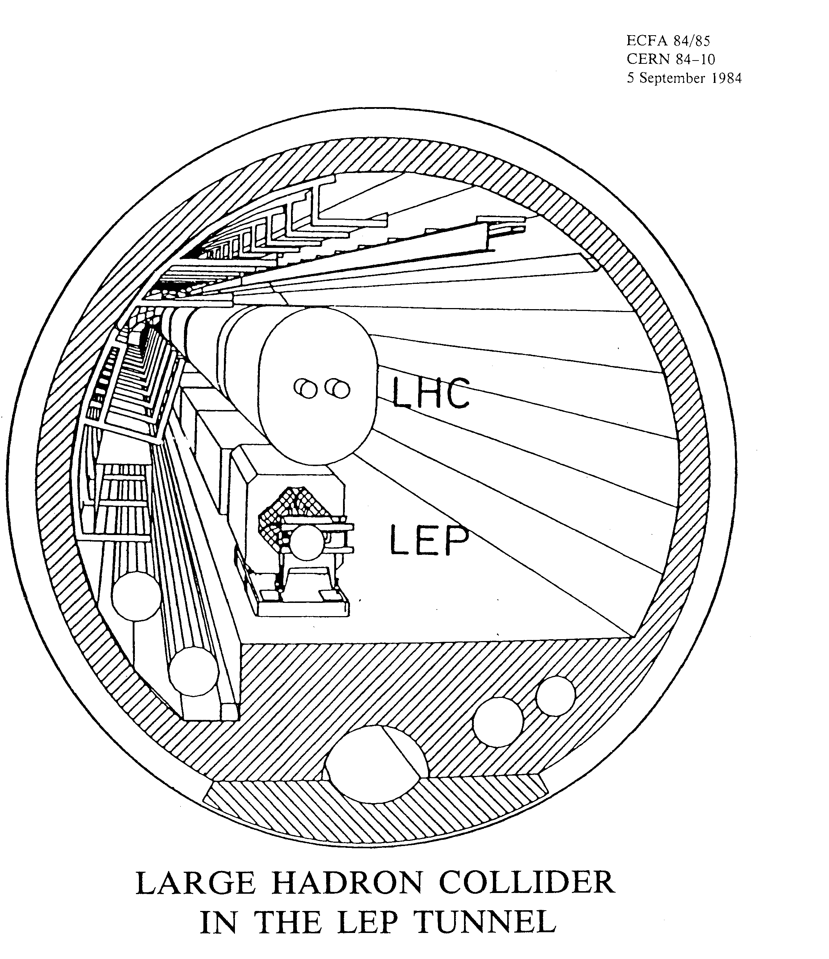
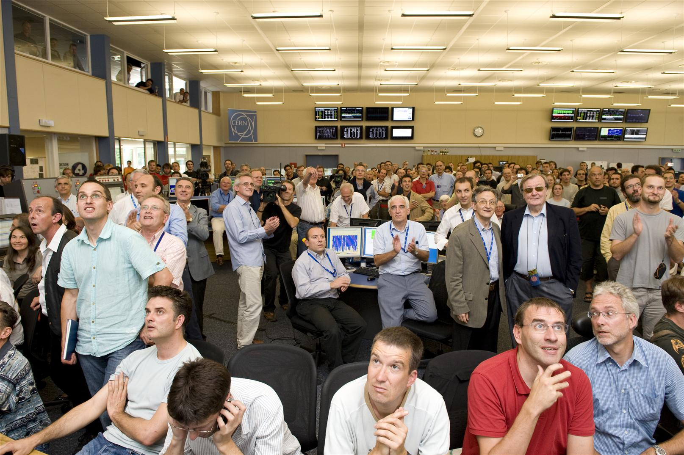
The 25 y LHC construction time line
Striking: only 2 y to make a design «near to final». The conductor was almost there! (thanks to SSC)

Slide 11
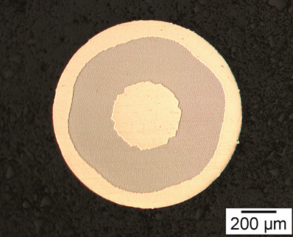
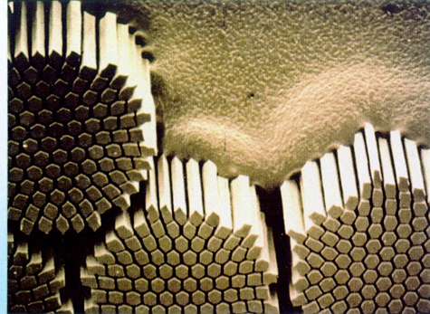
The key factor: superconductor
(but not the only factor!)
Developing SC is the key in SC accelerators.
The perfection of LHC superconductor is such that we basically «forget» the SC effects and is the base of the repeatibility and optimal performance of the collider

Slide 12





High Luminosity LHC -1 New Triplets IT QUADs
Connection to LHC (UL)
Service gallery (UR)
SC Links
Q2a
Q1
TAXS
Q2b
Q3
CP
DFX
D1
DFM

Slide 13



High Luminosity LHC – 2 New Matching section
UA gallery
Service cavern
(BBLR)
Q4
Crab cavities
D2
Collimators
TAXN

Slide 14
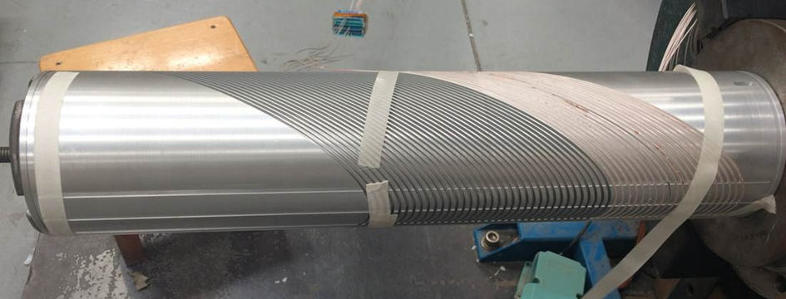
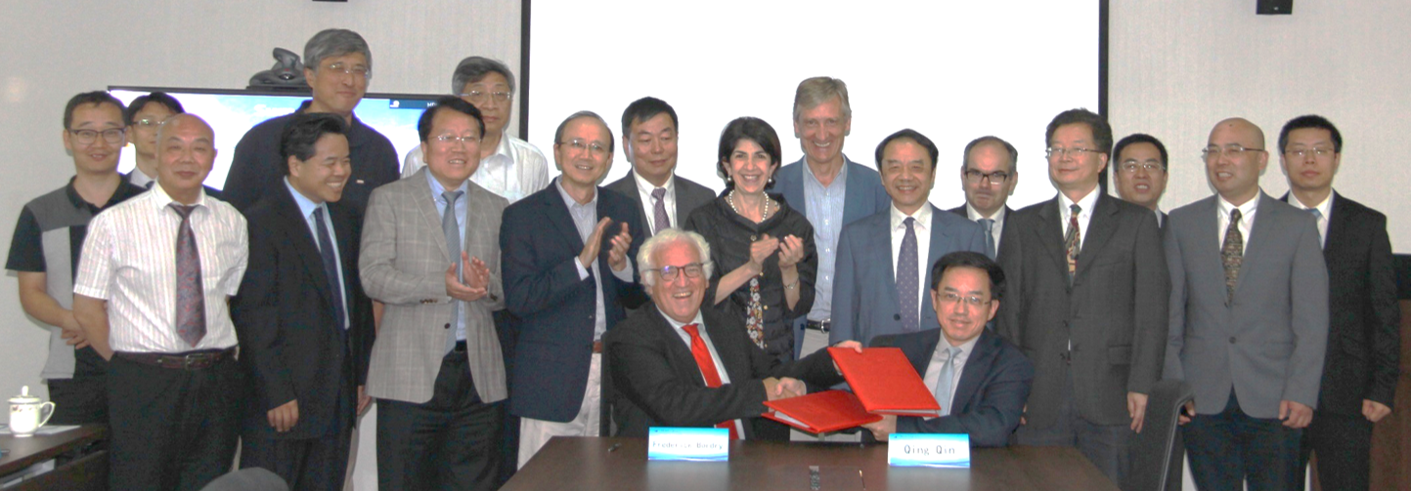
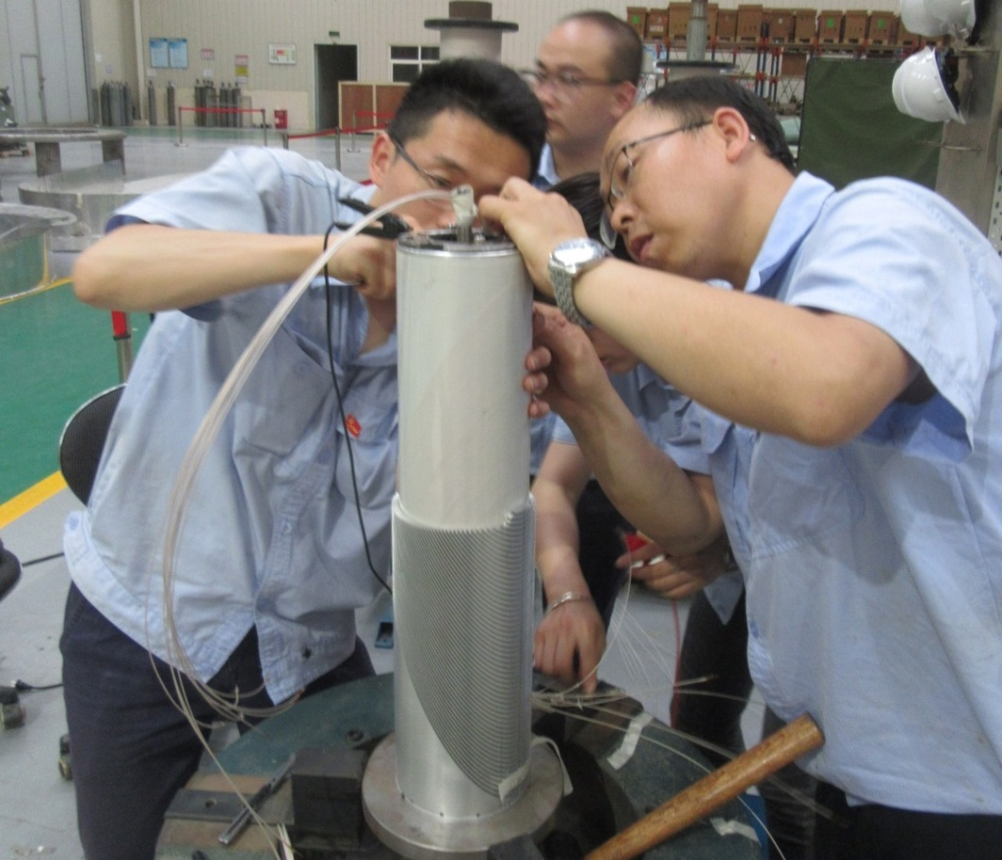
16 Sept 2018
  China will provide 12 units of CCT magnets for HL-LHC before 2022
  A 0.5m model is under construction, and 2.2m prototype to be fabricated and tested by June 2019

Slide 15
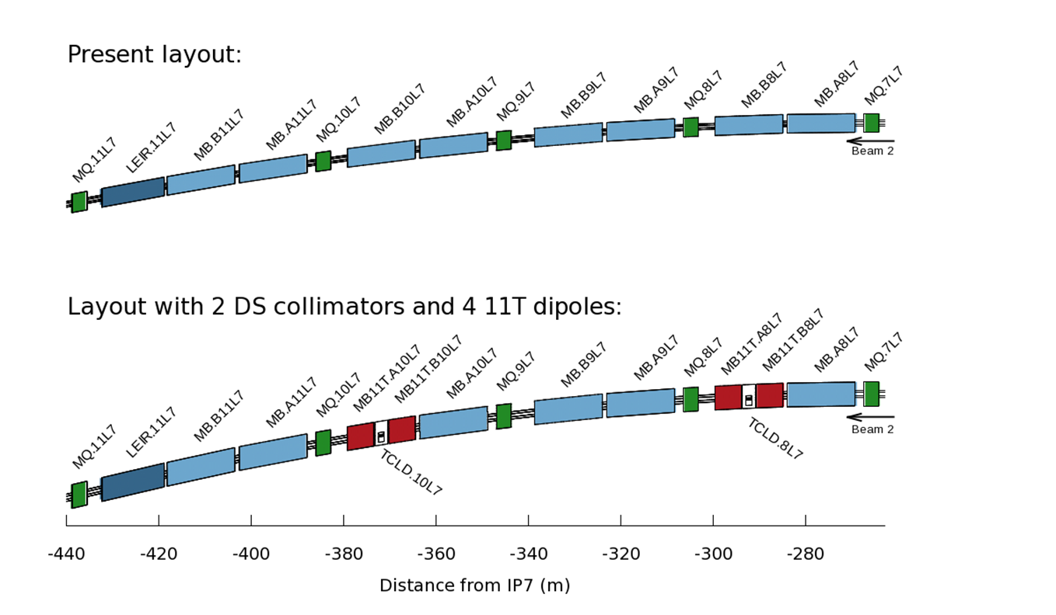
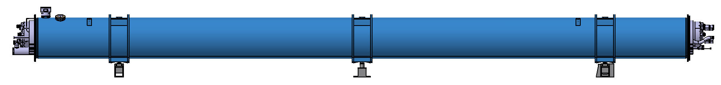
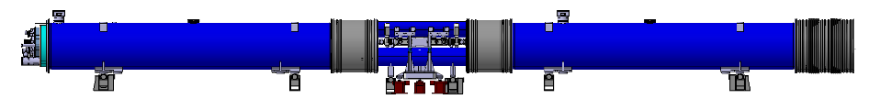
High Luminosity LHC 11 T dipole in the DS7
Present layout of the DS region:
15.660 m
LHC layout
New layout with one collimator and two 11T dipoles:
15.660 m
HL-LHC layout
11 T dipole
By-pass with collimator
11 T dipole

Slide 16
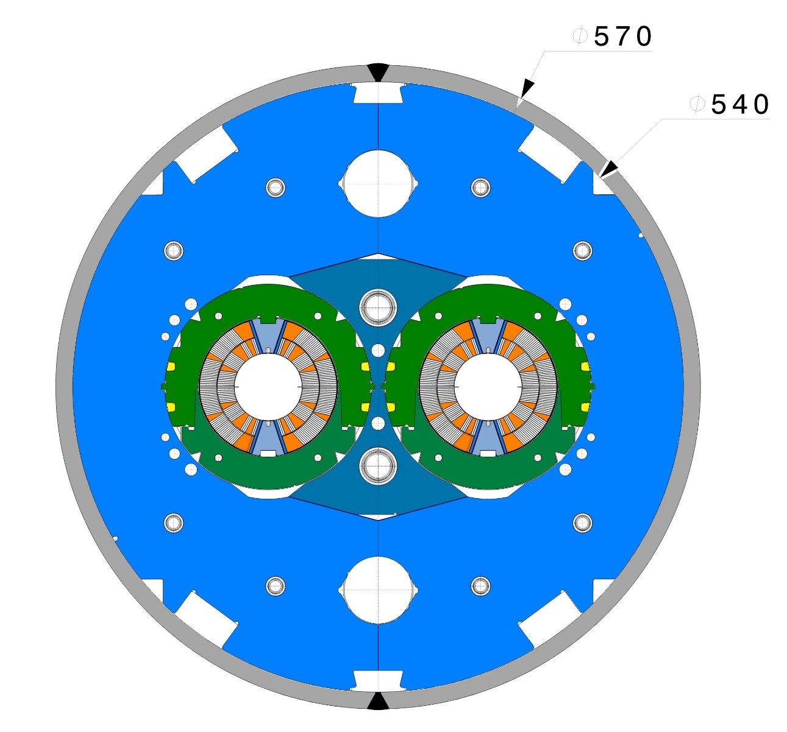
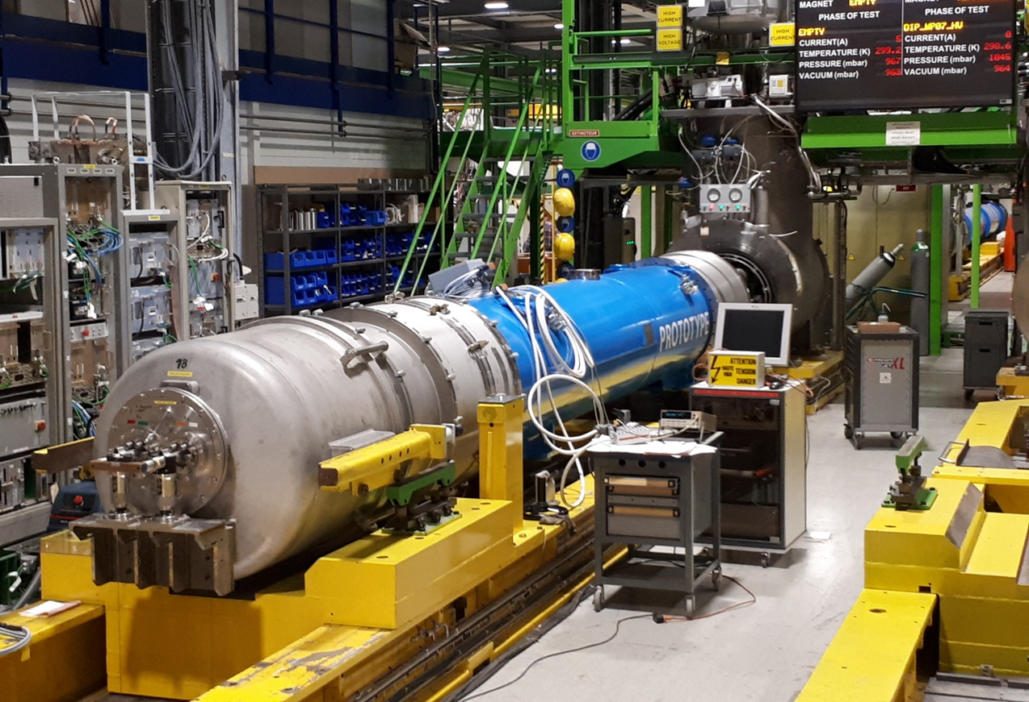
First 11 T prototype (full size) on test @ CERN
Result not positive (<10 T)
Magnet under rework to test second aperture alone

Slide 17
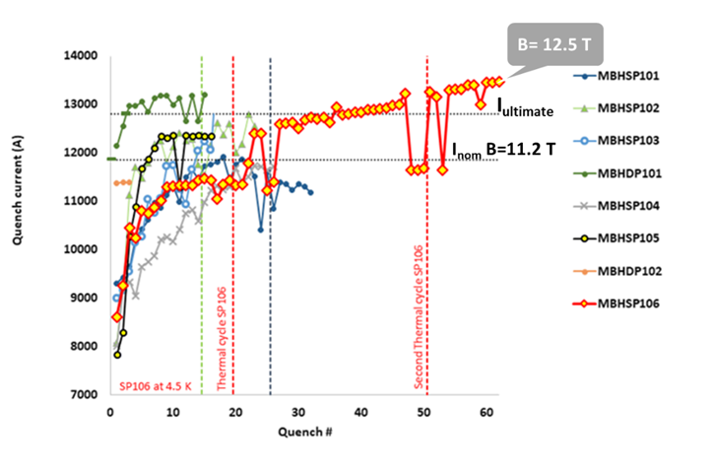
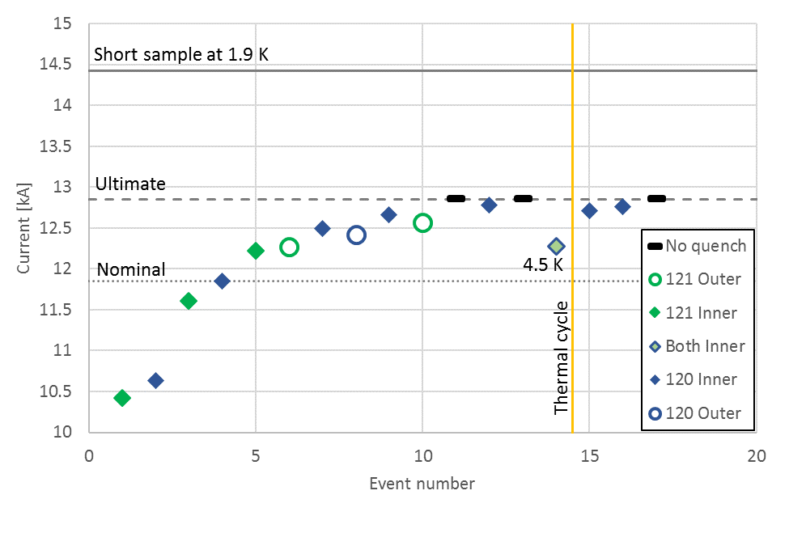
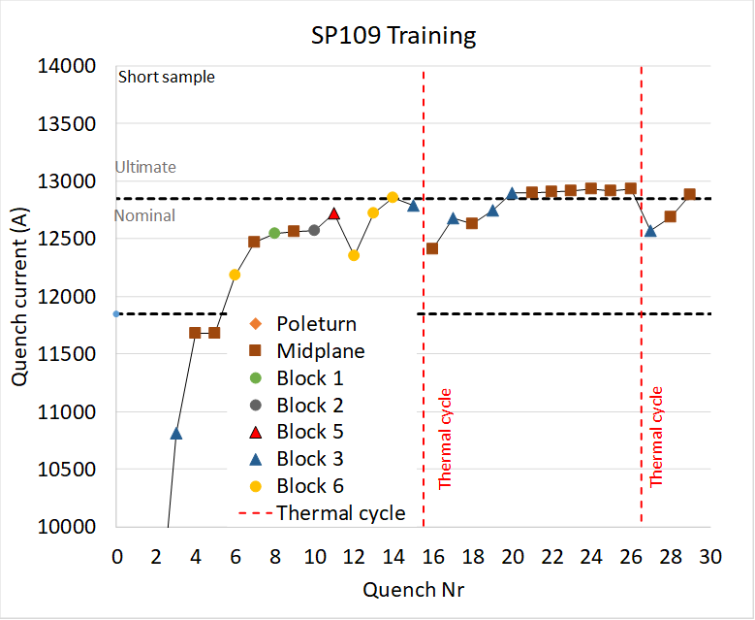
Review of 11 T results
Results on short models before test of long proto
Result of the first «new design» to cure «erratic» behaviour (July 2018)

Slide 18
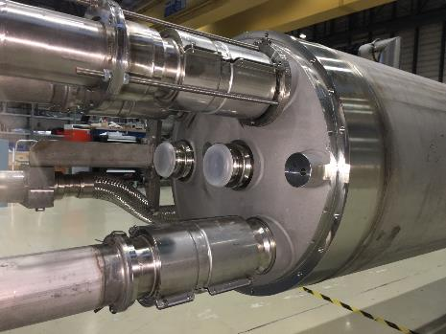
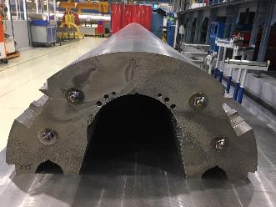
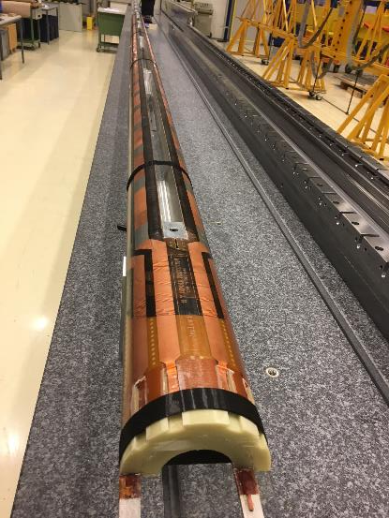
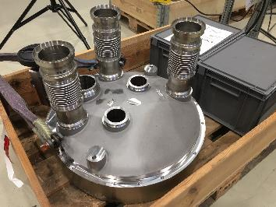
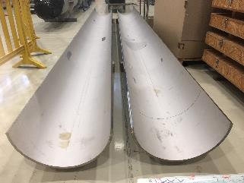
Now 11 T in full swing for production great care in QA given the sensitivity of Nb3Sn

Slide 19
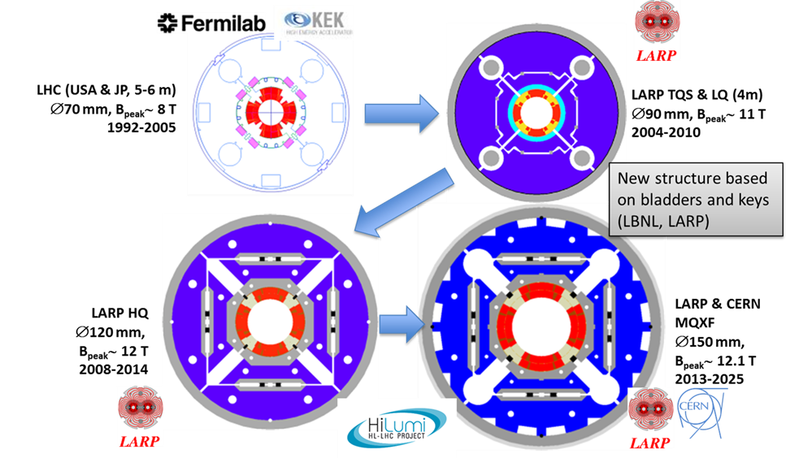
IT quadrupole. Increase in field btu also in size wrt LHC. Very relevant also for FCC magnets

Slide 20
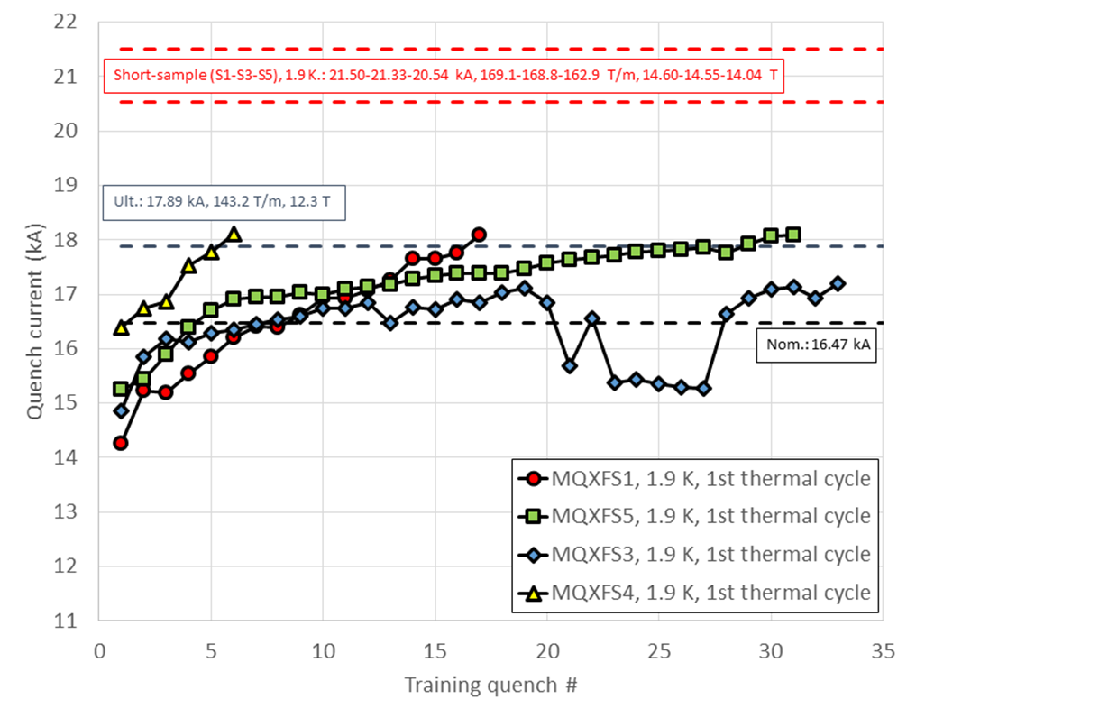
Result of IT quadrupoels
All magnets have exceptional memory (no low current quench after thermal cycle)
Best HF magnet ever tested in terms of behaviour (not max field)
Final conductor, final prestress procedure
This magnet had a too high prestress The last higher quench have fast ramp rate

Slide 21
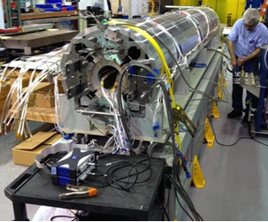
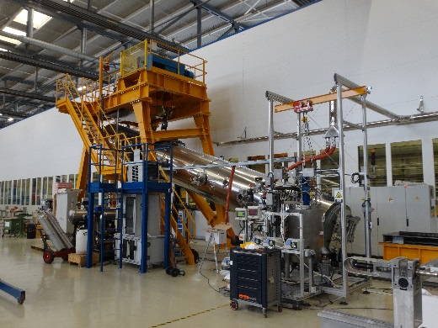
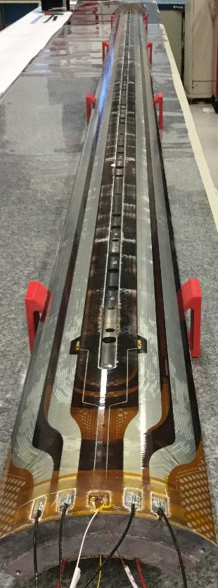
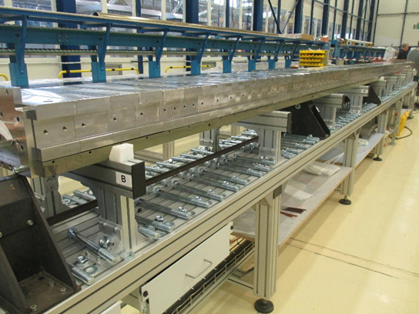
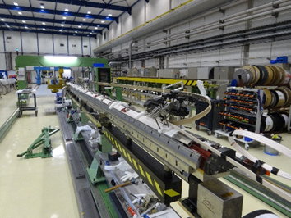
Construction of the 1st and 2nd long (7.5 m!) IT Quad in full swing (also in USA)
Making long magnets in Nb₃Sn is not granted but we are confident for Hilumi: the project is big but not enormous (about 30 magnets of 4.2, 5.5 and 7.2 m length)

Slide 22
A step between HL-LHC and a post-LHC?
Report under editing (by O. Bruning) in 2018 (not yet published).
Pushing to 15 TeV (ultimate dipole field of 9 T): not impossible, in the HiLumi time, sensible less availability, trade off with less lumi maybe not convenient, TBD
Pushing the energy using 11 T as middle cell dipole (1/3) gaining 11% energy: 15.5-16.6 TeV (nominal-ultimate field).
  Most probably not convenient in terms of cost, personnel resources,time (big installation) and very difficult for optics. I think is impossible to «touch» only the magnets. And needs at least a design revision of the HiLumi 11 T.
  Not for tomorrow, not easy, not cheap, not «transparent» for other CERN development, not a terrific gain…
Personal opinion: unlikely
Personal opinion: forget it

Slide 23
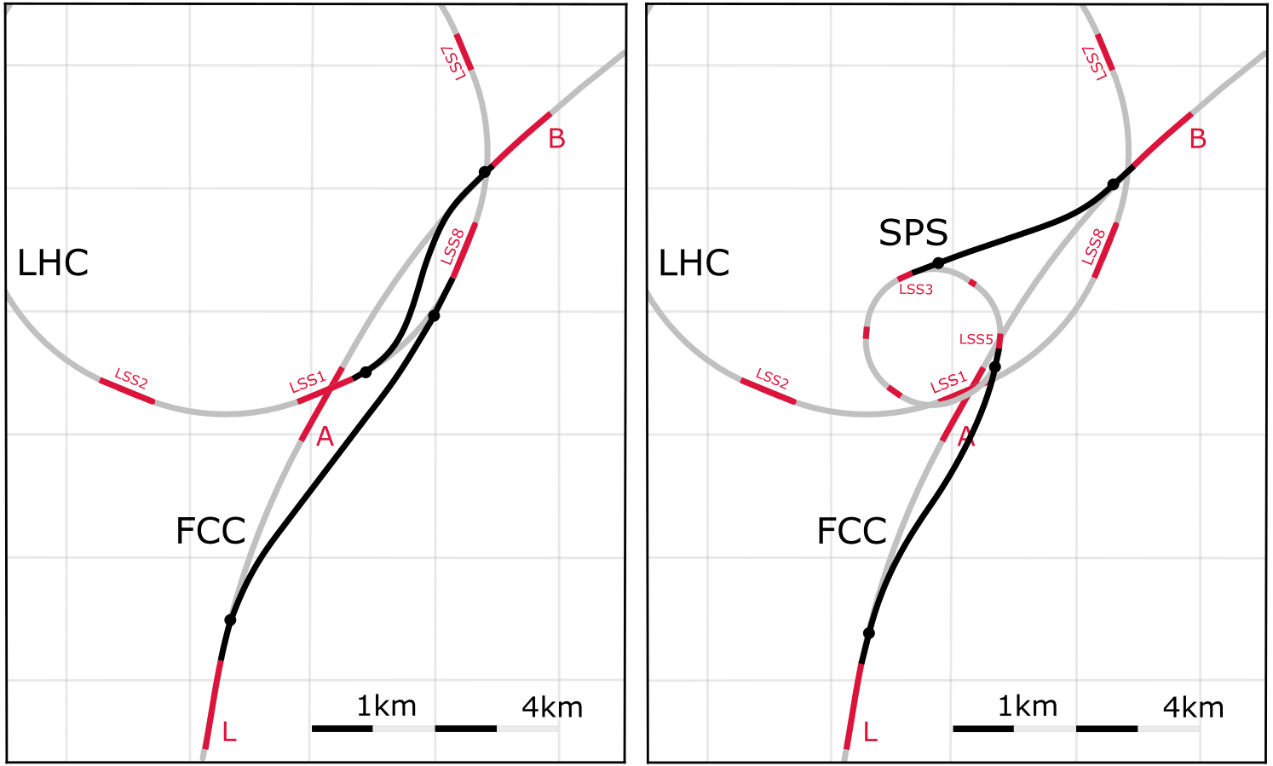
FCC-hh injector options: a 1.3 TeV injection may allow smaller cheaper HE magnets
Baseline:
LHC @ 3.3 TeV
Alternative:
scSPS @ 1.3 TeV
Current baseline:
Injection energy 3.3 TeV LHC
→ Field-swing FCC-hh like LHC
Alternative options:
Injection from SPS_{upgrade} around 1.3 TeV
SPS_{upgrade} could be based on fast-cycling SC magnets, 6-7T, ~ 1T/s ramp, cf. SIS 300 design
SPS_{upgrade} would also be an ideal injector for HE LHC (as alternative to the 450 GeV SPS)
Total of O(5.5 km) superconducting bends in transferlines from LHC, at 7.2 T
O(6.5 km) normal-conducting bends from SPS, at 1.8 T
Better option than keeping alive LHC

Slide 24
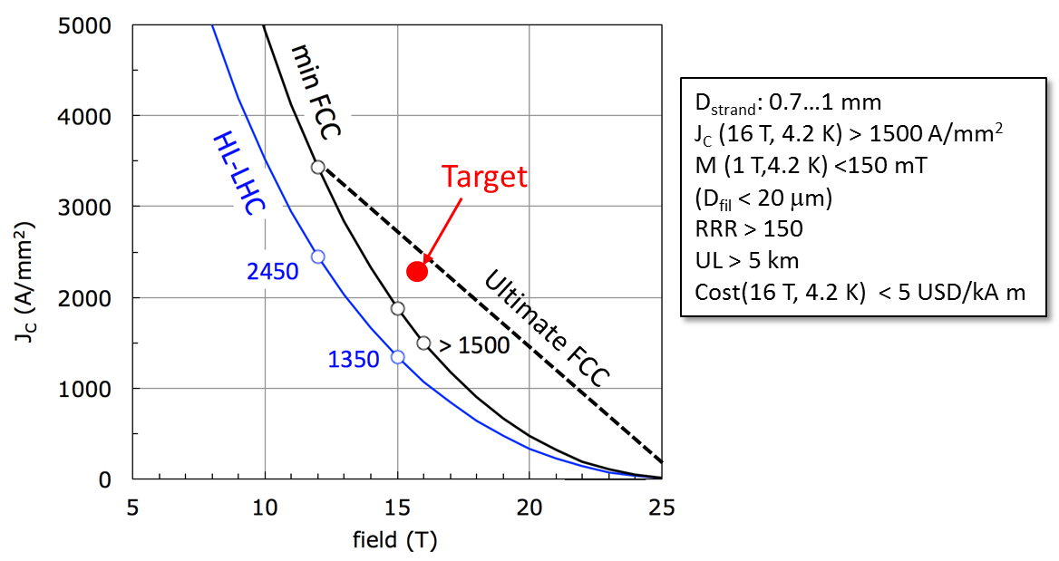
The critcal point to reach 16 T: superconductor!
Worldwide FCC Nb₃Sn program
5400 mm²
3150 mm²
Main development goal is wire performance increase:
J_{c} (16T, 4.2K) > 1500 A/mm² →50% increase wrt HL-LHC wire
Reduction of coil & magnet cross-section
~1.7 times less SC
~10% margin
HL-LHC
~10% margin
FCC ultimate
Conductor activities for FCC started in 2017:
Bochvar Institute (production at TVEL), Russia
KEK (Jastec and Furukawa), Japan
KAT, Korea
Columbus, Italy
University of Geneva, Switzerland
Technical University of Vienna, Austria
SPIN, Italy
University of Freiberg, Germany
  In addition, agreements under preparation:
  Bruker, Germany
  Luvata Pori, Finland
This is difficult
Notes:
New slide from Davide.
Showing that conductor development is launched at international level, Russia, Japan, (Korea and Europe in preparation)
Underline importance of that development as main cost driver for the hadron collider machine.

Slide 25

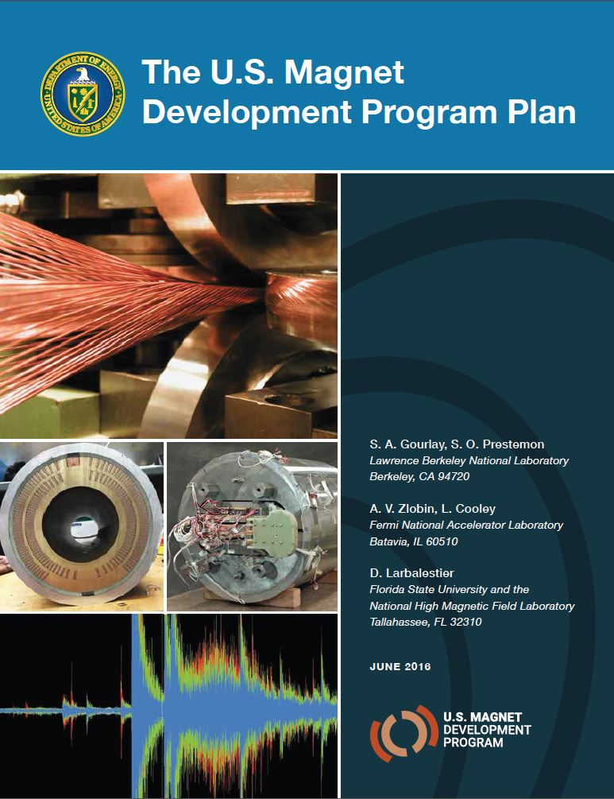
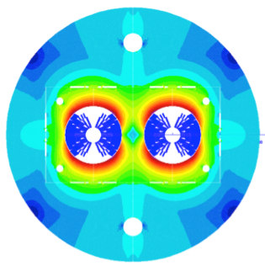





16 T dipole design activities and options
H2020
Swiss contribution
Cos-theta
Common coils
Canted
Cos-theta
Blocks
INFN
CIEMAT
Very good: gaining resources and supports by various labs…
But it is wise? Choose a design and concentrate on it? …
This is a personal opinion but seems to me evident... And 16 T will prove to take longer than previous projection → evident by the new strategy by CERN
Construction of hh launched in the 2020s the only way is to aim at 14 T range, 20% above HiLumi
LBNL
CEA
PSI
Short model magnets (1.5 m lengths) will be built from 2018 – 2022
Russian 16 T magnet program launched by BINP recently.
FNAL

Slide 26



Progress in magnets R&D
We need to fill here for FCC/HE
2018: FRESCA2
(14.6 T at 1.9 K, 100 mm)
HiLumi

Slide 27

And the HTS ? Only way to reach 16-25 T
15 T is the HTS crossing point

Slide 28



20 T or more: Super proton-proton Collider in China (after CEPC)
 | LHC | FCC | SppC
Circumference (km) | 26.7 | 97.5 | 100
Dipole field (T) | 8.33 | 16 | 12…24
C.o.M. energy (TeV) | 14 | 100 | 70…125
Courtesy of Q. Xu, IHEP, CN

Slide 29



CN high-field magnet R&D
Baseline design
  Tunnel circumference: 100 km
  Dipole magnet field: 12 T, iron-based HTS technology (IBS)
  Center of Mass energy: >70 TeV
Upgrade phase
  Dipole magnet field: 20…24T, IBS technology
  Center of Mass energy: >125 TeV
Development of high-field superconducting magnet technology
  Starting to develop required HTS magnet technology before applicable iron-based wire is available
  ReBCO & Bi-2212 and LTS wires be used for model magnet studies and as an option for SppC: stress management, quench protection, field quality control and fabrication methods
Conceptual design of common coil 12T dipole
Top priority: reduce cost!
Instead of increasing field
IBS structure
Courtesy of Q. Xu, IHEP, CN
Courtesy of Q. Xu, IHEP

Slide 30


Comments on HTS (YBCO/REBCO)
Working on new type of cables and magnets: reached 3.5 T, expected 7 T in March 2019
HTS situation and perspective
Very expensive (5 times than Nb3Sn)
Magnets are easier: great stability, no training!
May work in He gas at 20 K: big advantage for power consumption and easier system…
Basic R&D for 5-10 years to reach maturity is needed. Last 3 y has doubled performance! A solenoid of 32 T has been tested successfully.
We would not be alone… plenty of Institute (and companies) work on HTS
This is the ground for basic focus R&D.

Slide 31




Trying the magnets of the future… 20 tesla or more...
Working on Non-Insulated coils…

Slide 32


FCC-hh
20+ T is not out of reach

Slide 33

Conclusion
The program for FCC/He is under scrutiniy by the EU strategy
Maybe a better focus on some objectives and a reduction of those objectives may make the program more feasible.
A 14 T dipole (an HE-LHC of 24 TeV c.o.m., FCC-hh at 85 TeV) based on improved HiLumi superconductor is really feasable for R&D today.
The 16 T is still a long way to be demonstrated: it can, but it needs FOCUS and requires true synergy not just sum of various labs effort;
HE-LHC needs a different optimization for the magnet system and collider than FCC (but the SAME technology R&D) (personal opinion).
If there is an intermediate step (LHeC, or a lepton collider) that pushes 5-10 years back the post-LHc pp collider, then HTS is probably the best solution.
Embracing too large and unfocused R&D (generic High Field magnets) maybe not the best choice now for a project ready in the ‘30s…
From my talk at:

Slide 35











15 T dipole demonstrator (US-MDP)
Iron Laminations
AL I-Clamps
StSt Skin
End Plates
Fillers
Axial Rods
All coil parts, structural components and tooling are available at FNAL
Coil fabrication and the work with mechanical structure are in progress
First magnet test in September 2018

