Slide 1





Characterisation of prototype SiGe monolithic pixel detectors for the TT-PET project
Dean Forshaw
On behalf of the TT-PET Collaboration
University of Bern
Albert Einstein Center for Fundamental Physics

Slide 2
TT-PET Project
Scanner Overview
Monolithic Chip
Test beam characterization
TOF simulation
Prototype-0
dforshaw@cern.ch
PSMR2018
2

Slide 3
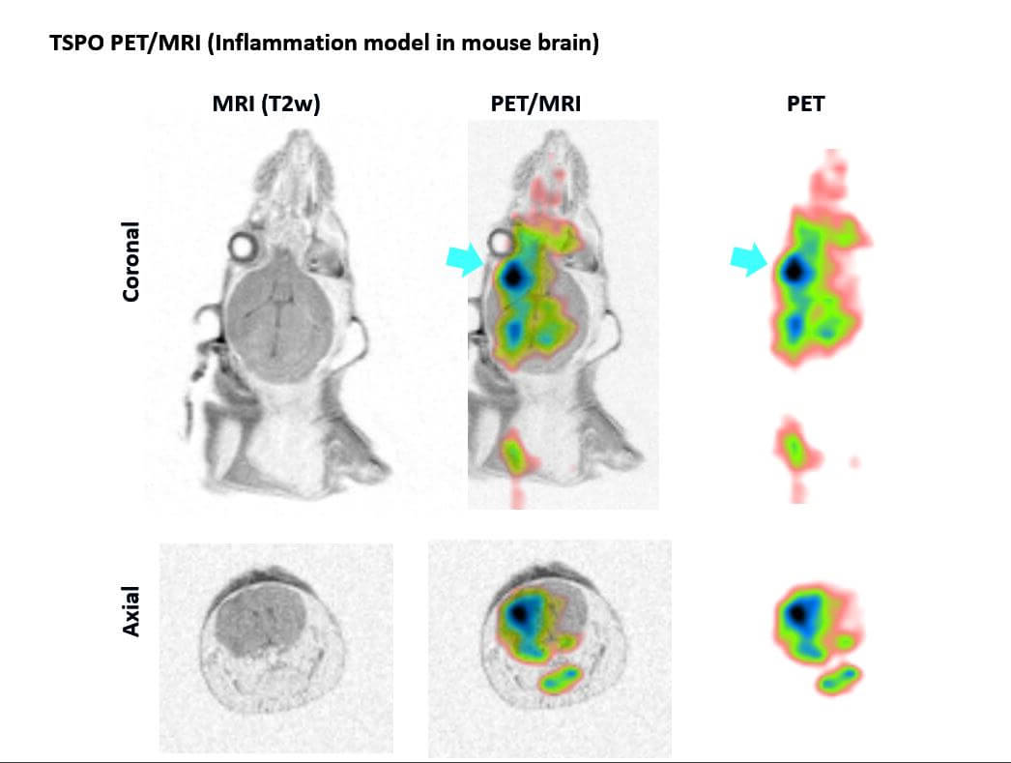
The TT-PET Project
3-year project to produce a PET Scanner for small animals based on silicon detector technology, insertable in an MRI machine and with 30ps RMS time resolution. The project started in March 2016.
Collaborating institutes:
University of Geneva
University of Bern
Hôpital cantonale de Genève
INFN of Roma Tor Vergata
CERN
dforshaw@cern.ch
PSMR2018
3

Slide 4
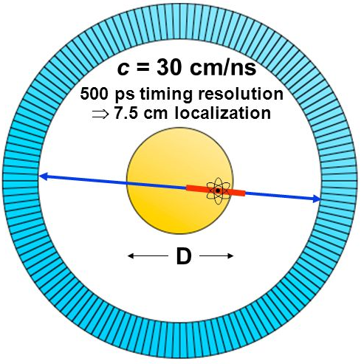
Why use Time-of-Flight?
Adding Time-of-Flight information to a PET scan can dramatically increase its performance!
It is used to localize the source along the line of flight
It leads to much lower noise, which can be used to increase image quality or decrease radiation dose to the patient
dforshaw@cern.ch
PSMR2018
4

Slide 5
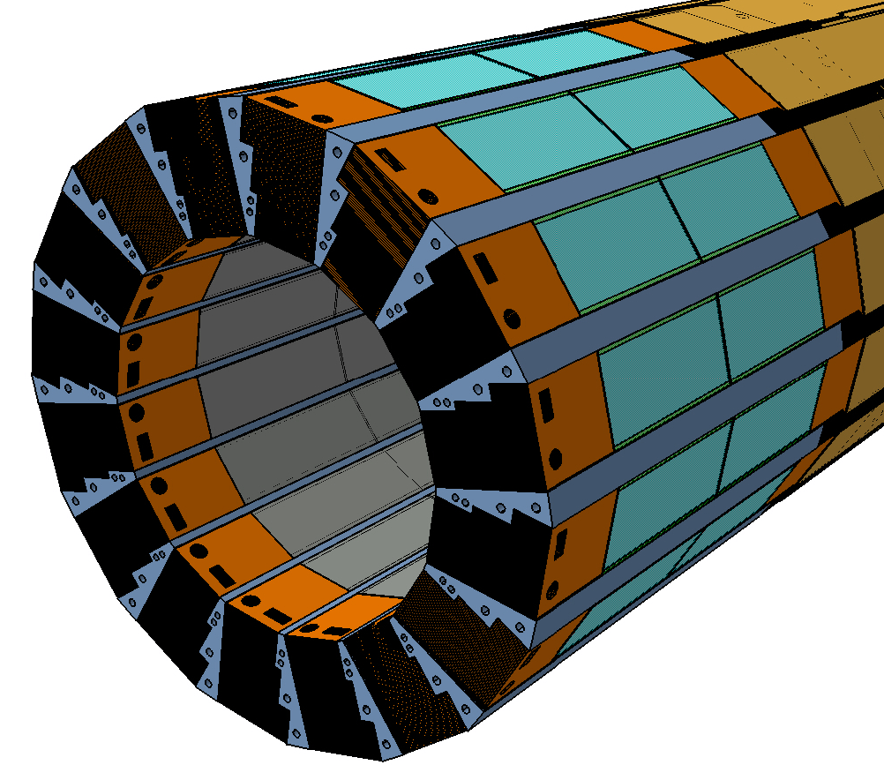
Scanner Overview
Designed to fit inside removable RF-Coil for nanoScan 3T
16 sensitive towers
16 cooling blocks: ceramic/ 3d printed
Exterior carbon fiber support and cooling pipes not shown
Inner radius: 65mm
Outer radius: 80mm
Total Pixel channels: 1,413,120
Pixel size: 500x500µm²
48mm
dforshaw@cern.ch
PSMR2018
5

Slide 6
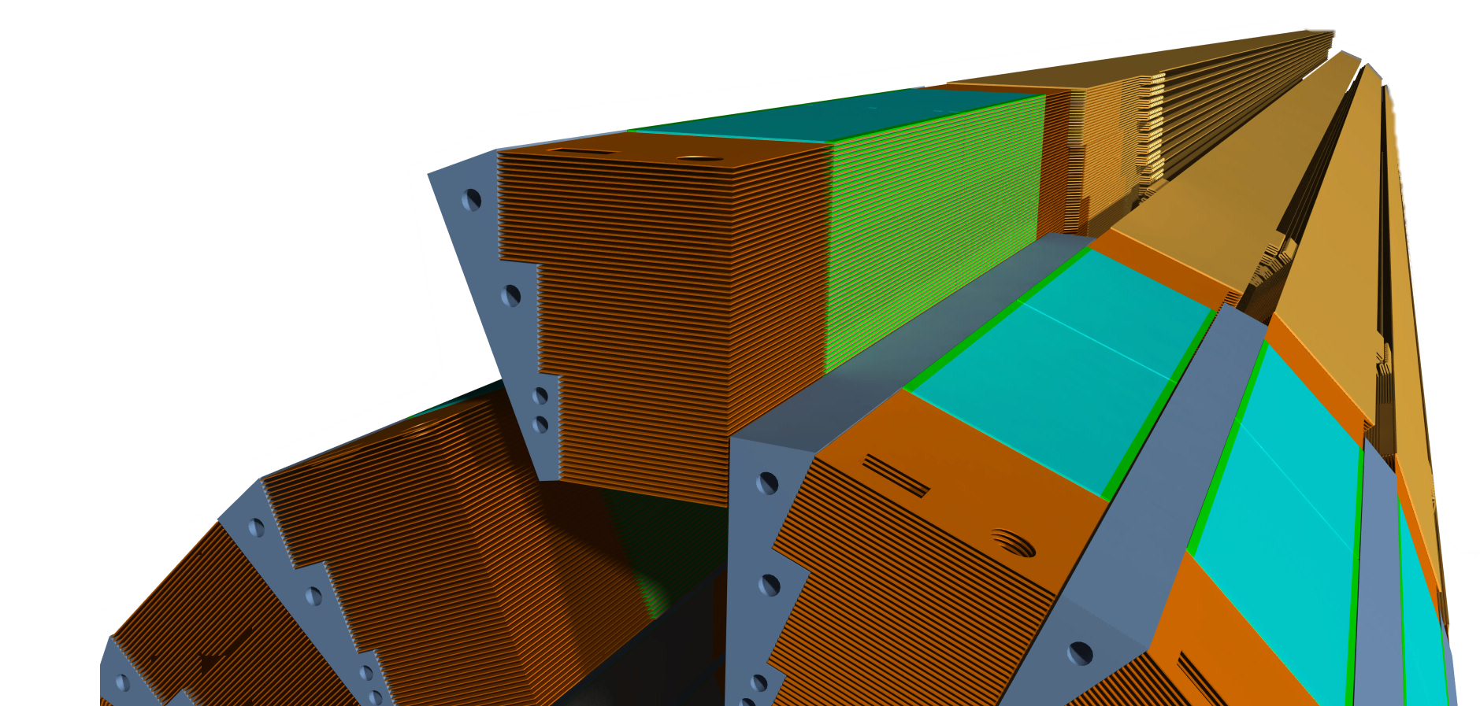
Scanner Overview
Sensitive towers composed of many layers of lead, flex circuit, and monolithic pixels sensors
1 tower = 60 sensitive detection layers
Sampling style detector
Geometrical acceptance is maximized using step like structure
Longer data cables connect to the DAQ outside of the RF-Coil
dforshaw@cern.ch
PSMR2018
6

Slide 7
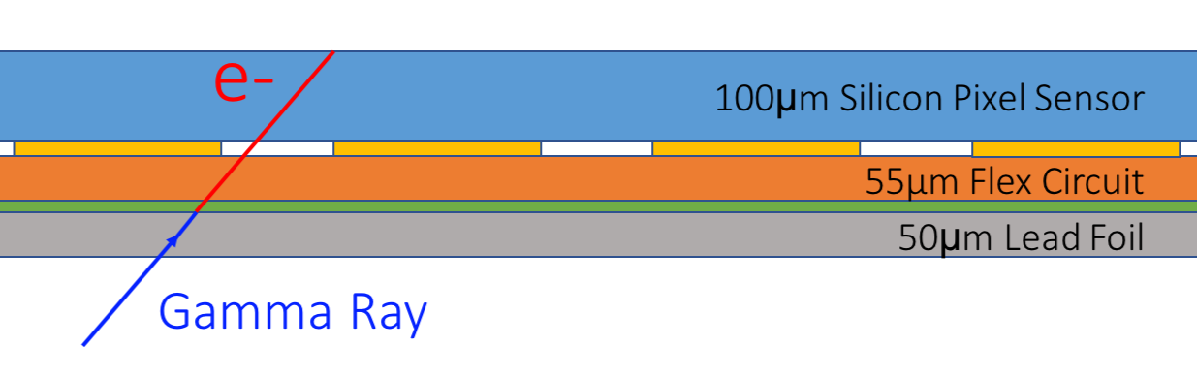
Single detection layer
500x500µm pixels
Baseline option: bump bond monolithic chip to flex circuit
Second option: stack multiple chips on top of each other and wire bond together (same process as inside memory chips)
dforshaw@cern.ch
PSMR2018
7

Slide 8
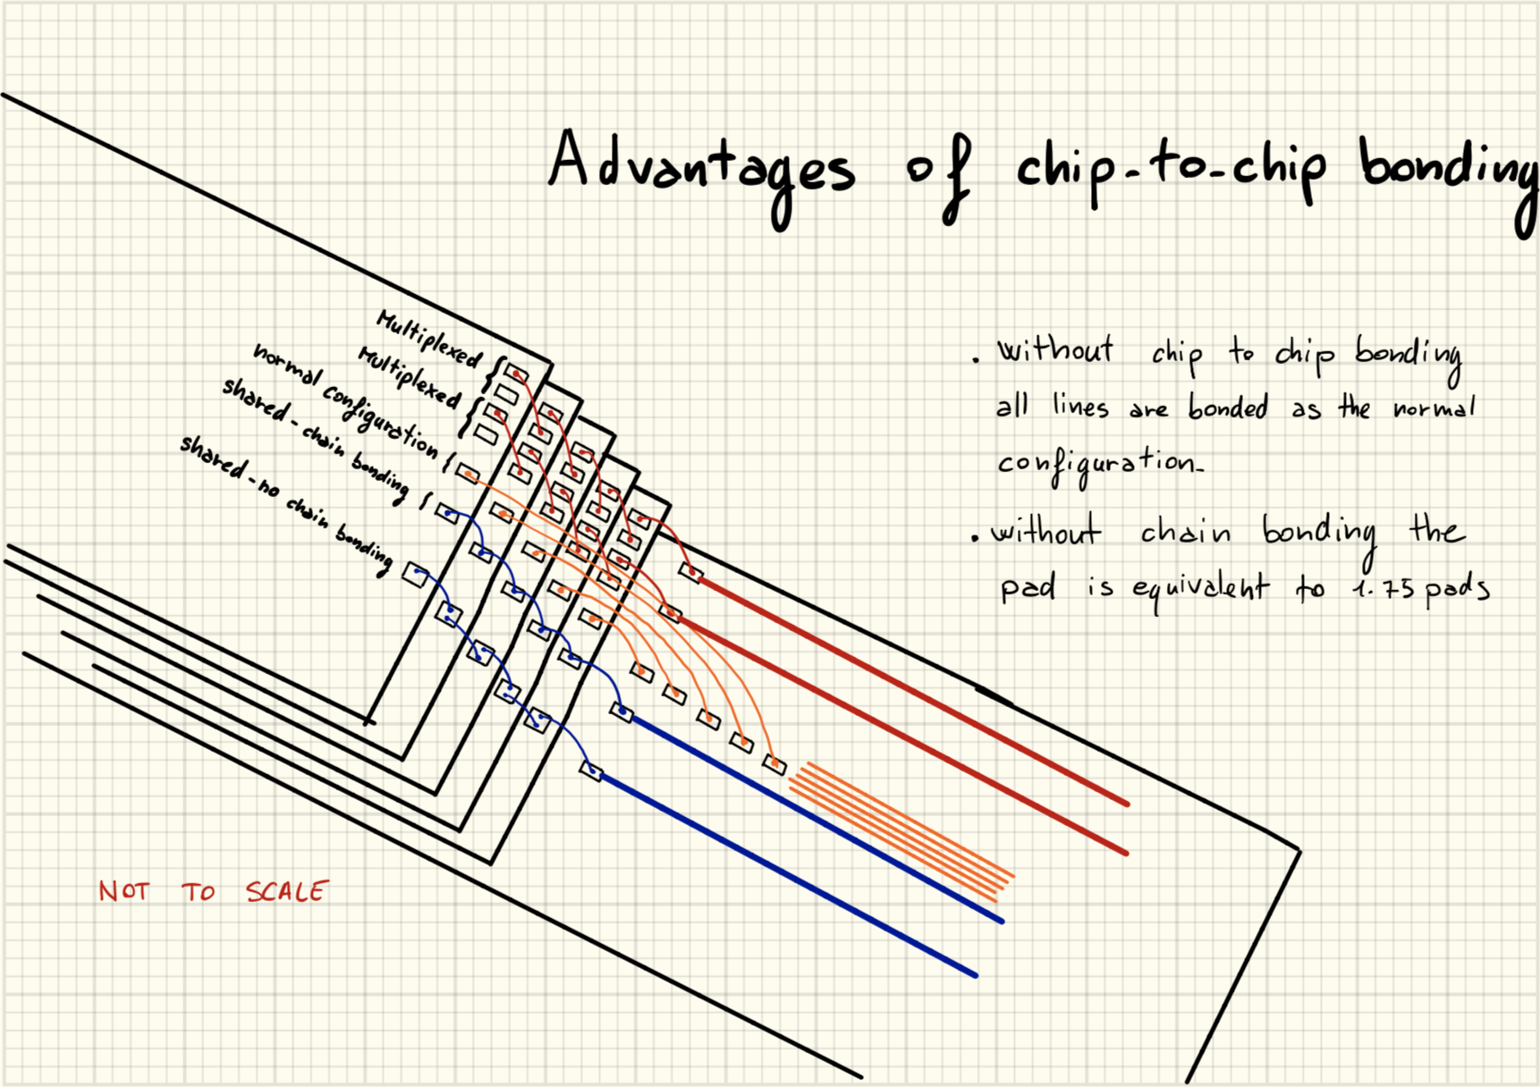
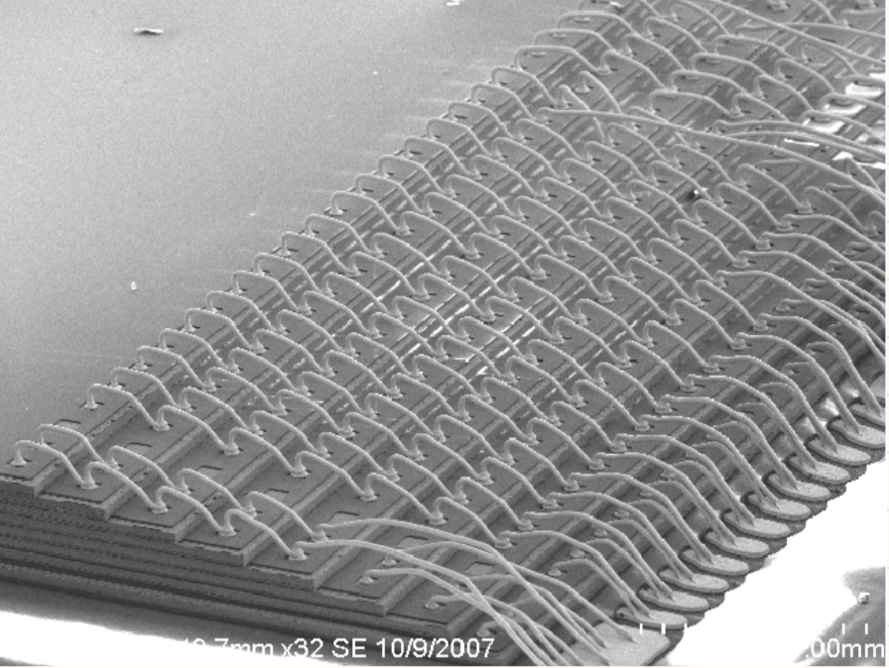
Single detection layer
Wire bondable solution
dforshaw@cern.ch
PSMR2018
8

Slide 9
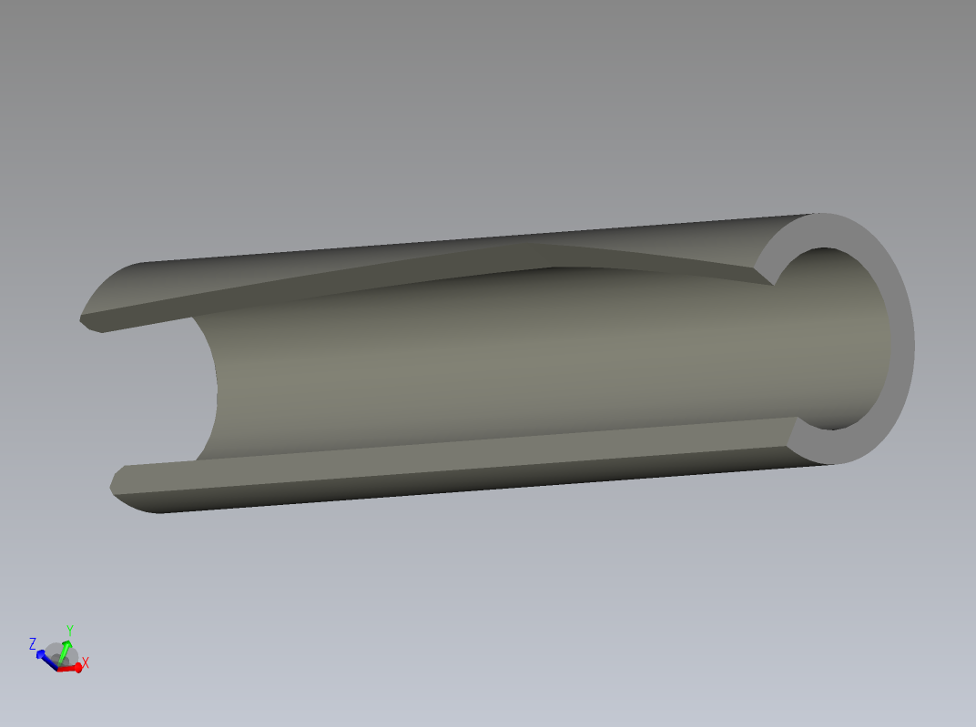
Mechanics
dforshaw@cern.ch
PSMR2018
Notes:
The AMS H18

Slide 10
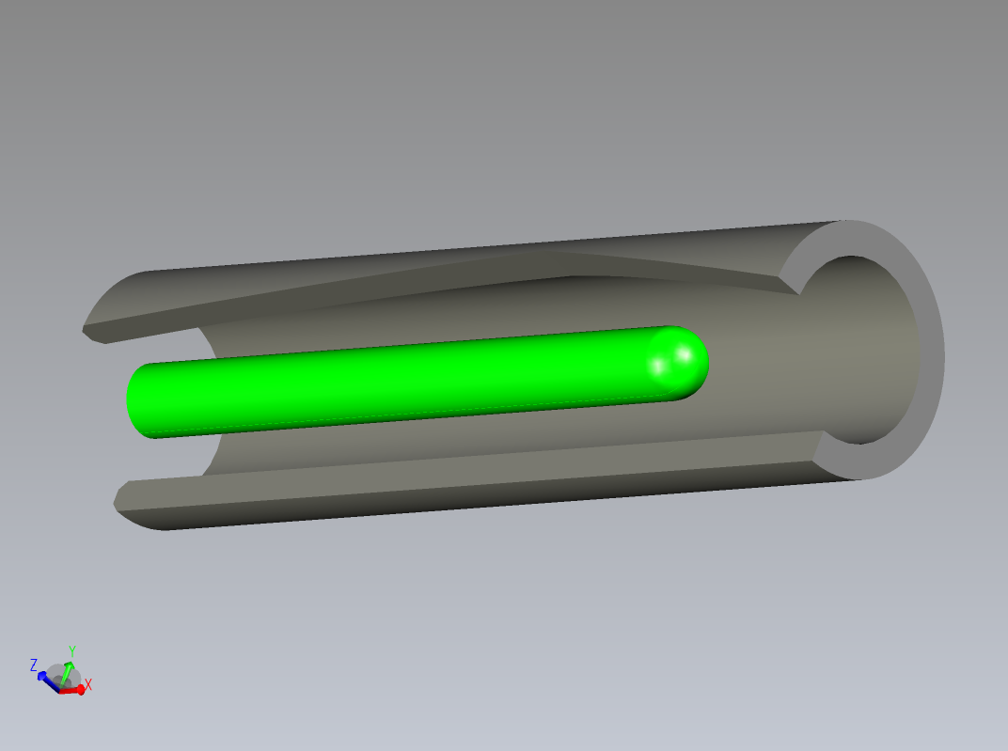
Mechanics
dforshaw@cern.ch
PSMR2018
Notes:
The AMS H18

Slide 11
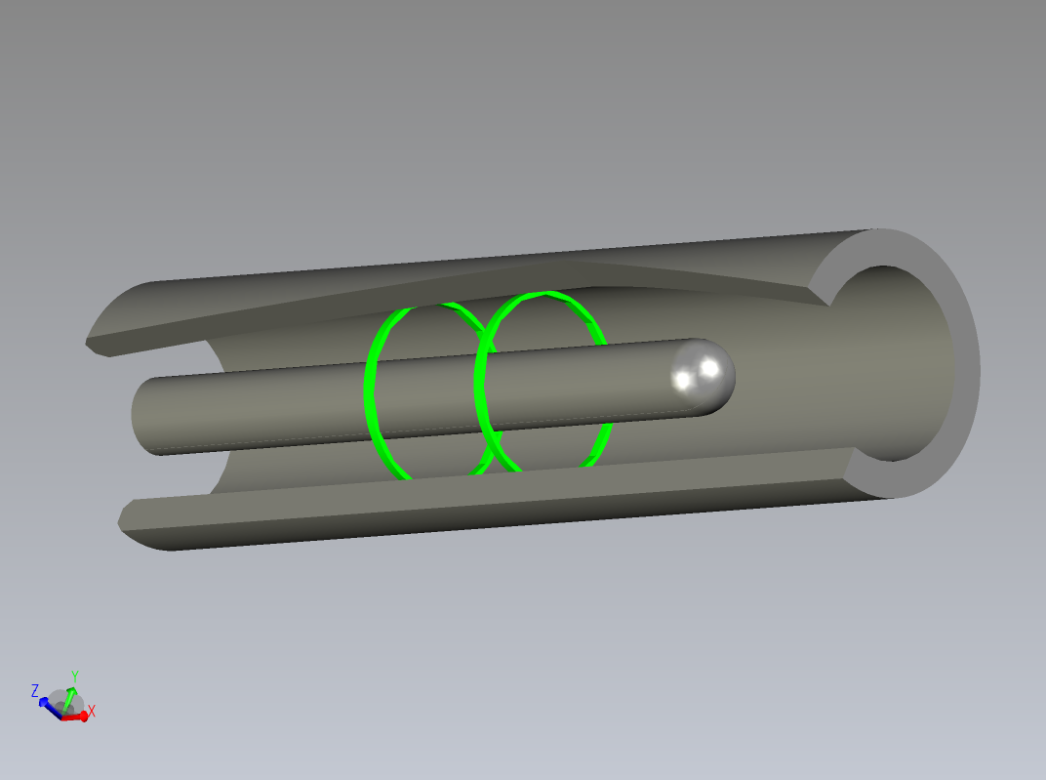
Mechanics
dforshaw@cern.ch
PSMR2018
8
Notes:
The AMS H18

Slide 12
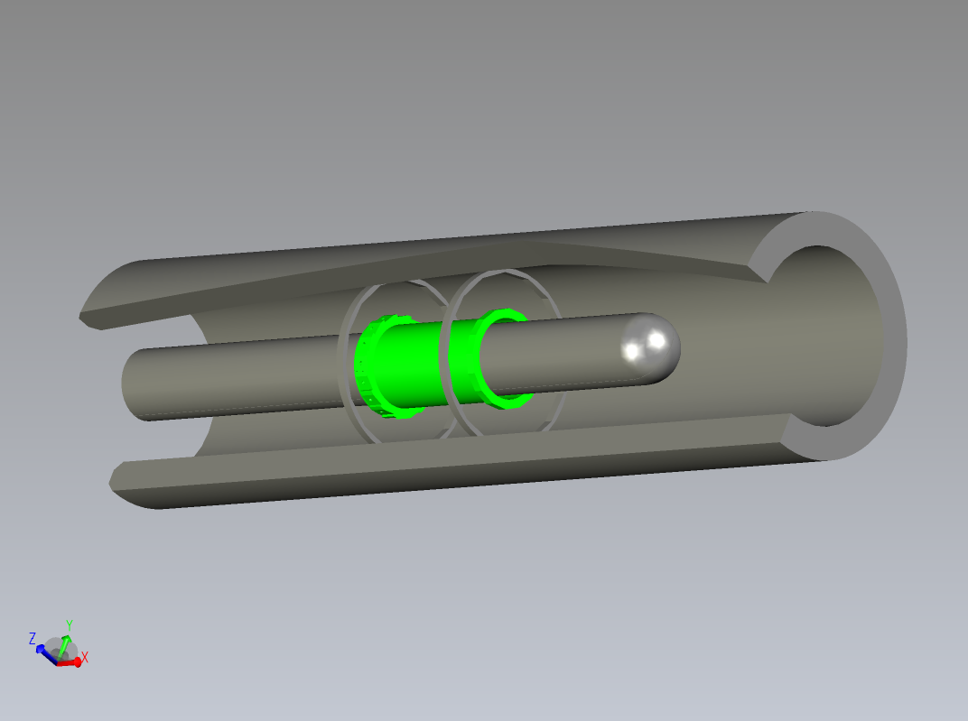
Mechanics
dforshaw@cern.ch
PSMR2018
8
Notes:
The AMS H18

Slide 13
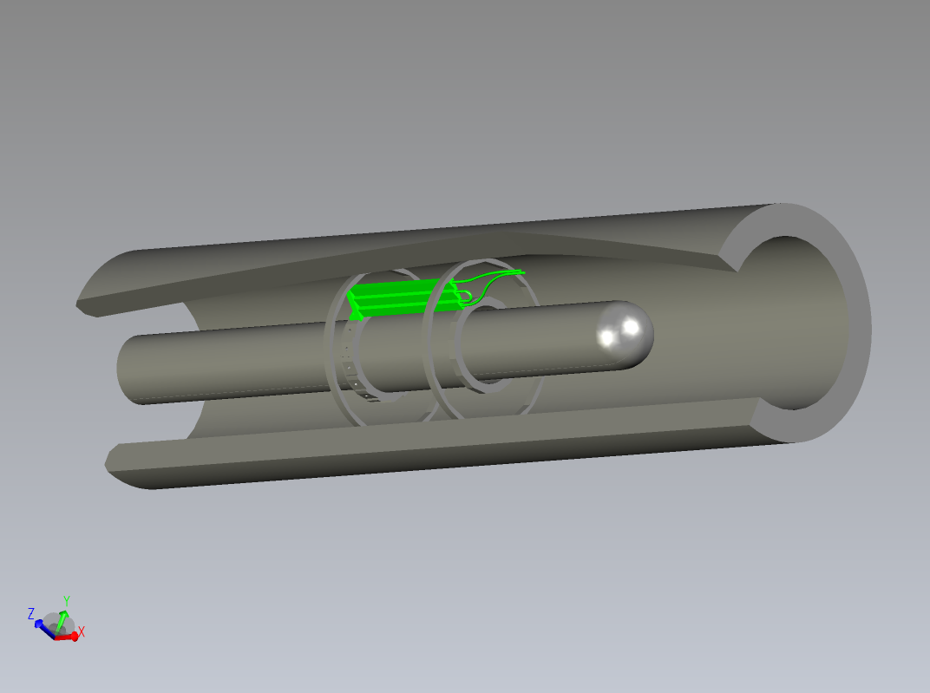
Mechanics
dforshaw@cern.ch
PSMR2018
8
Notes:
The AMS H18

Slide 14
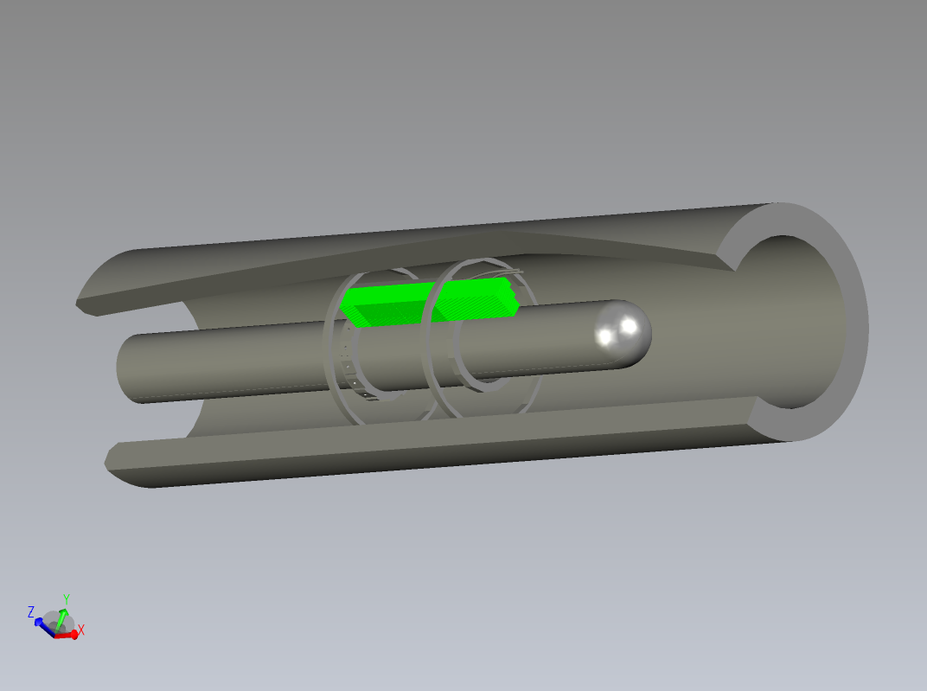
Mechanics
dforshaw@cern.ch
PSMR2018
8
Notes:
The AMS H18

Slide 15
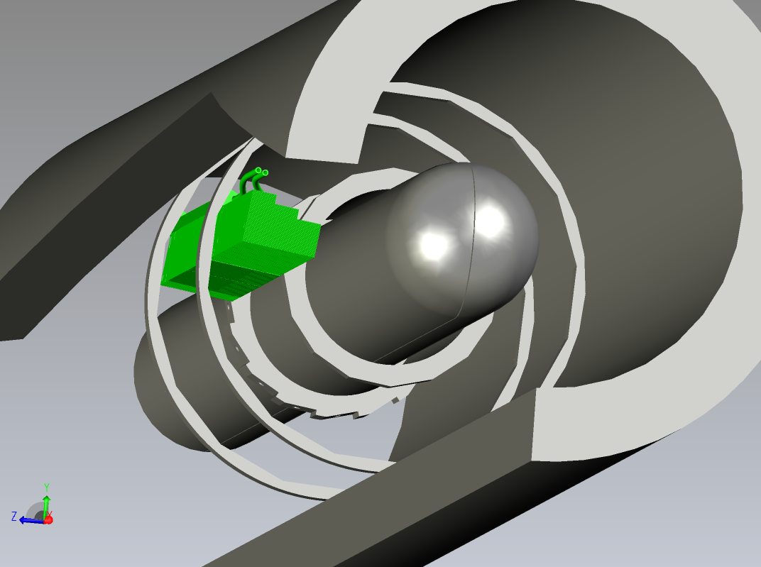
Mechanics
dforshaw@cern.ch
PSMR2018
8
Notes:
The AMS H18

Slide 16
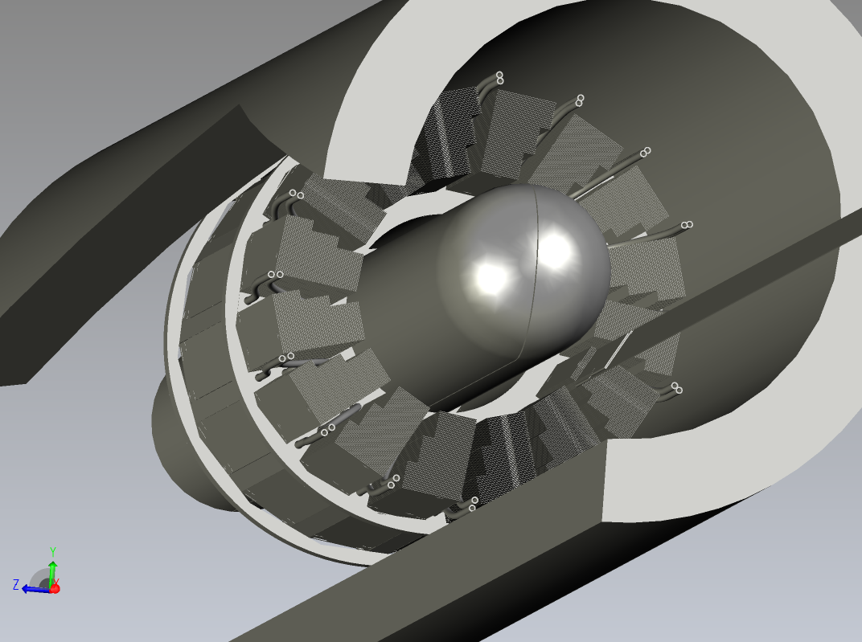
Mechanics
dforshaw@cern.ch
PSMR2018
8
Notes:
The AMS H18

Slide 17
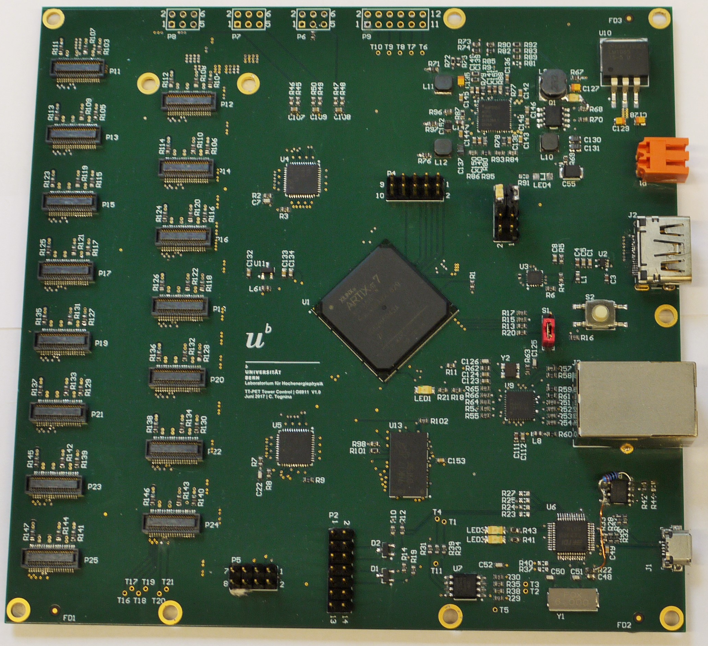
Event Rate and Data Pressure
Readout designed for 50MBq source
  19.2 MHz single hit rate
  5 MHz possible coincidences
  1.2 MHz real coincidences
System designed for scalability
  Custom Designed Tower Control board to control one Tower
  Commercial components used where possible
  CERN VLDB board (GBTx) used to multiplex multiple tower control DAQ boards
dforshaw@cern.ch
PSMR2018
9

Slide 18
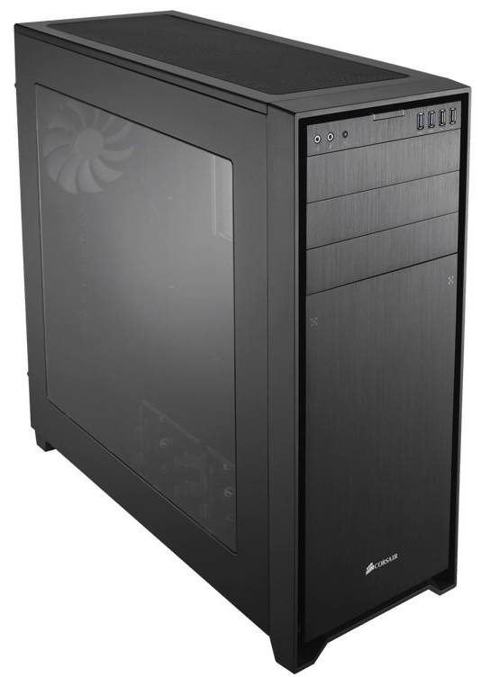
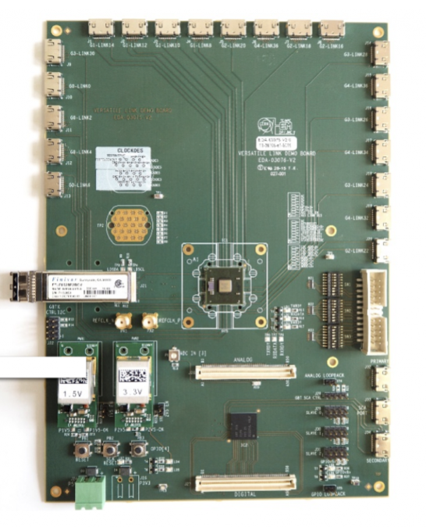
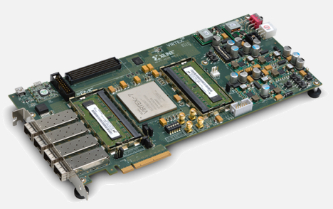
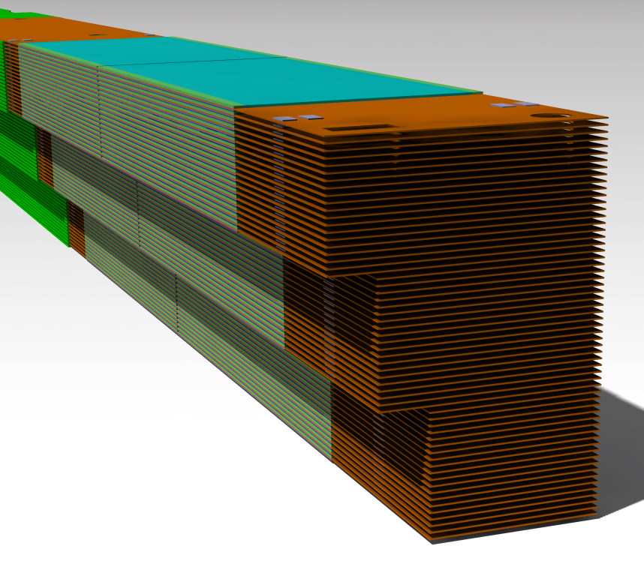
DAQ chain
Xilinx ZC709
x16
60 per Tower
PCIe
Optical GBTx
Sensor
Layer
Electrical
Electrical
Control full DAQ chain
Coincidence check
Calibration control
Multiplexer
Optical to electrical
Clk fanout
Custom FPGA board
Temporary data storage
Easily scalable
dforshaw@cern.ch
PSMR2018
10
Notes:
The AMS H18

Slide 19
Pro’s and Con’s
Very high granularity, with access to DOI and TOF information for every hit
Faster signals mean ability to have high-precision timing measurements
The scanner can be designed to be compatible with an MRI scanner, providing combined MRI-PET images
On the other hand...
The mechanics of the scanner are really complex (especially the data flex)
There are a very large number of channels, so the data acquisition scheme is critical
Every channel must be calibrated → very long procedure
dforshaw@cern.ch
PSMR2018
11

Slide 20
TT-PET Collaboration
Scanner Overview
Monolithic Chip
Test beam characterization
TOF simulation
Prototype-0
dforshaw@cern.ch
PSMR2018
12

Slide 21
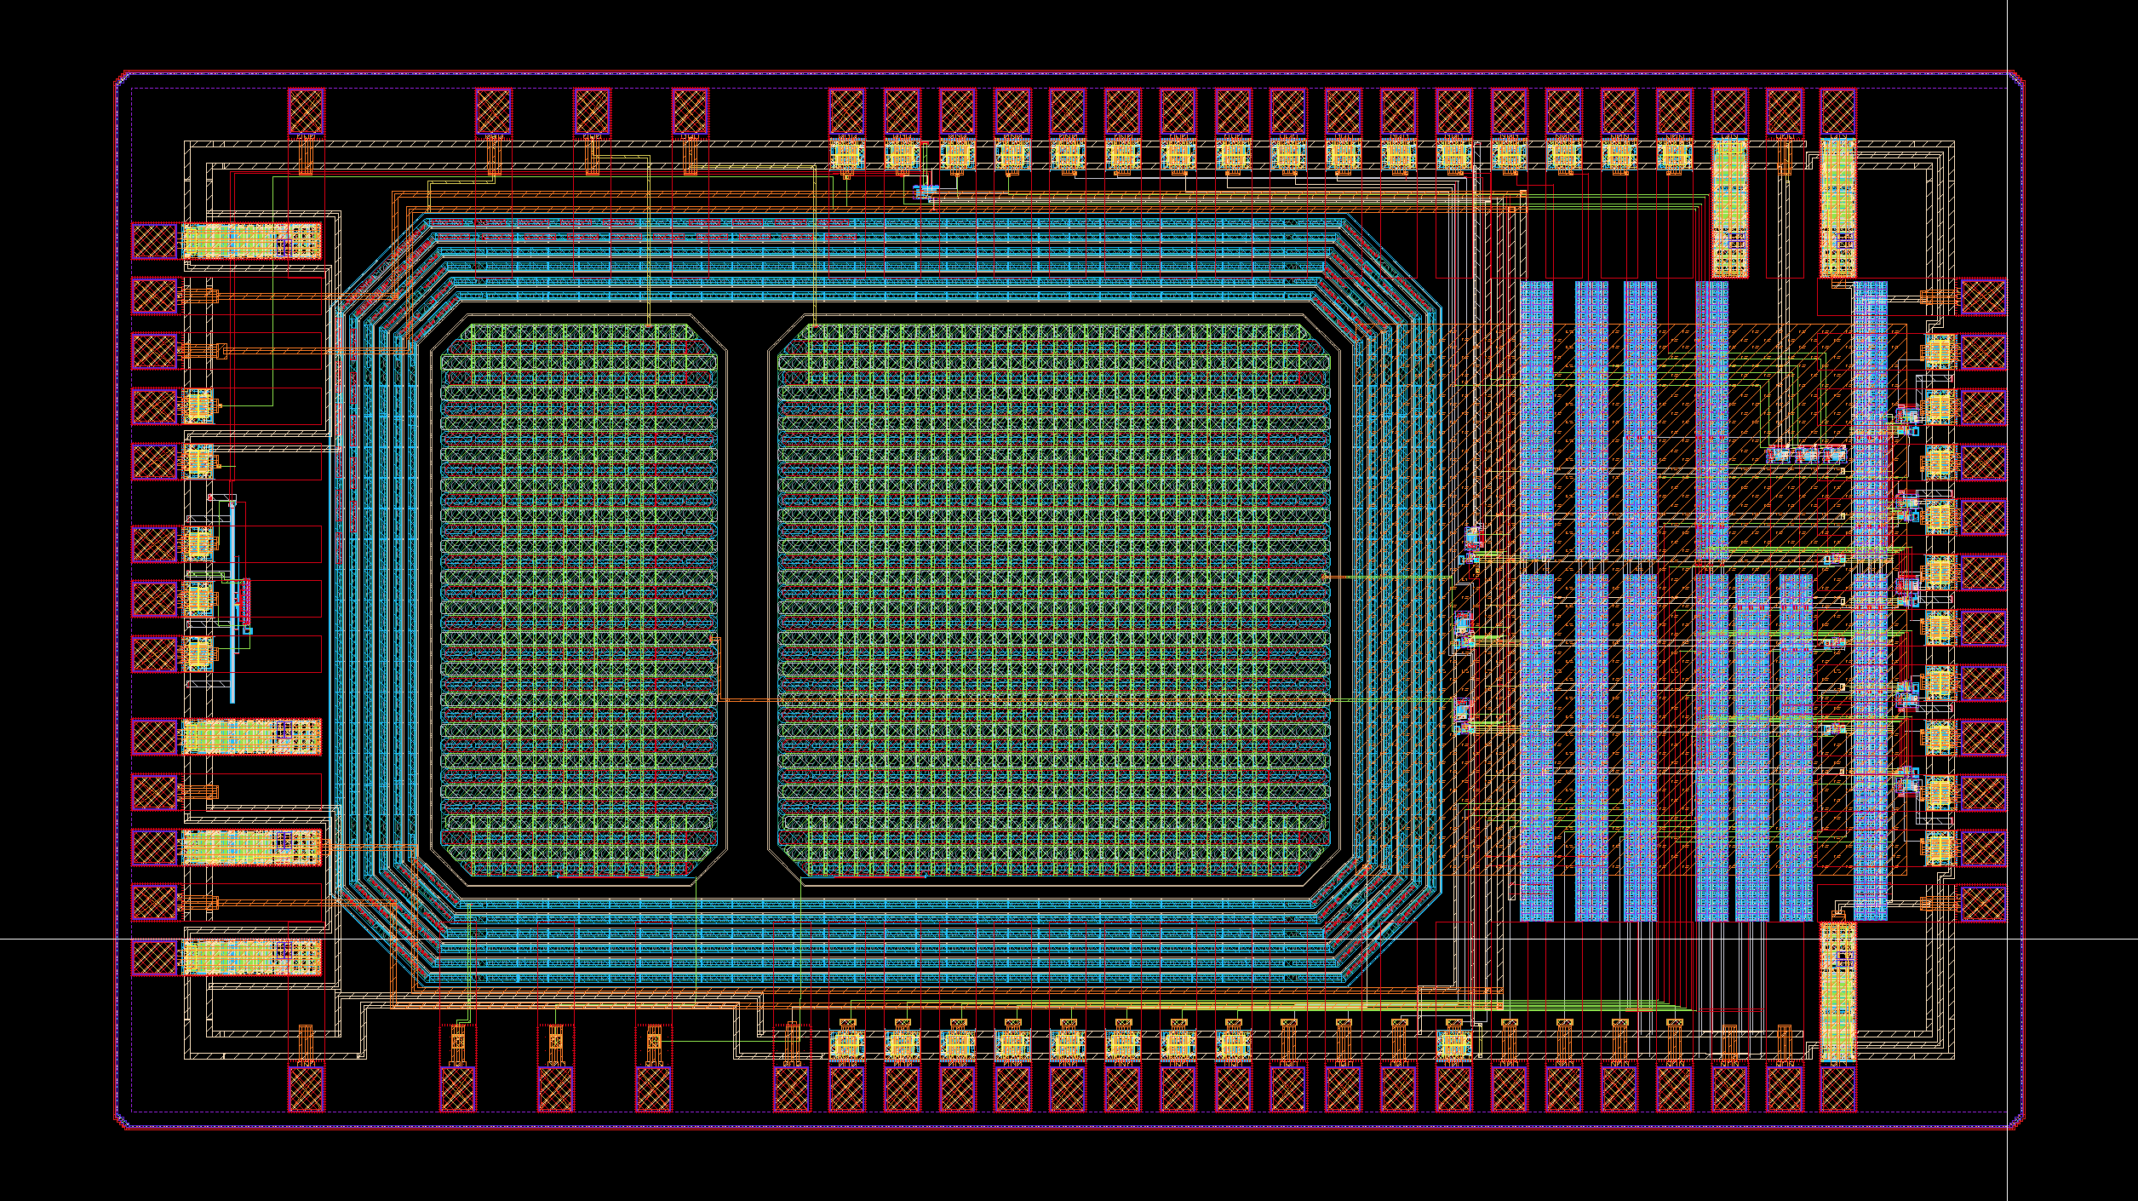
Monolithic Test chip
First Monolithic Test ASIC
SG13S SiGe BiCMOS process from IHP microelectronics (130nm)
Very High CMOS resistivity suitability (1kΩcm)
Test custom guard ring design and qualify HV tolerance (180V)
1 small pixel 900x450µm²
1 large pixel 900x900µm²
Geometry type: n-in-p
ToF RMS (mips): 100ps
dforshaw@cern.ch
PSMR2018
13

Slide 22
Monolithic Test chip
Electronics placed outside of the pixel guard
dforshaw@cern.ch
PSMR2018
14

Slide 23
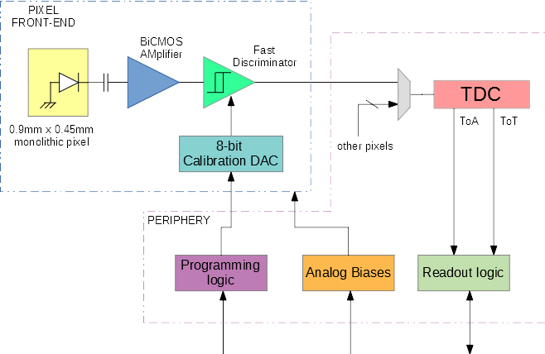
Monolithic Test chip
Electronics placed outside of the pixel guard
SiGe pre-amplifier
Amplifier rise time 1-2ns
Discriminator
Time-over-Threshold measurement
dforshaw@cern.ch
PSMR2018
15

Slide 24
TT-PET Collaboration
Scanner Overview
Monolithic Chip
Test beam characterization
TOF simulation
Other prototypes
dforshaw@cern.ch
PSMR2018
16

Slide 25
Test beam setup
180 GeV/c pion beam used (CERN SPS beamline)
Particle telescope (Geneva FE-I4 telescope) used for tracking
2 Monolithic test chips operated at 180V (backside not metalized, and referenced to Gnd)
LGAD sensor used as final plane (timing reference)
dforshaw@cern.ch
PSMR2018
17

Slide 26
Efficiency result
Overlap region (red dashed box)
Only particle tracks that intersect this ROI are used
Upstream Sensor efficiency (99.79 ± 0.01)%
Downstream efficiency (99.09 ± 0.04)%
No areas of large inefficiency
dforshaw@cern.ch
PSMR2018
18

Slide 27
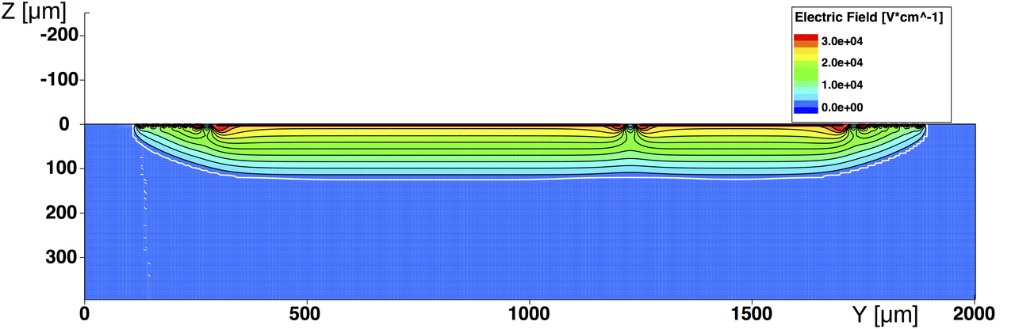
Charge Uniformity
Amount of charge shown in ToT
Drop in amount of charge collected around edges of pixel
Non-uniform electric field near edges
Sensor not thinned down to 100um and not backside metalised
Aim for 2-3 V/um to maximise e⁻ carrier mobility
dforshaw@cern.ch
PSMR2018
19

Slide 28
ToT and time-walk correction
Tot distribution on left
Time-walk correction done using a polynomial fit
Spread of the time-walk and SNR information used to estimate actual pre-amp peaking time <2ns (agree with our cadence simulations)
dforshaw@cern.ch
PSMR2018
20

Slide 29
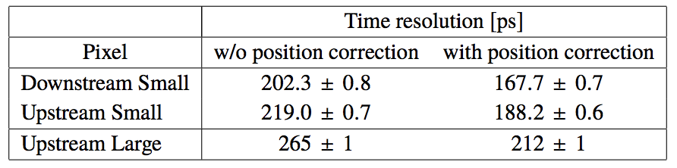
ToF measurement
Despite lack of vital processing steps ToF no so far away from 100ps for MIP’s expected
dforshaw@cern.ch
PSMR2018
21

Slide 30
TT-PET Collaboration
Scanner Overview
Monolithic Chip
Test beam characterization
TOF simulation
Prototype-0
dforshaw@cern.ch
PSMR2018
22

Slide 31
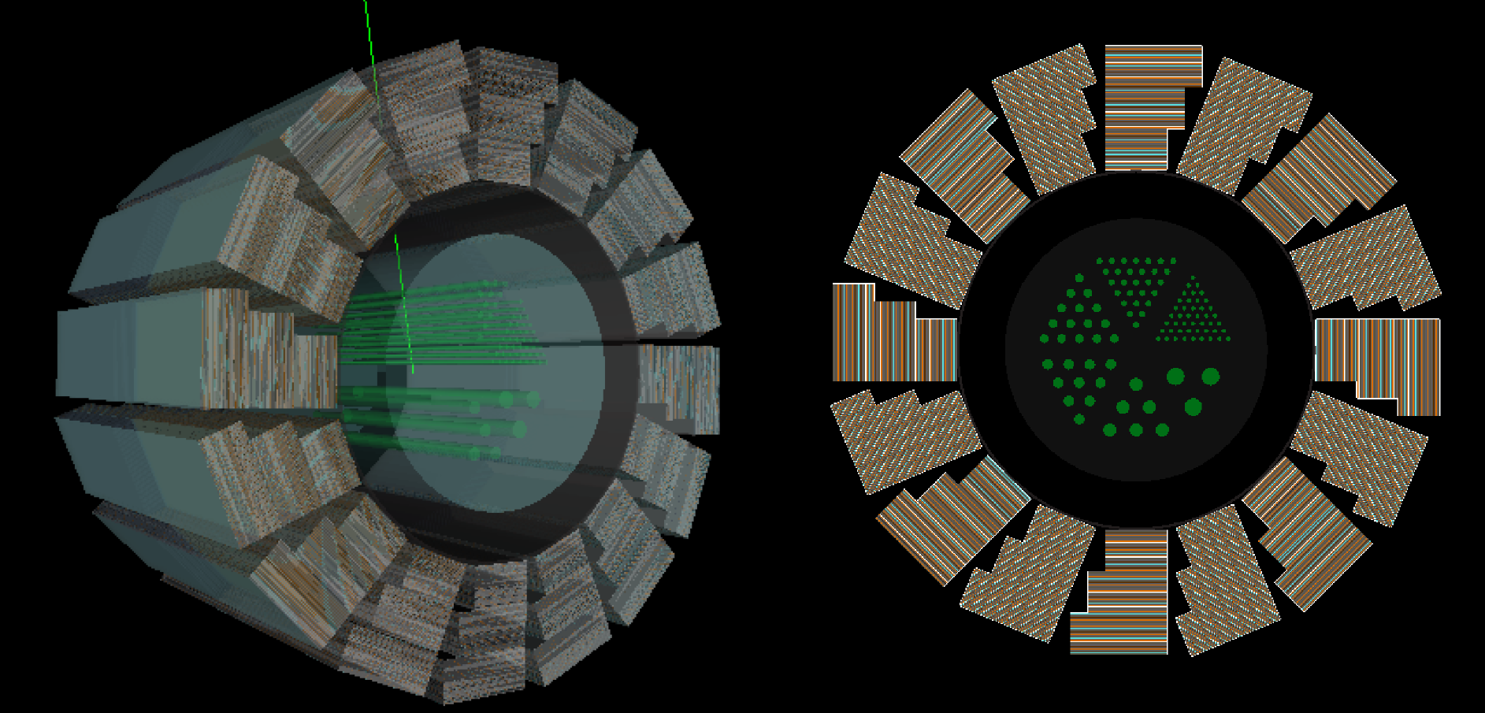
Simple phantom simulation
Geant4 simulation
Scanner geometry with acrylic phantom (variable rod sizes) filled with F18 (50MBq)
Phantom D = 15mm
Rod d = 0.5mm
Rod d = 0.7mm
Rod d = 1.0mm
Rod d = 1.2mm
Rod d = 1.5mm
Rod d = 2.0mm
Inter-rod distance 2d
dforshaw@cern.ch
PSMR2018
23

Slide 32
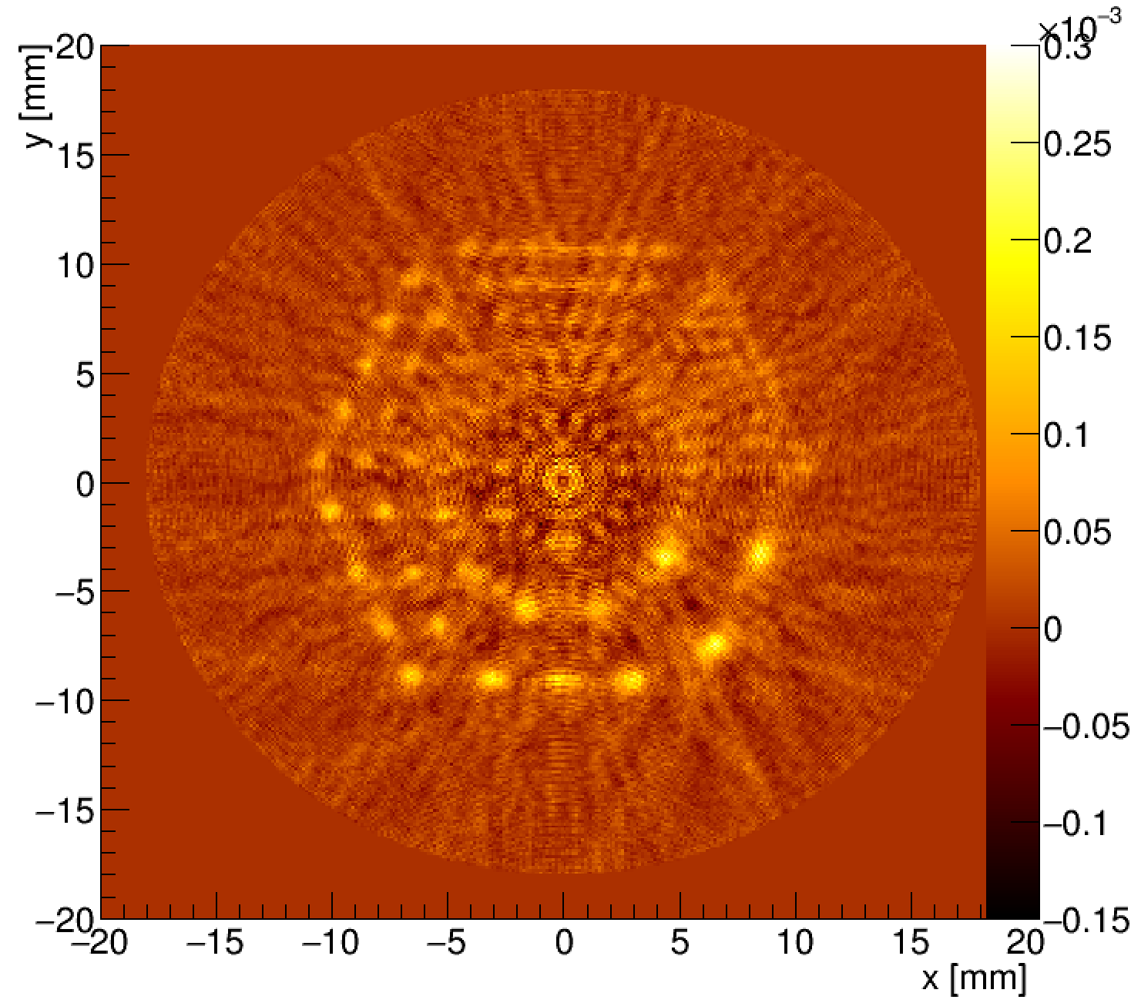
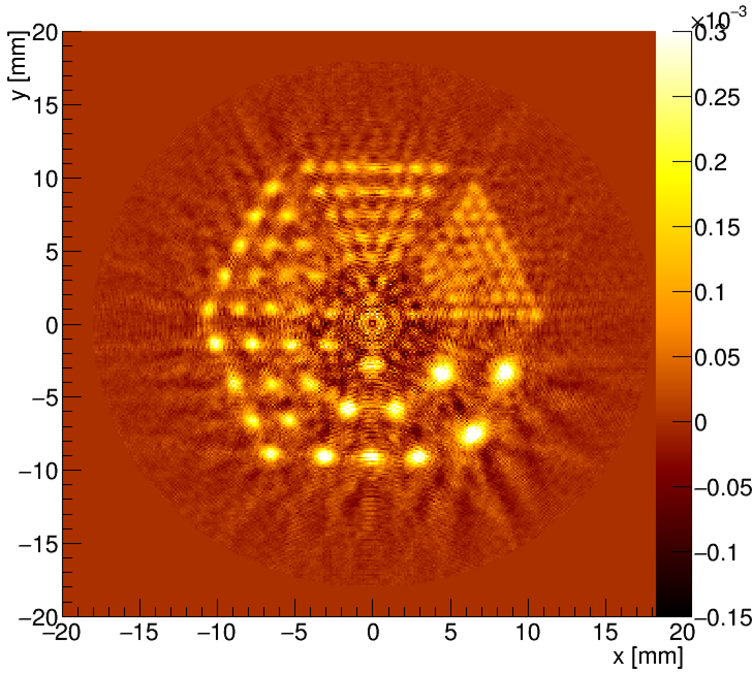
Simple phantom simulation
Simple reconstruction (FBP)
>10⁹ events simulated
Expected detector response included
no – TOF information
TOF information
dforshaw@cern.ch
PSMR2018
24

Slide 33
TT-PET Collaboration
Scanner Overview
Monolithic Chip
Test beam characterization
TOF simulation
Prototype-0
dforshaw@cern.ch
PSMR2018
25

Slide 34
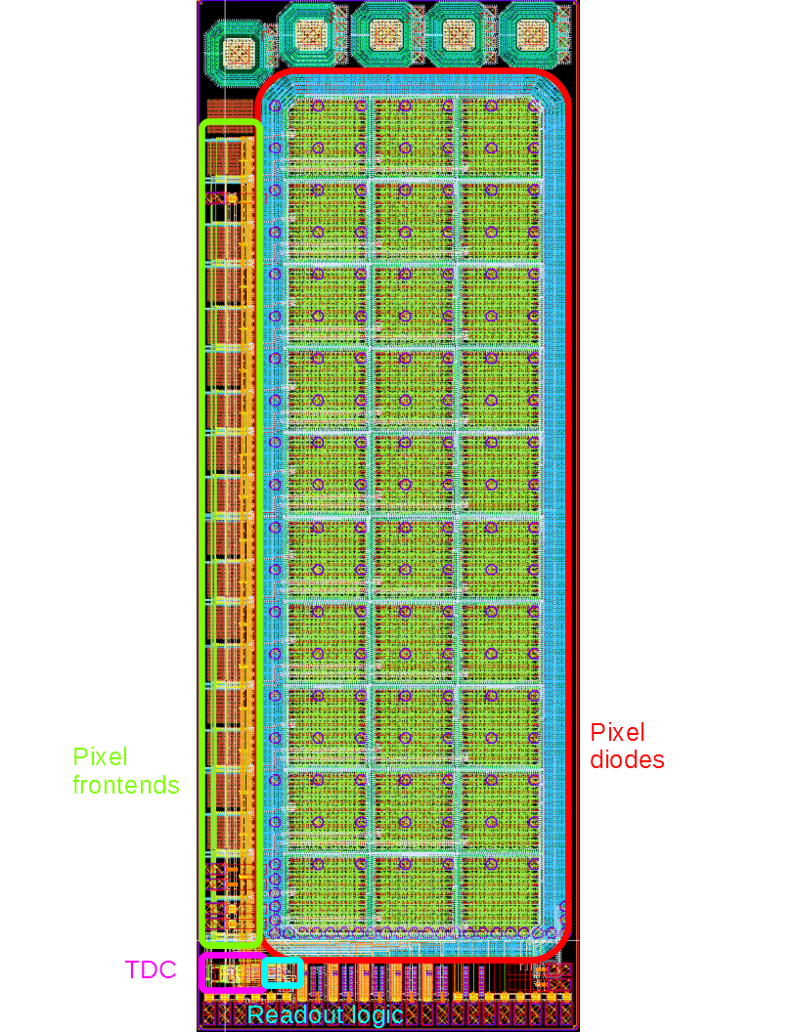
Prototype-0
A fully featured prototype was submitted in April 2017 (MPW run)
It has a smaller matrix (30 pixels) and a simplified readout scheme, but it's otherwise complete
Low resistivity wafer first (check HV doesn't interfere with LV electronics
It's useful to test integration issues (power delivery, crosstalk...)
dforshaw@cern.ch
PSMR2018
26

Slide 35
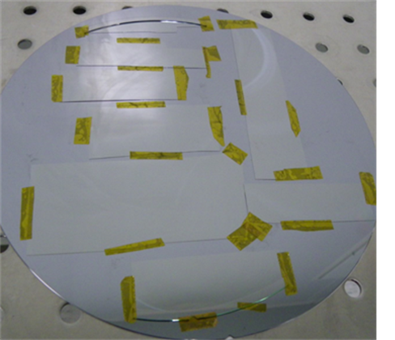
Prototype-0 HR
Delays in high resistivity delivery
Thin wafers broke at backside metaisation and dicing stage
4 MPW runs per year, ~4 month process time
HR backside metalised diced chips delivered last week
HV tested to work upto target 300V
dforshaw@cern.ch
PSMR2018
27

Slide 36
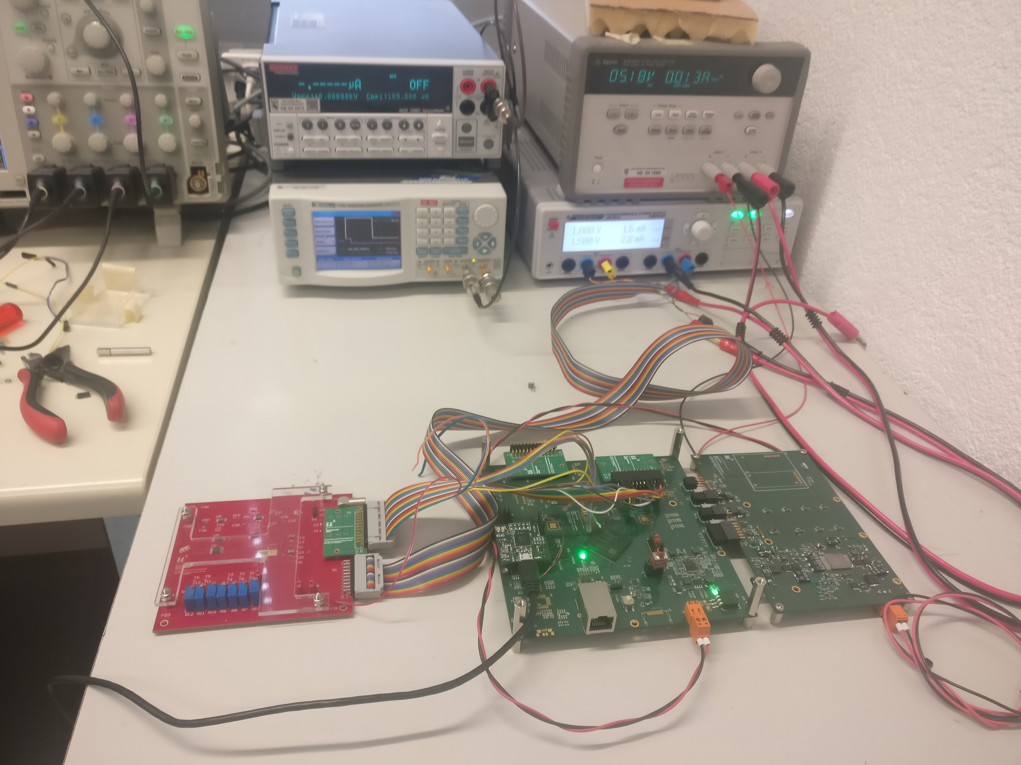
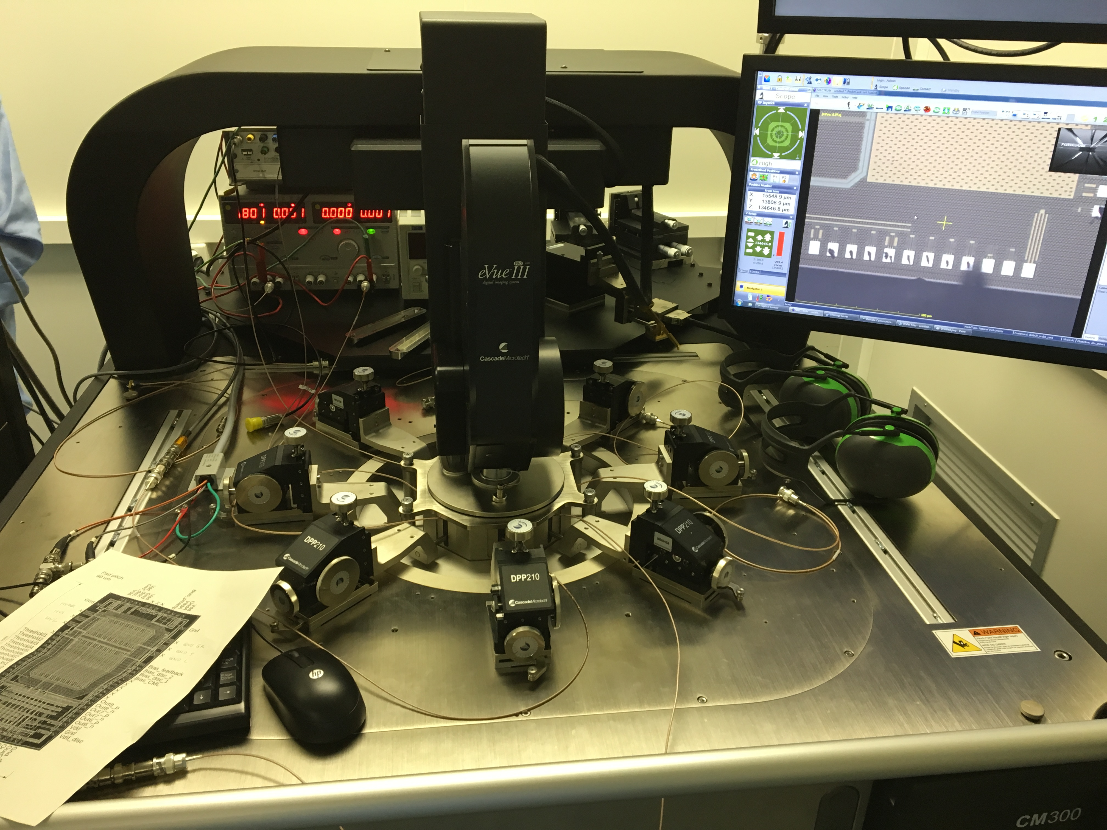
Test setups
DAQ software and firmware has already been developed
Continued to to be improved
Additional power module for the each Tower control FPGA board has been completed
Top left: Prototype-0 (red PCB) being tested at Bern
Probe station used to characterize monolithic chips before being mounted on PCB’s for testing (R&D)
dforshaw@cern.ch
PSMR2018
28

Slide 37
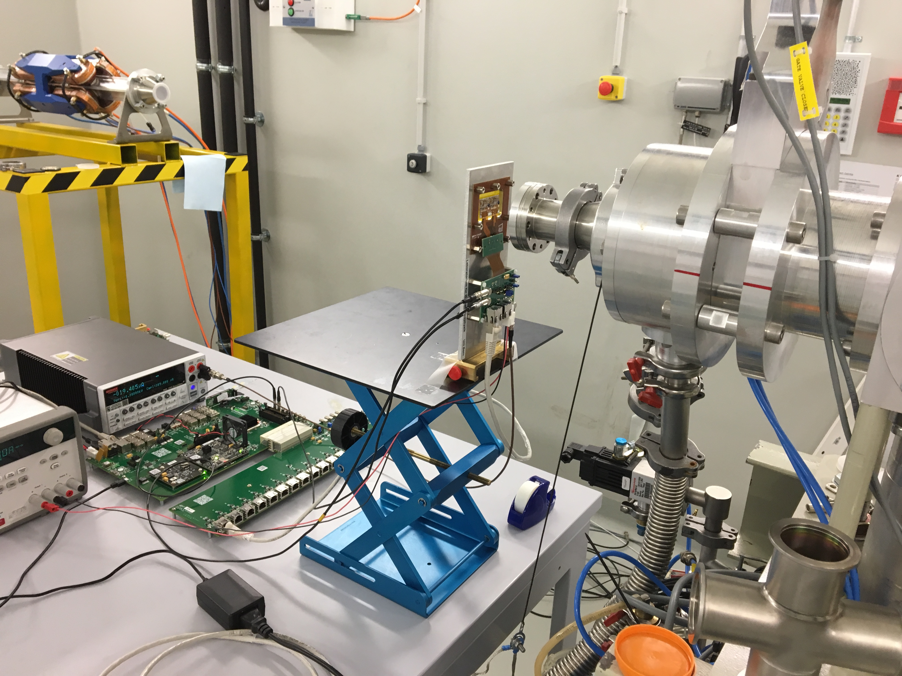
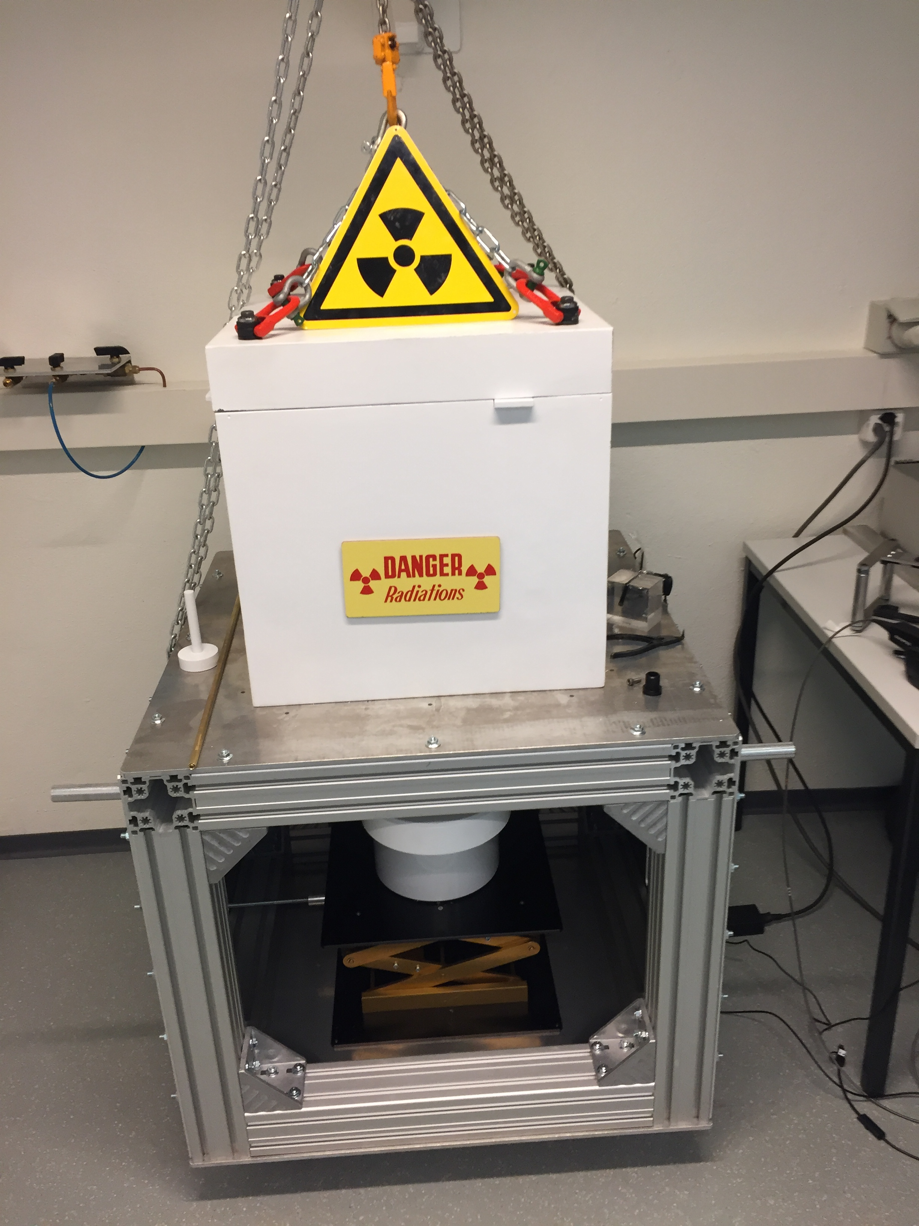
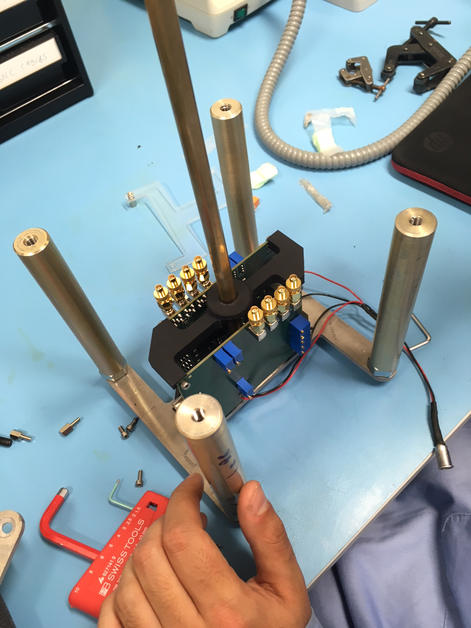
Future Tests
Now that Prototype-0 HR has been delivered
ToF / coincidence measurements will be performed in the coming weeks at Bern cyclotron using custom F18 phantom’s
ToF measurements using cyclotron 18 MeV proton beam
CFRP support + protective skin going through final revisions
Na22 ToF at Geneva University shortly
Final monolithic design submission expected Sept/October 2018
dforshaw@cern.ch
PSMR2018
29

Slide 38
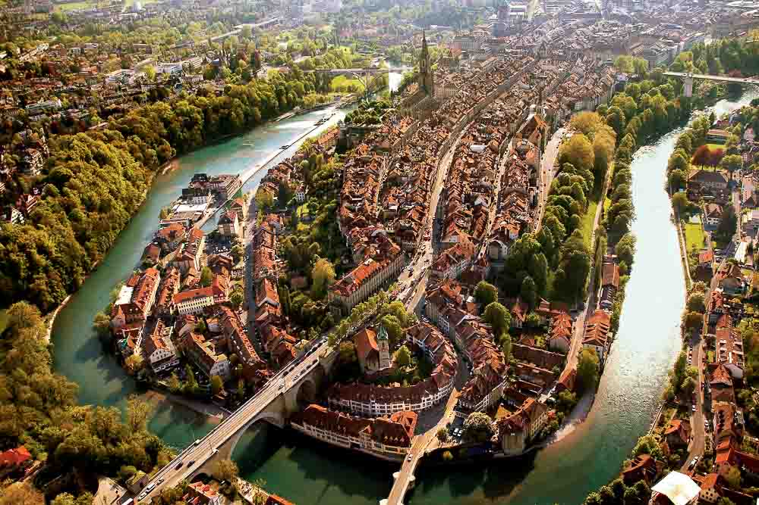
Thank You
Questions?
PSMR18
dforshaw@cern.ch
30

Slide 39
Backup

Slide 40
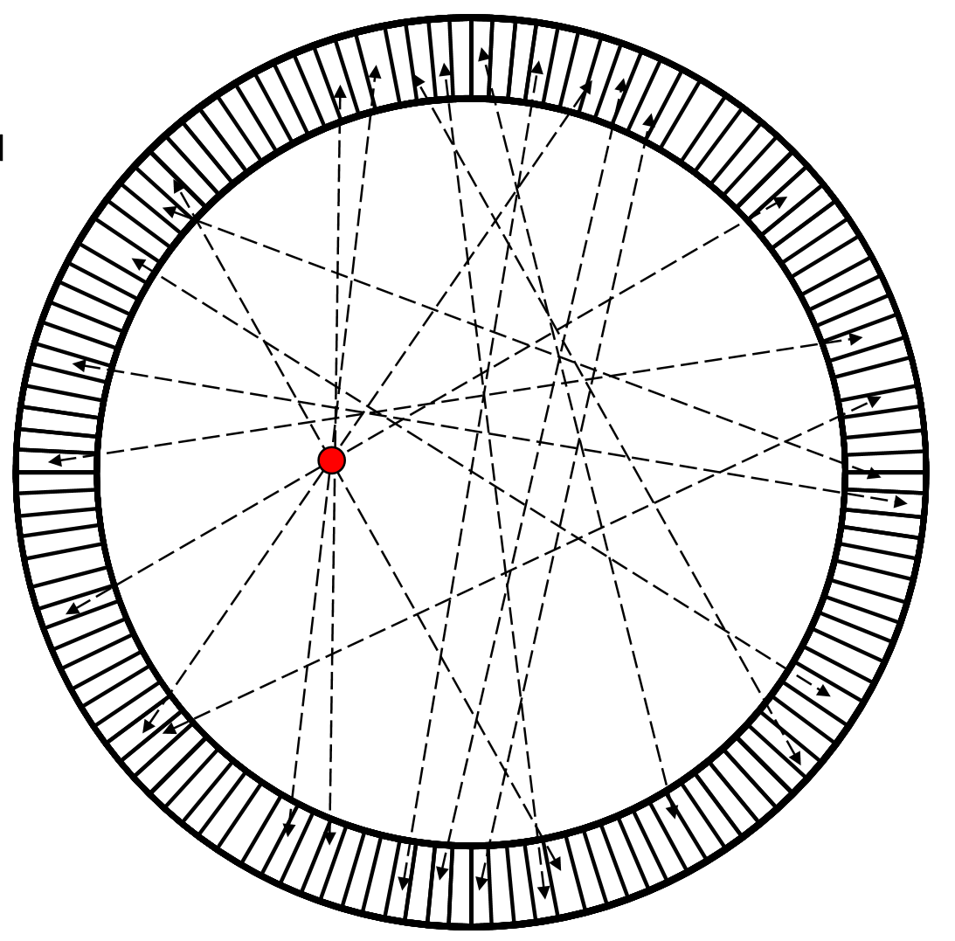
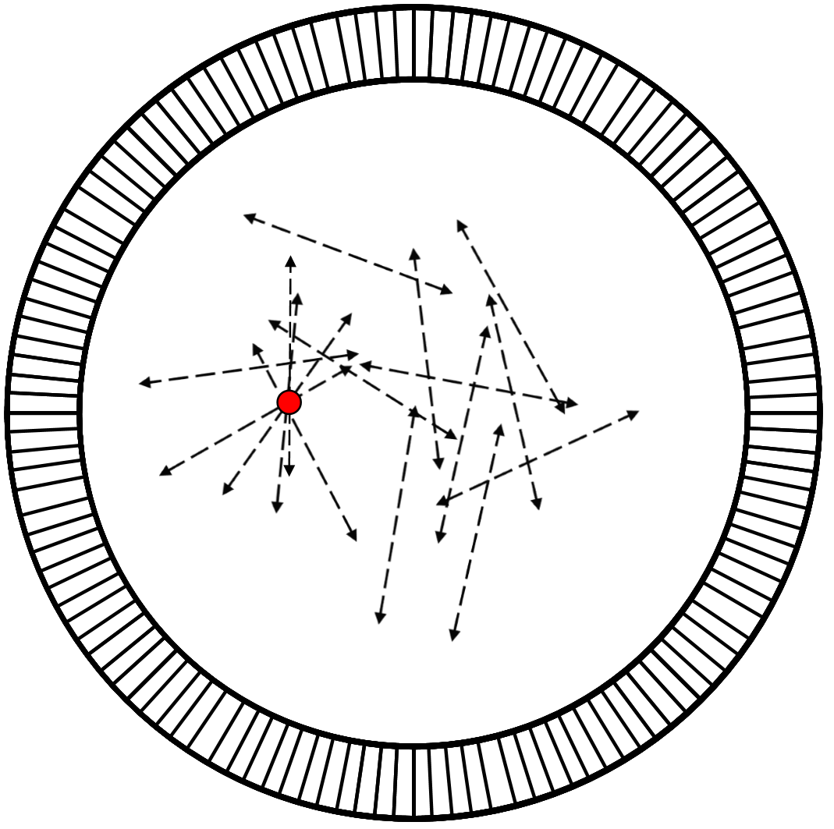
Why use Time-of-Flight?
Conventional PET
TOF PET

Slide 41
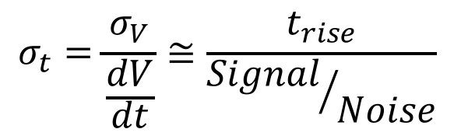
Time resolution
Detector time resolution depends mostly on the amplifier performance.
$$σ_{t}=\frac{σ_{V}}{\frac{dV}{dt}}≅\frac{t_{rise}}{{Signal}/{Noise}}$$
Threshold
Pulse time
Time

Slide 42
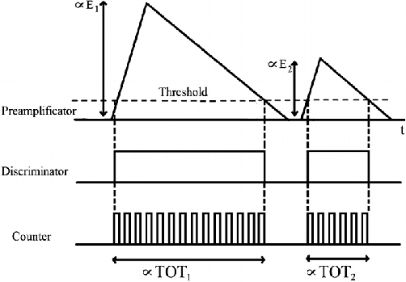
Time-over-Threshold

Slide 43
Event Rate and Data Pressure
Hit rate for a 50 MBq point source is still < 25kHz per layer
Geant4 Simulation

Slide 44
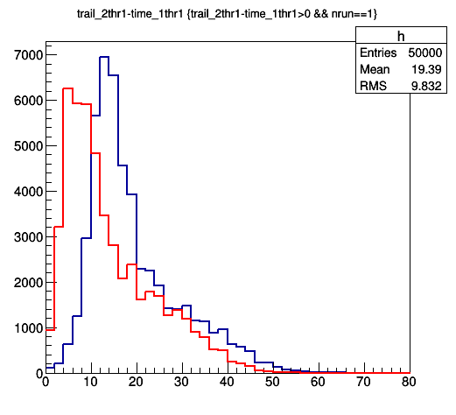
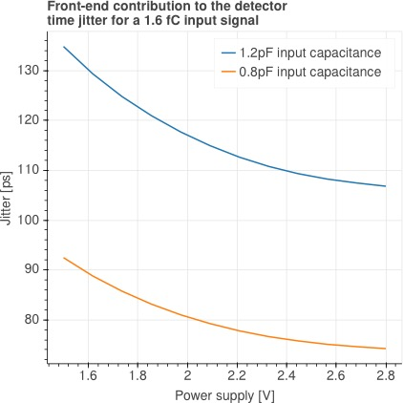
Monolithic Test chip
# hits
High-threshold
Low-Threshold
ToT [ns]
PSMR18
dforshaw@cern.ch
1

