Slide 1
High-Resolution Heterogeneous Digital PET Brain Phantom based on the BigBrain Atlas
M. A. Belzunce and A. J. Reader
PSMR 2018, 23rd May 2018
Faculty of Life Sciences & Medicine
School of Biomedical Engineering and Imaging Sciences

Slide 2
Outline
Motivation
Problems in available digital brain phantoms
The BigBrain dataset
A method for the creation of radiotracer dependent digital brain phantoms
A high-resolution heterogeneous digital brain phantom for [¹⁸F]FDG
Simulation and reconstruction results for the [¹⁸F]FDG phantom
How to get and use the phantoms
Conclusion

Slide 3
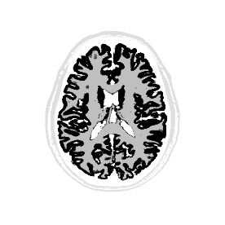
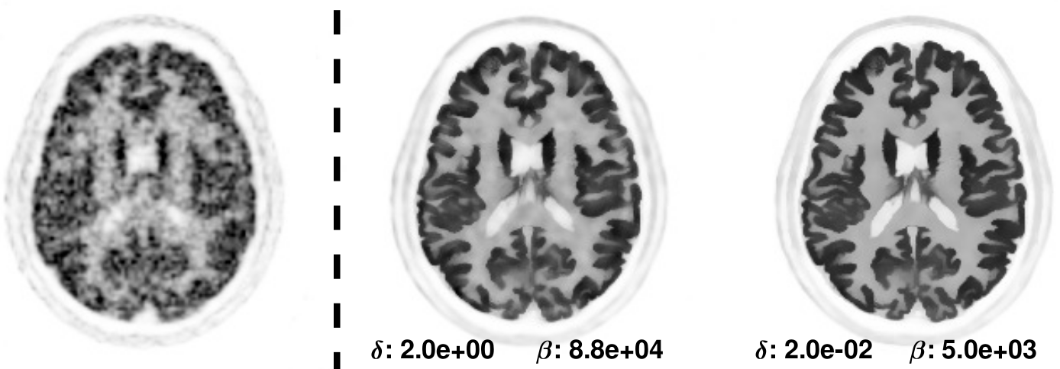
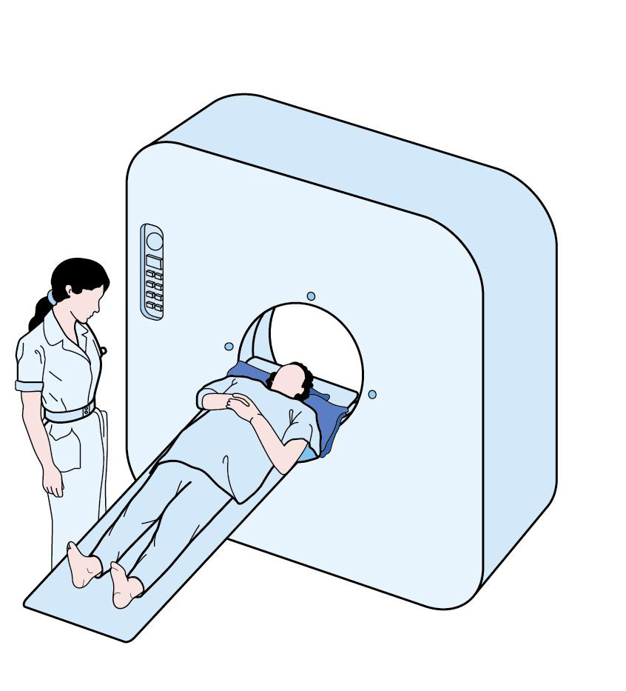
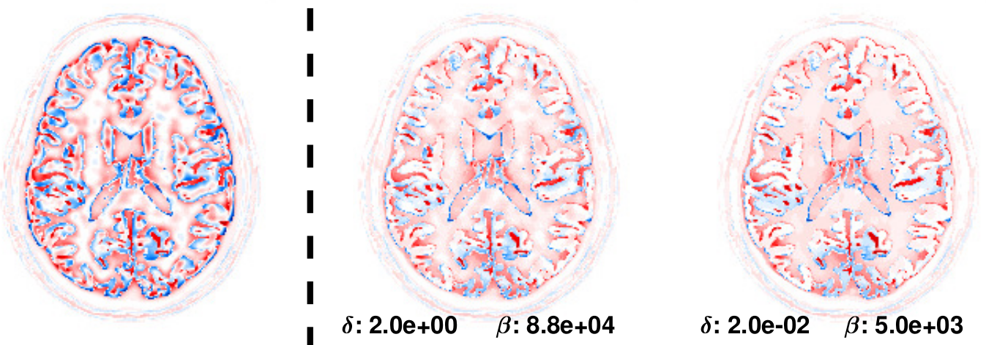
Motivation
The evaluation of image reconstruction algorithms needs realistic simulated data sets where the ground truth is known
Brain phantoms that emulate a radiotracer distribution are then needed to assess the accuracy of image reconstruction and post-processing algorithms in specific tasks
MR-guided reconstruction methods have attracted new attention since the introduction of clinical simultaneous PET-MR scanners, however the evaluation of MR-guided reconstruction methods is not completely satisfactory
Problem 1
Realistic ground truth?
Problem 3
PET-MR simulated data sets are too optimistic
Scan Simulation
Image Reconstruction
MLEM
Method 1
Method 2
Problem 2
Is this metric important in clinical applications?

Slide 4
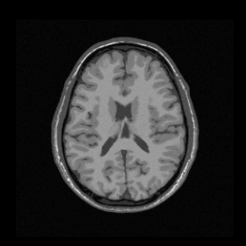
Problems of Available Digital Brain Phantoms
Most of the available digital brain phantoms are usually of limited spatial resolution making them not ideal to evaluate quantification errors due to partial volume effects (PVE)
They are piece-wise constant and usually generated from segmented MRI images of the brain
There is a controversy about the truthfulness of MR-guided reconstructions and using PET phantoms created from segmented MRI images is not beneficial to improve confidence in this methods
Piece-wise constant
(GM uniform)
Example of a simulated PET-MR data set for [¹⁸F]FDG:
Perfect match between PET and MR boundaries
The MRI image is segmented in tissue types and activity values are set to have a contrast of 4:1 between GM and WM
T1-weighted image
Brainweb phantom (Collins et al, IEEE TMI 1998 )
PET phantom

Slide 5
A New high-resolution heterogeneous digital brain phantom
We propose a new PET digital brain phantoms that overcomes most of the problems mentioned previously by using the BigBrain data set:
The PET phantom is created from ultra high-resolution histology images (100 to 400 μm) and not from an MRI image
The activity values in the phantom are region-dependent in order to match the particular distribution of a given radiotracer
A real MRI image that corresponds to the brain of the histology images is available
High-resolution
Heterogeneous
Realistic radiotracer distribution
Boundaries of PET and MRI phantoms do not match perfectly
Biological
information
Emulation of a radiotracer distribution
MRI scan
PET Phantom
MRI Phantom

Slide 6
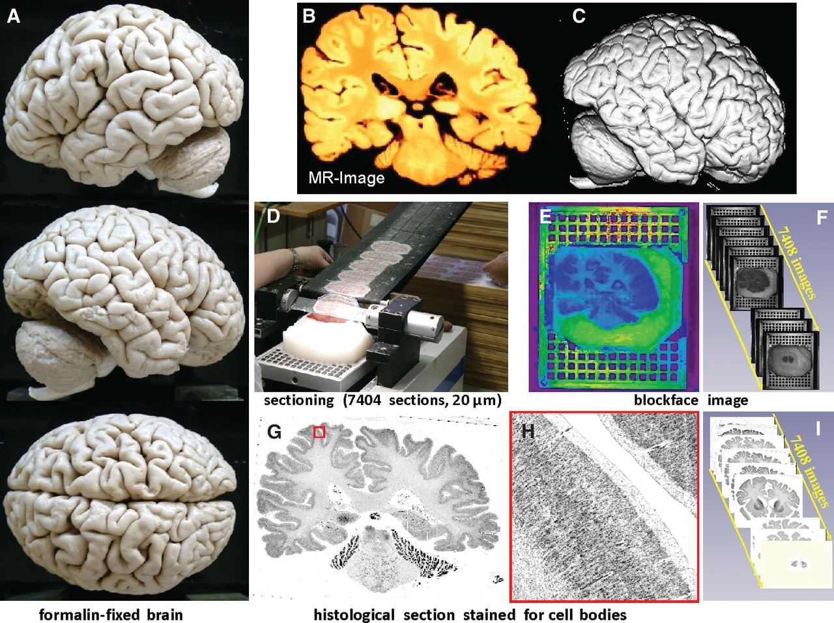
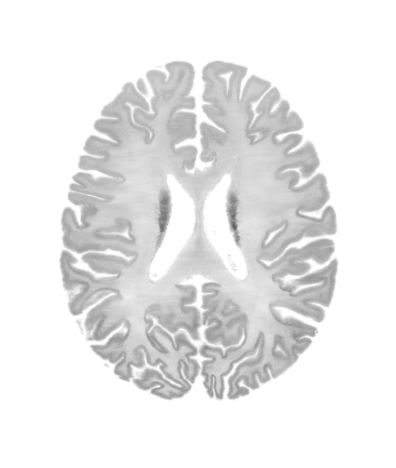
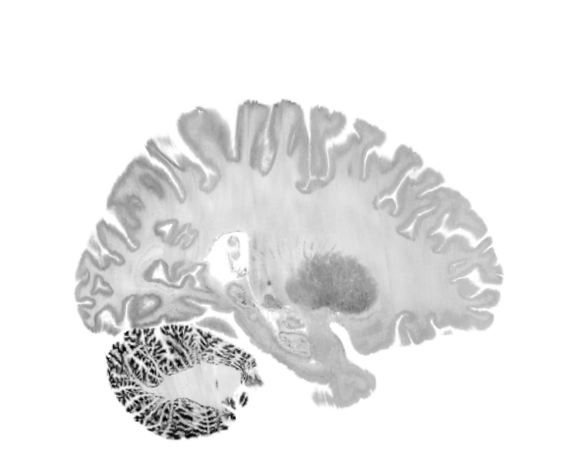
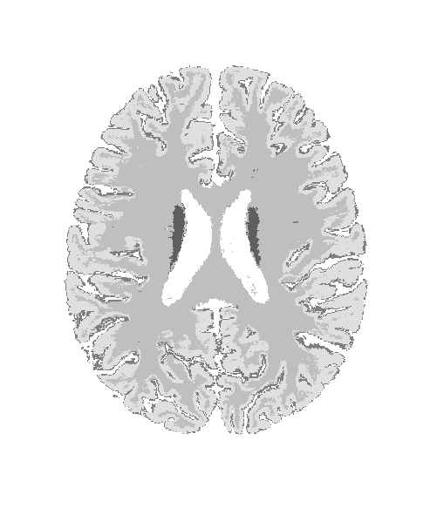
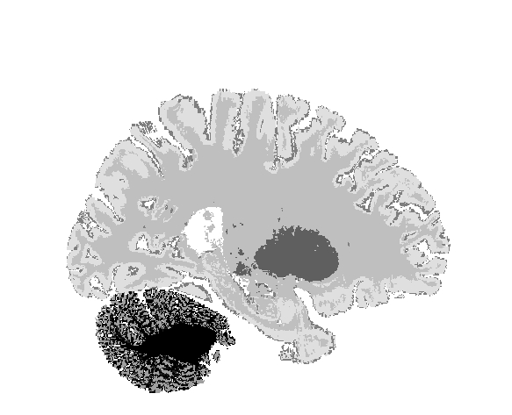
The BigBrain Dataset
The BigBrain dataset is a free accessible high-resolution 3D digital atlas of the human brain created by teams in Montreal Neurological Institute and Forschungszentrum Jülich (https://bigbrain.loris.ca/) (K. Amunts et al. Science 2013)
MRI
(histology space)
The brain model was created by slicing a paraffin-embedded brain (65 years old man with no neurological or psychiatric diseases in clinical records at time of death) and acquiring 7400 sections at 20-μm thickness stained for cell bodies
MR imaging (MPRAGE sequence, 0.4 x 0.4 x 0.8 mm³ resolution) was formed prior to histological processing to obtain an undistorted reference for further 3D reconstruction of histological sections
The resampled 3D stack of BigBrain sections at resolutions of 100 μm, 200 μm and 400 μm isotropic were normalized to MNI space.
Katrin Amunts et al. Science 2013;340:1472-1475
stained histological volume
(MNI space)
tissue classified volume
(MNI space)

Slide 7
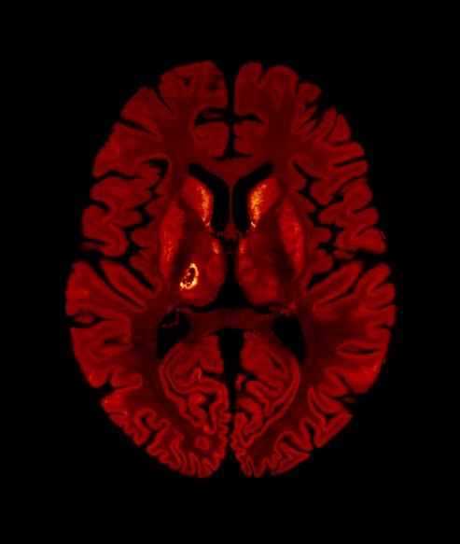
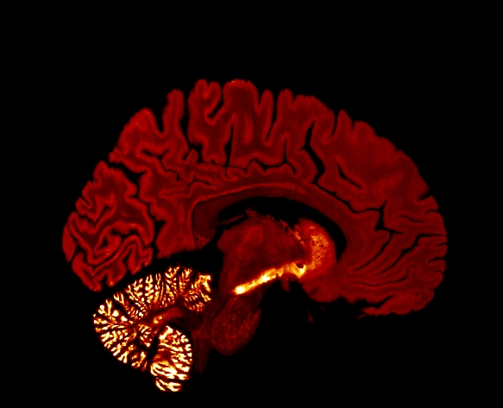
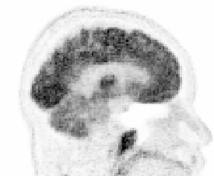
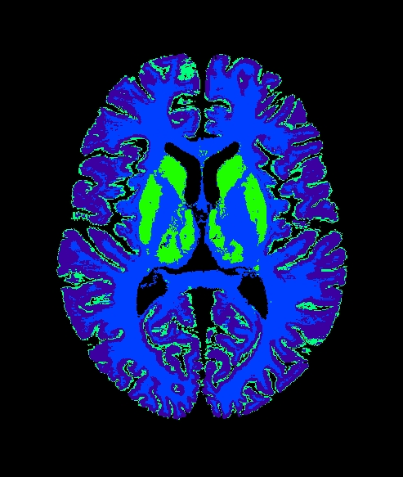
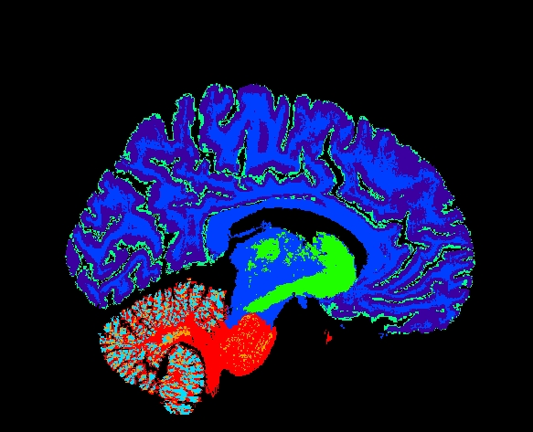
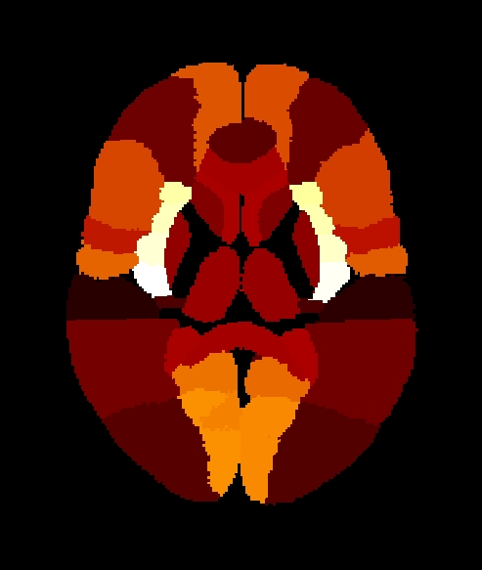
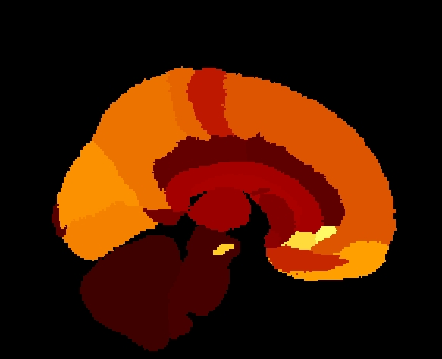
Estimation of a Radiotracer Specific Phantom
In order to create a realistic PET phantom, the voxel values in the phantom should match the distribution and contrast of the radiotracer to be simulated
Depending on the biological target of the radiotracer, the uptake in different regions of the brain would be different
[¹⁸F]FDG
Cell-body Density
Tissue Type
$$F(C,T,A)$$
Phantom
PET Scan
low resolution, noise
Brain Atlas
We propose a method to estimate uptake values in the phantom that matches real data from an specific radiotracer, based on cell-body densities, tissue types and standard regions of the brain

Slide 8
Estimation of a Radiotracer Specific Phantom (II)
The tracer uptake in each voxel of the phantom is obtained by maximizing a similarity metric between a single scan (i.e. [¹⁸F]FDG) and the estimated phantom:
Model proposed for the estimation of the phantom from parameters θ :
The objective function was optimized with the EM algorithm
$$\hat{θ}=\max_{θ}{L\left(θ|m\right)}$$
θ : vector with the relative uptake value for every atlas region in the brain and for a specific tissue type
m: scan image
-Kullback-Leibler distance
$$x=HCTAθ$$
A: is a matrix that has as many rows as voxels in the phantom and as many columns as uptake parameters to be estimated.
H: Gaussian filter that models the resolution of the PET scan or template
C: cell-body density
(diagonal matrix)
T: matrix that models tissue class for each voxel

Slide 9
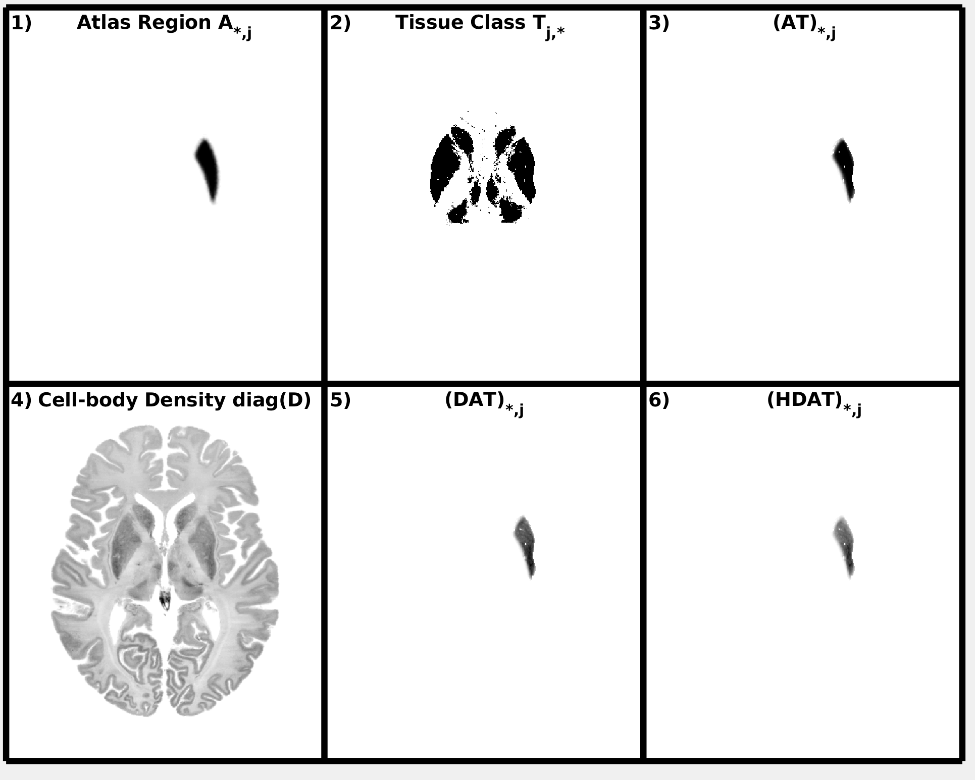
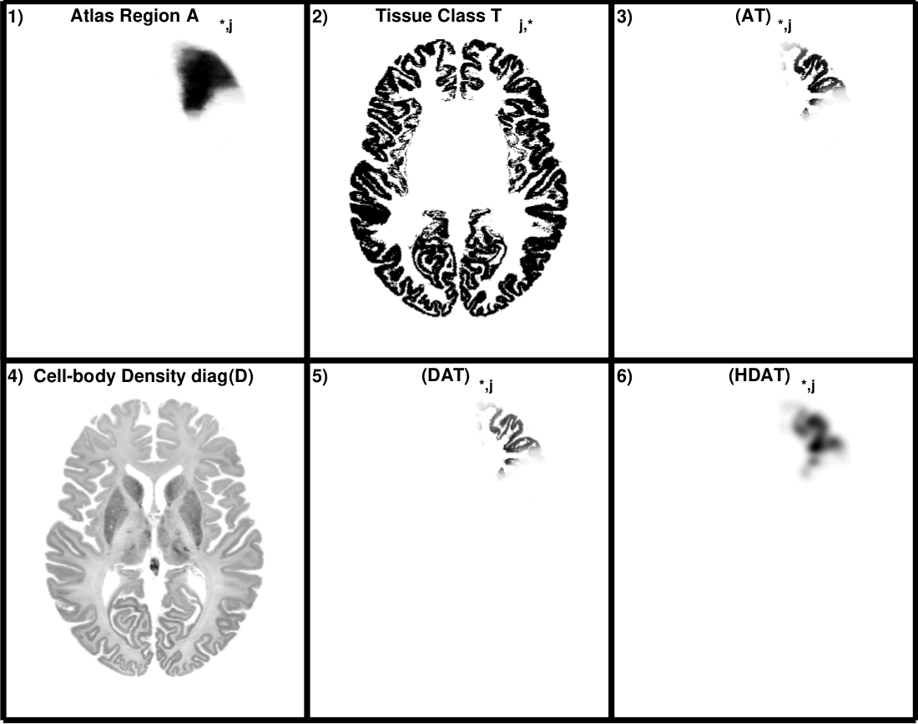
Implementation
All the data set used were registered to the BigBrain volumes and normalized into MNI space
To define the regions within the brain we used the probability maps of the Hammersmith Atlas (n30r95)
An uptake value was estimated for each tissue type (8 types) and region (95 regions + 11 ad hoc small regions) -> 848 parameters in total

Slide 10
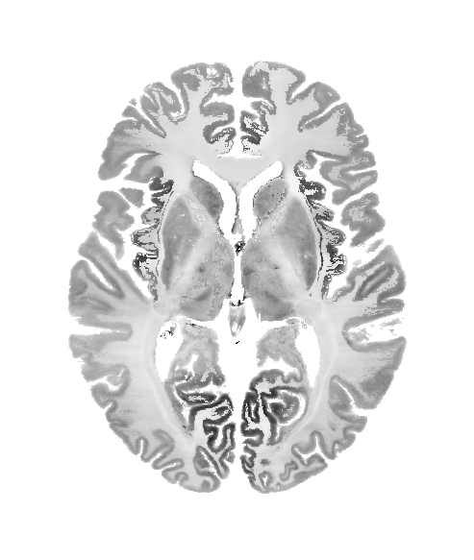
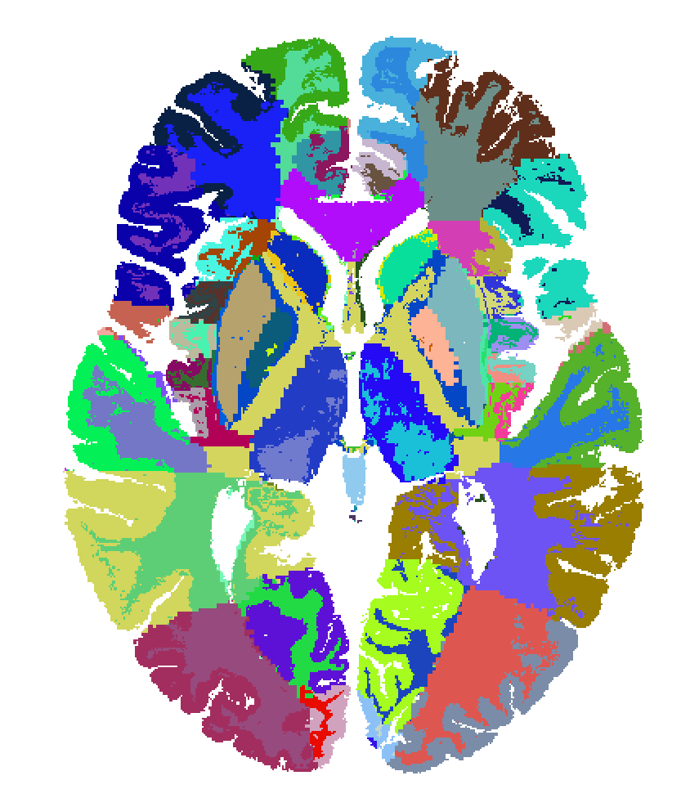
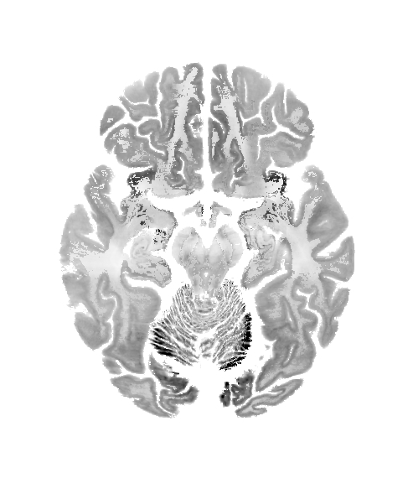
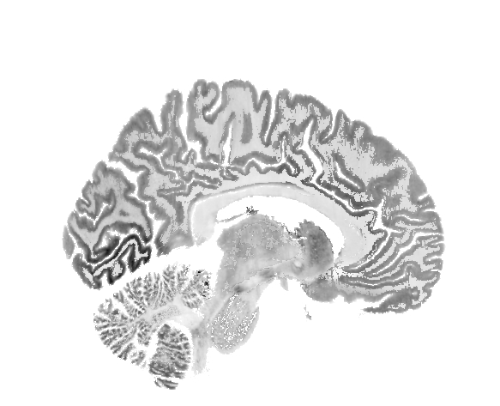
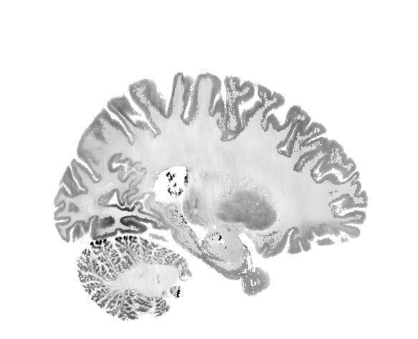
Results
Artificial small regions due to misregistration
High intensity values in small regions
(ill-posed problem)

Slide 11
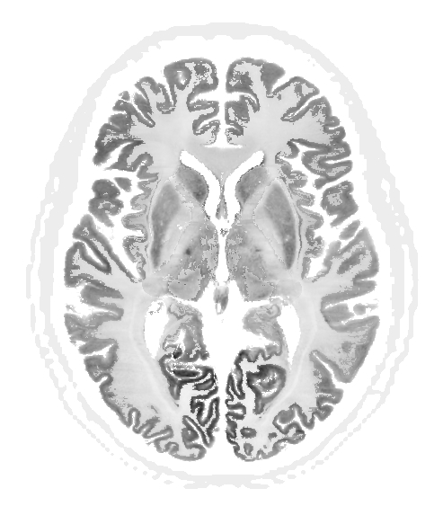
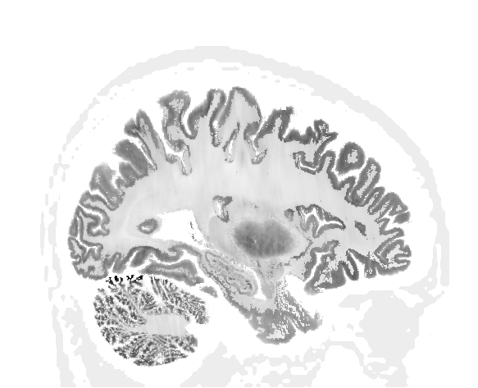
Penalized Estimation of the Parameters
$$\hat{θ}=\max_{θ}\left\{L\left(θ|m\right)−βU(θ)\right\}$$
Objective function
Quadratic regularization to penalize large intensity differences between close ROIs, OSL MAP-EM optimization
Penalty term
$$U\left(θ\right)=\sum_{j}^{N}{\sum_{k∈T_{j}}{ξ_{jk}{\left(θ_{j}−θ_{k}\right)}^{2}}}$$
ξ: inverse of the distance between the centroids of ROI j and k

Slide 12
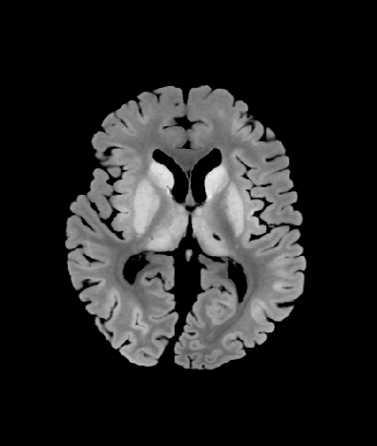
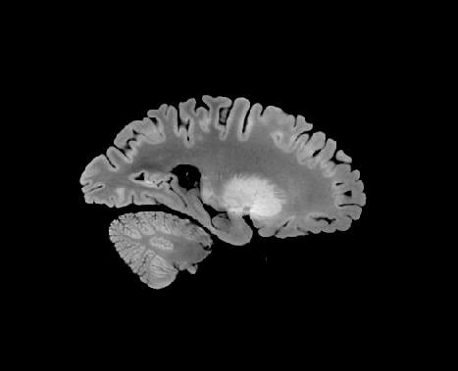
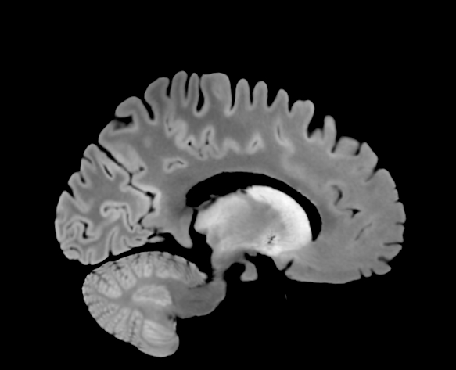
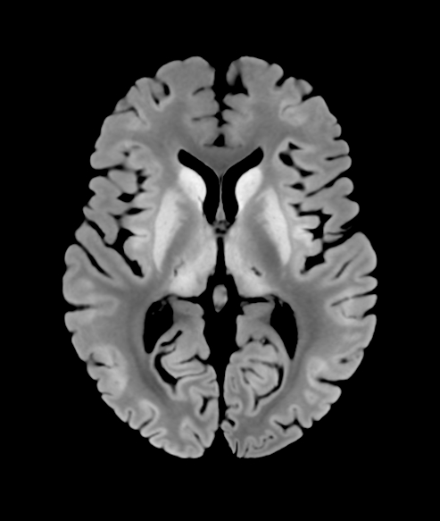
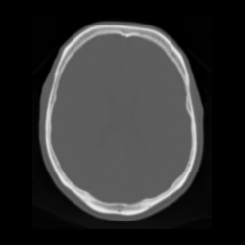
Post-processing and PET-MR Dataset Generation
The skull was added to the PET phantom after the estimation of the activity distribution
The MR T1-weighted image was registered to MNI space using the SyN algorithm (BB Avants et al, Med Image Anal 2008)
A pseudo CT was created from the T1-weighted image using the UCL method (N Burgos et al, TMI 2014)
An attenuation map for 511 keV was generated from the pseudo CT
$$μ=\left[1+\frac{HU}{1000}\right]μ_{water} for HU≤0$$
CT
$$μ=\left[1+\frac{F(kVP)HU}{1000}\right]μ_{water} for HU>0$$
μMap
convert into attenuation map
Notes:
SyN algorithm (symmetric diffeomorphic image registration)

Slide 13
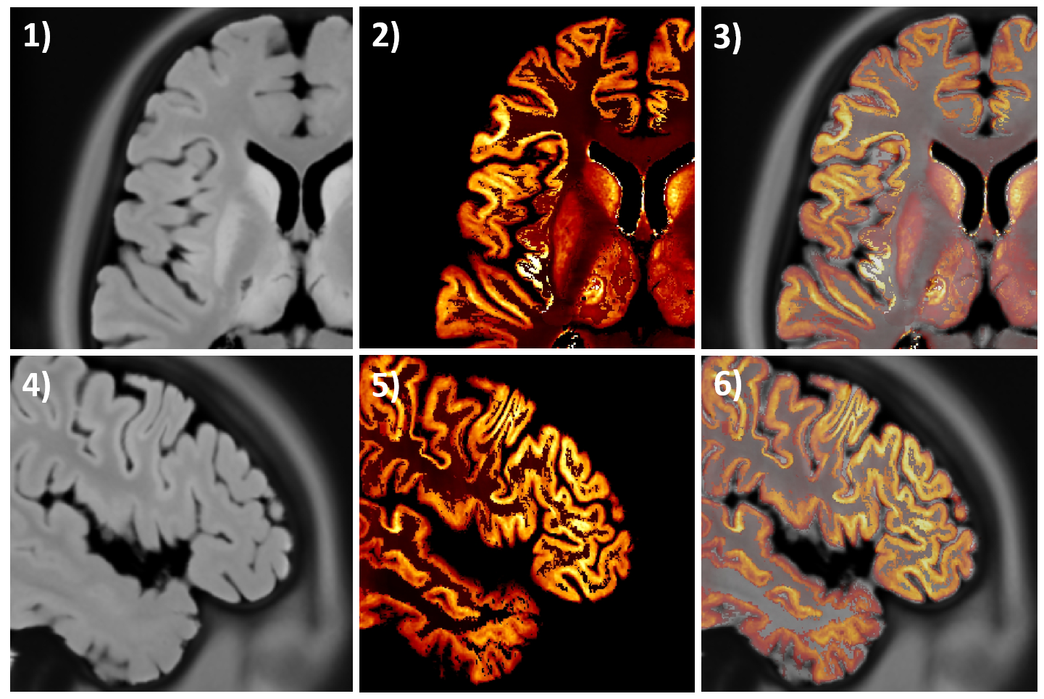
MRI Image Registration
MRI
PET Phantom
Fused Images

Slide 14
[¹⁸F]-FDG Full Data Set

Slide 15
Example of Simulated and Reconstructed Data
The original patient data was compared with simulated data of the proposed phantom and a Brainweb based phantom
A dataset was simulated using the following model:
Image reconstruction with MLEM and MR-guided MAP (Lange prior, Bowsher similarity weights and two different regularization hyperparameters)
f: phantom image
H: scanner resolution (Gaussian kernel)
X: geometrical projection (Siddon)
A: attenuation factors
N: normalization factors
s: scatter
r: randoms
$$Y=NAXHf+s+r$$

Slide 16
Example of Simulated and Reconstructed Data

Slide 17
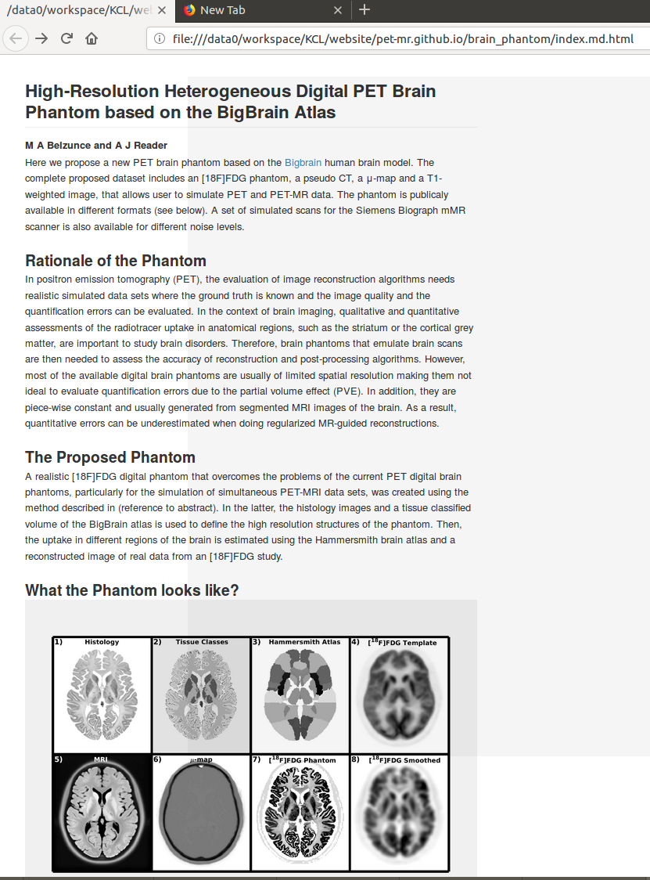
How to Get the [¹⁸F]FDG Dataset
Dataset available in zenodo: 10.5281/zenodo.1190598
Links and information on the full dataset will be found at https://pet-mr.github.io/
The dataset is available at 400 μm isotropic voxel sizes
Formats: NIfTI, binary and MATLAB .mat
In the future:
Simulated dataset for the Siemens
mMR scanner
MLEM reconstructed images
A set of functions to evaluate
quantitatively reconstruction methods
Datasets for other radiotracers

Slide 18
Conclusions and Discussion
A method to create high-resolution heterogeneous digital brain phantoms was presented
Using this method a realistic [18F]FDG PET-MR dataset was created and is publicly available
A limitation of this phantom is that the histology images used contain the cell-body density in the brain, which is not directly related to glucose metabolism
This limitation, only in effect at a very low scale, is compensated for by using an atlas and a scan data of the radiotracer of interest to estimate the uptake in different regions of the brain
The MR image boundaries does not match perfectly the histology images, however there are two possible source of errors: limitations of the MRI scan and misregistration

Slide 19
Acknowledgements
This work was supported by the Engineering and Physical Sciences Research Council [EP/M020142/1]; and by the Wellcome/EPSRC Centre for Medical Engineering [WT
203148/Z/16/Z].

Slide 20
THANKS FOR YOUR ATTENTION

