Slide 1









MR Compatibile power supply for PET detectors of an integrated PET/MR scanner
Vito Gagliardi
PSMR 2018, Hermitage Hotel, Elba Island

Slide 2



Neolite: a power supply compatible with hostile environments
Power supply in strong radiation fields (and magnetic fields up to 0.8 T)
Power supply in strong magnetic fields

Slide 3
Project goal: a power supply prototype for PET electronics
MR-compatible
MR compatible: power supply and MRI scanner must work togheter as if the other device is not there. The Power supply must be placed in an MRI scanner safely, in a way that are not observed:
MRI scanner performances alterations
Power supply performances alterations
Hostile environment reference: 1.5 T (TRIMAGE scanner)

Slide 4
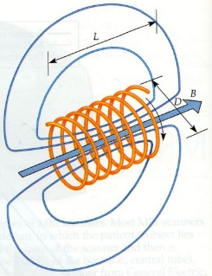
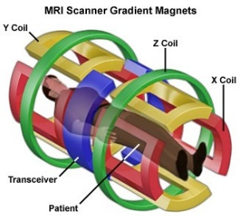
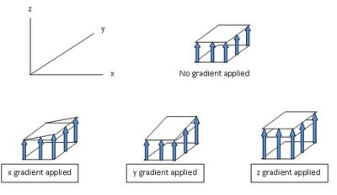
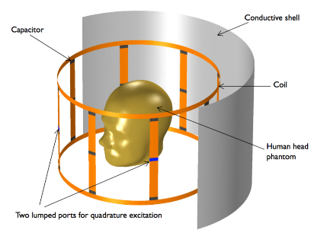
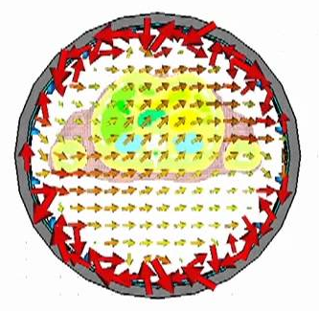
Magnetic fields in a common MRI system:
Static field B0
Generated by superconductive solenoid or a permanent magnet;
Oriented along the main axis of the scanner (Z axis);
Most common intensities in clinic: 1.5 T, 3 T, 7 T.
Grandient fields
Generated by specific coils along the three main direction, X, Y and Z;
Pulsed fields, with frequencies around 100 kHz;
Intensities: mT/m.
RF field
Generated by and RF coil in the XY plane;
Frequency range: 63,86 MHz at 1.5 T, 298,03 MHz at 7T;
Intensities around µT.

Slide 5
Compatibility
MRI scanner performances alterations:
B0 inhomogeneities: Larmor frequencies change spatially, inducing a change of the signal and consequent introduction of image artifacts;
RF signal interferencies: RF signals interfere with the RF coil loops, with a consenquent modification of the MRI RF signal and image artifacts;
Disturbs to the gradient fields: signals generated by the power supply can locally modify the gradient fields with consequent wrong phase and frequency encoding, resulting in image artifacts.
Power supply performances alterations:
Static field B0: interacts with ferromagnetic components, modifies performances of some components, saturates iron-core inductors;
Gradient fields: generate eddy currents in conductors (cables, PCB traces) as well as in large conductive areas, resulting in signal alterations and heating;
RF field: same effects of the gradient fields.

Slide 6
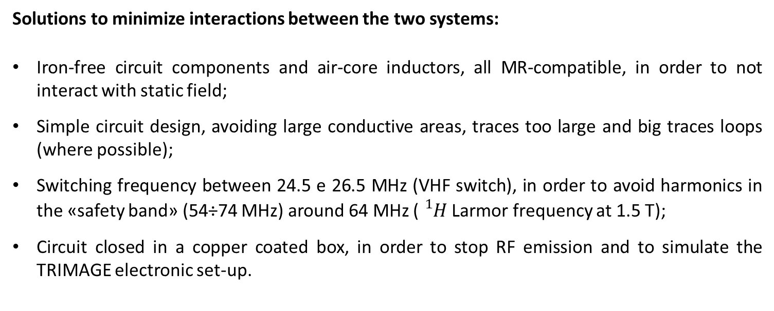
Compatibility
Solutions to minimizeinteractionsbetweenthe twosystems:
Iron-free circuitcomponents and air-core inductors, all MR-compatible, in order to notinteract with staticfield;
Simple circuit design, avoiding large conductiveareas, tracestoo large and big tracesloops (wherepossible);
Switchingfrequencybetween 24.5 e 26.5 MHz (VHF switch), in order to avoidharmonics in the «safety band» (54÷74 MHz) around 64 MHz (${}_{}^{1}H$ Larmor frequencyat 1.5 T);
Circuit closed in a coppercoated box, in order to stop RF emission and to simulate the TRIMAGE electronic set-up.

Slide 7
VHF power supply main parts:
DC-DC VHF class E converter, scheme of the power part
N. O. Sokal et al., Class-E High-Efficiency RF/Microwave Power Amplifiers: Principles of Operation, Design Procedures, and Experimental Verification, 2002, Springer US.
M. K. Kazimierczuk, D. Czarkoeski, Resonant Power converters, 2011, Wiley

Slide 8
VHF power supply main parts:
Inverter: generates from an input DC voltage an RF signal;
DC-DC VHF class E converter, scheme of the power part
N. O. Sokal et al., Class-E High-Efficiency RF/Microwave Power Amplifiers: Principles of Operation, Design Procedures, and Experimental Verification, 2002, Springer US.
M. K. Kazimierczuk, D. Czarkoeski, Resonant Power converters, 2011, Wiley

Slide 9
VHF power supply main parts:
Inverter: generates from an input DC voltage an RF signal;
Rectifier: converts the RF voltage in a DC voltage;
DC-DC VHF class E converter, scheme of the power part
N. O. Sokal et al., Class-E High-Efficiency RF/Microwave Power Amplifiers: Principles of Operation, Design Procedures, and Experimental Verification, 2002, Springer US.
M. K. Kazimierczuk, D. Czarkoeski, Resonant Power converters, 2011, Wiley

Slide 10
VHF power supply main parts:
Inverter: generates from an input DC voltage an RF signal;
Rectifier: converts the RF voltage in a DC voltage;
Impedance adaptation: between the previous two components, adusts the impedance for the inverter;
DC-DC VHF class E converter, scheme of the power part
N. O. Sokal et al., Class-E High-Efficiency RF/Microwave Power Amplifiers: Principles of Operation, Design Procedures, and Experimental Verification, 2002, Springer US.
M. K. Kazimierczuk, D. Czarkoeski, Resonant Power converters, 2011, Wiley

Slide 11
VHF power supply main parts:
Inverter: generates from an input DC voltage an RF signal;
Rectifier: converts the RF voltage in a DC voltage;
Impedance adaptation: between the previous two components, adusts the impedance for the inverter;
Feedback control: keeps the output DC voltage when input voltage and input load change.
DC-DC VHF class E converter, scheme of the power part
Frequency deviation feedback scheme
Feedback control works over the resonant frequency
N. O. Sokal et al., Class-E High-Efficiency RF/Microwave Power Amplifiers: Principles of Operation, Design Procedures, and Experimental Verification, 2002, Springer US.
M. K. Kazimierczuk, D. Czarkoeski, Resonant Power converters, 2011, Wiley

Slide 12
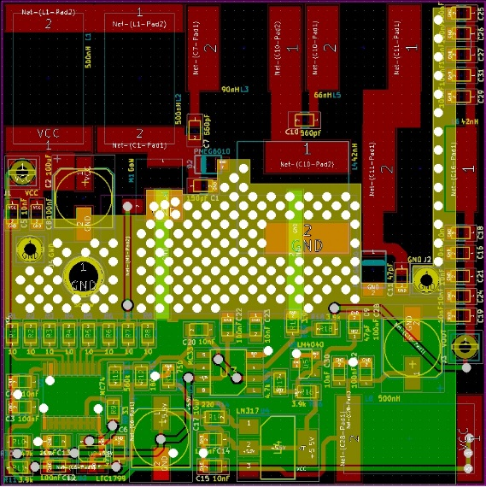
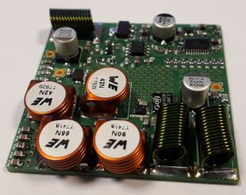
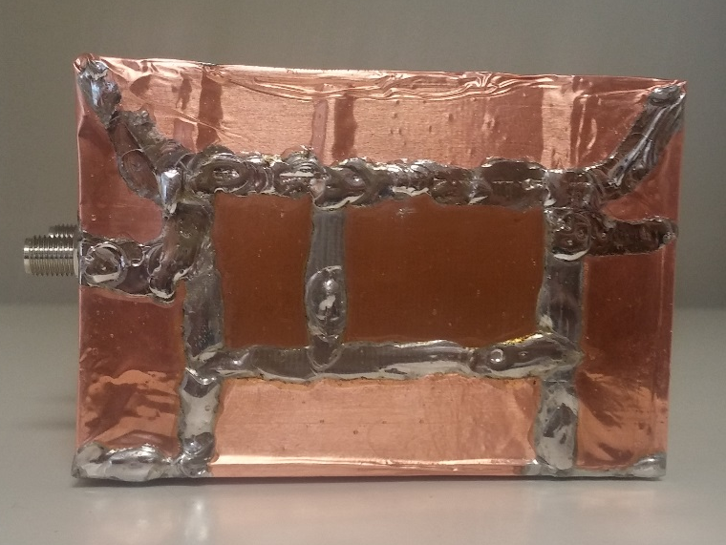
Circuit layout
Circuit prototype
Circuit copper shield
Power sect.
Linear regul.
Circuit measurements on the workbench

Slide 13
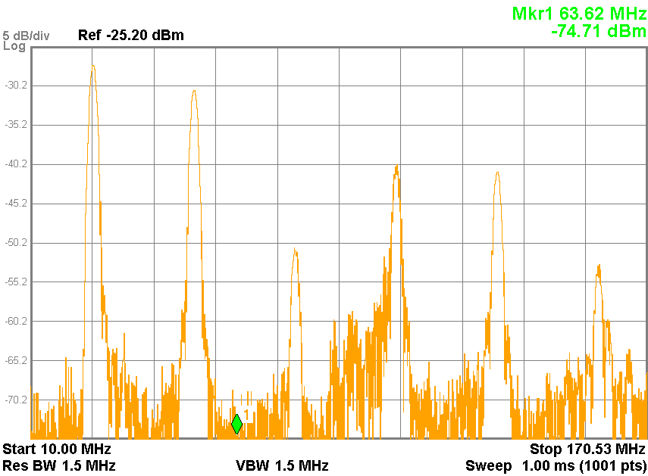
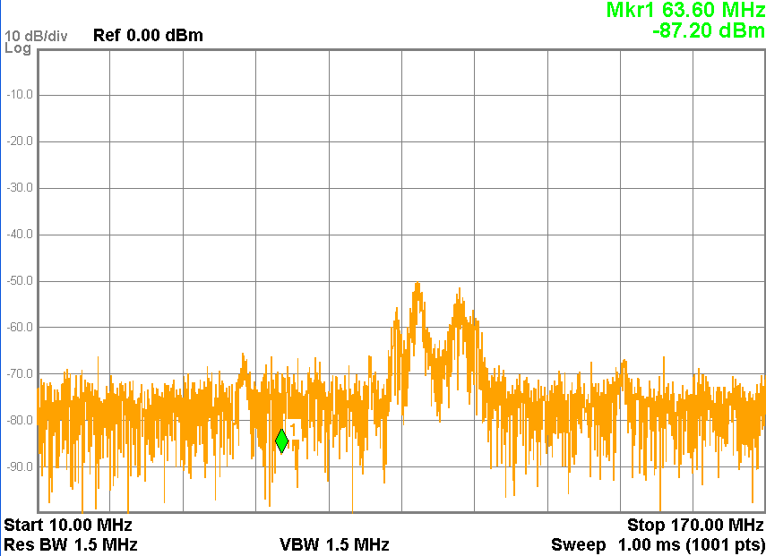
Measurements of the emission spectrum of the circuit with a Signal Analyzer
Emission spectrum without shielding
Emission spectrum with shielding

Slide 14
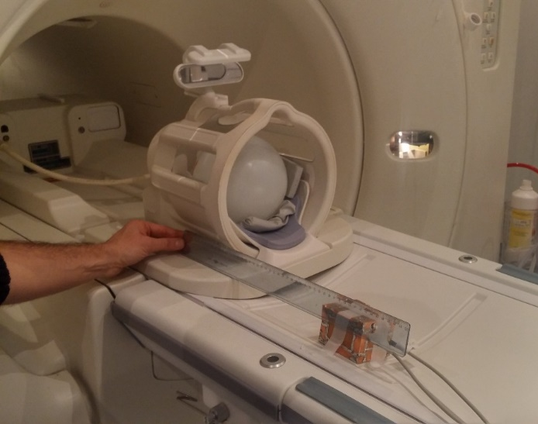
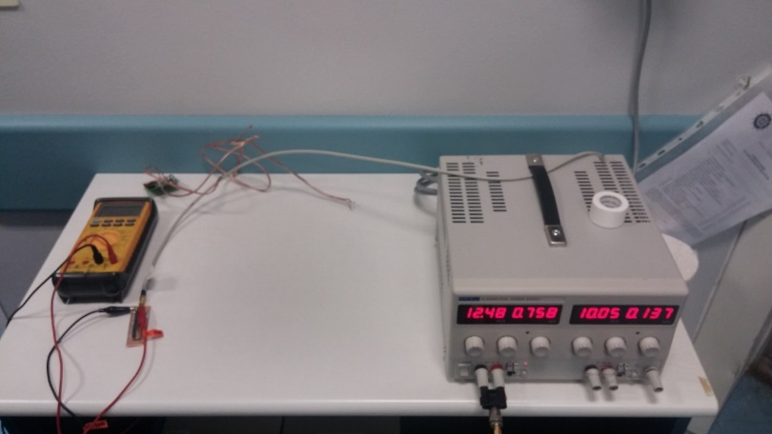
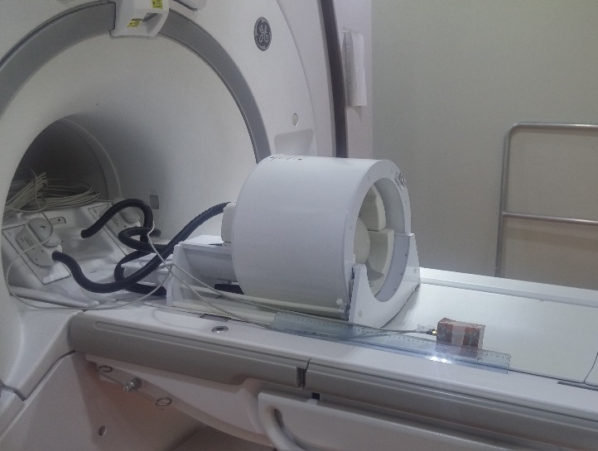
Experimental set-up for compatibility measurements in 1.5 T scanner of the Stella Maris Foundation and in 7 T of the Imago7 Foundation (Calambrone, Pisa)
Set-up in the 1.5 T magnet
Circuit power supply and tester for output parameters outside the scanner rooms
Set-up in the 7 T magnet

Slide 15
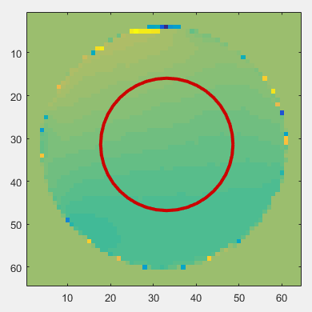
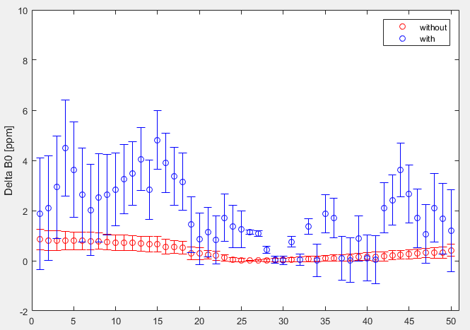
Compatibility test in 1.5 T scanner of Stella Maris Foundation
B0 field uniformity
B0 field map acquired in the phantom
B0 variation (ppm) in all the slice acquired, without (red) and with the circuit switched on (blue)

Slide 16
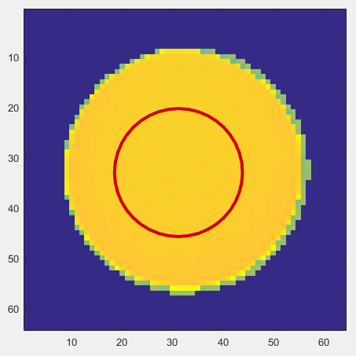
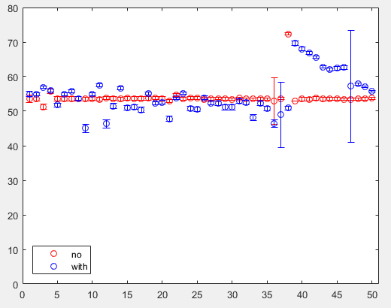
Compatibility test in 1.5 T scanner of Stella Maris Foundation
B1 uniformity: Flip Angle (FA) evaluation
FA map acquired in the scanner, with two different ROIs used for FA evaluation
FA value in all the slice acquired, without (red) and with the power supply switched on (blu) for both the ROIs

Slide 17
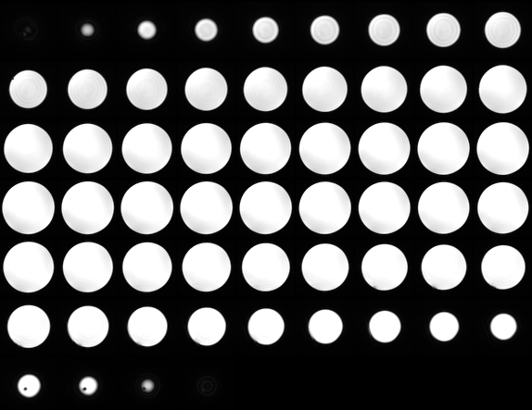
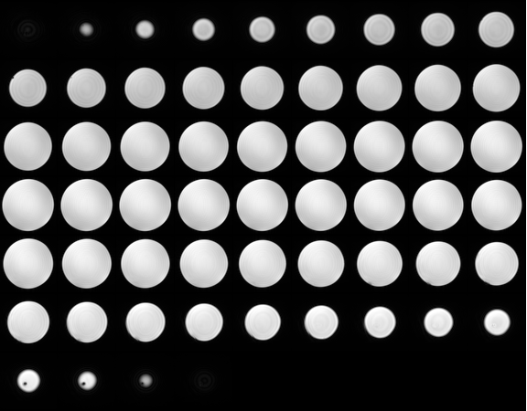
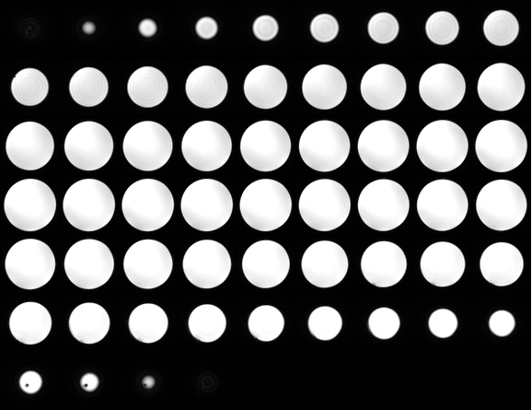
Compatibility test in 1.5 T scanner of Stella Maris Foundation
Anatomical imaging evaluation: Susceptibility Weighted ANgiography (SWAN).
Swan imaging with
power supply switched off
Swan imaging with the power supply switched on
Swan sequence without power supply

Slide 18
Compatibility test in 1.5 T scanner of Stella Maris Foundation
Anatomical imaging evaluation: Susceptibility Weighted ANgiography (SWAN).
None
Supply Off
Supply on
SNR without (blue) and with the power supply, switched off (red) and switched on (green) in the acquired slices

Slide 19
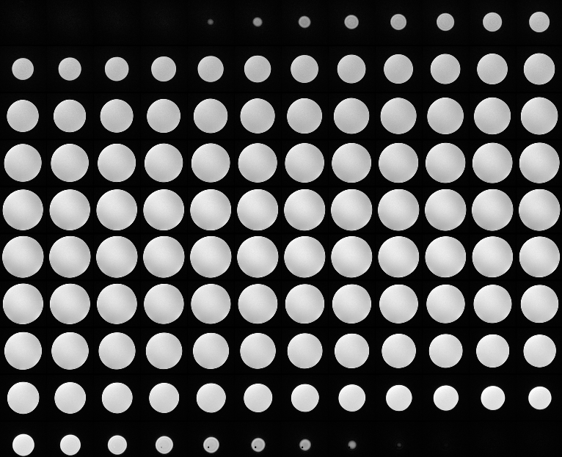
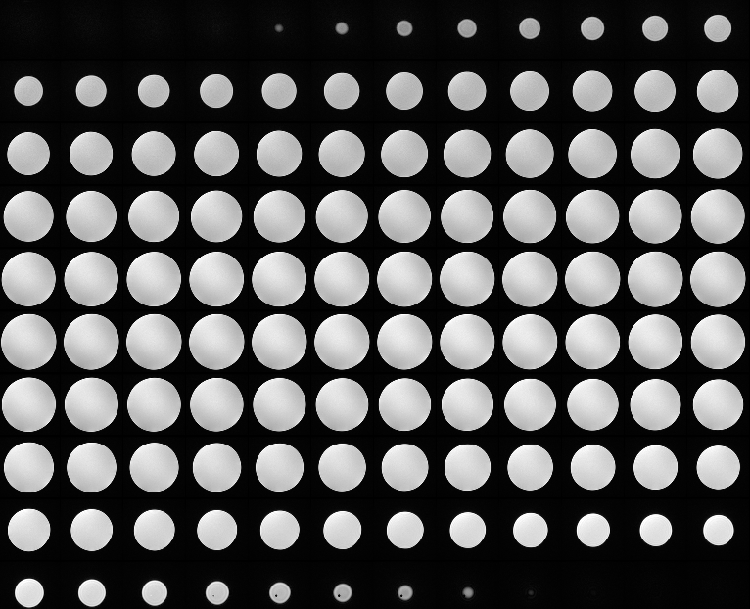
Compatibility test in 1.5 T scanner of Stella Maris Foundation
Anatomical imaging evaluation : Fast SPoiled GRadient echo (FSPGR).
FSPGR sequence images without power supply
FSPGR sequence images with power supply switched on

Slide 20
Compatibility test in 1.5 T scanner of Stella Maris Foundation
Anatomical imaging evaluation : Fast SPoiled GRadient echo (FSPGR).
None
Supply On
SNR without (blue) and with the power supply switched on (red) in the acquired slices

Slide 21
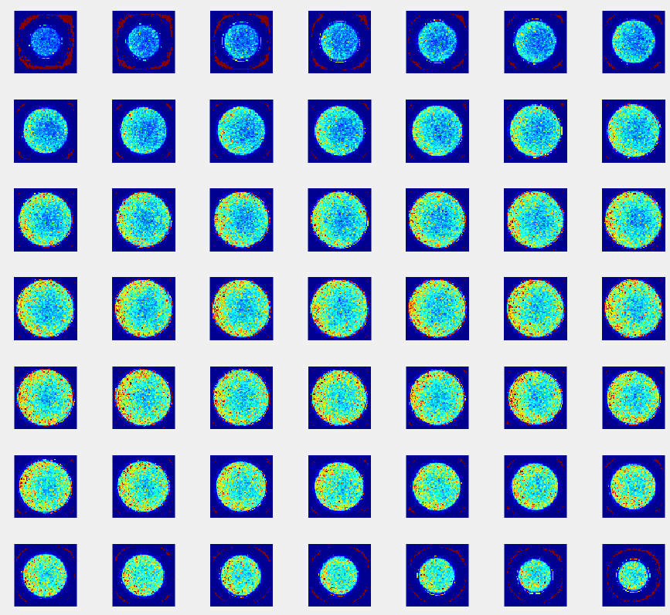
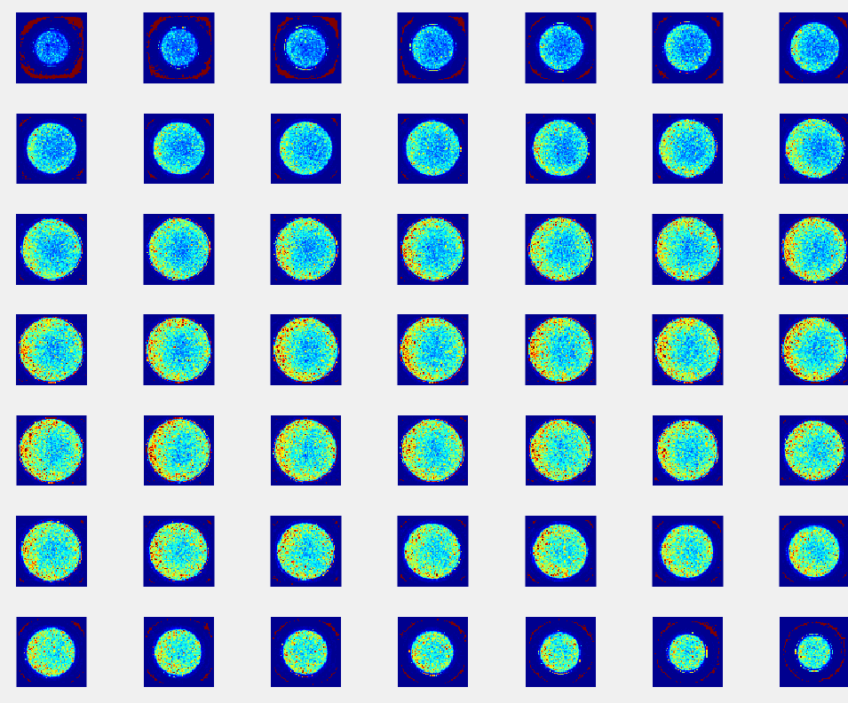
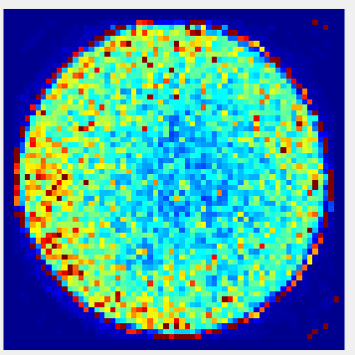
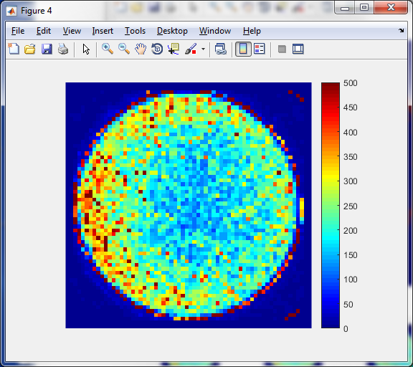
Compatibility test in 1.5 T scanner of Stella Maris Foundation
Functional imaging evaluation: Echo Planar Imaging (EPI).
SNR map of the acquired images without power supply
SNR map of the acquired images
with power supply switched on

Slide 22
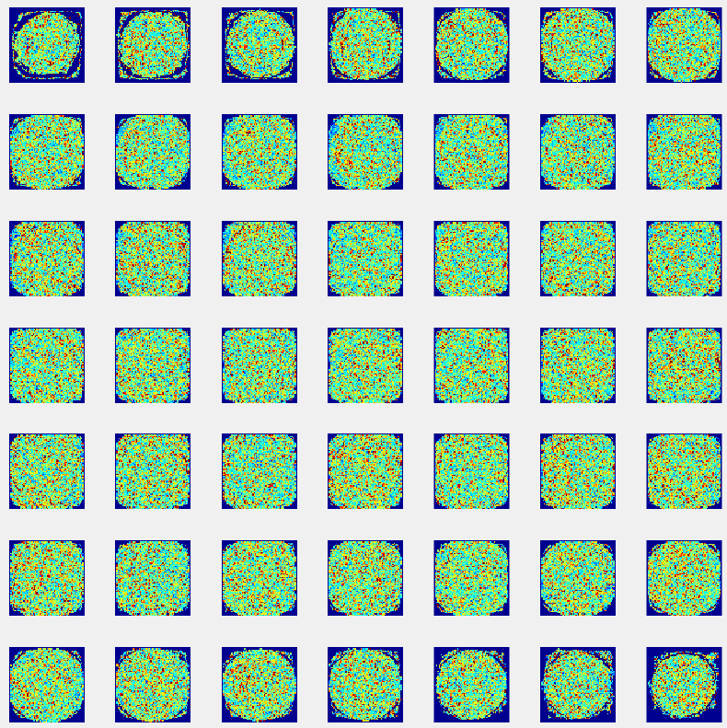
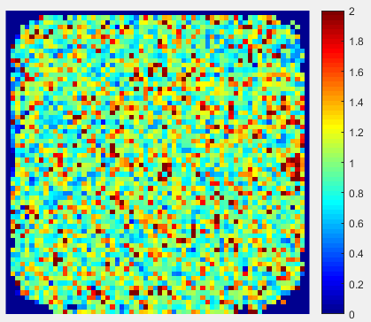
Compatibility test in 1.5 T scanner of Stella Maris Foundation
Functional imaging evaluation: Echo Planar Imaging (EPI).
tSNRno
tSNRwith
Ratio =
Map of SNR ratio in the acquired images
Map of SNR ratio in the central slice

Slide 23
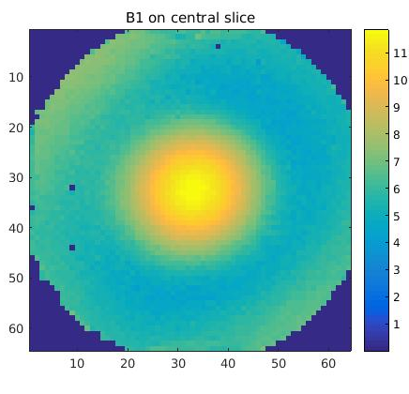
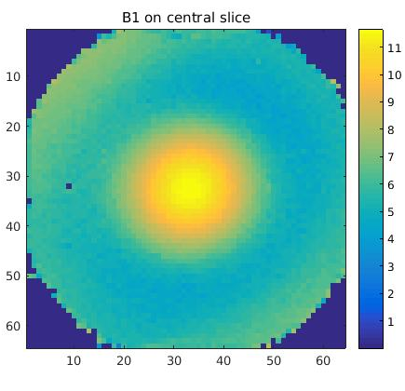

Compatibility test in 7 T scanner of Imago7 Foundation
B1 field uniformity: axial Bloch-Siegert
B1 map without power supply
B1 map with
power supply switched off
B1 map with
power supply switched on

Slide 24
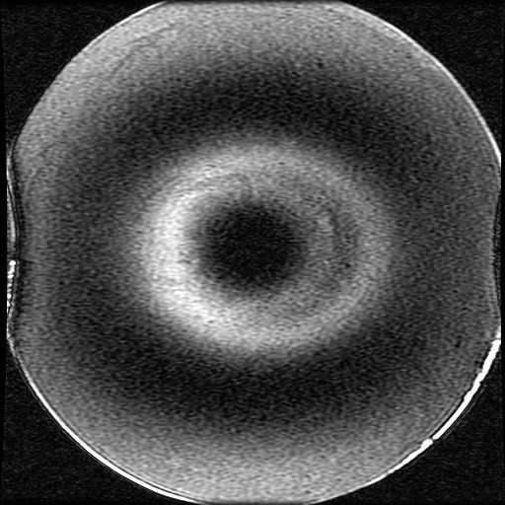
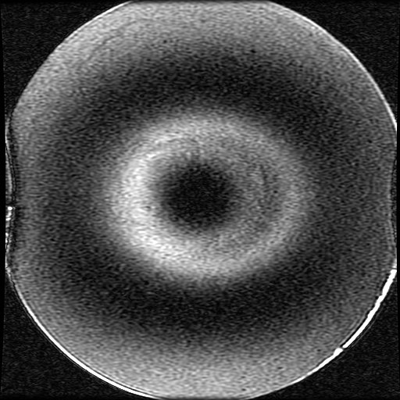
Compatibility test in 7 T scanner of Imago7 Foundation
Anatomical imaging evaluation: Spin Echo (SE).
Image acquired without power supply
Image acquired with power supply switched on

Slide 25
Conclusions:
We developed a VHF power supply that is able to convert 12 V DC input in a 5 V DC output with an efficiency around 70%, better than an equivalent linear converter, and very small thermal losses;
The power supply can be safely placed inside an MRI system since no magnetic effects are observed on it;
Scanner performances are not affected by the presence of the power supply inside the bore when the power supply is properly shielded;
The power supply showed magnetic compatibility also in a scanner the circuit is not designed for.

Slide 26
Thank you for your attention
RSI Grant POR-FES 2014-2020
CUP Tuscany Development 3389.30072014.068000018

