Slide 1
Study of TeV neutrinos in the FASER experiment at the LHC
Akitaka Ariga
University of Bern
on behalf of the FASER Collaboration

Slide 2
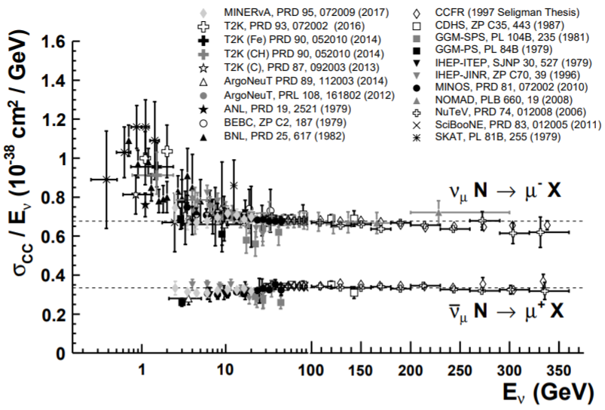
Motivation for high energy neutrinos
Muon neutrino cross-sections (PDG)
Neutrino-quark scattering are basic tools to study interactions between leptons and quarks
Those in high energy (DIS regime) tell fundamental interactions between neutrinos and quarks
Flavor physics with high energy neutrinos, $ν_{e}, ν_{μ}, ν_{τ}$ and charm, beauty
BSM search, e.g. flavor anomaly involving heavy leptons and quarks
QE, Res
$$ν−N$$
DIS
$$ν−q$$
$$\overline{ν}$$
$$l^{+}$$
$$\overline{ν}N→ℓ\overline{B}X$$
u
$$b$$
$$l$$
$$\overline{ν}$$
$$ν$$
$$l^{−}$$
$$b$$
$$νN→ℓBDX$$
$$c$$
$$\overline{c}$$
Anomalous b semileptonic decay.
$$\overline{b}$$
$ν$ CC $b$ production

Slide 3
Motivation for high energy neutrinos
Muon neutrino cross-sections (PDG)
Neutrino-quark scattering are basic tools to study interactions between leptons and quarks
Those in high energy (DIS regime) tell fundamental interactions between neutrinos and quarks
Flavor physics with high energy neutrinos, $ν_{e}, ν_{μ}, ν_{τ}$ and charm, beauty
BSM search, e.g. flavor anomaly involving heavy leptons and quarks
QE, Res
$$ν−N$$
DIS
$$ν−q$$
High energy $ν$ beam needed.
$ν$ CC $b$ production is kinematically possible at $E_{ν}>100$ GeV effectively
$$\overline{ν}$$
$$l^{+}$$
High statistics
The standard model process are suppressed by $V_{ub}^{2}=𝒪({10}^{−5})$
$$\overline{ν}N→ℓ\overline{B}X$$
u
$$b$$
$$l$$
$$\overline{ν}$$
$$ν$$
$$l^{−}$$
$$b$$
$$νN→ℓBDX$$
$$c$$
$$\overline{c}$$
Anomalous b semileptonic decay.
$$\overline{b}$$
$ν$ CC $b$ production

Slide 4
Status of high energy neutrino measurements
Few data available at high energy $E_{ν}≥300$ GeV.
Recent x-sec experiments focus on low energy ($E<10$ GeV) relevant for oscillation analyses.

Slide 5
Status of high energy neutrino measurements
Few data available at high energy $E_{ν}≥300$ GeV.
Recent x-sec experiments focus on low energy ($E<10$ GeV) relevant for oscillation analyses.
This talk: Let’s study high energy $ν$ from the LHC!
Study x-sec at currently unexplored energy regime.
First neutrino project from colliders.
Idea of $ν$ with the LHC itself existed since 80s, but I came today with new motivations and a practical setup.

Slide 6
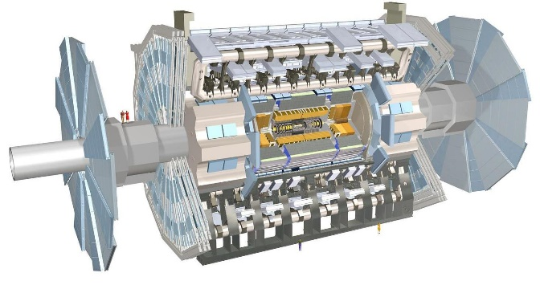
FASER: ForwArd Search ExpeRiment at the LHC
ATLAS and CMS searches focus on high p_{T} → appropriate for heavy, strongly interacting particles
No evidence of new particles is detected so far.
If new particles are light and weakly interacting to the SM particles (e.g. dark photon), they could be long-lived and collimated in the very forward region → FASER arXiv:1708.09389
The LOI (July 2018) and technical proposal (October 2018) were submitted. Approved by CERN in March 2019.
Preparing for physics run in 2021 (Run3 of the LHC operation)
FASER
divergence
$$𝒪\left(\frac{Λ_{QCD}}{E}\right)≃\frac{0.2GeV}{1TeV}∼1 mrad$$

Slide 7
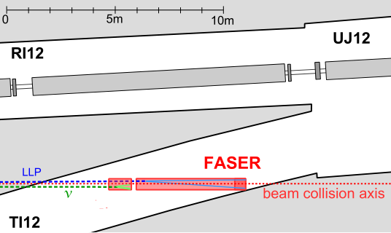
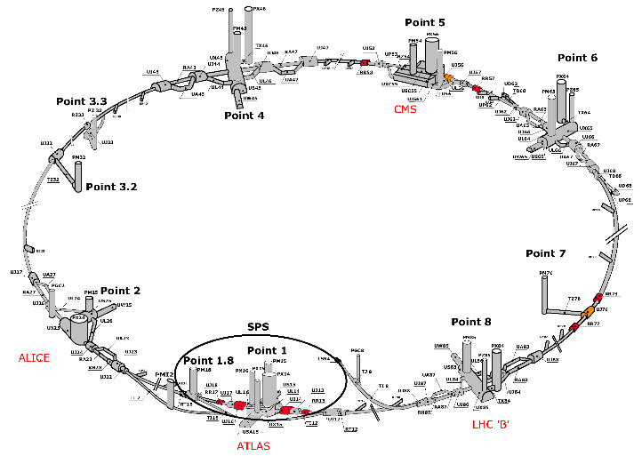
FASER LOCATION: TI12
LHC
TI18
FASER (TI12)

Slide 8
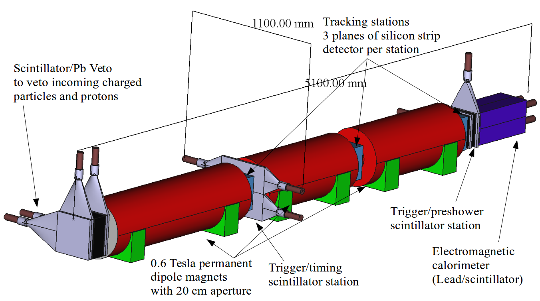
FASER detector & sensitivity
Signal: Dark photon decay into $e^{+}e^{−}$ pair
Detector schematic
Sensitivity for dark photon search in Run 3
Decay Volume
particles from IP1
FASER was approved and funded for BSM searches, however the collaboration is actively studying possible neutrino physics measurements → FASER$ν$

Slide 9
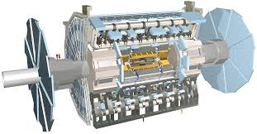
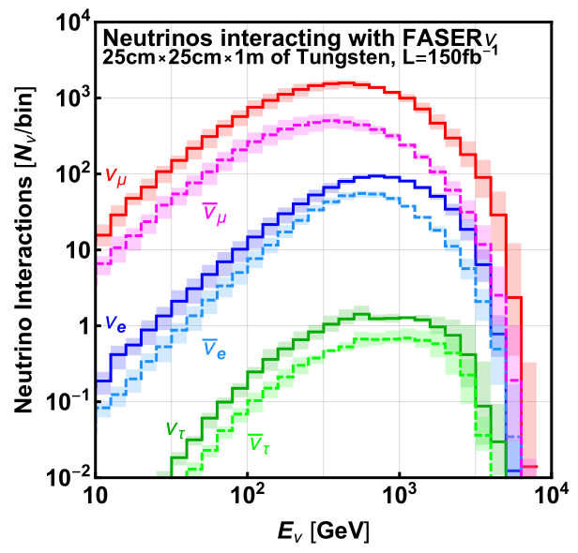
FASER layout $≡$ high energy neutrino beamline
charged particles (P<7 TeV)
LHC tunnel
TI12 tunnel
forward jets
neutrino, dark photon
FASER$ν$
LHC magnets
100 m of rock
p-p collision at IP of ATLAS
480 m
Interaction target=7 TeV p
Decay volume
Charged particle sweeping
Hadron stop
280 $λ_{int}$
Detector
Expected # of interactions in Run 3 (2021-2023)
with 7+7 TeV, 150 fb⁻¹, detector mass 1.2 ton
 | # of CC interactions | Mean interacting energy
$$ν_{e}+{\overline{ν}}_{e}$$ | 1296 | 827 GeV
$$ν_{μ}+{\overline{ν}}_{μ}$$ | 20439 | 631 GeV
$$ν_{τ}+{\overline{ν}}_{τ}$$ | 21 | 965 GeV

Slide 10
FASER layout $≡$ high energy neutrino beamline
charged particles (P<7 TeV)
LHC tunnel
TI12 tunnel
forward jets
FASER$ν$
High energy frontier!
Collimated beam $×$ high cross-section
Inexpensive and quick
No special beamline needed
No special beam operation needed, but LHC/ATLAS run
neutrino, dark photon
LHC magnets
100 m of rock
p-p collision at IP of ATLAS
480 m
Interaction target=7 TeV p
Decay volume
Charged particle sweeping
Hadron stop
280 $λ_{int}$
Detector
Expected # of interactions in Run 3 (2021-2023)
with 7+7 TeV, 150 fb⁻¹, detector mass 1.2 ton
How about background?
→ in situ measurement with emulsion detector
 | # of CC interactions | Mean interacting energy
$$ν_{e}+{\overline{ν}}_{e}$$ | 1296 | 827 GeV
$$ν_{μ}+{\overline{ν}}_{μ}$$ | 20439 | 631 GeV
$$ν_{τ}+{\overline{ν}}_{τ}$$ | 21 | 965 GeV

Slide 11
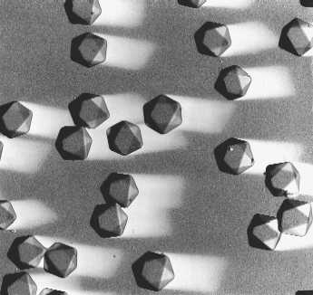
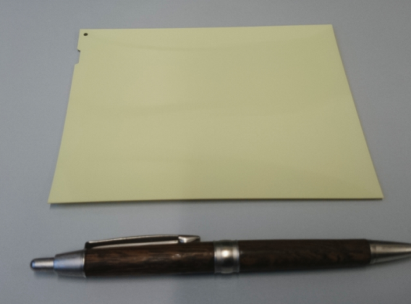
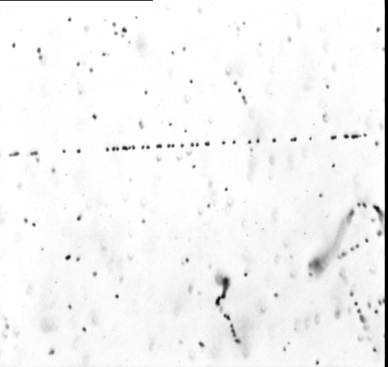
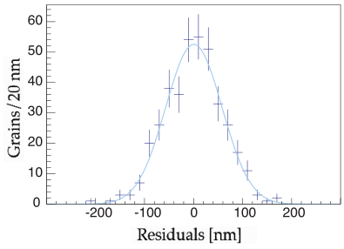
Emulsion detectors: 3D tracking device with 50 nm precision
AgBr crystal = detector
10¹⁴ channels/film or
10¹⁴ channels/cm³
Cross-sectional view
Emulsion film
Emulsion layer ($≃$50 μm)
Plastic base ($≃20$0 μm)
Emulsion layer
200 nm
Residual from fitted track
σ = 50 nm
Sensitivity 36 grains/100 μm
10 GeV/c π
beam
20 μm

Slide 12
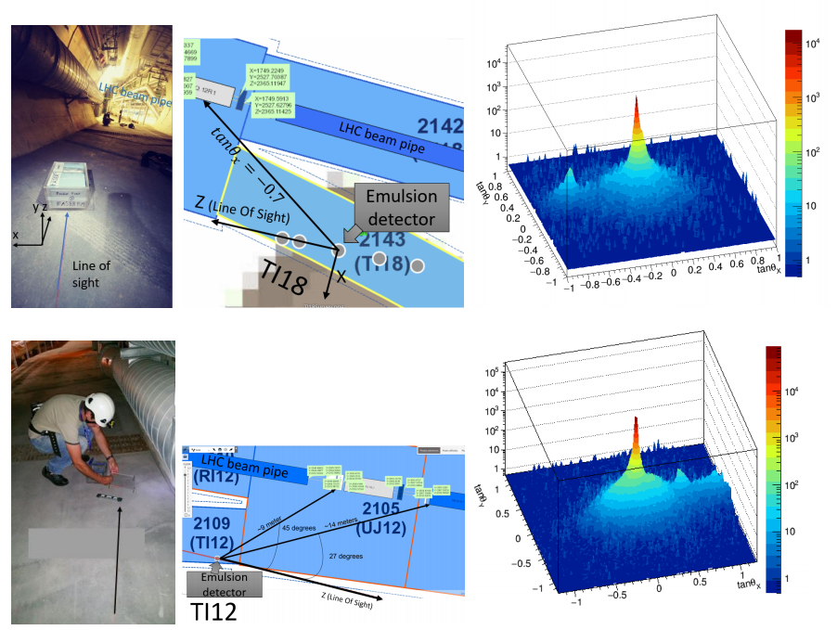
In situ background measurements
TI18
Emulsion detectors were installed in two sites in 2018
Charged particle flux, angle, momentum were measured
TI12
TI18
FASER
TI12

Slide 13
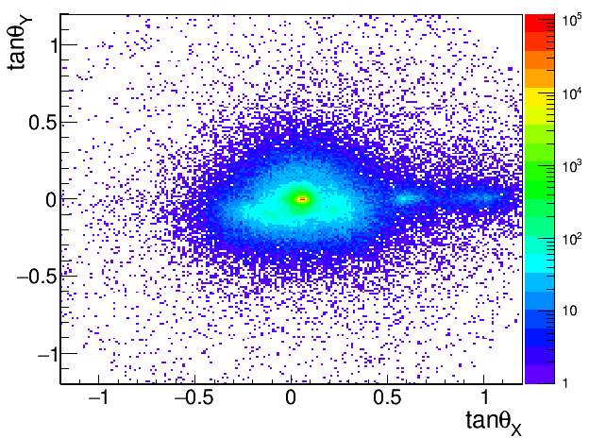
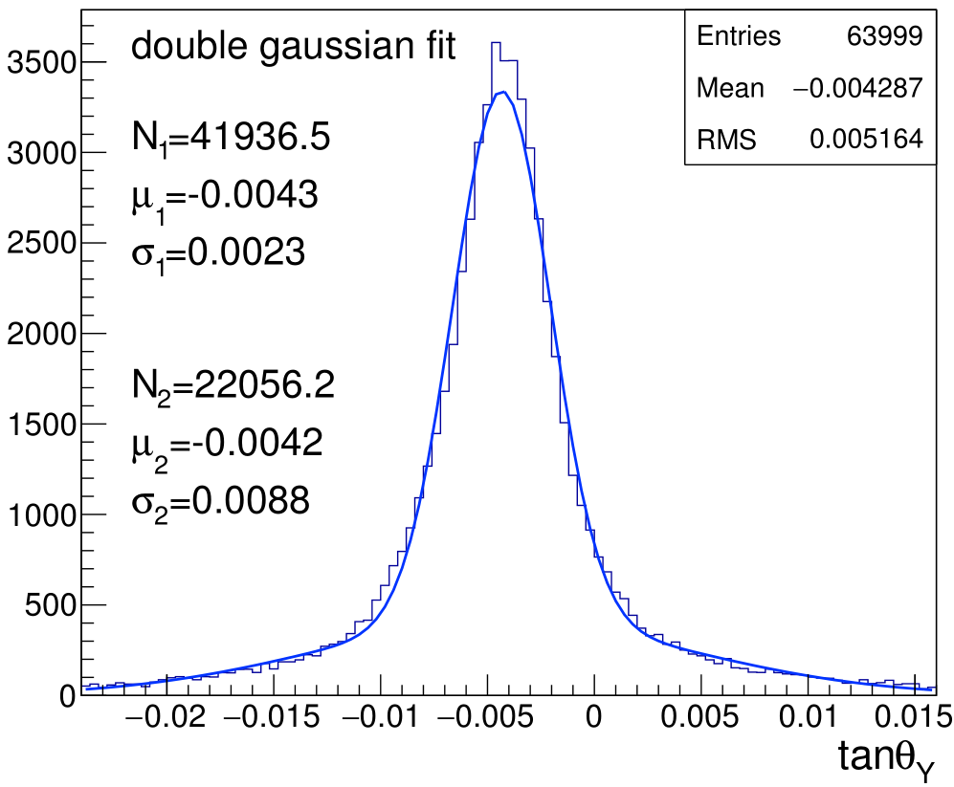
Angular distributions of beam backgrounds
Projection Y and zoomed
particles from ATLAS IP
$σ=2.3 mrad$
$≃$ measurement resolution
marginal multiple Coulomb scattering in 100 m of rock
the particles are very high momentum, P>300 GeV.
particles from the LHC beamline
Projection X
(uncertainty 100%)
Data and the FLUKA prediction agrees within their uncertainties.
beam
detector structure
Emulsion detector can work at the actual environment, at 15 fb⁻¹ of data $≃$ O(10⁵) tracks / cm²
tungsten plates, 0.5 mm
emulsion films, 0.3 mm

Slide 14
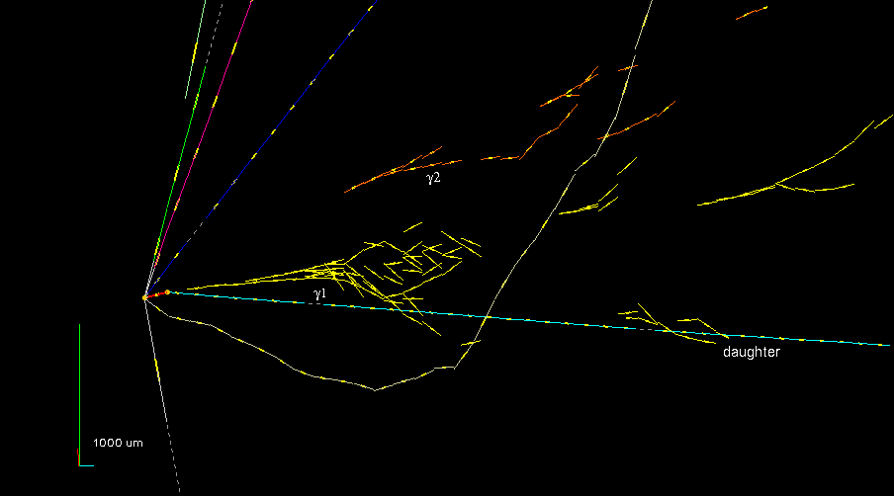
Neutrino detector design
$ν$ detector sensitive to heavy flavor particles
Sensitivity to $ν_{e}, ν_{μ}, ν_{τ} and also$charm and beauty
Kink angle = 41 +- 2 mrad
Decay length = 1335 +- 35 μm
P(daughter) = 12 ⁺⁶ _{– 3} GeV
P_{T}(daughter) = 470 ⁺²³⁰ ₋₁₂₀ MeV
Phi angle = 173 +-2 deg
M_{inv} (γγ) = 120 +-20 +- 35 MeV
M_{inv} (π π⁰ (ρ)) = 640⁺¹²⁵₋₈₀ ⁺¹⁰⁰₋₉₀ MeV
An event from OPERA
τ ◊ ρν_{τ}
ρ ◊ ππ⁰ ◊ πγγ

Slide 15
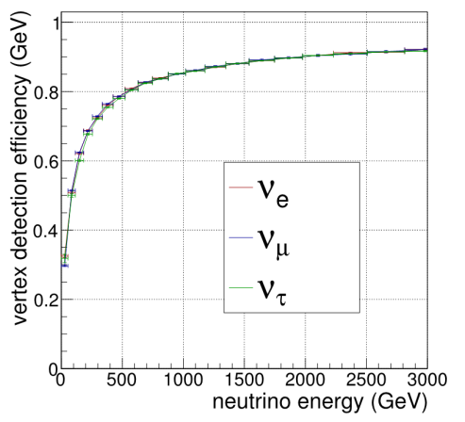
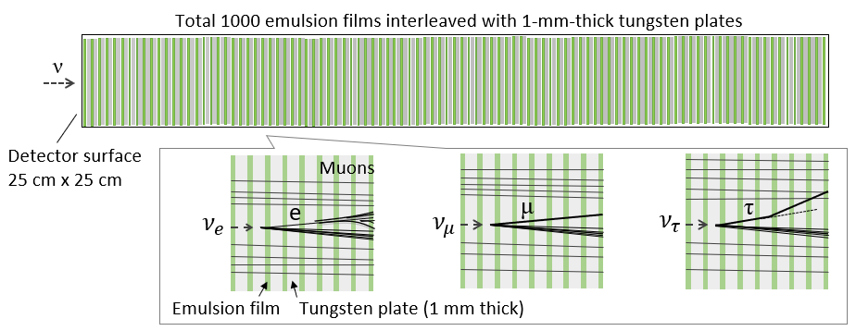
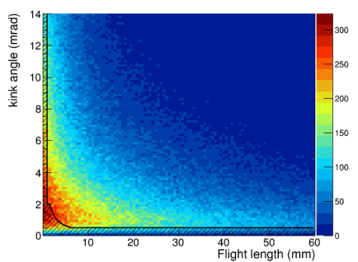
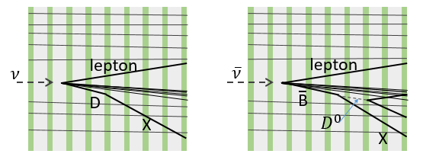
FASER$ν$ detector design
Based on GENIE
Detection efficiency
(charged multiplicity>=5)
Emulsion detector with tungsten target
Decades of experiences as neutrino detector
Replace every 15 fb⁻¹ to maintain track density low
1.2 tons
285 $X_{0}$
10 $λ_{int}$
25 cm x 25 cm x 1.3 m
Tau decay detection efficiency =75% ($τ→1$ prong)
Mean flight length $≃30 mm$
charm
beauty
heavy quark production channels

Slide 16
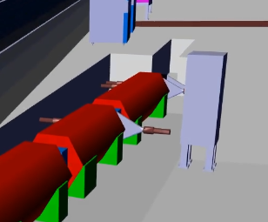
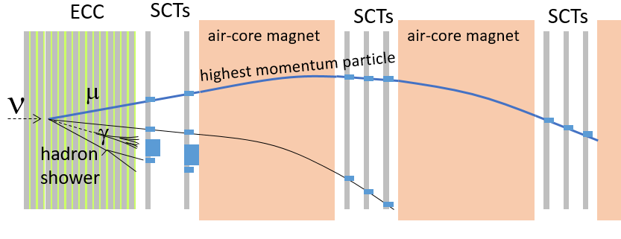
FASER$ν$ detector design
Possible hybrid structure under discussion
combine the FASER spectrometer
Timing, charge and momentum of interaction daughters
tag neutral hadron events due to muon photo-nuclear interactions
The floor at the site will be lowered to place the FASER detector on the line of sight.
A trench for neutrino detector is integrated in the design.
FASER detector
FASER$ν$
ECCs+SCTs
$m_{target}=1.2$ tons
EM calorimeter
Air-core magnetic spectrometer
with silicon strip detectors (SCTs)
scintillators
1 m

Slide 17
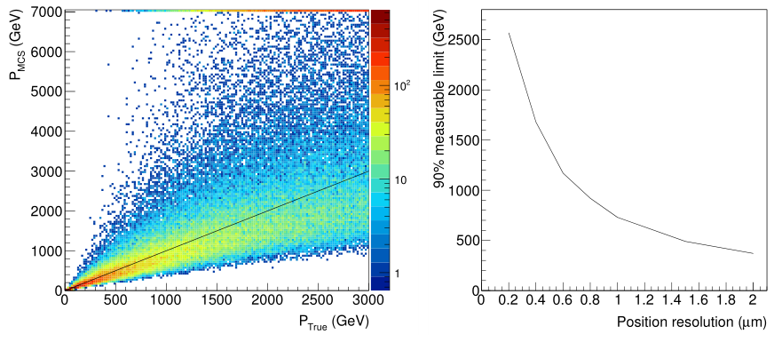
Particle momentum measurement by multiple Coulomb scattering (MCS)
Sub-micron precision alignment thanks to muons.
Our experience = 0.4 $μm$ (in DsTau)
This allow to measure particle momenta by the MCS, even above 1 TeV.
particle trajectory
$$y_{2}$$
$$s$$
$$y_{1}$$
$$y_{0}$$
$$x$$
$$x$$
Performance with position resolution of 0.4 $μm$, in 100 tungsten plates (MC)
Measurable energy vs position resolution

Slide 18
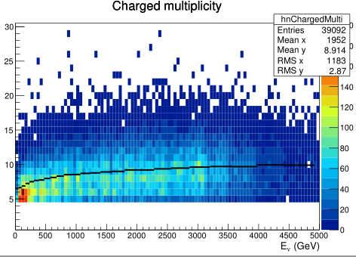
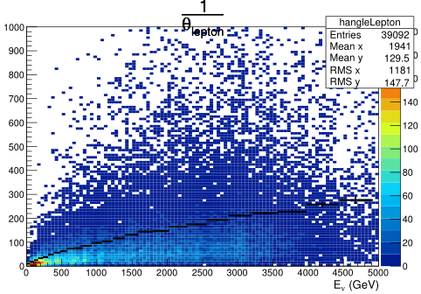
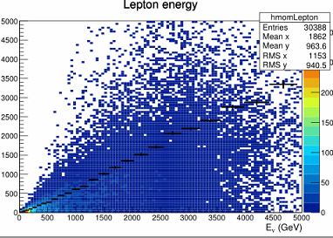
Neutrino energy reconstruction
Based on GENIE
Neutrino energy will be reconstructed by combining topological and kinematical variables
For $ν_{μ}$ CC
An ANN algorithm was build with
Topological info
# of charged particles →$E_{h}$
slopes of charged particles →$E_{h}$
# of $γ$ showers ($≃\# \text{of} π^{0}×2$)→$E_{h}$
lepton angle →$E_{ℓ}$
Kinematical info (smeared)
Sum of energies of $γ$ showers →$E_{h}$
Sum of charged particle energy →$E_{h}$
lepton momentum →$E_{ℓ}$
$$E_{ν}−E_{ANN}$$
$\frac{ΔE}{E}=25\%$(RMS)
# of charged particles
1/(lepton angle)
Lepton energy

Slide 19
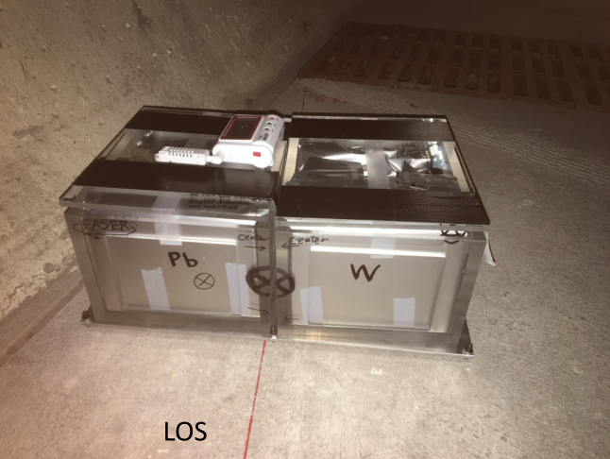
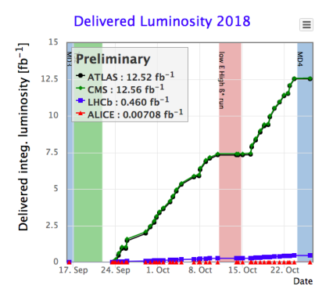
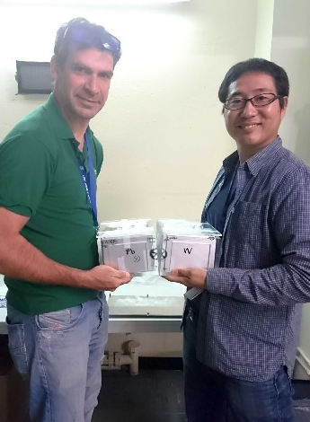
Pilot neutrino detector in 2018
Aiming to report a first detection of neutrinos from colliders
A 30 kg detector was installed in TI18, 12.5 fb⁻¹ of data was collected, → About 30 neutrino interactions in the detector expected to have occurred
15 kg with lead
15 kg with tungsten
line of sight

Slide 20
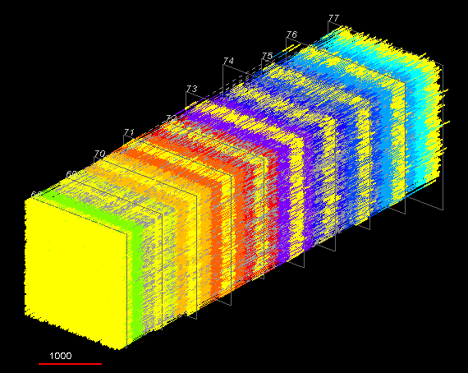
2018 neutrino analysis
30% of emulsion films were digitized. The analysis is currently ongoing.
Vertex search: Tracks emerging from a point were searched for. Several vertex candidates have been found so far.
Reconstructed tracks in a small volume of 2 mm x 2 mm x 10 emulsion films (9 tungsten plates, 0.5 mm thick)
13000 tracks
$≃3×{10}^{5}$ tracks/cm²
mostly muons and associated electrons
Background to neutrino events are carefully being estimated.
Main BG is neutral hadrons due to the photo-nuclear interactions of muons in upstream rock. However, this BG are expected to be lower energy, E<100 GeV.

Slide 21
Other events
Electromagnetic showers
(partial reconstruction, muon angle tracks not shown)
200 $μm$
tungsten is better than lead.
Some charged hadrons are expected from the photo-nuclear interactions of muons in the upstream rock.

Slide 22
Possible goals in Run3
 | # of CC interactions in 1.2 ton detector | Mean interacting energy
$$ν_{e}+{\overline{ν}}_{e}$$ | 1296 | 827 GeV
$$ν_{μ}+{\overline{ν}}_{μ}$$ | 20439 | 631 GeV
$$ν_{τ}+{\overline{ν}}_{τ}$$ | 21 | 965 GeV
Establishment of neutrino studies at collider environment → open a new domain of physics programs in the LHC/FCC
Neutrino cross-sections of three flavors
at currently unexplored energy range
Heavy quark production channels
(charm and beauty)
Many more topics:
Expected yields in Run 3 (2021-2023)
Approach the flavor anomalies by means of neutrinos
$ν$ prod. in 100 PeV proton int. → astrophysics/ intrinsic charm / …
Challenges: Logistics to transport and replace the 1-ton-scale detector every technical stops (3 times/year). We are seeking for funding.

Slide 23
Possible goals in Run3
 | # of CC interactions in 1.2 ton detector | Mean interacting energy
$$ν_{e}+{\overline{ν}}_{e}$$ | 1296 | 827 GeV
$$ν_{μ}+{\overline{ν}}_{μ}$$ | 20439 | 631 GeV
$$ν_{τ}+{\overline{ν}}_{τ}$$ | 21 | 965 GeV
Establishment of neutrino studies at collider environment → open a new domain of physics programs in the LHC/FCC
Neutrino cross-sections of three flavors
at currently unexplored energy range
Heavy quark production channels
(charm and beauty)
Many more topics:
Expected yields in Run 3 (2021-2023)
Approach the flavor anomalies by means of neutrinos
We are preparing a paper describing possible measurements.
$ν$ prod. in 100 PeV proton int. → astrophysics/ intrinsic charm / …
Challenges: Logistics to transport and replace the 1-ton-scale detector every technical stops (3 times/year). We are seeking for funding.

Slide 24
Summary
FASER$ν$: High energy frontier of man-made neutrinos at 1 TeV scale from the LHC.
Unique opportunity to study lepton-quark interactions
Few data is available in the SM regime
BSM effects might appear.
We identified a good location for neutrino programs, a synergy with the FASER dark sector searches and the LHC/ATLAS.
On-axis (high energy), quick, inexpensive
A 1-ton scale neutrino detector in Run 3 (2021-2023) can collect $𝒪$(10⁴) $ν_{μ,}$ $𝒪$(10³) $ν_{e}$ and $𝒪$(10) $ν_{τ}$ interactions
Emulsion neutrino detector would be effective to study different flavors ($ν_{e}$, $ν_{μ}$, $ν_{τ}$, charm and beauty).
An in situ measurement of background proved that emulsion detector can work at the actual environment.
The 30 kg pilot neutrino detector accumulated 12.5 fb⁻¹ of data in 2018. Hoping to report a first detection of man-made TeV neutrinos.
Preparing for the data taking in 2021.

Slide 25
THE FASER COLLABORATION
The FASER Collaboration: 35 collaborators, 16 institutions, 8 countries
Claire Antel (Geneva), Akitaka Ariga (Bern), Tomoko Ariga (Kyushu/Bern), Jamie Boyd (CERN), Dave Casper (UC Irvine), Franck Cadoux (Geneva), Xin Chen (Tsinghua), Andrea Coccaro (Genova), Candan Dozen (Tsinghua), Yannick Favre (Geneva), Jonathan Feng (UC Irvine), Didier Ferrere (Geneva), Iftah Galon (Rutgers), Sergio Gonzalez-Sevilla (Geneva), Shih-Chieh Hsu (Washington), Zhen Hu (Tsinghua), Peppe Iacobucci (Geneva), Roland Jansky (Geneva), Enrique Kajomovitz (Technion), Felix Kling (UC Irvine), Susanne Kuehn (CERN), Lorne Levinson (Weizmann), Josh McFayden (CERN), Friedemann Neuhaus (Mainz), Hidetoshi Otono (Kyushu), Brian Petersen (CERN), Osamu Sato (Nagoya), Matthias Schott (Mainz), Anna Sfyrla (Geneva), Jordan Smolinsky (UC Irvine), Aaron Soffa (UC Irvine), Yosuke Takubo (KEK), Eric Torrence (Oregon), Sebastian Trojanowski (Sheffield), Gang Zhang (Tsinghua)

Slide 26
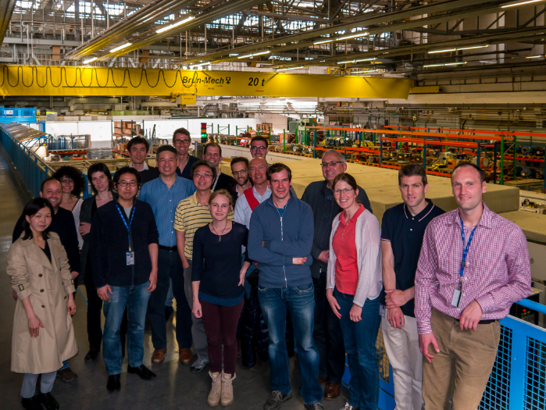
THE FASER COLLABORATION
The FASER Collaboration: 35 collaborators, 16 institutions, 8 countries
Claire Antel (Geneva), Akitaka Ariga (Bern), Tomoko Ariga (Kyushu/Bern), Jamie Boyd (CERN), Dave Casper (UC Irvine), Franck Cadoux (Geneva), Xin Chen (Tsinghua), Andrea Coccaro (Genova), Candan Dozen (Tsinghua), Yannick Favre (Geneva), Jonathan Feng (UC Irvine), Didier Ferrere (Geneva), Iftah Galon (Rutgers), Sergio Gonzalez-Sevilla (Geneva), Shih-Chieh Hsu (Washington), Zhen Hu (Tsinghua), Peppe Iacobucci (Geneva), Roland Jansky (Geneva), Enrique Kajomovitz (Technion), Felix Kling (UC Irvine), Susanne Kuehn (CERN), Lorne Levinson (Weizmann), Josh McFayden (CERN), Friedemann Neuhaus (Mainz), Hidetoshi Otono (Kyushu), Brian Petersen (CERN), Osamu Sato (Nagoya), Matthias Schott (Mainz), Anna Sfyrla (Geneva), Jordan Smolinsky (UC Irvine), Aaron Soffa (UC Irvine), Yosuke Takubo (KEK), Eric Torrence (Oregon), Sebastian Trojanowski (Sheffield), Gang Zhang (Tsinghua)
Part of the Collaboration at the first CM in Jan 2019

Slide 27
Backup

Slide 28
Topology of beauty channels
ν_{τ}
τ⁻
ν_{τ}
u
τ⁺
b
Sea cc quarks
c
b
c
Topology in detector
τ
τ
X
τ
X
B
B
D
X
D
X
D
X
$$σ_{τ}^{rel}\left(B\right)=\frac{σ\left({\overline{ν}}_{τ}N→τB\right)}{σ\left({\overline{ν}}_{τ}N→τX\right)}$$
$$σ_{τ}^{rel}\left(BD\right)=\frac{σ\left(ν_{τ}N→τBD\right)}{σ\left(ν_{τ}N→τX\right)}$$
$$R\left(B\right)=\frac{σ_{τ}^{rel}\left(B\right)}{σ_{μ}^{rel}\left(B\right)}$$
$$R\left(BD\right)=\frac{σ_{τ}^{rel}\left(BD\right)}{σ_{μ}^{rel}\left(BD\right)}$$
Notes:
SM : V_{ub} gg S_{Helicity} = Vub gg 1/3
H⁻: m_{τ} m_{b} = 0.14 Vub gg
|SM|² : |SM+H|² = 1.1 : 1.9

Slide 29
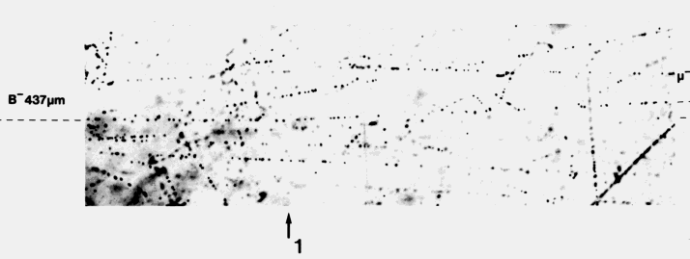
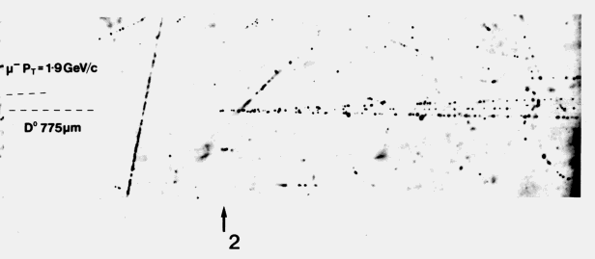
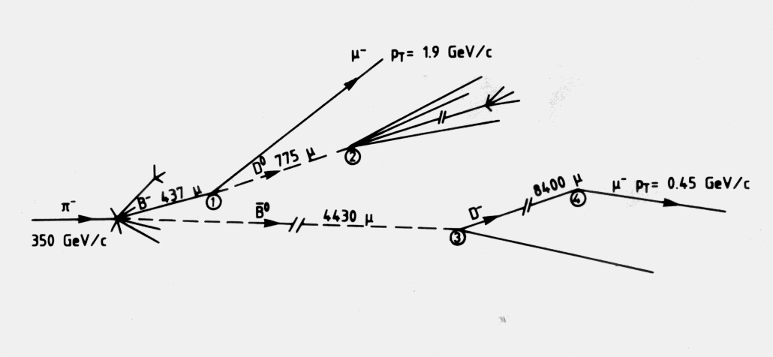
CERN WA75
Direct Observation of the Decay of Beauty particles into charm particles
Phys. Lett. B158, 186, 1985

Slide 30
DARK PHOTONS
Dark matter is our most solid evidence for new particles. In recent years, the idea of dark matter has been generalized to dark sectors
Dark sectors motivate light, weakly coupled particles (WIMPless miracle, SIMP miracle, small-scale structure, ..)
A prominent example: vector portal, leading to dark photons
The resulting theory contains a new gauge boson A’ with mass m_{A’} and εQ_{f} couplings to SM fermions f
SM
Hidden
U(1)

Slide 31
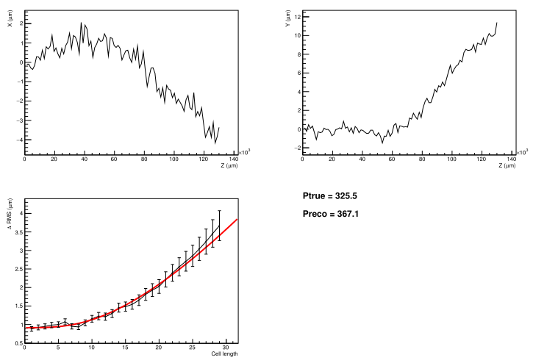
Example of MCS and fit
track in 100 layers of tungsten x 1 mm
Trajectory in Y
Trajectory in X
smeared with position resolution
RMS of scattering as a function of cell length
Fitting result
$$F\left(P,δ\right)=\sqrt{{\left(\frac{0.0136}{P}\sqrt{\frac{2}{3}}x\sqrt{\frac{x}{X_{0}}}\right)}^{2}+δ^{2}}$$
position resolution = 0.4 $μm$

Slide 32
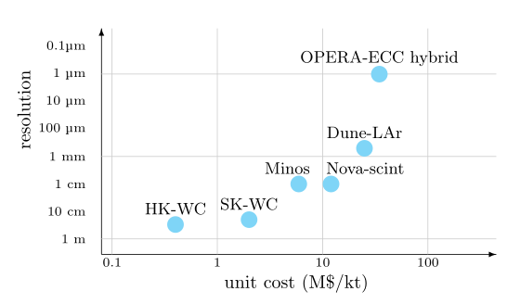
Detector cost comparison
Unit detector cost (M$/kt) is roughly estimated.
Emulsion-hybrid is not much expensive than LAr
Technology |  | Resolution | Unit cost
Emulsion hybrid | 45 M$ / 1.3 kt (OPERA) | 1 μm | 35 M$/kt
Water Cherenkov | 400 M$ / 1000 kt (Hyper-K) | 30 cm | 0.4 M$/kt
LAr | 500 M$ / 20 kt (Dune) | 0.5 mm | 25 M$/kt
ν_{τ} id by topology detection

