Slide 1
L0TP studies
Clock and distribution Scheme
Busy handling
Timing in PADME
Tests and measurements

Slide 2
Clock distribution scheme
In the present scheme the readout system is logically divided into left and right sides
Each crate contains all the V1742 of Ecal+veto of the Left or Right side
The time pix based Beam Monitor has a dedicated electronics
The clock is transmitted by the master to each crate
The clock is distributed in daisy chains to all boards delay are compensated inside the boards
Crate
Boards
SIDE LF
Master clock
Clock
Crate
SIDE R
Monitor

Slide 3
Trigger fan-out
The trigger fan-out is an essential piece of the architecture.
Its timing IS CRITCAL.
Differently from previously adopted architecture it is necessary here to measure the trigger timing.
SIDE LF
Trigger supervisor
To left side
Front end boards
V1742
To right side
SIDE R

Slide 4
Busy handling
The BUSY signal is crucial to maintain inter-board trigger coherence.
Luckily its timing it is not critical.
The BUSY signal will be delivered by the Front-End boards to the trigger supervisor. It will perform a logic or of the BUSY source and assert a veto if such a signal if present.
Busy 1
VETO
To the trigger decision matrix
Busy n

Slide 5
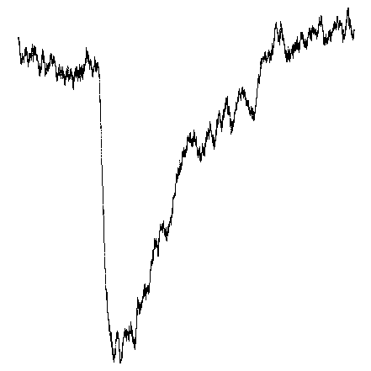
Timing with PADME (a premise)
A very good precision in timing is requested by the PADME experiment (about 100 ps).
We are planning to achieve this precision exploiting flash adc V1742 by CAEN.
This flash adcs are triggered by a logic clocked at 125 MHz. Therefore the use of this information would degrade by order of magnitudes the timing precision (we would achieve a precision of the order of 8 ns).
The idea is to sample the trigger signal asserted by the logic with a flash adc and perform a timing measurement by subtracting this signal to the signal of the “Physics”.
Time
Physics
A standard solution is: a very good CF discriminator + a TDC.
We use a flash adc so that we measure both the time of the «trigger» with
respect to a starting signal (the trigger itself) and the time of the Physics
and we subtract. The Physics signal is quite slow (tipical falling edge time
of the order of 10 ns, while the trigger falling edge signal can be made
As sharp as we want. BUT…………

Slide 6
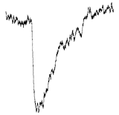
Timing with PADME 1
The input stage of the flash adc we use is bandwjdth limited to 500 MHz moreover we need to sample the trigger signal. Therefore we plan to change the trigger signal shape in such a way that sampling can occur and deliver at least 5 samples.
Time
Physics
ΔV
T0
This helps in measuring the trigger time, but still the sampling frequency in
unknown. We can assume that to be at 1 GHz since the BGO scintillating
Time is about 350 ns and a few lifetimes are needed to measure the
energy deposit and the time window of the V1742 is about 1 μs.

Slide 7
Timing with PADME 2
The trigger signal has to be delivered by a fan-out at the front-end level that allows to measure it in a very precise way in order to reach the desired accurancy.
But still we need to have a very high stability of the fan-out system. The T0 MUST not jitter (more than the 100 ps) among the 64 channels.
Further more the ratio ΔV/σ(noise) must be very high so that the measurement is accurate. This can be guaranted for a logic signal (ΔV about 1 Volt σ(noise) 5 mV) It cannot be guaranted for a detector signal.
The described strategy for timing measurements is different from the classic one this means we’ll have to perform many tests….I’ve described some of them later on…

Slide 8
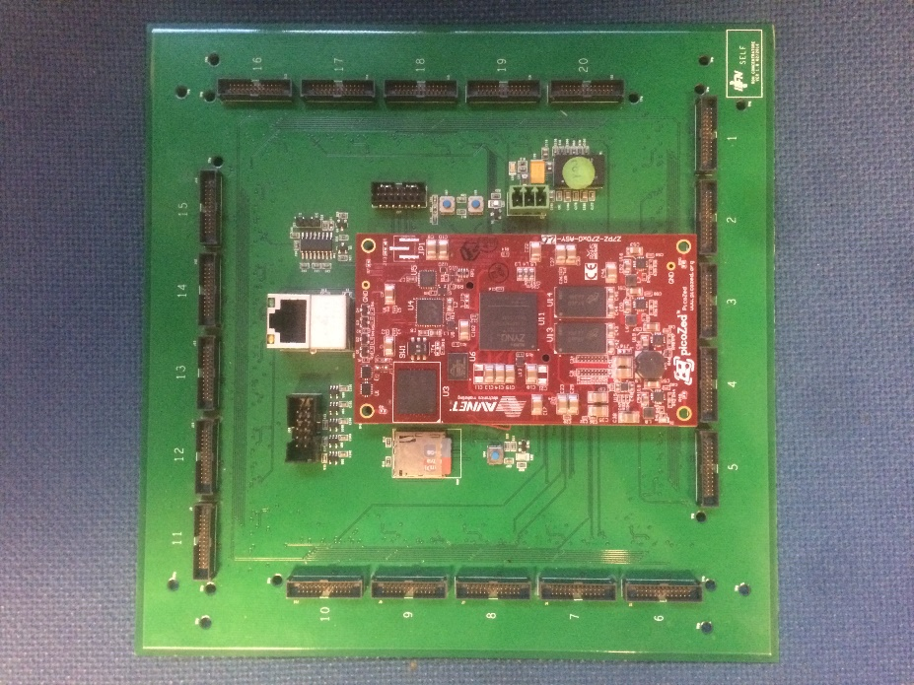
trigger logic implementation
FPGAs are perfectly fit to implement the trigger logic.
Logic part + Clock distribution source in the FPGA and analog splitting to produce the 64 synchronous trigger signals in a mezzanine seems viable.
We’ll use the latest FPGA Xilinx family to implement it (Zinq 7).
The idea is to make use of a board already developed and program it for our purposes.
This board has been developped
by the LNF electronic workshop for
another experiment we can make
a good use of it.

Slide 9
Laboratory tests (E. Leonardi, P. Branchini)
V1742 brief description (from HW point of view).
clock distribution strategy description.
Distributed signal characteristic.
Description of the algorithm we used to measure time.
Results

Slide 10
V1742 brief description (what we need to know)
The V1742 hosts two different mezz cards
Each mezz card hosts 2 DSR4 (domino chip) and an input trigger signal which can be digitized with the same sampling frequency of the DSR4 channells.
Each DSR4 hosts 8 different channells.
The Trigger signal is in common.
It can be programmed to receive an external clock. A PLL performs jiitter cleaning operations on the received clock and delivers it to the domino chip. This signal is essential to synchronize the different boards.
The V1742 can output a busy signal. This is relevant if we want to collect data asynchronously.

Slide 11
Clock distribution
We have changed the firmware of the V1742. What we have done is fully compliant with the experiment.
Board 1 exploits its internal crystal (50 MHz) to generate a 58.436 MHz Clock which is distributed to the following board. (Therefore its firmware has been changed in order to distribute the clock).
Caen on our requested checked that 10 MHz as input of the first board works as good as a 50 MHz one.
Board 2 receives the clock from board 1 cleans it using its PLL and distributes it to the mezz cards. It also delivers its clock in output. Therefore even its firmware had to be changed.
In the experiment we can apply this strategy to the full setup. If we need to synchronize the Calorimeter with other detectors we could use an external common trigger (Rubidium atomic clock) to deliver three 10 MHz clock lines.

Slide 12
Distributed signal features
We performed several tests, I’ll summarize here the most relevant ones:
ΔV
5 ns or 10 ns fall time
3 Volt swing.
We have used a (1 to 4) passive splitter.

Slide 13
Collected data samples
We have collected different data samples sampling at 1 GHz 2.5 GHz and 5 GHz:
a) signal delivered to two different channels of the same mezzanine.
b) Signal delivered to two mezzanine of the same board.
c) Signal delivered to two different boards.

Slide 14
Algorithm used
We have implemented a full digital algo.
The collected waveform is time shifted by a time which is less than the fall time of the
signal a fraction (0.35) is then subtracted to the original one.
The zero crossing is what we call the time of this signal. This algo is not sensitive to the
slope of the signal (in first approximation).
Upsampling has been implemented with a factor varying from 2 to 16.
What we quote as signal jiitter is the RMS of the time distribution of the time
difference of the two signal.

Slide 15
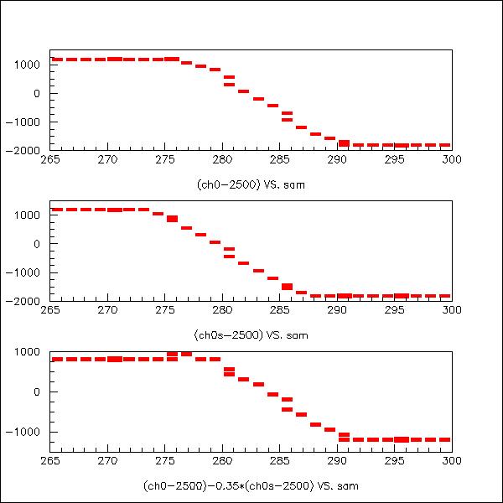
Just a quick look at the waveform
Original waveform (1GHz sampling)
Original waveform 3 ns shifted
Zero crossing
Original waveform -0.35*(shifted one)
Wave time

Slide 16
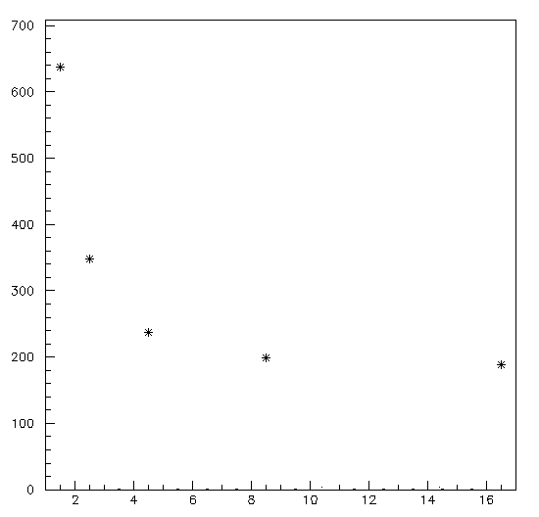
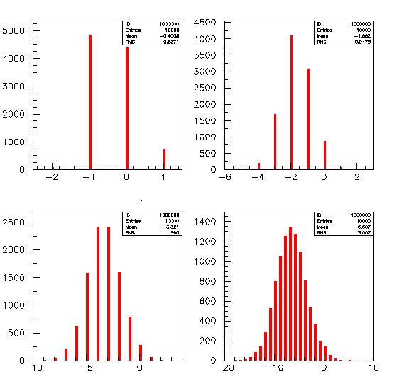
Just a quick look at the distributions
RMS (ps)
4 GHz
1GHz
These distributions are the difference
among two different channels of different
Boards. Each channel has been corrected
for its own trigger time as explained.
What I call 1 GHz is the distribution we get on
raw waveform we always quote the RMS.
4, 8, 16 GHz distribution have been obtained
using the described algo on the «upsampled»
distribution obtained from raw data.
The 16 GHZ show an «asymptotic» resolution
(RMS=3.007) of 188 ps. From here on we’ll only
show the «asynptotic» value for the resolution.
8 GHz
GHz
16 GHz

Slide 17
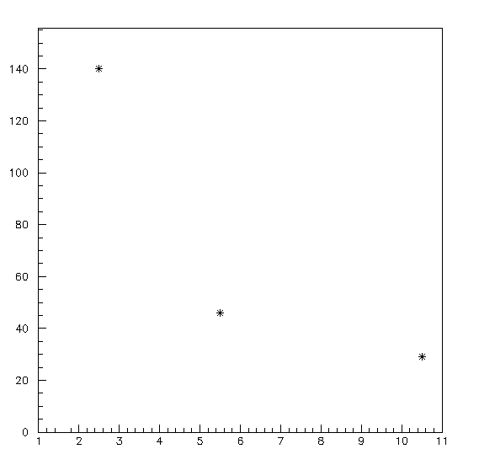
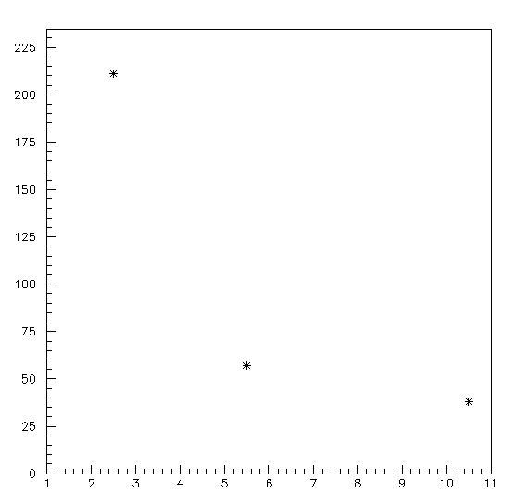
First set signal from T.U. passive splitter for channels
1 GHz
RMS(ps)
1 GHz
RMS(ps)
The two channels are on
the same mezz card
The two channels are on
Different mezz cards
2.5 GHz
5 GHz
2.5 GHz
5 GHz
A.U.
A.U.

Slide 18
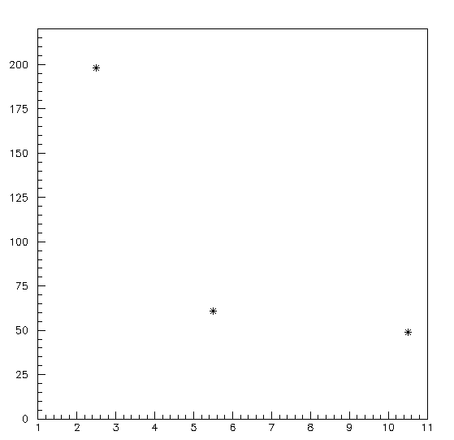
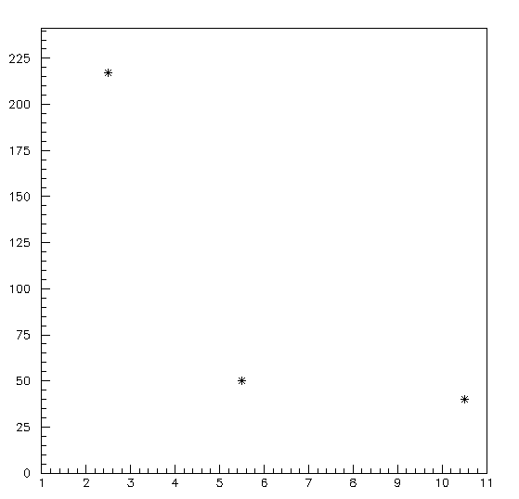
Signal from waveform generator + passive splitter for both trigger and «physics» 100 Hz
RMS(ps)
RMS(ps)
1 GHz
10 ns fall time signal
5 ns fall time signal
2.5 GHz
5 GHz
A.U.
A.U.
3 Volt swing signal

Slide 19
What if we sample 2 boards with different rates?
We used 10 ns fall time signal and a swing of 3 Volt.
b1(ch0)-b2(ch2)
1GHz +1GHz 188 ps
2.5GHz+1GHz 141 ps
5GHz +1GHz 142 ps
2.5GHz +2.5GHz 66 ps
5GHz +2.5GHz 64 ps
5GHz +5GHz 65 ps

Slide 20
Conclusions
An algorithm has been implemented to measure time from waveform.
This algorithm is a fully digital algorithm.
It has been tested on digital signal to clarify fan-out trigger distribution precision
needs.
With this respect results are encouraging but please notice:
All these results are true with high voltage swing signal (from 0.3 to 0.8 Volts) and
A very low noise level (2-4 mV).
Therefore any conclusion concerning detector signal should be made using
The output signal from the detector. Why? What can go wrong?
The noise could be higher and we could need the timing for a signal with a much lower
Voltage swing of 0.3 V.

