Slide 1

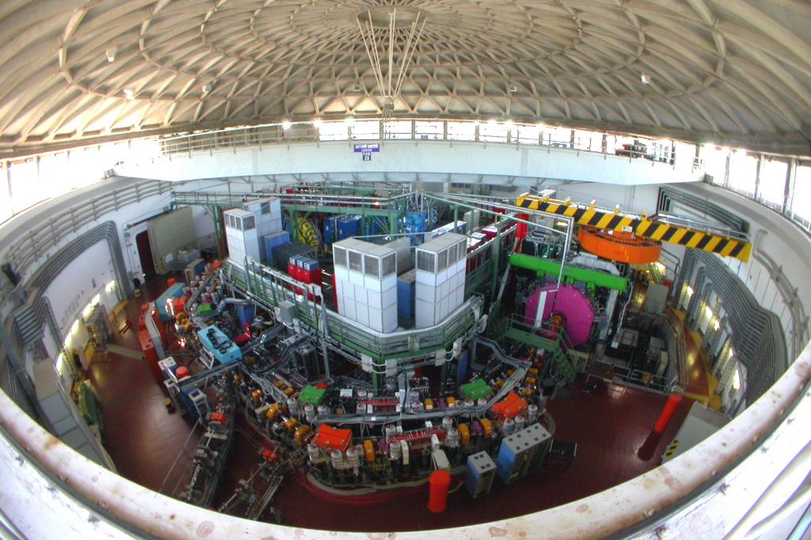
Investigating low energy strangeness QCD through kaon nucleon interactions by the SIDDHARTA & AMADEUS collaborations
Alessandro Scordo
TNPI 2017, 04-10-2017 Cortona (Italy)

Slide 2
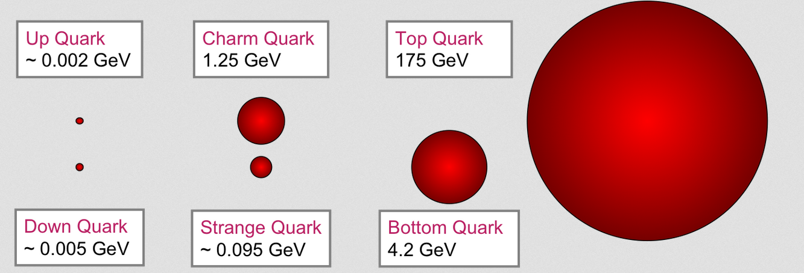

KN interaction at low energy
Strange quark mass is still, together with the u,d quark masses, lower than the Λ_{QCD} parameter (≈ 217 MeV)
How strong is the strange quark interaction with ‘standard’ matter?
Is there any place for strange matter?
Kaons are the lowest mass strange particles and their interaction with protons and neutrons at very low energy is fundamental to be investigated
SIDDHARTA
Atomic interaction
Kaonic atoms
Kp/Kd scattering length
KN potential
AMADEUS
Nuclear interaction
Single/multi nucleon absorption & KNN(N) bound states
Resonant and non resonant interaction products
YN interaction, Λ(1405) puzzle

Slide 3
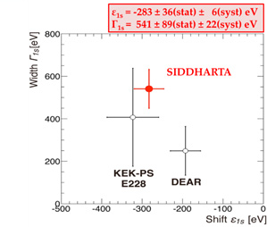
KN interaction at low energy
K⁻ - nucleus potential is attractive
Predicted by theory
Confirmed by kaonic atoms
D. Cabrera, et al., PRC90 (2014) 055207
M. Bazzi et al.. 2011. (SIDDHARTA Coll.), Phys. Lett. B704, 113
Possible influence in nature of neutron stars?

Slide 4
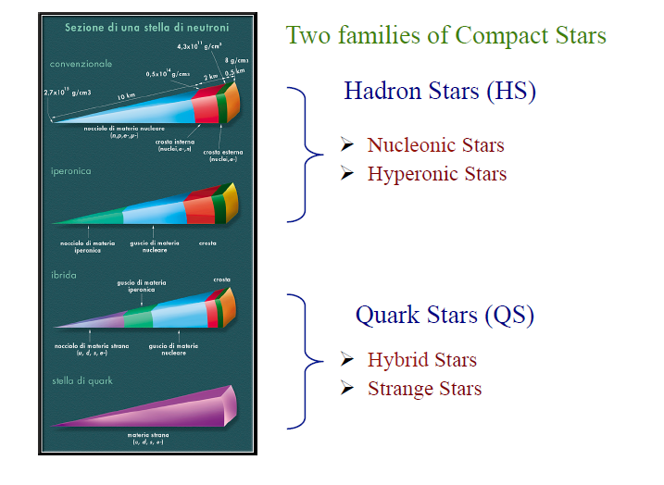
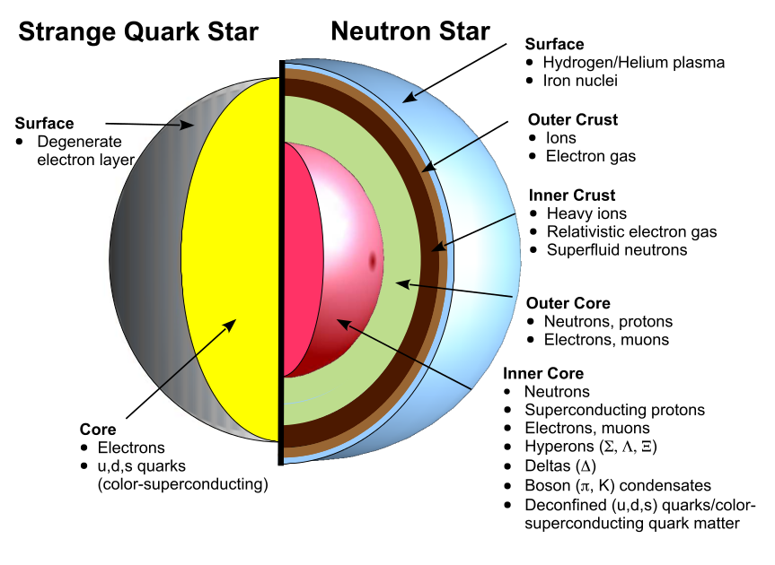
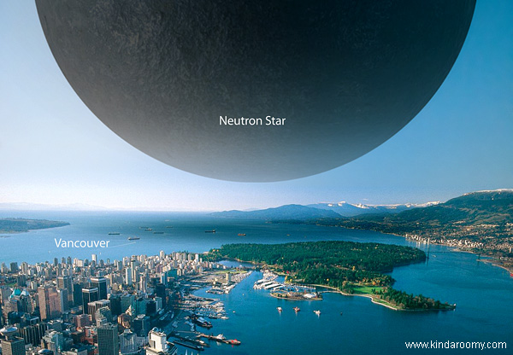
Strangeness in the stars
Evidences?
Experimental constraints?

Slide 5
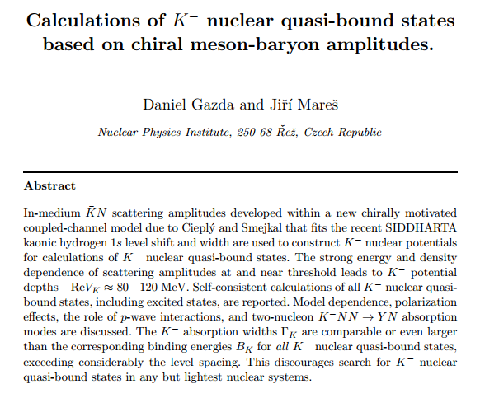
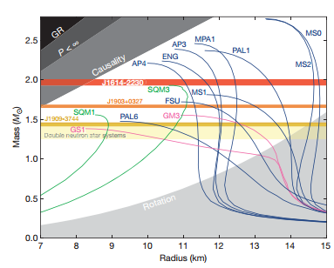
KN interactions
Recent measurements constrain the neutron star EOS to be stiff
“most EOS curves involving exotic matter, such as kaon condensates or hyperons, tend to predict maximum masses well below 2.0M₀ and are therefore ruled out. Including the effect of neutron star rotation increases the maximum possible mass for each EOS. For a 3.15-ms spin period, this is a =2% correction and does not significantly alter our conclusions”
P.B. Demorest et al, Nature 467 (2010) 1081-1083
Gazda D., Mares J., Nucl.Phys. A881 (2012)
More experimental data are needed (KN(s) interactions, bound states,…)

Slide 6
KN(s) physics @ LNF
The SIDDHARTA & SIDDHARTA-2 experiments
  Kaonic helium
  Kaonic hydrogen
  Kaonic deuterium
The AMADEUS data analysis
  Kaonic bound states
  Kaon single and multi nucleon absorption (Σ⁰p, Λp, Λt)
  Λ(1405) shape (Σ⁰π⁰, Σ⁺π⁻,Σ⁻π⁺)
  Resonant and non resonant formation (Λπ⁻)
  YM cross sections (Σ⁰π⁰,Λπ⁰)
What do they have in common???

Slide 7
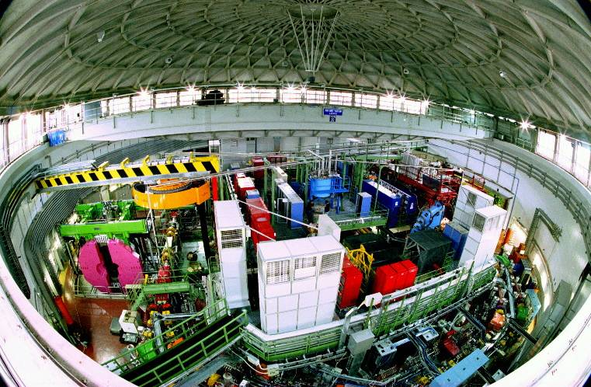
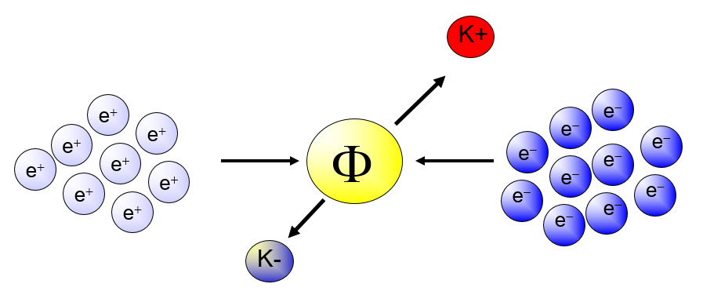
DAΦNE @ LNF
e⁺ e⁻ at 510 MeV
resonance decays at 49.2 % in K⁺ K⁻ back to back pair
Very low momentum (≈ 127 MeV) K⁻ beam
Flux of produced kaons: about 1000/second
Best low momentum K⁻ factory in the world

Slide 8
Exotic atoms physics:
SIDDHARTA
&
SIDDHARTA-2

Slide 9
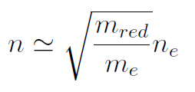
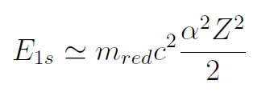
Kaonic atoms physics
e⁻
highly-excited state
Auger Electron
K⁻
1) Initial capture
deexcite
K⁻
X-ray
2) Cascade
K⁻
N
3) Strong interaction
Broader transition line due to strong interaction
4) Absorption
stopped in a target medium
Shift and Width
of last orbit
e.g.
1s for K-p, K-d
2p for K-He

Slide 10
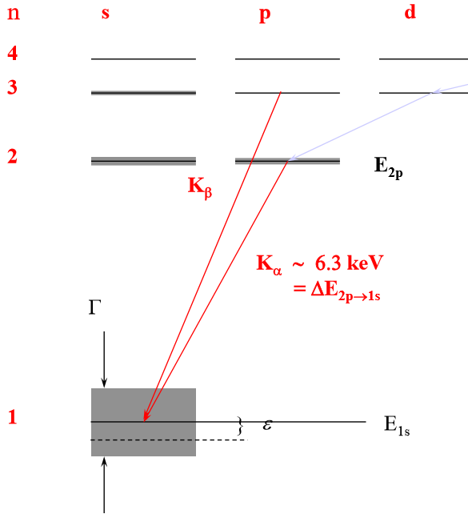
Exotic atoms physics
Energy shift ε and line width Γ of 1s state are related to real and imaginary part of the S-wave scattering length (Deser-Trueman formula) :
Scattering lengths can be expressed in terms of antiK-N isospin dependent scattering lengths:
Strong interaction causes a shifting of the energy of the lowest atomic level from its purely electromagnetic value
Absorption reduces the lifetime of the state, so Xray transitions to this final atomic level are broadened.

Slide 11
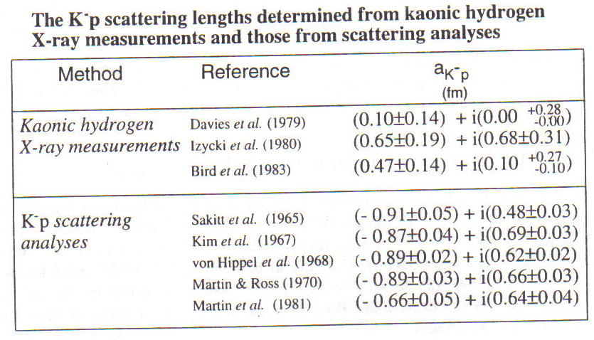
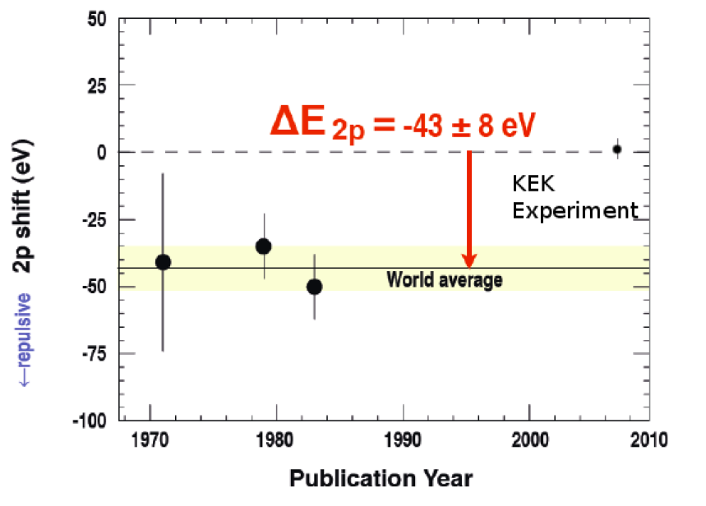
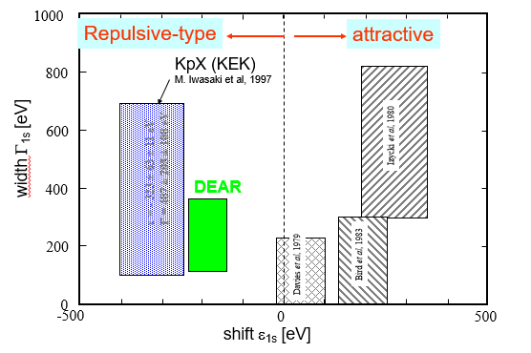
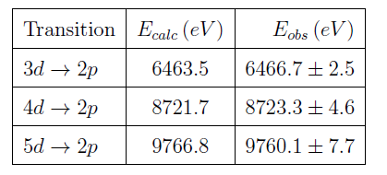
Kaonic atoms puzzles
Both puzzles have been finally solved by the SIDDHARTA experiment

Slide 12
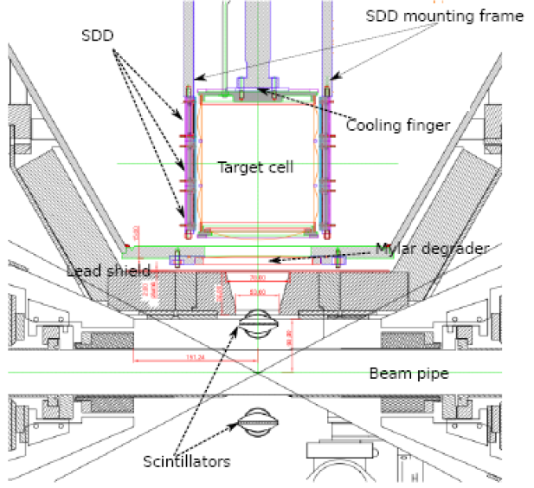
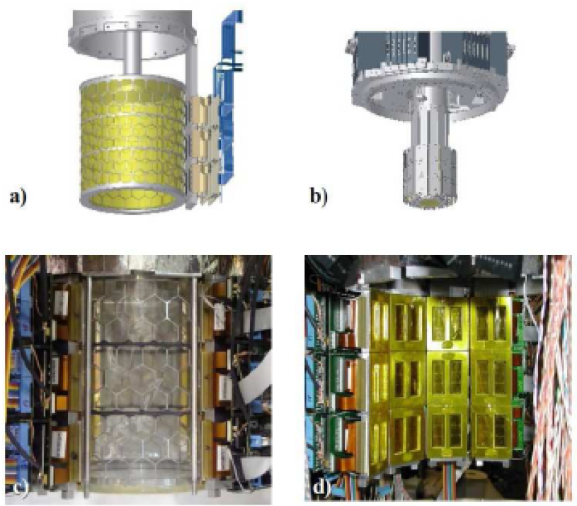
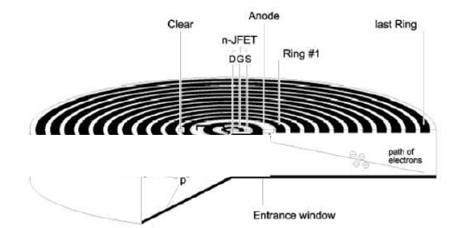
The SIDDHARTA setup
Gaseous target
T = 18 K
P = 1.2 bar
K⁻
Silicon Drift Detectors
e⁻
Φ
e⁺
K⁺
Very fast and triggerable
Used for the first time as energy detectors

Slide 13
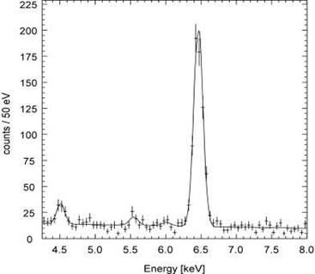
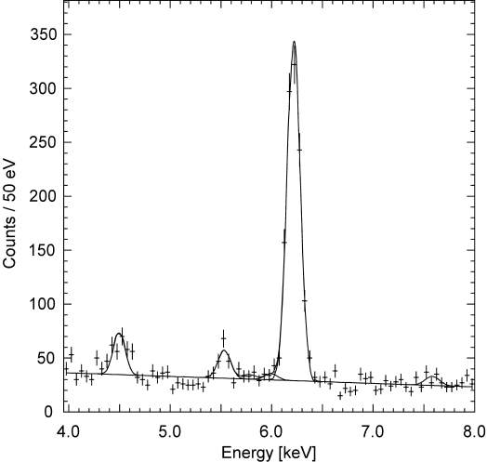
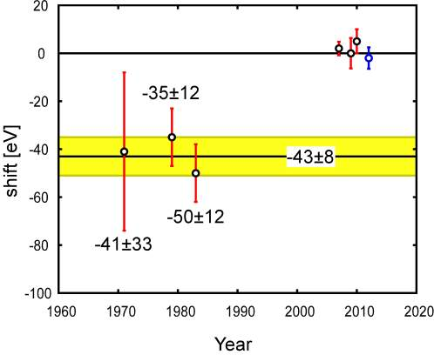
K-4He & K-3He results
K-4He (3d-2p)
K-3He (3d-2p)
 | Shift [eV] | Reference
KEK E570 | +2±2±2 | PLB653(07)387
SIDDHARTA (He4 with 55Fe) | +0±6±2 | PLB681(2009)310
SIDDHARTA (He4) | +5±3±4 | arXiv:1010.4631, PLB697(2011)199
SIDDHARTA (He3) | -2±2±4
First measurement with a gaseous target both on ³He and ⁴He

Slide 14
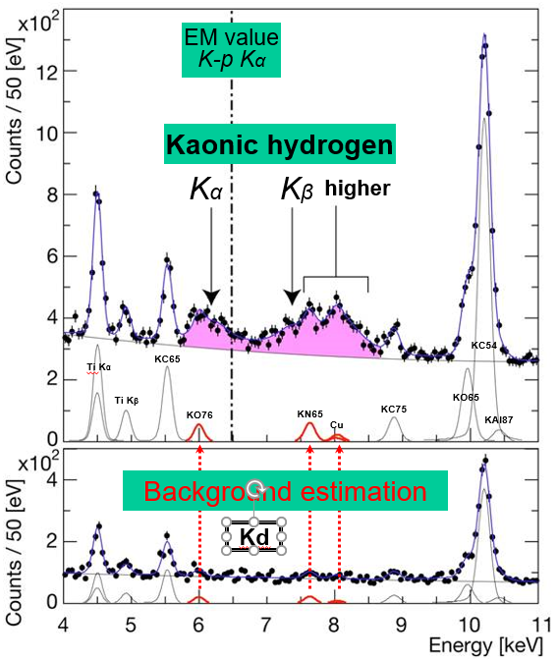
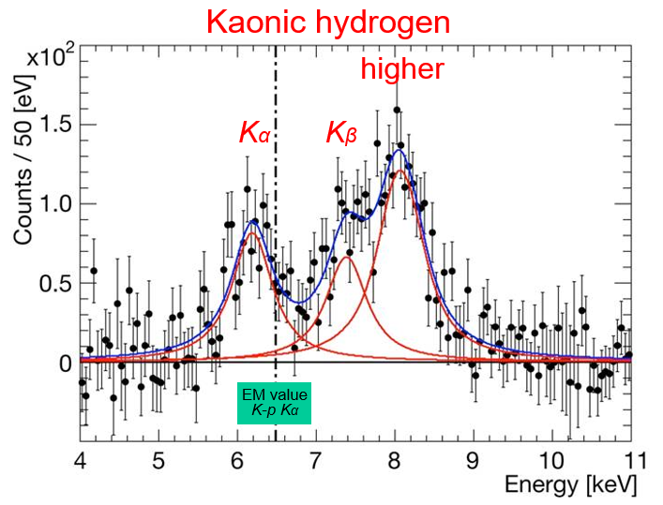
KH & Kd results
Residuals of K-p x-ray spectrum after subtraction of fitted background
ε_{1S}= −283 ± 36(stat) ± 6(syst) eV
Γ_{1S}= 541 ± 89(stat) ± 22(syst) eV
Only exploratory measurement for Kd, no measured ε,Γ values obtained
M. Bazzi et al.. 2011. (SIDDHARTA Coll.), Phys. Lett. B704, 113

Slide 15
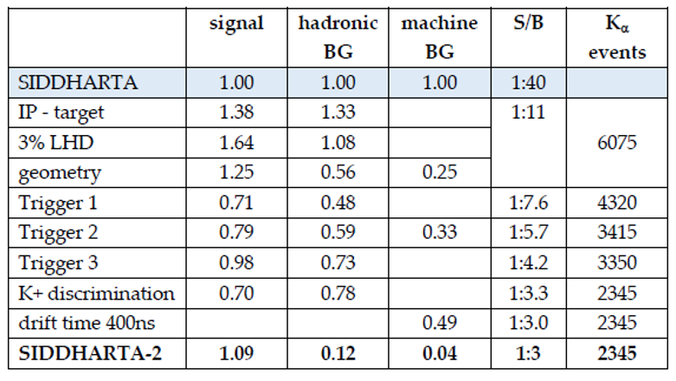
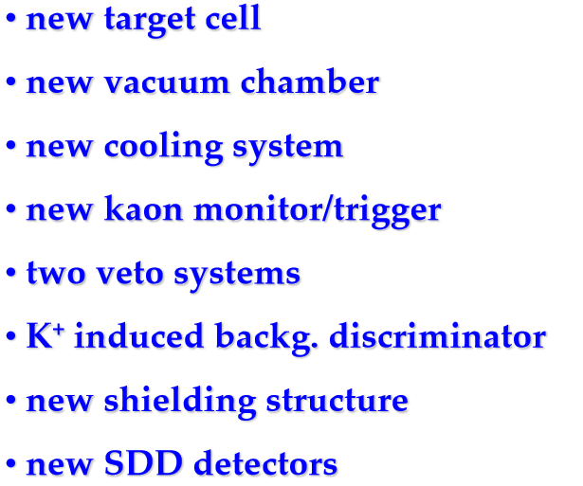
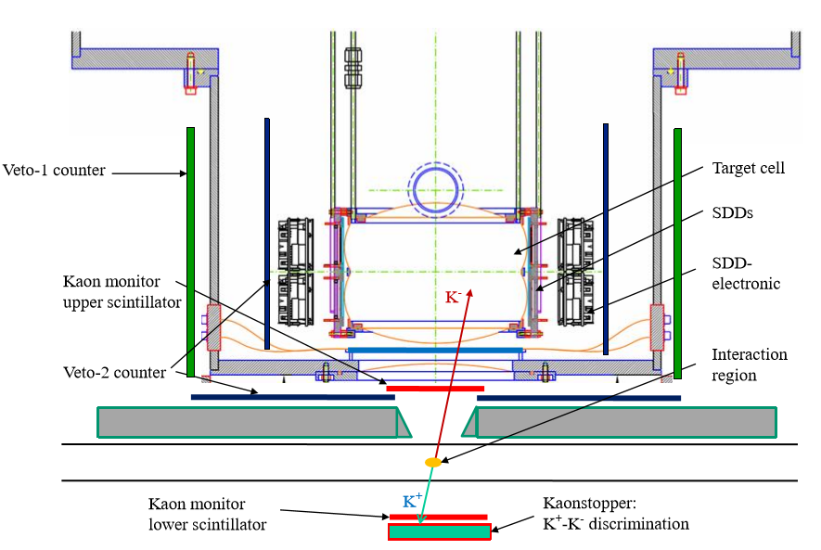
From SIDDHARTA to SIDDHARTA-2
With the new S/B, Kd measurement will be possible
(Y_{KH} / Y_{Kd} ≈ 10)

Slide 16
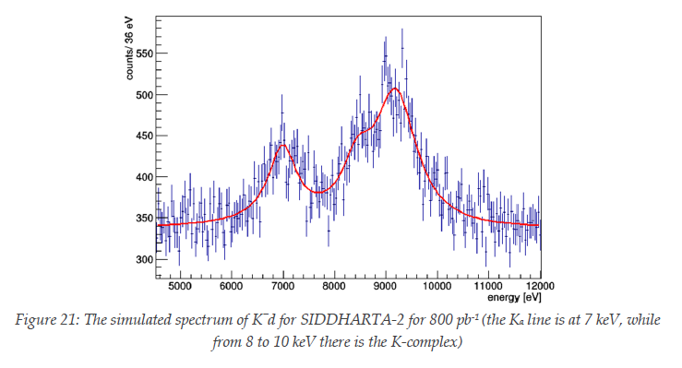
Expected Kd spectrum
Assumptions
signal: shift - 800 eV
width 750 eV
density: 5% (LHD)
detector area: 246 cm²
Kα yield: 0.1 %
yield ratio as in K⁻p
Achievable precisions:
Δε(1s) = 30 eV and ΔΓ(1s) = 70 eV

Slide 17
Conclusions (1)
Kaons are the lowest mass strange particles and their interaction with protons and neutrons at very low energy is fundamental to be investigated
Kaonic atoms, in particular KH & Kd, represent a unique tool to investigate the KN low energy interaction,
The SIDDHARTA experiment, with its data taking campaign in 2009, delivered fundamental results based on the KH, K⁴He and K³He shift and width measurements
The SIDDHARTA-2 experiment, in 2019, aims to deliver the first measurement ever of the Kd 1s level shift and width
SIDDHARTA-2 future program and perspectives involve also:
Other light kaonic atoms (K⁻O, K⁻C,…)
Heavier kaonic atoms (K⁻Si, K⁻Pb…)
Kaonic helium transitions to the 1s level
Kaon mass - precision measurement at a level < 7 keV
Radiative kaon capture – Λ(1405) study
Possible measurement of other types of hadronic exotic atoms (sigmonic hydrogen ?)

Slide 18
Kaon Nucleon interaction:
AMADEUS

Slide 19
Experimental program of AMADEUS
AMADEUS aims to perform high precision studies of the low-energy K⁻ interactions in solid and gaseous targets (H, ¹²C, ⁴He, ⁹Be) in order to obtain unique quality information about:
Interaction of K- with one or more nucleons
Possible existence of kaonic nuclear clusters
Nature of the controversial Λ(1405) resonance
Low-energy K⁻p cross sections for p < 100 MeV/c (still missing)
Many other processes of interest in the low-energy QCD in the strangeness sector

Slide 20
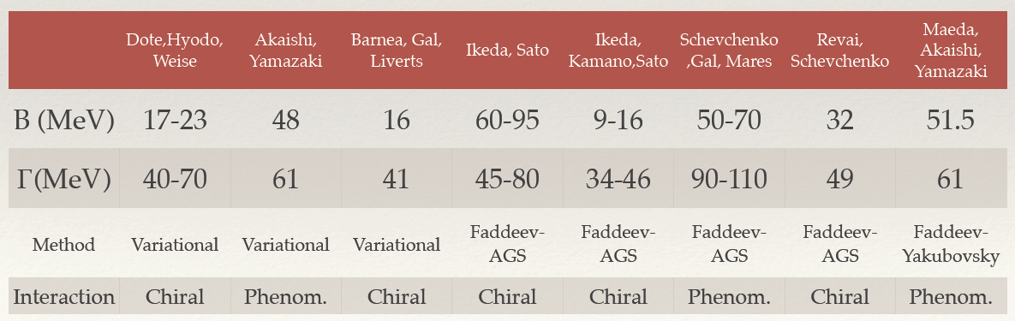
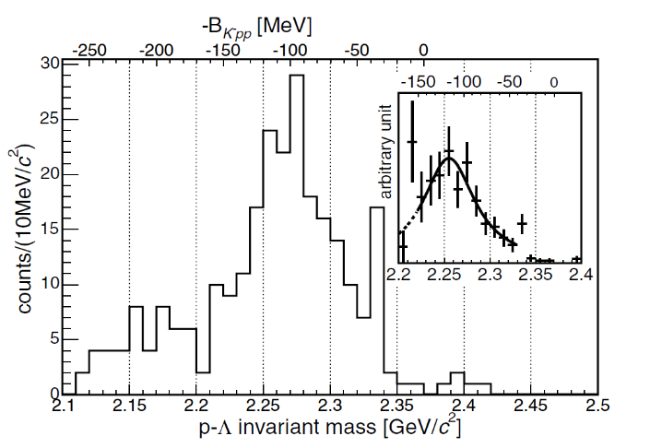
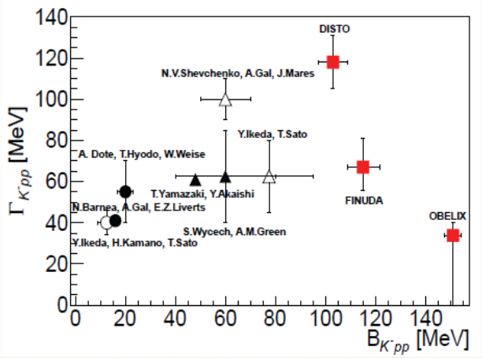
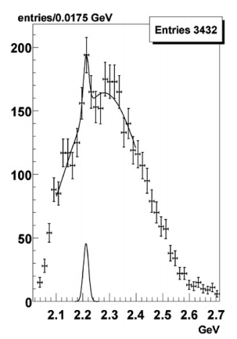
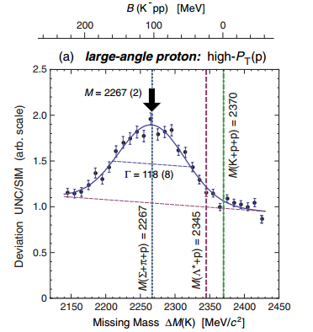
K⁻pp bound state
Theoretical predictions
First evidence of K⁻pp with ⁶Li+⁷Li+¹²C by FINUDA
measured
acc. corr
B=115+6/-5+3/-4 MeV
Γ= 67+14/-11+2/-3 MeV
M. Agnello et al.,
PRL94, (2005) 212303
Prof. Nagae, HYP2015, Sep. 10, 2015
OBELIX: anti(p)+⁴He -> K⁻pp (pΛ)
DISTO data: p+p->K⁻pp (pΛ)+ K+ at 2.85 GeV
B=160.9 ± 4.9 MeV
Γ < 24.4 ± 8.0 MeV
B=103±3±5 MeV
Γ= 118±8±10 MeV
G. Bendiscioli et al,
Nuclear Physics A 789 (2007) 222–242
T. Yamazaki et al.,
PRL 104 (2010) 132502

Slide 21
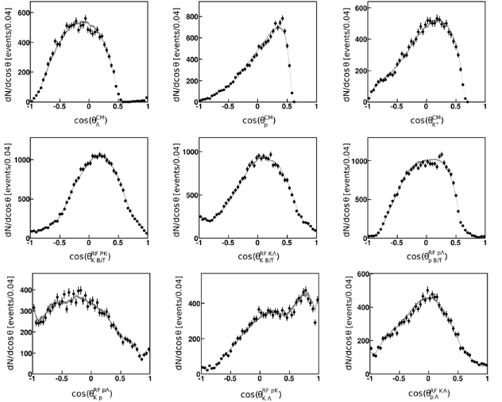
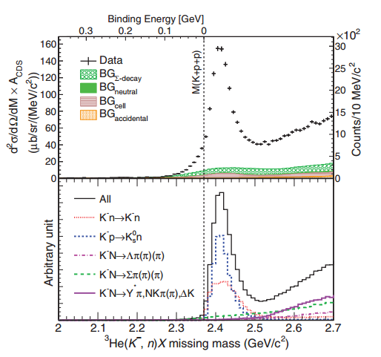
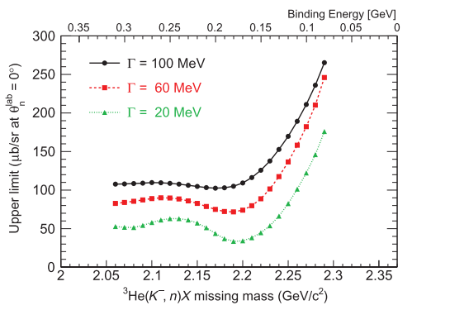
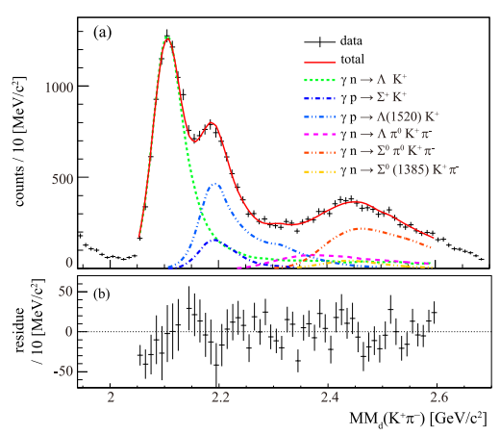
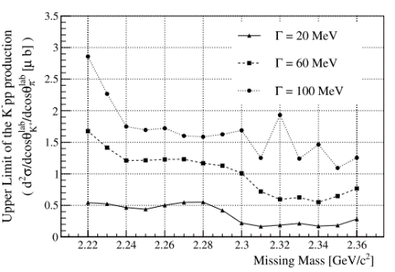
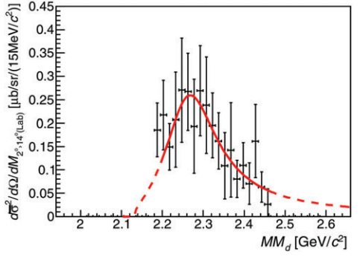
K⁻pp bound state
HADES: p+p -> K+pΛ @3.5 GeV
J-PARC E15 : ³He(K⁻,n) reaction @ 1 GeV/c
Bonn-Gatchina
Partial Wave Analysis
well reproduces the data
Extraction of upper limit
T. Hashimoto et al.,
PTEP (2015) 061D01
G. Agakishiev et al.,
Phys. Lett. B 742 (2015) 242-248
LEPS/SPring-8: d(γ,K⁺π⁻ ) reaction (Eγ=1.5-2.4 GeV)
J-PARC E27: d(π⁺, K⁺) reaction @ 1.69 GeV/c
Y. Ichikawa et al.,
PTEP 2015, 021D01
A.O. Tokiyasu et al.,
Phys. Lett. B 728 (2014) 616-621
Extraction of upper limit
B =95 +18 −17 (stat.) +30 −21 (syst.) MeV
Γ = 162 +87 −45 (stat.) +66 −78 (syst.) MeV

Slide 22
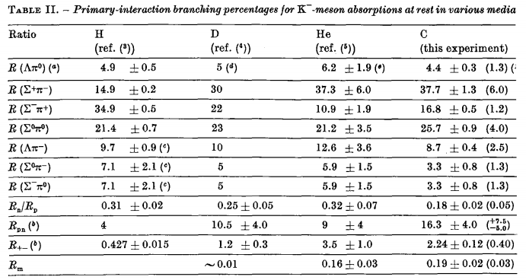
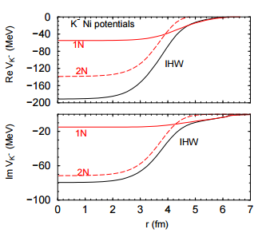
Multi Nucleon absorption
A K- produced in nuclear matter can undergo absorption on one or more nucleons
Important role in kaonic atoms
First attempts to measure multinucleonic absorption
A. Gal, Nucl.Phys. A914 (2013) 270-279
C. Van Der Velde-Wilquet et al.,
Il Nuovo Cimento Vol. 39 A, N. 4 21 Giugno 1977
Determination of the Branching Fractions
for K- Multi Nucleon Absorptions at Rest in C
1N and 2N components of the Ikeda-Hyodo-Weise
kaonic atom potential in Ni
Competing process to the experimental search of di/tri-kaonic bound states

Slide 23
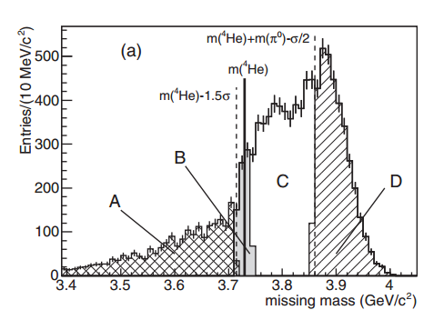
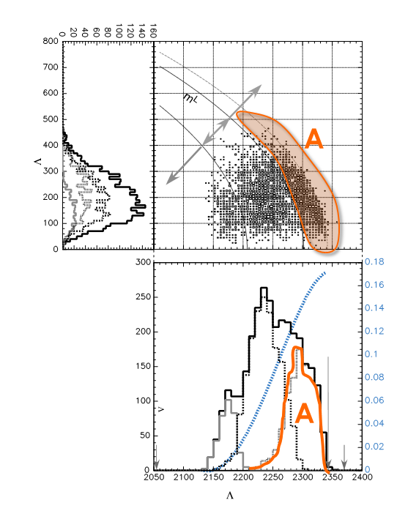
Multi Nucleon absorption
KEK-PS: E549
FINUDA: Σ⁻ p emission rates in K⁻ absorptions at rest on ⁶Li, ⁷Li, ⁹Be, ¹³C, and ¹⁶O
M. Agnello et al., Phys. Rev. C 92 (2015)
T. Suzuki et al., Mod. Phys. Lett. A23 (2008) 2520
Selection of the different mechanisms only on the base of the ΛN missing mass. A: associated to 2N absorption
Missing mass of the K⁻ +⁶Li → nπ⁻pA’ reaction:
(B) events from K⁻ ⁶Li → Σ⁻p ⁴He two-body QF
(D) events compatible with the K⁻ ⁶Li → Σ⁻ pπ⁰ A

Slide 24
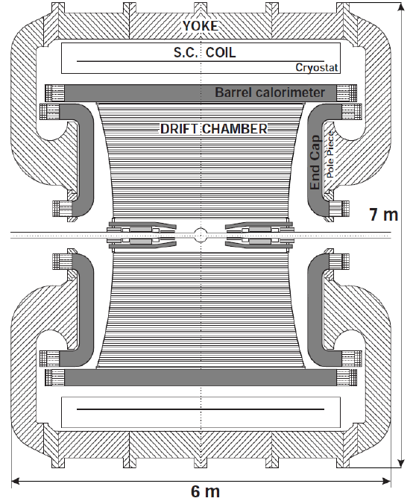
Low-energy K⁻ hadronic interactions studies with KLOE 2005 data
MC simulations show that :
~ 0.1% of K⁻ stopped in the DC gas (90% He, 10% C₄H₁₀)
~ 1% of K⁻ stopped in the DC wall (750 mm c. f. , 150 mm Al foil).
Possibility to use KLOE materials as an active target
Advantages:
Very good resolution : σ_{p}/p ~ 0.4
4π-geometry with ~ 96% acceptance
Calorimeter optimized for γ : σ(m_{γγ}) ~ 18 MeV/c²
Vertex position resolution ~ 1 mm (in DC)
Disadvantages:
Non dedicated target → different nuclei contamination → complex interpretation .. but → new features .. K⁻ in flight absorption.
K⁻
K⁺

Slide 25
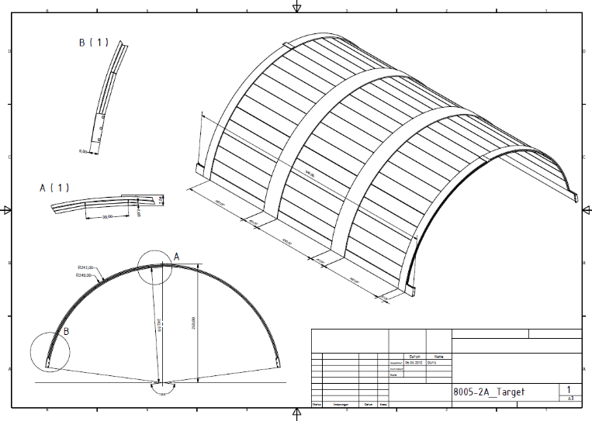
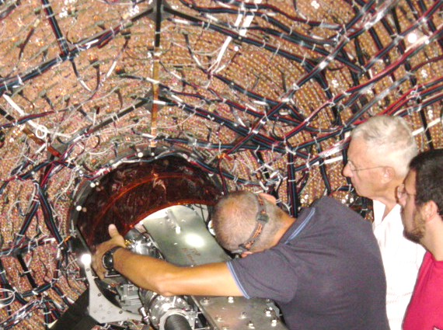
AMADEUS step-0:
Pure Carbon target inside KLOE (2012)
Dedicated run in 2012 with a 4/6 mm thick ¹²C target
Advantages:
gain in statistics
(~90 pb⁻¹; analyzed 37 pb⁻¹, x1.5 statistics)
K⁻ absorptions occur in ¹²C at-rest.

Slide 26
K⁻ + ¹²C -> Σ⁰p +A
In DC wall (¹²C+²⁷Al)
Goal of the analysis:
K- Absorption
Kaonic Bound States
Pin down the contribution of the process:
(Σ⁰ --> Λγ)
with respect to processes as:
Search for the formation of the ppK⁻ and its decay in:
Yield Extraction and Significance
Free from ΣN --> ΛN background

Slide 27
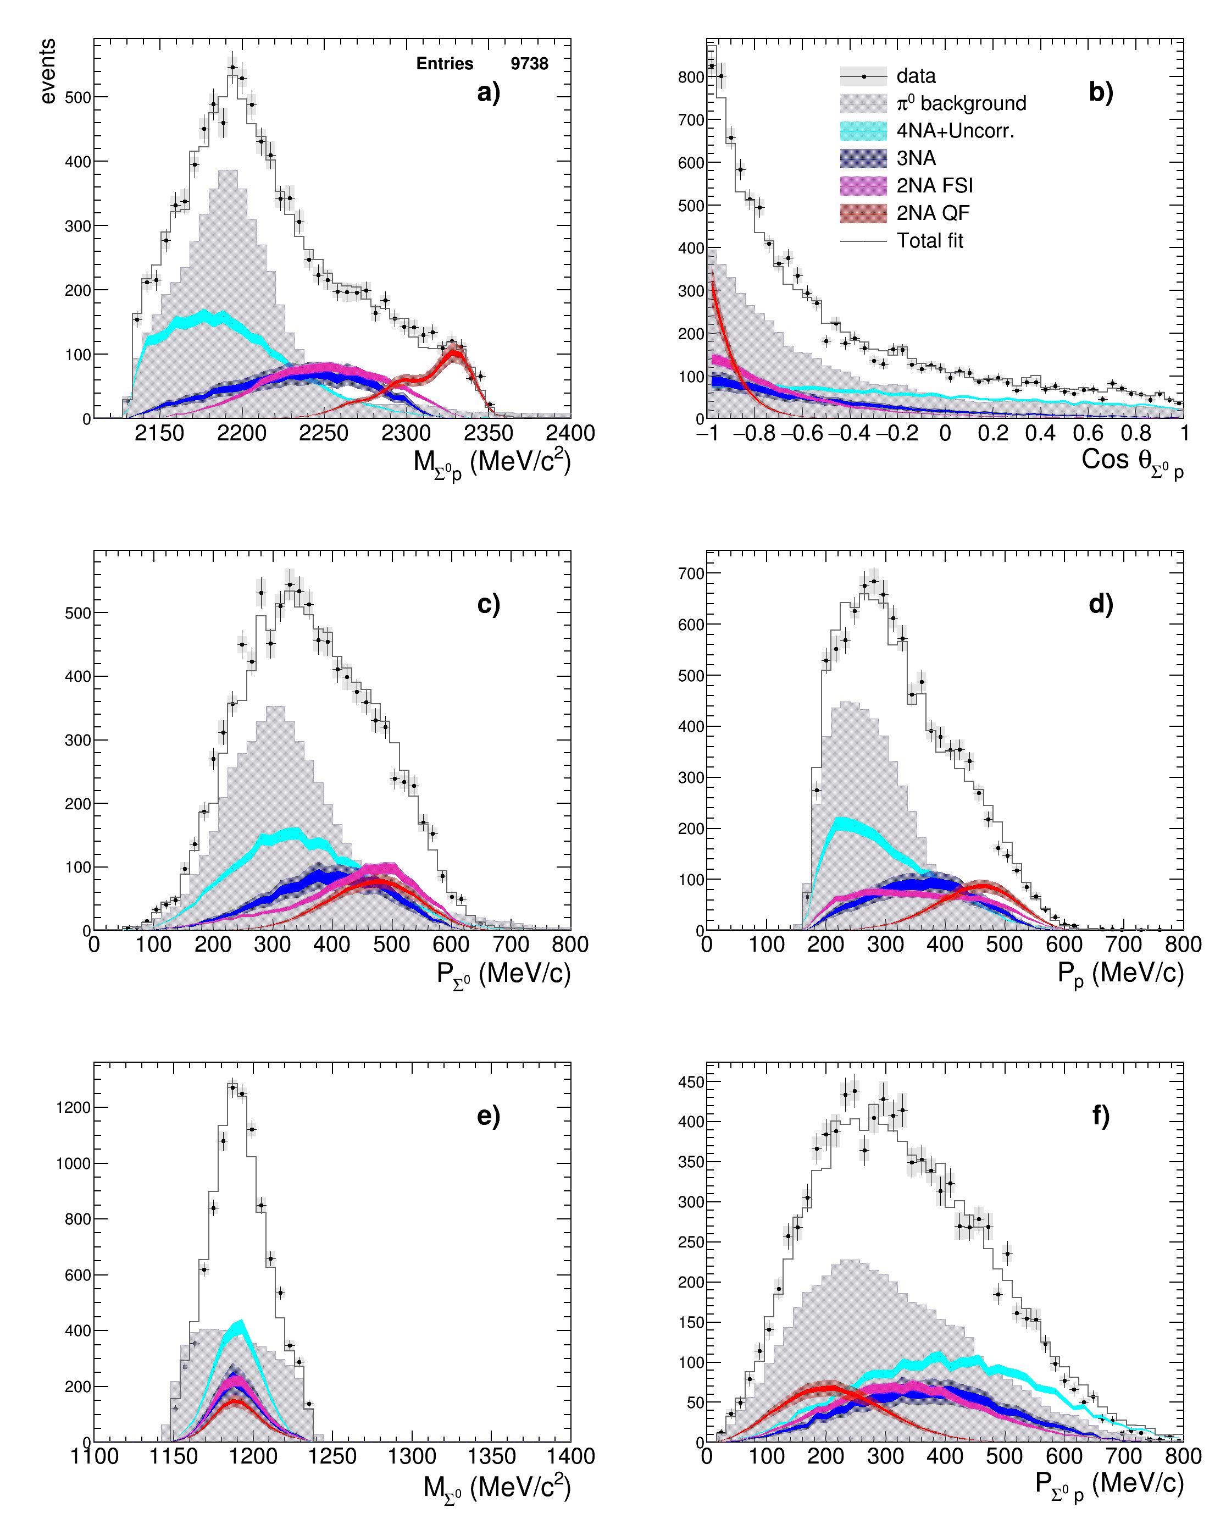
K⁻ + ¹²C -> Σ⁰p +A
Final fit
From the contributions to the fit, the yields are extracted for K⁻ stop
2NA-QF clearly separated
From other processes

Slide 28
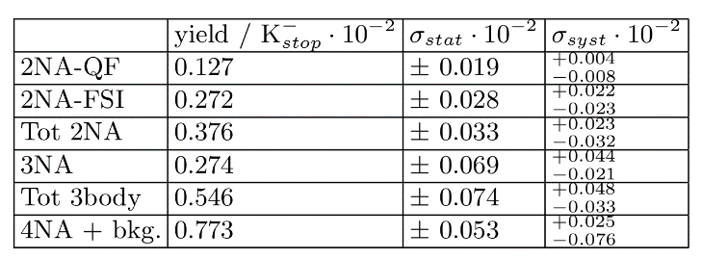
Absorption results
K⁻ + ¹²C -> Σ⁰p +A
...is there room for the signal of a ppK⁻ bound state?
Repeat the fit with the inclusion of a simulated bound state in a grid with different values for the Binding Energy and Width:
B : 15-75 MeV/c² (15 MeV/c² steps)
Γ : 30-70 MeV/c² (20 MeV/c² steps)
1.74 fb⁻¹ 2004-2005 KLOE data

Slide 29
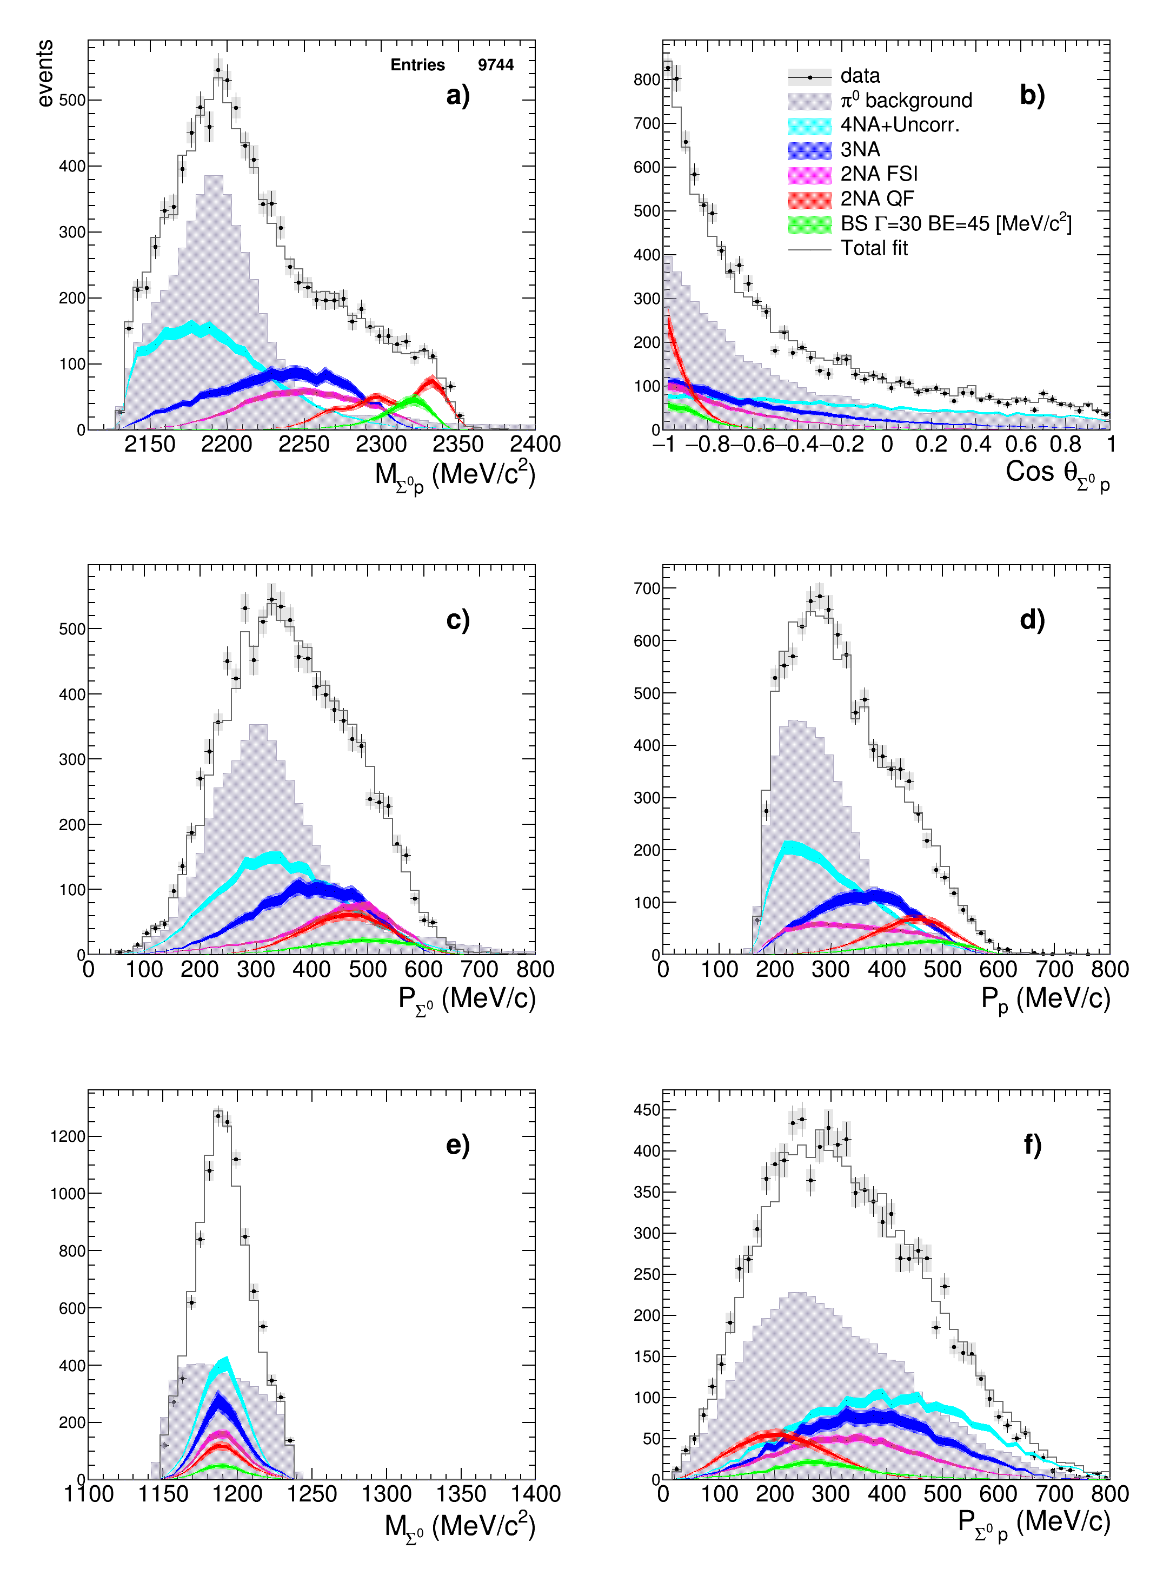
K⁻ + ¹²C -> Σ⁰p +A
Fit with ppK⁻
Best solution:
(best χ² and higher yield)
- B = 45 MeV/c²
- Γ = 30 MeV/c²

Slide 30


K⁻ + ¹²C -> Σ⁰p +A
Evaluation of the significance of the ppK⁻ signal
F-test to evaluate the addition of an extra parameter to the fit:
MINOS 1σ
MINOS 2σ
MINOS 3σ
  Significance of “signal” hypothesis w.r.t “Null-Hypothesis” (no bound state)
P-value = 0.25 --> 1σ significance

Slide 31


K⁻ + ¹²C -> Σ⁰p +A
The Σ⁰p analysis has been completed for events in the DC wall ¹²C + ²⁷Al
  Obtention of the 2NA-QF yield
  2NA-QF yield is very small w.r.t. all 3 body processes (3NA, FSI)
  Bound state ppK⁻ yield for B.E. 45 MeV/c² and Width 30 MeV/c²
  the significance of the ppK⁻ signal is of 1σ according to F-test
Recently published in
Phys. Lett. B758 (2016) 134-139

Slide 32




K⁻ + ¹²C -> Λp +A
Total reduced χ² = 0.9435
NOT TO BE
DISTRIBUTED
NOT TO BE
DISTRIBUTED
NOT TO BE
DISTRIBUTED
NOT TO BE
DISTRIBUTED

Slide 33


K⁻ + ¹²C -> Λp +A
NOT TO BE
DISTRIBUTED
Obtained Multi-nucleon yield Λ (Σ⁰) p = ( 17.0 ± 2.4 stat. ^{+2.7} syst. ) %/K⁻stop
_{-3.2}
comparable with
Yield(K⁻ ⁴He → Λ (Σ⁰) (no pion) ) = (11.7 ± 2.4)% / K⁻stop
[P.A. Katz et al., Physical Review D, Vol. 1, no.5 (1970) ]
From the ratio between the 2NA-QF Λp and Σ⁰p yields we extracted the ratio between the modulus of the transition amplitudes

Slide 34

K⁻ ⁴He → Λt 4NA process
Rare process of a K⁻ absorbed on 4 nucleons (4NA)
Available data:
in Helium :
bubble chamber experiment
[M.Roosen et al, Il Nuovo Cimento 66, (1981), 101]
K⁻ stopped in liquid helium, Λ dn/t search.
3 events compatible with the Λt kinematics
were found
BR(K⁻⁴He → Λt) = (3 ± 2) × 10⁻⁴ /K_{stop}
global, no 4NA
Solid targets
FINUDA [Phys.Lett. B669 (2008) 229]
(40 events in different solid targets)
The Branching Ratio (BR) for non-pionic hyperon production (from K⁻ multi-nucleon absorption in ⁴He) was measured in [P. A. Katz et al., Phys.Rev. D1 (1970) 1267],
2/3/4 – NA were not distinguished

Slide 35



K⁻ ⁴He → Λt 4NA process
K⁻ + 4N → Λ + t
Detected by TOF
In KLOE DC (⁴He + ¹²C + H)
90% 10%
p + π⁻
I. Tucakovic, Ph.D Thesis, 2015
Best Λt statistics ever (150 events)
Clear back-to-back
enhancement of Λt events
Preliminary
Cosθ(Λt)
4NA process in ⁴He :
highest part of invariant
mass spectrum
- back-to-back topology
extra proton events
(not possible in pure ⁴He)
M_{Λt} (MeV/c²)

Slide 36



The nature of Λ(1405)
two poles: (z1=1424+7-23– i 26+3-14; z2=1381+18-6– i 81+19-8) MeV (Y. Ikeda et al., Nucl.Phys. A881 (2012) -114)
    mainly coupled to KN mainly coupled to Σπ → line-shape depends on production mechanism
J. Esmaili et al.,
Phys.Lett. B686 (2010) 23-28
    Line-shape also depends on the decay channel :
Fitted data:
B. Riley, Phys. Rev. D 11 (1975) 3065
Only at rest events (cut at mass limit)

Slide 37


The nature of Λ(1405): Σ⁰π⁰
Λ(1405) signal searched by K- interaction with a bound proton in Carbon
K- p → Σ⁰π⁰ detected via: (Λγ)(γγ)
Strategy : K- absorption in the DC entrance wall, mainly 12C with H contamination (epoxy)
N.U.
N.U.
2005 data
2012 data
2005 data
2012 data
Mass limit
on ¹²C at rest
Invariant Mass (MeV/c²)
Momentum (MeV/c)

Slide 38


The nature of Λ(1405) : Σ⁰π⁰
P(π⁰) resolution: σ_{p} ≈ 12 MeV/c
m_{lim} ¹²C at-rest
m_{lim} ¹²C in-flight
At-rest
In-flight
Counts/(10MeV/c)
Counts/(10MeV/c)
In-flight component
M(Σ⁰π⁰) (MeV/c²)
M(Σ⁰π⁰ ) (MeV/c²)
P(π⁰) (MeV/c)
P(π⁰) (MeV/c)

Slide 39



The nature of Λ(1405) : Σ⁺π⁻
Total
H
IF ⁴He
AR ⁴He
Removing the H component is fundamental since it behaves like a high mass pole!!!
Total
H
IF ⁴He
AR ⁴He
Reactions in DC gas (⁴He): at rest / in flight
Total
H
IF ⁴He
AR ⁴He

Slide 40



The nature of Λ(1405) : Σ⁺π⁻
Total
IF H
IF ¹²C
AR ¹²C
Total
IF H
IF ¹²C
AR ¹²C
Total
IF H
IF ¹²C
AR ¹²C
Reactions in DC wall : at rest / in flight

Slide 41

The nature of Λ(1405) : Σ⁻π⁺
Future perspectives: neutrons!
The possibility to detect neutron is fundamental for the Σ⁻π⁺ --> nπ⁻π⁺ but is also very useful
to increase the statistics in the Σ⁺π⁻ --> nπ⁺π⁻

Slide 42



Λπ⁻ (I=1); Res (Σ*⁻) vs Non Res
K⁻ n → Λπ⁻ single nucleon absorption processes in ⁴He for:
non-resonant / resonant (I=1)
at-rest / in-flight
Non Resonant
At-rest
Resonant
At-rest
Non Resonant
In-flight
Resonant
In-flight
K. Piscicchia, S. Wycech, C. Curceanu, Nucl. Phys. A 954 (2016) 75
the goal is to measure |f ^{N-R} _{Λπ} (I=1)|
to get information on |f ^{N-R} _{Σπ} (I=0)|

Slide 43





Λπ⁻ (I=1); Res (Σ*⁻) vs Non Res
From the well known Σ* transition probability:
Light band sys err.
Dark band stat. Err.
Preliminary
Preliminary
J. Hrtankova, and J. Mares, ArXiv:1704.07205v1
compatible with K⁻ p → Λπ⁰ scattering above threshold
J. K. Kim, Columbia University Report, Nevis 149 (1966),
J. K. Kim, Phys Rev Lett, 19 (1977) 1074:
Good agreement with chiral calculation:
Y. Ikeda, T. Hyodo and W. Weise, Nucl. Phys. A 881 (2012) 98.

Slide 44

σ(K⁻p->Σ⁰π⁰) @ 100 MeV/c
­Cross sections measurements at or below 100 MeV/c missing
Existing data at (120, ..) MeV/c with big relative errors (about 50% )
Calculations in according with latest kaonic hydrogen measurements
M. Bazzi, et al., SIDDHARTA Collaboration, Phys. Lett. B 704 (2011) 113;
M. Bazzi, et al., SIDDHARTA Collaboration, Nucl. Phys. A 881 (2012) 88.
Possible AMADEUS contribution
Y. Ikeda et al. / Nuclear Physics A 881 (2012) 98–114

Slide 45

σ(K⁻p->Σ⁰π⁰) @ 100 MeV/c
Strategy:
Fit of the measured Σ⁰-π⁰ distributions (from K- captures in gas) including:
Preliminary
K⁻ H capture
at-rest + in-flight (signal)
p_{Σ0π0} (MeV/c)
K- ⁴He capture
at-rest + in-flight (bkg)
K- ¹²C capture
at-rest + in-flight (bkg)
K- H interaction considered
non-resonant
(T = 1440 MeV far above the Λ(1405))

Slide 46



Future of AMADEUS
127 MeV/c K⁻ from φ --> K⁺K⁻

Slide 47
Conclusions (2)
Interaction of strange mesons and hyperons with nuclei is not yet fully understood
Many questions are still open and need to be answered
Accurate and high statistics data are needed in order to disentangle between the wide range of available theoretical models
The AMADEUS experiment has the possibility to deliver high quality and high statistics data in this direction
AMADEUS capability have been already anticipated by the very good results obtained analysing the KLOE data 2005
Multi Nucleon absorption in Σ⁰p channel (exp) and K⁻p->Λπ⁻ (theo) published
Other interesting analyses are ongoing (Λ-p/d/t, Σ⁰π⁰,Σ⁺π⁻)
Other interesting analysis will start soon (Σ⁰-d/t, Σ⁰π⁻, Σ⁻π⁺)
DAΦNE + AMADEUS represents a unique possibility to perform high quality experiments with low momentum kaons and should not be missed

Slide 48




Off records…VOXES!!!
eV resolution
Sub-eV precision
Idea for possible applications???

