Slide 1




LIGHT-MATTER INTERACTIONS IN ORGANIC OPTOELECTRONIC DEVICES
PhD course in «Physics and Nanoscience»
XXIX cycle
Author: Armando Genco
Supervisor: Prof. Marco Mazzeo
18/07/2017

Slide 2
Summary
Light-matter interactions
Experimental techniques
Exploiting light-matter interactions in organic electroluminescent microcavities
The steps towards electrically pumped laser
Novel materials for lasing: hybrid perovskites
Final remarks

Slide 3
Light-matter interactions

Slide 4
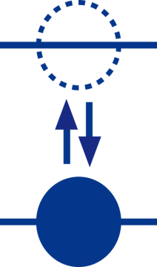

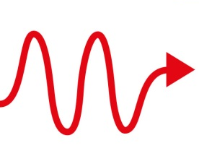
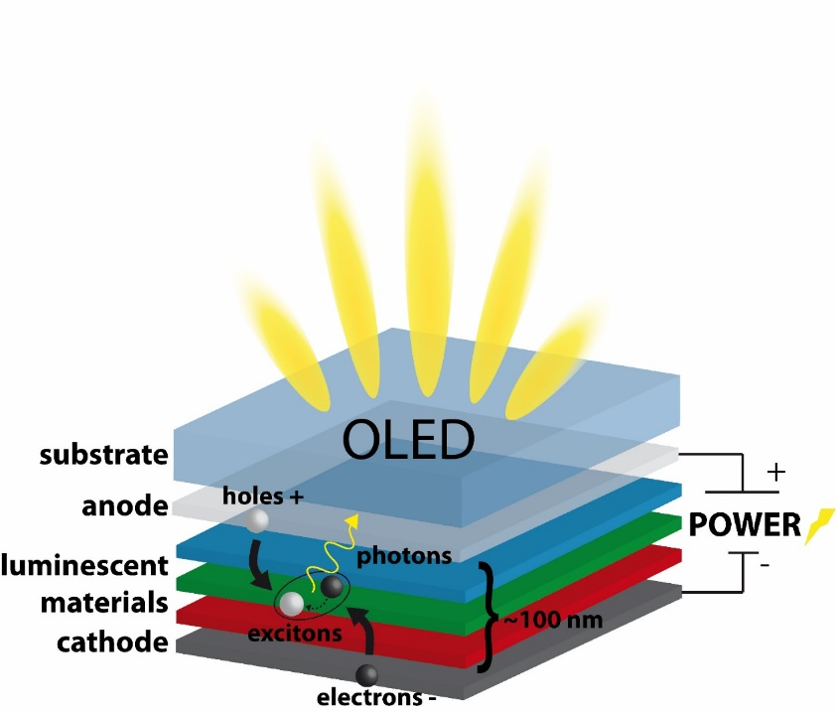
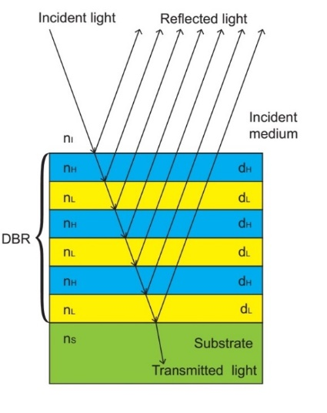
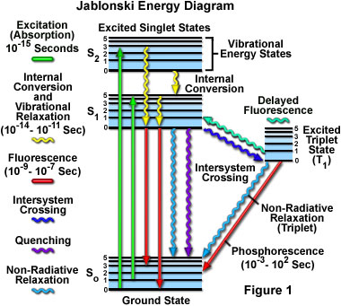
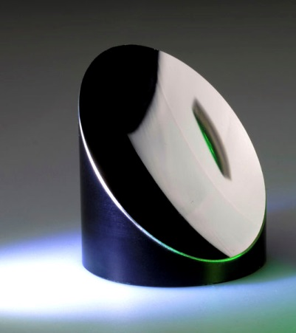
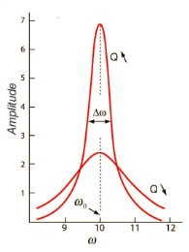
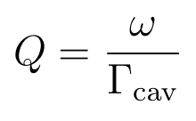
Light-matter interactions
Exciton
Fabry-Perot Microcavity
Notes:
First element: microcavity->optical resonator to confine photons-> mirrors made of metals or dielectric periodic structure exploiting diffraction
Here the Q-factor of the cavity plays a fundamental role: defined as the ratio between the resonant mode splitting and the linewdth of the spectral density (dephasing rate): high Q means low loss rate, photons better confined.
Second element-> exciton, electron in an excited state bound to a hole in the fundamental one->formed in OLEDs by injecting carriers from the electrodes to the acive layer. The dephasign rate of a molecule depends on a lot of factors but in general is dependent to the radiative and non radiative decay pathways

Slide 5
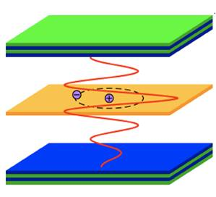
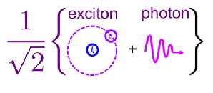
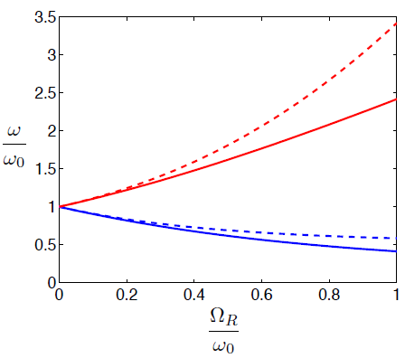
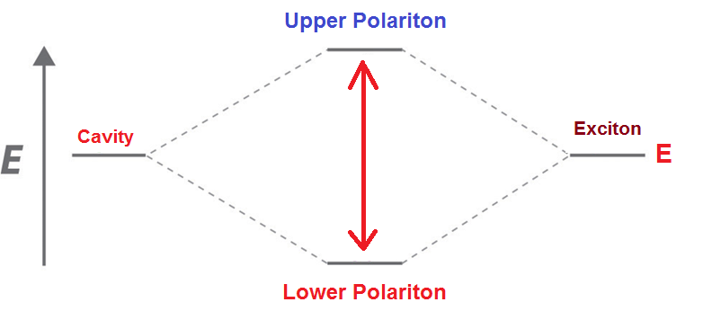
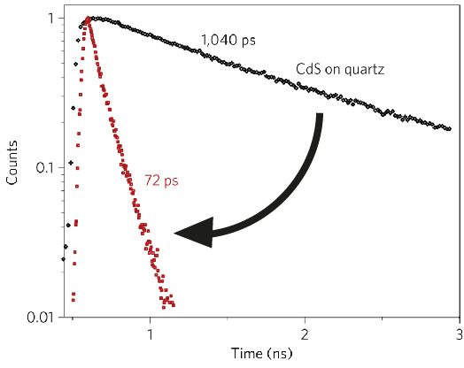
Light-matter interactions
Ω
γ_{exc}
Γ_{cav}
Weak
coupling
Strong
coupling
Ultra-strong
coupling
Γ, γ
0,2*ωexc
ΩR
0
Fermi Golden Rule
Polariton =
Upper polariton
Purcell effect
2hΩ_{R}
Lower polariton
Notes:
Interaction->these 2 structure can be easily integrated->the interaction condition is controlled by 3 main parameters: dephasing rates and rabi frequency
In the quantum picture the system can be described by the Jaynes cummings hamiltonian where…complex frequecies and operators
This has an analogous in the classical world: coupled harmonic oscillators
When the loss rates are bigger than the interaction frequency we are in the weak coupling regime
First important effect comes from the fermi golded rule, which states that the transition porbability of an emitter scales with the photonic mode density at the emission frequency-> in a cavity a transition in resonance with the optical mode will be strongly favored proportionally to the Q-factor.
The strong coupling appears when the interaction strength overcome the losses: in this case the transition and the cavity photons at the same energy exchange energy at the so called Rabi frequency where each system enters in a cycle of collapses and revivals.
In the light-matter interaction framework, the uncoupled states ar splitted in two new hybrid states, whose energy difference is porportional to the Rabi requency
In these states photons and excitons are mixed and the arising quasiparticles are called polariton, which merges some properties of both the uncoupled systems
When the coupling ratio between the rabi energy splitting and the exciton energy goes beyond 0,2 the Jaynes cummings hamiltonian is no longer enough to describe the new eigen states of the system: we are in the so called ultrastrong coupling regime. Here some non-linear effects begin to manisfest due to the contribution of antiresonant terms in the interaction hamiltonian involving virtual photon processes.

Slide 6
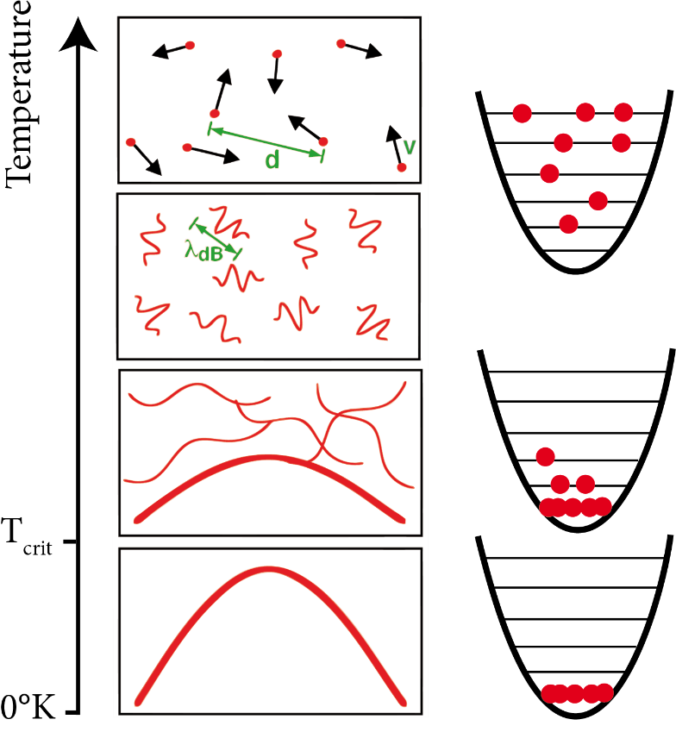
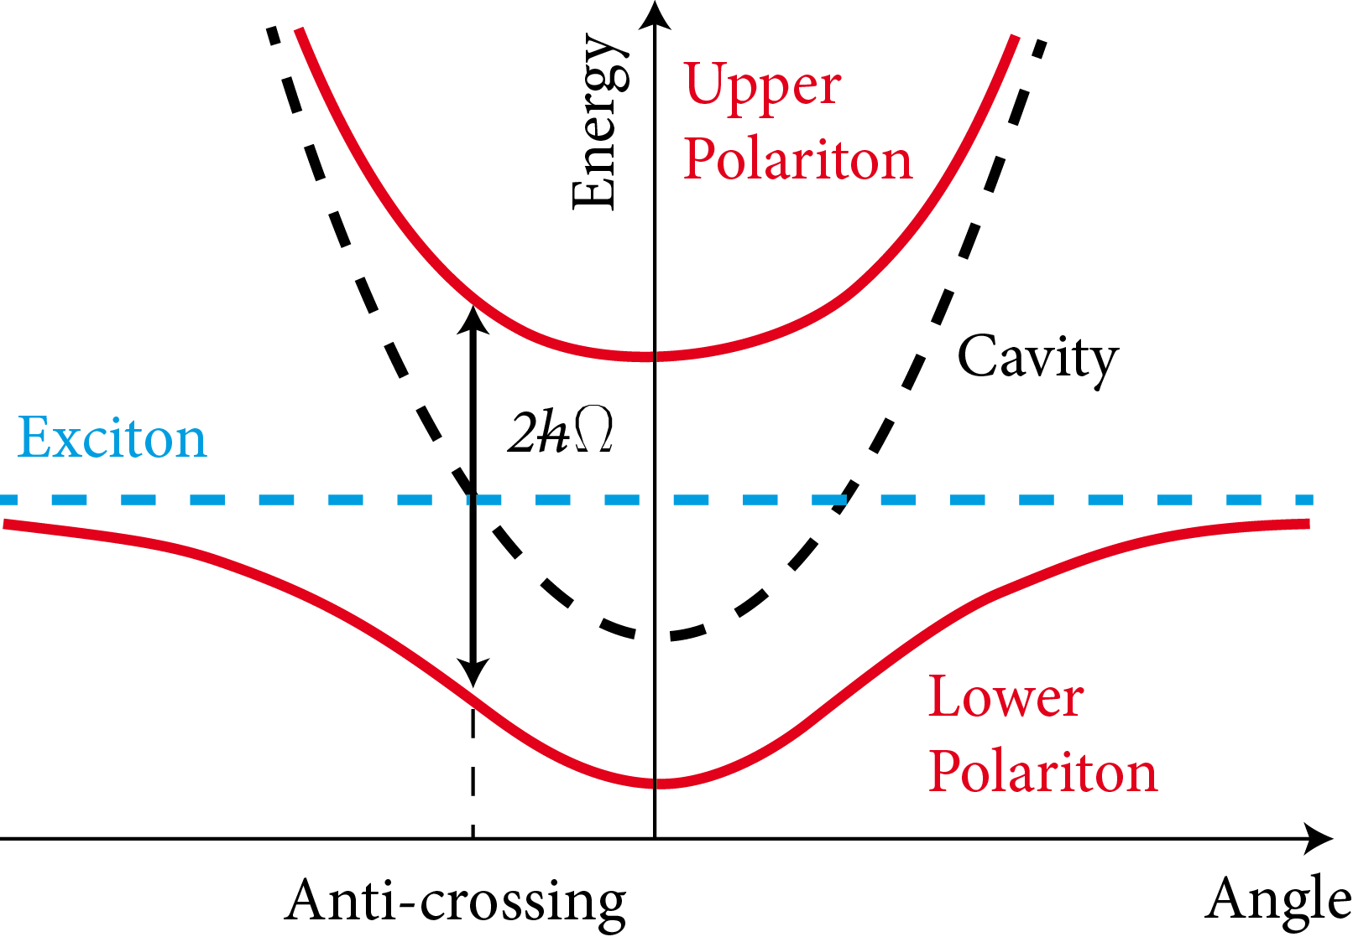
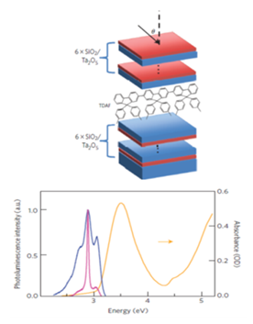
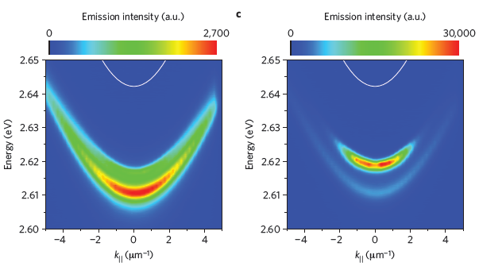

Polariton BEC at room temperature
Atoms
Polaritons
$$λ_{dB}=\frac{h}{\sqrt{3mkT}}≈d$$
K. S. Daskalakis, S. A. Maier, R. Murray, S. Kena-Cohen. Nonlinear interactions in an organic polariton condensate, Nature Materials (2014).
Notes:
The main applications of polaritons is the possibility to obtain a Bose-Einstein condensate at room temperature. This phenomenon was dimostrated for the first time using ultracold atoms: when an atomic ensemble confined in an harmonic potential is cooled to very low temperatures the atoms begin to slow down and as a consequence thier thermal de broglie wavelength approaches the interparticle distance making the matter-waves overlap. Below a critical temperature this interaction lead to a quantum phase transition towards a new macroscopic object where particles collapse in the same quantum state with a unique phase. In the case of polariton the trick is that those bosonic particles have a high delocalization given mostly by the photonic charchter and a sufficiently high interaction cross section given by the excitonic part. The confinement potential is formed if the cavity is negatively detuned with respect to the flat exciton dispersion, resulting in an energetic minimum in the lower polariton states dispersion. Owing to this unique properties it has been possible to measure the formation of a BEC at room temperature in an optically pumped organic microcavity.

Slide 7
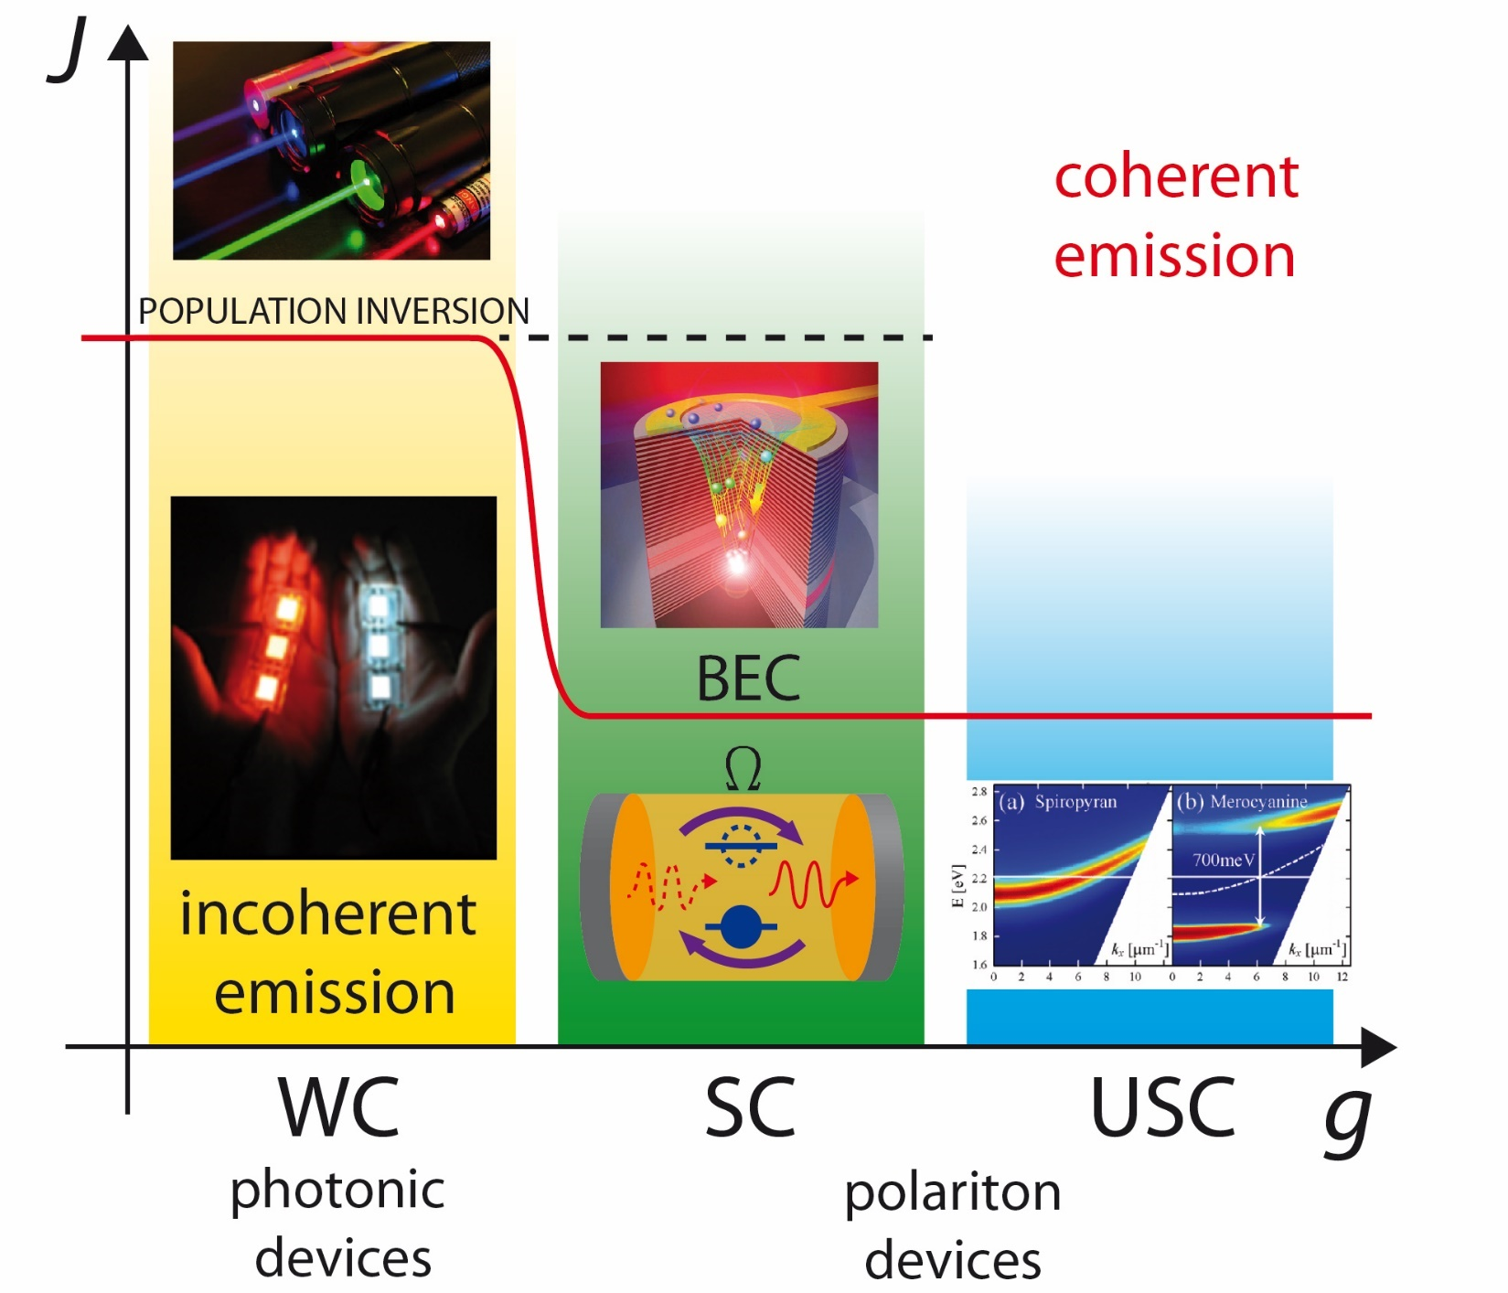
Exploiting light-matter interactions
Notes:
My work has been focused on the exploitation of the different light-matter coupling regimes in organic electroluminescent devices which emit incoherent light, looking towards obtaining coherent emission from an electrically pumped organic device. In weak coupling regime the light confinement can lower the tresholds for the population inversion but this is not enough to overcome the losses of organic systems. As an effective alternative it has been porposed to explolit the strong coupling in order to achieve coherent emission from the decay of condensed polaritons.

Slide 8

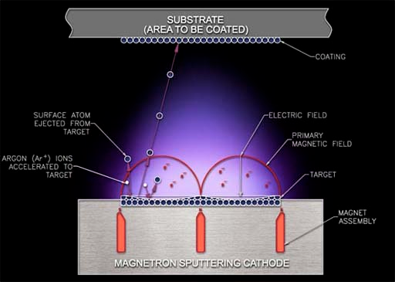
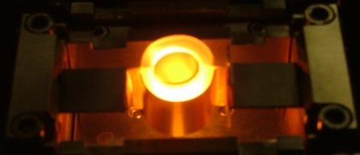
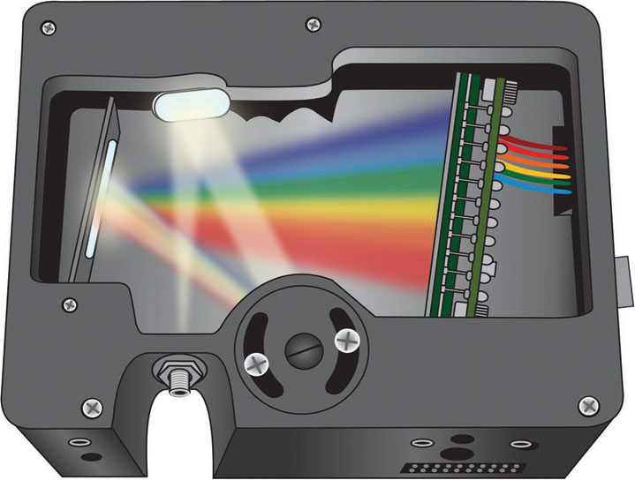
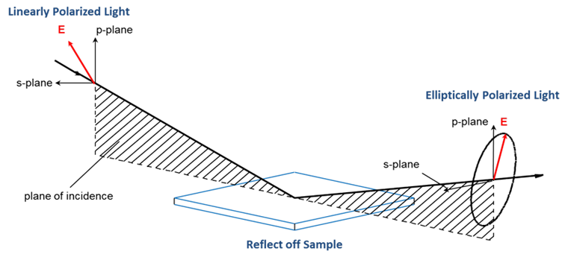
Experimental techniques
RF plasma sputtering
Transfer matrix optical simulations
Thermal evaporation
Spectroradiometers
Ellipsometer

Slide 9
Exploiting light-matter interactions in organic electroluminescent microcavities

Slide 10
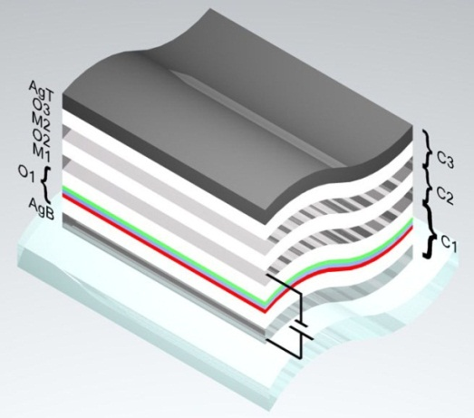
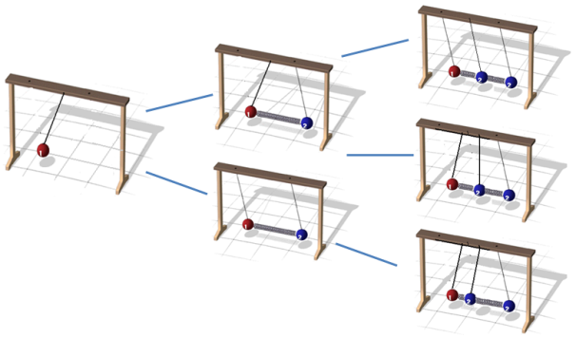
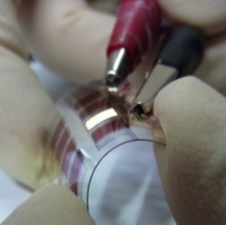
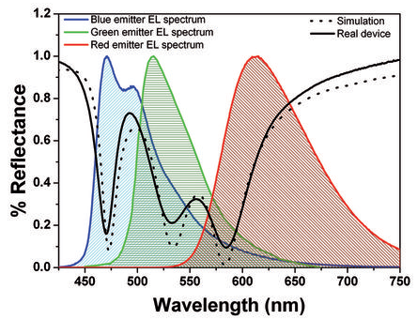
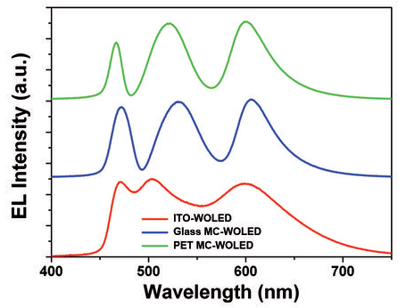
Coupled cavities for white OLEDs
M. Mazzeo et al.,Organic Electronics, 11 (2013).
Notes:
First of all we played with the concept of coupled oscillators applied to white emiting oleds. To produce white light the emitted light spectrum must cover the whole range of visible wavelength, but apparently this is not compatible with microcavities with a single narrow resonant mode. Our approach was to fabricate three cavity in strong coupling between them, thus leading to a three peaks spectrum. By placing the organic emitters inside the first electrically active cavity we where able to finely tune the whole emission spetrum reaching an high color quality and simultanesously boosting the efficiency owing to the weak coulping with the multicavity strucuture. We used only organic and metallic layer, so we avoided the use of the expensive and brittle ITO, thus producing a highly efficient flexible white oled.

Slide 11
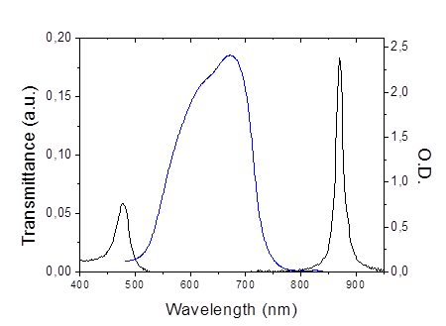
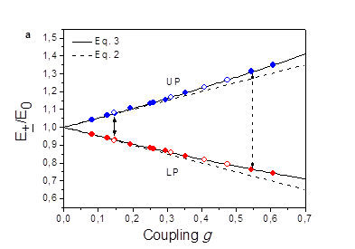


Squaraine microcavities: from SC to USC
LP
UP
USC
$$Ω_{R}∝\sqrt{αd}≈\sqrt{fN}$$
SC
$$\sqrt{αd}$$
Notes:
Then we studied a squaraine molecule with a high absorption coefficient that allowed to reach different degrees of coupling up to the ultra strong coupling regime. From the graph: formation of upper and lower polariton states around the absorption band with a rabi splitting above 1eV which lead to a record value of coupling strength in these systems. simply changing the layer thickness We demonstrated in this system that the rabi splitting and the active layer absorbance are proportionals, related to the number of coupled molecules and the oscillator strength of the molecular dipole. A non linear behaviour of UP and LP stes was also found as a clera proof of the USC regime.

Slide 12
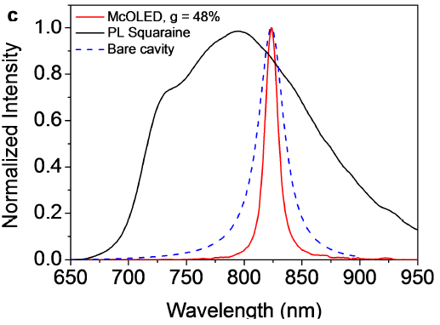
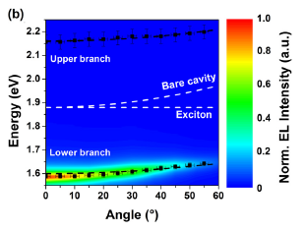
Polariton OLEDs in USC
M. Mazzeo et al, Applied Physics Letters, 23 (2014).
S. Gambino et al., ACS Photonics, 10 (2014).
Notes:
Measuring the transmission spectrum of the cavity in USC regime we found an ultra-narrow linewidth and a nearly flat cavity dispersion. Thus we exploited these features in an OLED working in USC regime obtaining an electroluminescent spectrum with a linewidth even lower than a cavity mode tuned at the same wavelength solving in addition the problem of angular dependence of weakly coupled cavities. But despite the high absorption oeffient of this molecule, the radiative efficiency was too low for BEC or lasing.

Slide 13
The steps towards electrically pumped laser

Slide 14
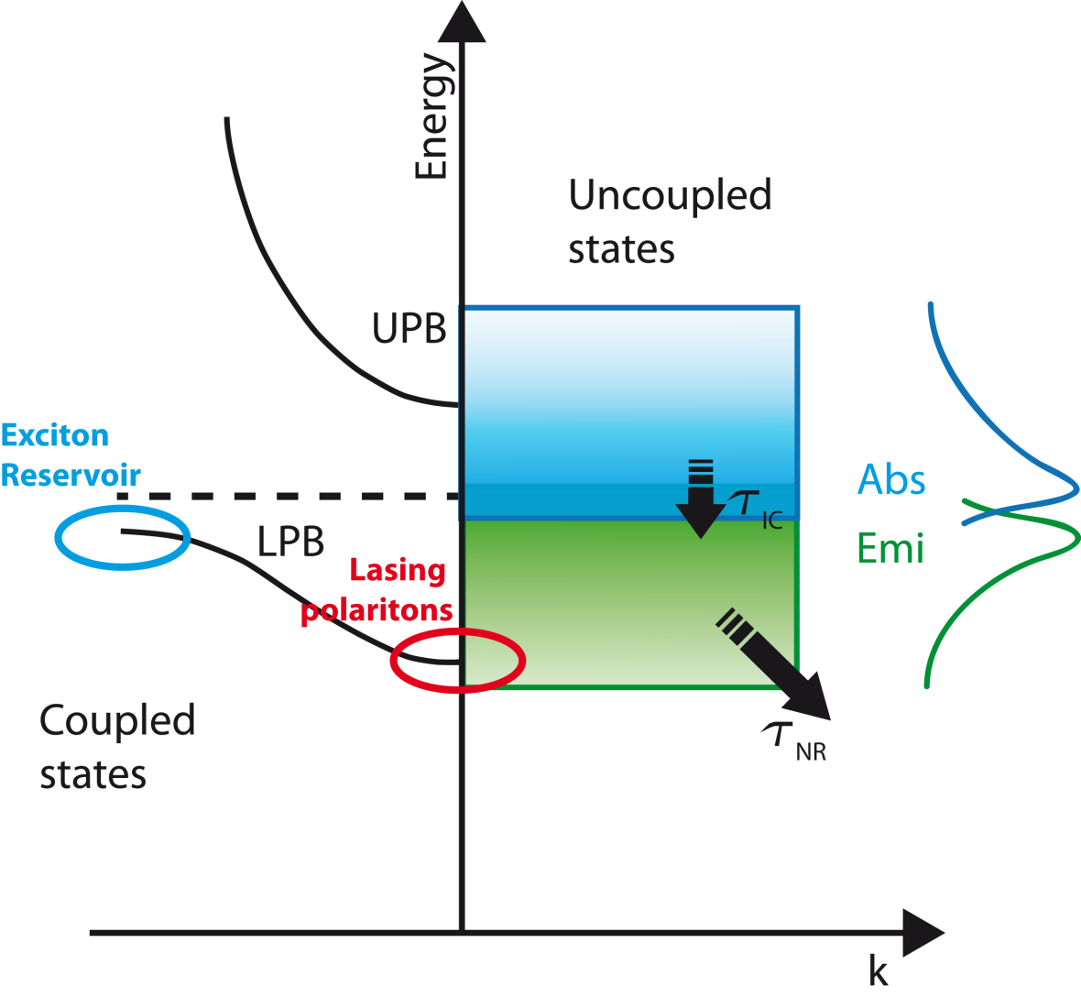

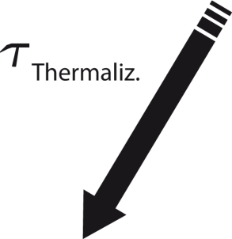



Polariton emission in disordered organic cavities
Hamiltonian eigenvalues of a disorderd many-body system in SC
P Michetti, L Mazza, GC La Rocca –
«Organic Nanophotonics», 2015 - Springer
k, θ
FAST INPUT
SLOW OUTPUT
Notes:
To optimize the devices to obtain BEC we first studied the emission dynamics of polaritons in disordered organic microcavities. A peculiar aspect of these disordered systems is that not all the molecules are strogly coupled to the cavity: in fact solving the hamiltonian in presence of energetci disorder for a many-molecules systems it has been found that only a small fraction of eigenstates are coherent polaritons while the majority are localized states near the transition energy. This explains the emission dynamics in organic polariton microcavities: first excitations at a high energy are fomred by external pumping, then they relax to the exciton reservoir. At this poitn they can take two different pathways: thay can scatter along the coherent polariton branche assisted by phonons or they can follow the standard route of molecular decay, emitting photons at the walengths of the polariton states. Thus these states can be populated or by excitons or by emitted photons. To increase the polariton poulation, decreasing the threshold for BEC the two input channels must be enhanced while hindering the photon loss channel principally controlled by the cavity Q-factor.

Slide 15
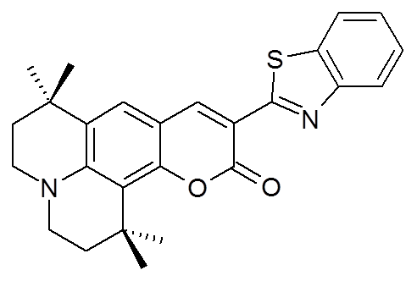
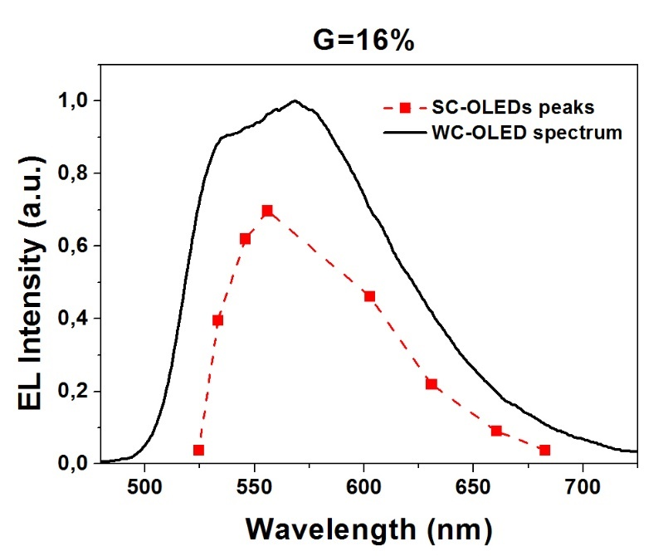
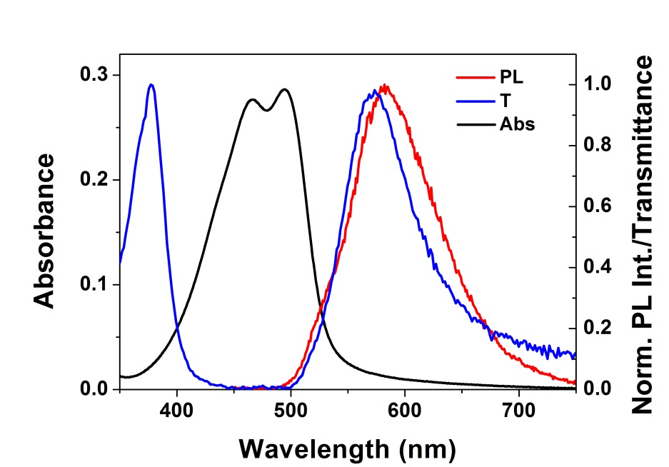
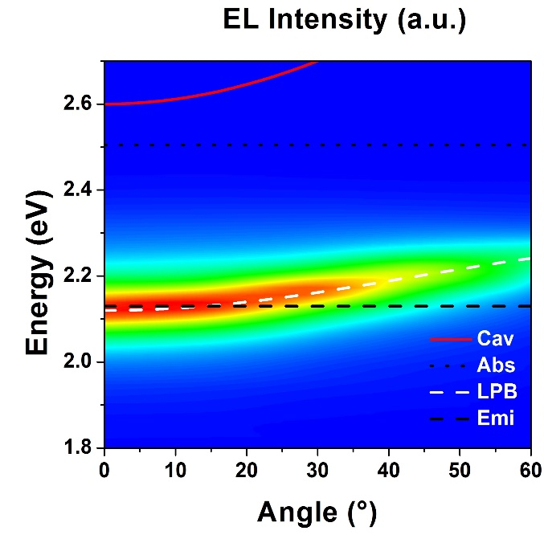
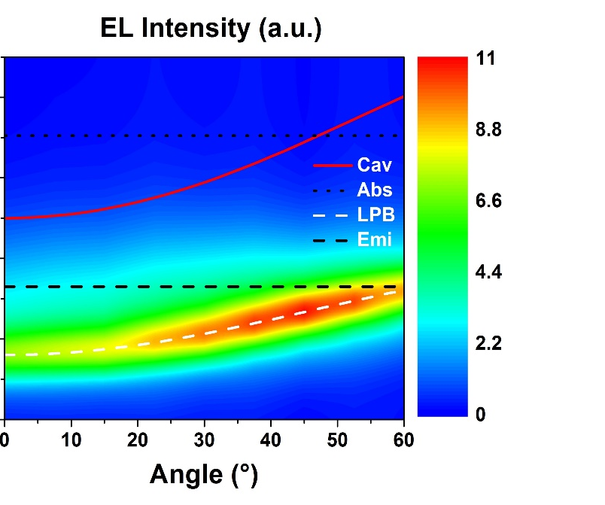
Polariton OLEDs with an efficient dye
C545T
G=31%
G=31%
Notes:
Considering this picture, we fistly optimized polariton OLEDs exploiting an highly efficient molelar dye which also has an high absorption coefficient. In this way we could finely tune the polariton states at the energies of the bare molecular emission, thus maximizing the radiatve pumping. From these figures you can see that indepently from the coupling and the detunign the maximum EL emission occurrs always near peak of the bare molecule emission, confirming that the dominatnt mechanism is the radiative pumping.

Slide 16
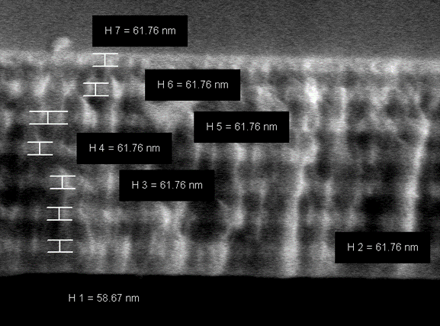
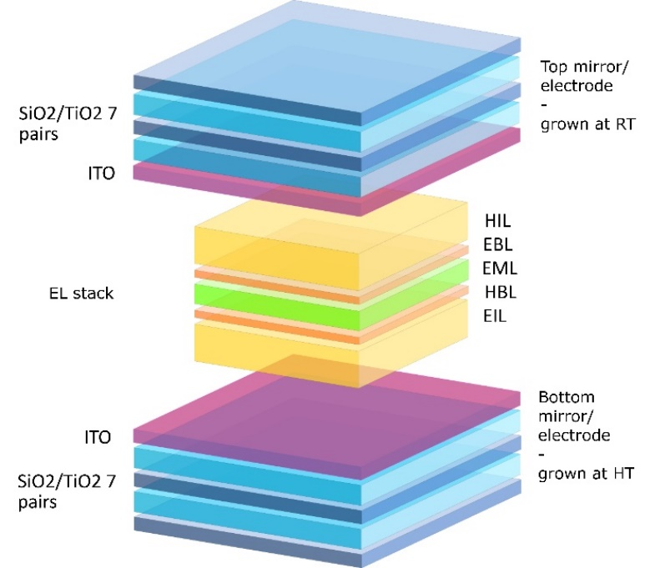
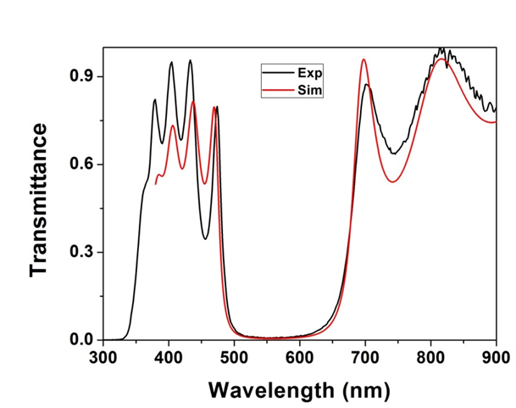
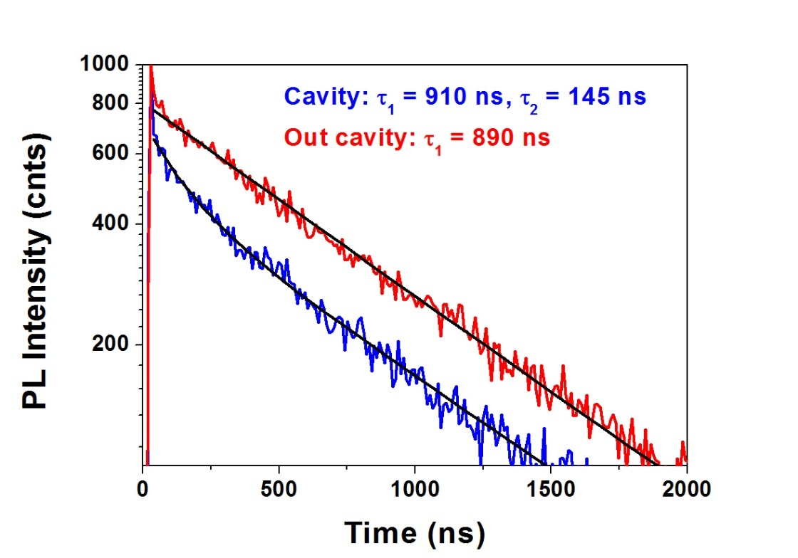
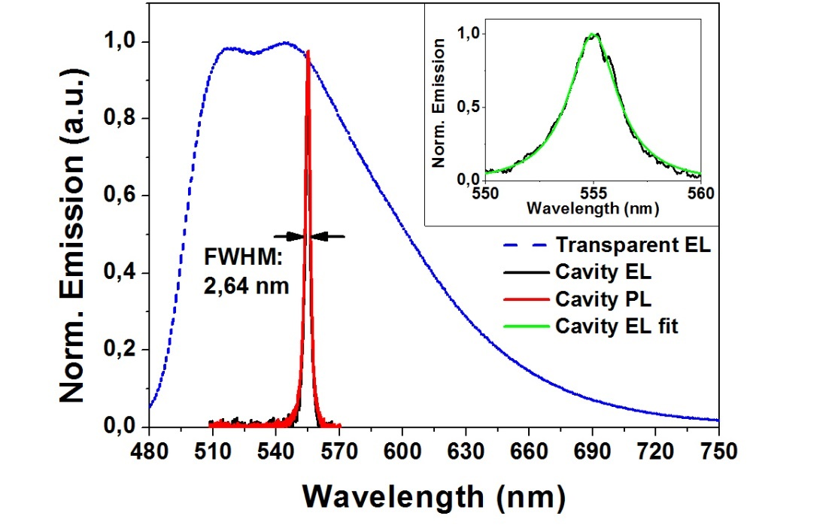
High Q electroluminescent organic cavity
Purcell effect
Notes:
Regarding the decrease of cavity losses, the first stepp was to fabricate an organic LED by using only dieletric mirrors. In fact the quality factor of a metallic microcavity is limited by metals absorption, while using DBRs this limit can be overcome. The higher obstacle here was to deposit an high quality DBR comprising a transparent and conductive layer of ITO to electrically supply th device without damaging the underlying organic layers. By the use of themally resistent inorganic hole injection layer we succesfully overcome the problem. In the final optimized cavity in weak coupling we measured an ultra-narrow EL emission related to a record value of q-factor for organic eletrcoluminscent microcavities. Measuring also the PL lifetimes we found a decrease in the decay time which could be ascribed to a Purcell effect.

Slide 17
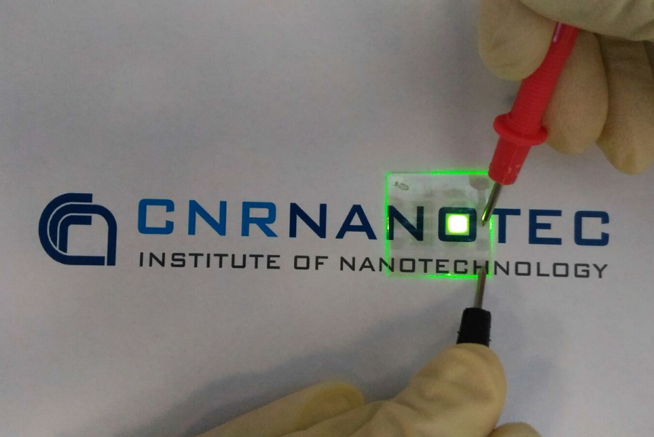
Fully transparent OLEDs
-2.4
-2.7
TCTA
-3
TPBI:Irppy3
TPBi
Bphen:Cs
-4.7
WO₃
-4.7
ITO
ITO
-5
ITO
Ag
-5.7
Bphen:Cs
WO3
TCTA
-6.2
-6.4
TPBI:
Irppy3
TPBi
Bphen:Cs
ITO
GLASS
Max eff.: 7cd/A
Notes:
Besides the application in high Q cavities we exploited the optmized electroluminescent stack with double transparent electrodes to build high luminance transparent OLEDs which could be already used in a number of technological applications

Slide 18
Novel materials for lasing: hybrid perovskites
e ^{-γt}

Slide 19
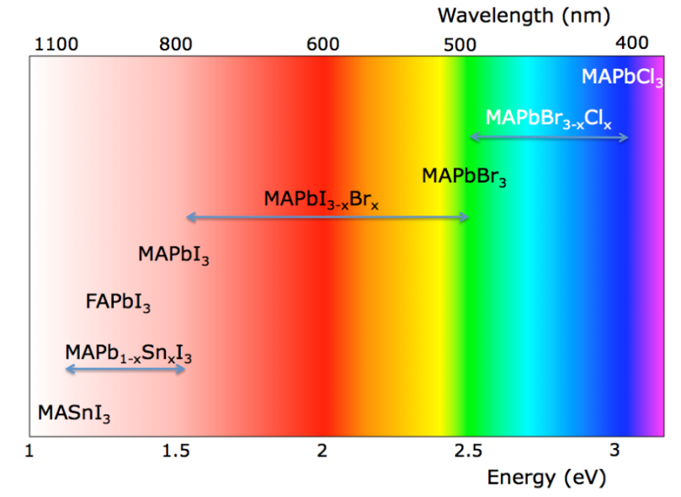
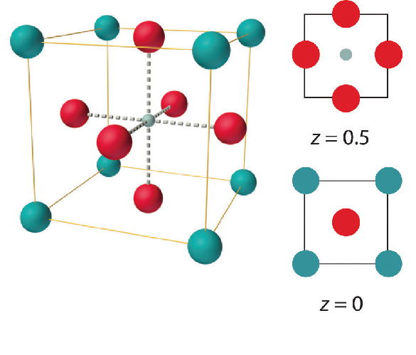
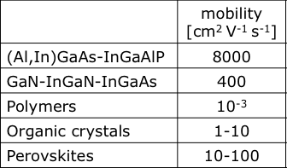
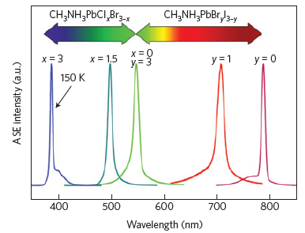
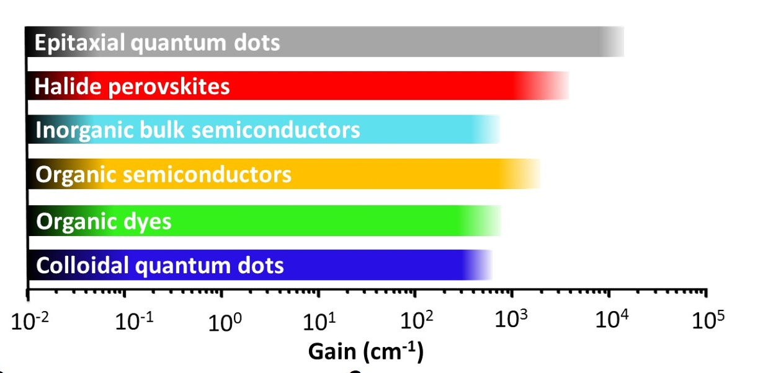
Hybrid perovskites
I/Br/Cl ion
Pb/Sn ion
Methylammonium
ion
Notes:
Apart the coherent emission by BEC, there is a novel promising material that can be exploited for standard organic lasers: the hybrid perovskite. This is a polycristalline soft material that has inside its lattice structure both organic and inorganc ions, giving the possibility to exploit all the deposition tecqniques already used for organics , with a spectrally tunable emission and very high charge carriers mobilities. These features plus an excellent thermal resistance make these materials a good candidate for the active alyer of an electrically pumped laser. Indeed coherent emission from these structures has been already measured by optical excitation.

Slide 20
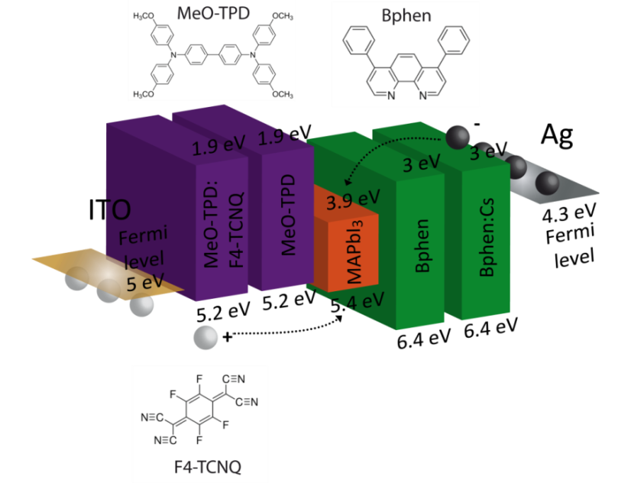




Vapour-deposited PeroLEDs
A. Genco et al., Advanced Electronic Materials, 1500325 (2016).
Notes:
A drawback of these materials is that they have reached high performance only depositing them with wet techniques, which can damage the underlying organic layers and withot a fine thickness control. Then we wanted to optimize the deposition also by thermally evaporating two precursors which formed the perovskite film directly on the substrate. In this way we fabricated the first fully evaporated hybrid perovskite LED achieving an optimal perovskite film with good cristallinity and homogeneity.

Slide 21
Final remarks
Weak coupling:
  Multi-cavity white OLEDs with high efficiency and color quality on flexible substrates
  High Q-factor electroluminescent microcavities
Strong coupling:
  Efficient polariton emission exploiting radiative pumping
  Elecroluminescent cavities in USC with record coupling strength
Optimization of vapour deposited hybrid perovskites LEDs toward lasing

Slide 22
Thank you!

