Slide 1

Lambda polarization in peripheral heavy ion collisions
Laszlo Pal Csernai, Yilong Xie,
Dujuan Wang, Marcus Bleicher, Horst Stoecker
Workshop on Chirality, Vorticity and Magnetic Field in Heavy Ion Collisions, 19-22 March 2018, Galileo Galilei Institute, Firenze

Slide 2
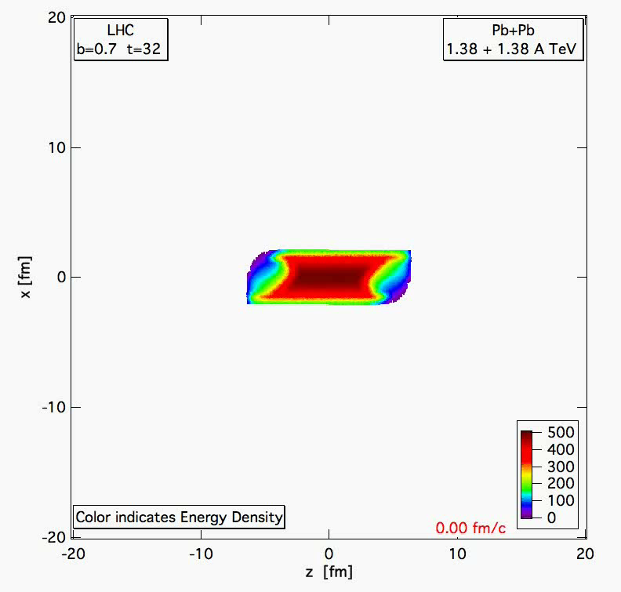
PIC-
hydro
Pb+Pb 1.38+1.38 A TeV, b= 70 % of b_max
Lagrangian fluid cells, moving, ~ 5 mill.
MIT Bag m. EoS
FO at T ~ 200 MeV, but calculated much longer, until pressure is zero for 90% of the cells.
Structure and asymmetries of init. state are maintained in nearly perfect expansion.

Slide 3
Periheral Collisions - Initial State
Peripheral reactions
ⱻ Shear ➔ vorticity ➔
L: in -y direction
Hw P: L = ?

Slide 4
Initial State – Peripheral reactions
Magas, Csernai, Strottman (2001), (2002)
Yang-Mills flux tube model for longitudinal streaks
String tension is decreasing at the periphery
Initial shear & vorticity is present

Slide 5
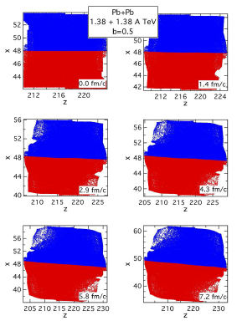
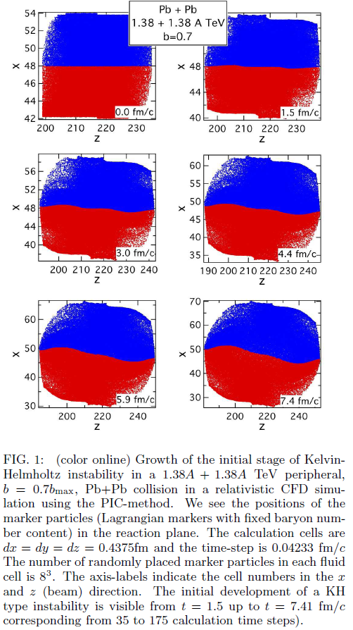
Shear & Turbulence → KHI
ROTATION – high η
KHI– low η
KHI
2.4 fm

Slide 6
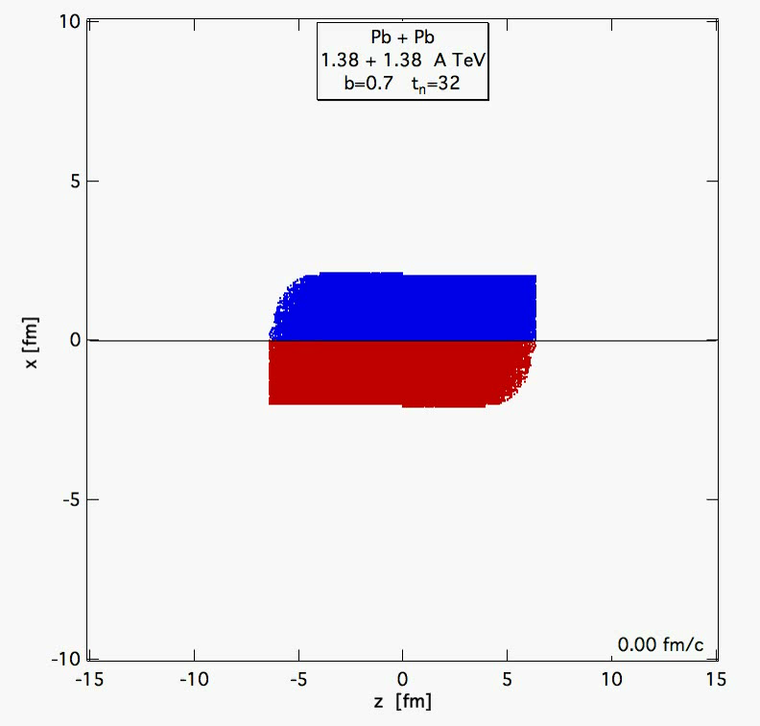
Kelvin –Helmholtz
Instability
PICR
Hydro
(2012)

Slide 7
Present parton kinetic models
- HIJING, AMPT, PACIAE
Different space-time configurations
[Long-Gang Pang, Hannah Petersen, Guang-You Qin, Victor Roy and Xin-Nian Wang, 27 September - 3 October
2015, Kobe, Japan; and Long-Gang Pang, Hannah Petersen, Guang-You Qin, Victor Roy, Xin-Nian Wang, arXiv: 1511.04131 ]
[Wei-Tian Deng, and Xu-Guang Huang, arXiv: 1609.01801]

Slide 8
Present parton kinetic models
- HIJING, AMPT, PATHIA
Different space-time configurations
[Wei-Tian Deng, and Xu-Guang Huang, arXiv: 1609.01801]
Max ω_{y} is at x=0 !!!
ε flow
ρ flow

Slide 9
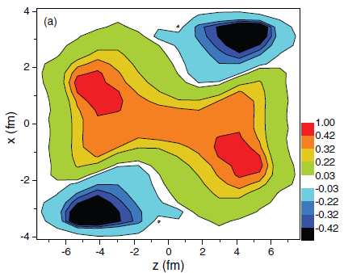
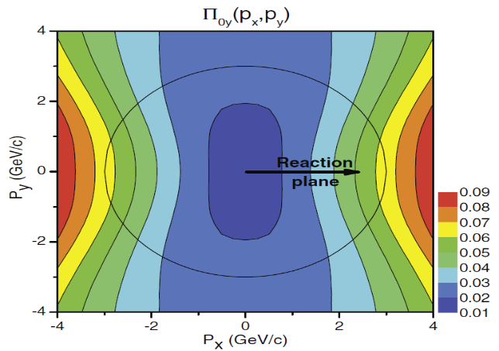
Consequences – vorticity (2013):
Will be similar to the 2001-2 I.S. in (t,z) coordinates
More compact → vorticity may survive better
The earlier results will remain qualitatively similar:
Fig. 3 The vorticity calculated in the reaction (xz) plane at t = 0.17 fm/c after the start of fluid dynamical evolution.
Fig. 4. The dominant y component of the observable polarization, Π₀(p) in the Λ’s rest frame.
The initial rotation can lead to observable vorticity (Fig. 3),
and polarization (Fig. 4): Leading vorticity term.
The initial angular momentum can be transferred to the polarization at final state, via spin-orbit coupling or equipartition.
[L. P. Csernai, et al, PRC 87, 034906 (2013) ]
[F. Becattini, et al. PRC 88, 034905 (2013) ]

Slide 10
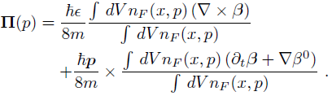


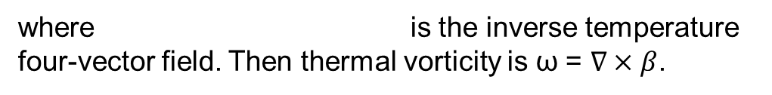
Consequences:
Based on Ref. [Becattini, 2013], Λ polarization can be calculated as:
Vorticity, 1st
Expansion, 2nd
where is the inverse temperature four-vector field. Then thermal vorticity is ω = $∇×β$.
The polarization 3-vector in the rest frame of particle can be found by Lorentz-boosting the above four-vector:
[F. Becattini, L.P. Csernai, and D.J. Wang, Phys. Rev. C 88, 034905 (2013) ]

Slide 11
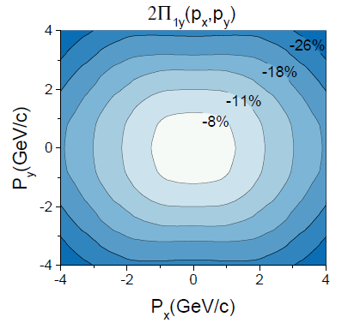
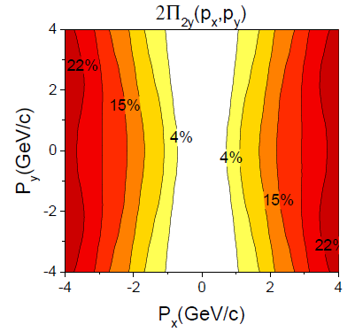
Consequences:
Fig. 6 The first (left) and second (right) term of the dominant y component of the Λ polarization for momentum vectors in the transverse plane at p_{z} = 0,for the FAIR U+U reaction at 8.0 GeV
The y component is dominant, is up to ~20%, as we can compare it with x and z components later.
1st & 2nd terms are opposite direction. Result into a relatively smaller value of global polarization.

Slide 12
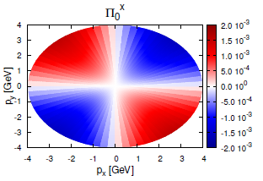
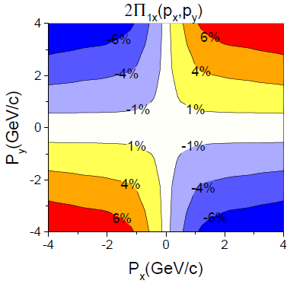
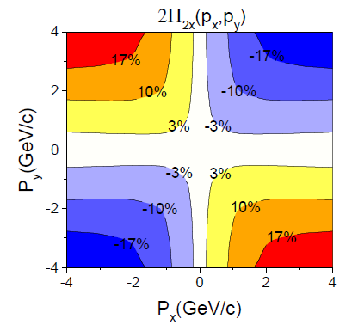
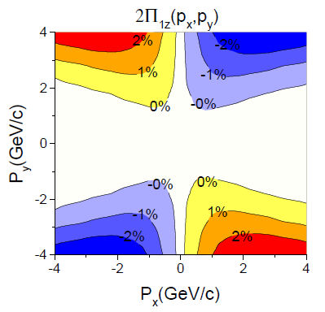
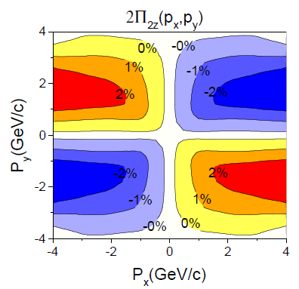
Consequences / c.m. !
[Becattini, et al.,
Eur. Phys. J. C
75, 406 (2015).]
Anti-symmetry
Fig. 7 The first (left) and second (right) terms of the x(up) and y(down) components of the Λ polarization for momentum vectors in the
transverse plane at pz = 0,for the FAIR U+U reaction at 8.0 GeV
[ Xie, Bleicher,
Stoecker, Wang, Csernai,
PRC 94, 054907 (2016). ]

Slide 13
At the highest energies / Rel. Hydro.
[ Xie et al., PRC
94, 054907 (2016)]

Slide 14
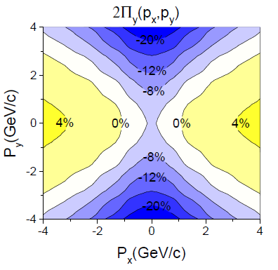
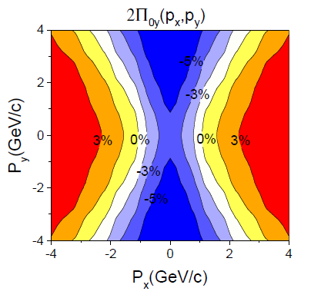
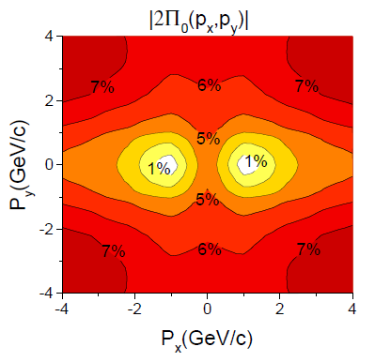
Consequences FAIR
The modulus of polarization is very similar with the y component of polarization, both in magnitude and the structure. I. e. the other x and z components do not contribute to the polarization, which is in line with previous observations in this work and other papers.
[ Xie et al., PRC
94, 054907 (2016)]
Fig. 8 The y component (left) of polarization vector in center of mass frame and Λ’s rest frame. The right sub-figure are the modulus of the polarization in Λ’s rest frame. At FAIR, 8.0 GeV at time 2.5+4.75 fm/c.

Slide 15
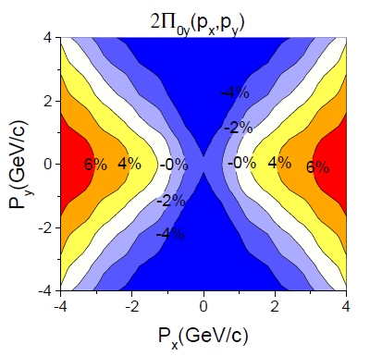
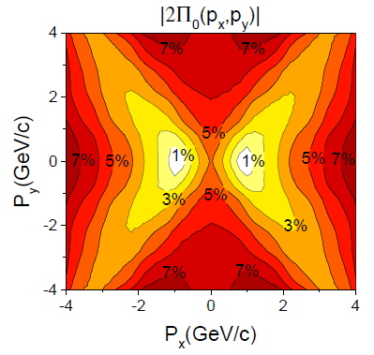
Consequences NICA
Fig. 9 The y component (left) and the modulus (right) of the polarization for momentum vectors in the transverse plane at pz = 0, for the NICA Au+Au reaction at 9.3 GeV. The figure is in the Λ’s rest frame.
[ Xie et al., PRC
94, 054907 (2016)]
Similarity between y component and modulus of Polarization, in magnitude and structure.
Similarity between NICA and FAIR’s polarization results.
The net polarization is still negative, which means the first term is larger than the second term, at this time.

Slide 16
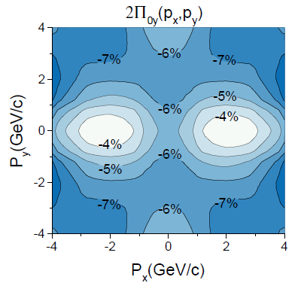
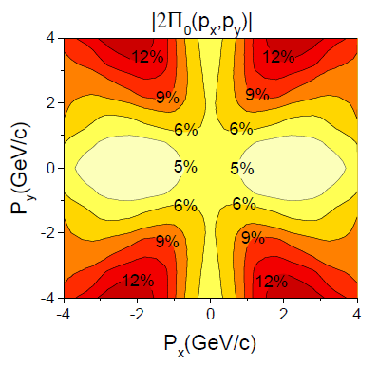
Consequences FAIR
[ Xie et al.,
PRC 94,
054907 (2016)]
Fig. 9 The y component (left) and the modulus (right) of the polarization for momentum vectors in the transverse plane at pz = 0, for the FAIR U+U reaction at 8.0 GeV, but at an earlier time t= 2.5+1.7 fm/c. The figure is in the Λ’s rest frame.
Initially, the first term is very dominant

Slide 17
Polarization and EbE c.m. determination
Earlier EbE c.m. determination ➔ increased V₁ by a factor of 2 [Cs.,E.,M., (2012)].
Now polarization in x and z directions is symmetric in EbE c.m. frame!!!
➔ integrated x & z polarizations vanish (except random fluct.)
➔ finding EbE c.m. is possible by
  Minimizing integrated Π_{x} & Π_{z}
  Maximizing integrated –Π_{y}

Slide 18
Observable consequences
[Yilong Xie, Dujuan Wang, and Laszlo P. Csernai1
PHYSICAL REVIEW C 95, 031901(R) (2017)]
-y
PICR
Hydro
x
Mike Lisa & STAR:
Angular mom.→
Vorticity (rot v)→
Λ & anti- Λ
polarization
z
[ Xie et al., PRC
94, 054907 (2016).]

Slide 19
Λ & Anti-Λ Polarization
AMPT
[Li, Petersen, et al.,
NPA 967 (2017) 772.]
AMPT
AMPT
[Sun & Ko, PRC
96, 024906 (2017).]
[ Li, Pang et al.,
PRC 96, 054908 (2017).]

Slide 20
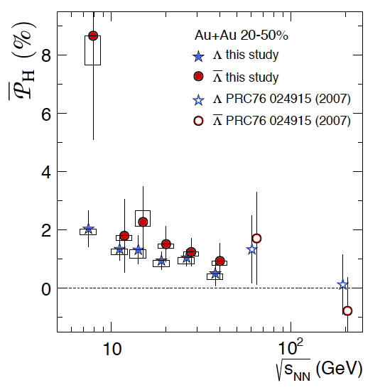
Global Λ Polarization
[Global Λ hyperon polarization
in nuclear collisions,
STAR Collaboration
Nature Letters -548, 62 (2017).]
Positive Λ signal → positive vorticity
First time non-zero signal observed!
Λ > Λ (?) → magnetic coupling
First measurement on ϕ meson spin alignment
arXiv:1701.06657

Slide 21
Λ & Anti-Λ Coupling to Nucleons
Difference based on Hypernuclei:
1.0 – 1.5 MeV i.e. ~ 20% of nuclear
binding energy !!!
ⱻ ~ 20 Λ-hypernuclei (Τ_{1/2} = 10⁻¹⁰s) 1953-1995
[ZhouSG-etal-PhysRevLett.91(2003)262501]
[SongCY-etal-IJMPE19(2010)2538]

Slide 22
Initiative: new I.S. in τ, η coordinates ➔ x,y,z,t
Thus for each streak, i, we can get the origin of the τ=τ₀ hyperbola,
Energy density GeV/fm³
propagated to the c.m. hyperbola

Slide 23
Consequences – vorticity (2017):
Vorticity is max. at the edges, at high +/- X
Consequence of the Bjorken type model
Contradicts to AMPT and parton cascade results of
[Wei-Tian Deng, and Xu-Guang Huang, arXiv: 1609.01801], where max. is at x=0.

Slide 24
Consequences – vorticity (2017):
Vorticity in x direction is max. at the edges, at high +/- y
The two edges point to opposite directions, +/- x, i.e. cancel in total ω_{x}

Slide 25
Relativistic corrections in the new I.S. :
The time derivative is not included in the I.S. but the gradient term,
, has finite contribution (on τ =0 hypersurface):

Slide 26
New Initial State – 2017/8
z-directed vorticity
I.S. : v_{x} & v_{y} vanish everywhere, β_{x} & β_{y} too
➔ Initial ω_{z} = 0 ➔ init. class. Π_{z} =0.
(except surface effects)
y-directed vorticity
→Classical polarization, Π_{y} , is negative
(-y directed),
→Rel. polarization, Π_{y} , may have small negative domains
x-directed vorticity
Integrated ω_{x} = 0, → integrated class. Π_{x} vanishes, p-dependence is symmetric.

Slide 27
Summary
Collective flow is the most dominant collective feature of HI reactions.
Peripheral reactions show shear, vorticity (turbulence) for small transport coefficients ➔ exp. Λ-Polarization
I.S. is of utmost importance, it can be implemented in (t, z) and ( τ, η) hydro codes
Different components, -y, x, z, and momentum dependence do show the weight of different dynamical flow patterns.
➔ Λ-Polarization is highly sensitive diagnostic tool
_{--- * ---}

