Slide 1
π⁰ reconstruction in PHOS and EMCAL
Yuri Kharlov
IHEP, Protvino
EMCAL offline meeting
19-21.05.2008

Slide 2
Physics motivation
Cross section of inclusive production of pp→π⁰X at 10 (0.9) TeV
Validation of pQCD calculations, constraints on PDF and FF
Reference for future AA collisions to measure R_{AA}: π⁰ spectrum was the first evidence of jet quenching at RHIC
Study the π⁰ production in pp collisions at high multiplicity: insight on thermalization in pp
π⁰ spectrum is the easiest measurement in calorimeters, therefore it used for calibration purposes

Slide 3
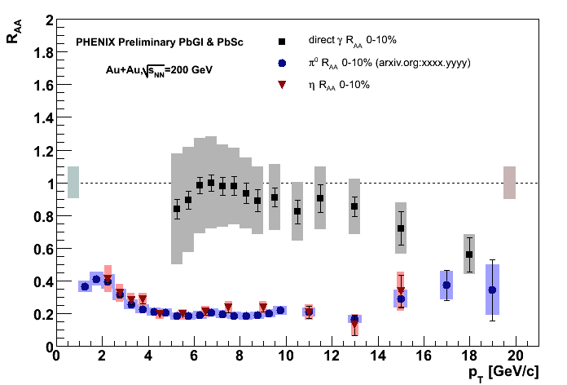
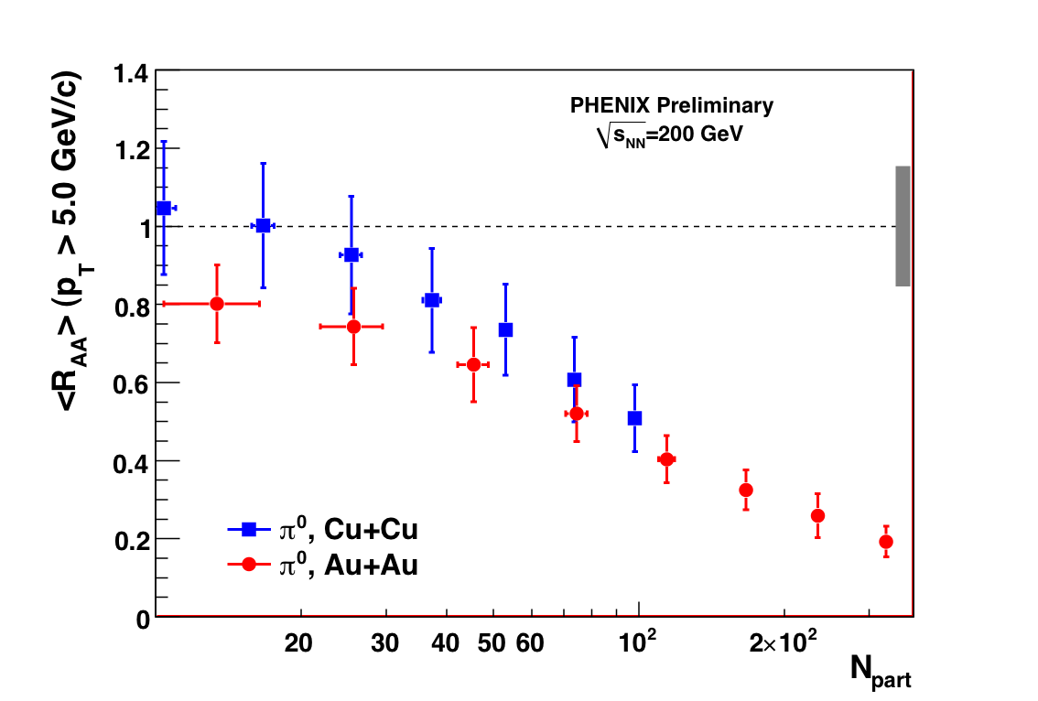
Direct photons and π⁰ in AA collisions
[PHENIX, QM2008]
R_{AA} scales with N_{part}

Slide 4
π⁰ detection in ALICE
π⁰→γγ, where γ’s are detected in PHOS or EMCAL
High efficiency, but limited acceptance
π⁰→γγ, γ→e⁺e⁻, where are detected in e⁺e⁻ TPC (TRD)
Low photon conversion probability is compensated by a large TPC acceptance

Slide 5
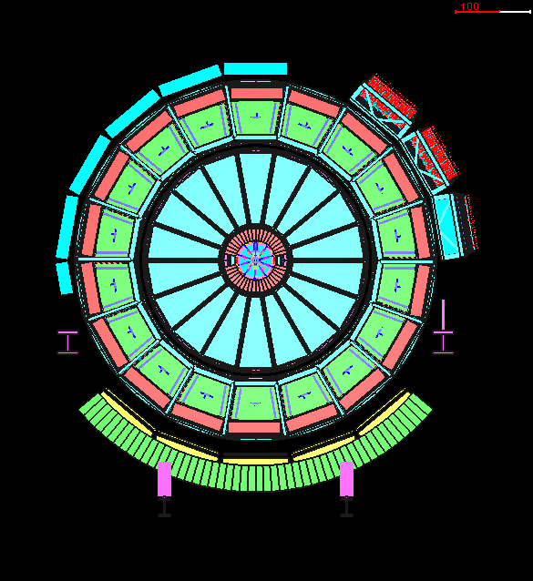
π⁰ detection in ALICE
π⁰→γγ in PHOS and EMCAL
π⁰→γγ, γ→e⁺e⁻ in TPC
γ
γ
e⁺
e⁻
γ
γ
e⁻
e⁺

Slide 6
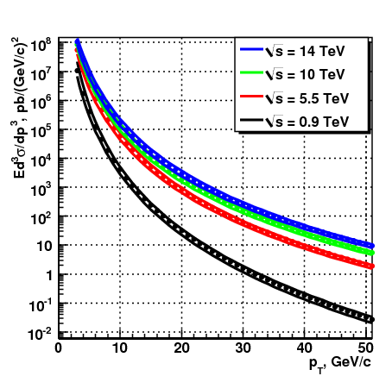
Production cross section
NLO pQCD + CTEQ5M + KPP
Bands indicate possible uncertainties in QCD scale
[P. Aurenche, et al., Eur. Phys. J. C 13,347 (2000)]

Slide 7
From inclusive π⁰ spectrum to event rate
N^{π0} : number of detected π⁰ in selected p_{T}-bin (raw spectrum)
L: luminosity
T: run time
Br: branching ratio
C_{trig} : trigger bias correction
C_{geom} : geometrical acceptance
C_{rec} : reconstruction efficiency
C_{offvtx} : correction due to off-vertex background

Slide 8
LHC run scenarios
Nominal LHC scenario for ALICE:
pp collision energy: 14 TeV
luminosity: 3⋅10³⁰ cm⁻²s⁻¹
First LHC run scenario:
pp collisions at 10 TeV (?)
luminosity: 5⋅10²⁸ cm⁻²s⁻¹ (?)
Data taking time: from days to months
If PHOS/EMCAL are triggered by the ALICE minimum bias trigger, then event rate is limited by 200 Hz: L_{eff} = 5⋅10²⁷ cm⁻²s⁻¹
If PHOS/EMCAL are triggered by their standalone L0 trigger on high p_{T}, event rate is defined by p_{T} spectrum only
Integrated luminosity, nb⁻¹
Run time T | L, cm⁻²s⁻¹
 | 5⋅10²⁷ | 5⋅10²⁸ | 3⋅10³⁰
3 days | 1.3 | 13 | 780
1 month | 13 | 130 | 7800
3 months | 39 | 390 | 22000

Slide 9
Raw π⁰ spectrum
π⁰ analysis is implemented as a part of the Particle identification and Hadron/Jet correlations analysis framework
$ALICE_ROOT/PWG4PartCorrDep, $ALICE_ROOT/PWG4PartCorrBase
Documentation in: http://aliceinfo.cern.ch/Offline/Activities/Analysis/PWGDocumentation/PWG4/PartCorr.html
Requirements to run π⁰ analysis:
Root installed
Data ESD, AOD or MC
A “.par” files or analysis libraries with your analysis class inside
To produce a “.par” file the user should execute :
cd $ALICE_ROOT
make XXX.par
AOD.par, ESD.par, ANALYSISalice.par, ANALYSIS.par, STEERBase.par, PWG4PartCorrBase.par, PWG4PartCorrDep.par.
Analysis configuration file (for example ConfigAnalysisPi0.C)
Analysis macro ana.C
If the five conditions are satisfied and everything is well written the user has just to execute by : root -q –b –l ana.C
It is running in the analysis train.

Slide 10
AliAnalysisTaskSE
AliAnalysisTaskParticleCorrelation
Output
Data
Input
AliAODPWG4ParticleCorrelation
AliAODPWG4Particle
and/or
AliAODCaloClusters
and/or
Histograms
PWG4PartCorrBase
AliAnaPartCorrMaker
Data
AliCaloTrackReader
ESD, AOD, MC
aodEMCal,
aodPHOS, aodCTS
aodEMCal,
aodPHOS, aodCTS
aodPWG4Particle
AliAnaPhoton
derives from AliAnaBaseClass
AliAnaPi0
derives from AliAnaBaseClass
PWG4PartCorrDep

Slide 11
AliAnaPi0 Class
Analyze ESD and AOD
Extraction of 2γ inv mass spectrum, Real and Mixed
Invariant mass is filled in 3D histogram (p_{T}, asymmetry, mass)
In one pass it should be able to
Evaluate centrality dependence
Evaluate PID dependence
Evaluate dependence on distance to bad modules
Evaluate dependence on asymmetry cut
Produce as flat Re/Mi ratio around peak as possible

Slide 12
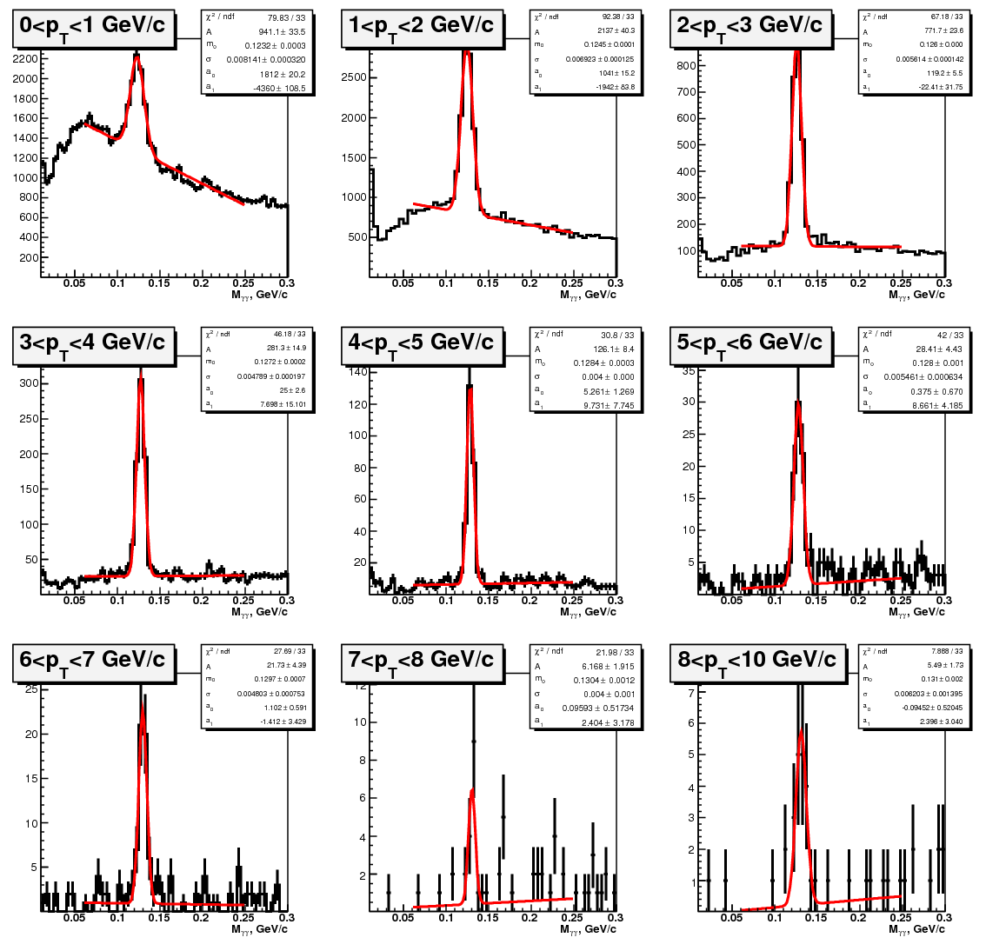
Invariant mass
4M pp min.bias events in PHOS
Fit by gaus+pol1

Slide 13
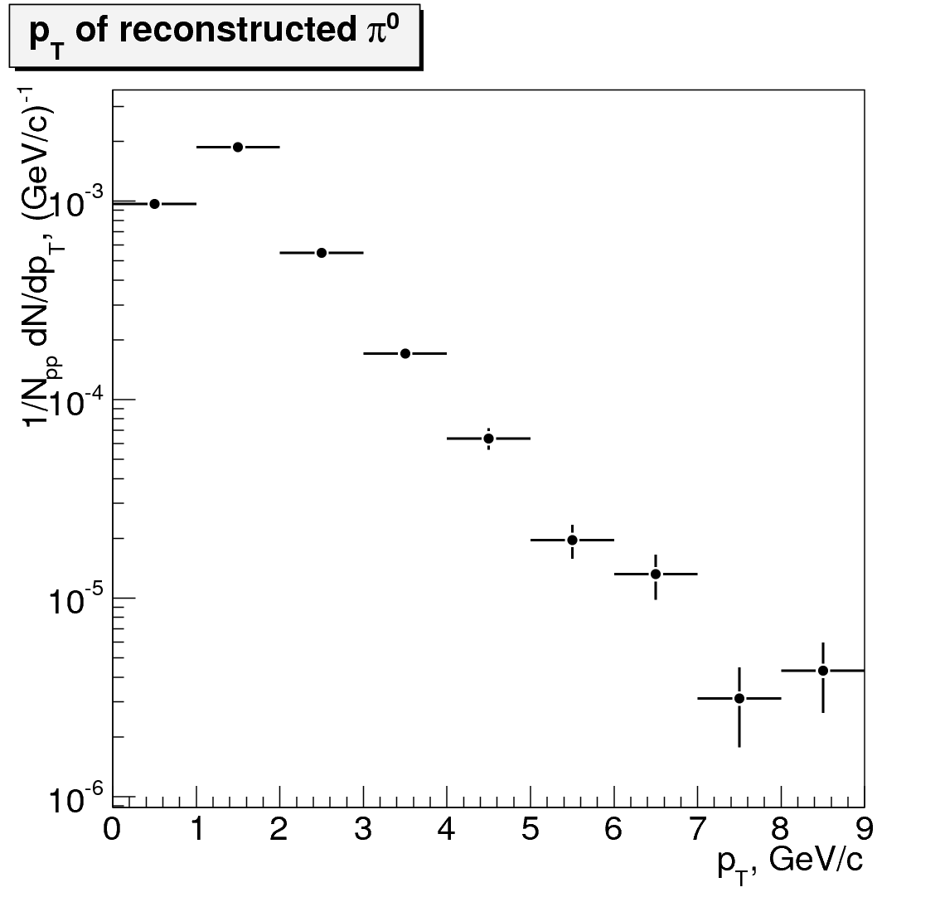
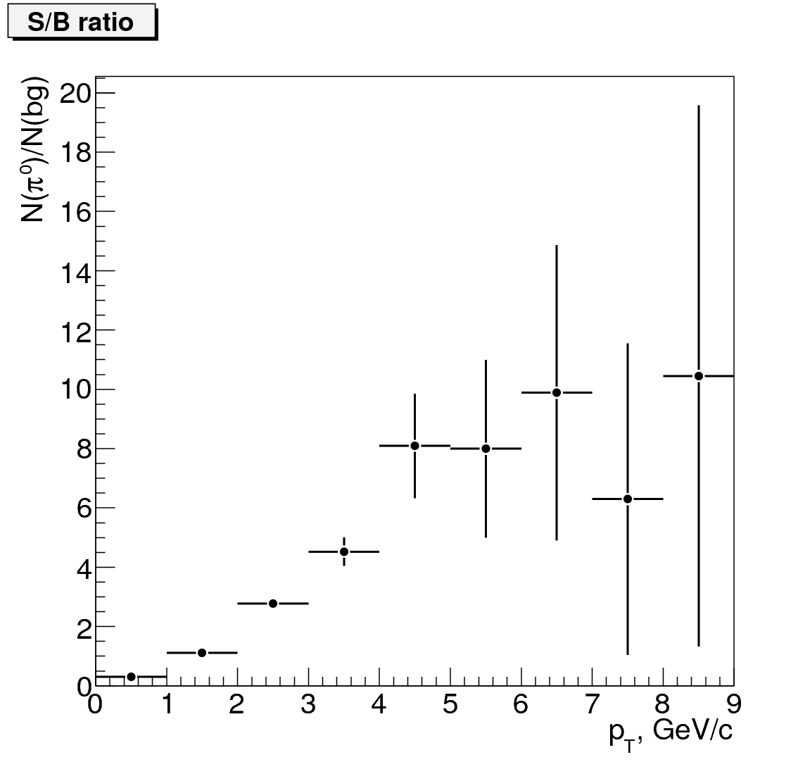
Raw π⁰ spectrum and S/B ratio

Slide 14
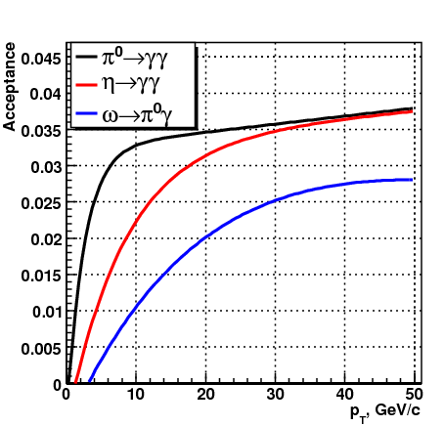
Acceptance parameterization for 3 PHOS modules
Acceptance is normalized per |y|<0.5, Δϕ=2π:
 | a | b | c | d
π⁰ | 0.032 | 1.1⋅10⁻⁴ | 0.355 | 2.51
η | 0.033 | 9.1⋅10⁻⁵ | 1.33 | 8.10
ω | 0.183 | 2.0⋅10⁻³ | 2.37 | 120

Slide 15
Reconstruction efficiency × conversion probability

Slide 16
Spectrum recovery for converted π⁰
If a photon from π⁰ decay converts to e⁺e⁻ far from a calorimeter, a π⁰ can be detected as 3 clusters, and π⁰ will be lost at invariant mass spectrum.
If a photon from π⁰ decay converts to e⁺e⁻ close to a calorimeter, a π⁰ can be detected as 2 clusters, and π⁰ will not be lost.
If we rely on the material description of central ALICE detectors, a recovery factor due to converted π⁰ can be evaluated in simulations:

Slide 17
Spectrum correction due to p_{T} smearing
π⁰ has a finite p_{T} resolution in a calorimeter K(p_{T}^{true}-p_{T}^{meas})
Measured pT spectrum has a steep slope
As a result of a finite p_{T} and a slopy spectrum, a distribution of a measured p_{T} f’(p_{T}^{meas}) is not the same as a distribution of a true p_{T} f(p_{T}^{true}).
f’(p_{T}^{meas}) is measured experimentally
K(p_{T}^{true}-p_{T}^{meas}) can be evaluated in MC simulations
f(p_{T}^{true}) has to be defined as a solution of integral equation

Slide 18
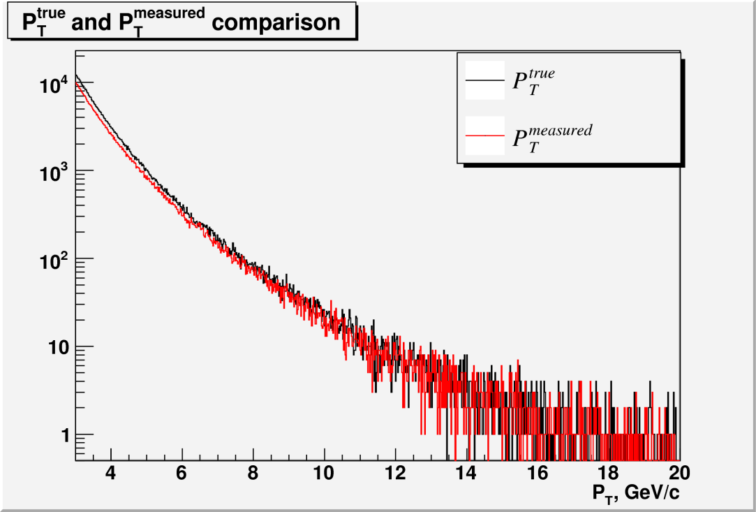
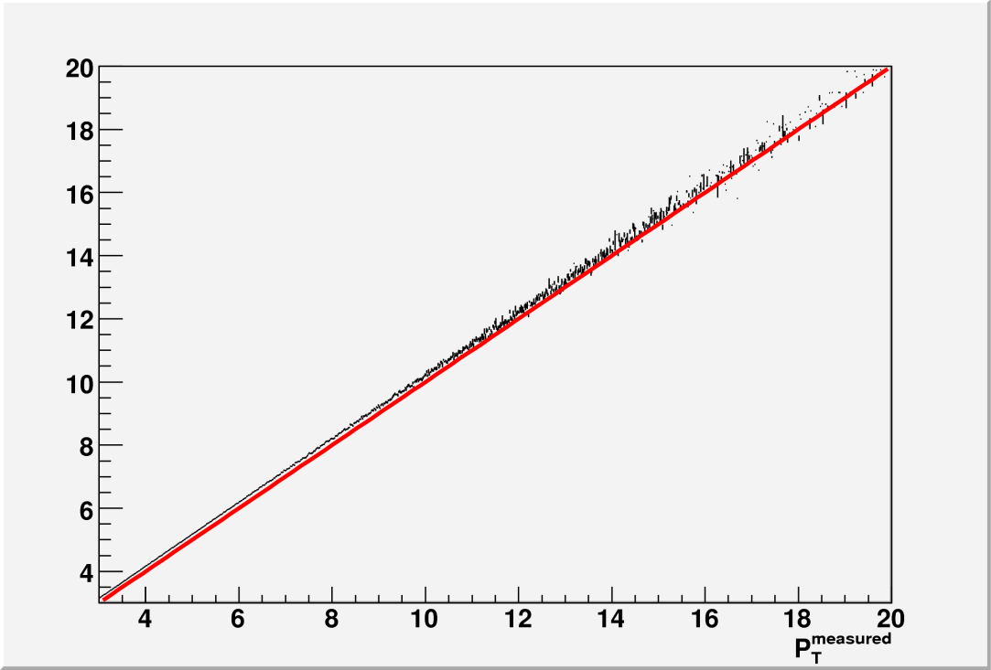
Smearing effect in “toy” model
Measured p_{T} is always softer than true p_{T}.
Measured spectrum of measured p_{T} is always lower that a true spectrum of true p_{T}

Slide 19
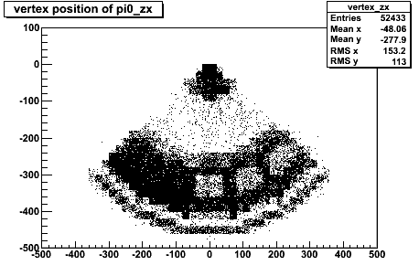
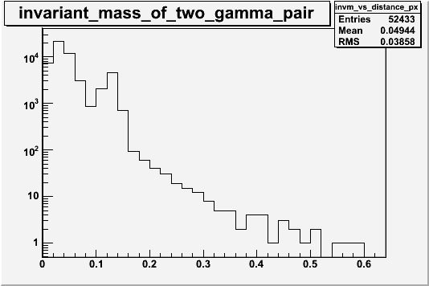
Off-vertex background to π⁰ spectrum
In 2-photon invariant mass spectrum, some fraction of π⁰ are produced off-vertex
Secondary interactions of hadrons with ALICE medium can produce 2 clusters which will be detected in PHOS with invariant mass around π⁰ mass (135 MeV)
For example, primary π⁺ can scatter off medium and produce secondary pi0 in charge-exchange reaction. Reconstructed photons are assigned to a primary vertex.
Example: single π⁺ 2.5M events at
0 <p_{T}< 50GeV/c, ：220°<φ<320°, ：-0.3< η <0.3

Slide 20
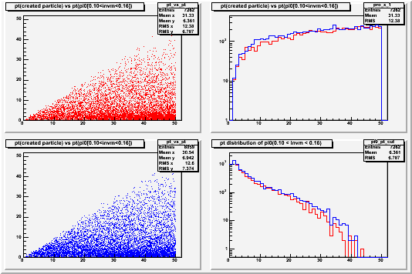
single π±
π+
Projection X
Red line : π+
Blue line : π－
π－
Projection Y
The π⁰(off vertex)/ π⁰(real) ratio can be calculated as a convolution with hadron/π⁰ production yields ratios

Slide 21
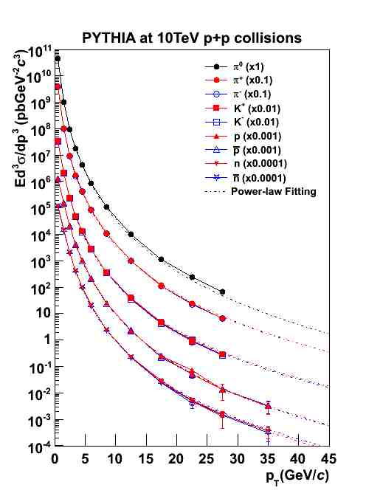
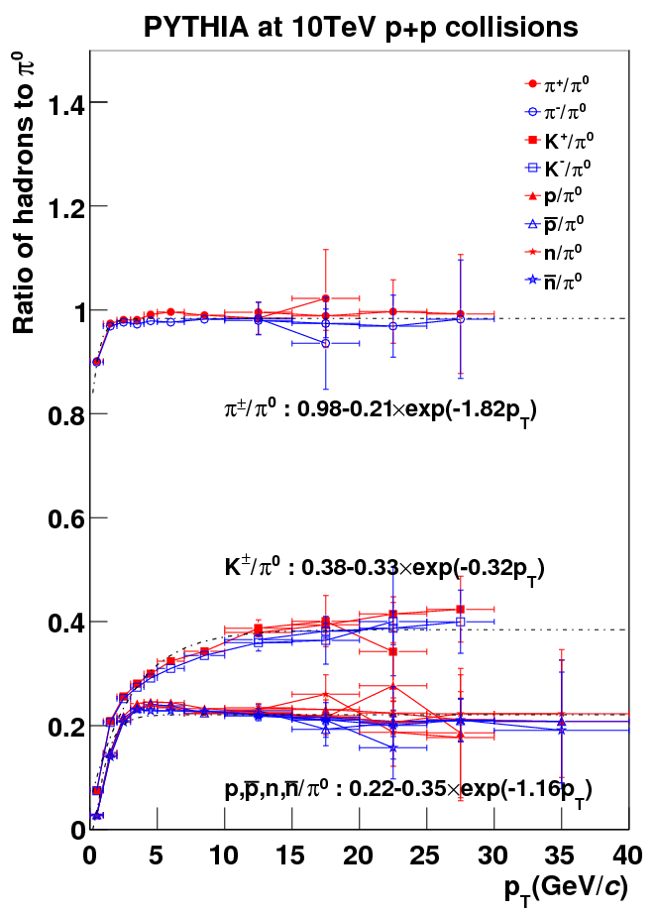
Hardon/π⁰ ratio in pp @ 10 TeV

Slide 22
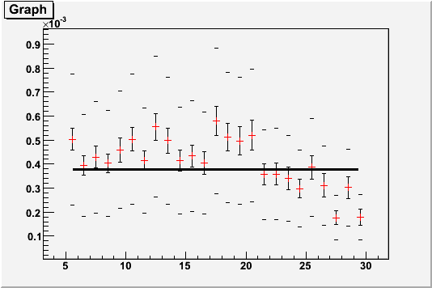
π0(off vertex)/π0(real) ratio （π±, K±, K0L, p, anti-p, n, anti-n)
π0(off vertex)/π0(real)
Error bars:
inside: statistic error
outside: systematic error
systematic error
π±: 10%
K±,K⁰_{L}: 30%
p,anti-p,n,anti-n: 50%
Geant: 50%
Fit the data with statistic error by constant at 5<p_{T}<30GeV/c
3.77×10⁻⁴±0.09×10⁻⁴
0.04% of off vertex π0 contribute to π0 measurement.

Slide 23
Trigger simulation
AliPHOSTrigger class: simulation model of PHOS L0 trigger
AliEMCALTrigger: similar class for EMCAL
Simulation with 5 PHOS modules, pp min.bias events by Pythia
Ideal calibration: all cells provide exact deposited energy (not true in real life!)
threshold to keep digit: 0.012 GeV
LHC luminosity: L=5⋅10²⁸ cm⁻² c⁻¹ ⇒ interaction rate: 3.5 kHz

Slide 24
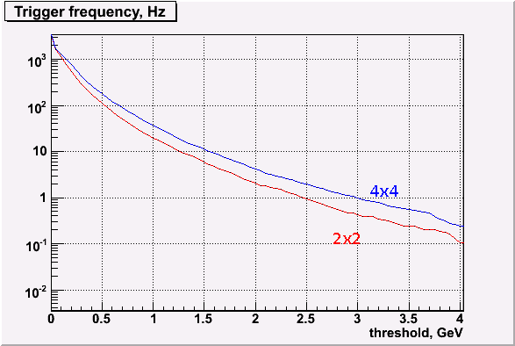
PHOS L0 trigger rate
L0 definition: 2x2 (4x4) cells energy sum above a threshold somewhere in PHOS

Slide 25
Calibration
PHOS/EMCAL will be pre-calibrated by adjusting APD bias to the same gain, using Hamamatsu datasheets. Decalibration of pre-calibrated PHOS is 10%
Online DAs will deliver calibration parameters from physics events (pp or AA peripheral):
equalization of mean deposited energy per cell
equalization of MIP peak per cell
these algorithms give 5% accuracy of calibration parameters
Offline calibration aims to refine calibration parameters to 1% accuracy.
Offline calibration for ALICE calorimeters was defined: see http://indico.cern.ch/conferenceTimeTable.py?confId=58016

Slide 26
Basics of Calorimeters Offline Calibration
Calorimeters (PHOS and EMCAL) offline calibration requires the full available statistics:
PHOS needs ~10⁹ - 10¹⁰ events estimated from a requirement to have 100-1000 π⁰’s photons per cell,
EMCAL might need less statistics due to a larger (×7.5) cell.
Calorimeters offline calibration is an iterative procedure, needs 5-10 iterations with the full statistics.
Objects needed for calorimeter calibration:
AODCaloClusters (clusters energy and coordinate)
AODCaloCells (cells energy and ID)
Vertex V0
Tracks (only needed for particular calibration algorithms)
Geometry from OCDB GRP
Since the input for Calo calibration is AOD, the algorithm is implemented as an Analysis Task

Slide 27
Calibration algorithm
Reconstruct invariant masses. For every cell, take all invariant masses which has a cluster with a center in cell and plot those in a “cell histogram”.
In each “cell histogram”, find the π⁰ mass by fitting the plots by Gaussian+polynomial.
Correct calibration parameters by adjusting π⁰ mass to 135 MeV
Repeat until calibration is achieved, using the new calibration coefficients from step 3 in step 1.
Simple converging function

Slide 28
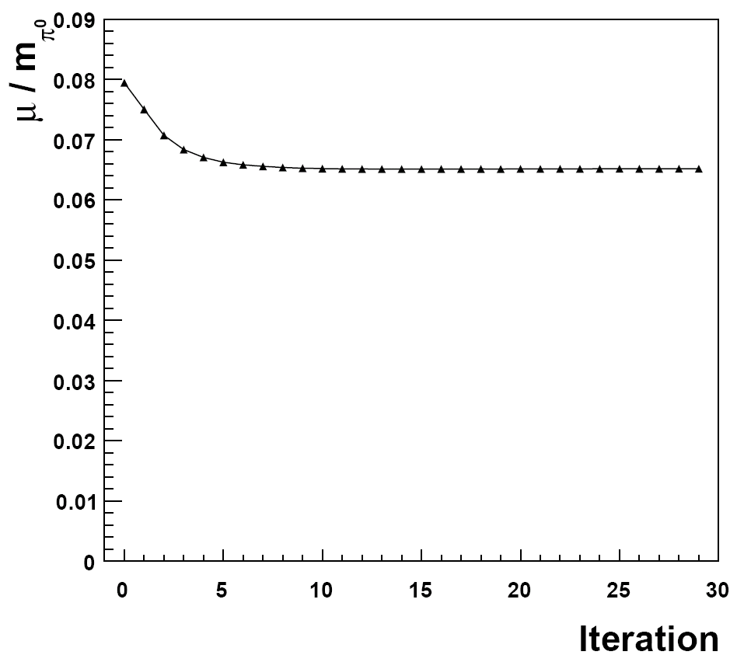
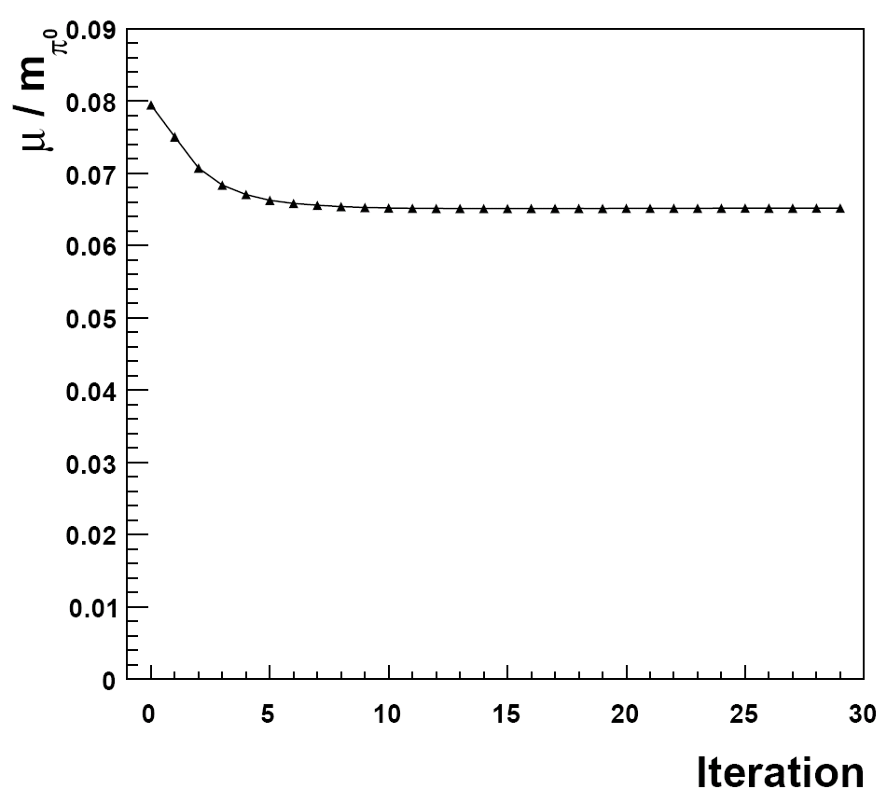
Convergence of iterations
Single π⁰ at pT=10 GeV/c: H.Qvigstad

Slide 29
Each (i-th) iteration does:
Opens ESD/AOD, reads calibration parameter corrections calculated from (i-1)th iteration
Writes the output of the Calibration Analysis Task as a set of N histograms TH1 (N is a number of cells, N=18k for PHOS and N=11k for EMCAL)
Calibration analysis task analyzes data of several chunks in parallel (GRID jobs). Output histograms from all chunks should be merged to create an accumulated set of N histograms. Some bookkeeping is required to mark the merged chunks, in order to avoid double merging and missed chunks.
As soon as enough statistics is accumulated, the histograms are analyzed to calculate the new set of calibration parameters corrections
The output histograms and calibration parameters corrections are transient objects:
no need to store them in a persistent mass storage system.
Should survive until the i-th iteration processes the full statistics and full merging is completed

Slide 30
End of iterative calibration
Criteria of the calibration procedure convergence:
Variation of the calibration parameters corrections in the (i-1)th and i-th iteration is less then ε₁;
Variation of the π₀ mass distribution width in the (i-1)th and i-th iteration is less then ε₂.
After the final iteration, a new set of calibration parameters is calculated as a product of the initial calibration parameters from OCDB and the calibration parameters corrections.
Note that calculation of the new set of calibration parameters may require manual intervention.
The new set of calibration parameters should be submitted to production managers to register to OCDB

Slide 31
A step after offline calibration
Besides creating the new OCDB object, we aim to recalibrate the ESD created after the first reconstruction pass. For this, this first ESD should pass through another filter, and parameters of the CaloClusters (energies, coordinates, shower shape) should be recalculated with the use of corrections to the cell amplitudes found by recalibration procedure.
As a result of this filtering, a new AOD will be created with better calibrated CaloClusters. This new AOD should be used for the official physics analysis.

Slide 32
Summary
π⁰ analysis in both ALICE calorimeters PHOS and EMCAL is unified.
All steps to achieve the final goal - π⁰ inclusive spectrum can be adapted from PHOS to EMCAL:
Acceptance×reconstruction efficiency
Raw spectrum extraction
Corrections due to photon conversion
Corrections due to off-vertex background
Trigger efficiency
Calibration
Materials of the PHOS analysis WG can are available in http://indico.cern.ch/categoryDisplay.py?categId=662
Simultaneous measurement of π⁰ spectrum in PHOS and EMCAL is important for systematic error estimations
Joining the efforts looks natural

Slide 33
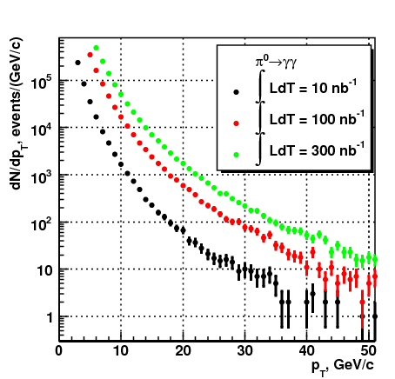
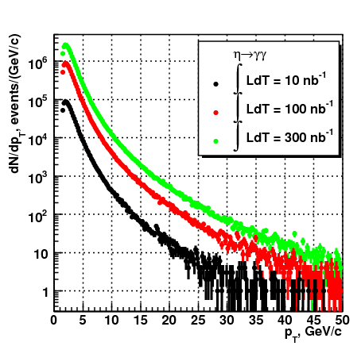
Expected detection rate in PHOS
What will EMCAL provide?

