Slide 1
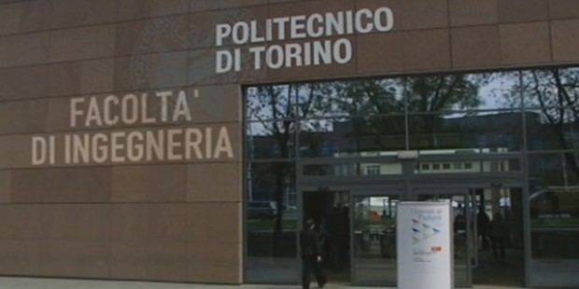
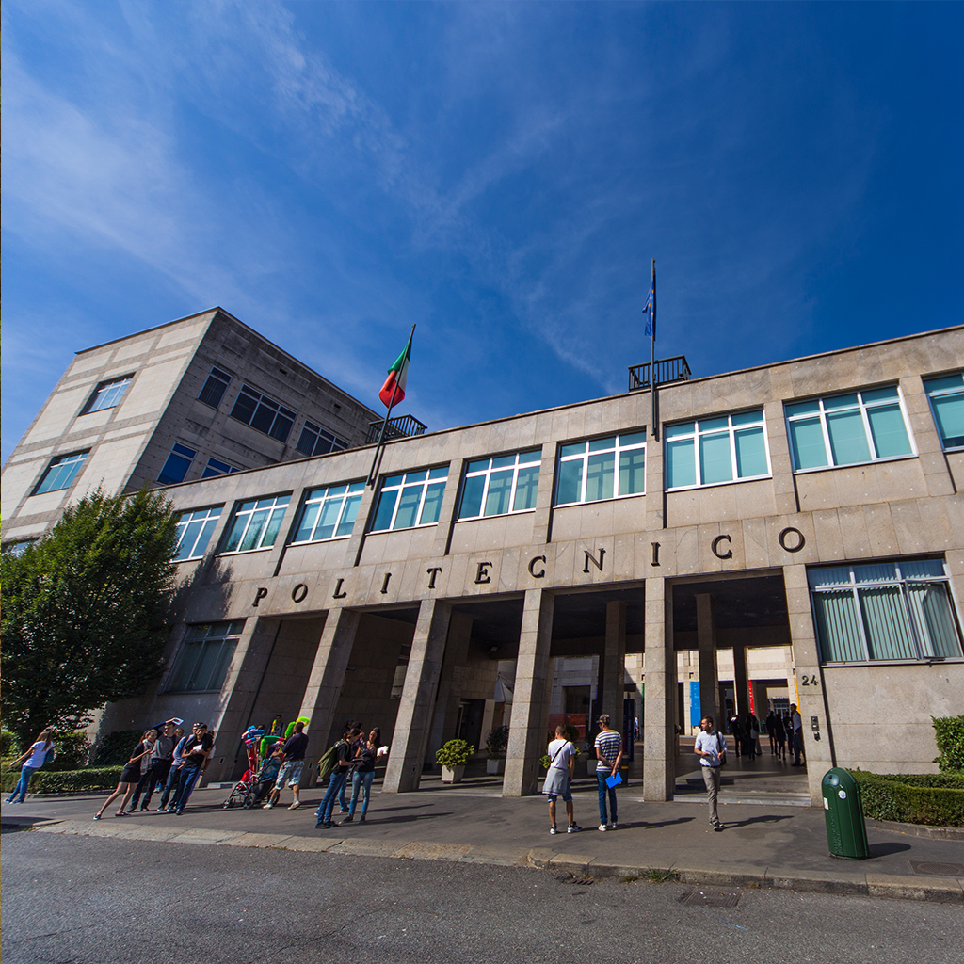
L’esperienza POLITO nel campo delle tecnologie additive ed il Master in Additive Manufacturing
Prof. P. Fino
Dipartimento DISAT, Politecnico di Torino

Slide 2
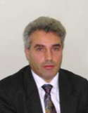
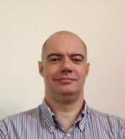
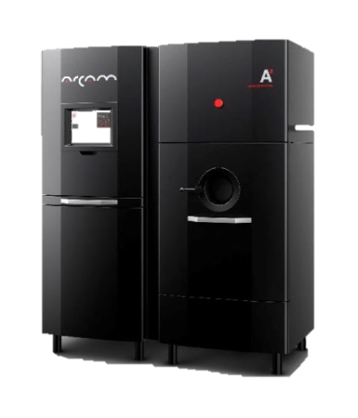
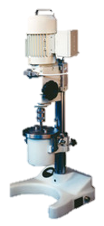

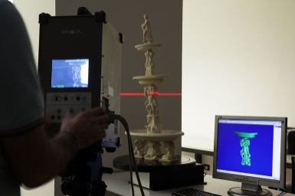
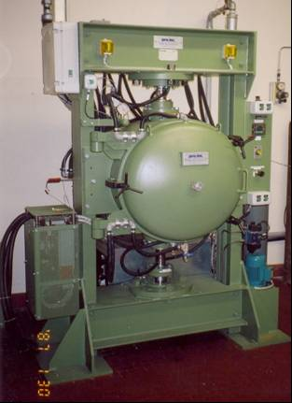

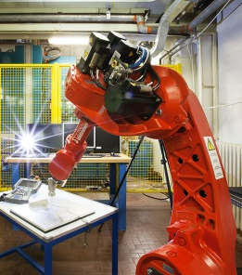
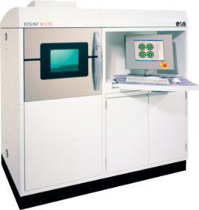

AM @ Politecnico di Torino
Luca
Iuliano
Paolo Fino
Material Science and Technology
CAD/CAE/CAM
and 3D scanning systems
Politecnico di Torino
Department of Management and Production Engineering
Politecnico di Torino
Applied Science and Technology Department
Advanced
CNC machining and additive manufacturing
TEAM di Ricerca
13 ricercatori strutturati;
18 assegnisti di ricerca/dottorandi

Slide 3

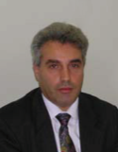
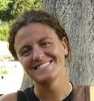
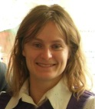
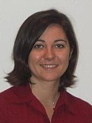

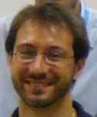
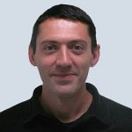

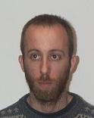

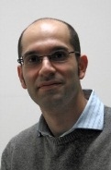
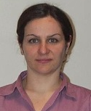
AM @ Politecnico di Torino
Istituto Italiano di Tecnologia
Centre for Sustainable Futures CSF@PoliTo
Paolo Fino
Full Professor
Luca
Iuliano
Full Professor
Elisa Paola Ambrosio
Researcher Technologist
Sara Biamino
Associate Professor
Eleonora
Atzeni
Assistant Professor
Diego Manfredi
Researcher Technologist
Daniele Ugues
Associate Professor
Paolo
Minetola
Associate Professor
Politecnico di Torino
Department of Management and Production Engineering
Politecnico di Torino
Department of Applied Science and Technology
Flaviana Calignano
Researcher
Matteo Pavese
Associate Professor
Massimo Lorusso
Researcher
Alessandro
Salmi
Assistant Professor
Mariangela Lombardi
Associate Professor
Alberta Aversa
Research fellow
Giorgio Baudana
Research fellow
Giulio Marchese
Research fellow
Francesco Trevisan
Research fellow
Jukka Pakkanen
Research fellow
Giulio Cattano
Research fellow
Manuela Galati
Research fellow

Slide 4


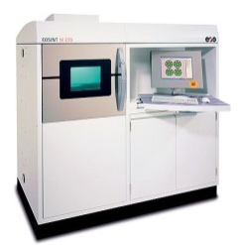





AM@POLITO
2005
2006
2007
2008
2009
2010
2011
2012
2013
2014
2015
Arcam A2
Intermetallics
Superalloy
Ceramics
Polito @ Tecnogrnada Spa
M270 EOS
Lightweight
Composites
SMA
M250 EOS
CoCr alloy
EBM - TiAl Intermetallics
Blow Powder Tech.
Large components
Partnership Prima Industrie – Polito
European research project
Partnership AVIO – Polito
Regional research project
E-Break
Great2020-F2
AMAZE
Cluster
TiAl-Charger
Helmet
Borealis

Slide 5
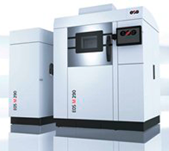
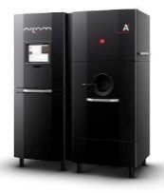
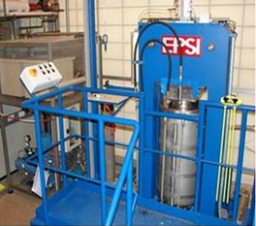
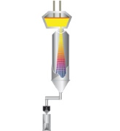
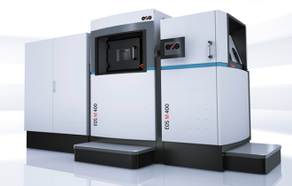

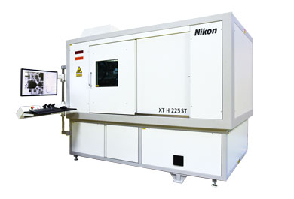

AM@POLITO
2015
2016
2017
2018
2019
Arcam A2
Intermetallics Superalloy
Ceramics
Hot Isostatic Pressing
Gas atomization system
M290 EOS
M400 EOS
Tomography
HUB - DIMA
Cluster – P. Fino
Borealis – M. Lombardi
Helmet – D. Ugues
4D-Hybrid – S. Biamino
STAMP – M. Lombardi
AMABLE – M. Lombardi

Slide 6

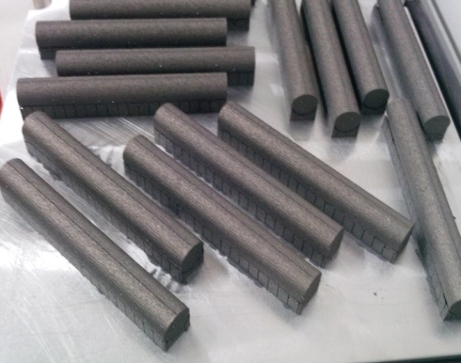
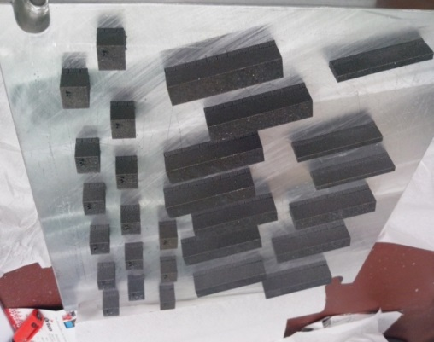
Approach
DMLS/EBM design and production
Alloy selection and design
Process optimization
Heat treatmet setup and surf. finishing
Optimal microstructure definition
Microstruc-tural selection
Mechanical and thermal properties tests

Slide 7
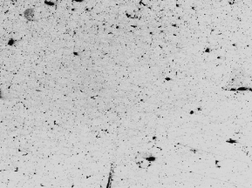
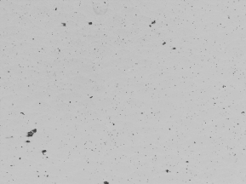
Process optimization
Fundamental to find the best process window

Slide 8
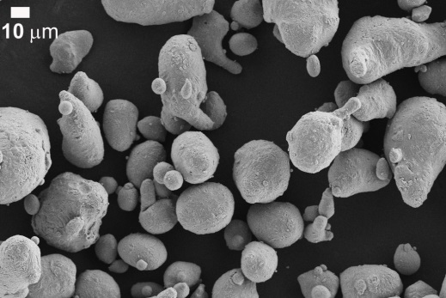
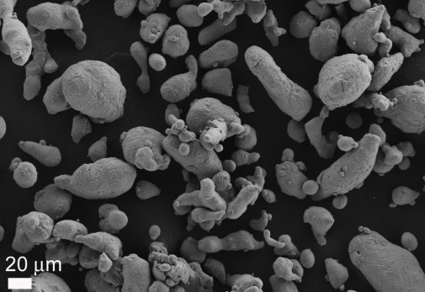
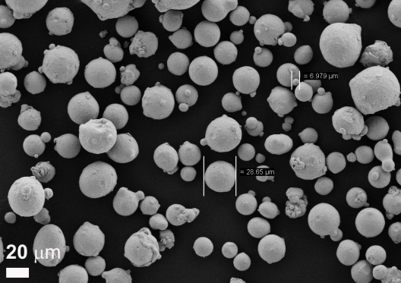
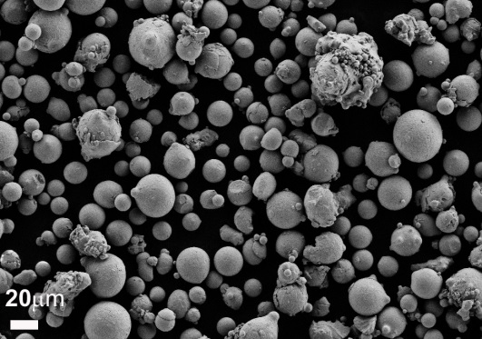
AM in Polito/IIT DMLS machine
MATERIALS DEVELOPED @ POLITO/IIT
A357
7075
MATERIALS under investigation
- Other Al alloys for aerospace
(2xxx, 6xxx, etc)
- Other Al based Composites
In718
In625
Ti based Composites
- Functional materials
(e.g. SMA)

Slide 9
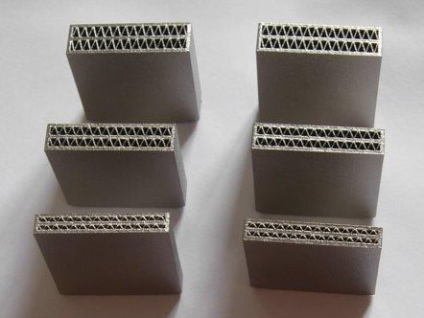
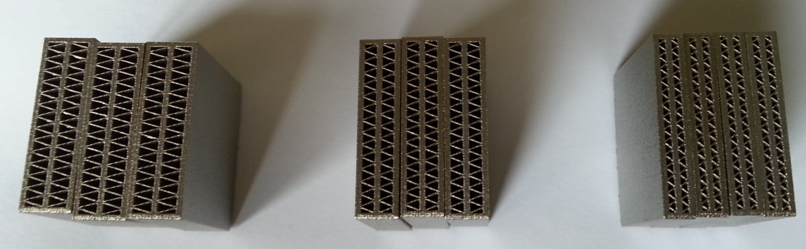
AM for heat exchangers
EU Project – FPVII HELMETH “Integrated High-Temperature Electrolysis and Methanation for Effective Power to Gas Conversion”
Design and fabrication of fins and heat exchanging elements by DMLS: complex shapes and hollow structures to work at high T (800 °C) and in a corrosive gas environment (H₂)
In718 @ IIT-PoliTo
Scale up → assembly of modules with different heights

Slide 10
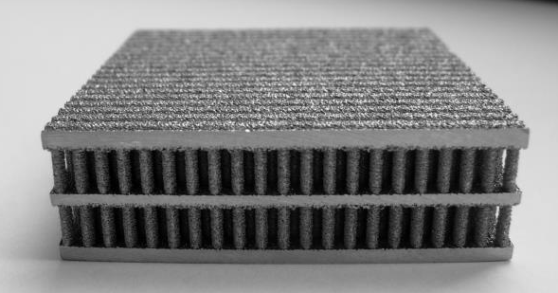
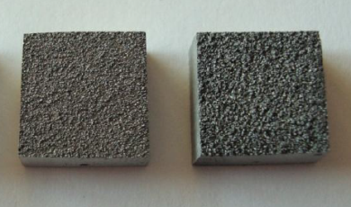
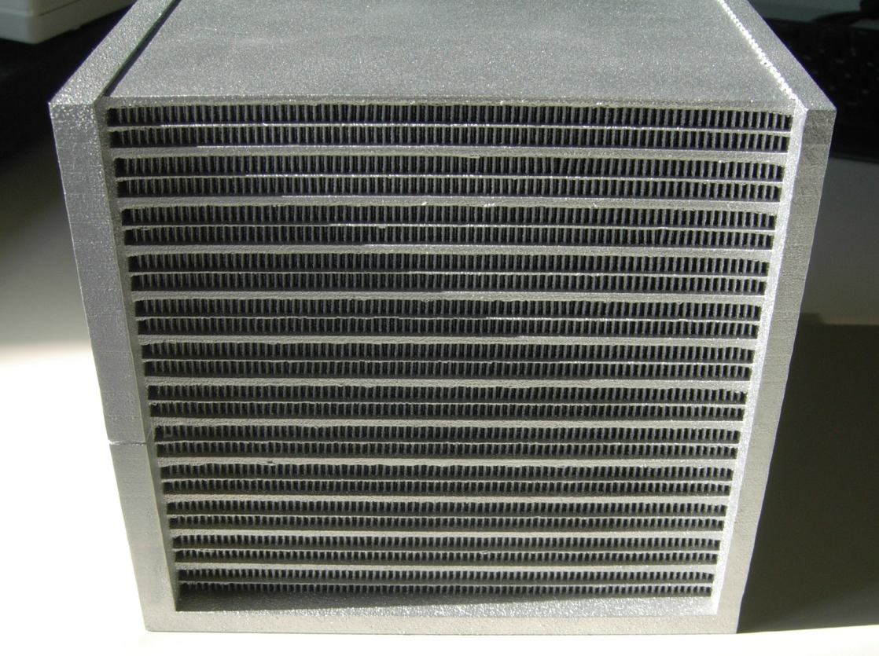
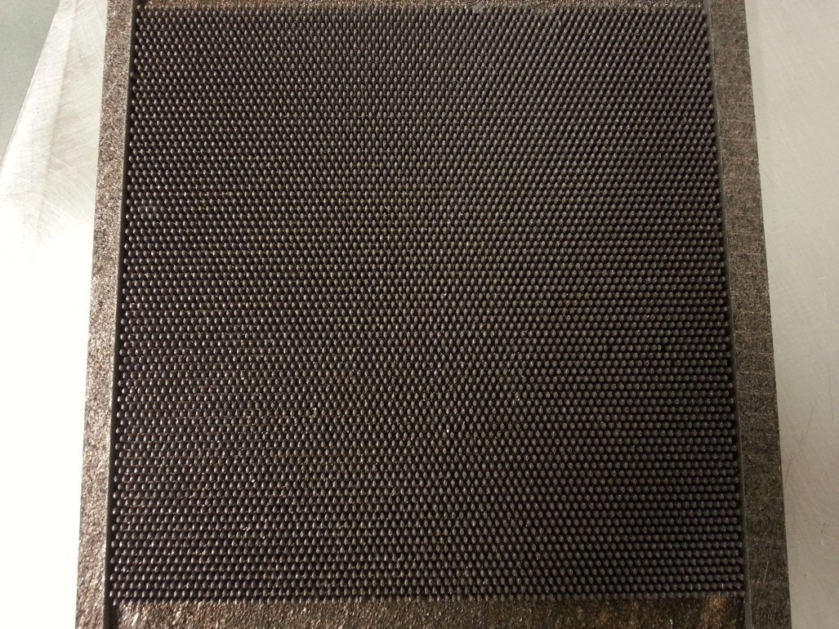
AM for heat exchangers
Produced in AlSi10Mg @ IIT-PoliTo
From single module to scale up
Microstructured Roughness
High Ra → increase efficiency
160 cm x 160 cm x 170 cm
For each layer 6320 ellyptical fins

Slide 11

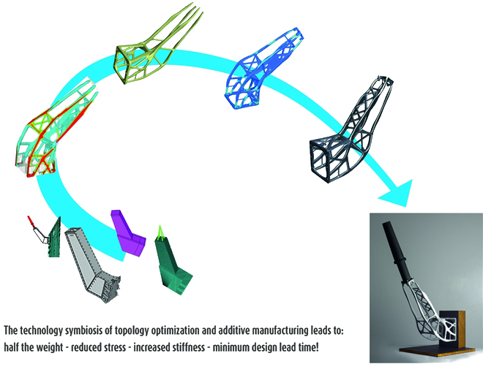
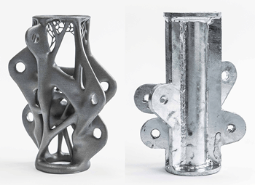
Topology Optimization
Calculated stresses
Weight saving
  --> Usage cost saving
Manufacture time
Before
After
http://www.metal-am.com/news/002857.html

Slide 12
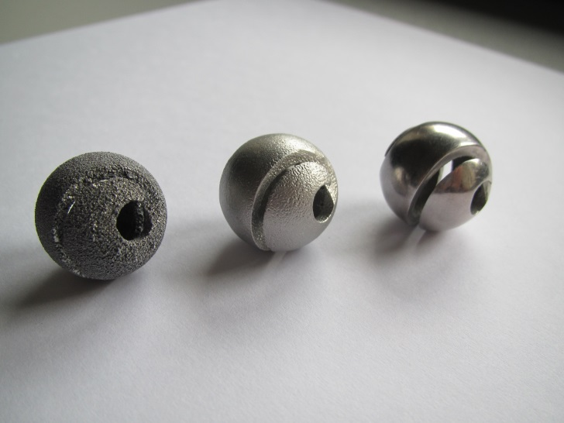
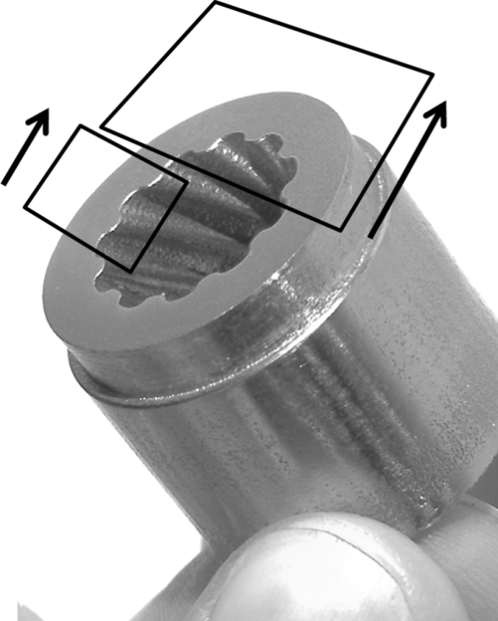
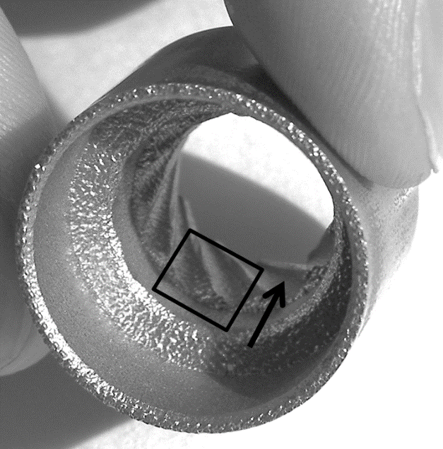
Surface post processing
Combination of mechanical and electrochemical polishing, abrasive flow machining (AFM)
Surface post processing → and subsequent stereomicroscope analysis
and 3D scanning

Slide 13
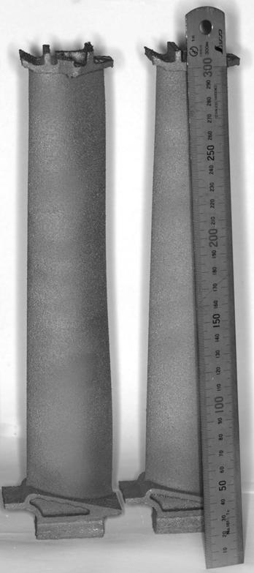
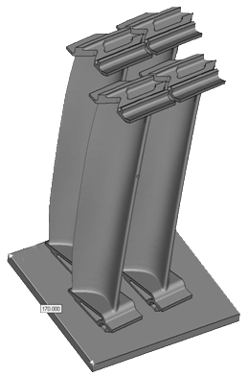
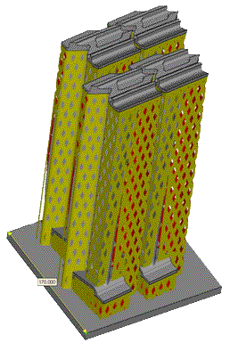
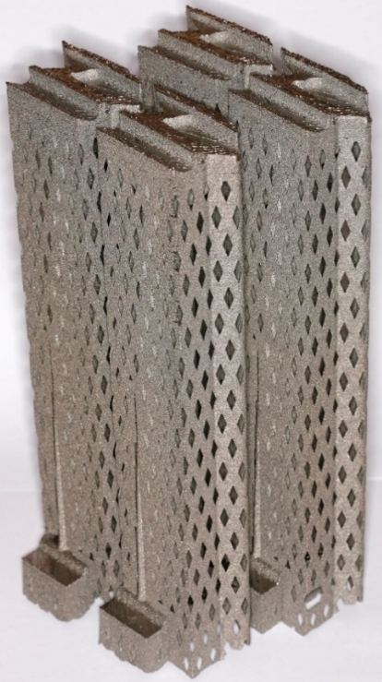
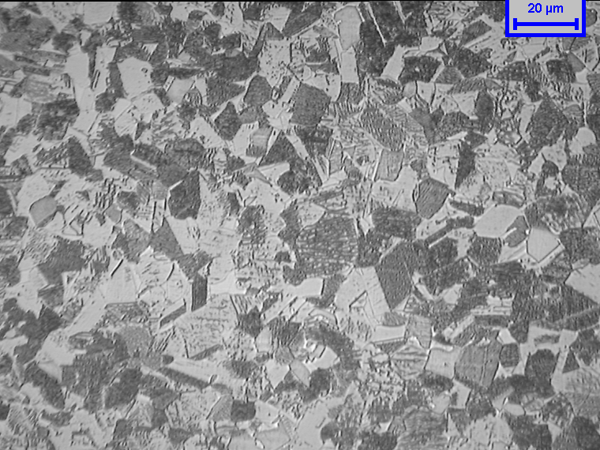

γ-TiAl prototype turbine blades manufactured with EBM

Slide 14







Automotive Application
Turbocharger Wheel
Turbocharger:
Increase power output
Improve fuel-efficiency
Light weight TiAl Turbine wheel:
Improve performance
Further improve fuel-efficiency
Reduction in emission

Slide 15
Strategy for the growth
Technology redesign
Increase Power source
Chamber thermal stability
Combinatory metallurgy
etc
Materials innovation
Material development
Design strategy
Increase chamber dimension
Multiple power sources
etc.
Component dimension

Slide 16
PP Platform
Research
Training
Cross fertilization
Polito
PPP Since 2007
PPP Since 2009
AVIOAERO
Prima Industrie
NDA Since 2013
Process
Component
Technology Development

Slide 17
Current Environment
EU HUB DIMA
KIC – AVM ?
CC @ Polito ?
Partnership with AvioAero – Lab TAL
Partnership With IIT
Interdip. LAB
Regional Platform Smart Manufacturing

Slide 18

To redesign the designer….

Slide 19

Corso di Laurea Magistrale in Ingegneria Meccanica:
Orientamento in Fabbricazione Additiva

Slide 20










MASTER UNIVERSITARIO DI II LIVELLO IN
“ADDITIVE MANUFACTURING”

Slide 21


Progetto di Formazione - FONDIMPRESA

Slide 22

2016: two multidisciplinary projects in the ASP educational programme (XII cycle), in which students of Politecnico di Torino and Politecnico di Milano may practice the process of envisioning, framing, planning and implementing innovation.
Finishing processes for additive manufactured metal components
Eleonora Atzeni, Alessandro Salmi, Sara Biamino, Mariangela Lombardi, Maurizio Vedani, Luigi De Nardo, Flaviana Calignano, Elisa Paola Ambrosio
The main objective of the project is the study and development of a surface finishing technology for improving the surface quality of the components fabricated by additive manufacturing.
Challenging 3D food printing
Monica Bordegoni, Barbara Del Curto, Francesca Montagna, Paolo Fino, Fabrizio Cassotta
The objective of the project is to analyse the potential use and impact of 3D printing in the food industry, investigating new possible printer configurations and architectures, new materials (mixtures) and printing processes, and also possible stakeholders and business models for new markets for Barilla.

Slide 23
Projects
GREAT 2020 – GReen Engine for Air Traffic 2020 – Regional project (2009-2012).
ProTiAl – Developing of a new concept for optimal Production and machining of aerospace components in TiAl (2009-2012).
AMAZE – Additive Manufacturing Aiming Towards Zero Waste and Efficient Production of High-Tech Metal Products – UE Project, VII FP (2012-2015).
E-BRAKE – Demonstration of breakthrough sub-systems enabling high overall pressure ratio engine – UE Project, VII FP (2012-2015).
TiAl Charger – Titanium Aluminide Turbochargers – Improved Fuel Economy, Reduced Emissions – UE Capacities Project, VII FP (2012 – 2014).
EXOMET – Physical processing of molten light alloys under the influence of external fields – UE Large-scale integrating collaborative project, VII FP (2012-2015).
HELMET – Integrated High-Temperature Electrolysis and Methanation for Effective Power to Gas Conversion - New generation of high temperature electrolyser, UE Project, VII FP (2014-2016).
BOREALIS - the 3A energy class Flexible Machine for the new Additive and Subtractive Manufacturing on next generation of complex 3D metal parts – UE Horizon2020 Project (2015-2018).
GETREADY - HiGh spEed TuRbinE cAsing produced by powDer HIP technologY – UE JTI Cleansky (2014-2015)
4DHYBRID - Novel ALL-IN-ONE machines, robots and systems for affordable, worldwide and lifetime Distributed 3D hybrid manufacturing and repair operations – UE H2020 FoF 2016 - 1 (2017-2020)
AMABLE - AdditiveManufacturABLE - H2020-IND-CE-2016-17
GREAT 2020 phase 2– GReen Engine for Air Traffic 2020 – Regional project (2009-2012).
Cluster Aerospazio – Greening the propulsion – National project (2014-2017).
POP3D – Progetto ASI - Validazione del livello di maturità tecnologica di un sistema di fabbricazione additiva polimerica in microgravità per utilizzo a bordo della Stazione Spaziale Internazionale (2014-2016).
STAMP – Sviluppo tecnologico dell’additive manufacturing in Piemonte – Regional project (2016-2019)
Industrial PPP on additive manufacturing with: FCA, GE-AVIO, ENI, ENEL, …..

Slide 24












  For more information: paolo.fino@polito.it
  luca.iuliano@polito.it

