Slide 2
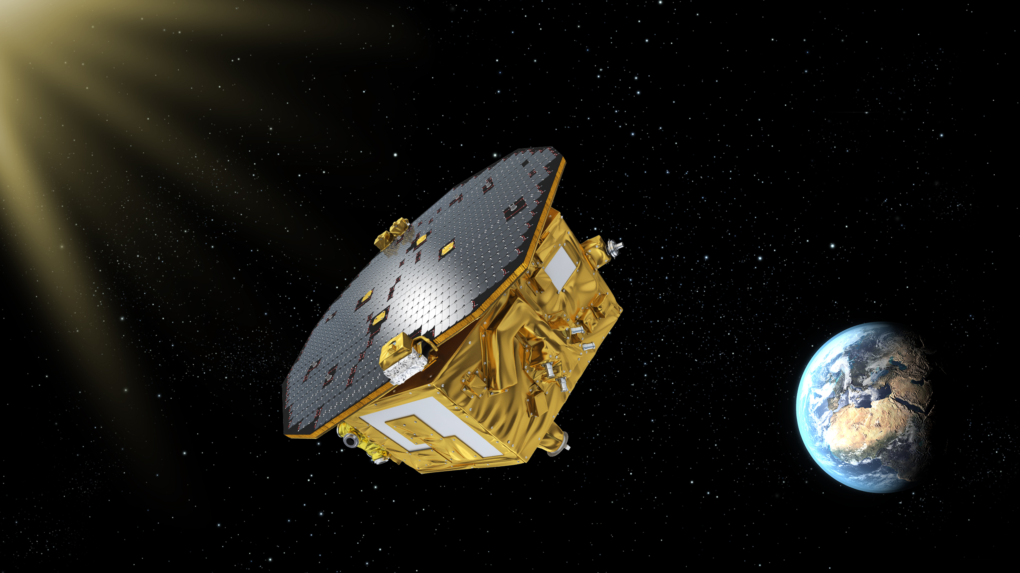
LISA Pathfinder: closes in 2017 after 14 years
LISA Pathfinder:
ESA mission for technology testing of the instruments to be placed aboard LISA: the first interferometer for gravitational waves in space in the frequency range 10⁻⁴-10⁻¹ Hz
2016 ESA Team
Achievement
Award for the
LISA Pathfinder Team
Ceremony:
October 4th 2017 Paris
Launch: December 3rd 2015 5.04 GMT+1
Mission end: July 18th, 2017

Slide 3
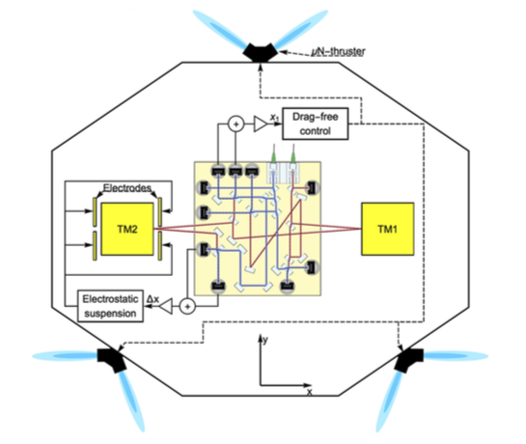
LISA Pathfinder instrument
Test masses
electrode housing
(electrostatic shield
and 6 degrees of
freedom sensor and
actuator)
Spurious forces acting on
Test Masses:
Coulomb forces from
cosmic-ray charging
UV light discharge system
Two independent
laser interferometers
measure the differential
displacement between
test masses and the
displacement of test-mass 1
with respect to the S/C
Armano et al., PRL, 116, 231101, 2016

Slide 4
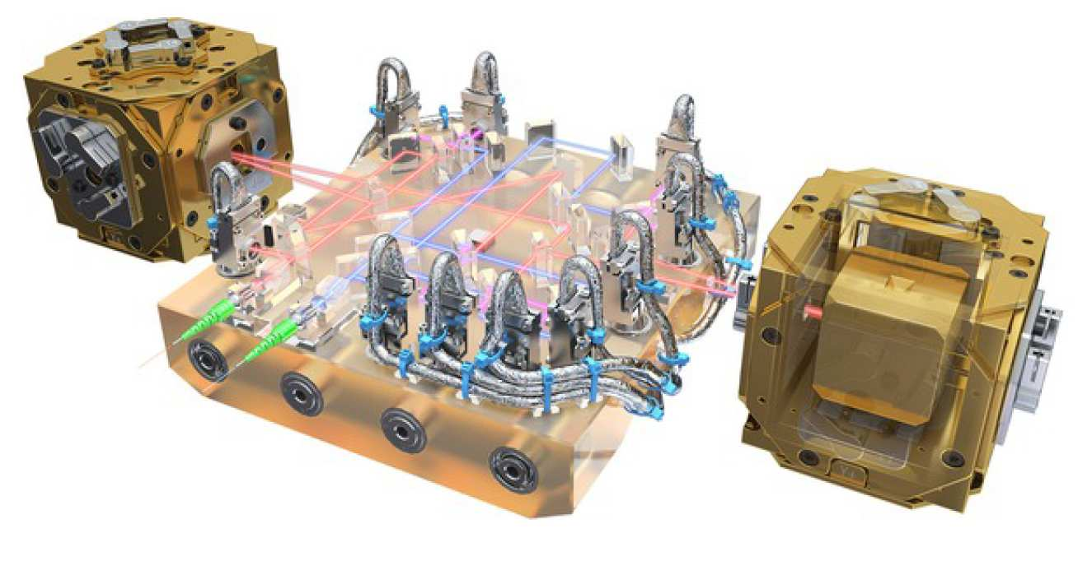
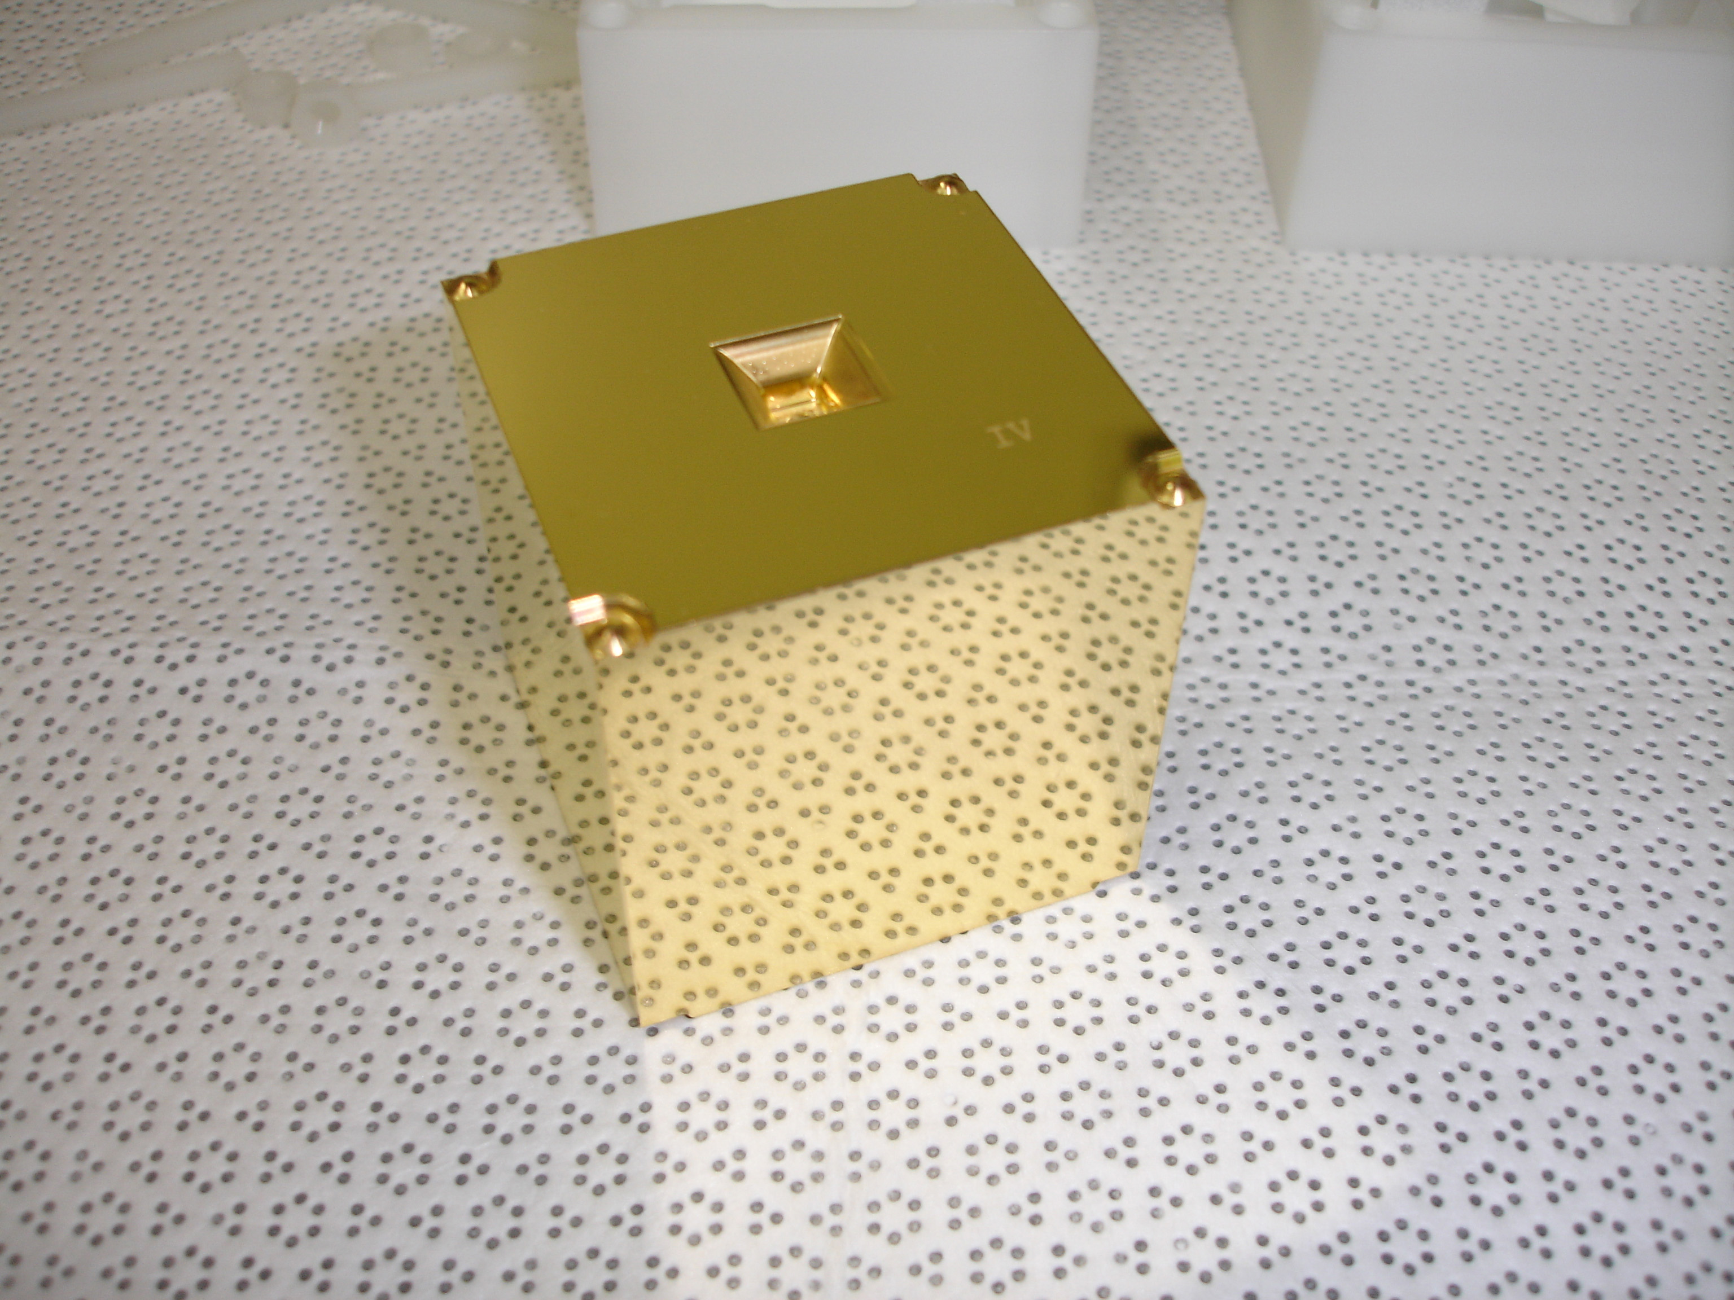
LISA-PF FREE-FALLING TEST-MASSES
Test masses (TMs):
cubes of 70% Pt-30% Au
4.6 cm side
2 kg mass
38 cm distance
Approximately 13 g cm⁻² of matter surround the TMs
Armano et al., PRL, 116, 231101, 2016

Slide 5
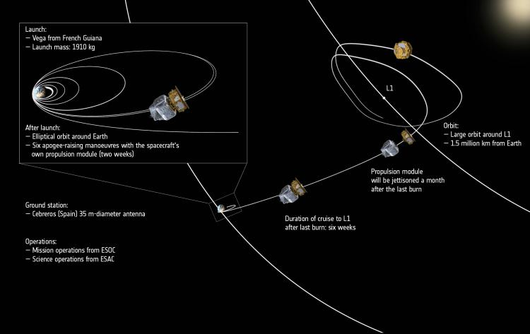
LISA-PF Orbit
Science operation mode: March 1st 2016 - June 30th 2017
Notes:
L’orbita è pseudo-ellittica intorno a L1 ad 1.5 milioni e mezzo di km dalla terra. Inclinata di 45 gradi sull’eclittica e di dimensioni500000 km per 800000 km

Slide 6
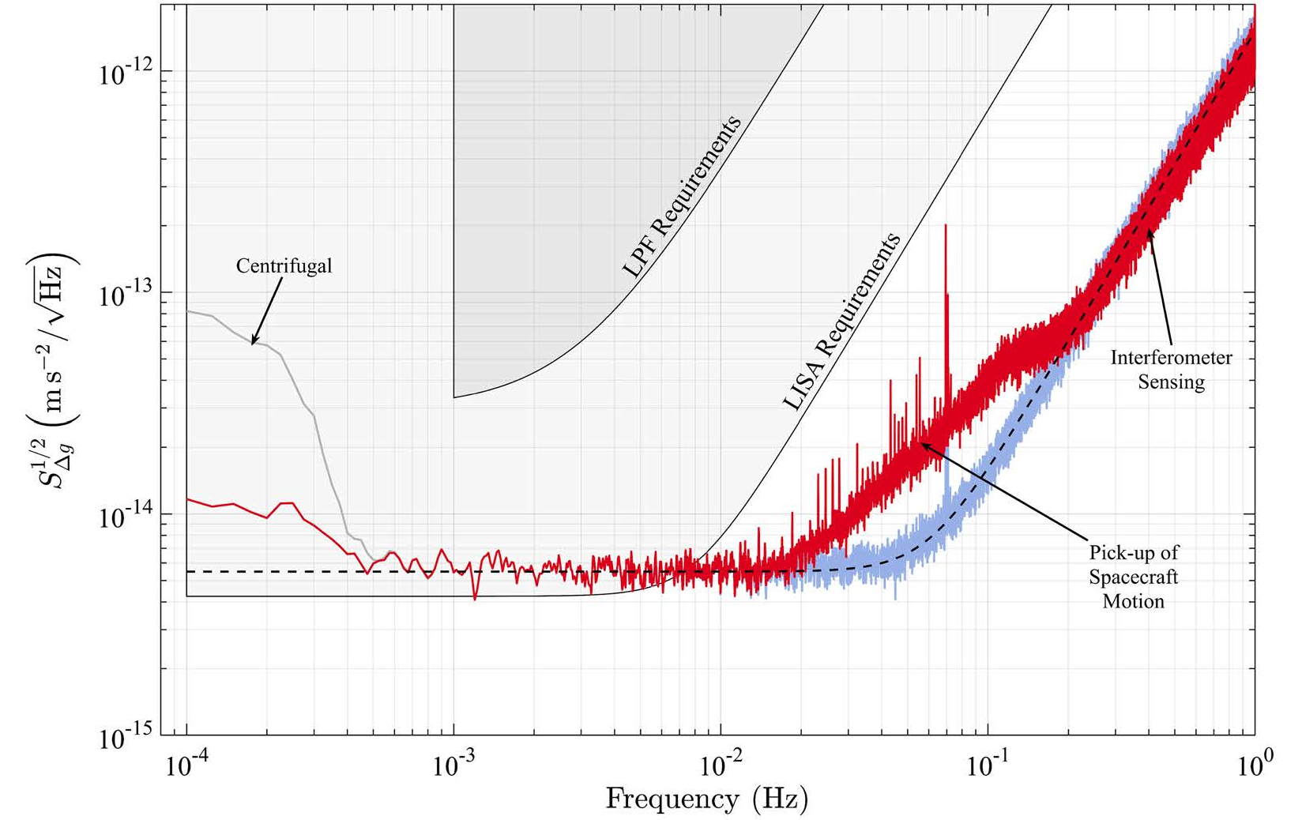
LISA-PF ASD
<0.1- 0.5 mHz 12 fm s⁻² Hz^{-1/2}
0.7-20 mHz 5.2+/-0.01 fm s⁻² Hz^{-1/2} 5 times better than expected
> 60 mHz (34.8+/-0.3) fm Hz^{-1/2}
Notes:
ASD: Un fattore 5 meglio di quanto richiesto per LISA-PF, consistente con I requirements per LISA

Slide 7
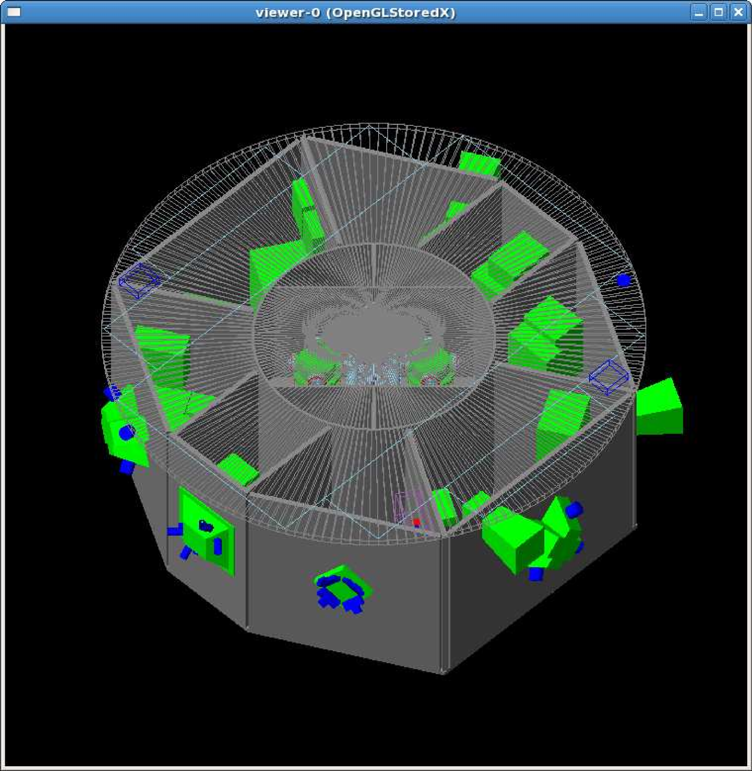
Work in Florence -
Test-mass charging study with Fluka
FLUKA MC
Simulation
Wass et al., CQG, 22, 2005, S311-S317
CG et al., CQG, 32, 2015, 035001
Notes:
Modello GEANT importato in Fluka

Slide 8
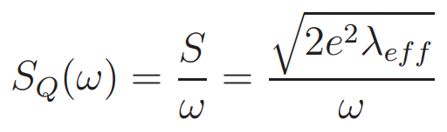

Test-mass charging
Net and effective charging estimated with the
Fluka MC Program
Ferrari et al., 2005-10 (Geneva:CERN)
Battistoni et al.,
AIP Conf. Proc. 896,
Albrow and R. Raja, 31-49
2x10⁶ events
in each run
In order to
limit the
uncertainty on
λ _{eff} <2%
Where: j is the amplitude of the charge released by each event and λ _{j} is
rate of occurrence of that event.
Catia Grimani
Notes:
Abbiamo calcolato la carica netta e la carica effettiva (shot noise in charging)

Slide 9
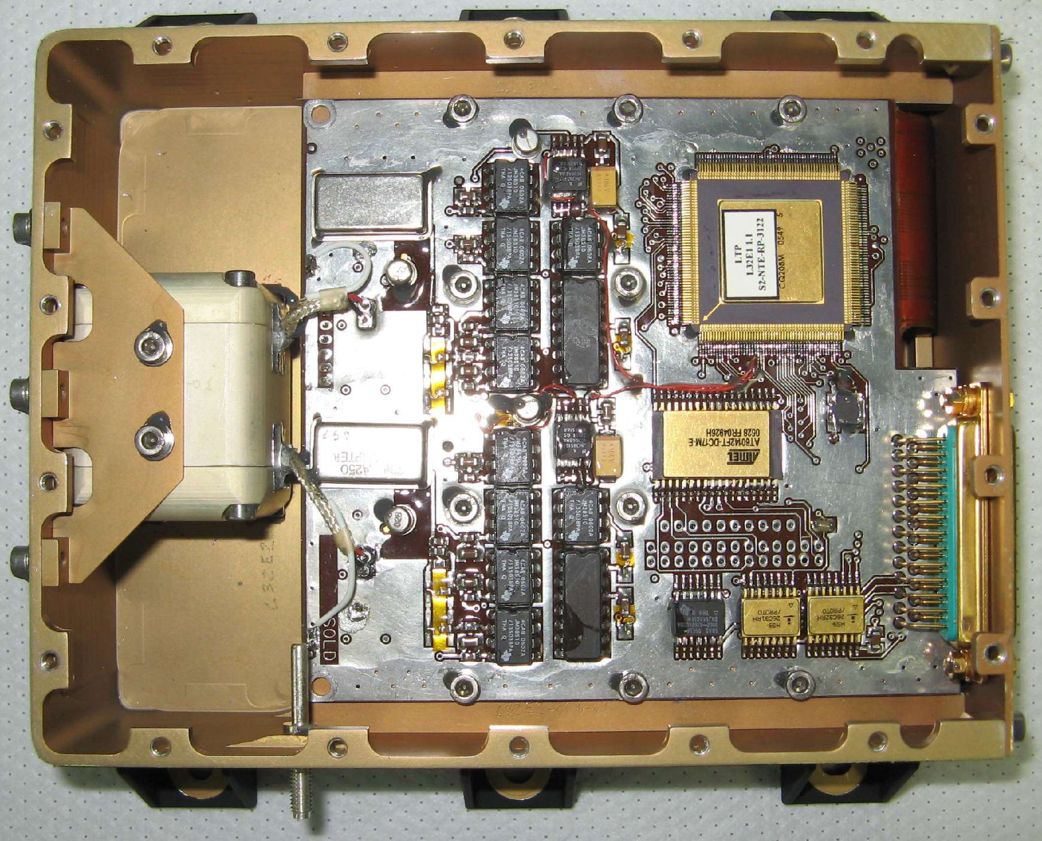
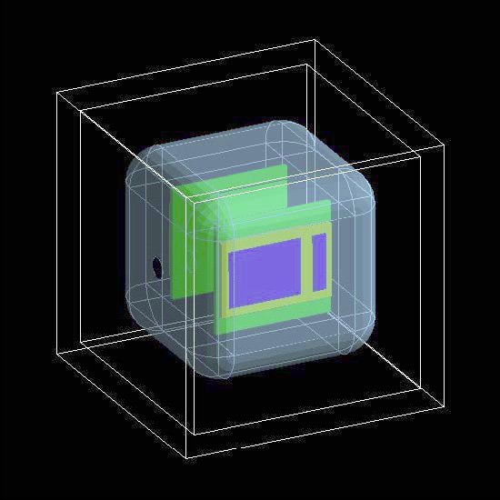
LISA-PF radiation monitors
2 silicon wafers
of 1.4 x 1.05 cm² area
placed 2 cm apart.
Notes:
A bordo di LISA Pathfinder ci sono i radiation monitors: due strati di silicio in posizione telescopica. Misuriamo il count rate dei raggi cosmici e l’energia depositata per gli eventi in coincidenza

Slide 10
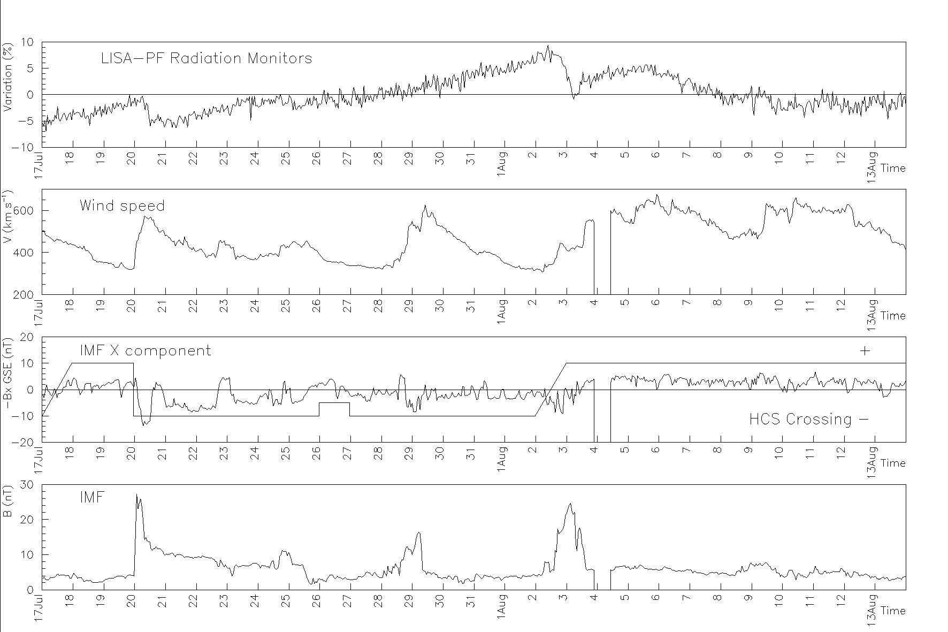
BARTELS ROTATION 2496
http://omniweb.sci.gsfc.nasa.gov/html/polarity/polarity_tab.html
cdaweb.gsfc.nasa.gov
10
Notes:
Risultato dell’analisi dati dai radiation monitors: variazioni a corto termine dei raggi cosmici galattici (notare il 2 agosto un decremento di Forbush non ricorrente). Confronto (pannello di sinistra) con I dati interplanetari di vento solare e campo magnetico. Pannello di destra confronto I misure da neutron monitors.

Slide 11
About gravitational wave detection
In November 2013 ESA selected the Gravitational Universe as one of its corner-stone science themes.
In June 2017 LISA was selected by ESA as the third large mission after JUICE (L. 2022) and ATHENA (L. 2028). initially scheduled for launch in 2034 will go probably by 2029.

Slide 12
LISA performance whith the LISA-PF acceleration noise
Black hole merging with total mass 10⁶ solar masses at redshift z=3 with S/N ratio of 5000 (several % of LISA expected performance)
Heavy black hole merger with 10⁷ solar masses total mass at redshift z=3 with
S/N ratio of 1400 (2000 expected with LISA).
EMRIs and coalescing compact binaries will
present S/N ratio similar to LISA.

Slide 13
Florence Activity - 2018
ANALYSIS OF RADIATION MONITOR DATA AND INTERPLANETARY SOLAR WIND PARAMETER FOR SPACE WEATHER APPLICATIONS (END)
PARTICIPATION TO THE OPTIMIZATION OF THE DIAGNOSTICS DETECTORS FOR LISA WITH BARCELONA TEAM
TEST-MASS CHARGING IN LISA: the charging process will be studied with Fluka (BEGIN).

Slide 14
NEW LISA Group - Florence
Catia Grimani 100%
Ruggero Stanga 70%
Noemi Finetti 60%
Simone Benella 100% (Dottorando-nuovo)
Assegnista di ricerca (100% )(Concorso da bandire in autunno 2017)
Monica Laurenza 20%
Daniele Telloni 20%
FTE: 3.7 + (1)
Recent publications:
Grimani C. et al., CQG, 32, 035001 (14 pp), 2015
Armano M. et al., Ph. Rev. Lett., 116, 231101, 2016
Telloni D., Fabi M, Grimani C, Antonucci E,
AIP Conference Proceedings 1720 (1), 100001, 2016
Grimani, C., MNRAS 460 (2), 2186-2192, 2016
Armano, M. et al., CQG, 33 (23), 235015, 2017
Armano M. et al., PRL, 118 (17), 17110, 2017

Slide 15
FINANCIAL REQUESTS
20 keuro MISSIONI:
For collaboration meetings and conference
presentations (participation to the LISA international collaboration activities).

