Slide 1


First INFN International School on Architectures, tools and methodologies for developing efficient large scale scientific computing applications
Ce.U.B. – Bertinoro – Italy, 12 – 17 October 2009
Exercise on Parallelization
Caveats: what I suggest here is my way to proceed, but I’m far to be an expert of parallelization!
So, of course, it is possible to better…

Slide 2
When we want to parallelize
Reduction of the wall-time: we want to achieve better performance, defined as (results response/execution) times
Memory problem: large data sample, so we want to split in different sub-samples
Remember the two strategies:
  SPMD: Same program, different data
  MIMD: Different programs, different data

Slide 3
Typical problem suitable for parallelization
The problem can be broken down into subparts:
  Each subpart is independent of the others
  No communication is required, except to split up the problem and combine the final results
  Ex: Monte-Carlo simulations
Regular and Synchronous Problems:
  Same instruction set (regular algorithm) applied to all data
  Synchronous communication (or close to): each processor finishes its task at the same time
  Local (neighbor to neighbor) and collective (combine final results) communication
  Ex: Algebra (matrix-vector products), Fast Fourier transforms

Slide 4
Before parallelization
Parallelization is not the first solution when your program is slow
  Look if you can improve the performance improving the code
  Sometimes compiler optimizations can make the difference (and they do the work for you!)
  Try to understand if there are better implementations of your problem (see our example)
  Do not re-invent the wheel
    Use parallel libraries and look if there are already similar parallel implementations
  Remember that parallel implementations are more difficult to debug than serial ones

Slide 5
Parallelization Suggestions
General Law: THINK PARALLLEL!
  Start to write your program directly thinking parallel implementations
    Can be challenging for beginners
  Write a serial version of the code and then move to parallelization
    Good for beginners (use serial as reference)
    Anyway it is wasting time! It can be not so straightforward to move from a serial to a parallel implementation of the code
So, again, THINK PARALLLEL

Slide 6
Real-life case
Usually we start to think in parallel when our serial implementations are too slow (or in general we want to achieve better results response/execution times)
  In this case we start with a serial implementation (or in general we “inherit” the code from previous users)
  Worst situation: sometimes it can be useful to write the code from scratch (when convenient)
    Many complex serial code implementations are strictly serial, very difficult to parallelize (no thread-safe, complex data structure,…)

Slide 7
More practical suggestions (1)
Either if you are writing a new program or you have a serial implementation:
  Understand which part of the code is useful to parallelize
  Understand your data structure
    Which data you want to share, which data are private
  Consider the communications and synchronizations
    Keep low the communication-time/calculation-time
  Start with a simpler parallel implementation, for example reducing the data structure
  Each parallel implementation MUST have the possibility to run in serial (a single process)
    Make sure that when run in parallel it gives the same results

Slide 8


More practical suggestions (2)
  Remember to balance the load between the processes
    Final time is given by the slowest process!
  Scalability:
    Depends on your problem, usually on data decomposition
      Ex. a parallelization of a simulation of 10 particles, you can have a limit of 10 processors
  Speed-up:
    Do not expect to run a program of 1 week in 1 second!
    Remember the Amdahl’s Law:
    S → speedup
    P → portion of code which is parallelized
    N → number of simultaneous process
    Need to find good algorithms to be parallelized!

Slide 9
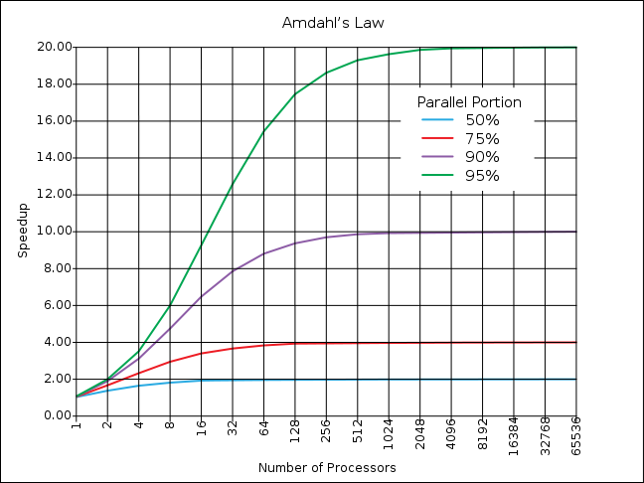
Amdahl’s Law

Slide 10
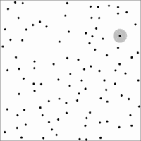
The exercise
Simulation of N interacting particles in a 1D box
  Example from Par Lab Boot Camp
  http://www.cs.berkeley.edu/~volkov/cs267.sp09/hw2
  Short-range interaction
Common simulation problem
  Same implementation can be applied in several other cases

Slide 11
How to proceed
Copy the directory
/nfsmaster/innocente/parallel
in your area
Inside this directory you find a README.txt file
3 proposed serial implementations (see corresponding directories)
Make copies of the serial.cxx, renaming in openmp.cxx, mpi.cxx, and thread.cxx
  Look at the comments inside the file to understand where to apply parallelization (essentially require modifications only inside these files)
  You find all “solutions” in our lectures, but you can look in the web or ask me to find better solutions

Slide 12
case1
Compile the code with
make serial
Run ./serial –h
Options:
-h to see this help
-d draw the particles
-n <int> to set the number of particles
-o <filename> to specify the output file name

Slide 13
case1
Basically two loops
for (int i=0; i<N; i++)
for (int j=0; j<N j++)
// interaction between [i, j]
Example (serial execution):
N = 1000 ---> 5.49 seconds
N = 500 ---> 1.38 seconds ---> x3.98
N = 200 ---> 0.22 seconds ---> x24.95
The parallel implementation in this case is easy...
Example (OpenMP)
P = 2, N = 1000 ---> 2.78 seconds ---> x1.97
P = 3, N = 1000 ---> 1.86 seconds ---> x2.95
P = 4, N = 1000 ---> 1.40 seconds ---> x3.92
P = 8, N = 1000 ---> 0.72 seconds ---> x7.62
SCALE as N²!!!
SCALE as P processors

Slide 14
case2
Note that the interaction between B and A is the opposite of between A and B
  We can calculate an half of the interactions
  for (int i=0; i<N-1; i++)
  for (int j=i+1; j<N j++)
  // interaction betwen [i, j] and [j, i]
  Example (serial execution):
  N = 1000 ---> 2.66 seconds ---> x2.06
  N = 500 ---> 0.70 seconds ---> x7.84
  N = 200 ---> 0.11 seconds ---> 49.91x
  Requires some attention to avoid race conditions
SCALE as N²!!!

Slide 15
case3
How can we scale as N (not N²)?

Slide 16
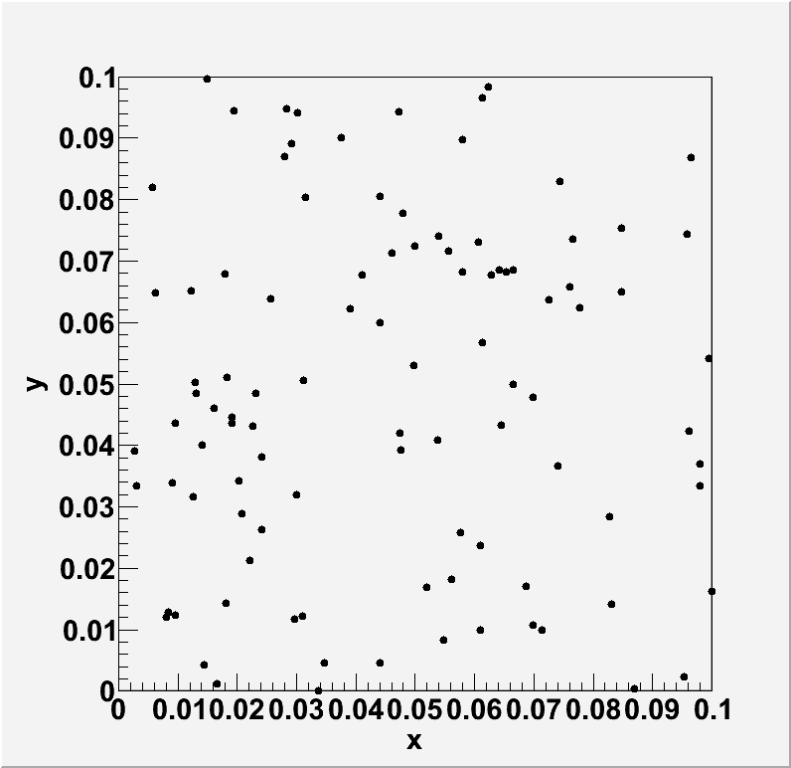
case3
How can we scale as N (not N²)?
  Hint: remember that we have a short-range interaction, i.e. do not need interaction between all particles

Slide 17
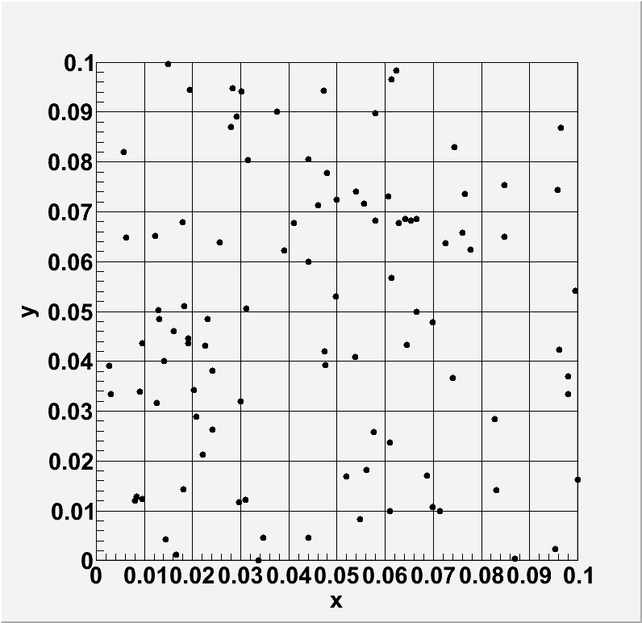
case3
How can we scale as N (not N²)?
  Hint: remember that we have a short-range interaction, i.e. do not need interaction between all particles
Do a mesh (decomposition of the data sample), where the size of the cells is the range of the interaction

Slide 18
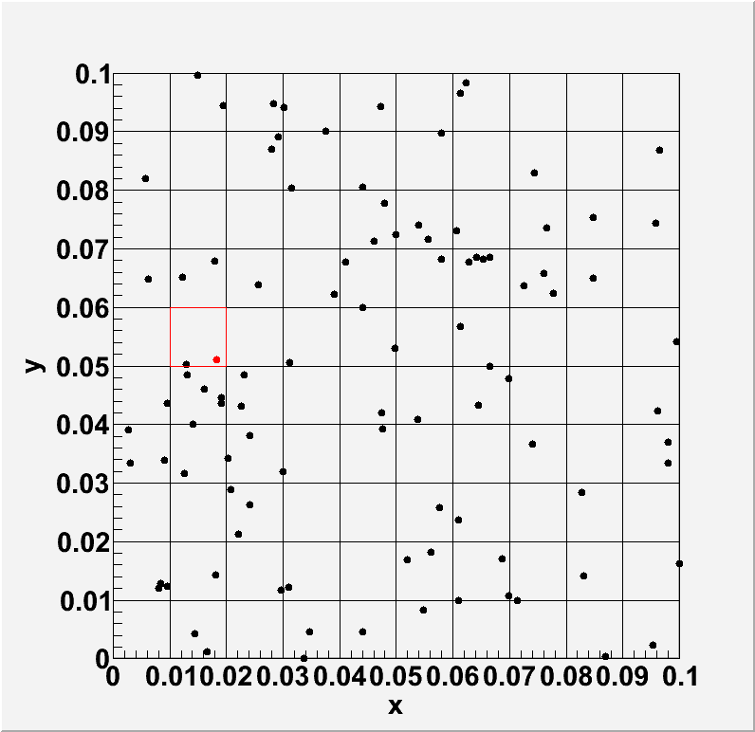
case3
How can we scale as N (not N²)?
  Hint: remember that we have a short-range interaction, i.e. do not need interaction between all particles
Loop over the cells.
For each cell, loop over his particles and make the interactions with the particles of the neighboring cells

Slide 19
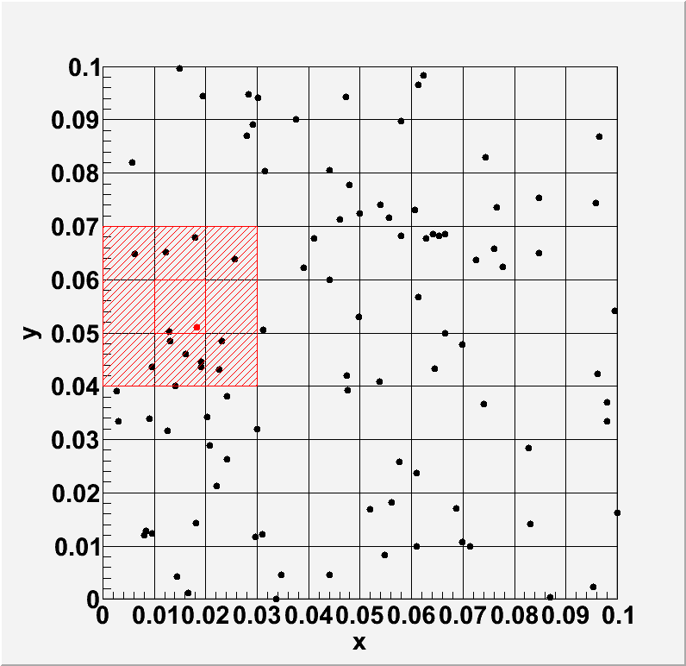
case3
How can we scale as N (not N²)?
  Hint: remember that we have a short-range interaction, i.e. do not need interaction between all particles
What do you expect as speed-up for the serial implementation?

Slide 20
case3
N = 1000 ---> 0.19 seconds ---> x28.89
N = 2000 ---> 0.39 seconds ---> x14.08
N = 4000 ---> 0.79 seconds ---> x6.95
Better performance are still possible…
Decomposition problem are common in many problems
  You can split the data over the processors
  To have a good balance you can do an adaptive mesh (or more complex adaptive mesh refinement)
SCALE as N

Slide 21

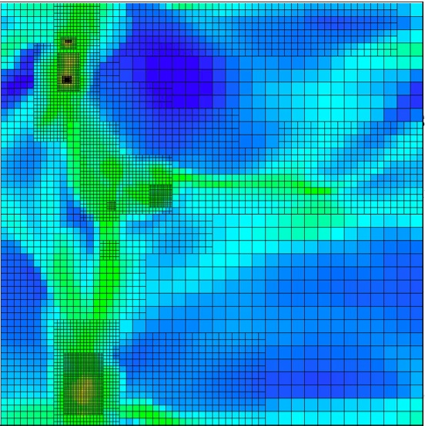
Galaxy formation (example from http://www.isgtw.org/?pid=1001250)
  a total of about one billion individual grid cells
  adaptive mesh refinement
The 3D domain (2 billion light years of side). Colors represent the density of the gas

Slide 22
And now enjoy the exercise!

