Slide 1


Software Physical Design
First INFN International School on Architectures, tools and methodologies for developing efficient large scale scientific computing applications
Ce.U.B. – Bertinoro – Italy, 12 – 17 October 2009
Pere Mato (CERN)

Slide 2
Outline
Physical design concepts
Software development model
Packaging
Keeping dependencies under control
Monitoring and maintaining the software organization

Slide 3
Physical Design Concepts
Large-scale software development requires more than just logical design issues
Distribution of logical entities (classes, functions, etc.) on physical entities (files, directories, etc.)
The physical design is the skeleton of the system
The quality of physical design dictates from the cost of maintenance to run-time performance
Additional the potential for re-use
Component¹ is the fundamental unit of design
The most important relationship is DependsOn
Logical design addresses architectural issues; physical design addresses organizational issues
John Lakos, Large-Scale C++ Software design, Addison-Wesley, 1996

Slide 4
Logical vs. Physical View
Logical View
Physical View
EdgeIter
NodeIter
Graph.h
Graph.cxx
Graph
includes
Node
Edge

Slide 5
Components
Logical design emphasizes interaction of classes and functions in single seamless space
It can be viewed as a ‘sea’ of classes and functions
It does not take into account physical entities such as files and libraries
A Component would embody a subset of logical design that makes sense to exists as an independent and cohesive unit
Typically a Component would consists of a single header file (.h) and implementation files (.cxx)

Slide 6
Packages
Typically in HEP we put each C++ class in a different file (naming convention & convenience)
The Lakos’s Component concept does not fit completely.
A Package is a collection of components organized as a physically cohesive unit
A Package is therefore a collection of Classes and functions that implements some functionality
Physically a Package is a collection of header files and implementation files organized in some directory structure
Package is the basic unit in the HEP software development process

Slide 7
Software Development Process
How do you create software?
Lots of parts: writing, documenting, testing, sharing, fixing,…
Usually done by lots of people
The ‘Process’ is just a big word on how we do this
It exists whether you talk about it or not
Every software production unit (e.g. HEP experiment) follows a process
Sometimes undocumented
Tools to support the process

Slide 8
Package as Development Unit
For convenience a Package is developed by one or few developers
Concurrent development is essential for large projects
It is the basic development unit (at least in the HEP communities)
It can checked-out and versioned (tagged)
It can be tested
It can be documented
Example: ATLAS has ~3000 packages written mainly in C++ and Python (also Fortran, Java, PERL, SQL)

Slide 9
Tools to support the ‘Process’
Code repositories and versioning systems
CVS, SubVersion
Management of versions
TagCollectors
Build and configuration tools
Make, CMT, SCRAM
Nightly build systems
Test frameworks
CppUnit, QMTest
Documentation
Doxygen, lxr, OpenGrog, …
Distribution
Pacman, APT, ..

Slide 10
Physical Elements
Public Header Files (.h)
Private Header files (.h)
Static Libraries (.a)
Shareable Libraries (.so)
Linker Libraries
Component Libraries (plug-ins, i.e. no symbols exported)
Other modules (e.g. Python extension modules)
Programs
Documentation Files (.html, .doc, …)

Slide 11
Public Interface of a Package
Everything declared in its set of public header files
Regardless of access privilege (public, protected, private)
Any change would cause a re-compilation of clients
The less information is put on header files the better
Favor forward declarations of types used as references and pointers

Slide 12
Major Design Rules
Avoid definitions with external linkage in .cxx files that are not declared explicitly in the corresponding .h file
Define exclusively what is declared (no backdoors)
Avoid accessing a definition with external linkage in another package via local declaration
Include the .h file for that package

Slide 13
Typical Package Structure
packA
Version number
v1
v1r1
v2
$PACKAROOT
cmt
src
packA
doc
win32
Linuxdbx
. . .
i386- linux22
manager directory contains the requirements file
public include files
#include “packA/xxx.h”
binaries
Notes:
Package Structure
All packages in LHCb follow the structure shown in the viewgraph.
Package version name follow the convention “v<version number>r<release number>p<patch number>” or “v<version number>r<release number>d<date>”. Versions with the same v number should be considered compatible.
The /cmt directory is mandatory (see later with CMT)
The source files are located in /src and the exported header files are in /packA. In that way it is visible from which package a header is included.
The /doc directory contains the documentation for the package. It is mandatory to have a file called “release.notes” where we keep the changes on the package up to date.
A number of binary (platform & configuration dependent) directories will exists in each package.
Package Groups (Hats)
We have organized the packages in LHCb by putting together all related packages into a package group. Examples are: Event, Det, SICB, Ex, etc.

Slide 14
Package Products
Linker Libraries
Are traditional libraries. They export a number of symbols
Component or plug-in libraries
These libraries are loaded at run-time on demand by the application (framework)
Typically they do not export any symbol. In some cases a single global one
Programs, Tests
Either direct executables or plug-ins
Documentation
Additional framework files
Configuration files, plugin databases, etc.

Slide 15
Package Dependencies
A package Y DependsOn a package X if X is needed in order to compile or link Y
Compile-time dependency if one or more .h files in X are needed for compilation
Link-time dependency if one or more libraries in X are needed for linking
Run-time dependency if a program/library in package Y requires X for running
In general compile-time dependency implies link-time dependency and this implies run-time dependency
Templates defeats this general rule!
The DependsOn relation is transitive
Y
DependsOn
X

Slide 16
Package Dependencies (2)
A package defining a function will have a physical dependency to any other package defining a type used in the function
The logical relationship HasA and IsA translates into a physical dependency
Dependencies limit
flexibility
ease of maintenance
reuse of components or parts
Dependency management tries to control dependencies

Slide 17
Packages Dependencies (3)
a
a
b
c
b
g
c
d
e
d
h
g
h
f
f
i
i
j
k
l
k
l
o
n
m
j
o
n
m

Slide 18
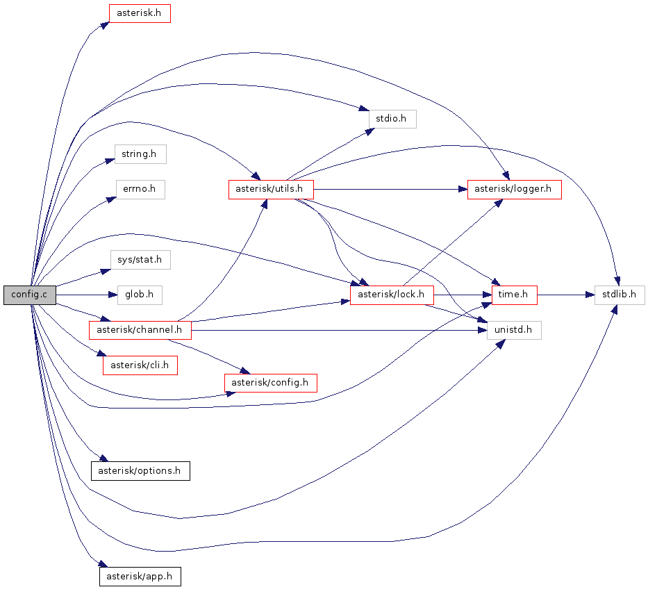
Compile-time dependencies
Cyclic dependencies would prevent building the package. End of story.
Tools such as Doxygen allows to monitor dependencies
Thinning header files will speedup building process
External include guards, or redundant include guards, were suggested by John Lakos
#ifndef FILENAME_H_ #include "Filename.h" #endif // FILENAME_H_

Slide 19
Link(Load)–time dependencies
The use of dynamic libraries converts link-time dependencies to load-time ones
Static libraries are not in fashion nowadays
Tools such ldd (depends.exe on Windows) allows to monitor link dependencies
Performance is strongly affected by the number and the size of dependent libraries
Interest to keep the them under control
Reduce the number of needed libraries
re-packaging, re-engineering
Remove unnecessary libraries
Control package dependencies; use --as-needed‬ flag

Slide 20
Compile and Link Times
Compile and link times are unproductive
In a project with N modules compile and link time can grow like N² (assuming every package is tested) when dependencies are not controlled
Loss of productivity
Long turnaround times → slow development
Dependency management essential in large projects

Slide 21
Realistic Example
>>> ldd libMCEvent.so
libdl.so.2 =>
libLHCbKernel.so =>
libPartPropLib.so =>
libGaudiKernel.so =>
libpthread.so.0 =>
libGenVector.so =>
libstdc++.so.6 =>
libgcc_s.so.1 =>
libc.so.6 =>
libGaudiAlgLib.so =>
libm.so.6 =>
libLHCbMathLib.so =>
libReflex.so =>
libboost_thread-gcc34-mt-1_39.so.1.39.0 =>
libboost_system-gcc34-mt-1_39.so.1.39.0 =>
libboost_filesystem-gcc34-mt-1_39.so.1.39.0 =>
libCore.so =>
libCint.so =>
libGaudiUtilsLib.so =>
libboost_regex-gcc34-mt-1_39.so.1.39.0 =>
libgsl.so.0 =>
libgslcblas.so.0 =>
librt.so.1 =>
libcrypt.so.1=>
libHist.so => l
libMatrix.so =>
libMathCore.so =>
libMCEvent.so is a library for MC event classes
A priory it should not depend on Boost, ROOT, Math, GSL, etc.
The problem is that it depends on GaudiKernel and others that these depend on Boost, ROOT, etc.

Slide 22
Understanding Dependencies
The 22 classes in the MCEvent package DependOn only 4 packages
Only few classes/functions of these packages are really needed
These initial dependencies brings the rest
Is this a real problem?
MCEvent
LHCbKernel
PartPropLib
GenVector
GaudiAlgLib
GaudiUtilsLib
LHCbMathLib
ROOT
GaudiKernel
GSL
Boost
Reflex

Slide 23
Run-time dependencies
These dependencies are due typically to the plug-in mechanism, [Reflex] dictionary loading, Python extension modules, etc.
Frameworks make extensive use of run-time dependencies
Moving compile and link time dependencies to run-time dependencies is not a bad move
Only needed functionality will be loaded
Packaging and installation of ‘plug-ins’ is non-trivial

Slide 24
Plugins
At least three possibilities for packaging plug-ins
(C) is the one that creates less coupling
(A) and (B) forces a dependency between the library and the framework
Library A
Plug-in
Library A
Framework
Package
Library A
Plug-in
(A)
(B)
Framework
Package
Library A
Library A
Plug-in
Framework
Package
Library A
(C)

Slide 25
Configuration Tools
To manage the the dependencies between packages and to facilitate the building of packages, experiments are using configuration and build tools
Remember ATLAS has ~3000 packages :-0
CMT (ATLAS, LHCb), SCRAM (CMS), SRT (BaBar)
These tools can typically
Find inconsistencies
Create include and library options
Connect build constituents
➔ Automation of the process

Slide 26
CMT
Configuration Management Tool written by C. Arnault (LAL, Orsay)
It is based around the notion of Package
Provides a set of tools for automation the configuration and building packages
A variety of products: libraries (linker, plugins), executables, documentation, etc.
It has been adopted by LHCb, ATLAS (other experiments are also using it)
Notes:
CMT introduction
CMT is an attempt to formalize software production and especially configuration management around a package-oriented principle. The notion of packages represents hereafter a set of software components (that may be applications, libraries, documents, tools etc...) that are to be used for producing a system or a framework. In such an environment, several persons are assumed to participate in the development and the components themselves are either independent or related to each other.
The environment provides conventions (for naming packages, files, directories and for addressing them) and tools for automating as much as possible the implementation of these conventions. It permits to describe the configuration requirements and automatically deduce from the description the effective set of configuration parameters needed to operate the packages (typically for building them or using them).

Slide 27
Using CMT
What to build
How to build
Package dependencies
CMT
makefiles
DevStudio files
requirements
CVS
repository
Building
tools
(compilers,
linkers,
IDEs )
code
code
code
code
code
Libraries
&
Executables
Notes:
How we use CMT
The user interacts mainly with the CMT tools to configure and build the packages. The instructions on what to build, how to build and dependencies are located in a single text file called requirements. Very often the user needs to edit this file.
From the requirements, CMT is able to automate the creation of the makefiles (or Visual Studio projects) required for building the different package constitues (libraries, programs, documentation, etc).

Slide 28
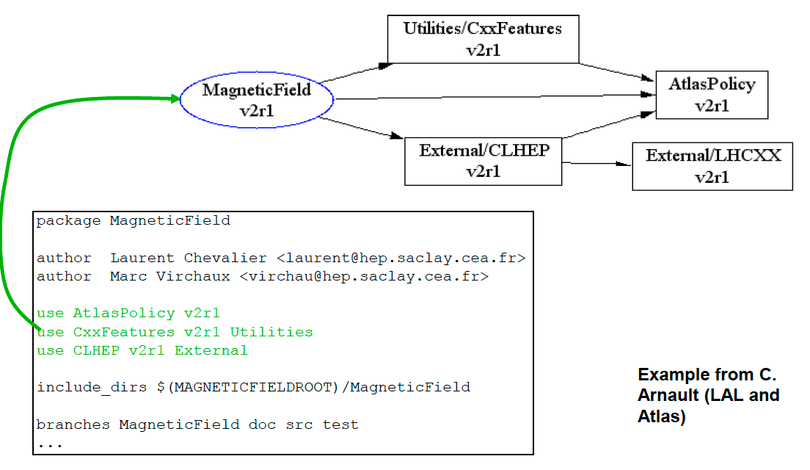
CMT requirements file
Notes:
CMT introduction
CMT is an attempt to formalize software production and especially configuration management around a package-oriented principle. The notion of packages represents hereafter a set of software components (that may be applications, libraries, documents, tools etc...) that are to be used for producing a system or a framework. In such an environment, several persons are assumed to participate in the development and the components themselves are either independent or related to each other.
The environment provides conventions (for naming packages, files, directories and for addressing them) and tools for automating as much as possible the implementation of these conventions. It permits to describe the configuration requirements and automatically deduce from the description the effective set of configuration parameters needed to operate the packages (typically for building them or using them).

Slide 29
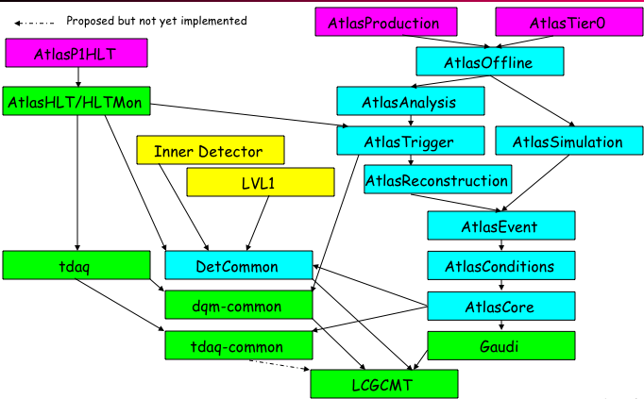
Grouping Packages
Managing and releasing many packages is complex
Integrating and validating releases may take very long
Some experiments are grouping ‘packages’ into ‘projects’
A ‘project’ is basic unit of release
The same way packages facilitated concurrent development; projects facilitates concurrent integration and validation
ATLAS Project Structure

Slide 30
Software Release
Experiments do not release individual packages
Each individual package is ‘tagged’ by developer
Experiments release complete ‘projects’
The release candidate of a project is made of a collection of ‘tags’ for each package that constitutes the project
Tag collector tools helping here
Obviously the release order is opposite to the DependsOn relationship
The version of the top-level project fixes the version of each dependent project and each package within the project
Not all the software system needs to be released at once

Slide 31
Package Levelization Techniques
a
c
a
c
b
d
b
d
Example: avoid cyclic dependencies among packages

Slide 32
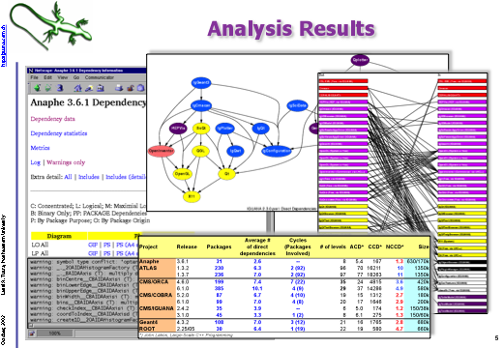
Tools to Check Dependencies
Ignominy (L. Tuura)

Slide 33
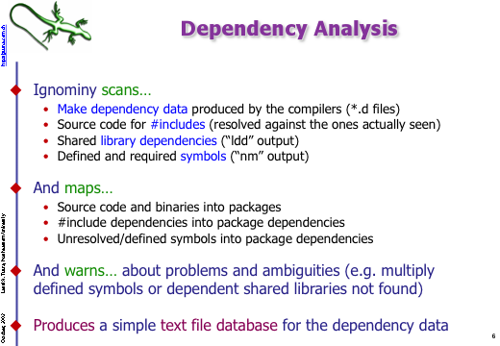
Ignominy

Slide 34
More Principles
When adding a new component to a package, both the logical and physical characteristics of the component should be considered
Minimizing the number and size of exported header files enhances usability
A [binary compatible] patch must not affect the internal layout of any existing object (i.e. no change in any header file)
➔ Physical design is

Slide 35
Summary
A large software system is organized as Classes ➔Components ➔ Packages ➔ Projects
Keep complexity under control
Facilitating concurrent development
Physical dependencies limits strongly the performance and overall quality of the system
Flexibility, ease of maintenance, reuse of components or parts
Tools to monitor and optimize dependencies are essential
The software architect is also responsible for the physical design

Slide 36
References
John Lakos, Large-Scale C++ Softare Design, Addison-Wesley, 1996

