Slide 1


Andrew Hanushevsky: File System I/O
First INFN International School on Architectures, tools and methodologies for developing efficient large scale scientific computing applications
Ce.U.B. – Bertinoro – Italy, 12 – 17 October 2009

Slide 2
Goals
Sensitize you to File System limitations
How I/O choices make or break performance
Show what to do and not to do
Keeping performance high
How to broadly translate advice
Databases and frameworks

Slide 3
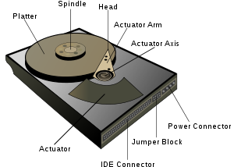
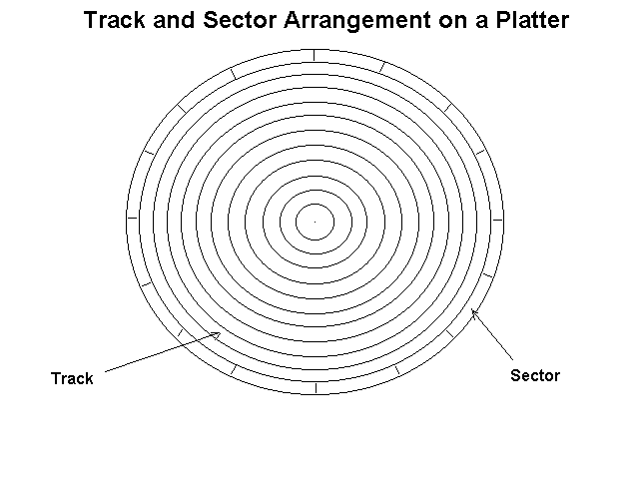
Disk Mechanics
Disk surface is divided into sectors
Usually 512 bytes
An I/O operation requires that the disk
Move the head to the right circular track (seek time)
Wait until the proper sector arrives (rotational delay)
Then transfer the data
Disk rotation
Sources: http://upload.wikimedia.org/wikipedia/commons/thumb/5/52/Hard_drive-en.svg/300px-Hard_drive-en.svg.png
http://www.comptechdoc.org/hardware/pc/begin/hwharddrive.html

Slide 4
Mechanical Devices Are Slow
Characteristic Seagate Seagate Cheetah Seagate
Barracuda 180 X15-36LP Barracuda 36ES
Type High Capacity High Performance Desktop
Capacity 181.6GB 36.7GB 18.4GB
Min Seek Time 0.8ms 0.3ms 1.0ms
Avg seek time 7.4ms 3.6ms 9.5ms
Spindle speed 7200rpm 15K rpm 7200 rpm
Avg Rotational
Delay 4.17ms 2 ms 4.17 ms
Max xfr rate 160 MB/s 522-709 MB/s 25 MB/s
Sector Size 512 512 512
Source: ftp://ftp.prenhall.com/pub/esm/sample_chapters/engineering_computer_science/stallings/coa6e/pdf/ch6.pdf

Slide 5
Slowness In Perspective
Seagate Barracuda 180
-t
0
1
2
3
4
5
6
7
8
9
10
11
12
cwt
Seek time 7.4ms
Rot Delay 4.17ms
x
Reading 64K requires, on average, 11.77ms,
excluding channel wait time (cwt).
Actual data transfer (x) occupies disk 1.7% of the total time.
You need to read almost 2MB to achieve 50% channel utilization!
The faster Cheetah drive accomplishes this 48% faster (5.652 ms)
But channel utilization drops to less than 1%
requiring a read of 3MB for 50% channel utilization.

Slide 6
File System Mechanics
File System groups N sectors into an I/O Unit
Usually 8 to 256 sectors (4K to 128K, sometimes more)
Data always read & written in I/O units or blocks
Simplifies mapping files into memory
This is why a block size is typically a multiple of the page size
Data, in unit sizes, is cached in memory
Speeds future access to data within the block
Additional subsequent blocks may be pre-read
With the hope they will be wanted in the future

Slide 7
File System & Slowness
File system tries to hide disk slowness
Memory caching to avoid disk I/O
Also done in high-end disk controller caches
Pre-reading to keep channel utilization high
Done in the background to minimize impact
Also done in some high-end RAID disk controllers
Offset ordering
Reduces seek time
Also done in high-end disk controllers

Slide 8
File System Performance Varies
Operation Ext3 Ext4 Improvement
Creation of eight
1 GB files 155.9 sec 145.1 sec 6.9 %
Write speed 55.4 MB/sec 59.3 MB/sec 7.0 %
Deletion of eight
1 GB files 11.87 sec 0.33 sec 97.2 %
10,000 random
reads and writes
in an 8 GB file 80.0 ops/sec 88.7 ops/sec 10.9 %
Source: http://www.h-online.com/open/The-Ext4-Linux-file-system--/features/113403/1

Slide 9
What This Implies
FS performance ≈ Disk Performance
Behavior of application is the determinant
How much application data per I/O request?
Sequential access?
Random access?
What is the r/w cycle length?
How many different blocks will be hit before a block revisit?
All of these have a profound effect
Independent of file system or disk device
These might make it a little better or worse

Slide 10
Effect of I/O Request Size
Recall FS reads/writes data in blocks
Assume block is 4K then reading…
512 bytes = 12.5% efficiency
1024 bytes = 25.0% efficiency
2048 bytes = 50.0% efficiency
4096 bytes = 100 % efficiency
Application should try to keep efficiency high
Each read should be as large as possible
Subsequent reads should use cached data

Slide 11
Effect of Sequential Access
This is the easiest for FS and Disk
Large disk devices are inherently sequential
However, your app is not alone
Application interleaving produces random I/O
FS read-ahead attempts to alleviate some of this
Each sequential request should be large
1-4MB per request usually the works best

Slide 12
Effect of Random I/O
Random I/O is a performance destroyer
True for mechanical disks but not for SSD’s
Cycle length is important
Read
Offset
0
4096
8192
12288
16384
20480
24567
2048
2048
Cycle Length
of 7 pages
> cache size
of 6 pages
Read Offset:
0
4096
8192
12288
16384
20480
24567
Page
Page
Page
Page
Page
Page
Page containing offset 0 replaced
Reading offset 2048 requires re-read!
Fixed size for file system memory cache

Slide 13
Contrived Example?
Yes, memory caches are very large today
Typically, 1,048,576 pages (4GB)
Works great if your application is alone
Not true for multi-core batch nodes
Can shrink to 131,072 pages (500MB) for 8 cores
Effective size per running job
Definitely not true for file servers
They serve thousands of simultaneous clients

Slide 14
Advising The File System
Can use posix_fadvise()
Tells file system how the app will access data
Starting at an offset for some number of bytes
Allows file system to better manage the memory cache
Few OS’s support this API
Not present in MacOS X 10.3, FreeBSD 6.0, NetBSD 3.0, OpenBSD 3.8, AIX 5.1, HP-UX 11, IRIX 6.5, OSF/1 5.1, Solaris 10, Cygwin 1.5.x, mingw, Interix 3.5, BeOS.
Present in others but ignored (e.g.,OpenSolaris)
So, for now, consider it Linux specific
Or using HP/UX 11.31

Slide 15
posix_fadvise() Details
#include <fcntl.h>
int posix_fadvise(int fd, off_t offset, off_t len, int advice);
Advice:
POSIX_FADV_NORMAL
Standard processing
POSIX_FADV_SEQUENTIAL
Doubles the read-ahead size for entire file
POSIX_FADV_RANDOM
Disables read-ahead for entire file
POSIX_FADV_WILLNEED
Initiates block read for specified byte range (also see readahead())
POSIX_FADV_DONTNEED
Discards cached file pages in specified byte range
POSIX_FADV_NOREUSE
Data will not be used again
Problematic, some OS’s support this, some ignore it (e.g., Linux)

Slide 16
If It Were So Simple. . .
Application data framework complications
Databases like mySQL
Persistency frameworks like root
Most HEP applications use one or more
Actual disk device is hidden
Hard if not impossible to directly apply advice
What to do?

Slide 17
Databases & Performance
Translate advice to schema development
Avoid wide tables when not needed
Increases payload of only some data wanted
Use indices for sparsely accessed rows
Allows database to optimize access
Normalize the tables within reason
Keep related data together

Slide 18
Frameworks & Performance
Know how framework lays out data
This is the most difficult part
Consult framework experts
Carefully construct your data objects
Keep useful payload as large as possible
Be cognizant of any compression done by framework
Cluster related payloads as much as possible
Avoid scattered references
This reduces widely spaced random reads

Slide 19
Conclusions
Be aware you’re dealing with mechanics
Disks are slow and unwieldy devices
Overlap I/O and CPU as much as possible
Choose algorithms that make this possible
This also requires deft multi-threading
Carefully layout your data
Keep in mind the database and framework
Use the advice in this section

