Slide 1


Designing Architectures and Frameworks for HEP
First INFN International School on Architectures, tools and methodologies for developing efficient large scale scientific computing applications
Ce.U.B. – Bertinoro – Italy, 12 – 17 October 2009
Pere Mato (CERN)

Slide 2
Outline
HEP [LHC] Data processing Overview
Software project scale
Architectural Design
<break>
Software Frameworks
Example: GAUDI
Software integrating elements

Slide 3
LHC computing characteristics
Large number of physicists and engineers participating actively in the data analysis and for extended period of time
Widely distributed computing environment
Huge quantity of data that has to be distributed and shared by all members of each experiment

Slide 4
Data Flow and Processing stages

Slide 5
LHC software requirements
Design should take into account the >15 years lifetime of the LHC
Resilient designs, technology choices will evolve over time
The standard language for physics applications software in all four LHC experiments is C++
language choice may change in the future or multi-language could be introduced
Operate seamlessly in a distributed environment and also be functional in ‘disconnected’ local environments
Modularity of components with well-defined interfaces and interchangeability of implementations

Slide 6
LHC software requirements (2)
Integrate well in a coherent software framework and other tools
Favor software re-use. Use of existing software should be consistent with the architecture
The software quality of the framework should be at least as good than the internal software of any of the sub-detectors
Multi-Platforms. Software should be written in a portable manner and conformant to the language standards

Slide 7
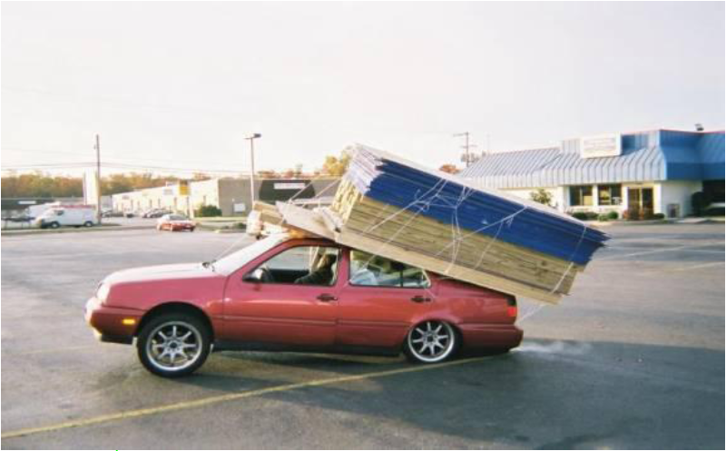
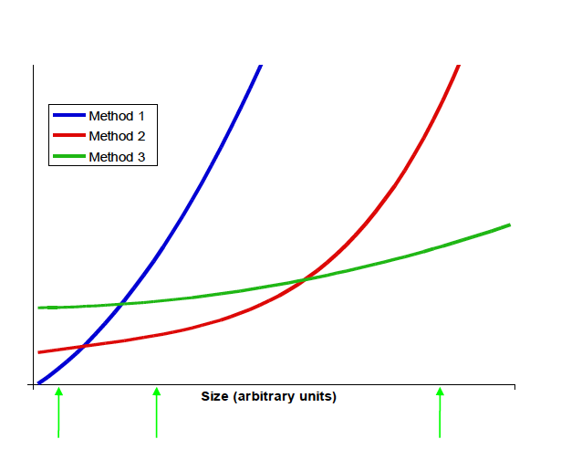
Software Scale
Small problems can be solved with simple techniques
For large problems you need to use different techniques that are in general more complex and with a up front cost

Slide 8
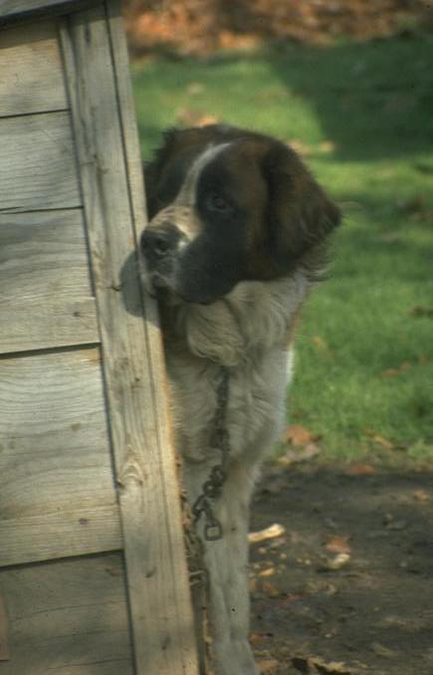
Architecting a dog house
Can be built by one person
Requires
Minimal modeling
Simple process
Simple tools
Little risk

Slide 9
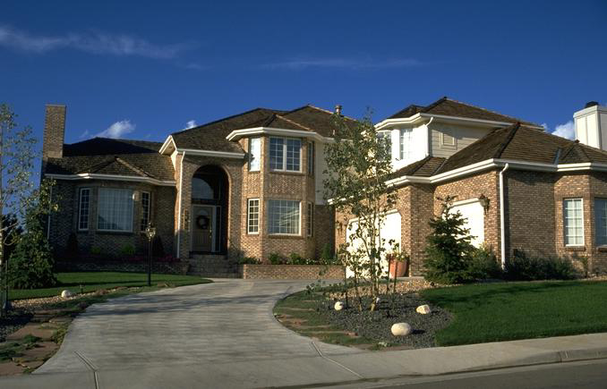
Architecting a house
Built most efficiently and timely by a team
Requires
Modeling
Well-defined process
Power tools

Slide 10

Architecting a high rise
Built by many companies. Requires:
Modeling
Simple plans, evolving to blueprints
Scale models
Engineering plans
Well-defined process
Architectural team
Political planning
Infrastructure planning
Time-tabling and scheduling
Selling space
Heavy equipment
Major risks

Slide 11
Tools for large projects
To make communication possible to you need to share a vocabulary
Standards for languages, design patterns, architecture, etc.
To work together you need to control the integrity of source code
Tools for code versioning (e.g. CVS, SubVersion)
To build, test and release a large system can be difficult
Tools for creating releases (e.g. CMT, SCRAM), tracking problems
But individual effort is still important
Good tools and methods can help to do a better job

Slide 12
Performance
“More computing sins are committed in the name of efficiency (without necessarily achieving it) than for any other single reason - including blind stupidity”, William Wulf (AT&T Professor)
Overall efficiency is what really matters
The cost of the improving the code (people are expensive) should be included
Perceived performance is what really matters
Is the system getting the job done or not?
Reminder: Performance assumes correctness
A fast program delivering [sometimes] wrong results is not helpful

Slide 13
Importance of Reuse
Put extra effort into building high quality components
Be more efficient by re-using these components
Many obstacles to overcome
too broad functionality / lack of flexibility in components
organisational - reuse requires a broad overview to ensure unified approach
we tend to split into domains each independently managed
cultural
don’t trust others to deliver what we need
fear of dependency on others
fail to share information with others
developers fear loss of creativity
➔ Reuse is a management activity

Slide 14
Application Domains
Event Processing Applications
Trigger, Simulation, Reconstruction, Selection programs
Data Analysis
Event/Detector display, data presentation programs
Detector calibration
Calibration and Alignment programs
Job configuration, submission, monitoring and control
Grid awareness
Mainly batch oriented. Interactive for development & debugging. Real-time.
Mainly interactive
Batch and interactive
Mainly interactive

Slide 15
No Disjoint Domains
For example, the LHCb requirements for interactive analysis:
Better [than PAW] integration with experiment framework
consistent with the analysis batch environment, use the same toolkits and experiment algorithms/tools
access the experiment data objects and allow browsing
integrated with event display
allow interactive reconstruction and simulation

Slide 16
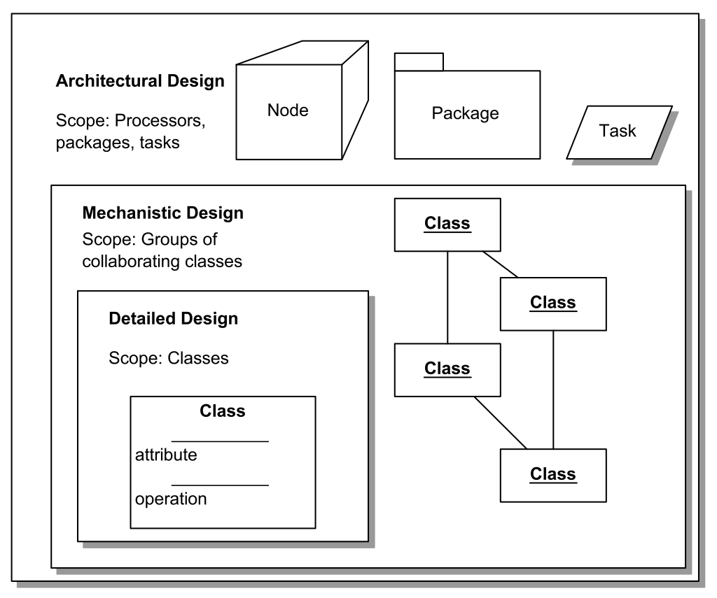
Software Design
System Architecture
Component design
Class design

Slide 17
Architectural Design
Capture major interfaces between subsystems and packages early
Be able to visualize and reason about the design in a common notation
Common vocabulary, running scenarios
Be able to break the work into smaller pieces that can be developed concurrently by different teams
Acquire an understanding of non-functional constrains
Programming languages, concurrency, database, GUI, component re-use

Slide 18
Architecture Defined
Definition of [software] architecture [1]
Set or significant decisions about the organization of the software system
Selection of the structural elements and their interfaces which compose the system
Their behavior -- collaboration among the structural elements
Composition of these structural and behavioral elements into progressively larger subsystems
The architectural style that guides this organization
The architecture is the blue-print (architecture description document)
[1] I. Jacobson, et al. “The Unified Software development Process”, Addison Wesley 1999

Slide 19
Architecture defined (continued)
Mary Shaw, CMU
Grady Booch,
Philippe Kruchten,
Rich Reitman
Kurt Bittner, Rational
Software architecture also involves
usage
functionality
performance
resilience
reuse
comprehensibility
economic and technology constraints and tradeoffs
aesthetic concerns

Slide 20
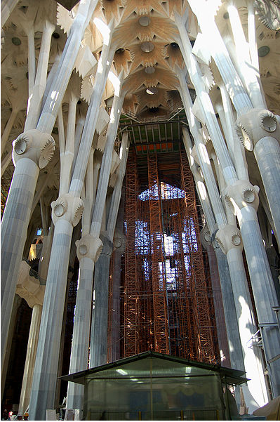
Architectural Design Qualities
A well designed architecture has certain qualities:
layered subsystems
low inter-subsystem coupling
robust, resilient and scalable
high degree of reusable components
clear interfaces
driven by most important and risky use cases
easy to understand

Slide 21
Models
Models are the language of designer, in many disciplines
Models are representations of the system to-be-built or as-built
Models are vehicle for communications with various stakeholders
Visual models, blueprints
Scale
Models allow reasoning about some characteristic of the real system

Slide 22
Many stakeholders, many views
Architecture is many things to many different interested parties
end-user
customer
project manager
system engineer
developer
architect
maintainer
other developers
Multidimensional reality
Multiple stakeholders
multiple views, multiple blueprints

Slide 23
Architectural design workflow
Select scenarios: criticality and risk
Identify main classes and their responsibility
Distribute behavior on classes
Structure in subsystems, layers, define interfaces
Define distribution and concurrency
Implement architectural prototype
Derive tests from use cases
Evaluate architecture
Iterate
Use case view
Logical view
Implementation view
Deployment view
Process view

Slide 24
Scenario-based evaluation
Scenario is a brief description of an interaction of a stakeholder with a system
What if…
What if…
System
What if…
What if…
What if…

Slide 25
Scenarios evaluation examples
User scenarios
What if I want to run a new track fit algorithm?
What if I need to use the newest calibration?
Deployment engineer
What if we need to port the software to the Solaris platform?
What if we embed the software in real-time systems
Manager
What if we need to support some standard data formats
What if we integrate a commercial GUI system

Slide 26
Sources of architecture
Method
Method
Theft
Intuition
Theft
Intuition
Classical system
Unprecedented system

Slide 27
Architectural style
Mary Shaw, CMU
An architecture style defines a family of systems in terms of a pattern of structural organization.
An architectural style defines
a vocabulary of components and connector types
a set of constraints on how they can be combined
one or more semantic models that specify how a system’s overall properties can be determined from the properties of its parts

Slide 28
Architectural styles
General categorization of systems [1]
user-centric focus on the direct visualization and manipulation of the objects that define a certain domain
data-centric focus upon preserving the integrity of the persistent objects in a system
computation-centric focus is on the transformation of objects that are interesting to the system
[1] G. Booch, “Object Solutions”, Addison-Wesley 1996

Slide 29
Different style in different domains
The applications in the different domains may have different emphasis in:
Interactivity
Database
Computation
Elements of all three are present in all applications
data-
centric
user-
centric
User Interface
Interactivity
Scripting
Object store
Database
Data Integrity
Algorithms
Computation
computation-centric

Slide 30
Computation-centric: GAUDI
Framework adequate for “all” event processing applications
Algorithms process “event data” with the help of “services” and using “detector data”.

Slide 31
UML
Unified Modeling Language (UML) is a standardized general-purpose modeling language
Includes a set of graphical notation techniques to create visual models of software-intensive systems
Is an open standard
Supports the entire software development lifecycle
Supports diverse applications areas
Is based on experience and needs of the user community
Supported by many tools

Slide 32
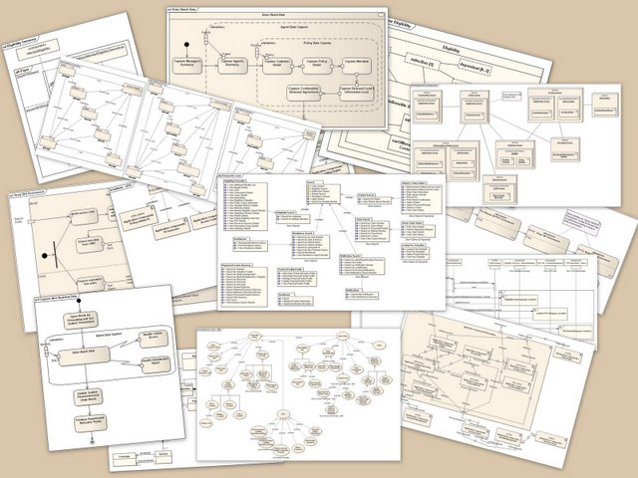
UML Diagrams
Structure diagrams
Class
Component
Deployment
Object
Package
Behavior diagrams
Activity
State machine
Use case
Interaction diagrams
Communication
Interaction
Sequence

Slide 33
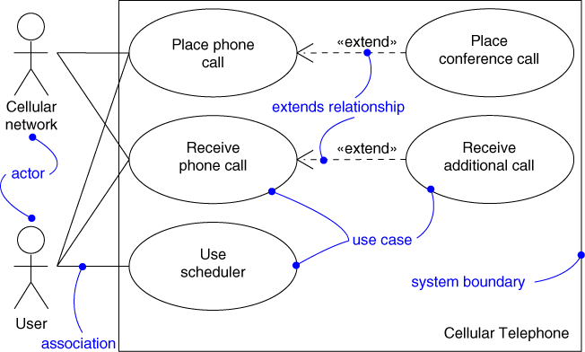
Use Case Diagram
Captures system functionality as seen by users
Built in early stages of development
Specify the context of a system
Capture the requirements of a s
Validate a system’s architecture
Drive implementation and generate test cases
Developed by analysts and domain experts

Slide 34
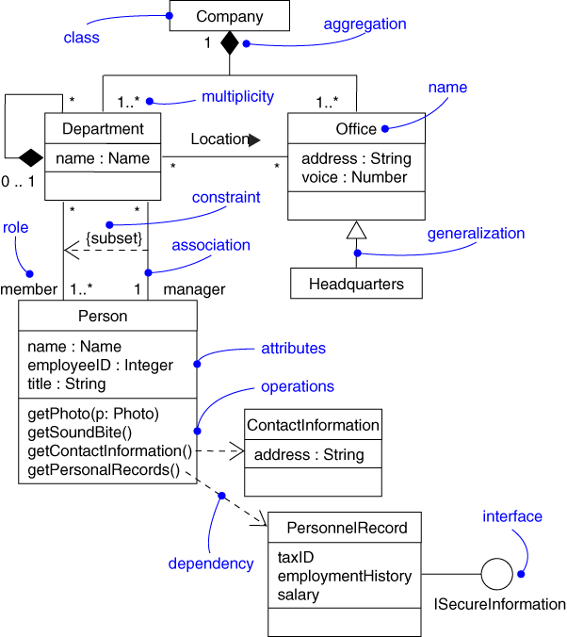
Class Diagram
Captures the vocabulary of a system
Built and refined throughout development
Name and model concepts in the system
Specify collaborations
Specify logical database schemas
Developed by analysts, designers, and implementers

Slide 35
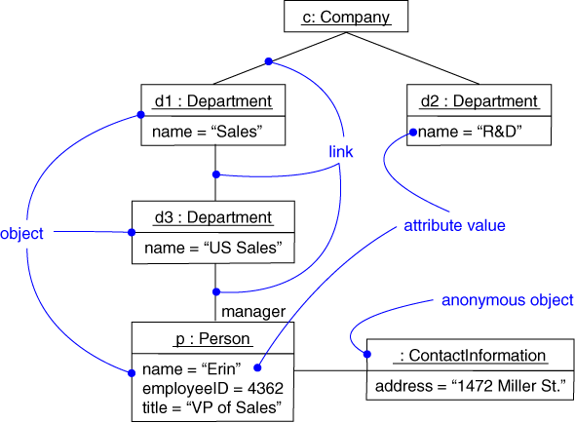
Object Diagram
Shows instances and links
Built during analysis and design
Illustrate data/ object structures
Specify snapshots
Developed by analysts, designers, and implementers

Slide 36
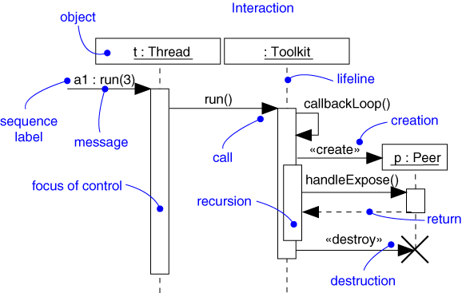
Sequence Diagram
Captures dynamic behavior (time-oriented)
Purpose
Model flow of control
Illustrate typical scenarios

Slide 37
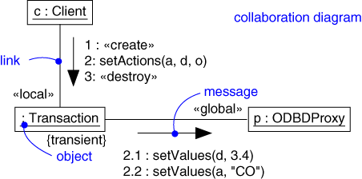
Collaboration Diagram
Captures dynamic behavior (message-oriented)
Model flow of control
Illustrate coordination of object structure and control

Slide 38
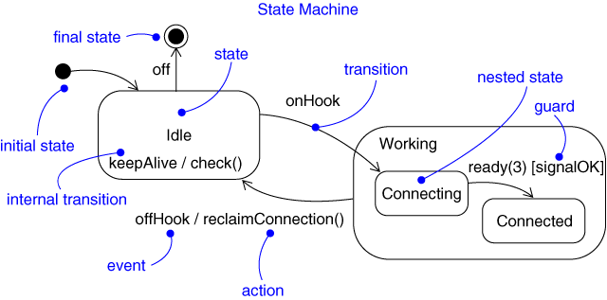
Statechart Diagram
Captures dynamic behavior (event-oriented)
Purpose
Model object lifecycle
Model reactive objects (user interfaces, devices, etc.)

Slide 39
The Architect
Experience
In software development
In the domain
Pro-active, goal oriented
Leadership, authority
Architecture team
Balance between technologists, domain experts, users

Slide 40
The Architect
Not just a top level designer
Need to ensure feasibility
Not the project manager
But “joined at the hip”
Not a technology expert
Purpose of the system, “fit”,
Not a lone scientist
Communicator

Slide 41
Software architecture team charter
Defining the architecture of the software
Maintaining the architectural integrity of the software
Assessing technical risks related to the software design
Proposing the order and contents of the successive iterations
Consulting services
Assisting marketing for future product definition
Facilitating communications between project teams

Slide 42
Architecture is making decisions
The life of a software architect is a long (and sometimes painful) succession of suboptimal decisions made partly in the dark.

Slide 43
Frameworks

Slide 44
Software Framework
A software framework is an abstraction in which common code providing generic functionality can be selectively overridden or specialized by user code providing specific functionality.
A software framework is similar to software libraries in that they are reusable abstractions of code wrapped in a well-defined API
Typically the framework “calls” the user provided adaptations for specific functionality
Is the realization of a software architecture and facilitates software re-use

Slide 45
Frameworks in Practice
A skeleton of an application into which developers plug in their code and provides most of the common functionality

Slide 46
Not a Single Framework
A single Framework does for fit everywhere
Each software domain provides its specialized framework
E.g. a GUI framework based on signal-slot can be used to build GUI application
Real complex applications are made typically with a collaboration of frameworks

Slide 47
Software Structure
Applications
Applications are built on top of frameworks and implementing the required algorithms
Event
Det Desc.
Calib.
Every experiment has a framework for basic services and various specialized frameworks: event model, detector description, visualization, persistency, interactivity, simulation, calibrarion, etc.
Experiment Framework
Simulation
Data Mngmt.
Distrib.
Analysis
Specialized domains that are common among the experiments
Core Libraries
Core libraries and services that are widely used and provide basic functionality
non-HEP specific
software packages
General purpose non-HEP libraries

Slide 48
What is a Framework?
Framework Definition [1,2]
A architectural pattern that codifies a particular domain. It provides the suitable knobs, slots and tabs that permit clients to use and adapt to specific applications within a given range of behavior.
In practice
A skeleton of an application into which developers plug in their code and provides most of the common functionality.
[1] G. Booch, “Object Solutions”, Addison-Wesley 1996
[2] E. Gamma, et al., “Design Patterns”, Addison-Wesley 1995
Notes:
What is a Framework
We have developed the Gaudi object-oriented framework with the intention of using it to develop all event data processing applications running in the various processing environments. Examples include the high level triggers that acquire their data directly from the on-line system, the event simulation software that runs off-line in a batch environment and the event visualization software which is used interactively. The basis of the framework is the architecture which defines the basic components and how they are interfaced. The framework is real software that implements the architecture and ensures that its design features are respected.
Use of the framework in all applications will help to ensure the integrity of the overall software design and will result in maximum reuse of the core software components.
Although GAUDI has been developed in the context of the LHCb experiment, it has been designed to be easily customizable, so that it can be adapted to the different tasks and integrated with components from other frameworks. It can easily be adapted for use in other experiments.

Slide 49
Framework Benefits
Common vocabulary, better specifications of what needs to be done, better understanding of the system.
Low coupling between concurrent developments. Smooth integration. Organization of the development.
Robustness, resilient to change (change-tolerant).
Fostering code re-use
Notes:
Framework benefits
The main benefit of adopting a framework is to give a frame to the developments of the different groups and people, adopt a common vocabulary, etc. Without a framework, the different contributions will be very difficult to integrate into a coherent application like the reconstruction program. It is secondary in importance which concrete framework you adopt, the important thing is to have one.

Slide 50
Gaudi Architecture and Framework
An Example of Framework for HEP Applications

Slide 51
Principal Design Choices
Separation between “data” and “algorithms”
Three basic categories of “data”
event data, detector data, statistical data
Separation between “transient” and “persistent” representations of data
Data store-centered (“blackboard”) architectural style
“User code” encapsulated in few specific places
Well defined component “interfaces” with plug-in capabilities

Slide 52
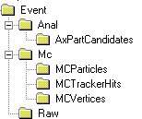
Gaudi Object Diagram
Converter
Application
Manager
Converter
Event
Selector
Transient Event Store
Converter
Data
Files
Message
Service
Event Data
Service
Persistency
Service
JobOptions
Service
Algorithm
Algorithm
Algorithm
Transient Detector
Store
Data
Files
Particle Prop.
Service
Detec. Data
Service
Persistency
Service
Other
Services
Transient
Histogram Store
Data
Files
Histogram
Service
Persistency
Service
Notes:
Gaudi Object Diagram
The main components of the GAUDI software architecture can be seen in the object diagram in the slide. Object diagrams are very illustrative for explaining how a system is decomposed.
The essence of data processing applications are a set of Algorithms. This is what is shown in the diagram. These Algorithms require the functionality provided by a set of Services. See next slides.

Slide 53
Definition of Terms
Algorithm
Atomic data processing unit (visible & controlled by framework)
Algorithm Tool
Class called by the Algorithm or another Tool to perform a specific function (private and public)
Data Object
Atomic data unit (visible and managed by transient data store)
Transient Data Store
Central service and repository for data objects (data location, life cycle, load on demand, …)
Notes:
Algorithm
The essence of the event data processing applications are the physics algorithms, which are encapsulated into a set of components that we call Algorithms. Algorithms implement a standard set of generic interfaces and can be called without knowing what they really do. In fact, a complex algorithm can be implemented by using a set of simpler ones.
Data Object and Transient Store
The data objects needed by the algorithms are organized in several transient data stores, depending on the nature of the data itself and its lifetime: event data, detector data, statistical data.. Although the stores behave slightly differently, particularly with respect to the data lifetime (e.g. the event data store is cleared for each event), their implementations have many things in common and are based on a common component.
Mapping to the old FORTRAN terms
An Algorithm is equivalent to a FORTRAN subroutine that produces new ZEBRA banks from some input banks
Data Object is equivalent to a ZEBRA bank
Transient Data Store is equivalent to the ZEBRA common block

Slide 54
Definition of Terms (2)
Services
Globally available software components providing framework functionality
Data Converter
Provides explicit/implicit conversion from/to persistent data format to/from transient data
Properties
Control and data parameters for Algorithms and Services
Notes:
Services
Services are a category of components that should offer all the services directly or indirectly needed by the algorithms. This approach releases the algorithm builder from having to develop the routine software tasks that are typically needed in a physics data processing application. Some examples of services can be seen in the object diagram. They include:
The services for managing the different transient stores (event data service, detector data service,...) should offer simplified data access to the algorithms.
The different persistency services provide the functionality needed to populate the transient data stores from persistent data and vice versa. These services require the help of specific converters which know how to convert a specific data object from its persistent representation into its transient one, or the other way around.
The job options service, message service and particle properties service.

Slide 55
Algorithm
IAlgorithm
initialize()
execute()
finalize()
Users write Concrete Algorithms
It is called once per physics event
Implements three methods in addition to the constructor and destructor
initialize(), execute(), finalize()
Algorithm
IProperty
setProperty()
getProperty()
Concrete
Algorithm
Notes:
Algorithms
Algorithms encapsulates the physics contents of the data processing program. It is the “place holder” foreseen by the framework for the end-user code. This is why most of the tutorial will be devoted to development of algorithms.
Algorithms are scheduled to be executed explicitly once per physics event. If the complexity requires, the algorithm can be made as a composite of a number of sub-algorithms. The complex algorithm schedules explicitly the execution of the sub-algorithms in the proper order to produce the desired results. If an algorithm requires some data that happens to be produced by another algorithm, then the system has to ensure by explicit coding that the algorithms are executed in the correct sequence.

Slide 56
Interfaces
ApplicationMgr
ISvcLocator
EventDataSvc
IDataProviderSvc
IAlgorithm
IProperty
Concrete
Algorithm
DetectorDataSvc
IDataProviderSvc
HistogramSvc
IHistogramSvc
MessageSvc
IMessageSvc
Obj_A
Obj_B
ParticlePropertySvc
IParticlePropertySvc
Notes:
Basic abstract interface concept
This figure illustrates the concept of an Concrete Algorithm implementing a couple of abstract interfaces (IAlgorithm, IProperty) and at the same time “using” a number of other abstract interfaces offering some services (histogramming, messages, particle properties, etc,). The interaction between the algorithm and the services are always through this interfaces. This is the technique that minimizes the coupling between software and allows to be able to replace different implementation without affecting the algorithm clients.

Slide 57



VCR Interface Model
IRfInput
IEuroConnector
TV set
Each interface is specialized in a domain.
Interfaces are independent of concrete implementations.
You can mix devices from several constructors.
Application built by composing.
Standardizing on the interfaces gives us big leverage.
VCR
IUserInterface
IInfraredInput
Notes:
VCR Interface Model
This analogy illustrates the building of a system from a number of components connected by their interfaces. It clearly shows the advantages of standard interfaces and the possibility to evolve the system by replacing some of the components without having to re-do the rest of the system.

Slide 58
Interfaces in Practice
IMyInterace.h
class IMyInterface {
void doSomething( int a, double b ) = 0;
}
ClientAlgorihtm.cpp
#include “IMyInterface.h”
ClientAlgotihm::myMethod() {
// Declare the interface
IMyInterface* myinterface;
// Get the interface from somewhere
service(“MyServiceProvider”, myinterface );
// Use the interface
myinterface->doSomething( 10, 100.5);
}
Notes:
Interfaces in Practice
The declaration of the interface (IMyInterface.h) contains a number of abstract methods (= 0). The client of the interface does not know who is implementing the interface, it has no necessity to know it. It needs to include only the interface definition (this is the contract between the client and the implementation)
Notice that an interface (class with abstract methods) can not be instantiated. You can not call “new IMyInterface”, therefore you need to have a mechanism to instantiate objects implementing the interface indirectly. This is one of the functionalities offered by the framework.

Slide 59
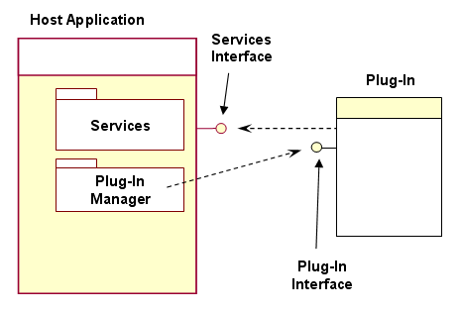
Plug-ins
Program extensions to provide a certain, usually very specific function "on demand”
Applications/frameworks support plug-ins for many reasons (in HEP)
to enable third-party developers to create capabilities to extend an application
to support features yet unforeseen
to reduce the size of the basic application

Slide 60
Reflex Plug-in Service
Coding the plugin/component
No predefined model
Declaring factory with signature
Creating the rootmap file
Text file listing all plugins and the associated dynamic library
Created with the genmap tool
Instantiating the plugin
Library loaded if needed
Strong argument type checking
No implementation dependency
class MyClass : public ICommon {
MyClass(int, ISvc*);
...
};
MyClass.h
PLUGINSVC_FACTORY(MyClass,ICommon*(int,ISvc*));
/* implementation */
MyClass.cpp
Library.MyClass: MyLibrary.so
Library.AnotherClass: MyLibrary.so
rootmap
...
ISvc* svc = ...
ICommon* myc;
myc = PluginSvc::create<ICommon*>(“MyClass”,10, svc);
if ( myc ) {
myc->doSomething();
}
Program.cpp

Slide 61
Algorithm & Transient Store
Data T1
Data T1
Transient Event
Data Store
Data T1
Algorithm
A
Data T2, T3
Data T2
Algorithm
B
Data T4
Data T3, T4
Algorithm
C
Data T5
Apparent dataflow
Real dataflow
Data T5
Notes:
Algorithm & Transient Store
In order to minimize the coupling between algorithms, the transient data store acts a “black-board” between algorithms. An Algorithm does not need to know from where the data has been produced, it only knows what data it requires and what data will be producing.
As in shown in the viewgraph, we can create “data-flows” using a number of Algorithms known only, their inputs and outputs, by scheduling them in the adequate order.

Slide 62
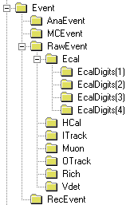
Loading Transient Store
Algorithm
(client)
1
Event Data
Service
3
Persistency
Service
retrieve
object
load
request
2
Search
dispatch
4
8
register
Conversion
Service
Conversion
Service
9
create object
5
Direct
reference
7
new
Converter
read
6
Event Data Store

Slide 63
Complex Control Sequences
Concept of sequences of Algorithms to allow processing based on physics signature
Avoid re-calling same algorithm on same event
Different instances of the same algorithm possible
Event filtering
Avoid passing all the events through all the processing chain
Event
Input/Output
Algorithm
Filter
Decision
Single
Instances

Slide 64
Data Object Description
Definition of objects on a higher level
Easy language for defining objects
Ability to derive several implementations from this source
Uniform layout of objects
Easily extensible
Produce C++ headers and Reflex dictionaries automatically
Global optimization possible (e.g. memory pools)
Back
End
C++ .h
GOD files (xml)
Parser
Back
End
Reflex Dict
Exp. Policies
Back
End
…

Slide 65
Auditors
The Auditor Service provides a set of auditors that can be used to provide monitoring of various characteristics of the execution of Algorithms
ChronoAuditor, MemoryAuditor, etc.
Each auditor is called immediately before and after each call to each Algorithm instance
Tracks some resource usage of the Algorithm
➔Built-in performance monitoring is essential !!

Slide 66
Auditors
List of
Auditors
jobOptions
IAlgorithm
Algorithm
IAuditorSvc
AuditorSvc
Auditor
Auditor
MyAlg
Auditor_1

Slide 67
Incidents
The Incident Service provides synchronization facilities to components in a Gaudi application
Incidents are named software events that are generated by software components and that are delivered to other components that have requested to be informed when that incident happens
A number of predefined incidents such as ‘beginRun’, ‘endEvent’, ‘openFile’

Slide 68
Incident Service
IService
IProperty
Originator
IIncidentSvc
Incident
Svc
fire
Add/remove
IIncidentListener
Client
Object
Client
Object
Listener
Object

Slide 69
Data On Demand
Typically the execution of Algorithms are explicitly specified by the initial sequence and and sub-sequences
Avoid too-late loading of components (HTL)
Easier to debug
For some use-cases it is necessary to trigger the execution of a given Algorithm by accessing an Object in the Transient Store
The DataOnDemand Service is can be configured to provide this functionality

Slide 70
Other Gaudi Services
JobOptions Service
Message Service
Particle Properties Service
Event Data Service
Histogram Service
N-tuple Service
Detector Data Service
Magnetic Field Service
Tracking Material Service
Random Number Generator
Chrono Service
(Persistency Services)
(User Interface & Visualization Services)
(Geant4 Services)
Notes:
Gaudi Services
Open ended list of available services in Gaudi. The services in the top of the list will be the ones that will be used and exercised during the tutorial. Many of the existing services are not really used directly by the Algorithms implementing a physics algorithm but they are used by the Framework itself in implementing some of the functionalities (persistency, visualization, interactivity, etc.)

Slide 71
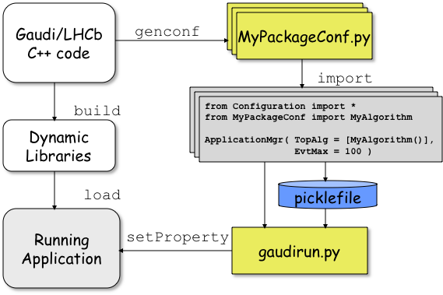
Configuring the Application
Each Framework component can be configured by a set of ‘properties’ (name/ value pairs)
In total thousands of parameters need to be specified to fully configure a complex HEP application
Using Python to facilitate the task
Build-in type checking

Slide 72
Interactivity and scripting
Interactivity and scripting are essential use cases for any HEP framework
Scripts for rapid prototyping and trying new ideas
Testing frameworks
GUI applications
A convenient way to achieve it is to provide bindings to a scripting language such as Python (or a C++ interpreter)
Once this is done the rest comes automatically

Slide 73

PyROOT: Mode d’emploi
From class definitions (.h files) a “dictionary” library is produced
Description of the class
“stub” functions to class methods
Absolutely non-intrusive
The PyROOT module does the adaptation between Python objects and C++ objects in a generic way
It works for any dictionary
select.xml
MyClass.h
genreflex
MyClassDict.so
MyClass.so
load
PyROOT
MyScript.py
Python interpreter

Slide 74
Summary: Frameworks
All experiments have developed Software Frameworks
General architecture of any event processing applications (simulation, trigger, reconstruction, analysis, etc.)
To achieve coherency and to facilitate software re-use
Hide technical details to the end-user Physicists
Help the Physicists to focus on their physics algorithms
Applications are developed by customizing the Framework
By the “composition” of elemental Algorithms to form complete applications
Using third-party components wherever possible and configuring them
ALICE: AliROOT; ATLAS+LHCb: Athena/Gaudi; CMS: CMSSW

Slide 75
Integrating Technologies
Software Re-use

Slide 76
When Frameworks are not Possible
At occasions you need to a build software system/application made of independently developed components
Using existing class libraries
They cannot be re-done using a single ‘framework’
Building adaptation layers are not always possible and effective
Examples
Integrating MC generators in ROOT
Performing ROOT I/O on Geant4 Applications

Slide 77
Software Integration Elements
Dictionaries
Dictionaries provide meta data information (reflection) to allow introspection and interaction of objects in a generic manner
Scripting languages
Interpreted languages are ideal for rapid prototyping
They allow integration of independently developed software modules (software bus)
Standardizing on CINT and Python scripting languages
Component model and plugin management
Modeling the application as components with well defined interfaces
Loading the required functionality at runtime

Slide 78
Strategic role of C++ reflexion
Python
CINT
Object I/O
Scripting (CINT, Python)
Plug-in management
etc.
Root meta C++
ROOT
Reflex
Reflex
DS
rootcint -cint
XDictcint.so
rootcint -reflex
X.h
rootcint -gccxml

Slide 79
Python <-> C++ Interoperation
The bulk of code for the new HEP experiments is written in C++
Still some portions of FORTRAN with plans to migrate
Java and other languages almost non-existent
Need Python bindings to C++ code
Hand-written (C-API) or generated
Requires taking care of:
Object, parameter conversions
Memory management
C++ function overloading
C++ templates
Inheritance and function callbacks

Slide 80
Python as Software “Bus”
Very rich set specialized generic modules
LHC modules
Several GUI toolkits
EDG API
PVSS
XML
Database
GUI
GUI
Python
Gateways to other frameworks
shell
JPE
PyROOT
GaudiPython
math
math
Java
Classes
ROOT
Classes
Gaudi
Framework
Very rich set of Python standard modules

Slide 81
Summary
Introduced the main concepts of software architecture
Why it is needed, what it means, modeling concepts and languages (UML), etc.
The role of architect
Introduced software frameworks and their hierarchy
Used GAUDI framework as an example of HEP event data processing framework
The main design criteria
Introduction to few of the main concepts and functionalities
Software integration elements

Slide 82
References
Grady Booch, Object Solutions, Addison-Wesley, 1995.
Eric Gamma, John Vlissides, Richard Helm, Ralph Johnson, Design Patterns, Addison-Wesley 1995.
Rational Unified Process 5.0, Rational, Cupertino, CA, 1998
Len Bass, Paul Clements & Rick Kazman, Software Architecture in Practice, Addison-Wesley, 1998

