Slide 1


First INFN International School on Architectures, tools and methodologies for developing efficient large scale scientific computing applications
Ce.U.B. – Bertinoro – Italy, 12 – 17 October 2009
Vincenzo Innocente
“Software Architectures
For
Parallel Programming”
Implemented using
std::thread
OpenMP
MPI

Slide 2
Goal of Today
Learn a methodology to analyze a computational problem and provide a (optimal) parallel solution
Review structural building blocks
Architectural & Design patterns
Algorithmic structures
Implementations
Study few use cases
Identify pitfalls, use measurement tools, apply optimization strategies

Slide 3
Resources
This lectures is largely based on
the excellent 2009 Par Lab Boot Camp – “Short Course on Parallel Programming”
http://parlab.eecs.berkeley.edu/bootcampagenda
The OpenLab/Intel courses at CERN
Examples and exercises use the latest C++0x proposed standard as implemented in gcc 4.4.1
Not finalized, implementation incomplete and buggy…
Very little doc (best: Anthony Williams ongoing blog)

Slide 4


Top-to-Bottom Parallelism
Cluster/Grid/Cloud
Multi-socket
Multi-core
Hyperthreading
SIMD/Wide execution
Pipelining
Superscalar execution
Our 7 dimensions

Slide 5
Parallel Environments
Applications
P
P
P
P
P
T
T
T
T
T
T
T
T
T
T
T
Operating System & Run-Time System
P: process
T: thread
C: core
S: socket
(Shared) Memory
C
C
C
C
C
C
C
C
C
C
S
S
S
S
Schematic overview

Slide 6
(Parallel) Software Engineering
Engineering Parallel software follows the “usual” software development process with one difference: Think Parallel!
Analyze, Find & Design
Analyze problem, Finding and designing parallelism
Specify & Implement
How will you express the parallelism (in detail)?
Check correctness
How will you determine if the parallelism is right or wrong?
Check performance
How will you determine if the parallelism improves over sequential performance?

Slide 7
Foster’s Design Methodology
Four Steps:
Partitioning
Dividing computation and data
Communication
Sharing data between computations
Agglomeration
Grouping tasks to improve performance
Mapping
Assigning tasks to processors/threads
From “Designing and Building Parallel Programs” by Ian Foster

Slide 8
Designing Threaded Programs
Partition
Divide problem into tasks
Communicate
Determine amount and pattern of communication
Agglomerate
Combine tasks
Map
Assign agglomerated tasks to created threads
The
Problem
Initial tasks
Communication
Combined Tasks
Final Program

Slide 9
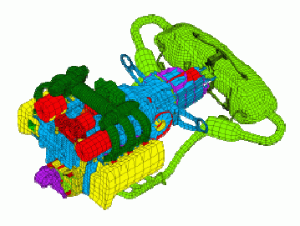

Domain (Data) Decomposition
Exploit large datasets whose elements can be computed independently
Divide data and associated computation amongst threads
Focus on largest or most frequently accessed data structures
Data parallelism: same operations(s) applied to all data

Slide 10


Functional Decomposition
Divide computation based on a natural set of independent functions
Predictable organization and dependencies
Assign data for each task as needed
Conceptually a single data value or transformation is performed repeatedly
Atmosphere Model
Hydrology Model
Ocean Model
Land Surface Model

Slide 11
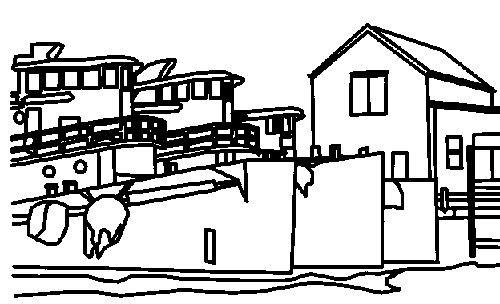
Activity (Task) Decomposition
Divide computation based on a natural set of independent tasks
Non deterministic transformation
Assign data for each task as needed
Little communication
Example: Paint-by-numbers
Painting a single colour is a single task
6
6
3
3
11
5
6
5
5
5
5
5
5
5
5
4
3
5
5
3
4
5
8
4
3
3
5
3
3
3
3
9
10
5
7
9
4
3
3
7
8
3
3
1
8
8
2
1
1
2
1

Slide 12
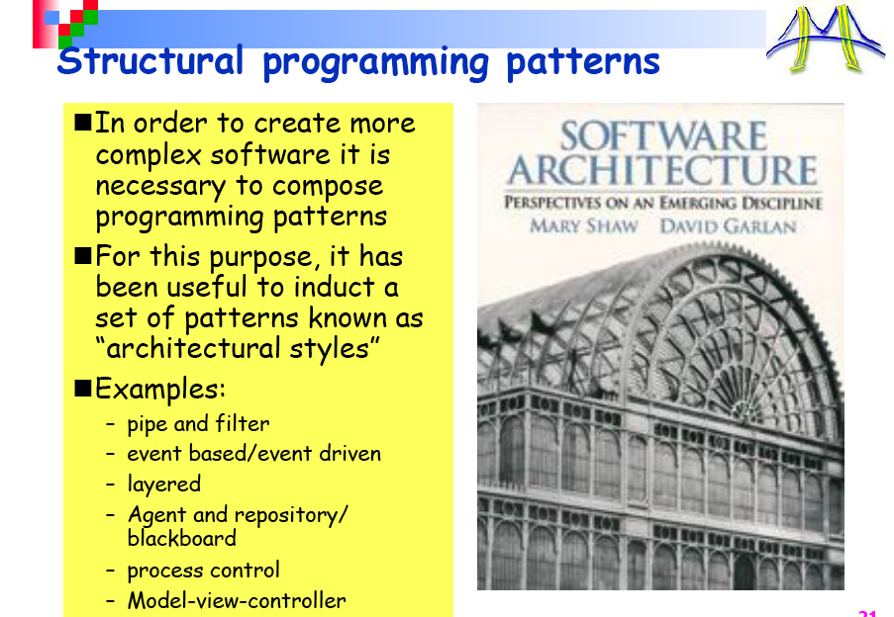

Slide 13
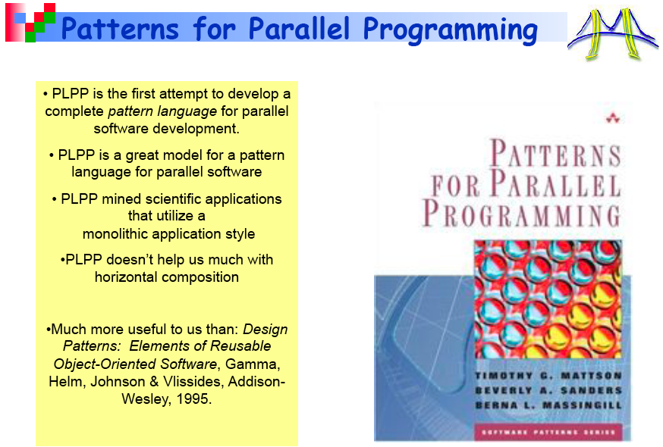

Slide 14
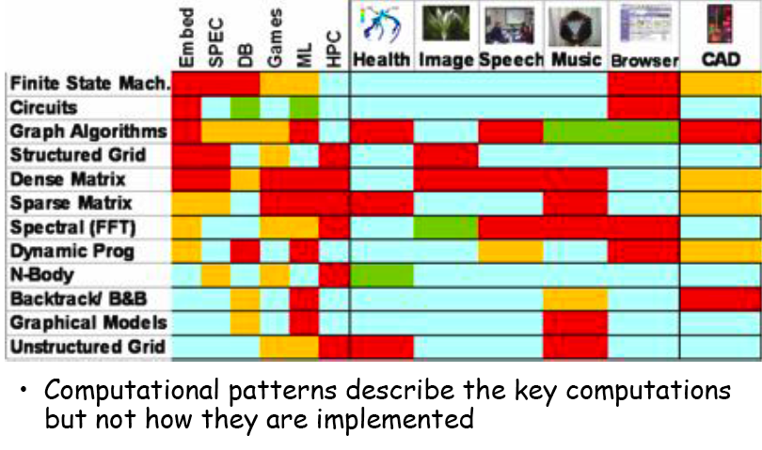
Computational Patters

Slide 15
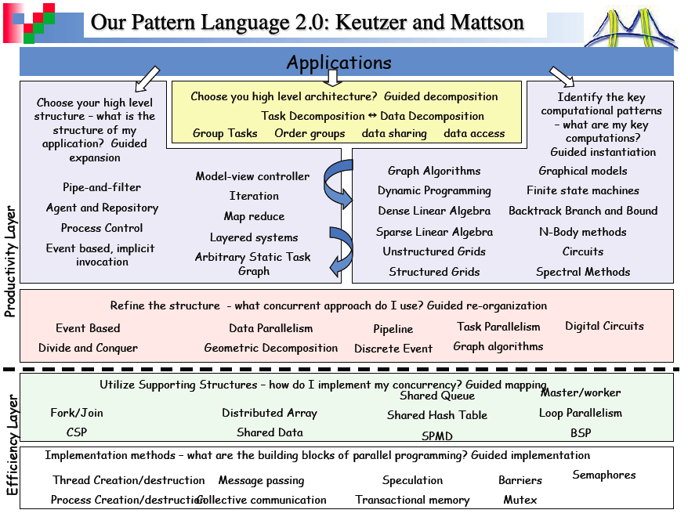

Slide 16
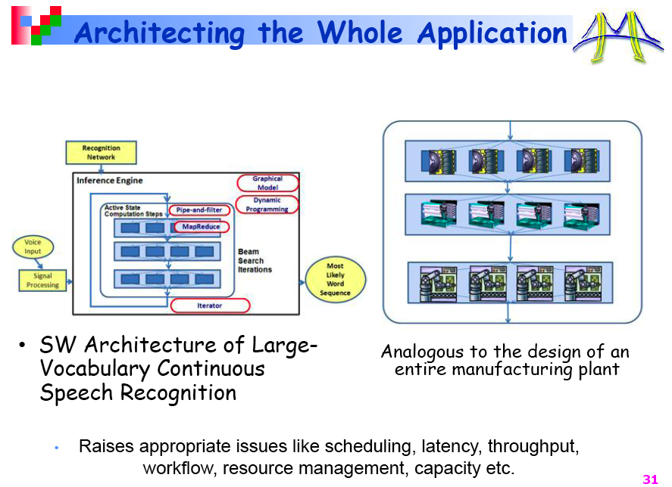
Main Challenge:
Build an architecture that scales
and will survive hardware evolution

Slide 17
Patterns
Think Parallel

Slide 18
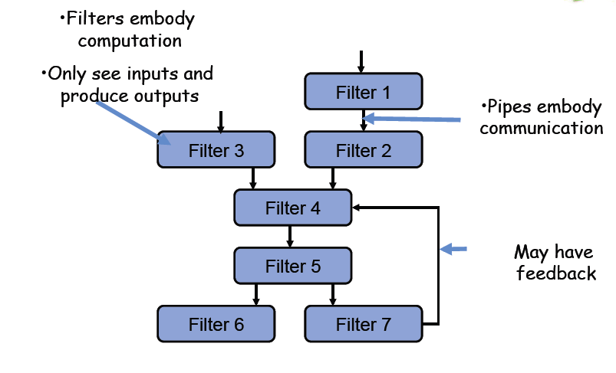
Pipes and Filters

Slide 19
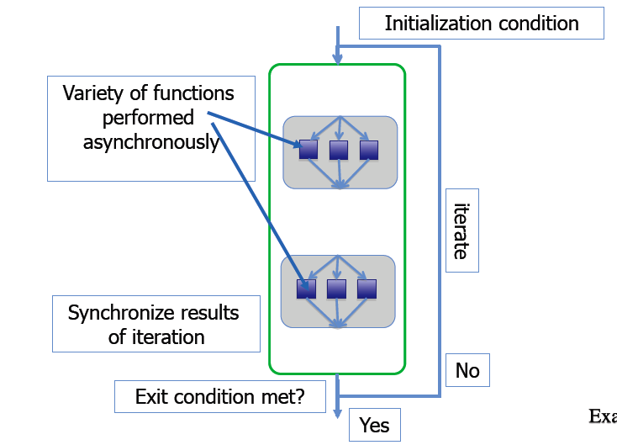
Iteration

Slide 20
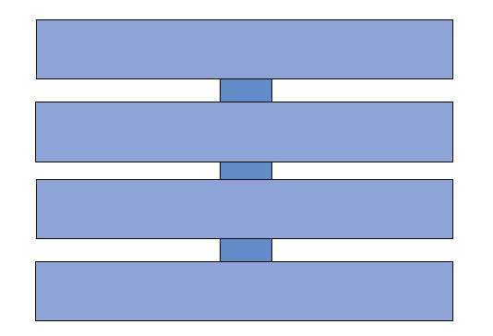
Layered Systems
Delegation pattern: Lower layers “work” for the upper ones
Individual Layers are big
Interface between two adjacent layer is narrow
No communication among not adjacent layers
Challenge:
where parallelization shall occur?
Often lower layers is legacy software

Slide 21
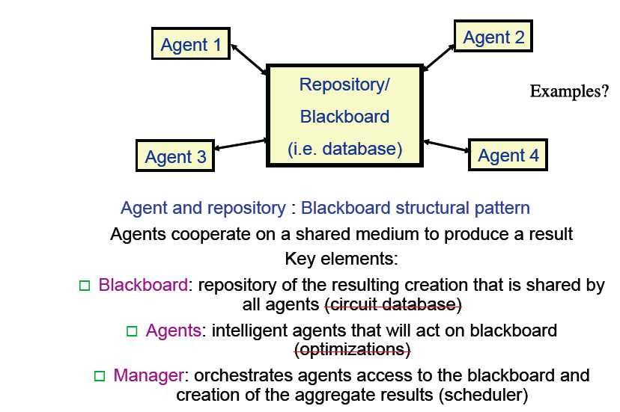
Agents and Repository

Slide 22
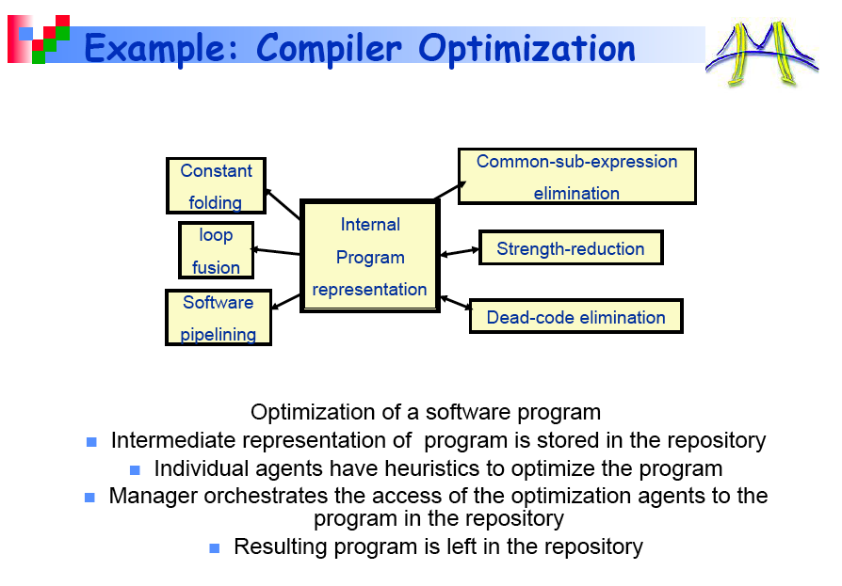

Slide 23
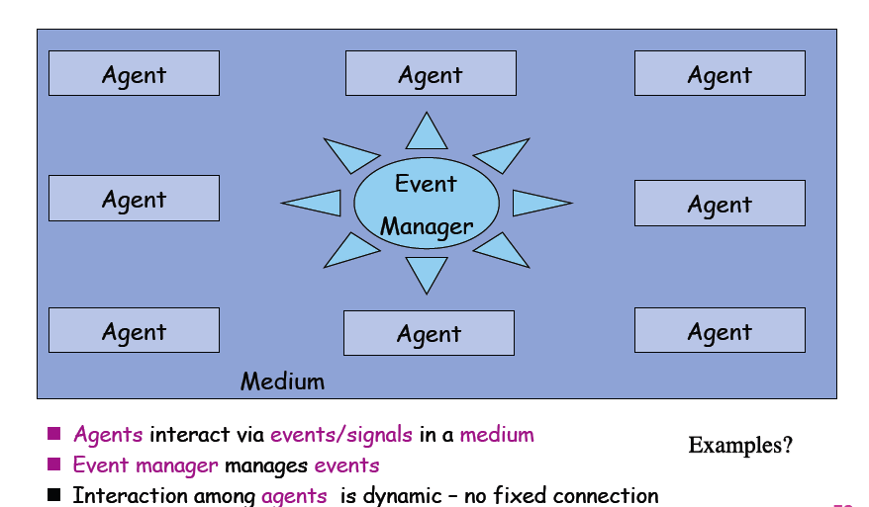
Event-Based Systems

Slide 24
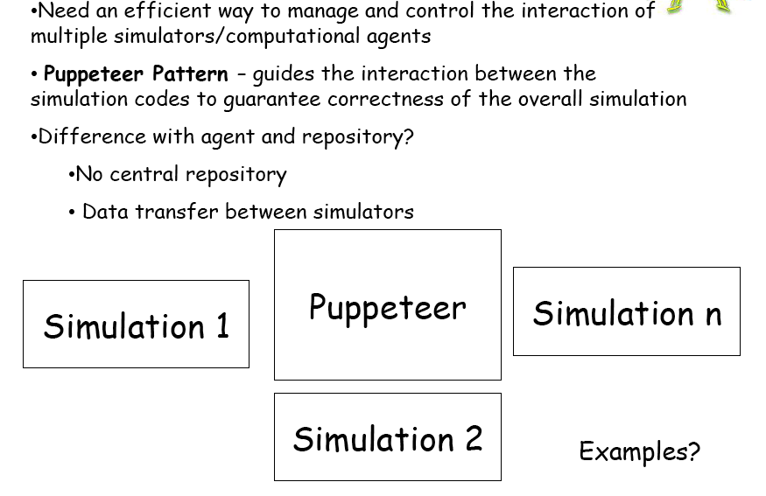
Puppeteer

Slide 25
Map/Reduce
Original (google, Hadhoop) Map/Reduce takes a set of input key/value pairs, and produces a set of output key/value pairs.
Map (written by the user)
takes an input pair and produces a set of intermediate key/value pairs.
The MapReduce library
groups together all intermediate values associated with the same intermediate key I and passes them to the Reduce function.
Reduce , also written by the user,
accepts an intermediate key I and a set of values for that key. It merges together these values to form a possibly smaller set of values.

Slide 26
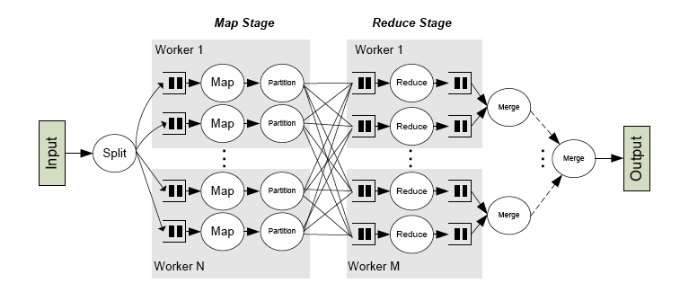
Word count
reduce(String key, Iterator values):
// key: a word
// values: a list of counts
int result = 0;
for each v in values:
result += ParseInt(v);
Emit(AsString(result));
map(String key, String value):
// key: document name
// value: document contents
for each word w in value:
EmitIntermediate(w, "1");

Slide 27
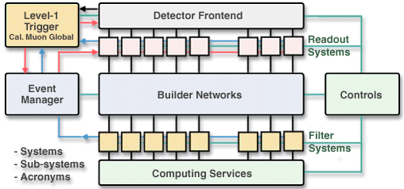

Event Building!
Map: Detector frontend assign event-id to each fragment
DAQ dispatch all fragment with same id to a given filter node
Reduce: filter node assemble the event and process it

Slide 28
Parallel ArchitecTures for Hep Event Processing

Slide 29
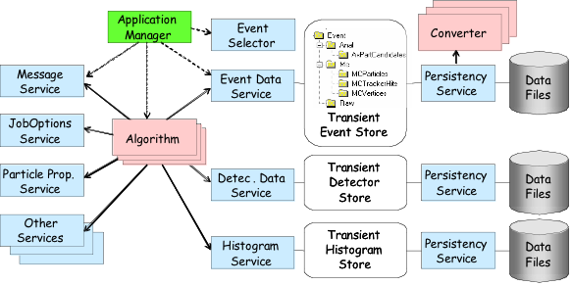
HEP Application

Slide 30
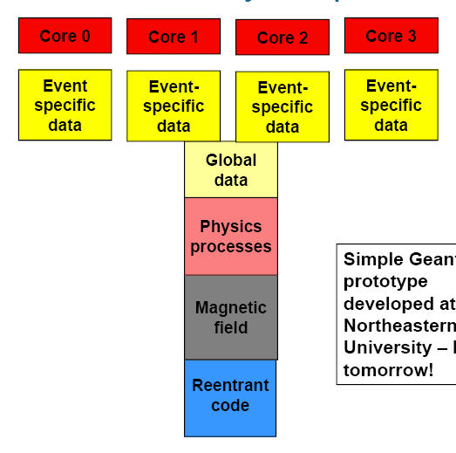
Event parallelism
Opportunity: Reconstruction Memory-Footprint shows large condition data
How to share common data between different process?
CMS:
1GB total Memory Footprint
Event Size 1 MB
Sharable data 250MB
Shared code 130MB
Private Data 400MB !!
multi-process vs multi-threaded
Read-only: Copy-on-write, Shared Libraries
Read-write: Shared Memory, sockets, files

Slide 31
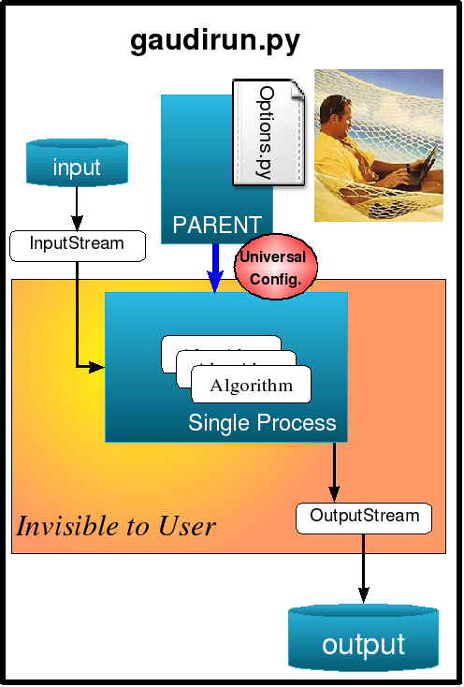
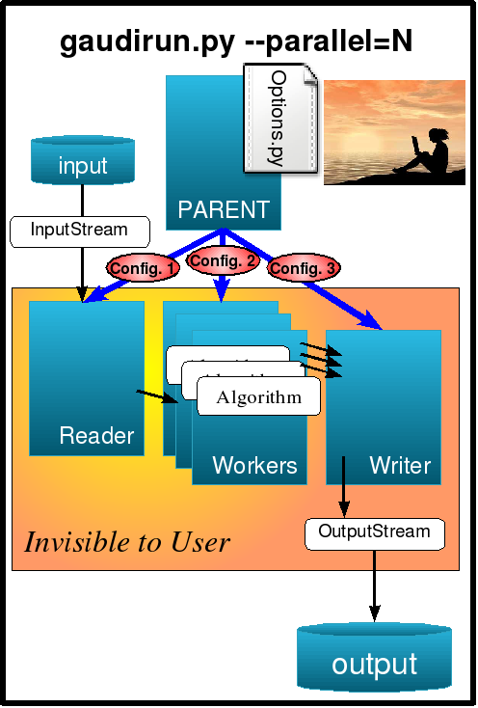
Parallelization of Gaudi Framework

Slide 32
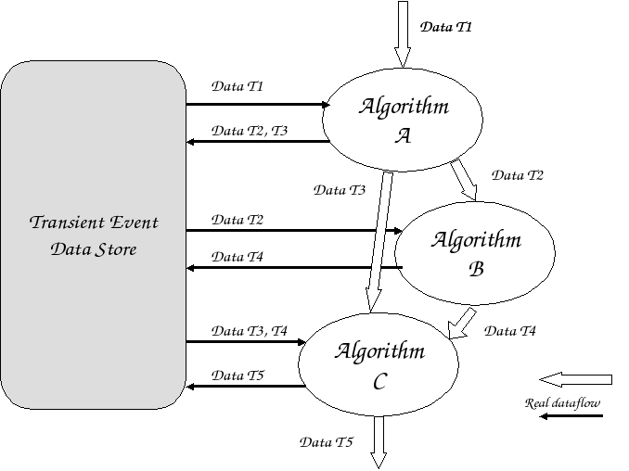
Gaudi : HEP Event Processing
Transient Event Store : Part of Framework
Stores DataObjects during processing
Loaded from Persistent Storage at Start
Constantly modified during run
Notes:
Add Advantages here?

Slide 33
HEP data processing
No need of a coherent event state:
Algorithms
read specific event-fragments, store new fragments: never modify existing ones
Storage:
Fragments map root branches: independent of each other
Conditions shared among events and (some) algorithms
Event parallelism will profit of coherent shared conditions
Algorithm parallelism can make them private to each of them

Slide 34
Algorithmic Structure
Act Parallel

Slide 35
Hello Word!
void hi() {
std::cout << "Hello World from ”
<< std::this_thread::get_id() << std::endl;
}
void hello() {
std::thread t1(hi);
std::thread t2(hi);
hi();
t1.join();
t2.join();
}
Create (Fork) new Threads where hi will run
Run hi in the “main” thread
wait for Threads to terminate

Slide 36
OO Hello Word!
Create local Hi object
Pass it by copy to Thread
void hello() {
std::thread t1(hi);
std::thread t2(Hi(3));
hi();
Hi oneHi;
std::thread t3(std::ref(oneHi));
std::thread t4(std::ref(oneHi));
oneHi();
t1.join();
t2.join();
t3.join();
t4.join();
std::cout << "j is " << oneHi.j < std::endl;
}
class Hi {
public:
Hi() : j(0) {}
explicit Hi(int i) : j(i){}
void operator()() {
++j;
std::cout << "Hello World from "
<< std::this_thread::get_id()
<< " where j is " << j << std::endl;
}
int j;
};
Create local Hi object
Pass it by reference to Threads
Create (Fork) new Threads where Hi::operator() will run
wait for Threads to terminate

Slide 37
What Happens?
[pcphsft60] ~/public/Bertinoro $ ./a.out
Hello World from Hello World from 140186020210544
Hello World from 1090701632 where j is 4 start is 0
1113024832
start is 3
Hello World Hello Hello World from from World from \
1090701632 where j is 11130248321401860202105442 \
where j is where j is 11 start is start is start is 00
0
start is 0
j is 2
[pcphsft60] ~/public/Bertinoro $ ./a.out
Hello World from 1091725632Hello World from
Hello World from 1102555456 where j is 4 start is 0
139953850718064
start is 2
Hello World from Hello 139953850718064Hello where j is \
World 1 start is World 0from
start is 0
from 1102555456 where j is 2 start is 0
1091725632 where j is 3 start is 0
j is 3
[
[pcphsft60] ~/public/Bertinoro $ ./a.out
Hello World from Hello 139882834876272World from
1108351296 where j is 4 start is 0
Hello World from 1084438848
start is 2
Hello World Hello Hello World from from 1398828348762721108351296 where j is where j is 1 start is 0World
from start is 0
3 start is 0
1084438848 where j is 2 start is 0
j is 3
[pcphsft60] ~/public/Bertinoro $ ./a.out
Hello World from Hello 140206101608304World from 1093429568 where j is
4 start is Hello World from 0
1085036864
start is 2
Hello Hello Hello World World from World from 140206101608304 where j is from 110934295681085036864 where j is start is where j is 0
start is 0
1 start is 0
2 start is 0
j is 2

Slide 38
Synchronization
Critical sections
A critical section is a portion of code that shall be executed by only one thread at a time.
Used to protect access to shared resources (memory)
In C++0x, a critical section can be protected by a “guard” that takes care to lock and then release a “Mutual exclusion object (mutex)”
typedef std::mutex Mutex;
typedef std::unique_lock<std::mutex> Guard;
Mutex lock;
{
Guard guard(lock);
std::cout….
}
Constructor locks the mutex
Destructor unlocks it

Slide 39
Optimize Critical Sessions (and avoid pitfalls)
Critical sections may introduce a significant fraction of sequential (non parallel) operations
Granularity shall be chosen properly
Make critical sections small
Use different mutex to guard independent sections
Major Pitfall: DeadLock
Are sections really independent?

Slide 40
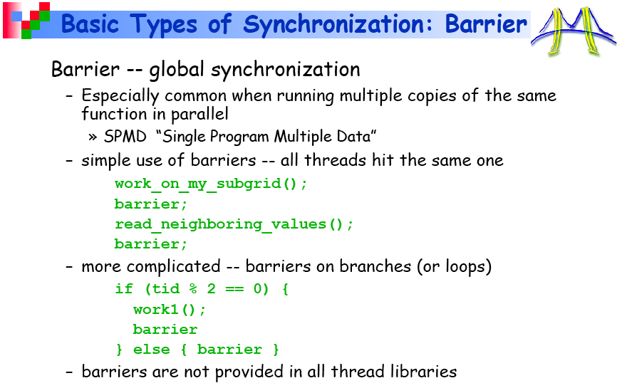
No “barrier in C++0x: use modified boost::barrier

Slide 41
Explicit Synchronization
C++0x provides a simple explicit synchronization mechanism based on “condition_variable”s
typedef std::mutex Mutex;
typedef std::unique_lock<std::mutex> Guard;
typedef std::condition_variable Condition;
Mutex goLock;
Condition go;
{
Guard guard(goLock);
go.wait(guard);
// do something
}
{
Guard guard(goLock);
// prepare data
go.notify_all();
}
release mutex, put thread in wait
When notified re-acquire mutex

Slide 42
Barrier implementation
#include <thread>
#include <exception>
class barrier {
public:
typedef std::mutex Mutex;
typedef std::unique_lock<std::mutex> Guard;
typedef std::condition_variable Condition;
barrier(unsigned int count)
: m_threshold(count), m_count(count), m_generation(0) {
if (count == 0)
throw std::invalid_argument("count cannot be zero.");
}
bool wait() {
Guard guard(m_mutex);
unsigned int gen = m_generation;
if (--m_count == 0) {
m_generation++;
m_count = m_threshold;
m_cond.notify_all();
return true;
}
while (gen == m_generation)
m_cond.wait(guard);
return false;
}
private:
Mutex m_mutex; Condition m_cond;
unsigned int m_threshold, m_count;
unsigned int m_generation;
};

Slide 43
Future
C++0x provides a data exchange mechanism among threads based on promise-future pattern
Able to transfer exceptions too!
std::promise<T> promise;
try {
// prepare data
promise.set_value(result);
}catch (…){
m_promise.set_exception(std::current_exception());
}
// continue processing
unique_future<T> input = promise.get_future();
// now I need the result of the other thread
try {
T data = input.get();
// continue processing
}catch (…) { /*handle error*/}
Wait till other thread does not set value (or exception) in promise

Slide 44
Synchronization
Lost time waiting for locks
#pragma omp parallel
{
#pragma omp critical
{
...
}
...
}
Busy
time
Idle
In Critical

Slide 45
Load Imbalance
Unequal work loads lead to idle threads and wasted time
#pragma omp parallel
{
#pragma omp for
for( ; ; ){
}
}
Busy
time
Idle

Slide 46
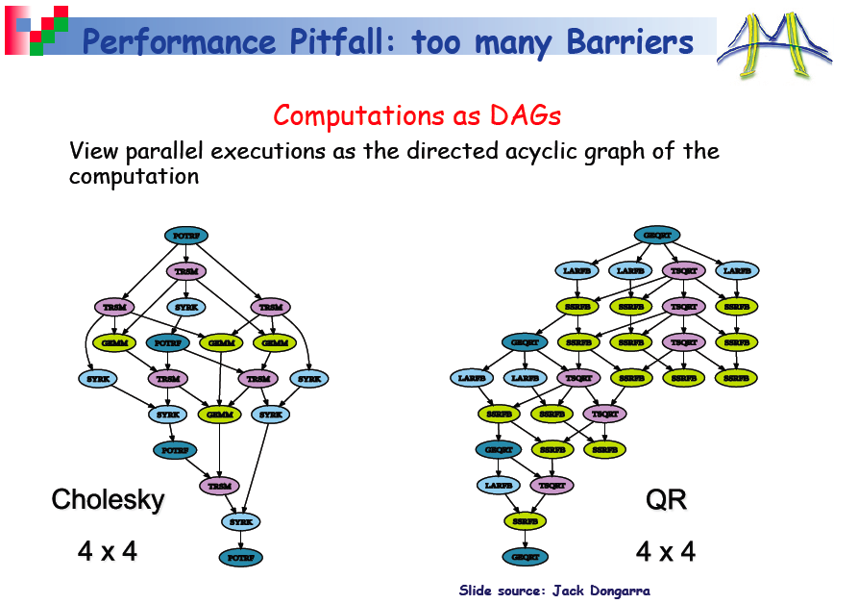

Slide 47
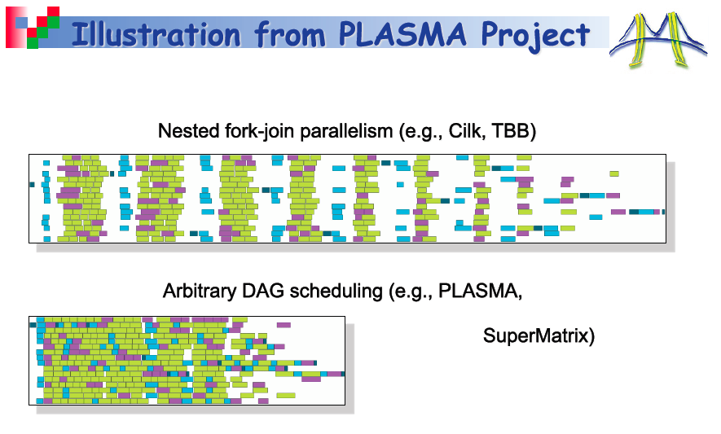

Slide 48
Performance Calculations
Best serial code timing (single thread/core)
Parallel code timing using n threads/cores (p fraction parallel, p∈[0,1] )
Parallel code timing using 1 thread/core
Indication of parallel overhead
Actual Speedup over single thread using n threads/cores (p fraction parallel)
Efficiency using n threads/cores (p fraction parallel)
Max. Speedup over single thread using n threads/cores (p fraction parallel)

Slide 49

Speedup
Maximum speedup defined by Amdahl’s law:
Which just state the obvious:
A bare 10% non-parallel fraction limits the speedup to a factor 10!
n=#threads, p=parallel fraction

Slide 50
Classical parallel Algorithms
Single Program Multiple Data (SPMD)
Loop parallelism
Wait for OpenMP/MPI presentation!

Slide 51
Divide&Conquer by Fork&Join
/* re-entrant function Mattson el al. 5.29 page 170 */
template<typename Iter, typename Compare>
void parallel_sort(Iter b, Iter e, Compare c) {
size_t n = std::distance(b,e);
// final exit
if (n< SORT_THRESHOLD) return std::sort(b,e,c);
// Divide
Iter pivot = b +n/2;
// Conquer
// fork first half
Thread forked(parallel_sort<Iter,Compare>,b,pivot,c);
// process locally second half
parallel_sort(pivot,e,c);
// wait for the other half
forked.join();
// merge...
std::inplace_merge(b,pivot,e);
}
Exercise:
rewrite Map-Reduce-Like
Eventually using OpenMP
What about returning data,
error management,
exceptions?
Wait for future!

Slide 52
Master/Worker
Master distribute tasks to workers
No communication among workers
Many possible data access patterns
Scheduling and queue theory applies!
Single queue multiple workers
Multiple queues
Dedicated queues/workers
Roundrobin, priorities,…
Workers
Workers
Master/
Orchestrator
Workers
Workers
Workers

Slide 53
Shared Queue
void push(T const & t) {
Guard g(m_lock);
if (full()) m_full.wait(g);
m_q.push(t);
m_empty.notify_all(); // (or notify_one?)
}
Full chapter in Mattson el al.
bool pop(T & t) {
Guard g(m_lock);
while (empty()) {
if (m_drain) return false;
m_empty.wait(g);
}
t = m_q.front();
m_q.pop();
if ( !full() ) m_full.notify_all(); // (or notify_one?)
return true;
}
std::queue (?)

Slide 54
(managing) shared data
Single Lock:
Last resort (in case of legacy data-structures)
Distributed Locks
Optimize granularity
Heuristic: #locks = #threads
Distributed data
Map-Reduce:
overhead of reduce vs overhead of locks
Transactional memory access
Atomic operations
No lock, unroll if fails
Promising technology…

Slide 55
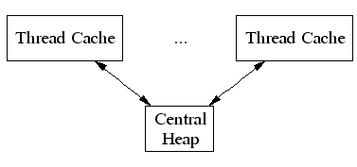
TCMalloc (Google Malloc)
TCMalloc assigns each thread a thread-local cache.
Small allocations are satisfied from the thread-local cache.
Objects are moved from central data structures into a thread-local cache as needed,
Periodic garbage collections are used to migrate memory back from a thread-local cache into the central data structures.
Not the end of the story…
Read Phenix Rebirth about porting on a 256-thread UltraSPARC T2+ system.
http://csl.stanford.edu/~christos/publications/2009.scalable_phoenix.iiswc.pdf

Slide 56
Atomic operation
Modern architectures provide atomic operations
Guaranteed to be fully completed by just one thread
gcc intrinsics on x86_64
http://gcc.gnu.org/onlinedocs/gcc-4.4.1/gcc/Atomic-Builtins.html
CAS
__sync_bool_compare_and_swap(addr,expected,new)
__sync_val_compare_and_swap(addr,expected,new)
Op and fetch (also fetch and op)
__sync_add_and_fetch(addr,n)
Swap
__sync_lock_test_and_set(addr,n)

Slide 57
Atomic operation
C++0x std::atomic<type>
#include <cstdatomic>
std::atomic<int> x;
CAS
x.compare_exchange_strong(expected,new)
Fetch and op ; Op and fetch
x.fetch_add(n); x++; x+=n; etc
Swap
x.exchange(n); x=n;

Slide 58
Atomics in use
Barrier with spinlock
struct barrier {
void wait(} {
__sync_add_and_fetch(m_n,-1);
while(m_n) {/* std::this_thread::yield(); */}
}
volatile long m_n;
};
next
Shared linked list
pointer insert(pointer p, value_type const & value) {
Node * me = new Node; me->value=value;
if (p==0) p=&head;
while (true) {
me->next = p->next; // next sequential code p->next=me;
if (__sync_bool_compare_and_swap(&(p->next),me->next,me)) break;
}
next

Slide 59
Non Blocking Shared Queue
// single producer only
void push(T const & t) {
while (true) {
waitFull(); // head always empty…
volatile size_t cur=head;
container[cur] = t; // shall be done first to avoid popping wrong value
if (__sync_bool_compare_and_swap(&head,cur,cur==0 ? last : cur-1 )) {
// container[cur] = t; // too late pop already occured!
break;
}
}
}
// circular buffer
T container[last+1];
bool pop(T&t) {
while (true) {
if(waitEmpty()) return false; // include a signal to drain and terminate
volatile size_t cur=tail;
if (cur==head) continue;
t = container[cur];
if (__sync_bool_compare_and_swap(&tail,cur,cur==0 ?last : cur-1)) break;
}
return true;
}

Slide 60
Lock Free Hash Table (Cliff Click at Google Camp 2007)
Insert: CAS as before
Delete: just mark
The difficult part is to implement lock free resizing
Do not block operation from other threads
Allow other threads to collaborate in resizing
Memory management is the other big issue
Read slides and papers: very instructive

Slide 61
Singleton, Services
Very unclear, static seems to introduce a full memory barrier in any case
Will not be covered
Slide will be deleted

Slide 62
Use CASES
(Sorting)
Word count
Histograming
Clustering
N-body dynamics

Slide 63
Histograming
Produce amplitude histogram (0-255) for each 10MPixel image
Throughput: process images in parallel
Embarrassingly parallel
Latency: process each image in parallel!
Input: vector<uchar> image(10000000);
Output: vector<int> histogram(256);
Function: ++histogram[image[i]];

Slide 64
Word count
Count the number of occurrences of each word in a text
Input: Sequence<char> text(N); N large
Output: AssociativeContainer<string,int> words;
Function: WordIterator word(text);
++words[*(++word)];

Slide 65
Clusterize
Clusterize points in 3D using Kmeans
Input vector<Points3D> points
Output vector<Cluster> clusters
Algorithm
Start with a set of seeds
Associate points to closest seed: (clusters)
Compute mean (cluster position, new seed)
iterate

Slide 66
Bibliography
Google, wikipedia
Architecture:
http://www.cs.berkeley.edu/~volkov/cs267.sp09/
http://parlab.eecs.berkeley.edu/wiki/patterns/pattern1_0
http://citeseerx.ist.psu.edu/viewdoc/summary?doi=10.1.1.55.3594
http://www.sigsoft.org/phdDissertations/theses/JorgeOrtega.pdf
Computational Patterns
http://www.eecs.berkeley.edu/Pubs/TechRpts/2006/EECS-2006-183.pdf
Map-Reduce
http://hadoop.apache.org/ (distributed: cluster, grid, cloud)
Phoenix http://mapreduce.stanford.edu/ (multicore)
C++0X
http://www.justsoftwaresolutions.co.uk/threading/multithreading-in-c++0x-part-1-starting-threads.html
http://www.stdthread.co.uk/doc/

