Slide 1


First INFN International School on Architectures, tools and methodologies for developing efficient large scale scientific computing applications
Ce.U.B. – Bertinoro – Italy, 12 – 17 October 2009
Fabrizio Furano: “From IO-less to Networks”
The most common pitfall: “Everything is just the same”
  A little provocation
Optimizing code is good, often not enough
Latency
  Latency in local IO
  Path of the data
  Latency in networked IO
  Path of the data
Techniques to higher the I/O performance

Slide 2
Focus of the lecture
The mid-high level aspects of I/O
  As seen by a competent user (= programmer of the final app)
Generic issues with I/O
  Which are much heavier with networks
Then switch to networked I/O
  Why is it particular
We will not treat the low-level specifics
  E.g. system calls for TCP/IP, exotic flags, etc.
  99% of the times these are encapsulated by some product which we use to exchange data
The focus is how to write generic applications which will perform well
  By using some sane encapsulation of the TCP-related things
  And becoming able to see what’s really wrong to do

Slide 3
A little provocation
Suppose you are now a “Jedi code writer”
  And your code is optimized to perfection
    Multicore – SSEx etc
  Will it run as fast as the CPU(s) can?
    It depends on what it does
  Most of the HEP tasks can be classified as “I/O intensive”
    The softwares read and write a lot of data
    No processing can take place without input
    Also, some output has to written

Slide 4
A little provocation
There is really the chance that your application wastes more time in waiting than in computing
  Simple measure of it: the CPU time / Wall time
  Let’s have a look at a simple real case
    Which is absolutely good, but still inspiring.
    It’s very difficult to perform better at a large scale.

Slide 5
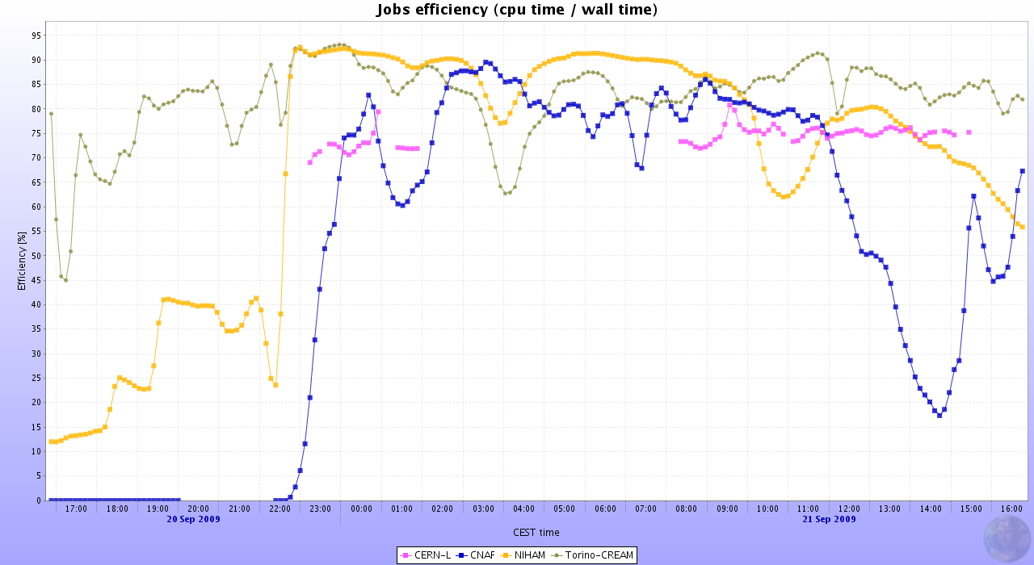
A little provocation

Slide 6
A little provocation
A small selection of ALICE sites
The ALICE computing by now is very efficient
  This means that other’s situations can be much worse
  We see nice peaks of 90-95% efficiency
  But also lower values
A delusion?
  We spent months optimizing the code and now it runs at 70-80% in average
  Don’t be frustrated enough, with other apps and other environments you may find 40% and even much less
    Just look around

Slide 7
What can we do
First: “Be prepared”
    In order not to get frustrated
Know very well the specifics of I/O performance
    Throughput, latency and transaction rate
    Disk I/O and networked I/O as well
Design your app with this in mind
  Or be prepared to (painfully) fix it

Slide 8

What’s behind the scenes
An application doing simple I/O (r/w)
Your favorite OS
Your local disk
OS
Cache
Disk
App
Better to start from this extreme simplification, just to see where we are going

Slide 9
The application
We can consider it as a producer of requests
  File opens
  And then a sequence of couples
    (offset, length) [+data if it wants to write]
    For each file it accesses
  Every request asks the storage to do something
    Typically it’s composed by disks
    It can be reading or writing
  And typically waits for the response because it needs it to proceed with the computation

Slide 10
The disk in 30 seconds
We know how a disk works
        See the previous lecture by A.Hanushevsky
  Some time is spent to find the data
  Some time is spent to send (or write)
It can be an ultra-fast Solid State Disk
Or a cheap floppy disk
It will always work like that
  The difference is in how these times are related to the computing phase of the app

Slide 11
Reading and writing
In general, reading data is a bit harder than writing data
  In a simple case (rules of thumb):
    Write case: the app has to produce buffers as fast as it can
      The bigger the buffer, the faster it will be
      We can also accumulate many buffers and flush them later (delayed write, very well known also for USB pendrives)
    Read case: if the app needs a chunk of data, it will wait until it has come. No option for the ingenuous programmer.

Slide 12
A key factor: the OS cache
Modern OSs are very smart
  For each read request they remember the result
  They also remember what’s in the proximity
So, they can just fool us
  By making us believe that our sw is very efficient
    Just because we execute it more than once in our disk
    Let’s have an inspiring quick try
Believing that our app is efficient (while it is not) is the first big mistake we can make

Slide 13
An example: the forward reader
int f = open("/tmp/bigfile.dat", O_RDONLY);
if (f < 0) {
printf("Error: %s", strerror(errno));
exit(-1);
}
long long offs = 0;
struct stat st;
if (fstat(f, &st)) {
printf("Error: %s", strerror(errno));
exit(-1);
}
long long filelen = st.st_size;
printf("File length: %lld\n", filelen);
char buf[1024];
while (offs < filelen) {
int n = pread(f, &buf, 1024, offs);
if (n <= 0) {
printf("Error: %s", strerror(errno));
exit(-1);
}
offs += (10240-1024);
}

Slide 14
An example: the forward reader
It reads 1KB every 10KB
For a 2GB file it reads 200MB
  Somebody might think that the disk is able to get 20-50MB/s, hence it should take 10s
  Instead it takes 5 minutes (in my machine)
  It takes a few seconds only at the second run (and not always)

Slide 15
An example: the forward reader
It runs very fast, yes… apparently
Unless you clear the OS cache with the given tool ‘clearcache’
  And then it has (in my laptop) an efficiency of 4%
  To make it fast (the second time) the OS uses a lot of memory
    The OS uses for that the unallocated memory
    It can cache gigabytes in common hardware
  If there are many users or the app consumes it all, it will not run so fast
  This program is very inefficient, but you might think it’s not
  Conclusion (for now): don’t be fooled

Slide 16
Even worse
In the real life your app is almost never alone
Disk manufacturers declare “very” low times to execute a (read) transaction
  But often between two transactions there are many others (from other users/processes)
Let’s suppose that it takes 5ms for a disk to pick up the requested chunk
In those 5ms the disk bus could read AT LEAST 5ms*266Mbit = >1GByte
Instead it does nothing.
In those 5ms a cheap hard disk could read 5ms*50MB/s = 250KB
Instead our test app is idle in order to read 1KB each time

Slide 17
Another example: the backward reader
We can be amazed by how many things in OSs and disk hardware/firmware are optimized for increasing offsets
  What happens if we read the same data chunks backwards?
  The performance (with and without) OS caching gets much lower. Try!
  Conclusion (for now): this is one more way to make our tiny program even more inefficient.
      At least, we are starting wondering some of the things to avoid, and the true goal of this lecture

Slide 18
Conclusion (for now)
There are several ways to do the same I/O operations
  We are focusing on reads: often more ‘difficult’ than writes
  E.g. getting some chunks of data to process
  Some ways are much more efficient than others
  To avoid having highly inefficient applications we have to:
    Know very well the details of the technology (hw and sw) we use
    Exploit it in order to always choose the best opportunities
      And know the possibilities we have
  Hence, some important choices are:
    The sequence of the operations (e.g. the lengths@offsets to read)
    The moment in which a request is issued.

Slide 19
The enemy: Latency
  Simply speaking: The time it takes to get the response to a data request
    More precisely: the time it takes to start getting it
    Typically the throughput is very high
  It is present and measurable also in our very simple examples
  It can DOMINATE your computation also in simple cases (e.g. 1 app, 1 user with 1 disk)
    Like the forward/backward reader
    It will do it much more in the multiprocess case
  In all the cases we saw, we never reached the maximum available data throughput from disk
    So, for now that’s not a problem, we don’t need a faster disk
    It may become later, but that’s problem #2

Slide 20
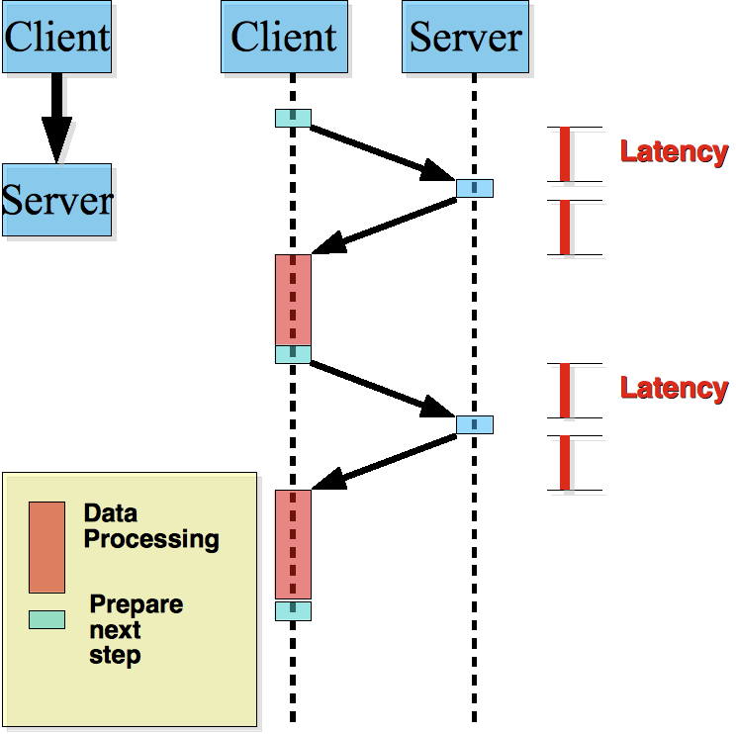
Latency: A sequence graph

Slide 21
Latency
“Latency” can be anything which makes the client wait
  Network latency
  Time to move the disks heads
  Server congestion
    Which makes it process the requests slowly
  <put your reason here>

Slide 22
Closer to HEP apps. An example.
An app can read 1M chunks of 2KB each
  2GByte, a typical HEP file
  If it takes 1ms of latency per chunk (highly optimistic!) the app will do nothing for 1000 seconds (~20min)
  If, in average, the app computes 1ms per read chunk the efficiency will be ~50%
    Very common case
    Remember that we are still speaking of local disks
      Supposed to be the easy case
      Instead we might have been just fooled by the OS
    This makes us not very confident in our super-optimized application anymore
      Again, that was NOT wasted time

Slide 23
Where’s the network?
We are able to successfully measure the (in)efficiency of our app even in a simple case, i.e. a local disk.
With networks the things can become more problematic
  Because latency plays an even greater role
  Because we do not have the hope that a new technology will save us. With networks we are fighting against the speed of light.
    New technologies will higher the throughput, but here we saw that the worst enemy is latency
Let’s see why and how.
  This will give us a basic additional insight. Later on, we will look at a few techniques to reduce such a heavy negative impact
    And get our performance

Slide 24
The data flows: local and network
OS
Cache
Disk
App
Client
app
OS
TCP/IP
Ether
net
Ether
net
OS
TCP/IP
Server
app
OS
Cache
Disk
App
Just with a quick look:
  Many steps = Many places for latency
  Still space for low throughputs as well
  Some of the steps can be really problematic
  Here, we suppose that the software quality is at its best
    Which, unfortunately, often is not the case

Slide 25
Networked case: information flow
Client
app
OS
TCP/IP
Ether
net
Ether
net
OS
TCP/IP
Server
app
OS
Cache
Disk
App
Potentially every step can cause a slowdown
The base mechanism in the app is still the same
  Send request + get response
  Both request and response follow the same steps (reversed)
  Need to know the characteristics of each step
    To have an idea about its impact
    With respect to the used technologies
    Let’s have a deeper look

Slide 26
Networked case: information flow
Client
app
OS
TCP/IP
Ether
net
Ether
net
OS
TCP/IP
Server
app
OS
Cache
Disk
App
The application asks for a chunk to read
It asks for it to its client
  Can be the client of NFS/AFS/GPFS/XROOTD/RFIO/ORACLE/MYSQL etc.
  Common clients immediately forward it (but not necessarily) by invoking the proper OS primitives
Possible source of slowdowns (beside a slow app):
The client takes too much to translate the request and to pass it forward

Slide 27
Networked case: information flow
Client
app
OS
TCP/IP
Ether
net
Ether
net
OS
TCP/IP
Server
app
OS
Cache
Disk
App
The OS forwards the request’s parts to the network part
  Depending on the settings, this can be delayed
    Ref: the TCP_NODELAY socket option for example
  The quality of the implementation of such client may be important
    But typically it is not up to the user… good and bad clients come bundled with something else.
Possible source of slowdowns:
A single request can be unreasonably big or demanding for the OS to treat it
The client app translates simple requests into super-complicated interactions

Slide 28
Networked case: information flow
Client
app
OS
TCP/IP
Ether
net
Ether
net
OS
TCP/IP
Server
app
OS
Cache
Disk
App
The network can be:
      High latency by itself (e.g. 0.1ms for a LAN up to a 300ms RTT WAN)
      Too slow (takes time just to send the bytes composing the request)
      Very loaded (collisions make the OS/Ethernet retry/wait)
Possible source of slowdowns:
Size of the data or number of chunks composing the request
Characteristics of the network
The latency here can be EXTREMELY variable (0.1ms -> 150ms)

Slide 29
Networked case: information flow
Client
app
OS
TCP/IP
Ether
net
Ether
net
OS
TCP/IP
Server
app
OS
Cache
Disk
App
The OS can be:
  Incorrectly tuned (happens very often for WANs)
  Can suffer from the excessive fragmentation of the request
Possible source of slowdowns:
Latency+throughput: typically bad TCP settings in the OS

Slide 30
Networked case: information flow
Client
app
OS
TCP/IP
Ether
net
Ether
net
OS
TCP/IP
Server
app
OS
Cache
Disk
App
The server (in the TCP side) can be a problem.
  The software quality here plays a major role and offers a very broad range of inefficiencies
  These can be linked with latency, throughput and stability
    Yes, restarting everything manually is a form of latency as well!
Possible source of slowdowns:
Ingenuous, scholastic programming in the server

Slide 31
Networked case: information flow
Client
app
OS
TCP/IP
Ether
net
Ether
net
OS
TCP/IP
Server
app
OS
Cache
Disk
App
When there is a server we are never alone using it
  There can be many other connections ( O(10³) )
  Not all the implementations/products are equal
    In fact we are surrounded by so many of them
  Also here software quality makes the difference
Possible source of slowdowns:
Ingenuous, scholastic programming in the server

Slide 32
Networked case: information flow
Client
app
OS
TCP/IP
Ether
net
Ether
net
OS
TCP/IP
Server
app
OS
Cache
Disk
App
OS+Disks: we already spoke about this
  Taken alone it can cause unacceptable inefficiencies in the data flow
  They are just one among others now…
Possible source of slowdowns:
The stream of requests is not compatible with disk access, which becomes very inefficient

Slide 33
Let’s simplify
From this point on we suppose that:
  All the softwares of the blocks in the prev. slide are “perfect software”
  Perfectly tuned
  No slowdowns due to poor sw quality
Note that this is a very strong assumption
  We already have enough troubles
  Anyway we’ll have a better insight useful to spot bad softwares in the future

Slide 34
Latency again
This time we know that the latency may be a sum of many things
  The result does not change, this is what the client (and the app) see

Slide 35
What to do?
We don’t have to get depressed
We don’t have to stop (or avoid) optimizing our code
There are some ways to deal with latency
  They must be implemented in the data access framework (e.g. ROOT+xrootd)
  But the app must be a bit aware of that
    In order to exploit them
  The programmers must know how it works
In the next part we will explore what’s possible
  And how it works

