Slide 1


First INFN International School on Architectures, tools and methodologies for developing efficient large scale scientific computing applications
Ce.U.B. – Bertinoro – Italy, 12 – 17 October 2009
Fabrizio Furano: “From IO-less to Networks”
Part 2
Techniques to higher the I/O performance

Slide 2
A simple idea: pack things together
Instead of requesting one data chunk at a time and waiting for it:
  Request two chunks IN THE SAME REQUEST
  When they arrive, put them in a buffer
  The application reads twice from this buffer
In principle by doing this we have cut the total latency by two
  Because, trivially, we have cut the number of interactions
  In our million-chunks job this means being idle 10m instead of 20m
  This mechanism can be put to work for many more chunks
    And cut the latency by a bigger factor

Slide 3
Another idea: work in the background
Request the (n+1)th chunk just before starting processing the (n)th
  This implies some form of tricky lower level parallelism
  While the app computes, the data flows
    When the app finishes computing the (n)th chunk, it again:
      Requests the (n+2)th
      Wait for the (n+1)th to finish its incoming path
        Eventually it’s already available
      Process the (n+1)th

Slide 4
Two ideas or just one?
It may look the same idea, but they imply completely different architectures/implementations
  1: the ability of issuing composite requests
  2: the ability of handling asynchronous data transfers
Both techniques deal with when to issue a data request

Slide 5
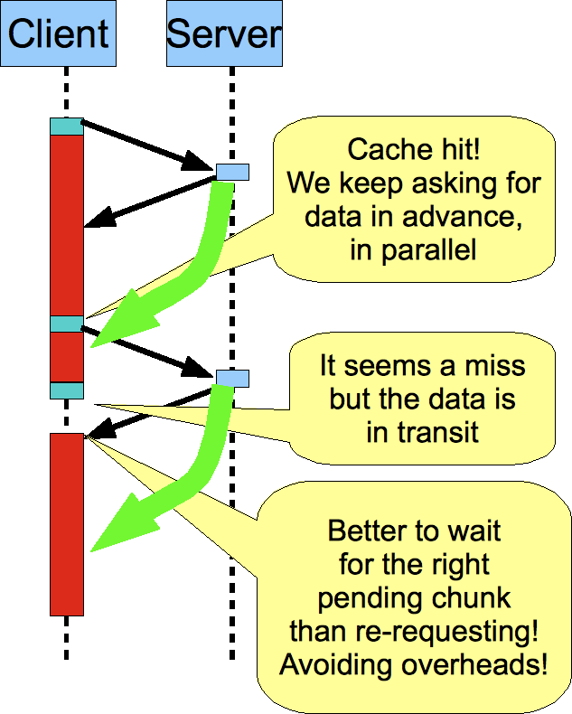
Work in the background

Slide 6
How to do it… in principle
In the real world these can be accomplished in two different ways:
  A Vectored read primitive (readv)
    Instead of a single couple (offset, length) we want to aggregate many of them in the same request
      A single request pays the network latency once
      Even if it is much heavier
      All the data chunks will travel together, serialized in a big composite data block
      The request will be much more demanding for the disk
        But there is a higher probability that it will be treated efficiently
  Asynchronous capabilities in the communication
      The client can send requests without waiting for each response
      The responses are collected by a parallel thread
      The app gets the data from internal buffers populated by the requests

Slide 7
About vectored reads
We are speaking about a concept
  Aggregating multiple requests into one
  Send these composite requests through the network to a server which supports them
  Then, the server forwards these requests to the disk system it is connected to
  Doing this way:
    We aggregate requests at the app/network level, cutting the network latency (well, dividing it by a ‘big’ factor)

Slide 8
About vectored reads
This kind of request must be supported by the data transport protocol
    e.g. xrootd, dcap, http, etc.
  The server receives such a request
  And then forwards it to its disk system
    Eventually translating it into normal reads
    The server builds up its unique (composite) response and sends it back
    The client unpacks it and puts the individual subchunks into memory buffers for the app to access them
    Yes, it needs a complicated machinery which also has to be very efficient
    Better to hide it from the application’s perspective

Slide 9
About vectored reads
What the disk sees is more or less unchanged
  Still the same stream of requests, eventually sorted
  So, same number of requests, same number of interrupts
  It is believed to be somehow more efficient at the disk level
    But still very controversial
    Request streams from several clients will interleave, leading to a completely random pattern
At the OS/disk side there are the primitives to do that:
  If you do man readv you can see that that one is not what we are talking about
  Try instead man lio_listio
  So there is no easy way to aggregate requests towards the disks
    At least, we need to implement one more complicated machinery
    And the creator of the application should better be shielded against all the technicalities
    The disks heads will still have to move
    Hence, in principle, we cannot cut the disk latency, or not too much
    Nor the disk thrashing due to an excessive load

Slide 10
This is not what we need
ssize_t
readv(int d, const struct iovec *iov, int iovcnt);
(. . .)
Readv() performs the same action, but scatters the input data into the iovcnt buffers specified by the members of the iov array: iov[0], iov[1], ..., iov[iovcnt-1].
For readv(), the iovec structure is defined as:
struct iovec {
char *iov_base; /* Base address. */
size_t iov_len; /* Length. */
};
Each iovec entry specifies the base address and length of an area in memory where data should be placed.
Readv() will always fill an area completely before proceeding to the next.

Slide 11
An example of the readv we need
// Read multiple blocks of data compressed into a sinle one. It's up
// to the application to do the logistic (having the offset and len to find
// the position of the required buffer given the big one). If no error
// occurs, it returns all the requested bytes.
// NOTE: if buf == 0 then the req will be carried out asynchronously, i.e.
// the result of the request will only populate the internal cache.
// A subsequent read()
// of that chunk will get the data from the cache
kXR_int64 ReadV(char *buf, long long *offsets, int *lens, int nbuf);

Slide 12
No compromises
We want the best of both worlds
What about sending asynchronous vectored requests which are not too big?
  Transferred in parallel
    Hides the overall latency (network+disk)
  Big enough to cut their network latency by e.g. 512 times
  Small enough to avoid the serialization problem
      Having to wait for the last chunk in order to process the first
  This works
    Not very easy to exercise seriously
    This is the way ROOT works if used properly
    Anybody else could do it in principle

Slide 13
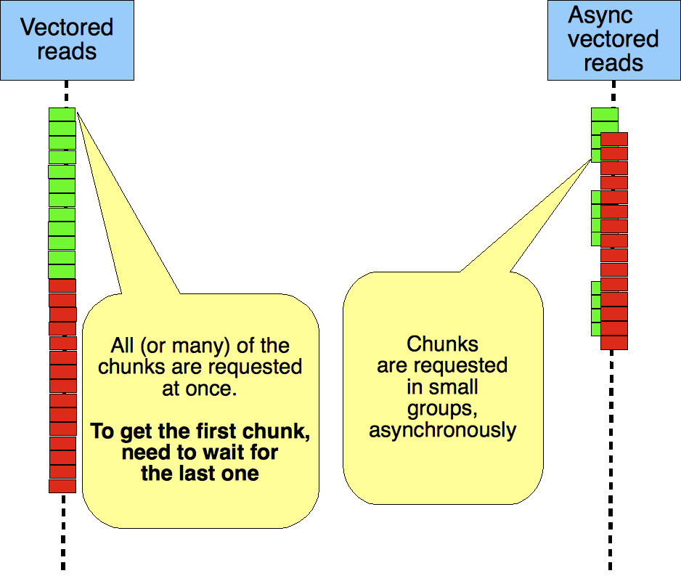
Pure Readv vs. Async

Slide 14
An example
Let’s see how all this behaves in my laptop towards a robust data server over a 1Gb LAN
  Nobody else using it (which is an optimistic situation)
  The server has already cached all the data (optimistic situation = no disk latency, only network)
    This is almost never true in the real world
    Even better than the performance of SSDs
  We use this case to see the difference between the various techniques
    And this difference can be even bigger in the real case!
      For the reasons we already described.

Slide 15
A practical evaluation: sync reads
./bin/TestXrdClient_read root://lxfsrc2802//cfs/fs10/fabrizio/h1huge.root 0 0 0 0 <
~/offsetlen_nurcan2.txt
Read style: Synchronous reads, ev. with read ahead.
.....--- Freeing buffer
Summary ----------------------------
$$$ starttime: 1.25414e+09
$$$ lastopentime: 1.25414e+09
$$$ closetime: 1.25414e+09
$$$ endtime: 1.25414e+09
$$$ open_elapsed: 0.013067
$$$ data_xfer_elapsed: 120.295
$$$ close_elapsed: 0.0252302
$$$ total_elapsed: 120.333
$$$ totalbytesreadperfile: 132851819
$$$ maxbytesreadpersecperfile: 1.10438e+06
$$$ effbytesreadpersecperfile: 1.10403e+06
$$$ readscountperfile: 95651
$$$ openedkofilescount: 1
This tells us that the network latency is ~1.25ms per request
  120.333 / 95651 = 0.00125
  Because we know that we have almost no disk latency here (everything is cached because we wanted it to be that way)

Slide 16
A practical evaluation: async reads
>./bin/TestXrdClient_read root://lxfsrc2802//cfs/fs10/fabrizio/h1huge.root 0 50000000 4 0 < ~/offsetlen_nurcan2.txt
Read style: Asynchronous reads.
.....--- Freeing buffer
Summary ----------------------------
$$$ starttime: 1.25414e+09
$$$ lastopentime: 1.25414e+09
$$$ closetime: 1.25414e+09
$$$ endtime: 1.25414e+09
$$$ open_elapsed: 0.0132041
$$$ data_xfer_elapsed: 5.6057
$$$ close_elapsed: 0.0121732
$$$ total_elapsed: 5.63108
$$$ totalbytesreadperfile: 132851819
$$$ maxbytesreadpersecperfile: 2.36994e+07
$$$ effbytesreadpersecperfile: 2.35926e+07
$$$ readscountperfile: 95651
$$$ openedkofilescount: 1
Looks interesting… from 120s to 5.6s doing the same sequence of reads
  >20 times faster. Seems a very good optimization!
  The latency has been “hidden” in this case

Slide 17
A practical evaluation: sync readv
>./bin/TestXrdClient_read root://lxfsrc2802//cfs/fs10/fabrizio/h1huge.root 0 50000000 1 0 < ~/offsetlen_nurcan2.txt
Read style: Synchronous readv
<snip>
--- Freeing buffer
Summary ----------------------------
$$$ starttime: 1.25414e+09
$$$ lastopentime: 1.25414e+09
$$$ closetime: 1.25414e+09
$$$ endtime: 1.25414e+09
$$$ open_elapsed: 0.0133462
$$$ data_xfer_elapsed: 2.13707
$$$ close_elapsed: 0.00490284
$$$ total_elapsed: 2.15532
$$$ totalbytesreadperfile: 132851819
$$$ maxbytesreadpersecperfile: 6.21653e+07
$$$ effbytesreadpersecperfile: 6.16389e+07
$$$ readscountperfile: 95651
$$$ openedkofilescount: 1
What? 120s to 2.1s doing the same thing?
  60 times faster!
  In this case the latency has been “cut” by aggregating reads

Slide 18
A practical evaluation: Async readv
>./bin/TestXrdClient_read root://lxfsrc2802//cfs/fs10/fabrizio/h1huge.root 0 50000000 3 0 < ~/offsetlen_nurcan2.txt
Read style: Asynchronous readv.
<snip>
--- Freeing buffer
Summary ----------------------------
$$$ starttime: 1.25414e+09
$$$ lastopentime: 1.25414e+09
$$$ closetime: 1.25414e+09
$$$ endtime: 1.25414e+09
$$$ open_elapsed: 0.0133181
$$$ data_xfer_elapsed: 2.6645
$$$ close_elapsed: 0.00909686
$$$ total_elapsed: 2.68691
$$$ totalbytesreadperfile: 132851819
$$$ maxbytesreadpersecperfile: 4.986e+07
$$$ effbytesreadpersecperfile: 4.9444e+07
$$$ readscountperfile: 95651
$$$ openedkofilescount: 1
Apparently just a bit slower then the previous.
  2.7s. In this case the latency has been “cut” and then “hidden”
    Hiding it needs a little more CPU
    Remember that here we only read, no time is spent in processing anything
    Hence, there is no place to hide the latency under
  Here there is an advantage which we like.
    And we are going to discuss it.

Slide 19
A practical evaluation: sync vs async
Let’s make the appication “think” and process the data (still in my laptop, reading from a robust server)
  i.e. using CPU cycles between reads, e.g. 10ms every 100 reads
  And the scenario becomes more clear:
    Silly sync reads: 153s , CPU usage=30% (please remember that this technique is what 3 of the 4 LHC experiments use)
    Sync readv: 12.7 seconds, CPU usage>100%
    Async readv: 10.5 seconds (2.2 secs less), CPU usage>100%
      So, why is this now faster? Before it was a bit slower.
      Because it:
        Cuts the latency by a factor by aggregating reads, then,
        Transfers the next bunch of chunks while the app is crunching numbers
        So it also can use CPU cycles from another CPU core.

Slide 20
What’s happening
App (2 thr)
Server
Request many chunks at once
Efficient processing
Few cycles are wasted
Total latency
Network+server+disk
Server+ disk
latency
CPU Overhead
Data taken
from internal
buffers

Slide 21
A practical evaluation: sync vs async
One more side effect is that this works amazingly well also in WAN if there is enough bandwidth
Yes, because now, finally the only limiting factor left is bandwidth. For that, we need only:
    A sane network design
    Very powerful disk systems to give enough throughput
    A lot of money
But now we can use it productively, in both LAN and WAN.
And, YES, when we are here, all the other CPU-based optimizations start making a lot of sense
  All that effort is worth the time. Do it.

Slide 22
Last considerations
Doing asynchronous things generates in general more CPU overhead
  If this is shorter (in time) than a latency hit then we gain anyway
A pure readv is very efficient
  But to process the first requested chunk we must wait for all of them to come
    And they come serially (very fast, however)
Very often, for very sparse patterns readv is a very good choice
  For less sparse patterns often not quite
  But typically analysis applications generate extremely sparse pseudo-random patterns

Slide 23
Last considerations
When multiple users hit the same disk, that disk ‘sees’ a truly random pattern.
  Hence its performance decreases
  It can decrease really a lot
  There’s not much that we can do for now
    Buy better disks
    Avoid RAIDs if you can (they move more heads/drives to do the same job)

Slide 24
But… Wait… Is that possible?
In both cases we are requested to know the future
  In the form of the data chunks which will be needed
  The client API and the servers must support the techniques of course
  But… Is knowing the future a realistic thing?
  How can an app which needs the (n)th chunk also suggest that it will need the (n+X)th ?

Slide 25
Feeding the communication pipe
Basically there are two techniques to make it possible:
  Guessing the future
    Applying statistics-based ideas
        Typically Read Ahead/Prefetching. We read data in advance, hoping that it will be useful to a sufficient extent for the next requests.
  Knowing the future exactly
      A list of (offset, length) which will be needed
      This is what any cp-like program can do (read everything!)
      This is what ROOT can do (TTree/TTreeCache)
      But not every app uses ROOT, and sometimes, if they use it, they do not use it in that way ☹

Slide 26
Feeding the communication pipe
We don’t need necessarily complicated things
For example, we know what our forward reader app needs
  1KB every 10KB
  So we might, in principle
    Produce this list of chunks at the beginning
    Fire it to the disk
    Loop on the results
  But the devil is in the details
    The sw machinery to do this is not so simple, e.g. we must remember that from a 10 lines program we might go to 100 with only such a simple scenario

Slide 27
You also need the right API
In the POSIX calls there is a way to “suggest” actions to be done in parallel
  O_NONBLOCK
  The app must deal directly with that complexity
    And explicitly keep track of what’s pending, what arrived, what will be requested
Here we are using the Xrootd client, which was built to do that
  And the complexity was hidden in it
  I am not aware of other similar APIs (probably my fault)
    Even if the principles are 20 years old

Slide 28
Read ahead
In simple words it means:
  “Read something which will likely be useful in the near future, and store it somewhere for fast lookup”
There’s a caveat:
  We rely on statistics, not on exact knowledge
  We could read a lot of useless data.
  We could miss what the app really needs
  To be statistically significant, we need a lot of memory to keep it, except in the trivial cases (e.g. purely sequential)
  These are the limits of this technique in its common implementations.

Slide 29
Read ahead: the simplest strategy
Given a read request to satisfy, trim it to a bigger block and store the whole result
  This is what typically the OS does for disks.
    The request is enlarged in order to cover the minimum number of pages which contain the needed data
    The request can also be enlarged much more, typically forward (even tenths of megabytes)
It’s an algorithm like many others
  Which should be smart enough to AVOID requesting the same data more than once
    Not very easy

Slide 30
Read ahead: another strategy
Given a read request to satisfy, make sure that the data in the internal buffers arrives up to the location offset+N
  Eventually requesting what’s missing as an unique big block
    And purging something else
We can call this also “look ahead”
  The last byte requested in advance is always at offset+N
Very efficient for sequential access
  The data stream can never stop

Slide 31
Read ahead: one more flavour
We compute the average offset of the last accesses
We try to keep in memory a “window” of data around this average
  Hoping that the next accesses will hit inside it
The window slides forward with the average offset
  Allowing some accesses to be outside it
  Reading (ahead) in steps of 1MB
  Dropping the block with the least offset
Good for not so sparse patterns which slowly proceed through the file length

Slide 32
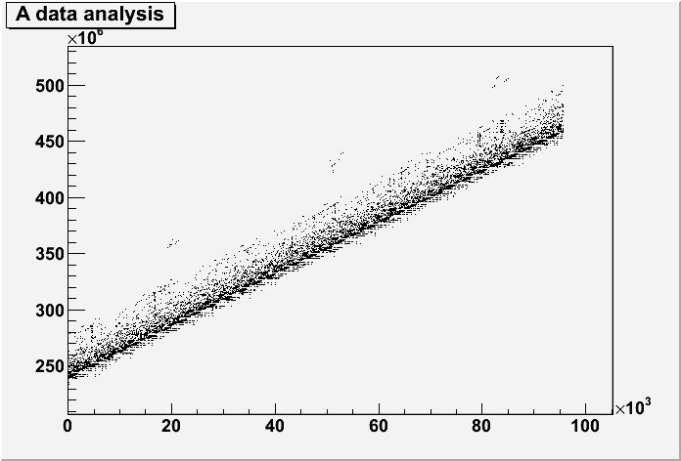
A snippet of a data analysis (ATLAS AOD)
Index of the read on the X, offset on the Y
It’s “random”, but not quite
  Even by looking at it we can almost predict where it goes

Slide 33
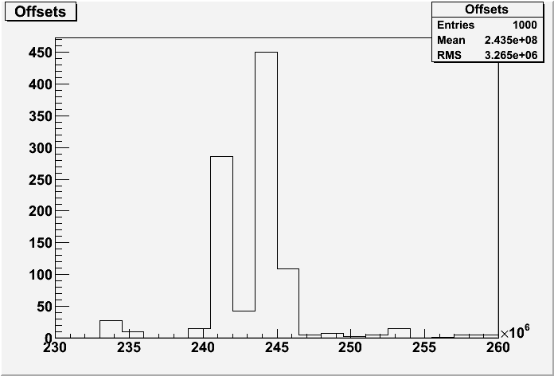
A snippet of a data analysis (ATLAS AOD)
A histogram of the first 1000 offsets is even more suspect
  With a buffer holding data from 235M to 255M we can accommodate the majority of the (very small) first 1000 reads

Slide 34
Do they work in practice?
Sometimes yes, sometimes no
  They can gain a lot or loose, depending on the case or on the class of applications
  We measure their efficiency like a cache:
    Miss rate: the ratio between the number of times a chunk is correctly prefetched with the number of times it has to be requested
    Byte overhead: how many useless bytes are read
  For a copy-like sequential read
    Missrate=0 and overhead=0
  For a generic application it depends
    A hit saves one interaction (hence, one latency hit also in the disk)
    The byte overhead (given the maximum throughput) must be lighter than the time (and resources) saving due to the hits
    The application consumes more CPU, because of the overhead due to the internal bookkeeping and calculations
    Keeping track of what’s outstanding is not cheap

