Slide 1
CNR-IIA
Benedetto Biagi
Palma Blonda, Saverio Vicario, Cristina Tarantino, Fabio Rana, Stefano Carito, Doriana Pugliese

Slide 2
Descrizione del proprio use case scientifico
Progetto H2020 ECOPOTENTIAL: attualmente usiamo servizi di repository per i dati di progetto. A breve saranno implementate funzionalità di catalogo gestibile via web. A medio termine il repository sarà punto sorgente di dati per elaborazione via web services.
Una istanza di web services implementata come risposta alla call AIP8 GEOSS con frontend WPS presso IIA Firenze e backend docker su ReCaS e script su github. Da integrare nel progetto ERA-planet con inizio operativo a settembre 2017
Supporto al calcolo HTC nell’ambito di lavoro di tesi magistrale con co-tutoring con prof. Attimonelli

Slide 3
Statistiche di utilizzo
Sottosistema utilizzato: Sistema HPC
Il sistema viene utilizzato: Quotidianamente;
Il sistema sarà presumibilmente utilizzato ancora: più di un anno;
Numero di job sottomessi: 5 job alla settimana (media annuale);
Storage utilizzato: attualmente 8 TB, con previsione di aumento;

Slide 4
Problemi più frequenti e/o più fastidiosi riscontrati
Procedura di registrazione per l’accesso non adatta a partners stranieri;

Slide 5
Suggerimenti e/o richieste per migliorare i servizi
Sarebbe importante, soprattutto per i partners stranieri, poter effettuare l’accesso con credenziali già verificate (posta elettronica, social, etc.);

Slide 6
ECOPOTENTIAL Project
Benedetto Biagi IIA-CNR biagi@iia.cnr.it
ECOPOTENTIAL is a large European-funded H2020 project that focuses its activities on a targeted set of internationally recognized Protected Areas, blending Earth Observations from remote sensing and field measurements, data analysis and modeling of current and future ecosystem conditions and services. ECOPOTENTIAL considers cross-scale geosphere-biosphere interactions at regional to continental scales, addressing long-term and large-scale environmental and ecological challenges.

Slide 7
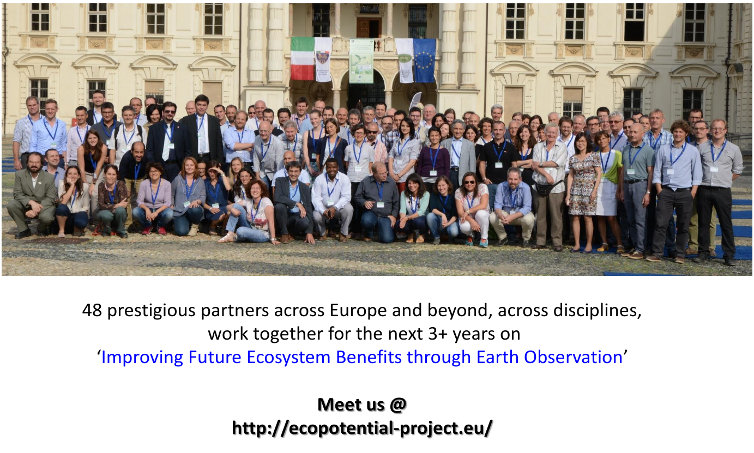
ECOPOTENTIAL: the biggest science platform on the topic for collaboration in Europe today
Benedetto Biagi IIA-CNR biagi@iia.cnr.it
ECOPOTENTIAL is funded by the European
Union’s Horizon 2020 research and
innovation programme under grant
agreement No 641762.
*Credits: imanakos@iti.gr

Slide 8
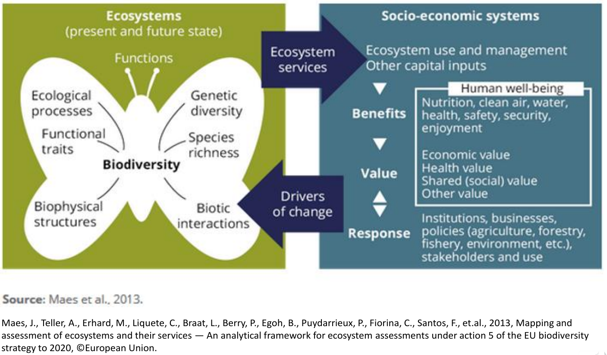
Conceptual framework for EU-wide ecosystem assessments
Benedetto Biagi IIA-CNR biagi@iia.cnr.it

Slide 9
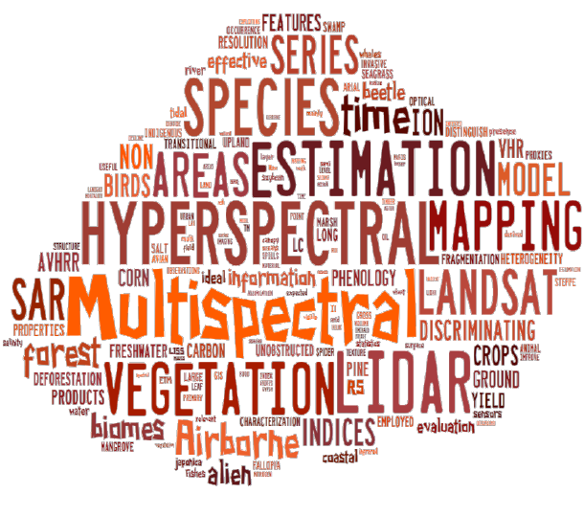
Land Cover and Land Use applications
Benedetto Biagi IIA-CNR biagi@iia.cnr.it
• Terrestrial mapping
• Ecosystem degradation and deforestation
• Ecosystem fragmentation and connectivity
• Agriculture and Forestry monitoring
• Species (plant, animal) distribution estimation
• Detection of pressures from climate change and pollution
• Food, raw material, and water provisioning services
• Assessment of carbon stocks
• Estimation of biotic stresses

Slide 10
H2020 and FP7 European projects using EO data for Ecosystem Monitoring
Benedetto Biagi IIA-CNR biagi@iia.cnr.it
*Credits: imanakos@iti.gr

Slide 11
H2020 and FP7 European projects using EO data for Ecosystem Monitoring
Benedetto Biagi IIA-CNR biagi@iia.cnr.it
*Credits: imanakos@iti.gr

Slide 12
H2020 and FP7 European projects using EO data for Ecosystem Monitoring
Benedetto Biagi IIA-CNR biagi@iia.cnr.it
*Credits: imanakos@iti.gr

Slide 13
ECOPOTENTIAL’s EODESM system
Benedetto Biagi IIA-CNR biagi@iia.cnr.it
Earth Observation Data for Ecosystem Monitoring
Previous EODHaM system (developed in FP7 BIO_SOS project, coordinated by Palma Blonda, IIA-CNR)
• Segmentation and attribution
• Rule-based classification using indices and image bands
• Translation to GHCs and Annex 1
Updated EODHaM system*
Refinement of existing rule-based approaches
Integration of existing land cover/habitat maps
Incorporation of external classifications (e.g., random forests, K means)
Introduction of sub-pixel proportions
Change detection (LCCS L3/L4 and indices)
Categorisation of processes of change (e.g., deforestation, agricultural expansion, woody shrub decline)
Inclusion of a scoring system that relates change events to impacts on ecosystem services.
Application of an accuracy assessment procedure (TBD).
*Credits: Richard Lucas and Anthea Mitchell
University of New South Wales, Sydney, Australia

Slide 14
ECOPOTENTIAL’s Virtual Laboratory Platform*
Benedetto Biagi IIA-CNR biagi@iia.cnr.it
Enables the discovery, access, and use of:
open (EO and in-situ monitoring) data, metadata, scientific models and results, semantic engines, and analytics’ provision;
ecosystem models and upscaling methods;
the necessary knowledge to analyse ecosystems services;
climate and land-use change scenarios, and definition of the requirements for future protected areas;
specific applications and portals for different users (e.g. experts, activists, decisions makers), enabling multidisciplinary applications.
All services are empowered by a set of transparent brokering services provided by the platform, as defined in the GEO/GEOSS framework and compliant with the GEOSS Common Infrastructure (GCI) and the GEO Portal (http:// www.geoportal.org/).
*Credits: Stefano Nativi, IIA-CNR

Slide 15
Nomenclature for common understanding
Benedetto Biagi IIA-CNR biagi@iia.cnr.it
European Nature Information System (EUNIS)
EUNIS is a comprehensive pan-European system to facilitate the harmonized description and collection of data across Europe through the use of criteria for habitat identification. It is hierarchical and covers all types of habitat types from natural to artificial, from terrestrial to freshwater and marine.
Mapping and Assessment of Ecosystems and their Services (MAES)
MAES aims to demonstrate the effectiveness of mapping and assessment of ecosystems and their services in planning and land management. Ecosystems are mapped by interpreting available land cover (LC) data on the basis of the European habitat classification (EUNIS).
Links to General Habitat Categories and Annex I are established within EU projects
Links to LCCS of FAO, as well:
V. Kosmidou, Z. Petrou, R.G.H. Bunce, C.A. Mucher, R.H.G. Jongman, M.M. Bogers, R.M. Lucas, V. Tomaselli, P. Blonda, E. Padoa-Schioppa, I. Manakos, M. Petrou, "Harmonization of the Land Cover Classification System (LCCS) with the General Habitat Categories (GHC) classification system", 2014, Ecol. Indic. 36, 290–300.
M. Adamo, C. Tarantino, V. Tomaselli, V. Kosmidou, Z. Petrou, I. Manakos, R.M. Lucas, C.A. Mucher, G. Veronico, C. Marangi, V. De Pasquale, P. Blonda, "Expert knowledge for translating land cover/use maps to General Habitat Categories (GHC)", 2014, Landscape Ecol., 29(6), 1045-1067.

