Slide 1
SW&C week highlights
Distributed production (Status and plans)
ADC hot topics
DDM operations
Monitoring

Slide 8
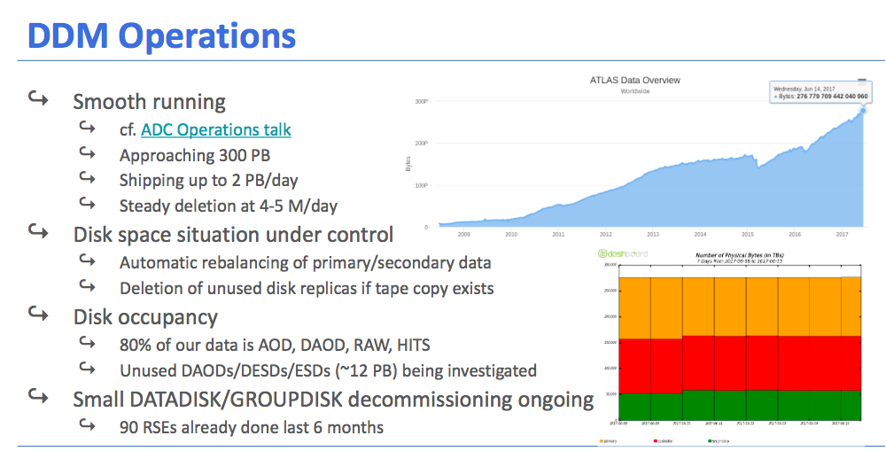

Slide 10
Altri argomenti discussi ma non riportati qui
CondDB for Run3
AthenaMT and Release22
Data Formats, Event Model and I/O model
Data Curation and Characterization
past

