Slide 1
Power Coupler in Pulsed Operation ~higher peak power & longer RF pulse~
Special thanks to Matsumoto-san, C. Arcambal, E. Cenni, W.D. Möller, W. Kaabi
Kirk

Slide 2
Outline
Motivation
Specification for each power coupler in pulsed operation
Necessary RF power at 35 MV/m operation in ILC
Issues for higher peak power and longer RF pulse
Necessary ceramic property for longer RF pulse
Summary

Slide 3
Motivation
Higher peak power
Maybe necessary at 35 MV/m operation by N-infusion in ILC
Longer RF pulse
Quasi-CW operation
Higher peak power
Longer RF pulse
P
P
P
P
t
t
t
t

Slide 4
Specification of power coupler in each project
Project | ESS | E-XFEL | STF-2 | ILC
Type | Coaxial structure
# of RF windows | 1 | 2 | 2 | 2
# of couplers | 120 | 808 | 12 | ~16,000
RF frequency | 704.42 MHz | 1.3 GHz | 1.3 GHz | 1.3 GHz
RF power in beam operation | 1.1 MW | 120 kW (195 kW at max.) | ? | 189 kW
RF pulse width | 3.6 msec | 1.40 msec | 1.65 msec | 1.65 msec
RF repetition rate | 14 Hz | 10 Hz | 5 Hz | 5/10 Hz
RF duty | 5 % | 1.4 % | 0.8 % | 0.8/1.6 %
Set position of Q_{ext} | 7.6 x 10⁵ | 4.6 x 10⁶ | 5 x 10⁶ | 5.5 x 10⁶
Range of Q_{ext} | fixed | 10⁶ ~ 10⁷ | 3~7 x 10⁶ | 10⁶ ~ 10⁷
Cooling for inner conductor | Water
※ C. Arcambal, E Cenni
※ W.D. Möller, W. Kaabi

Slide 5
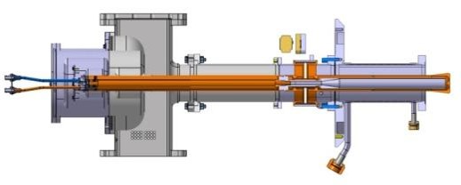
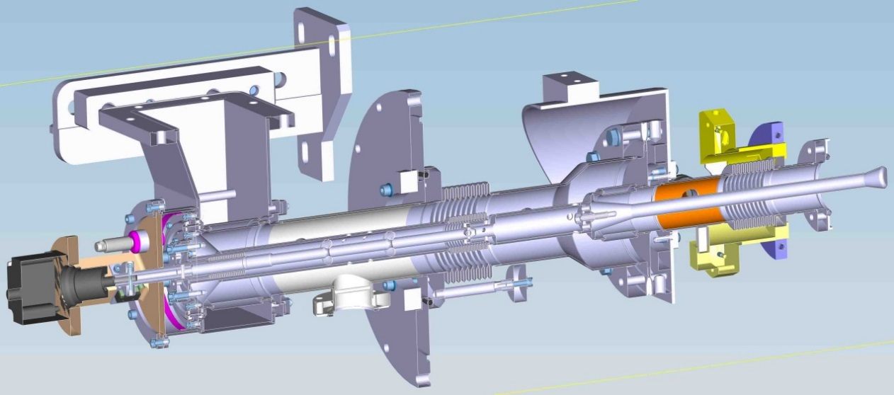
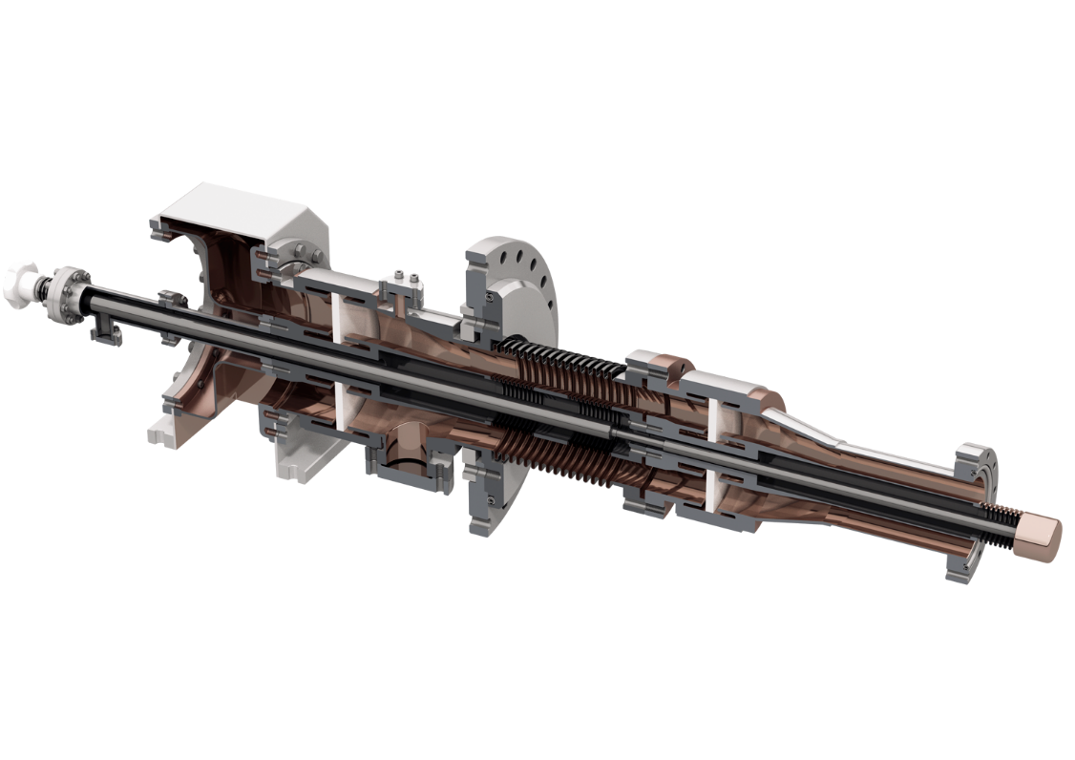
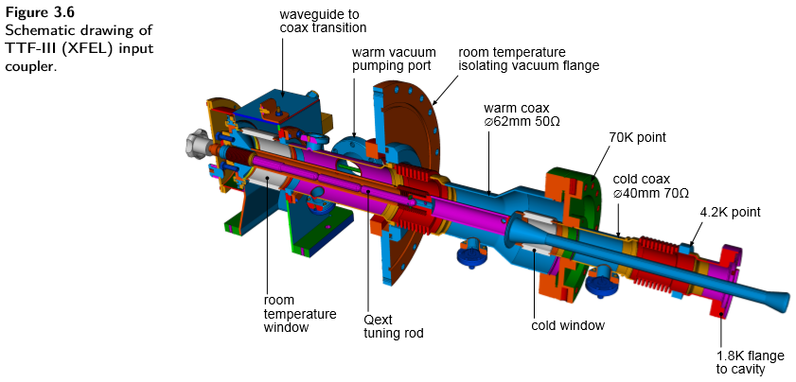
Power couplers in pulsed operation
ESS Coupler
E-XFEL Coupler
STF-2 Coupler
ILC/TDR

Slide 6
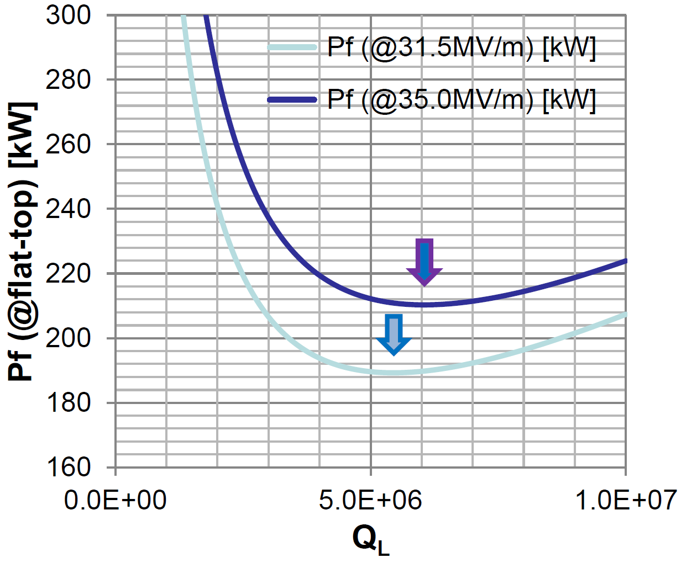
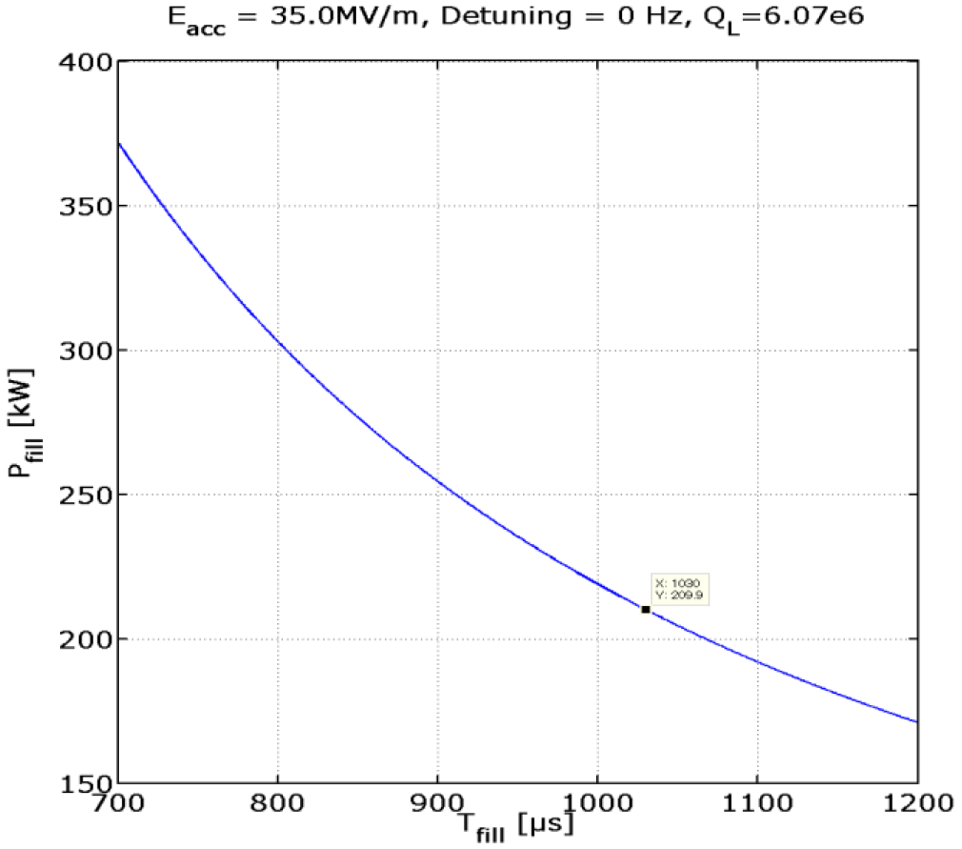
Necessary RF power at 35 MV/m operation in ILC
Matsumoto-san estimated necessary RF power for CM operation at 35 MV/m
 | 31.5 MV/m | 35.0 MV/m
RF power / coupler | 189 kW | 210 kW
Q_{L} | 5.46 x 10⁶ | 6.07 x 10⁶
Filling time | 927 μsec | 1030 μsec
RF pulse width | 1.65 msec | 1.76 msec

Slide 7
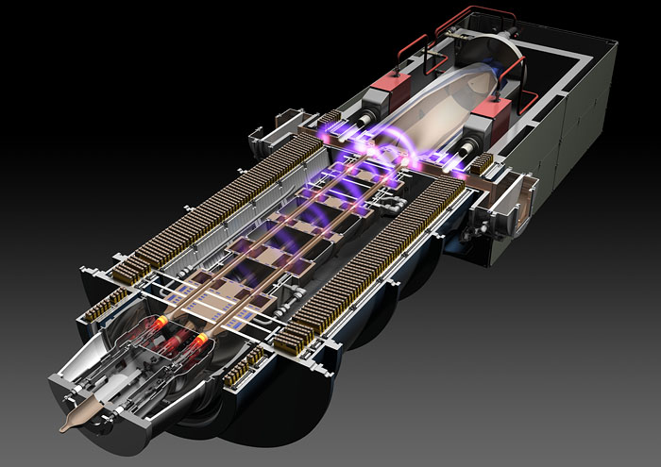
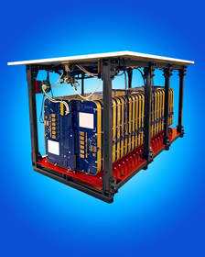
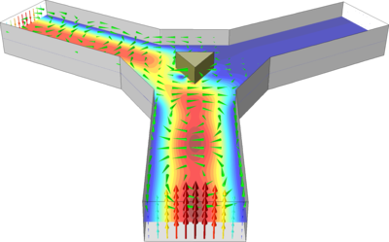
Klystron, modulator, circulator…
We have to think about not only power coupler, but also klystron and waveguide/circulator systems!
Multi beam klystron
Marx modulator
Circulator
10 MW → 11 MW (10% higher)
1.65 msec → 1.76 msec (7% longer)
Discharge issue
(SF6 with higher pressure?)

Slide 8
Issues to be considered
Higher peak power
Discharge in waveguide/circulator systems
Longer RF pulse
Thicker copper plating (30μm → 50μm?)
Lower tanδ ceramic

Slide 9
Necessary ceramic property
Longer RF pulse operation needs ceramic with lower dielectric loss tangent.
RF duty | ~1% | ~10%
Percent of Al₂O₃ | > 95% | > 99%
Surface resistivity | 10^{14~15} Ω/□ @25℃ | 10^{14~15} Ω/□ @25℃
Relative permittivity | 9~10 @1GHz | 9~10 @1GHz
Dielectric loss tangent | ~10⁻⁴ @1GHz | ~10⁻⁵ @1GHz
Secondary electron emission coefficient | ~2 (5 as production) | <2 (5 as production)
Specification for secondary electron emission coefficient is not clear.

Slide 10
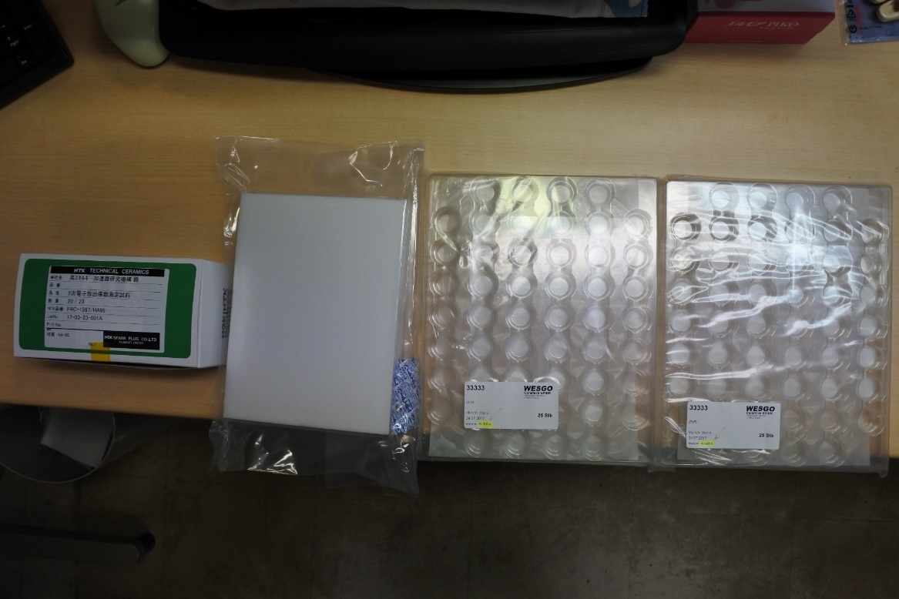
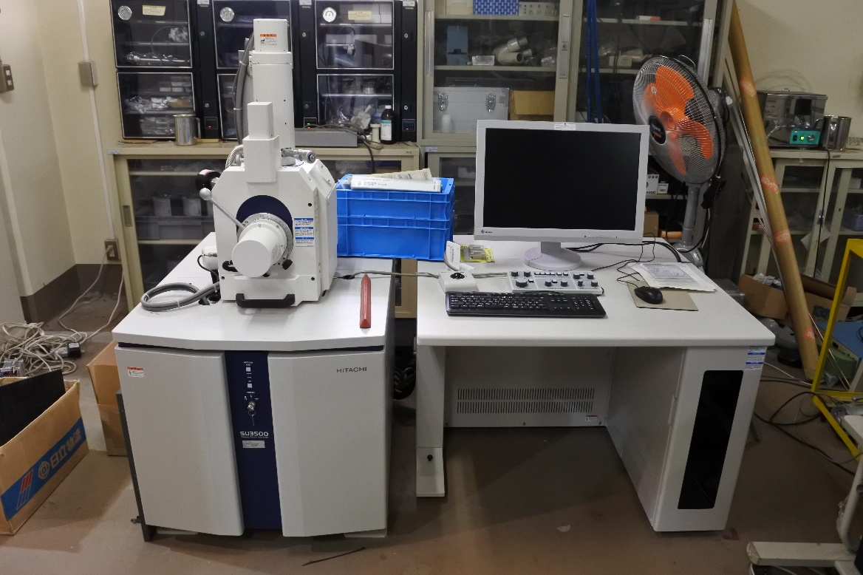
SEM for ceramic study
Many ceramic samples were fabricated to measure the secondary electron emission coefficient.
We are preparing the “improved” scanning electron microscope (SEM) in KEK.
Vendor A
(sample #1)
Vendor B
(sample #2)
Vendor C
(sample #4)
Vendor C
(sample #5)
SEM
19mm (dia.) ceramic samples
We can start the measurement from March!

Slide 11
Summary
Higher peak power operation
Should pay attention for discharge in waveguide/circulator systems
Should upgrade klystron/modulator systems
Longer RF pulse operation
Thicker copper plating
Lower loss tangent ceramic

Slide 12
Thank you very much for your attention
Special thanks to Matsumoto-san, C. Arcambal, E. Cenni, W.D. Möller, W. Kaabi

Slide 13
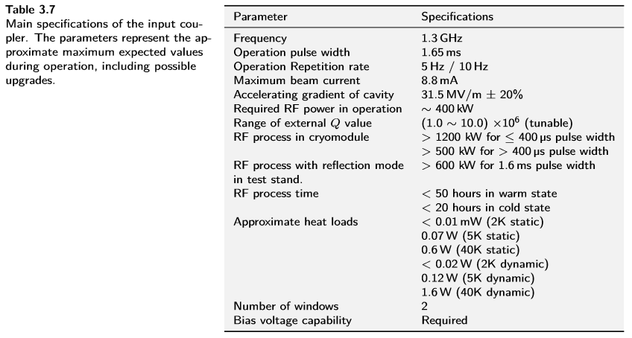
ILC-TDR (for Power coupler specification)
These figures are shown on Page 35 in ILC-TDR Vol.3 Part-II.

