Slide 1
IFMIF HWR cryomodule and magnetic shield properties
Juliette PLOUIN
Caifu FAN (Master Student)
Ttc meeting
08 February 2018, MILANO

Slide 2
outline
CARACTERISATION OF IFMIF MAGNETIC SHIELD
CARACTERISATION OF CYLINDRICAL SAMPLES
  In ambient field at room temperature
  In variable field at room temperature
  In ambient field at cold temperature

Slide 3
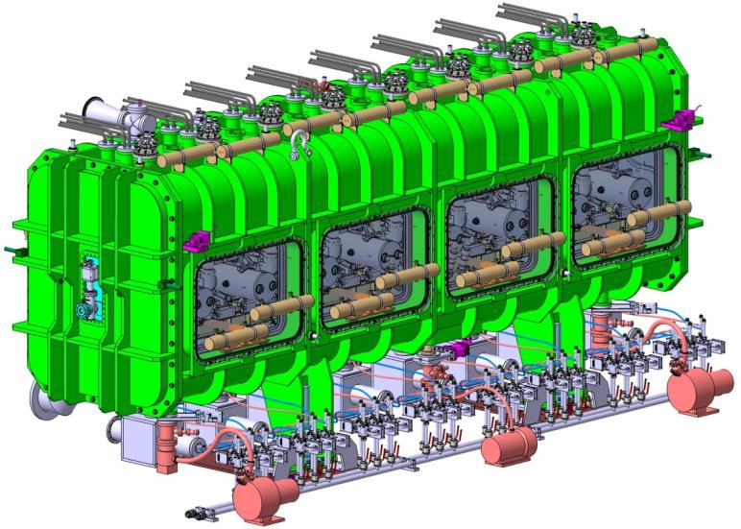
CRYOMODULE FOR THE IFMIF LIPAC
Cryomodule for the IFMIF LIPAC: 9 MeV, 125 mA
8 Half Wave Resonators
8 solenoids
8 RF couplers
1 overall magnetic shield

Slide 4

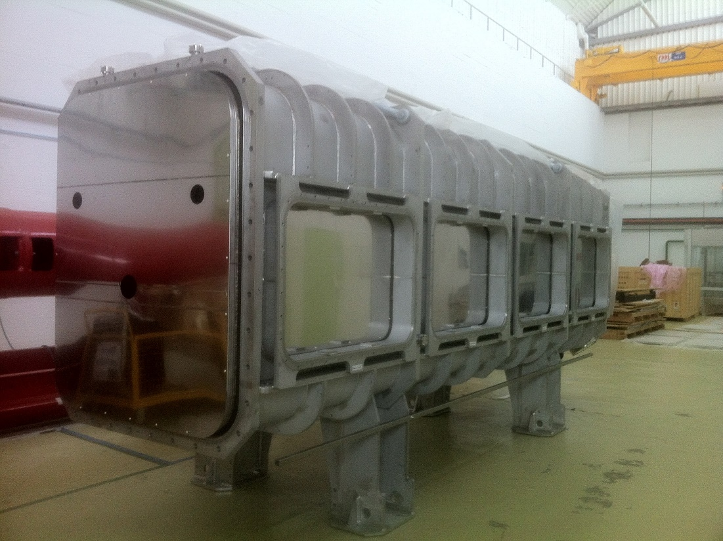
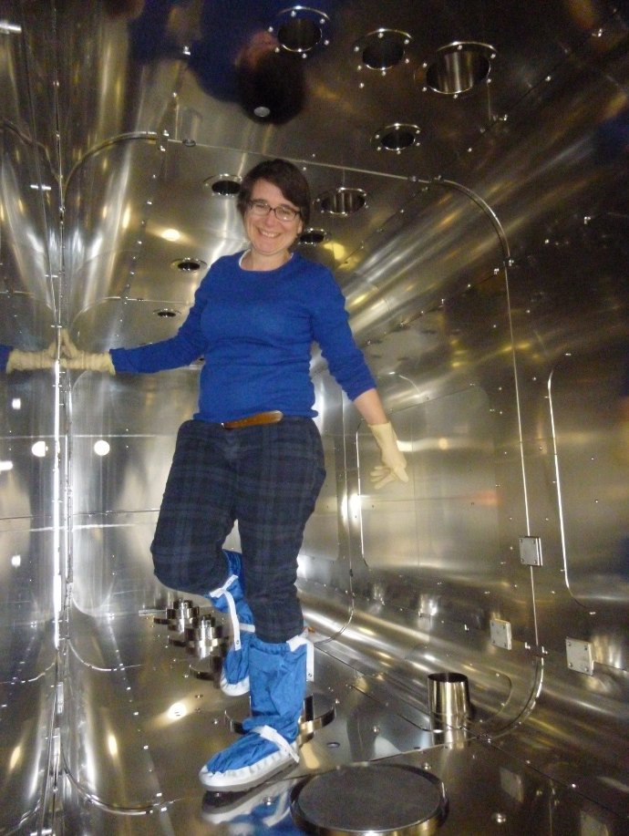


Magnetic shield for the ifmif/lipac cryomodule
Mumetal magnetic shield with thickness 2 mm
Target : field lower than 2 micT
Measured field inside : 0.2 – 0.5 micT
Estimated μ_{r} ~ 150000

Slide 5
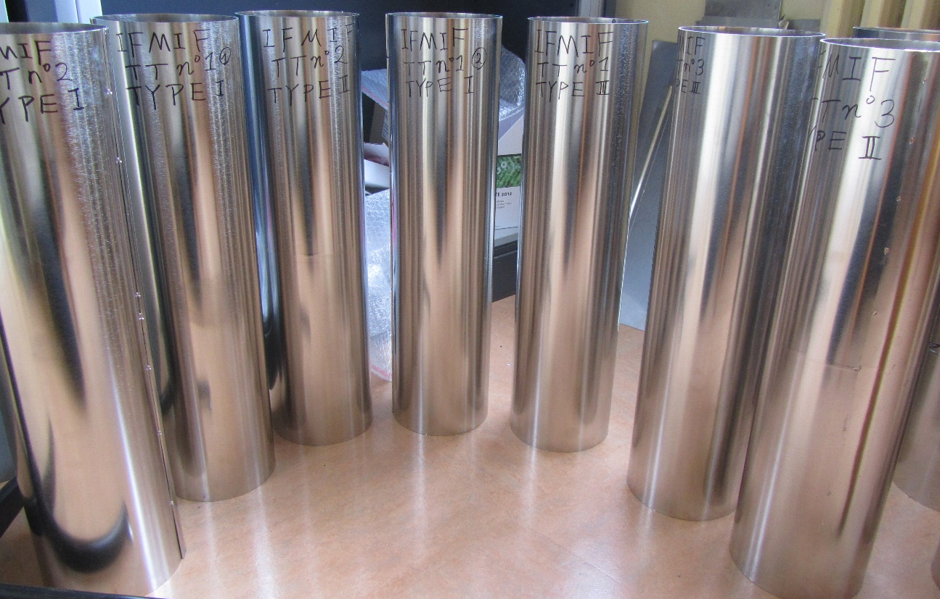
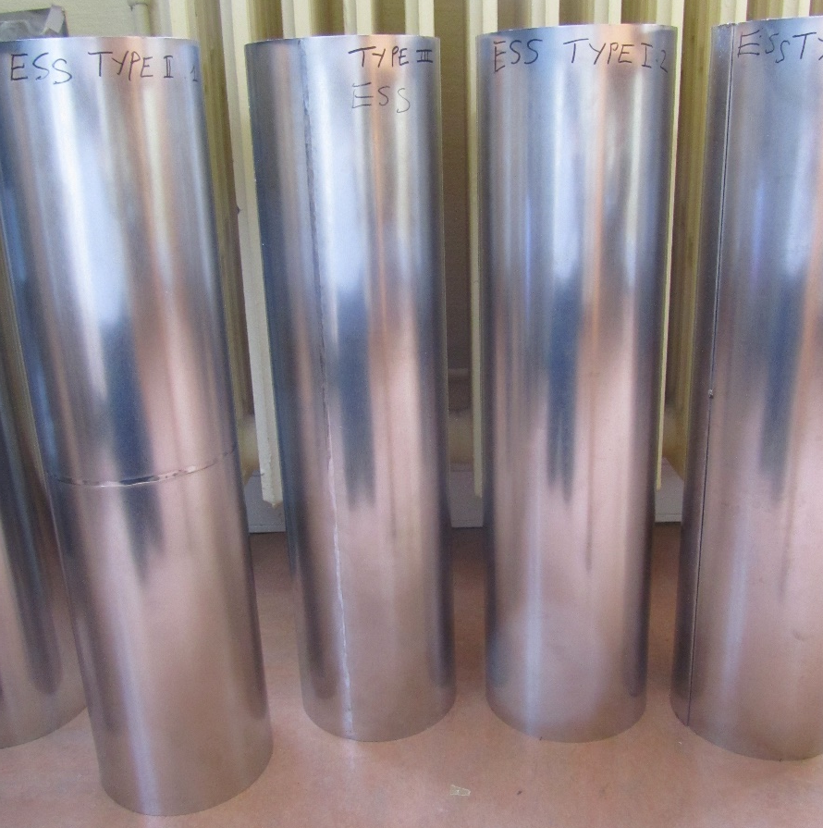



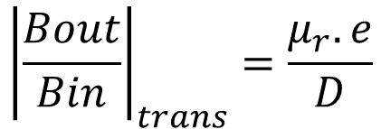
Samples for magnetic shield qualification
3 batches of thermal treatment (TT) same receipe
3 types of welding
1 batch of thermal treatment (TT)
3 types of welding
Diameter : D=155 mm
Length 600 mm
Thickness : e = 2 mm
$${\left|\frac{Bout}{Bin}\right|}_{trans}=\frac{μ_{r}.e}{D}$$

Slide 6
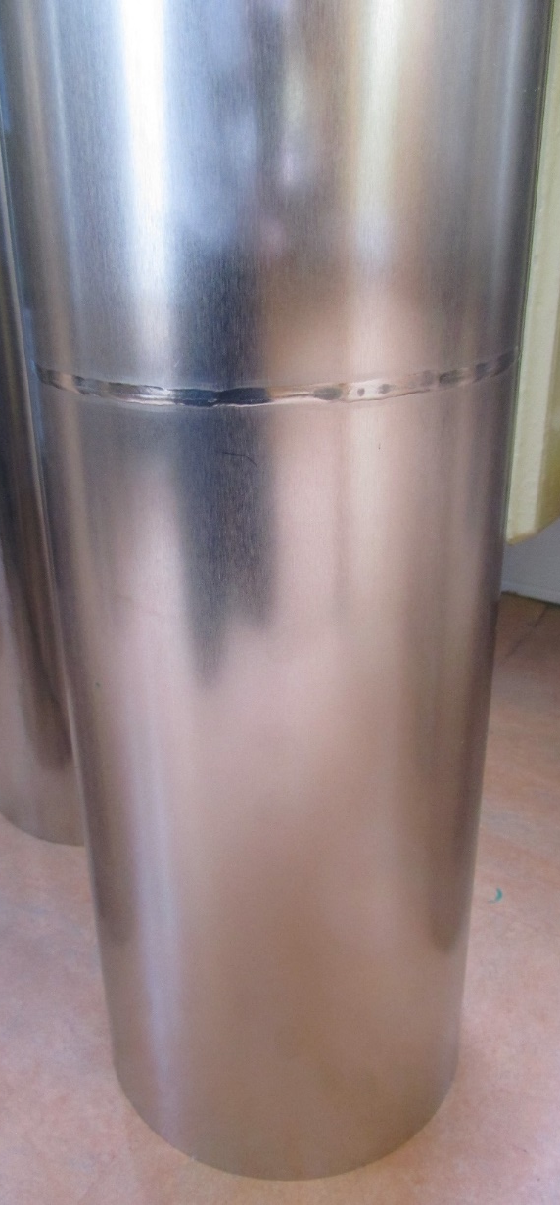
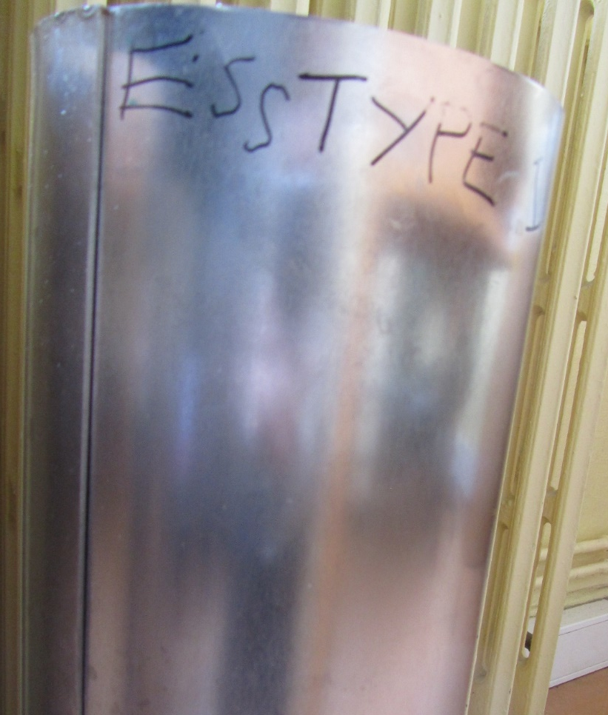
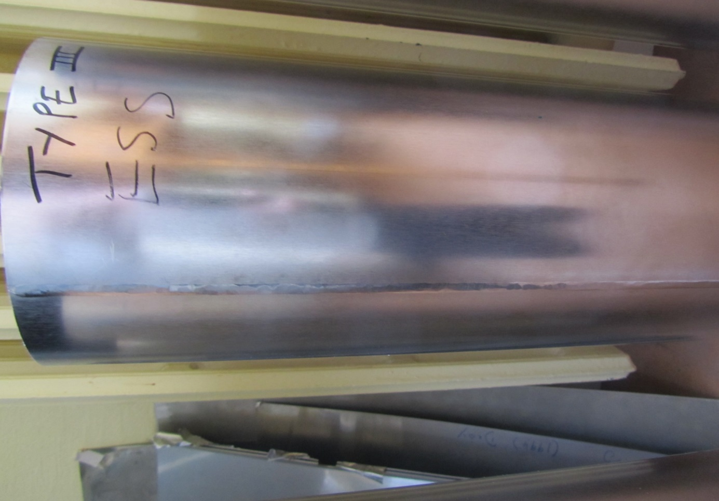
Samples for magnetic shield qualification
1 batch of thermal treatment (TT)
3 types of welding
TYPE II
radial full welding
TYPE III longitudinal full welding
TYPE I longitudinal spot welding
Diameter : D=155 mm
Length 600 mm
Thickness : e = 2 mm

Slide 7
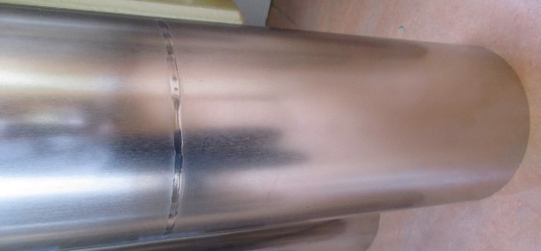
Cylindrical samples in ambient field at RT
⇨ effect of TT and welding type
Shield position
Shield position
TYPE II
radial full welding
No effect of thermal treatment batch for IFMIF (was expected..)
No effect of welding type.
  ⇨in particular, no enhancement of the B field in the full radial welding region

Slide 8
Cylindrical samples in ambient field at RT
⇨ estimation of permeability values
Permeability would be around 50000… Quite low.
Remark : measured B-fields are very low (<0.1 μT = 1 mG)… values are probably overevaluated by probes.

Slide 9
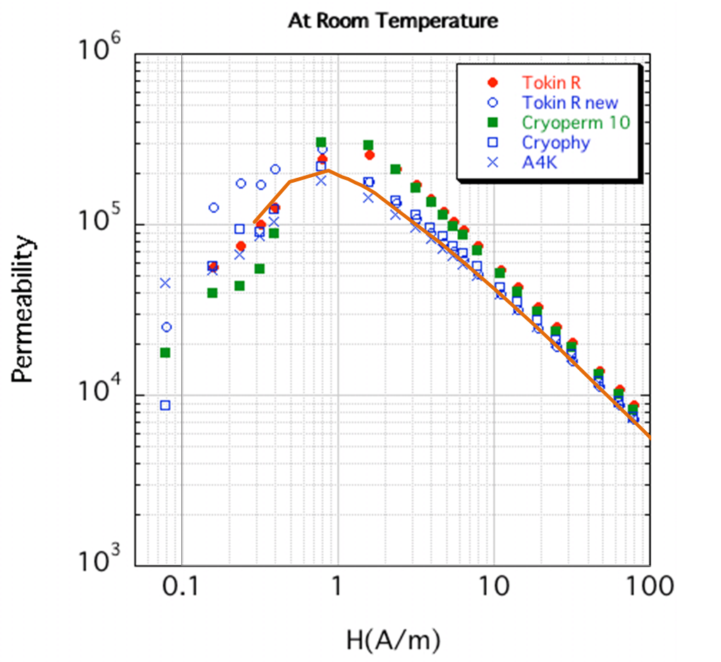
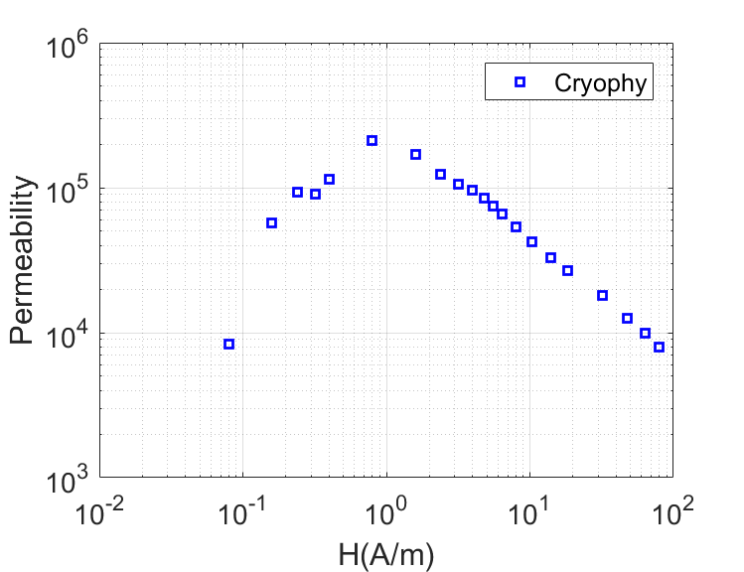
mu-H curve used FOR simulations
M. Masuzawa, SRF 2013
Measurements on small ring sample

Slide 10
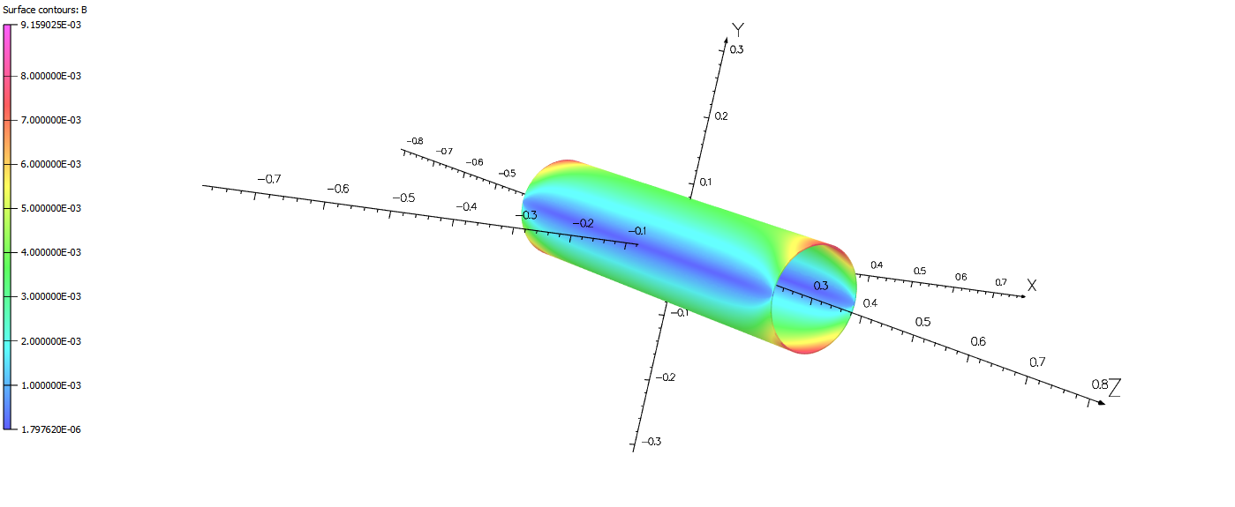
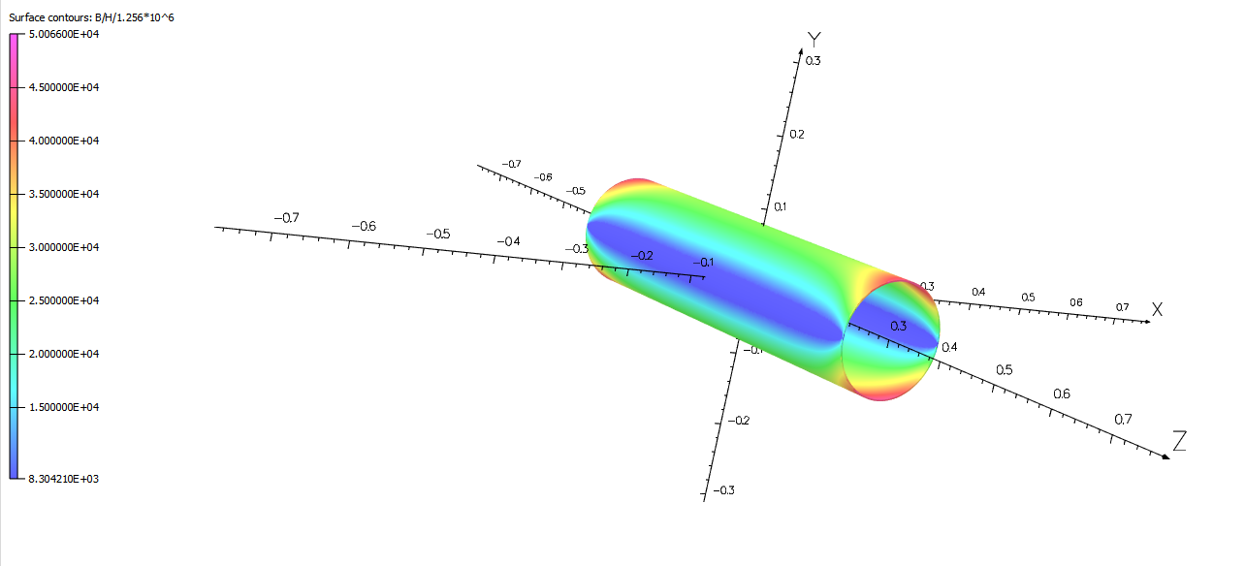
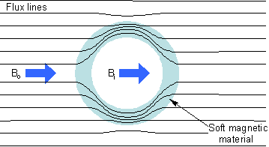
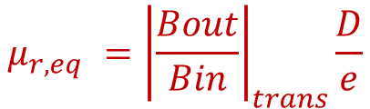


Definition of a « equivalent permeability »
$$μ_{r}=\frac{B}{μ_{0}H}$$
Simulation with OPERA software
$$B$$
Transverse earth field applied
We are in this region
Permeability of the material varies along the shield material
Local permeability is not measurable with our sample
For further sim/exp comparison we define:
$${μ_{r,eq} =\left|\frac{Bout}{Bin}\right|}_{trans}\frac{D}{e}$$

Slide 11
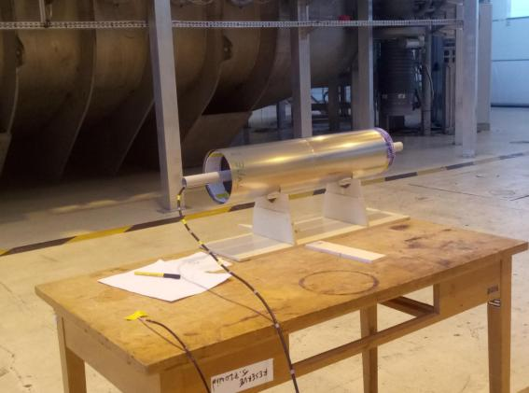
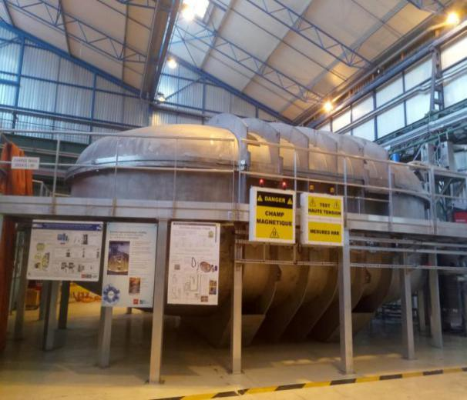
Magnetic shield caracterisation in variable field : setup
Experiments during JT60SA tests
Toroidal coil for fusion tested in Saclay cryostat.
Current goes from up to 27,5 kA
Magnetic field goes to 2.7 T
In this area, B goes up to 7.5 mT, transverse to shield and ~homogen
We measured field inside/outside the shield

Slide 12
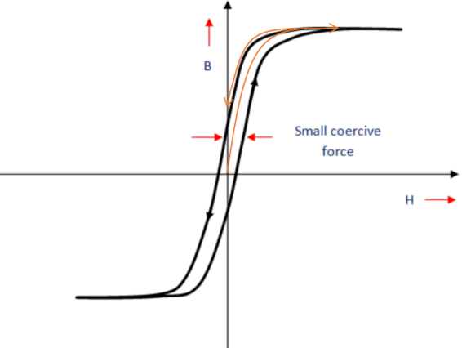
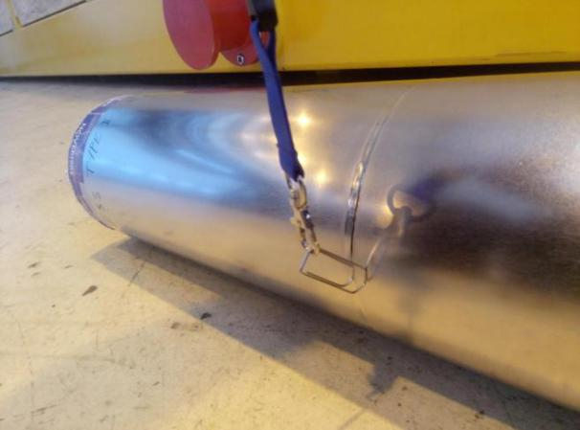
Magnetic shield caracterisation in variable field : results
50 μT (earth field)
2.5 mT
Measurements at low field unaccurate because probe offset seems to have changed during measurements…
Hysteresis effect observed
Magnetic shield is magnetized after solenoid switch off

Slide 13
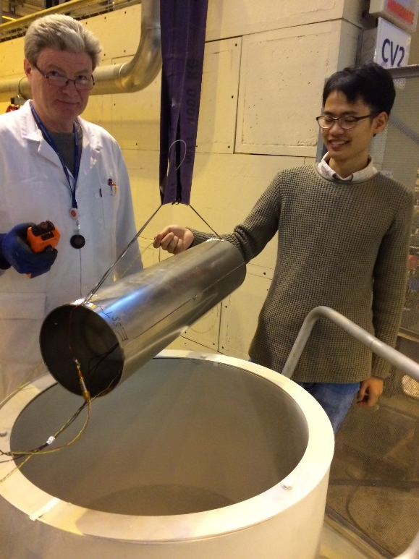
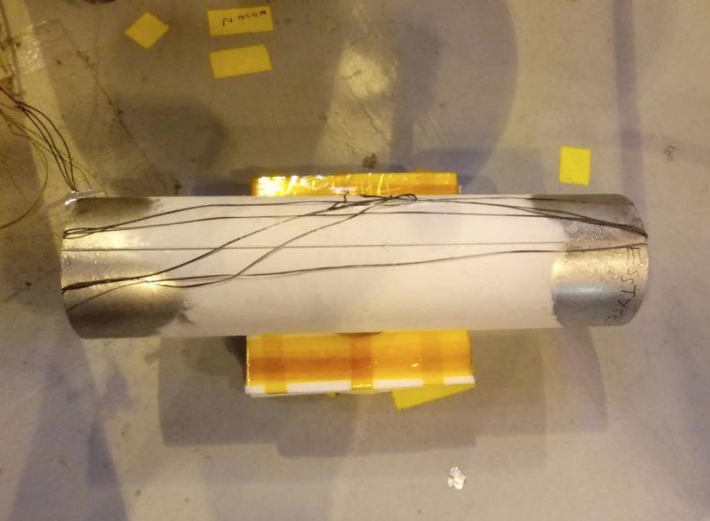
Magnetic shield caracterisation at low T in ambient field
Measurements during warm up in air : shield temperature is homogen.
Permeability tends to decrease with temperature, for both materials, maybe a bit more clearly for Mumetal.
What happens at lower temperature ?

Slide 14
Effect of shield thermal gradient ?!
Measurements during warm up in air : shield temperature is homogen
Measurements during cool down in LN : high temperature gradient measured between shield top and bottom parts
ESS sample
Strange behavior in presence of thermal gradient… Due to differential stress in material (permeability change with temperature is due to magneto-strictive effect) ??
How is shield temperature gradient in cryomodules ??

Slide 15
summary
Magnetic shields can provide magnetic field lower than 1 microtesla close to cavities
Key elements for achievement of high Q cavities
Magnetic shields can be magnetized by mT fields (e.g. field from solenoids).
Important to anticipate material behavior and properties for proper design
Equivalent permeability
Behavior at low temperature, in cryomodules

